Slide 1

Apache Spark – Usage and deployment models for scientific computing
Prasanth Kothuri, Danilo Piparo, Enric Tejedor Saavedra, Diogo Castro
CERN IT and EP-SFT

Slide 2
Outline
What is Spark?
Current Usage and Deployment models
Recent Developments
  Integration of SWAN with Spark Clusters
  Access and Authentication to EOS storage
Spark on Kubernetes
  TPC-DS – Validation of the infrastructure
  CMS Big Data – Data Reduction Facility

Slide 3

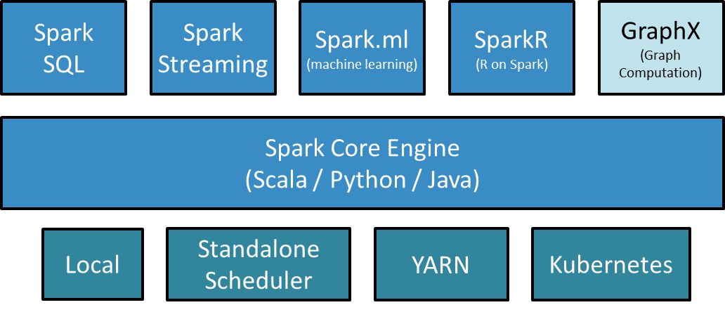
Apache Spark
Apache Spark is an open-source parallel processing framework with expressive development APIs (in multiple languages) that allows for sophisticated analytics, real-time streaming and machine learning on large datasets
Wide library support for
  unstructured input data
  efficient analysis storage formats
  stats and machine learning algorithms
provides parallel processing primitives
  declarative - traditional SQL queries
  imperative (no-SQL)
bindings to most popular analysis languages: Python, R, Scala, Java

Slide 4

Spark – Current Deployment
Spark in deployed on the Hadoop clusters and uses Hadoop YARN as resource manager
YARN – Yet Another Resource Negotiator
  general-purpose application scheduling framework for distributed applications
  responsible for allocating resources to the various running applications subject to familiar constraints of capacities, queues etc
Support multiple versions of Spark, from 1.6.0 to 2.3.0
Cluster Name | Configuration | Software Version
Accelerator logging | 20 nodes (Cores 480, Mem - 8 TB, Storage – 5 PB, 96GB in SSD) | Spark 1.6.0 – 2.3.0 hadoop_2.7.5
General Purpose | 48 nodes (Cores – 892,Mem – 7.5TB,Storage – 6 PB) | Spark 1.6.0 – 2.3.0 cdh5.7.5
ATLAS Event Index | 18 nodes (Cores – 288,Mem – 912GB,Storage – 1.29 PB) | Spark 1.6.0 – 2.3.0 cdh5.7.5
QA cluster | 10 nodes | Spark 1.6.0 – 2.3.0 hadoop_2.7.5
SNAPSHOT OF CURRENT DEPLOYMENT

Slide 5
Selected “Big Data” projects using Spark
Next Generation CERN Accelerator Logging system (NXCals)
  Critical system for running LHC – 700 TB today, growing 200 TB/year
  Spark is compute engine chosen for interactive exploration and analysis of data, API for Data Extraction and batch analysis
WLCG and CERN CC monitoring infrastructure [1]
  Critical application for CC operations and WLCG, 200 GB/day and 200M events/day
  Spark is used in streaming analytics (enrichment, validation), interactive and batch analysis
CMS Big Data Project [2] - Data Reduction Facility
  Ongoing investigations using Spark to produce reduced data n-tuples for analysis in a more agile way than current methods
CMSSpark [3]
  Spark is used to parse and extract useful aggregated information from various CMS data streams on HDFS
[1] https://indico.cern.ch/event/587955/contributions/2937899/
[2] https://cms-big-data.github.io/
[3] https://github.com/vkuznet/CMSSpark

Slide 6


Integration of SWAN with Spark Clusters
SWAN – Service for Web based ANalysis
  collaboration between EP-SFT, IT-ST and IT-DB
Analysis from a web browser
  Integrated with other analysis ecosystems: ROOT C++, Python and R
  Ideal for exploration, reproducibility, collaboration
  Available everywhere and at any time
Integrated with CERN services [1]
  Software: CVMFS
  Storage: CERNBox, EOS
  Compute: local (docker)
  Scalable Analytics: Fully Integrated with IT Spark and Hadoop Clusters
      powerful and scalable platform for data analysis
      Python on Spark (PySpark) at scale
[1] https://doi.org/10.1016/j.future.2016.11.035

Slide 7



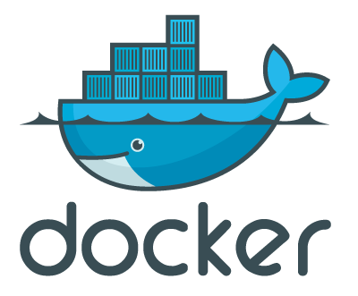



Integrating Services
Software
Compute
Storage
Isolation| local compute

Slide 8




SWAN – Architecture
SSO
Web portal
IT Hadoop and Spark clusters
Spark Worker
Python task
Container Scheduler
Python task
User 1
User 2
User n
...
Spark Driver
AppMaster
CERN Resources
EOS
(Data)
CVMFS
(Software)
CERNBox
(User Files)

Slide 9
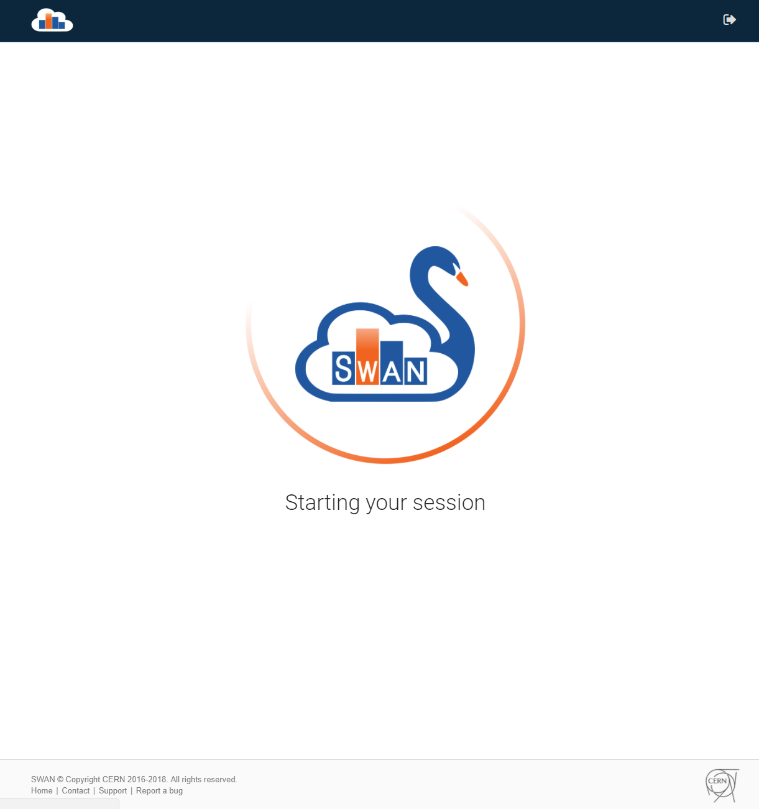
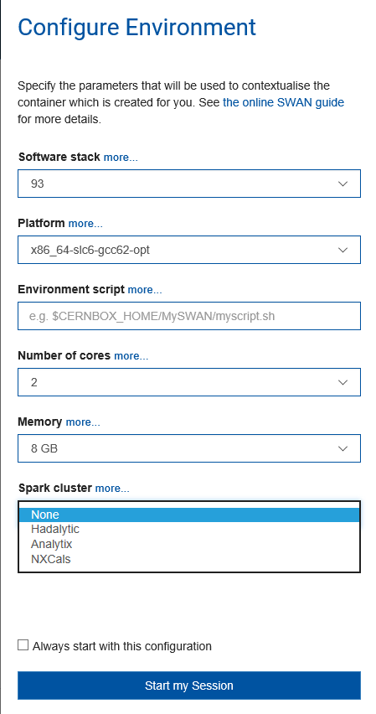
SWAN Interface

Slide 10
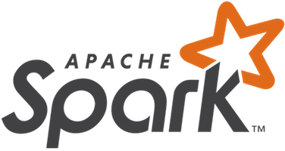


Scalable Analytics: Spark-clusters with SWAN integration
All the Spark (Hadoop) clusters are integrated with SWAN
BE NXCals project will offer their users SWAN as key entry point for analysis
Growing usage and reliance on SWAN (+ Spark)
Cluster Name | Configuration | Primary Usage
nxcals | 20 nodes (Cores 480, Mem - 8 TB, Storage – 5 PB, 96GB in SSD) | Accelerator logging (NXCALS) project dedicated cluster
analytix | 48 nodes (Cores – 892,Mem – 7.5TB,Storage – 6 PB) | General Purpose
hadalytic | 14 nodes (Cores – 196,Mem – 768GB,Storage – 2.15 PB) | Development cluster

Slide 11
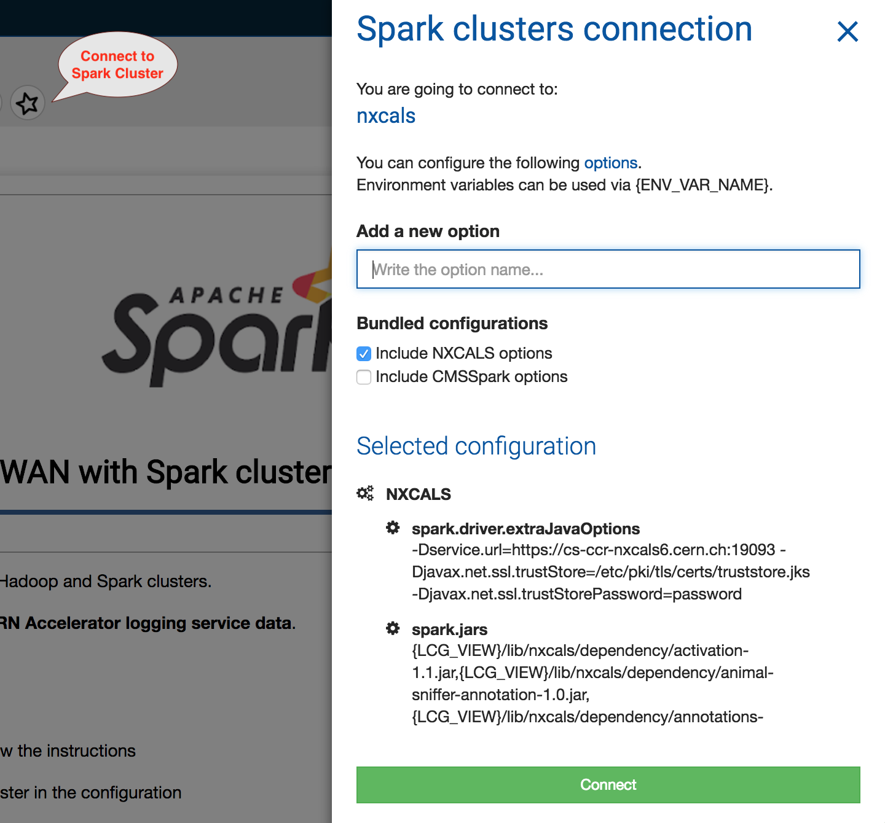
SWAN_Spark features
Spark Connector – handling the spark configuration complexity
  User is presented with Spark Session (Spark) and Spark Context (sc)
  Ability to bundle configurations specific to user communities
  Ability to specify additional configuration

Slide 12
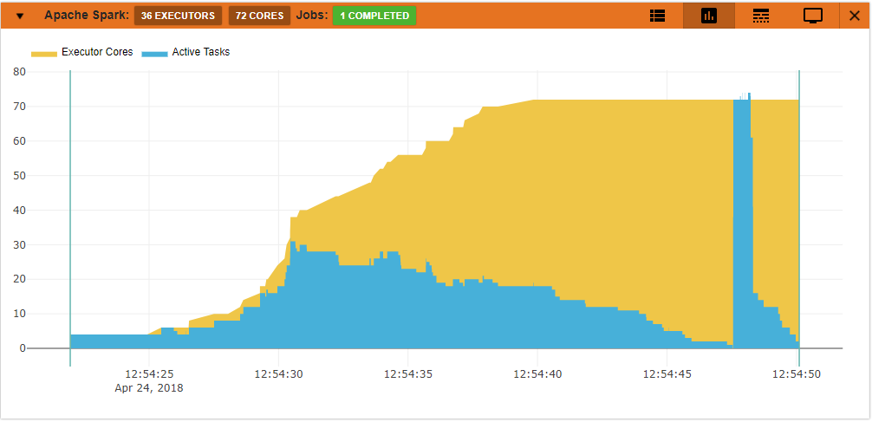

SWAN_Spark features
Spark Monitor – jupyter notebook extension
  For live monitoring of spark jobs spawned from the notebook
  Access to Spark WEB UI from the notebook
  Several other features to debug and troubleshoot Spark application
  Developed in the context of HSF Google Summer of Code program [1]
[1] http://hepsoftwarefoundation.org/gsoc/2017/proposal_ROOTspark.html

Slide 13
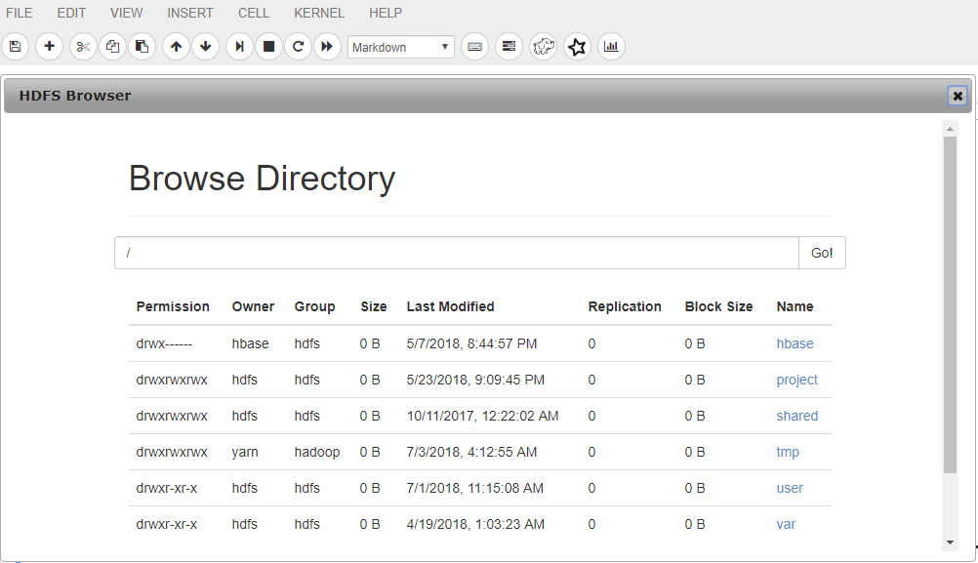
SWAN_Spark features
HDFS Browser – jupyter notebook extension
  browsing the Hadoop Distributed File System from notebook
  useful for selection of the datasets for analysis
All the required tools, software and data available in the single window!

Slide 14
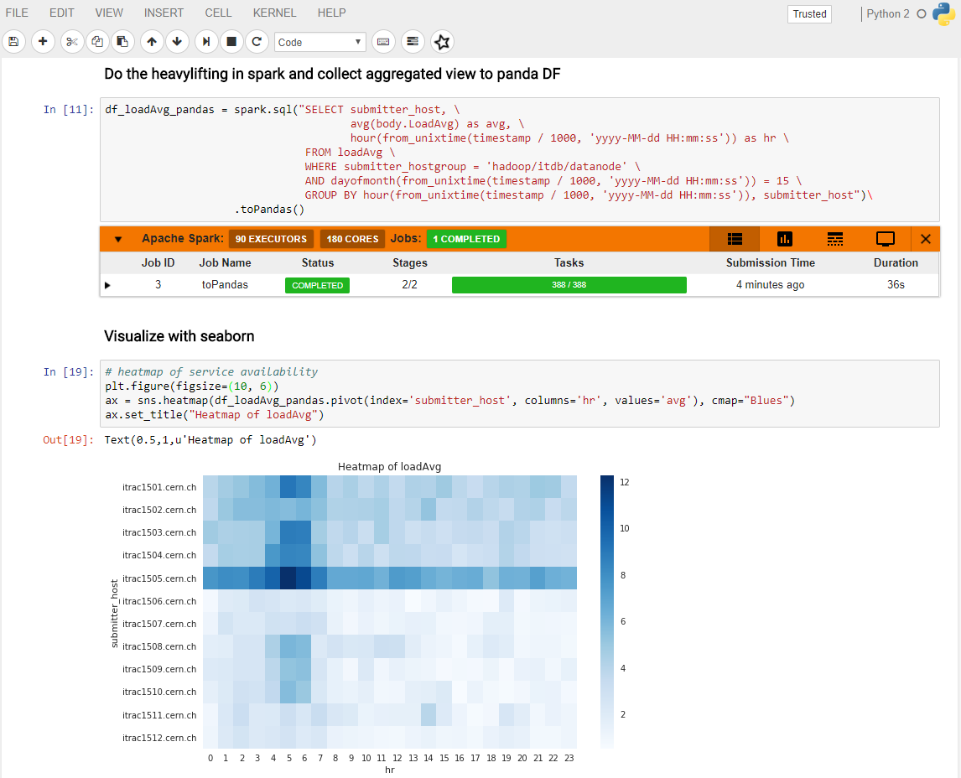
Text
Code
Monitoring
Visualizations

Slide 15


XRootD connector for Hadoop and Spark
A library that binds Hadoop-based file system API with XRootD native client
  Developed by CERN IT department
Allows most of components from Hadoop stack (Spark, MapReduce, Hive etc) to read from/write to EOS and CASTOR directly
  Works with Grid certificates and Kerberos for authentication
  Used for: HDFS backups, performing analytics on data stored on EOS / CERNBox
C++
Java
Hadoop
HDFS
Spark
(analytix)
EOS
Storage
System
EOS
Storage
System
XrootD
Client
Hadoop-XrootD
Connector
Xrootd
Client
JNI
JNI

Slide 16
Challenges
Spark on YARN satisfies the needs of stable, predictable and production workloads from NXCals, WLCG & CC monitoring, IT security and other smaller communities
Physical machines allocated – means static allocation of resources (no resource elasticity), no isolation from other users, compute coupled with data storage.
Periodic Load Spikes
  International Conferences, physics analysis with Spark
Future demand
  CERN EP-SFT and CMS Big Data project are investigating use of Spark for physics analysis
Physics data stored in external storage system – EOS storage with over 250 PB

Slide 17
Spark on Kubernetes
On-Demand Elastic Resource Provisioning of Spark for data processing
Spawn/resize/shutdown cluster of 10s/100s of nodes in minutes
Set of tools to manage the Spark cluster and submit Spark Jobs
High-availability, no infrastructure maintenance, no data storage maintenance, self-healing
Data decoupled from compute (Spark) - data is externally stored (Kafka, EOS/S3 Storage..), processing happens as in the cloud model
Spark on Kubernetes architecture much simpler and easier to maintain than YARN

Slide 18



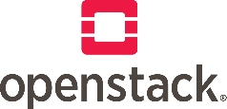
Elastic Resource Provisioning with Spark on Kubernetes
Hadoop/Spark
Spark on Kubernetes over Openstack
Apache Spark
compute and storage
on the same machines
Spark-on-Kubernetes
only compute
Spark-on-Kubernetes
only compute
HBase
YARN Resource Manager
External Storage (EOS, S3, HDFS)
Kubernetes Resource Manager
Kubernetes Resource Manager
HDFS Hadoop Distributed File System
Openstack Project 1 Resources
Openstack Project 2 Resources
On-Premise Bare metal Infrastructure
On-Premise
Openstack Cloud Infrastructure
- Stable production workloads
- Data Locality
- No on-demand resource elasticity
- Cloud-native (rapid resource provisioning)
- Elasticity (Scale up / down cluster resources)
- Separation of storage and compute

Slide 19
Provisioning Spark on Kubernetes cluster
Spark-on-Kubernetes
only compute
Spark-on-Kubernetes
only compute
CLIENT HOST
Linux | Mac | lxplus-cloud@cern.ch
Spark Driver
Spark Executor
Spark Executor
Spark Driver
Spark Executor
Spark Executor
Run Jobs
$ sparkctl
$ helm install spark-operator
$ opsparkctl create spark
Kubernetes Resource Manager
Kubernetes Resource Manager
Deploy Spark
Openstack Project 1 Resources
Openstack Project 2 Resources
Create Cluster
$ openstack coe cluster ..
$ opsparkctl create kube
$ opsparkctl resize kube
Openstack Cloud Infrastructure

Slide 20
Spark on Kubernetes architecture

Slide 21
Spark on Kubernetes@CERN – Current Status
Possible to run Spark on Kubernetes on OpenStack
  Spark version for driver and executor is taken from master branch (2.4.0)
  Kubernetes cluster is created on the openstack projects owned by the user
  S3 service is used to store event logs and checkpoints for spark streaming
Early Adapters
  CMS Big Data Project for their Data Reduction Facility [1]
Spark on Kubernetes installation is validated with industry standard TPC-DS benchmarks
[1] https://indico.cern.ch/event/587955/contributions/2937521/

Slide 22
Summary
Current deployment of Spark (on YARN) satisfies the needs of stable, predictable and production workloads from NXCals, WLCG & CC monitoring, IT security etc.
Integration of Spark clusters with SWAN allows interactive data exploration and analysis from notebook interface.
Future demand from the users, especially the usage of spark for physics analysis from experiments requires different deployment model.
Spark on Kubernetes on openstack is the target deployment model for physics analysis and early results look promising.

