Slide 1
CHEP18
Building, testing and distributing common software for the LHC experiments
Patricia Mendez Lorenzo
for the EP-SFT/SPI project

Slide 2
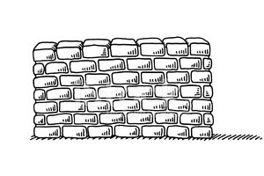

Overview
Applications
Event, Detector, Calibration
This talk relates to this part
Exp. specific packages
Simulation, Data Mgt.
Distributed analysis….
And here????
Core libraries and external packages non-HEP

Slide 3
What does the baseline contain? → ca. 400 packages
Including:
Common EP-SFT projects: ROOT and Geant4
55 MC generators and 18 Grid MW packages
Common tools: CMake, gcc, clang...
Full release volume
~500k directories | ~6,3 million files
~65k links | ~350 GB space
How do we provide it? → in LCG releases: LCG_XX
Packaged → EOS: /eos/project/l/lcg/www/lcgpackages
  https://lcgpackages.web.cern.ch/lcgpackages
  tar files, RPMS and docker containers
Expanded → CVMFS: /cvmfs/sft.cern.ch/lcg/releases
  10X2 platforms for both python 2 and 3

Slide 4
Our platform declaration
Platform = ${ARCH}-${OS}-${COMPILER}-${BUILD_TYPE}
(Definition agreed by the HSF Platform naming convention)
Compilers | Architectures (ARCH) | Operating Systems (OS) | Build type
gcc62 gcc7 gcc8 clang60 native (ubuntu) | x86_64(+avx2+fma) | slc6 Centos7 Ubuntu16 Ubuntu18 Mac arm64 | Release Debug
(Under testing in the so-called nightly builds)
See G. Amadio, Robust Linux Binaries, Hall 3 12th July 10:30

Slide 5

Our challenges
Reproducibility
  Sources stored in EOS independent of changes in code
  Specific branches per release
  Handling of the “internal” packages dependencies
Scalability
  Build software structure based on specific cmake modules handling dependencies
  Modular approach for the implementation of new packages and versions
Relocation
  Ability to install packages in different $PREFIXes
Automation
  Jenkins structure and own scripting
  Operations based on a fast feedback implementation
SW validation
  Execution of specific tests after binaries installation
LCG_XX
- SW validation
- Automation
- Relocation
- Scalability
- Reproducibility
- Feedback cycle

Slide 6
Technical aspects of the project

Slide 7
LCGCMAKE: the core
Responsible of the individual packages build recipes and the default packaging
Build and testing infrastructure CMAKE based
  Build specifications included in platform-independent list files
  Modular and scalable system
Based on “ExternalProject” CMAKE module implementation enabling:
    Builds from external software sources
    Control among package dependencies
# ------ EXAMPLE OF a PACKAGE BUILD
LCGPackage_Add(
mpfi
URL ${GenURL}/mpfi-${mpfi_native_version}.tar.gz
CONFIGURE_COMMAND ./configure --prefix=<INSTALL_DIR> --with-gmp=${gmp_home} --with-mpfr=${mpfr_home}
BUILD_COMMAND make
INSTALL_COMMAND make install
BUILD_IN_SOURCE 1
DEPENDS gmp mpfr
)

Slide 8



The system elements
GITLAB repo
CDASH
publication
Toolset.cmake
Files including declaration of packages to build and the versions
LCGCMAKE
Packages creation in tar files
1) Sources download
2) Build orders per package
Machinery
lcginfo.cern.ch
http:// (*)
Dependencies text (.txt)
EOS (**)
JENKINS
Separated build execution for every platform

Slide 9
Lifecycle of a new package
1. Local tests in build nodes
CVMFS(1)
sft-nightlies.cern.ch
2. Experimental slots
3. Incremental nightly builds
CVMFS(2)
sft.cern.ch
4. Releases LCG_XX and LCG_XXpython3 (Full build)

Slide 10
The packaging approach
Default packaging: .tgz files created after the individual build of any package → Stored in EOS
  Same structure for nightlies and releases
  Specific dependencies .txt file available
  Copy to EOS based on an incremental approach handled by the inclusion of a HASH parameter for each package (determined by the version-revision-dependencies )
Releases only:
  RPMS provided also in the case of releases by experiment demand → Stored in EOS
  Flexible Provision of docker containers → Stored in EOS
    Total or partial number of packages per release

Slide 11


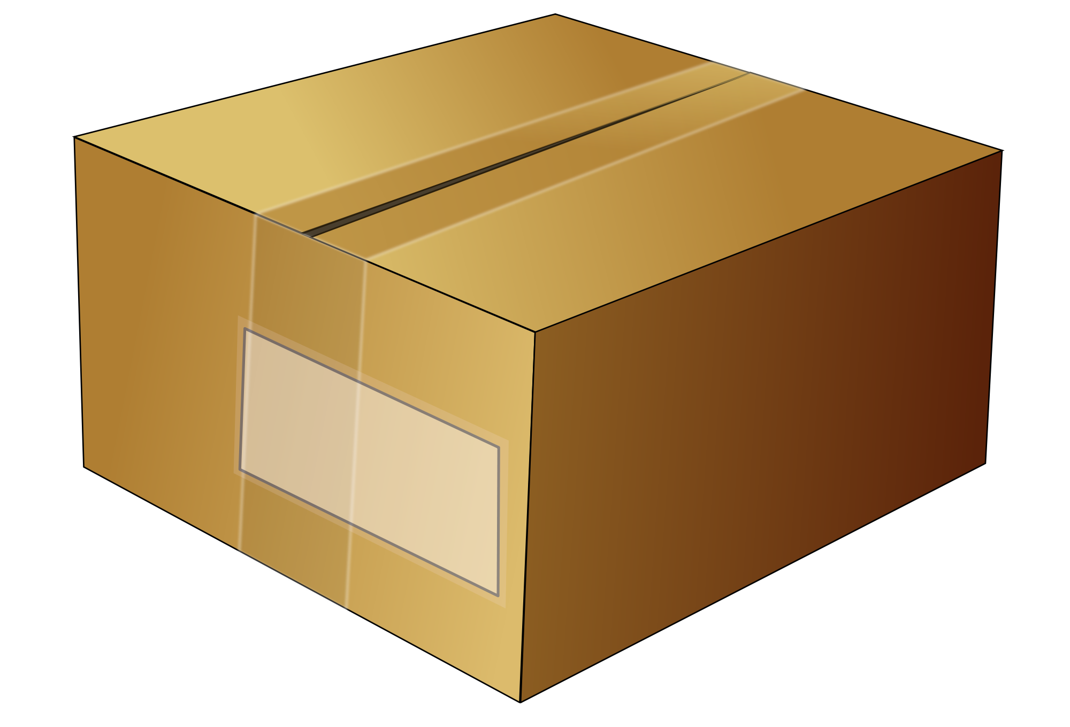
Binaries distribution workflow
… … ...
VM
VM
VM
VM
slc6
centos7
ubuntu
1st Job
Build of the binaries in VM/dockers
Creation of .tgz
Copy to EOS
.tgz
.tgz
.tgz
.tgz
.tgz
JENKINS
.tgz
.tgz
EOS
2nd Job
Stratum0 are build nodes in Jenkins
Download of .tgz from EOS
Expansion and reallocation in CVMFS
  Different mount point for releases/nightlies
  Job granularity: Platform
CVMFS

Slide 12
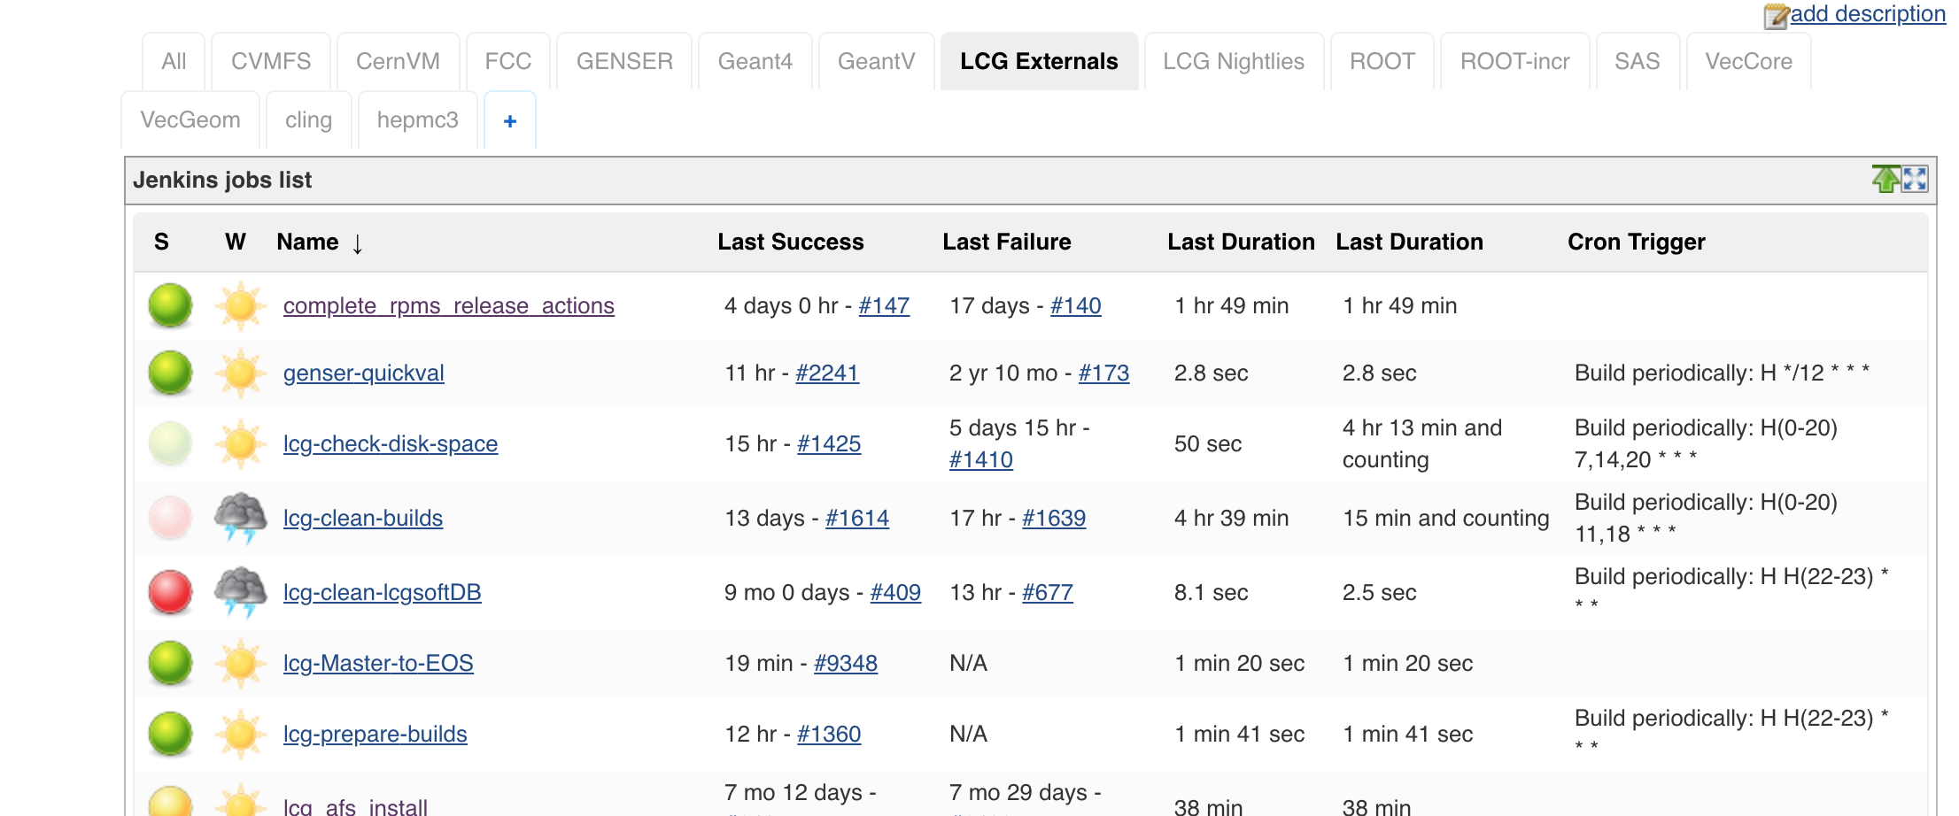
Automation infrastructure
Our own Jenkins structure
Around 500 CPUs distributed among ubuntu/mac/slc6/centos6/fedora systems
Docker containers (Centos7 VM) available for SLC6/Centos7/Ubuntu16/Ubuntu18/Fedora
https://epsft-jenkins.cern.ch

Slide 13
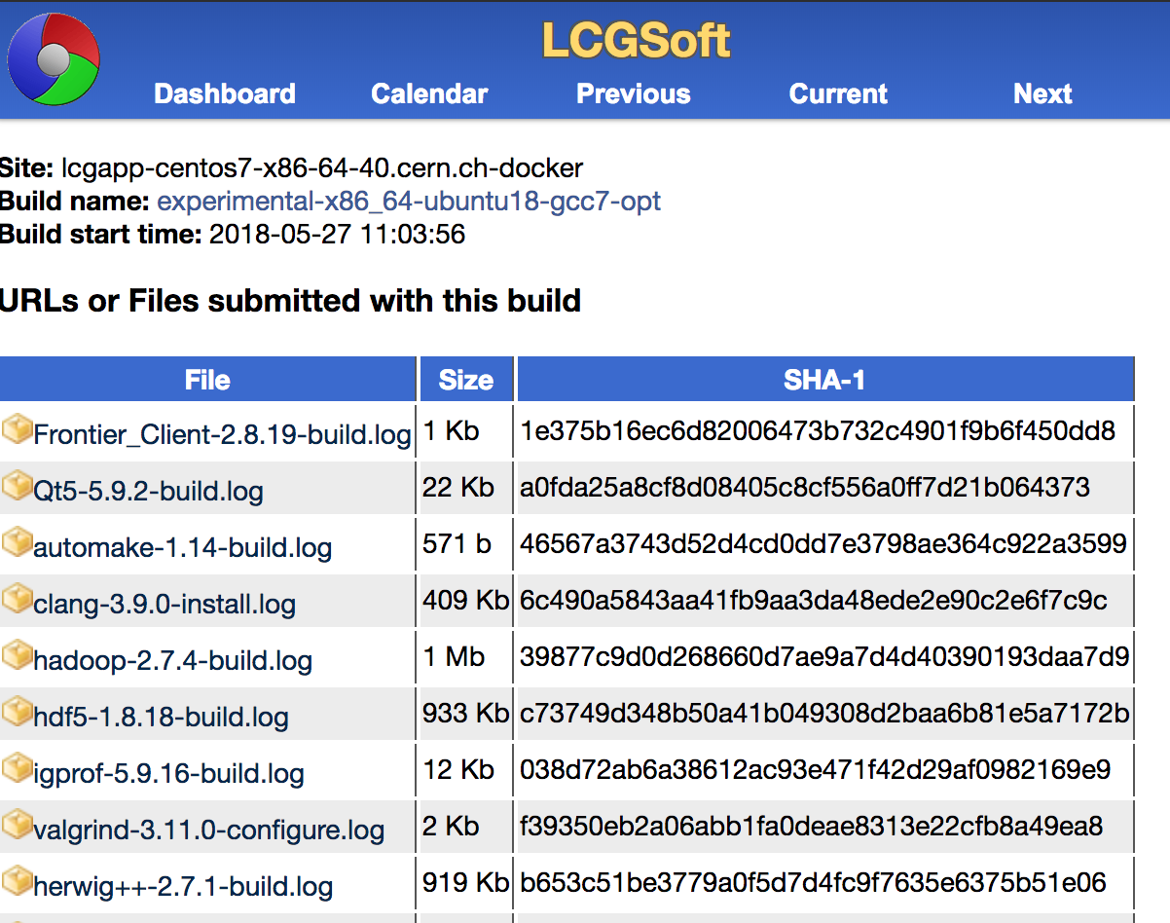
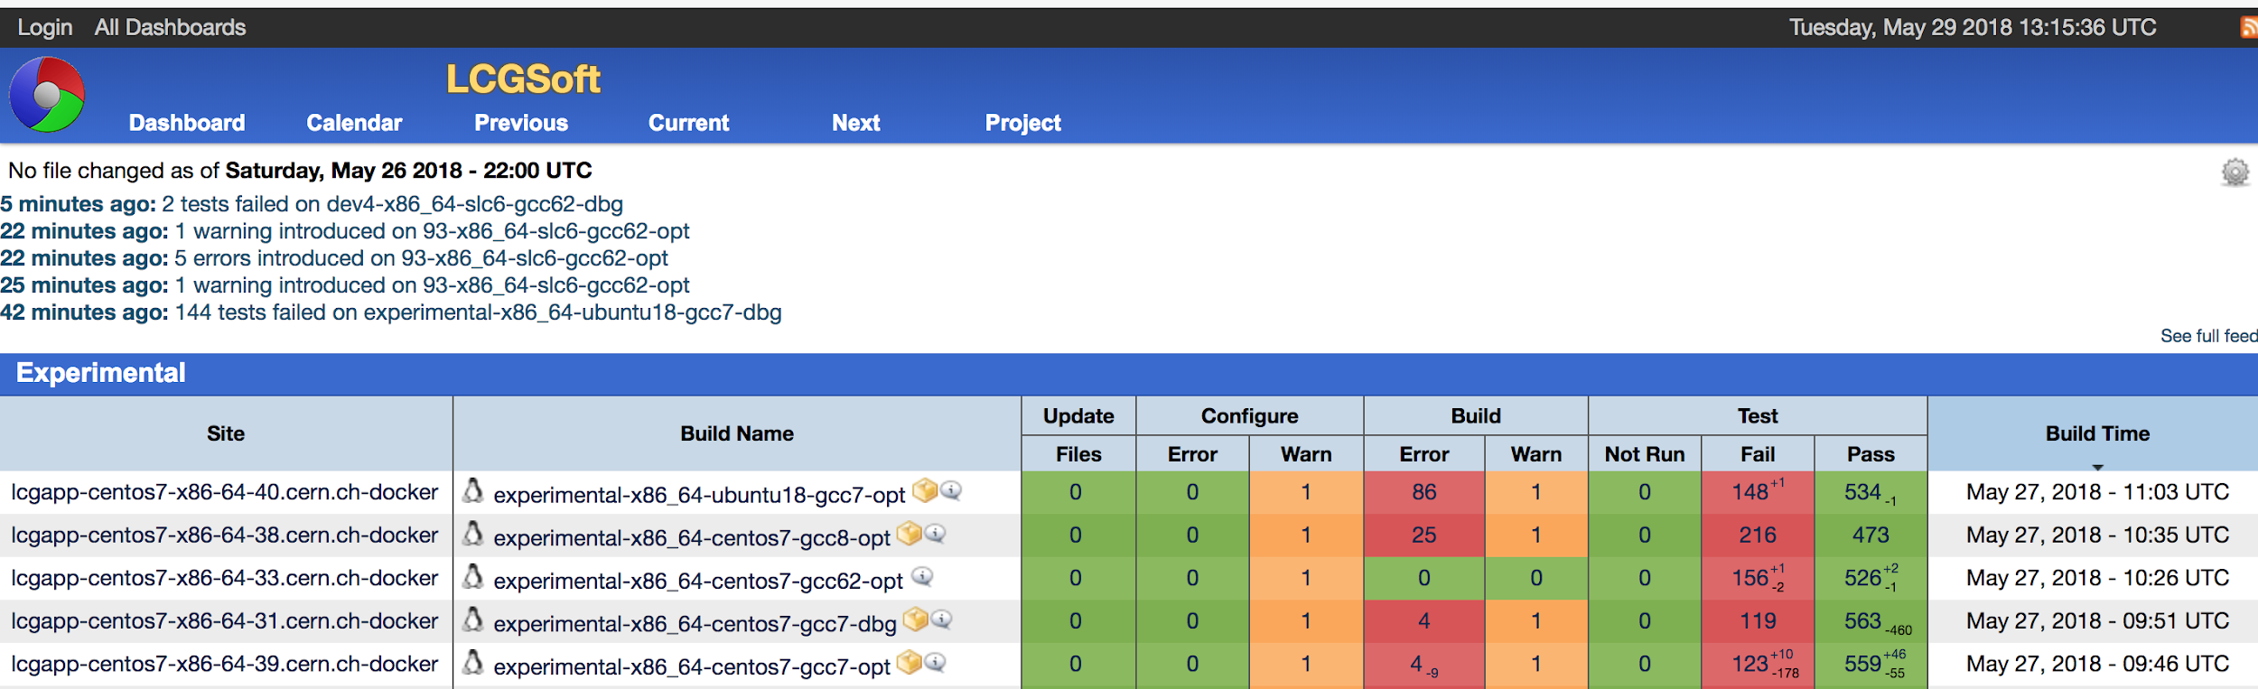
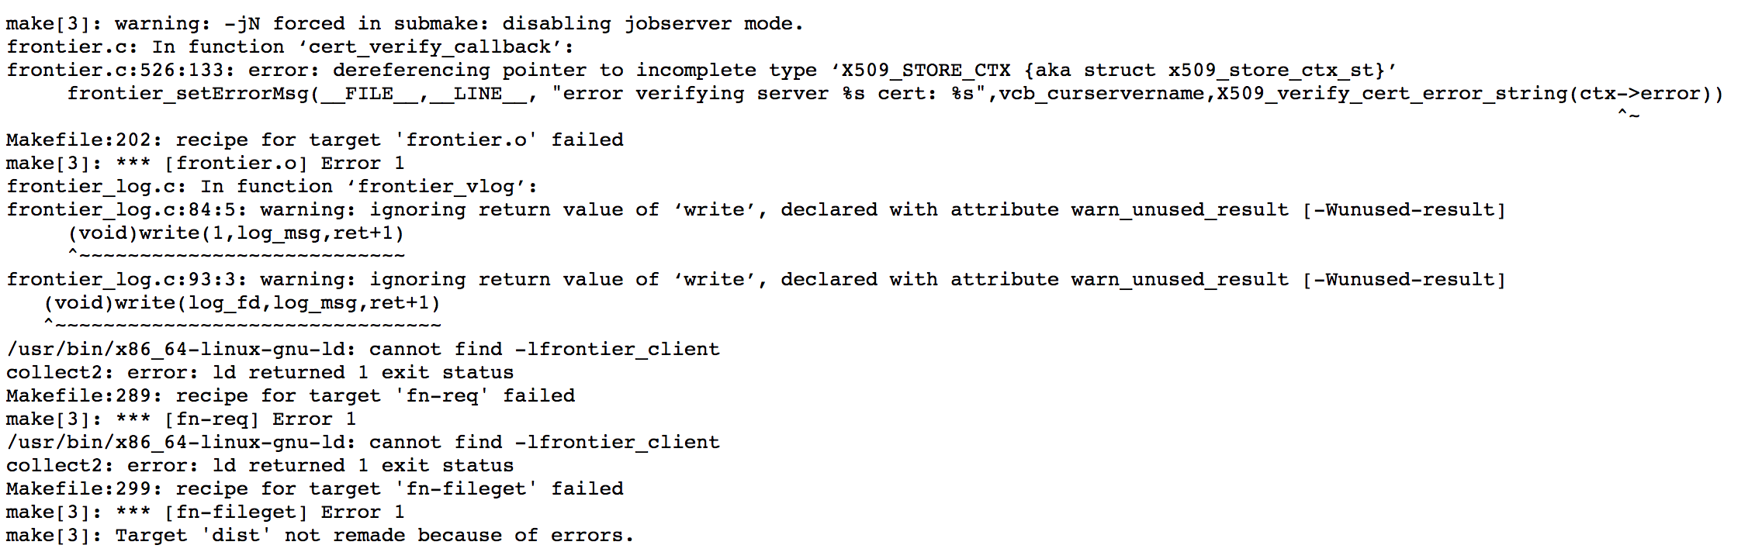
Build results dashboard
http://cdash.cern.ch → accesible outside CERN

Slide 14
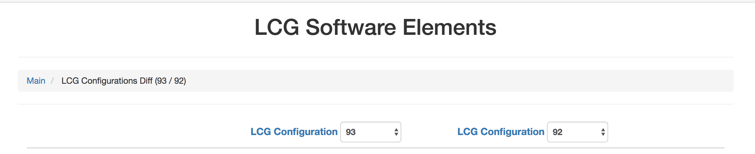
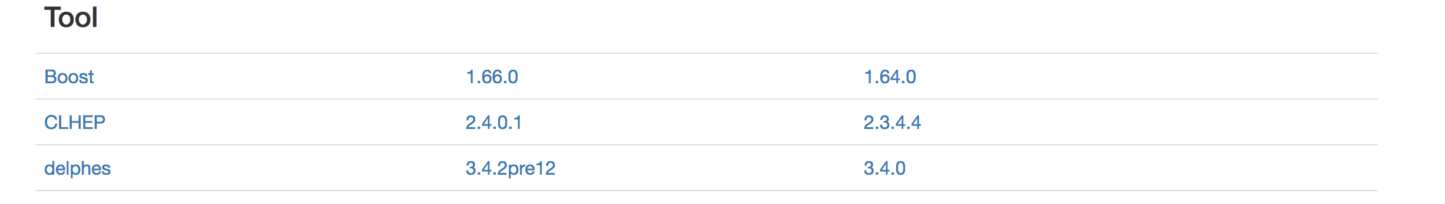
Publication of the releases
http://lcginfo.cern.ch/ → accesible outside CERN

Slide 15
Summary and Future
The EP-SFT group has enabled a robust and scalable structure to provide hundreds of binaries to the experiments and users
  Stable working bleeding edge available on a daily basis
  Biggest effort in the last years: Ensure a high level of automation
  Structure ready to escalate to a large range of compilers and OS
  Support to three packaging structures: tar files, RPMS and containers
Covering the needs of:
  ATLAS, LHCb, SWAN, FCC, Spark, Hadoop, BE dept. and a large range of individual users
Future:
  Increase the level of validation
  Provide pre-releases
  Structure embedded on the HSF project as part of the future build and packaging team

