Slide 1
From Catalogs to Cosmology: An Automated Weak Gravitational Lensing Analysis Pipeline
Michael Wang (presented by Eric Vaandering)
Fermilab
23rd International Conference on Computing in High Energy Physics
9-13, July, 2018, Sofia, Bulgaria

Slide 2
Introduction
The phenomenon of weak gravitational lensing provides cosmologists with a powerful analysis technique to gain a better understanding of dark matter and more insight into the nature of dark energy.
A typical weak lensing analysis consists of a complex pipeline involving many separate and complicated steps.
These pipeline steps involve heterogeneous workloads, some requiring HPC sites while others are best suited to HTC sites.
We describe a generic, automated weak-lensing analysis framework that starts from input survey catalogs and seamlessly carries out all the weak-lensing analysis steps up to the extraction of cosmological parameters. Furthermore, all individual pipeline steps can be distributed across different computing sites to optimally match workloads to the appropriate computing resources.
Such a generic tool can make it easier to analyze data from different surveys in a consistent way thereby also making it valuable for resolving possible discrepancies.

Slide 3
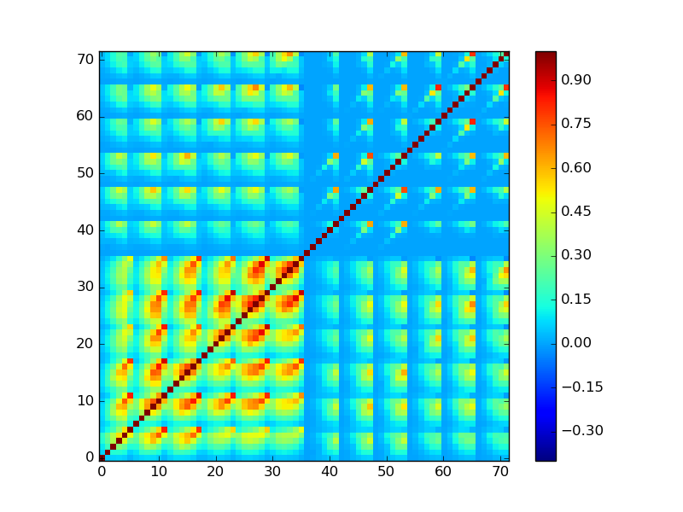
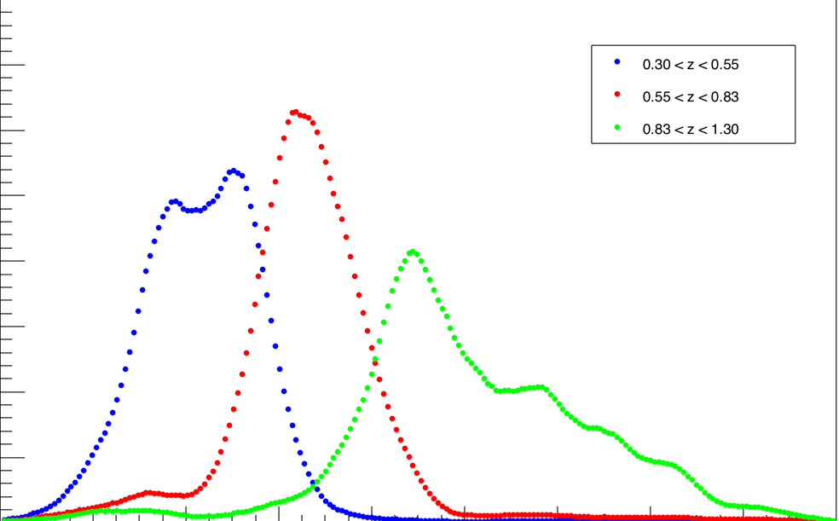


Survey Data
Weak Lensing pipeline steps (cosmic shear)
sva1_gold_r1.0 ngmix.fits:
e1, e2, c1, c2, m, w
sva1_gold_r1.0_wlinfo_point.fits:
ra, dec
sva1_gold_r1.0_skynet_point.fits:
z_mean
sva1_gold_r1.0_skynet_pdf.fits:
z_mean, pdf (200 bins)
CosmoLike covariance calculation
b₁
b₂
b₃
CosmoSIS input:
Treecorr
Fits file:
- COVMAT
- 2PTDATA θ₁: 11, 12, …. , 33
.
.
θ₆: 11, 12, …. , 33
- NZDATA b₁: N(z₁), ….. N(z₂₀₀)
.
.
b₃: N(z₁), ….. N(z₂₀₀)
θ₁
ξ±
θ₆
11
12
13
22
23
33

Slide 4
Weak Lensing pipeline DAG
From Catalogs …
Catalogs
Tomographic
Binning
dNdz calculation
2pt Correlation
Create CosmoLike
Config file
TreeCorrGG 11
TreeCorrKK 11
TreeCorrGG 12
TreeCorrKK 12
CosmoLike
1
Covariance
Calculation
CosmoLike
2
TreeCorrGG 44
TreeCorrKK 44
CosmoLike 210
Local job
Grid job
Cat
TreeCorrGG
Output
Cat
TreeCorrKK
Output
Cat
CosmoLike
Output
NERSC job
Create Cosmosis
Input Fits
… to Cosmology
CosmoSIS

Slide 5
Pegasus Workflow Management System (WMS)
Pegasus is a Workflow Management System that is well suited for implementing complex scientific workflows. It is widely used by various scientific collaborations including LIGO. With Pegasus, the description of the workflow or pipeline is abstracted away from details about execution sites, physical names and locations of files and executables, etc.
Abstract workflow is described using a high-level interface: Python, Java, or Perl APIs available.
“Catalogs” are used to specify execution sites and to associate logical filenames and executables with physical ones:
  REPLICA CATALOGS: maps logical to physical filenames
  TRANSFORMATION CATALOGS: maps logical to physical executables
  SITE CATALOG: lists job execution sites and describes their details and characteristics
In the next slides, we use Pegasus to implement our weak-lensing pipeline. We use the Python API to implement the abstract weak-lensing workflow.

Slide 6
daxgen.py: Abstract representation of workflow using python API (1)
from Pegasus.DAX3 import *
.
.
# Create an abstract dag
wlpipe = ADAG("wlpipe")
.
.
# Input Catalogs
shape = File("shape.fits")
wlinfo = File("wlinfo.fits")
pzpoint = File("pzpoint.fits")
pdf = File("pdf.fits")
# +--------------------+
# | Calculate dN(z)/dz |
# +--------------------+
wcl=File("calDndz-%s.wcl" % dataset)
dndz1 = File("%s_dndz1.txt" % fileprfx)
dndz2 = File("%s_dndz2.txt" % fileprfx)
calDndz = Job("calDndz")
calDndz.addArguments("--input",wcl,"--ntomo",str(nbtomo),"--zbins",zbins,"--ctomo","1",
"--pzcol",str(pz_startcol),"--pznb",str(pz_nbins),
"--pzlo",str(pz_zlo),"--pzhi",str(pz_zhi),
"--out1",dndz1,"--out2",dndz2)
calDndz.uses(wcl, link=Link.INPUT)
calDndz.uses(shape, link=Link.INPUT)
calDndz.uses(wlinfo, link=Link.INPUT)
calDndz.uses(pdf, link=Link.INPUT)
calDndz.uses(dndz1, link=Link.OUTPUT, transfer=True, register=True)
calDndz.uses(dndz2, link=Link.OUTPUT, transfer=True, register=True)
wlpipe.addJob(calDndz)
.
.
.
Replica catalog
# file-based replica catalog: 2017-03-31T17:35:03.423-05:00
shape.fits file://${CAT_DIR}/sva1_gold_r1.1_im3shape.fits site="local"
wlinfo.fits file://${CAT_DIR}/sva1_gold_r1.0_wlinfo.fits site="local"
pzpoint.fits file://${CAT_DIR}/sva1_gold_r1.0_skynet_point.fits site="local"
pdf.fits file://${CAT_DIR}/sva1_gold_r1.0_skynet_pdf.fits site="local”
.
.
.
Transformation catalog
tr calDndz {
site condorpool {
profile env "PYTHONPATH" "${WLPIPE_DIR}/deswrappers"
pfn "${WLPIPE_DIR}/bin/calDndz.py"
arch "x86_64"
os “LINUX"
type "INSTALLED"
}
}
tr treecorr {
site FNAL_GPGrid {
pfn "${TREECORR_DIR}/corr2"
arch "x86_64"
os “LINUX"
type "INSTALLED"
}
}
.
.
.

Slide 7
daxgen.py: Abstract representation of workflow using python API (2)
Sample site catalog: sites.xml
<?xml version="1.0" encoding="UTF-8"?>
<sitecatalog xmlns="http://pegasus.isi.edu/schema/sitecatalog" xmlns:xsi="http://www.w3.org/2001/XMLSchema-instance"
xsi:schemaLocation="http://pegasus.isi.edu/schema/sitecatalog http://pegasus.isi.edu/schema/sc-4.1.xsd" version="4.1">
<!-- The local site contains information about the submit host -->
<site handle="local" arch="x86_64" os="LINUX">
<!-- This is where intermediate data will be stored -->
<directory type="shared-scratch" path="/data/des61.b/data/mwang/scratch">
<file-server operation="all" url="file:///data/des61.b/data/mwang/scratch"/>
</directory>
<!-- This is where output data will be stored -->
<directory type="shared-storage" path="/data/des61.b/data/mwang/wlpeg/output">
<file-server operation="all" url="file:///data/des61.b/data/mwang/wlpeg/output"/>
</directory>
</site>
.
.
.
.
.
.
<site handle="FNAL_GPGrid" arch="x86_64" os="LINUX">
<grid type="condor" contact="gpce02.fnal.gov" scheduler="Condor" jobtype="auxillary"/>
<grid type="condor" contact="gpce02.fnal.gov" scheduler="Condor" jobtype="compute"/>
<profile namespace="condor" key="condor_collector">gpce02.fnal.gov:9619</profile>
<profile namespace="condor" key="+JobClass">"DES"</profile>
<profile namespace="condor" key="Requirements">TARGET.IsDESNode==True</profile>
<profile namespace="condor" key="Should_Transfer_Files">YES</profile>
<profile namespace="condor" key="When_To_Transfer_Output">ON_EXIT</profile>
<profile namespace="condor" key="use_x509userproxy">true</profile>
<profile namespace="condor" key="+Owner">undefined</profile>
<profile namespace="condor" key="Request_Memory">4096</profile>
<profile namespace="condor" key="+maxMemory">4000</profile>
<profile namespace="pegasus" key="auxillary.local">true</profile>
<profile namespace="pegasus" key="style">condorc</profile>
<profile namespace="pegasus" key="data.configuration">nonsharedfs</profile>
<profile namespace="pegasus" key="gridstart.path">/cvmfs/des.opensciencegrid.org/users/mwang/cosmosis/wlpipe/peg/kickstart-wrapper.sh</profile>
</site>
<site handle="FNAL_GPGrid-Staging" arch="x86_64" os="LINUX">
<directory type="shared-scratch" path="/pnfs/des/persistent/mwang/gridscratch">
<file-server operation="all" url="gsiftp://fndca1.fnal.gov:2811/des/persistent/mwang/gridscratch"/>
</directory>
</site>
</sitecatalog>

Slide 8
daxgen.py: Abstract representation of workflow using python API (3)
.
.
.
# +---------------------+
# | Tomographic Binning |
# +---------------------+
wcl=File("doTomoBinning-%s.wcl" % dataset)
neff = File("%s_neff.txt" % fileprfx)
doTomoBinning = Job("doTomoBinning")
doTomoBinning.addArguments("--input",wcl,
"--ntomo",str(nbtomo),"--zbins",zbins,"--ctomo","0",
"--cneff","1","--omdeg",str(omdeg),"--prefx",fileprfx)
doTomoBinning.uses(wcl, link=Link.INPUT)
doTomoBinning.uses(shape, link=Link.INPUT)
doTomoBinning.uses(wlinfo, link=Link.INPUT)
doTomoBinning.uses(pzpoint, link=Link.INPUT)
doTomoBinning.uses(neff, link=Link.OUTPUT, transfer=True, register=True)
ouname=[]
oufits=[]
for i in range(0,nbtomo):
filename=fileprfx+"_gg_z"+str(i+1)+".fits"
ouname.append(filename)
oufits.append(File(filename))
doTomoBinning.uses(oufits[-1], link=Link.OUTPUT, transfer=True, register=True)
wlpipe.addJob(doTomoBinning)
.
.
.

Slide 9
daxgen.py: Abstract representation of workflow using python API (4)
.
.
# +----------------+
# | 2PCF: TreeCorr |
# +----------------+
# Default TreeCorr config file
cfg=File("defTreeCorr.yaml")
# ... Calculate 2pcf for Xipm
# .. Xipm cross correlations
ggjobs=[]
ggnam=[]
ggout=[]
for c in combinations(range(1,nbtomo+1),2):
tc=Job("treecorr")
ggjobs.append(tc)
filename=fileprfx+"_gg%s%s.out" % c
ggnam.append(filename)
ggout.append(File(filename))
tc.addArguments(cfg,("file_name=%s" % ouname[c[0]-1]),
("file_name2=%s" % ouname[c[1]-1]),
"ra_col=RA","dec_col=DEC","ra_units=degrees","dec_units=degrees",
"g1_col=S_1","g2_col=S_2","w_col=W","flip_g1=false","flip_g2=false",
("min_sep=%s" % thetamin),("max_sep=%s" % thetamax),
("nbins=%s" % ntheta),("bin_slop=%s" % bin_slop),
("gg_file_name=%s" % filename))
tc.uses(cfg, link=Link.INPUT)
tc.uses(oufits[c[0]-1], link=Link.INPUT)
tc.uses(oufits[c[1]-1], link=Link.INPUT)
tc.uses(ggout[-1], link=Link.OUTPUT, transfer=True, register=True)
wlpipe.addJob(tc)
wlpipe.depends(tc, doTomoBinning)
.
.
Example of a pipeline step with multiple
parallel jobs and job dependencies

Slide 10
daxgen.py: Abstract representation of workflow using python API (5)
At the end of the workflow description file, the workflow is written out into an XML file (with a .dax extension):
.
.
.
f = open(daxfile, "w")
wlpipe.writeXML(f)
f.close()
print "Generated dax %s" %daxfile

Slide 11
dCache pool: grid staging area
CVMFS Server:
- Software stack
- Configuration files
32-core submit host:
- Pegasus installation
- Jobs that process
large files done here
input catalogs
local staging area
output directory
gridFTP
POSIX read-only
Distributed infrastructure used
to run the WL pipeline
FNAL “DEGrid”

Slide 12
Extracting the cosmological parameters
The last step of the pipeline involves extracting the cosmological parameters using CosmoSIS. This is a large MPI job ideally suited to NERSC.
We integrate this last step into the rest of the Pegasus-based pipeline by using the Globus Resource Allocation Manager (GRAM) to interface to NERSC’s SLURM batch system.
Although GRAM is deprecated, this is the only NERSC supported option available currently that would easily allow us to tie this last step into the rest of the pipeline.

Slide 13
Conclusion
We have developed an automated and seamless weak-lensing analysis pipeline based on Pegasus WMS that takes survey catalogs as input and produces cosmological parameter estimates as output.
Due to its generic nature, it is not tied to an particular survey.
In fact, we have used it within the LSST/DESC collaboration to conduct a pre-cursor re-analysis of the catalogs from 4 different surveys – DES-SV, CFHTLENS, KIDS450, and DLS. A paper draft is currently under DESC internal review.
It has played a supportive role in a number of the DES-Year1 cosmology results.
It is now being used officially by the DES weak-lensing group for its Year3 analysis.

Slide 14
End

