Slide 1
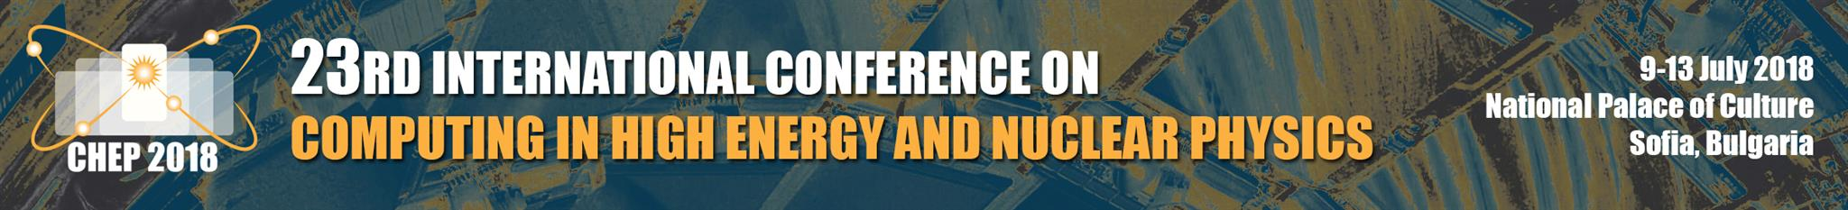


Software development for the NICA experiments:
MpdRoot & BmnRoot
K. Gertsenberger, O. Rogachevsky
Veksler and Baldin Laboratory of High Energy Physics, JINR, Russia
on behalf of the MPD & BM@N collaboration
9 July 2018

Slide 2
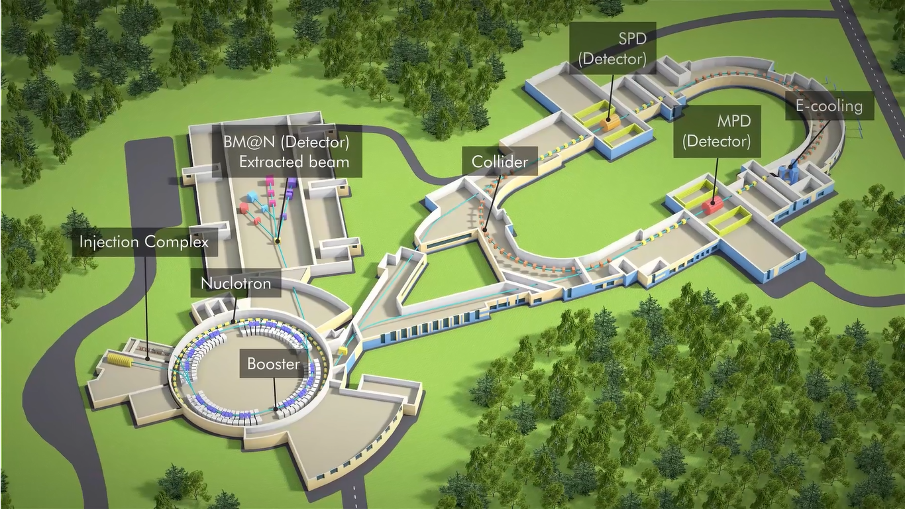
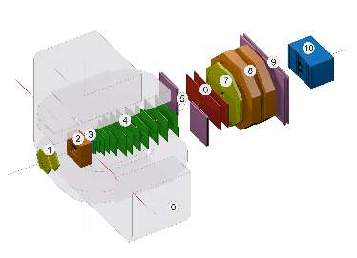
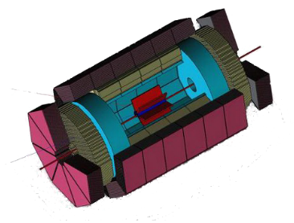
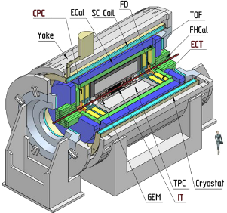


Nuclotron-based Ion Collider fAcility
Beams: from $p, d^{↑}$to${Au}^{79+}$
Fixed target experiment: BM@N (2018)
2 interaction points: MPD (2020) & SPD
Official site: nica.jinr.ru
Luminosity: ${10}^{27}$(${Au}^{79+}$), ${10}^{32}$ ($p$) $cm^{−2}s^{−1}$
Collision energy: $\sqrt{S_{NN_{AU}}}$ = 4 – 11 Gev $E_{lab}$ = 1 – 6 AGev
K. Gertsenberger

Slide 3

Simulation and analysis steps of experiments
UrQMD
LAQGSM
Pythia…
Geant3
Geant4
Fluka…
should be covered by software of the experiments!
Event generator
simulate physics process
(quantum mechanics and probabilities)
Simulation
simulate interaction with media and detector materials
Digitization
translate interactions with detectors into clusters of signals
Reconstruction
as for
experimental
data
Analysis
as for experimental data
Interaction of interest
Geometry of the system
Materials used
Particles of interest
Generation of test events of particles
Interactions of particles with matter and EM fields
Response to detectors
Records of energies and tracks
Analysis of the full simulation at whatever detail you like
Visualization of the detector system and tracks
Clustering
Hits reconstruction in subdetectors
Tracks reconstruction
Searching for track candidates in main tracker
Track propagation using Kalman filter
Matching with other detectors
Vertex finding
Particles identification
Phases of QCD matter at high baryon density
Hydrodynamics and hadronic observables
Femtoscopy, correlations and fluctuations
Local P and CP violation in hot QCD matter
Cumulative processes
Polarization effects and spin physics
Hypernuclei production in heavy ion collisions
and many others…
start from scratch?
K. Gertsenberger

Slide 4
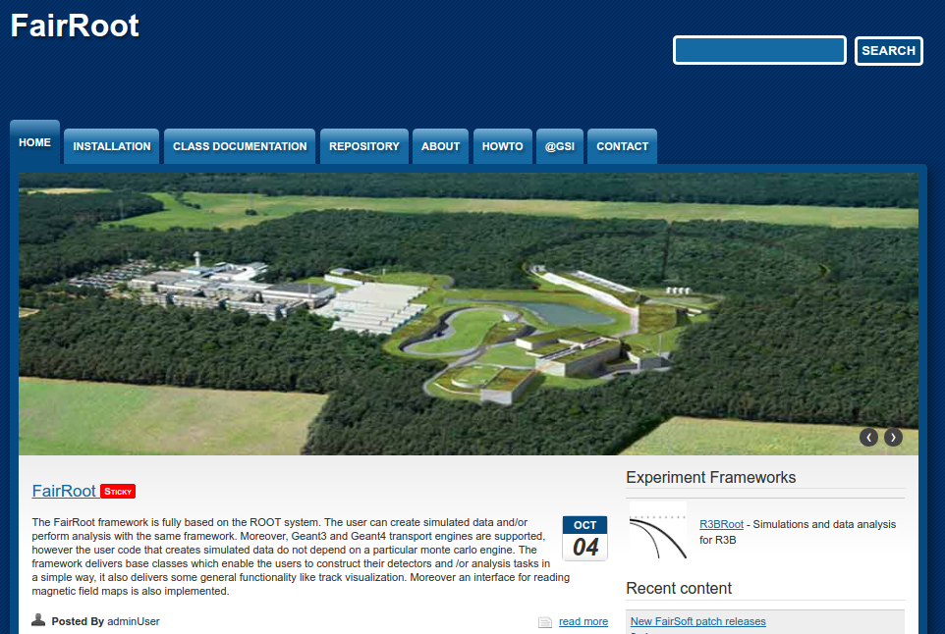

FairRoot Framework
The FairRoot package is an object-oriented simulation, reconstruction and data analysis framework based on ROOT. It includes core services for detector simulation and data analysis for HEP experiments. The framework delivers base classes which enable the users to easily construct experimental setup in a fast and convenient way. By using the Virtual Monte Carlo concept it is possible to perform the simulations using either Geant3 or Geant4 without changing the user code or the geometry description.
https://fairroot.gsi.de/
The basic idea of FairRoot is to provide a unified package with generic mechanisms to deal with
most commonly used tasks in HEP. FairRoot allow physicists to:
✗ Focus on physics deliverables while reusing pre-tested software components.
✗ Do not submerge into low-level details, use pre-built and well-tested code for common tasks.
✗ Allows physicists to concentrate on detector performance details, avoiding purely software engineering issues like storage, retrieval, code organization etc.
K. Gertsenberger

Slide 5
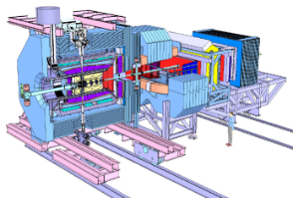
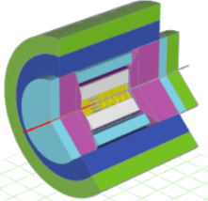
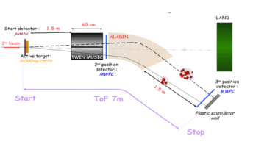


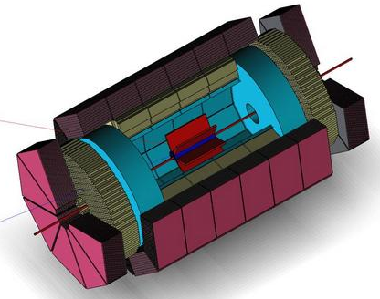
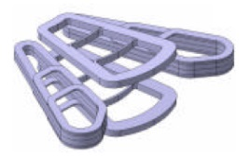
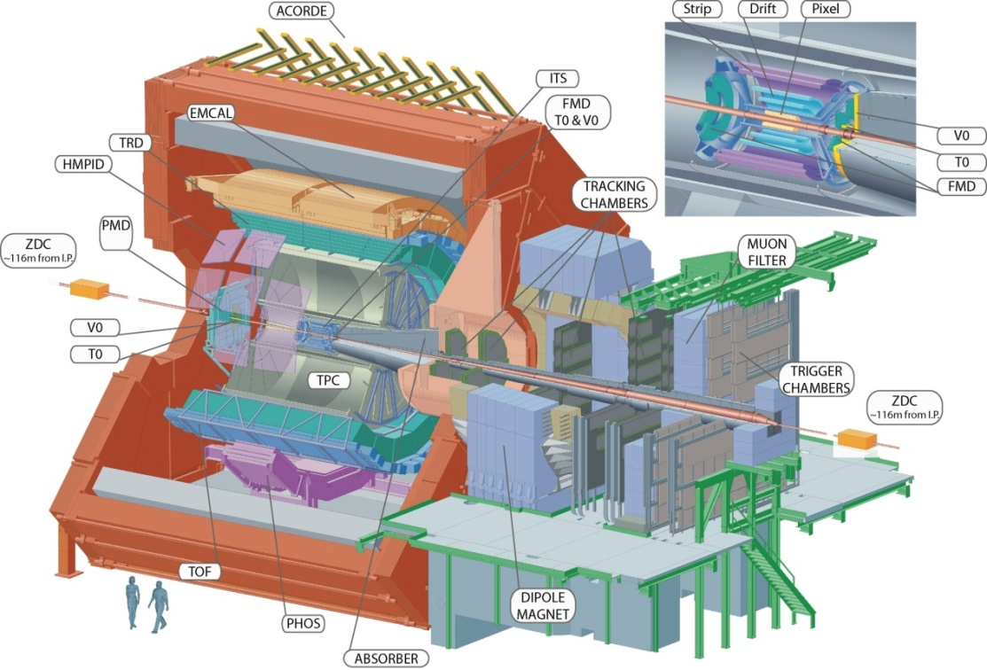
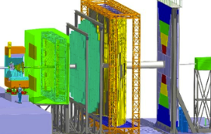
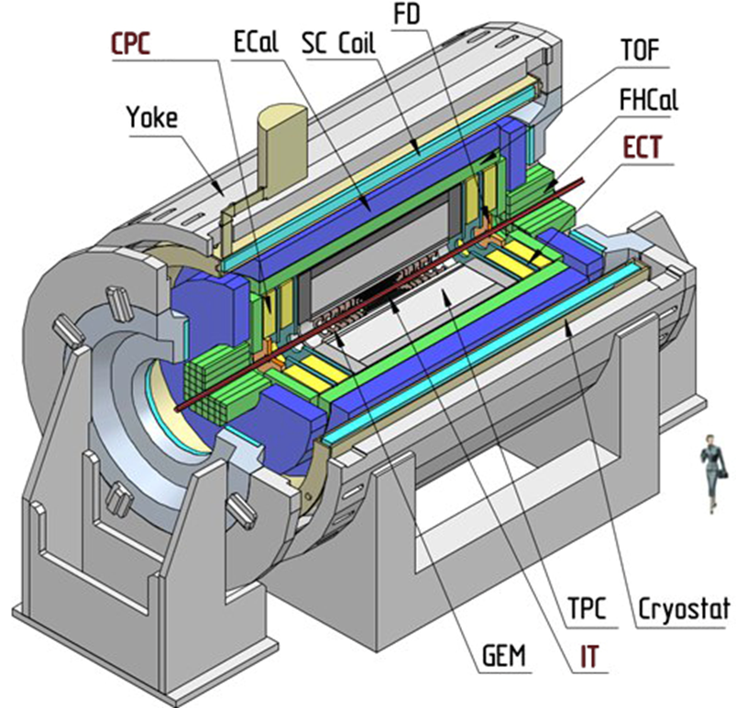
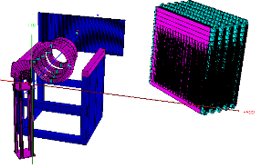
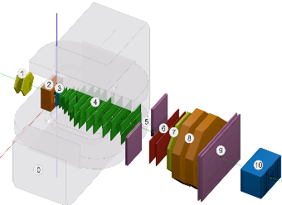
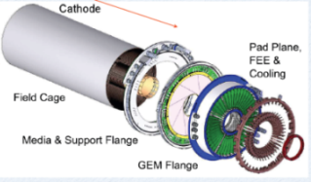
FairRoot Universe
Panda decided to join → oct.
FairRoot: base package for experiments
EIC (Electron Ion Collider BNL)
SOFIA (Studies On Fission with Aladin)
SHIP (Search for Hidden Particles)
Start testing the VMC concept for CBM
R3B joined
SPD@NICA joined
ALICE
FAIR
2004
2006
2010
2011
2012
2013
2014
2015
First Release of CbmRoot
MPD@NICA started with FairRoot
ASYEOS joined
GEM-TPC seperated from PANDA branch
ENSAR-ROOT
Collection of modules used by structural nuclear phsyics exp.
BM@N@NICA started with FairRoot
K. Gertsenberger

Slide 6
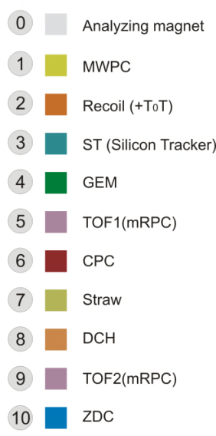
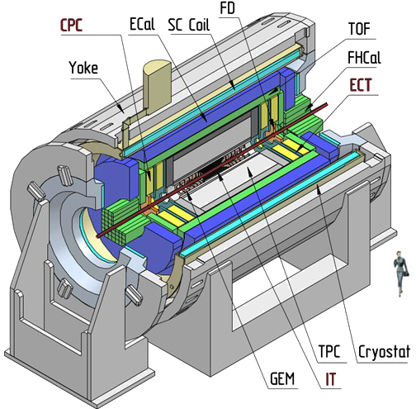

MpdRoot and BmnRoot software
The software MpdRoot and BmnRoot are developed for the MPD and BM@N event simulation, reconstruction of experimental or simulated data and following physics analysis of heavy ion collisions registered by the detectors.
C++ classes, Linux OS support, based on ROOT and FairRoot
*Stage 2
MpdRoot and BmnRoot are available in the GitLab@JINR https://git.jinr.ru/nica/
K. Gertsenberger

Slide 7
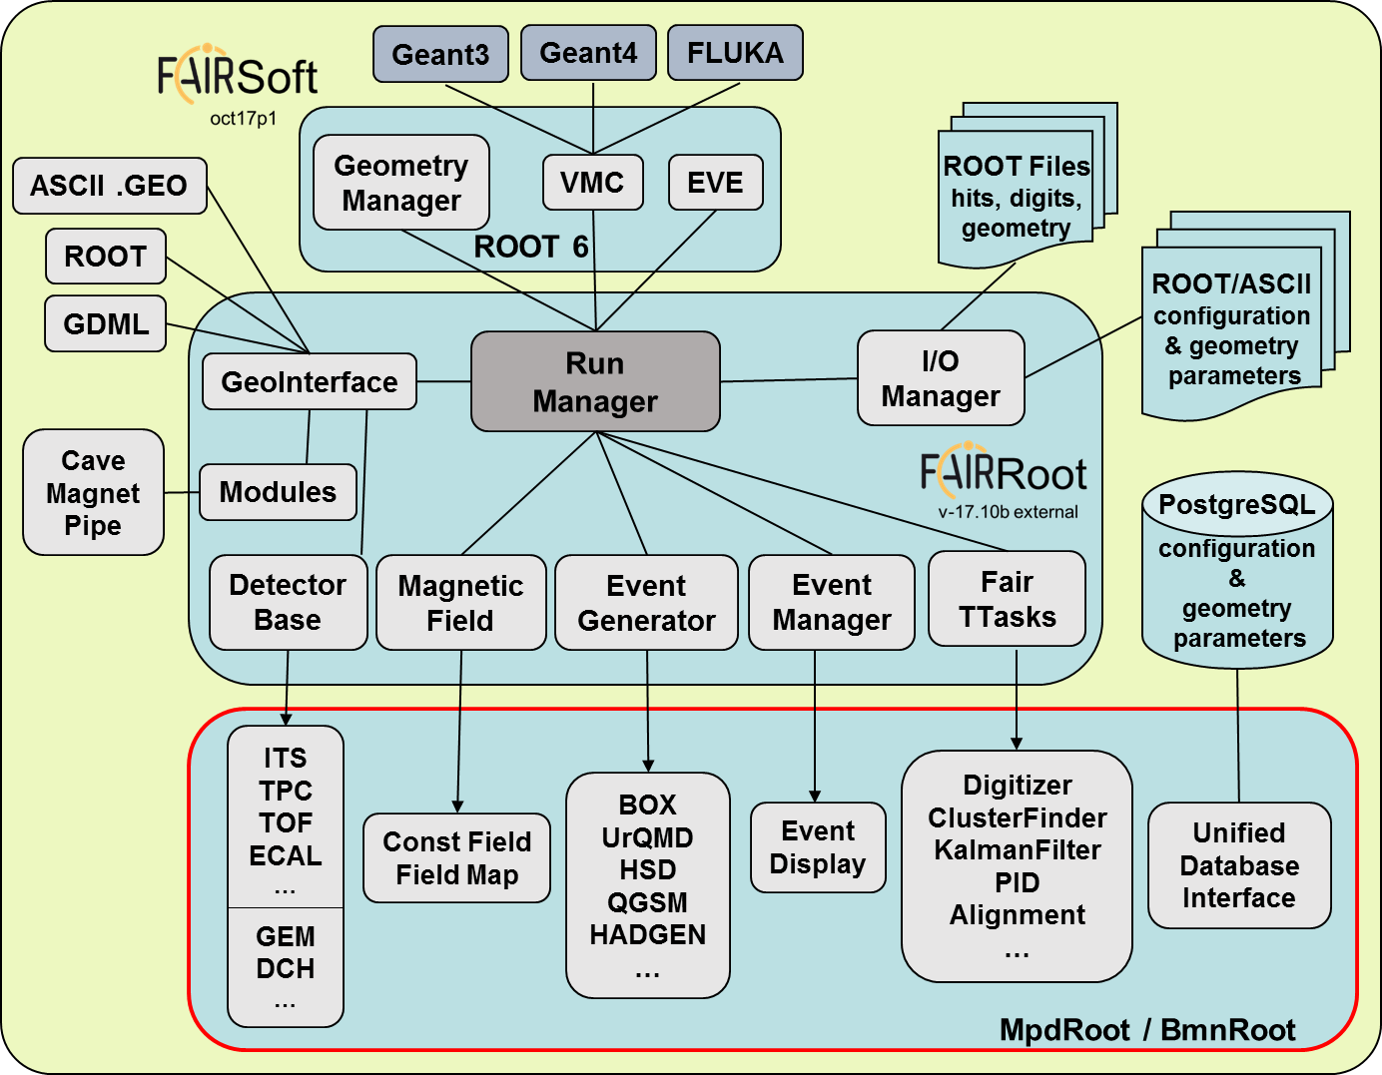
MpdRoot & BmnRoot design
Use FairSoft external packages
ROOT, XRootD, Pythia, PLUTO, HepMC, MillePede, Geant3/4, VGM, GSL, boost…
Use FairRoot as a set of base classes and modules of needed by particle experiments
Extended set of event generators for collisions:
UrQMD, Hybrid UrQMD, vHLLE + UrQMD, QGSM/LAQGSM, HSD/pHSD, HADGEN, 3 Fluid Dynamics, PLUTO
simple (for testing) - BOX, ION, PART
Experiment-specific parts and geometry are developed for each detector independently
Particle propagation by GEANT3 & GEANT4
Advanced detector response functions, realistic tracking, PID were included
MPD and BM@N homepage: http://mpd.jinr.ru
K. Gertsenberger

Slide 8

MpdRoot & BmnRoot data processing
DAQ Storage
raw data in MPD format
Geant 3/4, Fluka…
Event Generators
UrQMD, QGSM, Pythia…
raw_run.data
digitizer
run_raw.C
simulation
run_sim.C
generator.dat
digits.root
evetest.root
reconstruction
run_reco.C
dst.root
physics
analysis
DST format
K. Gertsenberger

Slide 9
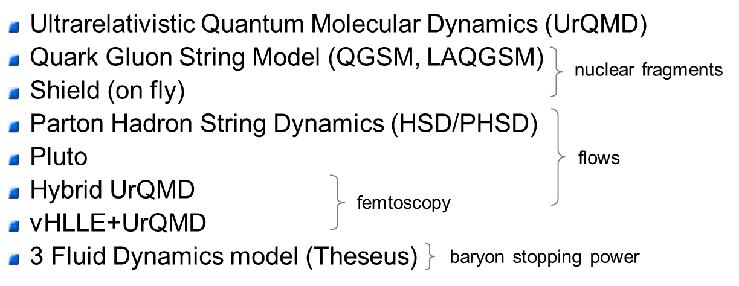
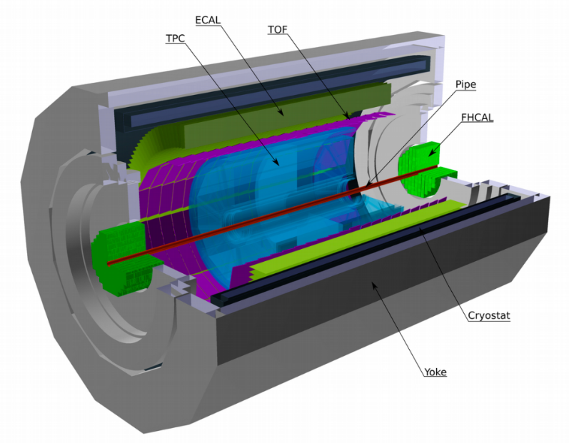
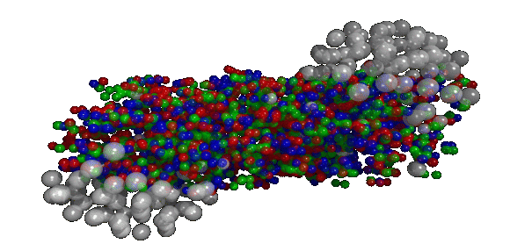
MPD geometry & simulation
extended set of event generators for collisions
Artistic
GEANT
K. Gertsenberger

Slide 10
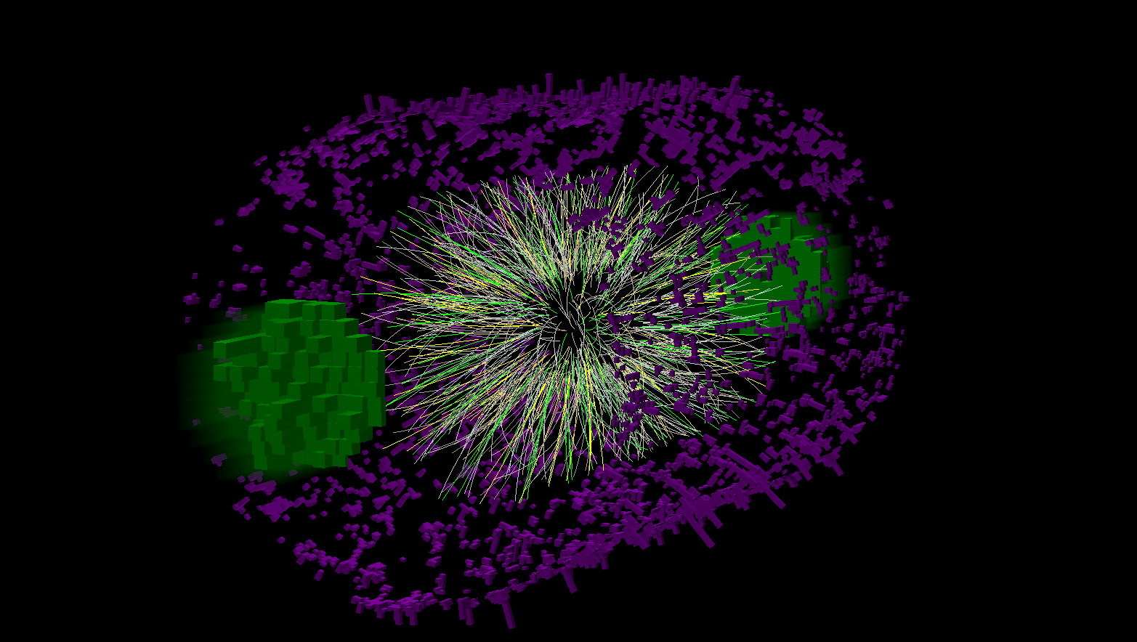
MpdRoot. Event reconstruction
Hit reconstruction in subdetectors.
Track reconstruction.
Searching for track-candidates in main tracker
Track propagation, e.g. using the Kalman Filter
Matching with other detectors (global tracking)
Vertex finding.
Particle identification.
K. Gertsenberger

Slide 11
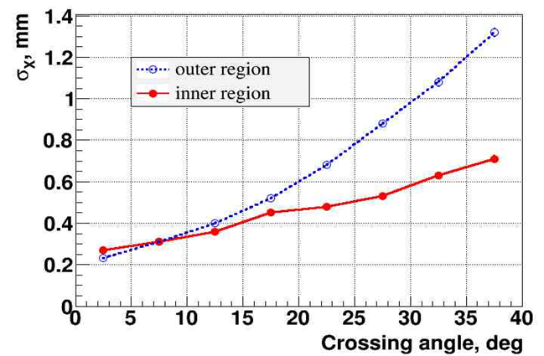
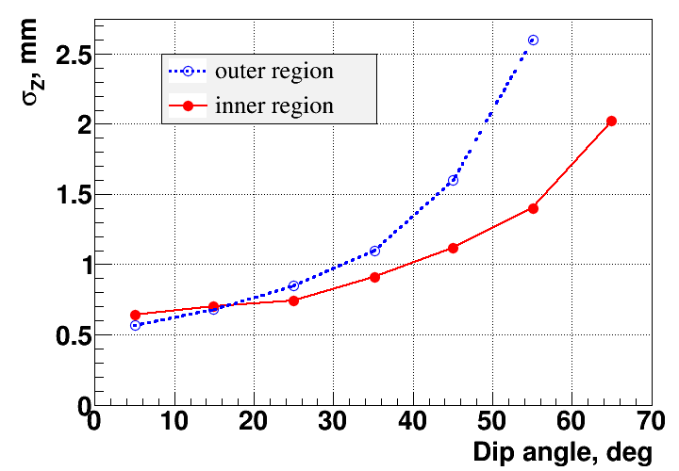
MpdRoot. Clustering in TPC
The hit reconstruction algorithm contains the following main steps:
Searching for extended clusters in (Pad-Time) for each pad raw.
Searching for peaks in time-profile for each pad in the found extended cluster.
Combining the neighboring peaks into resulting hits.
K. Gertsenberger

Slide 12
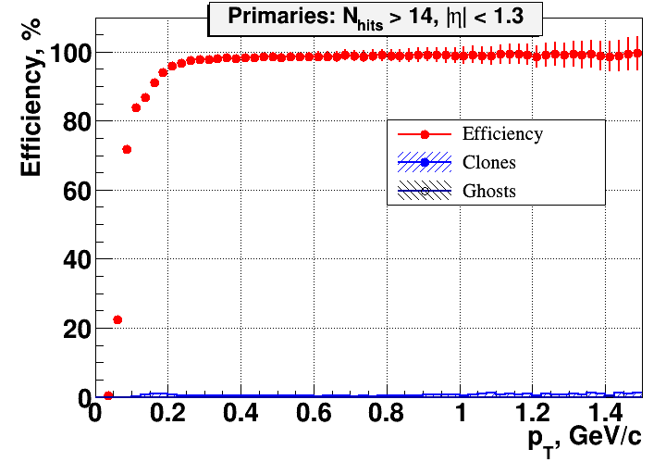
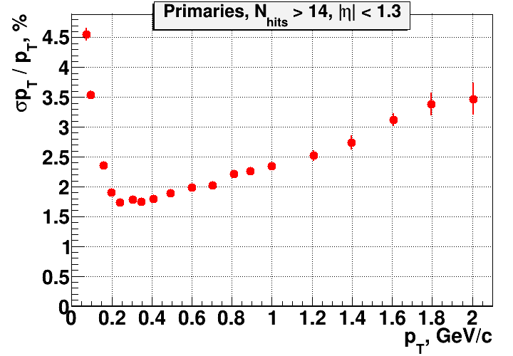
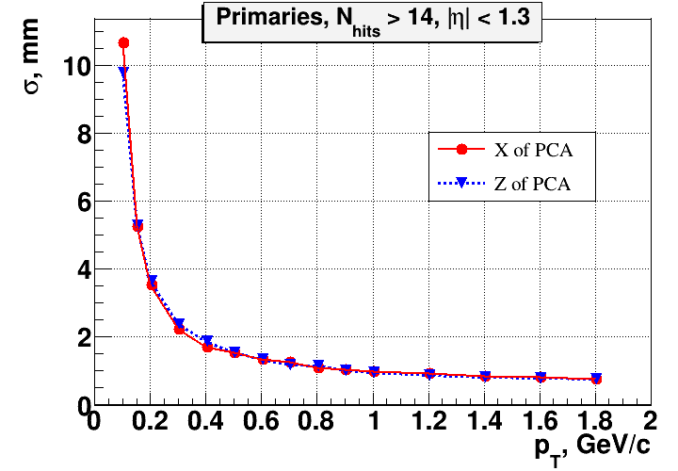
MpdRoot. Tracking
TPC tracking efficiency
Transverse momentum resolution
Efficiency of TOF matching
Primary vertex resolution
K. Gertsenberger

Slide 13
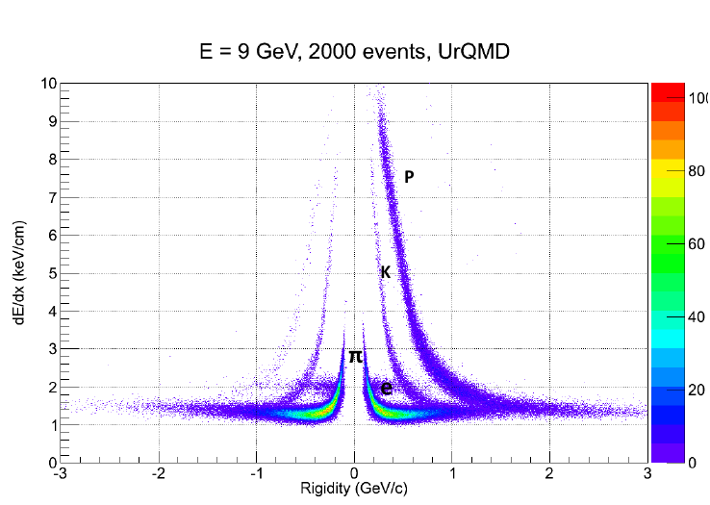
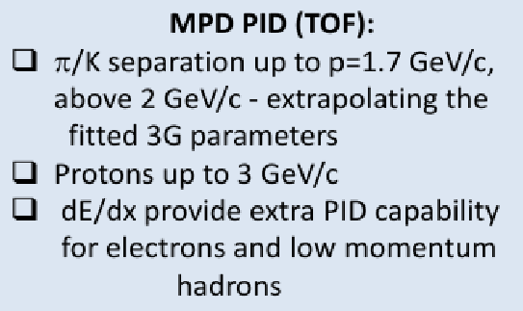
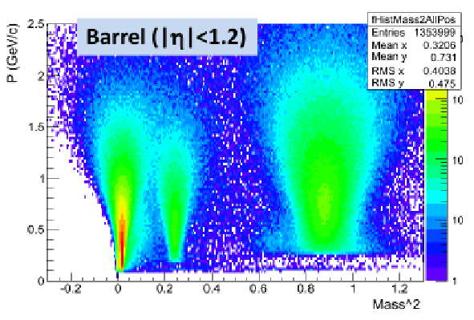
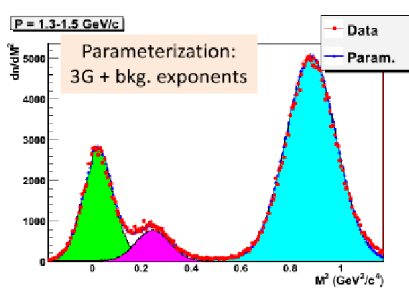
MpdRoot. Particle identification
TPC
PID: Ionization loss (dE/dx)
BBF + Aleph parametrization
Separation:
e/h – 1.3..3 GeV/c
π/K – 0.1..0.6 GeV/c
K/p – 0.1..1.2 GeV/c
K. Gertsenberger

Slide 14
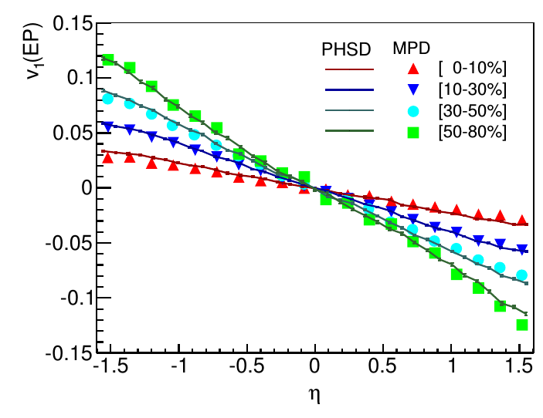
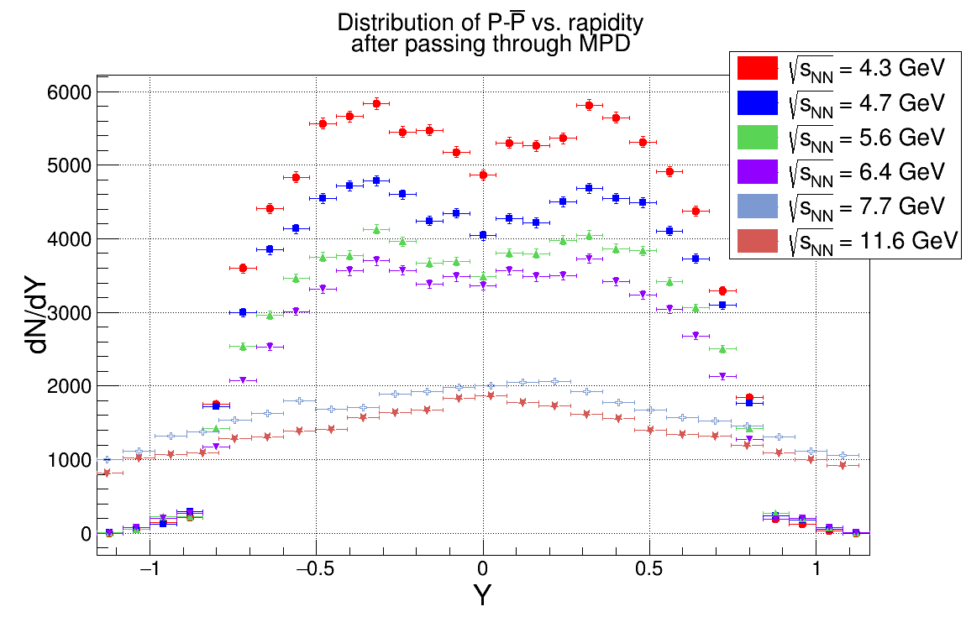
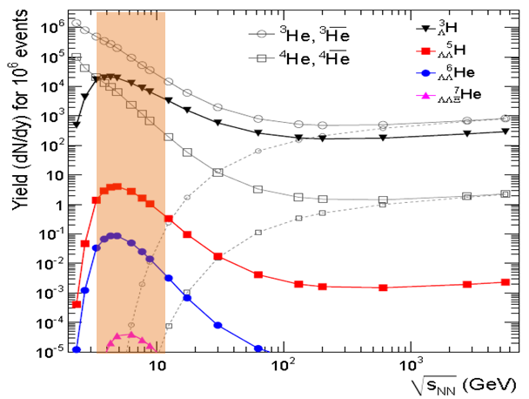
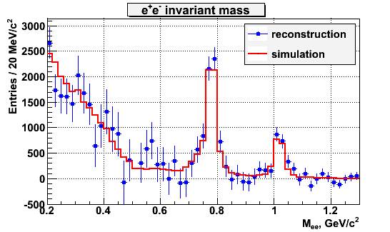
MPD physics with the MC generators
Direct flow
slop changes
Net baryon
rapidity curvature
MPD performance
for dileptons
Hypernuclei production
P. N. Batyuk, V. D. Kekelidze, V. I. Kolesnikov, O. V. Rogachevsky, A. S. Sorin, V. V. Voronyuk.
Feasibility study of heavy ion physics program at NICA // Physics of Particles and Nuclei 47:4, 2016, 540-566

Slide 15
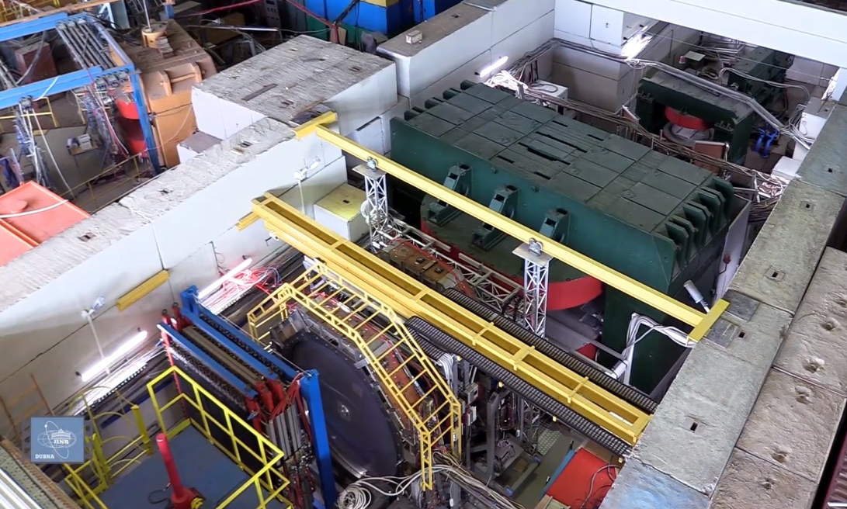
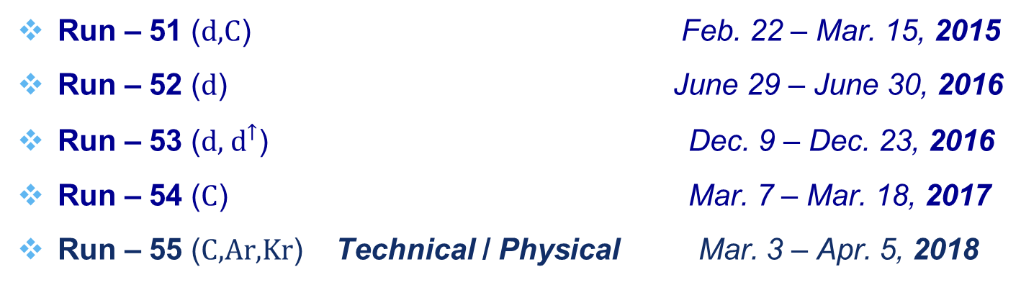
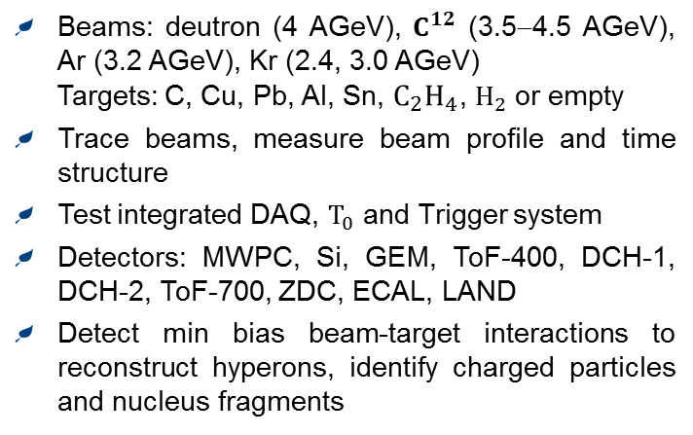
BM@N in Nuclotron runs (2015 – 2018)
Run – 51 (d,C) Feb. 22 – Mar. 15, 2015
Run – 52 (d) June 29 – June 30, 2016
Run – 53 (d, $d^{↑}$) Dec. 9 – Dec. 23, 2016
Run – 54 (C) Mar. 7 – Mar. 18, 2017
Run – 55 (C,Ar,Kr) Technical / Physical Mar. 3 – Apr. 5, 2018
Technical
Beams: deutron (4 AGeV), $C^{12}$ (3.5−4.5 AGeV), Ar (3.2 AGeV), Kr (2.4, 3.0 AGeV)
Targets: C, Cu, Pb, Al, Sn, $C_{2}H_{4}$, $H_{2}$ or empty
Trace beams, measure beam profile and time structure
Test integrated DAQ, $T_{0}$ and Trigger system
Detectors: MWPC, Si, GEM, ToF-400, DCH-1, DCH-2, ToF-700, ZDC, ECAL, LAND
Detect min bias beam-target interactions to reconstruct hyperons, identify charged particles and nucleus fragments
K. Gertsenberger

Slide 16
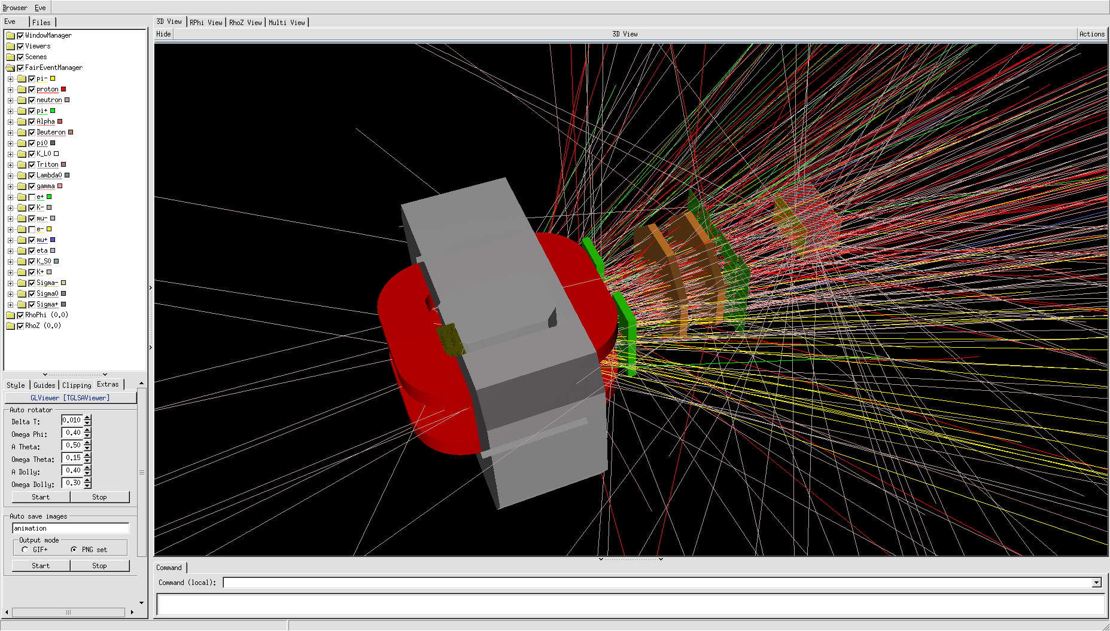
BmnRoot. Event reconstruction
Hit reconstruction in subdetectors.
Track reconstruction.
Searching for track-candidates by Kalman Filter in the GEM
Track propagation in the GEM using Kalman Filter
Matching of TOF-hits & DCH-hits with the GEM-tracks (global tracking)
Vertex finding.
K. Gertsenberger

Slide 17
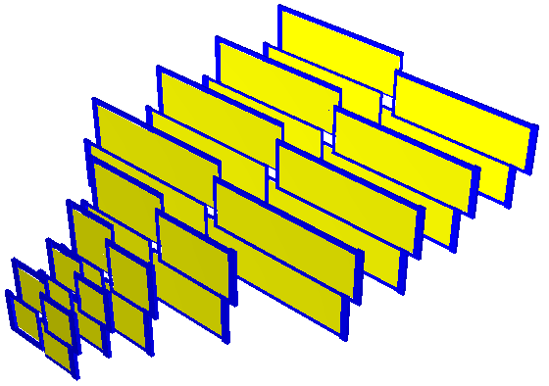
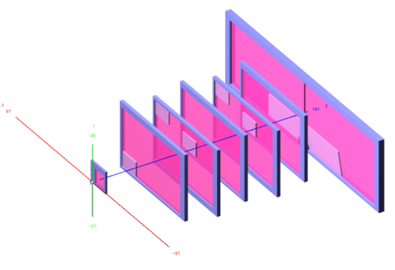
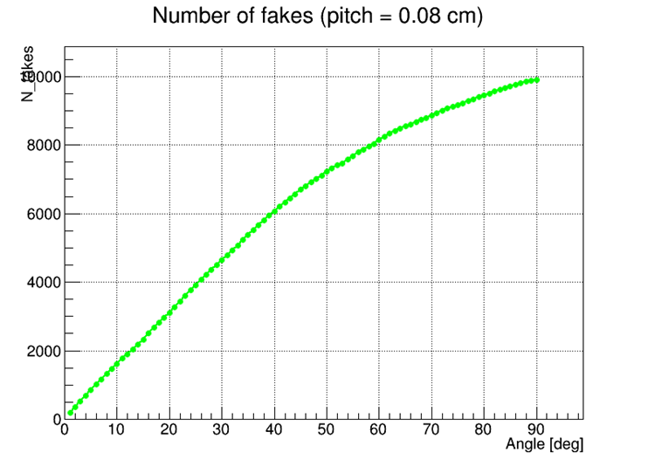
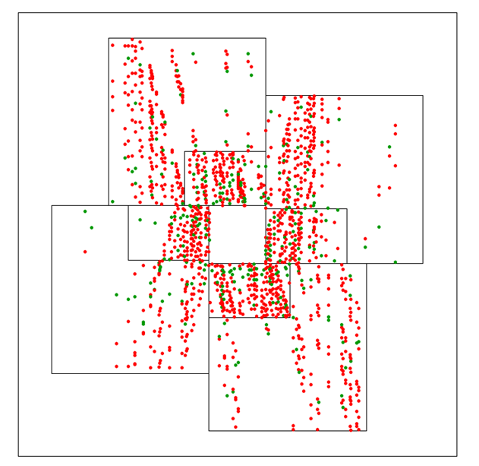
BmnRoot. Clustering in GEM
There are realistic hit finder in GEMs
For the GEM stations procedure of the fake hits production is implemented
K. Gertsenberger

Slide 18
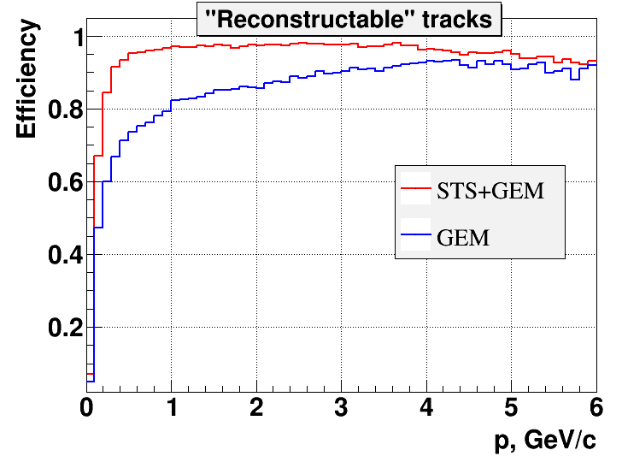
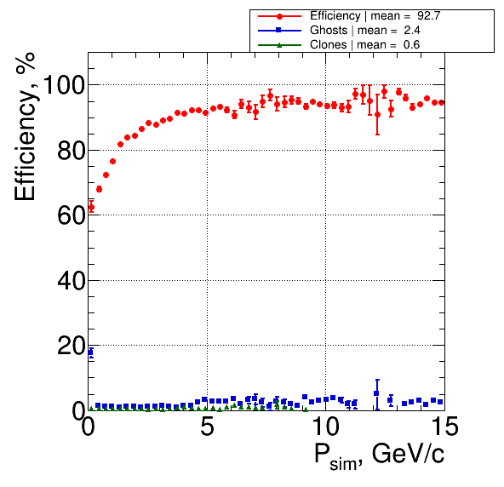
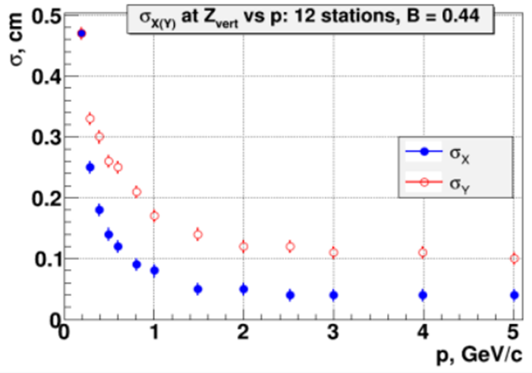
BmnRoot. Tracking in GEM
In BmnRoot there are two independent branches of tracking in GEMs:
The first tracking is based on the L1-tracking (CBM@GSI). Track-candidates are searched by the cellular automatons.
The second tracking is based on 3D conformal mapping. Track-candidates are searched by the developed special coordinate transformation.
Poster Session: 10/07/2018, 16:00. N. Voytishin - Tracking System Performance of the BM@N Experiment

Slide 19
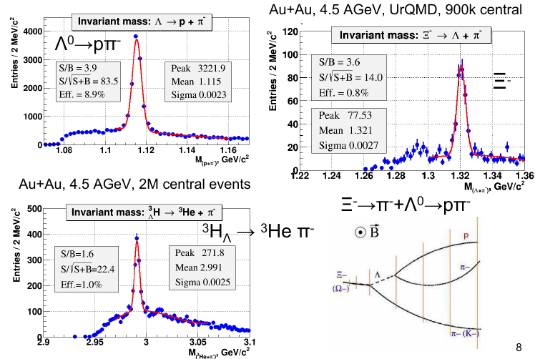
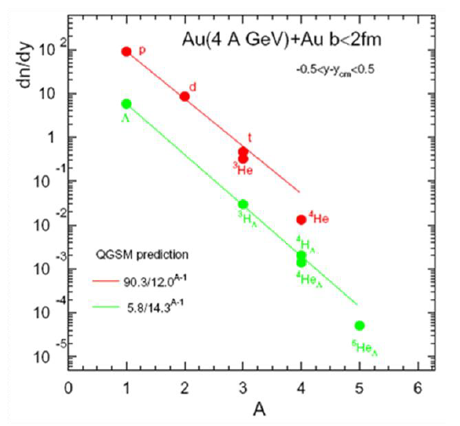
BmnRoot. Physics at BM@N
Hypernuclei
production
K. Gertsenberger

Slide 20







The Unified Database for offline processing
detector simulation
raw data processing
event reconstruction
physics analysis
reading and changing data
BmnRoot
users
C++ database interface w/o SQL
(connect, SQL I/O)
Unified
Database
ROOT
PHP
Tango Interface
Web-interface
PostgreSQL
central data storage for offline data analysis
unified access and data management
correct multi-user data processing
ensuring the actuality, data consistency and integrity
excluding the multiple duplication and use of outdated data
automatic backup
configuration
calibration
parameter and
algorithm data
Tango
Slow Control System
K. Gertsenberger

Slide 21




Event Display for the NICA experiments
based on EVE package
Event Display for reconstructed data:
hits, tracks, calorimeter towers
Au-Au $E_{lab}=4 GeV$
Event Display for simulated event data:
MC points, tracks, calorimeter towers
Au-Au $\sqrt{S_{NN}}=11 GeV$
K. Gertsenberger

Slide 22




Online Event Display
BM@N geometry
for a given run
Unified Database
C-C $E_{lab}=3.5 GeV$
Online Event Display
(GEM hits and tracks in run #1220)
K. Gertsenberger

Slide 23


Parallel event processing in MpdRoot&BmnRoot
MPD event reconstruction
with PROOF server
PROOF (Parallel ROOT Facility) is a part of the ROOT software
Parallel NICA event data processing in ROOT macros on the parallel architectures: user multicore machines, heterogeneous distributed clusters and GRID system
reconstruction of 72 sim. files
with MPD-Scheduler
Scheduling system (MPD-Scheduler) for task distribution to parallelize NICA data processing on multicore machines and cluster nodes
Supports SLURM, SGE and Torque system
Can use data of the Unified Database
Jobs are described and passed as XML file
K. Gertsenberger

Slide 24



Software Tests
Nightly Tests
(CDASH + QA Histograms)
User Tests
by request in CDASH or GIT
GIT CI Tests on merge requests
check compilation and main macros
→ stable dev and pro branches
In case of compilation or macro errors
e-mail is sent to software developers
K. Gertsenberger

Slide 25
Summary
The software frameworks for the NICA experiments provide to users all necessary tools to simulate any kind of detectors and study their properties.
The user can describe geometry of the detector in details and visualize the geometry and detector response for the considered particles by event display.
The methods of MPD and BM@N event reconstruction were implemented.
Users are able to make the proposed physics analysis by the available MC generators for the NICA project to study feasibilities with these experiments.
Many software systems have been developed: BM@N Unified Database, PROOF parallelization and MPD-Scheduler, Cluster Monitoring and Software Test System, Event Display and Online Histogramming, e-Logbook and official Web-site…
The big work has been done, but a lot of packages should be added or improved for the experimental data taking and data processing in distributed systems:
online clustering and fast tracking, online alignment and calibrations, physics analyses methods, distributed and cloud computing for the NICA experiments…
K. Gertsenberger

Slide 26


Today, T3 - Hall 7, 15:00. prof. Vladimir V. Korenkov - The JINR distributed computing environment
Thank you for your attention!
More information: nica.jinr.ru
mpd.jinr.ru
Email: gertsen@jinr.ru

