Slide 1
A tale of two programs
Philippe Canal, Federico Carminati
July 9th, 2018 14:00, Hall 3 (National Palace of Culture)
T5 - Software development: S2

Slide 2
Disclaimer
This is a presentation at a conference – not a peer-reviewed journal article or a sponsored publication. We make no representations as to accuracy, completeness, correctness, suitability, or validity of any information in this presentation and will not be liable for any errors, omissions, or delays in this information or any losses injuries, or damages arising from its display or use. All information is provided on an as-is basis. It is the reader’s responsibility to verify their own facts.
The views and opinions expressed in this presentation are those of the authors and do not necessarily reflect the official policy or position of any other agency, organization, employer or company. Assumptions made in the analysis are not reflective of the position of any entity other than the author(s) – and, since we are critically-thinking human beings, these views are always subject to change, revision, and rethinking at any time. Please do not hold us to them in perpetuity.

Slide 3
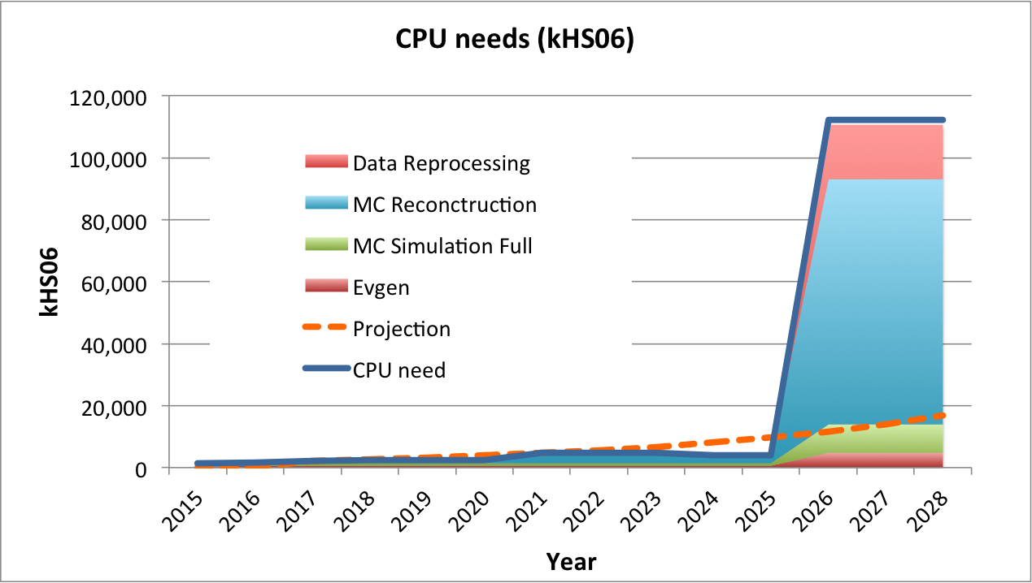
A performance wall
Need to leverage micro //
Some HEP code is here
Typical HEP code @ 0.8 CPI
{
200 Computing Centers in 20 countries: >600k cores
@CERN (20% WLCG): 65k cores; 30PB disk + >35PB tape storage
Large increase in demand
50% of resources used by a single application (GEANT4)

Slide 4
GEANT4
First release in 1998
~1MLOC of C++
~200 authors
One release per year
Complex governance structure
Relatively slow and conservative decision taking process
Experiments demand stability and improvements, typical oxymoron
Looking for performance in
SIMD
new techniques (DL GN)
Typical HEP-SIMD performance (0.8 CPI)
MT version: gain in memory footprint (it took 10 years to materialize)

Slide 5
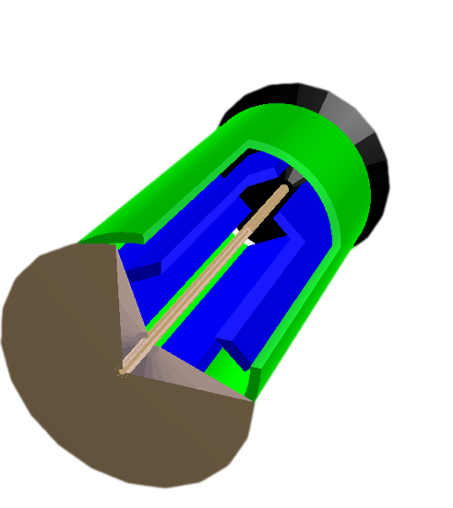
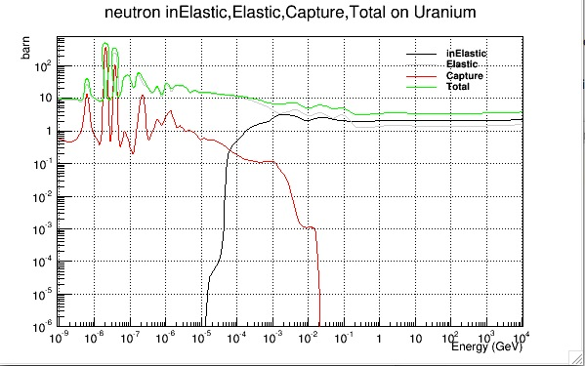
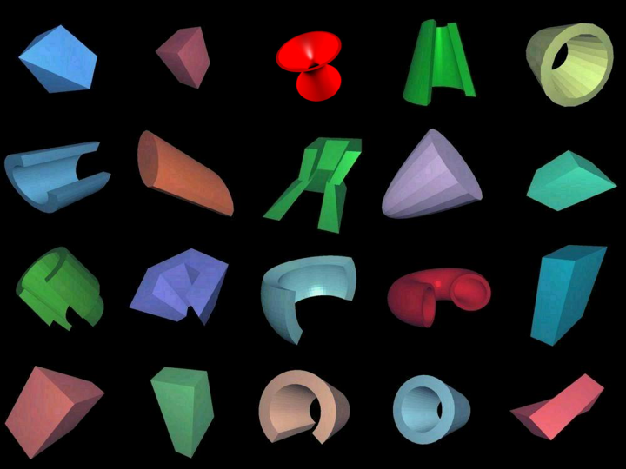
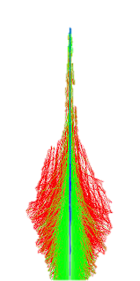
SIMD boost?
Scheduler
The initial ideas sounded easy
Basket of tracks
Basket of tracks
Dispatching
MIMD
SIMD
Geometry navigator
Physics
Geometry algorithms
x-sections
Reactions

Slide 6
(R)evolution?
One year of R&D in collaboration with FNAL
Very difficult to implement new transport model adiabatically – must literally “rip apart” the heart of GEANT4
A new start is needed
But GEANT4 is 20+ years x 200FTEs, how is it possible even to hope to do better?
Where to find the manpower
Is it even thinkable to “compete”?

Slide 7

A theoretical model
Clayton Christensen, Harvard Business School circa 1995 introduced disruptive innovation
incumbents almost always lose†
Pace of technological
progress
No sir,
you do not want a ¼” drill
Performance trajectory of present
technology driven by sustaining
technological improvements
Performance which
the marketplace
demands or can absorb
you want a ¼” hole!
Performance
New performance trajectory
Disruptive
innovation
Time
† BIG FOOTNOTE

Slide 8
Classical Disruptive Innovation
"A disruptive innovation is not a breakthrough innovation that makes good products a lot better.” Clayton Christensen
Every product has users that range from basic to average to sophisticated
Over time, customers can utilize more features and performance
Incumbent companies often add features, cost and functionality faster than their customers can utilize
Recognizing an opportunity, a startup creates a new offering that appeals to most users because it is simpler, easier to use and costs less
Basic and average users switch to the new offering and it gains market share
Do you dare to be a “crappy innovator”?

Slide 9
Classical example
25%-30%
Gross margins
% of tons
55%
Steel Quality
Sheet Steel
18%
Gross margins
22%
Structual Steel
8%
Blast Furnace
Steelmaking
ca. 1st Century AD
–
1995
Angle iron, bars & rods
12%
Gross margins
Quality of minimill-produced steel
Rebar
4%
7%
Gross margins
1975
1980
1985
1990
Time

Slide 10
More examples
Disruptor | Disruptee
Personal computers | Mainframe and mini computers
Mini mills | Integrated steel mills
Cellular phones | Fixed line telephony
Community colleges | Four-year colleges
Discount retailers | Full-service department stores
Retail medical clinics | Traditional doctor’s offices
Uber | Taxi companies

Slide 11
Does it applies?
In GEANT<X> case there is no incumbent and competitor and market and…
We are the same people!
Same users, same developers (sometimes overlapping), same market

Slide 12








Adopted Strategy
GEANT4 toolkit
VGeometry
Leave no (wo)man behind
Geometry
Math
VMath
Hadronic
MagF Tran
VHadronic
Electromag
Neutrons
GEANTV
core
VmagF Tran
Comp i
Comp j
VElectromag
VNeutrons
sapienti sat
Every new idea
has a spectrum
of acceptance

Slide 13
Disruptive (r)evolution?
An entirely new technology (Vectorized transporter)
A continuous flow of new and high quality elements into the existing product
A thorough test for the new elements – substantial reduction of the technological risk
A continuous improvement of performance and quality with the current framework
New code IS better code
No (wo)man left behind (users and developers)

Slide 14
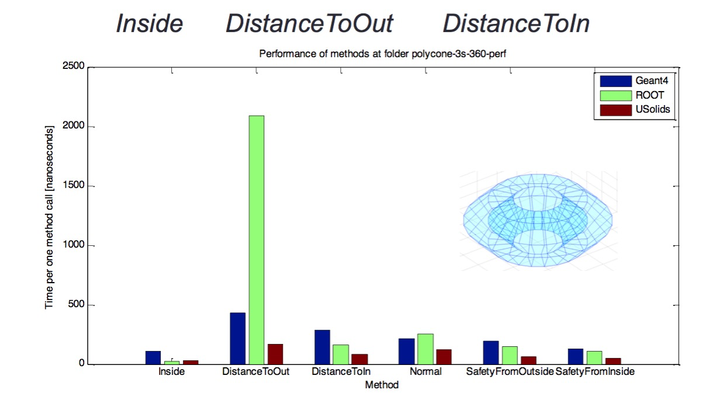
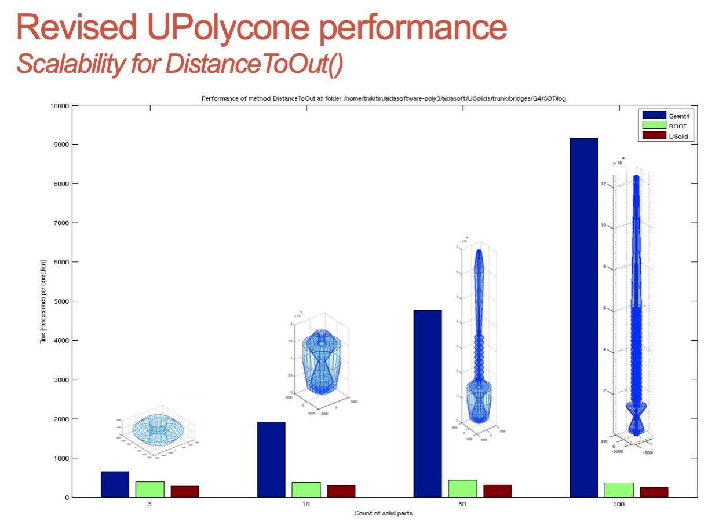
Geometry example
Snapshot from historical slide
It is today possible to run Geant4 simulations with VecGeom shapes replacing Geant4 shapes (seamless to user)
Geant4 10.1. ships USolids internally
optionally one may also compile against external USolids installation
Geant4 release 10.2. will remove internal module in favour of external USolids/VecGeom library
USolids source code repository: gitlab.cern.ch/VecGeom/VecGeom
Ugeom/VecGeom is developed by the AIDA project. PI Sandro Wenzell

Slide 15
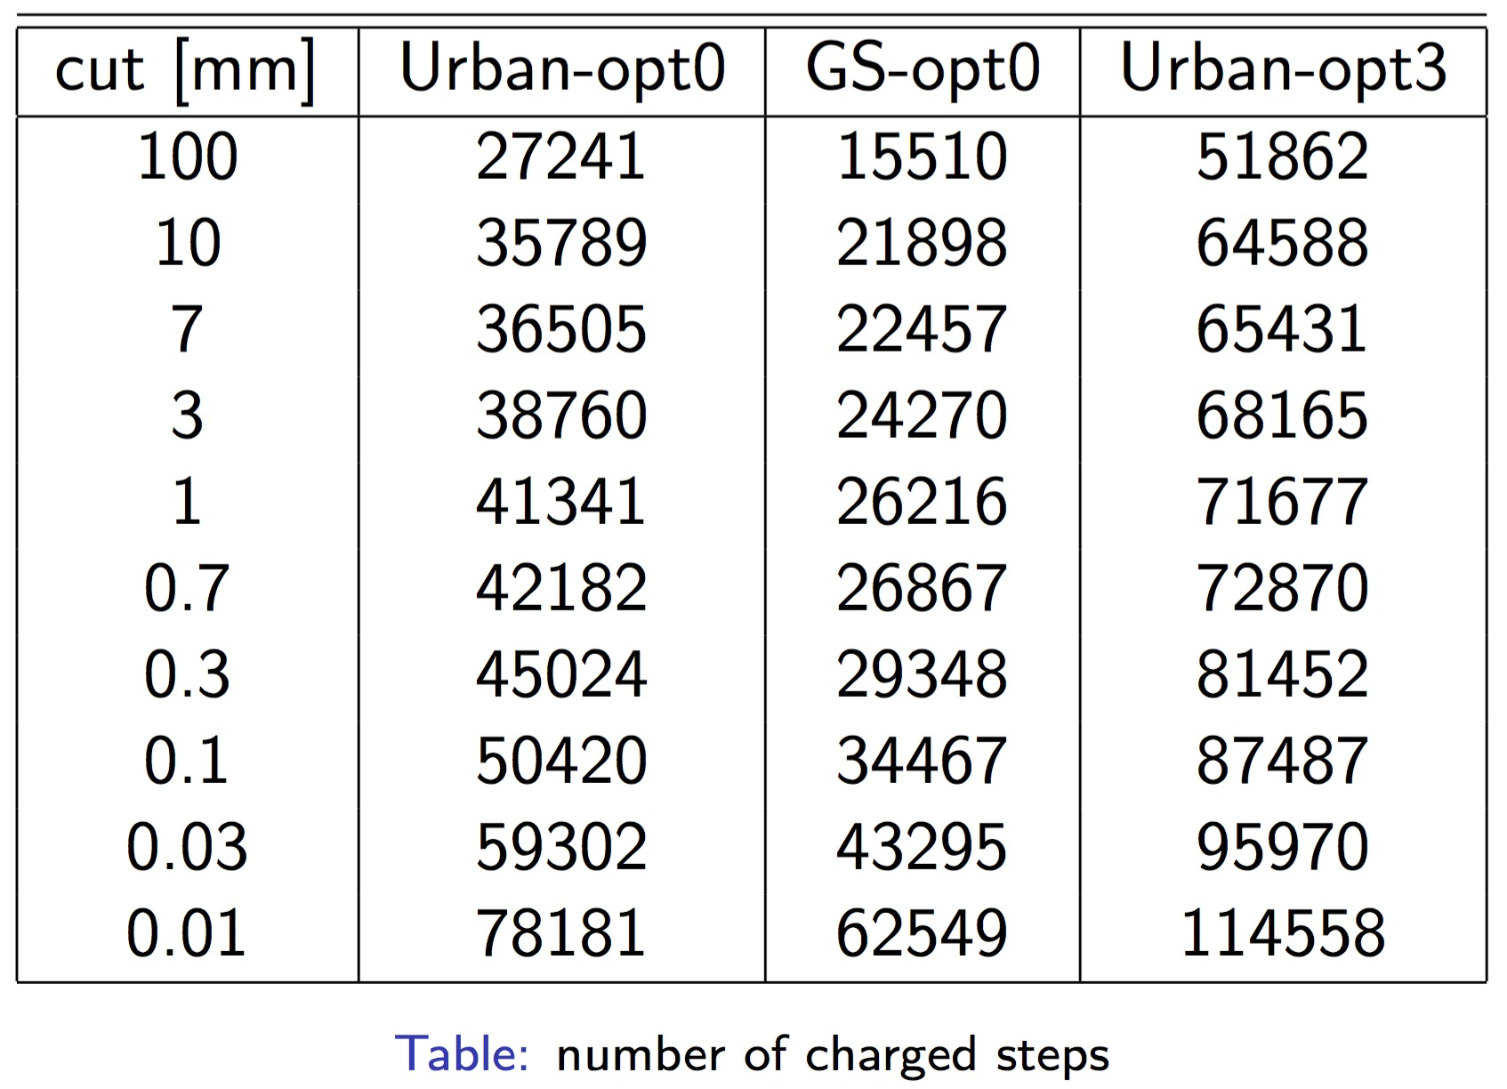
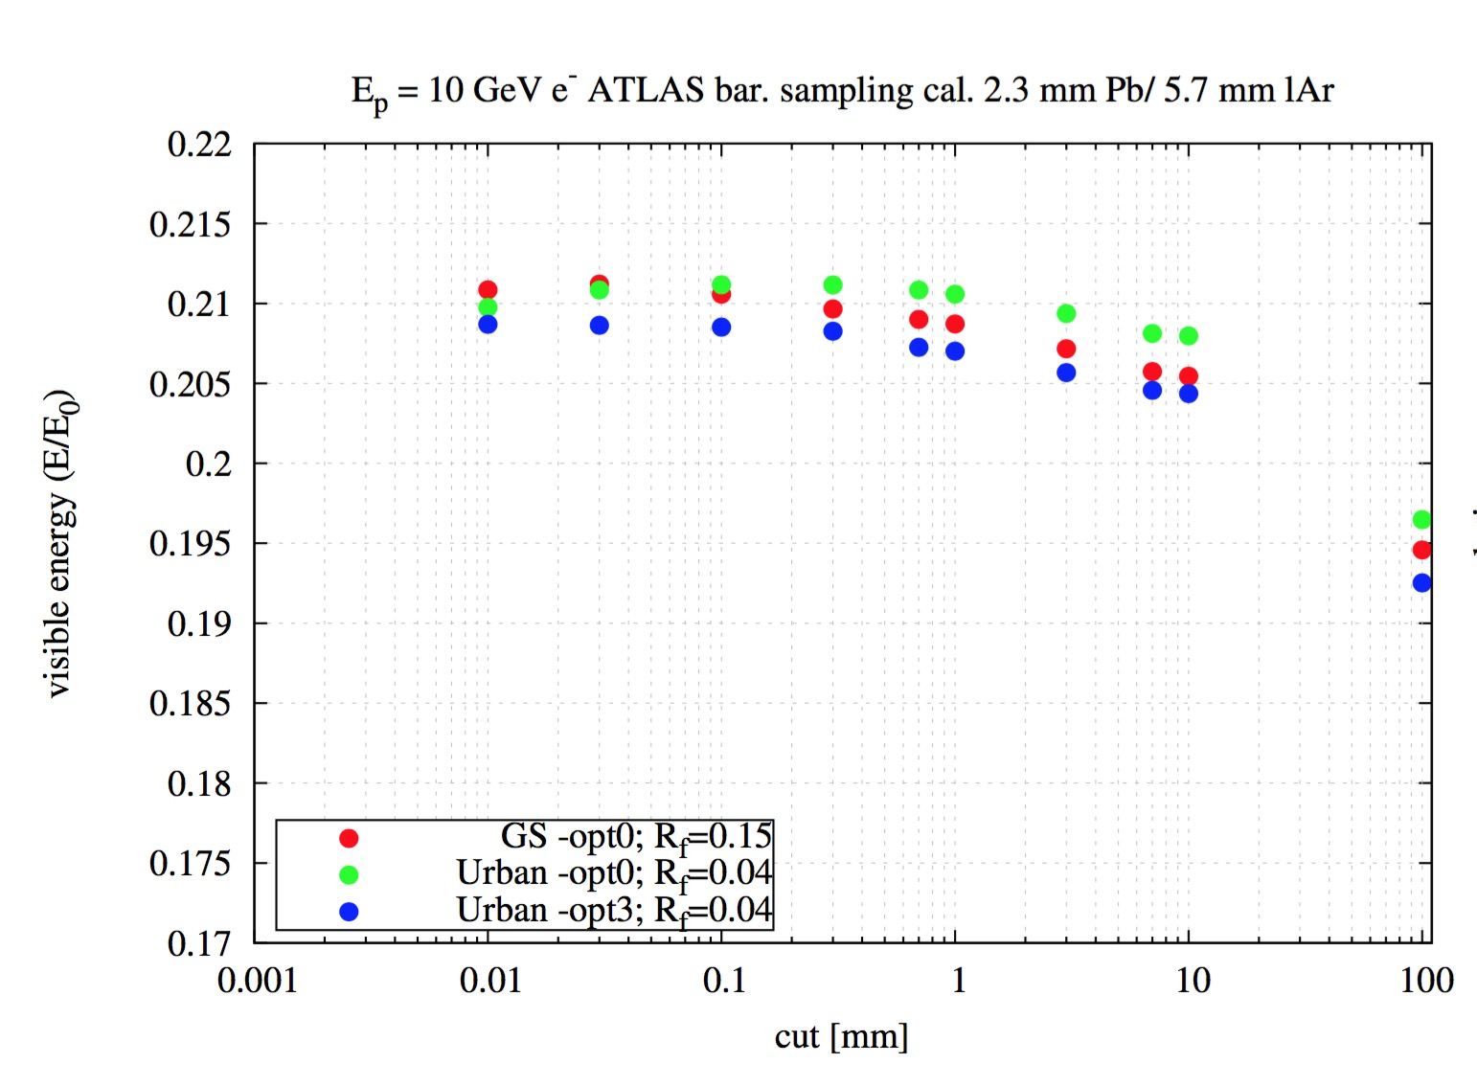
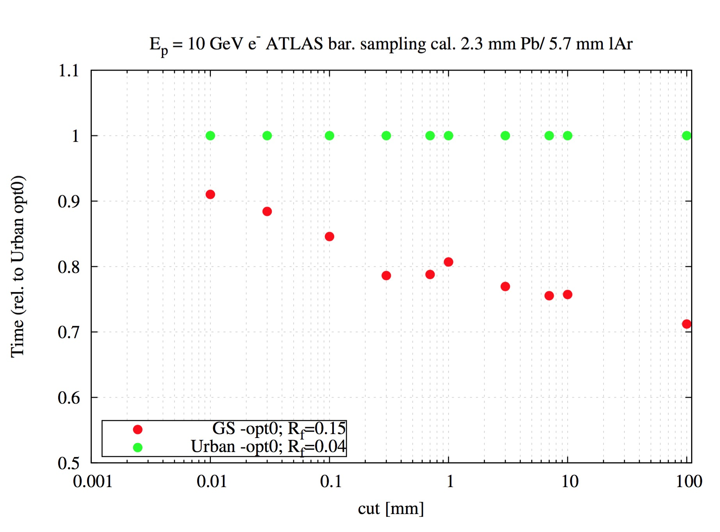
Physics example
Snapshot from historical slide
Less charged steps (30%-50%)
Physics validation
The new algorithm is being now vectorised for GeantV
It is in an experimental physics list for Geant4
  Candidate to become the default
Evolution or revolution?
Up to 30% faster in scalar
Source: M.Novak EP/SFT

Slide 16
Benefits to current experiments
CMS has adopted the new geometry with a 10%-15% speedup
The new physics is now becoming standard in GEANT4
The innovation pace has seen an acceleration since the inception of the GEANTV project (2013 onward)
  New geometry package
  New multiple scattering
  New/improved EM processes
  New neutron package
  New web site for GEANT4
  Fast simulation with DL
  Validation database
Could it have happened without GEANTV?
YES
Would it have happened without GEANTV?
depends whom you ask
… but if you ask me…
(in theory…) (…of course)

Slide 17
Conclusions
Bringing innovation into HEP code has often been traumatic and divisive
The concept of disruptive innovation is an interesting blueprint but not directly applicable to our community
The GEANTV model (2013-…) has tried to blend our reality with the basic principles of DI
The results have been positive for the HEP community

