Slide 2

Testing of complex, large-scale distributed storage systems: a CERN disk storage case study
J. Makai, A. J. Peters, G. Bitzes, E. A. Sindrilaru, M. K. Simon, A. Manzi (speaker)
CERN

Slide 3
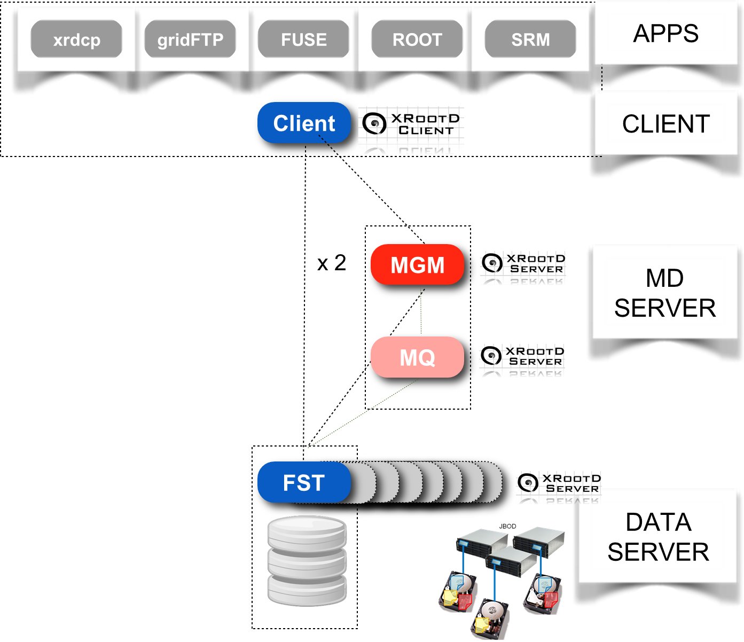
EOS
Disk file storage
Designed for Massive storage with high performances ( > 50PB, 500 M files and Khz metadata operations)
In memory namespace
New distributed namespace backend (QuarkDB)
https://indico.cern.ch/event/587955/contributions/2936873/

Slide 4
EOS CI till beginning of 2017
Jenkins CI
  Not state of the art anymore
  Lacks some functionalities
  Harder to maintain (lot of plugins from different sources)
No real CI present for EOS
  Only building RPMs for couple of platforms (CC7, SLC6 maintained mostly)
  Using mock for build
  No regression testing, regular static analysis in place
  No integration with other build facilities (e.g. Koji)
  Lot of manual steps, error-prone

Slide 5
Long journey behind us
We started again almost from scratch
Migration to Gitlab CI for EOS, XrootD and all related projects
Completely new technologies
  Docker containers instead of mock
  Docker images/containers for system testing and distribution
  Compiler caching
  Static analysis
  Google test for unit testing
New build cluster and new repos
Support for brand new platforms
Agile mindset, easy and quick to respond to new issues, needs

Slide 6
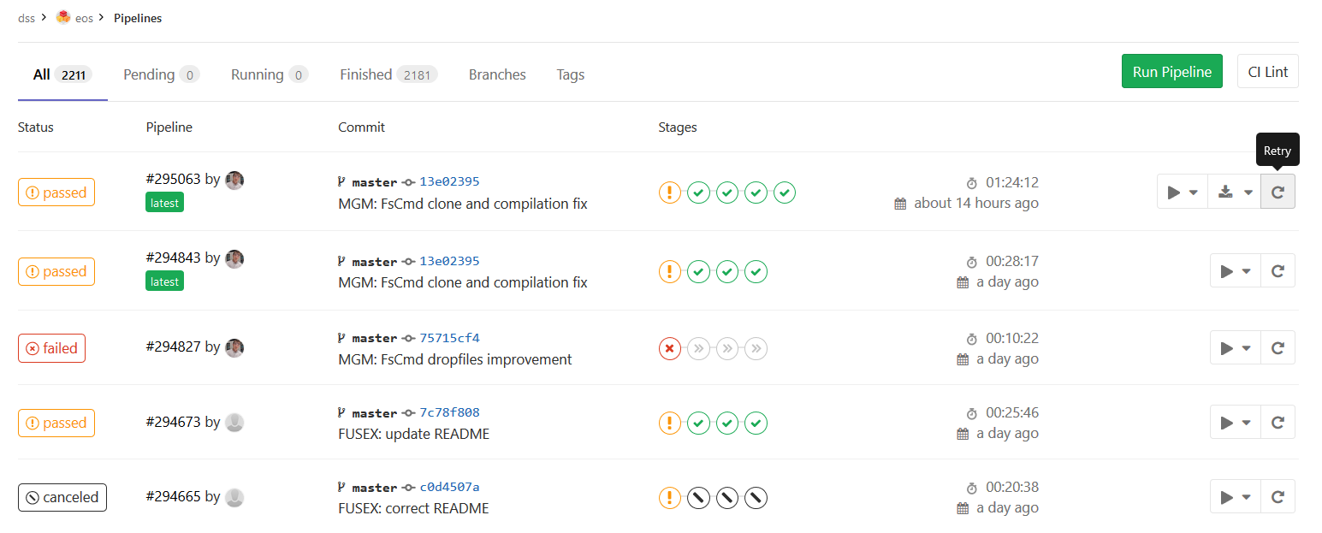
Migration to Gitlab CI

Slide 7
Docker containers for builds
Isolated build environment
Faster to support new platforms
  mock moves slowly
  Images are immediately present
Support other distributions with different packaging
Still one homogeneous build environment to manage

Slide 8
New platforms supported
Mac OS
  Not completely new but revived from its ashes
  Updated build to Sierra
Fedora
  We can update quickly to latest versions thanks to the new ecosystem
  Fedora 27, 28 and rawhide currently in CI
Debian
  Ubuntu artful & bionic in CI
Docker image for each release available via GitLab Registry
  gitlab-registry.cern.ch/dss/eos/eos-prod:4.3.2

Slide 9
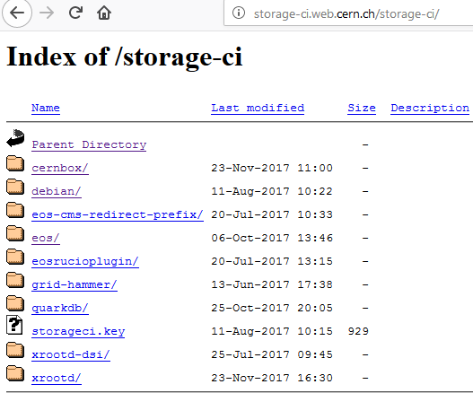
New yum and apt repositories
On EOSUSER (backup for release packages on CEPH volume)
Non-release packages kept for 10 days, automatic maintenance
Apt repo with Ubuntu packages under debian
Release RPMs and all DEB packages are automatically signed with GPG key
  rpm --import http://storage-ci.web.cern.ch/storage-ci/storageci.key
  curl -sL http://storage-ci.web.cern.ch/storage-ci/storageci.key | apt-key add -

Slide 10
Docker based testing
Docker image created for each build with fresh packages of the changes
Simulates a fully functional system with all its features
https://gitlab.cern.ch/eos/eos-docker project
  Independent from the CI environment
  Used also for development and easy functionality showcase

Slide 11
Docker based testing – System test
Both with old, in-memory and new, quarkdb namespace
New fully functional instance of EOS is created: tests booting, authentication, etc.
Runs eos functional tests: testing EOS commands with eos and xrootd clients
FUSE(X) testing: fuse microtests for both, benchmarks for FUSEX and POSIX compliance tests for FUSEX daily
  https://indico.cern.ch/event/587955/contributions/3012718/

Slide 12
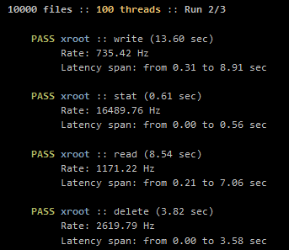
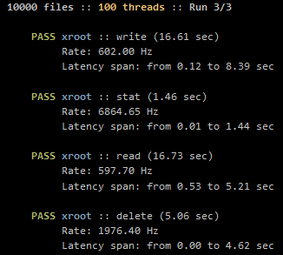
Docker based testing – Stress test
To put some load on the system
Write, stat, read, delete files from multiple threads simultaneously using xrootd protocol

Slide 13
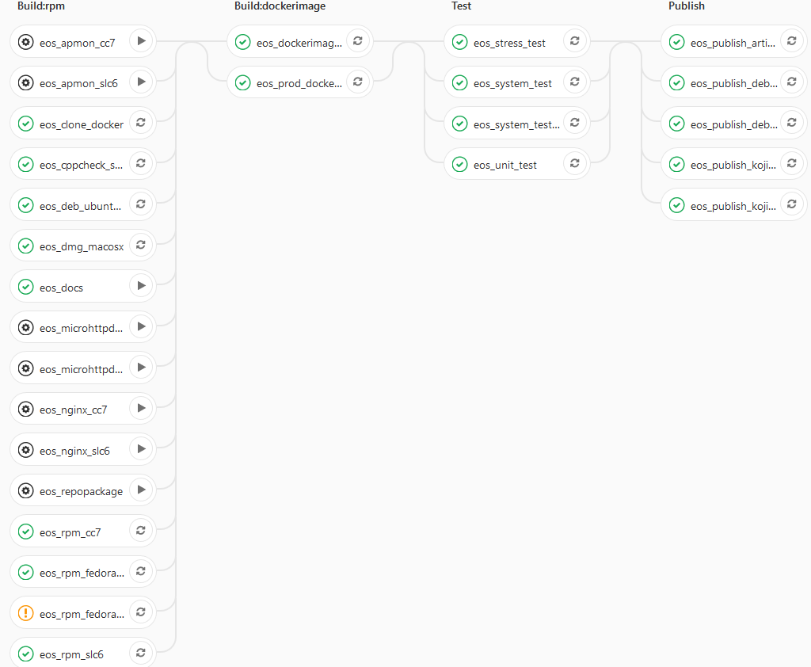
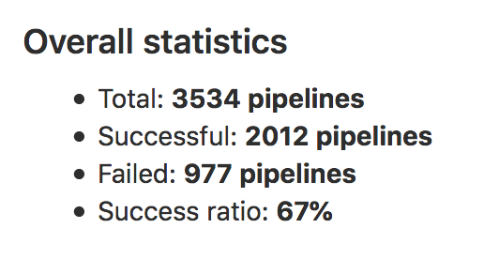
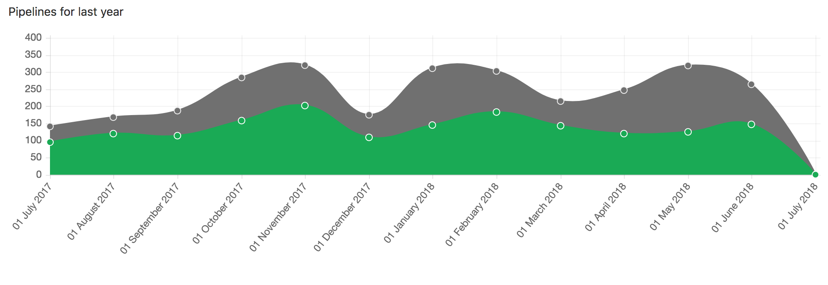
Gitlab CI Pipeline – 30 jobs, 4 stages
No manual,
no error-prone steps
Integrated with everything possibly
  SRPM → CERN Koji

Slide 14
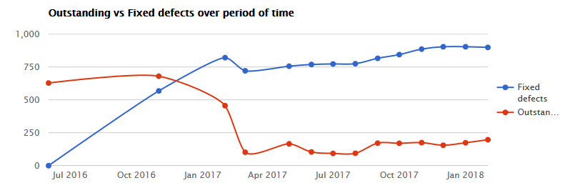
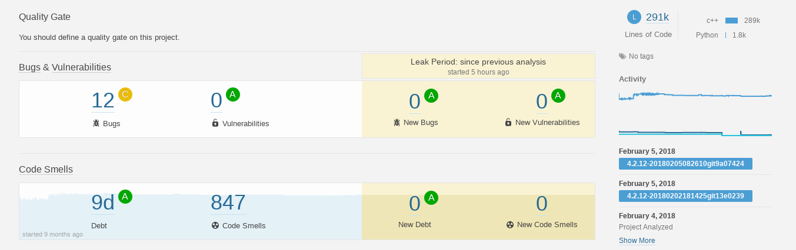
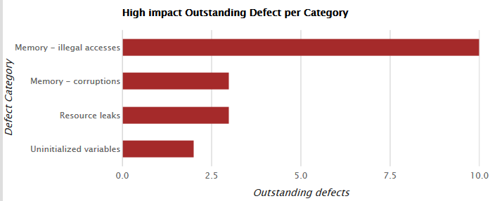
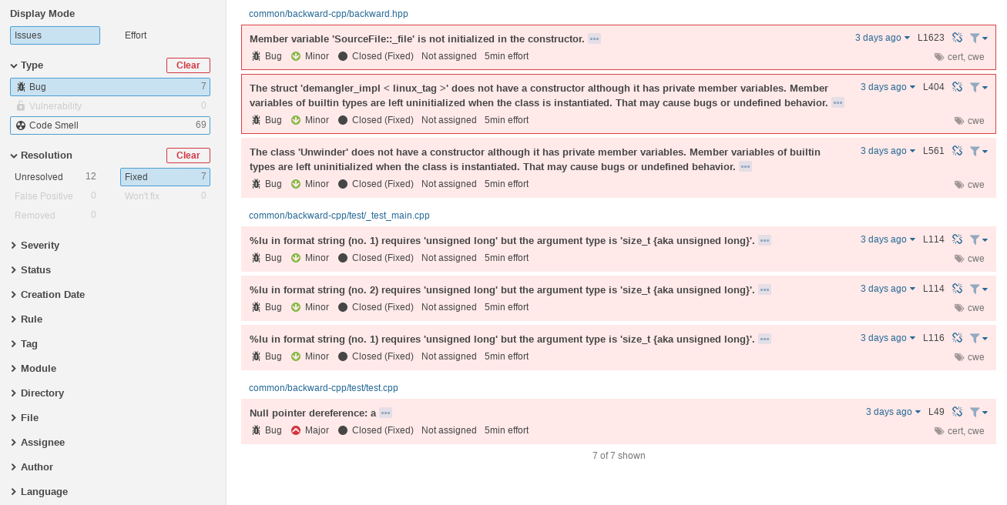
Static analysis – Coverity & Sonar
Runs once a day
Special instrumented compilation required
For each push to master
Cppcheck: analysis on source code level, no compilation

Slide 15
Conclusions & Future steps
Successfully implemented Continuous Testing for EOS since more than a year
Next Steps :
  Implement CD via Kubernetes integration in Gitlab
  Add EOS HTTP/GridFTP gateways testing
  Add more regression tests for functionality
  Implement Robustness testing

