Slide 1
Integrated HPC Infrastructure for the Research Communities in South-East Europe
Assoc. Prof. Emanouil Atanassov
Head of Grid Technologies and Applications Department
Institute of Information and Communication Technologies – BAS
Email: emanouil@parallel.bas.bg

Slide 2
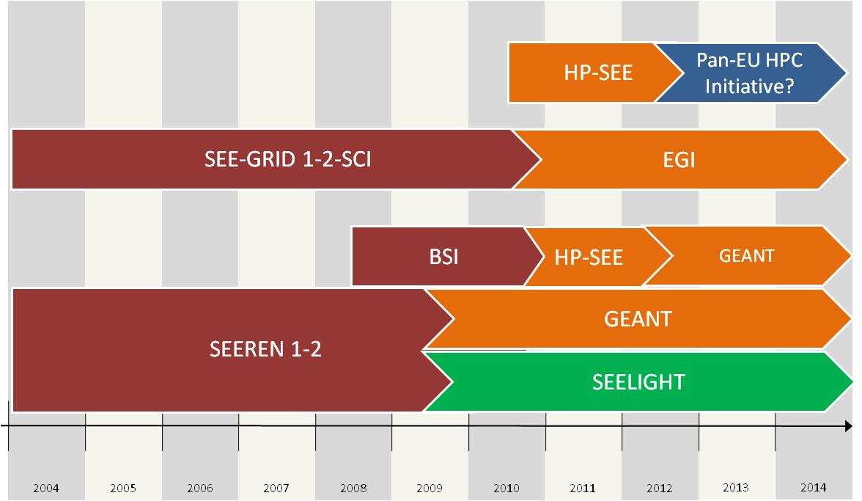
Regional Cooperation - History
PROJECTS
CHEP Conference 2018, Sofia, Bulgaria

Slide 3
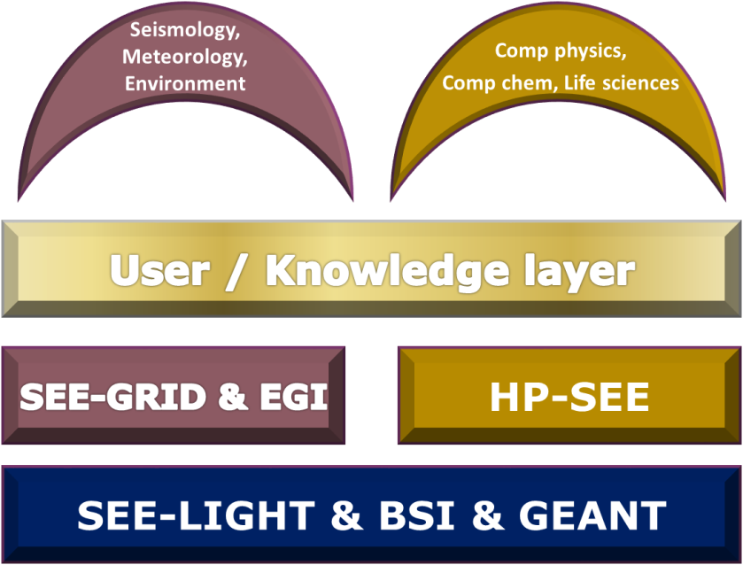
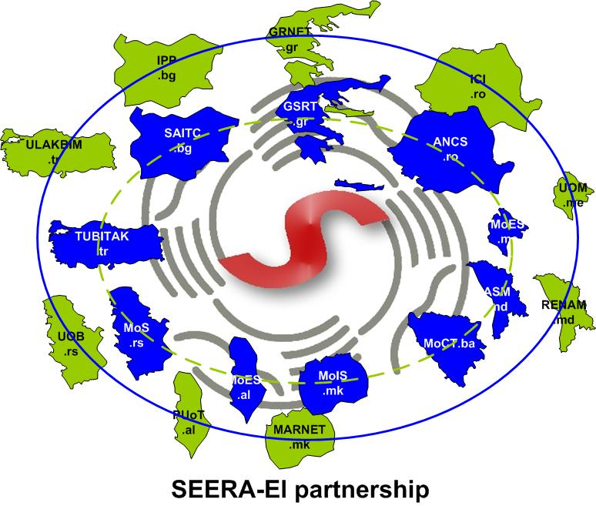
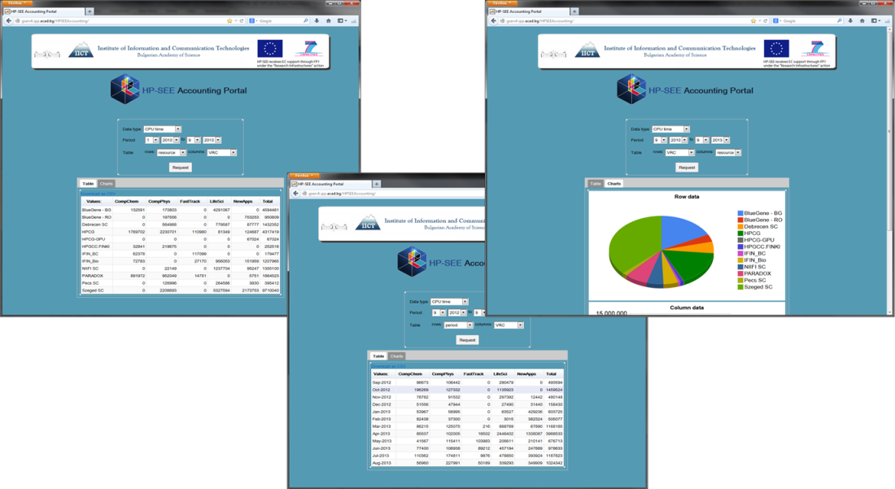
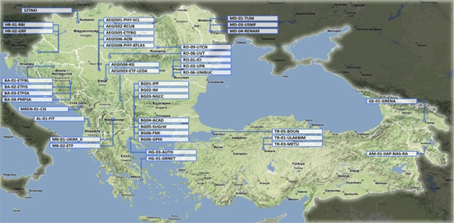
Regional partnerships – from infrastructure to applications
CHEP Conference 2018, Sofia, Bulgaria

Slide 4
National Roadmap for Research Infrastructures
RI: National Center for HPC and Distributed Computing - NC4HPC&DC
Financial coordinator: Ministry of Education and Science; Ministry of Transport, Information Technology and Communications. Scientific Coordinator: Institute of Information and Communication Technologies - Bulgarian Academy of Sciences (IICT-BAS)
Consortium for supercomputers applications (since 2009 г.) | Consortium for distributed (Grid and Cloud) applications (set up - 2004, updated - 2012)
Sofia University “St Kliment Ohridski” | Institute for Nuclear Research and Nuclear Energy - Bulgarian Academy of Sciences (INRNE-BAS)
Technical University – Sofia (TU-Sofia | Sofia University “St Kliment Ohridski”
Medical University – Sofia (MU-Sofia) | Technical University - Gabrovo
National Institute of Geophysics, Geodesy and Geography -Bulgarian Academy of Sciences (NIGGG-BAS) | Institute of Molecular Biology “Roumen Tsanev” -Bulgarian Academy of Sciences (IMB-BAS)
 | Institute of Organic Chemistry with Centre for Phytochemistry - Bulgaria Academy of Sciences ( IOCCP-BAS)
Institute of Mechanics – Bulgaria Academy of Sciences (IM-BAS) | National Institute of Geophysics, Geodesy and Geography -Bulgarian Academy of Sciences (NIGGG-BAS)
Remark: The consortium for supercomputer applications closely cooperates with Association “National Centre for Supercomputing Applications” (NCSA), which represents Bulgaria in PRACE | Institute of Mechanics – Bulgaria Academy of Sciences (IM-BAS)
 | Institute of mathematics and Informatics – Bulgarian Academy of Sciences (IMI – BAS)

Slide 5
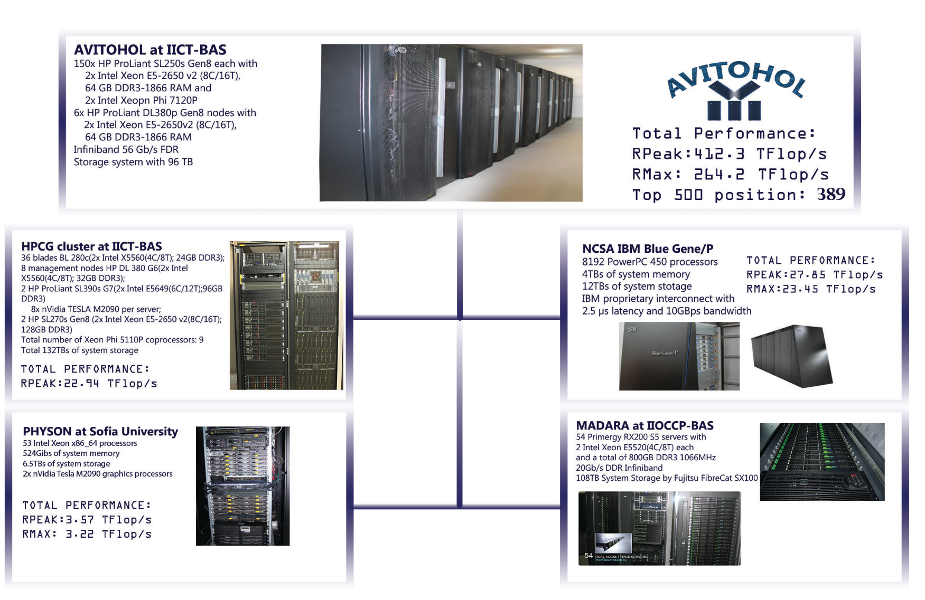
HPC resources for research in Bulgaria

Slide 6

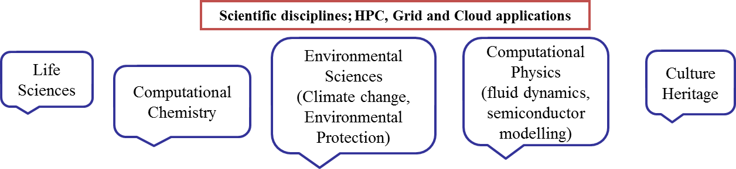

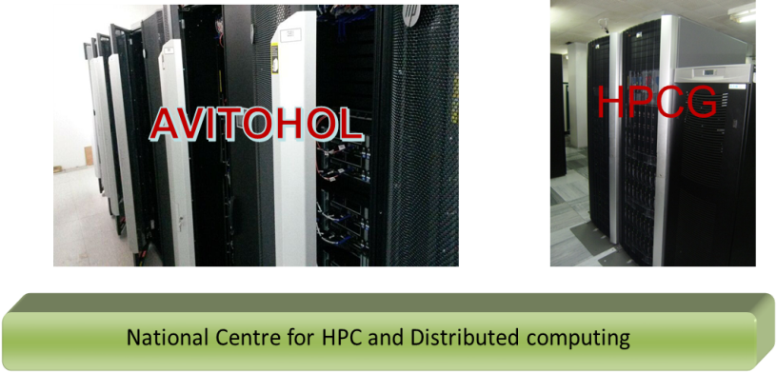
HPC Center “Avitohol” at IICT
150 HP Cluster Platform SL250S GEN8 servers with 2 Intel Xeon E 2650 v2 CPUs and 2 Intel Xeon Phi 7120P coprocessors
Site | IICT-BAS/Avitohol
Manufacturer | Hewlett-Packard
Cores | 20700
Interconnection | FDR InfiniBand
Theoretical Peak Performance | 412.3 Tflop/s
RMAX Performance | 264.0 Tflop/s
Memory | 9600 GB
Operation System | Red Hat Enterprise Linux for HPC
Storage capacity | 96 TB SAN
Top500 List on 389 place (Nov 2015)
http://www.top500.org/system/178609
tt
10 Gbps
Users workstations

Slide 7
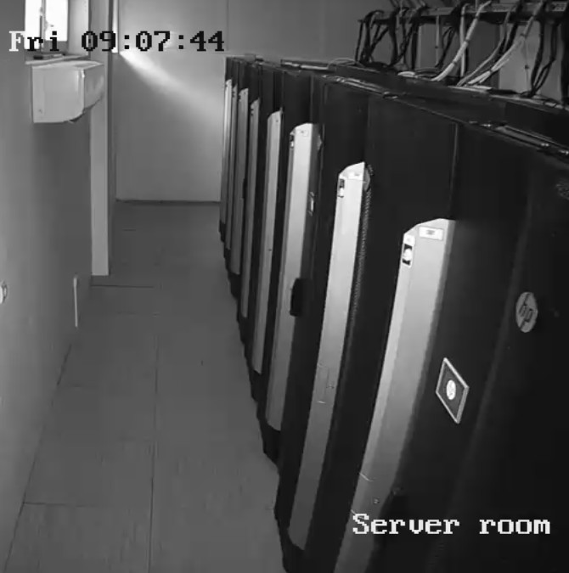
The Supercomputer System Avitohol at IICT-BAS
8 water-cooled racks of type HP MCS 200, paired in couples.
Each pair provides power and cooling for up to 50 kW of equipment
About 90% of the computational power comes from the accelerators – one 7120P coprocessor achieves 1.25 TFlop/s in double precision.
Total energy use at maximum load ~ 250kW.
RHEL, Intel Cluster Studio, SAP HANA
The most powerful system in the region

Slide 8
Efficiency of sparse matrix – matrix multiplication on
Intel Xeon Phi
Number of processes | 8 | 16 | 32
ALGORITHM 1 | 0.8494 | 0.7763 | 2.2047
ALGORITHM 2 | 0.6047 | 0.7149 | 0.9330
ALGORITHM 3 | 0.5619 | 0.3873 | 0.3994
MKL | 0.7182 | 0.9029 | 0.9098
Number of processes | 30 | 61 | 122 | 183 | 244
ALGORITHM 1 | 62.76 | 32.14 | 16.64 | 11.39 | 8.782
ALGORITHM 2 | 0.4603 | 0.2982 | 0.2826 | 0.2853 | 0.3036
ALGORITHM 3 | 0.3293 | 0.1664 | 0.1361 | 0.1822 | 0.4209
MKL | 0.5469 | 0.3713 | 0.3174 | 0.3157 | 0.3285

Slide 9

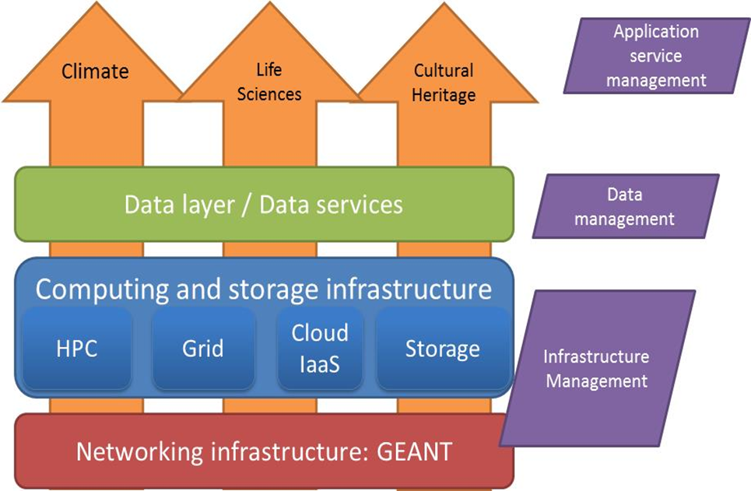
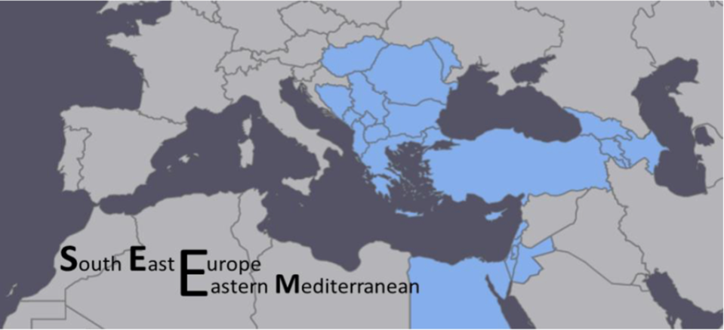
Regional HPC and distributed computing initiative – VI-SEEM
VI-SEEM integrates all kinds of electronic infrastructure in the region – Grid, Cloud, HPC, BigData, in order to provide single point of access for scientists in the region of South Eastern Europe and the Mediterranean.
Bulgaria is the leader in the HPC area.
Provides user-friendly integrated e-Infrastructure platform for Scientific Communities in:
  Climatology,
  Life Sciences,
  Cultural Heritage
  for the SEEM region
  by linking compute, data, and visualization resources, as well as services, software and tools.
CHEP Conference 2018, Sofia, Bulgaria

Slide 10

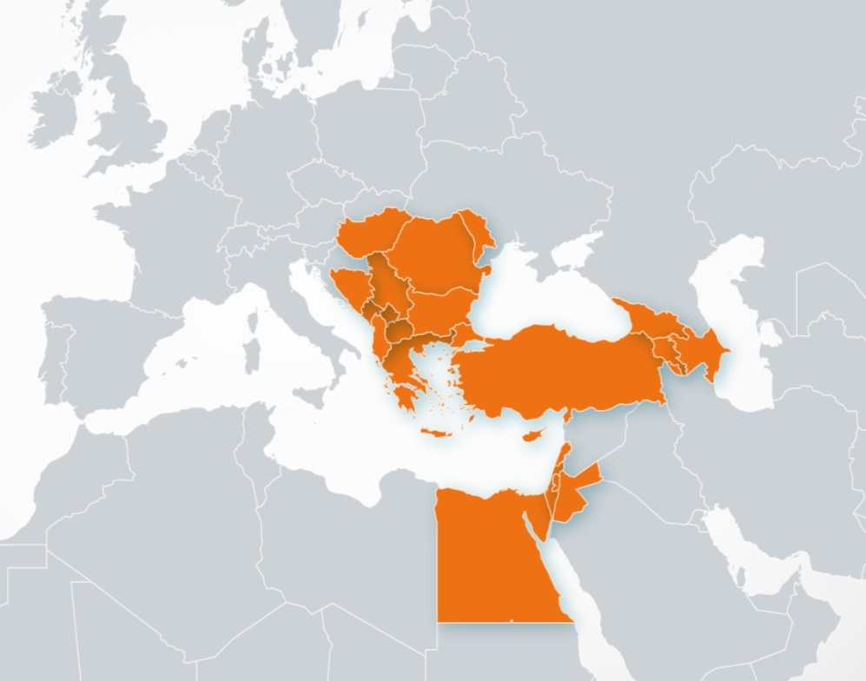
Regional historical and geographical context
VRE for regional Interdisciplinary communities in SEE and EM
Merging of SEE and EM regions
SEE: network SEEREN1-2, Grid SEE-GRID-1/2/SCI, HPC HP-SEE
EM: HPC LinkSCEEM1-2
Participant no. | Participant organisation name | Part. short name | Country
1 (Coord) | GREEK RESEARCH AND TECHNOLOGY NETWORK S.A. | GRNET | Greece
2 | THE CYPRUS INSTITUTE | CyI | Cyprus
3 | INSTITUTE OF INFORMATION AND COMMUNICATION TECHNOLOGIES – BULGARIAN ACADEMY OF SCIENCES | IICT-BAS | Bulgaria
4 | INSTITUTE OF PHYSICS BELGRADE | IPB | Serbia
5 | NATIONAL INFORMATION INFRASTRUCTURE DEVELOPMENT INSTITUTE | NIIF | Hungary
6 | WEST UNIVERSITY OF TIMISOARA | UVT | Romania
7 | POLYTECHNIC UNIVERSITY OF TIRANA | UPT | Albania
8 | UNIVERSITY OF BANJA LUKA | UNI BL | Bosnia and Herzegovina
9 | SS CYRIL AND METHODIUS UNIVERSITY OF SKOPJE | UKIM | FYR of Macedonia
10 | UNIVERSITY OF MONTENEGRO | UOM | Montenegro
11 | RESEARCH AND EDUCATIONAL NETWORKING ASSOCIATION OF MOLDOVA | RENAM | Moldova
12 | INSTITUTE FOR INFORMATICS AND AUTOMATION PROBLEMS OF THE NATIONAL ACADEMY OF SCIENCES OF THE REPUBLIC OF ARMENIA | IIAP-NAS-RA | Armenia
13 | GEORGIAN RESEARCH AND EDUCATIONAL NETWORKING ASSOCIATION | GRENA | Georgia
14 | BIBLIOTHECA ALEXANDRINA | BA | Egypt
15 | INTER UNIVERSITY COMPUTATION CENTER | IUCC | Israel
16 | SYNCHROTRON-LIGHT FOR EXPERIMENTAL SCIENCE AND APPLICATIONS IN THE MIDDLE EAST | SESAME | Jordan

Slide 11
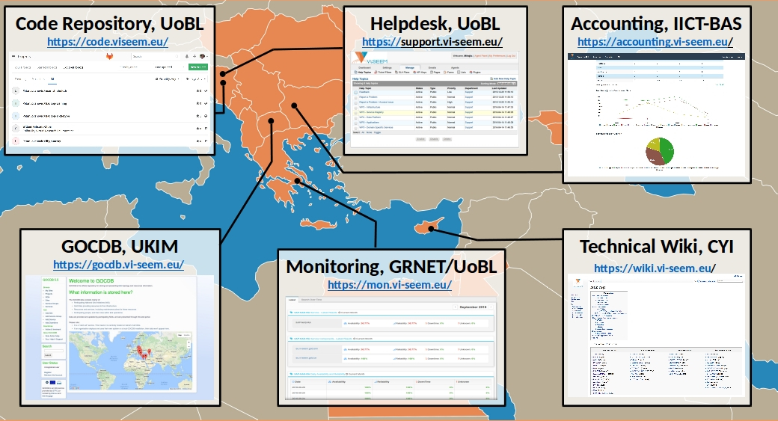
VI-SEEM Regional Services
Code Repository –
GitLab
GOCDB - topology and
resources information.
Monitoring – backend
based on Nagios with
custom frontend developed by GRNet
Accounting portal – developed by IICT-BAS
CHEP Conference 2018, Sofia, Bulgaria

Slide 12
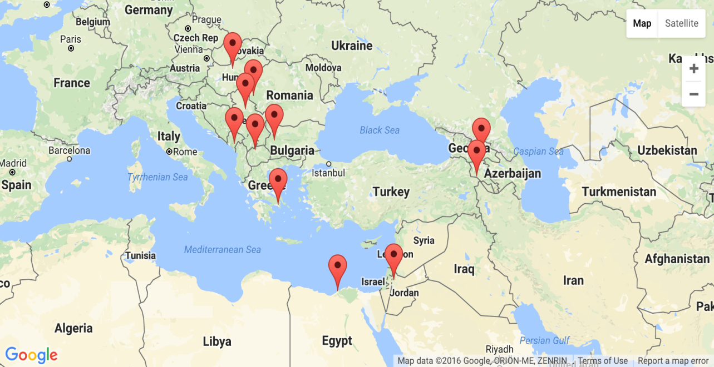
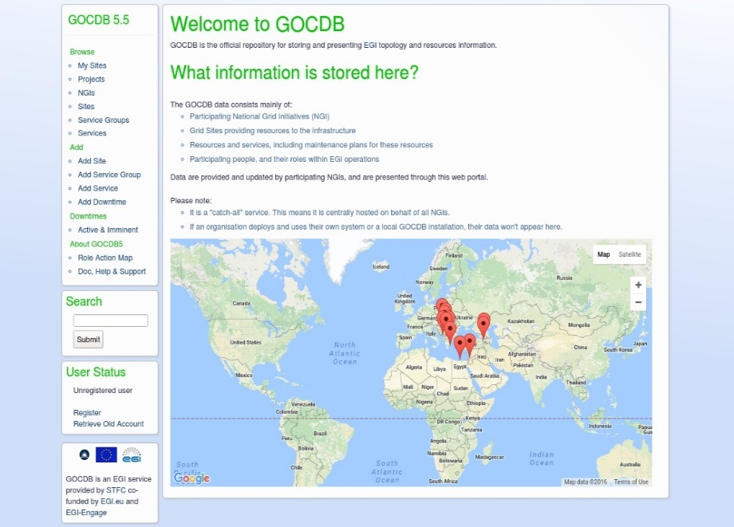
GOCDB
Overview of services deployed and registered in VI-SEEM GOCDB.
CHEP Conference 2018, Sofia, Bulgaria

Slide 13
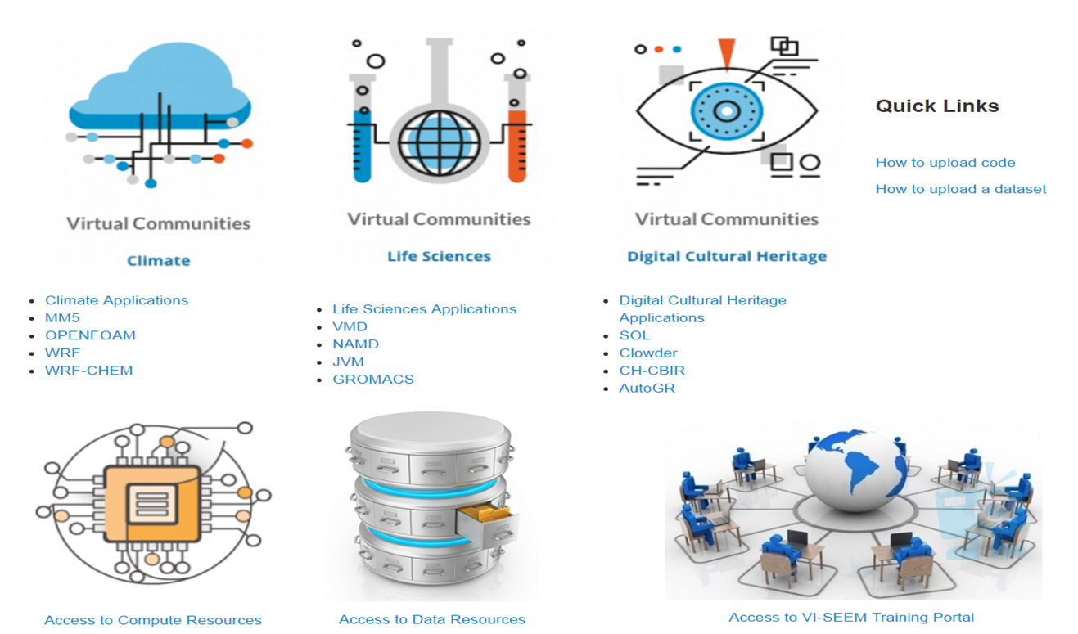
VI-SEEM VRE Portal
VRE Portal is available http://vre.vi-seem.eu/ Continuously populated with new content
CHEP Conference 2018, Sofia, Bulgaria

Slide 14
Authentication and Authorization
Web-based services
IdP
IdP
IdP
Code repo
Simple storage
Other
Helpdesk
Monitoring
VI-SEEM Proxy
Between internal services and
external IdPs
VI-SEEM
VHO
Token Translator
Service
eduGAIN
HEXAA
AuthZ
HPC
Cloud
IdP
IdP
IdP
Grid

Slide 15
HPC Resources in SEEM region
Main HPC Resources
Resource | Country | Total |  |  | Dedicated
 |  | CPU-cores | GPU-cores | Phi-cores | CPU-hours | GPU-hours | Phi-hours
ARIS | Greece | 8,520 | - | - | 3,000,000 | - | -
Cy-Tera | Cyprus | 1,392 | 16,128 | - | 1,829,088 | 21,192,192 | -
Avitohol | Bulgaria | 2,400 | - | 18,300 | 2,102,400 | - | 16,030,800
PARADOX | Serbia | 1,696 | 108,544 | - | 742,848 | 47,542,272 | -
NIIFI SC | Hungary | 768 | - | - | 421,882 | - | -
Leo | Hungary | 1,344 | 628,992 | - | 588,672 | 275,498,496 | -
InfraGRID | Romania | 456 | 3,136 |  | 350,400 | 5,494,272 | -
ICAM | Romania | 4,096 | - | - | 7,176,192 | - | -
FINKI | FYROM | 768 | - | - | 336,384 | - | -
BA-HPC | Egypt | 1,040 | - | - | 1,822,080 | - | -
Gamma | Jordan | 8 | 2,496 | - | 70,080 | 21,864,960 | -
Total |  | 22,816 | 759,296 | 18,300 | 19,273,978 | 367,353,754 | 16,030,800
WP3 objectives, tasks, devilerables, and milestones

Slide 16

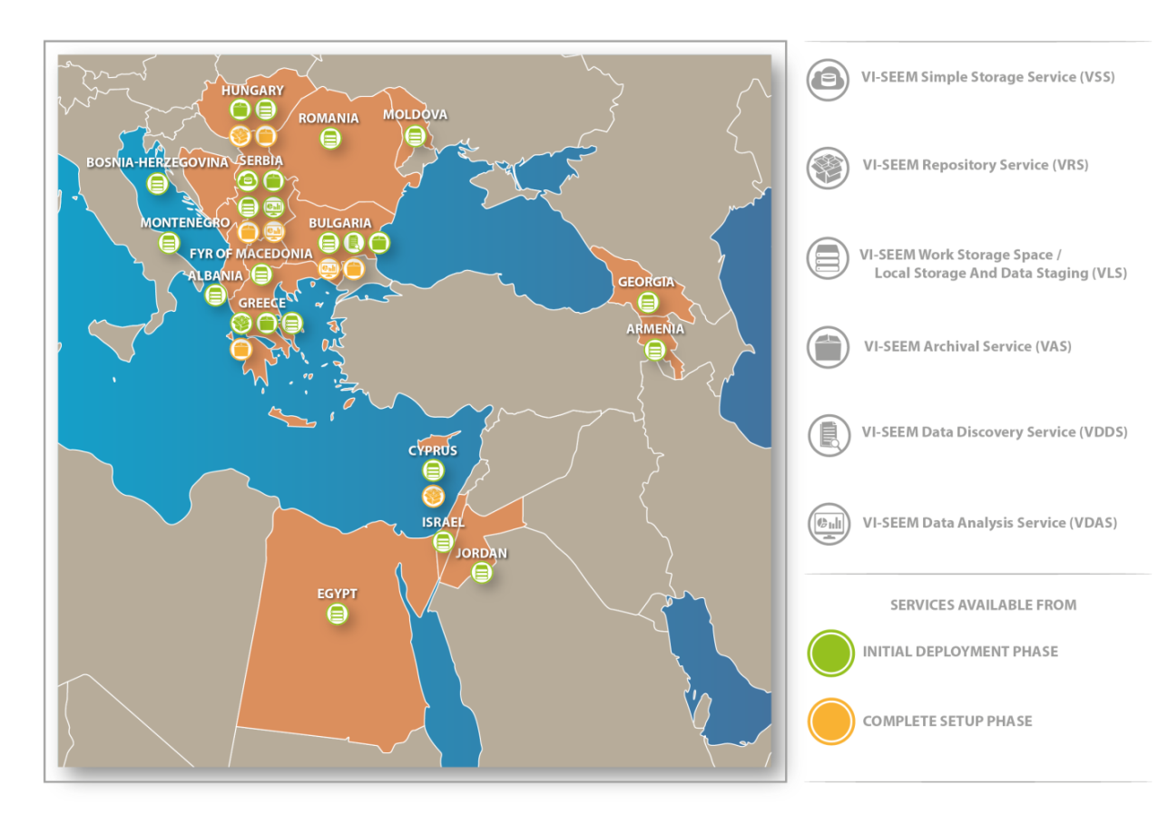
Data management services
CHEP Conference 2018, Sofia, Bulgaria

Slide 17
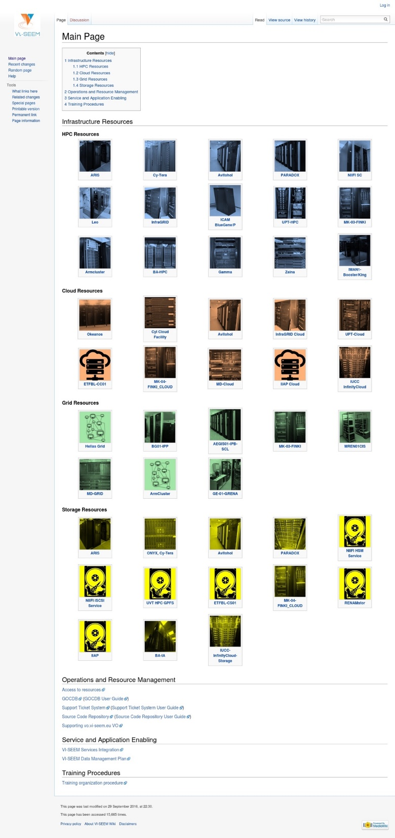
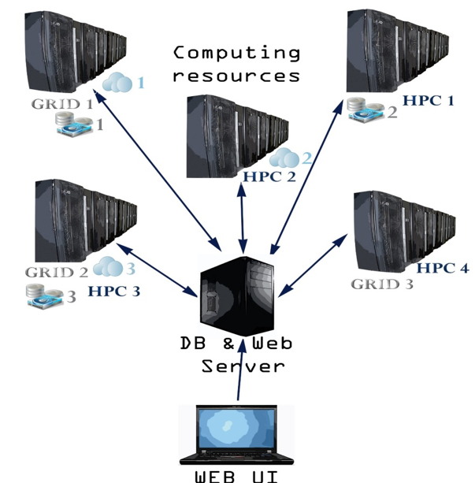
Accounting system
The accounting system covers HPC, Grid, Cloud, data resources
and services
CHEP Conference 2018, Sofia, Bulgaria

Slide 18
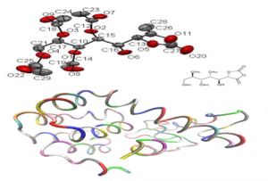
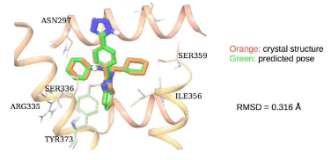
Applications from Life Sciences
Simulations can reduce the costs of developing new cures, which take 12-15 years and cost between 600 and 800 million US dollars, and accelerate process of compounds selection that are considered as part of new medicine.
Molecular dynamics simulations using GROMACS and NAMD focused on the examination of interactions between synthetized molecule and proteins of the cell membrane.
17 new and previously unknown molecules were synthetized, which are based on the existence of enol carbonate structural units
Cournia lab at the Biomedical Research Foundation, Academy of Athens participated in an international drug design competition. This competition was organized as a blind computational prediction of experimental results, and was coordinated by the Drug Design Data Resource (D3R), University of California. Cournia lab ranked 1st in the pose predictions out of 49 completed submissions with a median RMSD of 0.99 Å
CHEP Conference 2018, Sofia, Bulgaria

Slide 19
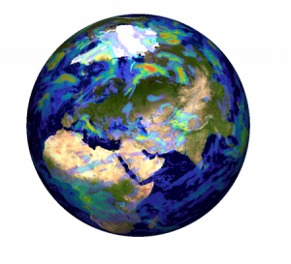
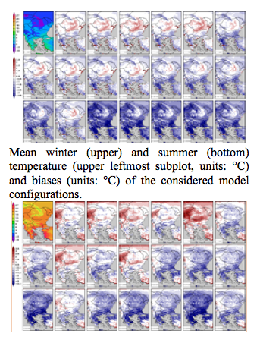
Applications from climatology
Publicly released source code have been developed, using a hybrid GPGPU cluster, that automatically ports the kinetics calculations on GPU architectures.
Each GPU thread calculates the chemical concentrations of an individual atmospheric grid box.
The achieved performance showed up to 22.4× improvement of the kernel execution time
The latest version of the Regional Climate Model system RegCM4, is now fully supported by the ESP. It can be applied to any region of the World, with grid spacing of up to about 10 km and for a wide range of studies, from process studies to paleoclimate and future climate simulation. The study documents the performance of 20 different model configurations in representing the basic spatial and temporal patterns of the SE European climate for the period 1999-2009
CHEP Conference 2018, Sofia, Bulgaria

Slide 20
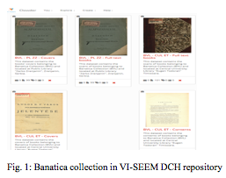
Applications from DCH
BANATICA collection gathers together all the printed products considered monographs (brochures, books, yearbooks, calendars in volumes, prints with an individual cover, atlases, book-like printed scores etc.) which represent documentation sources for the culture and civilization on the Banat region.
anatica Virtual Library makes rare and old publications accessible again for a wider scientific audience in SEE region and enables further machine processing to be applied on the entire collection.
CHEP Conference 2018, Sofia, Bulgaria

Slide 21
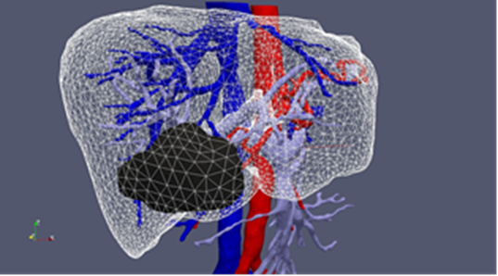
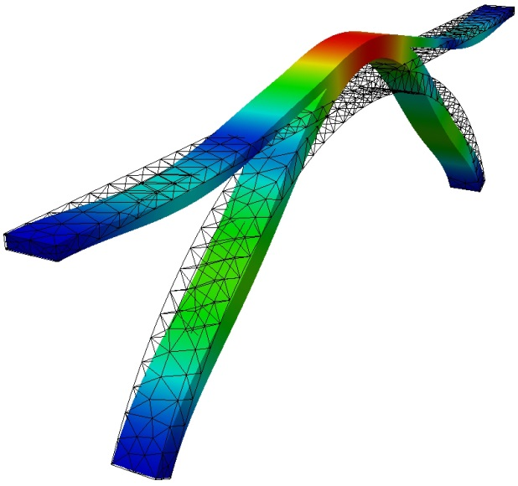
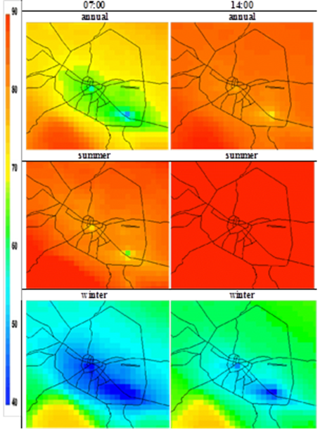
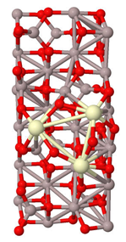
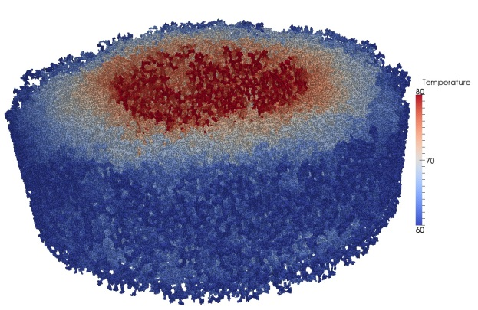
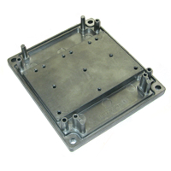
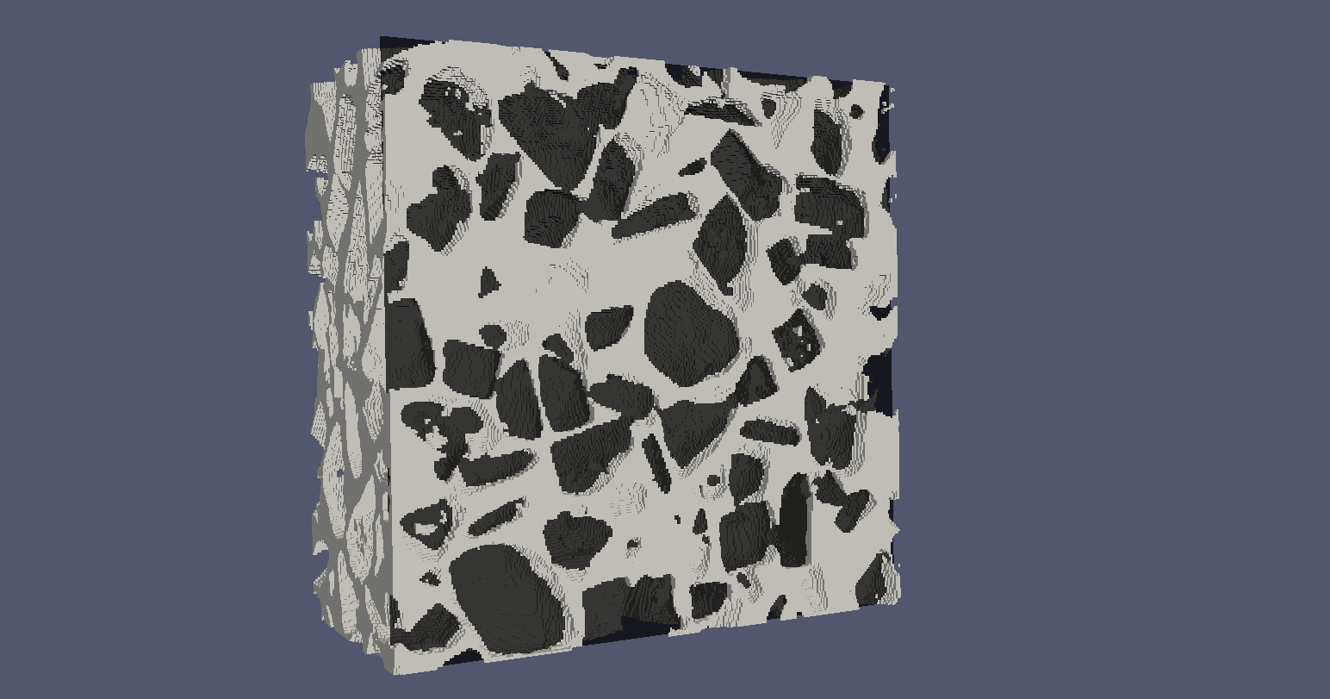
Supercomputing in Science and Engineering

Slide 22
Strong scalability of the shooting method
The parallel numerical tests are carried out on Avitohol supercomputer. The supercomputer has 300 CPUs (Intel Xeon E5-2650 v2 8C 2600 GHz) organized on 150 servers with non-blocking InfiniBand FDR. Each server has 64 Gb RAM.
A mesh of 5376 quadrilateral elements is used resulting into a system of 16 419 DOF.
P | CPU [s] | Speed Up | Efficiency [%]
16 | 6 169 | - | -
32 | 3 152 | 1.96 | 97.85
64 | 1 582 | 3.90 | 97.45
128 | 838 | 7.36 | 91.99
256 | 446 | 13.82 | 86.37
512 | 262 | 23.51 | 73.45

Slide 23
Conclusions and future work
The establishment of an integrated HPC infrastructure in the region, which supports also Data and Cloud resources and has a comprehensive set of operational and user-facing services, enables high quality research.
Apart from the initially designated user communities the resources were opened to other scientific areas and to SMEs in the region through open calls.
The operational teams follow established models and distribute the work efficiently between partners, achieving economies of scale and providing an integrated portfolio of services, as envisaged for EOSC.
The diversity of the underlying infrastructure allows for optimal distribution of the applications.
CHEP Conference 2018, Sofia, Bulgaria

