Slide 1
HNSciCloud Multi-Cloud Approach – An Open Hybrid Cloud for Science
Alastair Pidgeon, Claudio Gizzi, Sakis Kotisis – RHEA Group
Marc-Elian Bégin, Charles Loomis – SixSq
Lukasz Dutka – Cyfronet
Antoine Coetsier – Exoscale
Notes:
Follow-on from CERN and OTC presentations
Present on behalf of colleagues from RHEA, SixSq, Cyfronet & Exoscale

Slide 2
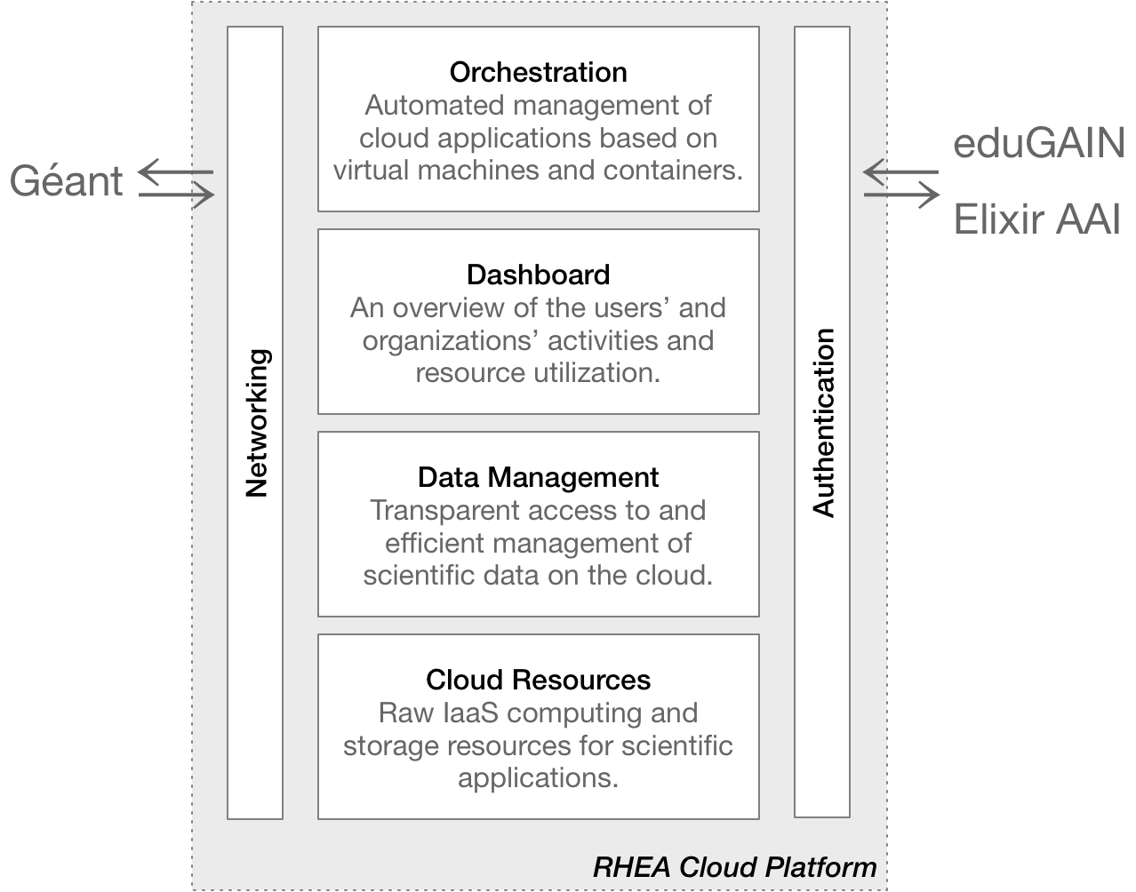


OUR VISION
Phase 3: 10,000 Cores/1PB
Designed for: 400,000/100PB+
Building an open, European platform for science data exploitation
Solution delivers a cost effective solution at scale
Minimal intrusion into Buyers’ sites.
Built on pure IaaS to ensure no-lock-in and best market pricing.
Laying the foundations of the European Open Science Cloud (EOSC)
Notes:
Multi-cloud – choice, no lock-in, open or commercial API, access to best market pricing
Designed to scale

Slide 3




Consortium
Established Partnership
RHEA: Prime contractor with proven management skills for large, institutional contracts and cyber-security expertise
Exoscale: Dynamic, innovative cloud provider that has worked with European scientific institutions like CERN
SixSq: Cloud experts that provide its expertise through the Nuvla service running the SlipStream platform software
CYFRONET: Provides Onedata for data management and IT services to research teams and educational institutions

Slide 4
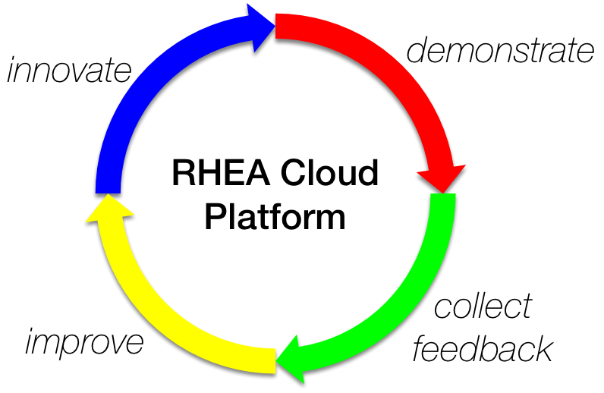
WORKING TOGETHER
Network-aware, multi-cloud, agnostic environment
Continuous improvement of production service
Built on established, market-leading cloud services
Enhance your community or private cloud with access to public cloud services
Create cloud native applications to take full advantage of the cloud, or
Adapt your application to deploy to the cloud
… Any App to Any Cloud!

Slide 5
CHALLENGES
Deliver end-to-end optimised platform and data throughput
Provide seamless user access and security through Federated Identities
Support a wide range of applications
Provide a true hybrid cloud able to integrate buyers’ own private clouds or academic clouds
Transparent data access, high data throughput:
  home institute ⬌ cloud;
  data source ⬌ application
Support different data layout and access patterns
Integrate containers and container orchestration engines with ease
… with minimum complexity!

Slide 6


Combined Solution
Complementary partners,
coherent solution,
flexible implementation…

Slide 7
PUTTING IT ALL TOGETHER
Coherent solution, flexible implementation…
User
    Support all connection means
    Portals, Libcloud, terraform, native APIs
    Identity & Access Management
    eduGAIN & Elixir integration
    Reporting, Accounting & Management
    By User, Project, Organisation
    Onedata, unified Data Management
    POSIX support across clouds
SlipStream API, Portal
Portal
CloudStack API
Libcloud
terraform
Nuvla
CloudStack API
Onedata API
Portal
Exoscale
Onedata
Notes:
Mention OTC and Advania to show multi-cloud, in Phase 1, 2 and early Phase 3

Slide 8
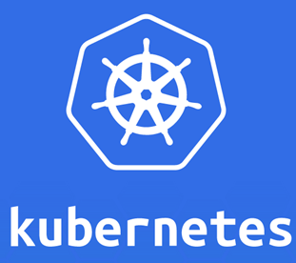
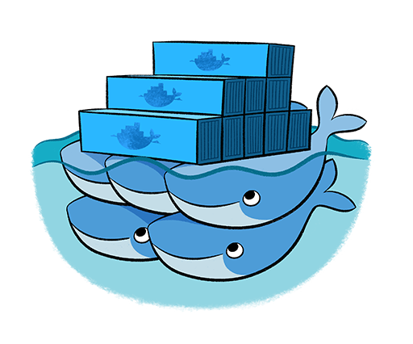
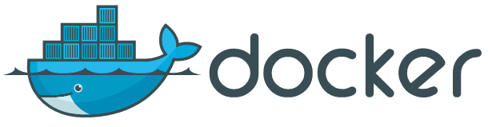
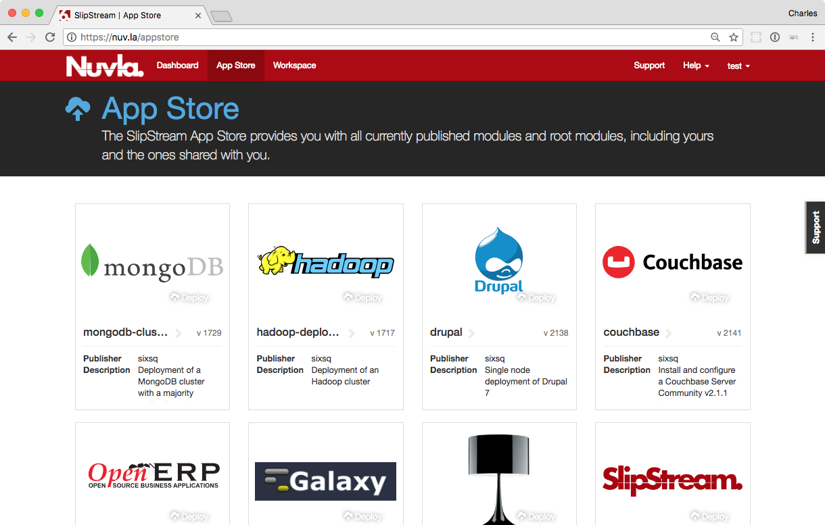
Orchestration
Simplifies and automates management of cloud applications…
Transparent interoperability with your own community and private clouds
Allows choice of cloud based on price, performance, service
guarantees, etc. without vendor lock-in
Automated deployment and dynamic management of
applications to minimize costs and maximize performance
  Predefined applications: SLURM, Docker Swarm, Kubernetes, Buyers’ Group Benchmarks etc.
  Direct access to the underlying clouds also supported
Advanced quota management & usage dashboard over multi-tenant user organisations

Slide 9
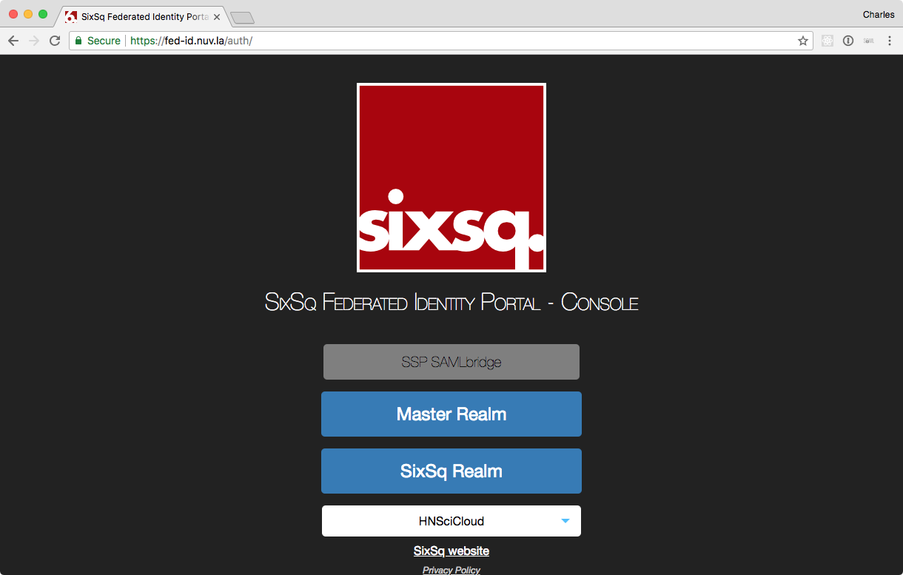

Authentication
Federated Identity Management
Full support for eduGAIN and Elixir AAI identity federations
  Keycloak based implementation allows management of users, groups, and their attributes
  Usage with non-browser applications (e.g. API, CLI)
    SAML ECP (Enhanced Client or Proxy) not supported by any identity providers
    Evaluate WebAuthn and CTAP with Nuvla/SlipStream API
    Report on suitability of these for general non-browser access
Notes:
W3C (Worldwide Web Consortium)
Really only emerging in 2018 as a standard. WebAuthn starting to be used in Chrome, Firefox and soon Microsoft Edge

Slide 10
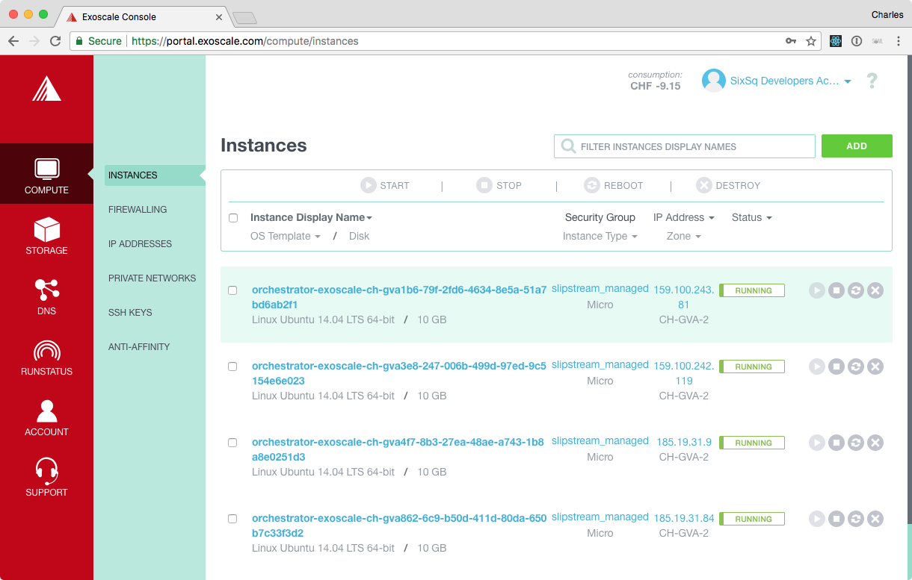
Exoscale: IaaS Cloud Services
Innovative cloud service provider optimized for cloud-native applications…
Four data centre regions: Geneva, Frankfurt, Zurich, and Vienna
Based on Apache CloudStack
    Supports CloudStack API, Libcloud, and Terraform
Browser-based portal
    Easy configuration and management of virtual machines
    Dashboard of compute, storage, and other resource utilization
GÉANT: Aggregate 40 Gb/s bandwidth (Geneva & Frankfurt)

Slide 11
EXOSCALE Compute & Storage
Simple to use IaaS with advanced features
VMs start in less than 30s with
    SSD, IPv4 and v6, public IP addresses
    Multiple networking options for public or hybrid cloud
    Scale from 1 to 225 GB
    S3 compatible object storage
Roadmap:
    2018: VPN Gateway
    2019: Block storage (hard-disk)
Management features:
    Optional voucher based registration to for new labs and users to try
    Organization and sub-Organizations concept
    Aggregated billing
Notes:
Fast start-up due to SSD
Choice of VMs, including HPC and GPU
S3 storage but block storage support in 2019

Slide 12
HPCAAS Support
Dynamically deployed batch clusters using high-performance hardware…
Automated SLURM deployment supporting normal and MPI jobs
Range of “Super VMs” with up to 16 vCPUs and 128 GB of RAM.
Two profiles with available GPUs
GPU Profiles
vCPU | 12 | 48
RAM | 56 GB | 225 GB
SSD (max.) | 2 TB | 8 TB
GPU Cores | 3584 | 14336
GPU NVIDIA Tesla P100 | 1 | 4

Slide 13
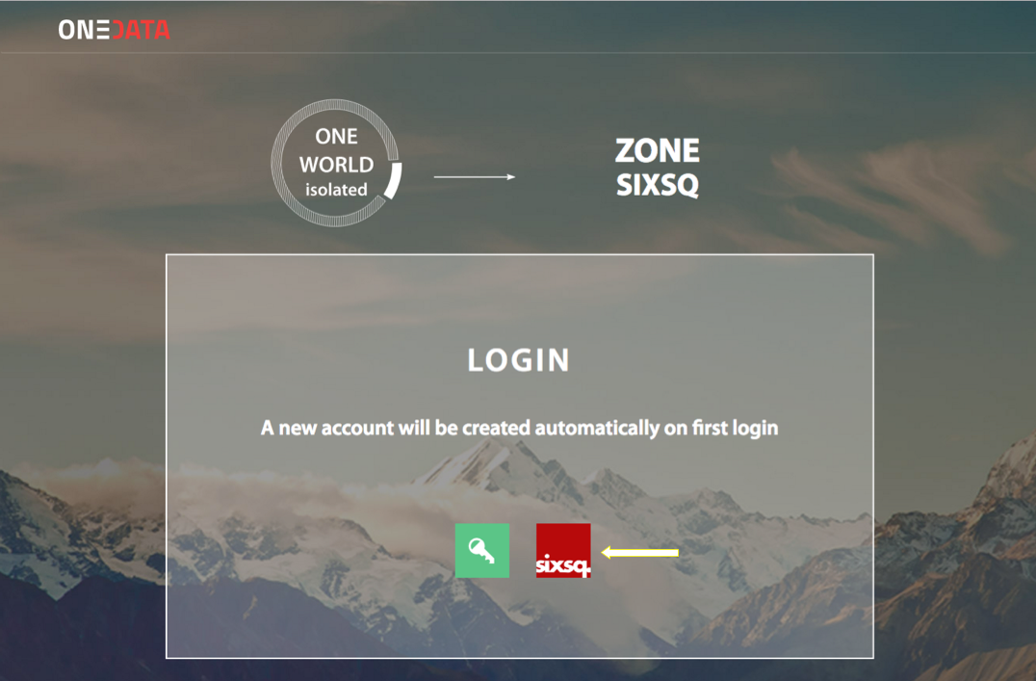
Onedata: Data Management
Flexible, effective data management solution built around shared “spaces”…
Uniform view of all shared data sets, no matter where they are stored
Transparent access to all data sets with dynamic migration
Support for POSIX access
Integrated with the eduGAIN and Elixir AAI identity federations

Slide 14



DATA PROCESSING IN MULTI CLOUD ENVIRONMENT
WHEN ONE CLOUD IS NOT ENOUGH
Cloud - OTC
Cloud - Exoscale
Local processing
access trough virtual fs
Local processing
access trough virtual fs
Local
Cache
Local
Cache
GEANT
40G
40G
Challenges:
Locked-in data collections on NFS or GPFS used for remote data processing in multi clouds
Transparent access to data in many public clouds without changing application
Data accessible as a POSIX file system
On-the-fly / job replications
Private Cloud
10G
Local POSIX
NFS/GPFS/Lustre

Slide 15
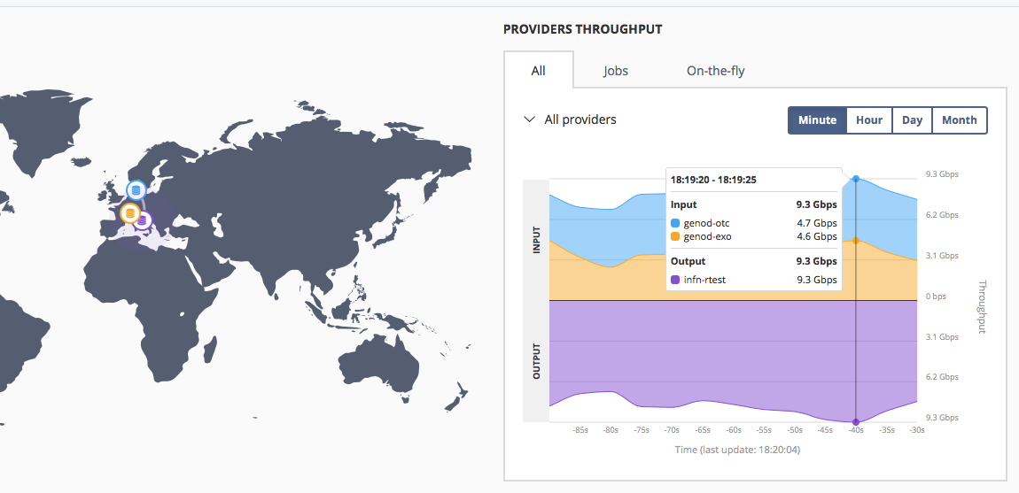
REAL DATA TRANSFERS BETWEEN INFN – OTC - EXOSCALE

Slide 16
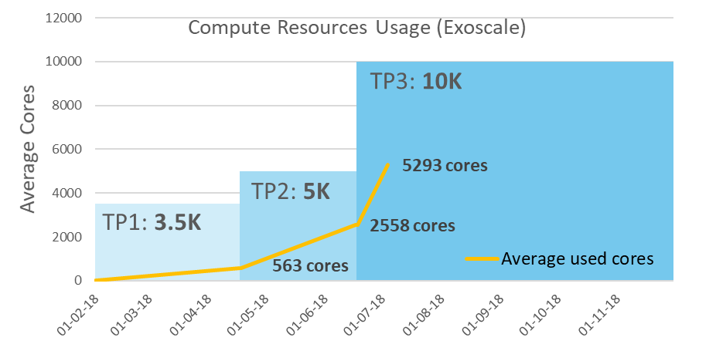
Cloud Usage in Phase 3
Ramping-up Quickly
Notes:
Slower initial take-up due to technical issues, GÉANT access for a new cloud, some BG members not ready, reconfiguration to Exoscale only

Slide 17
Business Model & Commercialisation
We deliver a flexible and commercial platform for science data exploitation
Multi-cloud gives the widest possible choices, avoid vendor lock-in
Provided “as a Service” supporting different procurement models
    Pay-as-you go/pay in advance
    Vouchers
    Support “Bring your own contract” concept to coordinate cloud resource consumption
    Data management as a service
    Ready to offer this service to science communities on a commercial basis

Slide 18
COME And SEE DEMONSTRATIONS at our Booth
Exoscale
Onedata
Nuvla
Provisioning cloud resources via web portal
Managing users and viewing resource utilization
Use of vouchers
…
Upload and download of data from Onedata browser interface
Data access from cloud applications with Oneclient
Strategies for importing and exporting data hosted in your data center
…
Automated deployment of platforms for container-based applications
Deployment of SLURM through browser interface and command line
User and user attribute management with Keycloak
…
General documentation: http://hn-docs.rtfd.io
Previous Training: https://hn-docs.readthedocs.io/en/d-pil-3.2/training/index.html

