Slide 2
SPECIAL CRG-TM: EYETS 2016 CRG coordination meeting
TE-CRG-ME
21 November 2016
S. Junker / J. Metselaar

Slide 3
CRG-ME : LHC consolidations
LHCA Linde Desmi Oil Pumps LHC P4/6
Installation of downstream “regulation valves”
ATLAS SR
Installation of oil pump with magnetic coupling
ATLAS MR CP2
Installation of volumetric oil-pump
LHCB-P18
Installation of prototype oil pump with magnetic coupling
QSCB-18-CP3 Change of oil injection connectors to allow oil injection regulation
LHCC P2 QSCCA-2-CP2
Installation of missing damper
LHC-P4 QSCA-4-CPA
Study of alignment issue
LHC-P6 QSCA-6-CP1
Installation of prototype IMO oil pump skid

Slide 4
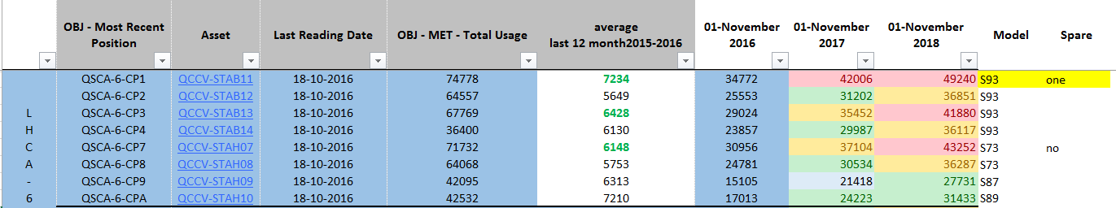
CPs major overhauling
 | EYETS 2016/2017 | Yets 2017/2018 | LS2
greater 40'000 | 0 | 1 | 9
Between 32'000 and 40'000 | 2 | 8 | 41
Between 24'000 and 32'000 | 9 | 42 | 21
Between 16'000 and 24'000 | 40 | 20 | 2
Between 08'000 and 16'000 | 23 | 4 | 2
Between 0 and 8'000 | 5 | 2 | 2
EYETS 2016/2017: No compressor to be sent for major overhauling
Running hours difference ~1600 hours between CP1 and CP2
Total running hours difference ~11’000 hours between CP1 and CP4

Slide 5
CRG-ME : issues for decision of actions
Concerns :
Vibration issues and improvement like balancing, alignment;
Caused by a lack of analysis expertise and a lack of communication S176 has not yet given any recommendation for machine improvements.
Work orders type PM
Decisions from the PM steering group meetings 2015 not yet fully implemented;
Status change to «R-lance» not fully automatic;
Status RADA-Accepte et Differe pour attente acces » created and used also for WO on compressor stations
Equipment Running hours counters;
Not fully reliable for compressors, oil pumps;
Not reliable also for the other equipment
Procedures and related documents
Actually no procedure concerning mechanical tasks are approved;
A lack of quality and QC is still noted for the LHC-TS tasks concerning preparation, performance and documentation

Slide 6
CRG-ME : EYETS Work Orders (QCSM)

Slide 7
CRG-ME : LHC Work Orders (QCSM) (1)

Slide 8
CRG-ME : Work Orders (QCSM) (2)

Slide 9
CRG-ME : Work Orders (QCSM) (3-consolidations & projects)

Slide 10
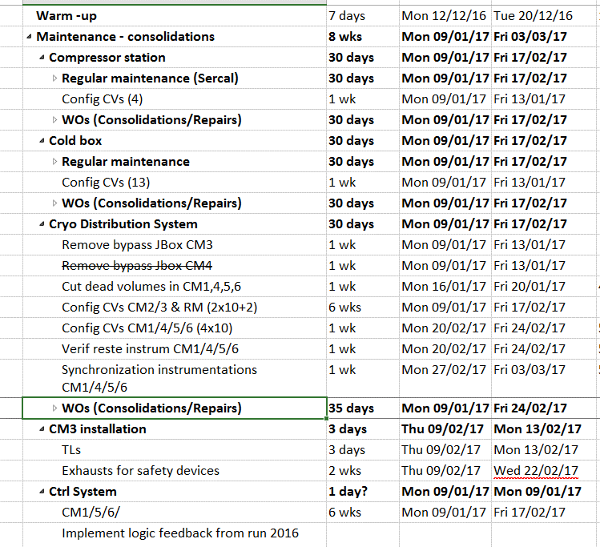
CRG-ME : Work Orders (QCSM) (4)
(See planning MS-Project)
HIE-Isolde
Also: BA6, BA7,…

Slide 11
Many thanks for your attention

Slide 12
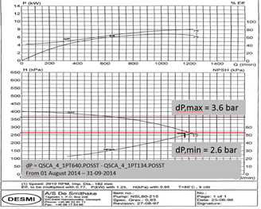
Pump curve Desmi oil pump

Slide 13
LHCB boosters discharge temperatures

Slide 14
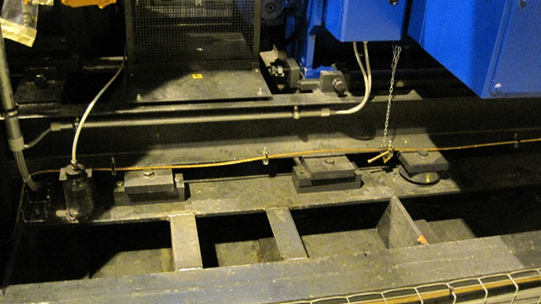
Lack of damper

