Slide 1
LHCb Online Computing for Real-Time Analysis and Reconstruction in Run 3
”Sc^Htreaming DAQ”, 16/01/17
Niko Neufeld
niko.neufeld@cern.ch

Slide 2
Thanks to
The LHCb High Level Trigger team, in particular to: M. Vesterinen, V. Gligorov, G. Raven for material and comments
My friends and colleagues in the LHCb Online team

Slide 3
Streaming DAQ
I define a “Streaming DAQ” as one where data is treated as streams of events, sometimes realized as files, in a fashion like data—processing in the offline world
Because the processing in the LHCb Online systems is (mostly) based on the same commodity CPUs, network and storage as Offline, it is possible to do the same (or almost the same) processing as Offline to the data already Online
Not all processing is strictly synchronous with the data-taking anymore, but it can still be done in the online facilities
This can assist and eventually replace (part of) the traditional offline post-processing
In this talk I will illustrate how these ideas are realized in LHCb in Run2 and talk about the technological challenges for doing the same in Run3

Slide 4
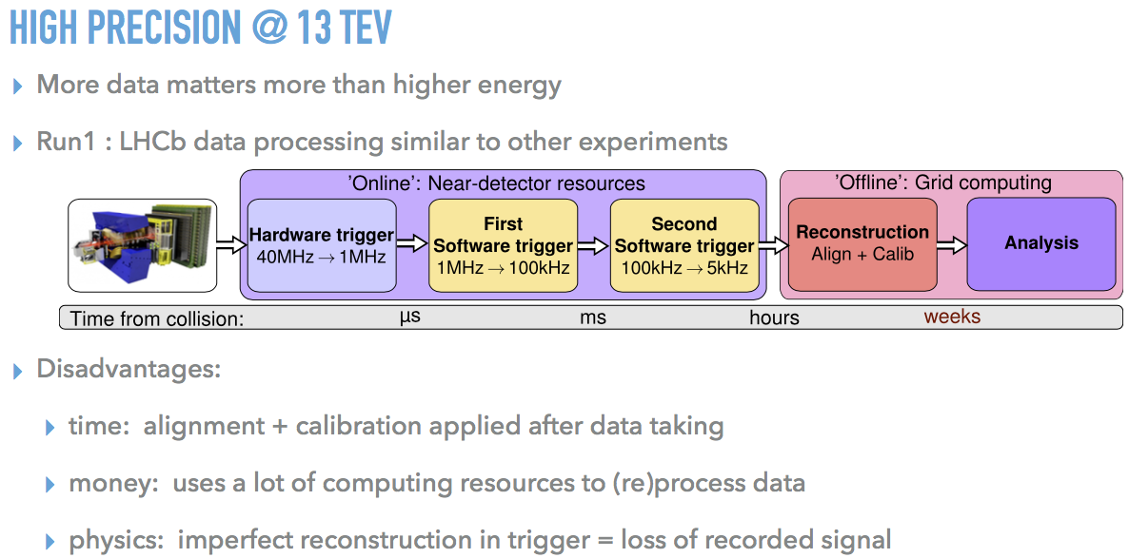
The traditional processing chain in Run1

Slide 5
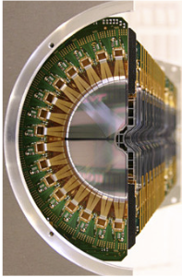
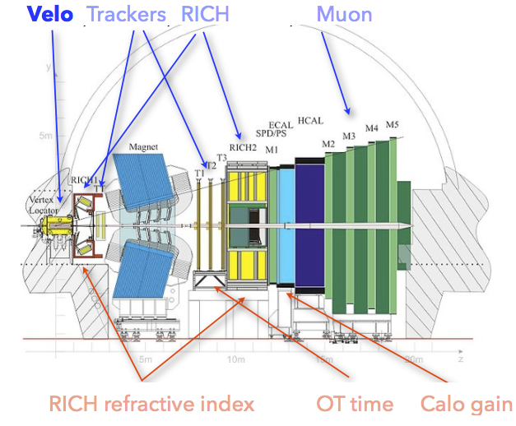
Varying conditions affecting the data quality
LHCb Vertex detector moves in 29 mm at every fill. Re-alignment required

Slide 6
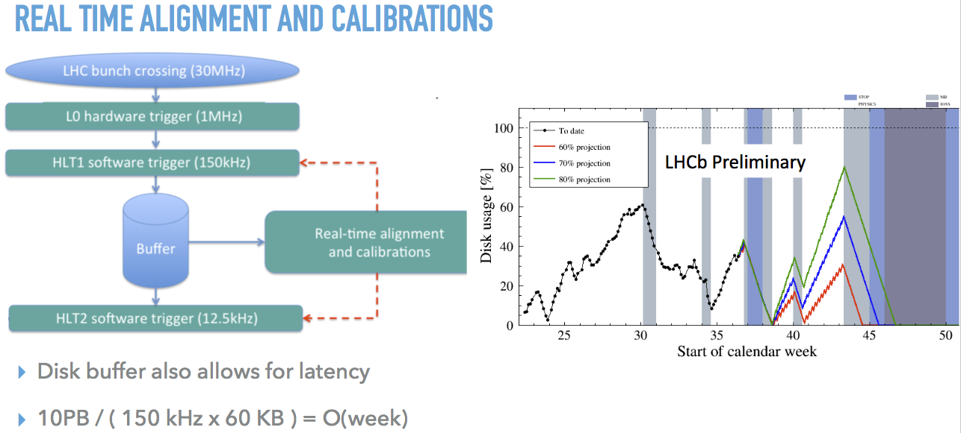
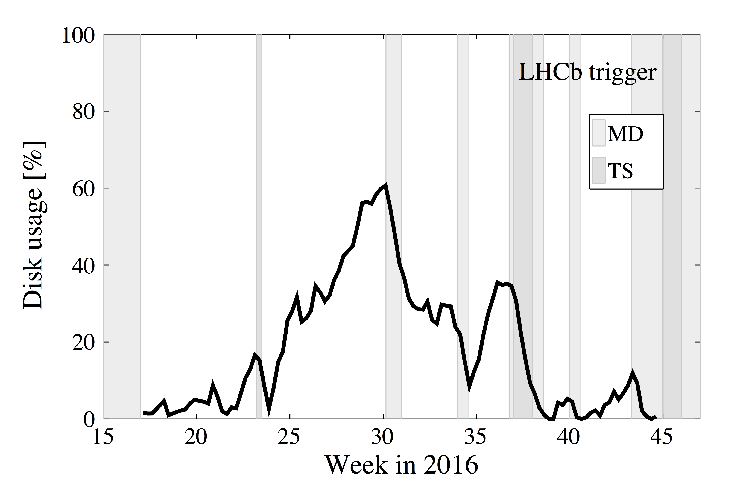
Adding the main missing part for “offline quality”: alignment and calibration
← Significant buffering needed
Significant speed-up in calibration & alignment software and procedures
Would have been probably possible before, but was not felt to be necessary

Slide 7
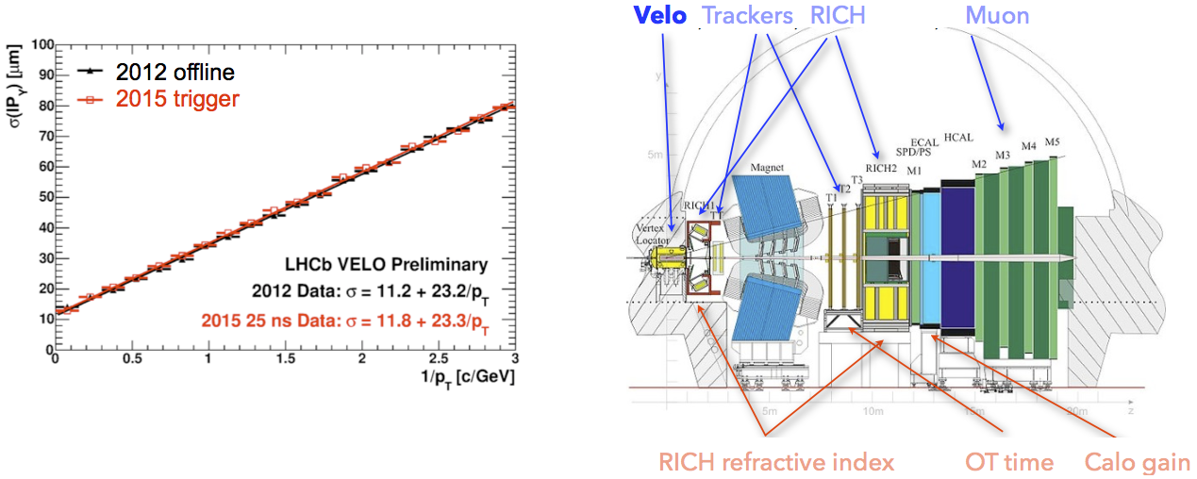
Real Time Alignment and Calibrations
Alignment constants available a couple of minutes(!) after start of fill

Slide 8
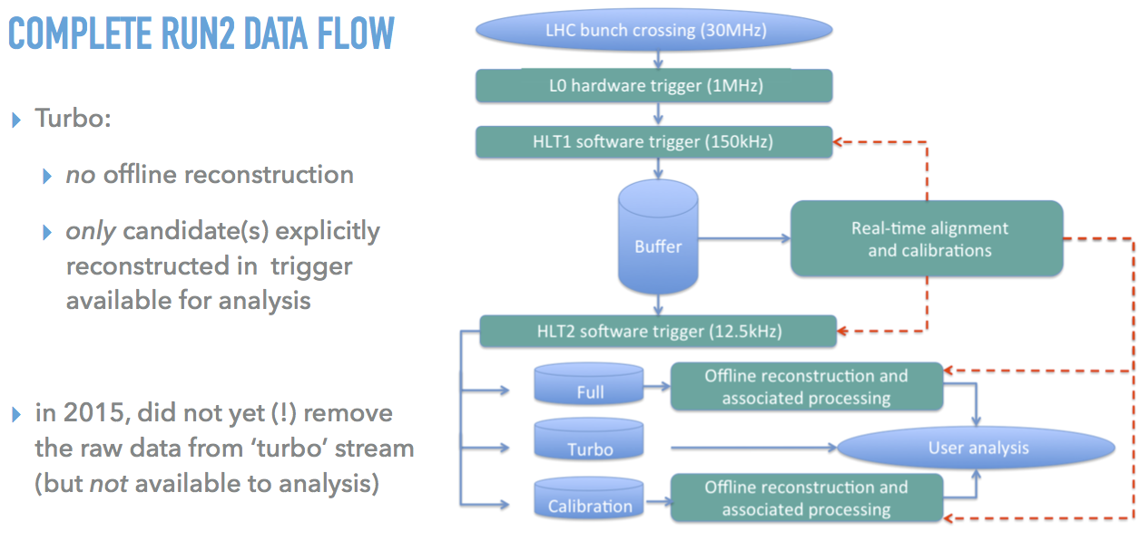
Real-time “loss-less” data reduction: Turbo

Slide 9
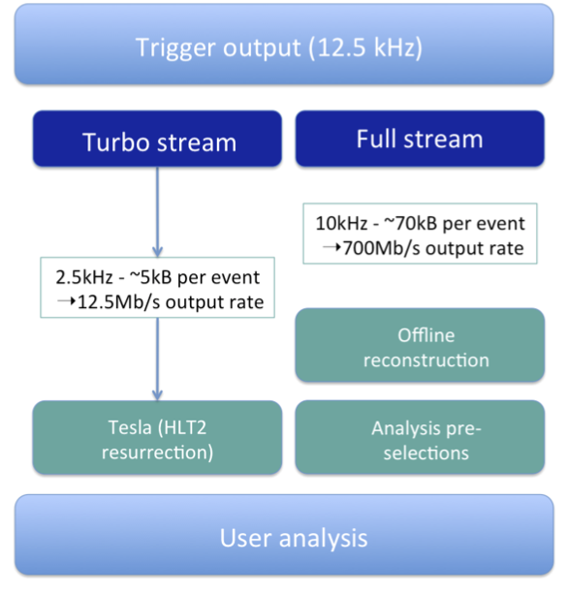
Turbo in detail
Commissioned in 2015
Successfully used for analysis and publications!
Stream-lined processing chain ensures same systematics offline and online → reduced systematics uncertainties → more and better data
Key concept for Run3

Slide 10
Some technical “details”
Temporary HLT1 output data waiting for calibration stored on local disks of filter-servers
HLT2 step is running completely asynchronously using all available CPU also outside data-taking (achieve almost 100% usage of farm)
CPU heavy alignment is run also on the event-filter-farm (distributed to speed up)
Alignment, HLT1 and HLT2 fully integrated into the same run-control
Completely local storage is possible (because data are self-contained), but operationally not so practical: load-balancing issues, management, constraints on server chassis
  completely distributed global storage most likely significantly more expensive
  Investigating “in-between” solutions

Slide 11
LHCb Trigger in from Run2 to Run3

Slide 12
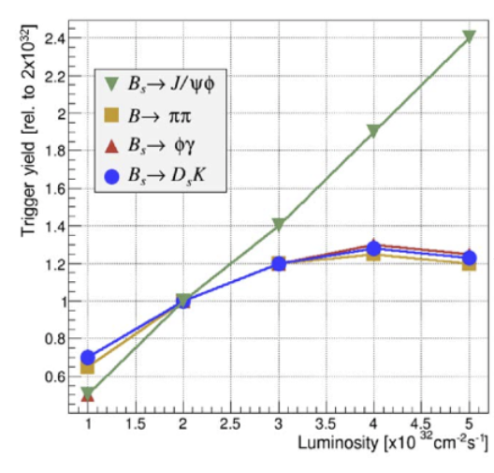
Why do we want to do that?
Hardware trigger loosing too much
Adding tracking to hardware trigger is complex and expensive and adds a lot of custom electronics with little other use + maintenance
And in LHCb we actually can readout all the data at 40 MHz (open geometry, relatively low occupancy)

Slide 13
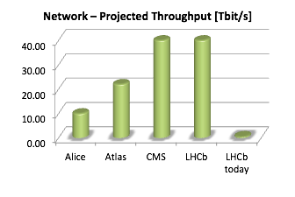
Run3 upgrade
Detector
Data acquisition
High Level Trigger farm
CERN long term storage
Offline physics analysis
Filter farm will need to handle:
  Event size (~130 kB ) (@ 30 MHz)
  Larger event rate (40MHz == LHC bunch crossings per second)
New challenges for
DAQ & High-Level Trigger
2020

Slide 14
Run3 Online System
Dimensioning the system:
  ~10 000 versatile links
    detector to surface (~350 m)
    up to 4.8 Gbps/link
  ~500 readout nodes
  (up to ~24 links/node)
  ~40 MHz event rate
  ~130 kB event size (@ 27 MHz)
High bisection bandwidth in event builder network
  ~40 Tb/s aggregate bandwidth
  Leverage 100G LAN technologies
Global configuration and control via ECS subsystem
Global synchronization via TFC subsystem
Detector front-end electronics
UX85B
Clock & fast commands
Clock & fast commands
x500
Event Builders (PC + readout board)
TFC
throttle from PCIe40s
Event Builder network
6 x 100 Gbit/s
6 x 100 Gbit/s
Point 8 surface
subfarm switch
subfarm switch
Online storage
Eventfilter Farm
~ 80 subfarms
2000 – 4000 nodes
Notes:
We are studying 100G Ethernet, InfiniBand EDR, Intel Openpath , this is a throughput problem (40 tbit/s!), we are not particularly latency sensitive (within reason). Number of links and subfarms are indicative only. Total is estimated to be about 4000 servers in the Eventfilter Farm.

Slide 15
Numbers
Event-size (@ 2x10^33) ~ 130 kB
Readout-rate 40 MHz
500 event-builder nodes
Between 1000 and 4000 event-filter nodes
  Dual-socket, accelerator to be decided
500 port minimum event-building network
  TDB: OPA, IB, Ethernet
1500 – 4500 port filter network
  Ethernet?
New data-centre
  4000 rack-units
  2 MW max
50 to 100 real nodes for “slow” and “fast” control
  Using PCIe40 cards
Rest of control-system on virtual machines as today
Local storage on each filter-unit at least 20 TB → will depend on disk-technology
Central output buffer storage ~ 1 to 2 PB
~ 10000 uni-directional fibres for DAQ (4.8 Gbit/s)
~2000 fibre-pairs for ECS/TFC (GBT)

Slide 16
DAQ cost optimisation
Main cost driver (apart from CPU) is the number and length of fast interconnects (like in HPC!)
Versatile links are there and optical anyhow
Most compact system has everything: event-builder, controls, TFC and farm in one place → new data-centre at the surface and run versatile links to the surface

Slide 17
Readout boards / Event builders
Detector front-end electronics
UX85B
Clock & fast commands
Clock & fast commands
x500
Event Builders (PC + readout board)
TFC
throttle from PCIe40s
Event Builder network
6 x 100 Gbit/s
6 x 100 Gbit/s
Point 8 surface
subfarm switch
subfarm switch
Online storage
Eventfilter Farm
~ 80 subfarms
Notes:
All Event-builder server need to exchange data with each other, because each contains only a small fraction of each event (collision). But we need the entire collision in a single computer to run our algorithms. This collection of event-”fragments” is called “event-building”. It’s a consecutive many-to-one communication (challenging on any network fabric).

Slide 18
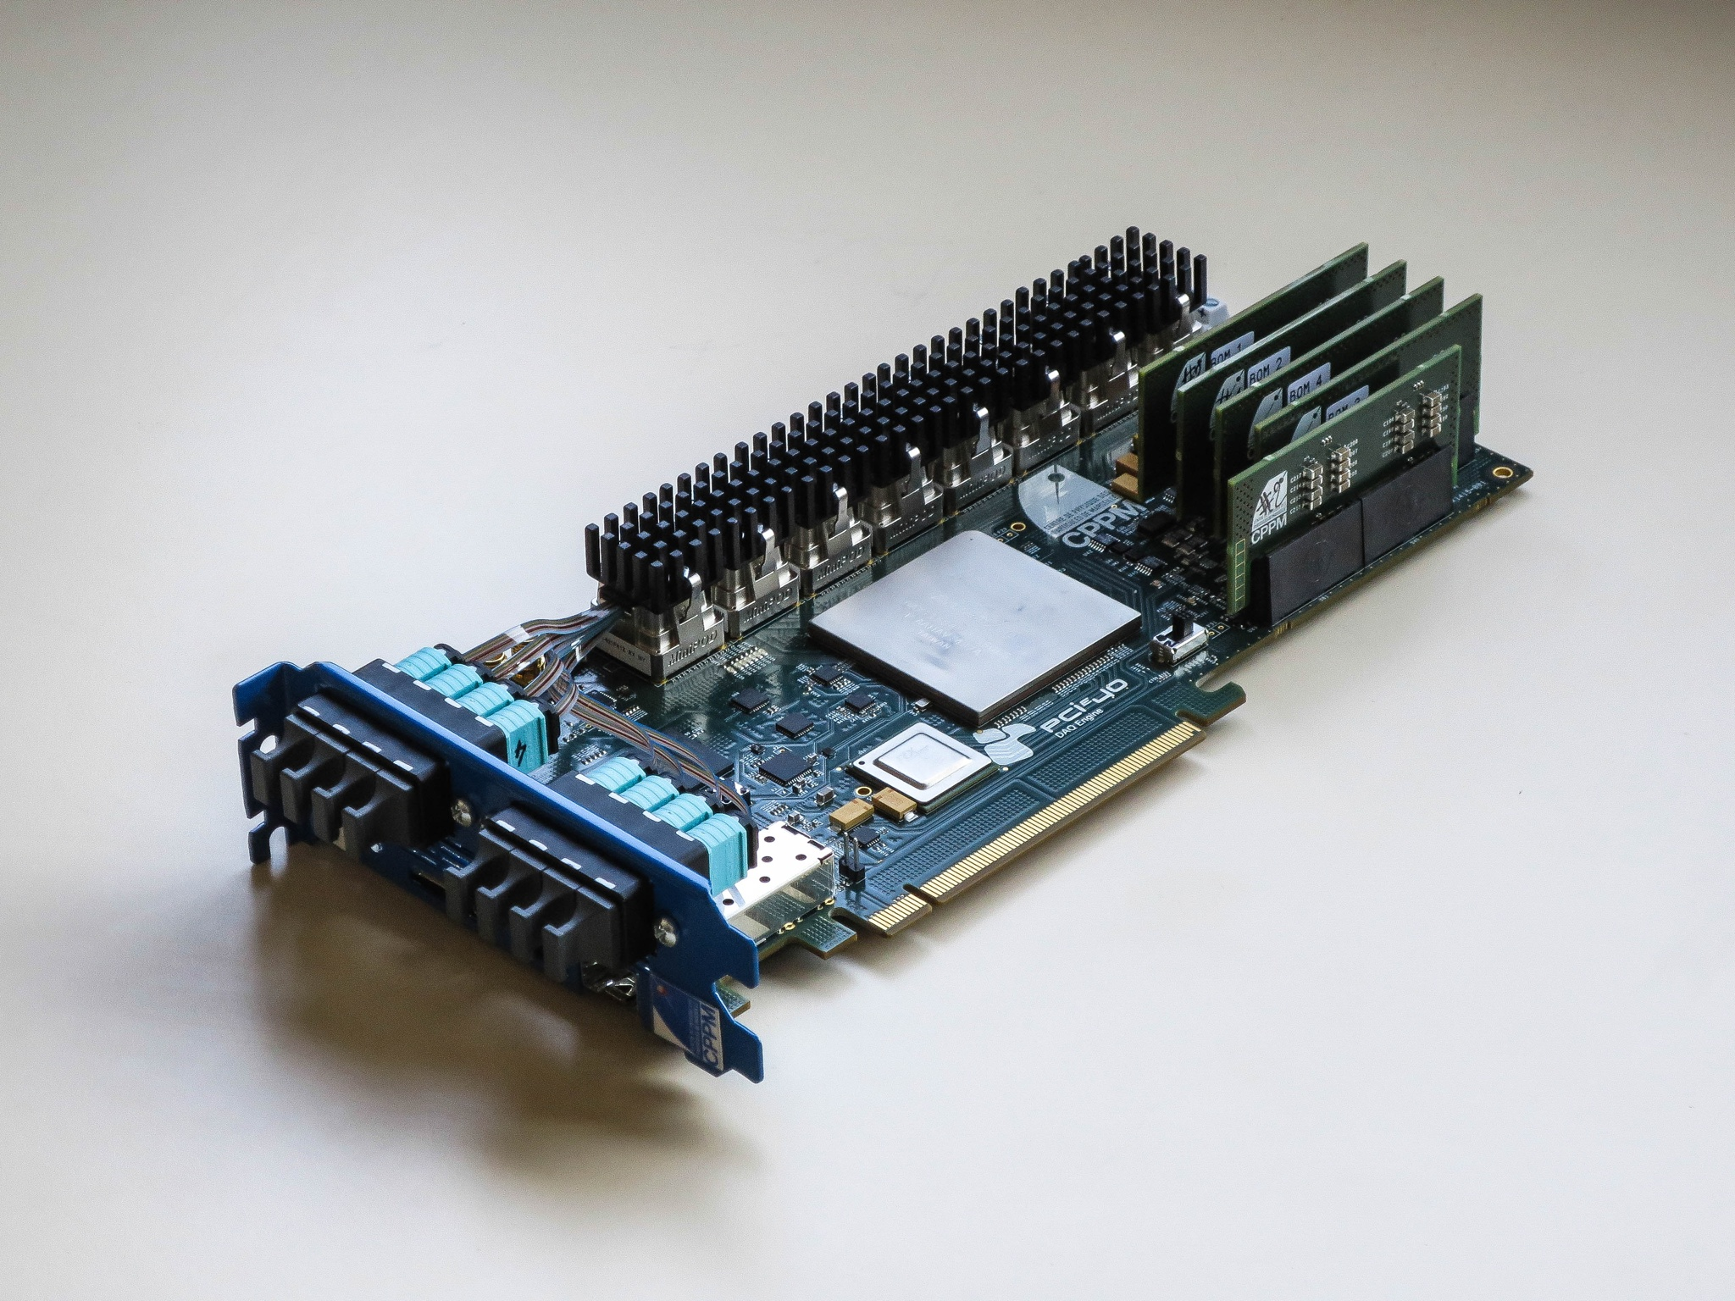
Readout board hardware (PCIe40)
PCI Express add-in card
  Altera Arria10 FPGA
  100 Gbps DMA engine
  to event-builder memory
High-density optical IO
  Up to 48 transceivers (Avago MiniPODs)
  Reuse same HW for timing distribution system
Decouple FPGA from network
  Maximum flexibility in network technology
Exploit commercial technologies
  PCI Express Gen3 interconnect
  COTS servers designed for GPU acceleration
With sufficient on-FPGA / on-card memory this could be re-purposed as a very powerful OpenCL accelerator
Notes:
In-house built PCIe card to receive data from custom links into a server PC

Slide 19
Readout unit dataflow
A single Readout unit must sustain ~400 Gbps IO bandwidth
Optimize memory bandwidth
  Design for zero-copy operations and RDMA over the network
  Organize dataflow according to topology and IO resources
  Exploit full network bandwidth
Eventbuilder PC 1
PCIe40
PCIe40
Eventbuilder PC n
Memory
CPU
CPU
Memory
Memory
CPU
CPU
Memory
FILTER
network
DAQ
network
DAQ
network
FILTER
network

Slide 20
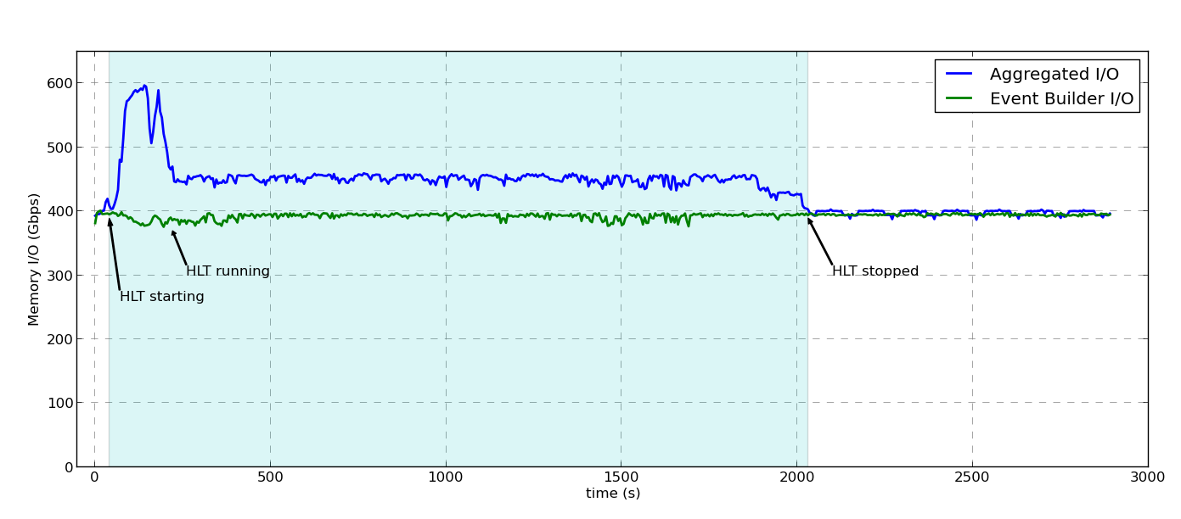
Using event-builder CPU for HLT
Cons: Every node is readout and builder unit at the same time → 400 Gbit/s I/O
Limiting factor will be the memory bandwidth (not a problem)
Pros: Fewer switch ports
Eventbuilder nodes see full events → opportunistic usage of the CPU
Protocol conversion: eventbuilder and filter LAN can be different technology

Slide 21
Real Time Alignment and Calibrations in Run 3
Same concept but now very challenging numbers
1 MHz * 130 kB →
4.5 PB / day @ a Hübner-factor of 0.4
To cover a good LHC week might need > 50 PB
Otherwise very benign I/O (streams, large files, single write / single read)
LHC bunch crossing (30 MHz)
HLT1 software trigger (1 MHz)
Buffer
Real-time alignment and calibrations
HLT2 software trigger O(100) kHz

Slide 22
Conclusions
If one can get the data out of the detector there are practically no limits for DAQ (network and server I/O)
Streaming DAQ brings offline quality to retained data - allowing significant data–reduction and better physics results
Intermediate storage is needed
  for calibration and alignment jobs to run, and to
  profit from periods with no live data for trigger processing
Ultimate limitation comes from cost for processing (CPU and/or accelerators) and storage

