Slide 1
ABSORBER / SCRAPER
Vacuum pressure estimation and profile
LIU-PSB section 8L4
Period 8
TE/VSC

Slide 2

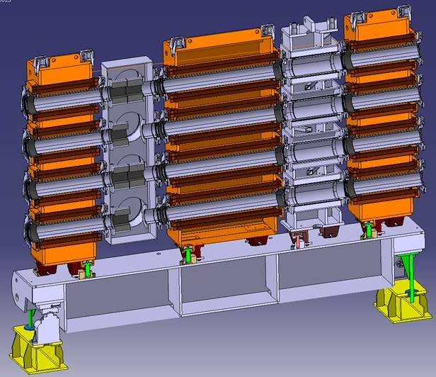
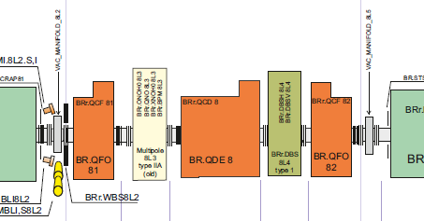
Triplet period 8 PSB
Position of old scrapers inside manifold (8L2)
Beam direction
Position of new
scrapers (8L4)
Courtesy EN/MME and EN/STI

Slide 3
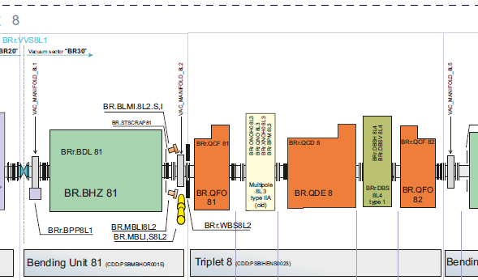
Vacuum profile in period 8 PSB (today)
Pressure: 5.8x10⁻⁹mbar
Pressure: 1.4x10⁻⁹mbar
Pressure: 1.4x10⁻⁸mbar
New scraper
Pressure profile 23rd September 2016. (Ion pump current / pressure)
Old scraper
-Ion pump S(N₂) 410l/s
-Sublimation pump S(N₂) 1290l/s
-2 x Ion pump S(N₂) 270l/s
-Sublimation pump S(N₂) 1290l/s
-Pumping fitted directly on scraper
-Ion pump S(N₂) 410l/s
-Sublimation pump S(N₂) 1290l/s
Sublimation pumps are used < 5x10⁻⁸mbar and pumping speed is decreasing between two sublimations
Ion pumps has maximum pumping speed at 1x10⁻⁴ mbar and 50% at 1x10⁻¹⁰ mbar

Slide 4
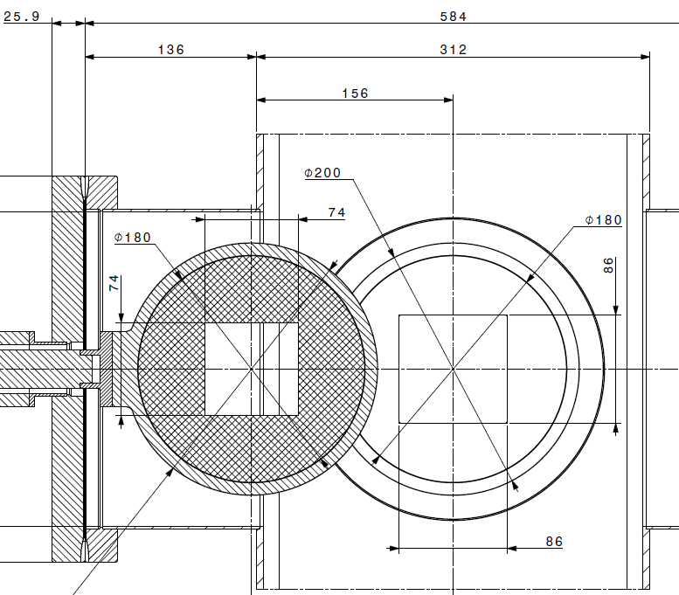
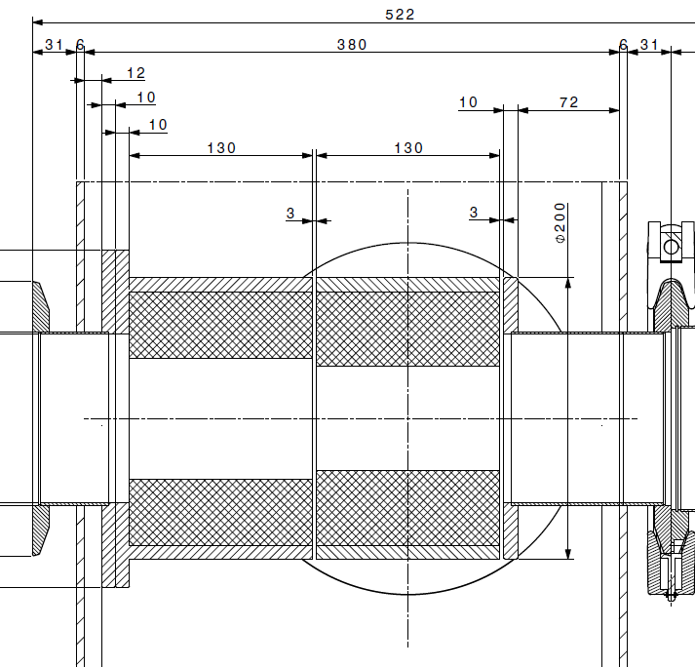
Total surface of Absorber / Scraper
Surface mobile scraper seen by the vacuum : 1519 cm2
Surface fixed scraper seen by the vacuum : 1543 cm2
Total Surface of 8 scrapers seen by the vacuum : 12246 cm2

Slide 5
Material outgassing
-Outgassing of Titanium is better or equal to Stainless steel and can work as a pump when heated.
  Outgassing measurements done for TA6V: < 1x10-12mbar l/s *cm2 at room temperature.
  Stainless steel: <2x10-11mbar l/s *cm2 at room temperature.
-New outgassing results for Graphite will be ready soon, as a new test stand has been build to make these measurements. (None vacuum fired, room temperature, heating up to 300 degrees).
-Bellow is the outgassing results we have for the Graphite used in the main L4 dumps and test samples.
  Graphite vacuum fired twice: 2x10-9mbar l/s *cm2 (room temp, 24 hours of pumping, Samples)
  Graphite vacuum fired twice: 5.9x10-9mbar l/s *cm2 (room temp, 24 hours of pumping, L4)
  Graphite vacuum fired twice: 7x10-9mbar l/s *cm2 (100 degrees)
  Graphite vacuum fired twice: 1x10-8mbar l/s *cm2 (200 degrees)
-Total outgassing of Absorbers in section 8L4:
  Graphite at room temperature: (5.9x10-9 mbar l/s*cm2 x 12246 cm2) = 7.2 x 10-5mbar l/s
  Titanium at room temperature (1x10-12 mbar l/s*cm2 x 12246 cm2) = 1.2 x 10-8mbar l/s

Slide 6
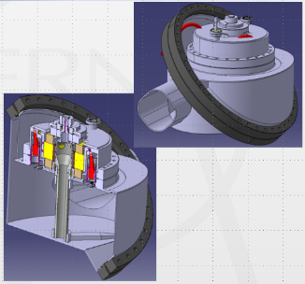
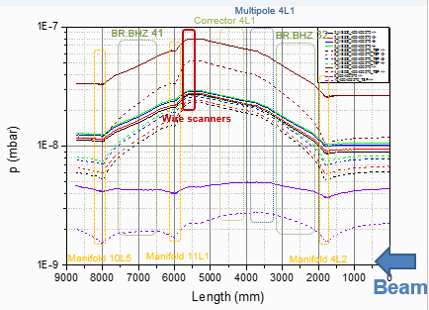
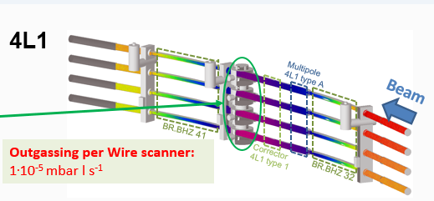
Pumping speed and pressure (4L1)
For the installation of the new FWS scanners (similar to the new scraper installation) a vacuum Molflow simulation were performed

Slide 7

Pumping speed and pressure (8L4)
Pressure: 1.4x10⁻⁹mbar (> 4 weeks)
Total outgassing: 6x10⁻⁷ mbar l/s
(Little or no activation of VPS)
Expected pressure at scrapper will be 2 x 10⁻⁷ mbar after 24 hours of pumping at room temperature, if graphite is used.
No pump down or limit pressure change will be observed if Titanium is used as scraper material.
Pressure: 1.4x10⁻⁸mbar (>4 weeks)
Total outgassing: 4x10⁻⁶ mbar l/s
(Little or no activation of VPS)
Pressure: 8x10⁻⁸mbar (Graphite)
Pressure: <2x10⁻⁸mbar (Ti)
(after 24 hours with scraper, scaled from FWS)
Pressure: 9x10⁻⁸mbar (Graphite)
Pressure: <4x10⁻⁸mbar (Ti)
(after 24 hours with scraper, scaled from FWS)
New scraper
Old scraper

Slide 8
Summery slide
Expected pressure at scrapper will be 2 x 10⁻⁷ mbar after 24 hours of pumping at room temperature, if graphite is used.
No change in pump down time or limit pressure will be observed if Titanium is used as scraper material.
The pressure will recuperate with time, but it might also be higher if the scrapers are used during the first days after an intervention due to temperature increase, as no cooling is foreseen.
TE/VSC would recommend to use Ti, as we cannot make a bakeout of this sector and difficult to add extra pumping to compensated for increased outgassing from the Graphite.

Slide 9
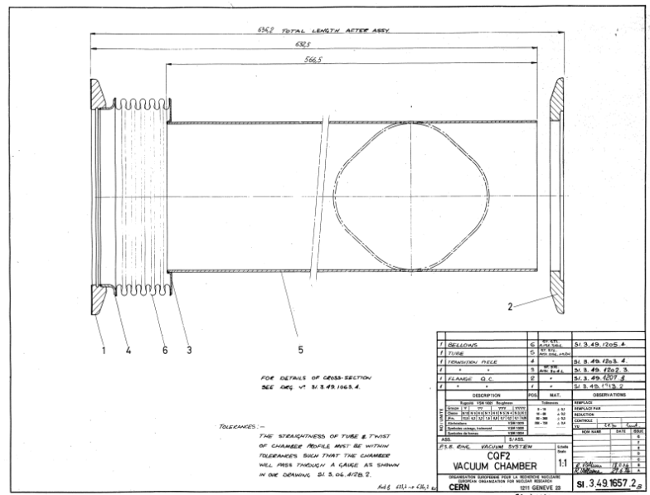
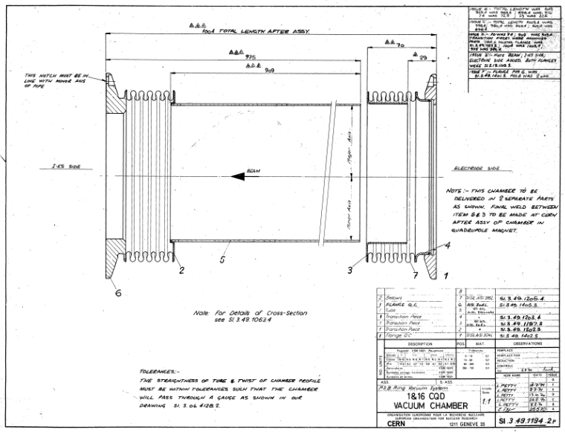
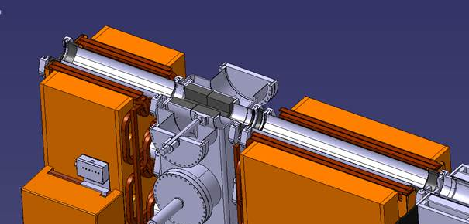
Mechanical modification
SI-3.49.1194.2
SI.3.49.1657.2
In the existing installation the vacuum chamber is free. In the new install it will be fixed so the installation must be design with a bellows each side (see functional design report)

Slide 10
END
QUESTIONS

Slide 11
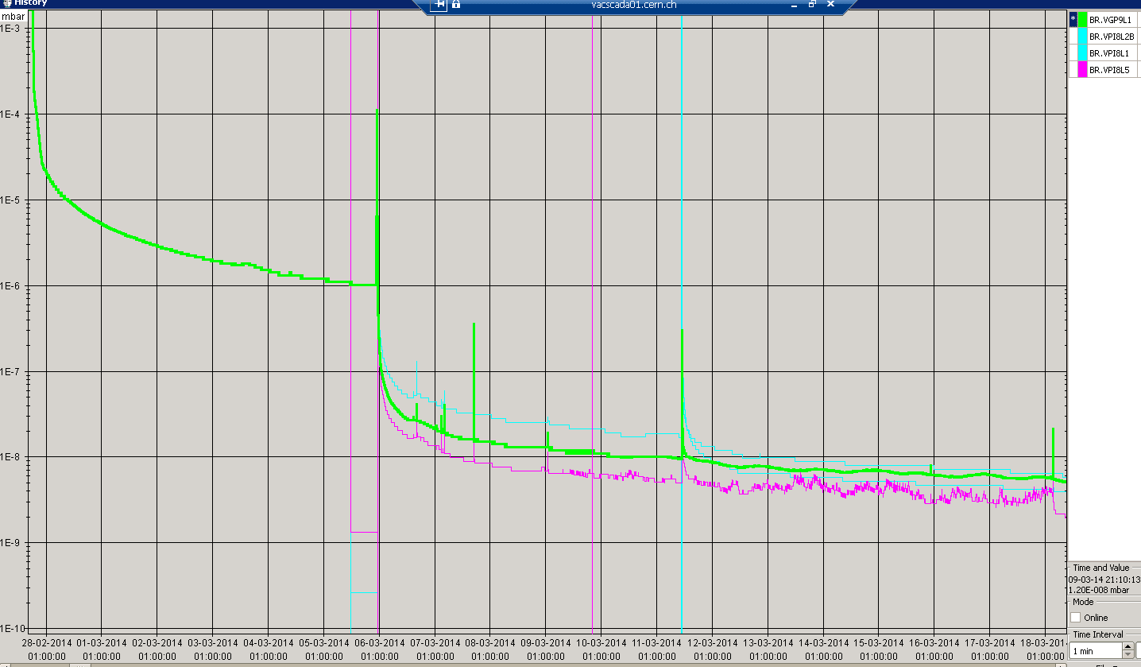
Pressure profile BR30 (pump down in 2014)

