Slide 2
Control of Linac4 from the CCC: status, missing items
J.L. Sanchez Alvarez EIC-PSB

Slide 3
Overview
CCC
Applications already available
Applications still to be prepared
Summary
Conclusion

Slide 4
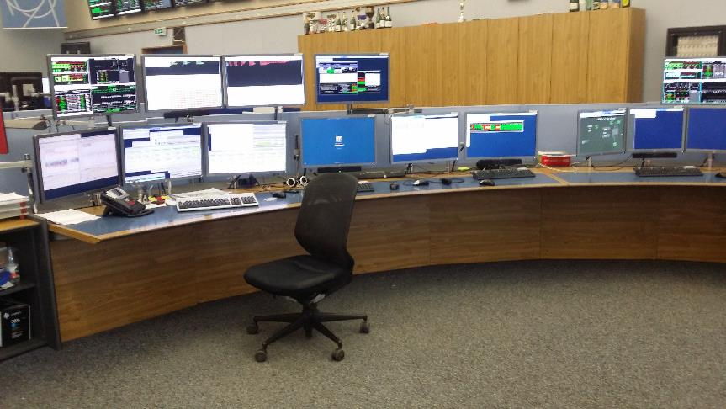

CCC

Slide 5
Applications already available
Generic CO tools
  Sequence Manager
  INCA
    WorkingSet, Knobs, Function editor
  OASIS
  LASER / DIAMON
  Logging System
  SIS
Logbook

Slide 6
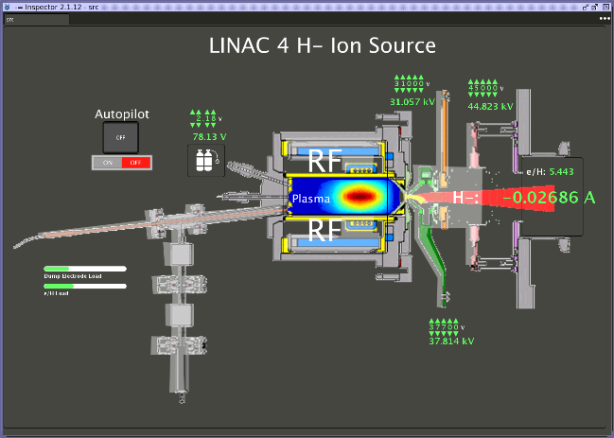
Applications already available
Source Autopilot

Slide 7
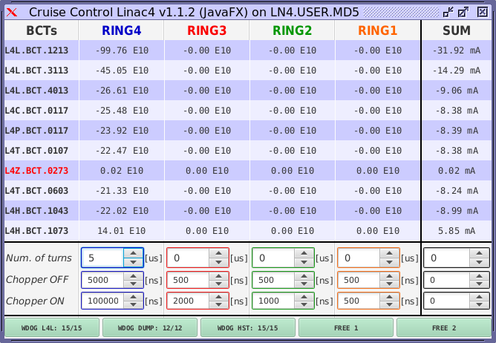
Applications already available
Cruise Control

Slide 8
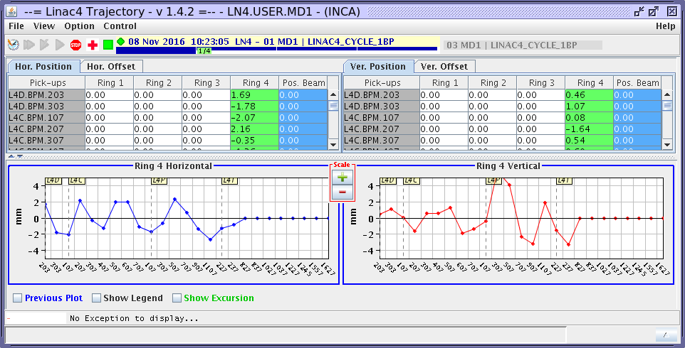
Applications already available
Trajectory application

Slide 9
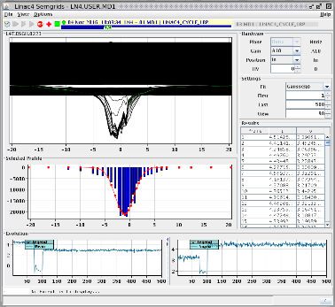
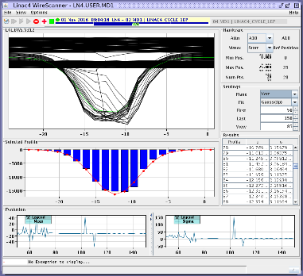
Applications already available
SEM grids / Wire scanners

Slide 10
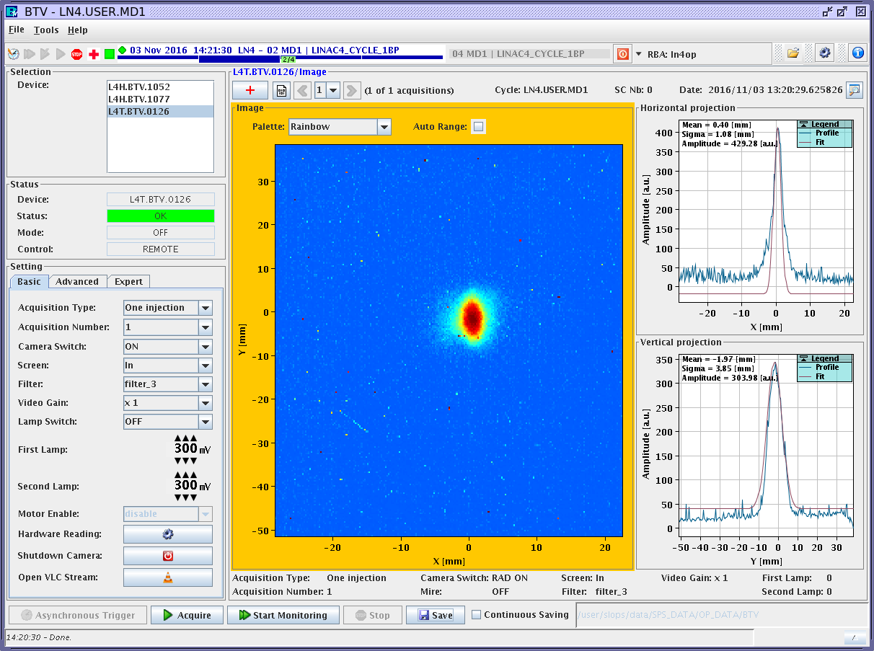
Applications already available
BTVs

Slide 11
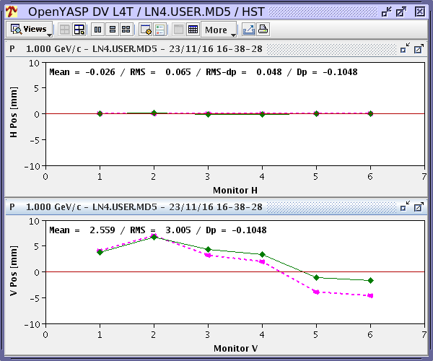
Applications already available
YASP

Slide 12
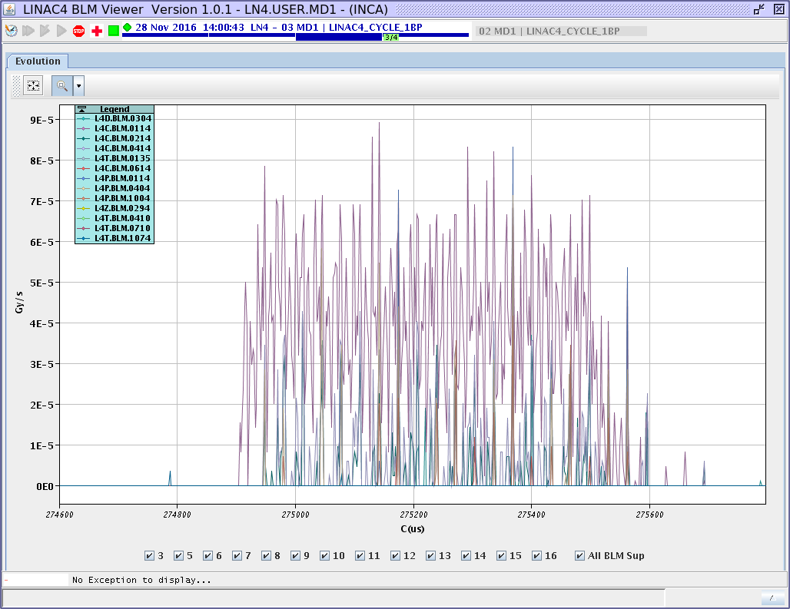
Applications already available
BLM GUI

Slide 13
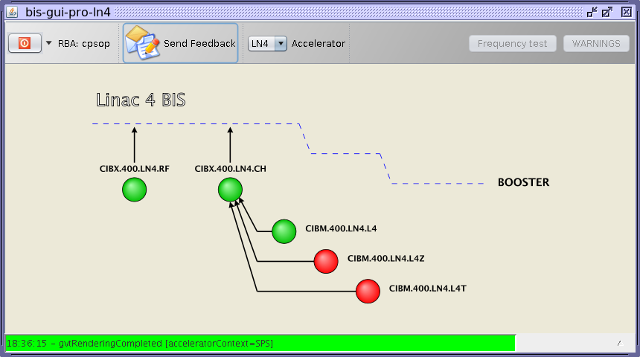
Applications already available
BIS

Slide 14
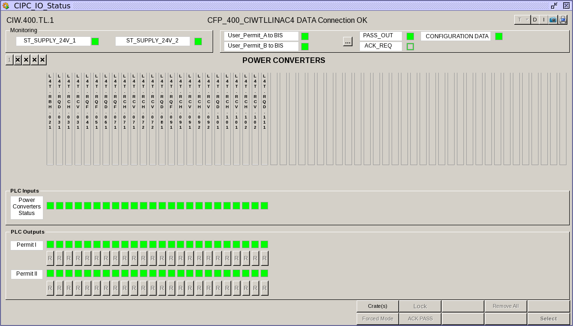
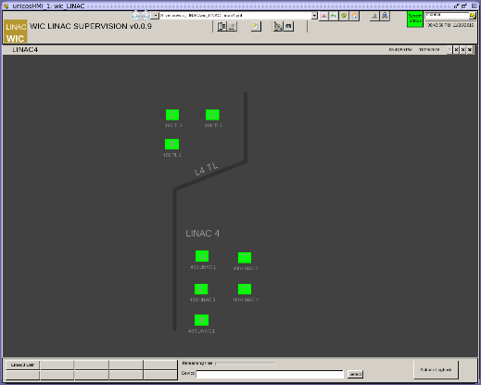
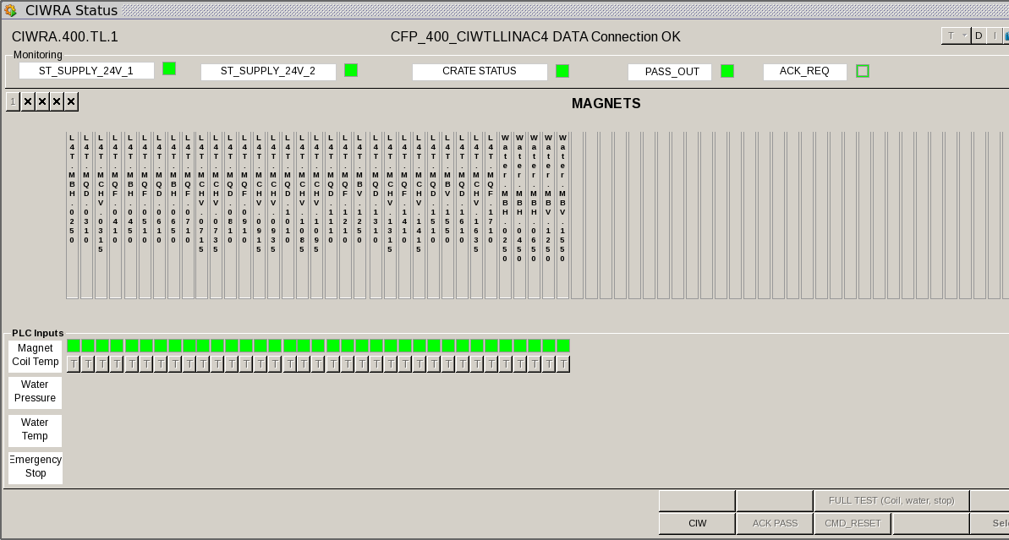
Applications already available
WIC

Slide 15
Applications still to be prepared
Synoptics of Linac4 and transfer lines
Fixdisplays Linac4
  Source and RF status, BCTs, BLMs, stripping foil status
  Linac4 machine and transfer line
Linac4 RF
  bunchers, RFQ, DTL (3 modules), CCDTL (7 modules), PIMS (12 modules), debuncher
  A mixture of FESA 2 and FESA 3.
  Many parameters not yet incaified. No standard PPM copy currently possible.
  The knobs and working sets are not yet defined.
  If special application required, specifications needed from RF team.
Time of Flight
  ToF to be calculated within FESA class
Bunch shape measurement
  Important to obtain energy spread. Application in progress.
Transverse emittance measurement application
  Emittance measurement in L4Z line (Linac4 dump line) using 3 Semgrids and taking into account space charge (algorithm needed from ABP)

Slide 16
Summary
A large amount of applications are available to control and qualify the beam.
Fixdisplays will show an overview of the LINAC4 status. The operator will be informed quickly when something wrong happened.
The logging system will help to do the post-mortem of the fault.
The RF control needs clarifications.
To better qualify the beam, some efforts are needed to improve the measurement of the energy, energy spread and the emittance.
The elogbook will be one of the main tools for the reliability run. Faults, measurements etc. should be described in detail in the elogbook.

Slide 17
Conclusion
Operation of the Linac4 from the ccc will be possible, but needs to be carefully prepared. The first week(s) might be needed to solve basic issues like RBAC, cleaning up LASER alarms etc. and should not be counted into the reliability period.
Operators will be available to survey Linac4 during the reliability run, but priority is Linac2 and PSB operation.
Need clarification of operational mode (simply survey and reaction to faults, or periodic change of settings, type and frequency of measurements etc.). What is the reaction to faults? (piquet coverage or not, nights/weekends?)

Slide 18
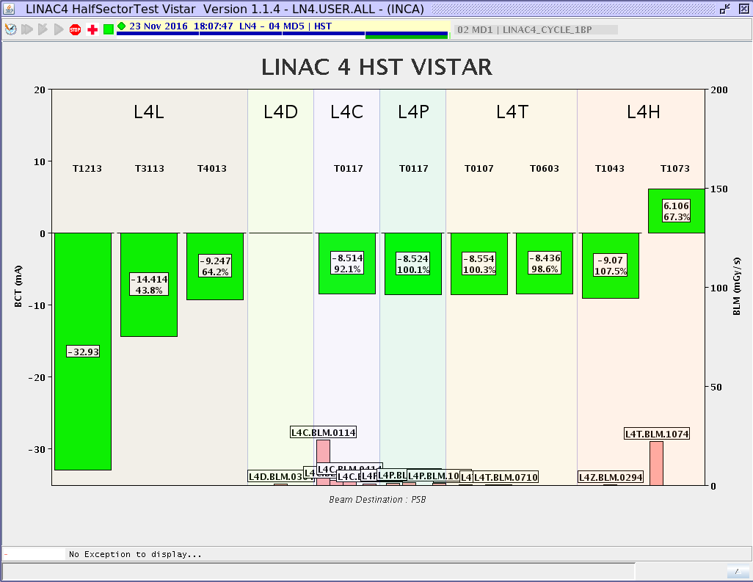
Spare

