Slide 1


Update on Junction Box Design
Edyta Pilorz
(Cracow University of Technology)

Slide 2
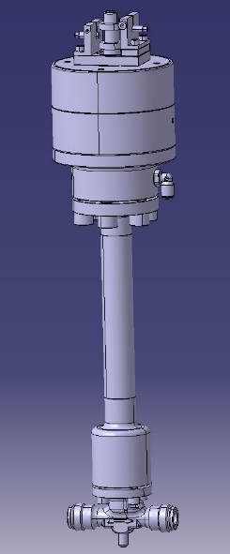
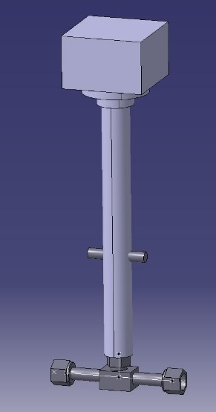
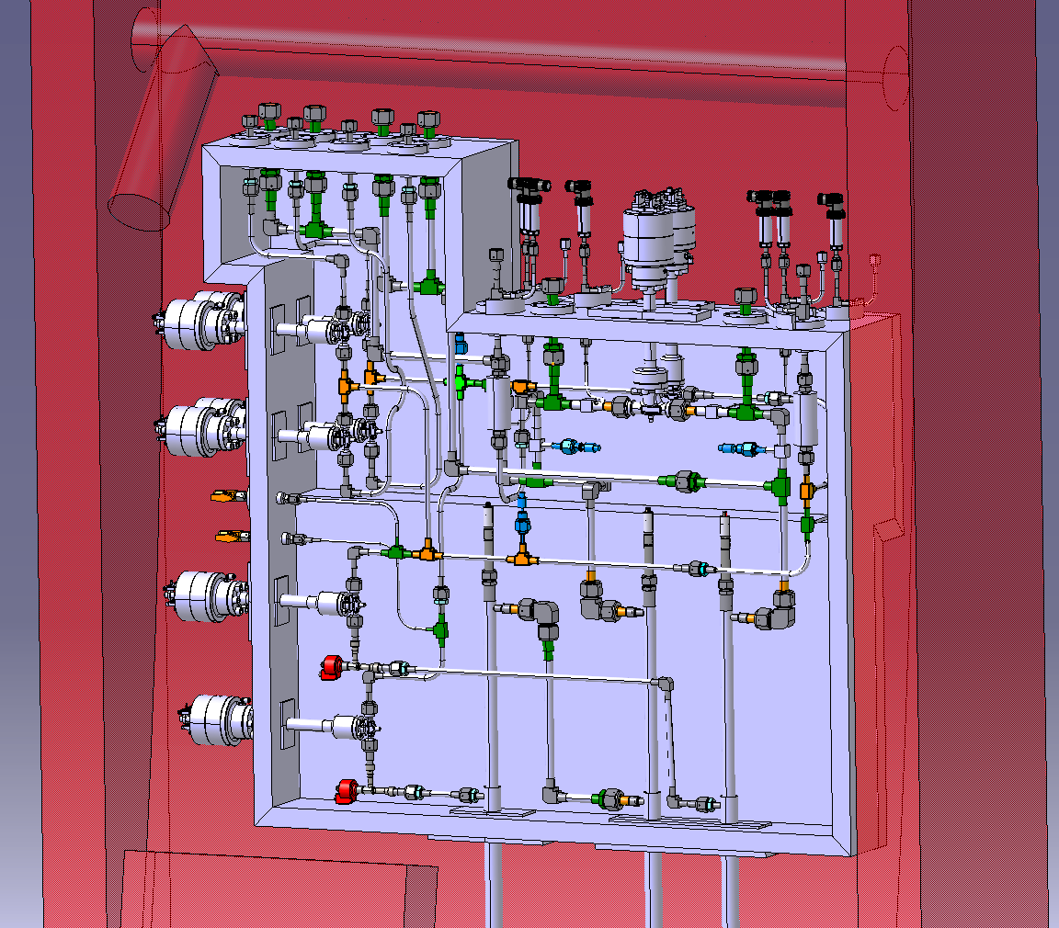
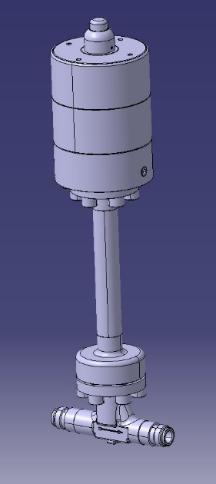
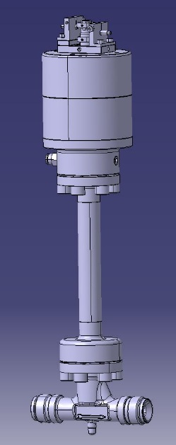


Junction Box – main view with new valves
With shape of the cavern

Slide 3
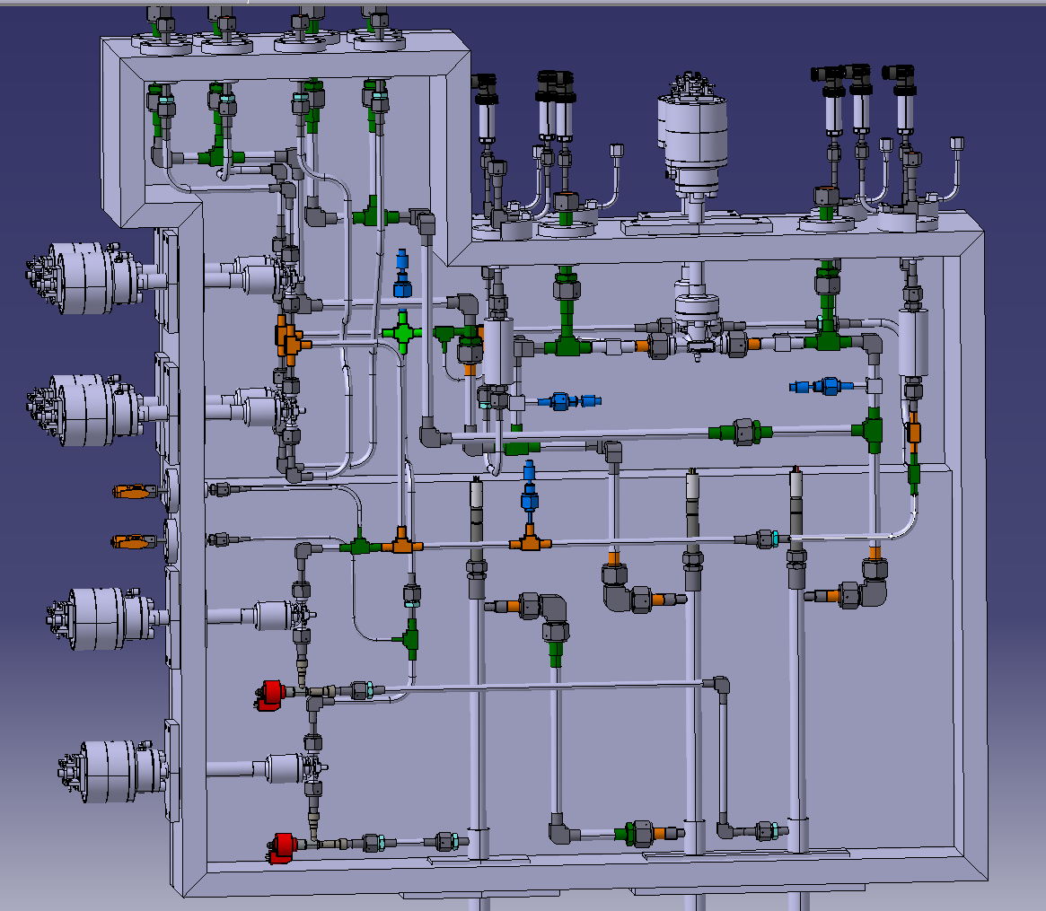
Components which may need to be replaced situated in the front
TT to be moved
Filter in the front
Filter in the front
TT in accessible position
TT in accessible position

Slide 4
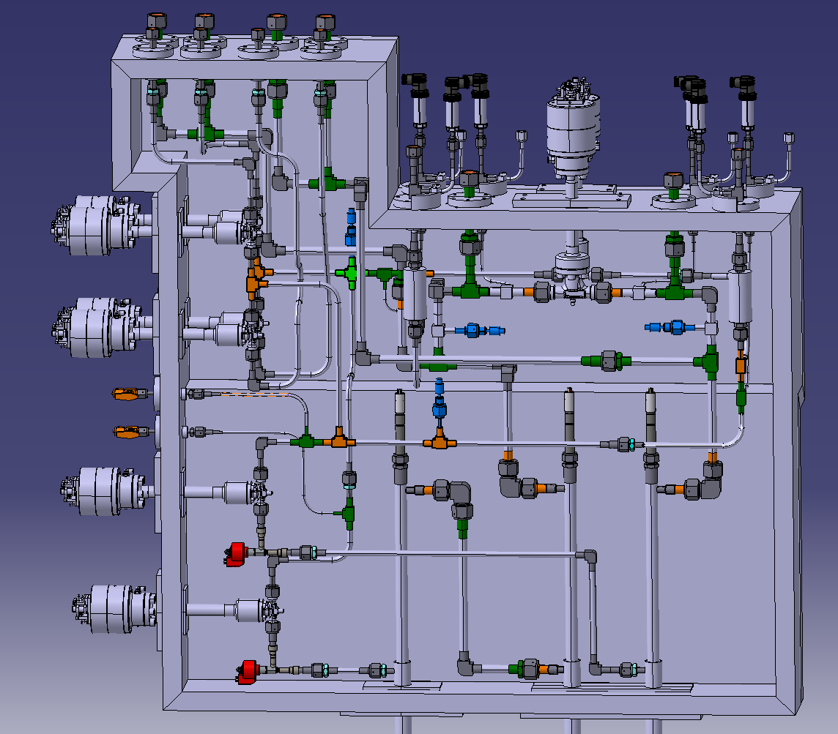
VCR connectors added to facilitate assembly process

Slide 5
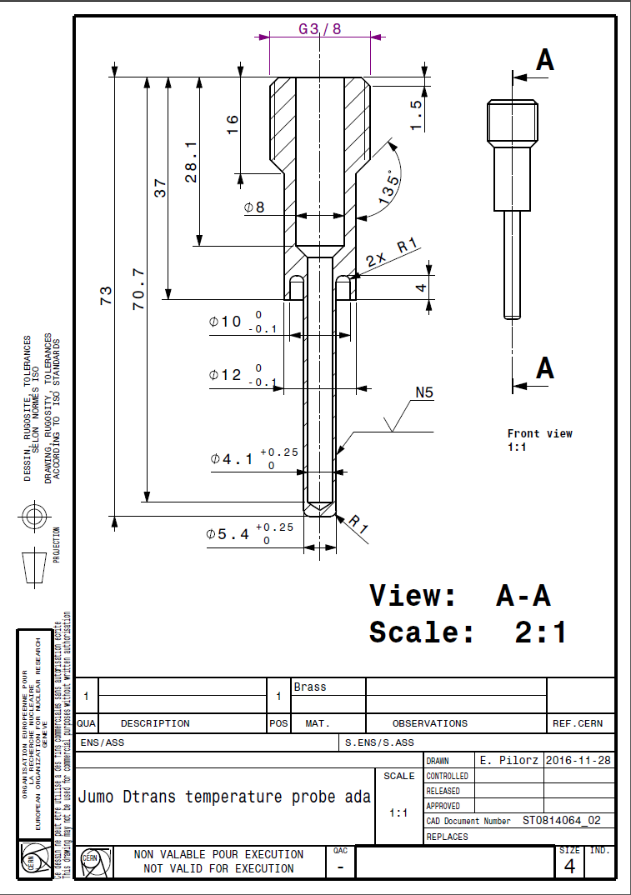
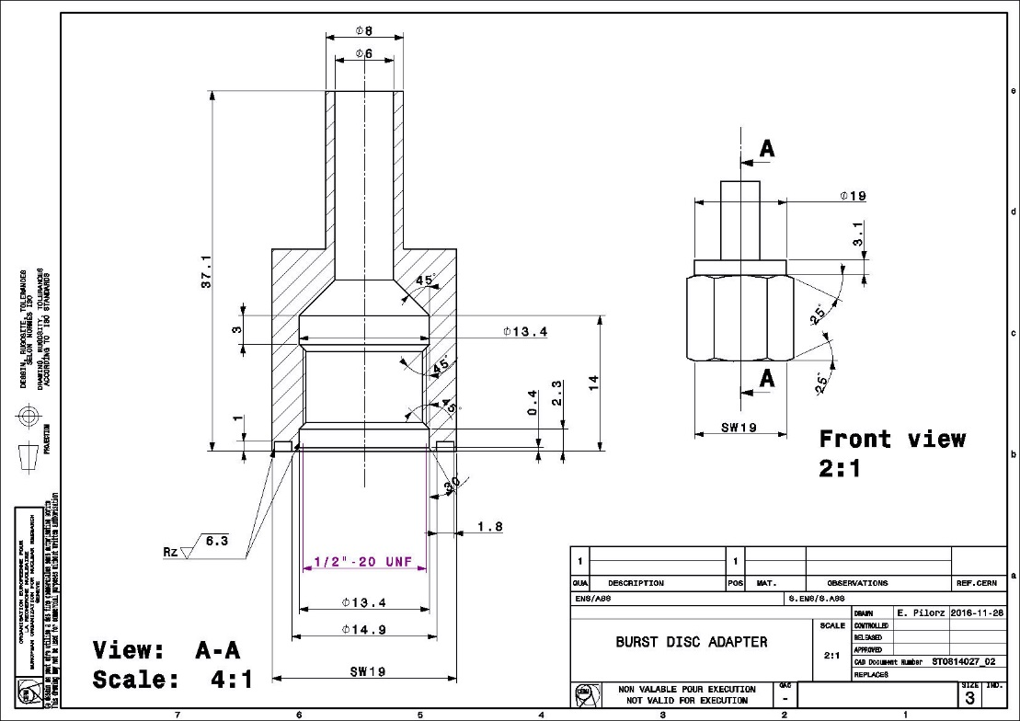
Drawings for the custom-made parts prepared

Slide 6
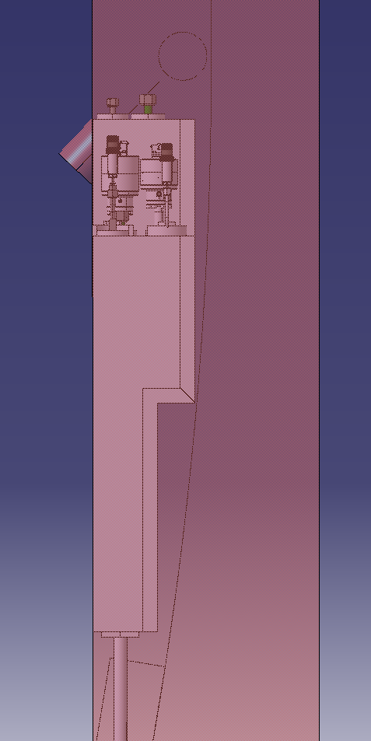
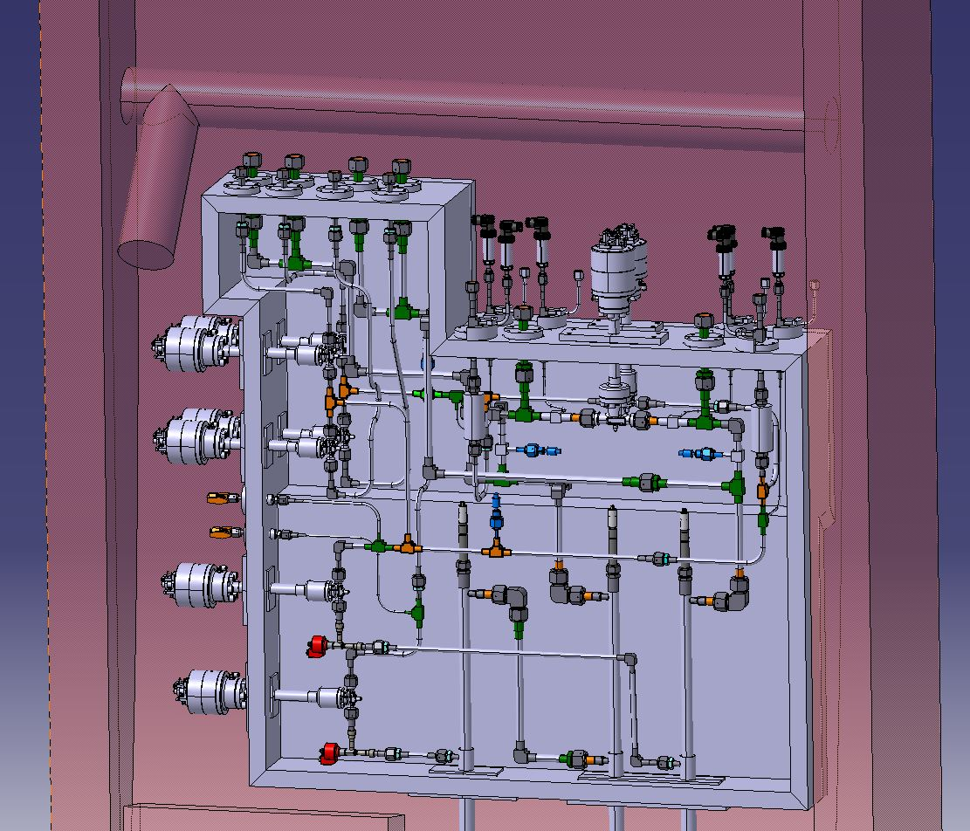
Mounting solution
Box to be screwed at some points
“Supporting shelves” to be designed

Slide 7
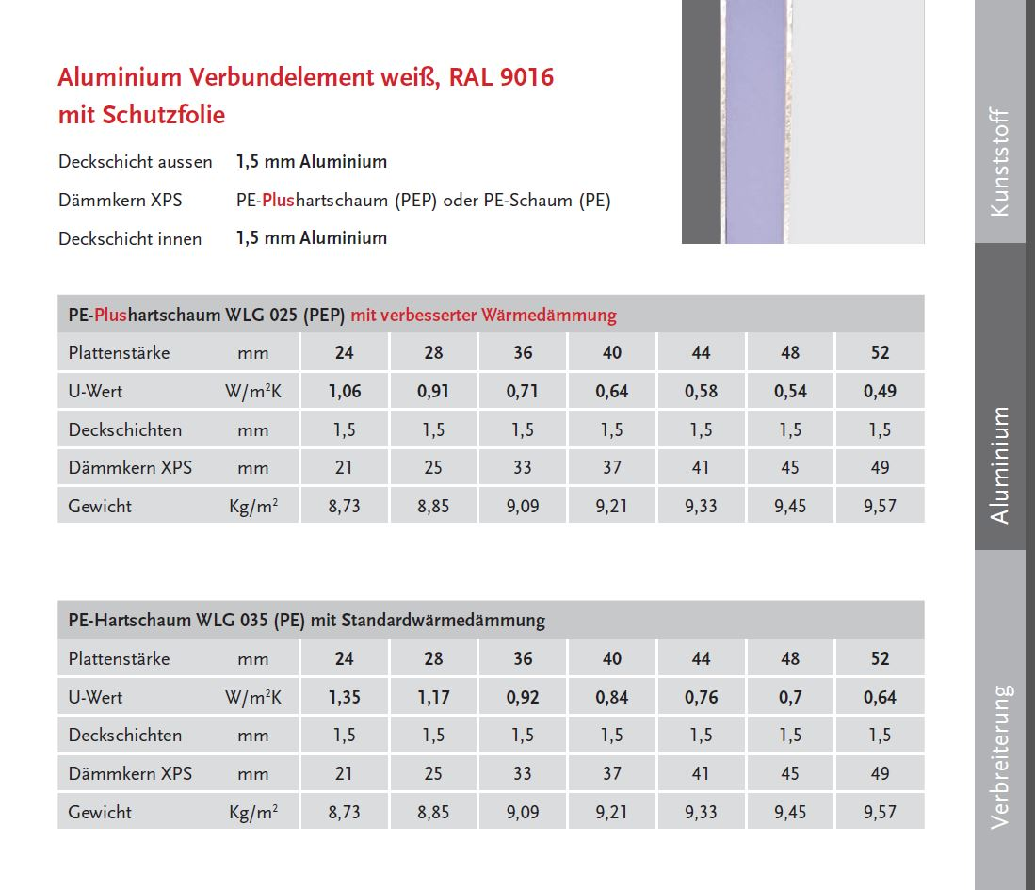
Material selection

Slide 8
Ordering status

Slide 9
Thank you for your attention!

