Slide 1
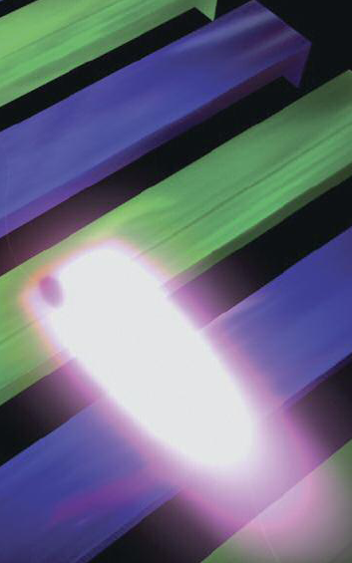
LEADING HIGH-TECH TOOLS for
NATURAL SCIENCES RESEARCH:
EUROPEAN XFEL
Bora KETENOĞLU
Ankara University
Department of Engineering Physics

Slide 2


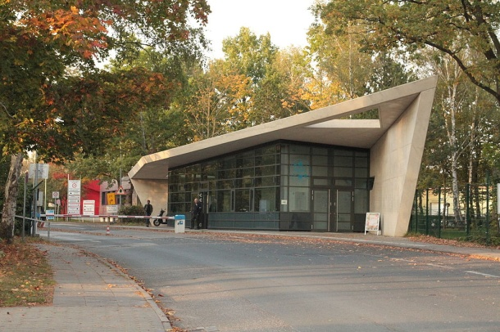
The European XFEL Facility:
founded jointly with Deutsches Elektronen-Synchrotron (DESY)
in Hamburg, Germany

Slide 3
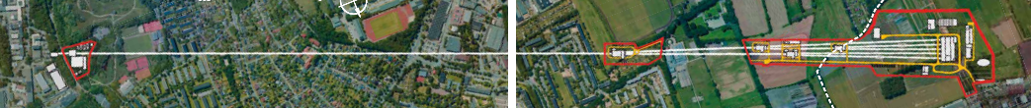
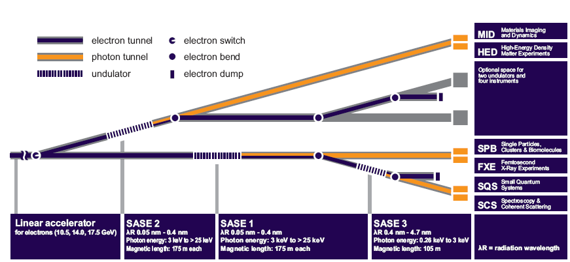

3.4 km-long Superconducting Linac-Based
X-ray Free Electron Laser Facility

Slide 4
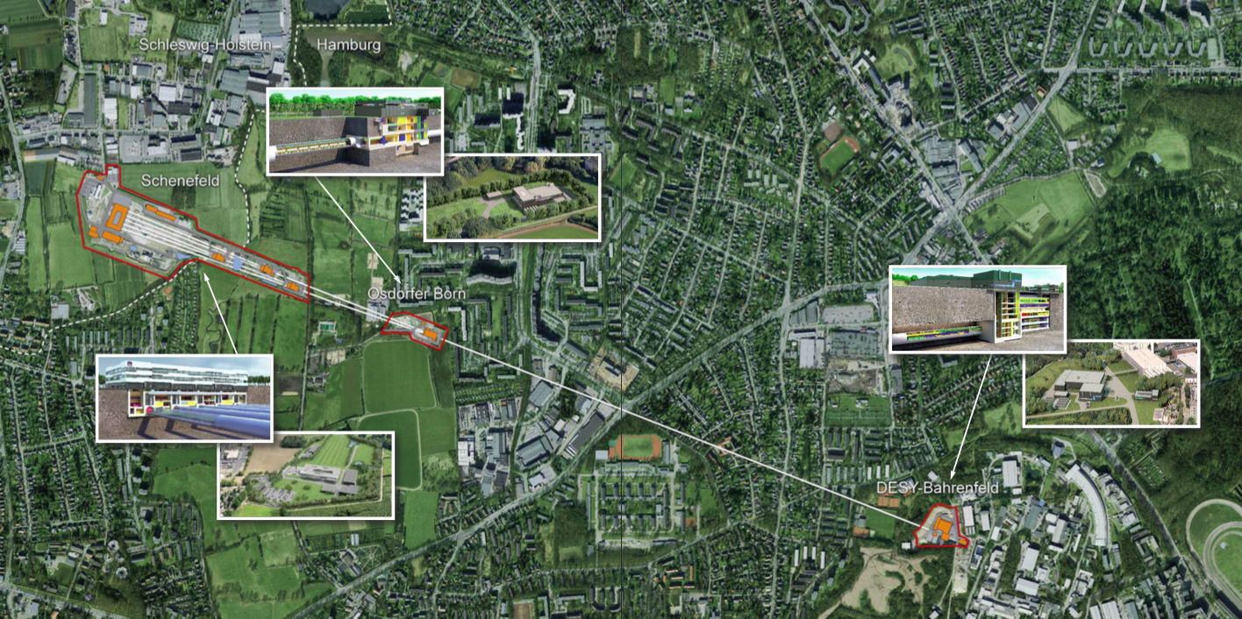
The Facility
Tunnel depth at two ends: 6 and 38 meters
Accelerator: 1.7 km-long superconducting linac,
electron beam energy up to 17.5 GeV (expandable to 20 GeV)
IDs: Totally 91 U40 and U68 undulators, each “5m-long and 8 tons weighing”

Slide 5
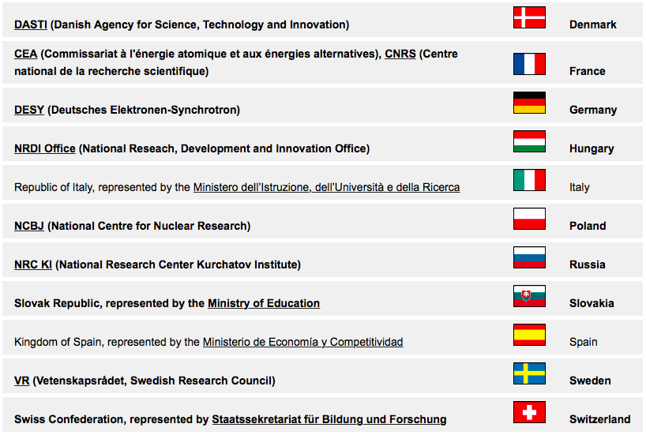
Present Shareholders of European XFEL: Germany, Russia, Denmark, France, Hungary, Poland, Slovakia, Sweden and Switzerland
Likely Future Shareholders: Italy and Spain
50%
25%

Slide 6
European XFEL’s International Collaborations with:
Scientific Research Centers, Institutes and Universities
CLPU, Spanish Center for Ultrashort Ultraintense Pulsed Lasers
CNRS, French National Centre for Scientific Research
European FEL and SPS (Short-Pulse and coherent light Sources)
DESY, Deutsches Elektronen-Synchrotron
EMBL, European Molecular Biology Laboratory
FERMI, Free-Electron Laser for Multidisciplinary Investigations
HAW Hamburg, Hamburg University of Applied Sciences
HZB, Helmholtz-Zentrum Berlin
NRC KI, National Research Centre “Kurchatov Institute”
LBNL, Lawrence Berkeley National Laboratory
LNLS, Brazilian Synchrotron Radiation Laboratory
LCLS @ SLAC, Linac Coherent Light Source
Rostov Southern Federal University
IC RAS, Shubnikov Institute of Crystallography of the Russian Academy of Sciences
STFC, Science and Technology Facilities Council
TISNCM, Technological Institute for Superhard and Novel Carbon Materials
The TURKISH ACCELERATOR CENTER (TAC) project, coordinated by Ankara University
University College London
University of Hamburg
University of Rostock
Uppsala University

Slide 7
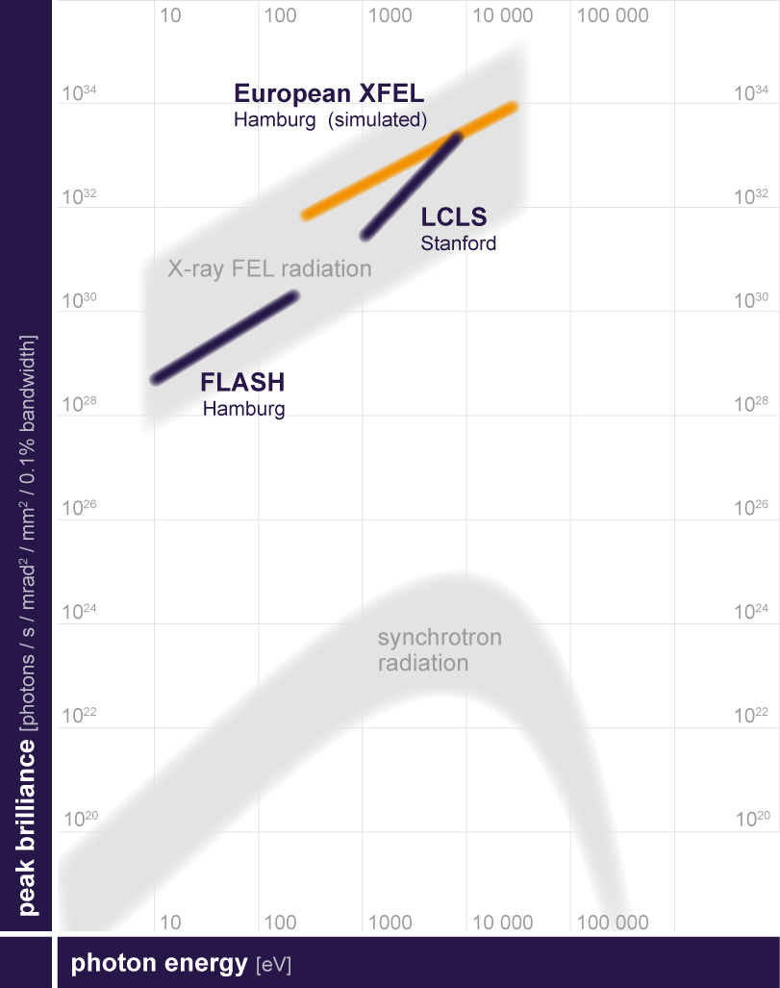
Parametric Comparison of European XFEL
with its Competitors Worldwide
Project | LCLS, USA | SACLA, Japan | European XFEL, Germany | SwissFEL, Switzerland | PAL XFEL, Korea
Max. electron energy (GeV) | 14.3 | 8.5 | 17.5 | 10 | 10
Wavelength range (nm) | 0.12 – 4.4 | 0.06 – 0.3 | 0.05 – 4.7 | 0.1 - 7 | 0.06 - 10
Photons per pulse | 10¹² - 10¹³ | 2 x 10¹¹ | up to 10¹⁴ | ~ 3.6 x 10¹⁰ | 10¹¹ - 10¹³
Peak brilliance | 1.5 x 10³³ | 1 x 10³³ | 5 x 10³³ | 7 x 10³² | 1.3 x 10³³
Pulses per second | 120 | 60 | 27000 | 100 | 60
Date of first beam | 2009 | 2011 | 2016 | 2016 | 2015

Slide 8
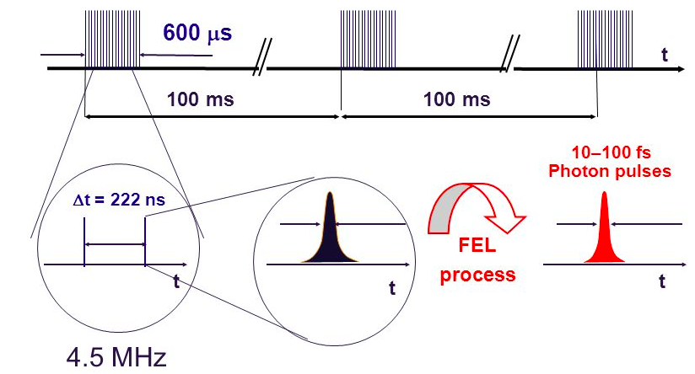
The Time Structure
Flashes per second: 27000, thanks to superconducting accelerator
technology operating at -271 ºC
Wavelength: 0.05 to 6 nanometers, atomic details become discernible
Pulse Length: Down to a few femtoseconds, making films of ultrafast processes
Peak Brilliance: 5x10³³ photons/s/mm²/mrad²/0.1%BW, a billion times higher than
that of the best conventional X-ray sources
Antonio Bonucci, “In-Kind Contributions to the European XFEL Facility” presentation, 2015.

Slide 9
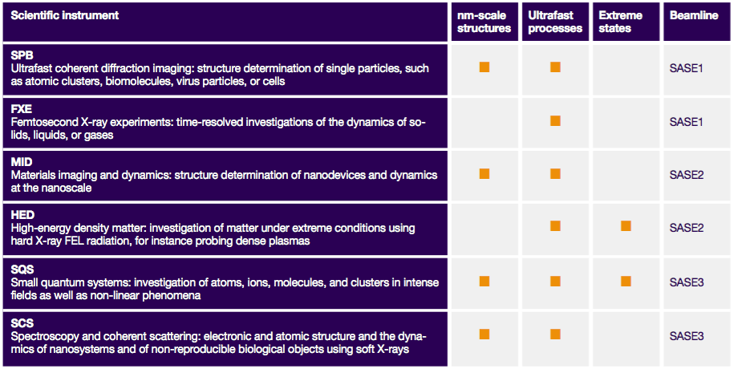
User Instruments, two per each SASE line

Slide 10
Applications of
X-ray Free Electron Lasers
in Natural Sciences Research

Slide 11
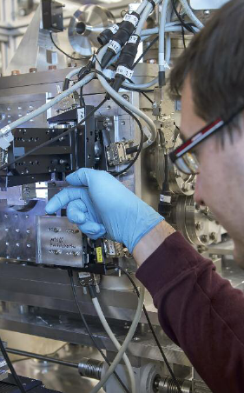
in Physics
Static properties of gases, liquids or solids
Insights into the dynamics of matter: can be initiated using electric or magnetic field pulses, or ultrashort optical laser flashes, as well as by extreme straining of samples
Phase transitions and oscillations (e.g. triggered by optical light pulses)
Crystallization or
crack formation and propagation, such as strength and elasticity

Slide 12
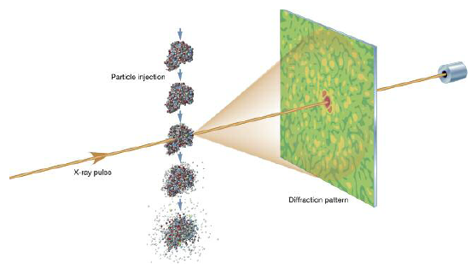
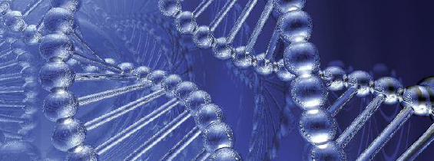
in Biology
When an X-ray FEL pulse illuminates a biomolecule, it scatters a portion of the X-rays, creating a diffraction pattern. Many patterns from differently aligned copies of the molecule enable biologists to determine its 3D structure

Slide 13
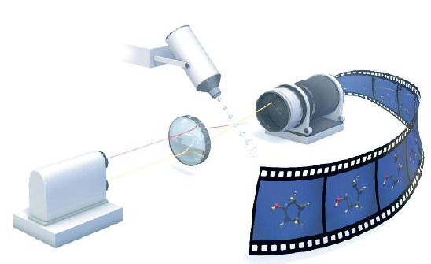
in Chemistry
Molecular movies:
A conventional laser flash first triggers a chemical reaction
And then the FEL pulse is sent at varying time intervals to take snapshots of the changes that have occured in the molecule

Slide 14
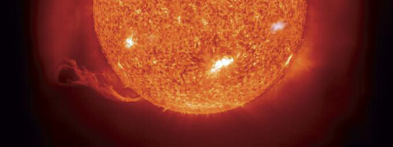
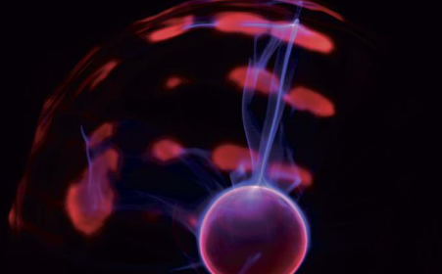
in Astrophysics and the Science of Extreme States
New insights into plasmas and other extreme states of matter existing inside stars or planets

Slide 15
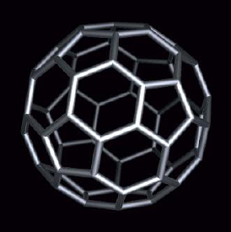
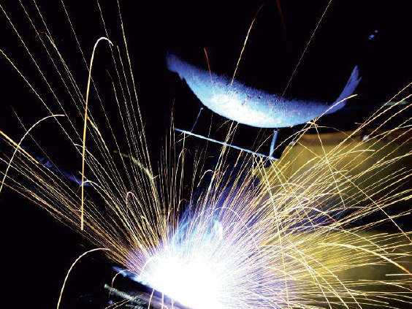
in Materials Science
Examination of welded seams, like those used in airplane construction

Slide 16
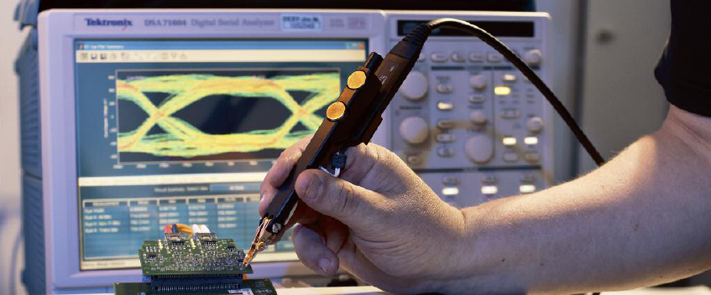
in Electronics
Improvement of data rates and storage capacity of computers and
consumer electronics

Slide 17
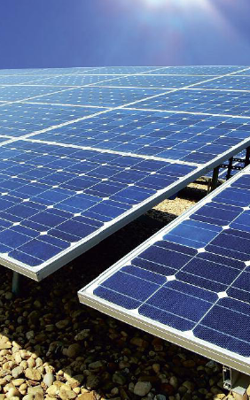
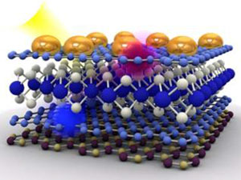
in
Environmental & Energy Research
Processes like those occuring in solar cells could be studied in detail at the atomic level

Slide 18
European XFEL’s
Magnetic Measurements Lab
(Located in DESY Site)

Slide 19
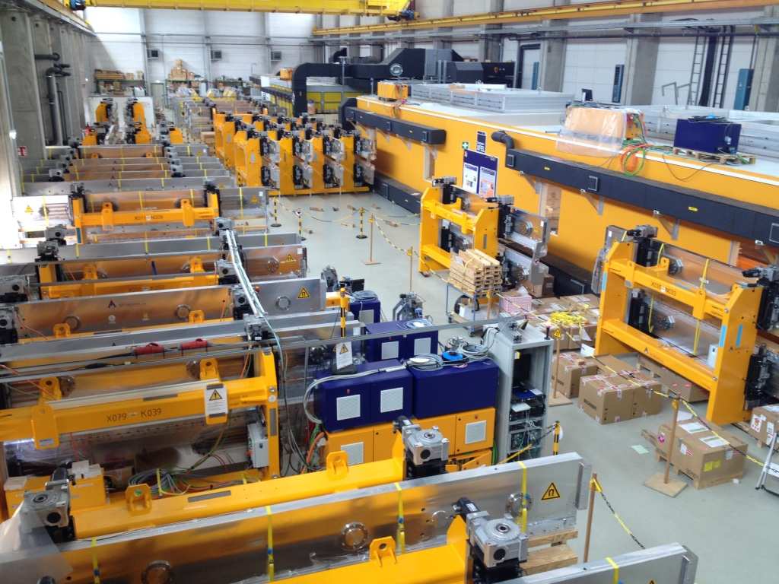
Undulator Hall
for jointly use of
European XFEL and DESY

Slide 20
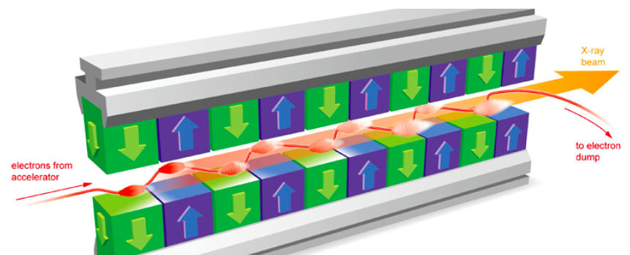
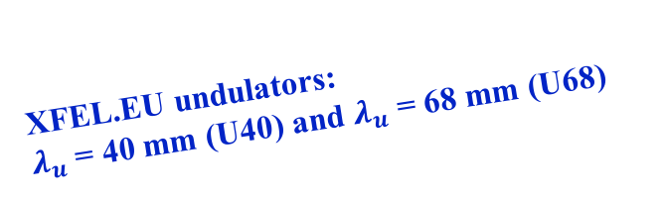

Planar Permanent Magnet Undulator
(Simply “Assembly of Alternating Dipole Magnets on Parallel Girders”)
XFEL.EU undulators:
$λ_{u}$ = 40 mm (U40) and $λ_{u}$ = 68 mm (U68)
Upper Girder
$$λ_{u}$$
Lower Girder

Slide 21
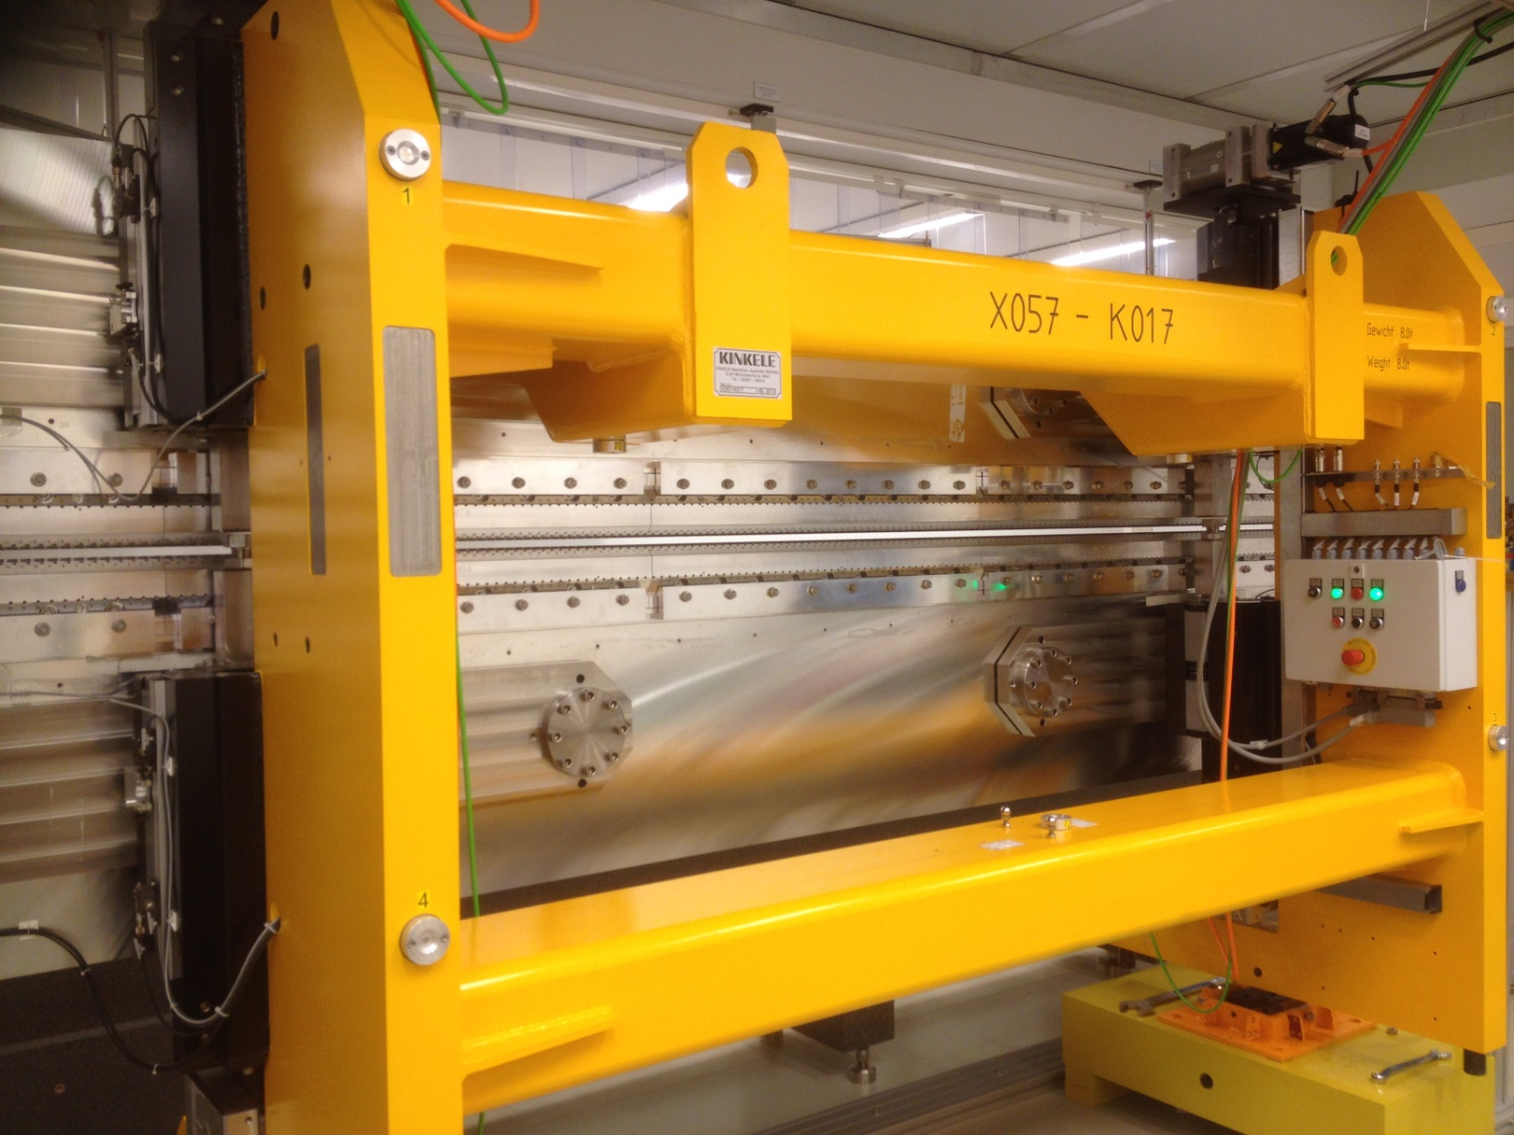
5m-long U40 Undulator
(Girders Controlled by 4 Independent Motors)

Slide 22
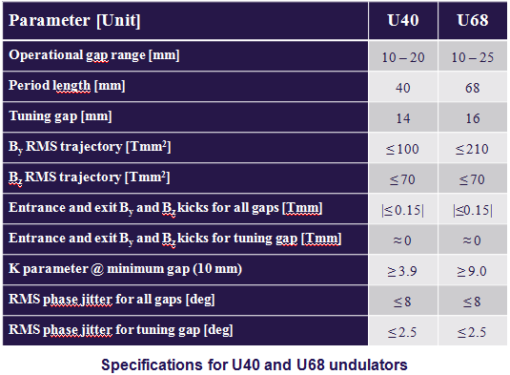

Slide 23
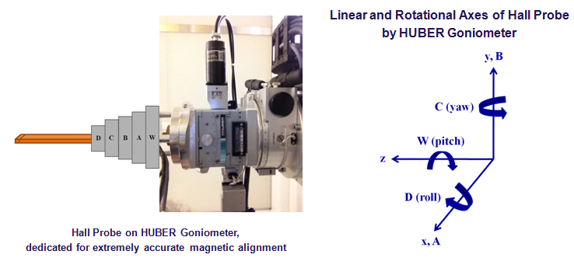
Micron-Precise Magnetic Alignment via
“Hall Probe on HUBER Goniometer”

Slide 24
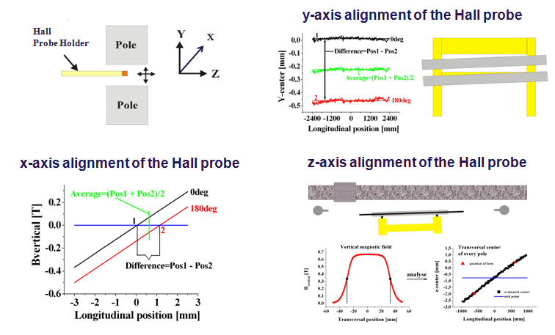
Magnetic Alignment Algorithm

Slide 25
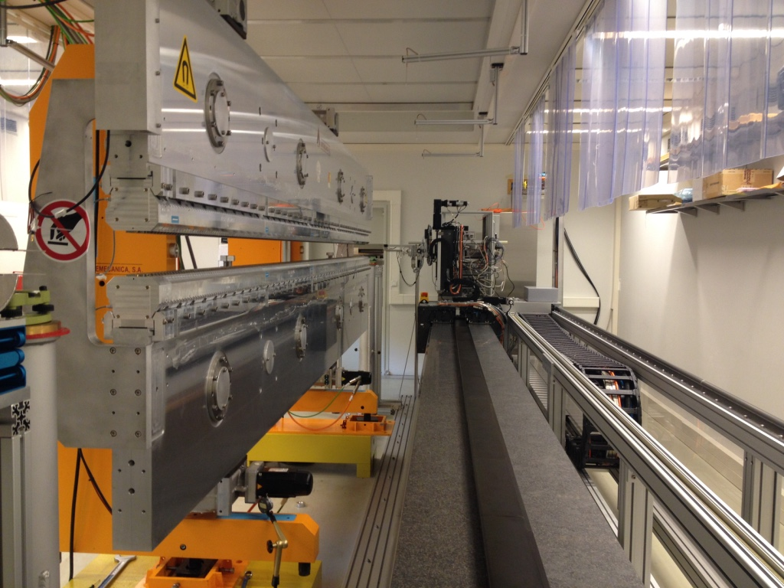
WP-71 Undulator Systems Magnetic Measurements Hutch
(Temperature Stabilized 21 ºC)
6.5m-long
Magnetic Measurements Bench

Slide 26

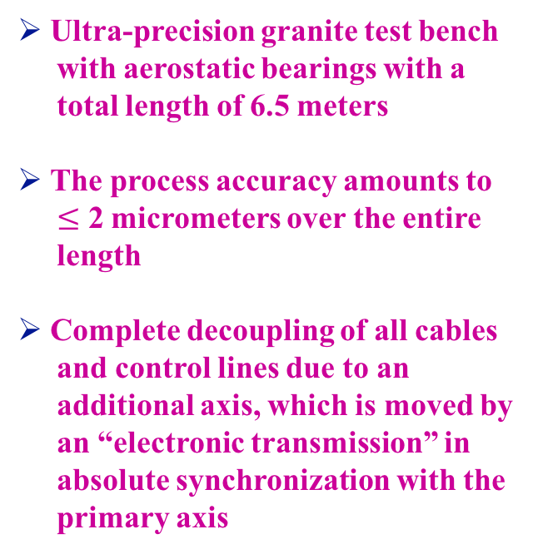
Ultra-precision granite test bench
with aerostatic bearings with a
total length of 6.5 meters
The process accuracy amounts to
$≤$ 2 micrometers over the entire
length
Complete decoupling of all cables
and control lines due to an
additional axis, which is moved by
an “electronic transmission” in
absolute synchronization with the
primary axis
https://www.kugler-precision.com/index.php?magnetic-test-bench-MMB-6500-EN

Slide 27
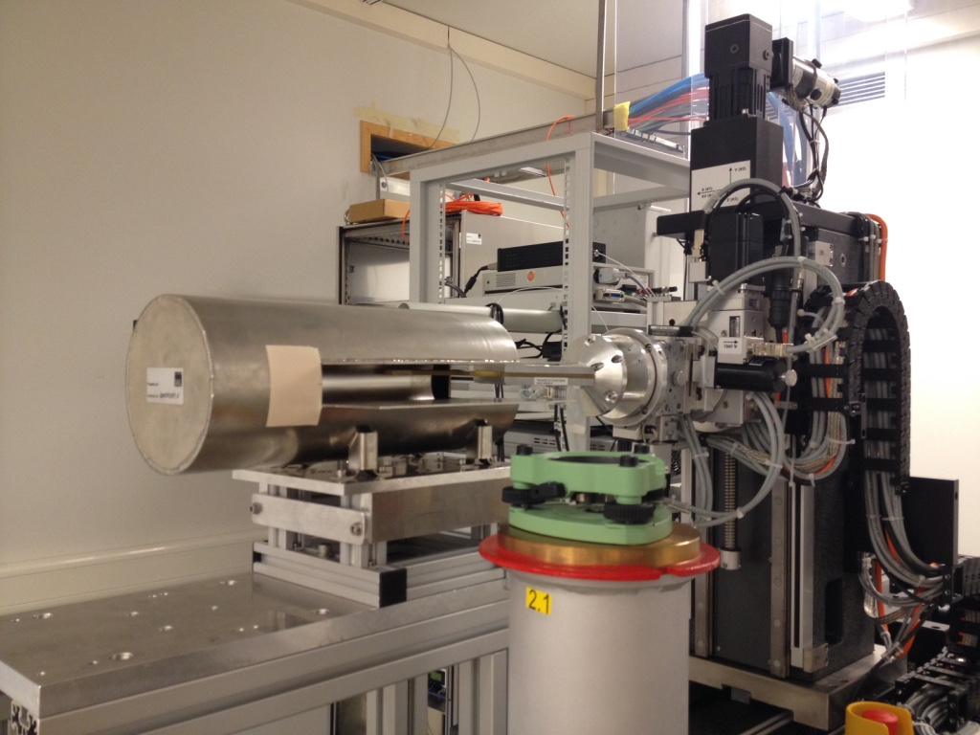
Zero-Gauss Chambers for
Elimination of Offset Voltages
Zero-Gauss Chamber

Slide 28
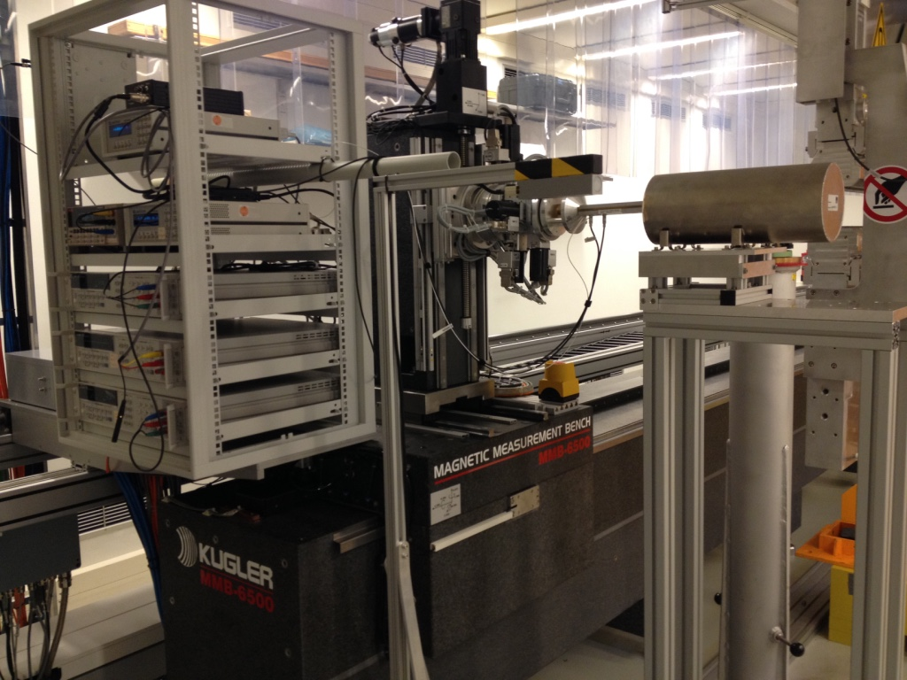

Slide 29
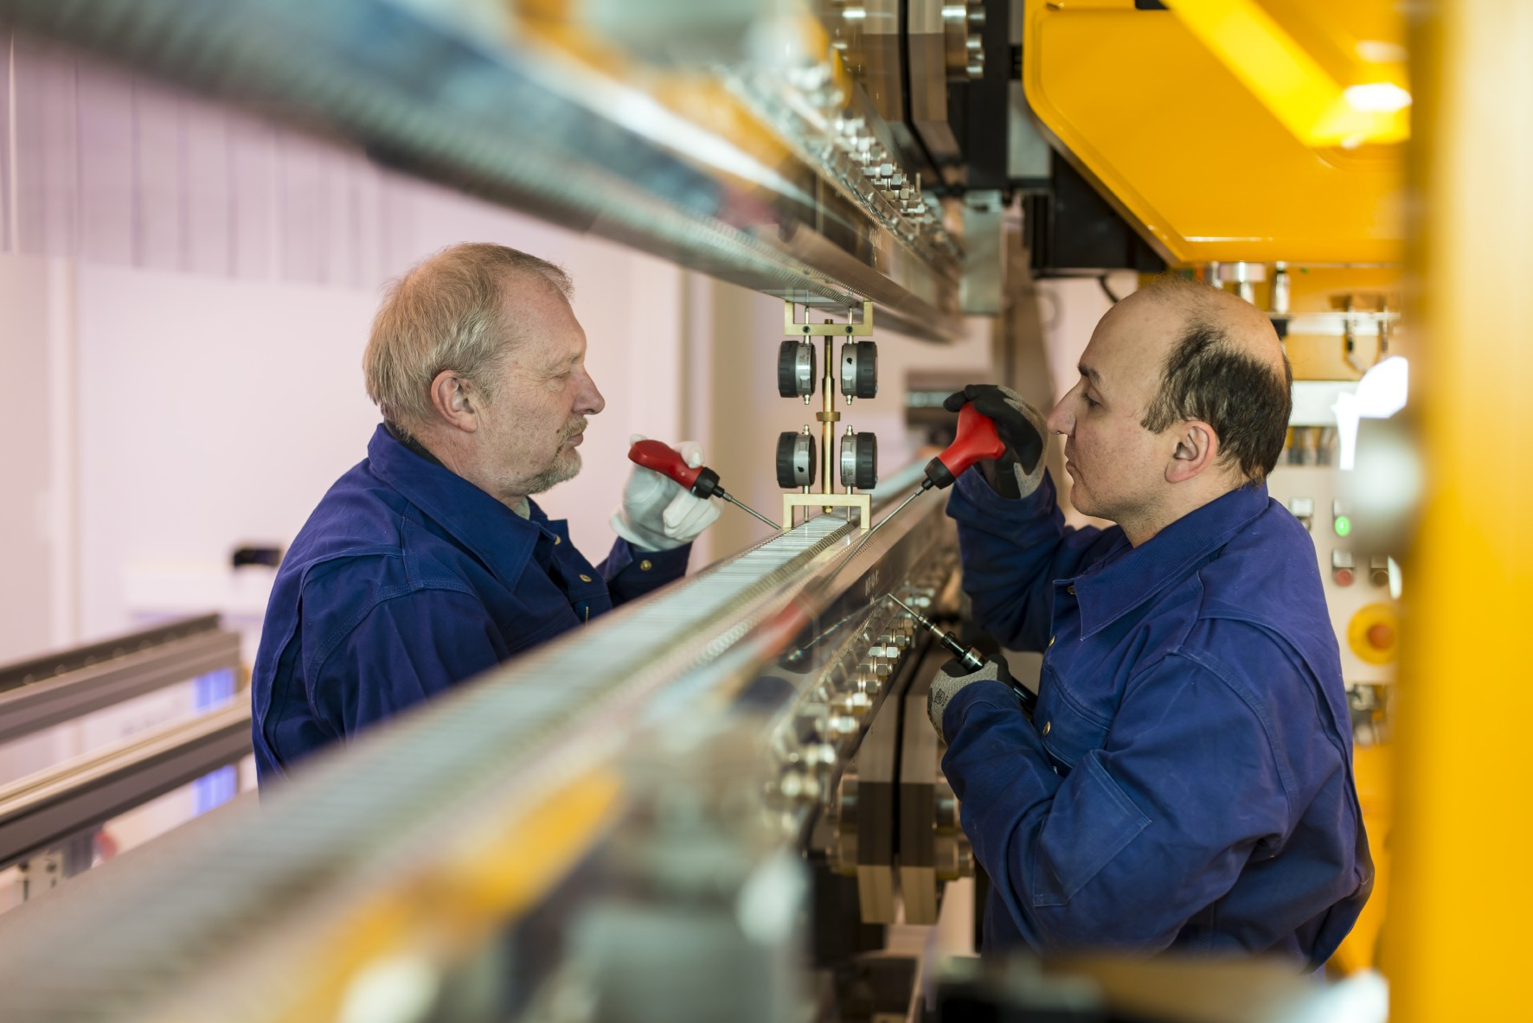
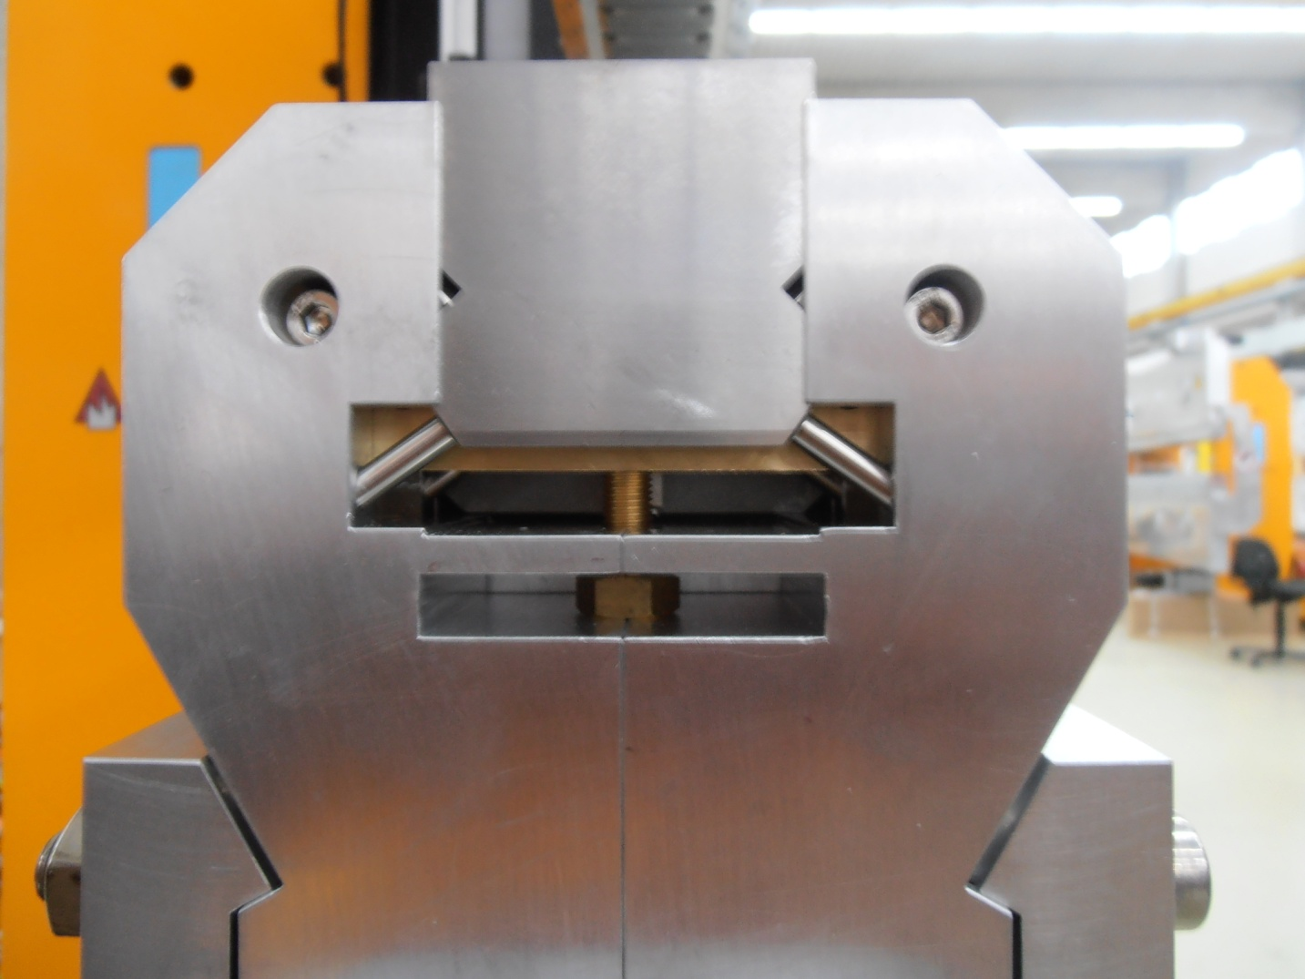
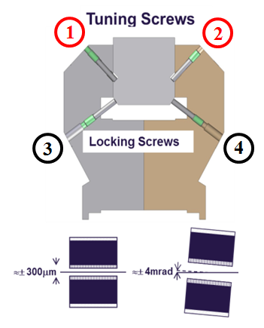
Mechanical Tuning
of the Poles

Slide 30
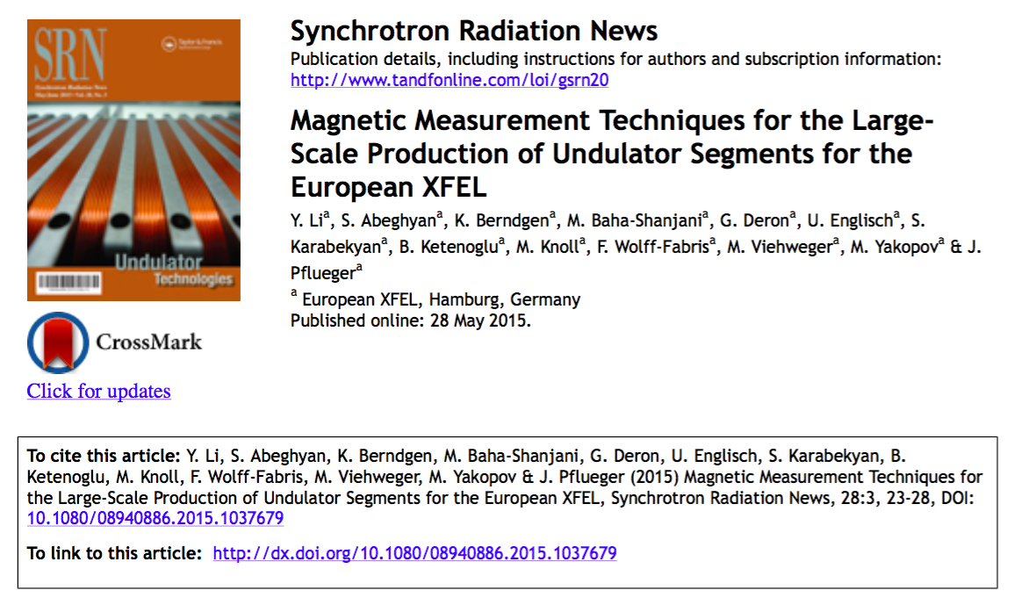
Further Info & Details for
“Magnetic Measurement Techniques of XFEL.EU Undulators”

Slide 31
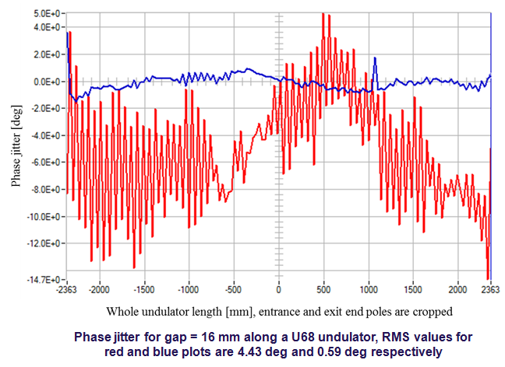
Phase Jitter
Red: Before Tuning Blue: After Tuning

Slide 32
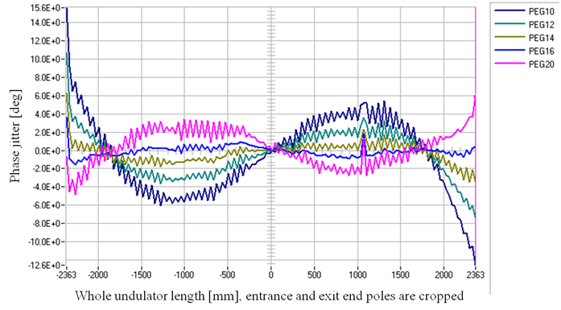
Gap Dependency of Phase Jitter
(for gaps: 10 mm, 12 mm, 14 mm, 16 mm and 20 mm)

Slide 33
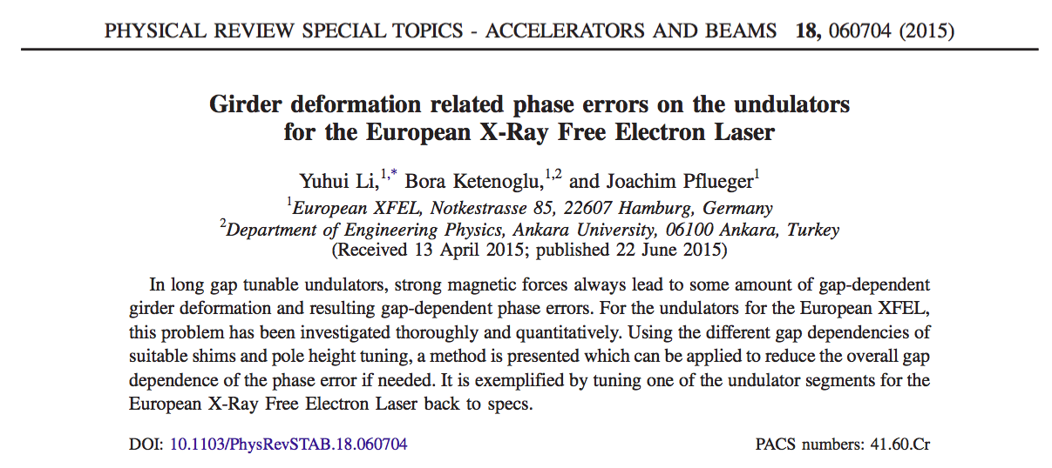
Further Info & Details for
“Girder Deformation Related Phase Errors of XFEL.EU Undulators”

Slide 34
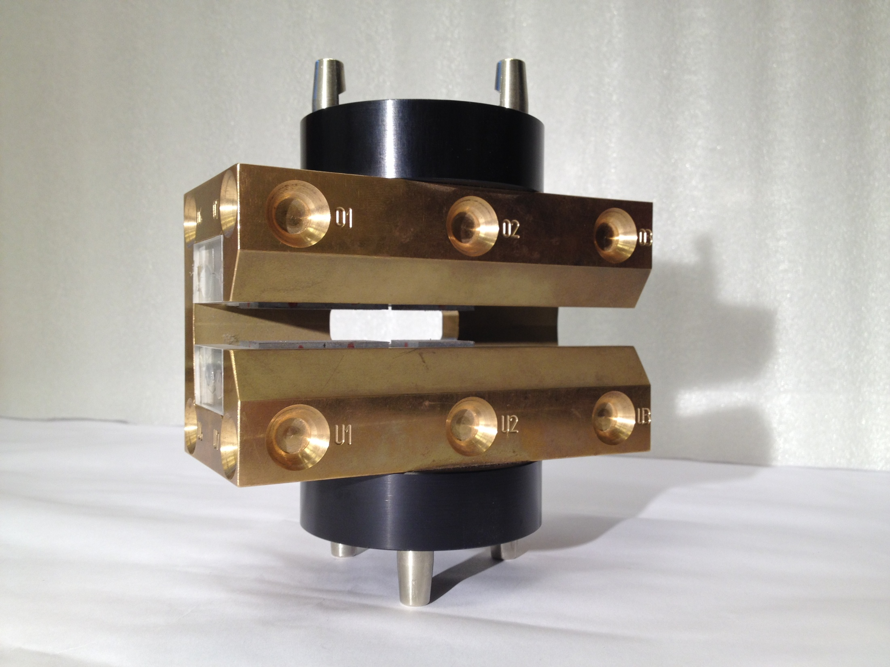
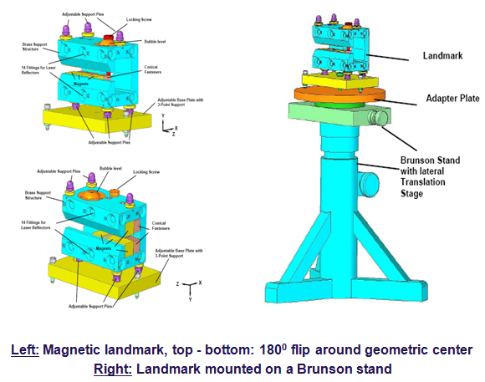
Magnetic and Optical Coordinate Transforming
(Landmark Measurements)

Slide 35
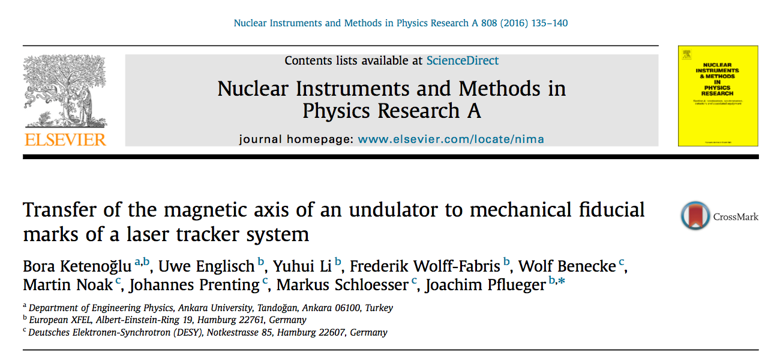
Further Info & Details for
“Landmark Measurements Techniques of XFEL.EU Undulators”

Slide 36
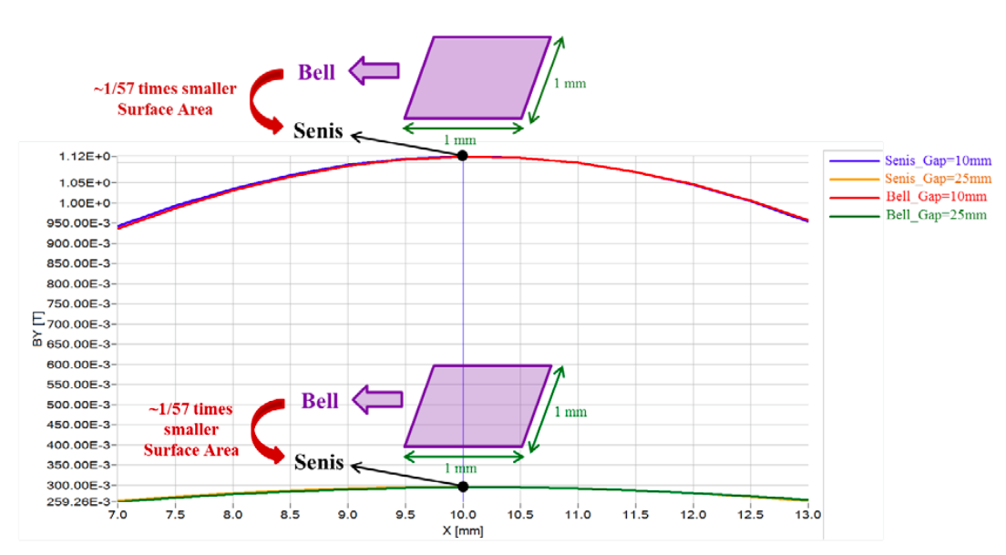
Drawing an Analogy for Magnetic Measurements
“Senis” vs “Bell”
Measuring an undulator with a Hall probe may simply be considered as:
“simulation of electron bunches travelling along the magnetic axis of an undulator with a non-relativistic speed (v << c)”
Gap = 10 mm
Gap = 25 mm

Slide 37
The Necessity of “Senis-after-Bell” Remeasurements
(named as “Remeasurement Campaign” by WP-71)
Following points for the “Senis and Bell equipments used in European XFEL’s Magnetic Measurements Hutches”, were noticed and experimentally observed:
It was noticed in XFEL.EU hutches that the Senis sensor seemed to provide more precise magnetic measurements, due to its 57 times smaller effective surface area than the Bell probe.
“1mm-long longitudinal dimension of the Bell probe” fits with cap of the peak magnetic field only for larger gaps, like g=25 mm. In other words, making use of the Senis sensors for whole gap range (i.e. from 10mm to 200mm) was decided to be more useful & precise than the Bell probe.
Inside the Zero-Gauss Chambers used in European XFEL’s magnetic measurements benches, Senis measured less noise than Bell.
The Senis equipments used in XFEL.EU hutches have integrated electronics, which means no additional Gaussmeters were needed. But considering Bell probes of XFEL.EU, switching the Gaussmeter off and on, or using the “Zeroing” function was sometimes needed, resulting loss of its initial electronical state causing inconsistent measurement conditions.

Slide 38
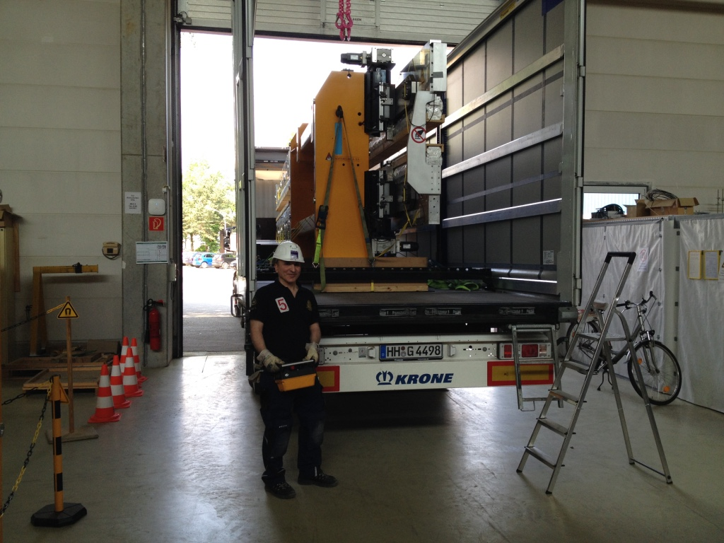
As soon as the undulator is successfully “tuned and landmark measured” in the Magnetic Lab,
then it is ready to be transported into the tunnel.

Slide 39
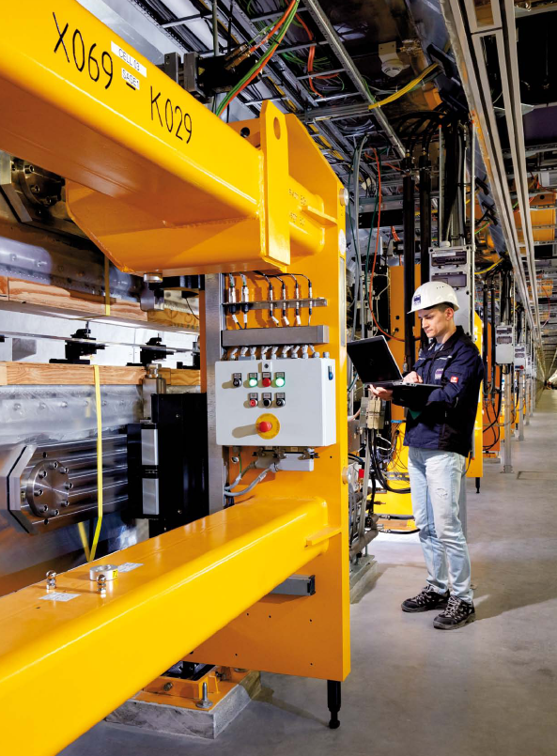
Once transported into the tunnel, control systems of all undulators, phase shifters and air coils are double checked by Control Group* of
WP-71 Undulator Systems.
*Control Group of WP-71:
Suren Karabekyan
Mikhail Yakopov (in the photo)
Suren Abeghyan

Slide 40
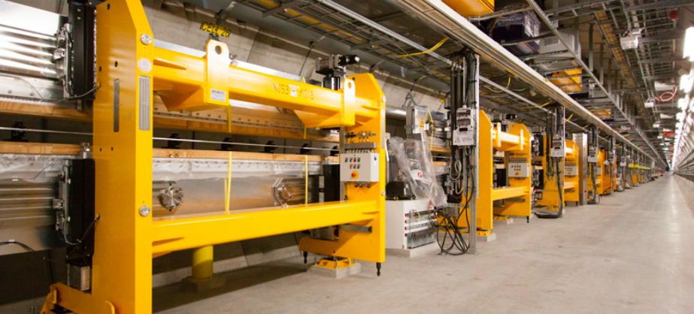
Current Status
SASE1 and SASE3 lines are already installed into the tunnel,
and both lines are ready to be commissioned.
SASE2 undulators will subsequently be installed.

Slide 41
Announcement:
Three Upcoming Events
for
European XFEL

Slide 42
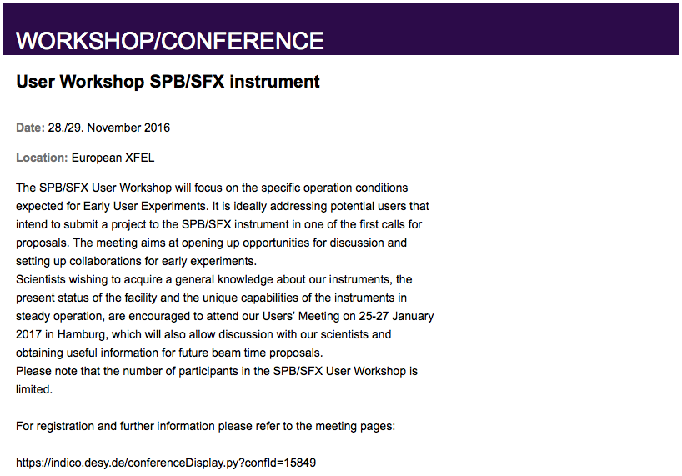
(next week on Monday and Tuesday)

Slide 43
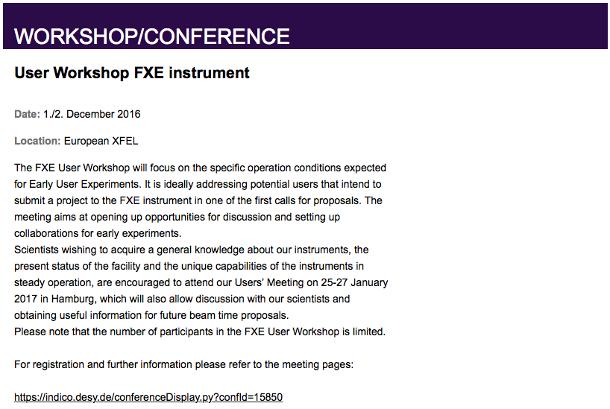
(next week on Thursday and Friday)

Slide 44


Slide 45
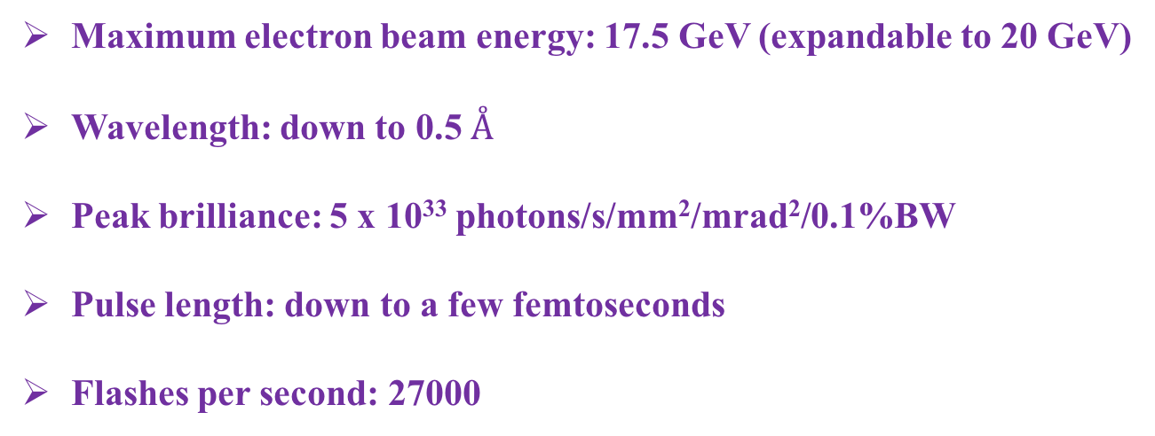
Brief Summary
Maximum electron beam energy: 17.5 GeV (expandable to 20 GeV)
Wavelength: down to 0.5 $Å$
Peak brilliance: 5 x 10³³ photons/s/mm²/mrad²/0.1%BW
Pulse length: down to a few femtoseconds
Flashes per second: 27000
The high repetition rate (27000 flashes per second) makes the European XFEL unique among the World’s X-ray lasers. This is possible only thanks to superconducting accelerator technology operating at -271 ºC

Slide 46
Many thanks for your attention.

