Slide 1
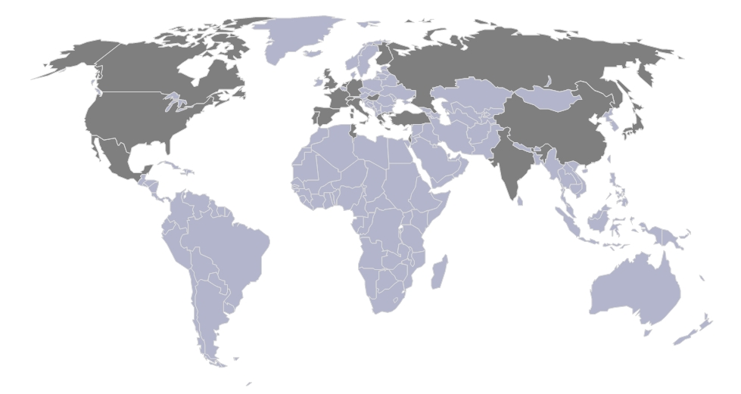
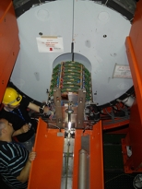
RD51 & WP5: Micropattern Gas Detectors
status report
Leszek Ropelewski
CERN – PH - DT
RD51 Collaboration Site
CERN, 4th of June 2009

Slide 2
RD51 Collaboration
350 authors from 59 Institutes
from 20 countries and 4 continents
CERN MPGD workshop (10-11 September 2007)
Micro Pattern Gas Detectors. Towards an R&D Collaboration. (10-11 September 2007)
1st draft of the proposal presentation during Nikhef meeting (17 April 2008)
Micro-Pattern Gas Detectors (RD-51) Workshop, Nikhef, April 16-18, 2008
Gas detectors advance into a second century - CERN Courier
Collaboration and Management Board meetings in Amsterdam (17-18 April 2008)
Conveners and Management Board meetings (10+15) RD51 MB meeting (19 February 2009)
Proposal sent to CB members (23 June 2008)
Proposal presentation in LHCC open session (2 July 2008)
94th LHCC Meeting Agenda (02-03 July 2008)
CERN‐LHCC‐2008‐011 (LHCC‐P‐011)
Meeting with LHCC referees (23 September 2008)
Meeting with LHCC referees (23 September 2008)
LHCC meeting closed session (24 September 2008) LHCC-095 minutes
2nd RD51 Collaboration meeting (Paris 13-15 October 2008)
2nd RD51 Collaboration Meeting (13-15 October 2008) ~100 participants; parallel session; ~60 presentations.
Research Board approval(5 December 2008) 186th Research Board meeting minutes
Memorandum of Understanding (final version signing procedure before the next Collaboration meeting in Crete) MPGD2009
Consolidation of the Collaboration around common projects; LHC experiments upgrades requirements collection
WG2 meeting (10 December 2008)
WG1-Task 1 meeting: large area MPGDs (21 January 2009)
GEM & Micromegas detector design & assembly training: Lecture Session (16 February 2009)
RD51 week (27-29 April 2009)

Slide 3
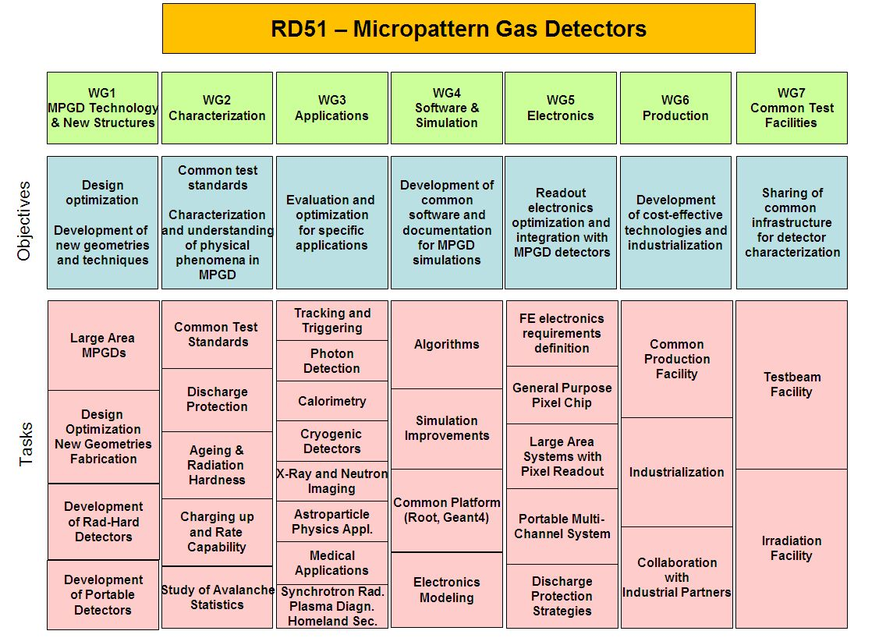
RD51 Collaboration – Working Groups

Slide 4
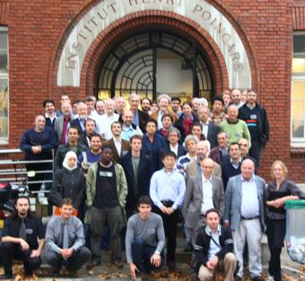
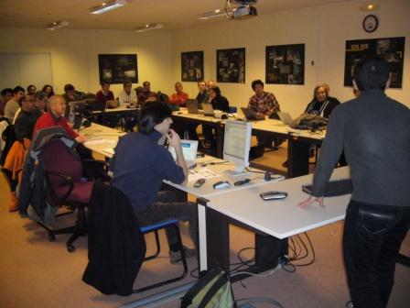
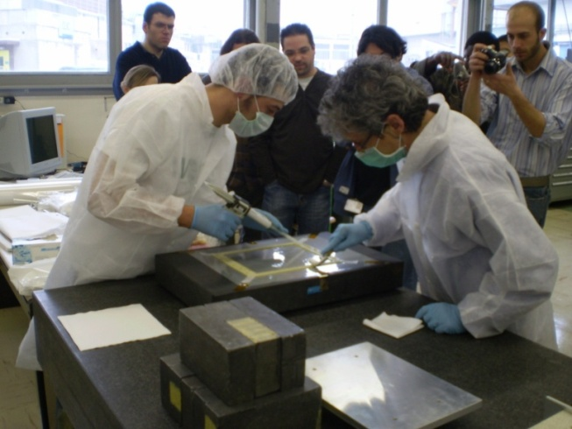
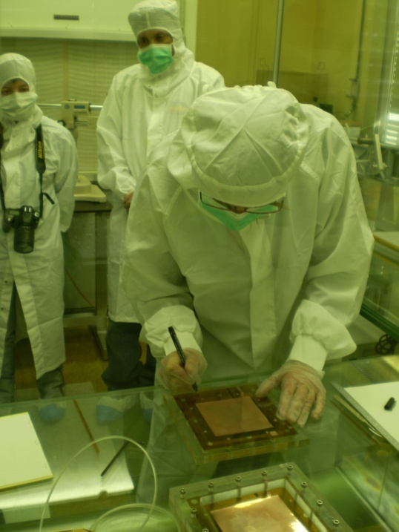
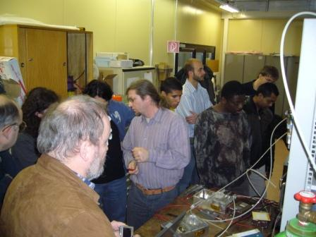
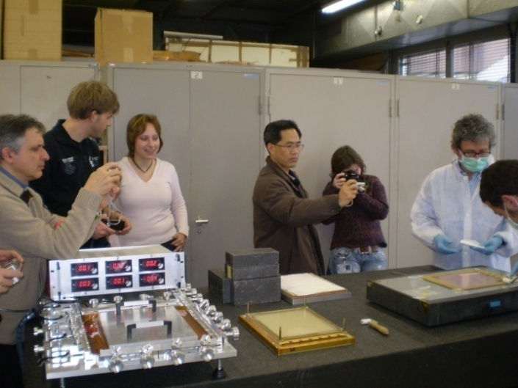
RD51 Collaboration

Slide 5
WP5 - DT RD51 activities Indico [MPGD]
People involved: L. Ropelewski(.6), H. Taureg (1) , W. Klempt (0.5), H. Muller(0.3), J. Wotschack (0.3), M. Alfonsi (1), R. Veenhof (1), S. Duarte Pinto (1), G. Croci (1), M. Villa (1), H. Schindler (1), E. David (.3), M. Van Stenis (.2), B. Brunel (.5)
RD51 organization proposal approved by CERN RB; coordination; 3 MPGD workshops (Leszek, Hans, Matteo, Serge, Rob) 94th LHCC Meeting Agenda (02-03 July 2008) CERN-LHCC-2008-011 186th Research Board meeting
Large area GEM detectors development new technology development and evaluation, prototype construction, paper presented in IEEE NSS/MIC Symposium in Dresden (Serge, Marco, Eric, Miranda, Leszek) test beam preparation – electronics, DAQ.
New amplifiers structures and geometries blind (TH)GEMs with/without resistive anode; spherical GEM (Gabriele, Serge)
Development of large UV photon detectors for RICH applications based on THGEM technology technology evaluation, beam test, paper presented in IEEE NSS/MIC Symposium in Dresden (Elena, Leszek)
Software tools development for MPGD simulations GARFIELD model refinements for electron transport and field calculation, interface to GEANT4 and ROOT, comparison with experimental data, RD51 WG coordination, detector seminar, progress reported during RD51 workshop (Rob, Heinrich, Gabriele, Matteo) micro tracking and neBEM field calculation implementation
Development of radiation hard MPGD technologies construction materials, detector components, detectors (GEM, Micromegas) radiation hardness evaluation, progress reported during RD51 workshop (Gabriele, Leszek)
Beam facility for RD51 RD51 WG coordination, requirements and contributions for the beam and irradiation facilities, CERN contribution (trigger, tracker), services installation (Matteo) SPS Schedule
Production aspects RD51 WG coordination, IP, production facility requirements, industrial partners (Hans) EN ICE DEM workshop upgrade proposal
Gas detector lab infrastructure gas system, new X-ray generator (Matteo, Marco, Miranda, Bernard) infrastructure for flammable gases

Slide 6
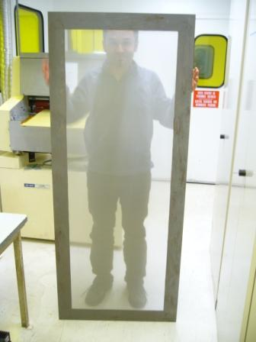
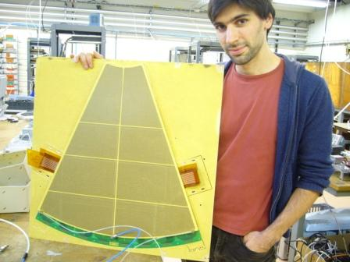
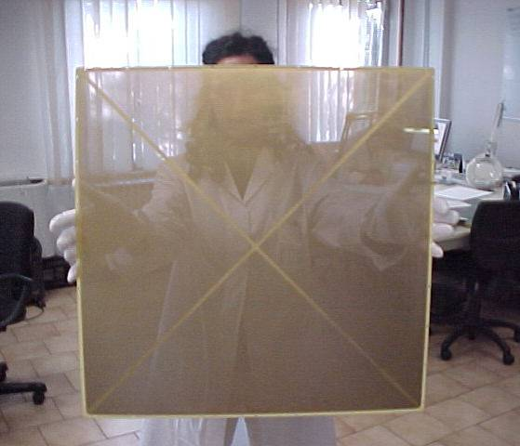
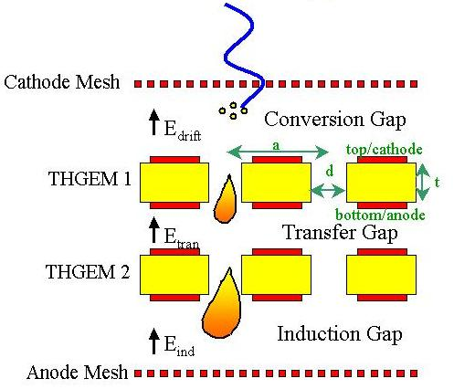
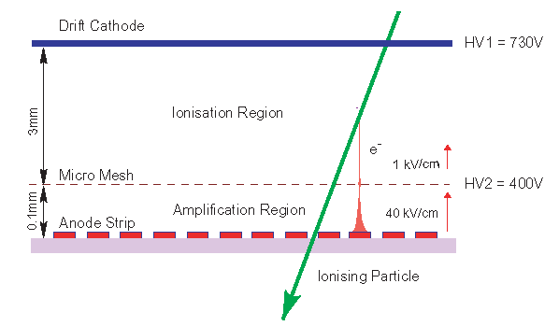
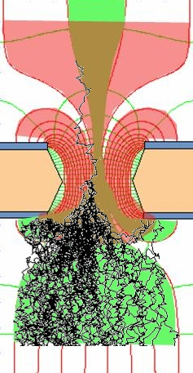
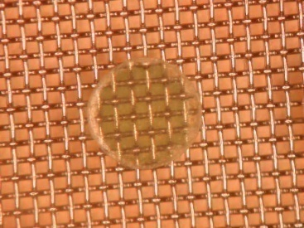
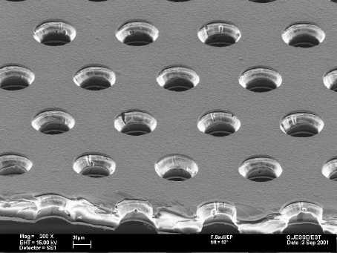
Example: WG1 - Development of large-area MPGDs
Bulk Micromegas
Single mask GEM
THGEM
Ions
40 %
60 %
Electrons
Notes:
6

Slide 7
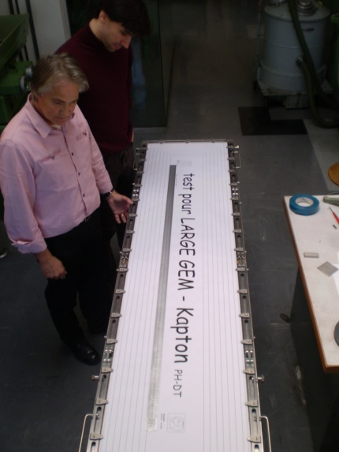
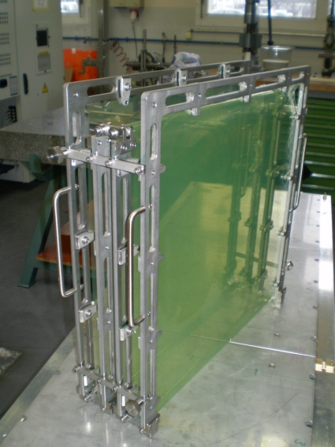
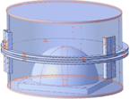
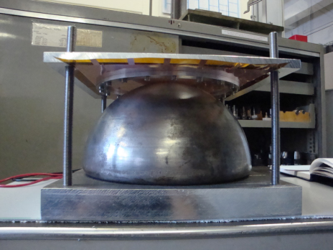
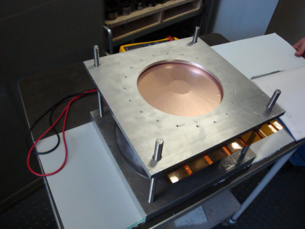
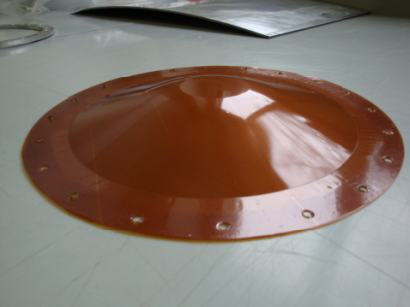
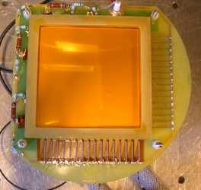
Large Area MPGDs and New Structures
Large area GEM foils
200 x 50 cm²
Financed by EN-ICE-DEM
Spherical GEM
for X-Ray diffraction application
Financed by industrial partner and KTT
New project: development of GEM based beam monitors for AD MWPC replacement (in collaboration with BE-Beam Instrumentation)

Slide 8
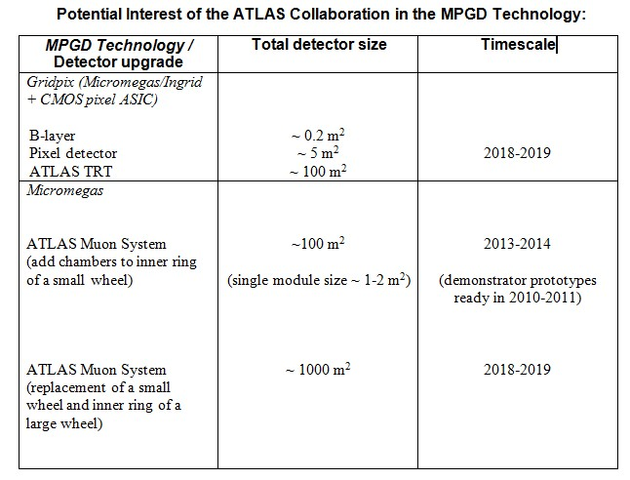
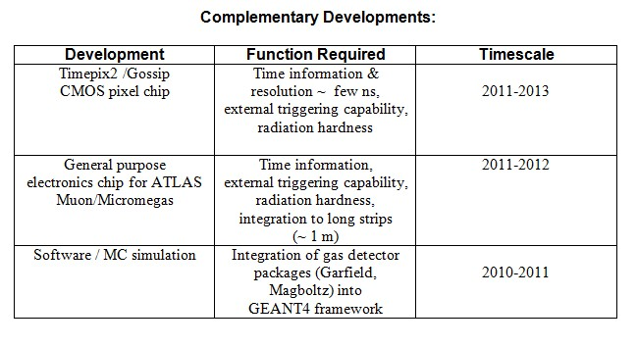
MPGD in the SLHC upgrades – requests from experiments
Atlas - Nigel Hessey
CMS - Jordan Nash
LHCb - Sheldon Stone
ALICE - Paolo Giubellino
TOTEM - Angelo Scribano
PANDA - Bernd Voss
....

Slide 9
EN-ICE-DEM workshop upgrade
technology |  |  | GEM |  | TGEM |  | Micromegas
 |  |  | single mask |  |  |  | bulk
dimensions (cm2) |  |  | 50*120 |  | 60*60 |  | 100*200
 | price | floor space | price | floor space | price | floor space | price | floor space
equipment | (CHF) | (m2)
laminator | 40,000 | 12 |  |  |  |  | 40,000 | 12
insolateur | 50,000 | 12 | 50,000 |  |  |  | 50,000 | 12
devellopeuse + rince | 110,000 | 12 |  |  |  |  | 110,000 | 12
secheuse x 2 | 60,000 | 12 |  |  |  |  | 60,000 | 12
etuve | 25,000 | 10 |  |  |  |  | 25,000 | 10
graveuse | 100,000 | 12 |  |  |  |  | 100,000 | 12
strippeuse | 100,000 | 12 |  |  |  |  | 100,000 | 12
enrouleur/derouleur x 4 | 80,000 |  | 80,000
stripping+sechage | 100,000 | 12 | 100,000 | 12
depot SN + sechage | 70,000 | 12 | 70,000 | 12
machine netoyage+sech | 60,000 | 12 | 60,000 | 12
machine perman + sech | 80,000 | 12 | 80,000 | 12
machine CR+sech | 80,000 | 12 | 80,000 | 12
gravure ethylene+sech | 120,000 | 12 | 120,000 | 12
perceuse | 350,000 | 20 |  |  | 350,000 | 20
sum | 1,425,000 | 174 | 640,000 | 72 | 350,000 | 20 | 485,000 | 82
Detector components production
Quality control
Detector assembly → participating institutes; industrial partners
Small standard detectors production
Readout electronics
WG6 Coordination
Generic R&D
Large area prototypes – demonstrators → DEM workshop upgrade
Towards large volume production:
Current detector size limitations
Detector size requirements
LHC experiments technology choice → DEM workshop upgrade
Industrial partners

Slide 10
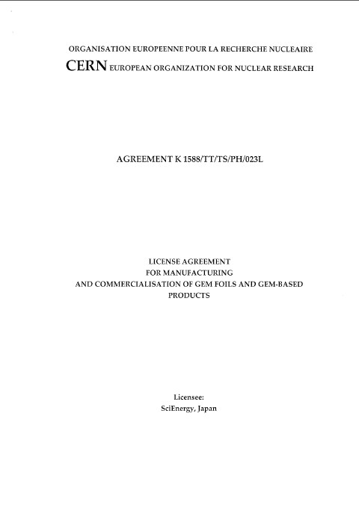
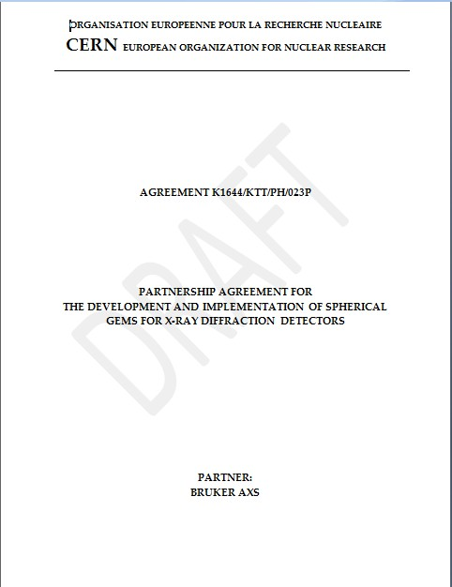
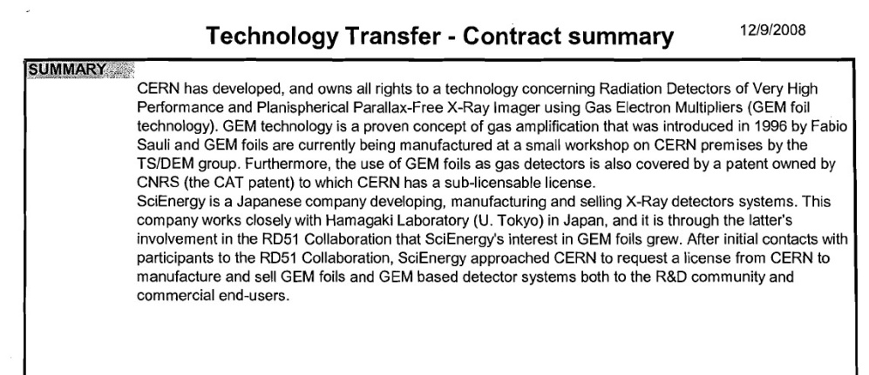
Technology Transfer
Activities by CERN TT / EN-ICE
Scienergy, Japan signed license contract for GEMs
Evaluation of Micromegas manufacturers in US is planned together with BNL
Visit TechEtch and restart negotiations
New industrial partners in Korea and China

Slide 11
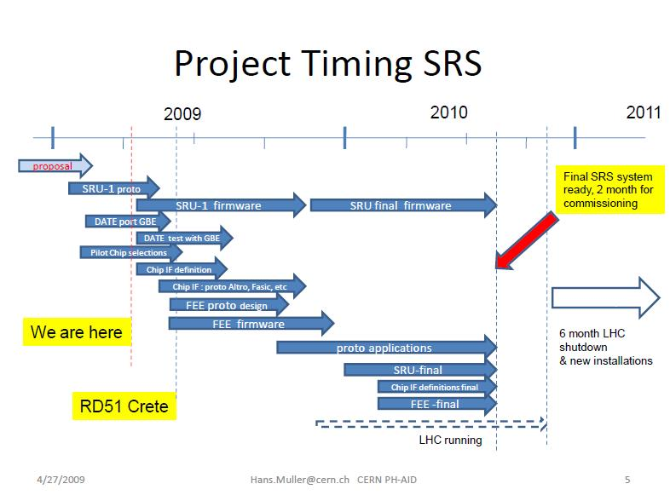
Electronics: Scalable Readout System
APV electronics for RD51 (11 March 2009)
VFAT electronics for RD51 (01 April 2009)
IDEAS chips for RD51 (09 April 2009)
Scalable Readout System SRS

Slide 12
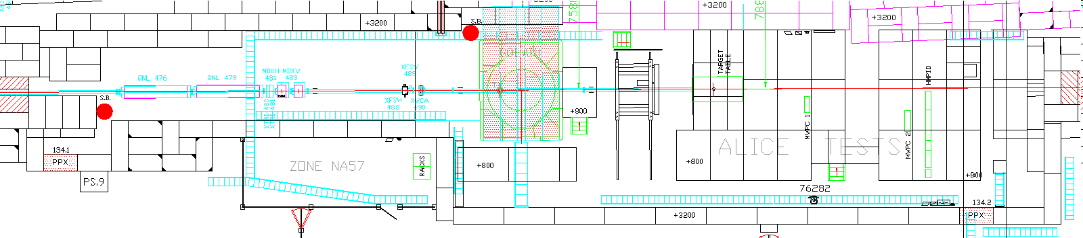
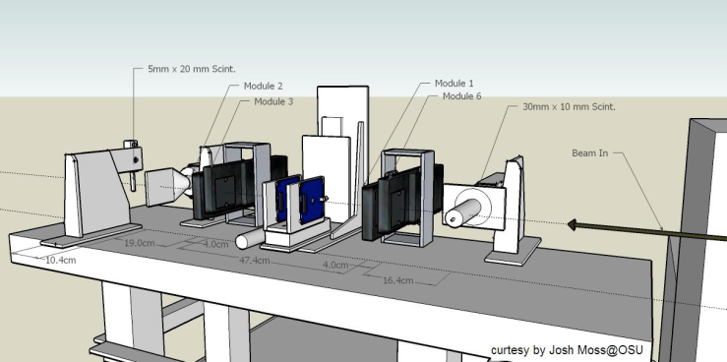
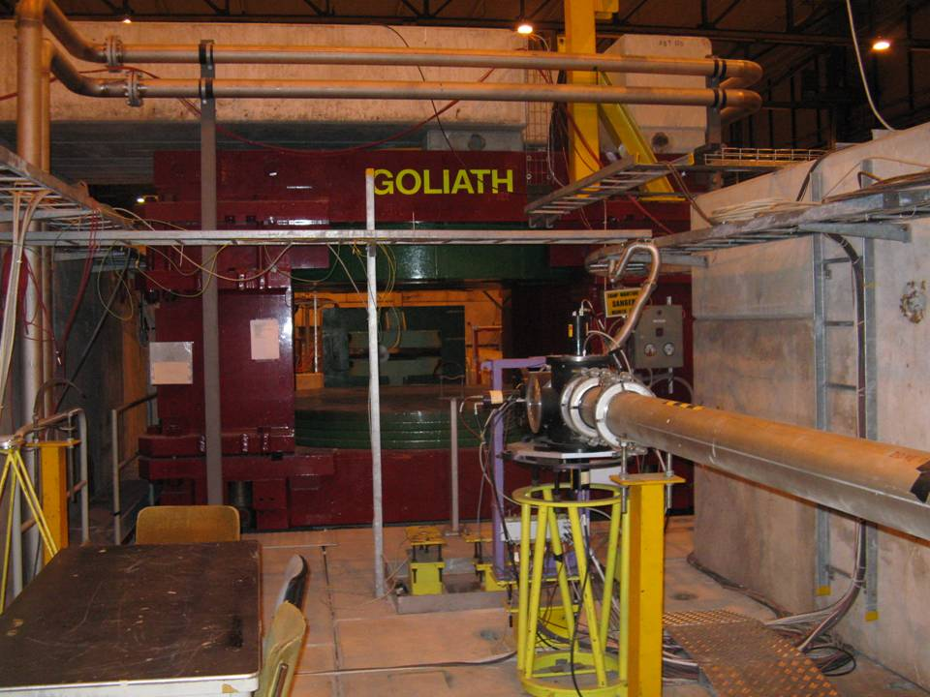
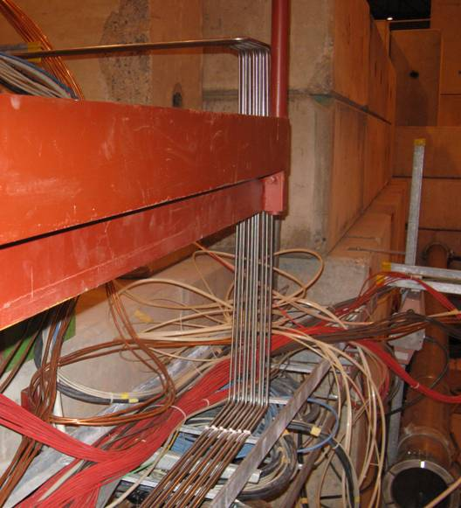
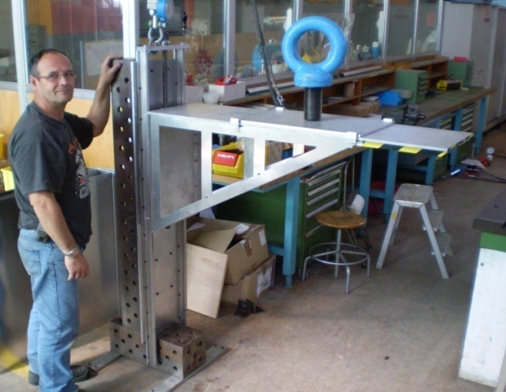
Beam facility for RD51 in H4@SPS
Beam direction
RD51 setup
Goliath magnet
Photonis XP2040B PMT
Initial Safety Discussion: RD51 (21 April 2009)
RD51 test beam periods: 21.06-6.07; 22.10-1.11

Slide 13
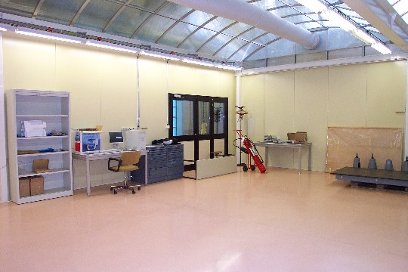
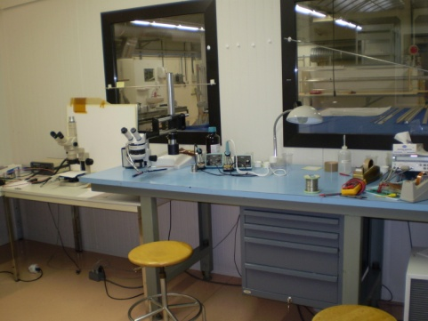
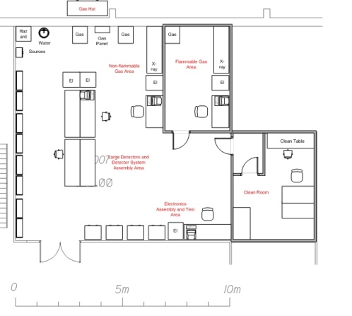
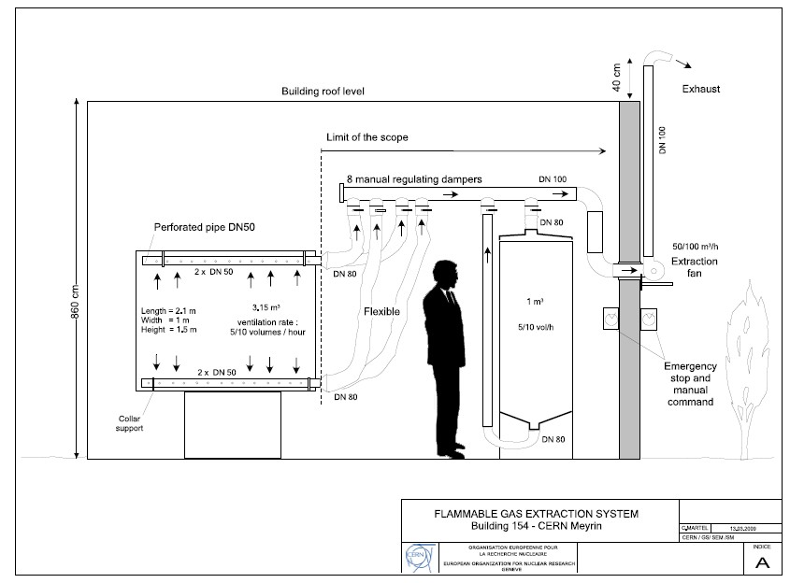
Gas Detector Lab infrastructure – bld 154
Lab infrastructure:
Clean room
4 test stations
assembly space
Gas system:
Upgrade to flammable
gas mixtures (2009/2010)
Une installation de détection constituée de
- 8 capteurs OLC20 avec ses supports et ses liaisons NG4
- 4 interfaces WB
- 6 panneaux lumineux avec leur liaison 2 x 2.5
- 4 sirènes avec leur liaison 2 x 2.5
- 1 interface d’acquit sirène
- la pose des chemins de câble et des câbles nécessaires à l’installation
- 1 électrovanne avec leur liaison 3 x 1.5
- 1 coupure électrique avec leurs liaisons NG4
- 1 commande ventilation/extraction
1 mode maintenance
Montant HT de l’ensemble : 30 384,42 Euros

Slide 14
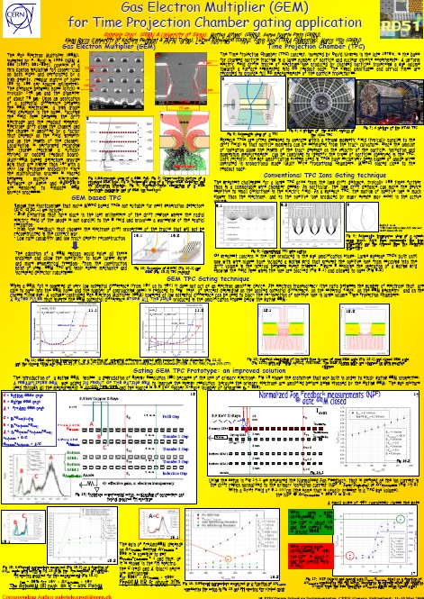
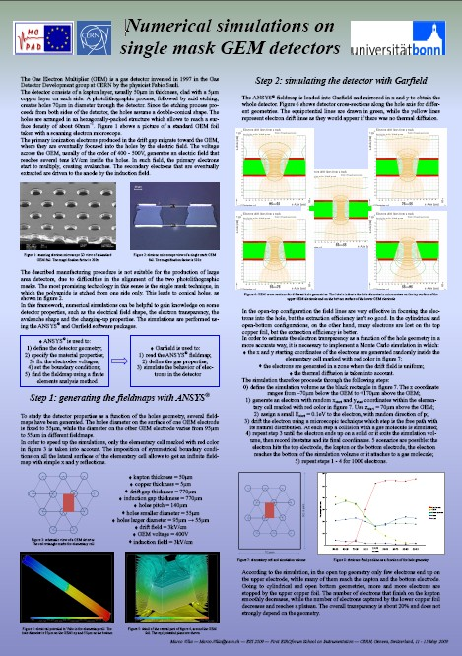
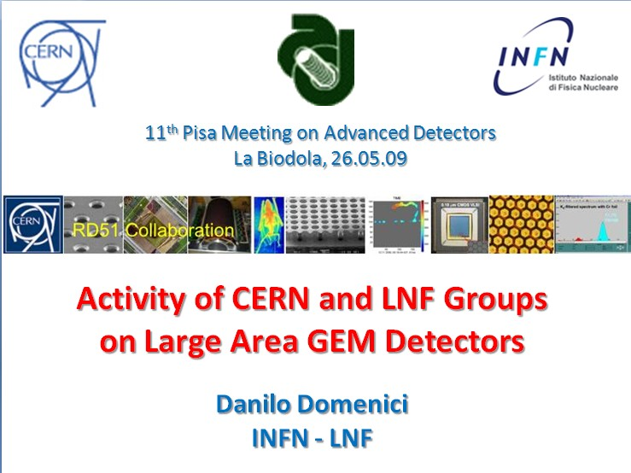
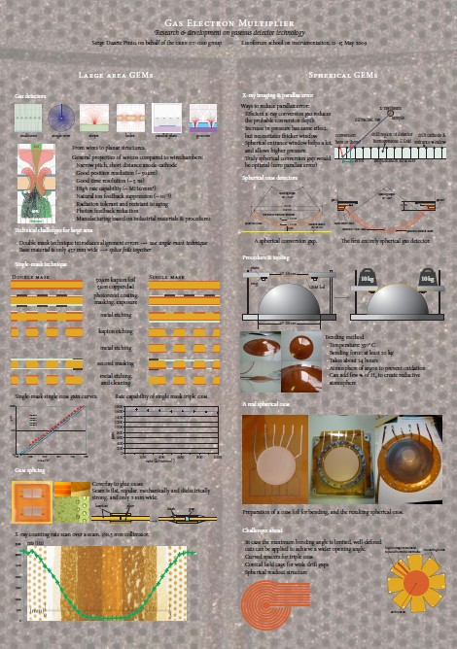
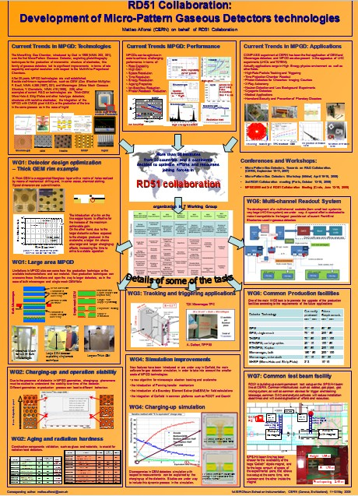
Education
Dear Colleagues,
It is my pleasure to inform you that the talk “Activity of CERN and LNF Groups on Large Area GEM Detectors”, presented by Danilo Domenici (LNF-Frascati) on behalf of the RD51 Collaboration at the "Frontier Detectors for Frontier Physics - 11th Pisa Meeting on Advanced Detectors", held in Isola d'Elba, Italy, has won the "Young Scientist Award" for the "contribution to the development and test of large area planar and cylindrical Gas Electron Multiplier detectors (GEM) in view of their use for various detector upgrades at SLHC and KLOE at LNF-Frascati”. I hope that this Award will motivate even stronger our younger collaborators to devote their efforts to the MPGD developments.
Congratulations !
Leszek Ropelewski

Slide 15
