Slide 1
White Paper R&D WP7
Facilities and Component Analysis for Detector R&D
Status Report by M.Capeans
Review, June 4th 2009

Slide 2
Outline
WP7 consists of 3 different activities:
  Construction of sLHC-compatible irradiation facilities
  Filtering techniques for RPCs at LHC
  Materials DB
For each, we show:
    Background
    Who is involved
    Technical Progress and Work ahead
Resources, Expenditures in 2009

Slide 3
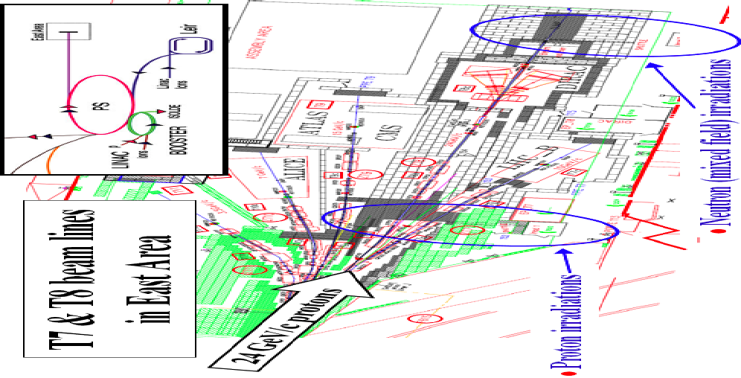
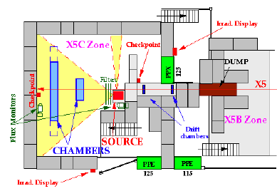
Activity 1: Construction of sLHC-compatible Irradiation Facilities
PH Proton, neutron facilities (IRRAD)
PH Gamma Irradiation Facility (GIF)
1992
1997
Current Drawbacks
No muon beam available since 05, old source
Space issue in building, needed for LHC magnet lab
sLHC: need more photon intensity + high energy muon beam
Current Drawbacks
Parasitic operation to DIRAC, access via primary beam area, personnel exposure, limited space.
sLHC: need 10 x more rate

Slide 4
Activity 1: Construction of sLHC-compatible Irradiation Facilities
GIF++: C.Rembser (10%), M.Capeans (10%), R.Fortin (50%)
PS facilities (p,n,mixed): M.Glaser (10%), M.Moll (10%)
In collaboration with I.Efthymiopoulos section in the EN Dept.
Studies are carried out in the framework of the Irradiation Facilities Working Group:
  http://cern.ch/irradiation-facilities/
  CERN wide WG (meets ~once/month), chaired by L.Linssen
  Mandate: Collect requirements for future irradiation facilities at CERN taking into account availability of facilities outside CERN
  Launched User Survey in 2008, analyzed 145 replies: 37 for GIF, 52 proton, 39 mixed field

Slide 5
Proton irradiation - Proposal
Plan for a high-intensity facility coupled to the future PS2
  PS2 facility at 20 GeV is preferred
    20 GeV is already conveniently used at the PS
    It allows placing several samples in the beam at the same time
  Flux: 1.1×10¹² p/pulse (16.8 s interval)
  Fluence: 2x10¹⁶ p/cm² over ~5 cm² to be reached in two weeks
  Future PS2 proton and mixed field irradiations could co‐exist
Maintain the PS East Area facility with minimal investment
  Improved duty time to gain x2 in integrated rate
  Upgrade the beam monitoring systems
  Upgrade inside the proton irradiation zone with 4 tables (cooled by water -10 ºC)

Slide 6
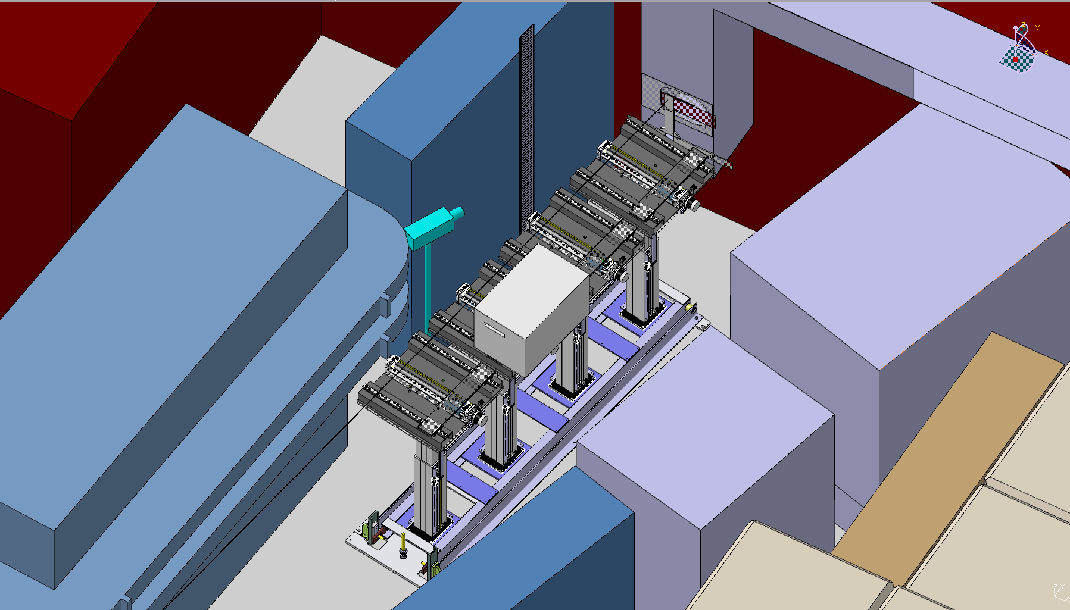
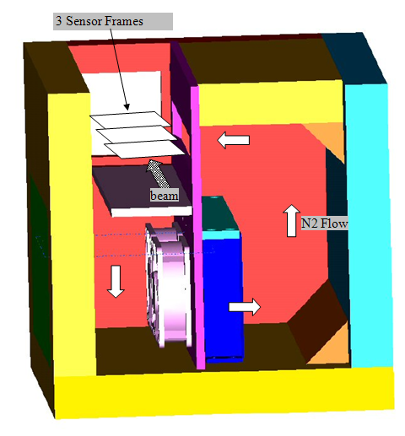
Improvements to the current PS facility
Tables for complex irradiations (M.Glaser)
Used for:
Integrated system (detectors and electronics)
Samples irradiated at low temperature < -10 ºC
Samples bigger than 10 x 10 cm²
Timescale:
IRRAD-7 reserved by Liverpool University , August, ATLAS Upgrade
IRRAD-3 is currently used by CPPM Marseille and Ohio Univ.
IRRAD-5 & IRRAD-9: Feb’ 2010

Slide 7
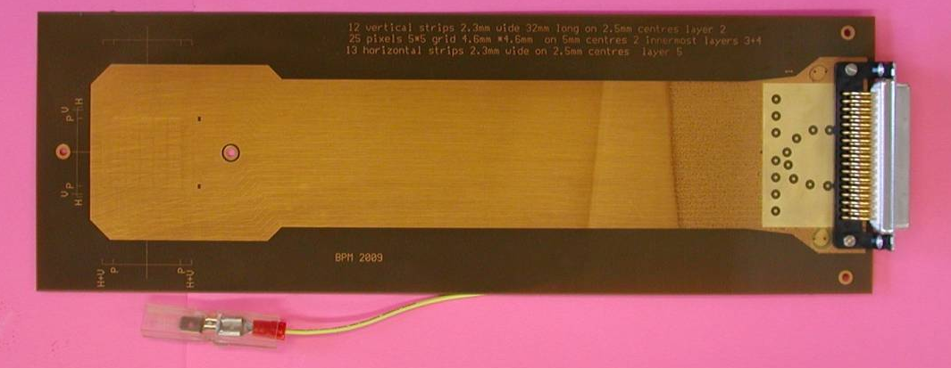
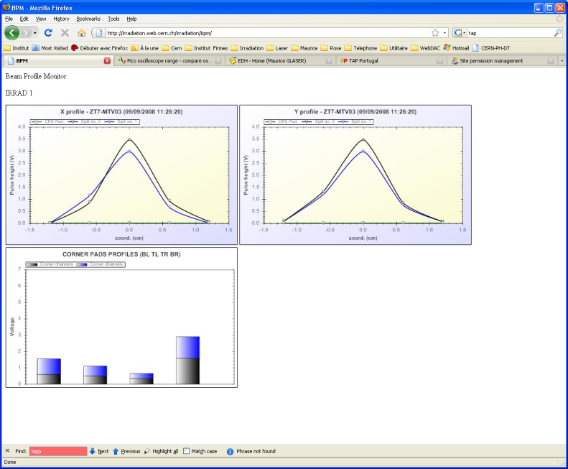
Improvements to the current PS facility
Rate x 2 (M.Glaser)
Beam Profiler Monitor - 2008 (16 channels)
Beam Profile Monitor 2009
Used to set up the irradiation beam line information for users
It will be installed in each box as a telescope to perform better alignment: smaller beam size = higher flux
Currently working on the installation a 50 channels BPM (5 x 5 pixels on the center ,13 horizontal strips, 12 vertical strips). To be installed in August’09

Slide 8
GIF++ Proposal
Collected User requirements via the Questionnaire and discussions with ATLAS & CMS (Feb-August 08):
  GIF++ User requirements Doc
  http://cern.ch/WP7/Documents/20080919_Specs_GIF++_V2.pdf
GIF++ Proposal prepared by EN Dept. and discussed with Users (April 09):
  GIF++ Technical Specifications
  http://cern.ch/WP7/Documents/GIF++TechnicalSpecs_DRAFT.pdf
Next: Release Final Design Proposal by EN and PH
- area, source, operation model, budget agreements
  PENDING on final meeting with users to be organized by Rembser

Slide 9
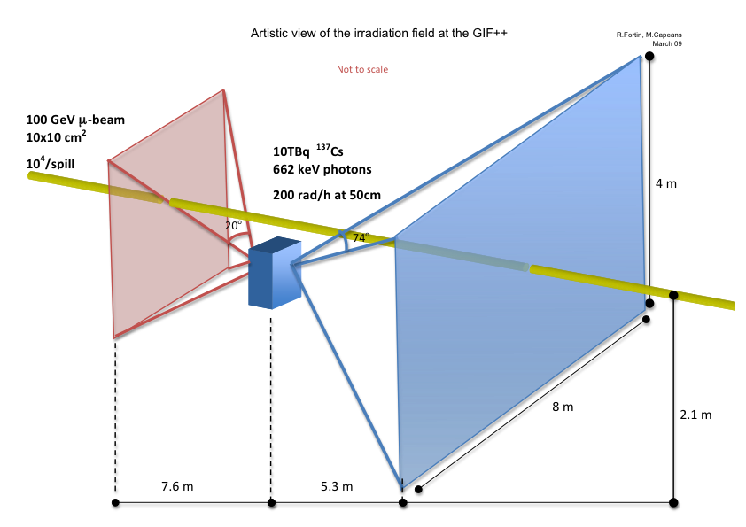
GIF++ Proposal
Irradiation Field
Muon beam:
  100 GeV covering an area of about 10 x 10 cm² for 10⁴ particles/spill
  H4 beam line in the EHN1 (CERN Building 887) area of the SPS
  6 weeks/year, on request to PS/SPS Physics Coordinator
Source:
  ¹³⁷Cesium source (662 keV photons), 30 y half-life
  ~10 TBq providing up to 2 Gy/h at a distance of 50 cm
  Shifted 50 cm wrt to Muon beam, 1.5 height
  2 Back to Back beams

Slide 10
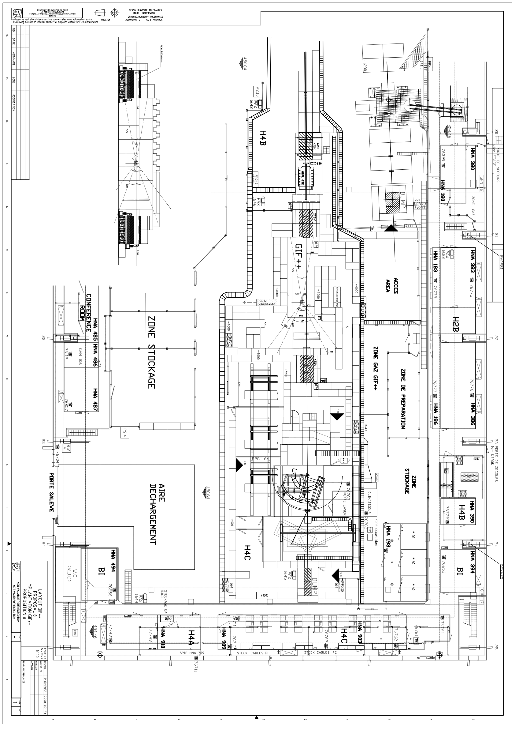
GIF++ Proposal
Area
GIF++ barracks
Preparation area
Gas area
CMS area
GIF++ bunker
Track Uploading
Crane access

Slide 11
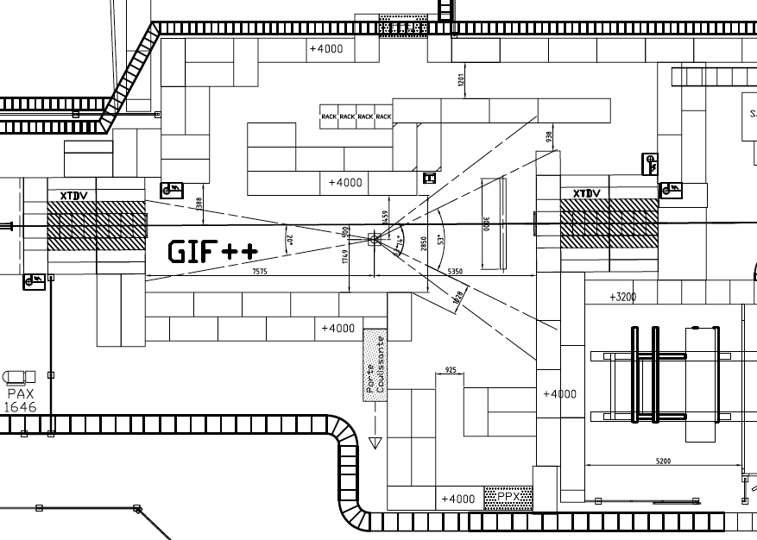
GIF++ Proposal
Bunker
μ beam
¹³⁷Cs

Slide 12
GIF++ Timescale
Evaluation of possible scenarios and Design Proposals: June – September 08 ✔
Preparation Technical Design Proposal (PH and EN Dept): September 08 – April 09 ✔
Design of Final Infrastructure (not related to beam): September 08 – February 09 ✔
Approval of Technical Specifications and Budget (PH&EN): May 09 >>>>>> DELAY 4-6 months wrt to plan, End of Summer?
Procurement and construction phase: Till December 09?
Infrastructure commissioning: January 10 – May 10
Target date ‘Ready for users’: May 10
Next Urgent Steps:
Case studies with users
Refine specs for radiator/source + Tender
Clear formally safety issues
Freeze the infrastructure needs
Get agreed contribution from users

Slide 13
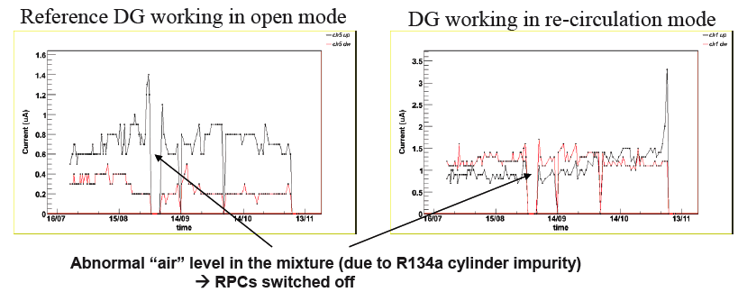
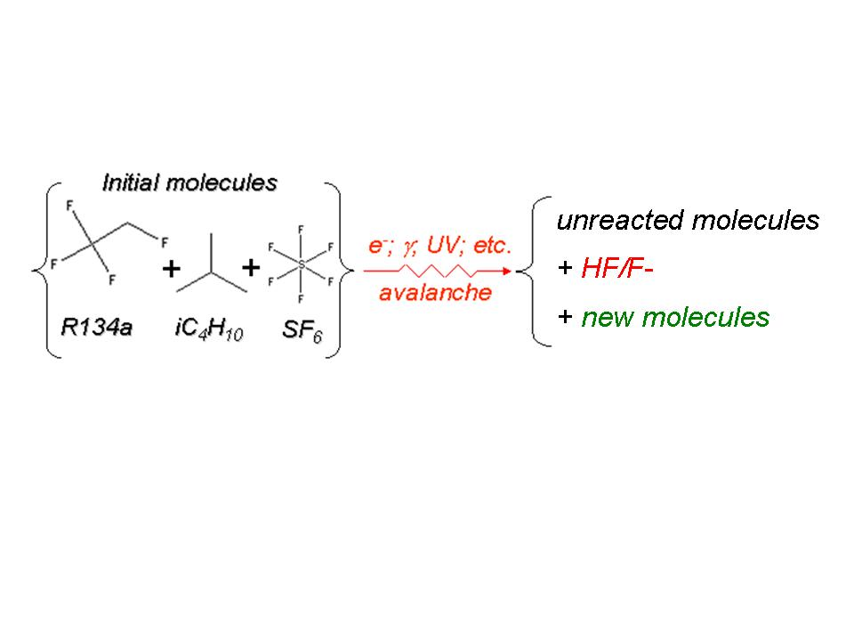
Activity 2: Filtering techniques for RPCs at LHC
Ex: ATLAS RPCs at the GIF have been tested for 5 LHC-equivalent years in open loop, <2 in closed-loop
High-currents Effect has been reproduced at the ISR several times, and there is clear correlation with closed-loop operation and/or gas quality
Objectives of this R&D activity:
  Understanding RPC-irradiated gas mixture: concentration of impurities, Identification of harmful impurities
  Systematic understanding of purifier agents for the LHC closed-loop gas systems: filters capacity, efficiency, lifetime, Optimal combinations filter combination, etc
  Final optimization of LHC closed-loop gas systems operation
PH-DT leads the activity: M.Capeans (10%) , R.Guida (50%), I.Glushkov (70%), F.Hahn (5%)
ATLAS and CMS RPC communities (RPC Task Force members)
Collaboration with CERN TE-VSC (Chemical analysis, consulting)
Soon, ILC RPCs (HCAL Glass RPC)

Slide 14
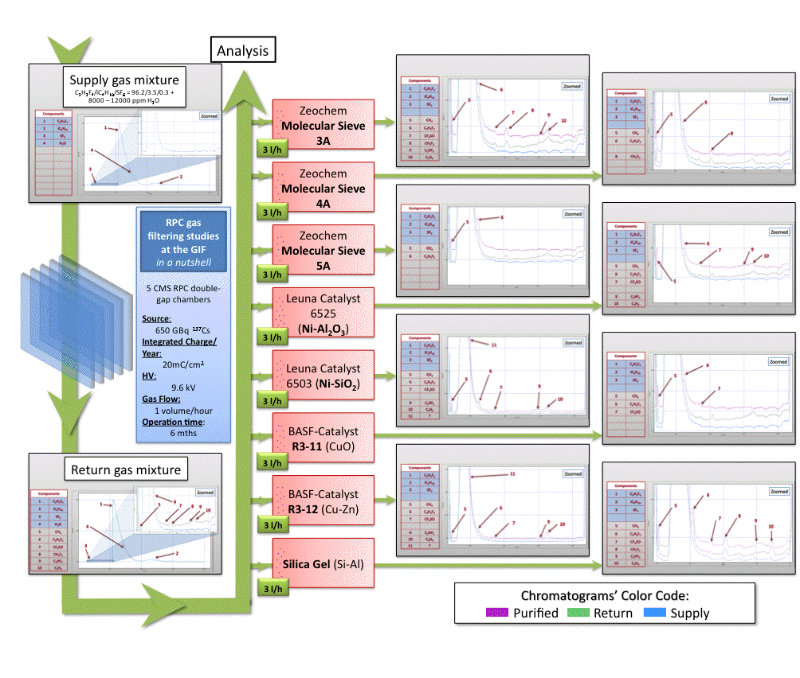
LHC
Selected
LHC
LHC
Selected
Selected
LHC
Selected
LHC

Slide 15
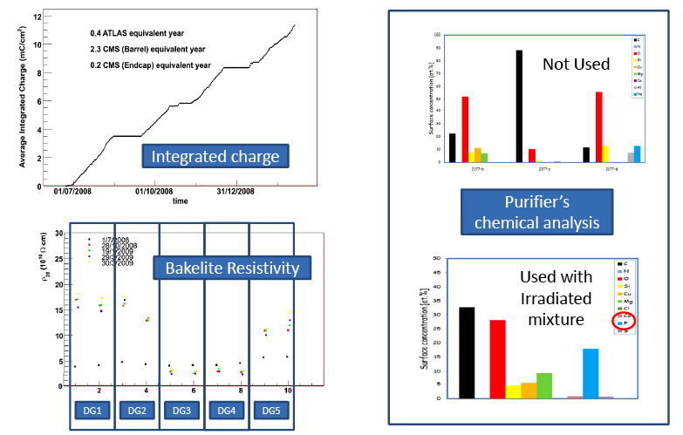
Activity 2: Filtering techniques for RPCs at LHC
Next steps:
Long-term test of RPC operated in closed-loop with the selected combination of absorbers (> 5 LHC equivalent years)
Study the long-term performance/efficiency of absorbers
Set-up has been significantly modified to host simultaneously CMS, LHC, ILC tests and our studies
Studies of RPC Performance
Chemical analysis of purifiers used at the GIF (seen lots of radiation), in ATLAS and CMS (seen lots of gas and regenerations, etc)

Slide 16
Activity 3: Materials DataBase
Objectives: Extend the available knowledge on materials for detectors and gas systems developed during the R&D LHC detector phases and, in collaboration with all LHC detector groups, collect and classify the available data in the best possible way.
Collaborators: M.Capeans (10%), S.Konovalov (30%), I.Glushkov (30%)
DB will be extended to:
    Structural materials (P.Petagna, M.Tavlet)
    Cooling systems components (M.Battistin, EN-CV)

Slide 17
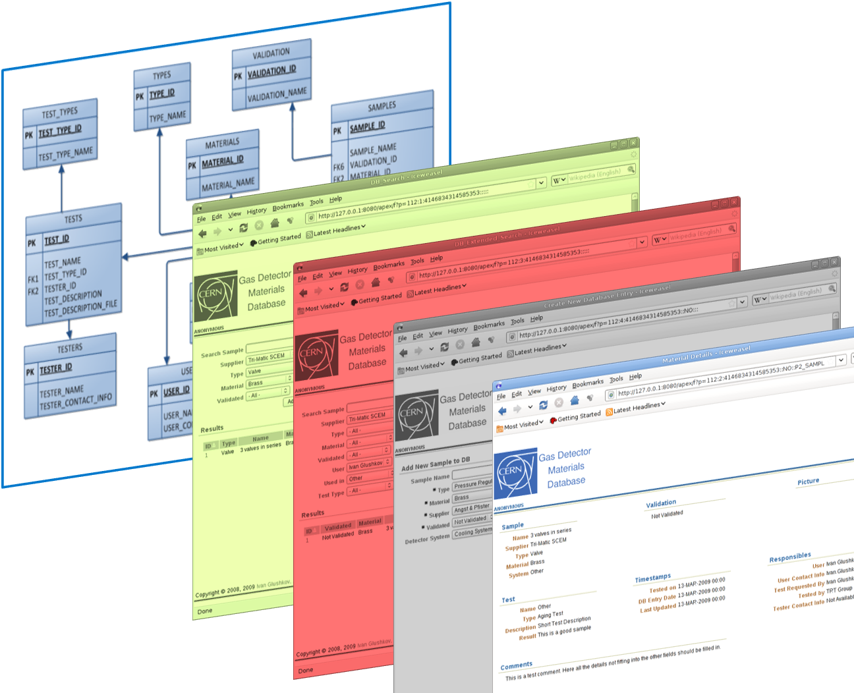
Materials Database
..we use..
Oracle 10g Express Edition
Oracle Application Express
HTML/JavaScript
http://cern.ch/materials/
DB design
& normalization
Search
Advanced Search
Adding new Material
QUERING Detailed MATERIAL record

Slide 18
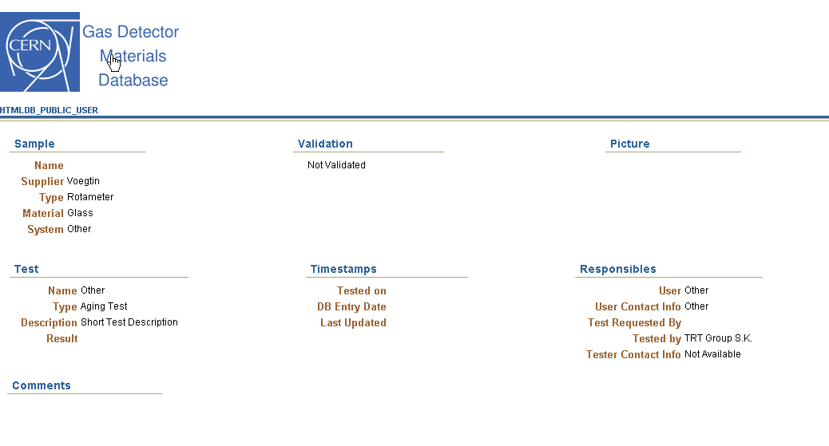
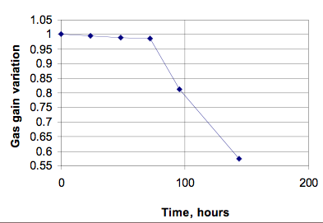
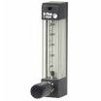
Stored Information
Detector Aging Test
Electron Microscope SEM/EDX analysis
Infrared Analysis
Outgassing Test (GC/MS) Outgassing Test (TML/CVCM)
Radiation hardness (gamma)
Radiation hardness (mixed field)
Radiation hardness (neutron)
Radiation Hardness (proton)
X-ray Photoelectron Spectroscopy (XPS)

Slide 19
Materials Database
Working on:
  pdf and Picture upload, material datasheets…
  Making the DB public (move DB in CERN apex servers)
  Enabling registration of special users to ‘Add Samples’
  Security issues
Target date for 1st release: end of summer?
Currently this is a side activity for Mar and Ivan. Would need more people involved to progress adequately.

Slide 20
WP7 Requested Budget for 2009
150 KCHF
It covers the 3 activities:
  33% go to investments in GIF/GIF++
  33% to Gas Filtering Studies (Consumables, of which Gas ~ 25%)
It does not include the work for the GIF++ area (PH, EN Depts)

Slide 21
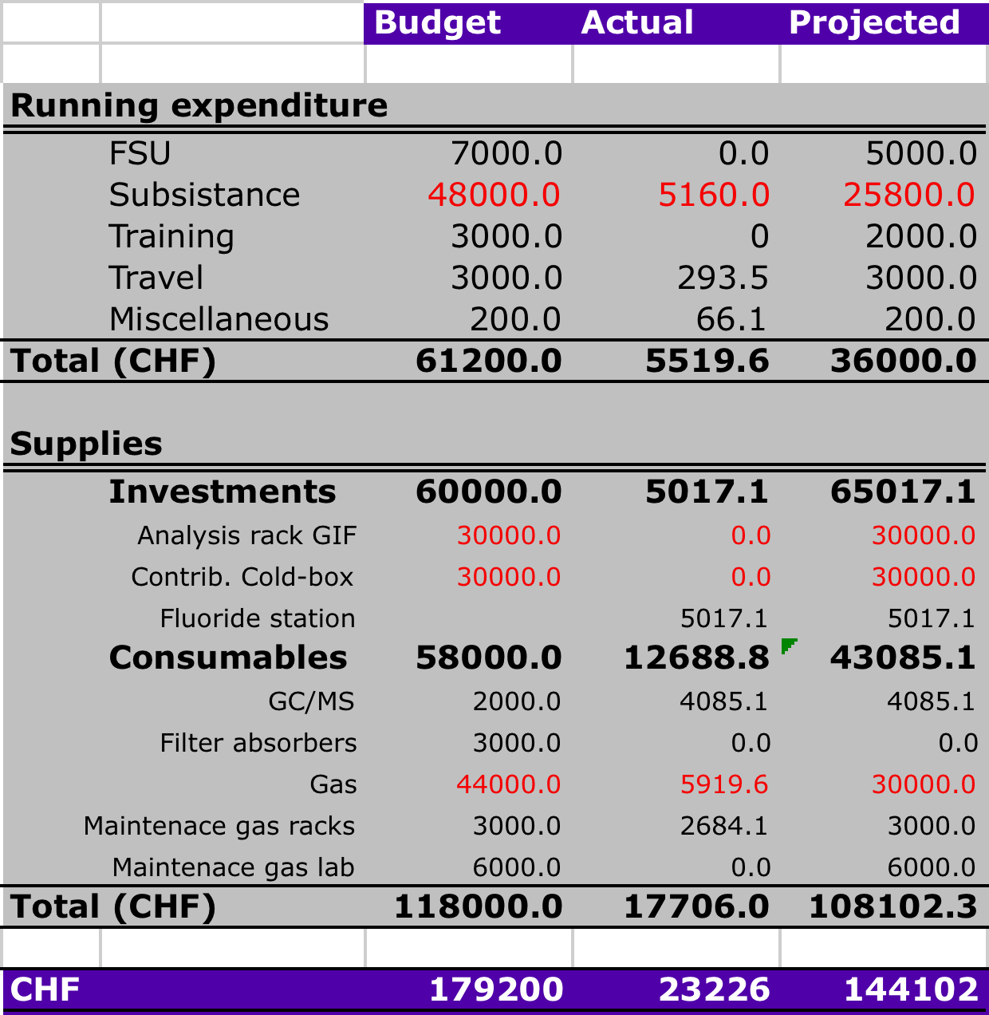
WP7 Expenditures 2009

Slide 22
Personnel
Need a new person (Autumn fellow?) to get involved in GIF++: physicist following up construction, setting up and commissioning the infrastructure
Need some serious help for the DB

Slide 23
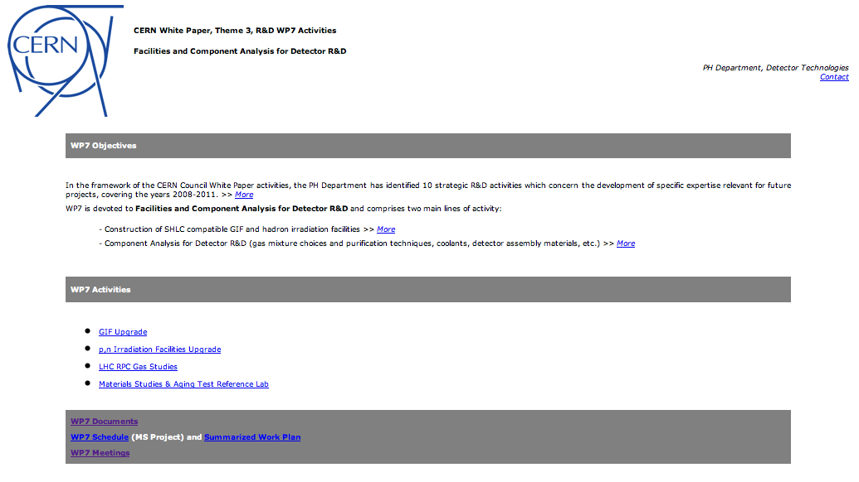
  http::/cern.ch/WP7

