Slide 1
Instrumentation in HEP
EIROFORUM School of Instrumentation
June 20 2017
Werner Riegler, CERN, werner.riegler@cern.ch

Slide 2
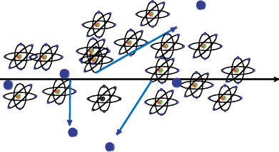
Creation of the Signal
Charged particles traversing matter leave excited atoms, electron-ion pairs (gases) or electrons-hole pairs (solids) behind.
Excitation:
The photons emitted by the excited atoms in transparent materials can be detected with photon detectors like photomultipliers or semiconductor photon detectors.
Ionization:
By applying an electric field in the detector volume, the ionization electrons and ions are moving, which induces signals on metal electrodes. These signals are then read out by appropriate readout electronics.

Slide 3
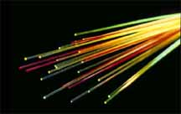
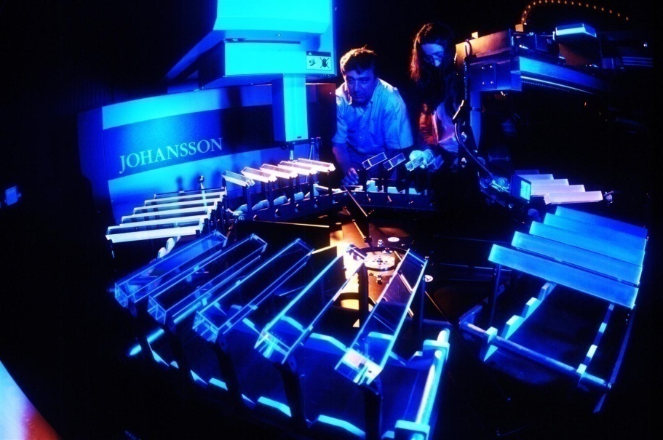
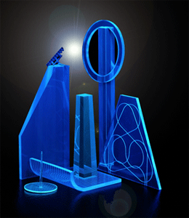
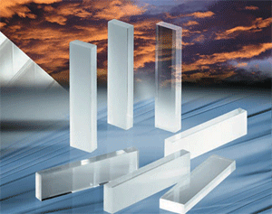
Detectors based on registration of excited Atoms → Scintillators
Scintillator Detectors

Slide 4
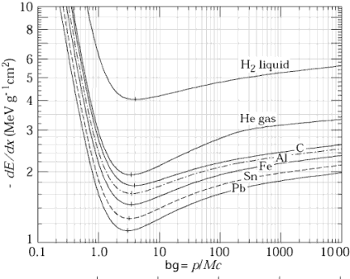
Detectors based on Registration of excited Atoms → Scintillators
Emission of photons of by excited Atoms, typically UV to visible light.
  Observed in Noble Gases (even liquid !)
  b) Inorganic Crystals
  Substances with largest light yield. Used for precision measurement of energetic Photons. Used in Nuclear Medicine.
  c) Polyzyclic Hydrocarbons (Naphtalen, Anthrazen, organic Scintillators)
  Most important category. Large scale industrial production, mechanically and chemically quite robust. Characteristic are one or two decay times of the light emission.
Typical light yield of scintillators:
Energy (visible photons) ≈ few % of the total energy Loss.
z.B. 1cm plastic scintillator, ρ ≈ 1, dE/dx=1.5 MeV, ~15 keV in photons; i.e. ~ 15 000 photons produced.
Scintillator Detectors

Slide 5
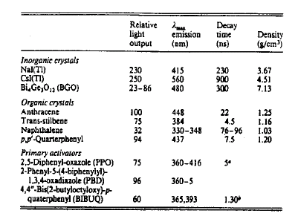
Detectors based on Registration of excited Atoms → Scintillators
Organic (‘Plastic’) Scintillators
Inorganic (Crystal) Scintillators
Low Light Yield Fast: 1-3ns
Large Light Yield Slow: few 100ns
LHC bunchcrossing 25ns LEP bunchcrossing 25μs
Scintillator Detectors

Slide 6
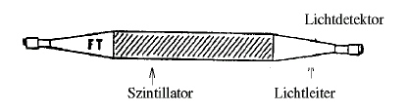
Scintillators
Photons are being reflected towards the ends of the scintillator.
A light guide brings the photons to the Photomultipliers where the photons are converted to an electrical signal.
Scintillator
Light Guide
Photon Detector
By segmentation one can arrive at spatial resolution.
Because of the excellent timing properties (<1ns) the arrival time, or time of flight, can be measured very accurately → Trigger, Time of Flight.
Scintillator Detectors

Slide 7
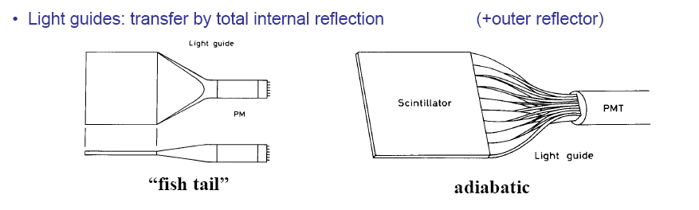
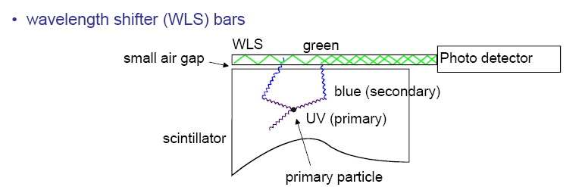
Typical Geometries:
UV light enters the WLS material
Light is transformed into longer wavelength
Total internal reflection inside the WLS material
‘transport’ of the light to the photo detector
From C. Joram
Scintillator Detectors

Slide 8
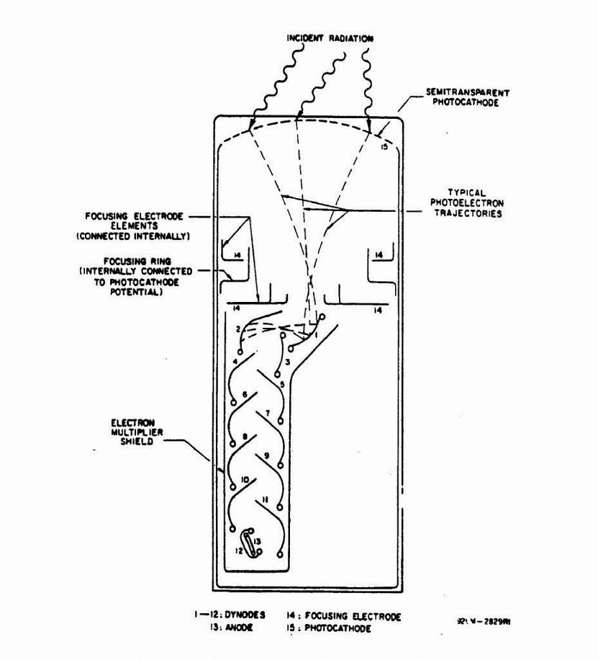
The frequent use of Scintillators is due to:
  Well established and cheap techniques to register Photons → Photomultipliers and the fast response time → 1 to 100ns
Semitransparent photocathode
γ
Schematic of a Photomultiplier:
Typical Gains (as a function of the applied voltage): 10⁸ to 10¹⁰
Typical efficiency for photon detection:
< 20%
For very good PMs: registration of single photons possible.
Example: 10 primary Elektrons, Gain 10⁷→ 10⁸ electrons in the end in T ≈ 10ns. I=Q/T = 10⁸*1.603*10⁻¹⁹/10*10⁻⁹= 1.6mA.
Across a 50 Ω Resistor → U=R*I= 80mV.
glass
PC
e⁻
Scintillator Detectors

Slide 9
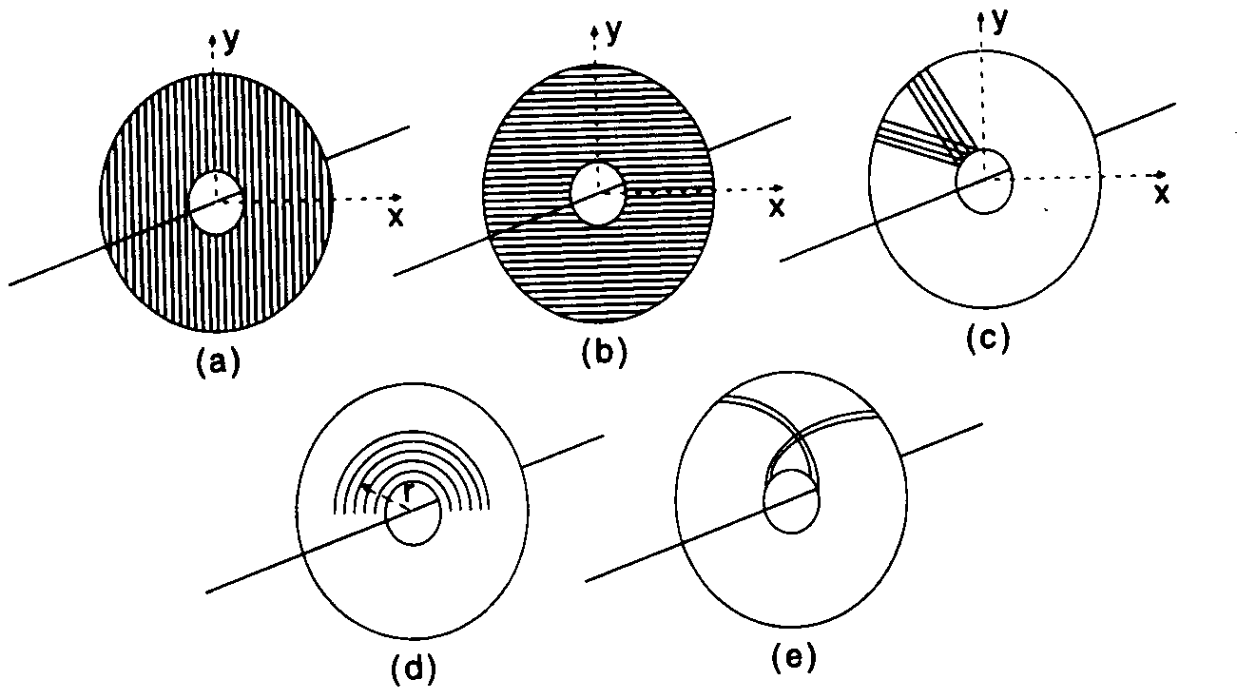
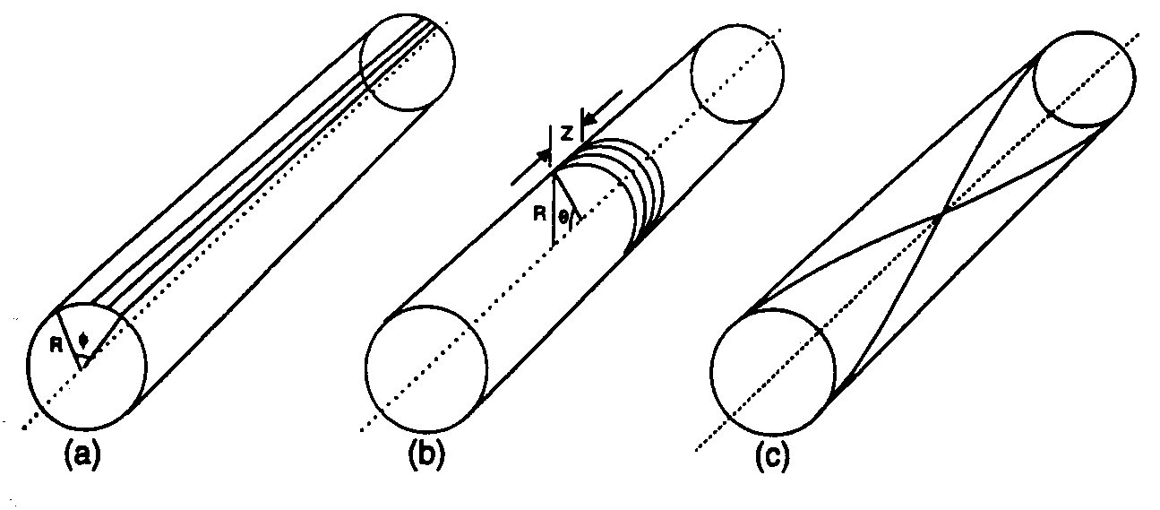
Fiber Tracking
Light transport by total internal reflection
Planar geometries
(end cap)
Circular geometries
(barrel)
High geometrical flexibility
Fine granularity
Low mass
Fast response (ns)
(R.C. Ruchti, Annu. Rev. Nucl. Sci. 1996, 46,281)
From C. Joram
Scintillator Detectors

Slide 10
Detectors based on Registration of Ionization: Tracking in Gas and Solid State Detectors
Charged particles leave a trail of ions (and excited atoms) along their path: Electron-Ion pairs in gases and liquids, electron hole pairs in solids.
The produced charges can be registered → Position measurement → Tracking Detectors.
Cloud Chamber: Charges create drops → photography.
Bubble Chamber: Charges create bubbles → photography.
Emulsion: Charges ‘blacked’ the film.
Gas and Solid State Detectors: Moving Charges (electric fields) induce electronic signals on metallic electrons that can be read by dedicated electronics.
In solid state detectors the charge created by the incoming particle is sufficient.
In gas detectors (e.g. wire chamber) the charges are internally multiplied in order to provide a measurable signal.
Tracking Detectors

Slide 11
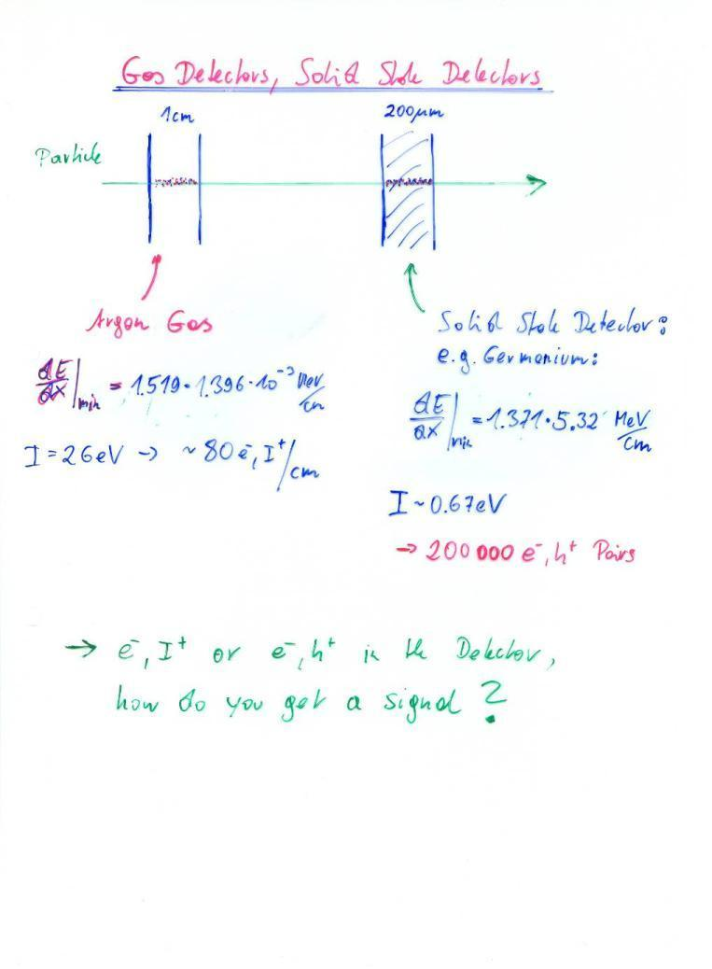
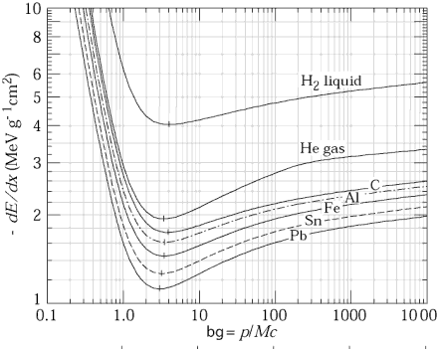
The induced signals are readout out by dedicated electronics.
The noise of an amplifier determines whether the signal can be registered. Signal/Noise >>1
The noise is characterized by the ‘Equivalent Noise Charge (ENC)’ = Charge signal at the input that produced an output signal equal to the noise.
ENC of very good amplifiers can be as low as 50e-, typical numbers are ~ 1000e-.
In order to register a signal, the registered charge must be q >> ENC i.e. typically q>>1000e-.
Gas Detector: q=80e- /cm → too small.
Solid state detectors have 1000x more density and factor 5-10 less ionization energy.
Primary charge is 10⁴-10⁵ times larger than is gases.
Gas detectors need internal amplification in order to be sensitive to single particle tracks.
Without internal amplification they can only be used for a large number of particles that arrive at the same time (ionization chamber).
I=2.9eV
2.5 x 10⁶ e/h pairs/cm
1/ρ
ßγ

Slide 12



Principle of Signal Induction by Moving Charges
The electric field of the charge must be calculated with the boundary condition that the potential φ=0 at z=0.
For this specific geometry the method of images can be used. A point charge –q at distance –z₀ satisfies the boundary condition → electric field.
The resulting charge density is
σ(x,y) = ε₀ E_{z}(x,y)
∫σ(x,y)dxdy = -q
A point charge q at a distance z₀
Above a grounded metal plate ‘induces’ a surface charge.
The total induced charge on the surface is –q.
Different positions of the charge result in different charge distributions.
The total induced charge stays –q.
q
q
-q
-q
I=0

Slide 13


Principle of Signal Induction by Moving Charges
If we segment the grounded metal plate and if we ground the individual strips the surface charge density doesn’t change with respect to the continuous metal plate.
q
The charge induced on the individual strips is now depending on the position z₀ of the charge.
If the charge is moving there are currents flowing between the strips and ground.
→ The movement of the charge induces a current.
V
-q
-q
I₁(t) I₂(t) I₃(t) I₄(t)

Slide 14

Gas Detectors with internal Electron Multiplication
Principle: At sufficiently high electric fields (100kV/cm) the electrons gain energy in excess of the ionization energy → secondary ionzation etc. etc.
  dN = N α dx α…Townsend Coefficient
  N(x) = N₀ exp (αx) N/ N₀ = A (Amplification, Gas Gain)
  Avalanche in a homogeneous field:
  Problem: High field on electrode surface
  → breakdown
  In an inhomogeneous Field: α(E) → N(x) = N₀ exp [α(E(x’))dx’]
Ions
Electrons
E

Slide 15

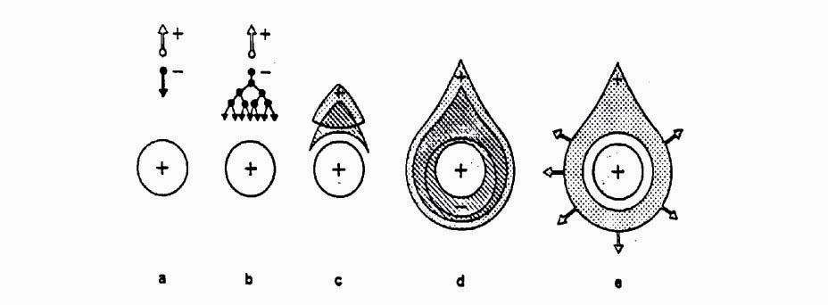
Wire Chamber: Electron Avalanche
Wire with radius (10-25μm) in a tube of radius b (1-3cm):
Electric field close to a thin wire (100-300kV/cm). E.g. V₀=1000V, a=10μm, b=10mm, E(a)=150kV/cm
Electric field is sufficient to accelerate electrons to energies which are sufficient to produce secondary ionization → electron avalanche → signal.
b
b
a
Wire

Slide 16
Wire Chamber: Electron Avalanches on the Wire
Proportional region: A≈10³-10⁴
Semi proportional region: A≈10⁴-10⁵
(space charge effect)
Saturation region: A >10⁶
Independent the number of primary electrons.
Streamer region: A >10⁷
Avalanche along the particle track.
Limited Geiger region:
Avalanche propagated by UV photons.
Geiger region: A≈10⁹
Avalanche along the entire wire.
LHC
1970ies
1950ies

Slide 17
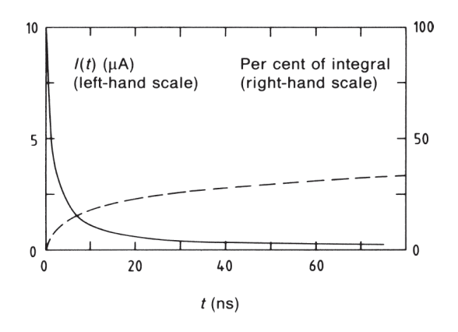

Wire Chamber: Signals from Electron Avalanches
The electron avalanche happens very close to the wire. First multiplication only around R =2x wire radius. Electrons are moving to the wire surface very quickly (<<1ns). Ions are difting towards the tube wall (typically several 100μs. )
The signal is characterized by a very fast ‘spike’ from the electrons and a long Ion tail.
The total charge induced by the electrons, i.e. the charge of the current spike due to the short electron movement amounts to 1-2% of the total induced charge.

Slide 18
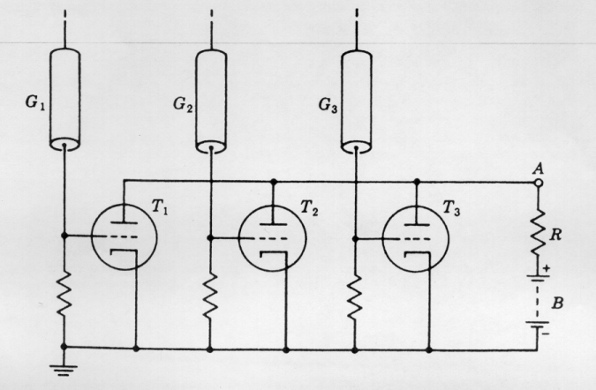
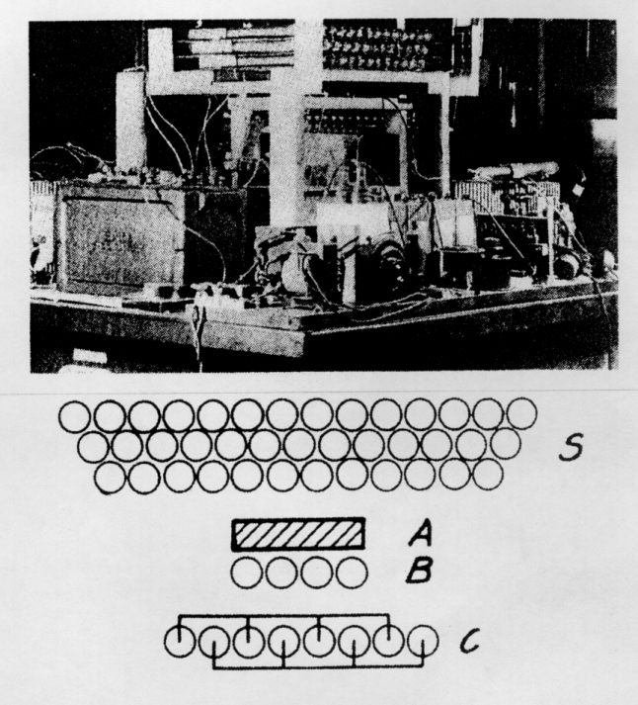
Detectors with Electron Multiplication
Rossi 1930: Coincidence circuit for n tubes
Cosmic ray telescope 1934
Geiger mode, large deadtime
Position resolution is determined by the size of the tubes.
Signal was directly fed into an electronic tube.

Slide 19
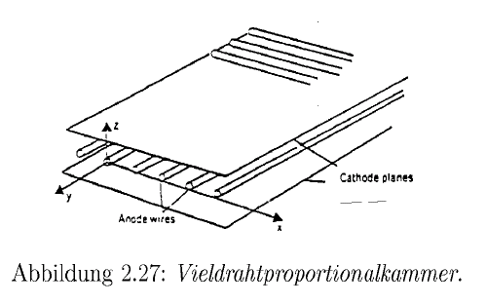
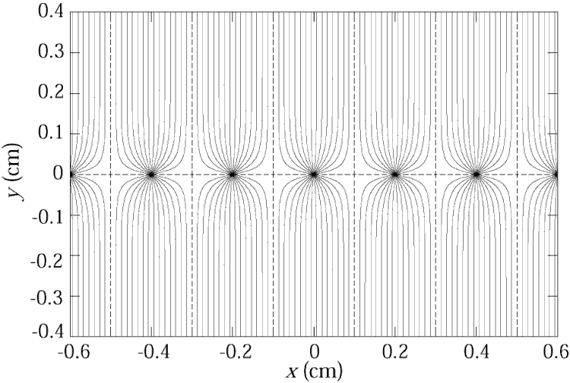
Multi Wire Proportional Chamber
Classic geometry (Crossection), Charpak 1968 :
One plane of thin sense wires is placed between two parallel plates.
Typical dimensions:
Wire distance 2-5mm, distance between cathode planes ~10mm.
Electrons (v≈5cm/μs) are collected within ≈ 100ns. The ion tail can be eliminated by electronics filters → pulses of <100ns length.
For 10% occupancy → every μs one pulse
→ 1MHz/wire rate capabiliy !
→ Compare to Bubble Chamber with 10 Hz !

Slide 20
Multi Wire Proportional Chamber
In order to eliminate the left/right ambiguities: Shift two wire chambers by half the wire pitch.
For second coordinate:
Another chamber at 90⁰ relative rotation
Signal propagation to the two ends of the wire.
Pulse height measurement on both ends of the wire. Because of resisitvity of the wire, both ends see different charge.
Segmenting of the cathode into strips or pads:
The movement of the charges induces a signal on the wire AND on the cathode. By segmentation of the cathode plane and charge interpolation, resolutions of 50μm can be achieved.

Slide 21

Multi Wire Proportional Chamber
Cathode strip:
Width (1σ) of the charge distribution ≈ distance between Wires and cathode plane.
‘Center of gravity’ defines the particle trajectory.
Avalanche

Slide 22
Drift Chambers
Amplifier: t=T
E
Scintillator: t=0
In an alternating sequence of wires with different potentials one finds an electric field between the ‘sense wires’ and ‘field wires’.
The electrons are moving to the sense wires and produce an avalanche which induces a signal that is read out by electronics.
The time between the passage of the particle and the arrival of the electrons at the wire is measured.
The drift time T is a measure of the position of the particle !
By measuring the drift time, the wire distance can be increased (compared to the Multi Wire Proportional Chamber) → save electronics channels !

Slide 23
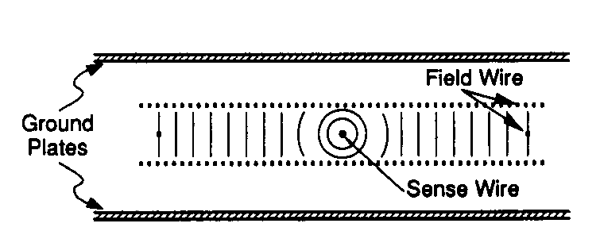
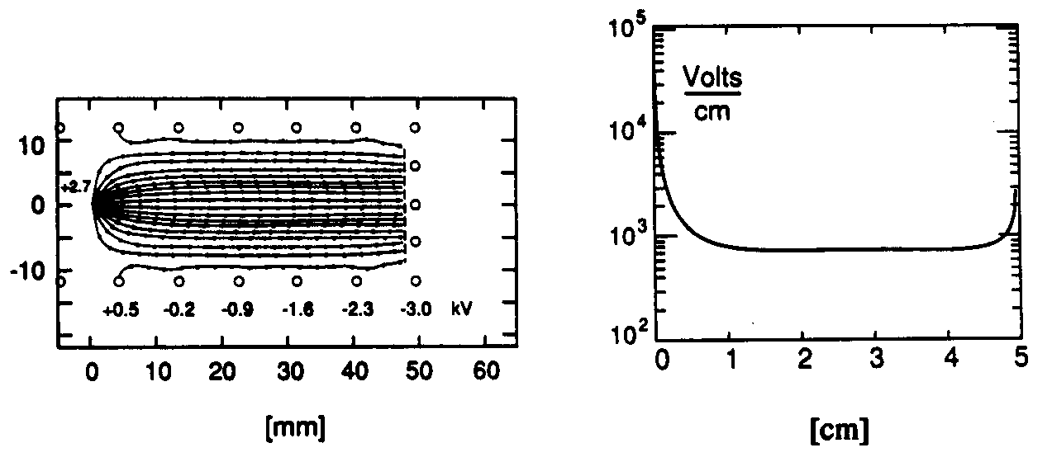
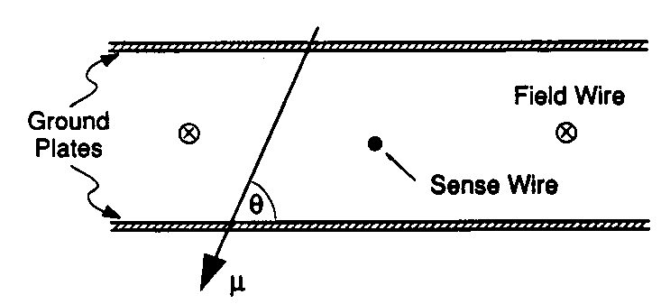
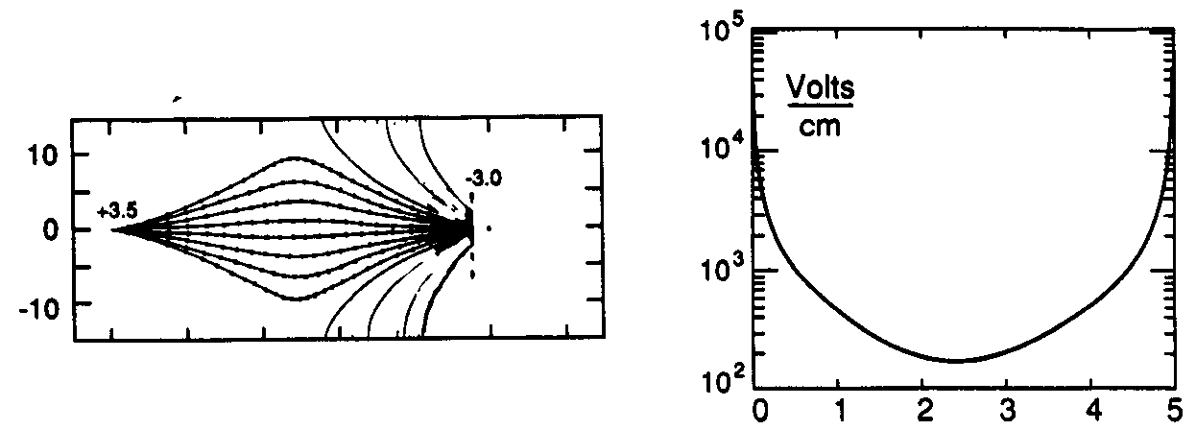
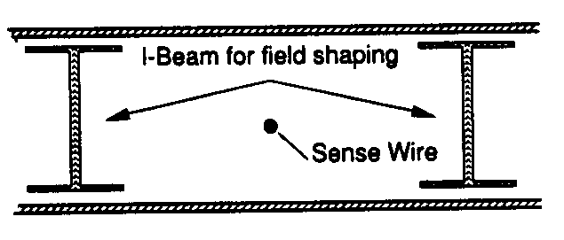
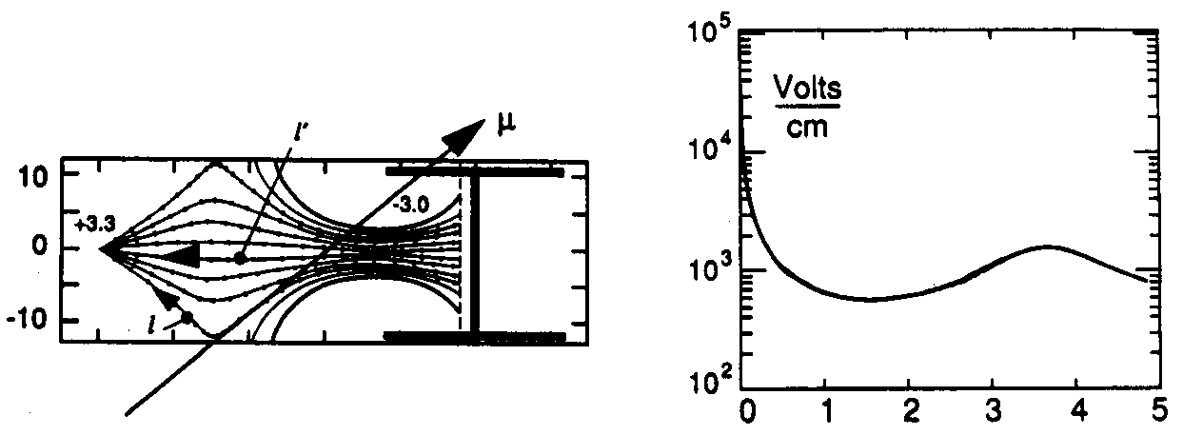
Drift Chambers, typical Geometries
Electric Field ≈ 1kV/cm
U.Becker Instr. of HEP, Vol#9, p516 World Scientific (1992) ed F.Sauli

Slide 24
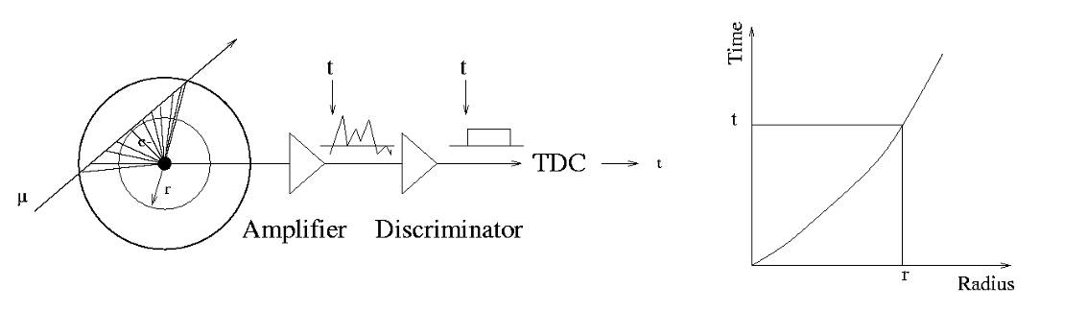
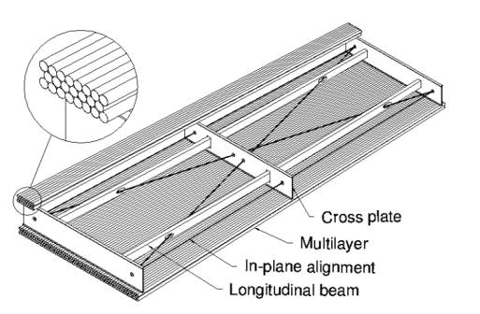
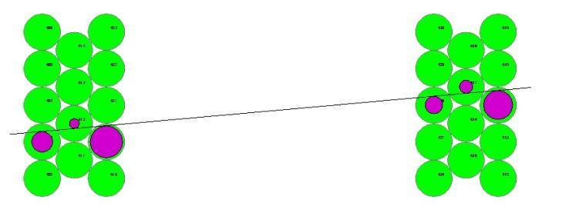
The Geiger Counter reloaded: Drift Tube
Primary electrons are drifting to the wire.
Electron avalanche at the wire.
The measured drift time is converted to a radius by a (calibrated) radius-time correlation.
Many of these circles define the particle track.
ATLAS MDT R(tube) =15mm
Calibrated Radius-Time correlation
ATLAS Muon Chambers
ATLAS MDTs, 80μm per tube

Slide 25

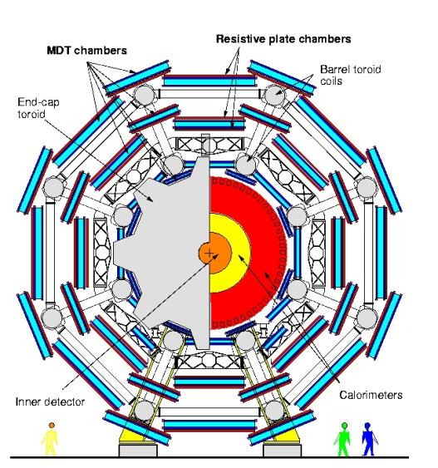
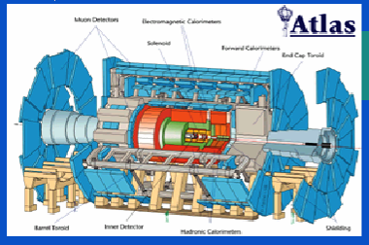
The Geiger counter reloaded: Drift Tube
Atlas Muon Spectrometer, 44m long, from r=5 to11m.
1200 Chambers
6 layers of 3cm tubes per chamber.
Length of the chambers 1-6m !
Position resolution: 80μm/tube, <50μm/chamber (3 bar)
Maximum drift time ≈700ns
Gas Ar/CO₂ 93/7

Slide 26
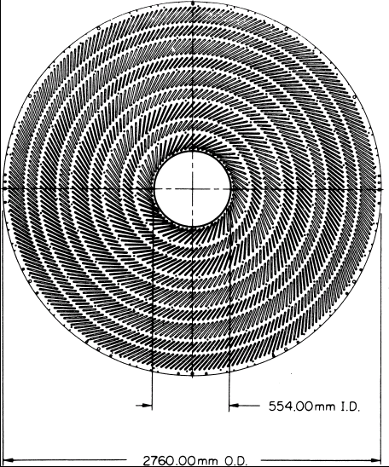
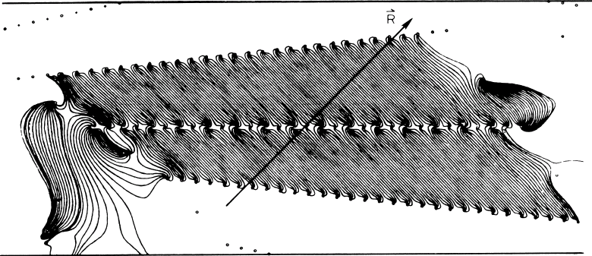
Large Drift Chambers
Central Tracking Chamber CDF Experiment.
660 drift cells tilted 45⁰ with respect to the particle track.
Drift cell

Slide 27
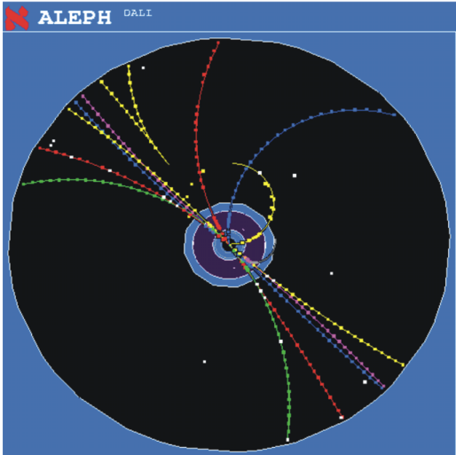
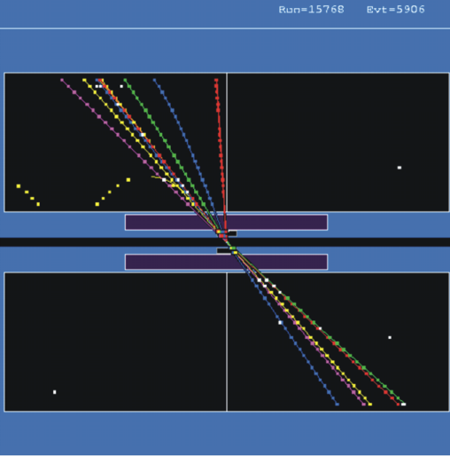
Time Projection Chamber (TPC):
Gas volume with parallel E and B Field.
B for momentum measurement. Positive effect: Diffusion is strongly reduced by E//B (up to a factor 5).
Drift Fields 100-400V/cm. Drift times 10-100 μs.
Distance up to 2.5m !
gas volume
B
drift
E
y
x
z
charged track
Wire Chamber to detect the tracks

Slide 28
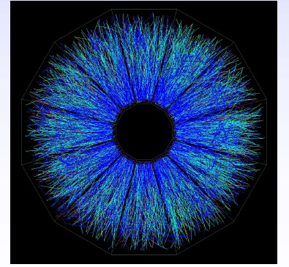
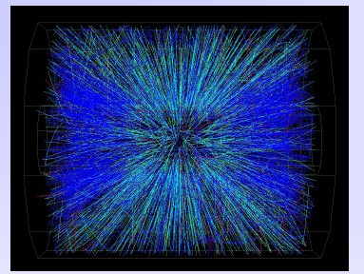
STAR TPC (BNL)
Event display of a Au Au collision at CM energy of 130 GeV/n.
Typically around 200 tracks per event.
Great advantage of a TPC: The only material that is in the way of the particles is gas → very low multiple scattering → very good momentum resolution down to low momenta !

Slide 29
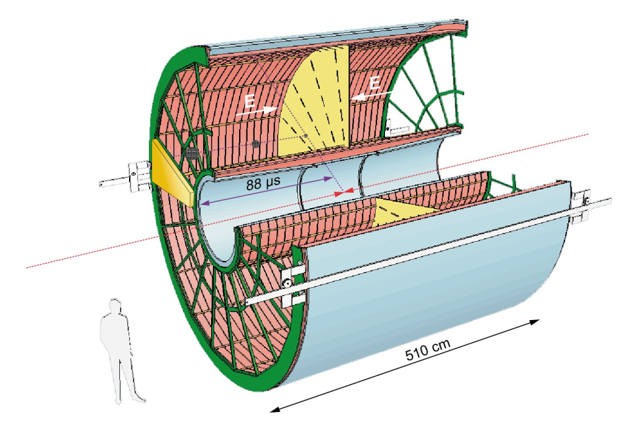
ALICE TPC: Detector Parameters
Gas Ne/ CO₂ 90/10%
Field 400V/cm
Gas gain >10⁴
Position resolution σ= 0.25mm
Diffusion: σ_{t}= 250μm
Pads inside: 4x7.5mm
Pads outside: 6x15mm
B-field: 0.5T

Slide 30
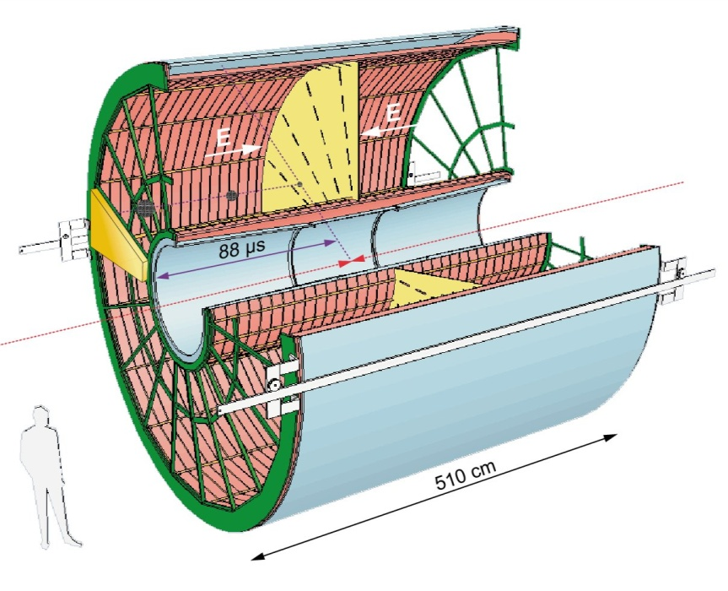
ALICE TPC: Construction Parameters
Largest TPC:
  Length 5m
  Diameter 5m
  Volume 88m³
  Detector area 32m²
  Channels ~570 000
High Voltage:
  Cathode -100kV
Material X₀
  Cylinder from composite materials from airplane industry (X₀= ~3%)

Slide 31
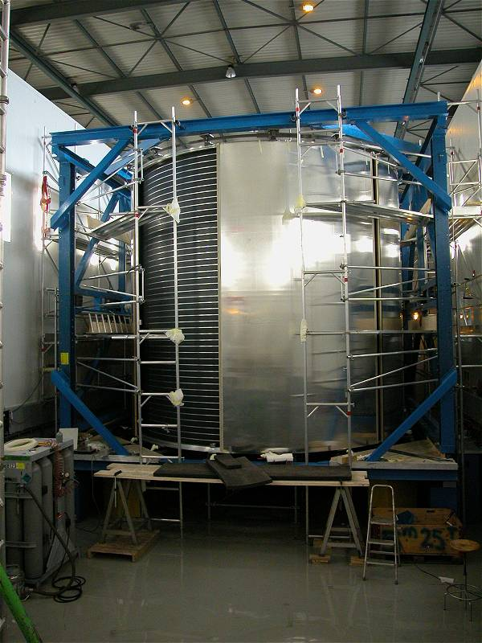
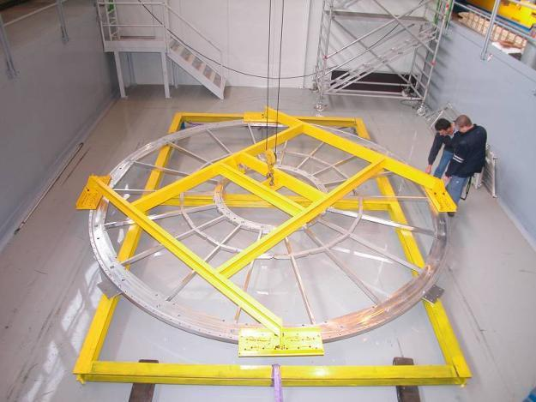
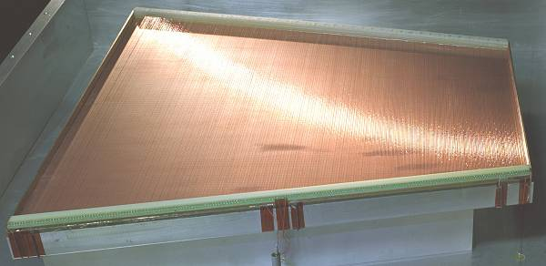
ALICE TPC: Pictures of the Construction
Precision in z: 250μm End plates 250μm
Wire chamber: 40μm

Slide 32
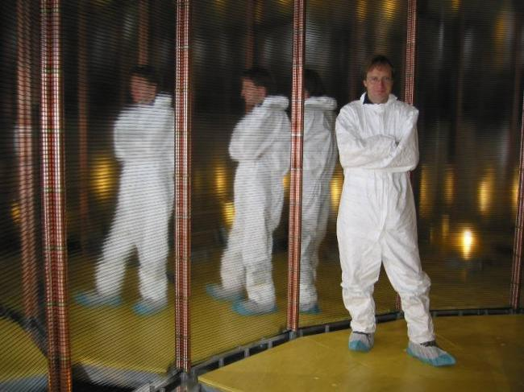
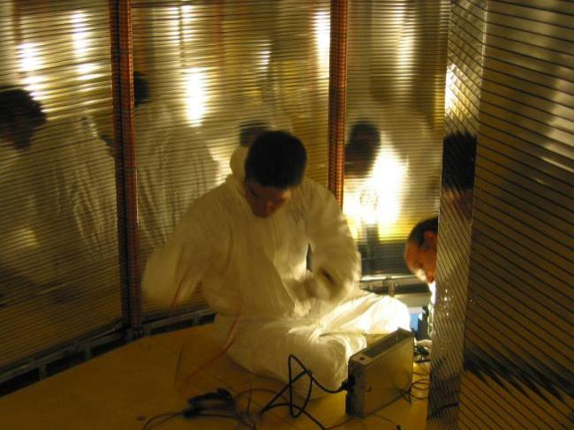
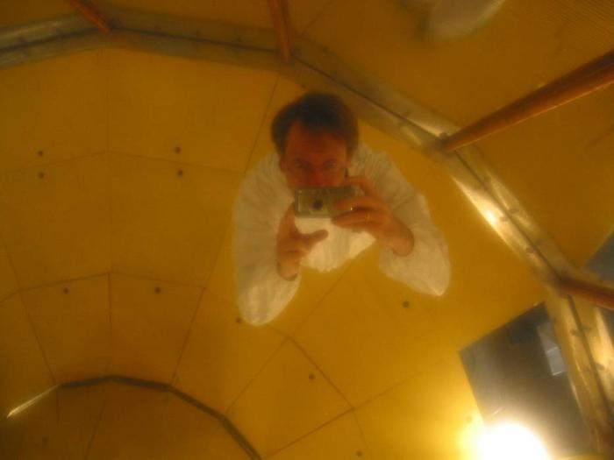
ALICE TPC Construction
My personal contribution:
A visit inside the TPC.

Slide 33
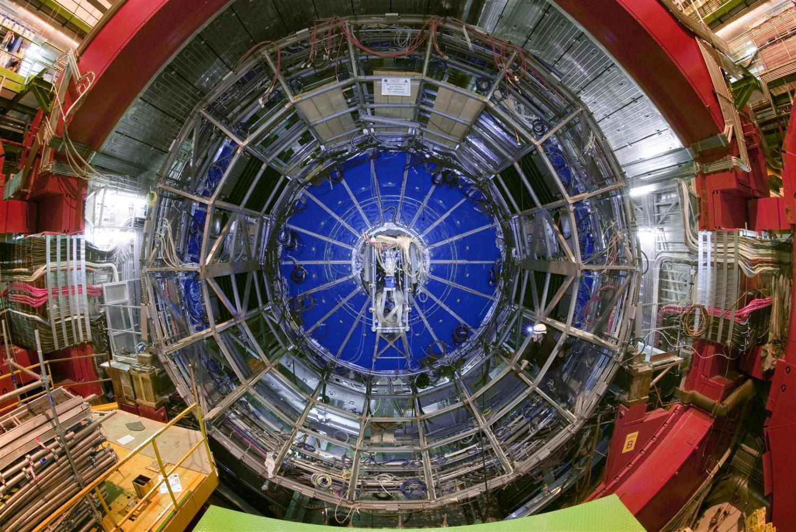
TPC installed in the ALICE Experiment

Slide 34
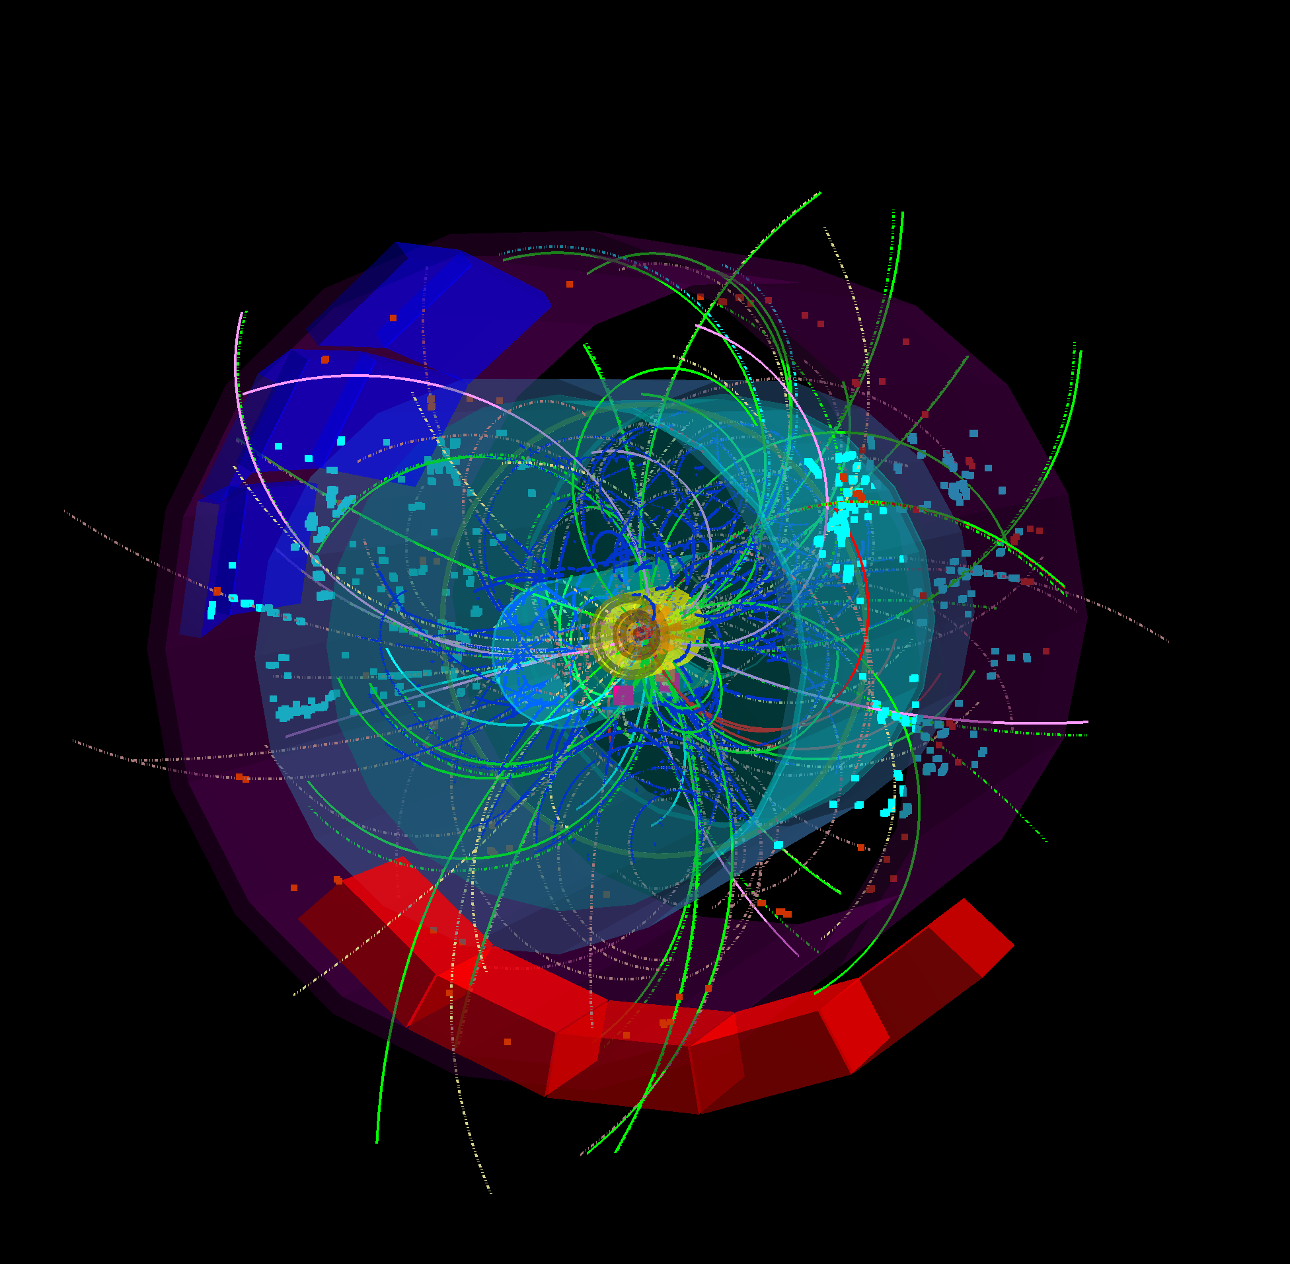
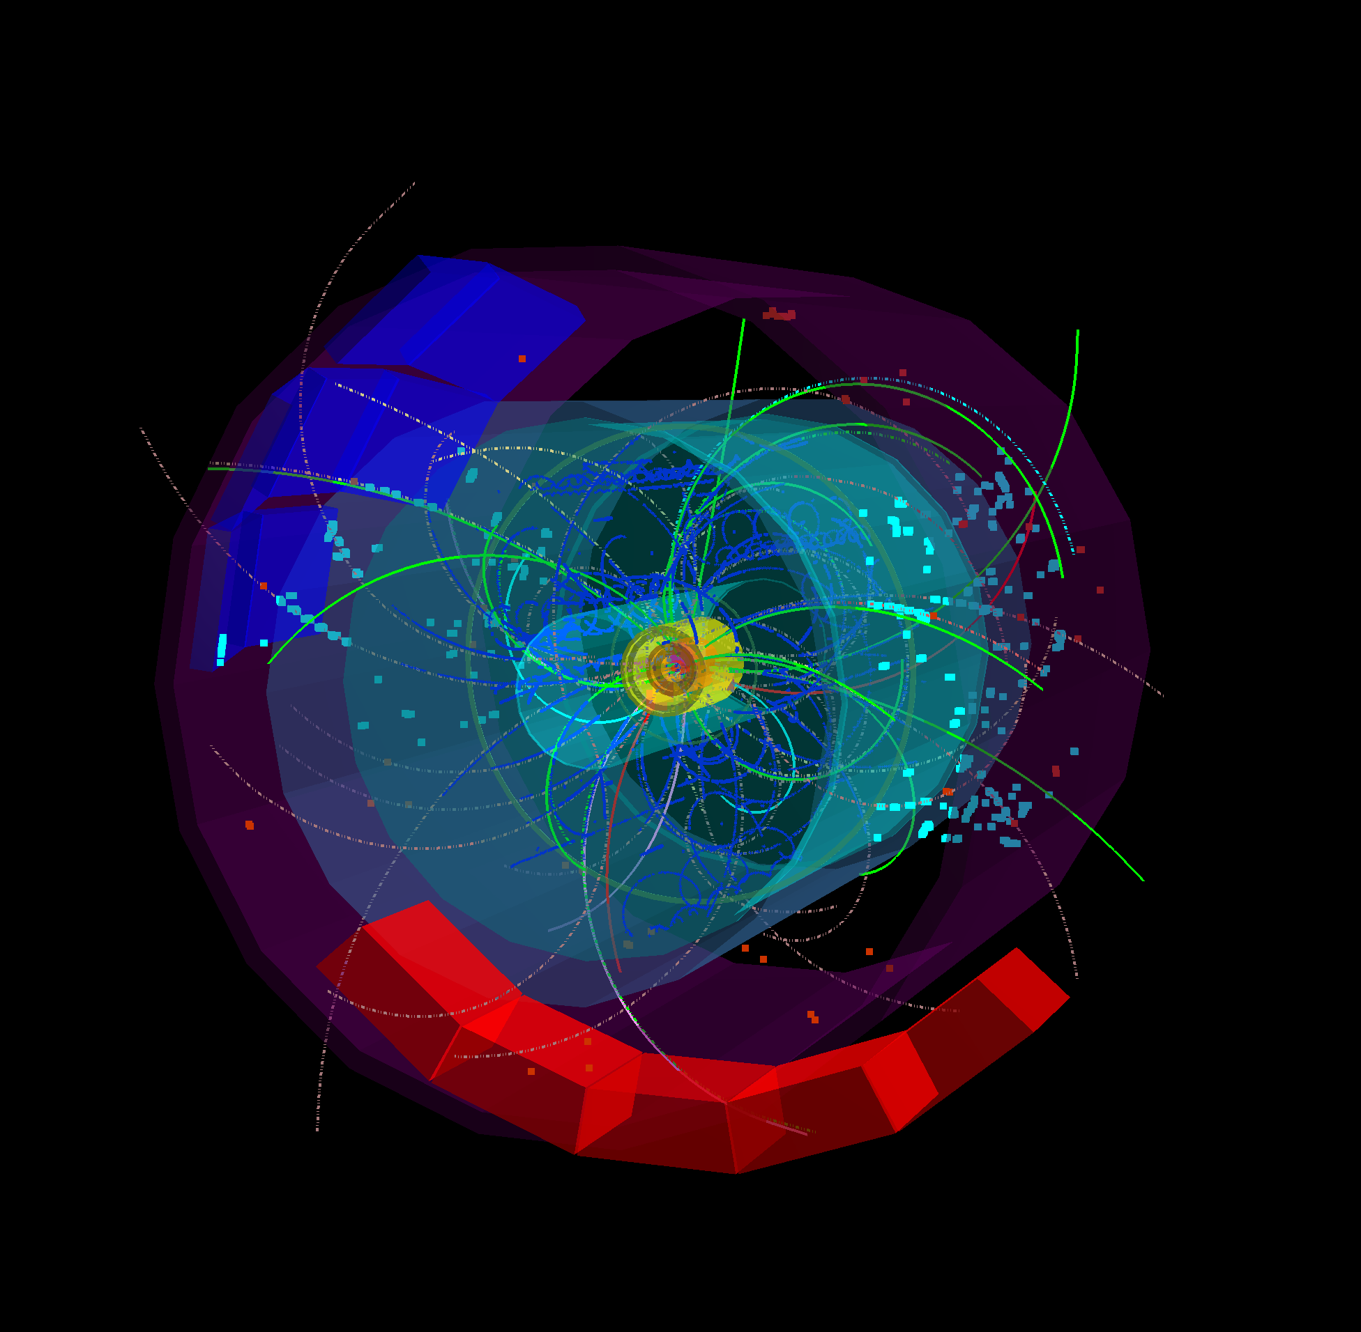
First 7 TeV p-p Collisions in the ALICE TPC in March 2010 !

Slide 35
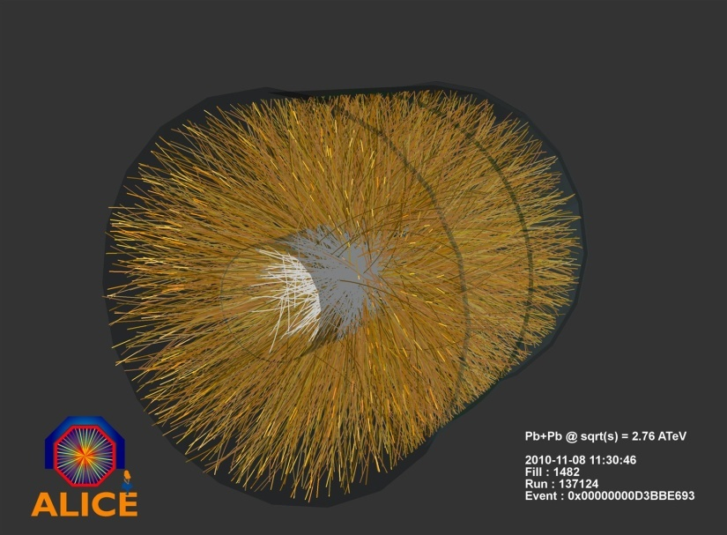
First Pb Pb Collisions in the ALICE TPC in Nov 2010 !

Slide 36




GEMs & MICROMEGAS
MICROMEGAS
Narrow gap (50-100 µm) PPC with thin cathode mesh
Insulating gap-restoring wires or pillars
GEM
Thin metal-coated polymer foils
70 µm holes at 140 mm pitch
Y. Giomataris et al, Nucl. Instr. and Meth. A376(1996)239
F. Sauli, Nucl. Instr. and Methods A386(1997)531

Slide 37
Summary on Gas Detectors
Wire chambers feature prominently at LHC. A decade of very extensive studies on gases and construction materials has lead to wire chambers that can track up to MHz/cm² of particles, accumulate up to 1-2C/cm of wire and 1-2 C/cm² of cathode area.
While silicon trackers currently outperform wire chambers close to the interaction regions, wire chambers are perfectly suited for the large detector areas at outer radii.
Large scale next generation experiments foresee wire chambers as large area tracking devices.
The Time Projection Chamber – if the rate allows it’s use – is unbeatable in terms of low material budget and channel economy. There is no reason for replacing a TPC with a silicon tracker.
Gas detectors can be simulated very accurately due to excellent simulation programs.
Novel gas detectors, the Micro Pattern Gas Detectors, have proven to work efficiently as high rate, low material budget trackers in the ‘regime’ between silicon trackers and large wire chambers.

Slide 38

Solid State Detectors
Gas Detectors
In gaseous detectors, a charged particle is liberating electrons from the atoms, which are freely bouncing between the gas atoms.
An applied electric field makes the electrons and ions move,
which induces signals on the metal readout electrodes.
For individual gas atoms, the electron energy levels are discrete.
Solid State Detectors
In solids (crystals), the electron energy levels are in ‘bands’.
Inner shell electrons, in the lower energy bands, are closely bound to the individual atoms and always stay with ‘their’ atoms.
In a crystal there are however energy bands that are still bound states of the crystal, but they belong to the entire crystal. Electrons in these bands and the holes in the lower band can freely move around the crystal, if an electric field is applied.

Slide 39
Solid State Detectors
Free Electron Energy
Unfilled Bands
Conduction Band
Band Gap
Valance Band
Conductor, Insulator, Semiconductor
In case the conduction band is filled the crystal is a conductor.
In case the conduction band is empty and ‘far away’ from
the valence band, the crystal is an insulator.
In case the conduction band is empty but the distance to the valence band is small, the crystal is a semiconductor.

Slide 40
Solid State Detectors
Band Gap, e-h pair Energy
The energy gap between the last filled band – the valence band – and the conduction band is called band gap E_{g}.
The band gap of Diamond/Silicon/Germanium is 5.5, 1.12, 0.66 eV.
The average energy to produce an electron/hole pair for Diamond/Silicon/Germanium is 13, 3.6, 2.9eV.
Temperature, Charged Particle Detection
In case an electron in the valence band gains energy by some process, it can be excited into the conduction band and a hole in the valence band is left behind.
Such a process can be the passage of a charged particle, but also thermal excitation → probability is proportional Exp(-E_{g}/kT).
The number of electrons in the conduction band is therefore increasing with temperature i.e. the conductivity of a semiconductor increases with temperature.
Band Gap

Slide 41

Solid State Detectors
Electron, Hole Movement:
It is possible to treat electrons in the conduction band and holes in the valence band similar to free particles, but with an effective mass different from elementary electrons not embedded in the lattice.
This mass is furthermore dependent on other parameters such as the direction of movement with respect to the crystal axis. All this follows from the QM treatment of the crystal (solid state physics).
Cooling:
If we want to use a semiconductor as a detector for charged particles, the number of charge carriers in the conduction band due to thermal excitation must be smaller than the number of charge carriers in the conduction band produced by the passage of a charged particle.
Diamond (E_{g}=5.5eV) can be used for particle
detection at room temperature,
Silicon (E_{g}=1.12 eV) and Germanium (E_{g}=0.66eV)
must be cooled, or the free charge carriers
must be eliminated by other tricks → doping → see later.

Slide 42

Solid State Detectors
Primary ‘ionization’:
The average energy to produce an electron/hole pair is: Diamond (13eV), Silicon (3.6eV), Germanium (2.9eV)
Comparing to gas detectors, the density of a solid is about a factor 1000 larger than that of a gas and the energy to produce and electron/hole pair e.g. for Si is a factor 7 smaller than the energy to produce an electron-ion pair in Argon.
Solid State vs. Gas Detector:
The number of primary charges in a Si detector is therefore about 10⁴ times larger than the one in gas → while gas detectors need internal charge amplification, solid state detectors don’t need internal amplification.
While in gaseous detectors, the velocity of electrons and ions differs by a factor 1000, the velocity of electrons and holes in many semiconductor detectors is quite similar → very short signals.
Diamond → A solid state ionization chamber

Slide 43

Diamond Detector
Typical thickness – a few 100μm.
<1000 charge carriers/cm³ at room temperature due to large band gap.
Velocity:
μ_{e}=1800 cm²/Vs, μ_{h}=1600 cm²/Vs
Velocity = μE, 10kV/cm → v=180 μm/ns → Very fast signals of only a few ns length !
I₂
Z=D
I₁(t)
z
E
q,v_{h}
Z=z₀
-q, v_{e}
A single e/h par produced in the center
Z=0
I₁
T=2-3ns

Slide 44

Diamond Detector
I₂
Z=D
E
-q, v_{e}
q,v_{h}
Z=0
I₁
However, charges are trapped along the track, only about 50% of produced primary charge is induced →
I₁(t)
I₁(t)
T=2-3ns
T=2-3ns

Slide 45

Silicon Detector
Velocity:
μ_{e}=1450 cm²/Vs, μ_{h}=505 cm²/Vs, 3.63eV per e-h pair.
~33000 e/h pairs in 300μm of silicon.
However: Free charge carriers in Si:
T=300 K: e,h = 1.45 x 10¹⁰ / cm³ but only 33000 e/h pairs in 300μm produced by a high energy particle.
Why can we use Si as a solid state detector ???

Slide 46




Doping of Silicon
In a silicon crystal at a given temperature the number of electrons in the conduction band is equal to the number of holes in the valence band.
Doping Silicon with Arsen (+5) it becomes and n-type conductor (more electrons than holes).
Doping Silicon with Boron (+3) it becomes a p-type conductor (more holes than electrons).
Bringing p and n in contact makes a diode.
p
n
doping

Slide 47

Si-Diode used as a Particle Detector !
At the p-n junction the charges are depleted and a zone free of charge carriers is established.
By applying a voltage, the depletion zone can be extended to the entire diode → highly insulating layer.
An ionizing particle produces free charge carriers in the diode, which drift in the electric field and induce an electrical signal on the metal electrodes.
As silicon is the most commonly used material in the electronics industry, it has one big advantage with respect to other materials, namely highly developed technology.

Slide 48
Under-Depleted Silicon Detector
-
-
+
+
+
+
+
+
-
+
+
-
+
+
+
+
-
+
+
-
+
+
+
+
+
+
+
+
+
-
p
n
Zone without free charge carriers positively charged.
Sensitive Detector Volume.
Zone with free electrons. Conductive.
Insensitive to particles.
Electric Field

Slide 49
Fully-Depleted Silicon Detector
-
-
+
+
+
+
+
+
+
+
+
+
-
+
+
+
+
-
+
+
+
+
+
+
+
+
+
+
-
+
+
+
+
+
-
+
+
+
+
+
+
+
+
-
+
+
+
+
p
n
Zone without free charge carriers positively charged.
Sensitive Detector Volume.
Electric Field

Slide 50
Over-Depleted Silicon Detector
-
-
+
+
+
+
+
+
+
+
+
+
-
+
+
+
+
-
+
+
+
+
+
+
+
+
+
+
-
+
+
+
+
+
-
+
+
+
+
+
+
+
+
-
+
+
+
+
In contrast to the (un-doped) diamond detector where the bulk is neutral and the electric field is therefore constant, the sensitive volume of a doped silicon detector is charged (space charge region) and the field is therefore changing along the detector.
→ Velocity of electrons and holes is not constant along the detector.
p
n
Zone without free charge carriers positively charged.
Sensitive Detector Volume.
Electric Field

Slide 51

Silicon Detector
ca. 50-150 μm
readout capacitances
Fully depleted zone
SiO₂
passivation
300μm
N (e-h) = 11 000/100μm
Position Resolution down to ~ 5μm !
Solid State Detectors

Slide 52


Silicon Detector
Every electrode is connected to an amplifier →
Highly integrated readout electronics.
Two dimensional readout is possible.
CMS Outer Barrel Module
Solid State Detectors

Slide 53


Slide 54


CMS Tracker

Slide 55
Pixel-Detectors
Problem:
2-dimensional readout of strip detectors results in ‘Ghost Tracks’ at high particle multiplicities i.e. many particles at the same time.
Solution:
Si detectors with 2 dimensional ‘chessboard’ readout. Typical size 50 x 200 μm.
Problem:
Coupling of readout electronics to the detector
Solution:
Bump bonding
Solid State Detectors

Slide 56



Bump Bonding of each Pixel Sensor to the Readout Electronics
ATLAS: 1.4x10⁸ pixels
Solid State Detectors

Slide 57

ATLAS Silicon Pixel Detector

Slide 58


Radiation Effects ‘Aging’
Increase in leakage current
Increase in depletion voltage
Decrease in charge collection efficiency due to under-depletion and charge trapping.

Slide 59

Obvious Goal: Monolithic Solid State Detectors
→Sensor and Readout Electronics as integral unit
Large variety of
monolithic pixel
Detectors are explored,
Currently mostly adapted
to low collision rates of Linear Colliders.

Slide 60
Summary on Solid State Detectors
Solid state detectors provide very high precision tracking in particle physics experiments (down to 5um) for vertex measurement but also for momentum spectroscopy over large areas (CMS).
Technology is improving rapidly due to rapid Silicon development for electronics industry.
Typical numbers where detectors start to strongly degrade are 10¹⁴-10¹⁵ hadron/cm².
Diamond, engineered Silicon and novel geometries provide higher radiation resistance.
Clearly, monolithic solid state detectors are the ultimate goal. Current developments along these lines are useful for low rate applications.

Slide 61


Calorimetry

Slide 62


Calorimetry: Energy Measurement by total Absorption of Particles
Only Electrons and High Energy Photons show EM cascades at current GeV-TeV level Energies.
Strongly interacting particles like Pions, Kaons, produce hadonic showers in a similar fashion to the EM cascade
Hadronic calorimetry
Momentum Spectrometer: Δp/p α p
Calorimeter: Δ E/E α 1/ √ E
Energy measurement improves with higher particle energies – LHC !

Slide 63

Calorimetry: Energy Measurement by total Absorption of Particles
Liquid Nobel Gases
(Nobel Liquids)
Scintillating Crystals,
Plastic Scintillators

Slide 64
Calorimetry
Calorimeters can be classified into:
Electromagnetic Calorimeters,
to measure electrons and photons through their EM interactions.
Hadron Calorimeters,
Used to measure hadrons through their strong and EM interactions.
The construction can be classified into:
Homogeneous Calorimeters,
that are built of only one type of material that performs both tasks, energy degradation and signal generation.
Sampling Calorimeters,
that consist of alternating layers of an absorber, a dense material used to degrade the energy of the incident particle, and an active medium that provides the detectable signal.
C.W. Fabjan and F. Gianotti, Rev. Mod. Phys., Vol. 75, N0. 4, October 2003

Slide 65


EM Calorimetry
Approximate longitudinal shower development Approximate transverse shower development
Radiation Length X₀ and Moliere Radius are two key parameters for choice of calorimeter materials

Slide 66

Crystals for Homogeneous EM Calorimetry
In crystals the light emission is related to the crystal structure of the material. Incident charged particles create electron-hole pairs and photons are emitted when electrons return to the valence band.
The incident electron or photon is completely absorbed and the produced amount of light, which is reflected through the transparent crystal, is measured by photomultipliers or solid state photon detectors.

Slide 67

Crystals for Homogeneous EM Calorimetry
Barbar@PEPII,
10ms interaction rate, good light yield, good S/N
KTeV@Tevatron,
High rate,
Good resolution
L3@LEP, 25us bunch crossing,
Low radiation dose
CMS@LHC, 25ns bunch crossing,
high radiation dose

Slide 68


Crystals for Homogeneous EM Calorimetry

Slide 69


Noble Liquids for Homogeneous EM Calorimetry
When a charge particle traverses these materials, about half the lost energy is converted into ionization and half into scintillation.
The best energy resolution would obviously be obtained by collecting both the charge and light signal. This is however rarely done because of the technical difficulties to extract light and charge in the same instrument.
Krypton is preferred in homogeneous detectors due to small radiation length and therefore compact detectors. Liquid Argon is frequently used due to low cost and high purity in sampling calorimeters (see later).

Slide 70
Noble Liquids for Homogeneous EM Calorimetry
I₂
Z=D
E
-q, v_{I}
q,v_{e}
Z=0
I₁
E.g. Liquid Argon, 5mm/ μs at 1kV/cm, 5mm gap → 1 μs for all electrons to reach the electrode.
The ion velocity is 10³ to 10⁵ times smaller → doesn’t contribute to the signal for electronics of μs integration time.
I₁(t)
T~1μs

Slide 71




Homogeneous EM Calorimeters, Examples
NA48 Liquid Krypton
2cmx2cm cells
X₀ = 4.7cm
125cm length (27X₀)
ρ = 5.5cm
KTeV CsI
5cmx5cm and
X₀ = 1.85cm
2.5cmx2.5cm crystals
50cm length (27X₀)
ρ = 3.5cm
NA48 Experiment at CERN and KTeV Experiment at Fermilab, both built for measurement of direct CP violation. Homogenous calorimeters with Liquid Krypton (NA48) and CsI (KTeV). Excellent and very similar resolution.
1%
0.8%
0.6%
1%
0.8%
0.6%

Slide 72


Sampling Calorimeters
Energy resolution of sampling calorimeters is in general worse than that of homogeneous calorimeters, owing to the sampling fluctuations – the fluctuation of ratio of energy deposited in the active and passive material.
The resolution is typically in the range 5-20%/Sqrt[E(GeV)] for EM calorimeters. On the other hand they are relatively easy to segment longitudinally and laterally and therefore they usually offer better space resolution and particle identification than homogeneous calorimeters.
The active medium can be scintillators (organic), solid state detectors, gas detectors or liquids.
Sampling Fraction = Energy deposited in Active/Energy deposited in passive material.

Slide 73
Calorimetry
Calorimeters are attractive in our field for various reasons:
In contrast with magnet spectrometers, in which the momentum resolution deteriorates linearly with the particle momentum, on most cases the calorimeter energy resolution improves as 1/Sqrt(E), where E is the energy of the incident particle. Therefore calorimeters are very well suited for high-energy physics experiments.
In contrast to magnet spectrometers, calorimeters are sensitive to all types of particles, charged and neutral. They can even provide indirect detection of neutrinos and their energy through a measurement of the event missing energy.
Calorimeters are commonly used for trigger purposes since they can provide fast signals that are easy to process and interpret.
They are space and therefore cost effective. Because the shower length increases only logarithmically with energy, the detector thickness needs to increase only logarithmically with the energy of the particles. In contrast for a fixed momentum resolution, the bending power BL² of a magnetic spectrometer must increase linearly with the particle momentum.
C.W. Fabjan and F. Gianotti, Rev. Mod. Phys., Vol. 75, N0. 4, October 2003

