Slide 1
Seeing elusive protein structures at high resolution: Instrumentation for XFEL crystallography and imaging
Grant Mills
SPB/SFX
Postdoctoral Scientist
Hamburg DESY, 09 June 2017

Slide 2
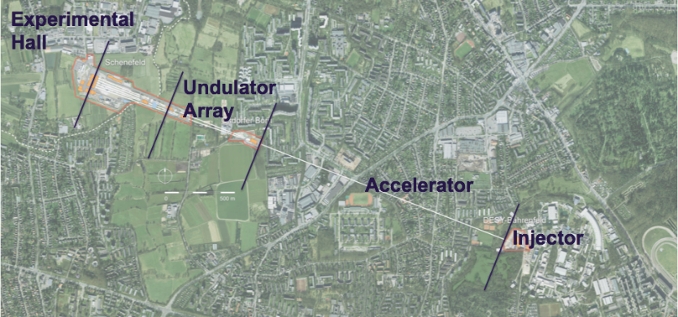
The European XFEL

Slide 3
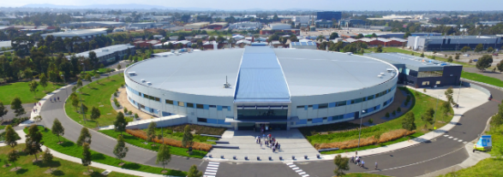
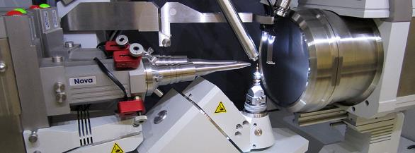
Traditional X-ray sources
Images:
https://industry.gov.au
http://www.xstruct.ugent.be

Slide 4
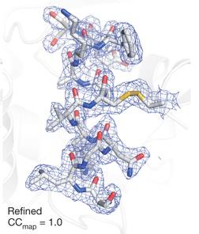
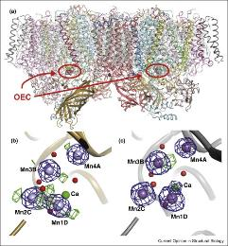
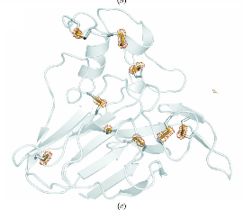
Protein structure
Nass et al. (2016)
TRM Barends et al. (2014)
R Neutze (‎2015)

Slide 5
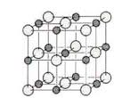
Non-crystalline material scatters fewer x-rays than crystalline material
Scattered x-rays is proportional to N²
(~ 100 x 100 x 100 elements)
If N=1, then scattering is proportional to 1
(~ a million times less than above)
Conclusion: Need a lot more x-rays
Slide modified: A. P. Mancuso

Slide 6
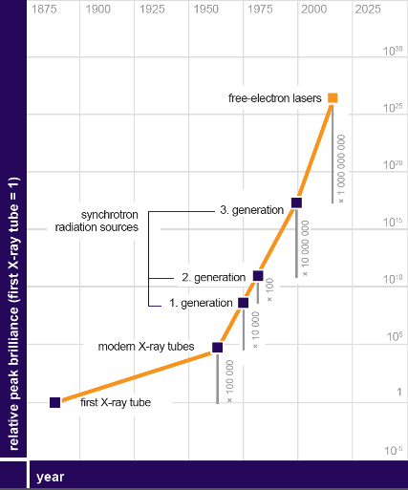
SASE radiation
FELs offer improvements over 3rd generation synchrotrons
Orders of magnitude brighter
Extremely short pulse duration
Both µm and nm focus

Slide 7
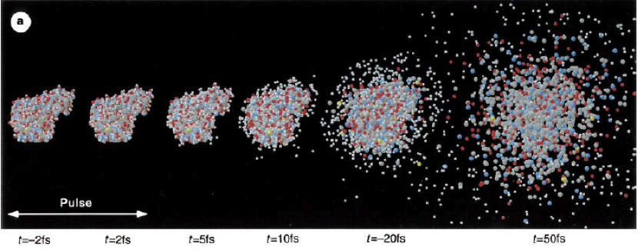
Diffraction before destruction
Image: R. Neutze et al. Nature (2000)

Slide 8
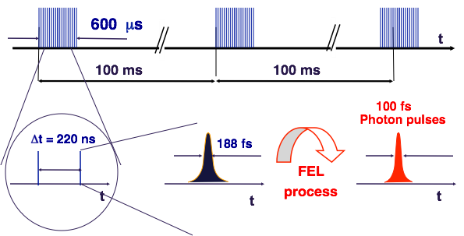
SASE pulse train
Slide: A. P. Mancuso

Slide 9
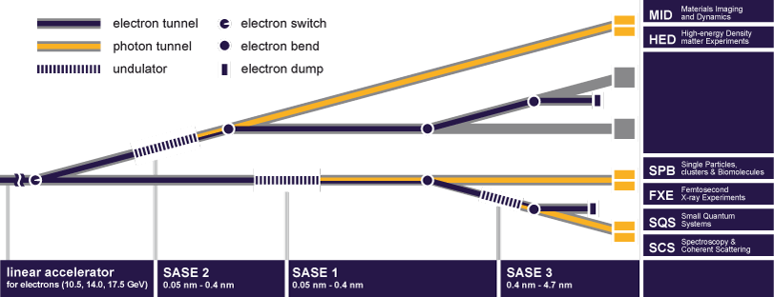
Undulator

Slide 10
Undulator

Slide 11
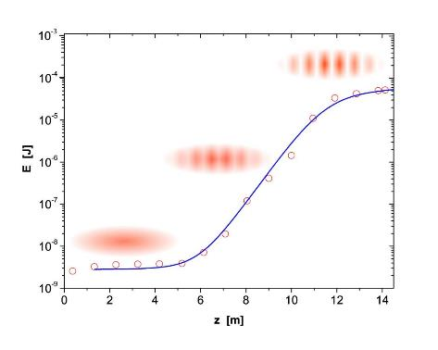
Undulator
Coherent radiation is emitted from 175 m of SASE undulator
Initial section of undulator produces radiation
The radiation couples with the electron’s to bunch the electrons
Saturation occurs when the electrons are completely microbunched
This process greatly amplifies the radiation emitted

Slide 12
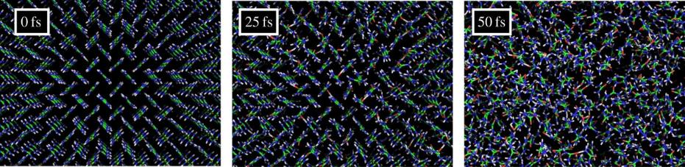
Radiation damage
Diffraction before destruction (2014)
Henry N. Chapman, Carl Caleman, Nicusor Timneanu

Slide 13
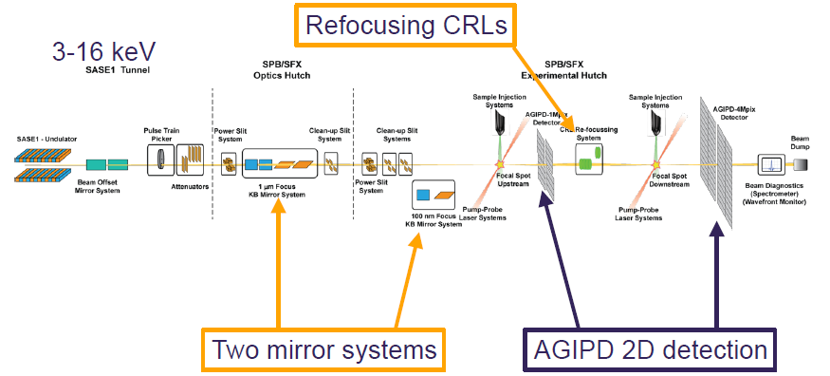
Imaging biomolecules and X-ray radiation
Technical Design Report: Scientific Instrument SPB, (2013) A. P. Mancuso, et al.

Slide 14
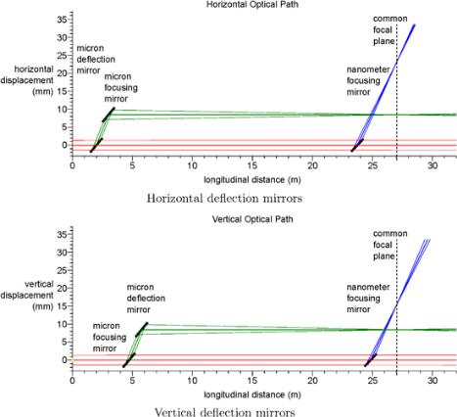
KB mirror systems
Kirkpatrick-Baez mirrors will produce a
1 micron and 100 nanometer focused beam
4 bounce system (1 µm) in green
2 bounce system (100 nm) in blue
B₄C and Ru coatings
Design of the mirror optical systems for coherent diffractive imaging at the SPB/SFX instrument of the European XFEL, (2016) Richard J Bean, et al.

Slide 15
KB mirror systems
Kirkpatrick-Baez mirrors will produce a
1 micron and 100 nanometer focused beam
4 bounce system (1 µm) in green
2 bounce system (100 nm) in blue
B₄C and Ru coatings
Design of the mirror optical systems for coherent diffractive imaging at the SPB/SFX instrument of the European XFEL, (2016) Richard J Bean, et al.

Slide 16
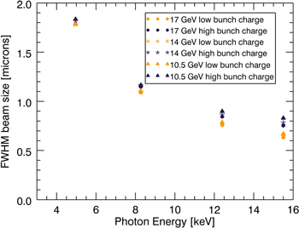
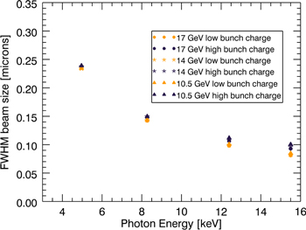
KB mirror systems
micron focus
nano focus
Design of the mirror optical systems for coherent diffractive imaging at the SPB/SFX instrument of the European XFEL, (2016) Richard J Bean, et al.

Slide 17
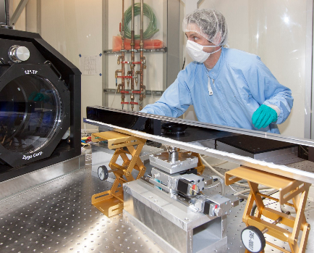
Manufacturing achievements
970 x 25 mm clear aperture
1.8 nm peak to valley variation
2x 50 nm thick polished coatings
  B₄C and Ru
  950 x 10 mm

Slide 18
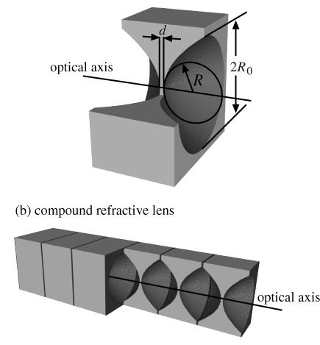
Compound refractive lenses
Initial operation will use the CRL in the tunnel
CRL is a repeating structure of parabolic surfaces
12 mm diameter
2 mm thickness
Focus to 2.5 µm diameter
Refractive x-ray lenses (2005) B. Lengeler, et al

Slide 19
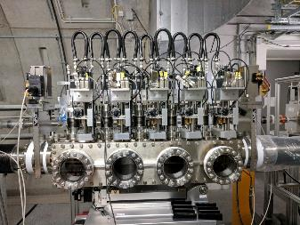
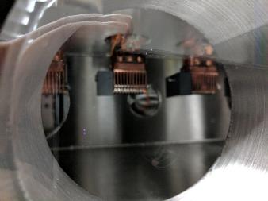
Cassette ordering
Initial operation will use the CRL in the tunnel
1, 2, 4, 8, 10, 10 …..
Allows the change of X-ray energy while still maintaining focal location

Slide 20
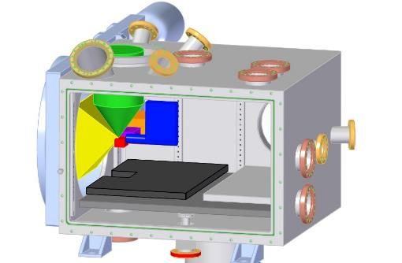
Interaction region
There are two inline interaction regions, thes 1st upstream region is available day 1
Day 1 will provide 60 pulses per train at
10 Hz
Photons at 8.4 keV
Pulse energy at 2 mJ
Pulse duration 43 fs
120° open scattering cone
Image: Joachim Schulz

Slide 21
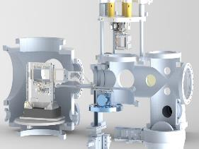
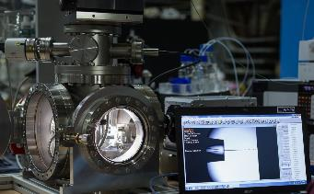
Sample injection
Many methods have been adopted to deliver sample into the interaction region
GDVN
Aerosol
Fixed targets
Images: J. Schulz and R. Graceffa

Slide 22
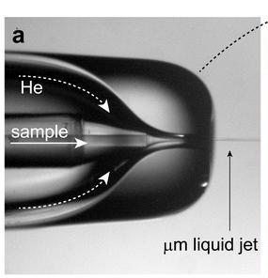
Gas Dynamic Virtual Nozzle
Capillary guides the sample into the interaction region
Inert gas focuses the jet into a thin stream
A µm thin jet can be maintained over more than 100 µm distance
A modified system can also handle viscous solutions
Image: http://www.sfx-consortium.org/e230143/e230213

Slide 23
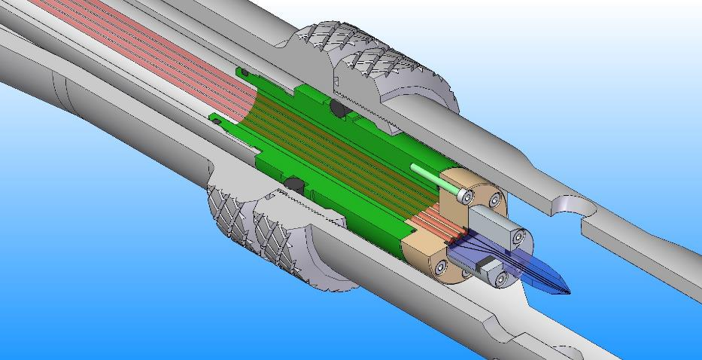
Design study of a microfluidic mixing nozzle in 25 mm nozzle rod
Image: Joachim Schulz, Rita Graceffa, Dennis Ropers

Slide 24
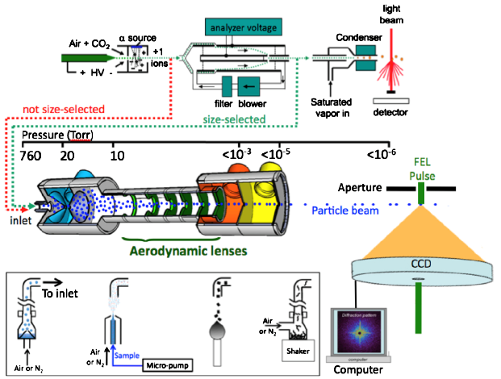
Aerosol injectors
Injector creates particle beam
Pressures decrease through the injector nozzle
Rapid motion of sample
Image: Joachim Schulz

Slide 25
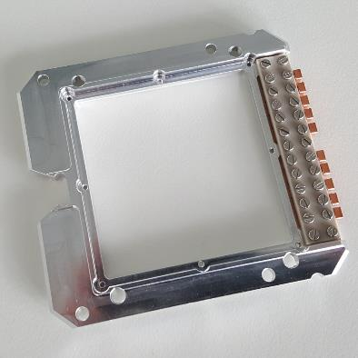
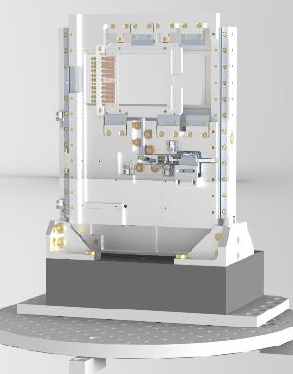
Fixed targets
Image: Joachim Schulz

Slide 26
AGIPD Detectors
6 – 13 keV
1 x 10⁴ at 12 keV dynamic range
5 σ at 12 keV sensitivity
Number of storage cells 352
Can store images at 4.5 MHz
Image: AGIPD Consortium

Slide 27
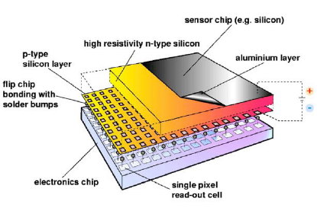
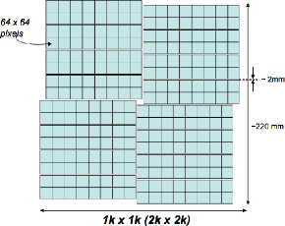
Pixel size 200 μm x 200 μm
128 x 512 pixels per module
64 x 64 pixels / chip
8 chips / module
4 module / quadrant
4 movable quadrants
Image: AGIPD Consortium

Slide 28
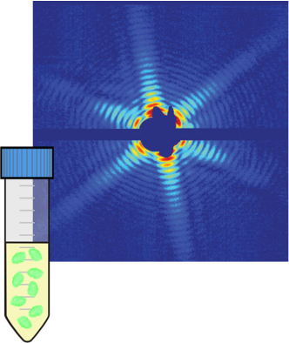
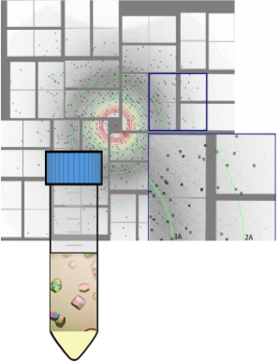
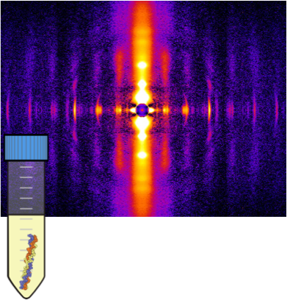
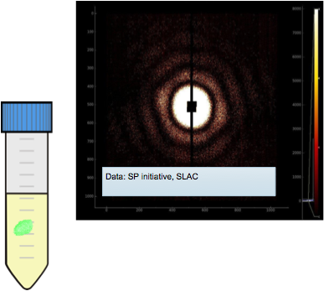
Experiments
Slide modified: Adam Round

Slide 29
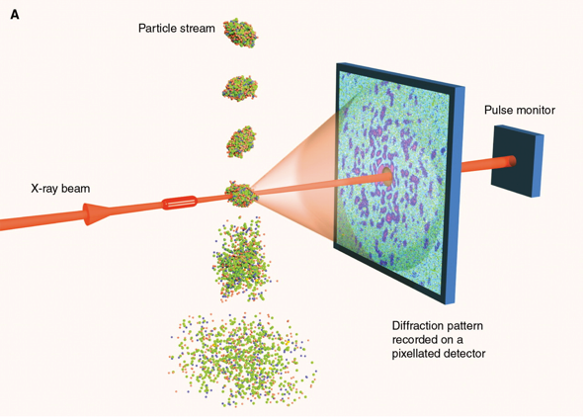
The Single Particle Imaging Experiment
Image: Gaffney, Champman. Science (2007)

Slide 30
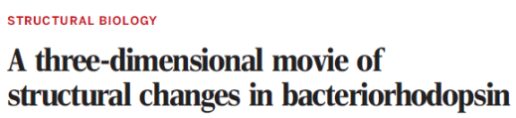
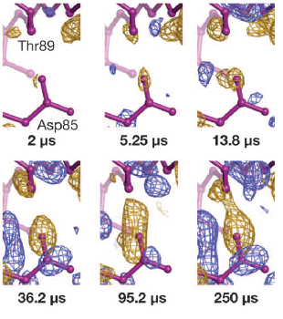
Experiments
Time-resolved SFX
Bacteriorhodopsin conformational changes
10 fs long pulses at SACLA
Eriko Nango, et al 2017, Science

Slide 31
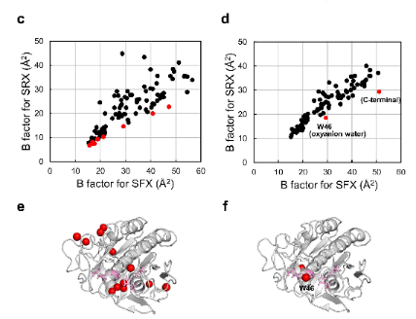
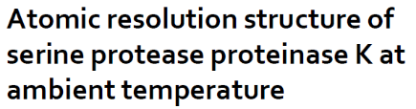
Experiments
High resolution SFX
1.2 Å res proteinase K
Comparision of SFX and SRX
B-factors
Tetsuya Masuda, et al 2017, Science Reports

Slide 32
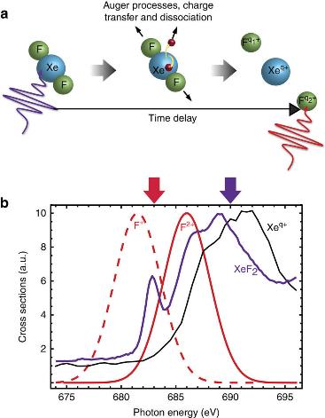
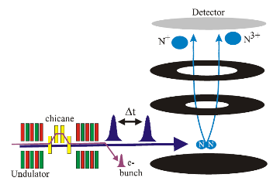
Experiments
Two-colour X-ray-pump/X-ray-probe scheme used for studying the molecular fragmentation of XeF₂
These reactions occur on the fs timescale, perfect for the European XFEL
A Picón, et al 2016
CS Lehmann, et al 2016

Slide 33

Experiments

Slide 34
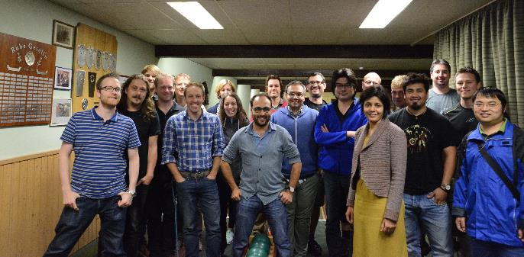








Acknowledgments: People—the most important components
  Sample Environment
  AGIPD consortium
  Adrian Mancuso
  Zunaira Ansari
  Richard Bean
  Johan Bielecki
  Carsten Fortmann-Grote
  Klaus Giewekemeyer
  Oliver Kelsey
  Felix Lemcke
  Luis Lopez Morillo
  Bradley Manning
  Masoud Mehrjoo
  Marc Messerschmidt
  Nadja Reimers
  Adam Round
  Tokushi Sato
  Marcin Sikorski
  Andrew Stawniczy
  Stephan Stern
  Britta Weinhausen
  Patrik Vagovic
  Prasad Thute
Particular thanks to all European XFEL groups supporting (too many to mention).

