Slide 1
Space instrumentation overview
ESI 2017, Hamburg
Thibaut Prod’homme, European Space Agency
Notes:
This is a very vast field as you can imagine, with a variety of applications, instruments in space can be pointed at the earth, other planets and bodies in our solar system, stars and galaxies, or even used to probe the fundamental laws of physics.
Instruments are used to perform remote or in-situ measurements: imaging, photometry, spectroscopy, altimetry, plasma measurements, and even soon gravitational wave sensing.

Slide 2
Space instrumentation overview
Why do we go to space? And what do we do in space?
What are the specifics of building instruments for space?
An example
Notes:
I will thus try in this first lecture to focus on:
Why do we go to space? That is what are the main and most frequent reasons to perform space borne measurements,
What are the specifics of building instruments for space?
And I’ll finish by giving a more detailed example of one particular mission and instrument

Slide 3
Why do we go to space?
Notes:
The answer is very often application specific:
For earth observation, it offers a unique vantage point
For astronomy, it enables observation free of the atmosphere (absorption and turbulence) across the entire EM spectrum
For fundamental physics experiments, it provides a very stable environment
For space exploration, it’s the only way to obtain close-up or in situ measurements

Slide 4
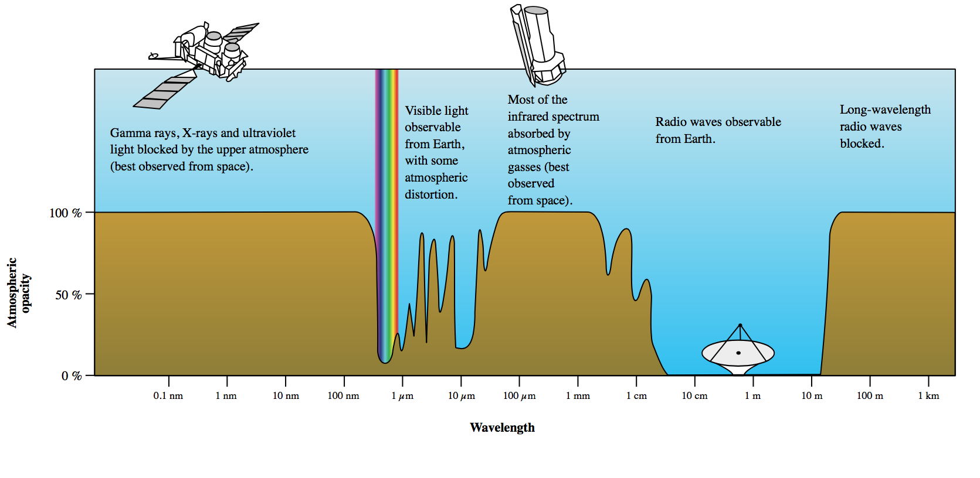
Why do we go to space?
Application driven: global or in-situ measurements
Higher accuracy
Atmosphere free
EM pollution free

Slide 5
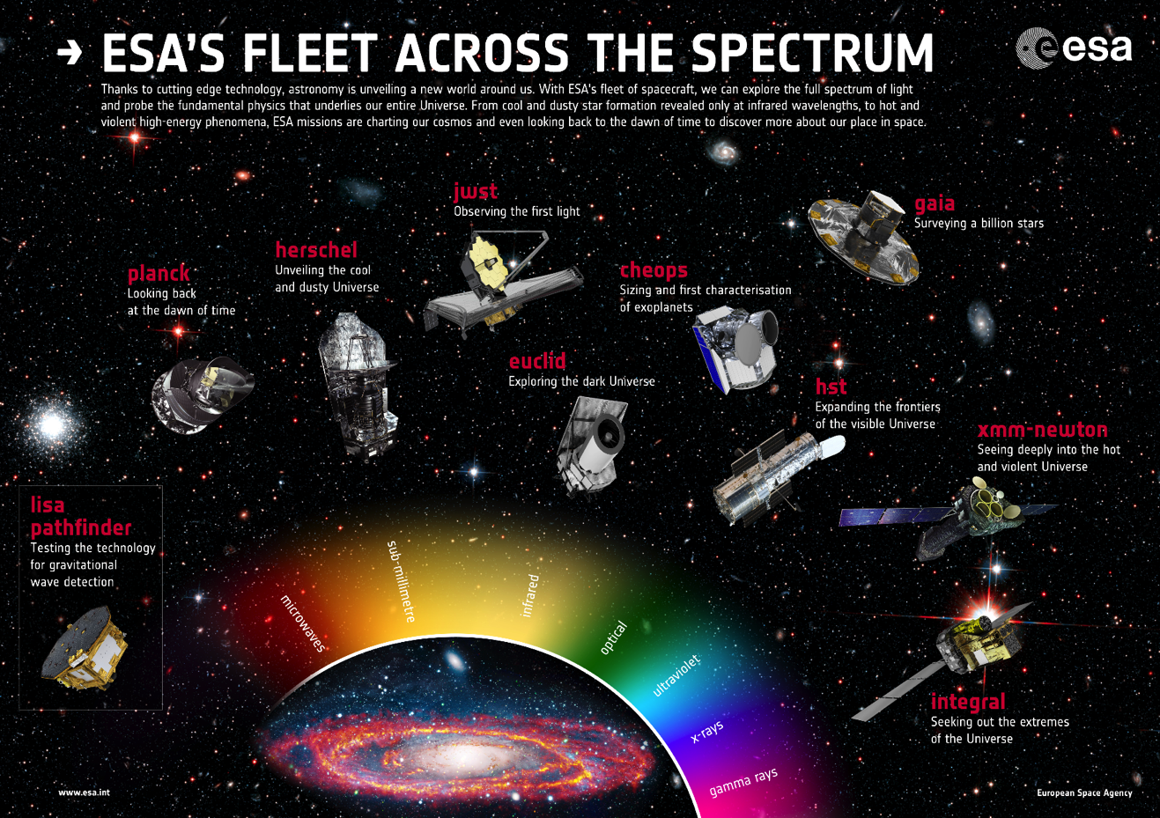

Slide 6
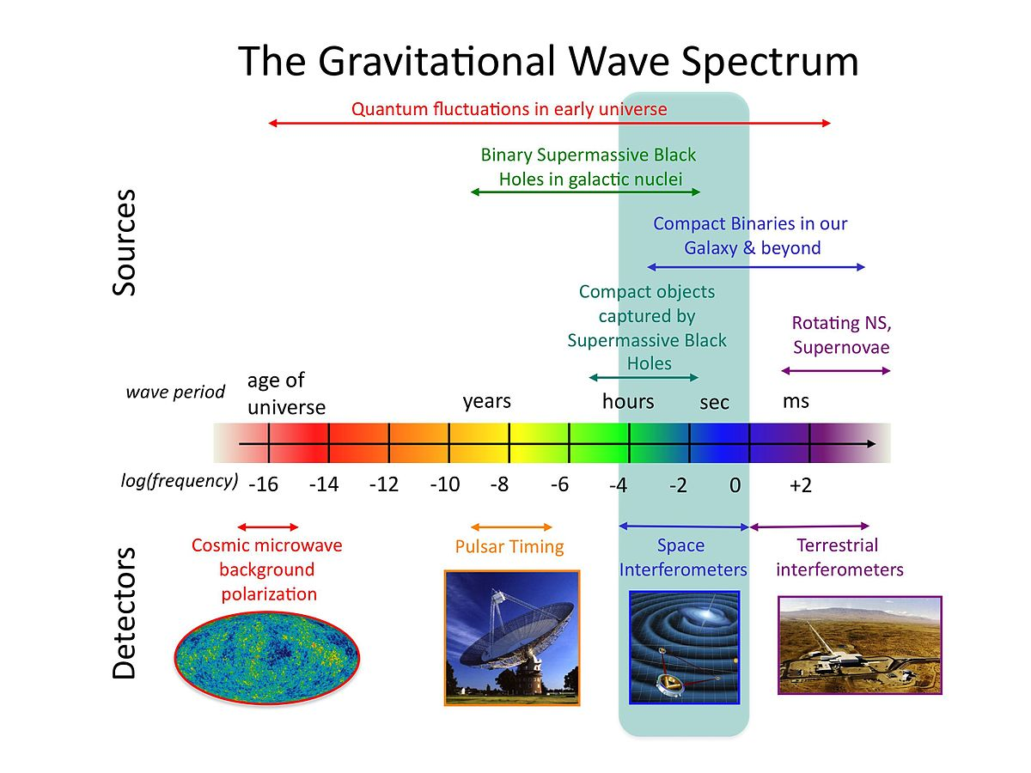

Slide 7
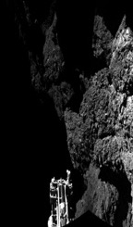
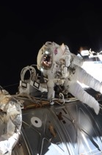
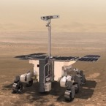

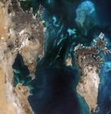
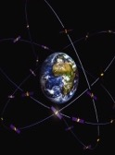

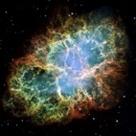
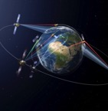
Space applications
space science
human spaceflight
exploration
Solar system
Solar science
earth observation
navigation
Fundamental physics
Astronomy
telecommunications

Slide 8
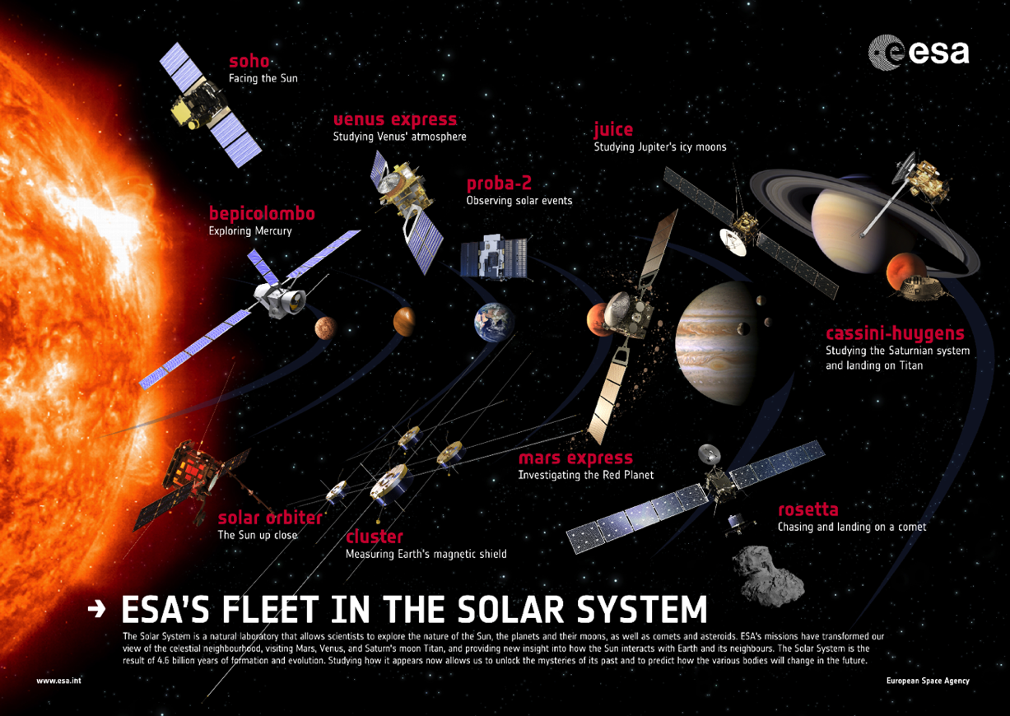

Slide 10

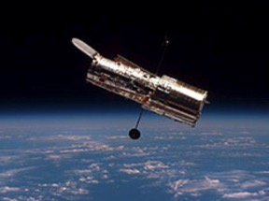
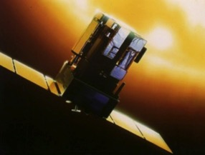
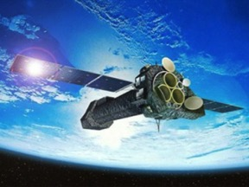
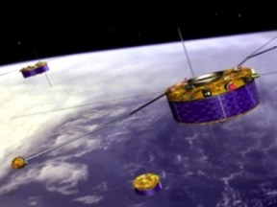
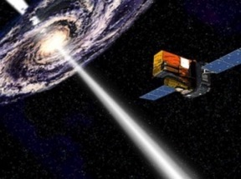
Today’s Science missions (1)
Hubble (1990– ) orbiting observatory for ultraviolet, visible and infrared astronomy (with NASA)
SOHO (1995– ) studying our Sun and its environment (with NASA)
XMM-Newton (1999– ) solving mysteries of the X-ray Universe
Cluster (2000– ) studying interaction between Sun and Earth's magnetosphere
Integral (2002– ) observing objects simultaneously in gamma rays, X-rays and visible light
Hubble
SOHO
XMM-Newton
Cluster
Integral

Slide 11
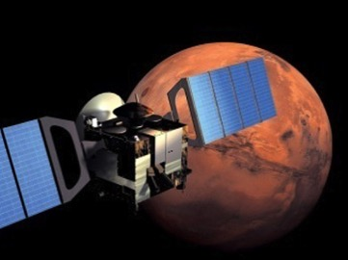
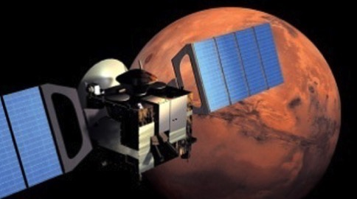
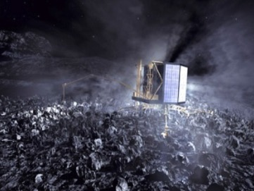
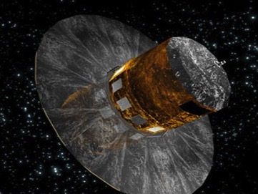
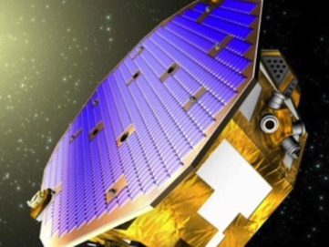
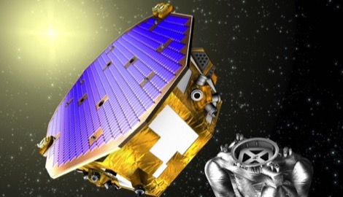
Today’s Science missions (2)
Mars Express (2003– ) studying Mars, its moons and atmosphere from orbit
Gaia (2013– ) mapping a thousand million stars in our galaxy
LISA Pathfinder (2015– ) testing technologies to detect gravitational waves
Mars Express
Mars Express
Rosetta
Gaia
Gaia
LISA Pathfinder
LISA Pathfinder

Slide 12
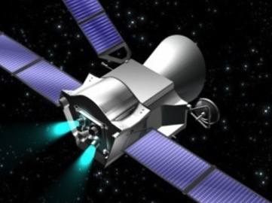
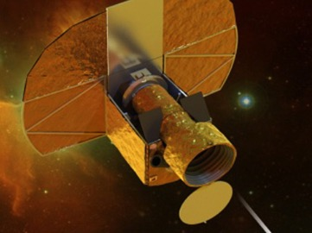
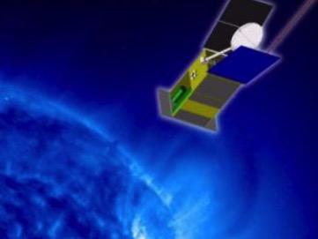
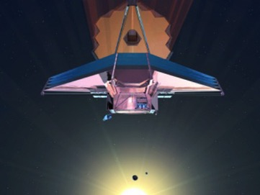
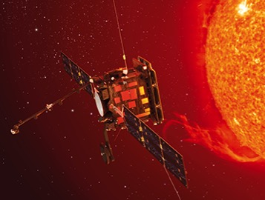
Upcoming missions (1)
BepiColombo (2018) a satellite duo exploring Mercury (with JAXA)
Cheops (2018) studying exoplanets around nearby bright stars
Solar Orbiter (2018) studying the Sun from close range
James Webb Space Telescope (2018) studying the very distant Universe (with NASA/CSA)
BepiColombo
Cheops
Solar Orbiter
James Webb Space Telescope
BepiColombo
Cheops
Solar Orbiter
James Webb Space Telescope

Slide 13
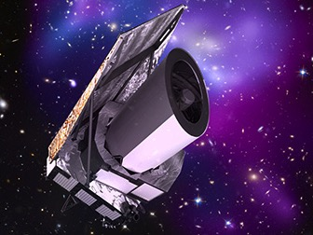
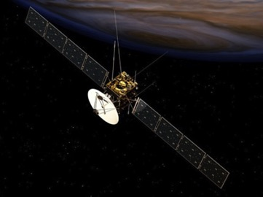
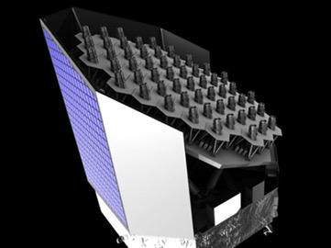
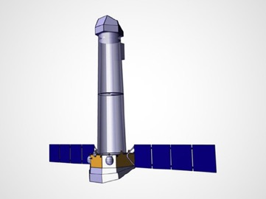
Upcoming missions (2)
Euclid (2020) probing ‘dark matter’, ‘dark energy’ and the expanding Universe
JUICE (2022) studying the ocean-bearing moons around Jupiter
Plato (2024) searching for planets around nearby stars
Athena (2028) space telescope for studying the energetic Universe
Gravitational wave observatory (2034) studying ripples in spacetime caused by massive objects in the Universe
Euclid
JUICE
Plato
Athena

Slide 14
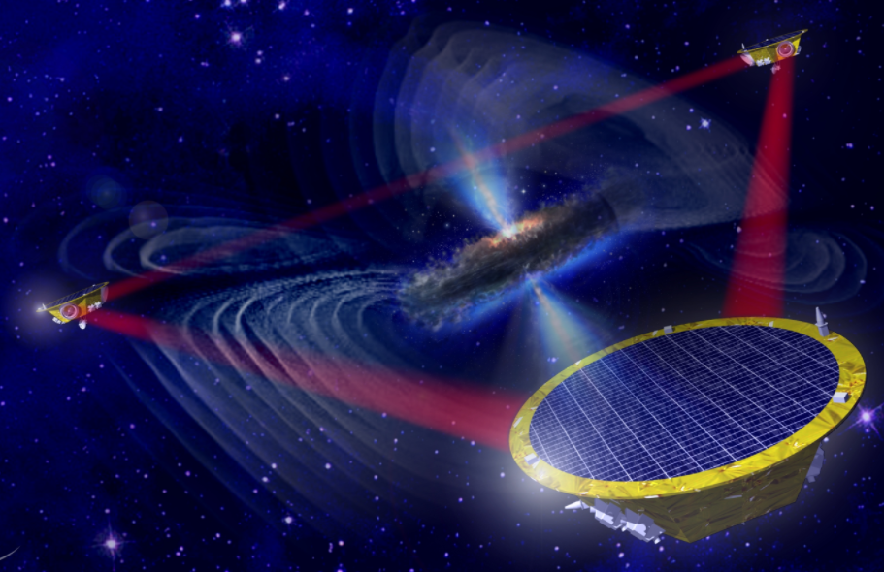
LISA
Measurement of path length variations caused by gravitational waves to ~10pm/sqrt(Hz) @ 0.1 mHz to 100 mHz

Slide 15
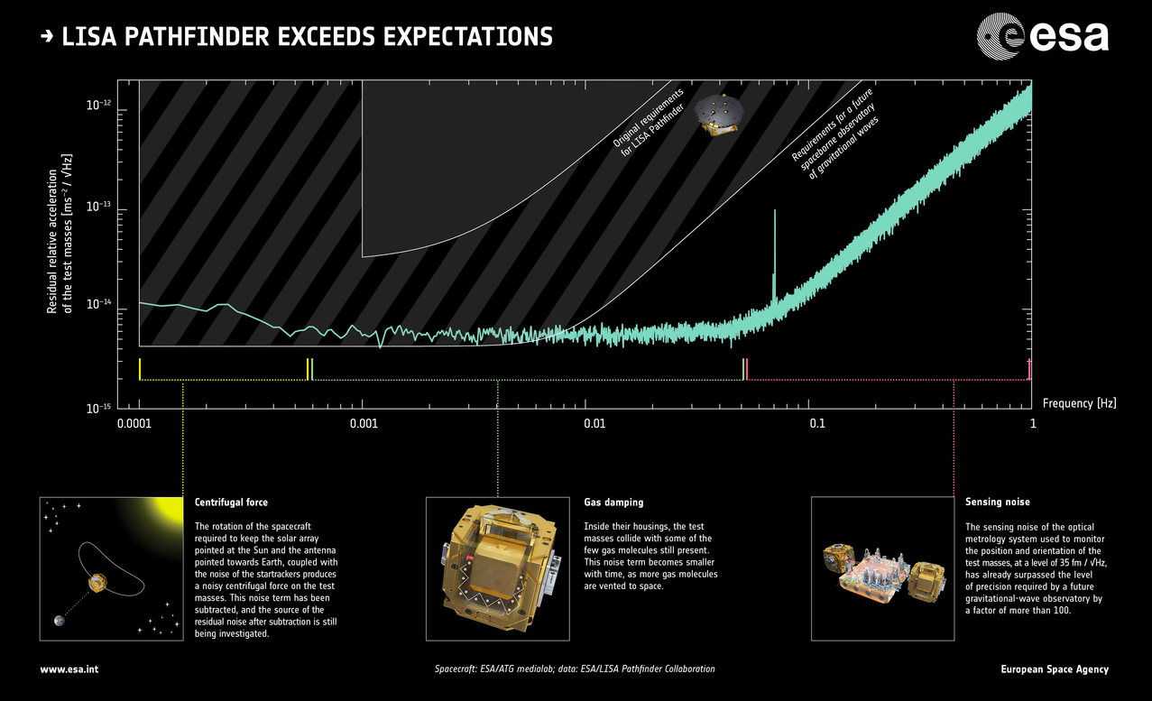

Slide 16
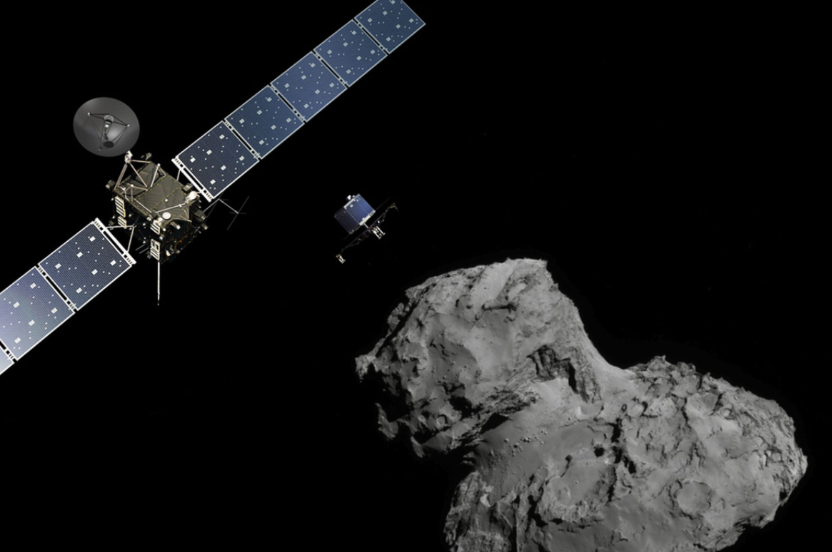
And of course Rosetta!
https://www.youtube.com/watch?v=nQ9ivd7wv30

Slide 17

And of course Rosetta!
https://www.youtube.com/watch?v=nQ9ivd7wv30

Slide 18

EARTH
OBSERVATION

Slide 19



Earth Explorers
These missions address critical and specific issues raised by the science community, while demonstrating the latest observing techniques.
GOCE (2009–13) studying Earth’s gravity field
SMOS (2009– ) studying Earth’s water cycle
CryoSat-2 (2010– ) studying Earth’s ice cover
Swarm (2013– ) three satellites studying Earth’s magnetic field
ADM-Aeolus (2017) studying global winds
EarthCARE (2018) studying Earth’s clouds, aerosols and radiation (ESA/JAXA)
Biomass (2021) studying Earth’s carbon cycle
FLEX (2022) studying photosynthesis
Earth Explorers 9 & 10 to be selected

Slide 20
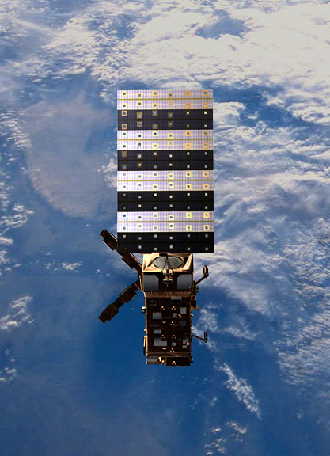
Meteorological missions
Next-generation missions dedicated to weather
and climate.
Meteosat Third Generation – taking over from Meteosat 11 in 2018/20, the last of four Meteosat Second Generation (MSG) satellites. MSG and MTG are joint projects between ESA and Eumetsat.
MetOp is a series of three satellites to monitor climate and improve weather forecasting, the space segment of Eumetsat’s Polar System (EPS).
MetOp-A (2006– ) Europe’s first polar-orbiting satellite dedicated to operational meteorology.
MetOp-B launched in 2012.
MetOp-C follows in 2018.

Slide 21
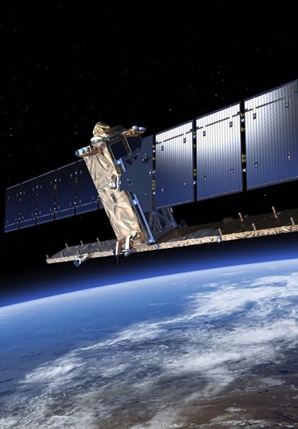
Global monitoring for a safer world
Copernicus: an Earth observation programme for global monitoring for environment and security.
Led by the European Commission in partnership with ESA and the European Environment Agency, and responding to Europe’s need for geo-spatial information services, it will provide autonomous and independent access to information for policy-makers, particularly for environment and security issues. ESA is implementing the space component: developing the Sentinel satellite series, its ground segment and coordinating data access.
ESA has started a Climate Change Initiative, for storage, production and assessment of essential climate data.

Slide 22
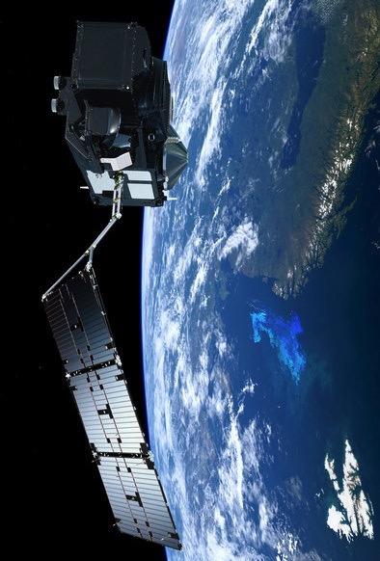
Copernicus space component: the Sentinels
Sentinel-1 – land and ocean services. Sentinel-1A launched in 2014/Sentinel-1B in 2016.
Sentinel-2 – land monitoring. Sentinel-2A launched in 2015/Sentinel-2B (2017).
Sentinel-3 – ocean forecasting, environmental and climate monitoring. Sentinel-3A launched in 2016. Sentinel-3B (2017).
Sentinel-4 – atmospheric monitoring payload (2019)
Sentinel-5 – atmospheric monitoring payload (2021)
Sentinel-5 Precursor – atmospheric monitoring (2017)
Sentinel-6 – oceanography and climate studies (2020)

Slide 23
What are the specifics of building instruments for space?

Slide 24
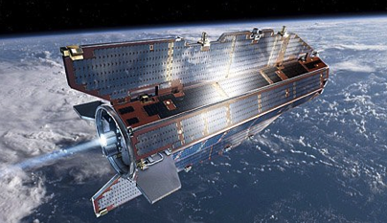
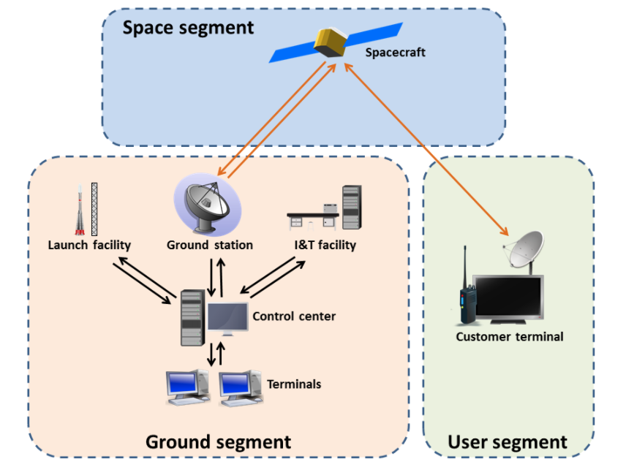
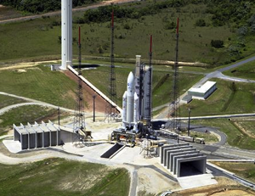
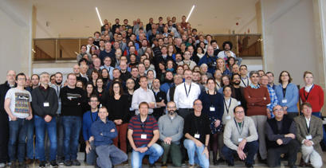
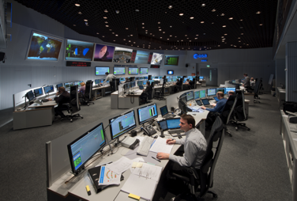
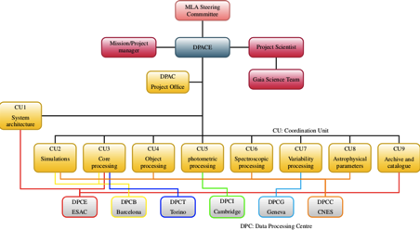
Space mission architecture

Slide 25
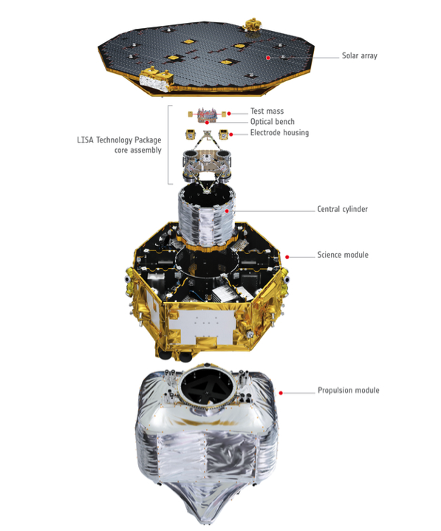
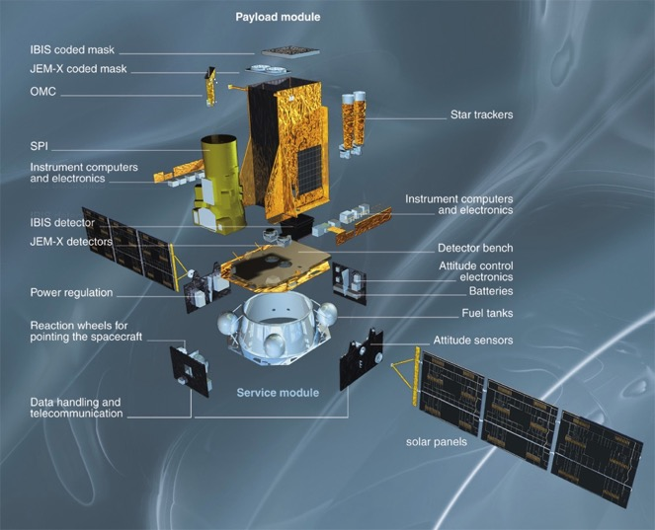
Space segment assemblies
payload module
telescope, instruments, focal plane, onboard data processing unit
service module
power distribution, attitude control, star trackers, propulsion, telecommand, telemetry and data handling

Slide 26

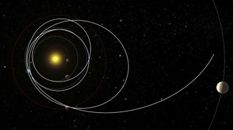

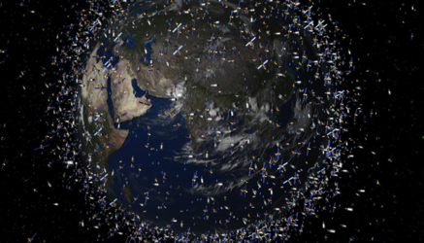
Mission lifetime cycle
Phase 0 Mission analysis and identification
Phase A Feasibility
Phase B Preliminary Definition
Phase C Detailed Definition
Phase D Qualification and Production
(incl. launch and commissioning)
Phase E Utilisation
Phase F Disposal
Notes:
Mission selection
Mission adoption
Commissioning
Typical durations

Slide 27
Space mission organisation
Scientific community: propose concept, responsible for data processing, release, users
Industry: manufacturer, prime contractor, sub contractors
Agency: customer, operator, responsible for launch, service module
Member states: customer, responsible for payload

Slide 28
Design to..
Surviving integration and assembly
Surviving storing (can last several years)
Surviving launch (can be a bit of a ride)
Surviving transport (can last several years)
Surviving space (vacuum, radiation, temperature gradients, micrometeorites)

Slide 29
Design constraints
Demanding science requirements
Long continuous operation without possible repair
Mass/volume (fit the rocket)
Power (different if orbiting Earth or Saturn)
Telemetry
EMC (Electro-magnetic compatibility)
Contamination (coldest parts collect molecular contamination, outgasing)
-> Redundancy
-> Qualification and testing
-> QM, EM, FM

Slide 30
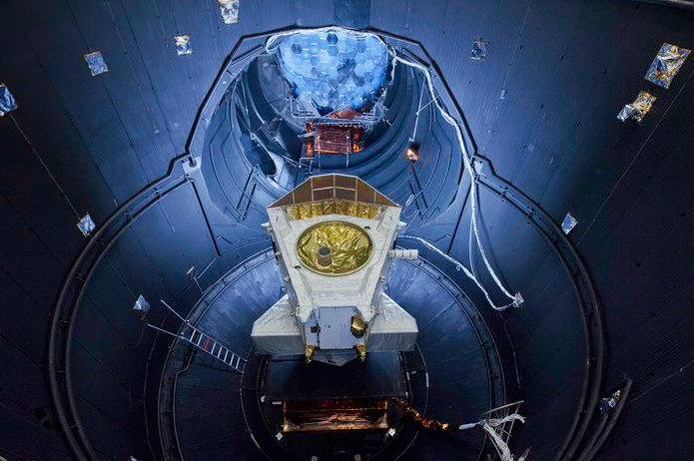
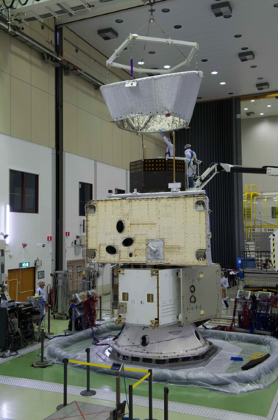
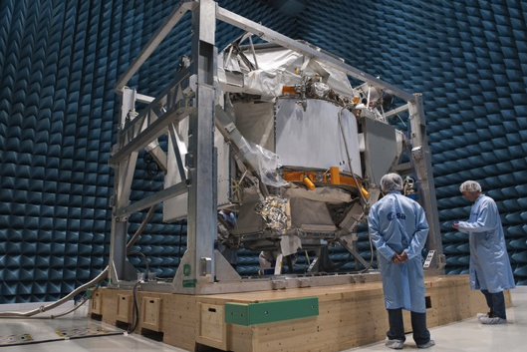
Testing and performance verification

Slide 31

An example..
Notes:
But first I’d like to introduce and illustrate this problematic through one example

Slide 32

Gaia mission
Launch date: 19 December 2013, 09:12 UTC
Mission end: nominal mission end after 5 years (2018)
Launch vehicle: Soyuz-Fregat
Launch mass: 2030 kg, including 710 kg of payload, a 920 kg service module, 400 kg of propellant
Mission phase: Operations
Orbit: Lissajous-type orbit around L2
Instruments: Astro (2 identical telescopes and imaging system); BP/RP (Blue and Red Photometers) and RVS (Radial-Velocity Spectrometer)
Partnerships: Gaia is a fully European mission designed, built, and operated by ESA. The Gaia Data Processing and Analysis Consortium (DPAC) are responsible for processing the raw data, which will be published in Gaia catalogue.

Slide 33
Gaia science objectives
Galactic census: for 2 billion stars (1-2% of Milky way stellar population) collect distance, position, motion, physical parameters
Most accurate 3D map of the Milky Way/Local group will:
Provide detailed information on stellar evolution and star formation in our Galaxy
Clarify the origin and formation history of our Galaxy
Probe the distribution of dark matter
Establish the luminosity function for pre-main sequence stars
Place unprecedented constraints on the age, internal structure and evolution of all stellar types
Establish a rigorous distance scale framework throughout the Galaxy and beyond.
Pinpoint exotic objects in colossal and almost unimaginable numbers: extra-solar planets (from both their astrometric wobble and from photometric transits); brown dwarfs and white dwarfs; extragalactic supernovae; Solar System minor planets; near-Earth objects, inner Trojans and even new trans-Neptunian objects, including Plutinos
Provide parametrized post-Newtonian parameters: γ and β, and the solar quadrupole moment J2 with unprecedented precision.

Slide 34

What it means..

Slide 35

Parallax measurement principle

Slide 36

Global absolute astrometry

Slide 37

Gaia science performance
10 μas

Slide 38



Gaia spacecraft

Slide 39


Gaia payload

Slide 40

Gaia instruments

Slide 41


Slide 42



Astrometric field

Slide 43



Blue and red photometers
Notes:
These photometers are actually low resolution spectrometer as the light passes through a prism which disperses it in different wavelengths. The Blue Photometer generates spectra in the bluer wavelengths (from 330 to 680 nm) and the Red Photometer in the redder ones (from 640 to 1050 nm).

Slide 44


Radial Velocity Spectrometer (RVS) instrument
Notes:
Gaia features the Radial Velocity Spectrometer (RVS) instrument. The RVS provides the third component of the space velocity of each star down to about 17th magnitude. The instrument is a near-infrared (845–872 nm), medium-resolution (λ/Δλ ~ 11500), integral-field spectrograph dispersing all the light entering the field of view. The spectral dispersion of objects in the field of view is materialised by means of an optical module located between M6 and the focal plane. This module contains a grating plate and an afocal field corrector lens, composed of four fused-silica prisms.
The optical module of the radial-velocity spectrometer, containing a grating plate (middle), four fused-silica prismatic lenses, as well as a bandpass-filter plate (far right).
This image shows the full size demonstrator model of the blazed transmission grating for the Gaia Radial Velocity Spectrometer (RVS). The large dimensions of the grating (20.5 × 15.5 cm), the image performance (wave front error < 8nm RMS) and the high efficiency (>70%) are the main requirements for this grating.
Within the frame of a feasibility study for ESA the Fraunhofer Institut für Optik und Feinmechanik (IOF) in Jena designed, built and tested this grating. The blaze of the grating is realized by a nano texture of a fused silica plate. At sub-wavelength scale (the RVS will observe in the near-infrared between 847-874 nm) the texture is a repeated pattern of discrete block-shaped patches, forming a binary index modulation structure. The blazed grating is therefore a fully monolithic structure with outstanding optical performance and an efficiency of >80%, well above the required 70%.
The grating has 302.11 grooves per mm. Each groove element (unit cell) has 5 patches of binary index modulation elements over a width of 3.31 µm. See the related image in the right-hand menu for an electron microscope image of individual grooves.

Slide 45


Basic angle monitor interferometer
Notes:
Like Hipparcos Gaia will observe the sky in two directions simultaneously, separated by the basic angle of 106.5°. The astrometric accuracy is highly dependent on the stability of this angle. Gaia will be equipped with a Basic Angle Monitoring (BAM) system, to monitor this angle with a precision of 0.5 μas. The BAM consists of two laser interferometers. Two pairs of parallel laser bundles are sent to the two telescopes, which create two interference patterns on a detector. If the basic angle varies, the interference patterns will shift.
TNO is responsible for the BAM Opto Mechanical Assembly (OMA). With the BAM, an Optical Path Difference (OPD) as small as 1.5 picometers RMS can be measured. To fulfil the stability requirements for such accurate OPD measurements, the entire BAM OMA is constructed from Silicon Carbide (SiC). Ultra stable cryogenic mounts have been developed for mirrors and beam splitters. The BAM OMA shall have an extremely small wave front error, less than 25 nm RMS over the entire optical path. TNO has developed processes for the polishing of SiC mirrors to very low surface errors.

Slide 46

Thermal Balance and Thermal Vacuum testing
Notes:
In preparation for Thermal Balance and Thermal Vacuum testing of the Gaia Flight Model Payload Module (PLM) at Centre Spatial de Liège (CSL), Belgium, the PLM (bipods, optical bench torus, mirrors, focal plane array) has been mated with a mechanical and thermal representation of the interface with the Service Module in the base of the vacuum chamber.
Now that the lifting equipment has been removed, the clean tent that surrounds the preparation area has been closed. With this protection against contamination of the optical components in place, the individual covers on the mirrors and focal plane array have been removed.

Slide 47

Vibration testing
Notes:
Fully integrated Gaia protoflight Payload Module (PLM) undergoing acceptance vibration testing on an electrodynamic shaker at the facilities of Intespace in Toulouse, France.
Qualification level vibration testing of the PLM was performed in June 2011, with many components represented by mass dummies. With all flight model components installed, the PLM was tested again, at lower excitation levels, to verify the integrity of the completed system. For acceptance testing, the PLM was subjected to swept-sinusoidal excitation along its Y and Z axes (both horizontal in this configuration).
The PLM is surrounded by a plastic tent to prevent contamination.

Slide 48

Electromagnetic compatibility
Notes:
The Gaia Flight Model spacecraft being prepared for electromagnetic compatibility testing in the EMC chamber at Intespace, Toulouse, France. The special lifting rig is used to position the spacecraft on a custom support structure for the tests.
As the EMC test facility cannot meet the cleanliness requirements for the spacecraft optics, the apertures in the Payload Module thermal tent have all been covered to prevent the ingress of contaminants.

Slide 49

Acoustic testing
Notes:
The Gaia Flight Model spacecraft being prepared for acoustic testing. Gaia was placed in the acoustic test chamber at the premises of Intespace in Toulouse, France, and subjected to a simulation of the acoustic environment it will experience during launch. The extreme acoustic levels during launch are due mainly to the noise of the launcher's engines, with a smaller contribution from the airflow over the fairing during the climb through Earth's atmosphere at supersonic speeds.

Slide 50

Leak testing
Notes:
The Gaia Flight Model (FM) spacecraft being prepared for leak testing. The propellants used for Gaia's propulsion systems are both highly toxic and corrosive, so it is important both for the correct operation of the mission and for the safety of the ground processing personnel during fuelling and subsequent ground operations that there are no leaks in the systems. To verify this, the Gaia FM spacecraft was enclosed in a plastic envelope and the propulsion systems were pressurised with helium. A mass spectrometer was used to detect changes in the concentration of helium inside the envelope once pressurisation had occurred. Any rise above the baseline level of helium present in the atmosphere would have indicated a leak. No leaks were detected.

Slide 51

Sunshield deployment testing
Notes:
Engineers from SENER and Astrium prepare to test Gaia’s Deployable Sunshield Assembly (DSA) in the S1B cleanroom at the Centre Spatial Guyanais in Kourou, French Guiana.
The Gaia spacecraft was flown on an Antonov transport plane from Toulouse Blagnac airport in France to Félix Eboué airport in French Guiana on 23 August 2013. The DSA arrived five days later.
Prior to transport, the multi-layer insulation (MLI) of the DSA had been removed for inspection and storage. Once in Kourou, the DSA had to be ‘reconstructed’ by installing the MLI and solar panels on the framework, and tested.
The DSA is stowed (folded against the spacecraft body) for launch and is deployed an hour later. Part of the testing at Kourou involved checking the deployment mechanisms. To partly simulate the conditions under which the deployment would take place, and to protect the DSA, the tests were carried out with a gravity compensation system. This system involves hanging each frame from a cable guided through pulleys along metallic beams to a system of counterweights placed around the spacecraft.
The DSA was successfully tested on 10 October 2013. (See the time lapse sequence of the tests here.)
The Prime Contractor for Gaia is Astrium SAS, based in Toulouse, France. SENER (Spain) is responsible for the development and manufacture of the Deployable Sunshield Assembly. The thermal blankets are provided by RUAG Aerospace Austria and the carbon fibre frames come from RUAG Aerospace Switzerland.

Slide 52


First results
https://www.cosmos.esa.int/web/gaia/dr1

Slide 53
The End!
ESI 2017, Hamburg
Thibaut Prod’homme, European Space Agency

