Slide 1
EUROfusion
João Figueiredo
EUROfusion

Slide 2

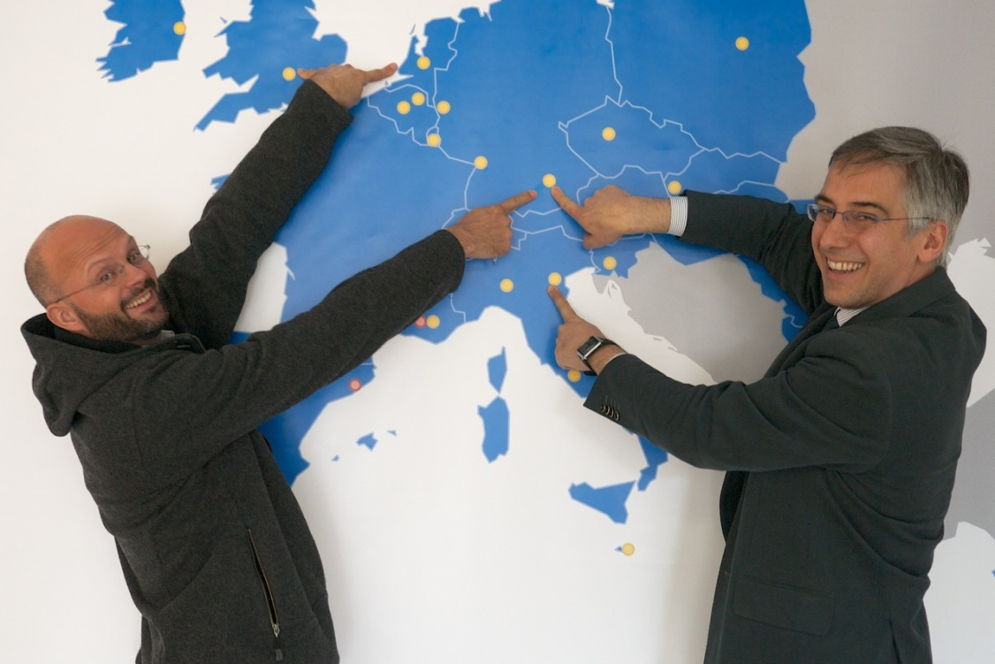
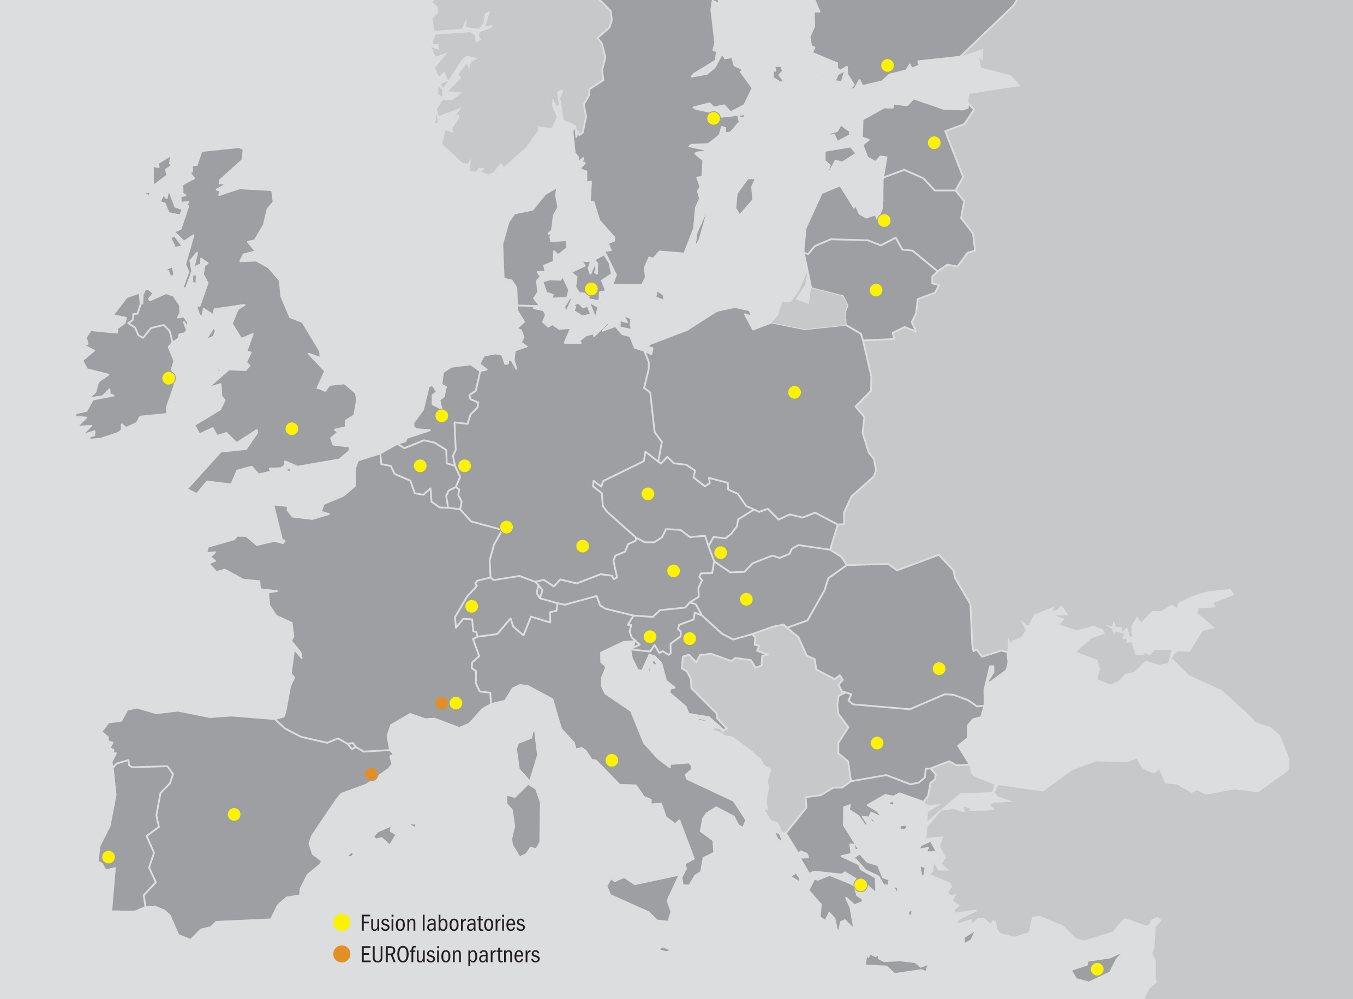
Programme Management Unit
ITER
Fusion for Energy (F4E)
All EU Member States plus Switzerland have joined the EUROfusion agreement involving 29 fusion laboratories and numerous Third Parties.
Their combined effort will achieve the ultimate goal: fusion electricity by 2050

Slide 3
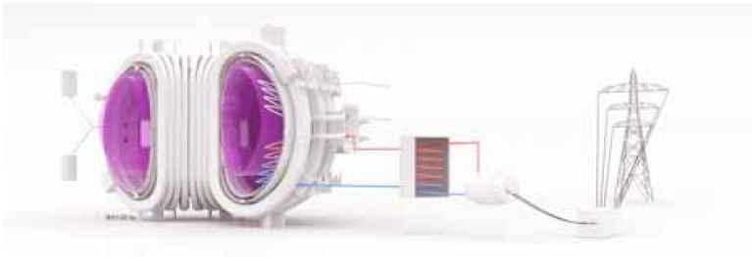
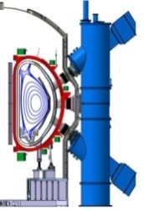
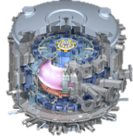
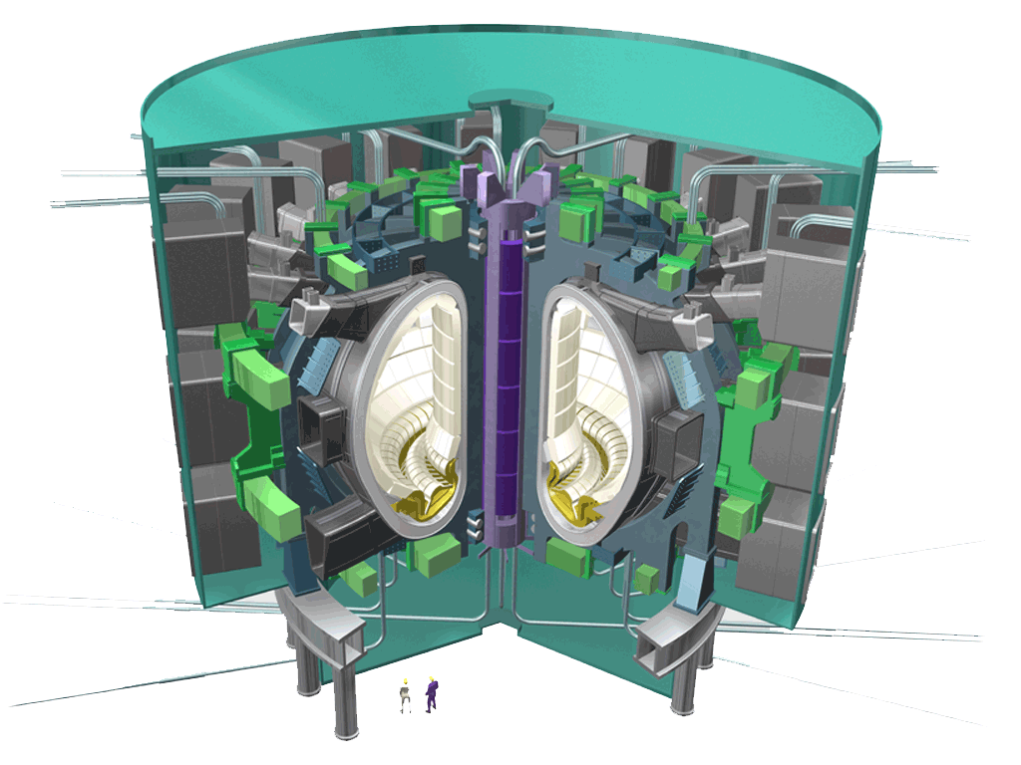
Roadmap towards fusion electricity
Fusion is practical, attractive
Power Plant
JT-60SA
ITER
DEMO
Fusion is feasible
Fusion is plausible
Fusion is commercially exploited
~2020
Operation
~2025
~2050
Fusion facilities around the world

Slide 4

Fusion Roadmap
Eight important missions
  For each mission:
    overview present status
    list of unresolved and urgent issues
    research & development plan
    estimation of required resources
Three periods
  2014 – 2020
  (Building ITER & Supporting Experiments)
  2021 – 2030
  (Exploiting ITER and Designing DEMO
  2031 – 2050
  (Building and Exploiting DEMO)
Important to intensify the involvement of industry
http://www.euro-fusion.org/

Slide 5
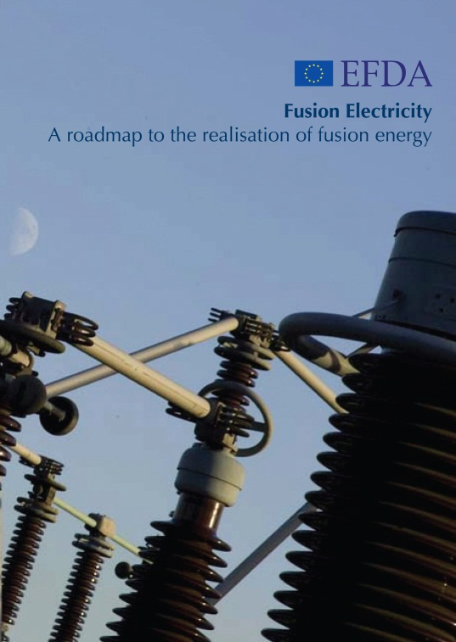
Fusion Roadmap
  8 Strategic Missions to tackle the critical challenges for Fusion:
    Plasma Operation
    Heat Exhaust
    Neutron resistant Materials
    Tritium-self sufficiency
    Safety
    Integrated DEMO Design
    Competitive Cost of Electricity
    Stellarator
IPH
DEMO
IPH
  Emphasis on:
  Central role of ITER
  DEMO as a single step to commercial fusion power plants that produce electricity and have a closed fuel cycle
  DEMO construction starting early in the 2030s
  Pragmatic Approach: It should not be perfect but good enough and must come on time to make an impact

