Slide 1
On the possibility of positive ion detection in gaseous TPCs
Lior Arazi
Weizmann Institute of Science
RD51 mini-week, December 12-15 2016, CERN

Slide 2

Motivation: accurate track reconstruction in rare-event searches
How accurate?
$σ_{ions}=\sqrt{2Dt}=\sqrt{\frac{2k_{B}T}{q_{e}}∙\frac{L}{E}}=0.225\sqrt{\frac{L}{E}} (σ \& L in cm, E in\frac{V}{cm})$
E.g. 10 bar Xe, E = 300 V/cm
$σ_{ions}=\left\{\begin{matrix}1.3 mm & L=1 m \\ 1.8 mm & L=2 m\end{matrix}\right.$
Electron diffusion under the same conditions:
$σ_{electrons}≈\left\{\begin{matrix}13 mm & L=1 m \\ 18 mm & L=2 m\end{matrix}\right.$

Slide 3
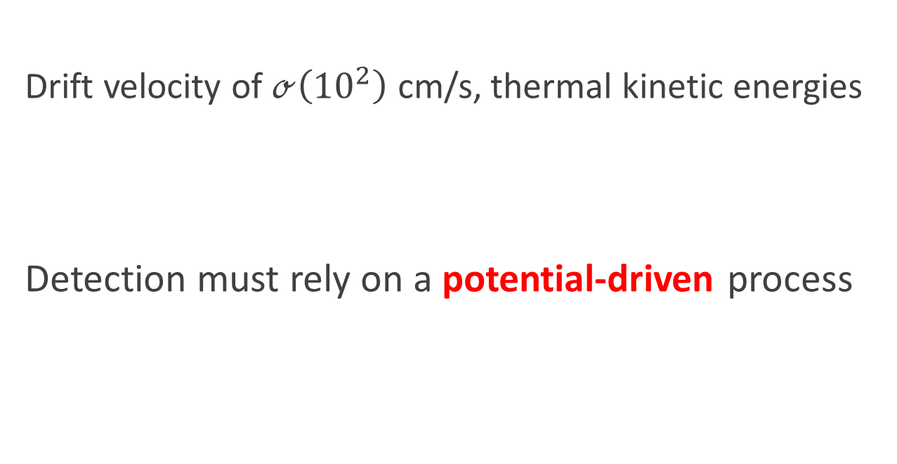
Problem: ions are slow
Drift velocity of $ℴ\left({10}^{2}\right)$ cm/s, thermal kinetic energies
Detection must rely on a potential-driven process

Slide 4
Luckily, Nature provided us with Auger neutralization (AN)
What is AN?
When a positive ion approaches a surface a first electron tunnels out and neutralizes it, leaving the system with excess energy
This energy is simultaneously transferred, in an Auger-like process, to a second electron which may be emitted into the gas
Historical context
First suggested by S. S. Shekhter in 1937
Experimental and theoretical foundations laid by H. D. Hagstrum (Bell Labs) in 1953-1961: studied AN for single ions of all noble gases, impinging on metals (W, Mo) and semiconductors (Si, Ge)
Was of central importance to the development of plasma panel displays
Still an active field in surface science theory

Slide 5

Key features of AN
Driven by potential energy → ok for thermal ions
Occurs for both atomic and molecular ions
Occurs for metals and insulators/semiconductors
Necessary condition: the ionization energy of the ion close to the surface must be larger than twice the work function: $E_{i}^{′}>2φ$
$γ_{i}$ : secondary electron yield = probability of ion-induced secondary electron emission (IISEE)
$γ_{i}$generally increases with increasing $E_{i}^{′}$ and decreasing $φ$. Can be as large as tens of %

Slide 6
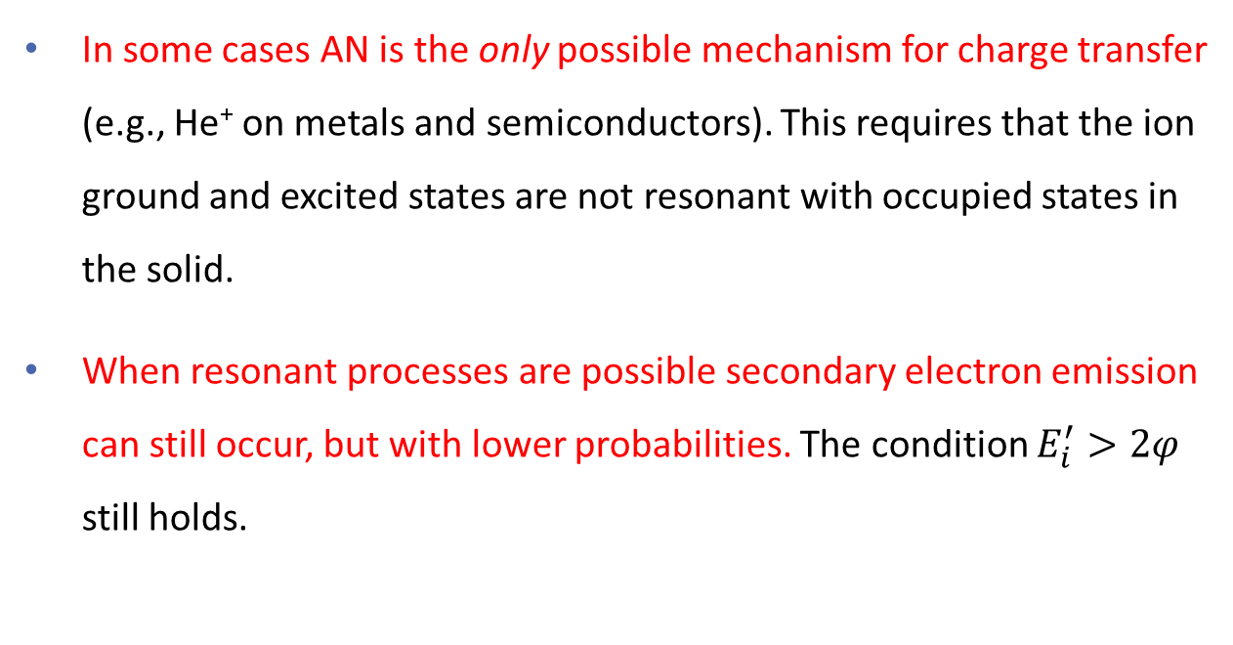
Other mechanisms?
In some cases AN is the only possible mechanism for charge transfer (e.g., He⁺ on metals and semiconductors). This requires that the ion ground and excited states are not resonant with occupied states in the solid.
When resonant processes are possible secondary electron emission can still occur, but with lower probabilities. The condition $E_{i}^{′}>2φ$ still holds.

Slide 7










Auger neutralization – external emission
✓
$$ε_{0}$$
Vacuum level
Conduction band
$$ε_{c}$$
$$χ$$
Energy lost by electron 1 is taken by electron 2
If sufficiently large and electron 2 starts from the upper valence band it may be emitted externally
$$ε_{g}$$
$$φ$$
$$ε_{v}$$
$$1$$
Valence band
$$2$$
$$E_{i}^{′}$$
$$0$$
Insulator
Ion ground state below bottom of valence band
Ion

Slide 8
Auger neutralization – internal emission
✗
$$ε_{0}$$
Vacuum level
Conduction band
$$ε_{c}$$
$$χ$$
If electron 2 starts from the lower valence band it may enter the conduction band without external emission
Also useful?
$$ε_{g}$$
$$φ$$
$$ε_{v}$$
$$1$$
Valence band
$$2$$
$$E_{i}^{′}$$
$$0$$
S. Shchemelinin and A. Breskin, “Observation of electron excitation into silicon conduction band by slow-ion surface neutralization”, arXiv:1607.02924
Insulator
Ion ground state below bottom of valence band
Ion

Slide 9
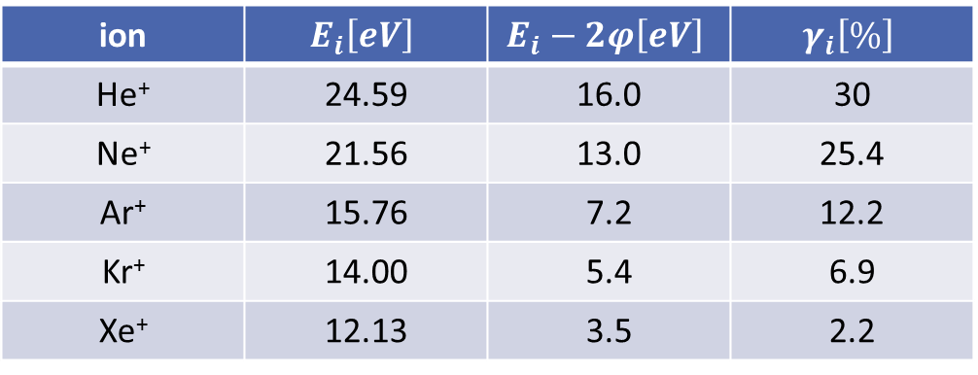
IISEE yields of noble gas ions
Target: atomically clean molybdenum, work function 4.3 eV
ion | $$E_{i}\left[eV\right]$$ | $$E_{i}−2φ\left[eV\right]$$ | $$γ_{i}\left[\%\right]$$
He⁺ | 24.59 | 16.0 | 30
Ne⁺ | 21.56 | 13.0 | 25.4
Ar⁺ | 15.76 | 7.2 | 12.2
Kr⁺ | 14.00 | 5.4 | 6.9
Xe⁺ | 12.13 | 3.5 | 2.2
Monolayer of N₂ on W reduces $γ_{i}$ by a factor ranging from 1.6 (He) to 6.5 (Xe)
H. D. Hagstrum, Phys Rev 104 (1956) 672

Slide 10
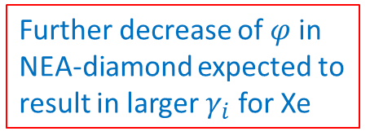



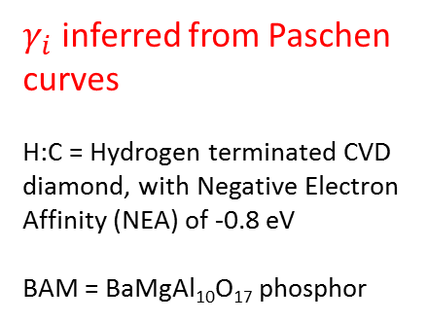

IISEE yields of noble gas ions
$γ_{i}$ inferred from Paschen curves
H:C = Hydrogen terminated CVD diamond, with Negative Electron Affinity (NEA) of -0.8 eV
BAM = BaMgAl₁₀O₁₇ phosphor
Xe: $γ_{i}=2\%$
$$φ=4.6 eV$$
Further decrease of $φ$ in NEA-diamond expected to result in larger $γ_{i}$ for Xe
Decreasing $φ$
Elsbergen et al, SID Int. Symp. Dig. Tech.
Papers, 2000, 220–223.
$$E_{i}^{}−2φ [eV]$$

Slide 11
So what’s NEXT?
MC of ββ0ν event – 2 blobs at the ends

Slide 12

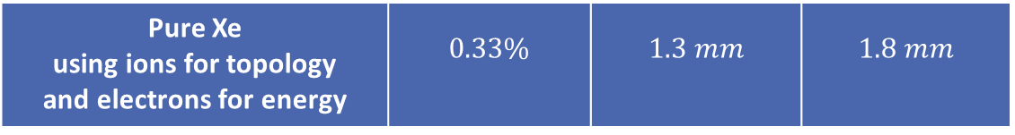
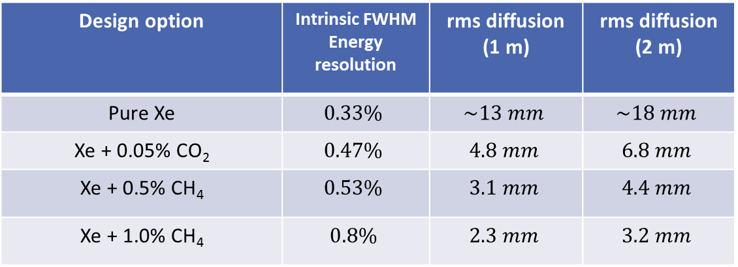
Compromise?
Searching for $ββ0ν$ in HPXe at the ton scale → compromise between energy resolution and accuracy in track reconstruction
Design option | Intrinsic FWHM Energy resolution | rms diffusion (1 m) | rms diffusion (2 m)
Pure Xe | $$0.33\%$$ | $$\sim 13 mm$$ | $$\sim 18 mm$$
Xe + 0.05% CO₂ | $$0.47\%$$ | $$4.8 mm$$ | $$6.8 mm$$
Xe + 0.5% CH₄ | $$0.53\%$$ | $$3.1 mm$$ | $$4.4 mm$$
Xe + 1.0% CH₄ | $$0.8\%$$ | $$2.3 mm$$ | $$3.2 mm$$
*
Pure Xe using ions for topology and electrons for energy | $$0.33\%$$ | $$1.3 mm$$ | $$1.8 mm$$
* Azevedo et al, JINST 11 (2016) C02007 arXiv:1511.07189 – 10 bar, 300 V/cm

Slide 13

Let’s take this one step at a time
$1∙{10}^{5}$ electron-ion pairs for event at $Q_{ββ}$
All Xe⁺ ions immediately ($\sim {10}^{−10}$ s) convert to Xe₂⁺
Electrons quickly reach EL region near anode (at +HV)
Energy + (smeared) track image measured by electrons EL signal
Xe₂⁺ ions reach cathode plane within <1 s
Xe₂⁺ ions ionization energy = 11.2 eV (lowest of all impurities) → no charge-exchange collisions → all Xe₂⁺ ions make it to cathode

Slide 14
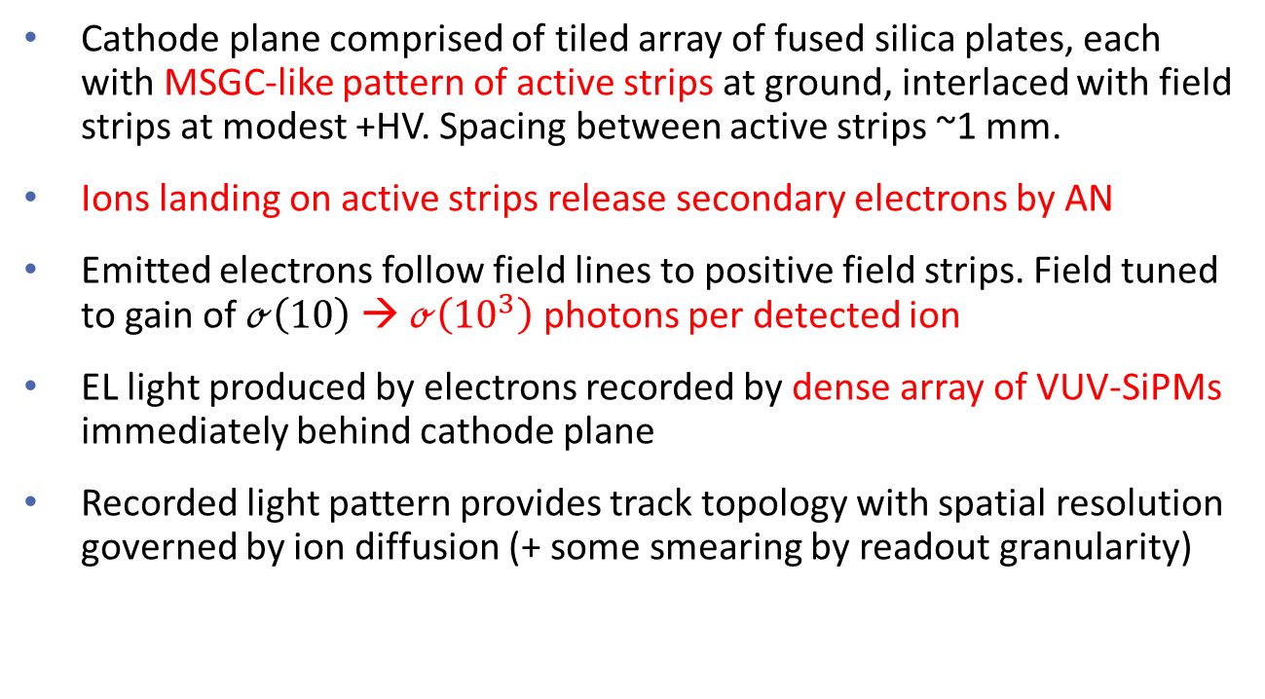
Now here comes the fun part
Cathode plane comprised of tiled array of fused silica plates, each with MSGC-like pattern of active strips at ground, interlaced with field strips at modest +HV. Spacing between active strips ~1 mm.
Ions landing on active strips release secondary electrons by AN
Emitted electrons follow field lines to positive field strips. Field tuned to gain of $ℴ\left(10\right)$→ $ℴ\left({10}^{3}\right)$ photons per detected ion
EL light produced by electrons recorded by dense array of VUV-SiPMs immediately behind cathode plane
Recorded light pattern provides track topology with spatial resolution governed by ion diffusion (+ some smearing by readout granularity)

Slide 15
Cathode plane cartoon
ion
~1 mm
Secondary electron
Active strip (ground)
Field strip (+V)
Fused silica
VUV sensitive SiPMs

Slide 16

Some numbers
EL signals sufficiently large ($ℴ\left({10}^{3}\right)$ photons)
Ion Detection efficiency $=γ_{eff}= γ_{i}∙ε_{ext}$
where $ε_{ext}$ is the extraction efficiency = probability that the emitted electron is not backscattered to the surface
$ε_{ext}$ can be readily >20% → $γ_{i}$ of a few % will provide several hundred detected ions (out of $1∙{10}^{5}$)
E.g. $γ_{i}=2\%$ & $ε_{ext}=20\%$→ 400 detected ions with ~0.5 mm spacing for 20 cm track

Slide 17
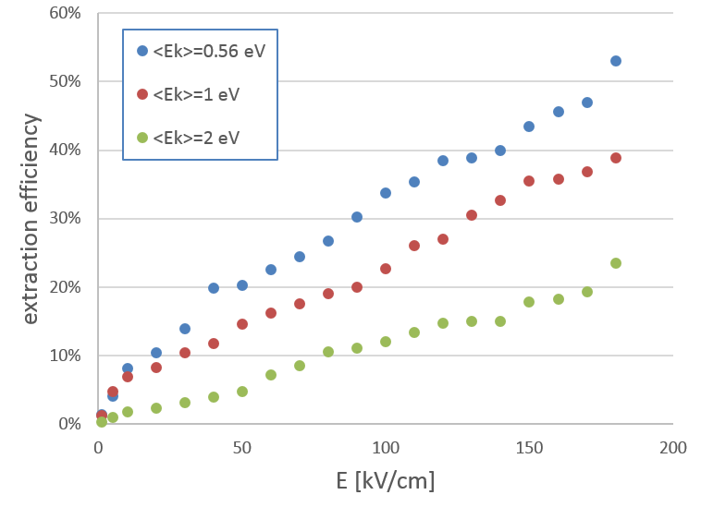
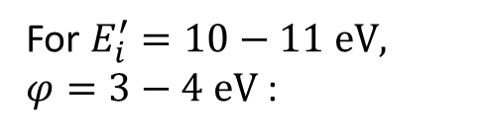
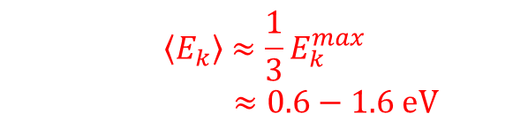
Extraction efficiency of electrons into 10 bar Xe at room temperature
For $E_{i}^{′}=10−11 eV,$
$φ=3−4 eV$ :
$$\left\langle E_{k}\right\rangle ≈\frac{1}{3}E_{k}^{max}$$
$≈0.6−1.6 eV$
Garfield++

Slide 18

Some more numbers
For 6 mm SiPMs with array PDE=10%, 3 mm behind the cathode plane, the emission of 2000 EL photons into 4π gives $σ_{xy}≈0.5 mm$ for center-of gravity (COG) determination
For avalanche gain = 10, the required EL is then ~200 photons/e over a trajectory of ~0.5-1 mm (NEXT-100 TDR: 2500 photons/e over 5 mm)
To avoid continuous ion feedback we need $gain∙γ_{eff}<1$ – readily satisfied for gain of $ℴ\left(10\right)$ and $γ_{eff}<1\%$
EL signals will last $ℴ\left(10−100 ns\right)$. Contribution of SiPM dark counts (even if 10⁵ Hz/mm²) will be small over the total area of the SiPM pixels used for COG
EL photon feedback expected to be low (for active material of low QE and thin strips)
BUT: Field emission must be kept very low (roughly <10⁻¹⁴ A/cm²)

Slide 19

Candidate materials
CVD diamond with negative electron affinity (NEA)
Either nanoparticles (UNCD – ultrananocrystalline diamond) or single-crystal layers
‘Tunable’ NEA depends on surface termination (e.g. by H, D or Mg) and annealing → work function can be tuned to 3-4 eV
(at $φ=4.6 eV$ $γ_{i}=2\%$for Xe ions; naively $φ=3 eV$→ $γ_{i}≈10\%$)
Passivation through surface termination → no monolayer of impurities
Can be used to form thin strips on fused silica
Field emission may be high for UNCD (much less for single-crystal layers), but can possibly be kept low enough by tweaking the parameters

Slide 20
Candidate materials
Thin MgO film on molybdenum
Few atomic layers of MgO grown on single-crystal Mo
Work function 3.2 eV
Passivation provided by MgO → no monolayer of impurities
No known issues with field emission
Stuckenholz et al, J. Phys. Chem. C 2015, 119, p. 12283

Slide 21

Summary and outlook
Positive ion detection in ton-scale $ββ0ν$ searches in HPXe may enable having both superb intrinsic energy resolution (0.3% intrinsic FWHM at $Q_{ββ}$) and accurate track reconstruction ($σ<1.8$mm over 2 m drift)
It will also enable having a $t_{0}$ signal from S1 (likely lost for Xe + admixtures)
Since we start with 10⁵ ions a modest IISEE yield of a few % will be sufficient for detecting several hundred ions with sub-mm spacing → should be enough to identify the two blobs + other track features
Such yields appear at hand using existing materials (but must keep an eye on field emission)
First samples for testing are expected soon from Argonne National Laboratory
Careful studies required to translate this to actual sensitivity to $ββ0ν$
Can AN be also used in directional dark matter searches?

Slide 22
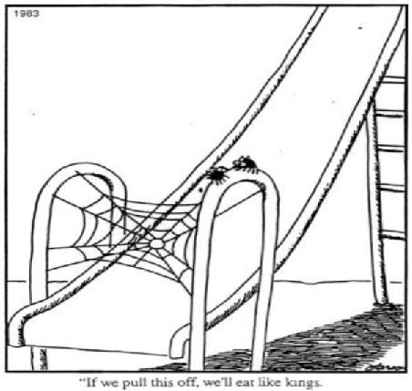
“If we pull this off, we’ll eat like kings.”
G. Larson, “The Far Side” (1983)

Slide 23
Backup slides

Slide 24

Resonance neutralization
Dominant when the ground state of the ion lies above the bottom of the valence band (in insulators)
A first valence electron tunnels resonantly to the ion ground state and neutralizes it, without losing energy
A second valence electron drops to fill the hole left by electron 1
The energy lost by electron 2 can be taken by a third electron only if it puts it in the conduction band (and may then be emitted) – otherwise it will be lost through other channels.
Electron emission out of the solid still requires $E_{i}^{′}>2φ$ and happens with lower probability than the pure AN case.

Slide 25




Resonance neutralization – external emission
$$ε_{0}$$
Vacuum level
Conduction band
$$ε_{c}$$
$$χ$$
If the energy lost by electron 2 as it drops to fill the hole is large enough, electron 3 can make it out.
$$ε_{g}$$
$$φ$$
$$ε_{v}$$
$$2$$
$$3$$
$$E_{i}^{′}$$
Valence band
✓
$$0$$
$$1$$
Insulator
Ion
Ion ground state above bottom of valence band

Slide 26



Resonance neutralization – forbidden transitions
$$ε_{0}$$
Vacuum level
Conduction band
$$ε_{c}$$
$$χ$$
If the energy lost by electron 2 is smaller than the band gap the transition is forbidden and the excess energy is released by other mechanisms (e.g., photon emission).
$$ε_{g}$$
$$φ$$
$$×$$
$$ε_{v}$$
$$3$$
$$E_{i}^{′}$$
$$2$$
✗
Valence band
$$0$$
$$1$$
Insulator
Ion
Ion ground state above bottom of valence band

Slide 27
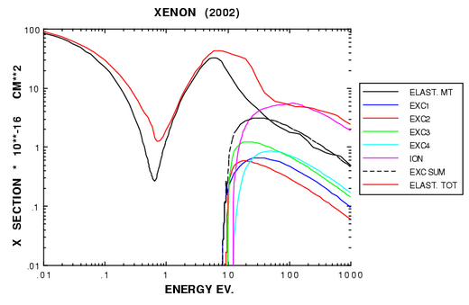
Xe cross sections (Magboltz)

Slide 28
H. D. Hagstrum, Phys Rev 104 (1956) 672
H. D. Hagstrum, Phys Rev 122 (1961) 83

Slide 29



$γ_{i}$ and $γ_{eff}$ for CH₄ ions on bialkali photocathodes
$$ε_{ext}=6\%$$
$$γ_{i}=47−49\%$$
Lyashenko et al, J. Appl. Phys. 106 (2009) 044902

