Slide 1
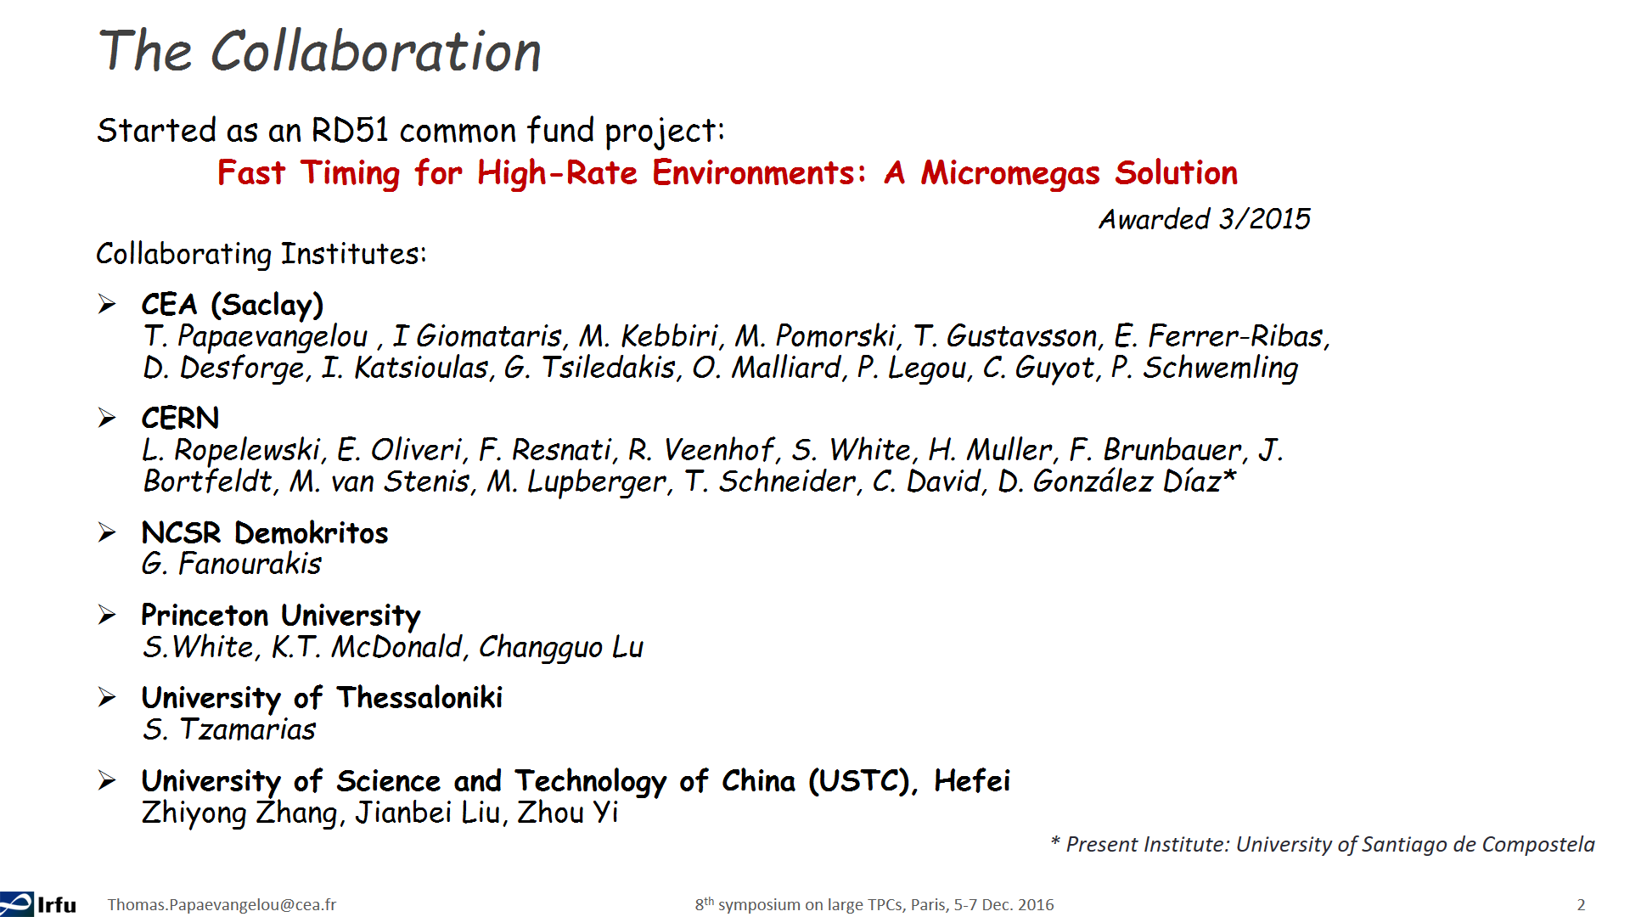
Picosecond
Summary of 2016 activities and future plans

Slide 2
outline
Introduction to picosecond
Summary of 2016 activities
Future R&D plans
  Intrinsic Resolution… looking for the limit
  Detector Optimization and Scaling… towards applications

Slide 3
References for more details…
A picosecond Micromegas EUV photodetector, T. Papaevangelou, 8th symposium on large TPCs for low-energy rare event detection, 5-7 December 2016, Paris (https://indico.cern.ch/event/473362/contributions/2317653/attachments/1384392/2105987/TPapaevangelou_MM_PicosecondPhotodetector.pdf)
(Ultra-) Fast tracking of Minimum Ionizing Particles with a Micromegas detector, T. Papaevangelou, 14th Topical Seminar on Innovative Particle and Radiation Detectors (IPRD16) 3 - 6 October 2016 Siena, Italy (http://www.bo.infn.it/sminiato/sm16/04_Giovedi/Mattina/10_Papaevangelou.pdf)
Report on PICOSEC Beam tests , S. White, MPGD Applications Beyond Fundamental Science Workshop and the 18th RD51 Collaboration Meeting, Aveiro, Portugal (https://indico.cern.ch/event/525268/contributions/2298965/attachments/1335651/2008896/aveiroSeb.pdf)
Picosec: test beam summary and outlook, F. Resnati, MPGD Applications Beyond Fundamental Science Workshop and the 18th RD51 Collaboration Meeting, Aveiro, Portugal (https://indico.cern.ch/event/525268/contributions/2297868/attachments/1336635/2010819/testBeam.pdf)
RD51–H4 –May/June 2016 Test beam, M Lupberger, RD51 Mini-Week 6-9 Jun 2016, CERN (https://indico.cern.ch/event/532518/contributions/2195706/attachments/1287366/1915899/PicosecondeTestBeam.pdf )
Fast Timing for High-Rate Environments with Micromegas, T. Papaevangelou, MPGD 2015 & RD51 Collaboration meeting 12-17 October 2015 Trieste – Italy (https://agenda.infn.it/contributionDisplay.py?contribId=83&sessionId=2&confId=8839 , https://arxiv.org/abs/1601.00123 )

Slide 4
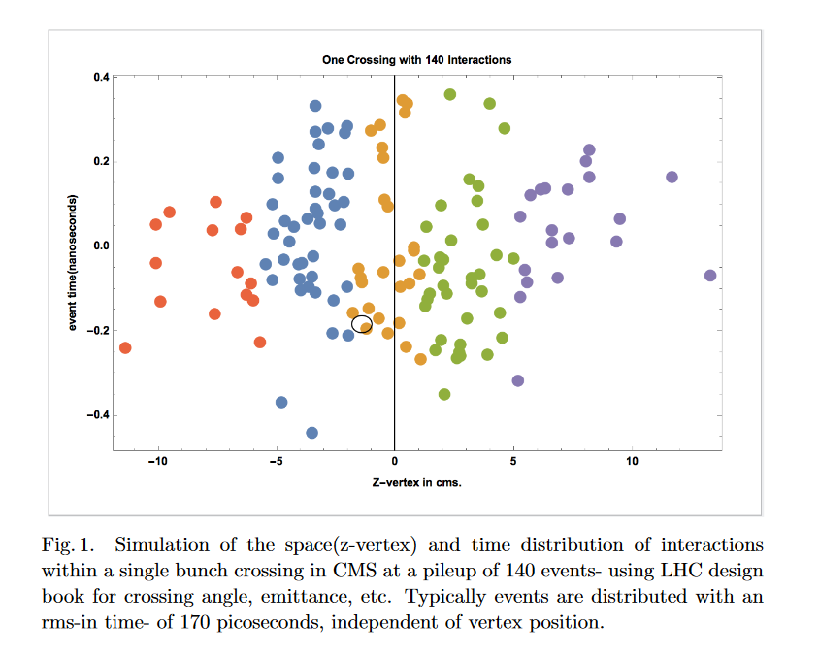
Why tens of picoseconds are interesting….
R&D for a Dedicated Fast Timing Layer in the CMS Endcap Upgrade S. White
https://arxiv.org/pdf/1409.1165v2.pdf

Slide 5
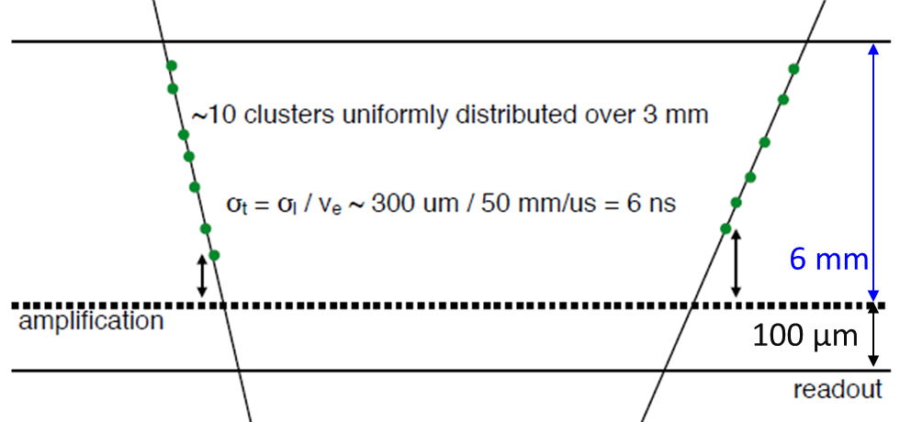
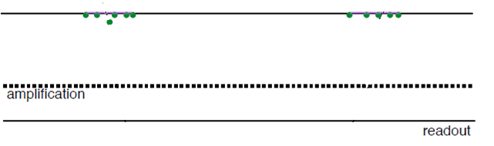
Being fast and precise with gaseous detector….
At the same time in the same place
“primary” electrons localized in time and space
(electrons from solid converter) with negligible contribution from the ionization in the gas
Direct ionization in gas limits the time response
A picosecond Micromegas EUV photodetector, T. Papaevangelou, 8th symposium on large TPCs for low-energy rare event detection, 5-7 December 2016, Paris

Slide 6
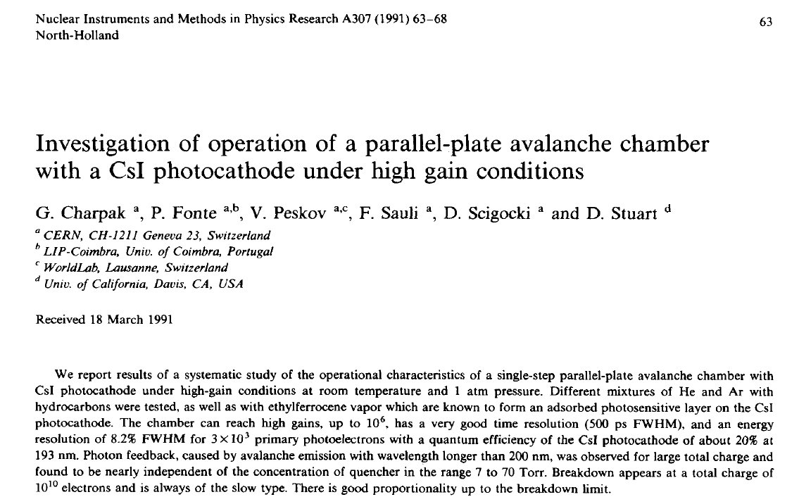
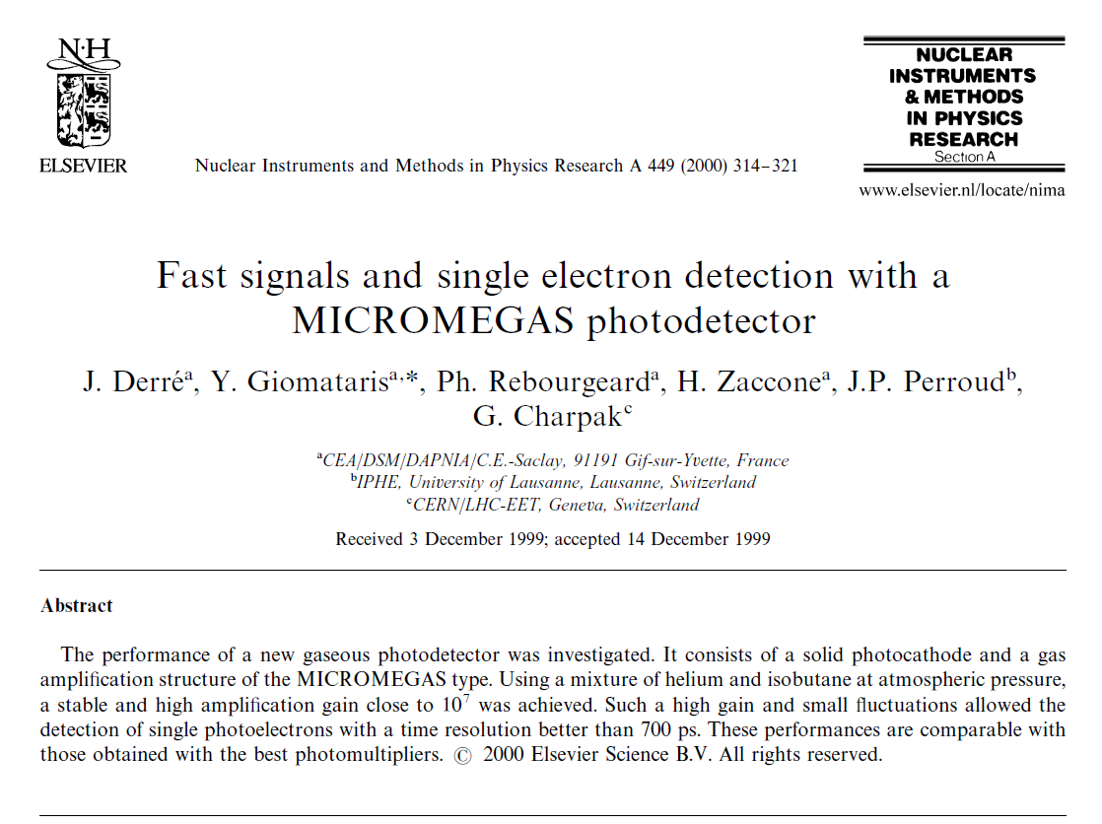
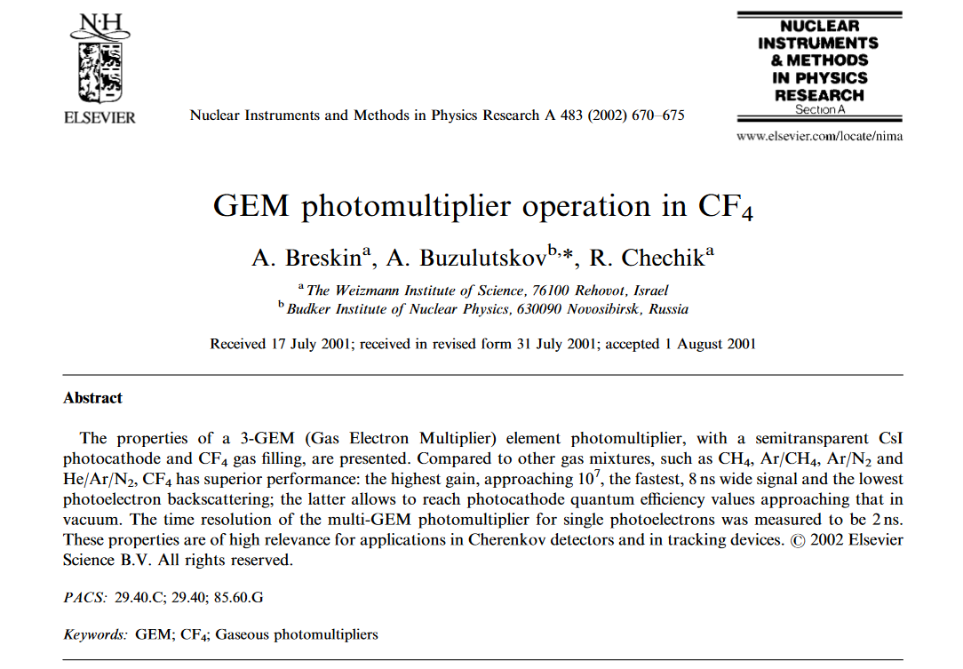
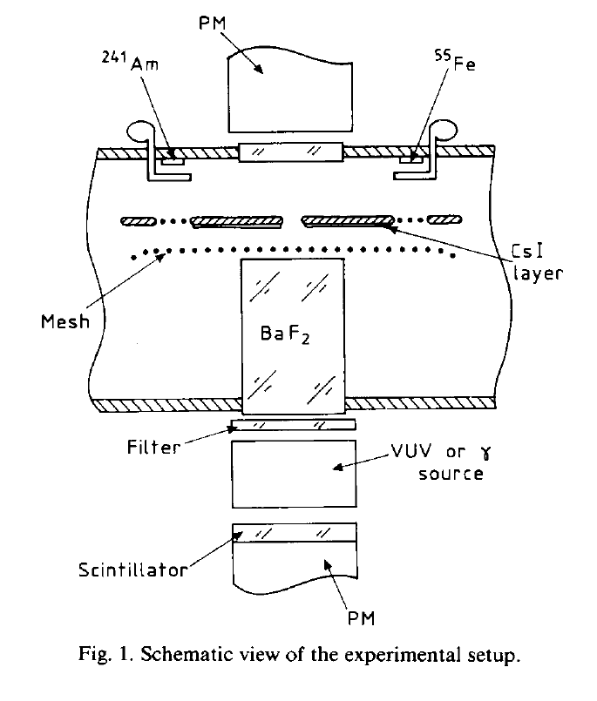
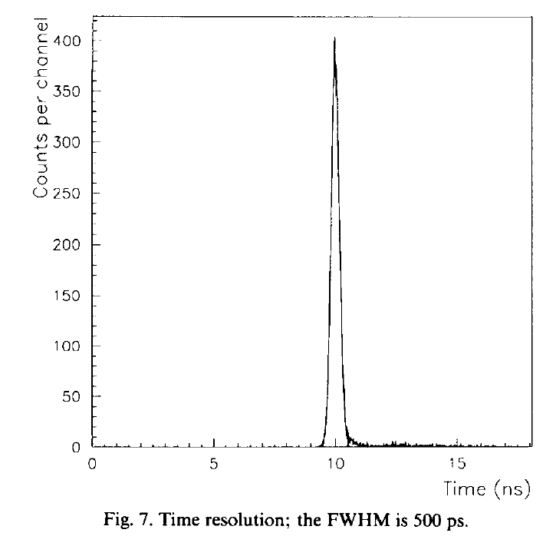
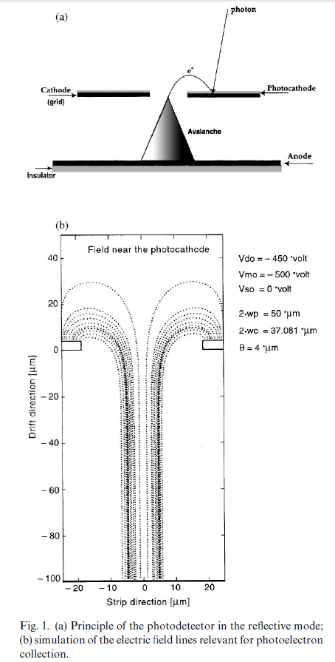
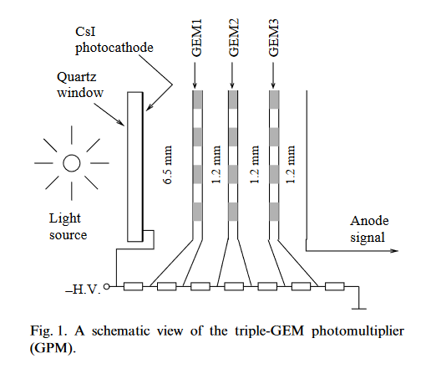
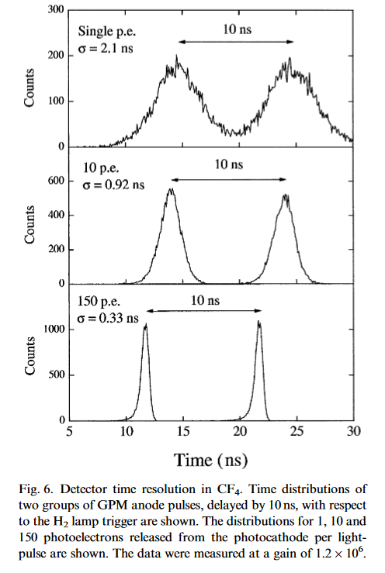
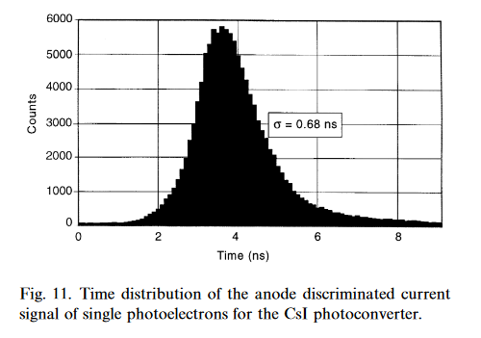
Photoconverters… CsI….
Sub-nanosecond time response

Slide 7
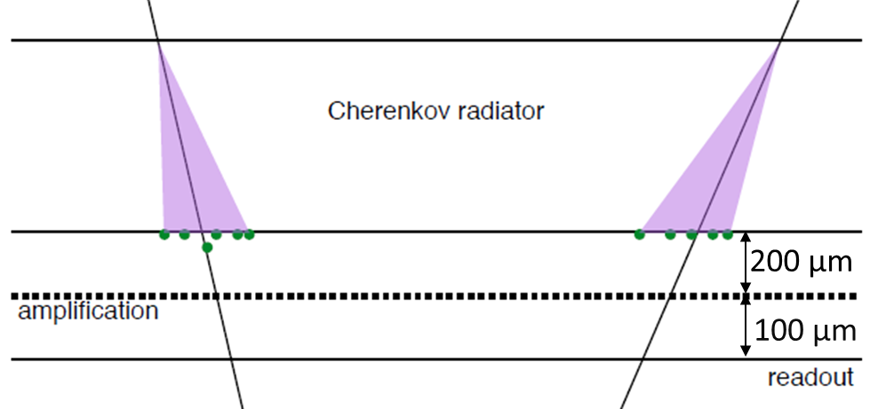
Saclay&CERN/Princeton (Ioannis&Sebastian..) proposal: Fast Timing for High-Rate Environments:
A Micromegas Solution
Cerenkov radiator
prompt photon source
Small Drift
low primary ionization in gas
low diffusion
Pre-amplification
longitudinal diffusion reduced
effects of primary ionization in gas reduced
(semitransparent photocathode configuration)
RD51 common fund project

Slide 8
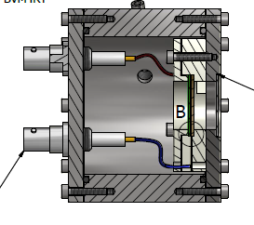
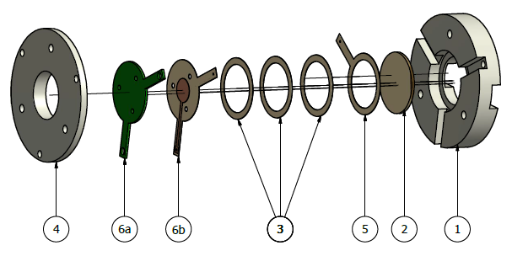
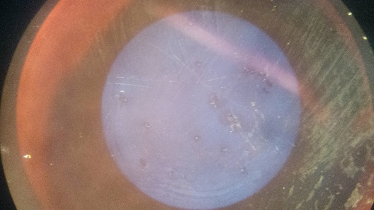
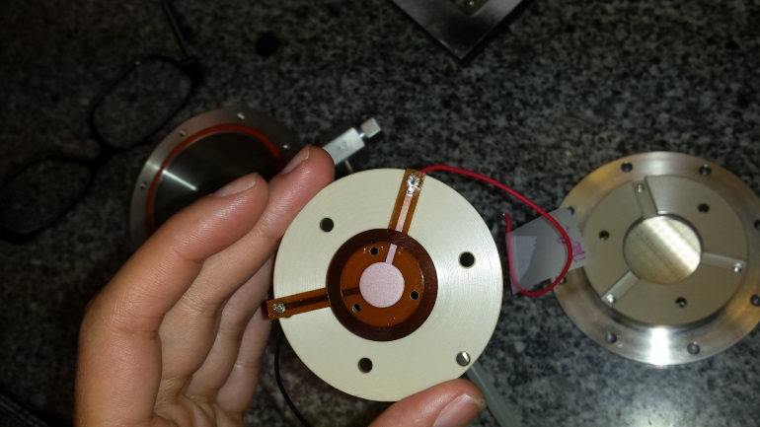
Starting form the first Picosec prototype (1cm diameter active area)….

Slide 9
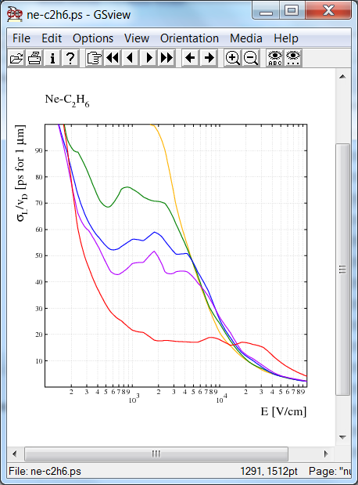
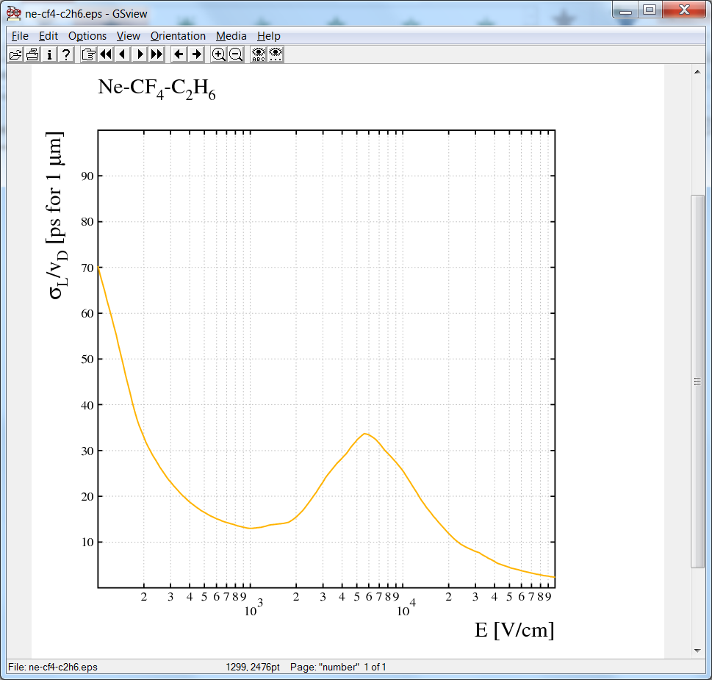
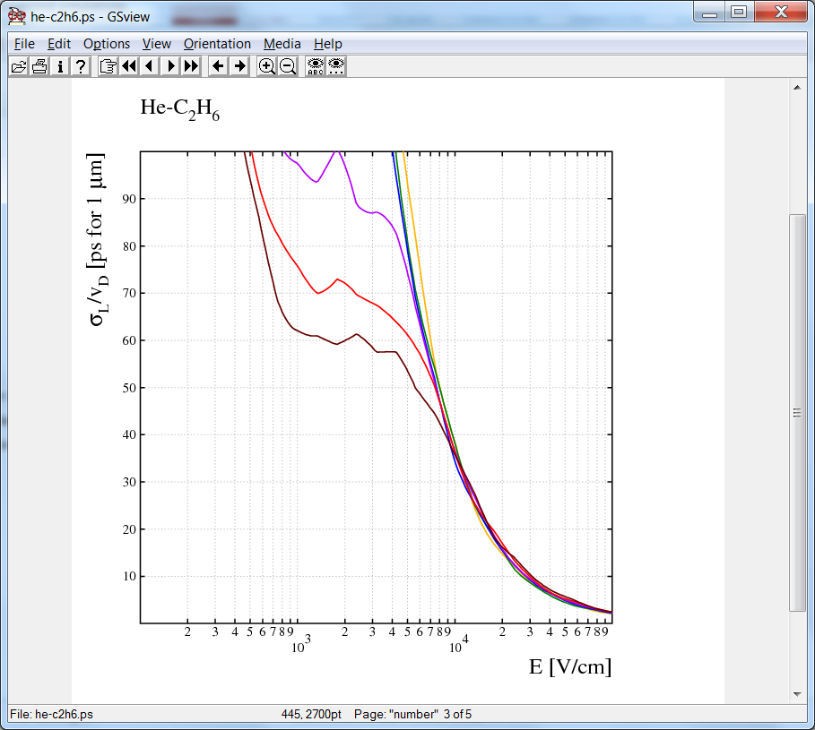
..plus some hints from (Rob) simulation for the gas choice….
5 %
10 %
15 %
20 %
100 %
@ 0.5 bar

Slide 10
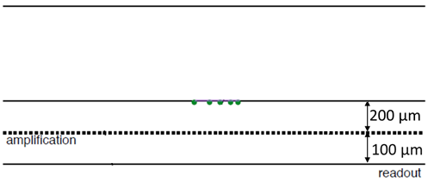
… the first validation of the idea came (2015)
Time response vs photoelectrons – Laser Tests
IRAMIS facility @ CEA Saclay
UV laser with σ_{t} << 100 fs
LASER
Al Layer
You forget about radiator and photo conversion…
you stay focused on n_{phe} … no matter how they are produced

Slide 11
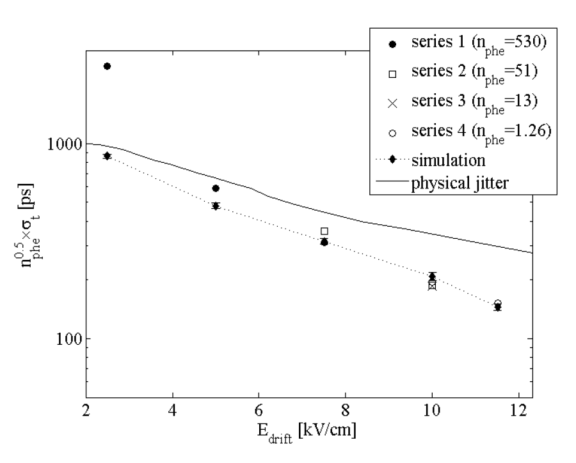
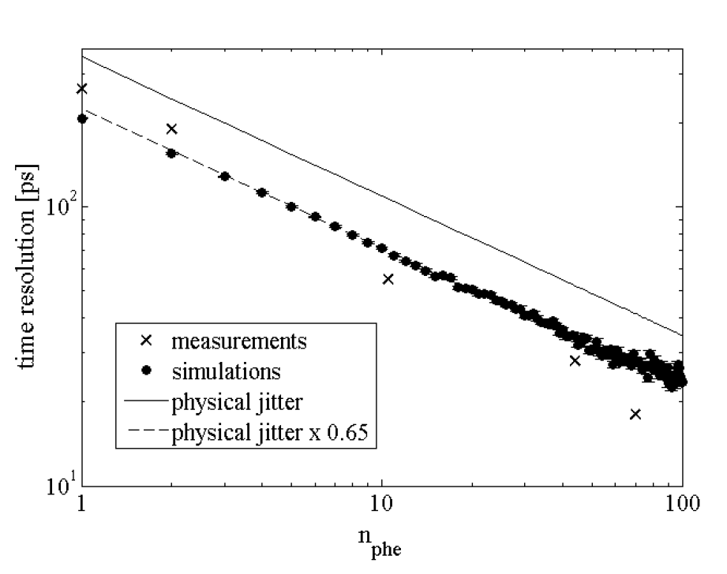
Dependence with the number of photoelectrons
Dependence with the drift field
1phe with about 150-200ps
100ps → 5phe
2015 run: Ne (90%) + C2H6 (10%)
No gas circulation - gas renewed every 24 h
Single p.e. σt~180 ps @ ~12 kV/cm2
(*)
50ps → 20phe
30ps → 60phe
(*) Results relative to the specific configuration used, to be NOT considered as the best results achievable.
Fast Timing for High-Rate Environments with Micromegas, T. Papaevangelou, MPGD 2015 & RD51 Collaboration meeting 12-17 October 2015 Trieste – Italy (https://agenda.infn.it/contributionDisplay.py?contribId=83&sessionId=2&confId=8839 , https://arxiv.org/abs/1601.00123 )

Slide 12
After the laser test… next step … validation with charged particles (MIPs):
Time response with muons beam (150GeV)
Picosec Readout: Cividec C2 2GHz, 40 db preamplifier acquired via (LeCroy) Oscilloscope
Timing: MCP-PMT (see S. White talk in WG1 session)

Slide 13
During the 2016 test beam campaign we learned how to get “clean” signal out of picosec…
Mesh Grounded, Signal routing and connectivity (SMA), grounding

Slide 14
Development of robust analysis
Analysis by S. Tzamarias(Aristotle University of Thessaloníki (GR))
See mini week talk: Re-analysis of picosec-Micromegas detector, WG2 session, Wednesday 14th

Slide 15
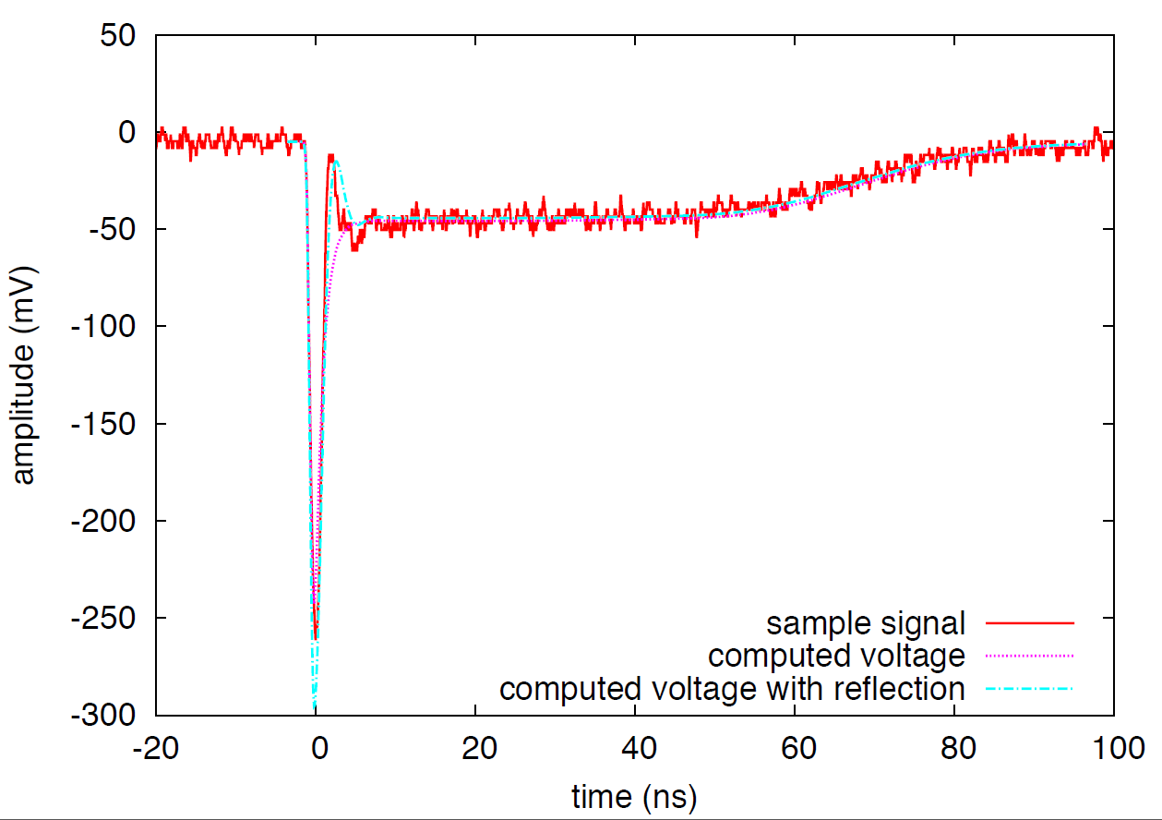
Development of simulations of the induced signals
F. Resnati, Internal GDD-FT Joint Meeting

Slide 16
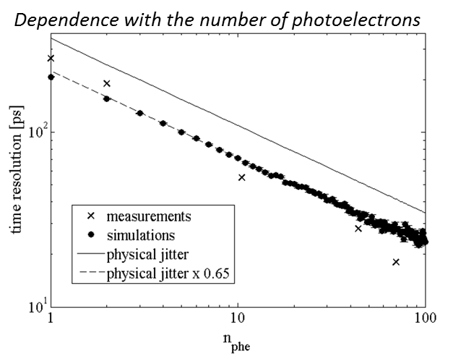
Current status of measurements, developments and tools of the Picosec Collaboration
Photoelectron response (laser)
(Clean) MIPs Response (test beam)
Robust data analysis
Simulation (and prediction) of Induced Signal

Slide 17
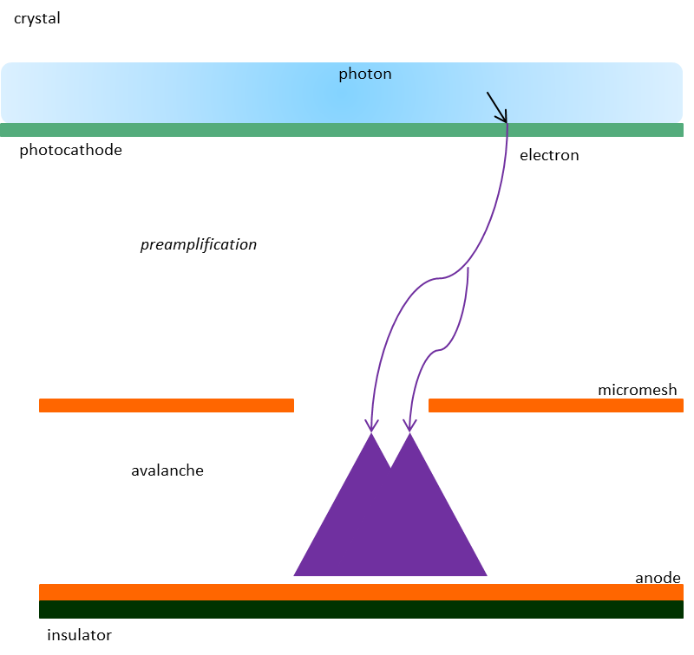
2016 Test Beam Campaign
150GeV muons, SPS North Area Extraction lines, RD51 Test beam (H4 area)
Picosec Readout: Cividec C2 GHz, 40 db preamplifier acquired via (LeCroy) Oscilloscope
Timing: MCP-PMT (see S. White talk after)
Triggering: small active area (efficiency) 5x5mm² with preliminary veto for single muon selection or large area (border effects) 2x2cm² scintillators
Tracking: triple GEM tracker (secondary veto for single muons selection, spatial response of picosec)

Slide 18
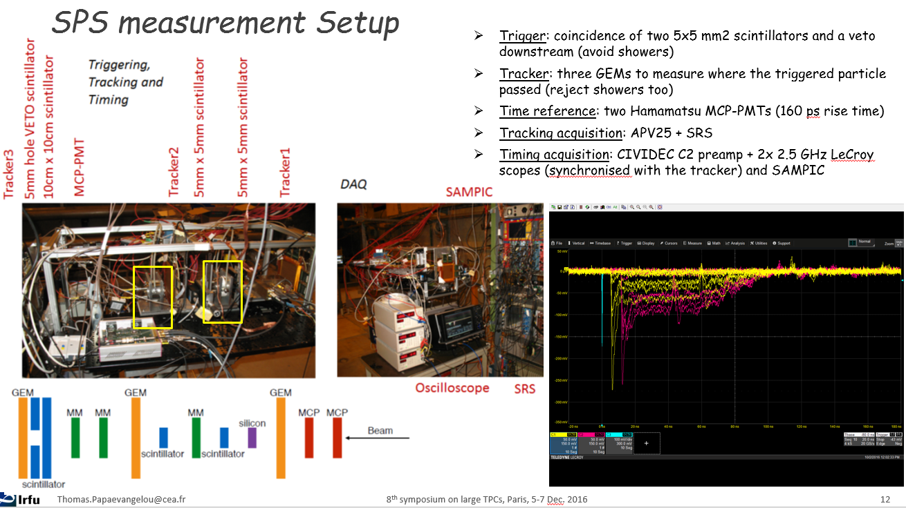
Signal (Timing,amplitude) info from Oscilloscope (Picosec/MCP-PMT)
Synchronization with SRS-APV25 GEM tracker (J. Bortfeldt) for uniformity/border effects/…
Analysis tools almost finalized (Spyros)… Binary data conversion and compression (Yi) ready to start

Slide 19
Radiator
Crystal:
Different Thicknesses of MgF2 (2,3,5mm)
Different MgF2 producer

Slide 20
Photocathodes
Photocathodes:
CsI
    different “producer” (CERN, Saclay, Hamamatsu)
    different thicknesses (11, 18, 25, 36nm)
    different metallic layer (Al, Cr)
    different metallic layer thickness (Cr 3,5.5nm)
Metallic
Al, Cr (10,15,20nm)
Diamond
B-doped Diamond on Cr

Slide 21
Sensor (Micromegas mesh)
Different Meshes Tested:
standard bulk
bulk with reduced number of pillars
thin mesh
micro-bulk (laboratory tests)

Slide 22
Gas and Fields
Test at different gas mixture
Ed
Test at different fields
Eg

Slide 23
Grounding and Signal routing
Important Improvement in the Signal Integrity
Mesh ground: amp and drift field (more) decoupled (in case of sparks)
Different grounding configuration
-HV
SHV/SMA connector
High Voltage on mesh / grounded mesh
+HV

Slide 24
Crystal:
Different Thicknesses of MgF2 (2,3,5mm)
Different MgF2 providers
Photocathode:
CsI
different producer (CERN, Saclay, Hamatsu)
different thicknesses (11, 18, 25, 36nm)
different metallic interface (Al, Cr)
different metallic interface thicknesses (Cr 3,5.5nm)
Metallic
Al(8nm), Cr (10,15,20nm)
Diamond
B-doped Diamond on Cr
Test at different gas mixture
Ed
Test at different fields
-HV
Eg
Mesh:
standard bulk
bulk with reduced number of pillars
thin mesh
micro-bulk (laboratory tests)
SHV/SMA connector
High Voltage on mesh / grounded mesh
+HV

Slide 25
2017 R&D Activities
Intrinsic Resolution (pure detector physics R&D):
photoelectrons extraction (crystal, photocathodes,…)
gas and fields optimization
meshes and gaps
Detector Optimization (towards application):
photocathode aging: measurement and improvement
(protection layer, metallic photocathodes, diamond,…)
photocathode robustness: sparks
Resistive micromegas
Detector Scaling (towards application):
multi-anode readout
Larger area

Slide 26
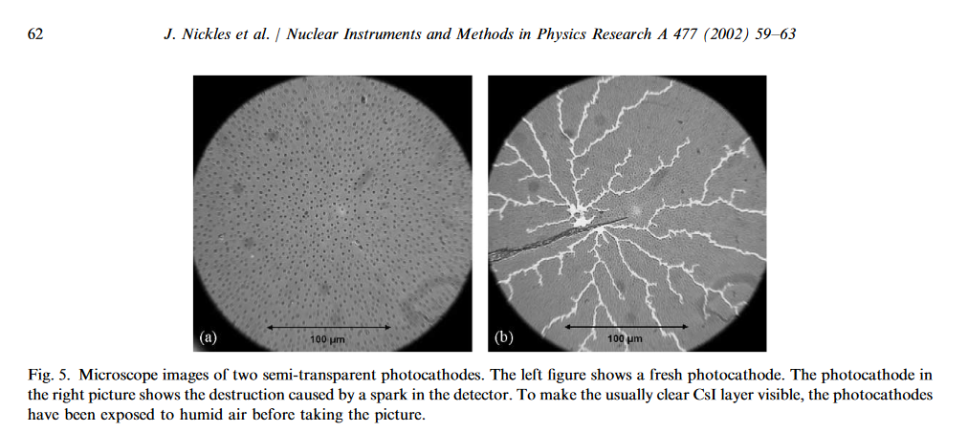
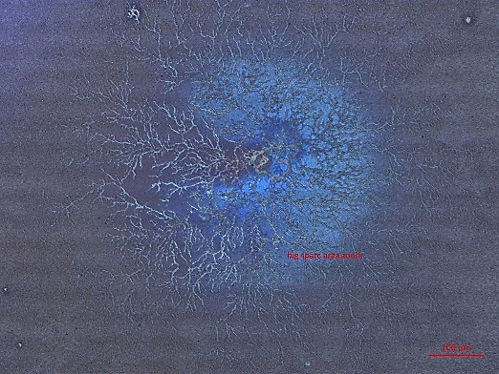
2017 R&D Activities
To be ready to face future problems
CsI…
How to preserve its properties.. Not necessarily bad but for sure difficult to handle in some applications
Detector Optimization (towards application):
photocathode aging: measurement and improvement
(protection layer, metallic photocathodes, diamond,…)
photocathode robustness: sparks
CsI Aging (std units μC/cm²-mm²) and sparks (protecting, quenching..)
From literature…
From the August Test Beam..…
Sparks
Picosec (T. Schneider)
Protection Layers (looking for new materials and protective structures… starting from literature – Va’vra[WIS] https://cds.cern.ch/record/287770/files/SCAN-9509070.pdf just as an example)

Slide 27
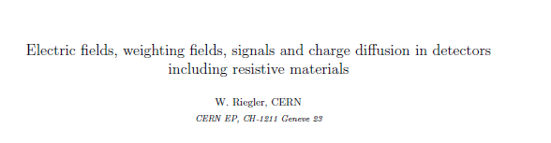
2017 R&D Activities
To be ready to face future problems
Detector Optimization (towards application):
photocathode aging: measurement and improvement
(protection layer, metallic photocathodes, diamond,…)
photocathode robustness: sparks
Resistive Micromegas…
More stable and spark quenching…
Resistive Micromegas
First step… same detector size as now (single channel, 1cm diameter active area)
Easy to test… no needs of beam… a lighter will be enough…
Induced Signal (analytical and simulation)
Interest expressed already by Supratik/Nayana…
Maybe the next task for W. Riegler: timing properties of induced signal in presence of resistive material…
time properties

Slide 28
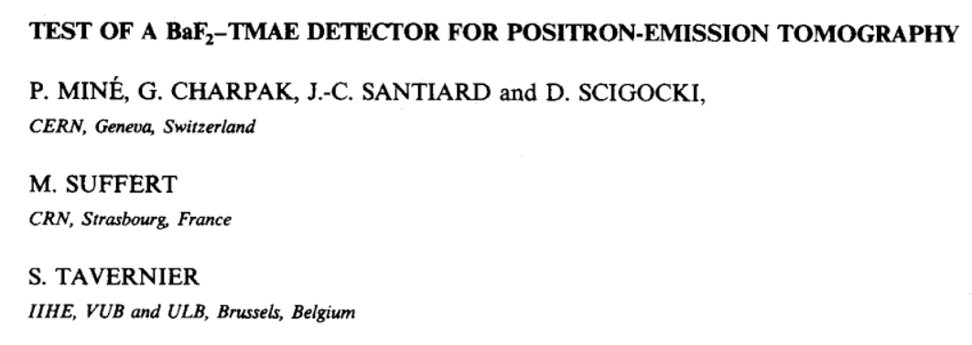
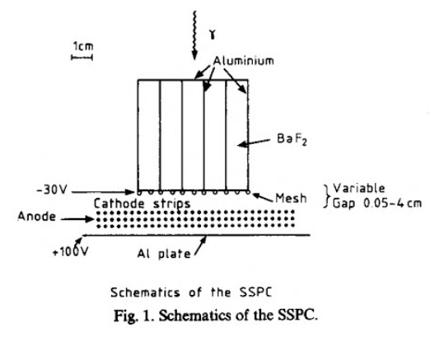
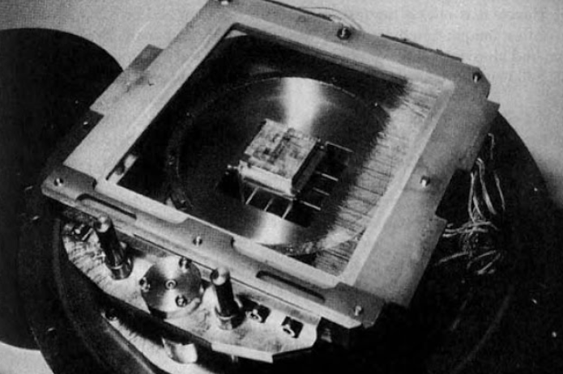
2017 R&D Activities
To be ready to face future problems
Metals…
Not bad… but to be improved
Detector Optimization (towards application):
photocathode aging: measurement and improvement
(protection layer, metallic photocathodes, diamond,…)
photocathode robustness: sparks
Metals…. Al, Cr … interesting results from beam measurements…
… looking for possible optimization (thickness, other metals/oxides…)..
or for an higher number of photons…
Thicker Crystal (more photons) in a pattern with reflective surfaces (parallelepipedes)…. To preserve position and high multiplicity operation? Maybe…. Already exploited in different application…

Slide 29
2017 R&D Activities
To be ready to face future problems
New materials..
Diamond … the first one we are looking more deeply….
Detector Optimization (towards application):
photocathode aging: measurement and improvement
(protection layer, metallic photocathodes, diamond,…)
photocathode robustness: sparks
Diamond…. as photocathodes… or as secondary emitter… ongoing activities and different “collaborators-producer” involved
Saclay (Pomorski et al) … tested already on beam
Aveiro (Joao Veloso et al)… sample in the lab to be tested
Russian Academy of Sciences, Moscow (Mikhail Negodaev)… preliminary sample in the lab, partially tested, new production ready to go after specs defined more precisely

Slide 30
2017 R&D Activities
Detector Scaling (towards applications):
Larger area.. MgF2.. 50mm standard production … possible to go for larger area too…
preserving the signal integrity and stability with larger meshes
preserving the gaps uniformity on larger surfaces
…
multi-anode readout (standard Micromegas 2x2, 4x4,.. Pads of about 1cm²)
preserving signal integrity with routing/vias/…
coupling between channels and S/N
….
multi-anode readout with Resistive Micromegas (resistive layer, discrete/embedded resistors,…)
Electronics...
Cividec for sure at the beginning but some new development (amplifier) could be needed to cope with a larger numbers of channels
Oscilloscopes and multichannel fast digitizer (SAMPIC,..)

Slide 31
Summary
Successful measurement campaigns in 2016
  Less than 50ps - “100%” efficient (MIPs) - achieved with CsI
  (in one of the good configuration, not necessarily in one of the best ones)
Complete analysis of the different configurations tested to be done
  To quantify and verify the actual feeling we have on the collected data
Interesting and exciting R&D (not exclusively Picosec related) in front of us
  Touching the intrinsic limit…
  Detector Optimization (new photocathodes, protection layer, secondary emitter,.., resistive mm)
  Detector Scaling.. Larger area and multi channel
Mandatory in view of certain applications
Large community (not only in our field) involved on this subject

