Slide 1




Position resolution of Gd-GEM detectors for the NMX instrument
Dorothea Pfeiffer
14.12.2016
RD51 miniweek
This work was funded by the EU Horizon 2020 framework, BrightnESS project 676548

Slide 2
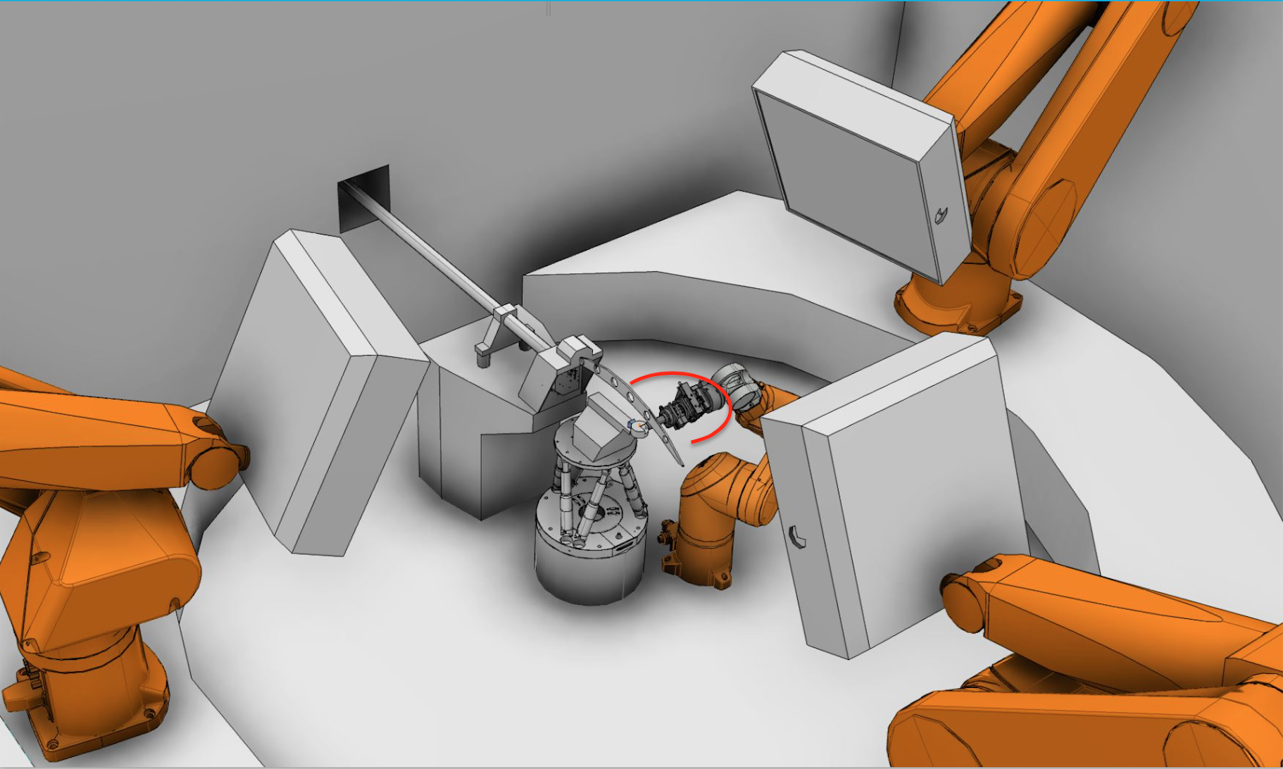
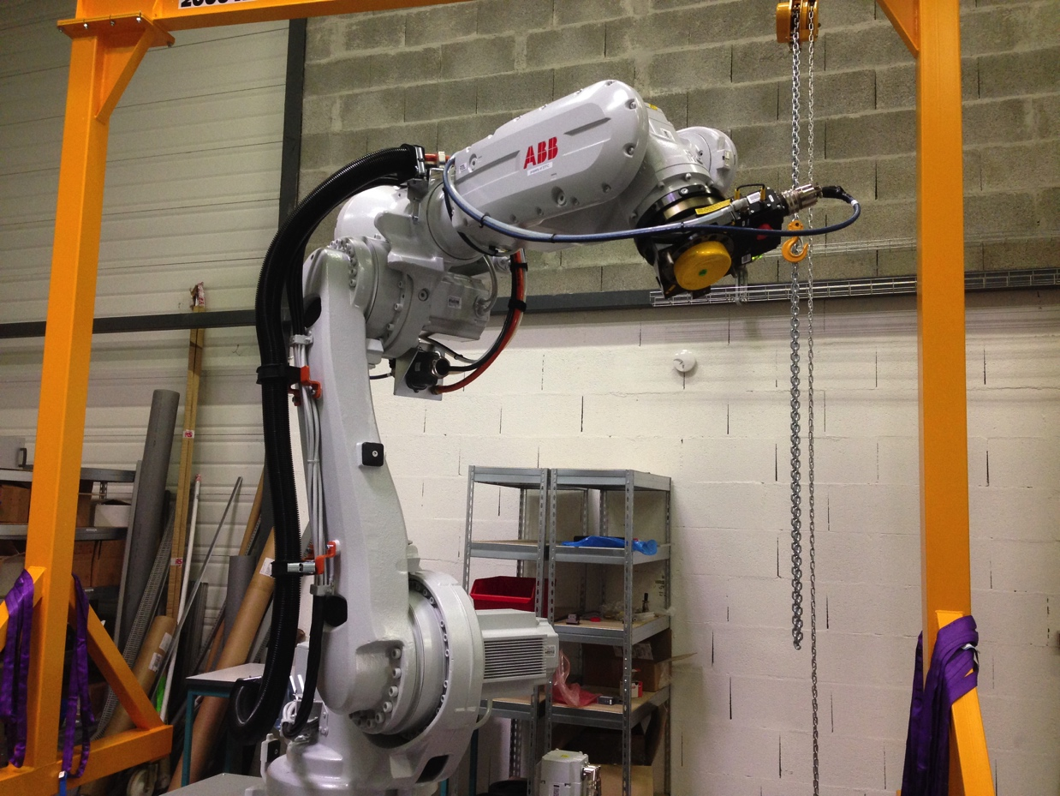
NMX detectors

Slide 3
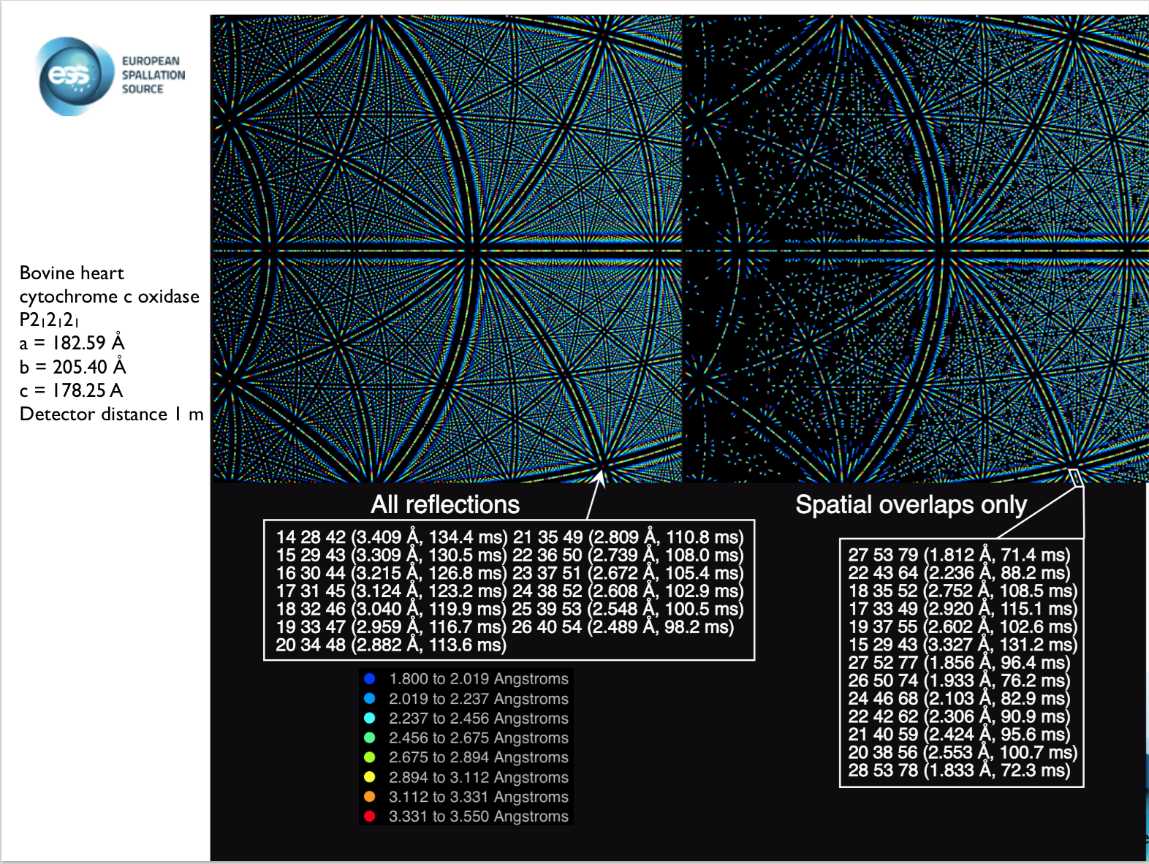
Reflections of example crystal
NMX: Macromolecular Diffractometer
Science goal: Protein crystallography with neutrons

Slide 4
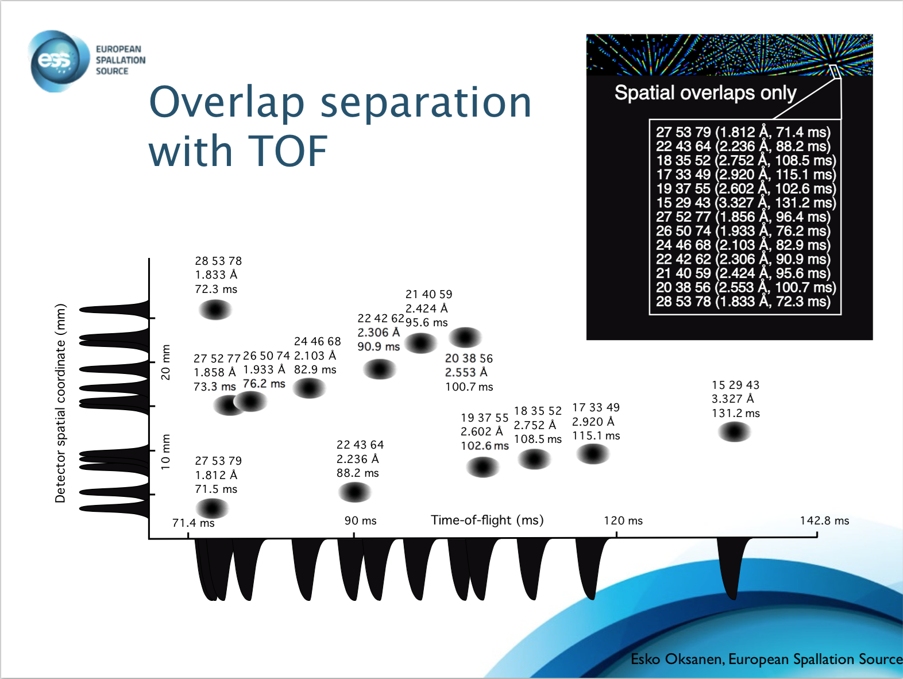
TOF separation of reflections

Slide 5
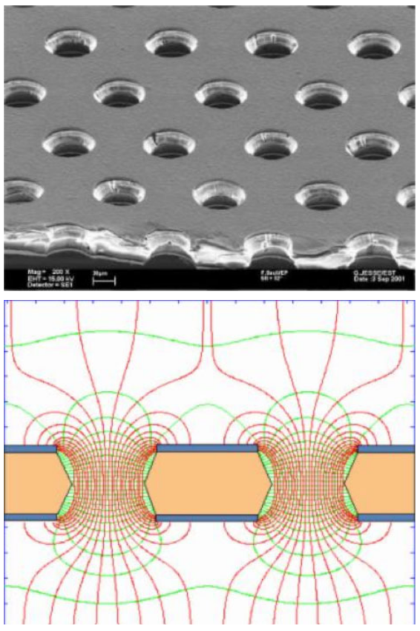
Requirements and challenges
GEM foil
200 μm position resolution (beyond state of art for time resolved neutron detectors)
High rate requirements with up to MHz/cm²
High gain stability and count rate stability
Mechanical robustness (detectors mounted on freely movable robotic arms)
Reasonable gamma suppression
Idea: Use GEM detector with Gd converter
Electrical field in holes

Slide 6
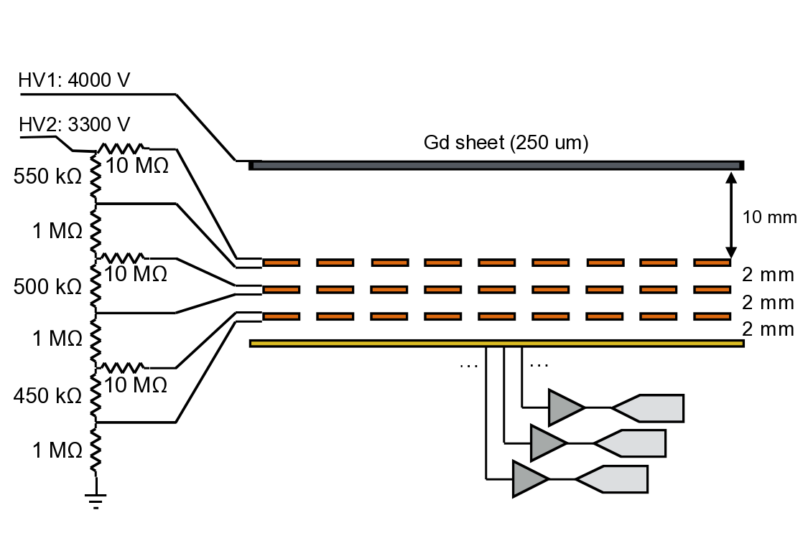
Gd-GEM backwards setup
conversion electron
Start of track
neutron

Slide 7
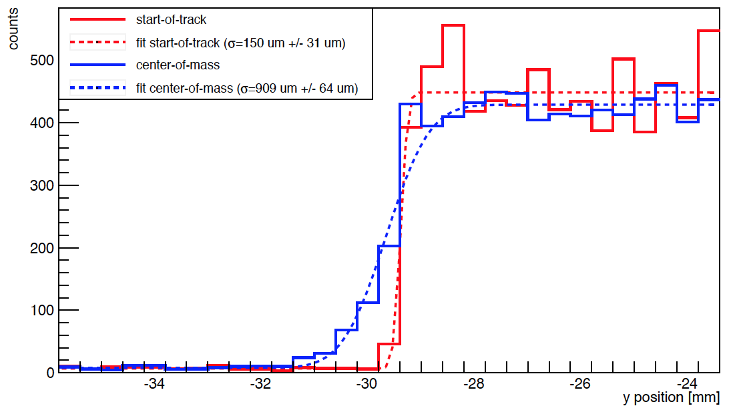
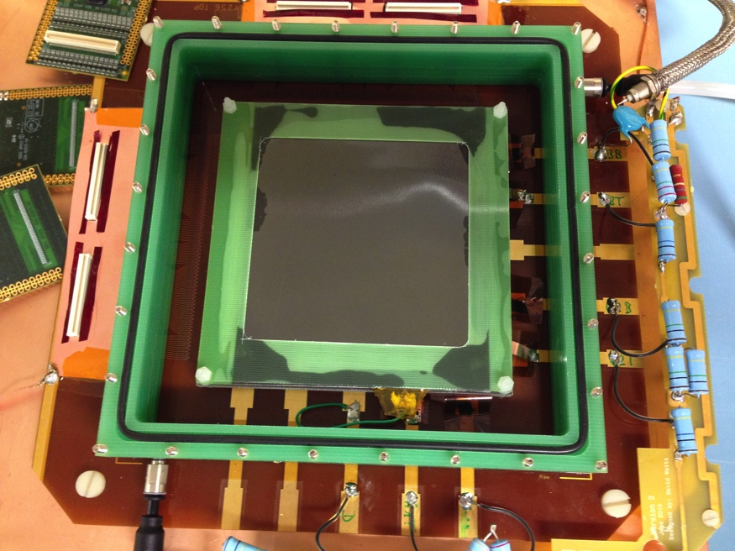
¹⁰B₄C GEM μTPC Results
D. Pfeiffer et al., JINST 10 (2015) 04,
P04004
Pristine position resolution σ <200 μm reached with Single GEM
Detection efficiency < 5 % at normal incidence of neutron

Slide 8
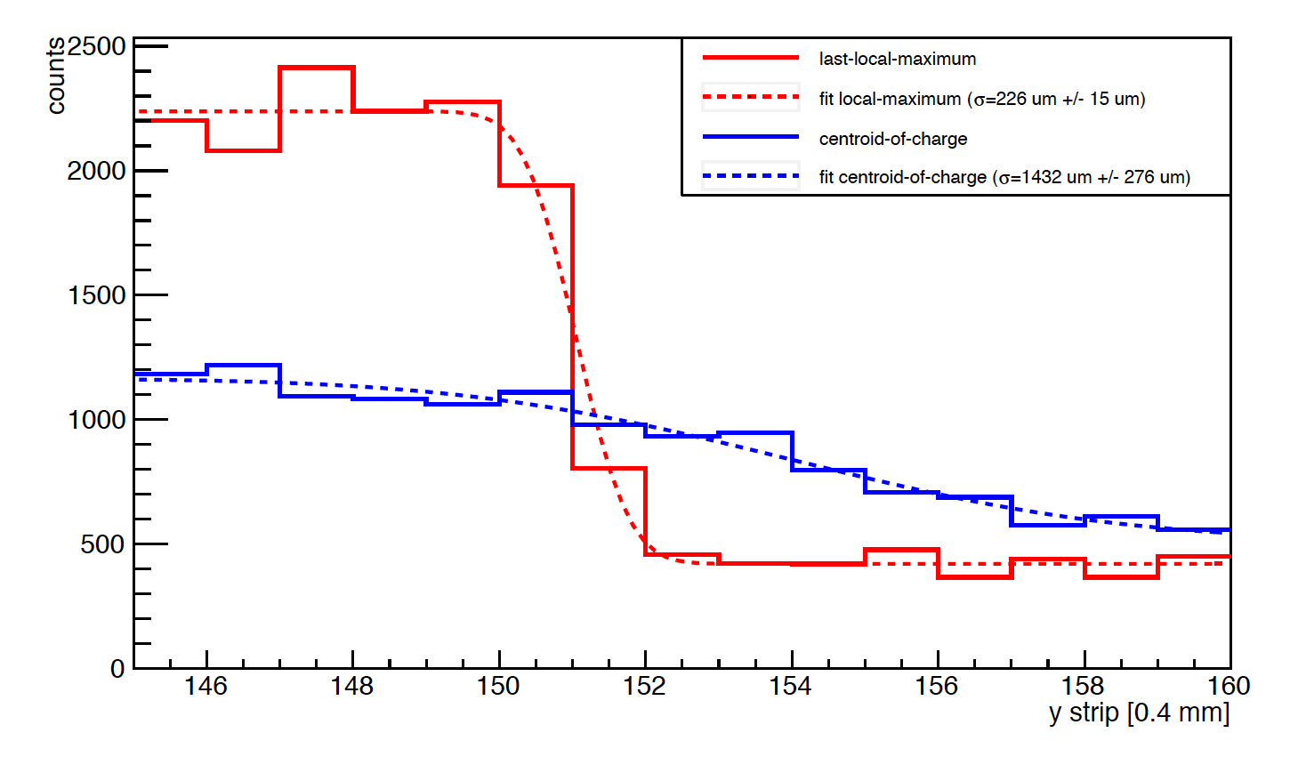
Gd-GEM μTPC Results
D. Pfeiffer et al, 2016 JINST 11 P05011
Position resolution σ <300 μm reached with Triple GEM, APV-25
Detection efficiency < 12 % at normal incidence of neutron

Slide 9
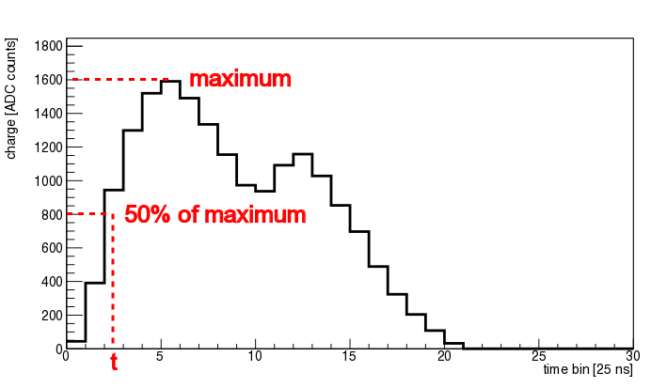
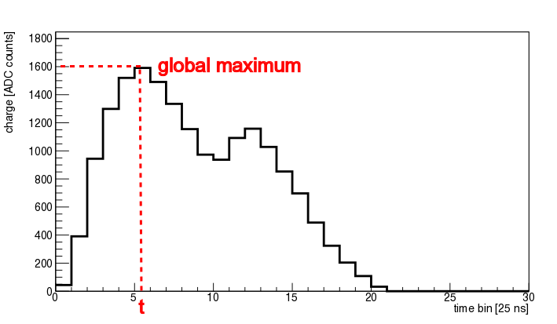
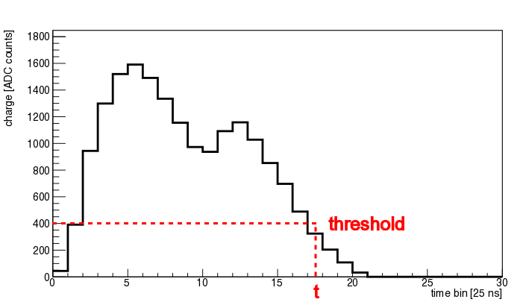
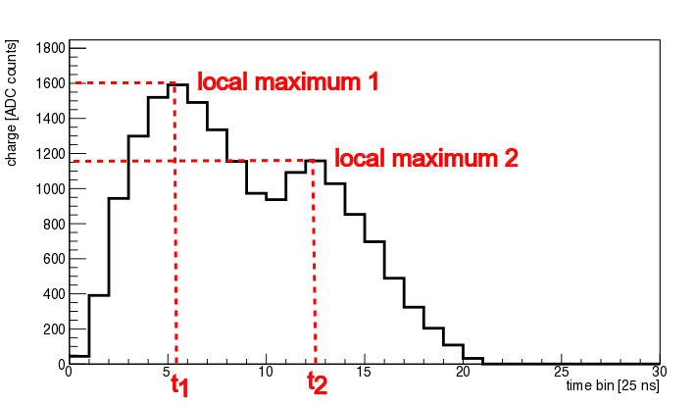
Better tracking algorithms needed
Used for ¹⁰B₄C
VMM-like?
Used for APV-25

Slide 10
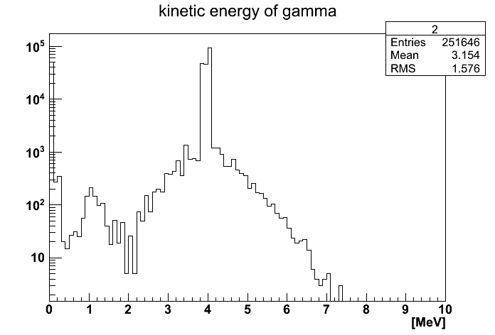
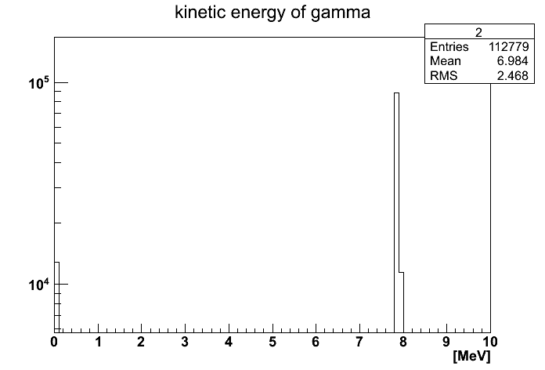
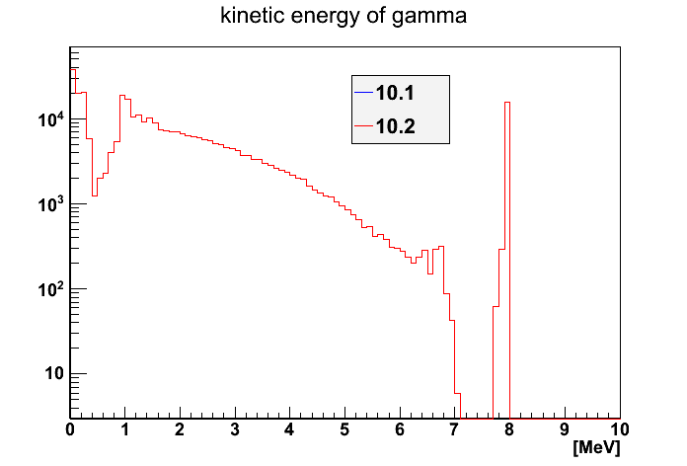
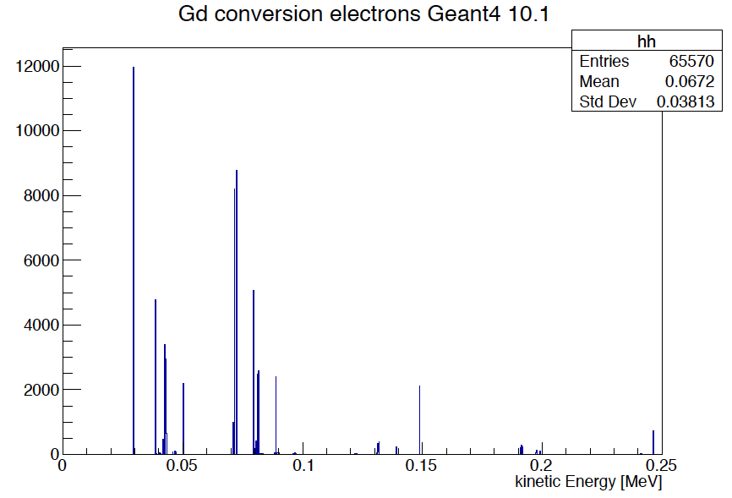
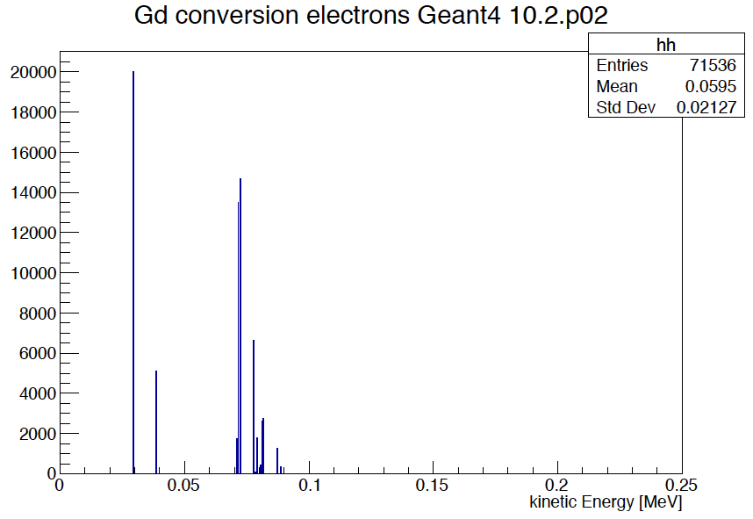
Geant4 Gd simulation problems
Getting worse in 10.2.p02
gamma
gamma
gamma
Photon Evaporation 10.1
Photon Evaporation 10.2
Without Photon Evaporation
ce
ce
  Problems with gamma spectra:
  https://zzz.physics.umn.edu/lowrad/_media/meeting8/ychen_gdgammas_aarm2015.pdf

Slide 11
Task division Geant4/Garfield++
1a
1b
2
Primary particle
entering gas
Charged particle
Charged particle
gamma
Physics model
in Geant4
PAI/PAIPhot Model
In gas region
(Standard and low energy EM physics)
(Standard and low energy EM physics)
Geant4
Point of transfer of
Control between
Geant4/Garfield++
“Kill” secondary e⁻ produced in gas region in Geant4
“Kill” primary when entering gas region in Geant4
“Kill” gamma when entering gas region in Geant4
TrackHeed Method
in Heed/Garfield++
TransportDeltaElectron()
SetParticle()
NewTrack()
TransportPhoton()
Garfield++
Garfield++ simulation according to needs

Slide 12
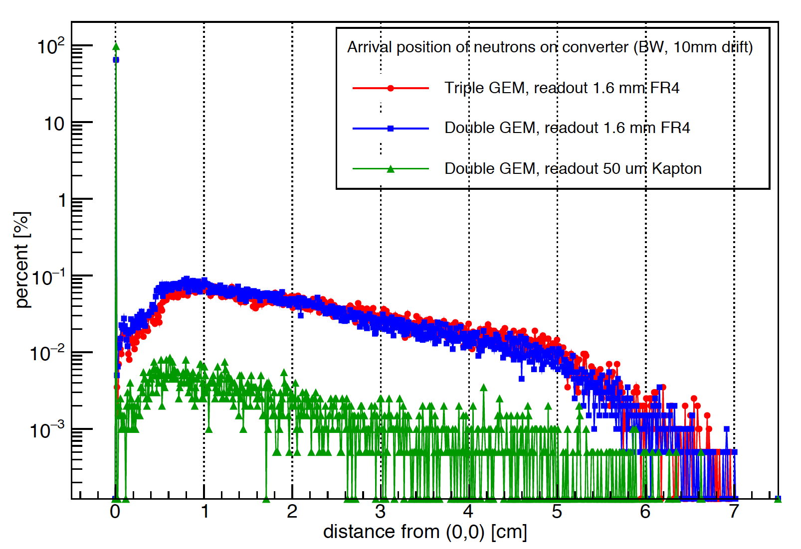
Arrival position neutron on converter
10cm x 10 cm detector

Slide 13
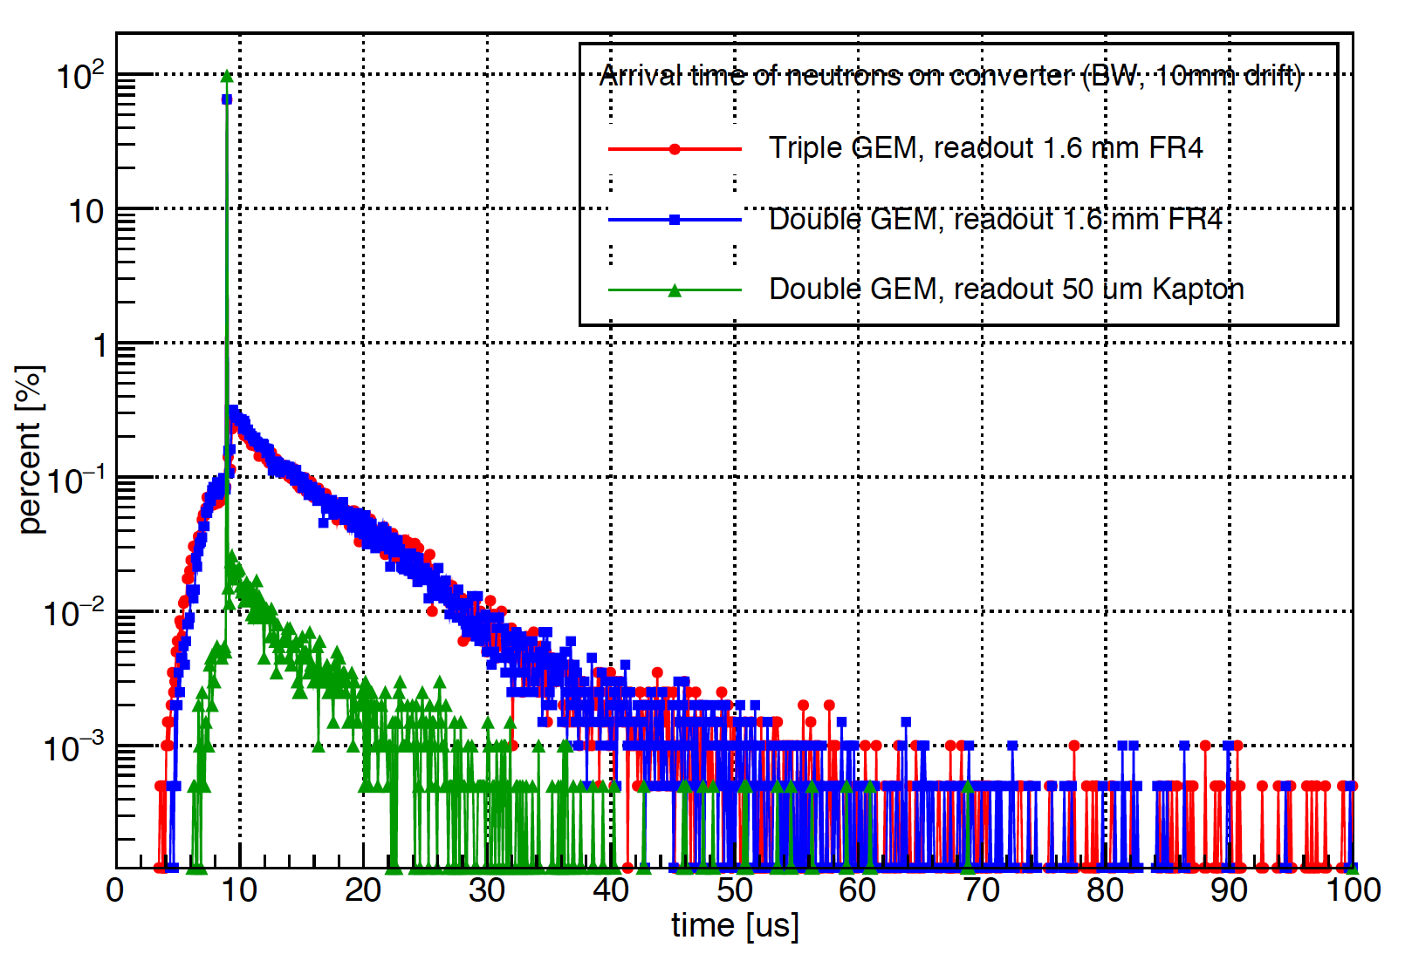
Arrival time neutron on converter
10cm x 10 cm detector

Slide 14
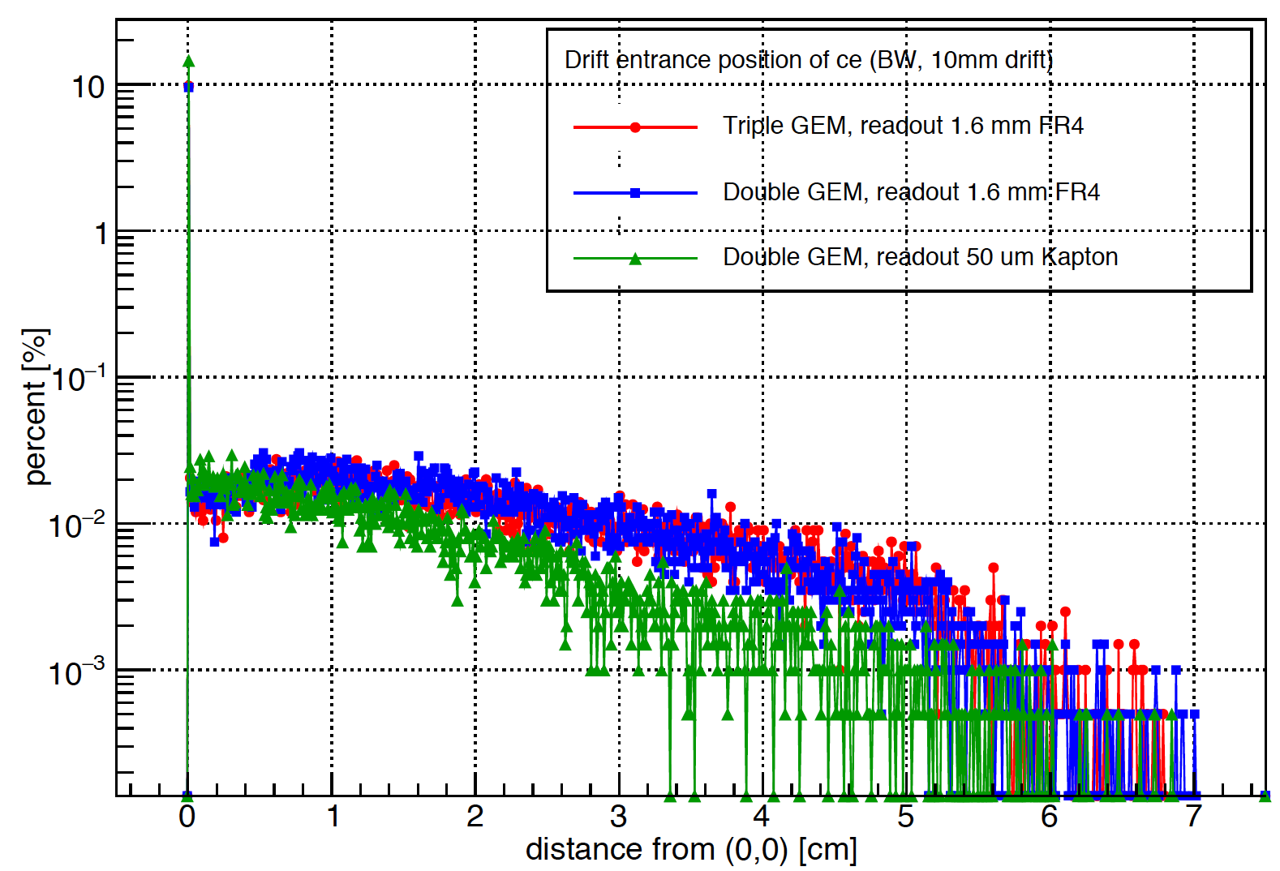
Arrival position ce in drift
10cm x 10 cm detector

Slide 15
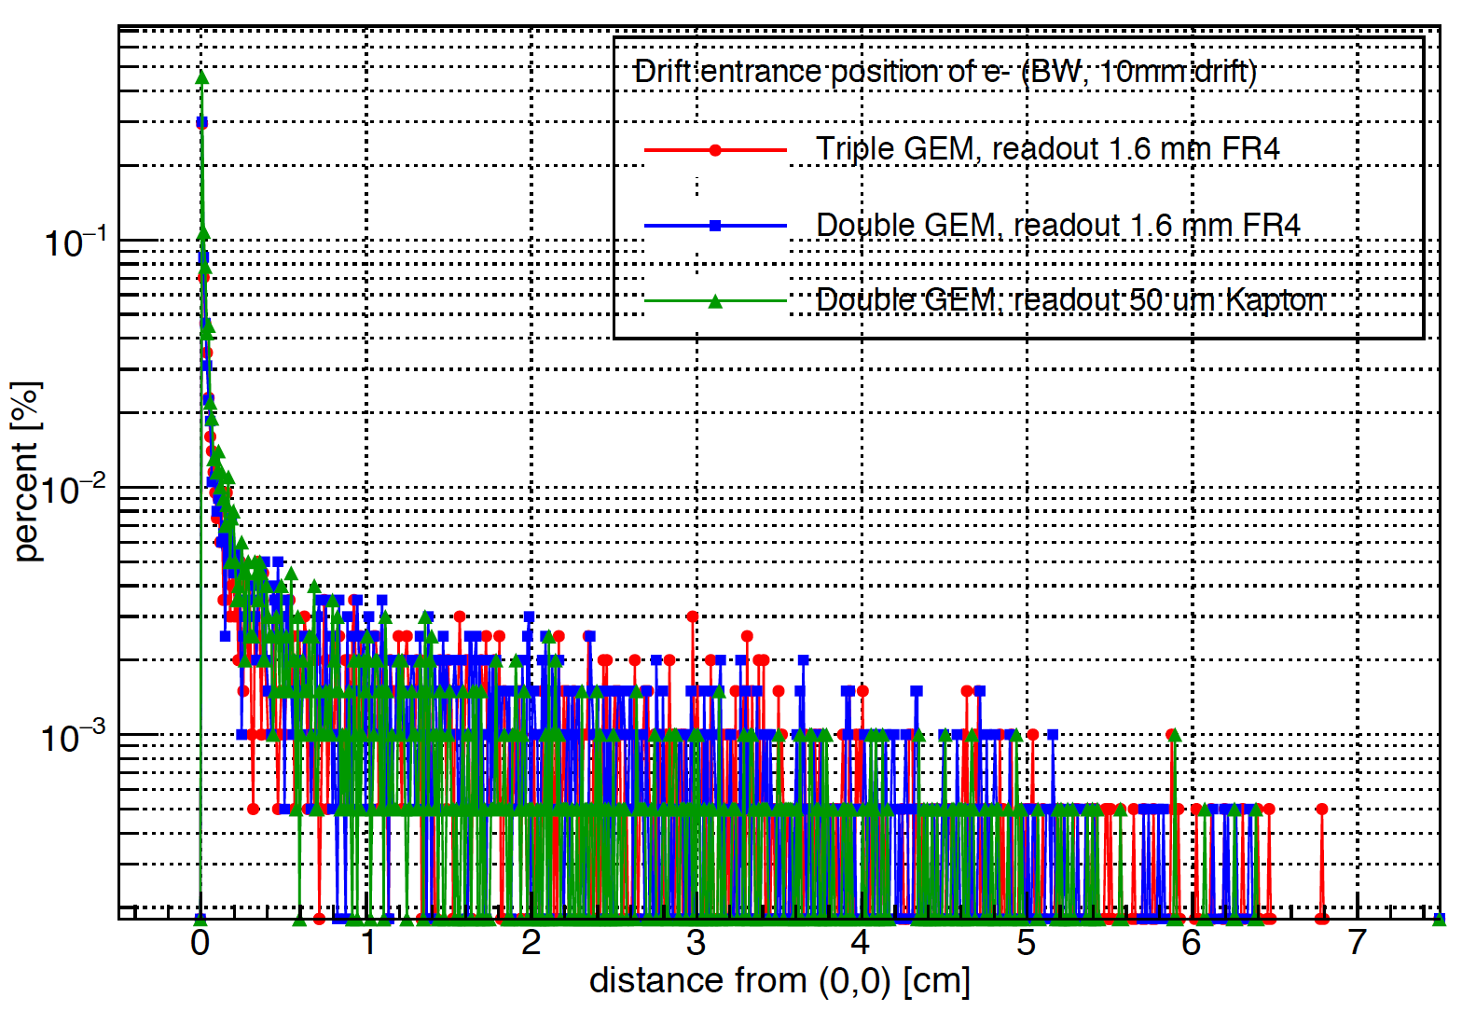
Arrival position Compton e⁻ in drift
10cm x 10 cm detector

Slide 16
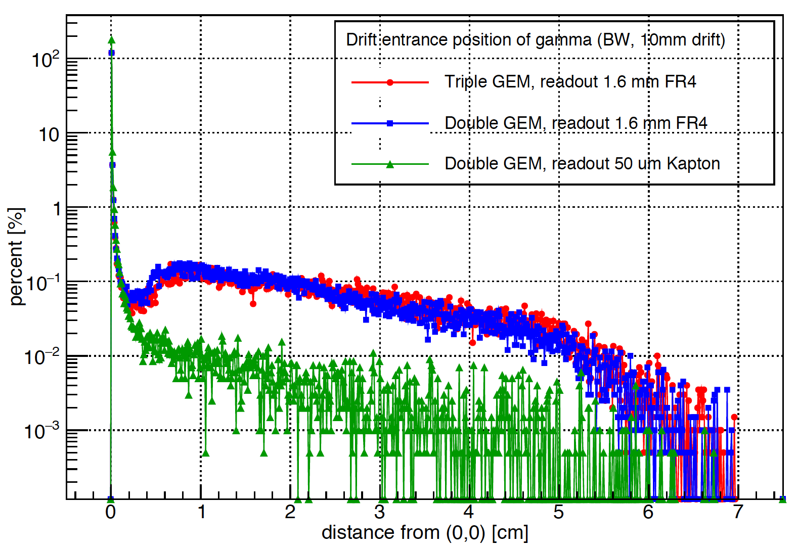
Arrival position gamma in drift
10cm x 10 cm detector

Slide 17
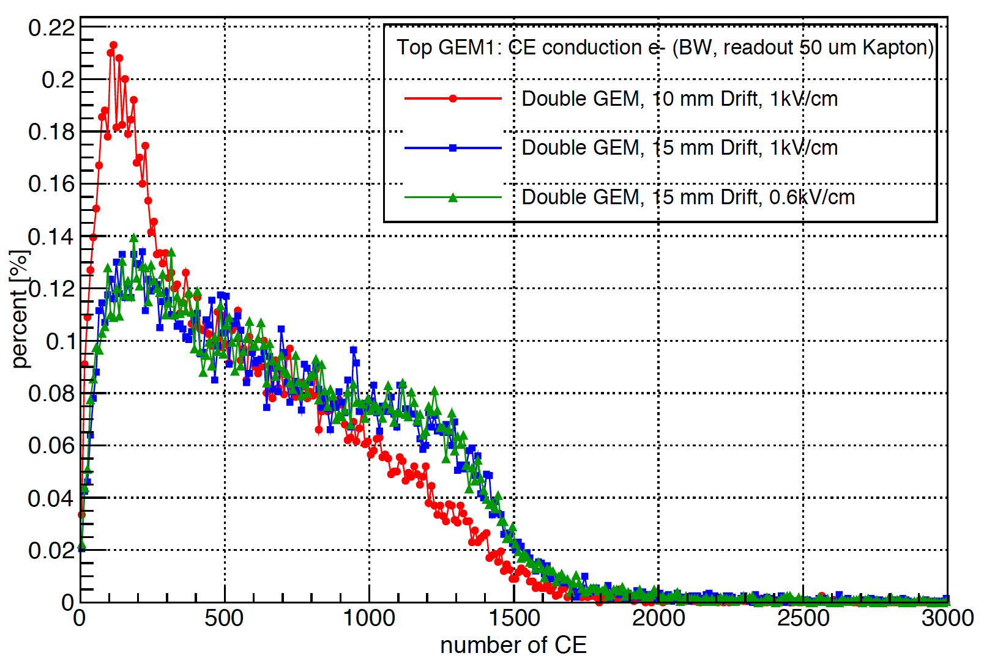
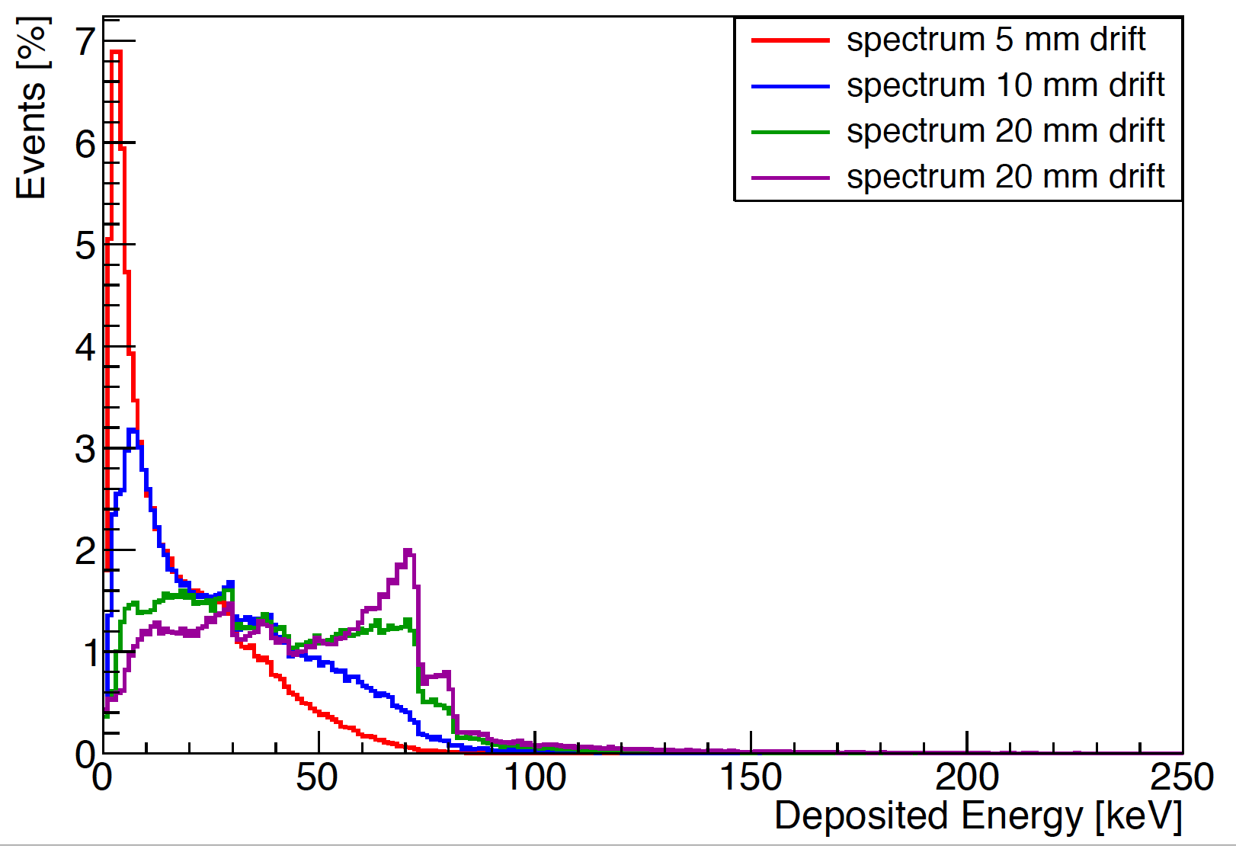
Number of conduction electrons in drift
10cm x 10 cm detector

Slide 18
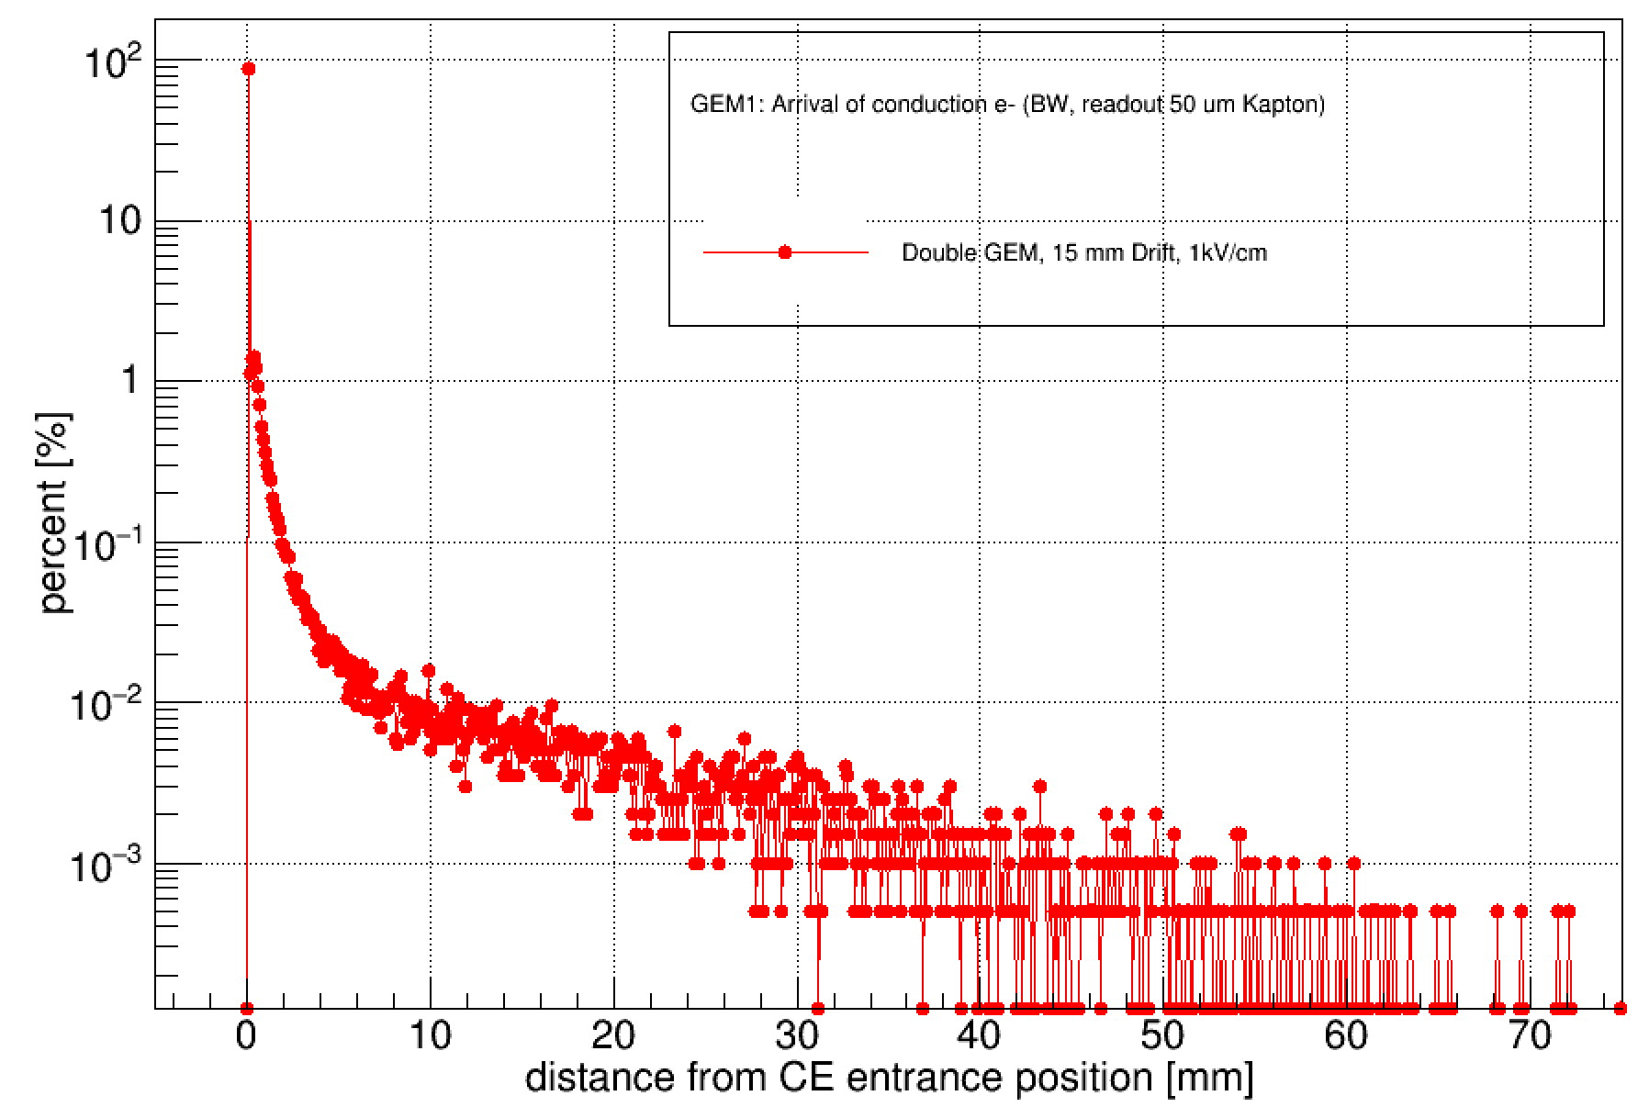
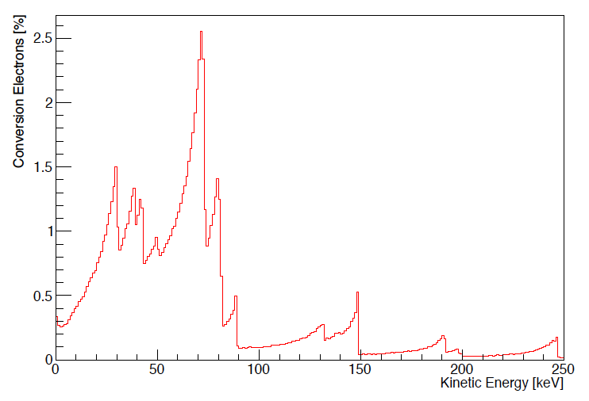
Position of conduction electron that arrives last in time on first GEM
10% <= 11 um
25% <= 29 um
50% <= 57 um
75% <= 86 um
90 % <= 238 um
92% <= 400 um
Spectrum of ce entering drift
10cm x 10 cm detector

Slide 19
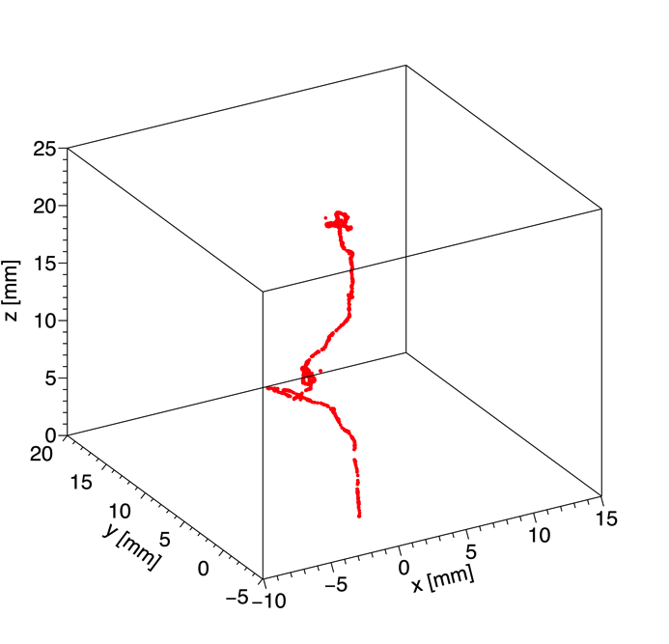
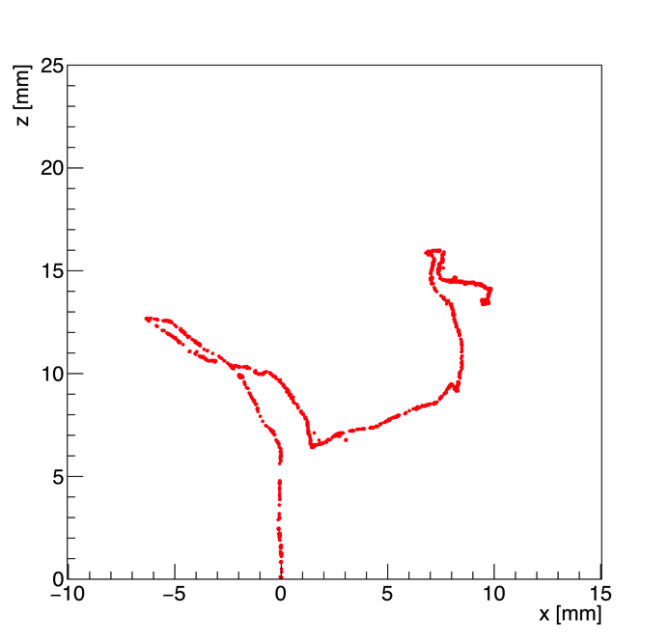
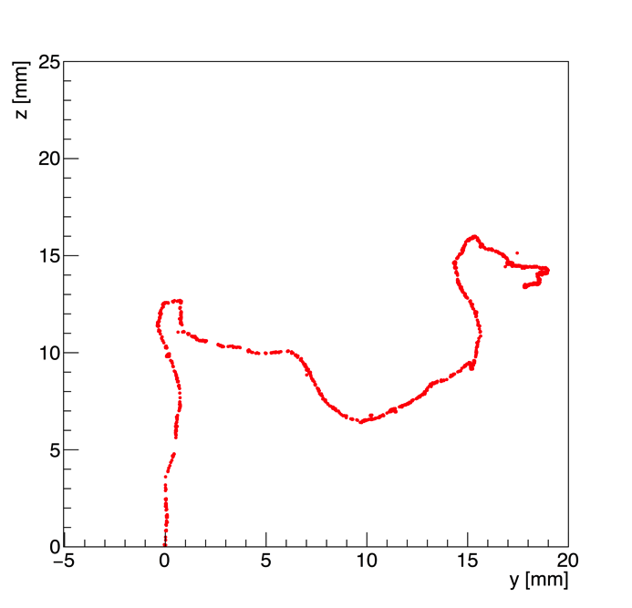
Degrad Simulations
3D
xz
yz
DEGRAD simulation of 70 keV electron in Ar/CO₂ 70/30
DEGRAD by Steve Biagi: http://magboltz.web.cern.ch/magboltz/
Only Monte Carlo program that incorporates all relevant physics processes for electrons in gas
Simulations with Geant4/Garfield interface have to be benchmarked against Degrad
Check of primary ionization distribution in Geant4/Garfield++

Slide 20
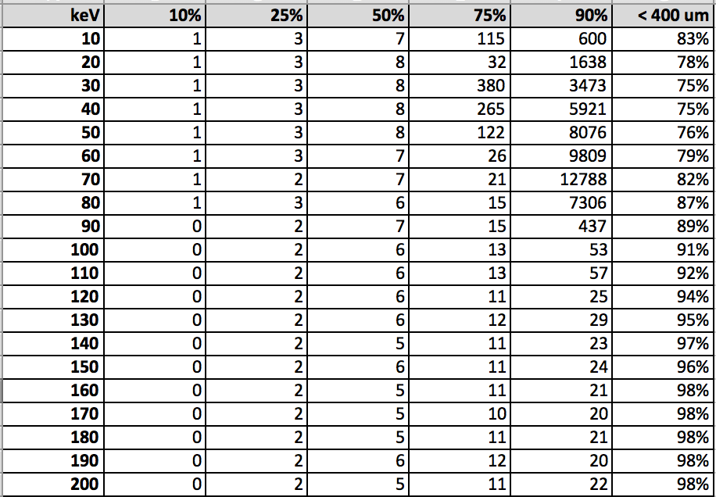
Degrad: Obtainable position resolution in um
Infinite volume
The (x,y) position of the electron with the smallest z position was taken
2-25% of tracks turn back depending on energy
No drift and diffusion

Slide 21
Summary
Scattering of neutron considerably deteriorates position resolution
Two GEM foils instead of three and low material budget readout lead to major improvement
The position where the conversion electron enters the drift can be reconstructed with <= 400 um precision for ca 90% of all conversion (without diffusion from amplification)
Announcements from Stephen: New Magboltz version 11 is out, includes better simulation of molecular light emission by using the null collision technique
New Degrad 3.1 before Xmas will inlcude C2H6 update

