Slide 1
Microscopic simulation of Xenon-based gaseous optical TPCs in the presence of molecular additives
C. Azevedo, S. Biagi, C. Henriques,
D. Gonzalez-Diaz
and the NEXT collaboration
@RD51 (14/12/2016)

Slide 2
I. The problem

Slide 3
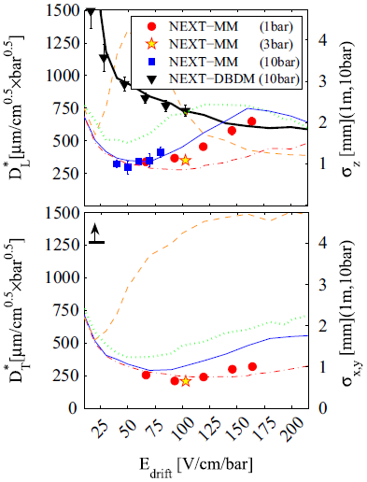
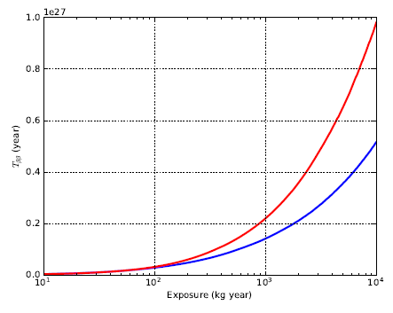
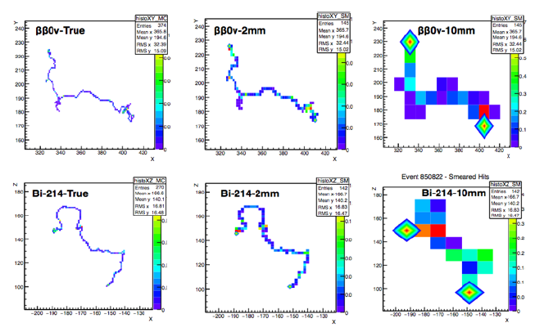
The importance of the ‘topological’ information in NEXT
Xe
but what happens to the Xenon scintillation when diffusion is reduced??
J. Renner et al., arXiv:1609.06202v3
(deep neural network analysis)
Xe
low-diffusion
low-diffusion
mixture
Xe
ββ0 signal
γ-background
MC-truth
low diffusion
pure Xenon

Slide 4
A ‘conceptual’ magic mixture
From TPC conference 2014!
(Penning)-Fluorescent
Low diffusion/light preserving
(2 candidate molecules identified)
(6+ candidate molecules identified)
Able to reduce electron diffusion in gas.
Able to reduce electron diffusion in gas.
Recombination small.
Recombination small.
Strongly fluorescent at higher λ and self-transparent.
Light mechanisms unaffected.
  Highly transparent to Xenon-light.
  Small quenching for S₁, S₂ and small fluctuations in EL.
Allows for EL at lower field due to low-lying excited states of the additive.
Suitable for Penning transfer. Can potentially reduce Fano factor.
~’low IP/high-reactive type’
~’high IP/low-reactive type’

Slide 5
II. The tool

Slide 6
A microscopic software for electron and photon transport in gas
Degrad
(W_{I}, F,
cloud size)
(recombination MC/model)
[not included here]
scintillation MC, and photo-absorption
x-section database
(S₁, S₂)
Magboltz electron
x-section database
Magboltz
Garfield++
(v_{d},D_{L},D_{T} )

Slide 7
III. Basic considerations

Slide 8
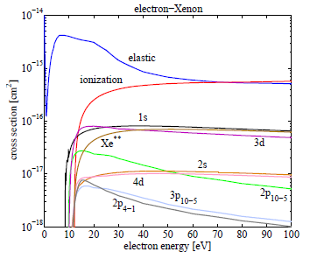
I
Electron x-sections of relevant gases
Xenon 2016

Slide 9
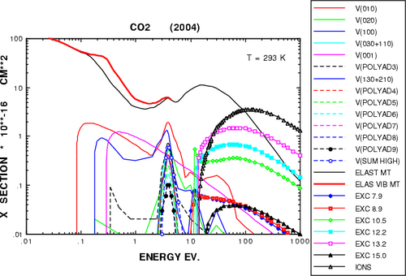
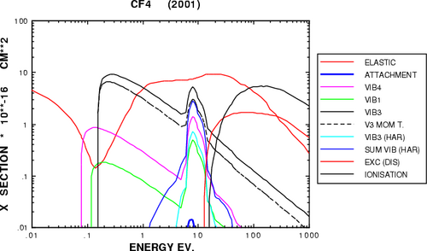
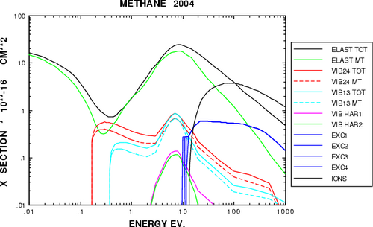
I
Electron x-sections of relevant gases
Xenon 2016
x-sections for molecules that are plot here are actually old ones (just illustrative!)

Slide 10
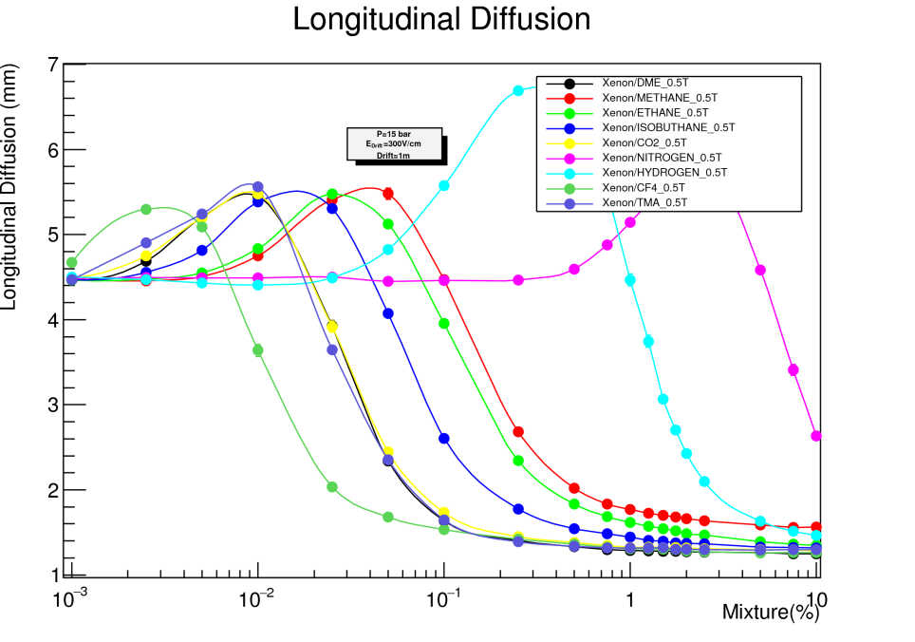
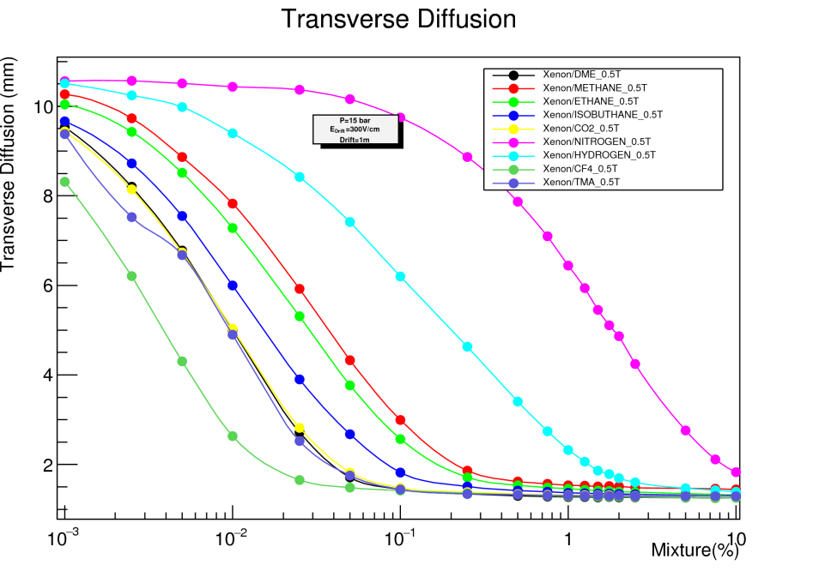
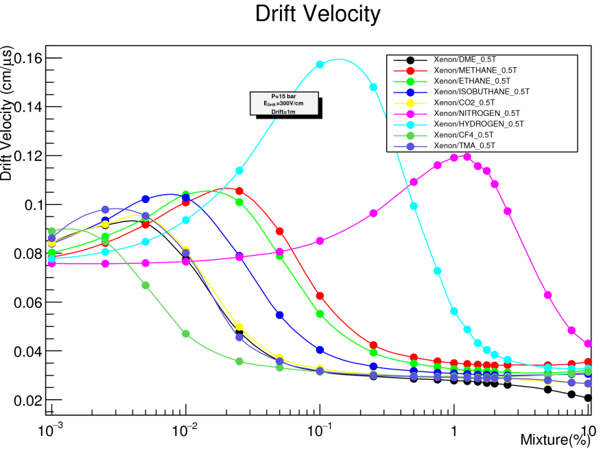
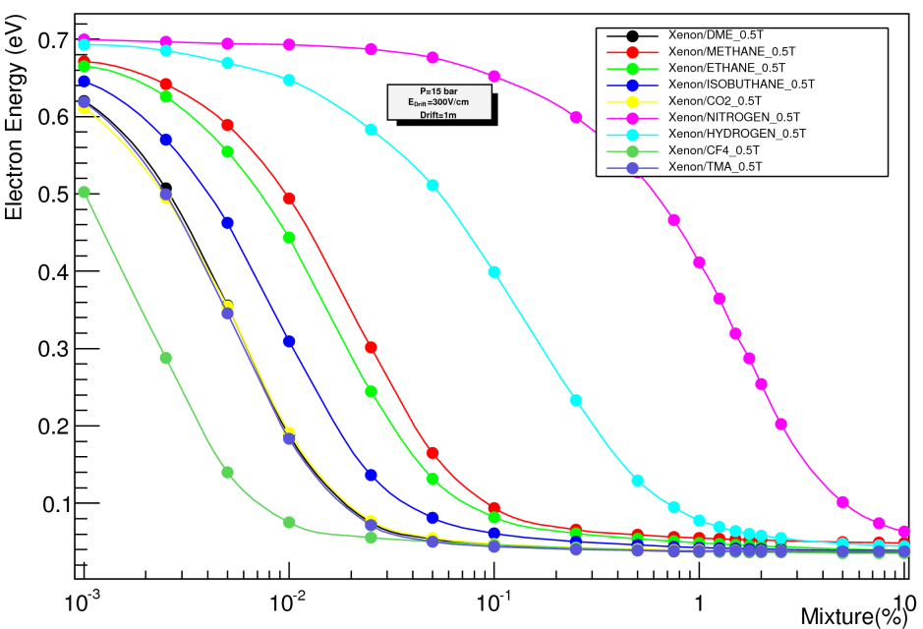
I
Ionization transport characteristics (v_{d}, D_{L}, D_{T})
Outside 20-30V/cm/bar it performs generally worse
E_{d}=20 V/cm/bar, P=15bar
H₂
N₂
CH₄
CO₂
N₂
CO₂
H₂
CF₄
CF₄
CH₄
Mean Electron Energy
CH₄(0.1%)
CO₂
H₂
N₂
N₂(4%)
CH₄
CO₂(0.02%)
H₂(0.8%)
CF₄
CF₄(0.007%)

Slide 11
I
Ionization transport characteristics (v_{d}, D_{L}, D_{T})
Outside 20-30V/cm/bar it performs generally worse
E_{d}=20 V/cm/bar, P=15bar
CH₄
CH₄
i-C₄H₁₀
C₂H₆
i-C₄H₁₀
C₂H₆
Mean Electron Energy
C₂H₆ (0.06%)
CH₄
i-C₄H₁₀(0.035%)
CH₄ (0.1%)
i-C₄H₁₀
C₂H₆

Slide 12
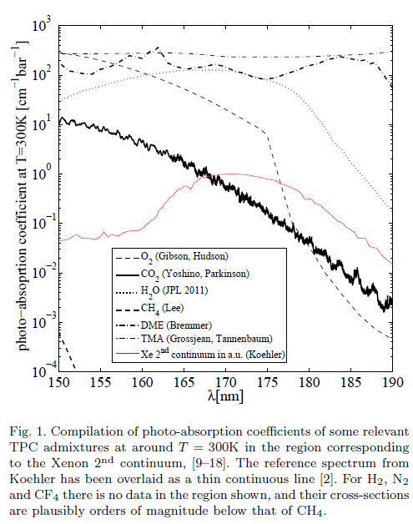
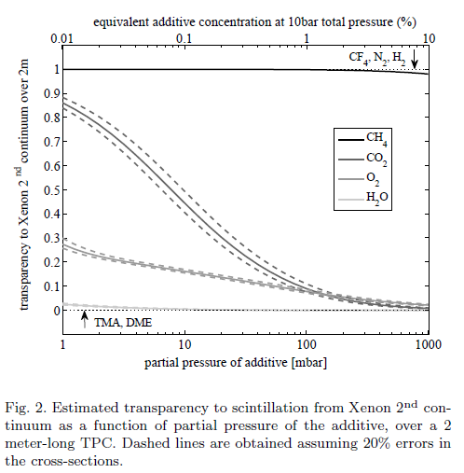


II
Light transparency

Slide 13
II
Light transparency
i-C₄H₁₀
C₂H₆

Slide 14
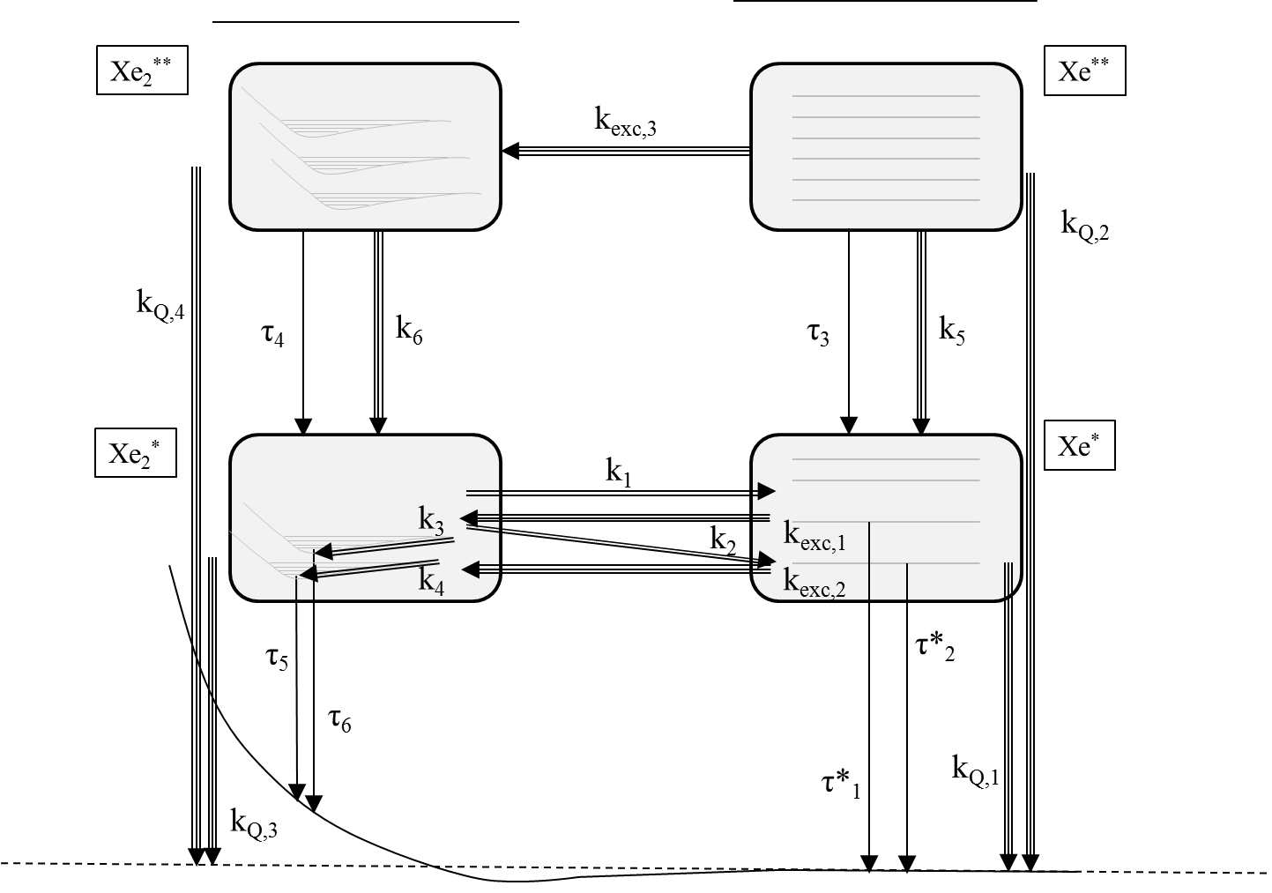
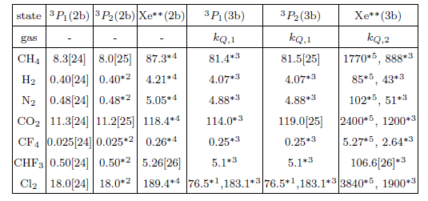
III
Light quenching (generic pathway diagram)
IP_{Xe2}
IP_{Xe}
3body
2body
decay
other continua
example of main (atomic) quenching reactions
relevant for S₁
relevant for S₂
2nd continuum (170nm)
Most serious difficulties related to S₁:
Distribution of initial excited states?.
Quenching/decay of Xe**, Xe₂** largely unknown.
S₂ much more robust (dominated by low-lying states):
Measurements exist, and scalings work reasonably.

Slide 15
IV. Electron transport + scintillation model

Slide 16
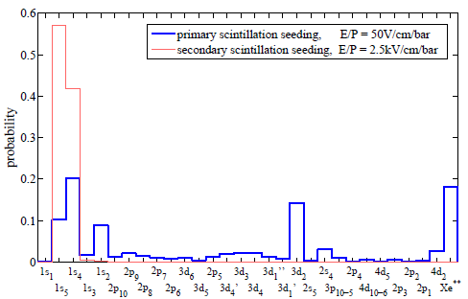
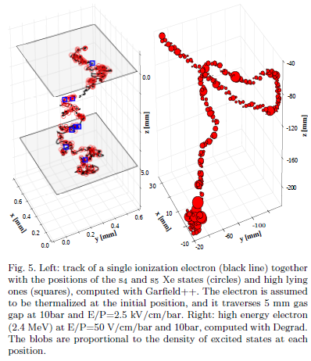
I. Computation of probability distribution of excited states
Degrad
Garfield++

Slide 17
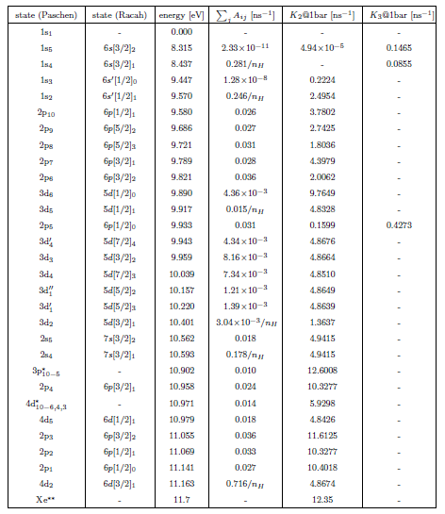
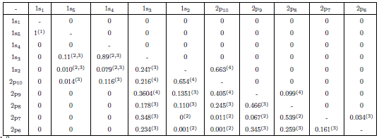
II. Computation of atomic cascade
decay constant
2-body collision rates
3-body collision rates
each value represents a vector!

Slide 18
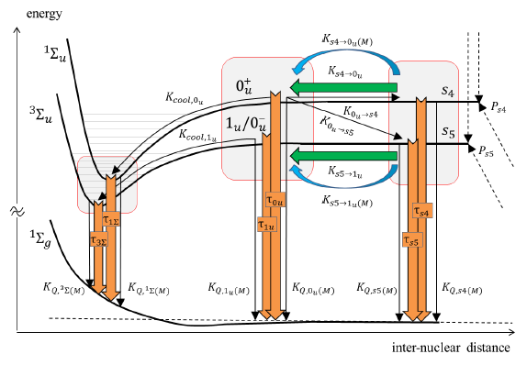
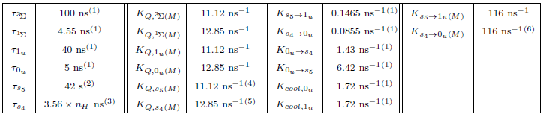
III. Excimer pathways
(analogous for 2p₅ and Xe**)

Slide 19
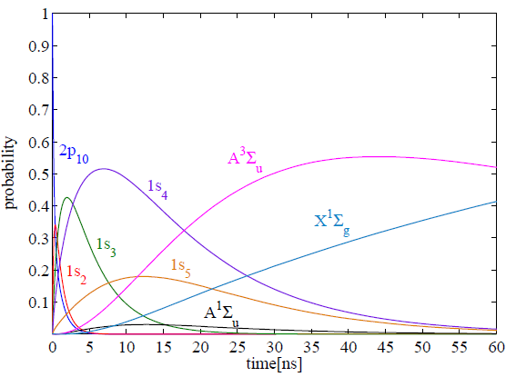
Example of light production code (population evolution from 2p₁₀)

Slide 20
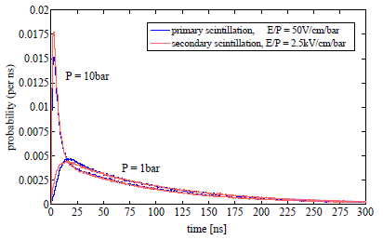
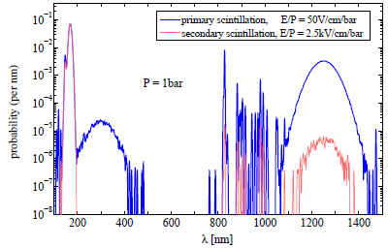
Example of electron transport + light production code
time distributions
energy spectra

Slide 21
V. Comparison with pure xenon data

Slide 22
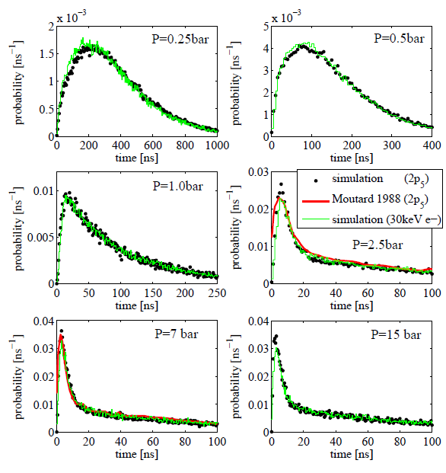
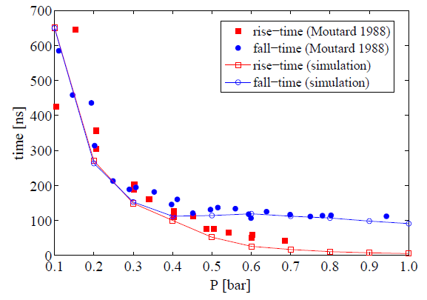
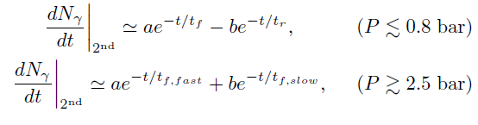
Time distributions

Slide 23
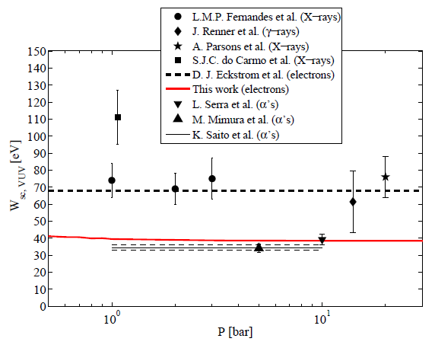
Yields
VUV region
IR region
simulated
measured (α’s)

Slide 24
VI. Comparison with xenon + additives

Slide 25

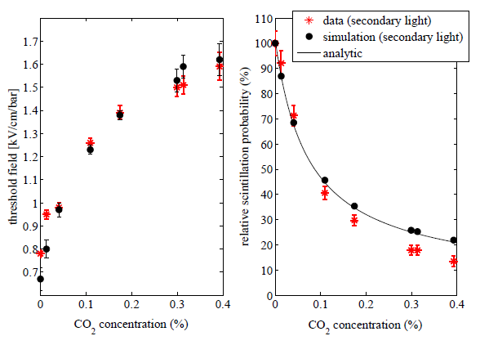
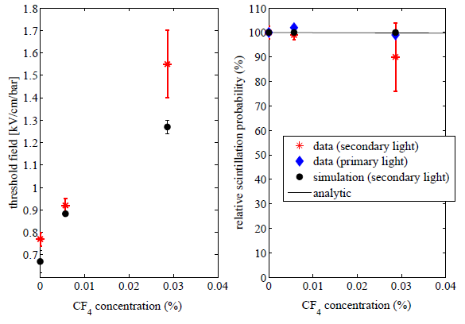
Electroluminescence (yield)

Slide 26

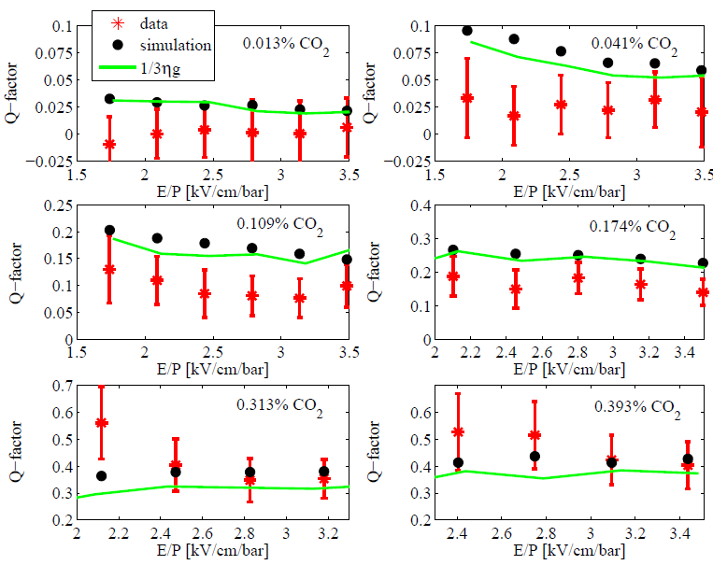
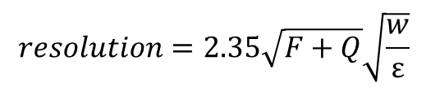
Electroluminescence (light fluctuations, Q)
$$resolution=2.35\sqrt{F+Q}\sqrt{\frac{w}{ε}}$$

Slide 27
VII. Fine, but what is happening here?

Slide 28





Xe-CO₂
!
if assuming
a fit gives:
The quenching rate of s₅ state in CO₂ is:
!

Slide 29

Xe-CF₄
!
if assuming
and the quenching rate of s₅ state in CF₄:
Predicts a 0.3% scintillation drop in
the range of concentrations shown…

Slide 30
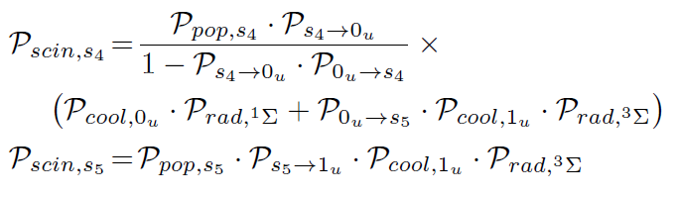

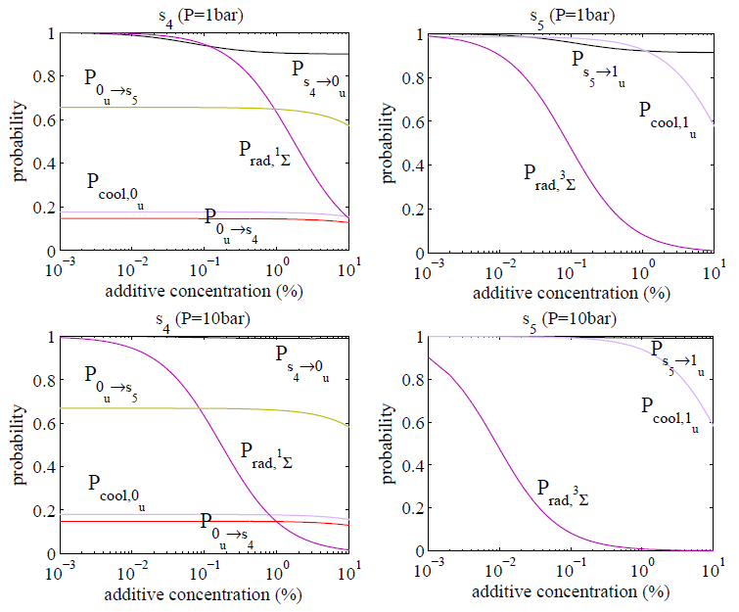
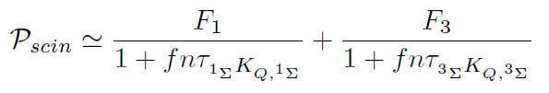

An analytic picture… and a simple one (I)
Indeed: dominance of triplet state
scintillation above 1bar!

Slide 31
An analytic picture… and a simple one (II)
This simple picture (triplet dominance) describes the quenching effect in earlier data by Suzuki for Ar-CO₂ and Ar-CH₄ (1983) and Conde and Policarpo for Xe-N₂ (1968),
…quantitatively!
It does describe the data for Xe-CH₄ from GIAN group (Carlos Henriques), but with a quenching rate for the excimer that is about x4-x8 less than that of the atom (!). This seems to enable CH₄ for high pressure operation in NEXT, and its figure of merit perhaps even surpasses the one from CO₂, contrary to the initial expectations…
still a lot to learn from good measurements!

Slide 32
Ambiguities in the scintillation model (I)

Slide 33
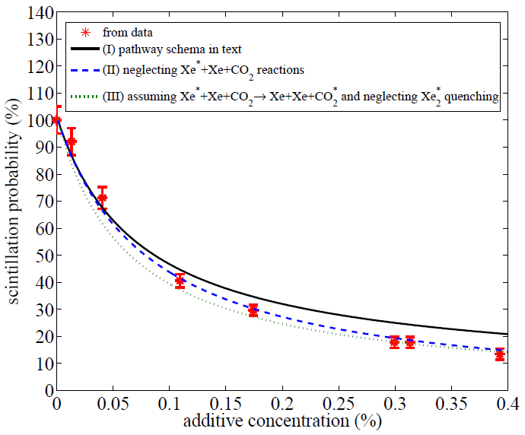
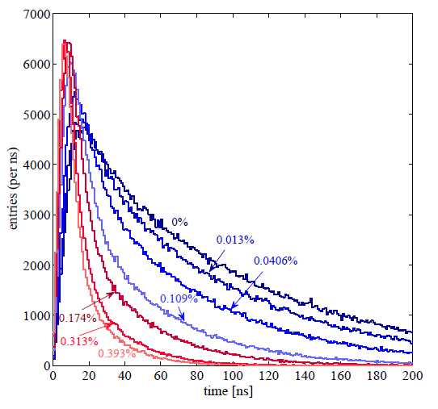
Ambiguities in the scintillation model (II)
default model used in simulations
model by J. Escada
(predicts no pressure dependence of time spectra!, just a global yield drop)

Slide 34
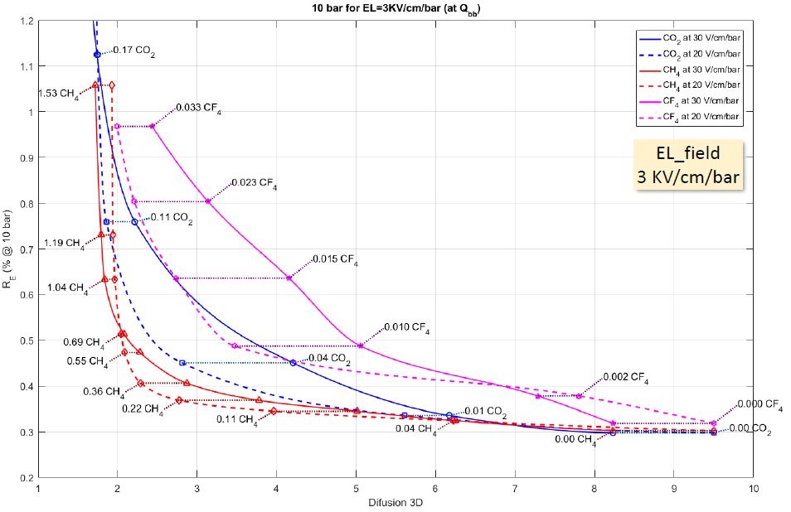
conclusions I (projections for NEXT)
preliminary

Slide 35
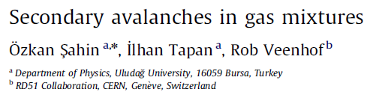
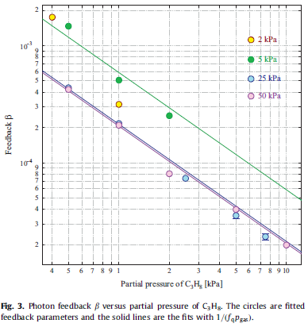
conclusions II (Ozkan/Rob’s feedback parameter β)
!

Slide 36
VI. Appendix

Slide 37
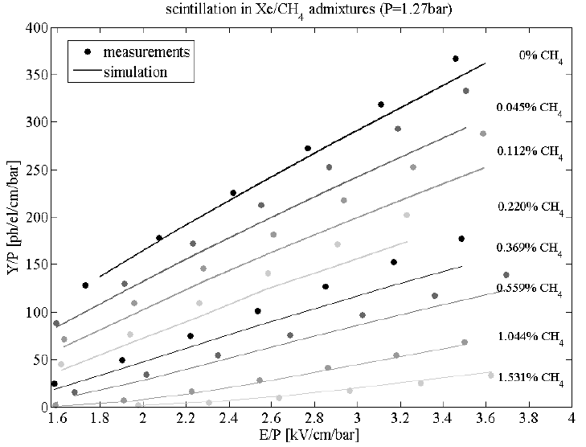

Slide 38
