Slide 1

Scalable Readout System
RD51/GDD lab status 2016
SRS was developed by RD51 collaboration for R&D on MPGD gas detectors
Collaborating SRS teams and users in 2016
MPGDs @ GDD-lab CERN, Photon detectors @ NEXT coll., Muon Tomografy @FIT, MICROMegas @ ATLAS MAMMA, DTC links and SRU@ ALICE DCAL, GEMs @ FTBF Coll., Timepix-SRS for ILC-TPC test@Bonn Univ,, GEM stack readout @BNL, GEMs@ CMS GEM collab, optical Readout@ TOTEM, GEM detectors @ PRad Coll., Neutron detectors@ ESS Brightness, Large surface MUST detector @ LSBB, VMM frontend for FOCAL E-PAD@ Univ. Tsukuba, GEMs for CP-Violation @CAPP, … and new projects joining these days

Slide 2
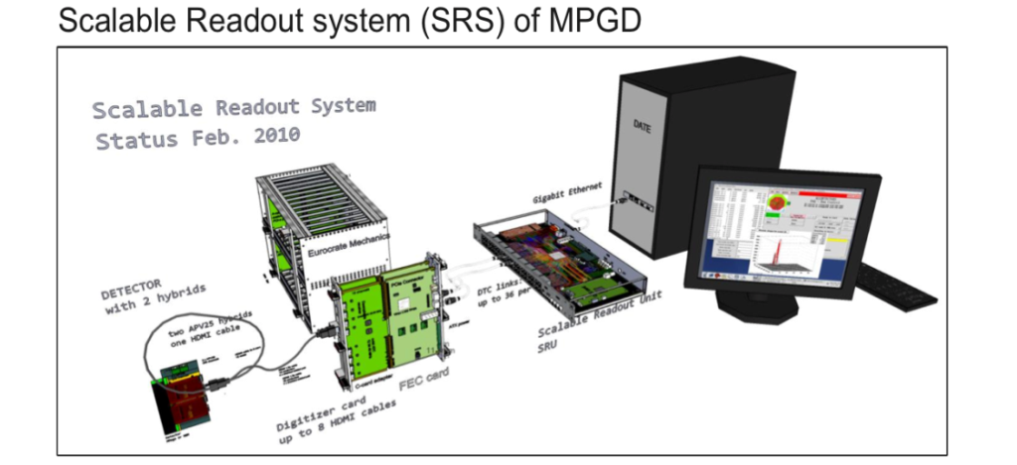
SRS concept (since 2009)
choose the best frontend for your detector
low noise, spark protection, dyn. range..
connect X frontends to SRS backend
scalable DTCC links instead of bus
start with few channels (1 hybrid=128 ch.)
get used with DAQ and Analysis software
scale up to X channels with same software
get support by large SRS user base RD51
many SRS systems, much experience
SRS services: detector-HV, amplifiers etc.
SRS Classic: purchase via @CERN store
Commercial SRS starting 2017 *
New SRS frontends: request-driven R&D collaboration based
Frontend carrier (hybrids)
ASICs, preamplifiers
on detector
FE Adapter (cards, mezzanines)
( ADC, DVM, Timepix, SiPM, PM)
+ Frontend concentrator (FEC)
Opt. Scalable Readout Unit (SRU)
data MUX/Buffer, TTCrx, clock and trigger source, Busy, Slow Controls
PC / Laptop with
DAQ and Analysis SW
Slow controls
DTCCP links
default HDMI
DTCC links
Default CAT7
UPD/ 10GBE
*exception: APV hybrid, only available through CERN

Slide 3

Scalable readout Architecture
Full SRS: stacks of vertical-slices
Minimal SRS: 1 or 2 vertical slices
PCs with Online SW
Laptop
with Test/Online SW
controls over
ethernet
high BW data
over UDP
UDP Ethernet
Data and Controls
trigger
SRU
CTF
Trigger
USB Device
Controls
& readout
Backend DTCC links
TC link
1 Vertical Slice
FEC
FECs
Crate(s)
(Mini)Crate
Adapters.)
Adapter (ADC, DVMcard, etc)
SRS
service
electronics
Frontend DTCC links
…..
Frontend link
SRS frontend
SRS Frontend (APV,VMM etc)
Detector
HV
Test Detector
Trigger Pickup

Slide 4
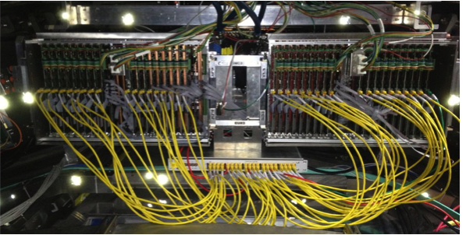
xTCX links ( SRS-specific links )
xTCx link flavors in use so far
DTC Data+Trigger+Clock (over CAT7, SRU-FEE ) 2009
DTCCP Data+ Trigger+ Clock +Control + Power ( over HMDI*, FEC-Frontend) 2010
TC Trigger + Clock ( over CAT7, CTF - FEC) 2010
DTCC Data +Trigger+ Clock +Control ( over CAT7, SRU - FEC) 2011
DTCCO Data+ Trigger+ Clock+ Control over Optical fibre ( planned , 2017 )
PC
ALICE DCal: DTC links over CAT7 from 40 FEE to 1 SRU
xTCx links make SRS scalable
10 Gigabit Ethernet / UDP
LINK scalability features vs. parallel Bus
Data in parallel over p-p links
=>Higher BW & Trigger rates
point-point controlled impedance
=> very high bitrates & lower error rates
overcome bus length limit
=> single point failures = non fatal
less wear-out of contacts
=> more reliable, less cost
D T C C
SRU
DTCC backend links
BUS
FEC
FEC
FEC
DTCCP frontend links
. . . . .
..
..
hybrids
..
* copper or fibre

Slide 5

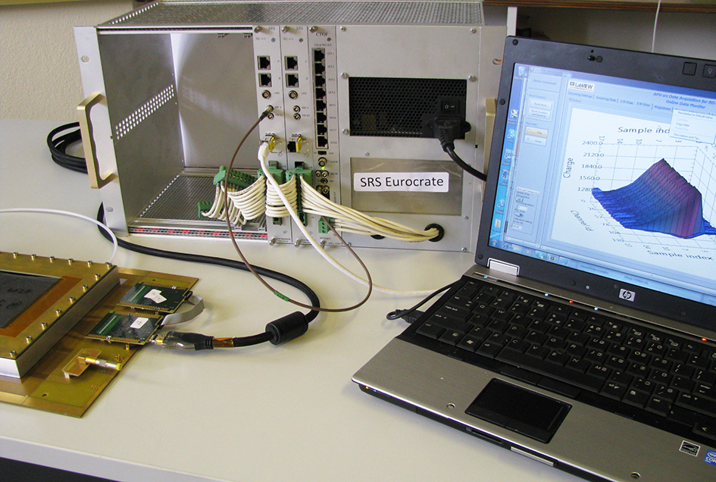
Table-Top SRS
Powered SRS crate with FEC / adapter combo
Detector
with APV hybrids
Readout & power
via HDMI link
Laptop connected via
Ethernet cable to FEC
Online Readout systems
DATE, and/or Labview SRS

Slide 6
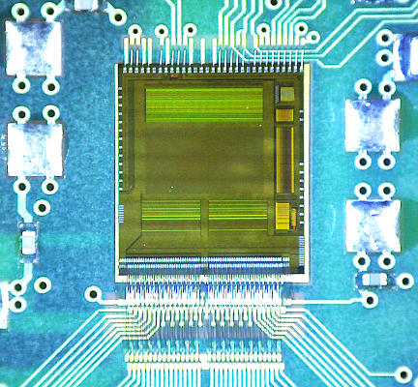
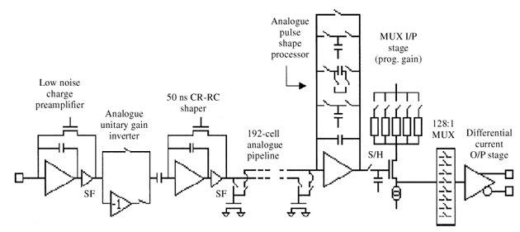
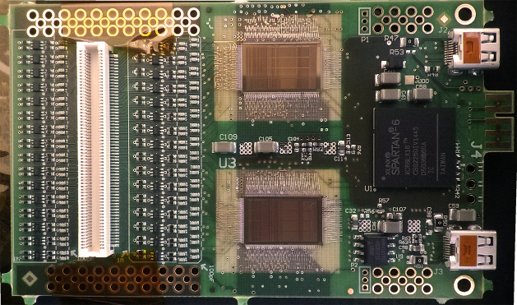
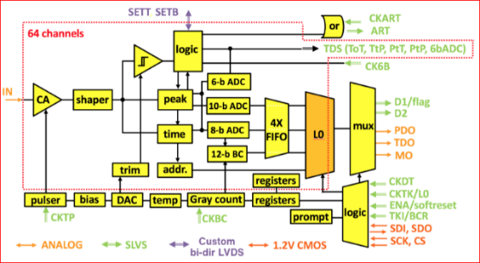
SCALABILITY ( a. over types of frontend )
APV wire-bonded, on SRS hybrid
1 ASIC: 128 analogue ch.
-general-purpose SRS:
APV frontend = 128 analogue ch. on hybrid
VMM frontend= 128 digital ch. on hybrid
-experiment –specific SRS:
SiPM and PM adapter (NEXT)
Octal Timepix-2 adapter (Univ. Bonn)
1 APV channel
2 x VMM wire bonded on SRS hybrid
1 ASIC: 64 digital ch.
Example of different frontends combined in a single RO system
1 VMM channel

Slide 7
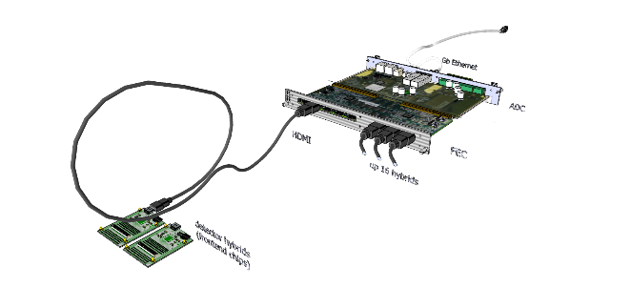
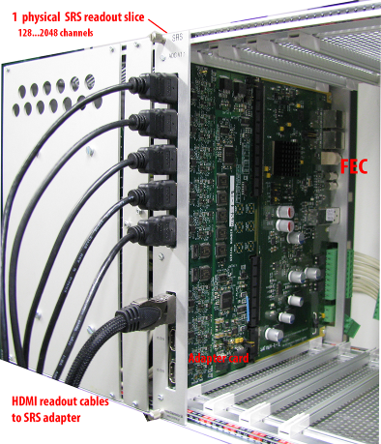
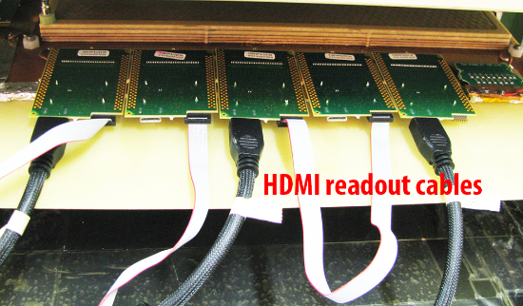
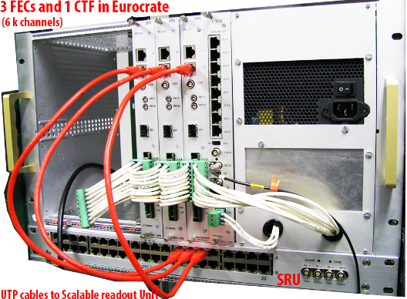
Scalability ( B. # channels )
Table-top minimal SRS system
1 ADC adapter card + 1 FEC
8 HDMI ports
SRS channel unit = 1 hybrid 128 channels
DTCCP readout cable* unit = 256 channels
FEC Frontend concentrator unit = 2k ch.
Multi-FEC system with SRU = 4k…16 k ch.
Multi-Crate with SRU(s) > 16k ch
Frontend Hybrids
along detector frame
* default = HDMI cables
SRS slices (FEC+Adapter)
in Euocrate with SRU below

Slide 8
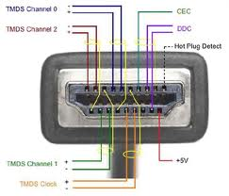
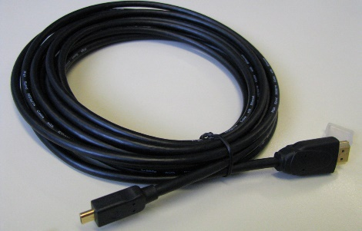
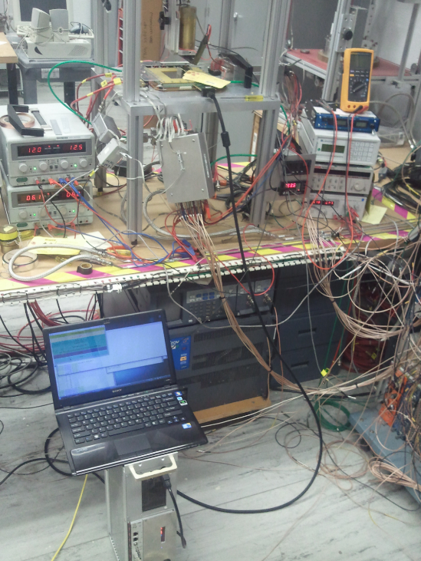
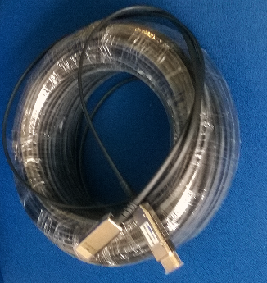
Frontend links (DTCCP)
5m HDMI standard A to micro (D)
HDMI* cables A-D (micro) up 5m
HDMI cables A-A coupled to A-D up 25m
Photo: SRS test with RCDAQ at BNL
GEM detector with
SRS APV hybrid,
powered over HDMI
New: active HDMI cables ( exploring the options )
- active HDMI copper A-A + A-D max 50 m
- active HMDI fibre A-A + A-D max 150 m
Laptop with RCDAQ
Commercial
100m active, optical
HDMI cable
DTCC link HDMI A-A
SRS Minicrate
* we do NOT use HDMI protocols

Slide 9
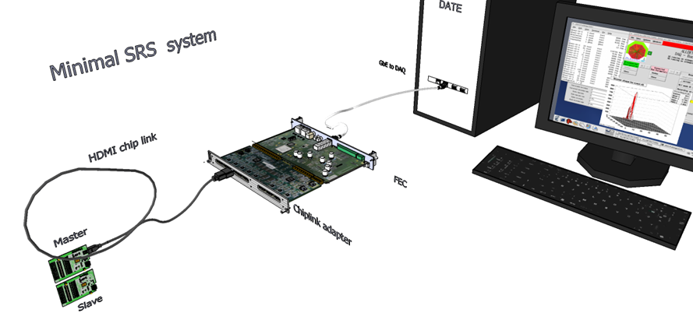
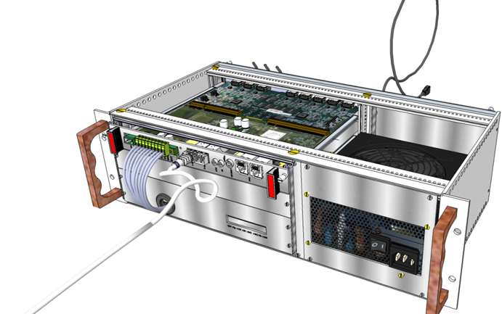
Small systems
“SRS Classic”
Complete
readout system from detector
up to offline Analysis
Table-top SRS
= 1 vertical slice
HDMI cables max 25 m
(active HDMI up 150m)
Crate –based SRS
Hardware available via CERN store
Firmware included
Software via RD51 database
2017+ commercial SRS sales licences
Mini-crate SRS system
> 100 crate systems in use worldwide
mainly by members of the RD51 collaboration

Slide 10
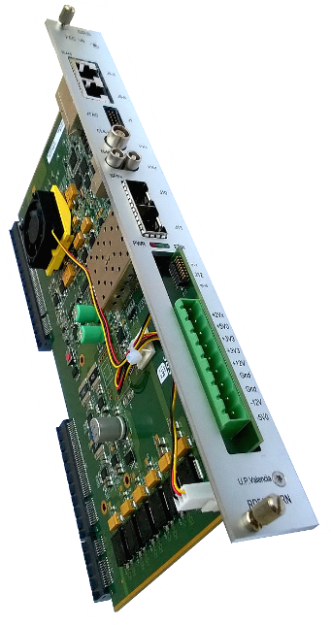
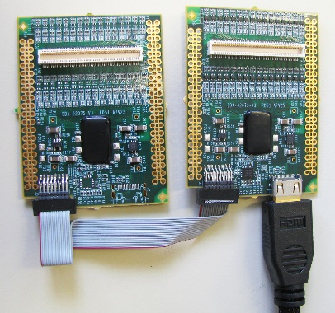
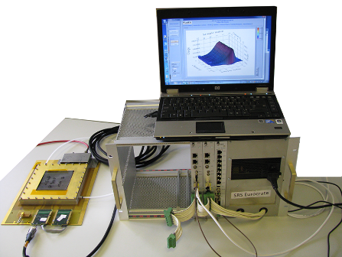
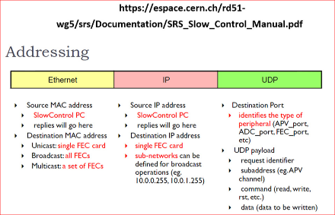
SRS frontends
SRS system Hardware
APV25 (128 ch, analog) @ CERN store, standard FE for RD51
VFAT (64 ch, digital) CMS/Totem -> prototype only
Beetle (128 ch, anal +digital) -> prototype only
SiPM and PM frontend @ UPV Valencia for NEXT
VMM (128 ch, digital+ ZS ) @CERN -> testing RD51/ESS
GEMROC (64 ch , digital) in prep @ AGH and EicSys
Timepix R&D for ILC TPC @ Bonn Univ. Proto system
FEC cards ( CERN store + commercial)
analogue adapter (16 x ADC 12 bit) ( CERN store + commercial)
digital adapter for VMM frontend (commercial)
Mini-crates up 4k channels (CERN store)
Eurocrates ( REV2 ) up 16 k channels (commercial)
ATCA crates, RTM cards 10 GBE, SFP (commercial)
ATCA blades ( 2x LX240) (commercial)
ATCA mezzanines (ADC, 6x12fibre ribbon) commercial, CDT (UPV)
CTF clock-trigger fanout (inhouse-> commercial)
Timepix adapter 6U card ( Bonn Univ, prototype )
Optocard VFAT 6U card (Totem)
High Voltage for MPGD’s AVD NIM ( in prep. -> commercial)
SRU LX240, 40xDTCC, NIM, 10GBE, 4x SFP (inhouse-> commercial )
APIC preamp-shaper , battery box ( finalized -> commercial)
Femto online current measurement over 10 decades (in prepar.)
SRS Online SW ( via UDP )
Slow controls (via IP )
DATE (= default RD51)
MMDAQ (ATLAS MM)
CODA ( PRad)
RCDAQ ( BNL/RHIC)
Labview SRS ( test systems)
SDC (Scalable Detector Controls )
scripts via Linux/DATE
Labview (for testing)

Slide 11
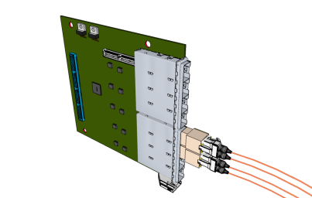
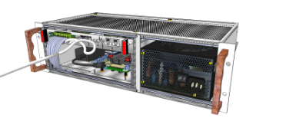

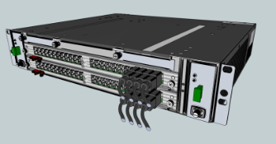
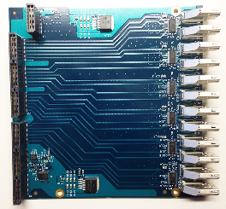
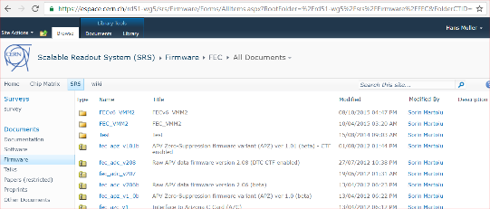
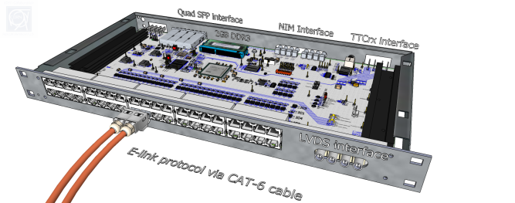
frontend link Adapters
Crate environment
ADC and DVM cards with HDMI ports
HDMI and SFP mezzanines (ATCA)
Optical ribbon mezzanines (ATCA)
Minicrate 19” 3U (CERN store)
Eurocrate 19” 6U (CERN store)
ATCA Minicrate (EicSys )
ATCA 14 slot full crate (EicSys)
Readout Units
SRS firmware
Network switch ( small systems)
SRU ( default, large systems)
SRU-ATCA (planned)
FEC -APV frontend
FEC -VMM frontend
analogue module APV readout
common mode/pedestal correction
Zero Suppression APV
10 Gbit core Virtex6 XAUI ( SRU)
DDL core ALICE
Slink core ATLAS
TTC rx module Virtex-6 (SRU)

Slide 12
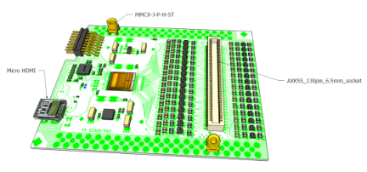
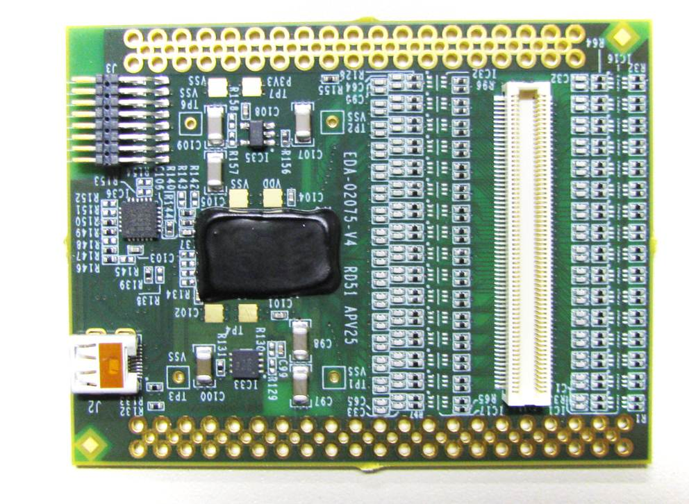
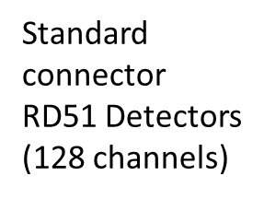
APV 128 hybrid SRS (CERN store SCEM 07.89.00.005.9 )
Master-Slave
cable
connector
Low noise LDO’s
Wire –bonded,
APV 25 chip,
analogue
128 channels
(below globtop)
IEC-61000
Level-4
spark
protection
PLL for clock/trigger
separation
Micro HDMI-D
readout plug
= SRS chiplink
Discrete AC coupling and grounding
MMCX connector
array for GND/click-in

Slide 13

VMM hybrid SRS ( new digital SRS frontend under test )
Photo: 2 x wire-bonded VMM2 chips
-> new VMM3 board fully routed
HDMI link 1 DTCCP
AC coupling
&
spark protection
JTAG
Companion FPGA
Panasonic 130 pin
connector for MPGDs
Will be replaced by new
140 pin HRS connector
HDMI link 2 DTCCP
Detector GND MMCx
Neighbor-channel via MMCX

Slide 14
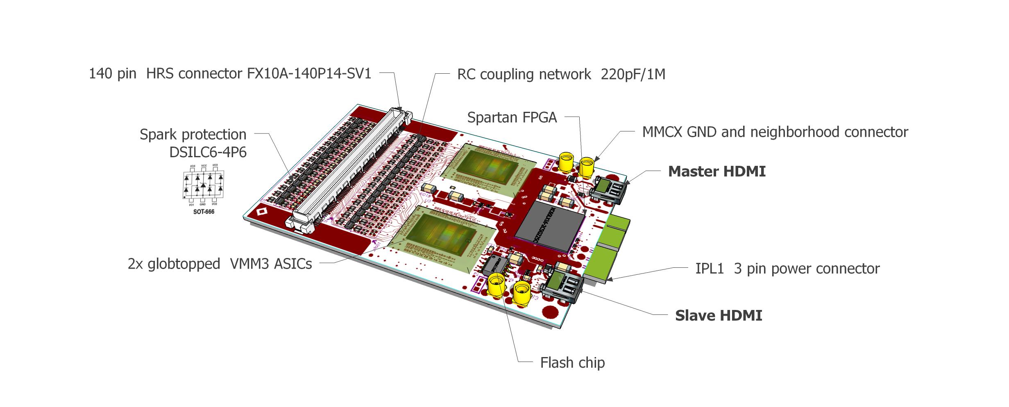
VMM3 hybrid design / RD51*
STATUS December 2016
-all updates applied
-routing finalized
-PCB order 15 cards in prep.
-Wire bonding ASAP.
VMM3 chip is larger and has ~30 more pads than VMM2
* 3rd revision of VMM hybrids for SRS

Slide 15
APV(analogue) VMM(digital)
APV (250 nm CMOS)
Pipeline depth: max. 192 clocks
Trigger latency: max. 3 us
Noise: < 500 e- intrinsic >750..1400 e- on detector
dynamic range: 25 fC
Detector capacity: 18… < 60pf
ADC ext. 4096/1000 [counts/baseline]
Gain: fixed CSA gain 100uA/mip, 5 output signal gains (in step of 20%)
Timing jitter : ½(1/fc) [+- 12ns]
Shaping times: 50 ns adjustable to 80 ns
max readout rate: 7 kHz
VMM (130nm CMOS)
Pipeline depth: 64 digital frames (peak)
Trigger latency: (self triggered) or L0 (12.8us)
noise : < 400 e- on 10x10 detector reported
dynamic range: expect >> 25 fC
Detector capacity: 30pF .. .. < 1nF
ADC: embedded, 10 bit
Gains: 8 CSA gains [0.5..16mV/fC]
Timing jitter: 20 bit t-stamp, 1ns resolution
Shaping times: 4 [ 25… 200ns]
max readout rates: estimated 4 MHz/ch

Slide 16
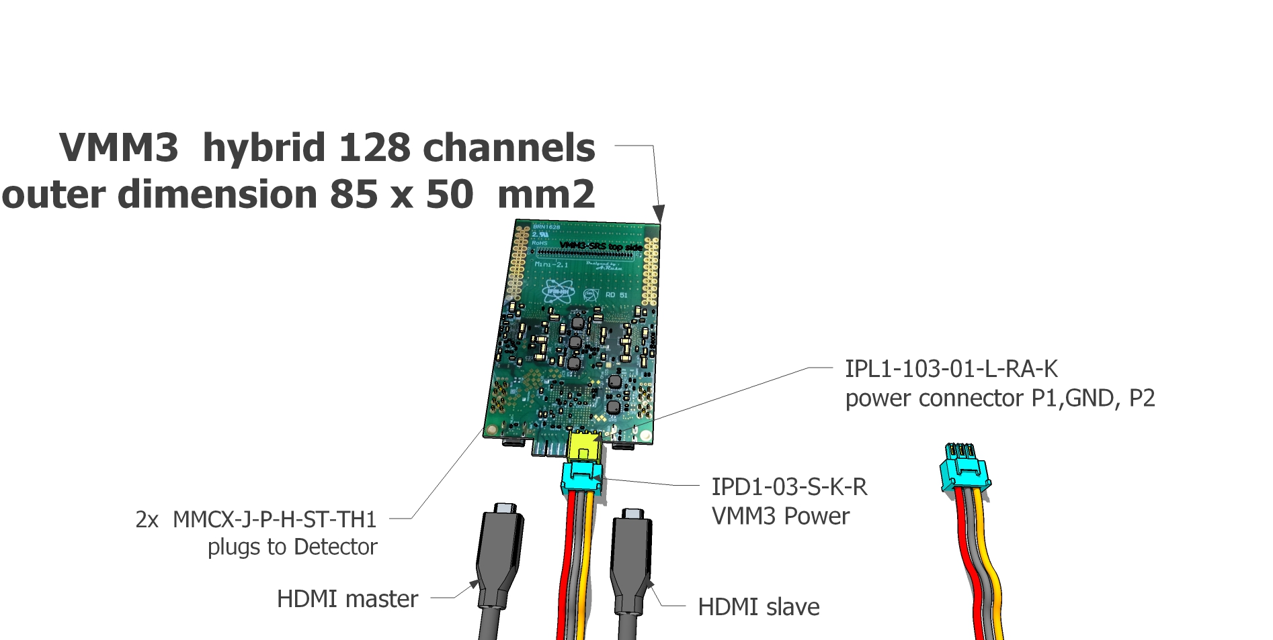
Connectors for VMM3
CONNECTORS VMM3
-2 x HDMI-D (Micro ) Master and Slave
IPL1 direct power option
MMCX for GND and neighbor signals

Slide 17
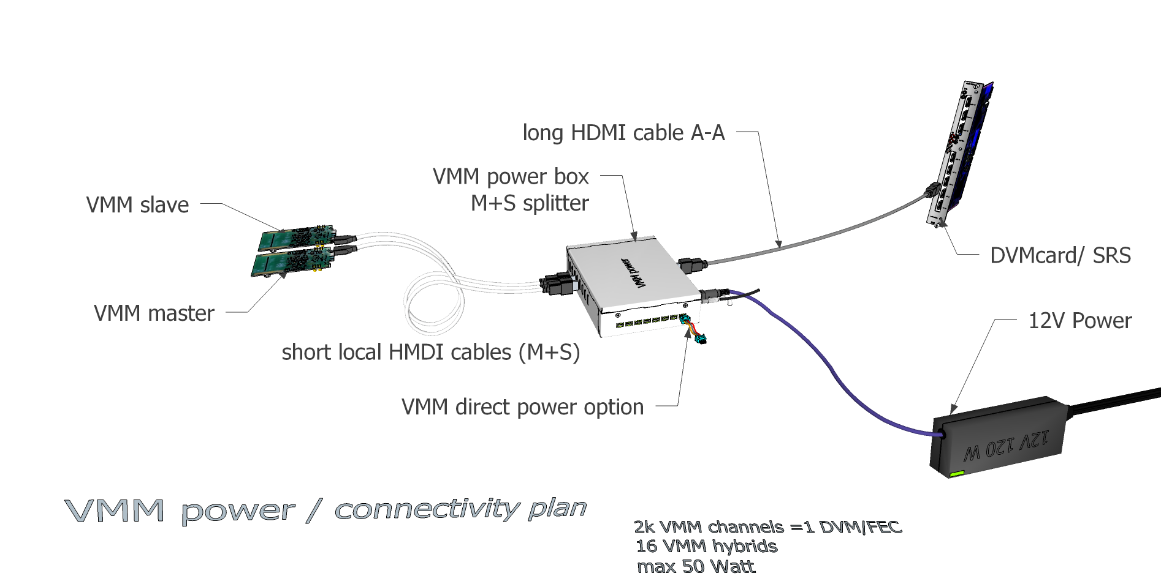
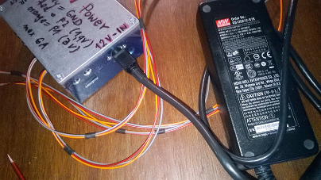
VMM3 Master-Slave connectivity plan
photo prototype power box

Slide 18
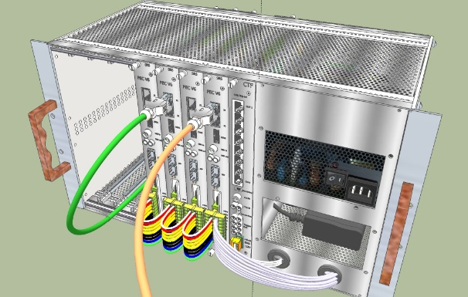
Eurocrates fOR larger systems
Stacking “of vertical slices”
up to 8K APV channels per crate
CTF card for common clock and Trigger (TC link)
HDMI frontend links connected on rear side
Power for APV or VMM via HDMI
With VMM power box, 12V from ATX can be used for VMM
(12V @ 250W ) -> fill up crate with 8 DVMcards/FECs
Revised Eurocrates with custom PS in discussion

Slide 19
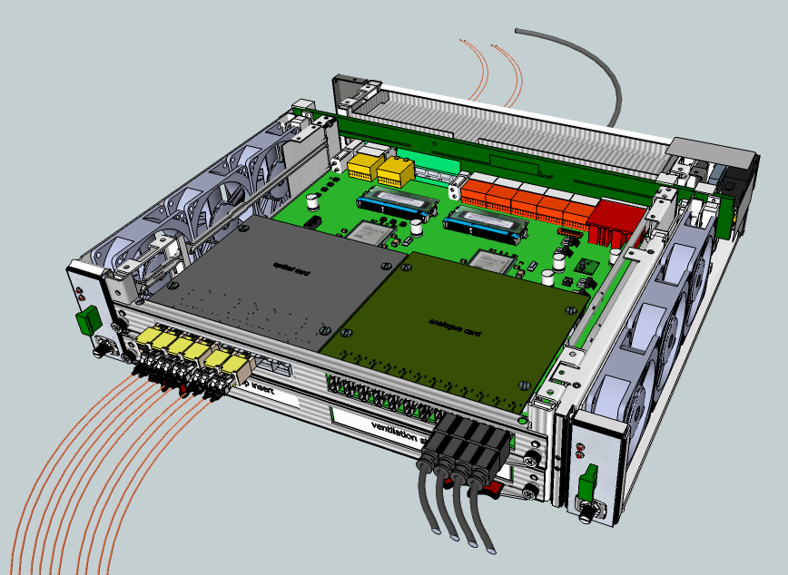
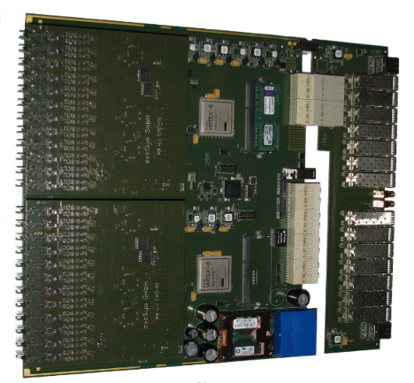
SRS ATCA
Meshed backplane
(6 Gbps, 100Ω links)
ATCA Minicrate
2 slots for SRS blades
shelf manager
RTM (rear Transition Module)
10 GB Ethernet, 3 GB SFP
SRS ATCA blade
2x FPGA LX240, 2 mezzanine slots
2x
SRS mezzanines
Left: optical
Right: ADC/HDMI

Slide 20
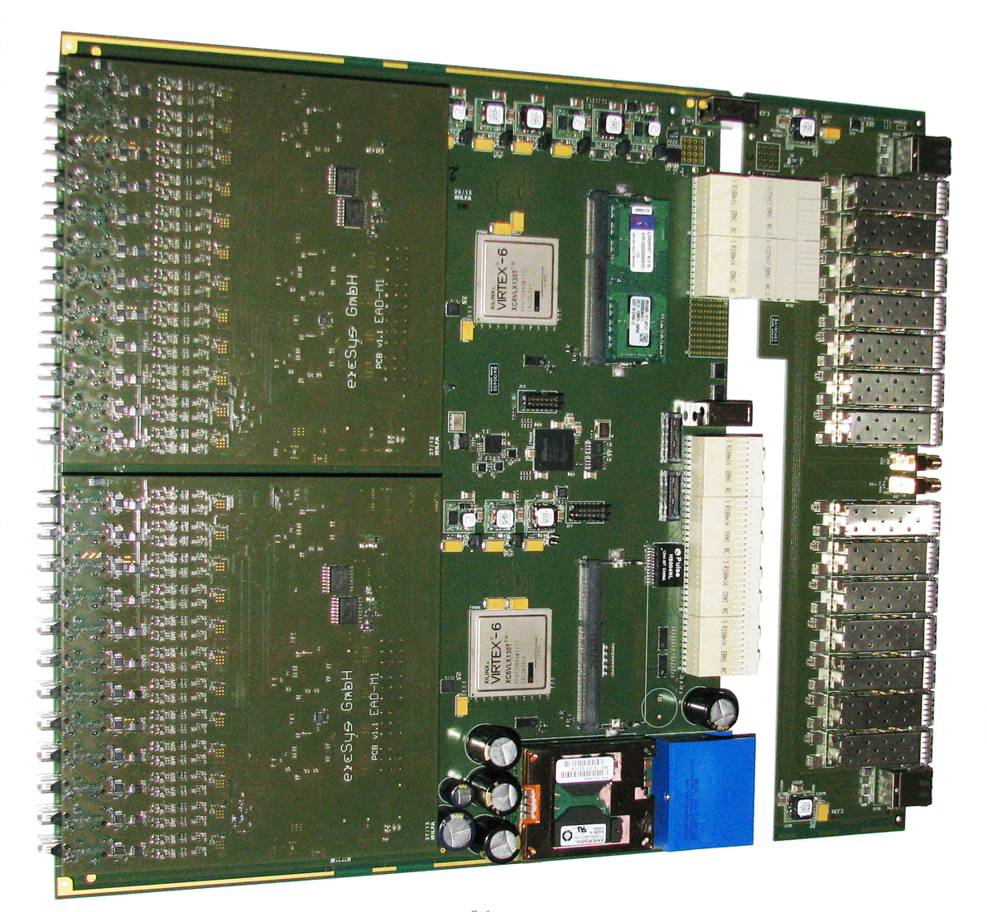
SRS ATCA overview
Blade main board:
2 x Virtex 6 LX240 FPGA
2 x DDR3 plugin
2 x mezzaine ports
RTM I/O card:
2 x 8 SFP+ ports
( 2x 10 GBE FPGA, 2 x 7 4Gbps to mezzanines)
2 x Rj45 (1 DTCC to each mezzanine)
2 x NIM (SMA)
ATCA Zone 3
RTM comemctor
2 x Mezzanines (ADC):
2 ADC mezzanines:
up to APV 6144 channels
ATCA Zone 2
backplane connectors
ATCA zone 1 power connector

Slide 21
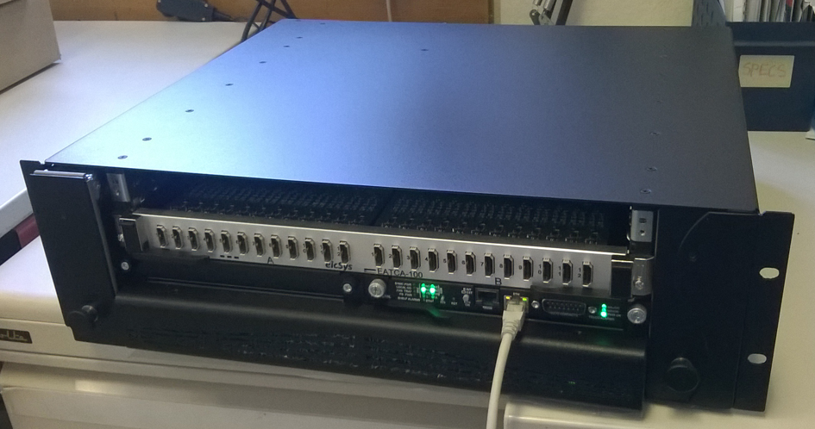
ATCA - based SRS
ATCA industry standard crates (Comtel, Schroff etc ) of different size
Very high-speed linked backplanes between blade-slots
3 x channel density compared to FEC
FEC => Blade with 2 x Adapter plugins
Adapter card=> mezzanine card
Photo SRS Minicrate (Comtel) with 1 blade, 24 HDMI ports for 6 kchannels

Slide 22
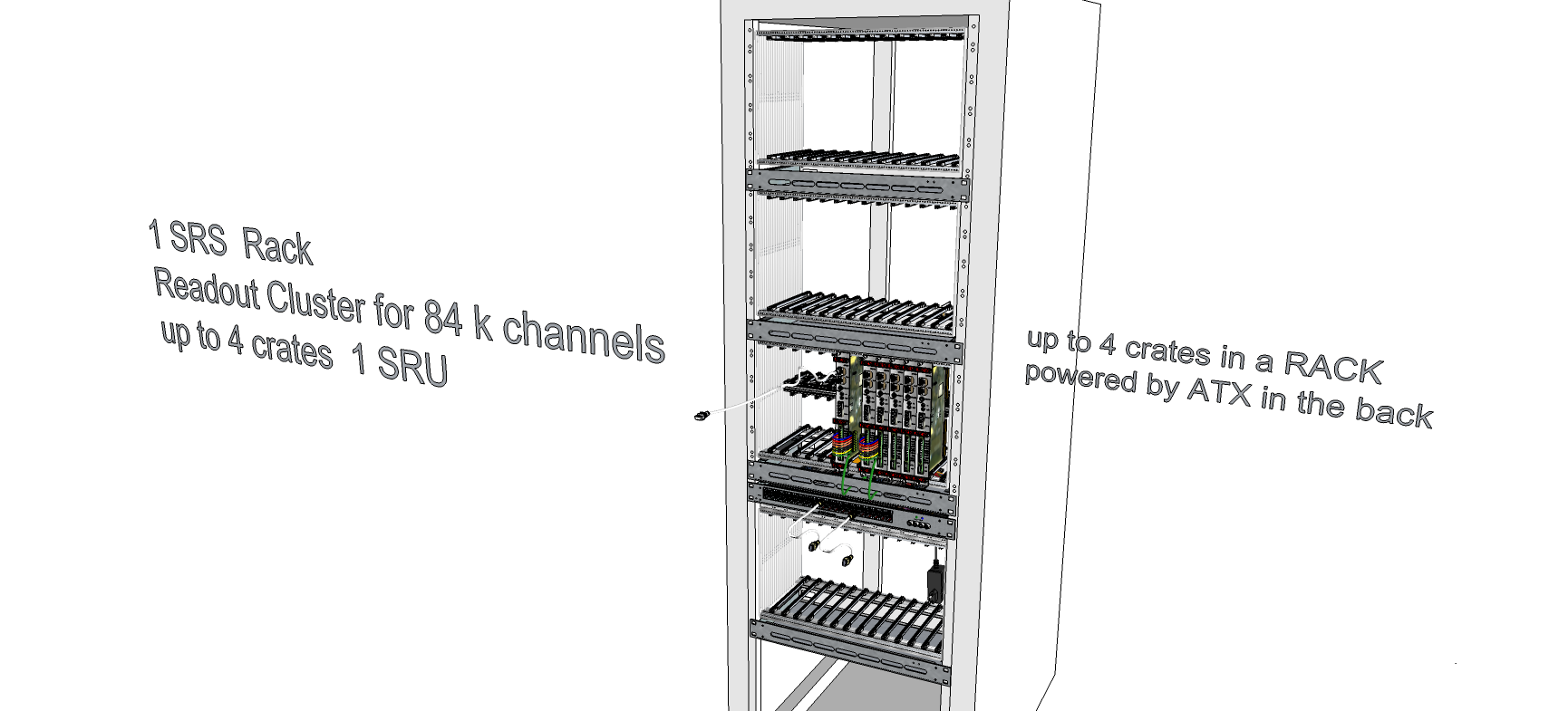
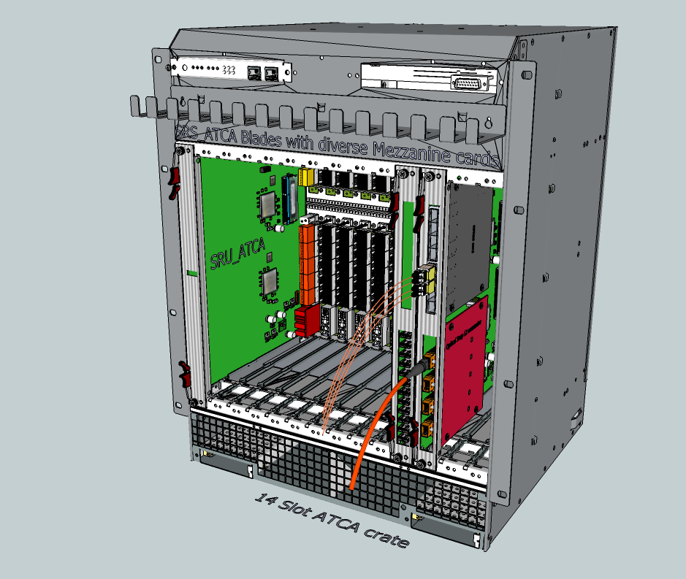
SRS Classic versus SRS ATCA
80 k APV channels 4 Eurocrates crates
in a Rack with SRS Classic
80k APV channels in one single 14 slot ATCA crate
with ATCA SRU in slot 1
ATCA:
3 x channel density
FECs, ADC, SRU available
Eurocrates for 8 FEC/ADC require ATX
power upgrade
ATCA blades, RTMs and ADC mezzanines are available
(ATCA SRU is a planned)

Slide 23
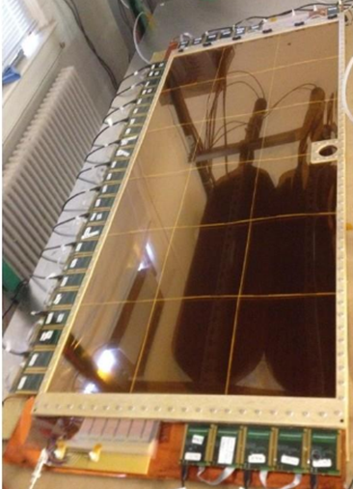
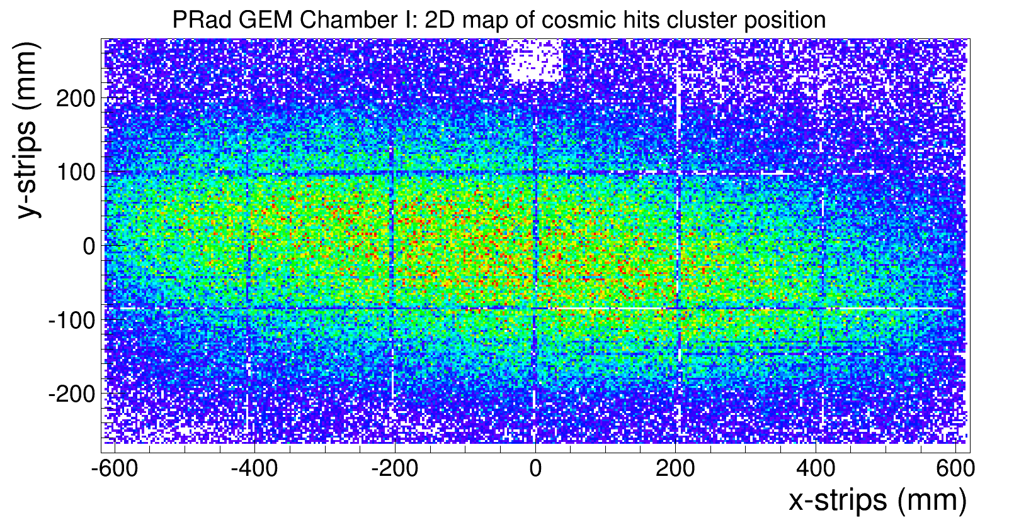
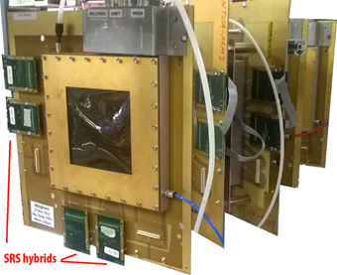

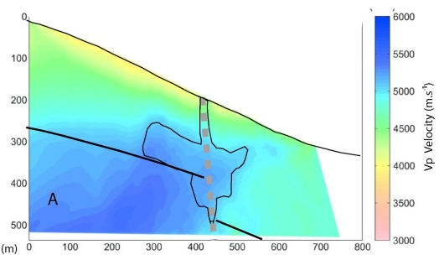
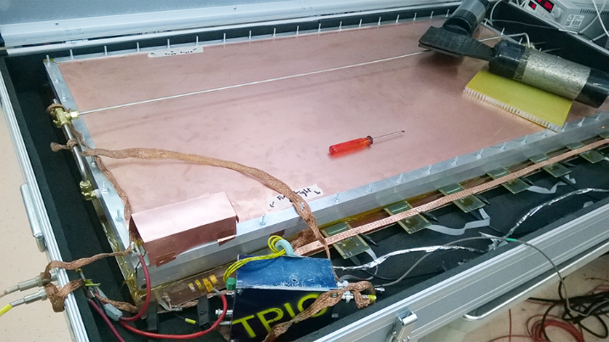
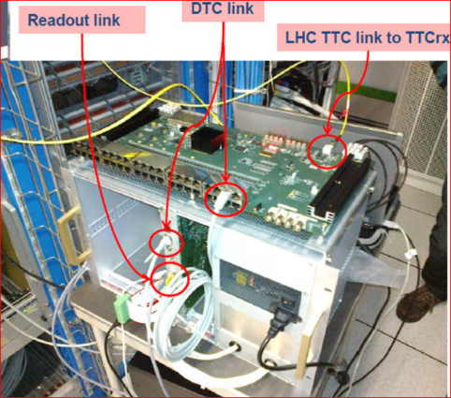

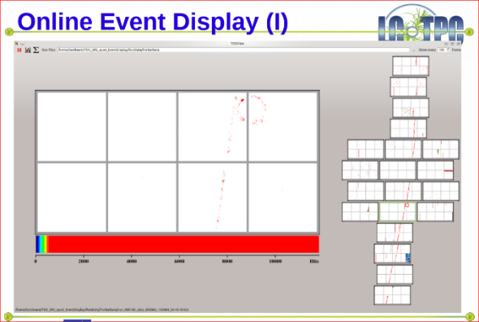
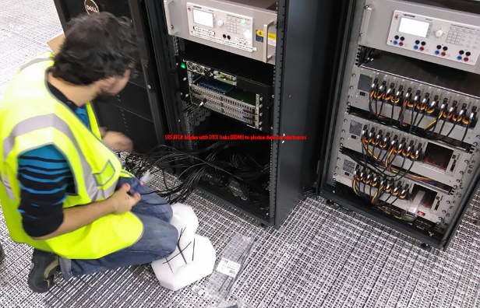
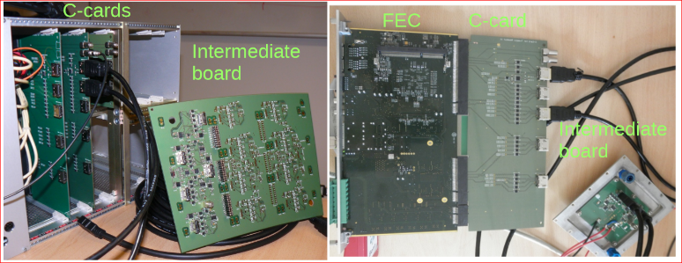
SRS in Experiments
Detector telescope with SRS readout
@testbeam 2016
PRad GEM with SRS- APV frontend @ UVa
Large surface MUST detector
with SRS Classic and APIC trigger
NEXT Collab. SRS-ATCA with photon
Detector frontend
SRS Totem: optical readout DTC
SRS with Timepix frontend

Slide 24








AIDA-sponsored Projects
APIC: preamplifier -shaper box, solar chargeable
4 APIC prototypes in use by teams ( blue boxes)
Tested with GEMs, Micromega mesh/strip, large surface MPPC , PMT’s
-> finalizing for commercial availability
Femto: Femto-ampere meter with realtime signal output
-> continued prototype status, new revision planned
AVD: Active Voltage Divider / generator for MPGD’s
-> 3rd prototype status, all issues understood, NIM-AVD planned for 1 Q 2017
VMM3 frontend for SRS

Slide 25


APIC finalization/ commercialization 2017
New box, commercial look
Added features: Trigger and Bias Voltage for Si detectors
Commercial APIC versions in prep. for sales for 2017
2 APIC types so far:
APIC-MPGD fast MPGD’s (20ns/400ns) for high rate up 4 MHz
APIC-SiPM high capacitance/charge MPPCs 4us/8us up 100 kHz

Slide 26
APIC characteristics
50 OHM outputs: Preamplifier and 2 x Shaper (+)/(-)
Spark protection: 0-failure since > 1 year in experiments
Preamplifier gain 2mV/fC
AC Input coupling from HV planes (SHV) or DC from strips/pads (BNC)
SHV input for detector Bias Voltage ( RF filter included)
Gain trimmer 1-1000 (max +/-1.5V)
Baseline selection fixed (0V) or tunable +/- 1.5V
Input rates up 4 MHz rates with 20 ns shaper
MPGD version: shaper 20ns/400 ns
MPPC version: shaper 4000/8000ns
Test pulse 5ns risetime (switch permanent/off/ single)
Battery autonomy 24h, charger cables from NIM or Solar panel
Battery-low blinking LED
commercial APICs: NIM trigger (CSA), Bias 25-70V for MPPC

Slide 27

AVD NIM scheduled for March 2017
AVD-NIM
The active voltage generator/ divider for MPGs
resolved design items:
Prompt Voltage and femtoampere current measurement from HV planes without cables or batteries
Control, and monitoring with parameter display (Arduino)
HV generation up 5kV
Short circuit immune active divider for max 9 cascaded HV’s
Optional e-Fuses for prompt “disconnection” of individual HV planes above threshold current >5uA
Still working on:
spark quencher, eliminate stored energy from detector plane
AVD NIM box with 3 functional units
-prototype NIM box with HV and
monitoring board exists
-AVD and eFuse box exists

Slide 28

Progress too slow ?
JOIN the GDD lab Electronics activities

Slide 29
Backups /reminders

Slide 30


Where to BUy SRS
( this is the most difficult about SRS )
SRS procurement until 2016
INHOUSE production RD51 ( basically all early systems )
CERN Store ( from produces like Rentron, Prisma, NEOHM etc ) https://edh.cern.ch/Document/SupplyChain/MAG
  AVP hybrids, FEC + ADC cards, Minicrates, HDMI cables, SRS accessories
  However !!! Only via team account, delivery only to CERN, APV purchase restrictions
EicSys http://www.eicsys.eu/
  Blades, RTM cards; ADC mezzanines
  waiting for news and testbeam qualification
SRS procurement from 2017+
INHOUSE production RD51: stopped !
CERN Store: continued for team account owners only
NEW SRS production and purchase licencies* 2017
No team account ? ask CERN/KT for SRS purchase licence
Direct SRS sales starting in 2017:
SAMWAY Electronics: http://www.samwayelectronic.com
FEC and ADC cards, Eurocrates, SRS-ATCA
mezzanines etc
SRS Technology: http://www.srstechnology.ch
APIC, hybrids, Powerbox, DVMcards, SRU, AVD etc

Slide 31



New HRS 140 pin connector to come on VMM3 version 3.1
first VMM3.0 prototypes still with PNASONIC 128 PIN
Altium design A.Rusu

Slide 32

Adapters for transition time

Slide 33

New functionalities a.) geographic address position
Will allow to read the geographical
position of a hybrid along a detector frame
Readout via
slow controls SRS
Detector side
TOP
VMM hybrid
+2V5
FPGA
6 code pins on right side viewed from top
10k pullups
6
Position coding by GND / No GND
Detector Frame
Example Position = 10 0001

Slide 34

New functionalities b.) optional I2C devices on detector
Will allow to place and
use intelligent sensors on the detector
I2C device control and readout
via slow controls SRS
TOP
Detector side
VMM hybrid
+2V5
FPGA
6 x support pins I2C (SDA,SCL)
and Signals (S-in/S-out) on left side, viewed from top
6pin connector plugin
Vcc
I2C device
gnd
sda
scl
S-out
S-in
Detector Frame

