Slide 1
Take part!

Slide 2


CERN – Serbia working Group
25th November 2016
Lore Taillieu
Head of Talent Acquisition, CERN HR Department

Slide 3

Serbia @ CERN
Since 15 March 2012, Serbia is an Associate Member in the pre-stage to Membership of CERN
-> access to number of learning and working opportunities within ceiling (incl. procurement)

Slide 4
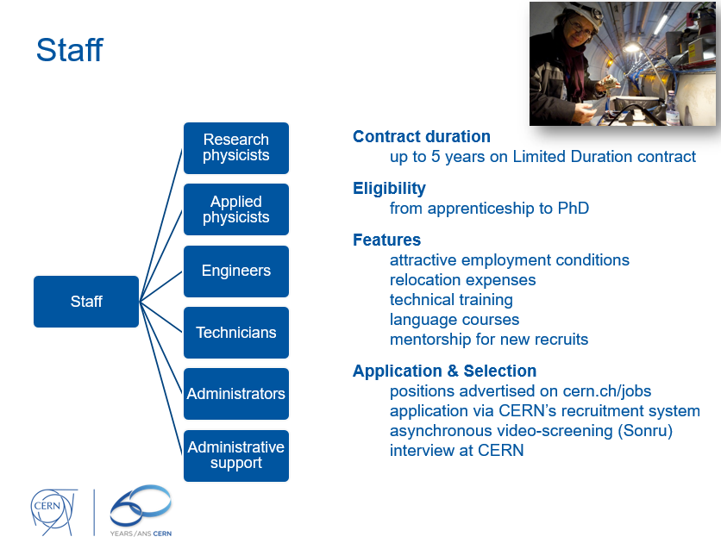
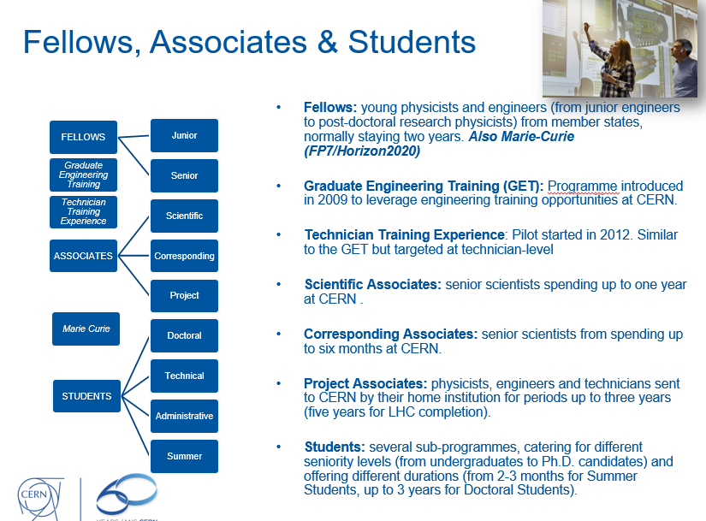
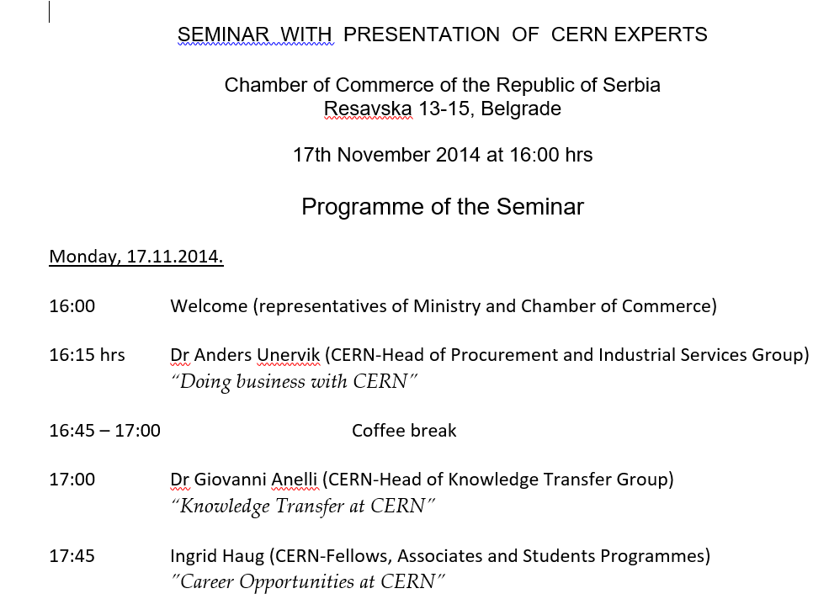
Serbia @ CERN

Slide 5
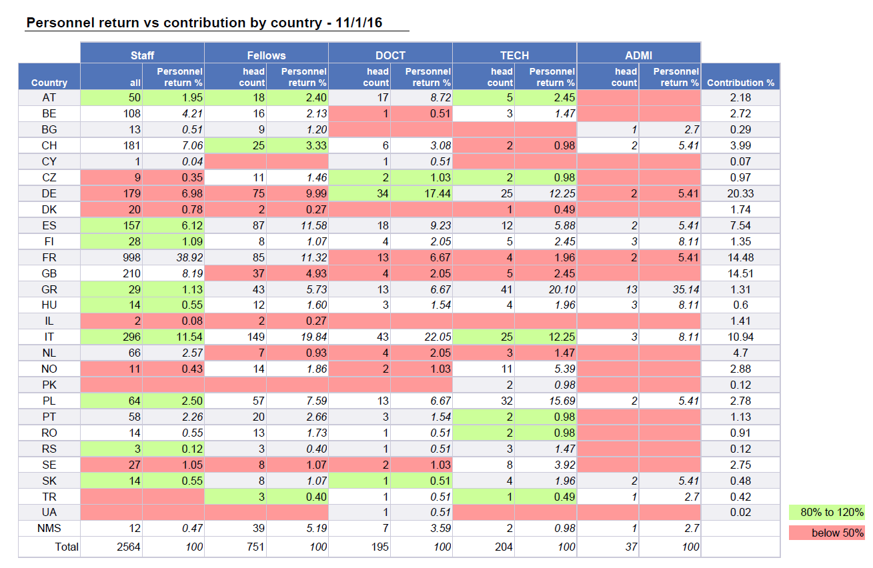
and it’s certainly encouraging
Notes:
I

Slide 6
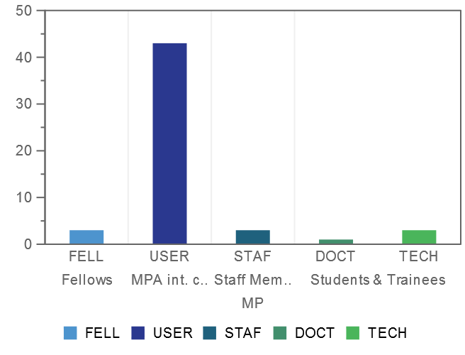
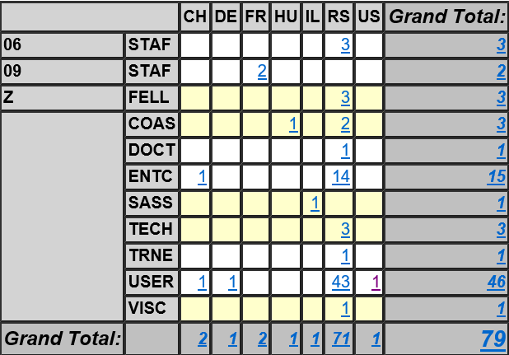
Serbia @ CERN – closer look

Slide 7

Serbia @ CERN
Electronics
57
Total
3 staff (5)
3 Fellows
Scientific Associate
(1)
3 Technical students
2 Cooperation
Associates
(3)
1 Doctoral Student
1 Visiting scientist
(2)
43
Users
(46)
1 Trainee
Theoretical physics
Experimental physics
Electronics
Computing
Good coverage in
Programs
Disciplines
CERN (tech & research dpts)
Electrical
2 Computing
1 Applied physics

Slide 8

zoom on staff
Since 15 March 2012: 3 new staff started at CERN
Status Description | Name | First Name | Primary Nationality | Secondary Nationality | Organic Unit | Benchmark Job Description | Contract Start
Staff Member | JOSIFOVIC | Ivan | RS |  | TE-EPC-MPC | Electronics Engineer | 01.09.2014
Staff Member | SPASIC | Jelena | RS |  | TE-MPE-EP | Electronics Engineer | 01.09.2016
Staff Member | TODORCEVIC | Todor | RS |  | TE-EPC-FPC | Electronics Engineer | 01.09.2015
Notes:
Broad overview of all Serbs at CERN

Slide 9
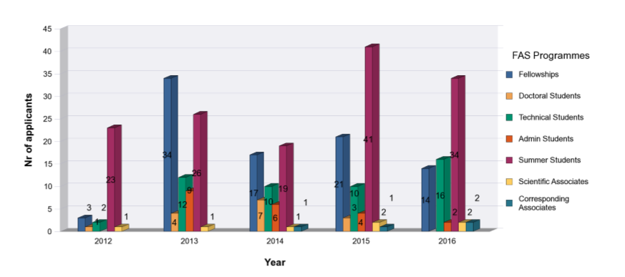
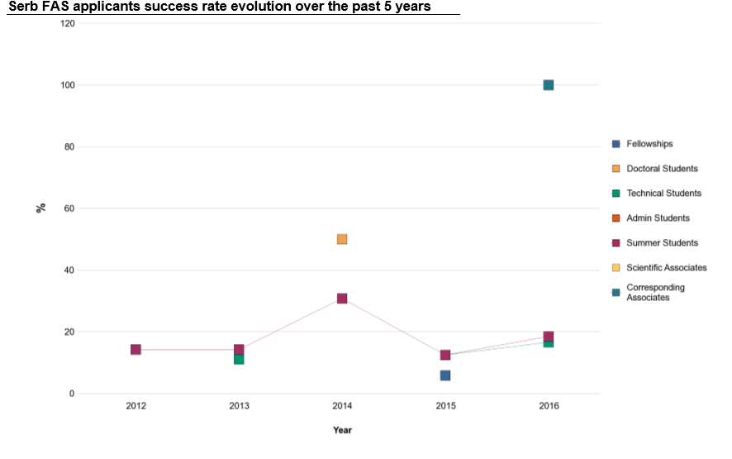
Evolution Serbia in FAS programs
Upcoming TSC:
No DOCT applications
1 ADM application
7 TECH applicants

Slide 10
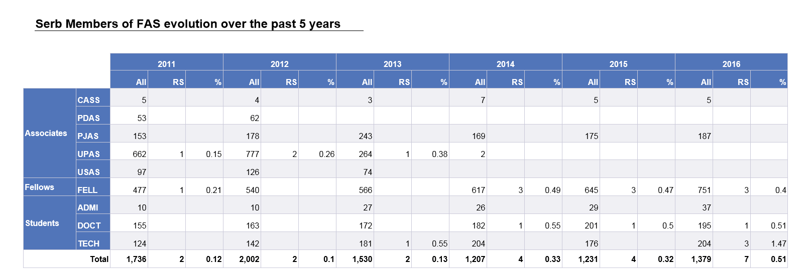
Evolution Serbia in FAS programs
Positive evolution in important programs – TECH, FELL (pipeline)
2016-2 committees – TSC (! DOC)

Slide 11
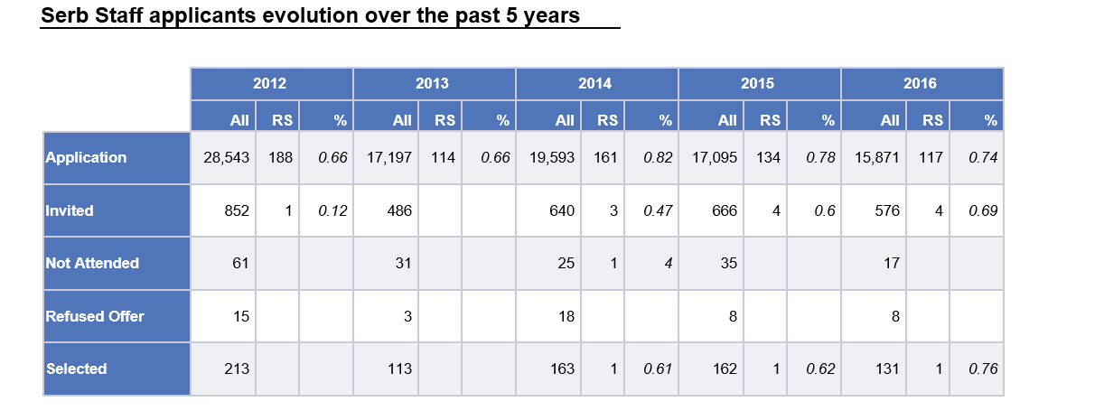
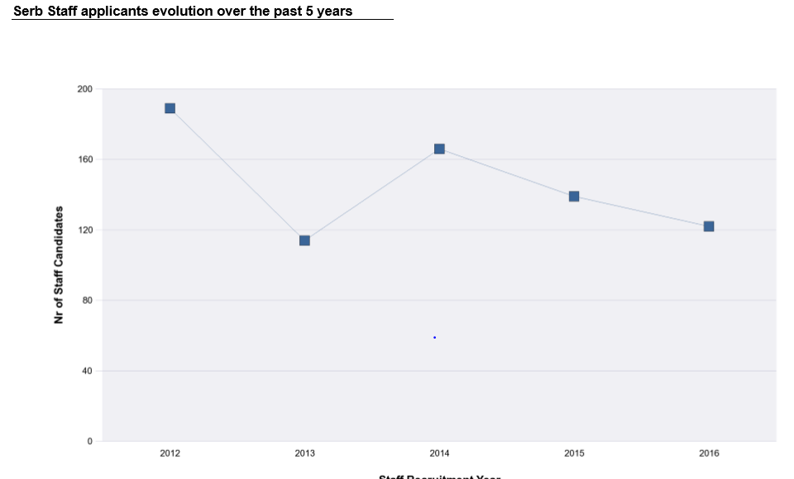
Evolution Serbia in staff
Positive evolution since 2014 with stable invitations, and a selection/ year;
Applicant nrs dropping (general trend)

Slide 12
Summary
Overall, very good success rate
  Doctoral students
  Nrs of staff applicants
  How can we help?
Good pipeline with increasing numbers of technical students, regular selection of fellows
Presence in different, important disciplines (physics, IT, engineering) and departments (technical & research sector)

Slide 13

Next application deadlines
27.01.2017 Summer Students (selection Mar-17)
28.02.2017 Fellows ( AFC May-17)
09.03.2017 Associates (AFC May-17)
12.04.2017 Doctoral, Technical & Admin students
(TSC Jun-17)
19.05.2017 Technician Training Experience (Jun-17)
04.09.2017 Fellows
16.09.2017 Associates
16.10.2017 Doctoral, Technical & Admin students
31.10.2017 Technician Training Experience

Slide 14
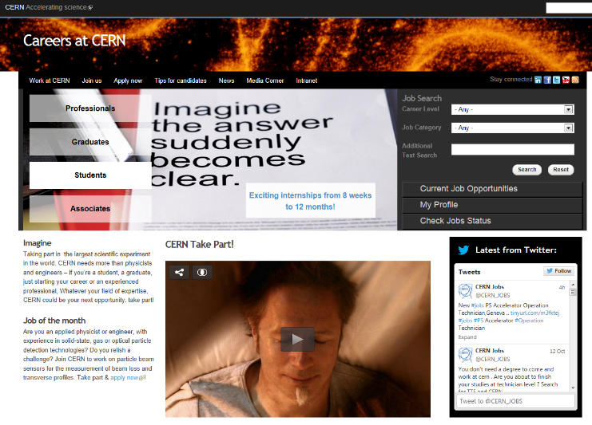
Careers website
25 November 2016
25 November 2016
cern.ch/jobs

Slide 15
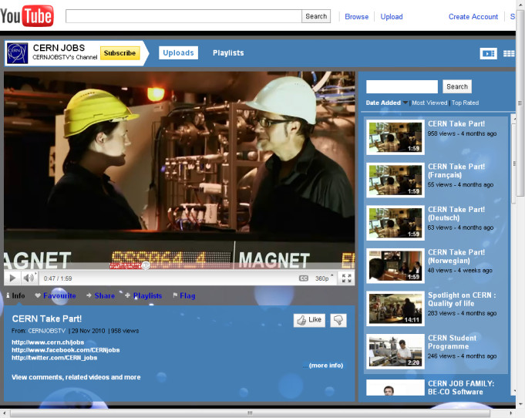
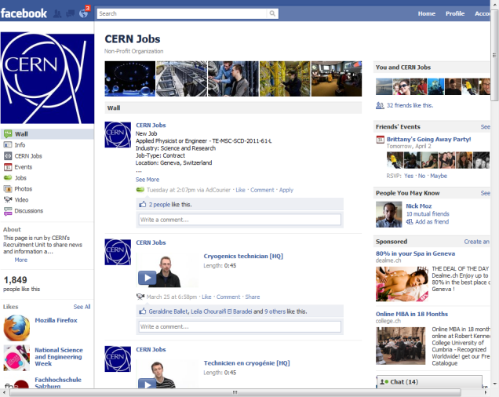
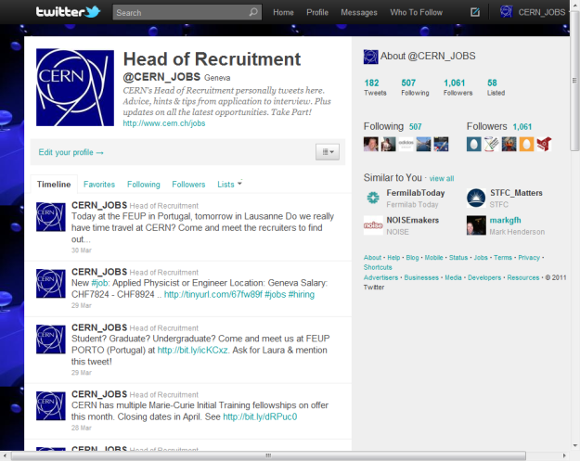
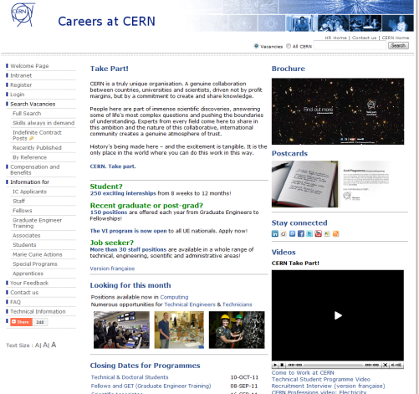
Find us !
Facebook
Twitter
Youtube

Slide 16
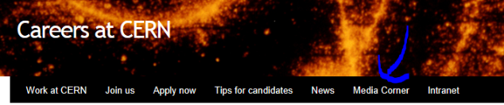
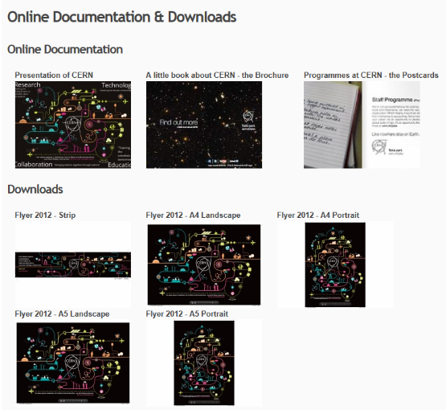

Slide 17
Thank you

Slide 18
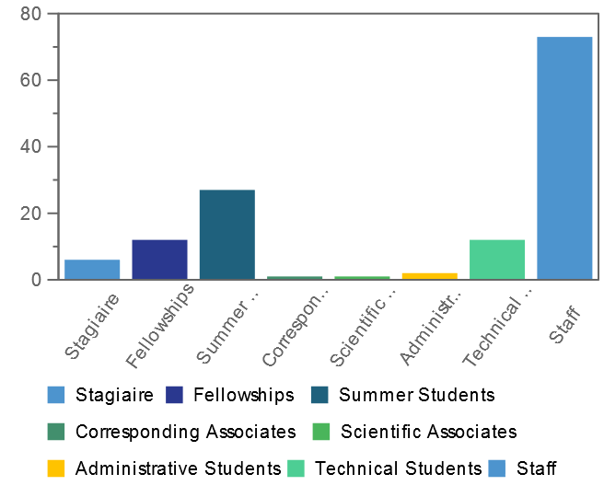
Applicants in 2016

Slide 19
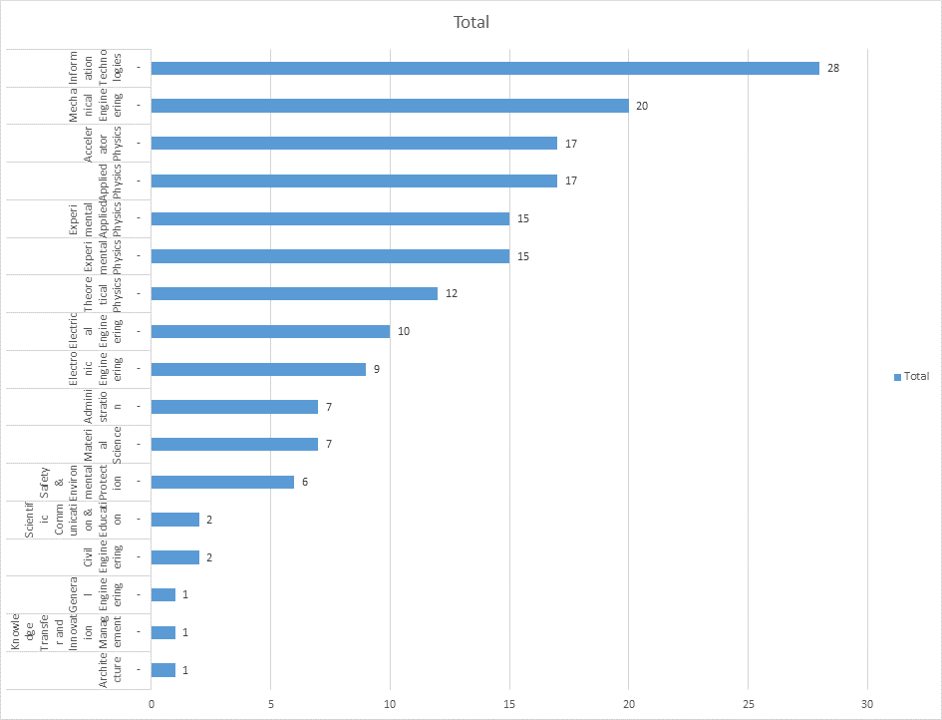
Focus on….
Continue to build the pipeline
Increase application nrs
IT
Physics, applied, research, theoretical
Engineering

Slide 20
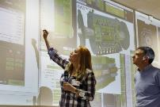
Fellows, Associates & Students
Junior
Senior
Marie Curie
Scientific
STUDENTS
Doctoral
Technical
Summer
Corresponding
Project
Administrative
FELLOWS
ASSOCIATES
Graduate Engineering Training
Technician Training Experience
Fellows: young physicists and engineers (from junior engineers to post-doctoral research physicists) from member states, normally staying two years. Also Marie-Curie (FP7/Horizon2020)
Graduate Engineering Training (GET): Programme introduced in 2009 to leverage engineering training opportunities at CERN.
Technician Training Experience: Pilot started in 2012. Similar to the GET but targeted at technician-level
Scientific Associates: senior scientists spending up to one year at CERN .
Corresponding Associates: senior scientists from spending up to six months at CERN.
Project Associates: physicists, engineers and technicians sent to CERN by their home institution for periods up to three years (five years for LHC completion).
Students: several sub-programmes, catering for different seniority levels (from undergraduates to Ph.D. candidates) and offering different durations (from 2-3 months for Summer Students, up to 3 years for Doctoral Students).

Slide 21

Technical Students programme
~ 200 positions/year
FIELDS : applied physics, engineering, computing
LENGTH : 4 to 12 months
ELIGIBILITY : 18 months of technical undergraduate studies
FEATURES : a technical project with a CERN supervisor
a living allowance, incl. health insurance
“It’s a great place to start a career,
it’s a great place to learn new skills, make new friends…”
Committees in June and December
Notes:
For students looking for a practical training period or a place to do your final project

Slide 22
Admin Students programme
~ 30 positions/year
FIELDS : Translation, human resources, business administration, law, finance, librarianship, science communication, audiovisual, communication and public relations…
LENGTH : 2 to 12 months
ELIGIBILITY : 18 months of undergraduate studies
FEATURES : an administrative project with a CERN supervisor - a living allowance, incl. health insurance
“My Admin Studentship was a great experience – I had exposure to more activities than I could have imagined”
Committees in June and December
Notes:
For students looking for a practical training period or a place to do your final project

Slide 23
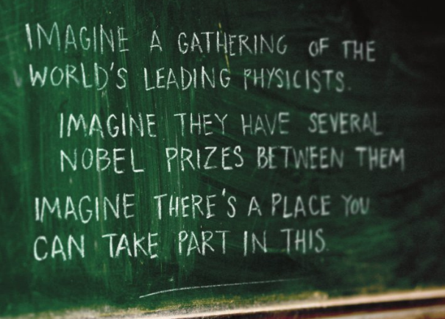
Doctoral Student programme
~60 positions/year
FIELDS : applied physics, engineering, computing
LENGTH : 1-3 years
ELIGIBILITY : enrolled in a doctoral program in
a Member State university
FEATURES : a technical project, leading to a PhD thesis
co-supervised by the university thesis advisor and a CERN staff member
a living allowance incl. Health insurance
“Gave me the opportunity to meet important people, especially in the research fields”
Committees in June and December
Notes:
CERN offers PhD subjects in collaboration with a University

Slide 24

Summer Students programme
~200 positions/year
FIELDS : physics, engineering, computing
ELIGIBILITY : 3 years of full-time studies at university
level
LENGTH : 8 to 13 weeks, during the summer
FEATURES : high-quality lecture programs
visits and workshops
living allowance
accommodation in CERN hostel
“Can’t imagine a better way
to spend my summer”

Slide 25

Fellowship & Graduate Engineering Training
~250 positions/year
FIELDS : physics, engineering, computing
ELIGIBILITY : BSc, MSc or PhD
no more than 10 years relevant post-MSc experience
SELECTION: 2 selection committees per year
FEATURES : 2-3 year employment contract
attractive salary incl. social benefits
training possibilities
Fellows are normally nationals of the Member States of CERN. There also exist a limited number of places for Fellows from non-Member States.
“An ideal place to follow
the most recent ideas in physics
and start new collaborations”
Committees in May and November
Notes:
Recent university graduates who typically come for a first work experience

Slide 26

Marie Sklodowska-Curie
For university graduates
FIELDS : physics, engineering, computing
DURATION: up to 3 years
ELIGIBILITY : MSc or PhD
≤5 years post-degree experience
FEATURES : funded by the European Commission
an employment contract with CERN
specific Marie-Curie vacancies published on CERN web pages
an attractive salary, social benefits, allowances
international network

Slide 27

Technician Training Experience
~30-50 positions/year
FIELDS : Mechanics, electronics, electricity, etc.
ELIGIBILITY : Technical diploma (Note: applicants with higher qualifications, BSc, MSc or PhD are not eligible)
no more than 4 years relevant experience after finishing your diploma
SELECTION: All applications for TTE opportunities will be considered by a panel of CERN specialists.
The panel meets once per year.
Successful applicants will be offered appointments which should begin within six months of the meeting.
FEATURES : An initial contract of one year renewable for a second year
attractive salary incl. social benefits
On-the-job and formal training will be provided at CERN. There are also in-house language courses for English and French
“I never imagined the possibilities CERN would offer me.”
Committees in June and December
Notes:
You are a national of a CERN Member State.
You have a technical diploma in the field of mechanics, electro-mechanics, electricity or electronics.
You have no more than 4 years relevant experience after finishing your diploma.
Candidates who are currently preparing a diploma are eligible to apply. However, they are expected to have obtained their qualification by the time they take up their appointment at CERN.
Applicants with a higher level diploma (BSc, MSc..) are not eligible.
You should have at least a basic knowledge of English or French.

Slide 28

Staff positions
~ 150 positions/year
EMPLOYED MEMBERS OF PERSONNEL RECRUITED FROM OUR 22 MEMBER STATES
Eligibility : > from apprenticeship to PhD
Selection : > vacancies published on the WEB
Features : - Maximum 5 year contract
- competitive salaries incl. social benefits
- training possibilities (language courses, technical training)
Notes:
The scientific and technical STAFF design and build the laboratory’s technological infrastructure and ensure its operation. They also help to prepare, run and analyze the scientific experiments.
Fields: Not only physicists, engineers, computer scientists but also technicians, technical engineers as well as administrators and assistants
Activities: ranging through the phases of Research and Development, Design, Production, Operation and Maintenance

Slide 29
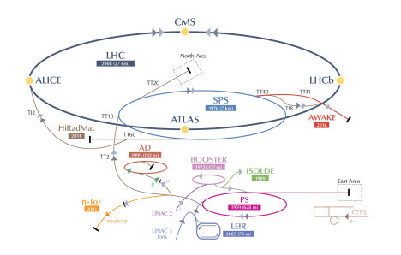
Associates
Paid Scientific Associates
Experienced individuals on leave of absence
mainly in physics
Normally 12 months (24 months max)
Unpaid Associates / Users
Scientists (including PhD students in physics)
Corresponding Associates
Experienced individuals from smaller Member States on
leave of absence mainly in physics
Up to 6 months
Project Associates
Physicists, engineers and technicians invited by
Departments (according to agreements)
Up to 3 years

Slide 30
Staff Recruitment Process & evolution
Generic
Advertising
Specialised
Sourcing
Candidate
Database
Tools & Innovations
Boarding Tool
Monitoring of Sourcing Actions
Multi-posting technology
Twitter, facebook & Youtube channels
Asynchronous video screening
Video Vacancy Notices
Skills always in Demand
Employee Value Proposition
Guidelines & Procedures
Feedback metrics
Integration of the CCM in the
recruitment process
Industry Recognition
~50 applicants
200-500 applicants
5 interviewed
10-15 screened
pro-active
staff recruitment
1 selected
4 interviewed
1 selected
Notes:
A comprehensive recruitment process
Industry recognition
Multiple tools and innovative processes implemented

Slide 31

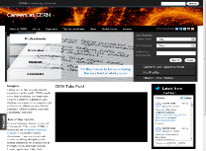


Procedures
Academic
Excellence
External
Ranking
Candidate
Eligibility
Experience
Discipline
Nationality
Research Fellows
e-recruitment
Internal
Ranking
Senior Applied Fellows
Junior / Students
HR
Departments
Completed
application
Selection
Committee
Referees

Slide 32
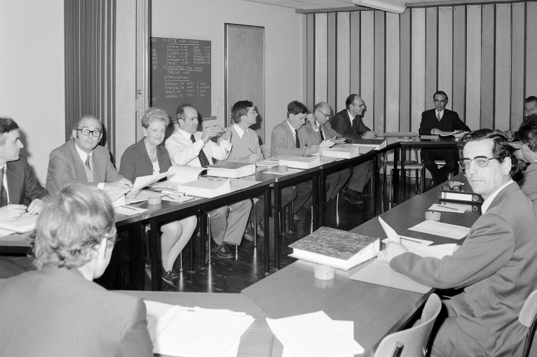
Selection (AFC & TSC)
Folders go to Departments via Reps
Requests submitted to Reps
Pre-meeting to resolve conflicts and ensure budget respected
Selection Committee:
  Takes selection decisions
  Ensure fairness & transparency across departments
  Ensure excellence
  Raise & decide on Policy issues
Quotas
1975 Fellows Selection Committee

Slide 33
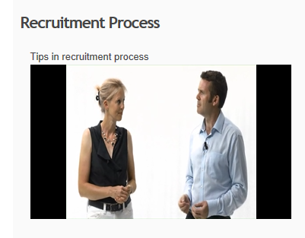
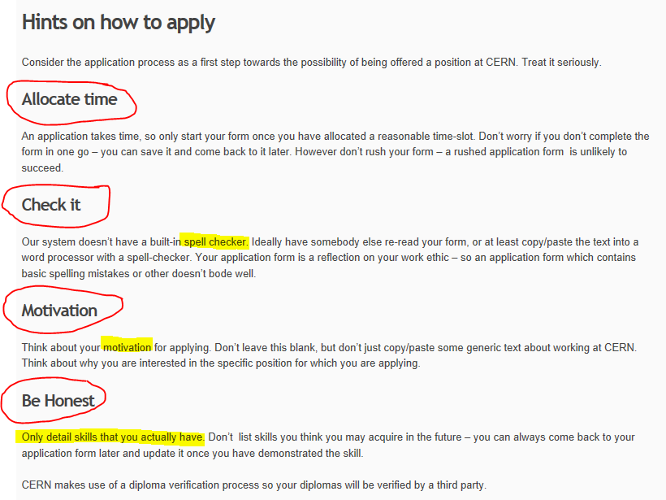
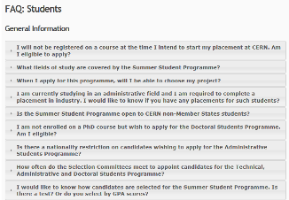

Slide 34


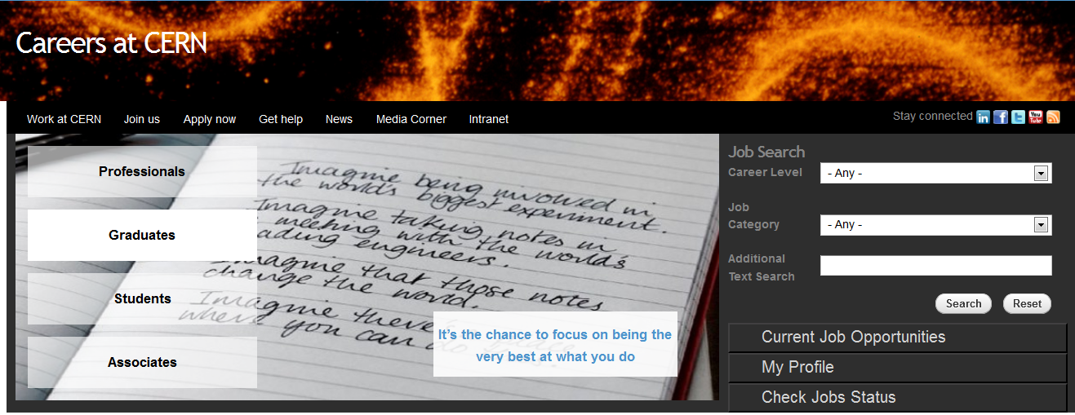





Find out more…
Facebook
  Create engagement
  Attracting through referrals
Youtube
  Showcase CERN
  Explain jobs that are hard to understand
  Help on recruitment process
LinkedIn
  Engage with professional community
Twitter
  Increase CERN’s presence
Careers site
cern.ch/jobs
Thanks to :

Slide 35
Thank you.

