Slide 1
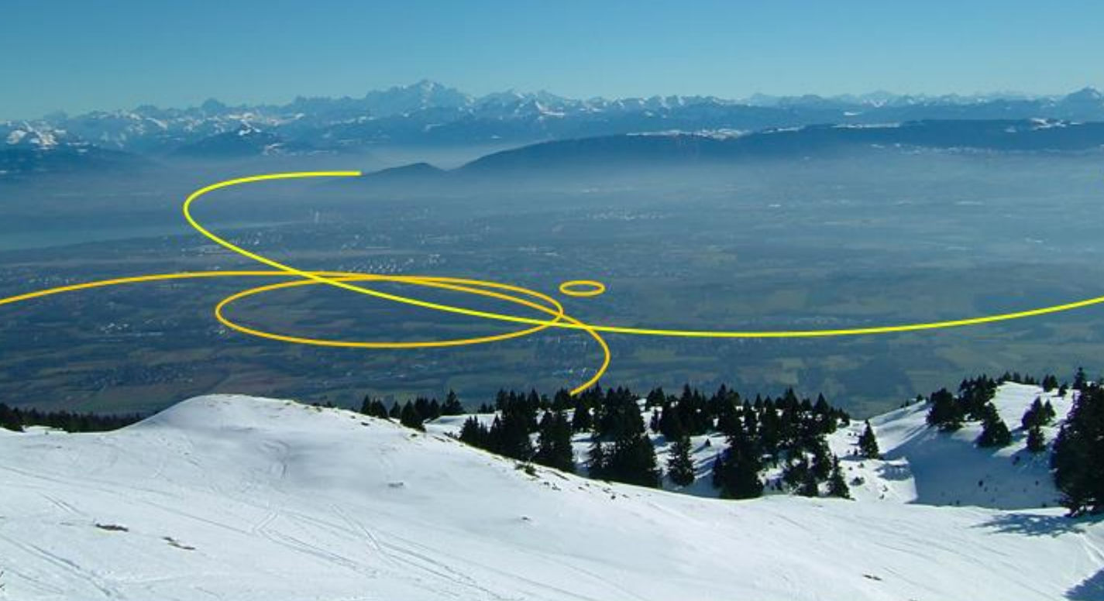

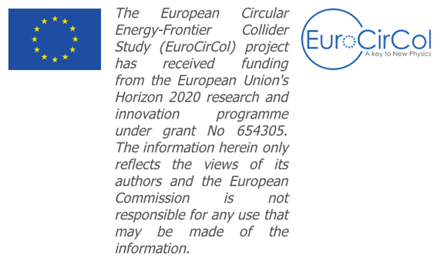
FCC-hh impedances and instabilities
O. Boine-Frankenheim (for EuroCirCol Task 2.4)
D. Amorim, S. Arsenyev, X. Buffat, L. Mether, B. Salvant,
D. Schulte (CERN)
D. Astapovych, U. Niedermayer, P. Krkotic (TU Darmstadt)
V. Kornilov (GSI)
B. Riemann (TU Dortmund)

Slide 2
Next steps (WP 2.4 Priorities)
Collimator impedance at injection and top energy (-> Impedance library).
-> David/Sergey
2) The increase of the beamscreen impedance due to the surface treatment.
(A factor 4 increase in resistivity at 3 GHz may be of concern.)
-> Patrick/Uwe
3) Are the new larger beamscreen holes a problem (impedance/photoelectrons) ?
-> Bernard/?
4) growth rate / damping (octupoles) estimates for k>=0 coupled bunch modes
-> Vladimir/Daria
5) check TMCI thresholds at injection/top energy (->1)
-> Daria/David
6) threshold electron cloud density vs. energy from simulations.
-> Daria/Oliver

Slide 3
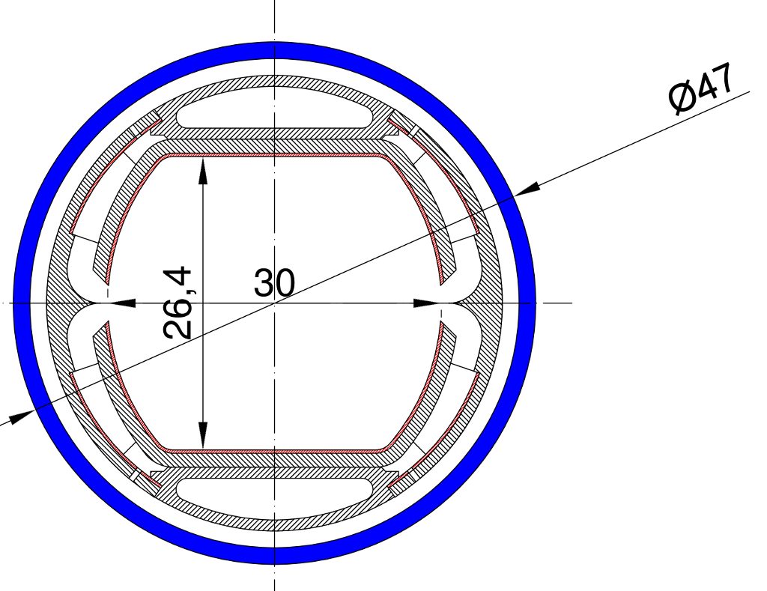
Absorption of synchrotron radiation
Synrad
40 %
1 %
0.6 %
Vertical orbit error tolerance:
approx. 1 mm
G. Canton, D. Sagan, F. Zimmermann, IPAC16 (2016)

Slide 4
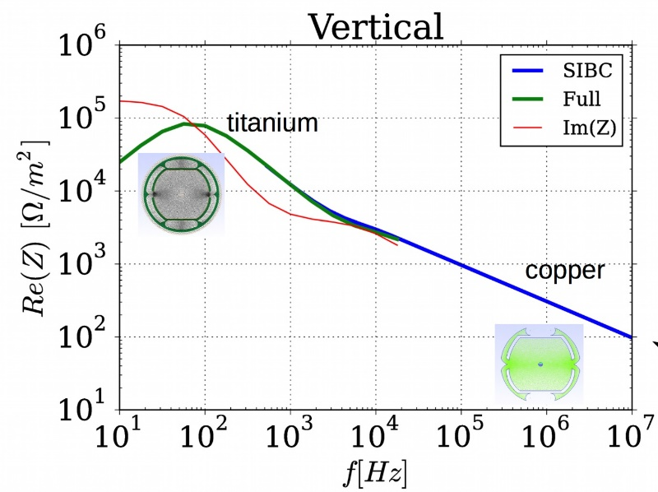
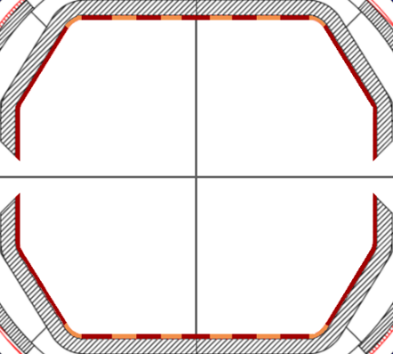
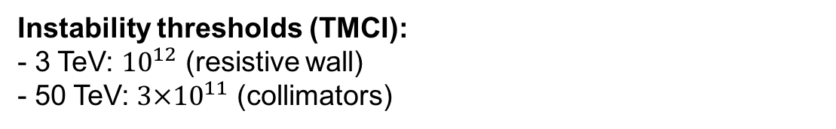
EuroCirCol Task 2.4: Summary
A 2D frequency-domain impedance solver (BI2D) has been developed and released:
FEM, focus on low frequencies, dispersive materials, SIBC
Resistive wall impedance/instability:
- Estimates growth time (k=0, 3 TeV) of about 100 turns
- Possible cures: Feedback, Octupoles, HTC coating
Other impedances:
Collimators: 2D simulation model/analytic models
Holes/Slits (analytical) + Interconnects
Electron cloud:
SEY < 1.1 required. More detailed simulations needed !
Instability thresholds (TMCI):
- 3 TeV: ${10}^{12}$ (resistive wall)
- 50 TeV: ${3×10}^{11}$ (collimators)
Next steps (selected activities):
Coupled-bunch instabilities (k>=0) and TMCI
Cures: RFQ, dual rf buckets,….
- Electron cloud thresholds (3/50 TeV) for detailed chamber.
Cu
YBCO
Notes:
Ich denke es ist selbsterklärend: zwei extreme Annahmen: ausreichend
Dämpfung für blau und nicht ausreichend bei rot.
LHC hat 168 Oktupole.

