Slide 1
New proposed beamscreen geometry

Slide 2
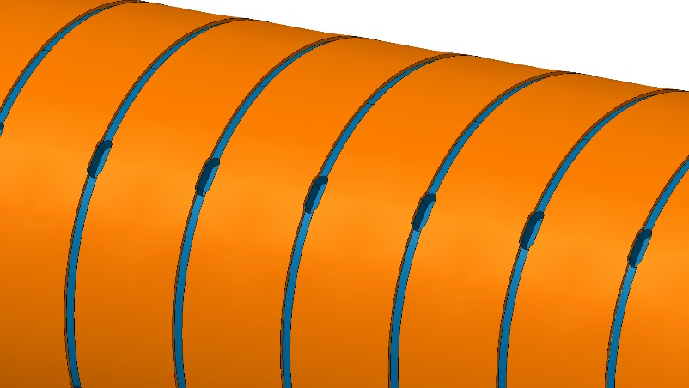
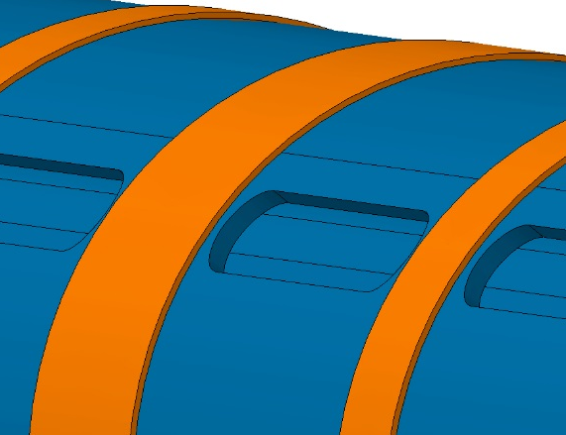
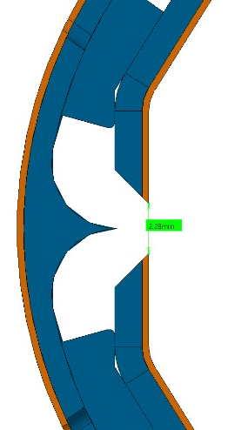
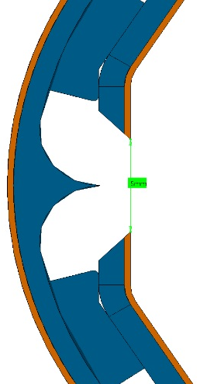
Beam Screen Design
Pumping capacity
Pumping slots length: 1.5 mm
Pumping slots length: 23.75 mm
Increasing pumping slots length and deflector gap, pumping speed will be improved.
Deflector gap: 2.5 mm
Deflector gap: 5 mm

Slide 3
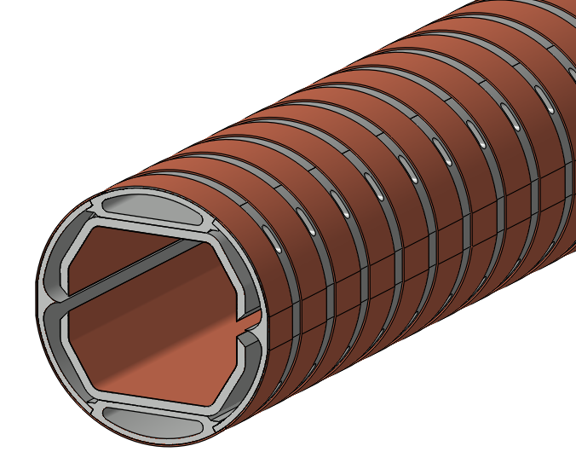
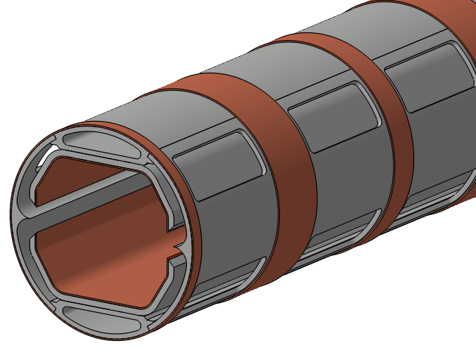

GEOMETRY COMPARISON
Exact drawings to be available by the end of November
Even larger holes?
Previous geometry, July 2016
WP4 5th meeting November 2016
Previous
Current
Holes length
∼5.3mm
10mm
$$S_{av}\left[l/s\right]= \frac{Q const\left[mbar∙l/s\right]}{P \left\lfloor mbar\right\rfloor }$$
Holes width
1.5mm
23.75mm
Central slot
2.28mm
5mm
Av. H₂ p. speed 50K
∼127 l/s/m
∼ 530 l/s/m
x4!

Slide 4
Effect of laser treatment on impedance

Slide 5
SUMMARY OF LASE properties
SEY
  LASE on a metal surface is a very viable solution for reducing the δ < 0.6.
  Even the initial (unconditioned) δ = 0.93 for SS is low enough to suppress e-cloud in, e.g., the SPS, LHC, HL-­LHC, ILC or FCC, etc.
  SEY is reduced by a combination of two geometrical effects
    due to the grooves which traps the electrons by multiple side wall collision (confirmed by measurements and modelling) and
    The nano-sphere which are superimposed on top of the walls of the groove (confirmed by measurements of metal powder and re-melting of the nano sphere)
    A further reduction can be achieved by the surface chemistry change during a bakeout and/or bombardment with electrons, ions and (very likely) photons .
Surface resistance with LASE can increase
  Measured values of surface resistance at 3.9 and 7.8 GHz shows that shallow groove type with superimposed nano-sphere is a preferable solution to minimise the surface impedance in accelerator beam pipe.

Slide 6
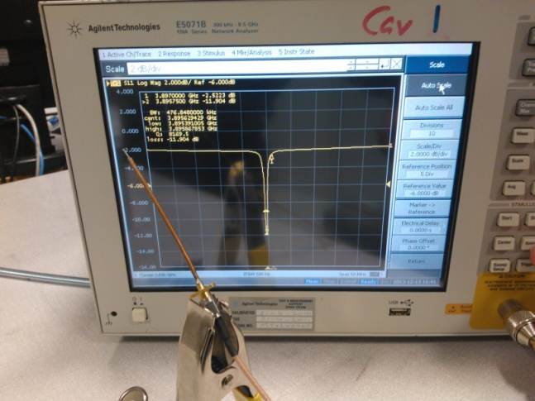
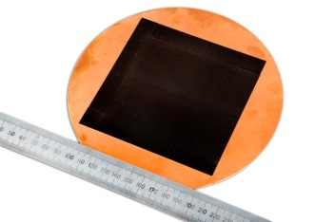
Surface resistance measurements
Test cavities (3.9 and 7.8 GHz):
  The simulation results obtained with Microwave Studio
  Fabricated from Al.
  3 choke cavity operating in TM₀₁₀ mode, has circular H field distribution hence Induces radial current.
  Half pill box cavity operating in TM₁₁₀ mode, has strong transverse H field hence induces axial electric current
Samples:
  3 of 100-mm² laser treated copper surface
Sample | Cavity | Measurement | R_{S} [Ω]
Cu-1L | 1 | average | 7.8×10⁻²
 | 2 | 0° | 0.11
 | 2 | 45° | 0.11
 | 2 | 90° | 9.5×10⁻²
Cu-2L | 1 | average | 0.13
Cu-3L | 1 | average | 0.14
 | 2 | 0° | 0.15
 | 2 | 45° | 0.19
 | 2 | 90° | 0.2
Cu untreated | 1 | average | 3.3×10⁻²
Al untreated | 1 | average | 7.2×10⁻²
SS untreated | 1 | average | 0.17
Measurement at room temperature with no external field, at a single frequency? Can we do better?

Slide 7
Beamscreen holes and stiffeners

Slide 8
Ways to calculate beamscreen holes impedance
Semi-analytical model based on Kurennoy’s theory
Traveling wave simulations
Already developed by B. Riemann.
Suited for the new larger holes?
Suited for the impedance of stiffeners?
Supposedly easier to simulate
Applies to holes of any size and stiffeners
Wakefield simulations
Hard to measure with CST (rectangular mesh)
Is Ace3P better? (tetrahedral mesh)
Either way, this is very time-consuming

Slide 9
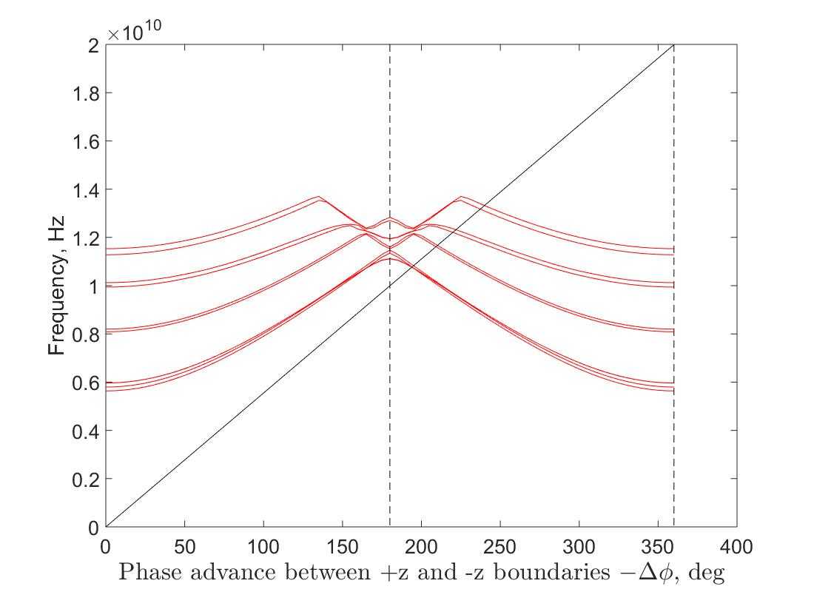
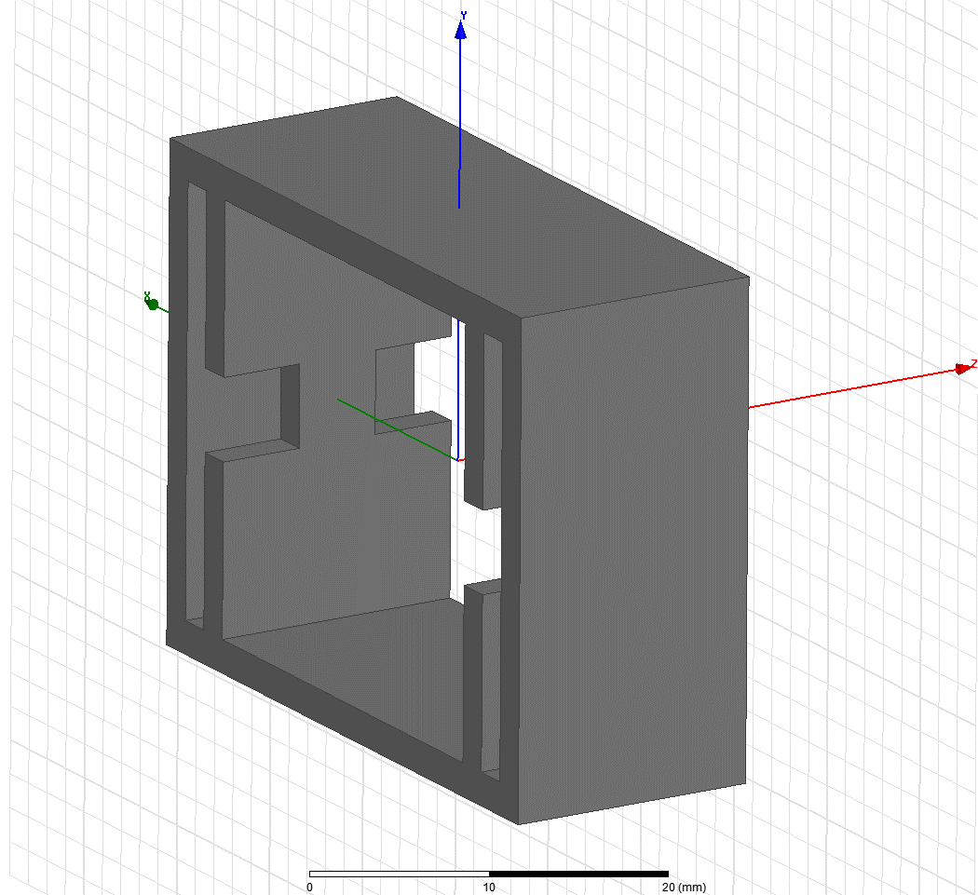
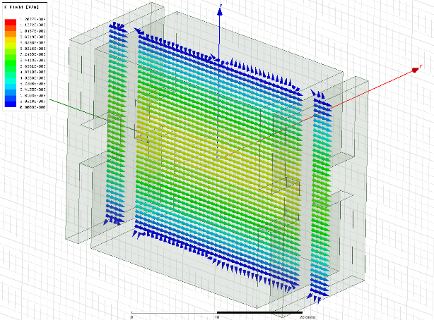


Possible method for calculation of impedance of beamscreen holes
beam
One beamscreen period
(example with simplified geometry)
$${\left(\frac{R}{Q}\right)}_{||}$$
$${\left(\frac{R}{Q}\right)}_{⊥}$$

Slide 10
Did we address all impedance contributions?

Slide 11
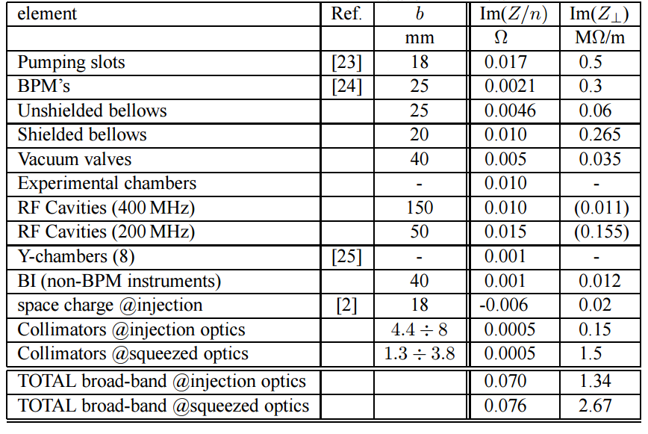
Main contributions to LHC impedance (LHC design report, volume I, chapter 5)
Scaled with local beta
Ongoing
Ongoing
Ongoing
Ongoing
Crab cavities?

