Slide 1


All-Chemical-Solution Coated Conductors at Deutsche Nanoschicht GmbH
Michael Baecker; Martina Falter; Ron Feenstra; Brygida Wojtyniak; Jan Bennewitz; Jan Kunert; Mark O. Rikel
Deutsche Nanoschicht GmbH
Heisenbergstr. 16
53359 Rheinbach
www.d-nano.com

Slide 2
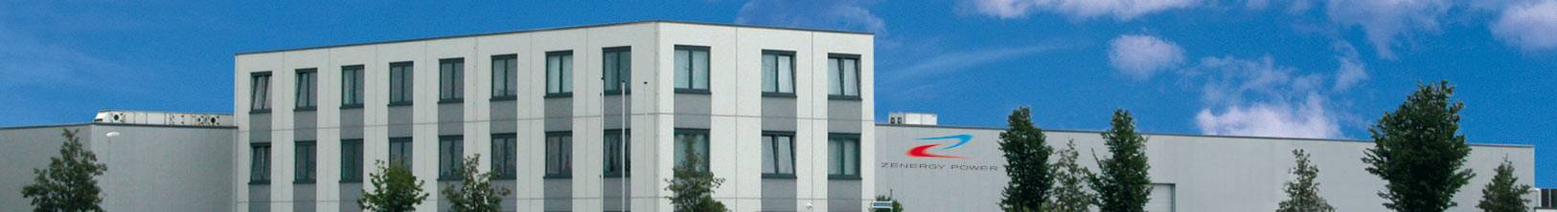
Outline
Deutsche Nanoschicht GmbH
Process technology
Expanded pilot line
Performance
Technical HTS conductor
Summary

Slide 3
Deutsche Nanoschicht GmbH
Since June 2013 part of BASF group
63 employees , located in Rheinbach and Heidelberg, Germany
  High Temperature Superconducting (HTS) wires,
    chemical solution deposition, ceramic functional layers, ink-jet-printing, epitaxial growth
  Additive manufacturing / 3D-printing

Slide 4

High Temperature Superconductors
Challenges for development and production
  Best price performance ratio (€/kAm)
  Scalable large volume production
  Reliable and in-time supply
  Flexible but mechanically and electrically stable

Slide 5
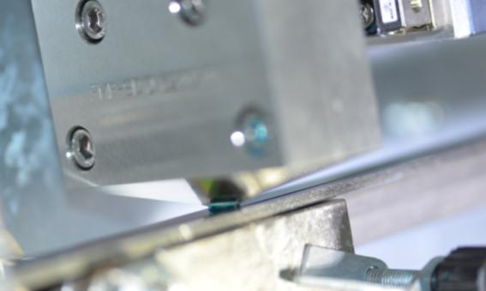
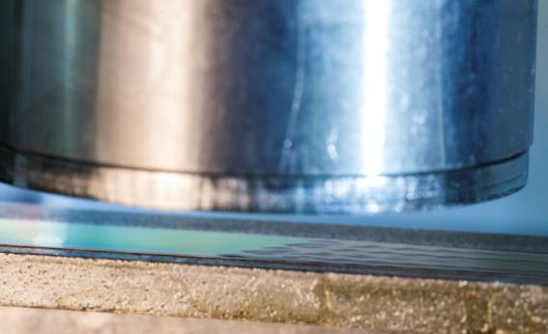
Process Technology
  Chemical solution deposition
  Chemical solution deposition (CSD) for all layers is considered to be the „most promising and most challenging process“
  Unique and protected CSD-multi-layer technology

Slide 6
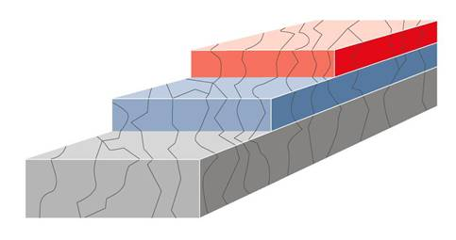
Process Technology
HTS wire architecture – thin flexible ceramic coatings
Superconductor layer
YBa₂Cu₃O_{x} (YBCO)
Buffer layer
La₂Zr₂O₇ (LZO), CeO₂
Metal alloy substrate
NiW-alloy

Slide 7

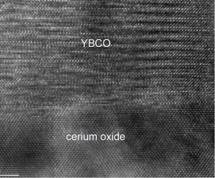
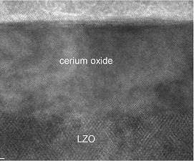
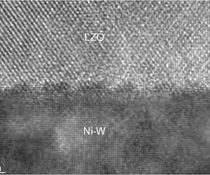
Process Technology
HTS wire architecture – thin flexible ceramic coatings

Slide 8
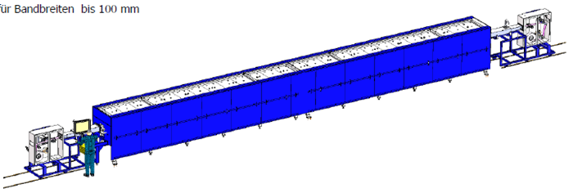
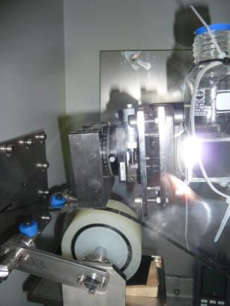
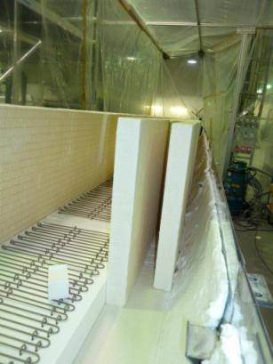
Expanded pilot line
Construction of key process devices in house
In-house built-up of more than 10 devices

Slide 9
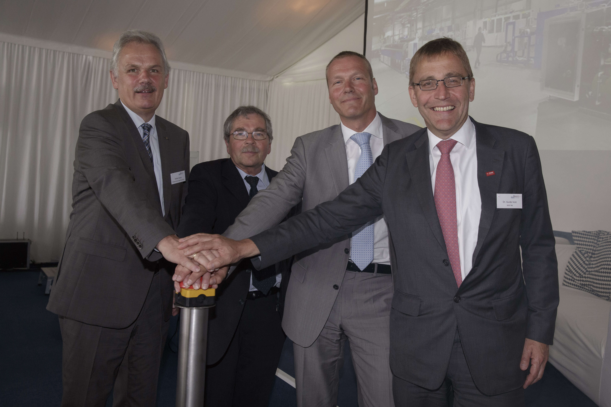
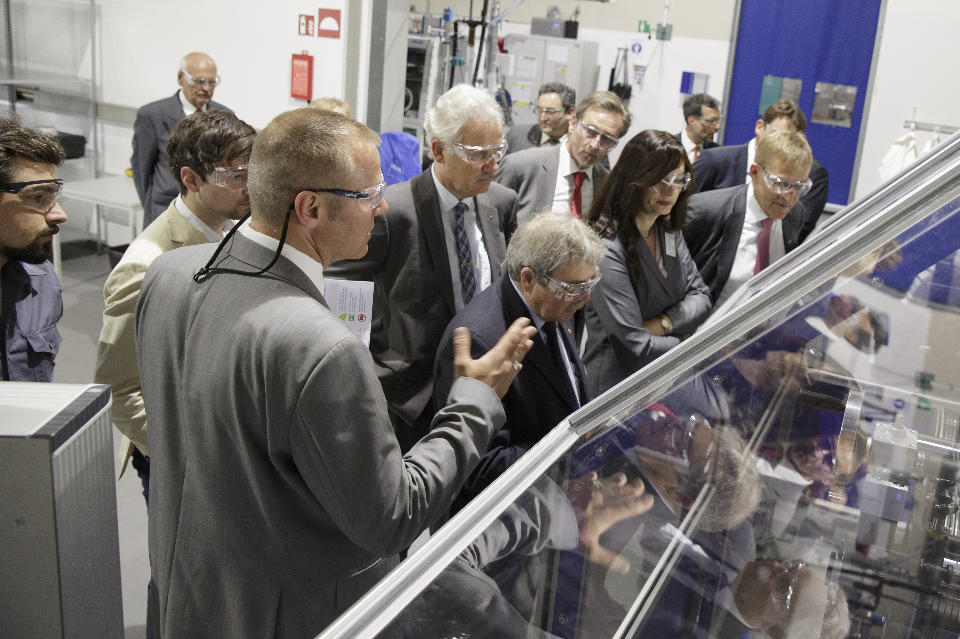
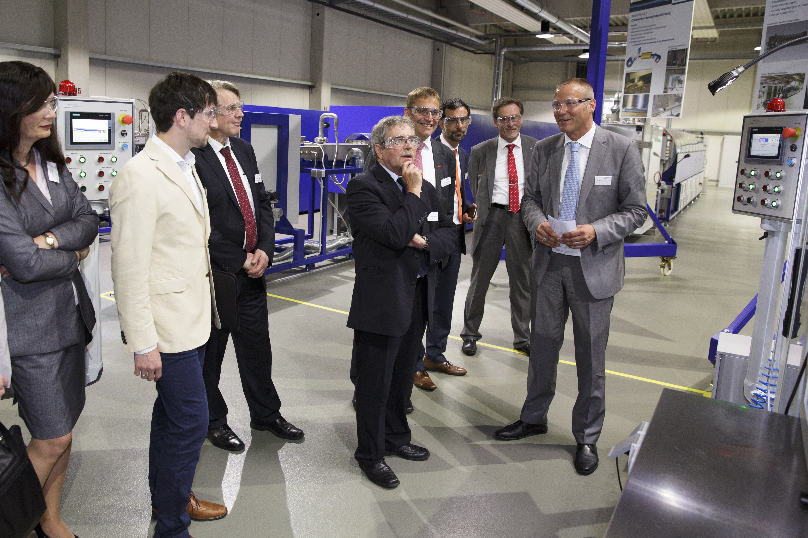
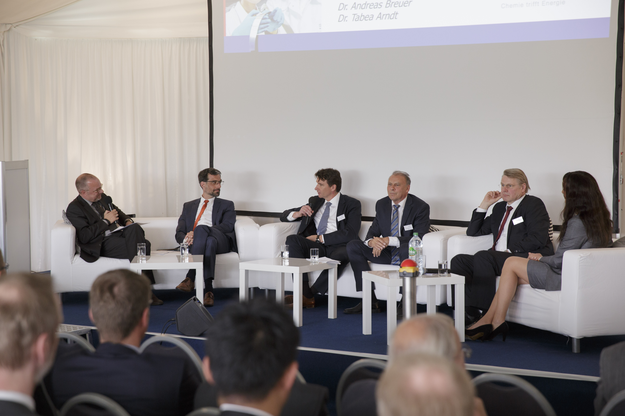
Expanded pilot line
Opening of expanded pilot line in Rheinbach at 10th May 2016

Slide 10
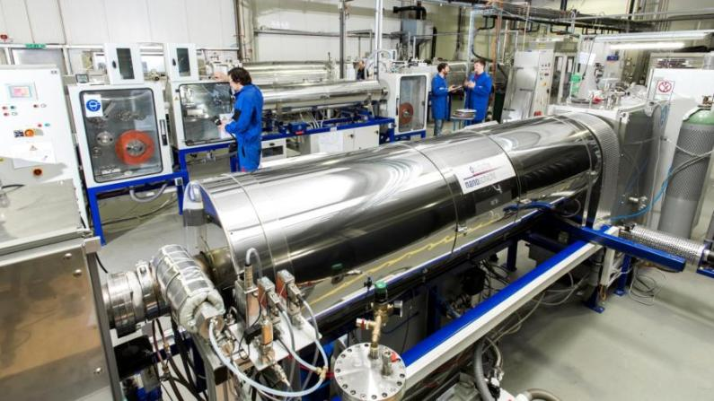
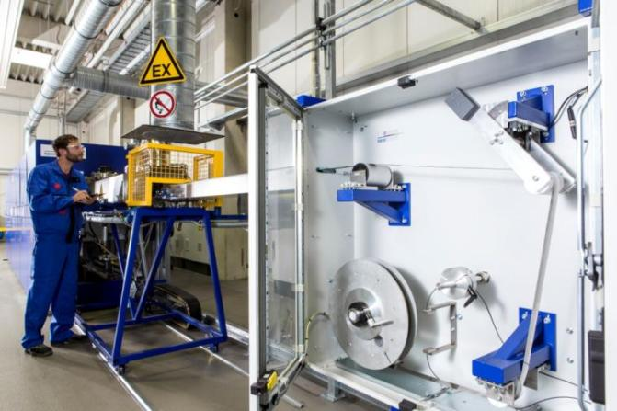
Expanded pilot line
EPL construction until mid 2016 completed
EPL capacity ramp-up completed. Increasing the yield is ongoing.
Theoretical capacity > 200km technical HTS wire
Started sampling for projects in 2016
Lab processing
Expanded Pilot Line

Slide 11


Performance
  Development with industrial partners over nearly 10 years
    Long lengths samples >20m
Ic [A/Acmw]

Slide 12
Performance
  D-nano has produced in 2016 1cm wide 50-100m tapes with Ic ≅ 250 A/cm
Tapestar calibrated
against transport Ic
248 A (100 m)
260 A (45 m)
288 A (55 m)
Ic (A)
n-value

Slide 13
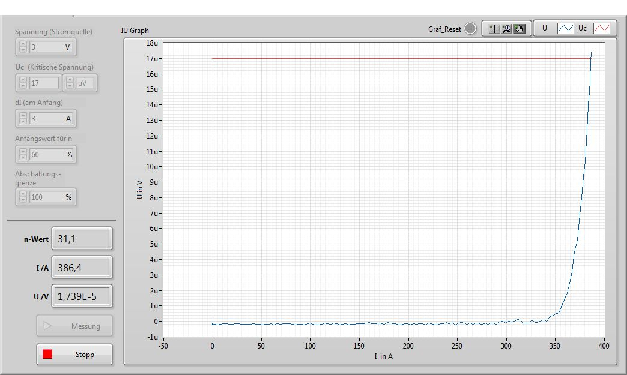
Performance
  Recent record value on EPL with length >20m (10mm width uncut)

Slide 14
Performance
  EPL at 6 month after opening: 90 m long / 10 width uncut
N4304703
Resistive measurement

Slide 15


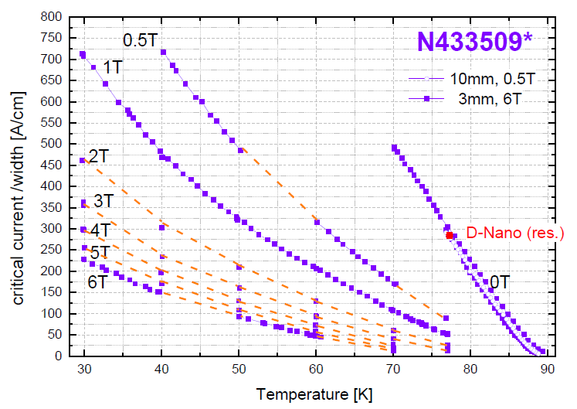
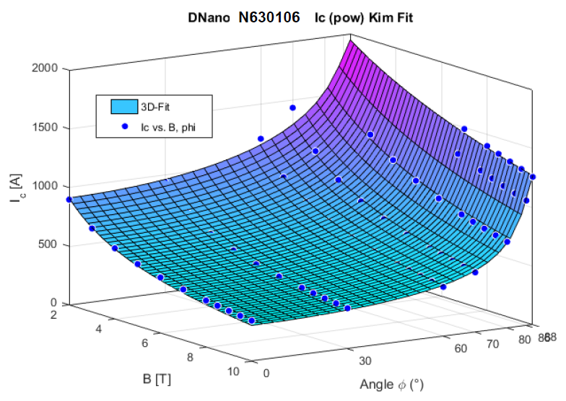
Performance
  Typical behavior in magnetic fields
4.2K

Slide 16
Technical HTS conductor
  Silver coating
    Unique chemical solution deposition process
    Fast and vacuum-free processing
    Thin and dense coating
Sample | T_{c} (K) | ρ _{contact} (μΩcm²)
N433460 | 90.1 | < 0.45
N432135 | 88.2 | < 0.68
N432161 | 88.2 | < 0.38
N432162 | 86.4 | < 0.45
N433507 | 89.9 | < 0.60
N433508 | 89.4 | < 0.35
N433509 | 89.3 | < 0.30
CSD Ag
500 nm

Slide 17
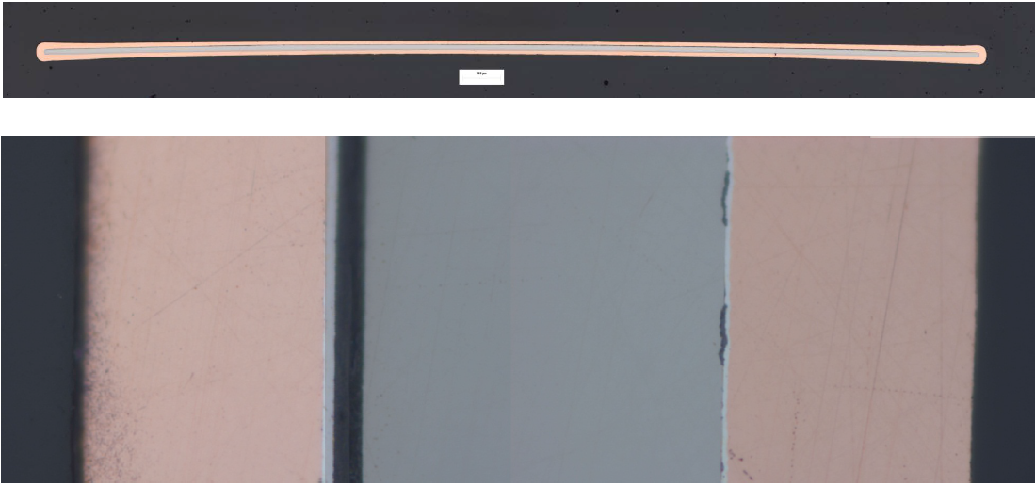
Technical HTS conductor
  Copper electro-plating
    Homogeneous coating
    Variable copper layer thickness
    Low contact resistance
Cu-plated HTS conductor, 45µm single Cu-layer
Sample | Cu layer thickness | T_{c} (K) | ρ _{contact} (μΩcm²)
N630078 | 9μm | 89.8 | 7.5
N630095 | 40μm | 89.8 | 3.7
N630102 | 9μm | 89.8 | 2.3
N630106Z | 45μm | 88.7 | 4.2

Slide 18
Technical HTS conductor
  Delamination strength
    c-axis tensile av. 28(6) MPa (bare insert, non-laminated)
    Architecture suitable for most energy applications
Threshold for cable applications
Specimen geometry: 12.8 x 6.4 mm²
(soldered on 10 x 20 mm² sample)

Slide 19
Technical HTS conductor
Temperature Stability
Tested CC with copper coating
250 deg C for >1 hour
300 deg C for 30 min
Material suitable for welding or soldering
Duration per cycle : 30 minutes @ peak T

Slide 20

Technical HTS conductor
Bending tests ( e.g. for CORT geometry )
4 mm wide conductor
45 deg, 7 µm Cu Shunt
35 deg, 7 µm Cu Shunt
30 deg, 7 µm Cu Shunt
30 deg, 4.7 µm Cu Shunt

Slide 21
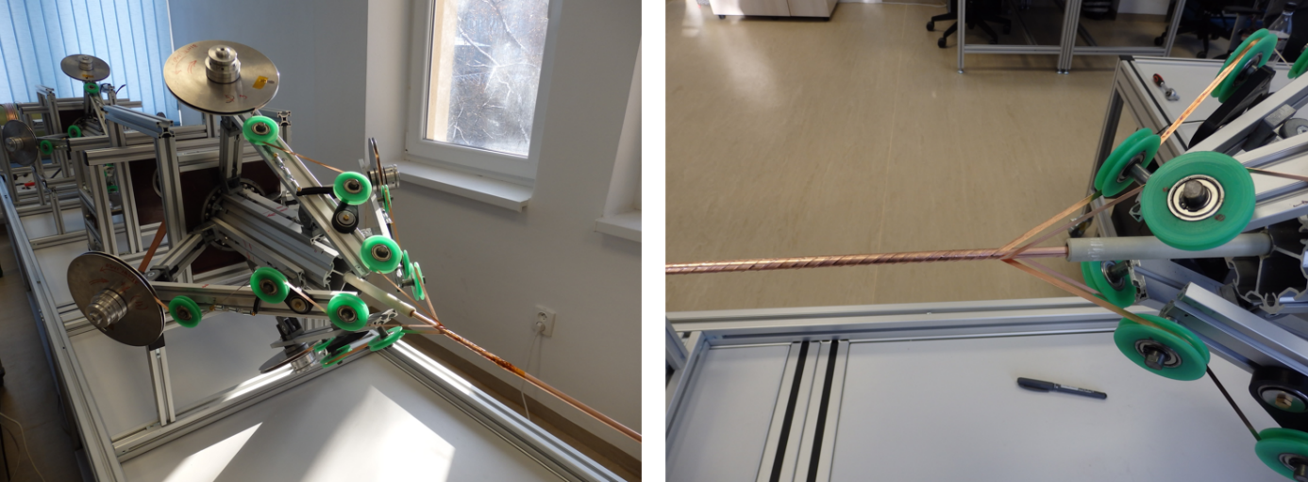
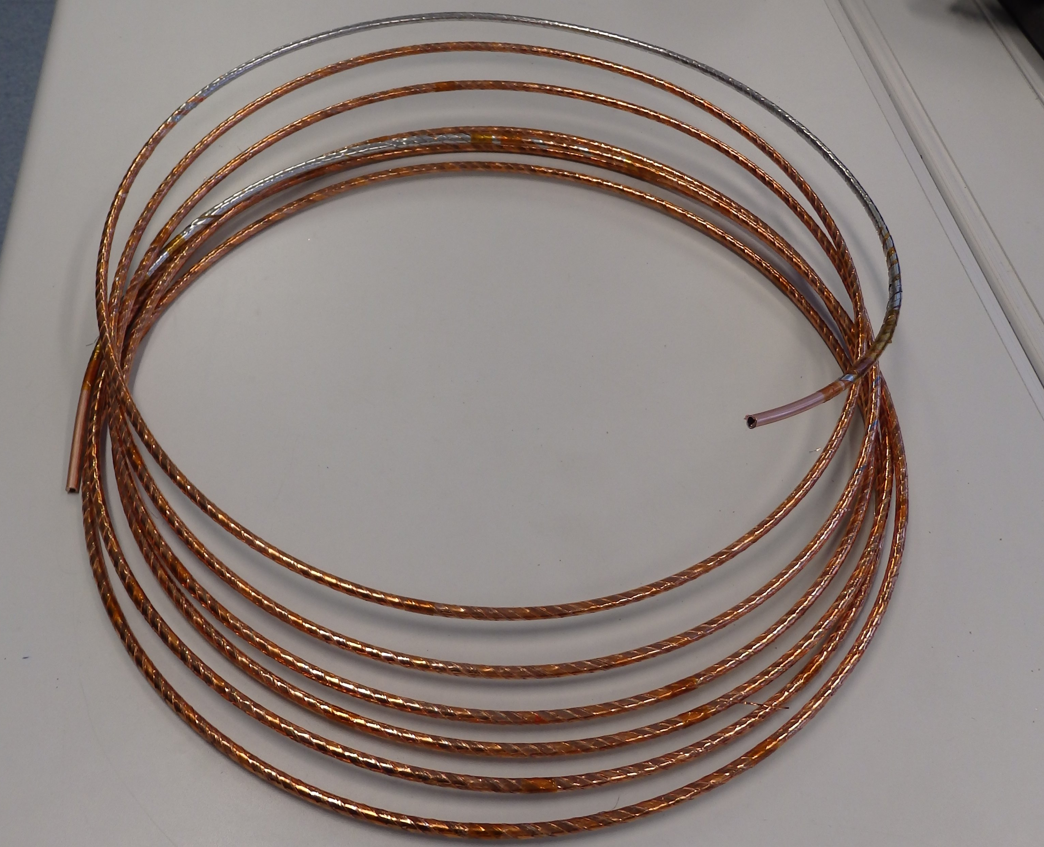
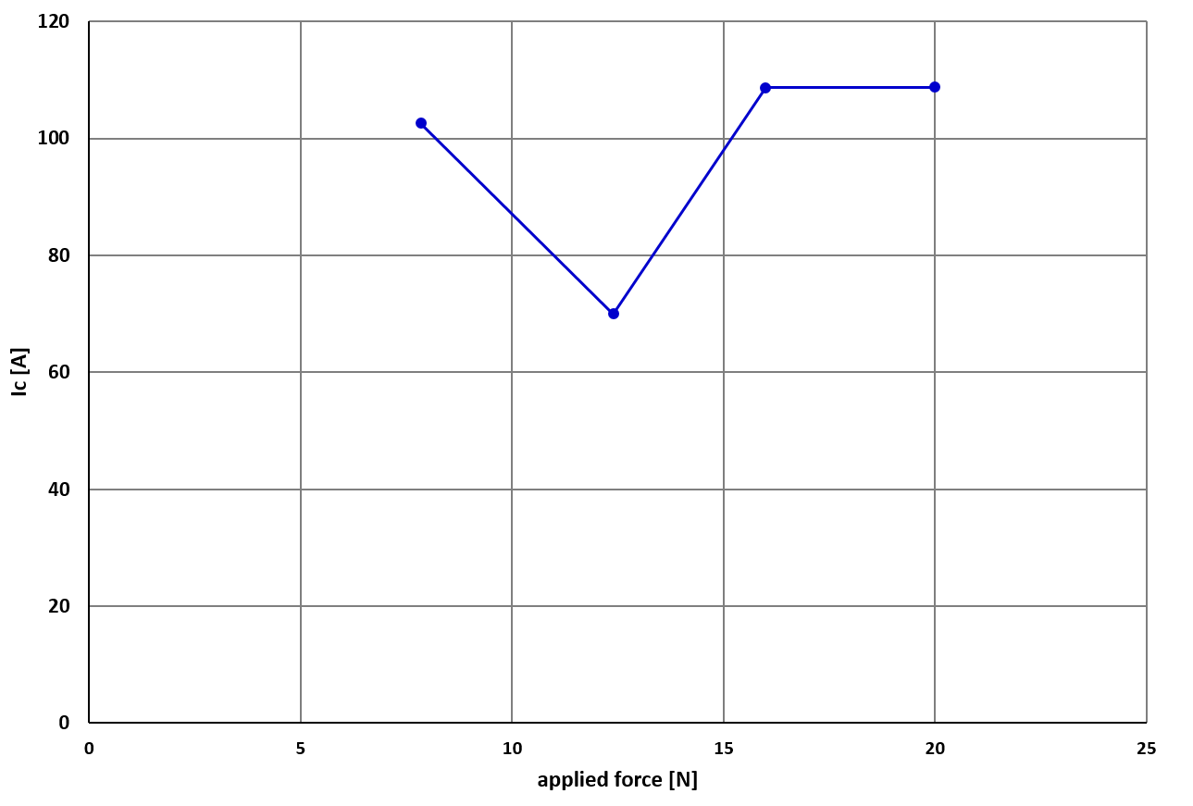
CORT Cable
about 9 m long
2 layers
4 tapes in each layer
lay angle about 33°
tension during winding 20 N
Stress test on 4 mm wide tapes.
(Pulling along the axis)

Slide 22

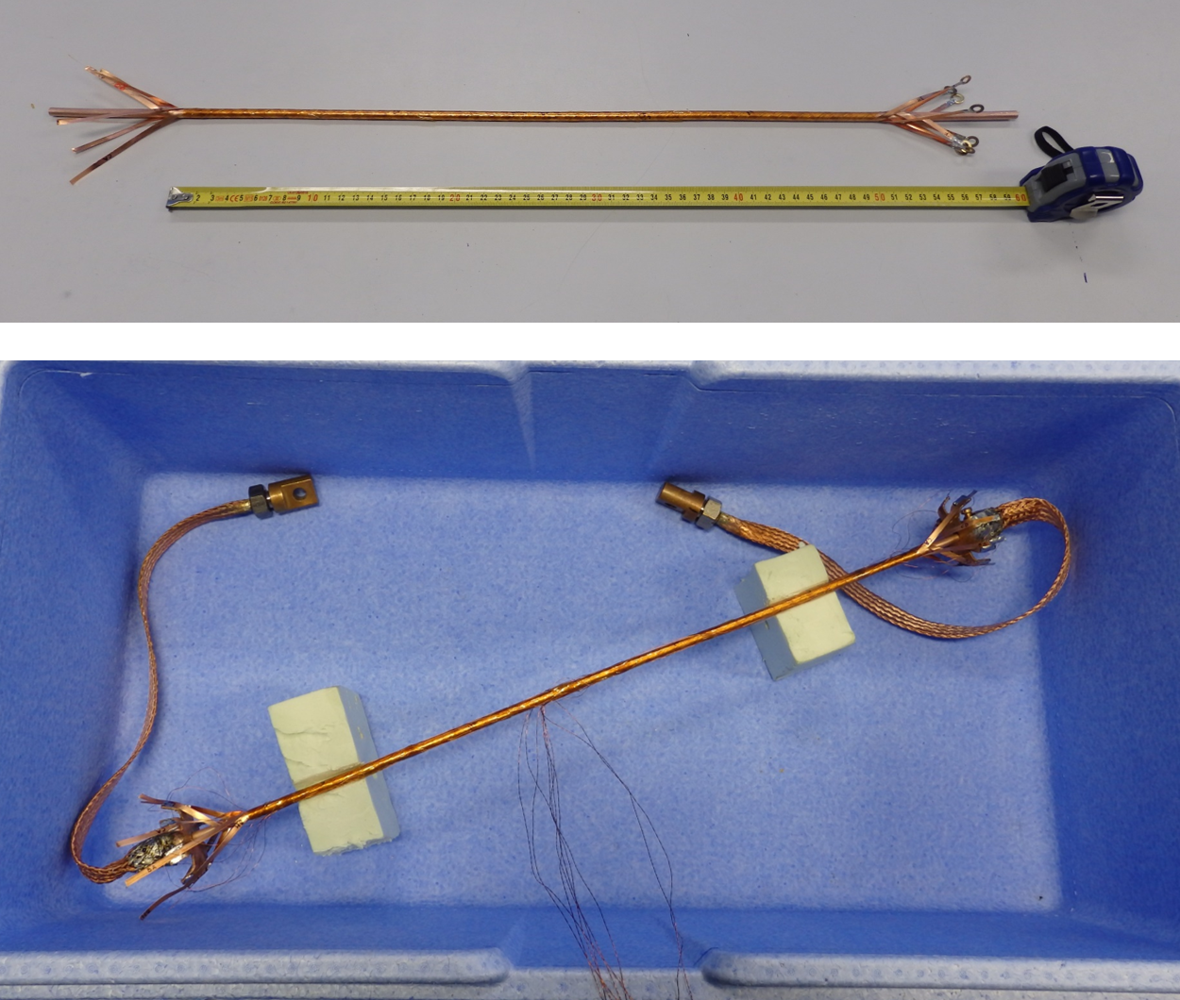
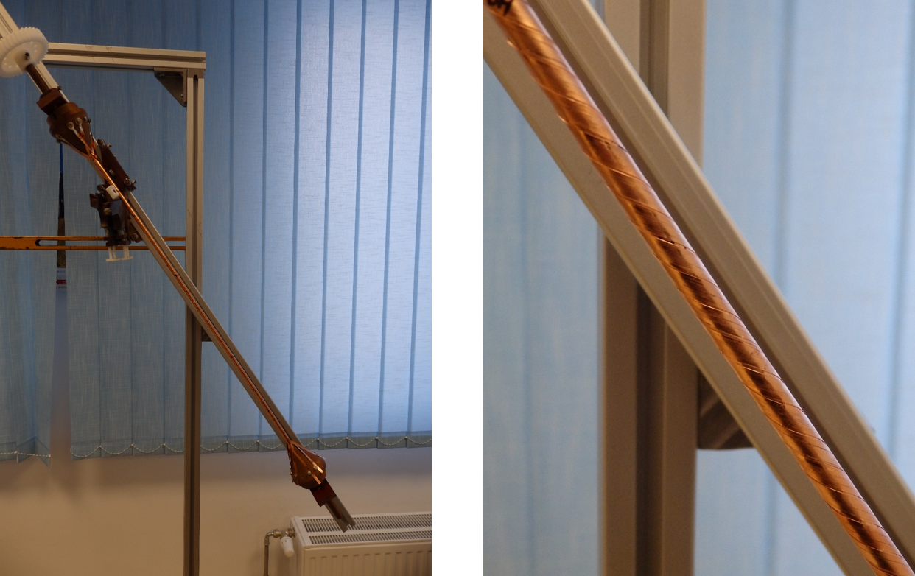
Technical HTS conductor
CORT cable, IEE Bratislava:
4mm copper coated tape
2 layers, 4 filaments each
6.35 mm tube
32° lay angle

Slide 23
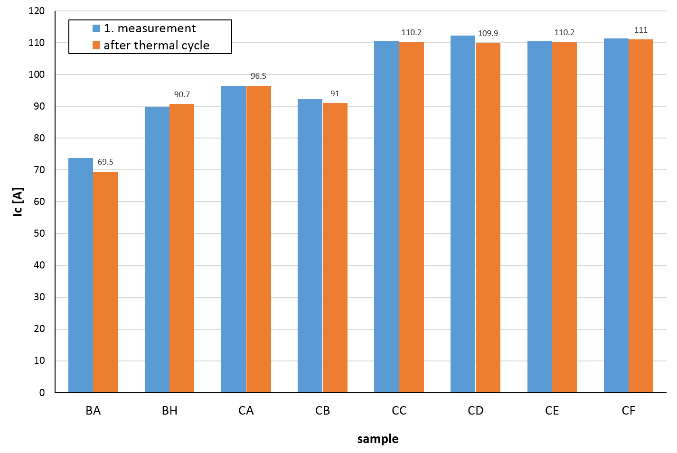
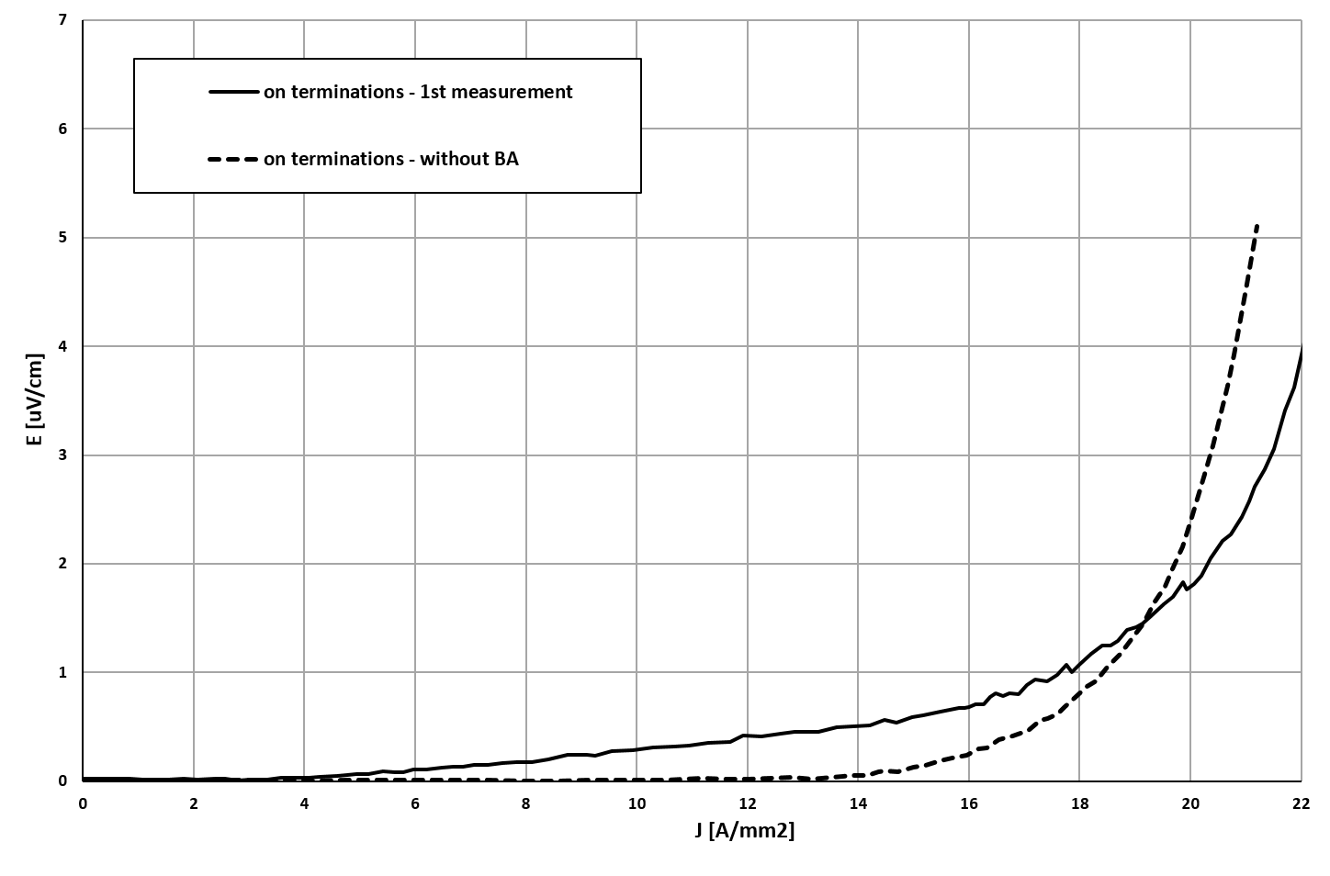
CORT cable
8 individual 4 mm filaments in 2 layers
Total current in the CORT: >600 A
Technical current density: 18 A/cm²

Slide 24

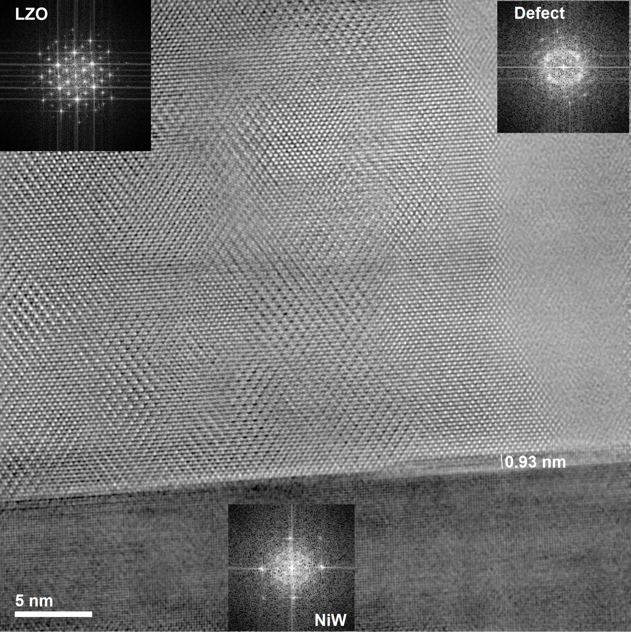
Process challenges
  Process stabilization
  Large area processing
  High throughput
  Local dropouts
    Interface defects
    Handling
    Raw materials
  customization
Interface defect: loss of orientation

Slide 25
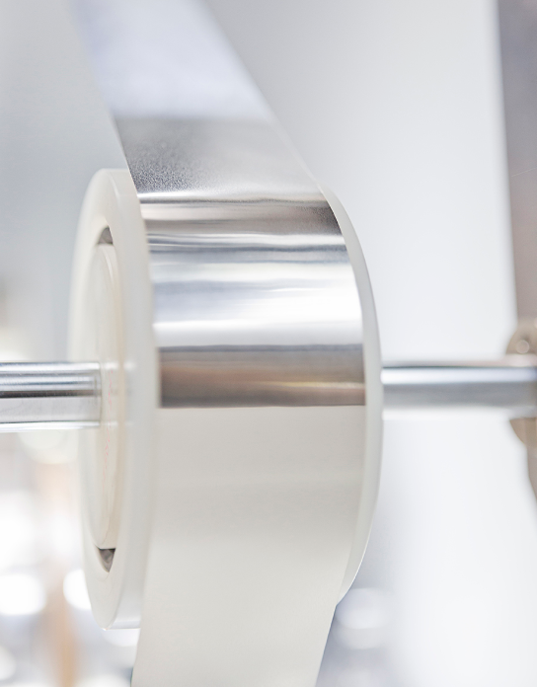
Summary
Chemical solution deposition enables economic mass production of high temperature superconducting tapes
Deutsche Nanoschicht reached significant performance increase over last years and starts pilot production in 2016/17
HTS conductor successfully customized for applications
First samples provided to customers
… but challenges remain in product and process development

Slide 26

Thanks for your attention
Deutsche Nanoschicht GmbH
Heisenbergstr. 16
53359 Rheinbach
www.d-nano.com
Special thanks to:
Roger Wördenweber, Forschungszentrum Jülich
Werner Mader, University of Bonn
Fedor Gömöry +Michal Vojenciak , IEE Bratislava

