Slide 1
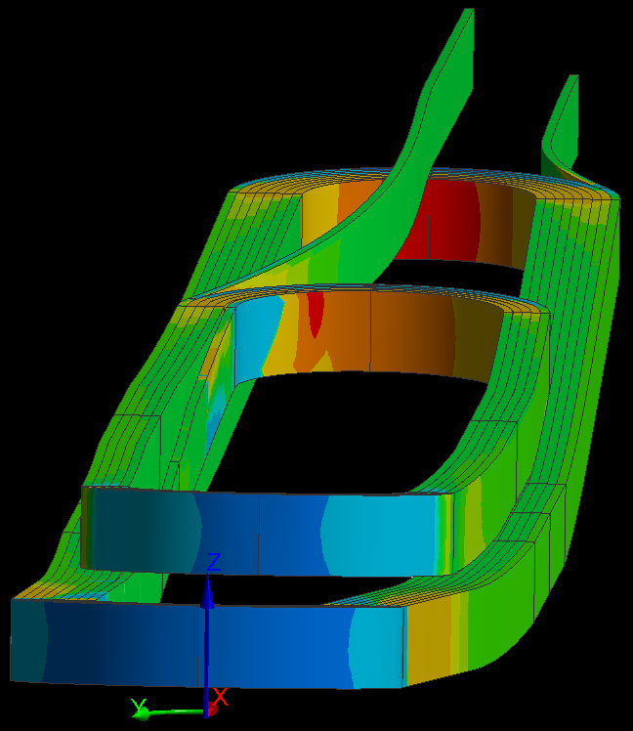
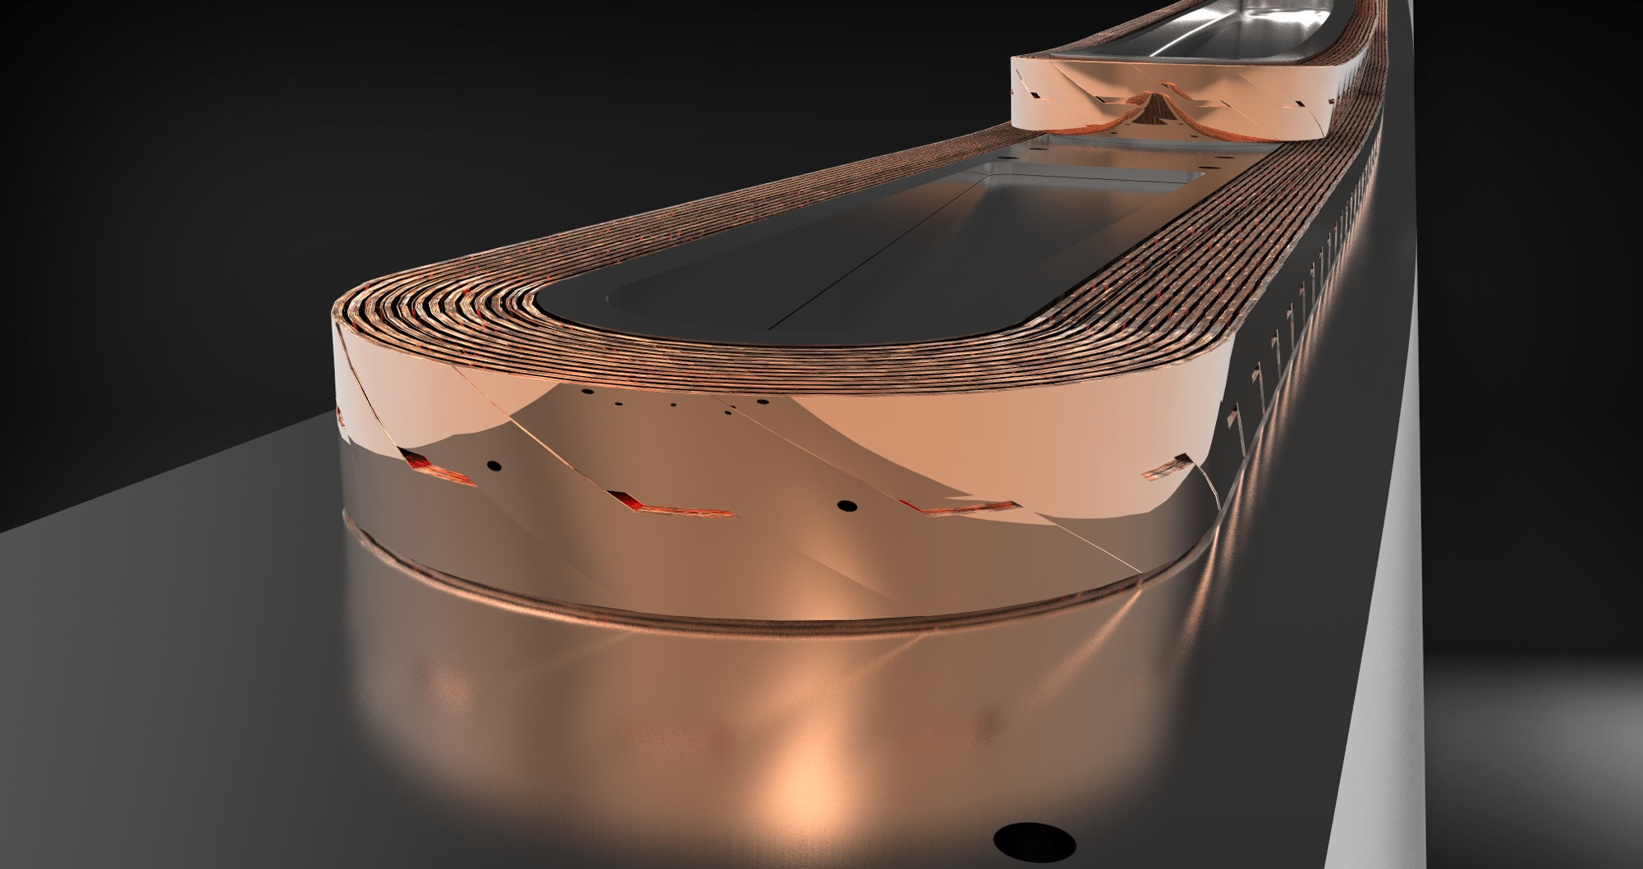
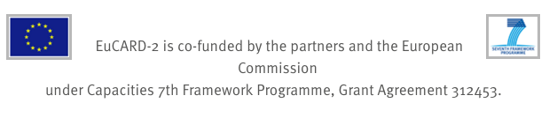


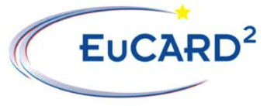

WAM-HTS-4 Progress in design for High Field Magnets: Stress in non-uniform current distribution and
Inductively Coupled Energy Dissipater (ICED)
http://eucard2.web.cern.ch/
17.2. 2017
Jaakko Murtomäki, thanks to J. van Nugteren, G. Kirby, L. Rossi
A. Stenvall, Gijs de Rijk

Slide 2
Talk Overview
Part 1:
EuCARD-2 High Temperature Superconductor (HTS) Project
WP10 Magnet design: 40 mm Clear-Aperture Accelerator Dipole Demonstrator
  Cable: so-called “Röbel” wound from REBCO tapes
Methodology for structural modelling using Finite Element Method
Management of electromagnetic forces in dissimilar meshes
Non-homogenous current distribution
Part 2:
Quench protection system in HF dipole magnets: Inductively Coupled Energy Dissipater (ICED)
Principle
Modelling
Preliminary results

Slide 3
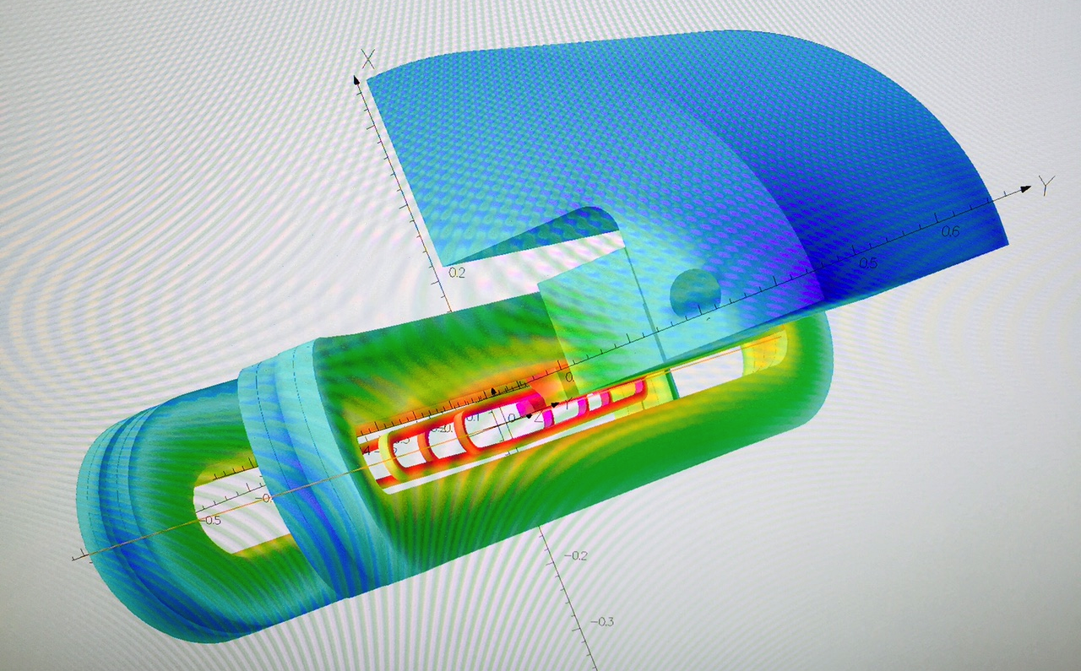
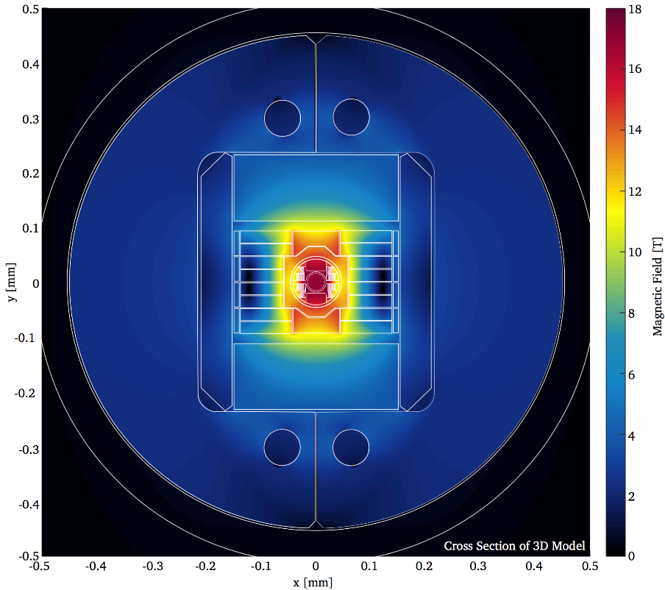
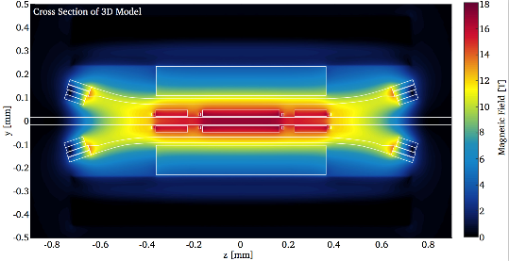
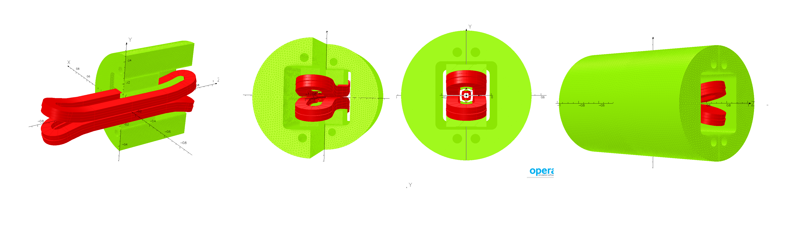
Insert configuration for going to High background fields (13 T)
Feather 2 inside Fresca2
Paulo Ferracin, Jeroen v. Nugteren
The main mechanical constraint is that the insert is mechanically
self-supported and decoupled from the Fresca 2 outsert magnet.
Main constraint for supports of the Feather!
Fresca 2
20/02/2017
Feather M2

Slide 4
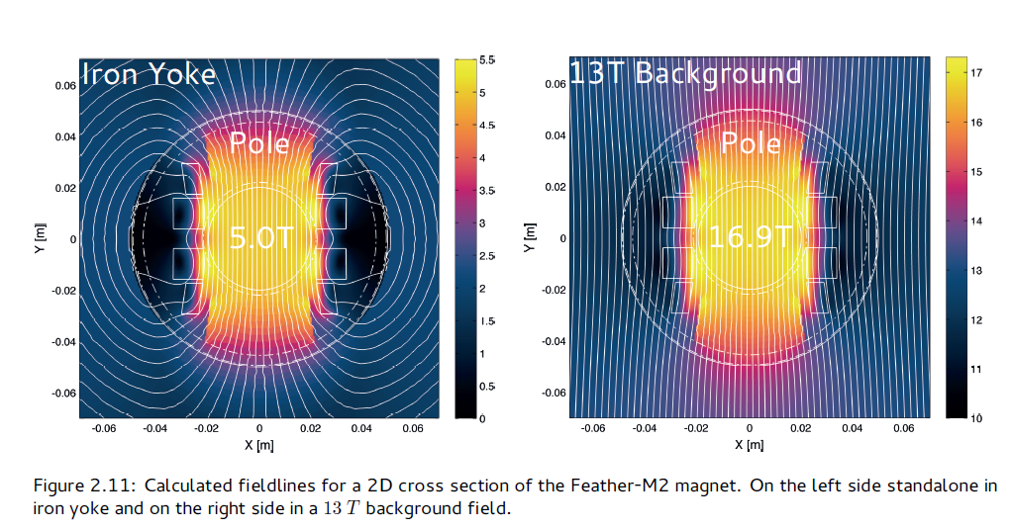
Magnetic field direction and forces
With permission of J. van Nugteren

Slide 5
Mechanical material properties
Roebel cable is challenging to model in large coils due to the complicated and thin 3D structure
GOAL: Simplify, but to the level where it is still possible to relate your model to the measured ultimate conductor limits (stress/strain maximum where Ic still reversible)
->Axial strain, transverse pressure

Slide 6
Mechanical material properties
Structural modelling of the coil requires good knowledge of the material properties:
Elastic modulus
Shear modulus
Poisson’s ratio
Thermal contraction
For orthotropic materials all three directions needed
All these properties required for the chosen coil geometry approximation

Slide 7
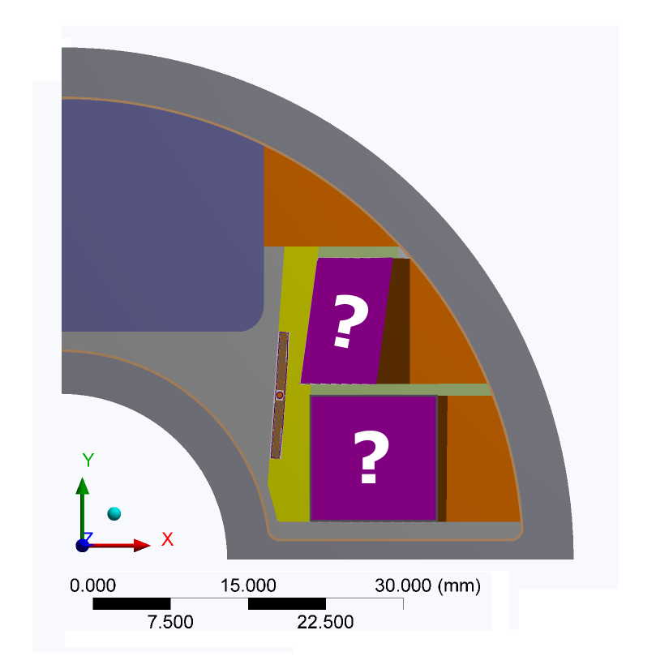
1. Block coil geometry approximation
Typically magnets have been modelled with single block coil using homogenous material properties (all turns with insulation around are represented with a block of homogenous material properties)
Block coil approximation
Feather M2

Slide 8
1. Block coil geometry approximation
It is challenging to address the conductor stress-strain state in block coil approximation since:
  Measured material properties are a mix of isotropic and orthotropic behaviour of the participating materials
  Each material measurement for a block coil applies well only for one configuration (number of turns, geometric alignment of turns, insulation thickness)
  How to read the results is not straightforward

Slide 9
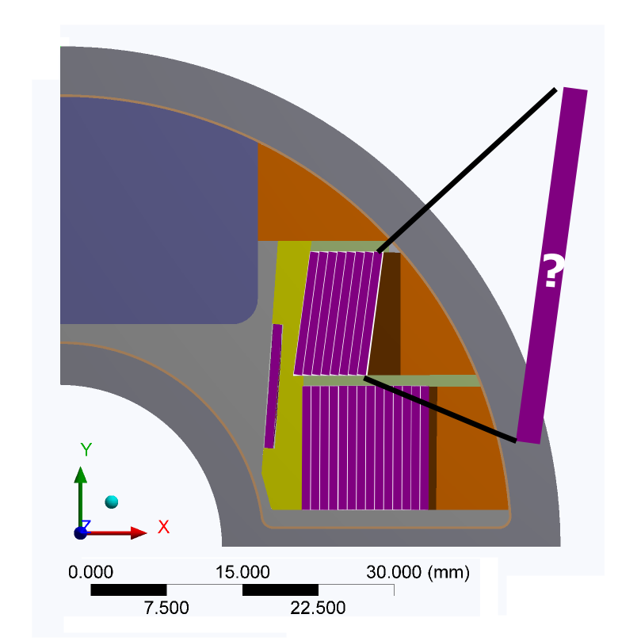
1. Block cable geometry approximation
?
Top stack
?
?
”Elastic boundary
layer” to approximate
the 0.2 to 1 mm
gap
See next slide
Rectangular
material domain to
approximate the gap
?
Bottom stack
C.) two
rectangular
domains +
boundary layer
A.) One
rectangular
domain
B.) three
rectangular
domains
In this approximation, we leave out the cross-over geometry for simplicity, because the forces are normal to the wide face.

Slide 10
2. Block cable geometry approximation: Elastic boundary layer
Roebel cable section
Elastic boundary layer at element level
Realized through input of tangential and normal elasticity at the
Bonded contact element
2D: [N/m^2]
3D: [N/m^3]
Top stack
Finite
element
?
”Elastic boundary
layer” to approximate
the gap
Contact elements
Target elements
These inputs
act like
elastic
2D springs
v
Finite
element
Bottom stack
node
Elastic boundary layer can be used to create ”soft or more elastic” boundary layers between parts that have much higher E-modulus than the bonding agent used between them. NO NEED TO MESH THESE THIN REGIONS!

Slide 11
2. Block cable geometry approximation
Between the turns, there is the relatively elastic impregnated glass-fiber layer. This can be approximated by elastic boundary layer as well.
In ANSYS Workbench, this is realized through bonded contacts and penalty formulation.
?
?
?
Due to the thin elastic boundary layer approximation, shear modulus
and poisson’s ratio are not needed as an input, also no meshing of thin
layers required

Slide 12
2. Block cable geometry approximation
+If direction of the forces is normal to the wide face of the Roebel, block cable approximation is good
-If the forces act parallel to the wide face and are acting differently on different tapes, the approximation is not practical

Slide 13
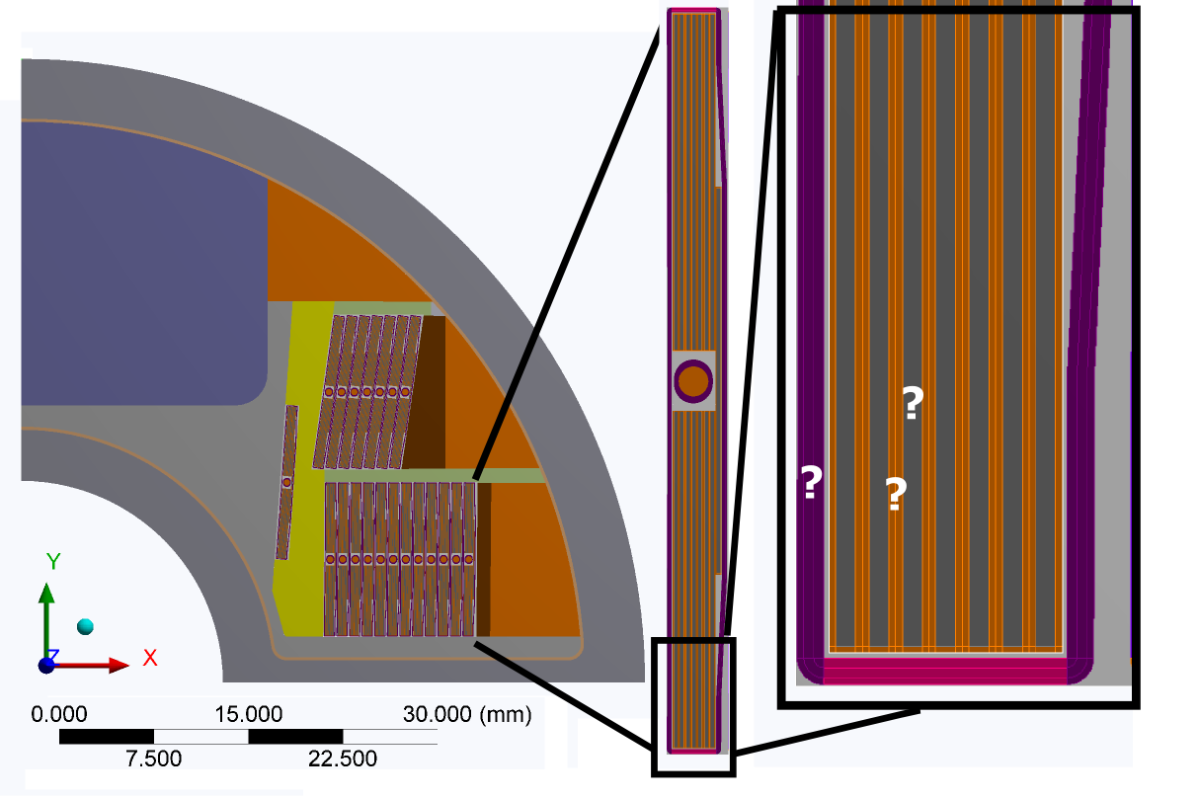
3. Strand level geometry approximation

Slide 14
Strand level geometry approximation
-Takes time to create and to solve due to non-linear
frictional contacts between the tapes.
-Uncertainty with friction
+Independently measured material properties are available, or easier to measure than properties for a block coil for example
+No need to re-measure properties for coils with different number of turns or turn orientations

Slide 15
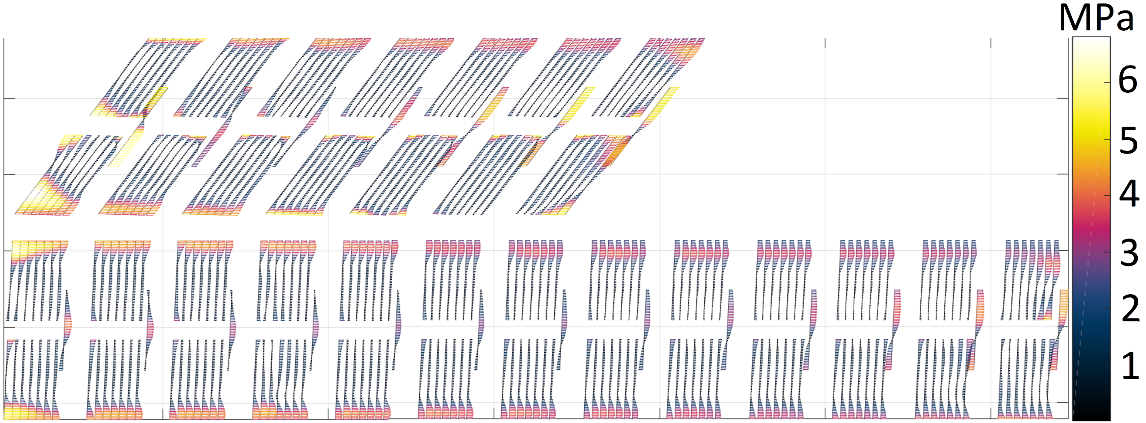
Results with the non-uniform current density
Strand level geometry approximation
Electromagnetic pressure distribution in Feather-M2
With permission of J. van Nugteren

Slide 16
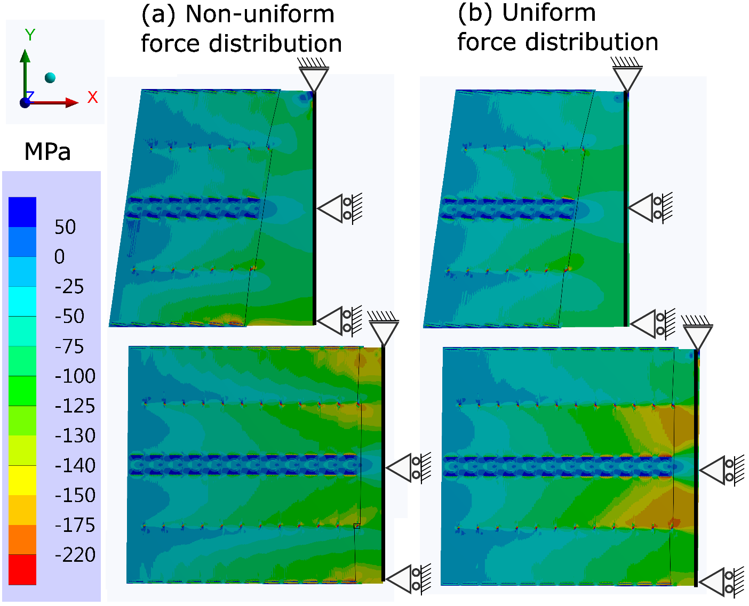
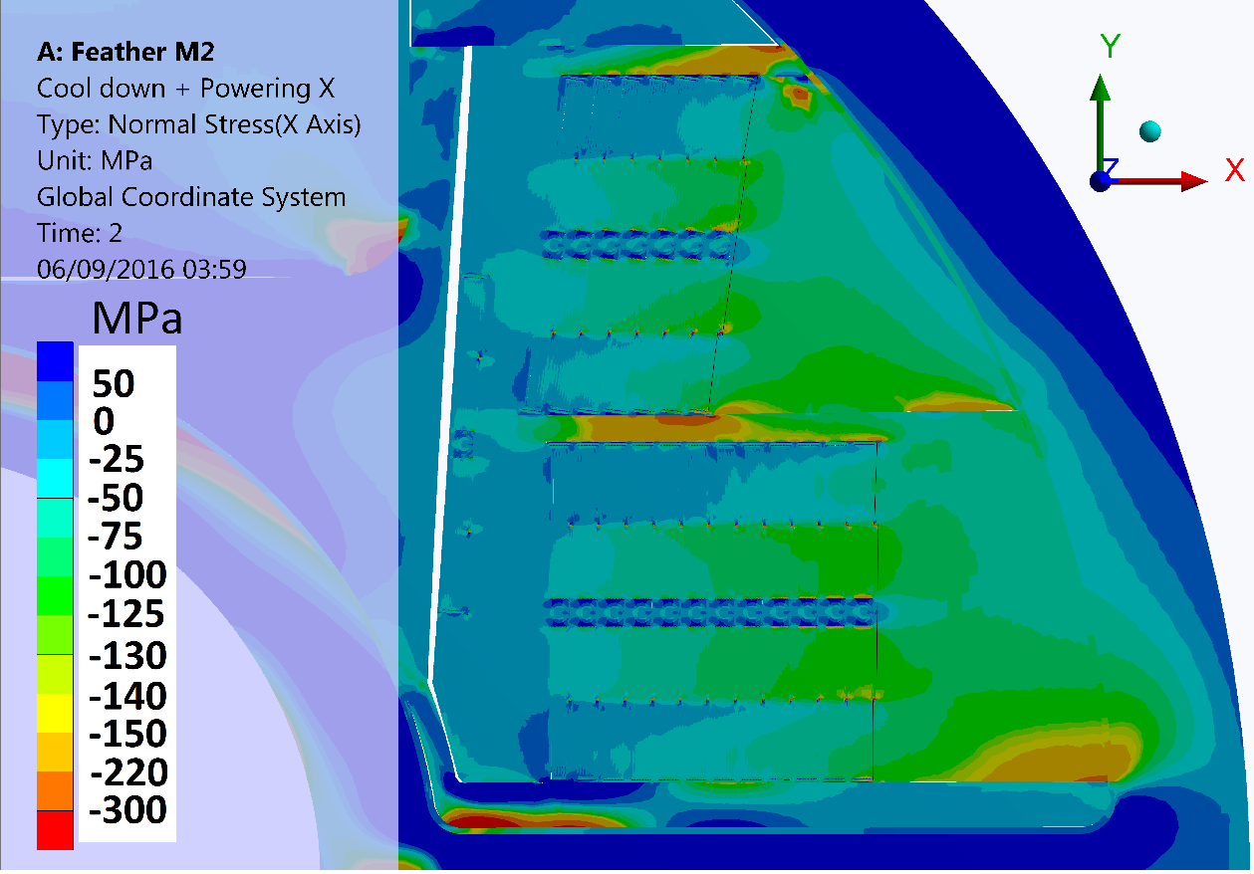
Results with the non-uniform current density
Strand level geometry approximation
Horizontal stress distribution in Feather-M2
ASC number 3LPO2F-03 1 under publication IEEE
“Mechanical Effects of the Non-Uniform Current Distribution on HTS Coils for Accelerators Wound with REBCO Roebel Cable”
J. S. Murtomäki, J. van Nugteren, G. Kirby, L. Rossi, IEEE fellow, J. Ruuskanen and A. Stenvall

Slide 17
Results with the non-uniform current density
Strand level geometry approximation
In 2D plane strain model the coil and magnet component ends are assumed be supported to infinitely rigid wall. Cool-down step creates high stresses in the out of plane direction.
-> stress in the 3rd dimensions has an effect on the 2D-plane due to Hooke’s law -> 2D-is not perfect to asses stress or strain -> 3D would be better

Slide 18
Main challenges of structural modelling in 3D
The original electromagnetic design and geometry exists in Matlab code format (J. van Nugteren)
How to create the coil in ANSYS Workbench?
What element types are feasible for thin layers?
How to transfer electromagnetic forces between dissimilar computational meshes in a conservative way?
Due to model size, we take block cable geometry approximation

Slide 19
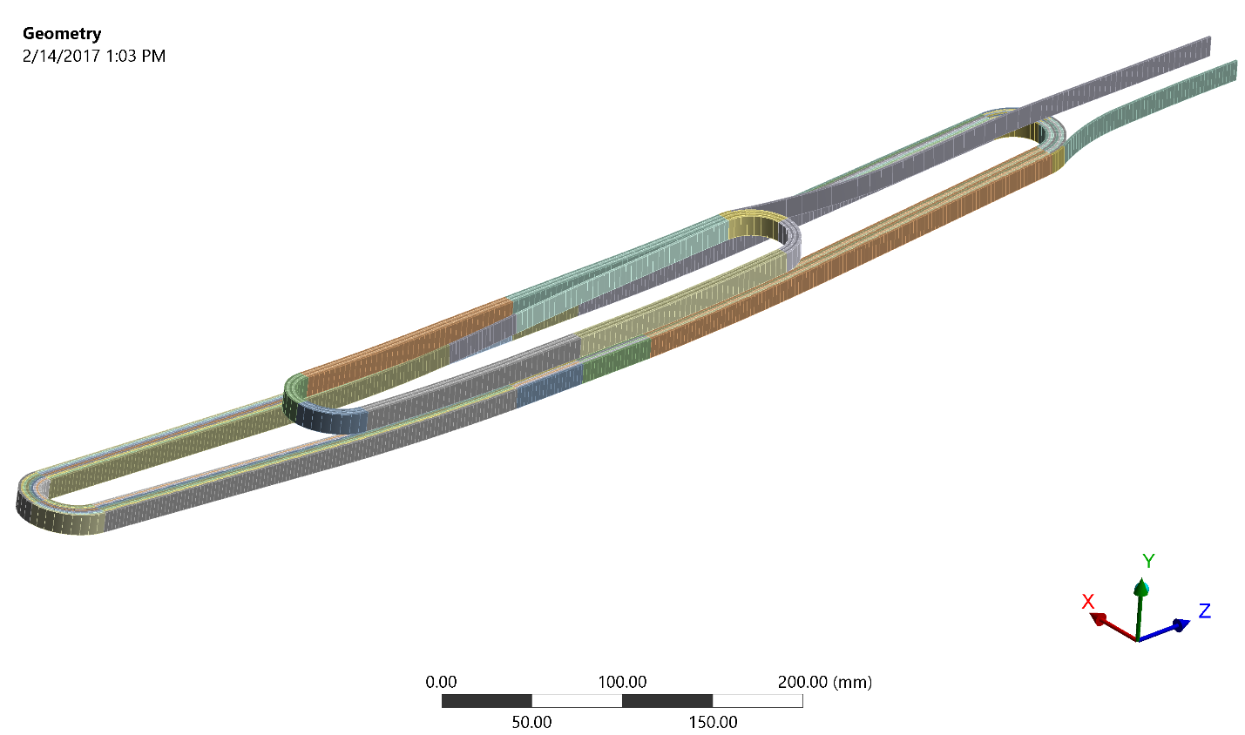
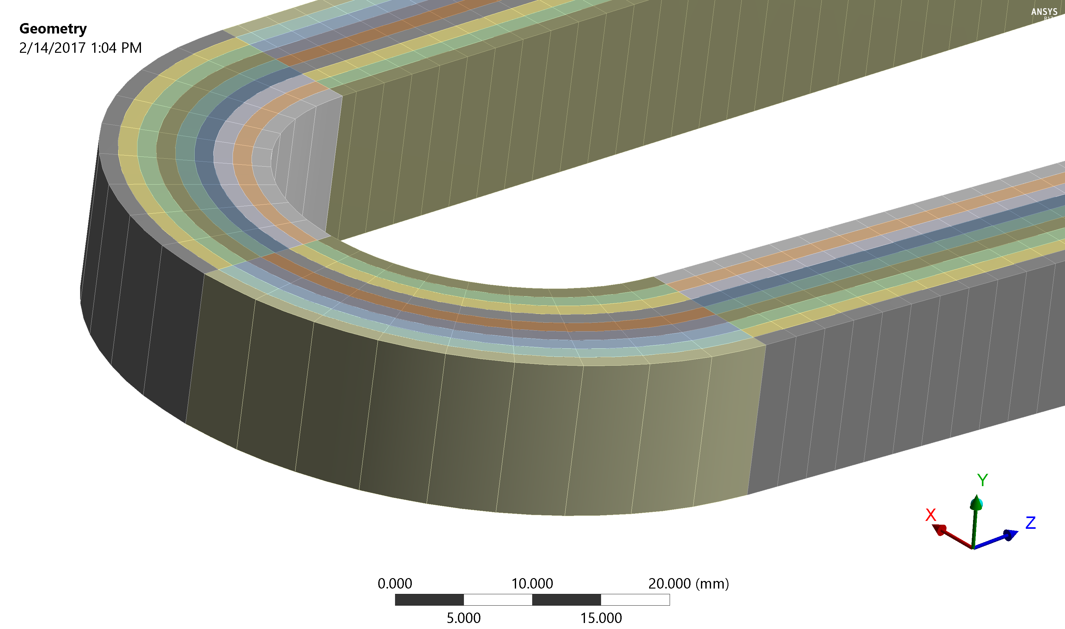
Geometry creation
ANSYS Workbench Scripting API used to rebuild the geometry (Python, JavaScript) for structural analysis to avoid manual operations in the graphical interface
Challenges: slow, no parallelization and all commands not working in batch mode (the screen has to update each time a solid block is built)

Slide 20
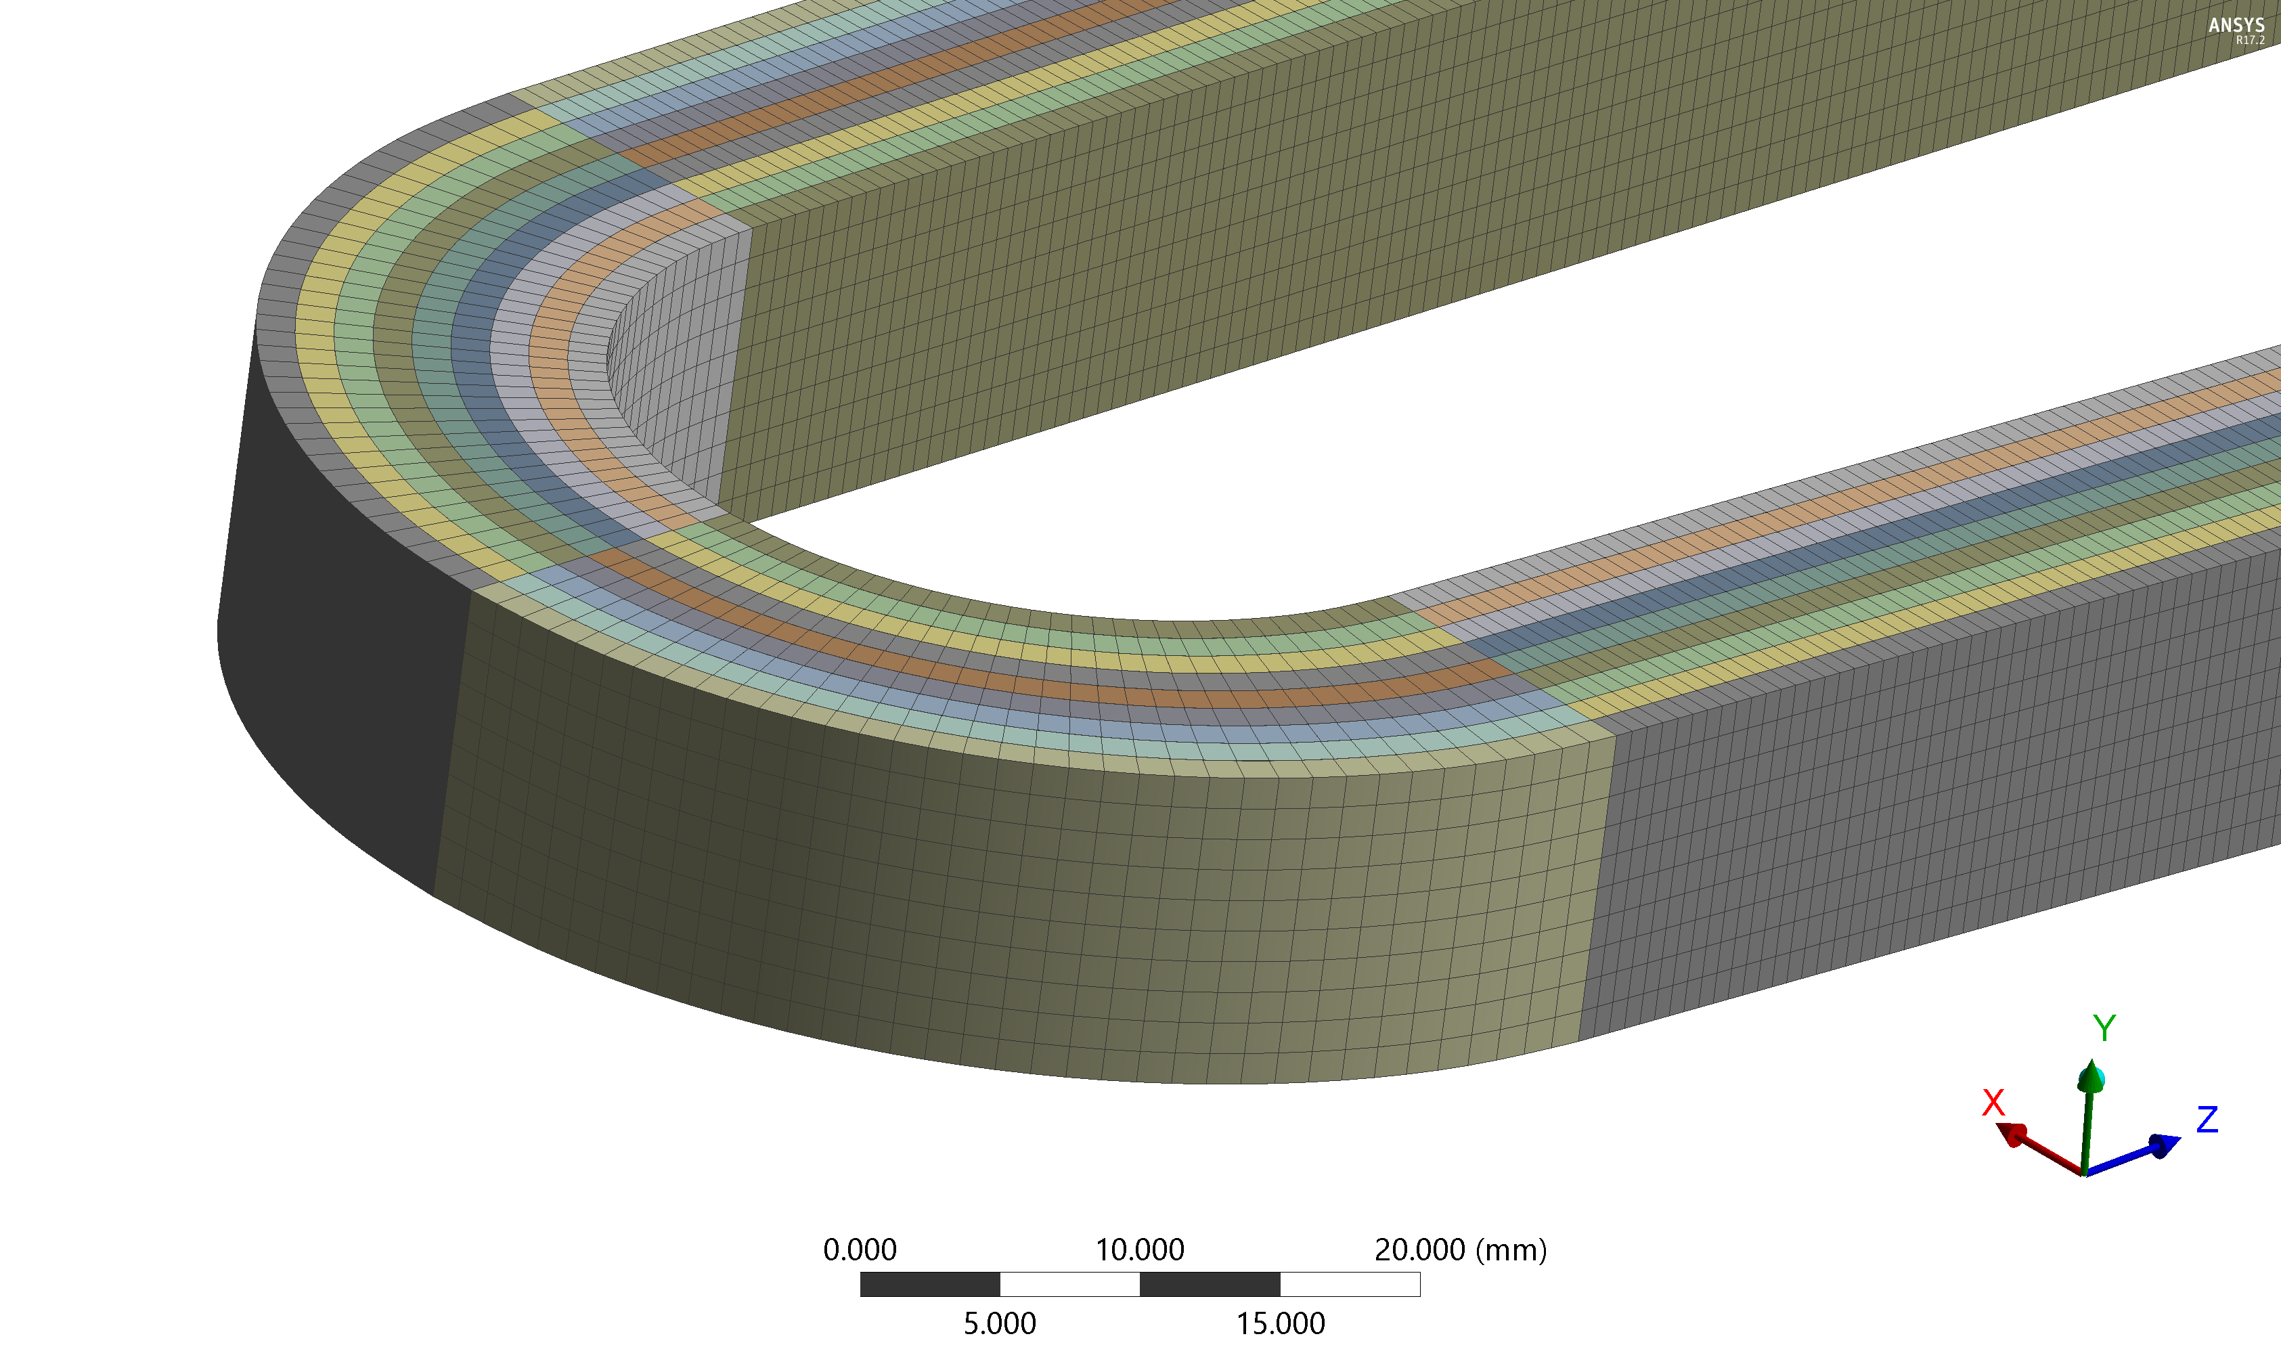

Mesh creation
Full model 500 000 nodes, 200 000 elements
Solves in 10 min with 9x 3GHz cores

Slide 21
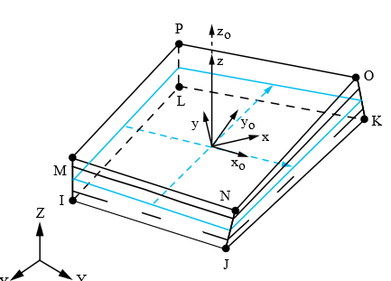
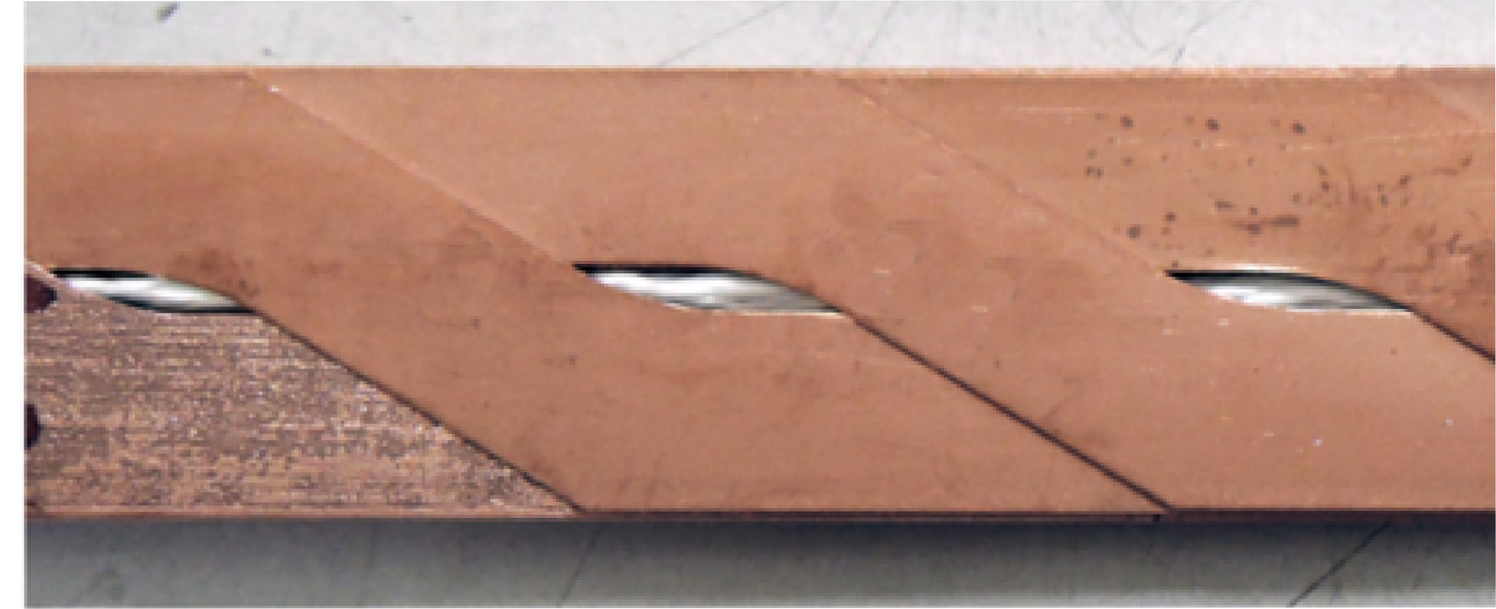
Modelling considerations
The Solsh190 allows for inputting the
tape layers (Cu, stainless steel or Hastelloy, etc) material properties as sectional data into the element -> all tapes assumed to move together as a one composite domain. No non-linearities due to frictional contacts.
Elastic boundary layers described before take in account the elasticity of the insulation between the turns without requirement to mesh
Cable axis
Coil meshed with solid shell Solsh190-elements to enable thin block cable mesh.
?
?
?
Other optional elements: Shell181, Solid185

Slide 22
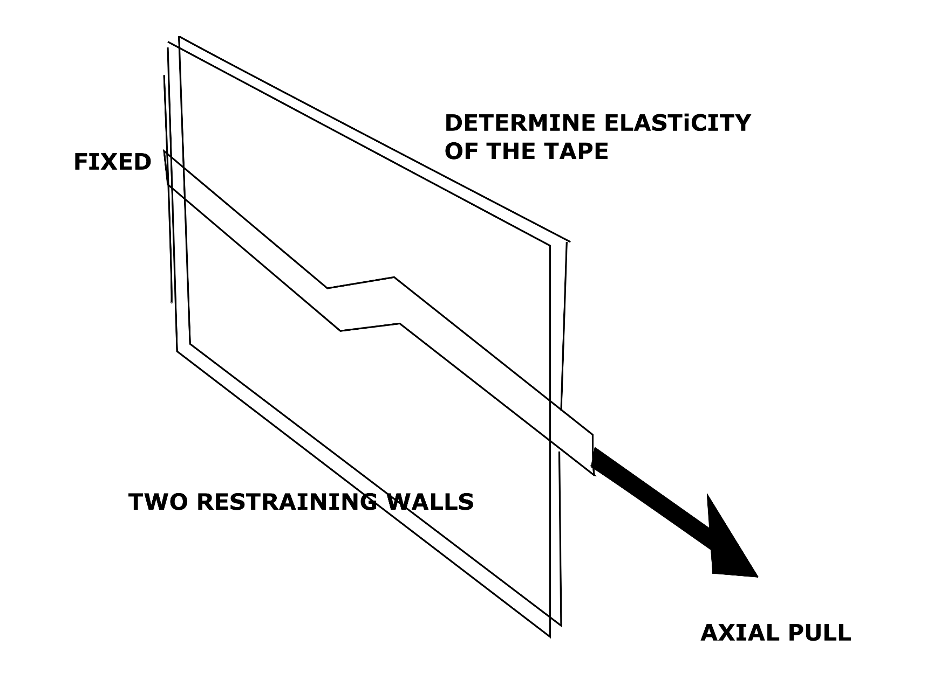
Modelling considerations
Experiment to determine
Axial elastic modulus
of the cable
(dominated by the substrate)

Slide 23

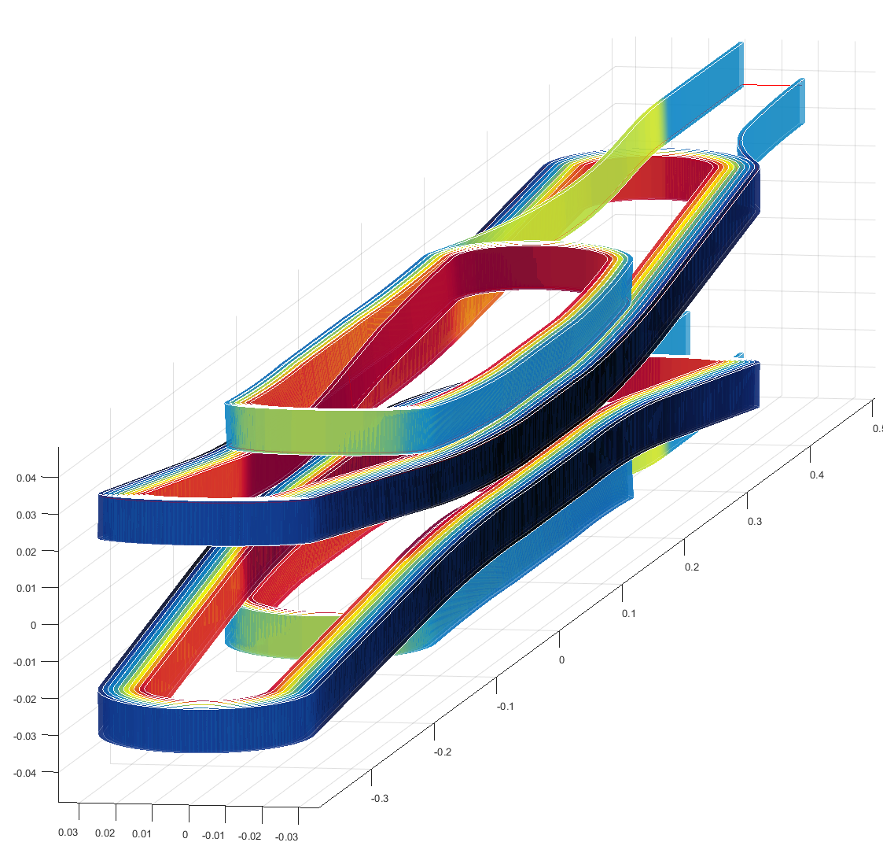
Force transfer from Field 2017 program to ANSYS between dissimilar meshes
FIELD2017 (J. van Nugteren)
ANSYS
Force density vectors
Find the nearest element
centroids between the
meshes
Element volume
Element centroid coordinates
Element centroid coordinates
Send the nodal loads into ANSYS
Multiply Force density vector by the element volumes in ANSYS and divide the load for the nodes of the elements

Slide 24
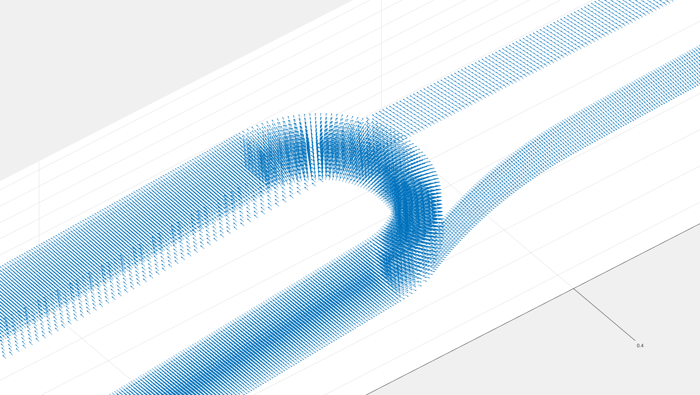
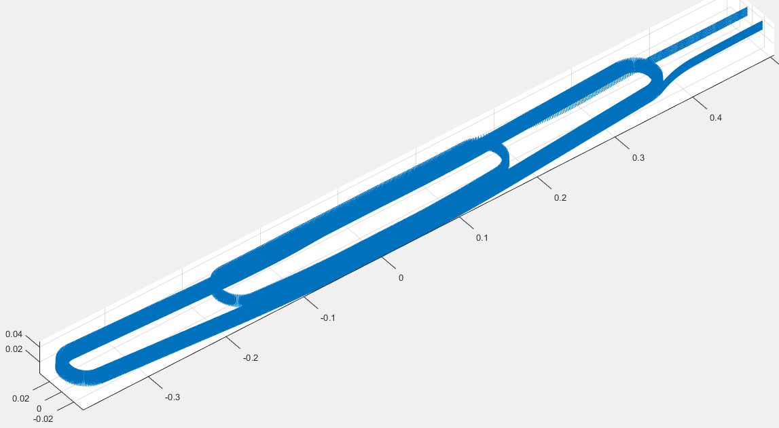
Force vector transfer

Slide 25
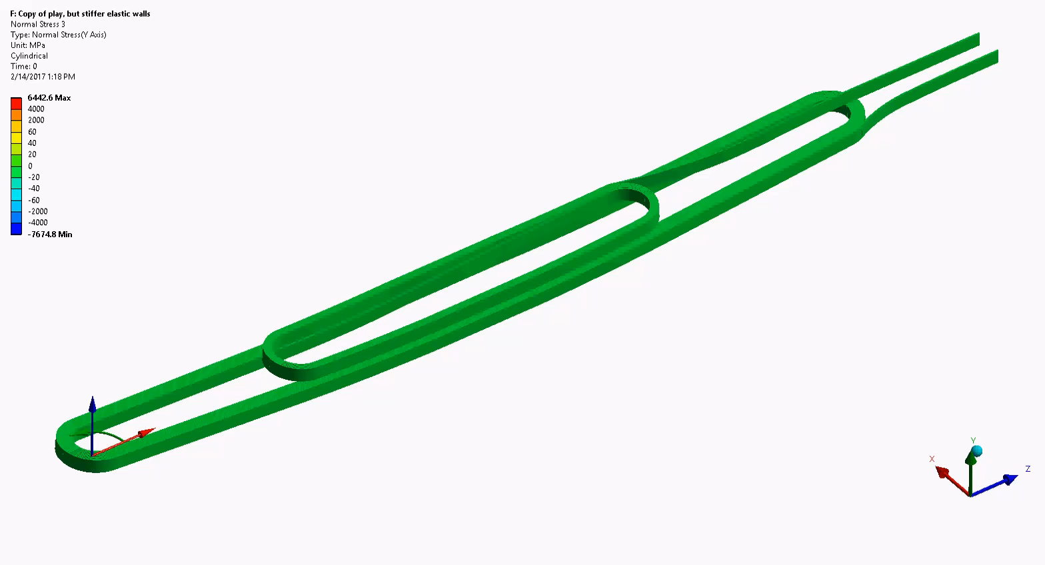
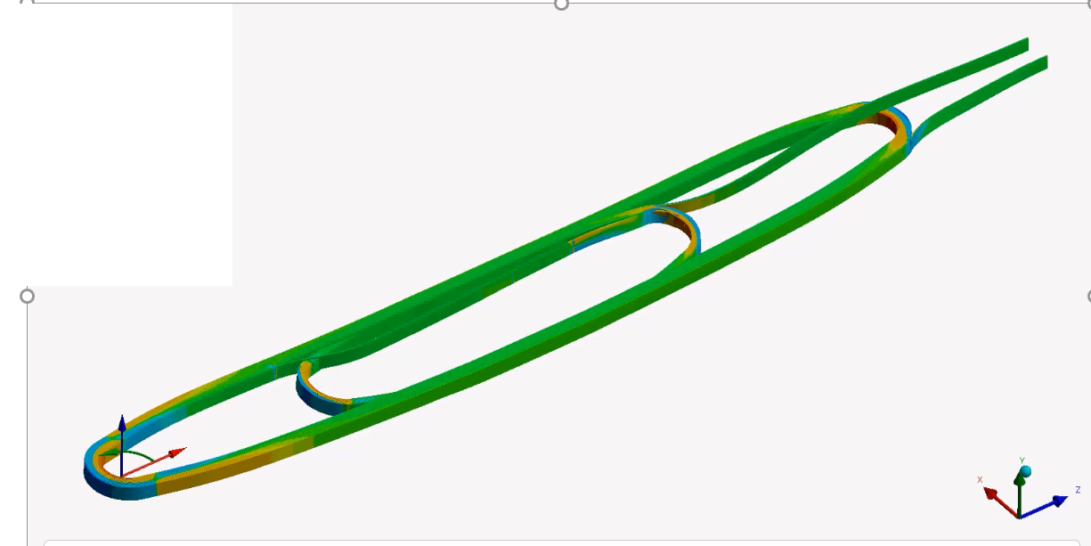
Model deformation (visual purpose)

Slide 26
Part 2
Inductively Coupled Energy Dissipater
High field magnets require efficient quench protection schemes
An inductively coupled secondary coils have been previously presented:
-M. Wilson, “Superconducting Magnets,” Oxford Science Publications, 1983.
-M. Gupta, R. Anerella, A. Ghosh et al., “High Field HTS Solenoid for a Muon ColliderDemonstrations, Challenges, and Strategies,” IEEE Transactions on Applied Superconductivity
-W. Witte, H. Sampson, R. Weggel et al., “Reduction of the Hot Spot Temperature in HTS Coils,” IEEE Transactions on Applied Superconductivity
ICED copper loops have been incorporated into Feather-M2 magnet
A novel proposal for a HF dipole magnet consists of a coupled secondary loops, one per each pole of a 2-in-1 dipole
Iron yoke laminations increase the flux coupling through the loops

Slide 27
Modelling methodology
We study the protection concept through a 16 T graded high-field magnet layout*, that is in no way optimized for functioning in conjuction with the ICED system
A multi-physics approach is used to simulate ICED. It includes quench modelling, magnetic field computation, heat transfer evaluation and circuit analysis.
For modelling the system, a Matlab and Comsol programs are used.
*With permission of J. van Nugteren

Slide 28
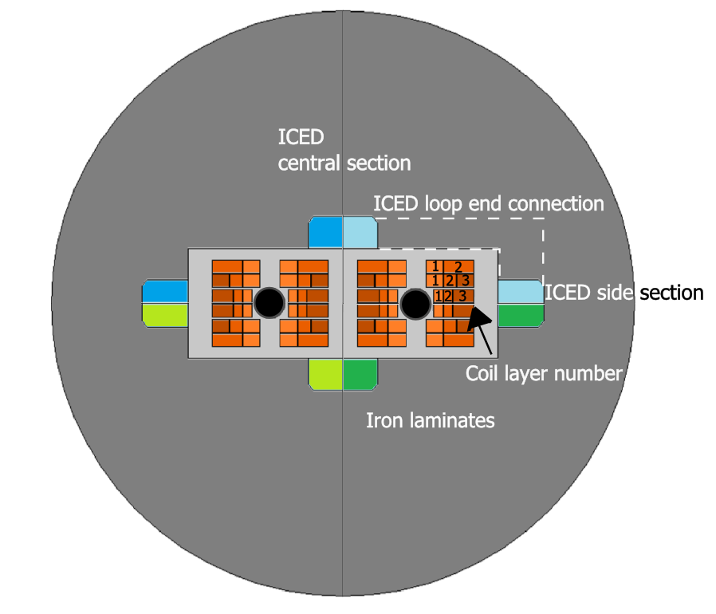
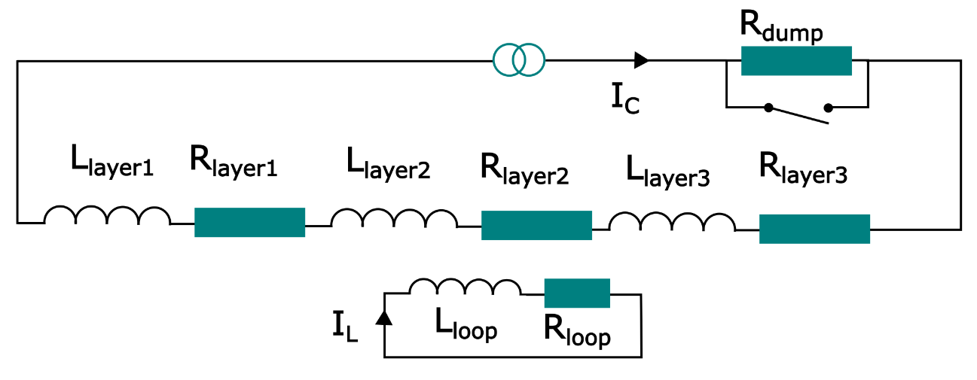
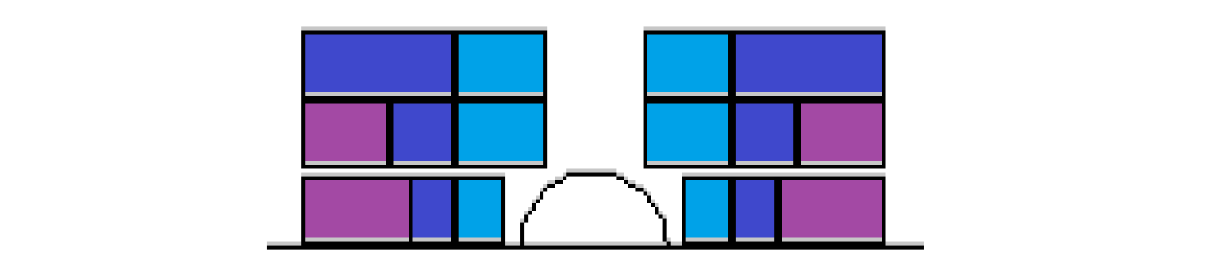
ICED Layout in 2-in-1 HF 16 T dipole magnet
Pole circuit
Restraining coil support structures
ICED
coupled secondary loops, one per each pole
Operating temperature 1.9 K
Loop cross-section 60 mm x 55 mm
1
2
3
Layers

Slide 29
Mechanical consideration
For an accelerator dipole, locating the loop around the coil like in the EuCard-2 demonstrator magnet Feather-M2 would in many cases mean a trade-off between quench protection and mechanical stability. To avoid this, it is desirable to locate the dissipaters outside the coil restraining structure, in a location where the dissipater does not interfere with coil critical supporting elements.
To ensure high coupling, it is nevertheless necessary that a large fraction of the magnetic flux is enclosed in the loop. By placing the loop inside the yoke of an accelerator dipole magnet a large fraction of the magnetic flux is conveyed through the dissipater loop, even if the loop is located far away from the coils.
Loop material in this computation was aluminium with RRR=2000 (suitable materials are any highly conductive materials like: aluminium, copper, etc.)

Slide 30
Modelling methodology
Two methods have been employed, a quench analysis using lumped element method in Matlab* and a more elaborated quench analysis using full FE analysis in Comsol. Matlab analysis includes an adiabatic quench model. The Matlab model is used to carefully validate various parts of the Comsol model, thus the iron is not present at first in the Comsol model
The iron is included in the computations in the final part of the Comsol computations.
The adiabatic quench initiation of the conductor is computed in detail in Matlab only.
*With permission of J. van Nugteren

Slide 31
ICED
The circuit model in Comsol FE model was validated against the circuit model implemented in Matlab. Due to this, the FE computation of magnetic field is not used initially in the Comsol computation. The Matlab quench model results show 1.2% higher peak temperature than the FE quench model with ICED and 1.0% without ICED
Once the temperatures agree the Multi turn coil feature in Comsol is validated against inductors in a circuit model in Matlab.
*With permission of J. van Nugteren

Slide 32
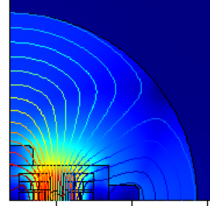
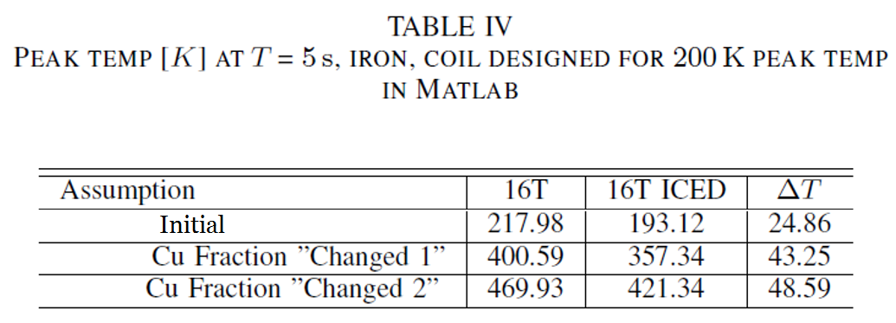
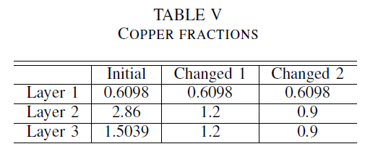
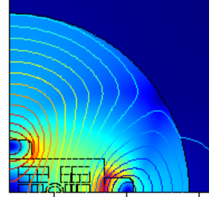
Peak temperature reduction
Magnetig flux density, flux lines
0.13 ms
1.5 s
Current in the loop at maximum: 500 kA
Heats up to 100 K

Slide 33
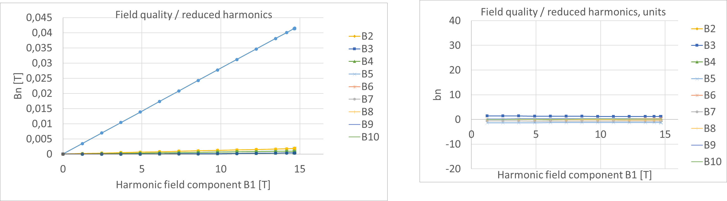
Field quality – ramp up in 20 min
No iron, no ICED
Ramp up into 12 kA in 1200 s
B3

Slide 34
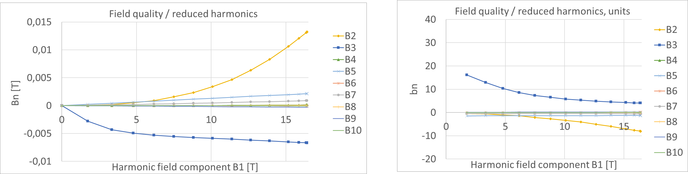
Iron, no ICED
Ramp up into 12 kA in 1200 s
B2
B3
B2
B3

Slide 35
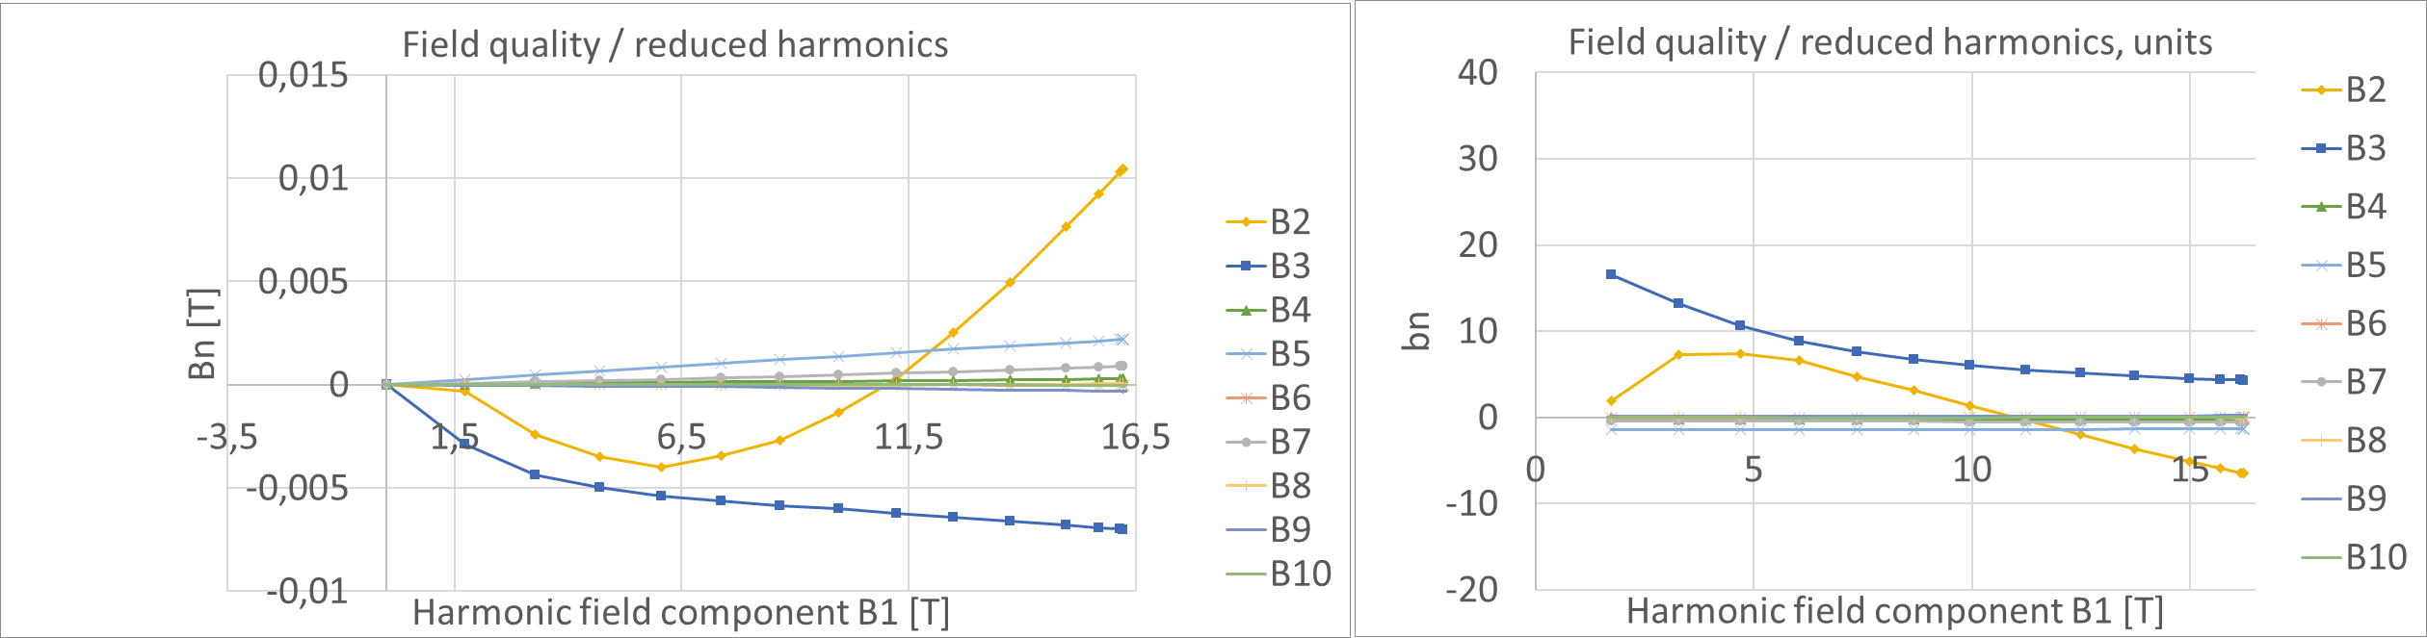
Iron, add holes to iron for ICED
Ramp up into 12 kA in 1200 s
B2
B3
B2
B3

Slide 36
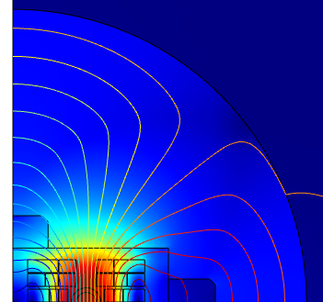
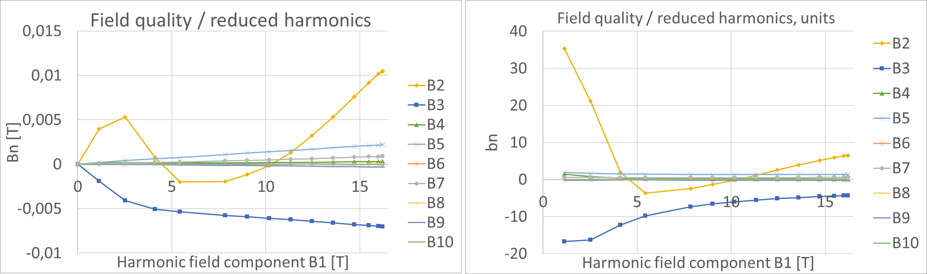
Magnetig flux density, flux lines
Ramp up into 12 kA in 1200 s,
and wait until 1800 s
Loop in adiabatic condition
Iron, add ICED
Ramp-up
finished
B2
B2
B3
B3

Slide 37
Conclusions
The modelling methodology for HTS magnets was presented
The stress distribution due to non-homogenous current distribution was modelled in Feather-M2
ICED concept was presented
Peak temperature can be reduced with a passive protection system in non-optimized 16 T coil by 49 K
Field quality was studied for the ICED in adiabatic condition, but additional studies needed
Thank you!
Thanks to G. Kirby, J. van Nugteren, L. Rossi, A. Stenvall, G. de Rijk

