Slide 1

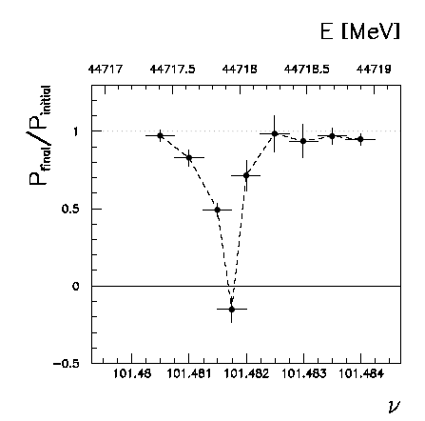
Beam polarization and E-calibration
Precise meast of E_{beam} by resonant depolarization
~100 keV each time the meast is made LEP→
At LEP transverse polarization was achieved routinely at Z peak.
instrumental in 10⁻³ measurement of the Z width in 1993
led to prediction of top quark mass (179+- 20 GeV) in March 94
Polarization in collisions was observed (40% at BBTS = 0.04)
At LEP a beam energy spread σ_{E} > 55 MeV destroyed polarization above 61 GeV
σ_{E} ∝ E²/√ρ ➔ At FCC-ee transverse polarization up to > 81 GeV (WW threshold)
FCC-ee: use ‘single’ bunches to measure the beam energy continuously
no interpolation errors due to tides, ground motion or trains etc…
➔ further work is needed to understand operability
<< 100 keV beam energy calibration around Z peak and W pair threshold.
Δm_{Z} ~0.1 MeV, ΔΓ_{Z} ~0.1 MeV, Δm_{W} ~ 0.5 MeV

Slide 2
Constraints on energy spread
Experimental evidence of effect of energy spread on polarization from LEP
Wigglers at fixed energy or hihest energy without wigglers
-- compilation was done – limit between 52 to 58 MeV
-- needs to cross-check J_{x} that was used.
2. Effect of energy spread on measurement of the Z width
-- needs to be known to a fraction of MeV – measure!
-- we cannot use the the bunch length measurement in crab waist
-- avoid measurements outside of physics conditions
-- synchrotron light monitors? Qs changes?

Slide 3
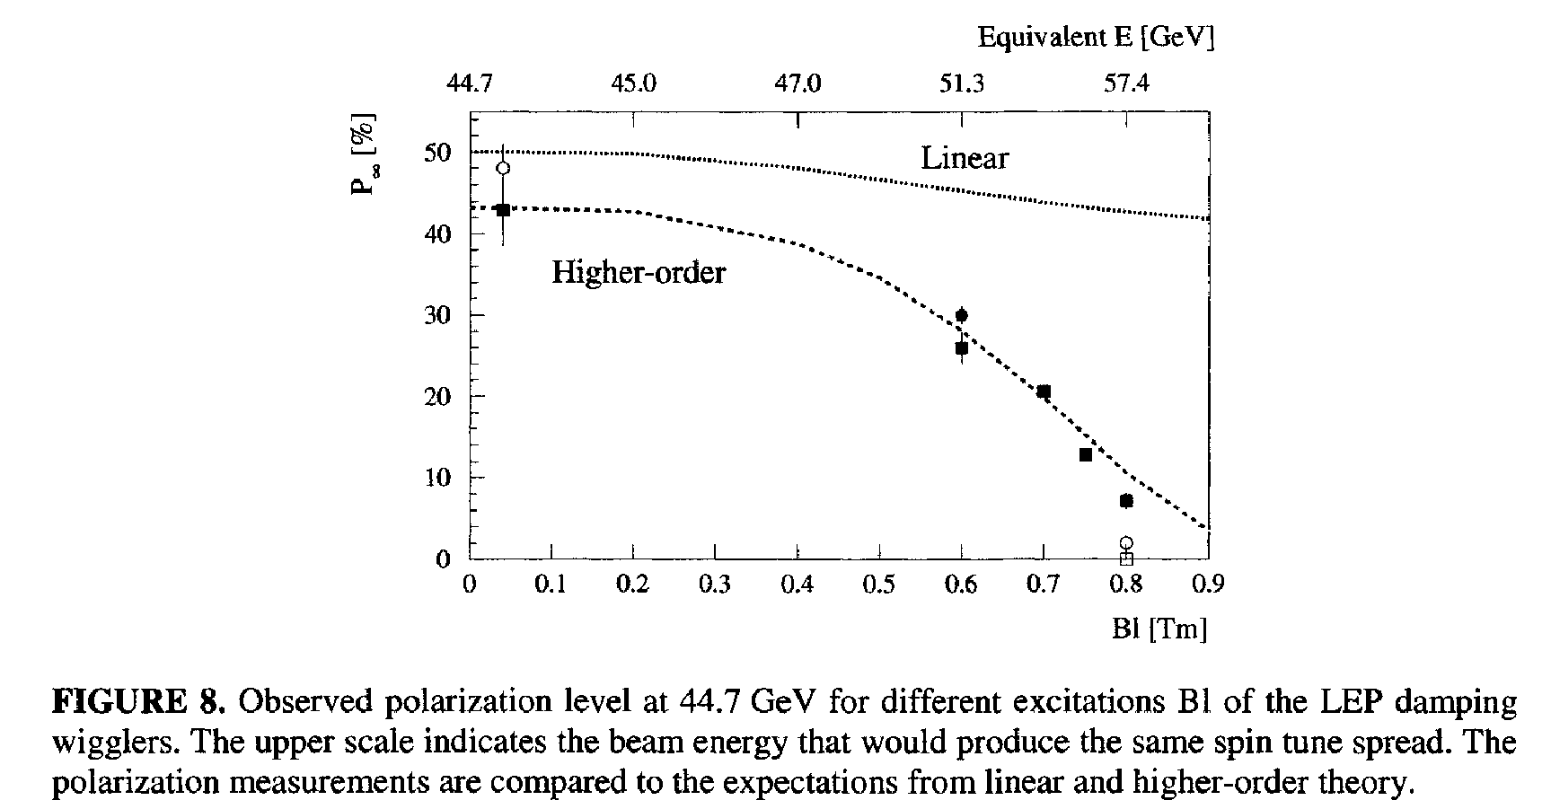
effect of energy spread on Polarization in a given machine was studied using the damping wigglers
σ_{E} ~ 55 MeV

Slide 4
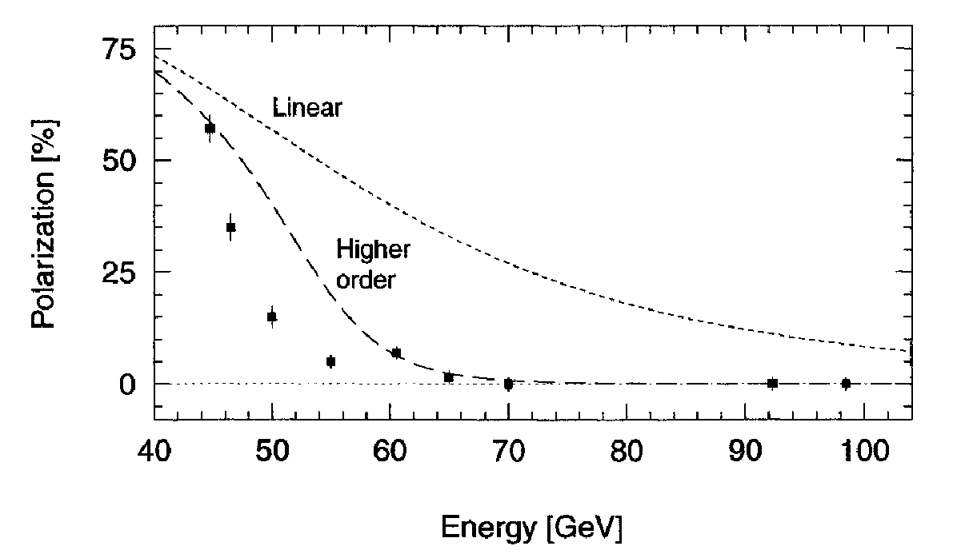
σ_{E} ∝ E_{b}² / √ρ
σ_{E} ~ 59 MeV
The good news is that polarization in LEP at 61 GeV corresponds to
polarization in TLEP at 81 GeV
➔ Good news for M_{W} measurement

Slide 5
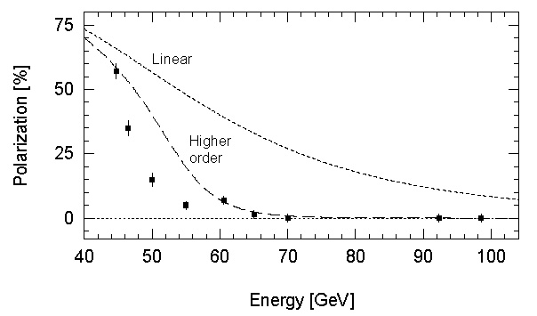
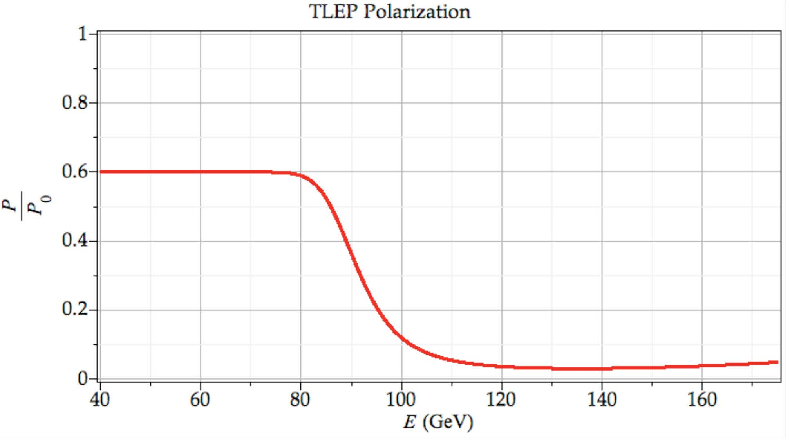
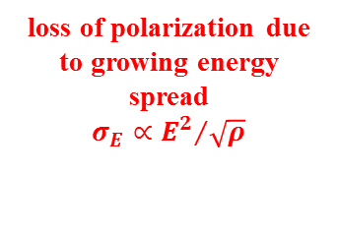
R. Assmann
LEP
loss of polarization due to growing energy spread
$$σ_{E}∝{E^{2}}/{\sqrt{ρ}}$$
this is confirmed by
higher order simulations
U Wienands, April 2013
TLEP
ρ = 9000 m, C = 80 km
lower energy spread, high polarization up to W threshold

Slide 6


Effect of Energy spread on Physics
For the Z width measurement, the energy spread needs to be known accurately.
The energy spread is related to the bunch length which can be measured accurately by the experiments by
Q(incoherent) can be estimated from
κ was measured to be 0.045±0.022. This introduced the dominant error (700keV)
Mom. Compaction factor α error of 1% translated to an energy spread error of 400keV
Total error was 1000keV translating to 200keV for the Z width
We need to improve this by at least a factor of 10 for FCC-ee
al this needs to
be checked

