Slide 1
Status of 1st and 2nd ASIC prototype
Inge Diehl
Measurement results of 1st ASIC with flower device
Inspection of 24 chips, assembled with 30-µm solder balls, delivered by PacTech, end of October
Status 2nd ASIC
Next steps and questions

Slide 2
Results of 1st ASIC with flower device of dSiMPl
Test set-up
Measurements with separate device
Measurements with device connected to ASIC pixel

Slide 3
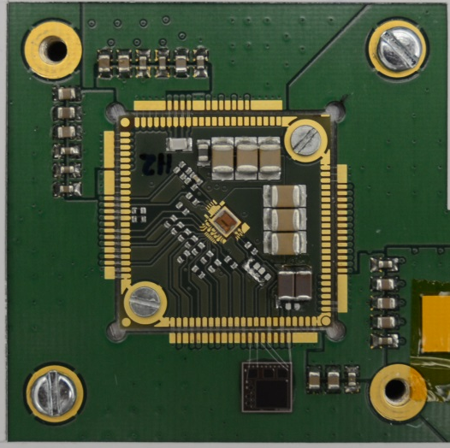
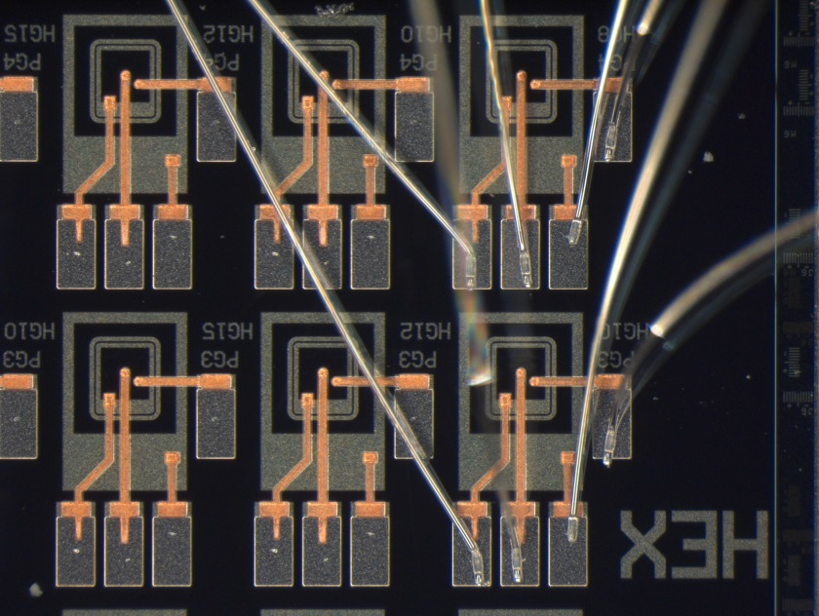
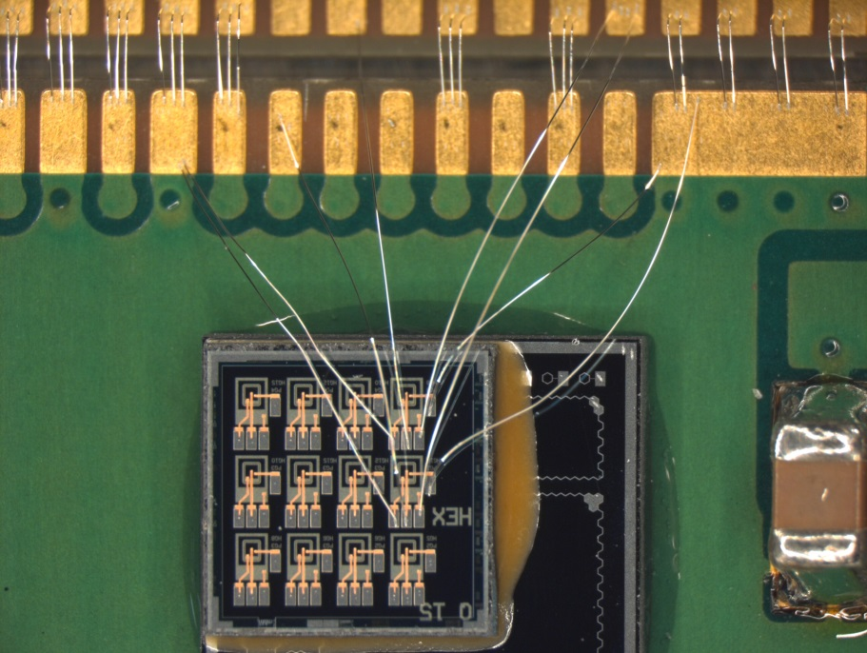
Test set-up
PG4 HG8 connected to ASIC pixel #31
PG3 HG10 connected to resistor and oscilloscope

Slide 4
I-V measurements on PG3 HG10
V_{bd}
in good agreement with Stefan’s results
V_{bd} = 35.09 V
R_{in} = 50 Ω
C_{in} = 16 pF

Slide 5
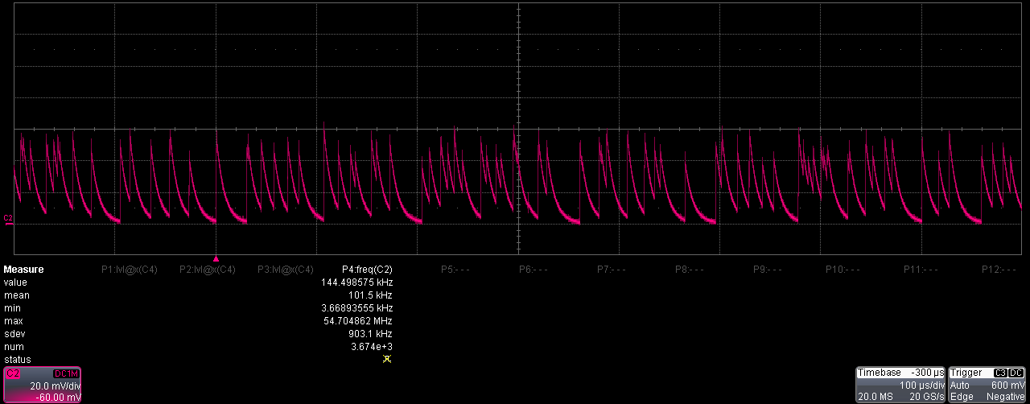
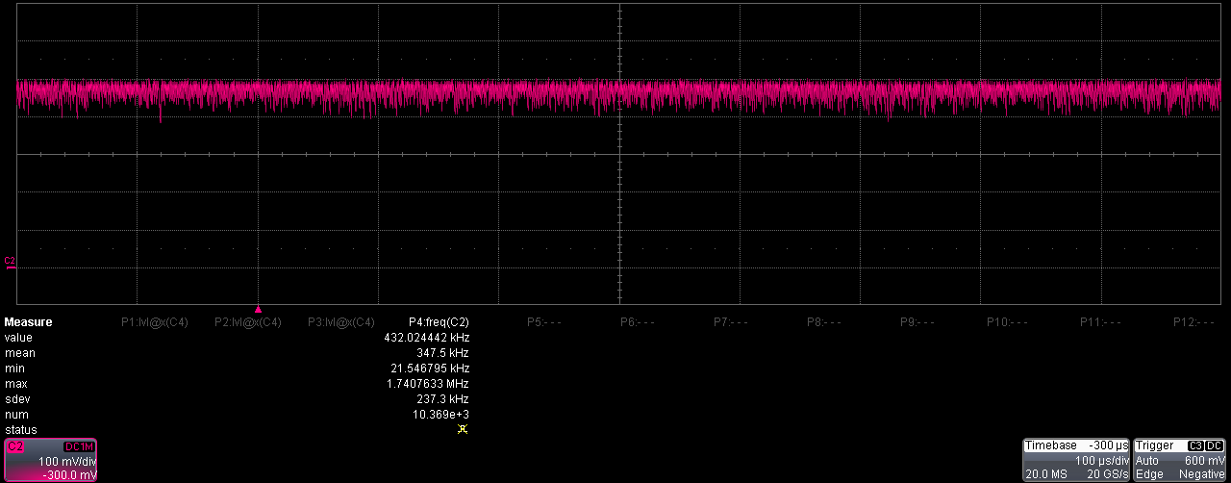
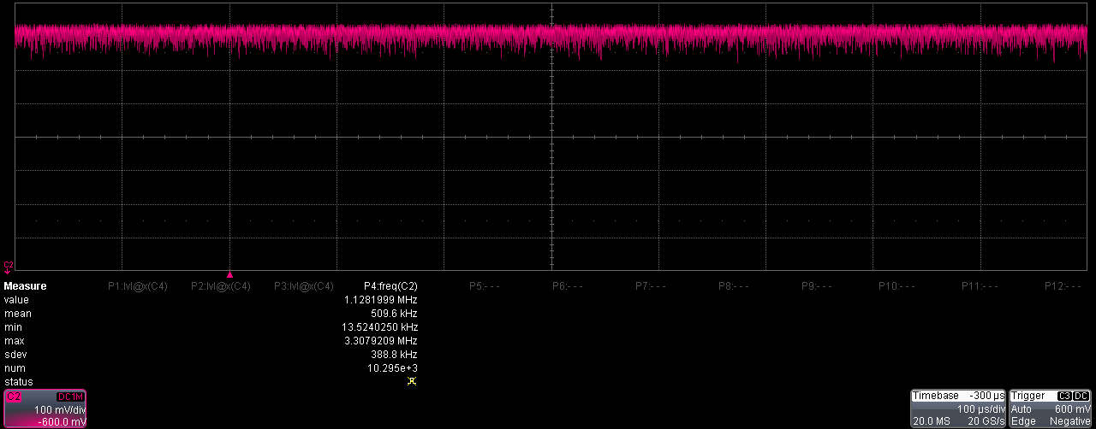

DCR measurements on PG3 HG10
$→$R_{res} = 333 kΩ
R_{Q} = 510 kΩ
R_{in} = 1 MΩ
C_{in} = 16 pF

Slide 6
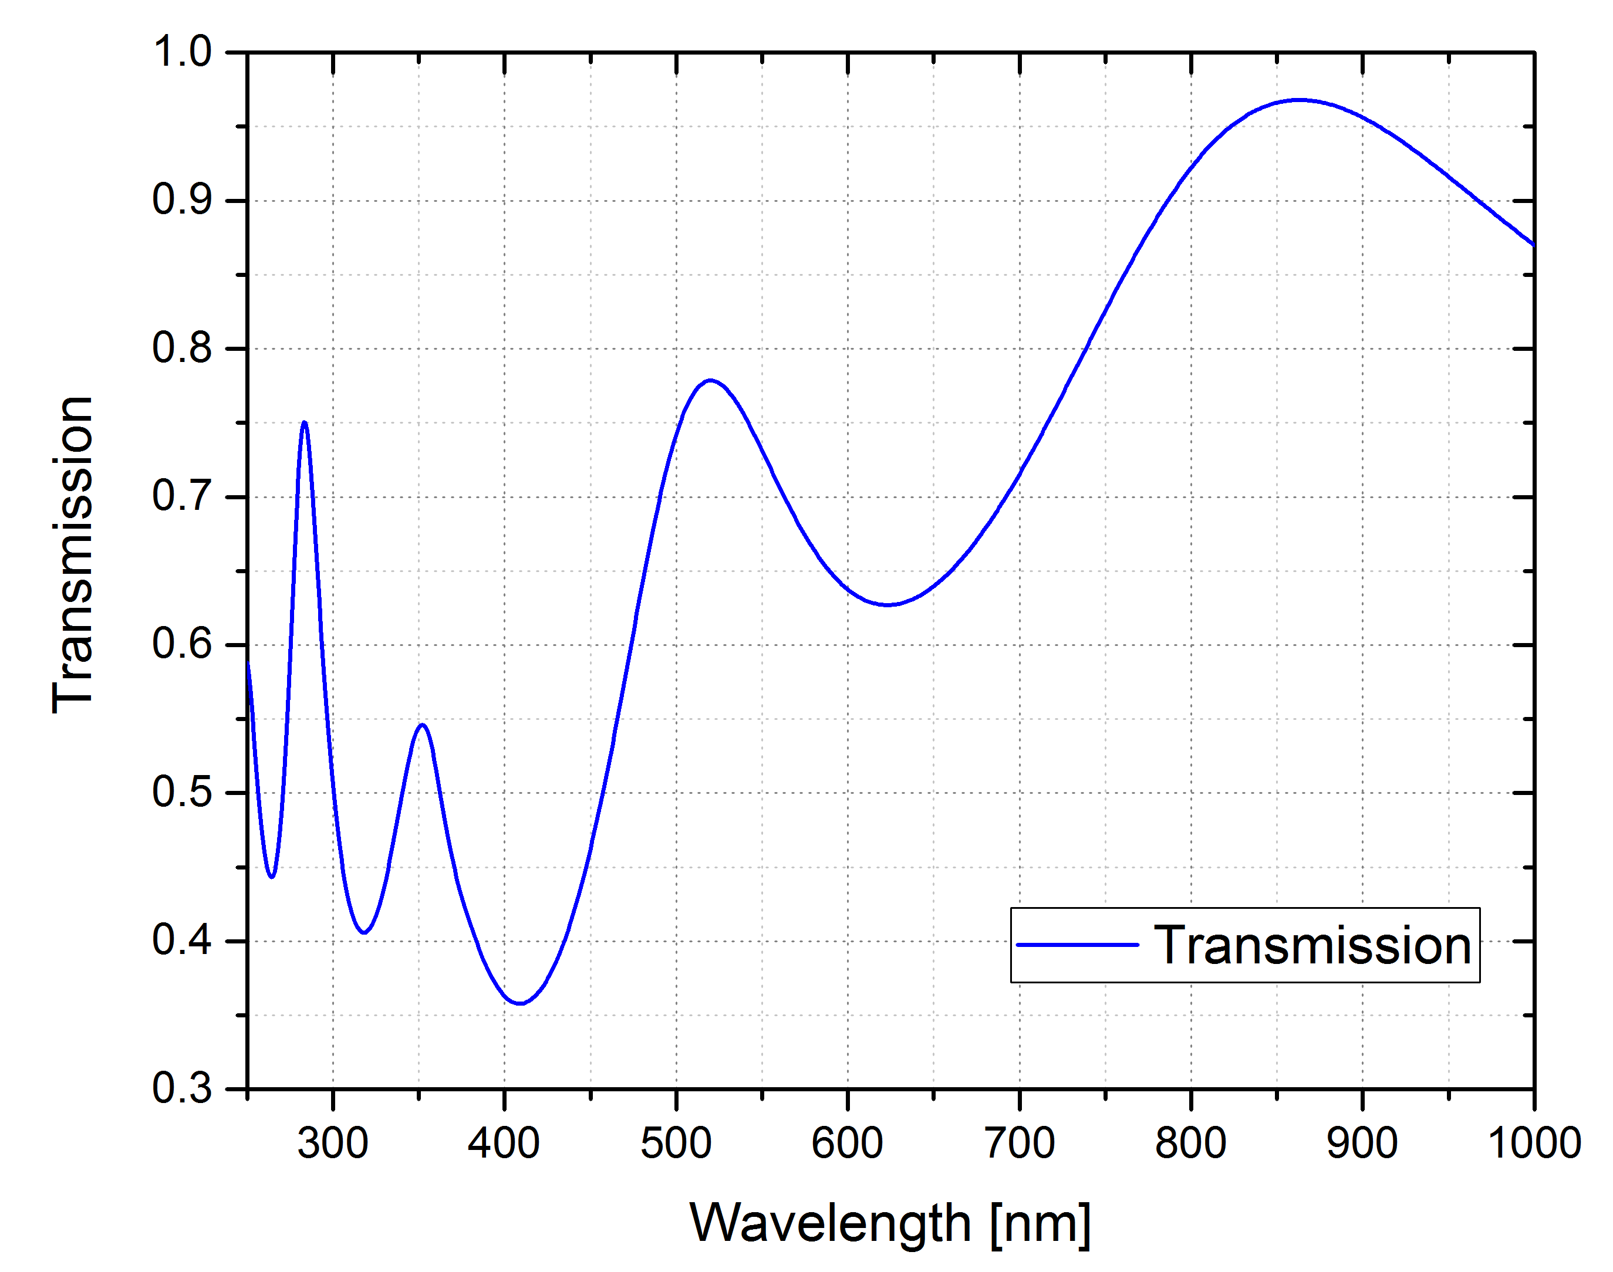
Connection scheme of ASIC and sensor
LED pulse length
adjustable
according to prior agreement with Stefan
infrared LED
V_{supply} = V_{ex}
hit counter
0…3
frame length: 1 µs
# of frames: 1000
ASIC pixel frontend
Test result: # of hits in one frame

Slide 7
Measurements on PG4 HG8, Hit-counting with ASIC, 25°C
V_{recharge} = V_{quench} = 1 V

Slide 8
Dark measurements on PG4 HG8, Hit-counting with ASIC
V_{ex} = 1.4 V instead of 3.3 V, to decrease V_{threshold} of FE-Inverter
V_{bd}
→ V_{bias 1 Hit} = V_{bd} + V_{ov} (V_{threshold}+ V_{x})
V_{recharge} = V_{quench} = 1 V

Slide 9
Measurements on PG4 HG8, Hit-counting with ASIC, V_{ex} = 1.4 V
100-ns IR-LED pulses, frame rate = 1 MHz
good range: V_{bias} = 35.52 V … 35.62 V
BUT: In this range, the sensor doesn’t work in Geiger mode, but in proportional mode!
Dark events produce too small signal → no detection.
In Geiger-mode range, DCR too high.

Slide 10
Measurements on PG4 HG8, Hit-counting with ASIC, V_{ex} = 1.4 V
DCR measurement limited by the hit-counter depth.
DCR very high and the increasing very fast.
Maybe we should increase the threshold again, to be sure that the sensor works in Geiger mode.
More investigation in measurements.

Slide 11
Measurements on PG4 HG8, Hit-counting with ASIC, V_{ex} = 3.3 V
V_{ex} = 3.3 V
More investigation in measurements.

Slide 12
30-µm bumping at PacTech
delivered end of October
24 chips with 30-µm solder balls
  Inspected by Keyence Digital Microscope VHX-5000
  2 chips with homogenous ball size: 22 – 24 µm
  8 chips with 1 – 5 Macro balls, in order of 27 – 31 µm
  2 chips with few missing bumps and Macro balls
  5 chips with solder bridges, 2 maybe useable
  2 with burnings, 1 maybe useable
  1 with some flat balls, usable
  4 not usable, setup, no balls on IO pads
  16 useable

Slide 13
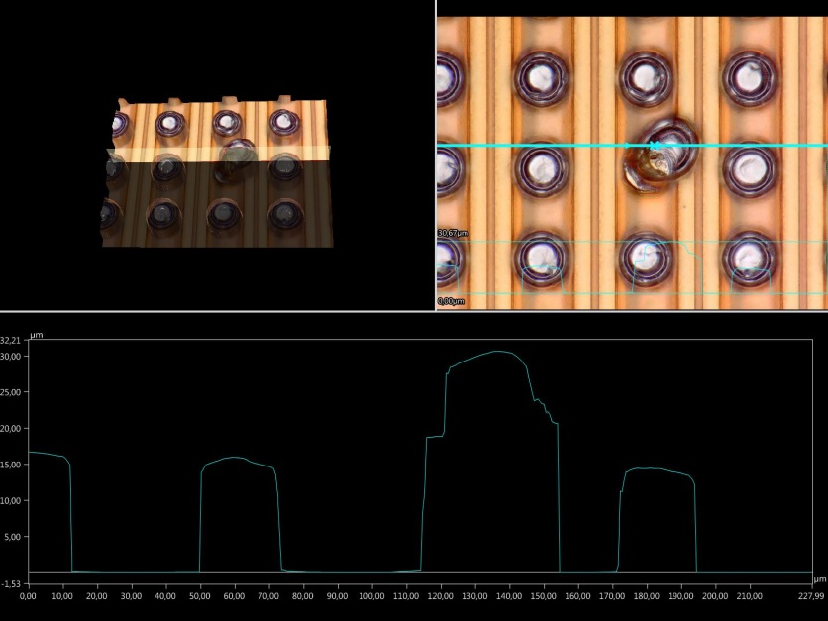
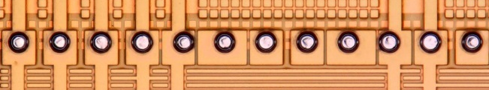
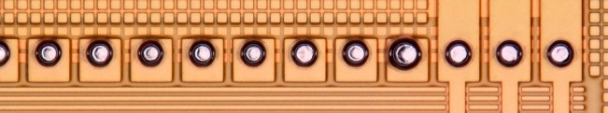
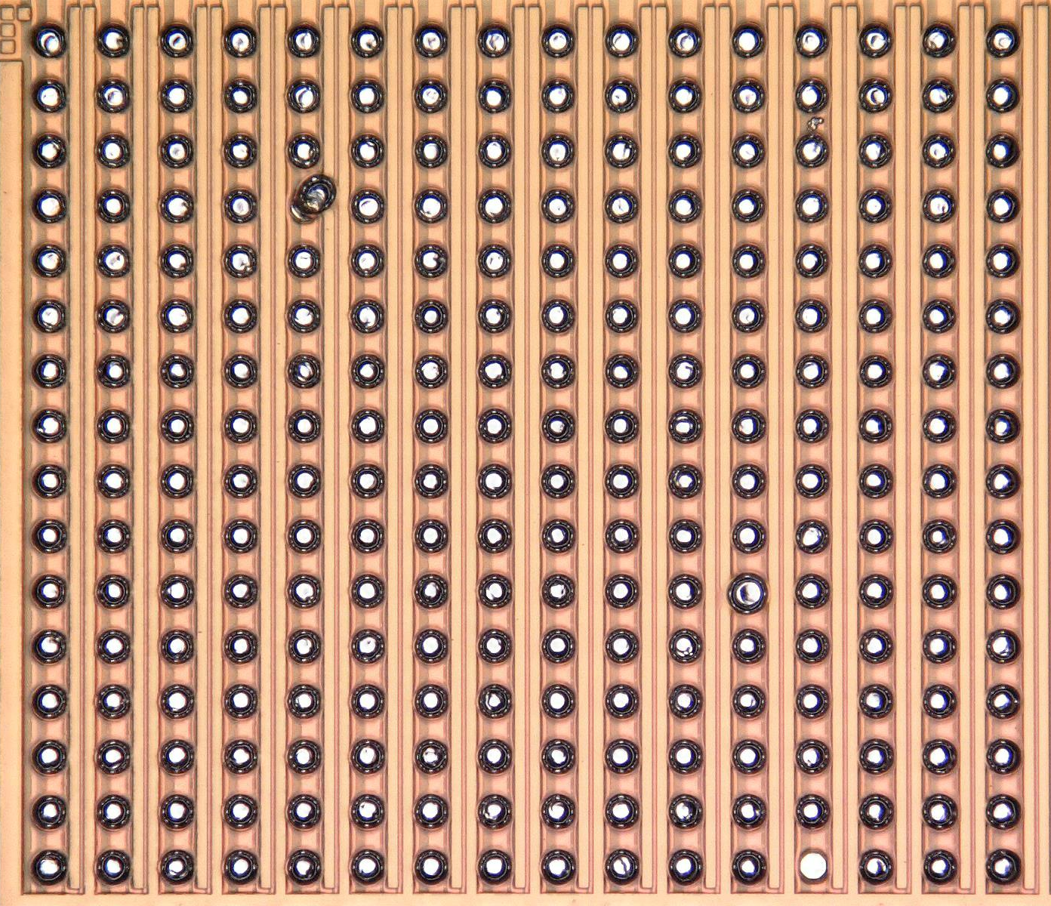
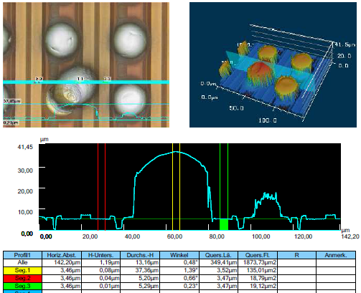
Bumping inspection: chip #g1
Chip with 3 macro balls and 1 missing bump

Slide 14
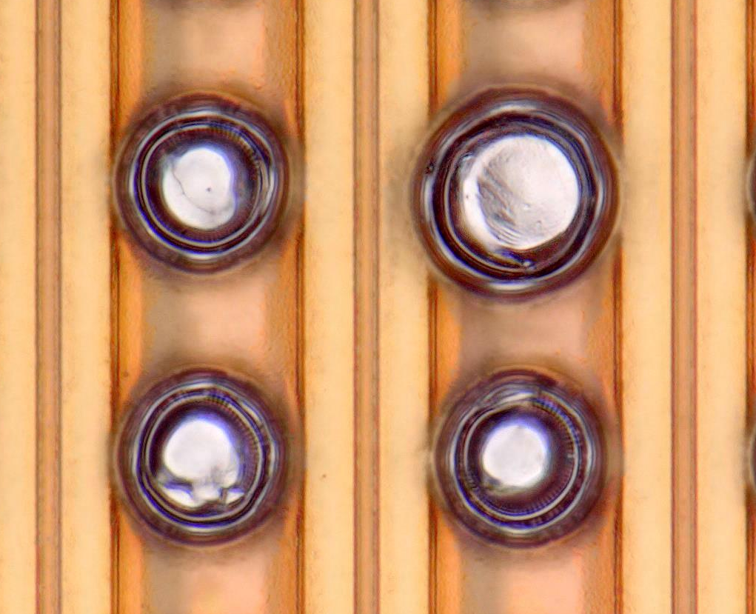
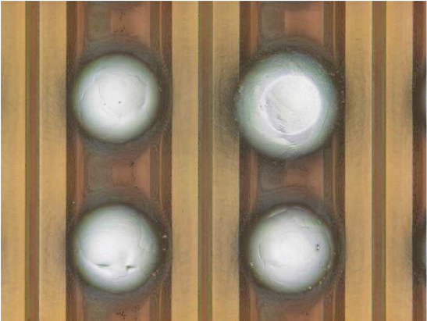
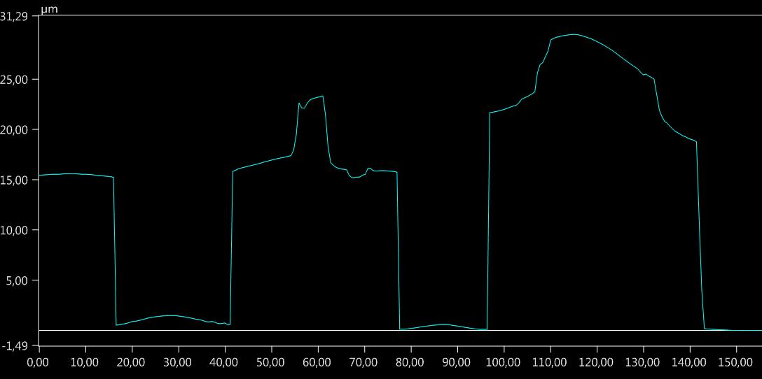
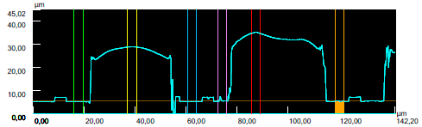
Bumping inspection: chip #g1
Keyence Digital Microscope VHX-5000
Keyence 3D-Laserscanning Microscope VK-X
Chip with 3 macro balls and 1 missing bump
Standard IO balls: 21.7 µm* (σ = 0.3 µm)
Standard Matrix balls: 23.2 µm* (σ = 0.6 µm)
Macro balls: 25.9 µm* (IO), 32.1 µm*, 29.4 µm*
Empty pad: 3.2 µm*
*height in respect to top metal layer

Slide 15
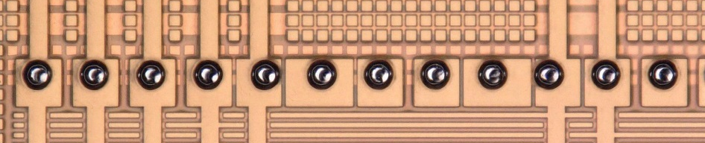
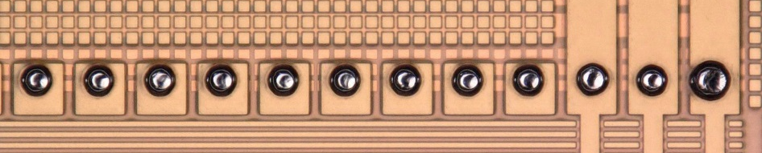
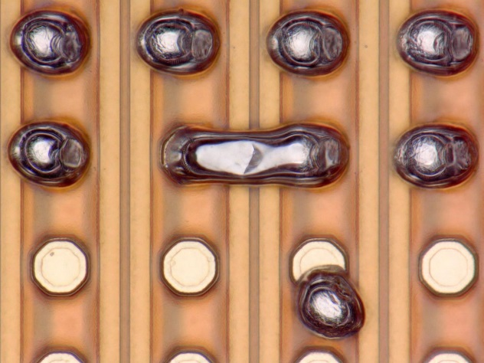
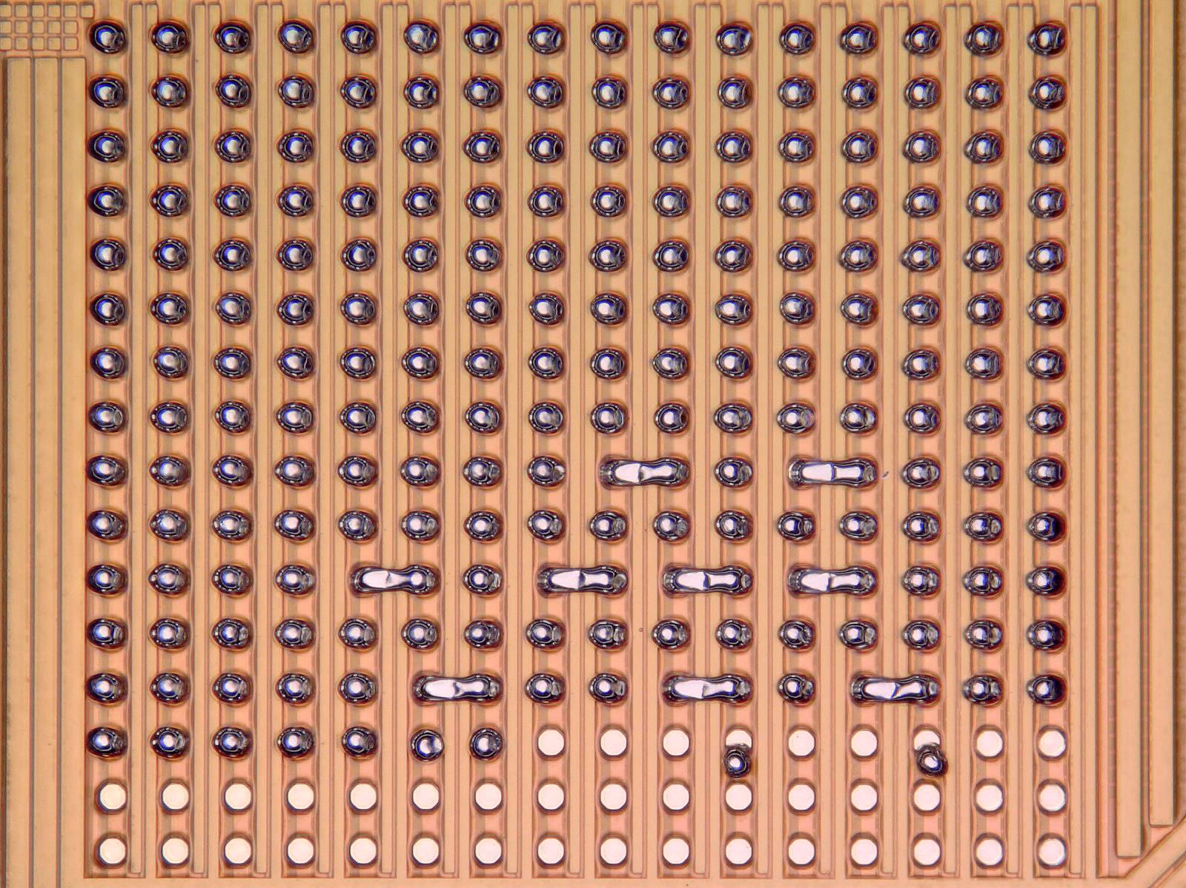
Bumping inspection: chip #sb1
Chip with 9 solder bridges, 1 macro ball, 2 displaced balls, and 39 free pads

Slide 16
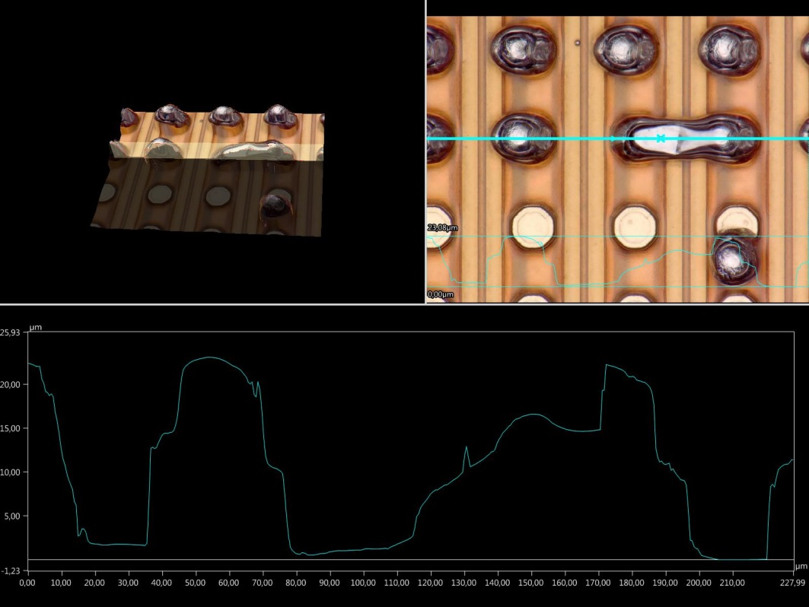
Bumping inspection: chip #sb1
Keyence Digital Microscope VHX-5000
Keyence 3D-Laserscanning Microscope VK-X
Chip with 9 solder bridges, 1 macro ball, 2 displaced balls, and 39 free pads
Standard IO balls: 23.3 µm* (σ = 0.6 µm)
Standard Matrix balls: 23.6 µm* (σ = 0.5 µm)
Solder bridges: 23.2 µm* (σ = 0.3 µm)
Macro ball: 29.2 µm* (IO)
Empty pads: 3.5 µm* (σ = 0.03 µm)
*height in respect to top metal layer

Slide 17
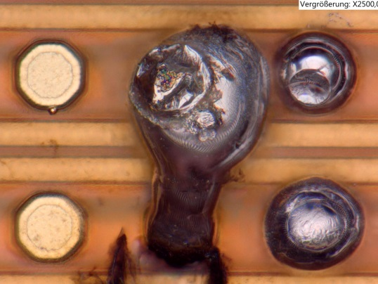
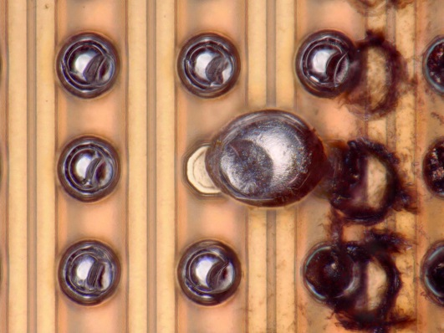
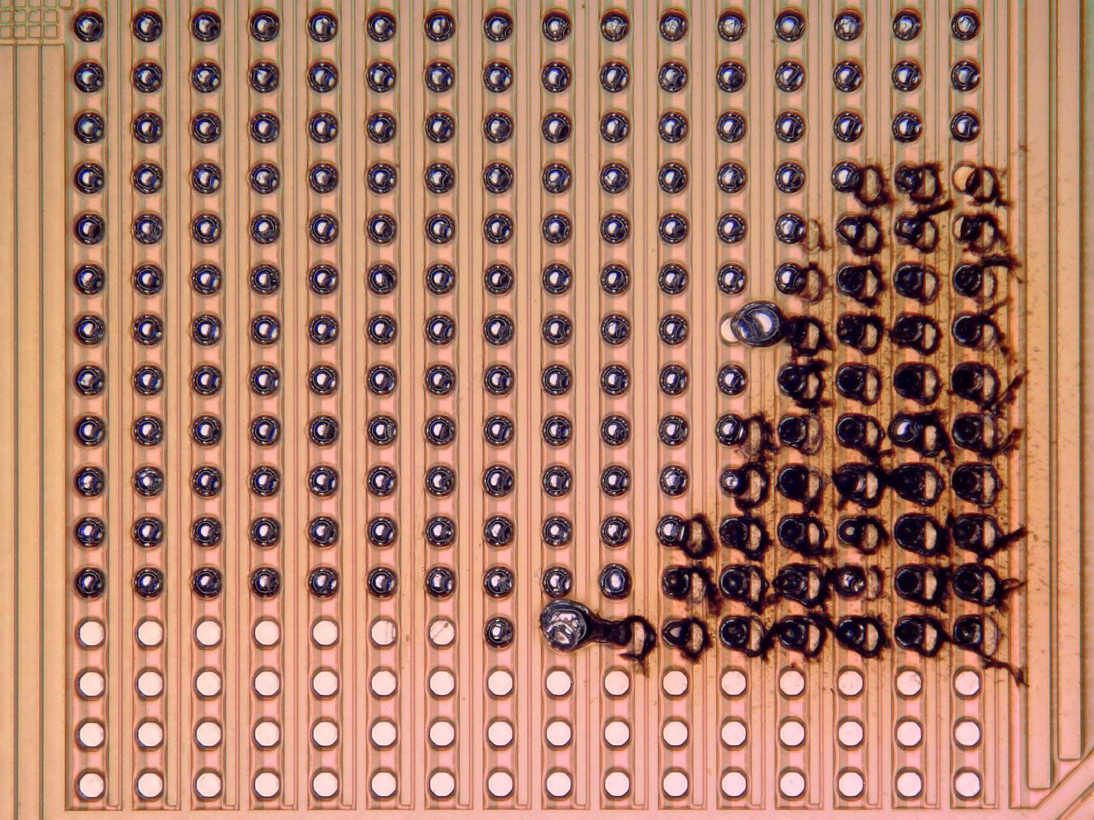
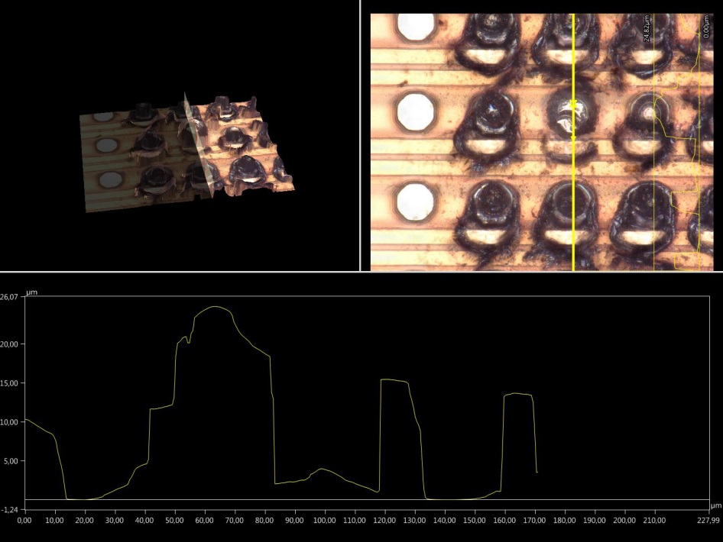
Bumping inspection: #b2
Chip with 3 macro balls
Standard ball: 22 – 25 µm
Huge macro balls: 43 – 47 µm
burnings of PI in Matrix
Residual metal on pad
3 rows without bumping
IOs good

Slide 18
Status 2nd ASIC
“Tape out”: 15. August
Number of prototypes: 40
Die size: 1918 x 2118 µm² (design: 1850 x 2015 µm²)
Die thickness: 256 µm (10 mils)
Parts already shipped to CERN: 11. November
Expected at DESY: this week

Slide 19
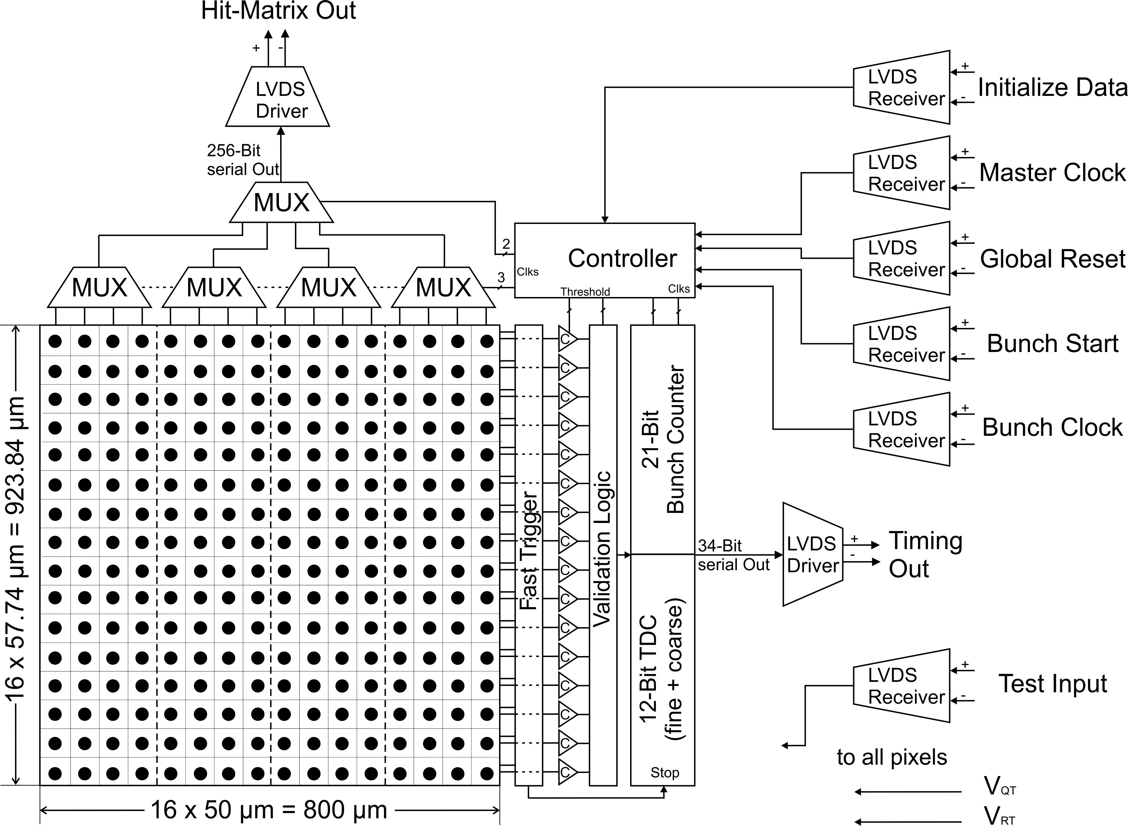
Readout ASIC - components
16-by-16 matrix of pixel readout electronics
  active quenching and recharging circuit
  hit-counting and –serializing
  masking
fast trigger via wired-OR
slow trigger for validation, returns valid-event signal
  16 slow row-triggers as pre-stage, with 4 adjustable ref. voltages as threshold condition (1…4 or more pixels in 1 row)
  2nd-stage with 2 adjustable ref. voltages (1…2 or more row-triggers)
12-bit TDC (7-bit coarse, 5-bit fine TDC)
21-bit bunch counter
16:1 multiplexing scheme
clock generator
control register for static signals
  pixel masking
  counting depth (1 or 2 Bit)
  reference voltages for validation
  process-corner settings for validation and TDC
pad ring with LVDS TX/RX
separate test-circuits
  LVDS RX/TX
  TDC
34-bit serial output timing data
valid: 1 bit
bunch-counting value: 21 bit (bunch<20:0>)
fine-TDC: 5 bit (fine<4:0>)
coarse-TDC: 7 bit (coarse<6:0>)
256-bit serial output hit data
interleaved
pxl<0,4,8,12,1,5,9,13,2,6,19,14,3,7,11,15, 16,20,24,28,17,21,25,29,18,22,26,30,19,23,27,31,…>
265-bit serial input data
“H” followed by 264 input control bits

Slide 20
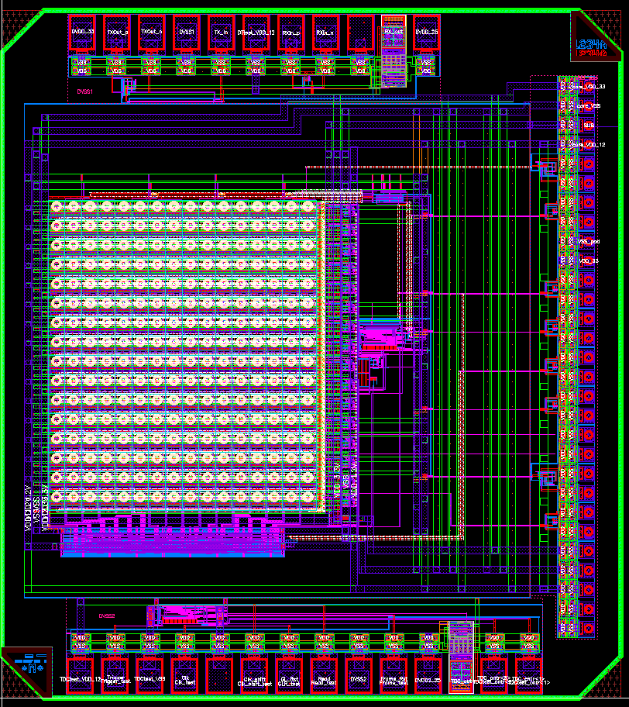
2nd ASIC prototype – final layout
test circuit (LVDS) with wire-bond pads
20-µm pads
LVDS IOs
16:1 multiplexer
clock generator
16x16 pixel matrix
bunch counter
TDC
serializer
fast trigger
validation logic
control register
test circuit (TDC) with wire-bond pads

Slide 21
Next steps and questions
Bumped 1st ASIC to Munich for ball reflow test and bonding
Status of corresponding tests of dummy structures?
2nd ASIC can be send to PacTech
Status measurements for result comparison in Munich? (before visit of Stefan)
Test-board design for flipped 1st ASIC with sensor and 2nd ASIC with sensor in preparation
  Connection to DAQ-system
  Test at test beam
Test preparation of test-circuits on 2nd ASIC

Slide 23
Measurements on PG4 HG8, Hit-counting with ASIC

