Slide 1

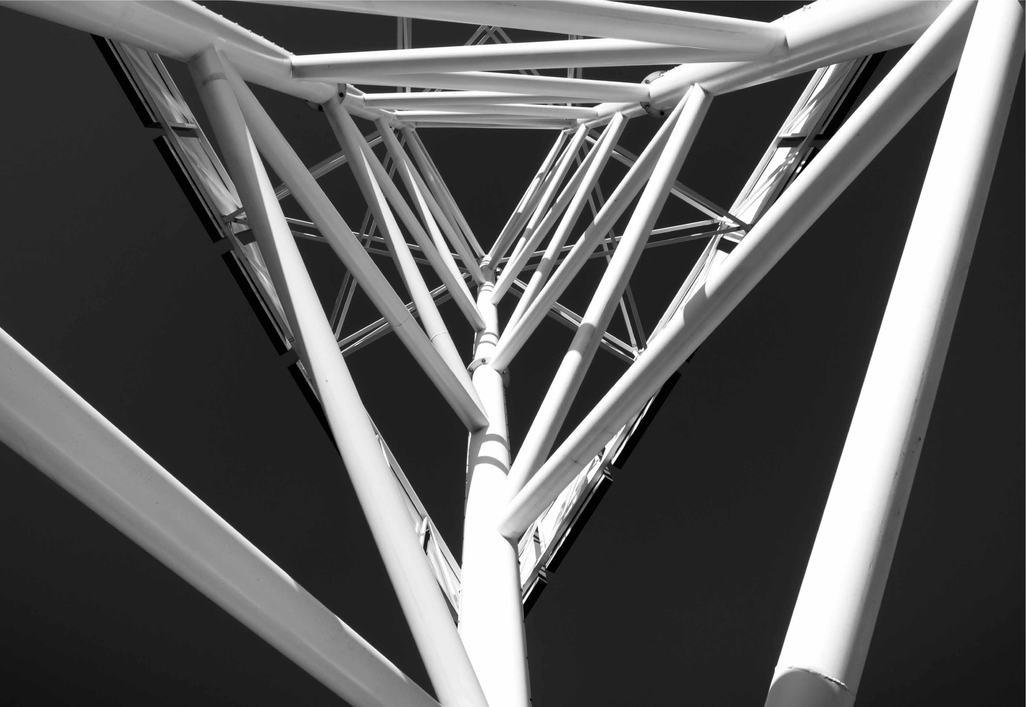

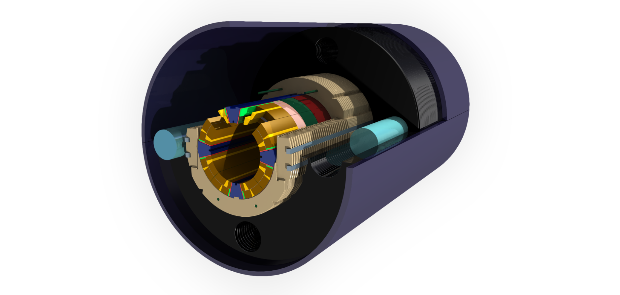
MKQXF
Ch. Kokkinos
M. Karppinen
Other FCC Magnets meeting 10
www.feacomp.com

Slide 2
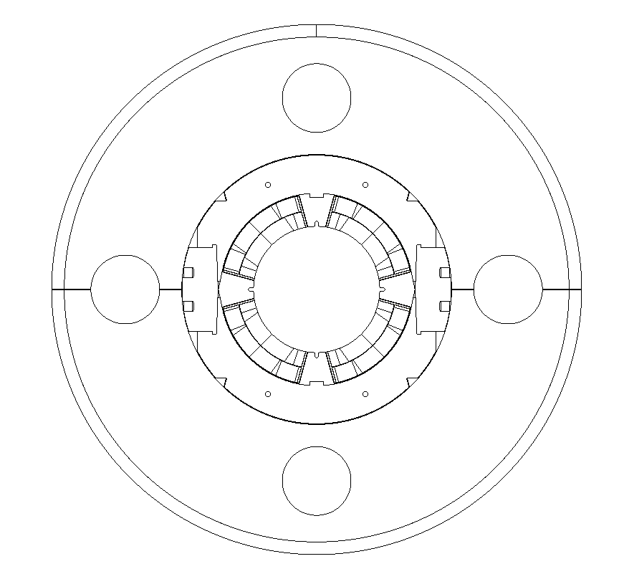
Outline
Introduction
Main Design Features
  Coil Design
  Collared Coil
  Yoke & Shell
  Shimming Locations
Design Goals
Magnetic Analysis
Structural Analysis
  Material Properties
  Load Steps
Results
ANSYS 2 ROXIE
Sensitivity Analysis
MQXF Vs. MKQXF
Conclusions
Haris Kokkinos
www.feacomp.com

Slide 3
Introduction
Haris Kokkinos
www.feacomp.com

Slide 4
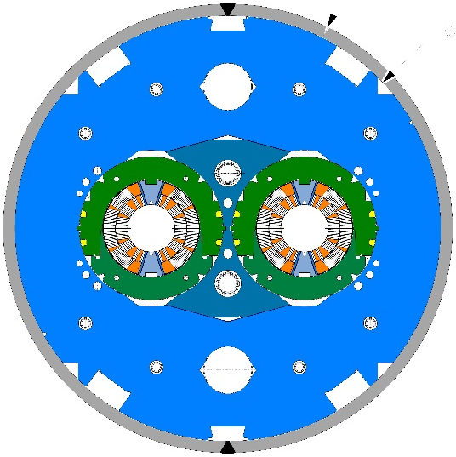
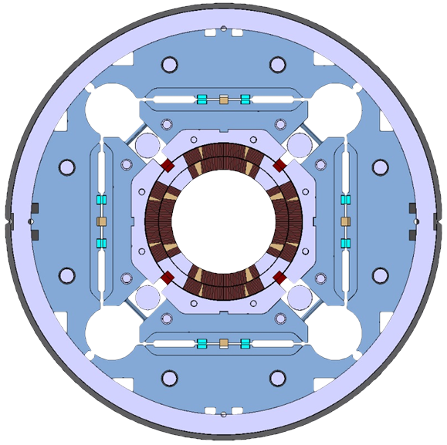
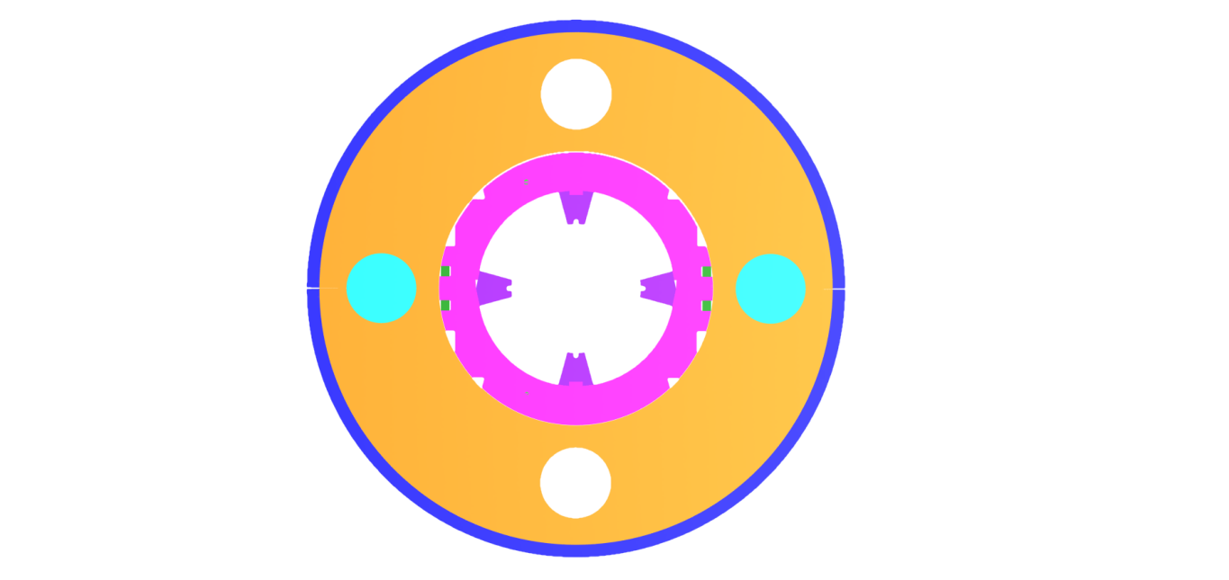
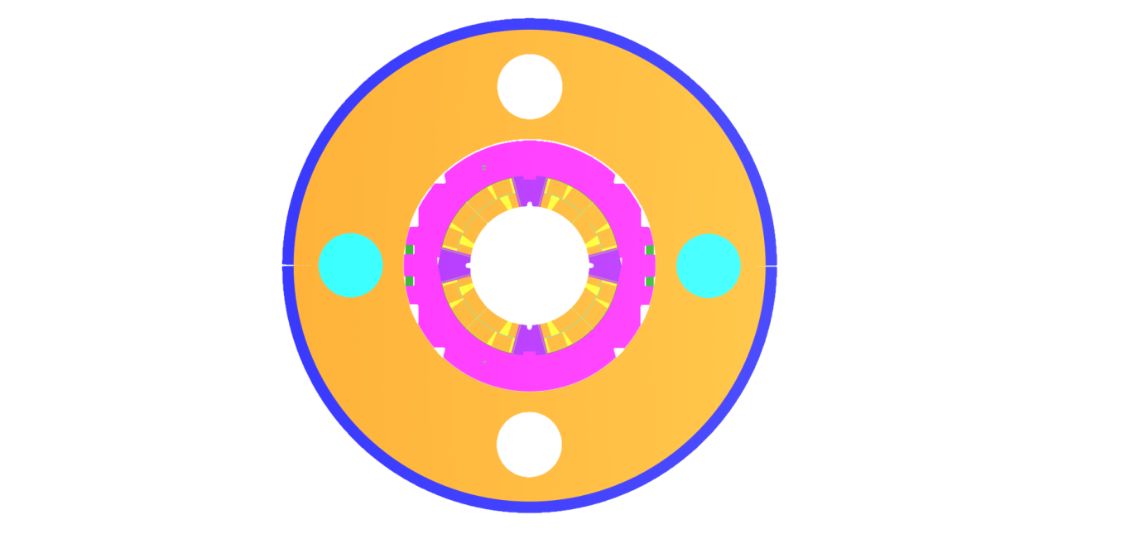

Introduction
11T Dipole
QXF
MKQXF
Nb3Sn
Accelerator requirements
Industrial production
Pole loading concept
For benchmarking & comparison
Identical coils
Pole-loading concept development
for Nb₃Sn quadrupoles
Dipole-type collars
Haris Kokkinos
www.feacomp.com
Notes:
MKQXF is inspired by the 11T Dipole model magnet, which is the first Nb₃Sn magnet designed from the beginning to be compatible with the accelerator requirements and industrial production.
The 11T Dipole is based on the pole loading concept, in which the Ti-alloy pole is not part of the coil, but inserted during the assembly process.
The first 2-m-long single aperture model magnets showed very good performance reaching the design field of 12 T and validated the pole-loading concept.
The pole-loading concept has been further developed forNb₃Sn quadrupoles. The pole region of the coils is identical to the dipole and the collared coil is based on dipole-type collars.
The main advantage of using the dipole-type collars is that the collaring is done simultaneously over the entire coil length thus avoiding local shear stress in the coil, and the use of existing infrastructure (collaring presses) and well-known assembly procedures.
For benchmarking purposes and to compare with the present base-line design of the HL-LHC IR quadrupole QXF, based on bladder-and-key concept, this conceptual study was made with identical coils and quasi-identical magnetic characteristics

Slide 5
Main Design Features
Filler wedge
Laminated yoke
Loading plate
Collaring Shoe
Aluminum Bars
Ground Insulation
Collaring Key
Trace
Shell (15mm)
Nb3Sn coils
Removable poles
Haris Kokkinos
www.feacomp.com
Notes:
The main features of the MKQXF design illustrated in this figure include:
Epoxy impregnated Nb₃Sn coils with two winding layers.
Filler wedges to align the pole angle of the inner and outer winding layers.
Removable Ti-alloy pole-wedges, which at the mid-plane have a 12º taper, such that the long collars with similar taper, push the wedge radially in during the collaring process.
2-mm-thick stainless steel loading plates to protect the coil and to evenly distribute pressure on the pole turns.
Ground insulation composed of 5 radial layers of 125 µm polyimide between the coil and the collaring shoe. The inner-most layer (so-called trace), that is glued to the coils, to ensure good thermal contact, includes the protection heaters and the electrical circuits for the voltage taps and the strain gauges.
St. steel collaring shoe protecting the coils from the collars. Dipole-type collars (long and short collar) with collaring keys and pins to form the pre-assembled collar packs.
The laminated yoke is made in two halves, with a horizontal tapered split
Aluminum gap controllers bars located on yoke mid-plane.
Collaring Keys
15-mm-thick stainless steel shell

Slide 6
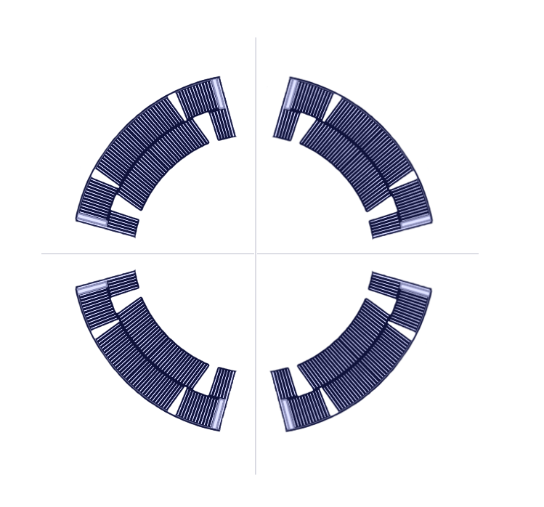
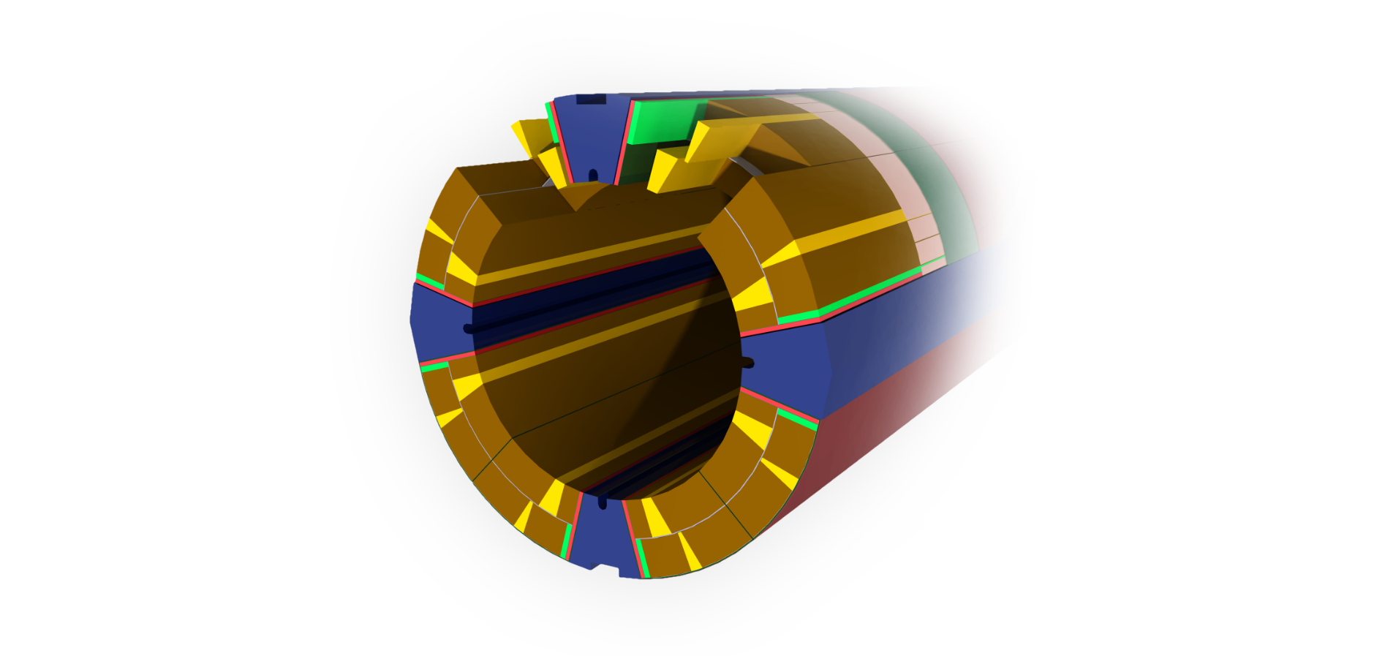
Coil Design
Filler Wedge
Loading Plate
Single length of Rutherford-type cable without internal splice
Coil dimensions & fabrication process identical to the QXF coils except for the pole region
Additional filler wedge on the outer layer to align the pole angle of the inner & outer winding layers
Loading plates to protect the coil & to distribute the pole pressure
Haris Kokkinos
www.feacomp.com
Notes:
The two-layer coils are wound with a single length of Rutherford-type cable without an internal splice
The coil dimensions and the fabrication process are identical to the QXF coils except for the pole region
The pole angle of the inner and outer winding layers is aligned by inserting additional filler wedge on the outer layer
To protect the coil and to distribute the pole pressure more evenly across the coil, 2-mm-thick stainless steel loading plates are added at the pole.

Slide 7
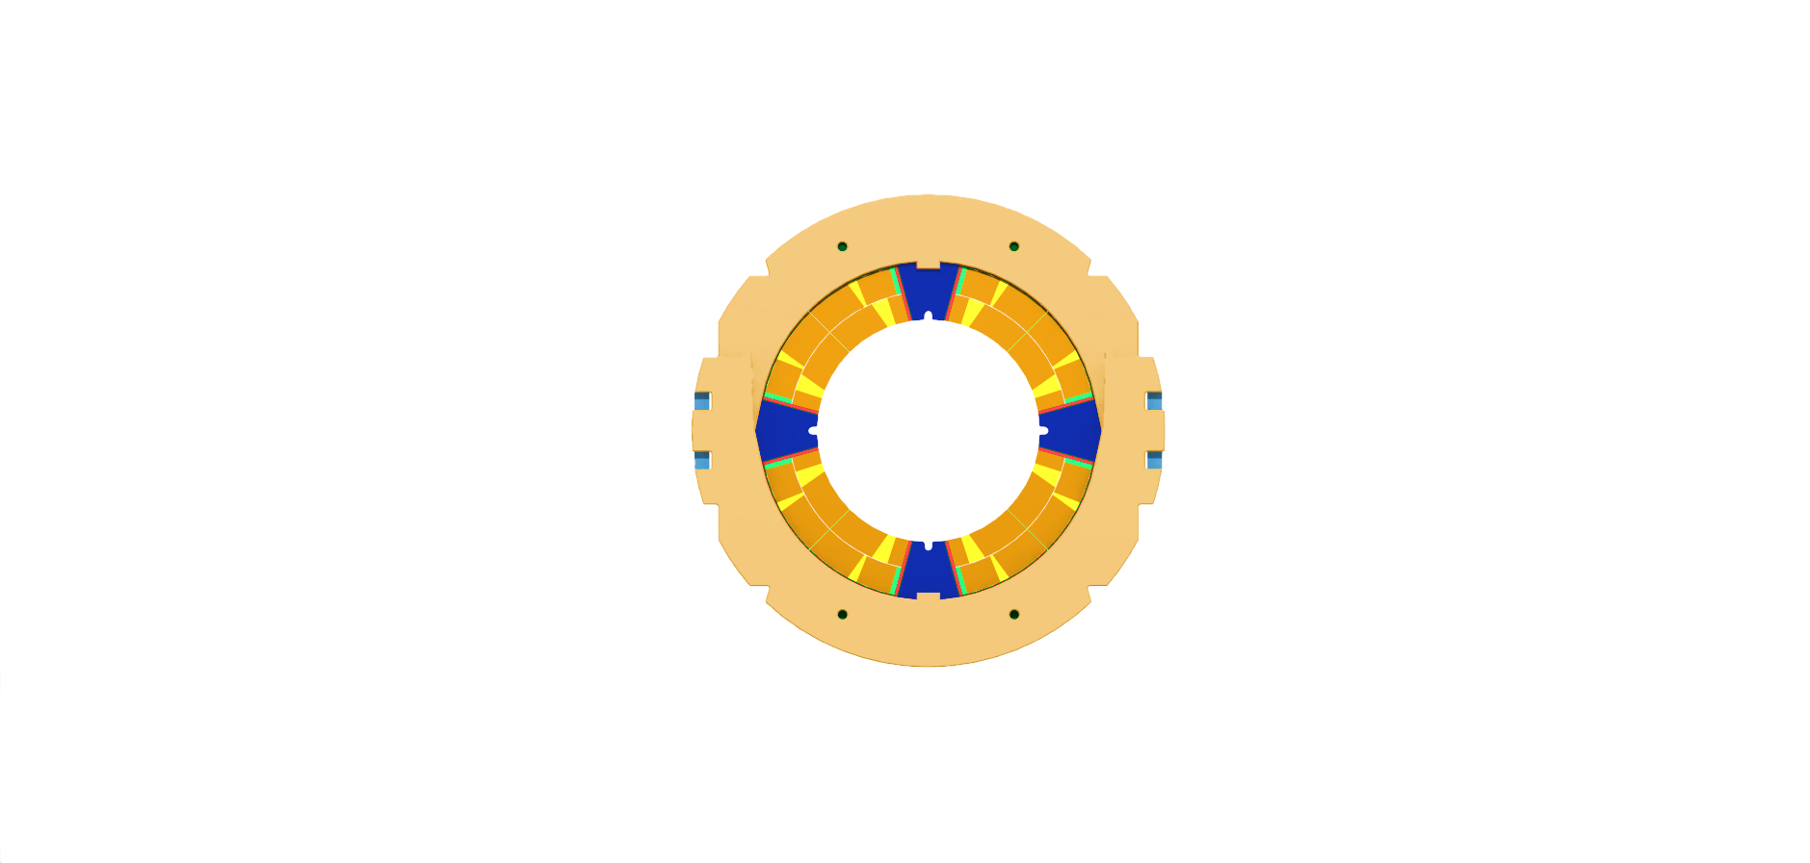
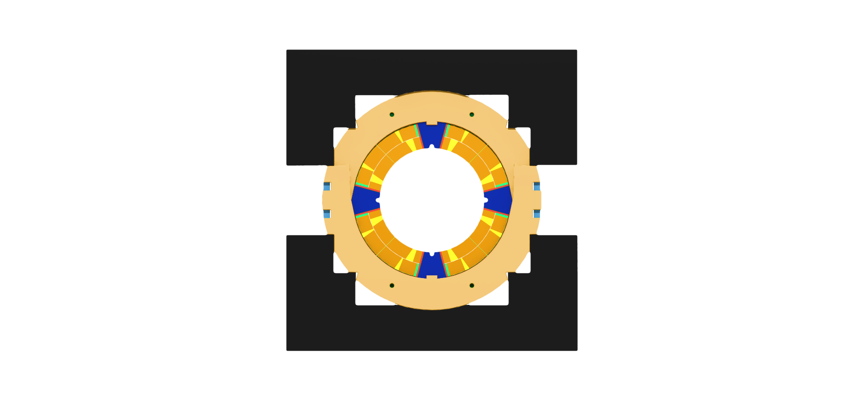
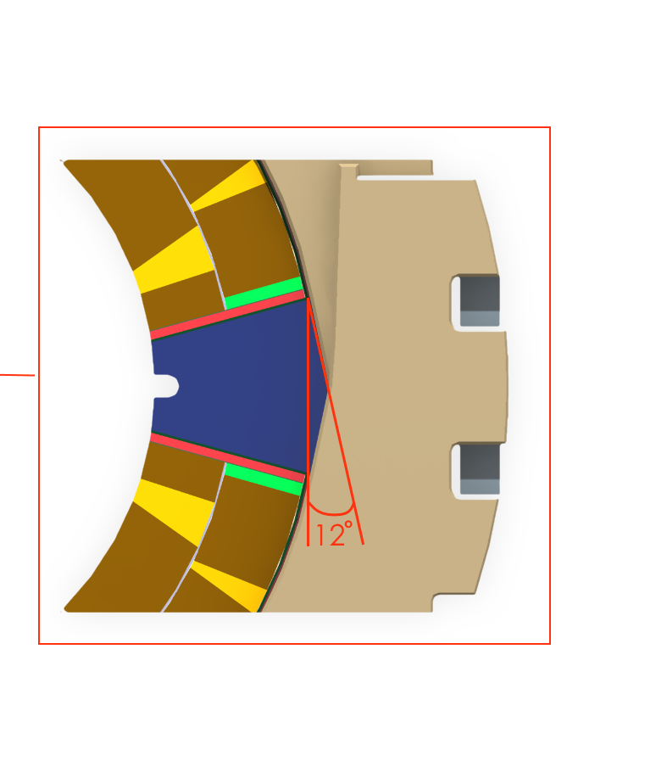
Collared Coil
Vertical Pole Wedge
Collared Coil assembly:
Impregnated coils + Ground Insulation
Pole Wedges insertion
Collaring shoes
Collar packs
Collaring Press
Horizontal Pole Wedge
Stress relief notch
Haris Kokkinos
www.feacomp.com
Notes:
The four impregnated coils are assembled together with the appropriate ground insulation that goes around the coil mid-plane and over the loading plate at the pole
The pole wedges are then inserted in the coils, which also secures the ground insulation in place
The collaring shoes are mounted around the ground insulation prior to pre-assembling the collar-packs
The collaring press has five contact areas with each collar, and pushes the upper collar pack towards the lower until the key-ways are aligned to allow the insertion of the narrow face of the tapered keys. Once the keys have been pushed in the press is released and the collared coil held together by the keys.
The pole wedges in the vertical axis are similar to the 11 T Dipole pole wedges with the alignment slot that locates the collar nose and transmits the vertical force from the collars to the pole wedge
In the horizontal plane the pole wedge has a 12º taper such that the long collars with similar taper near the horizontal plane push the wedge radially in during the collaring (Fig. 7). The stress relief notch in the pole wedges is essential for the stress distribution of the inner layer pole-turns.
On the outer radius the short collar is 0.5 mm smaller than the long collar. Therefore, the short collars can be considered essentially as fillers except for the mating plane region, where they contribute to the lateral rigidity of the collared coil.

Slide 8
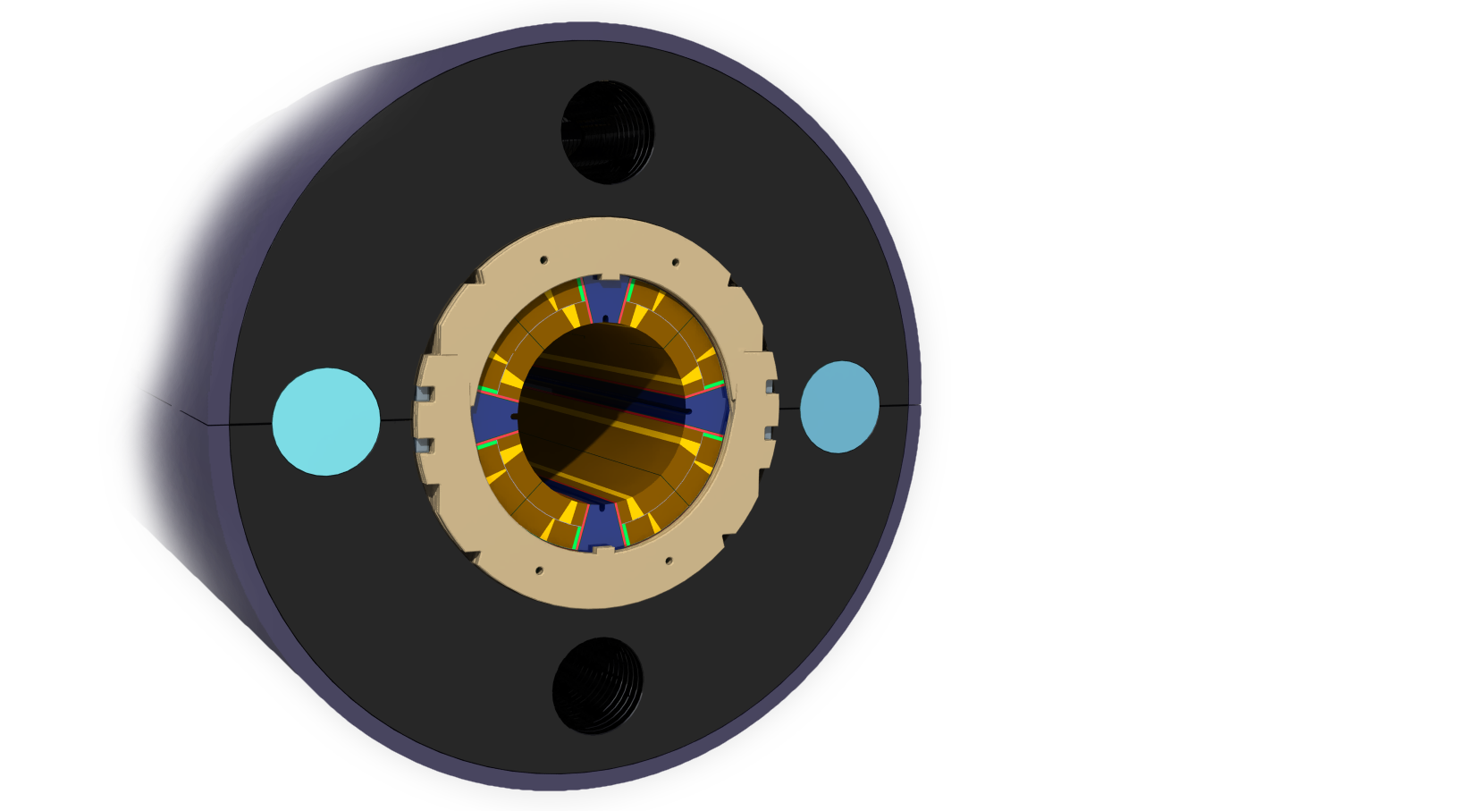
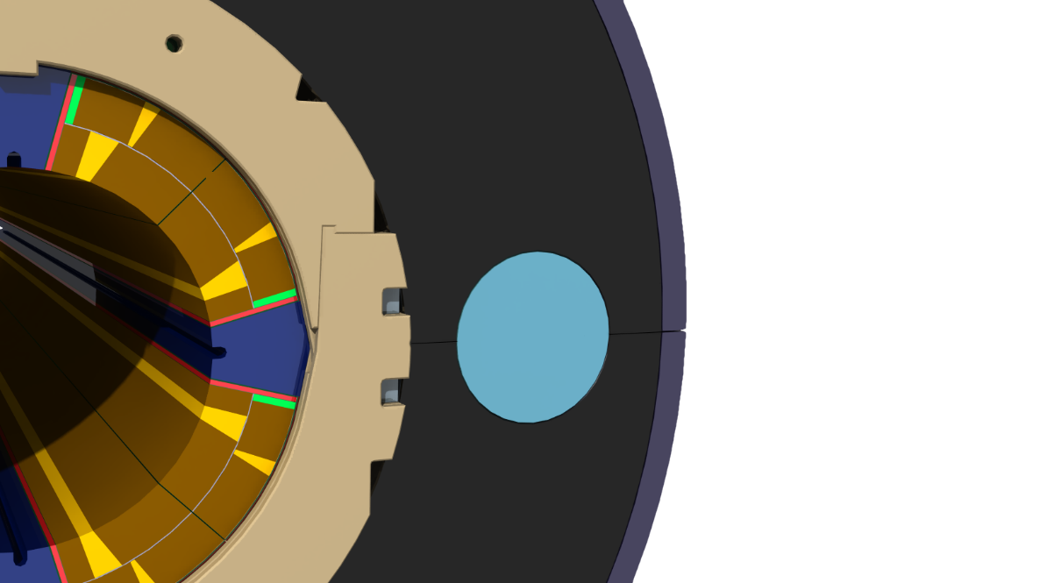
Yoke & Shell
Aluminum Bars
Φ 600
0.05 mm
0 mm
Horizontal split
Yoke Gap behavior:
@ RT, Yoke welding Open The Al-bars act as gap controllers. Coil is protected from over-compression.
@ CT Closed The Al-bars shrink away from the iron. Rigid envelope around the collared coil.
@ 140 T/m & 155 T/m Closed Rigid structure to sustain the magnetic forces and avoid coil deformation. Good field quality.
Haris Kokkinos
www.feacomp.com
Notes:
The laminated iron yoke, with an outer diameter of 600 mm, is made of two halves with a horizontal split
The yoke mid-plane is tapered such that with the contact on the inner radius the outer radius has a 0.05 mm gap in the free state
In single aperture quadrupoles operating at superfluid helium one or two heat exchanger tubes typically run through the yoke. For symmetry reason additional two holes are added in the yoke laminations and can be used for mechanical purposes by inserting Al-bars. By appropriate dimensioning, the differential thermal contraction of the yoke, the collared coil and the Al-bars shall be accounted for such that the yoke gap is closed at cryogenic temperature and contact at the collar-yoke interface is preserved. This requires the yoke gap to remain slightly open at ambient temperature.
An open gap is very difficult to accurately control during the yoke assembly in the powerful welding press and it is better to press against a known reference plane.
The Al-bars act as gap controller allowing an accurate adjustment of the yoke gap during the assembly phase and protecting the coil from over-compression.
During the cool down the gap controller then shrinks away from the iron allowing the closure of the gap and hence ensuring static and rigid envelope around the collared coil.
At cryogenic temperature, the yoke gap shall remain closed. This creates a very rigid structure to sustain the magnetic forces and to avoid coil deformation that can have deleterious effect on quench performance and field quality.

Slide 9
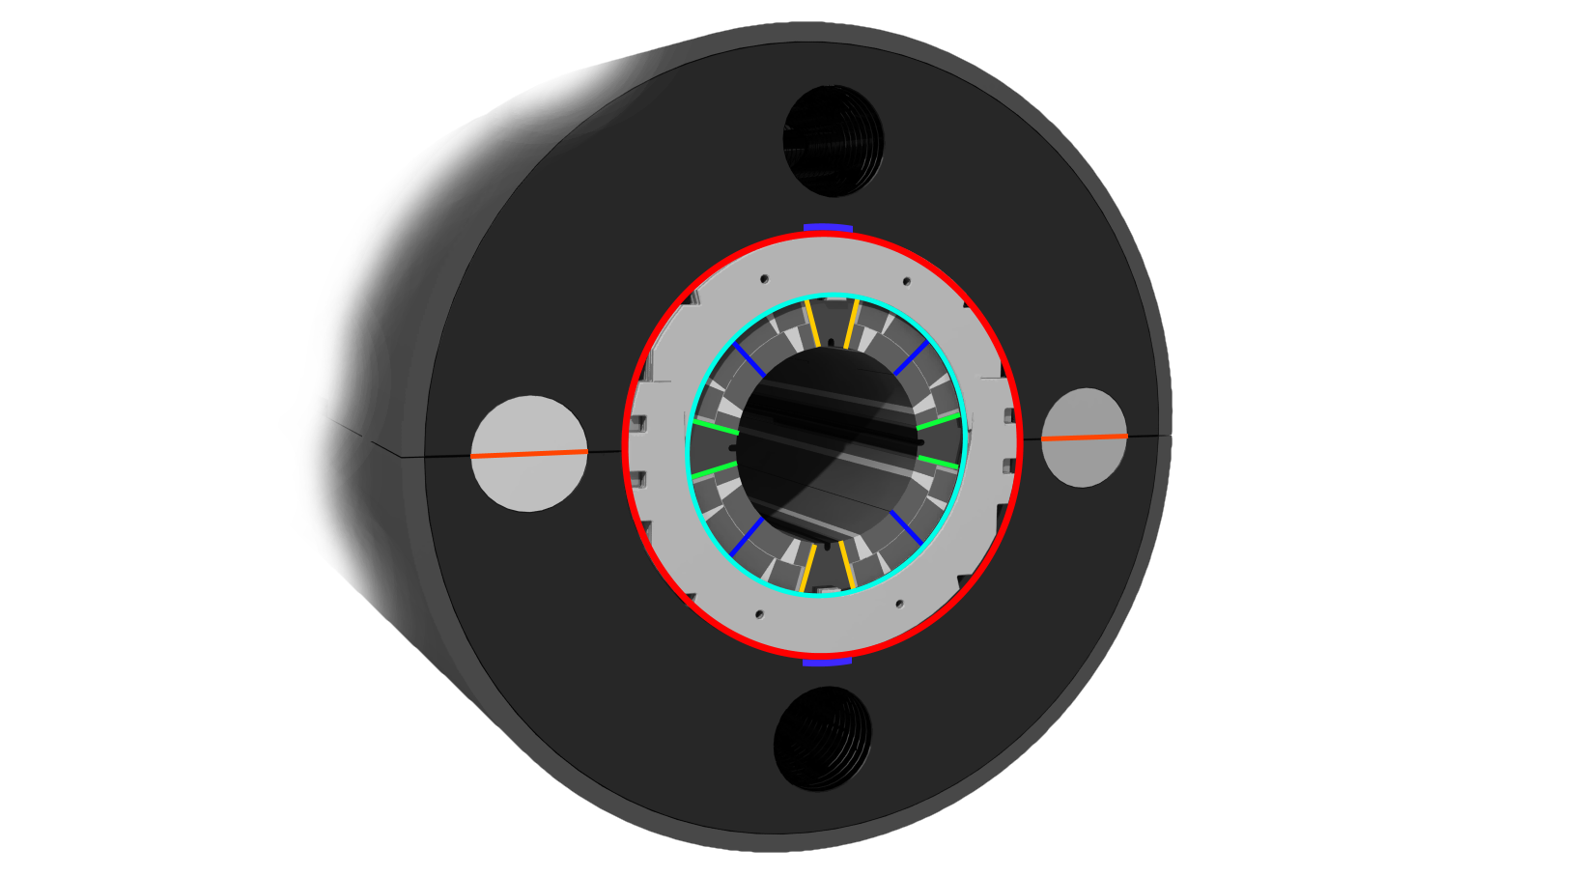
Shim Locations
Collar-Yoke radial shim
Collar-Yoke radial shim (vertical plane)
Coil-Collar radial Shim
Mid-plane shim
Vertical Pole shim
Horizontal Pole shim
Al-bars shim
Haris Kokkinos
www.feacomp.com
Notes:
The pole-loading concept allows the tailoring of the coil pre-compression to counter-balance the effects of the electromagnetic forces and to minimize the stress gradients across the brittle Nb₃Sn coils. The experience with the 11 T model magnets has also proven the compensation of the dimensional distortions (up to several tenths of mm) of the coils by shimming. The shim locations considered in this study are shown in this figure.
The pole and mid-plane shims are primarily used for the adjustment of the pre-stress and the radial shim between the collar and the coils can be used to compensate for the dimensional differences of the coils. In addition, the adjustment shim between the pole wedge and the collar can be used at the model phase to adjust the pre-loading by adjusting the radial position of the wedge relative to the coil without taking the coil assembly apart. These shims would not be used once a good dimensional reproducibility of the coils has been reached. There is a shim between the collared coil and the yoke that provides positive and negative adjustment of this interface. The contact area can also be limited to cover only part of the circumference, if necessary.

Slide 10
Design Goals
The coils shall be solidly clamped to minimize any dimensional distortions and conductor movements. The maximum value for the acceptable coil stress shall be below 165 MPa at all times.
The stress gradients in the coil shall be low. The distortions form the quadrupole symmetry shall be minimized.
The collaring press shall provide the necessary vertical displacement to allow the insertion of the tapered keys into the keyways.
The Al-bars determine the yoke gap during the assembly phase. The yoke gap shall close during the cool down and remain firmly closed up to the ultimate design gradient of 155 T/m.
Weld shrinkage of up to 1mm can be obtained with present welding techniques and the stainless steel outer shell tension shall be kept below 230 - 250 MPa at the ambient temperature.
At the pole regions the Lorentz forces are unloading the coil from the poles. Contrary to the coils with integrated poles, the pole-loading concept is not expected to show degradation even in the case of complete unloading, as the pole is not bonded to the coils. For modeling reasons, however, for this FEA the maximum allowed tensile stress at the pole turns was set to 10 MPa
Haris Kokkinos
www.feacomp.com
Notes:
The design goals of MKQXF are summarized here:
The coils shall be solidly clamped to minimize any dimensional distortions and conductor movements. The maximum value for the acceptable coil stress is still a subject of debate in the magnet community, but keeping it below 165 MPa at all times is generally considered safe.
The stress distribution and deformation of the coils shall be symmetric, minimizing the stress gradients especially at the pole regions. The distortions form the quadrupole symmetry shall be minimized.
During collaring, the press shall provide the necessary vertical displacement to allow the insertion of the tapered keys into the keyways. The collars are dimensioned to provide most of the coil pre-stress in a well-controlled fashion during collaring with minimum spring-back and elliptical deformation.
The Al-bars inserted in the mid-plane holes determine the yoke gap during the assembly phase and after the welding of the outer shell. The yoke gap shall close during the cool down and remain firmly closed up to the ultimate design gradient of 155 T/m.
Weld shrinkage of up to 1mm can be obtained with present welding techniques and the stainless steel outer shell tension shall be kept below 230 - 250 MPa at the ambient temperature, depending on the steel grade.
At the pole regions the Lorentz forces are unloading the coil from the poles. Contrary to the coils with integrated poles, the pole-loading concept is not expected to show degradation even in the case of complete unloading, as the pole is not bonded to the coils. For modeling reasons, however, for this FEA the maximum allowed tensile stress at the pole turns was set to 10 MPa.

Slide 11
Magnetic Analysis
Haris Kokkinos
www.feacomp.com
Notes:
The electromagnetic model was analyzed in MAXWELL, to transfer the electromagnetic forces to the structural analysis model. The distribution and magnitude of the magnetic field was in very good agreement with ROXIE results.

Slide 12
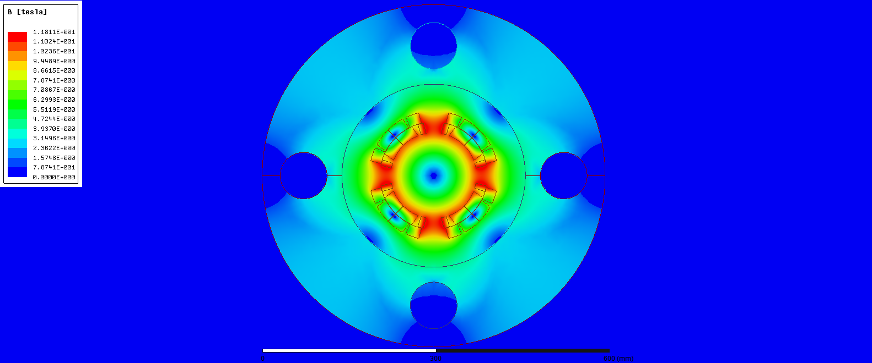
Magnetic Analysis
@ 17.3 kA 11.81 T, 140 T/m
Haris Kokkinos
www.feacomp.com
Notes:
At 17.3 kA the coil peak field is 11.82 T corresponding to a gradient of 140 T/m (nominal design gradient)

Slide 13
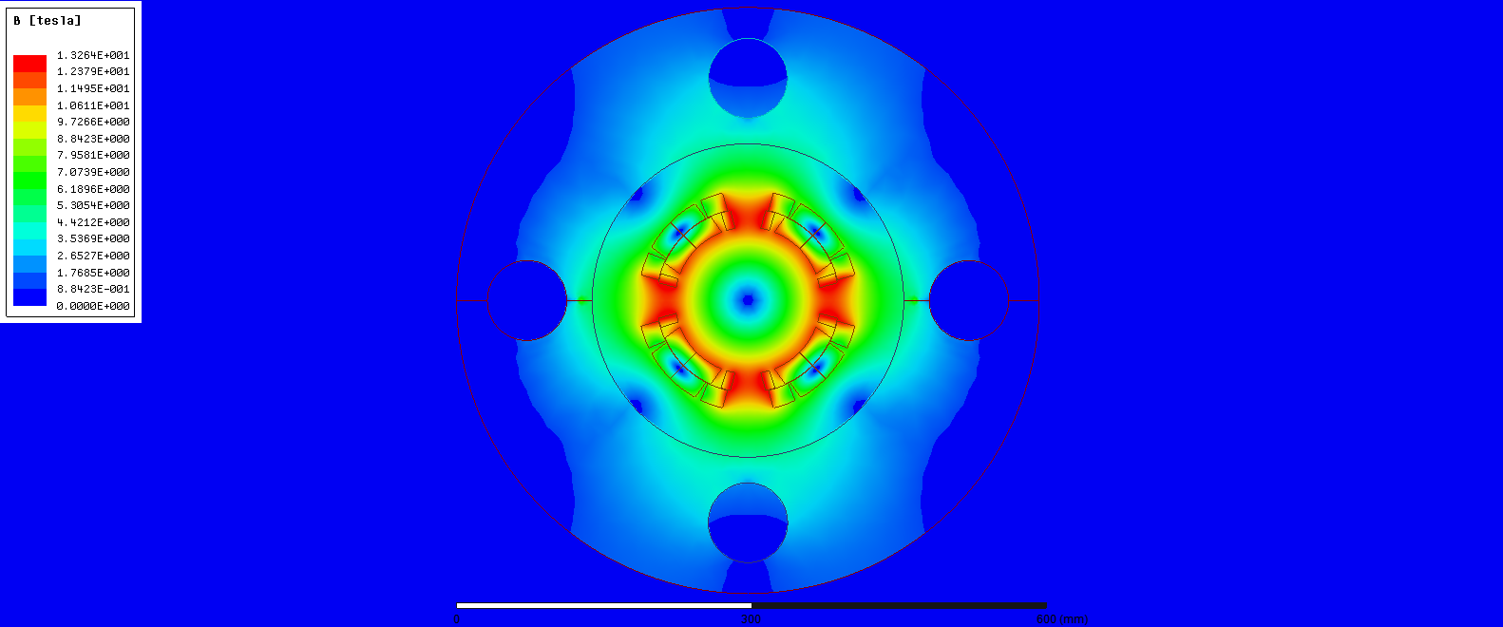
@ 19.25 kA 13.26 T, 155 T/m
Haris Kokkinos
www.feacomp.com
Notes:
At 19.25 kA the coil peak field is 13T corresponding to a gradient of 155 T/m (ultimate design gradient)

Slide 14
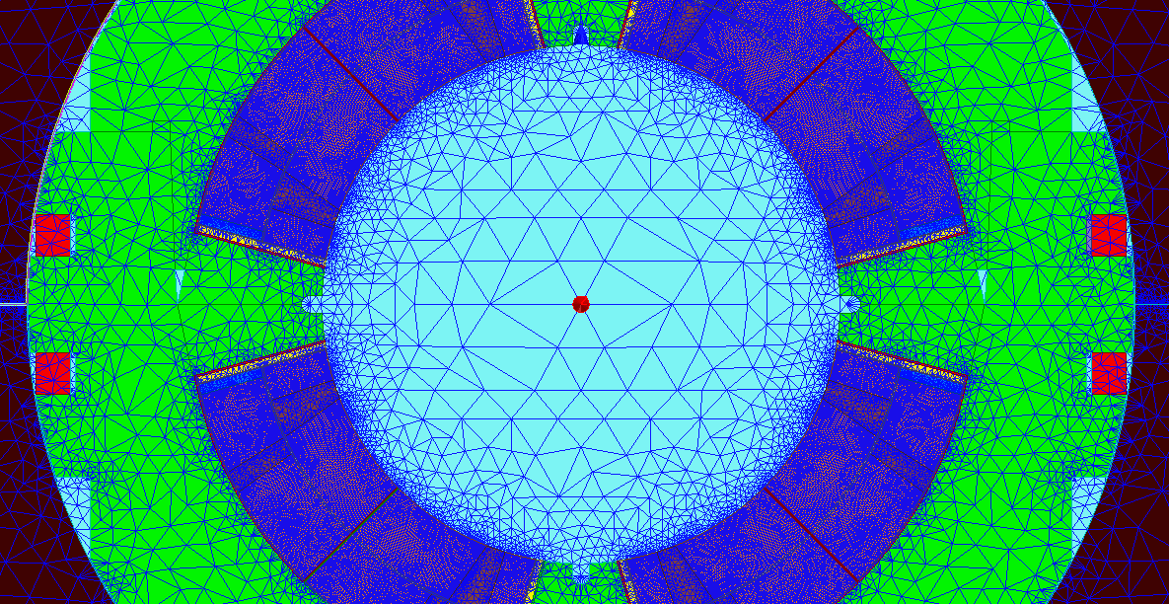
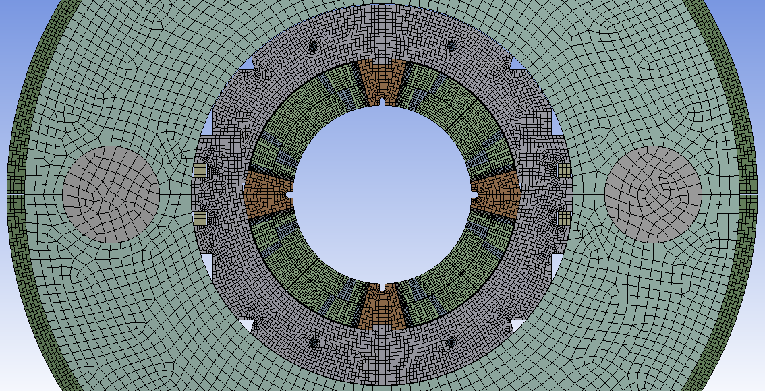
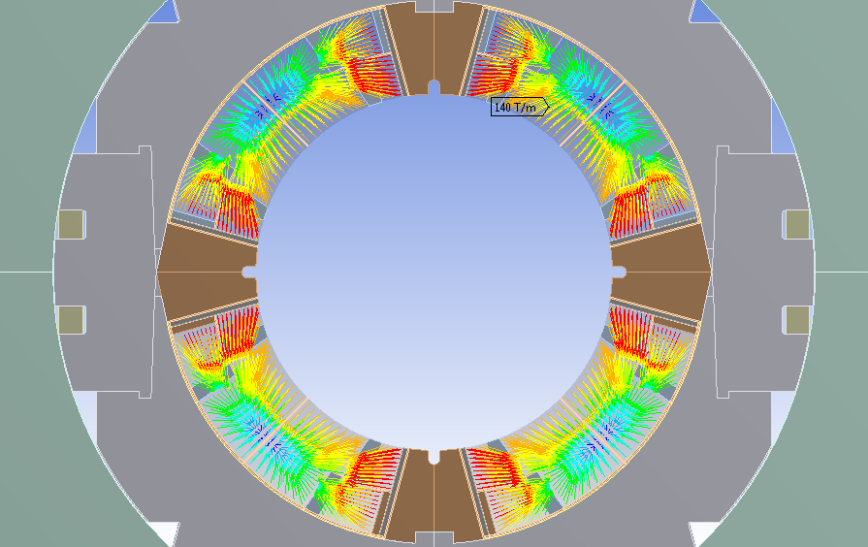
Lorentz Forces
Magnetic Mesh
Structural Mesh
Mapped Forces
Haris Kokkinos
www.feacomp.com
Notes:
The electromagnetic forces were transferred using the ANSYS Workbench environment and all nodes from the MAXWELL model were mapped on the structural mesh.

Slide 15
Structural Analysis
Haris Kokkinos
www.feacomp.com

Slide 16
Material Properties
Magnetic Steel (7) - Yoke
E(293K) = 210 GPa E(4.2K) = 225 GPa
Prxy(293K) = 0.3 Prxy(4.2K) = 0.3
α= 6.894e-06
St. Steel - Loading Plates
E(293K) = 193 GPa E(4.2K) = 210 GPa
Prxy(293K) = 0.28 Prxy(4.2K) = 0.28
α= 9.83e-06
St. Steel - Collars
E(293K) = 195 GPa E(4.2K) = 215 GPa
Prxy(293K) = 0.3 Prxy(4.2K) = 0.3
α= 9.215e-6
Aluminium Bronze - Wedges
E(293K) = 110 GPa E(4.2K) = 120 GPa
Prxy(293K) = 0.3 Prxy(4.2K) = 0.3
αx= 1.08e-5
St. Steel (6) - Keys
E(293K) = 190 GPa E(4.2K) = 210 GPa
Prxy(293K) = 0.3 Prxy(4.2K) = 0.3
α= 9.01e-06
Aluminium (55) - Bars
E(293K) = 70 GPa E(4.2K) = 79 GPa
Prxy(293K) = 0.34 Prxy(4.2K) = 0.34
αx= 1.45e-5
G10 - Insulation
E(293K) = 30 GPa E(4.2K) = 30 GPa
Prxy(293K) = 0.3 Prxy(4.2K) = 0.3
αx= 2,44e-5
St. Steel – Collaring Shoe
E(293K) = 195 GPa E(4.2K) = 215 GPa
Prxy(293K) = 0.3 Prxy(4.2K) = 0.3
α= 9.215e-06
St. Steel (10) - Shell
E(293K) = 195 GPa E(4.2K) = 215 GPa
Prxy(293K) = 0.3 Prxy(4.2K) = 0.3
α= 9.897e-06
Coil
Ex(293K) = 52 GPa Ex(4.2K) = 52 GPa
Ey(293K) = 44 Gpa Ey(4.2K) = 44 GPa
Gxy(293K) = 21 Gpa Gxy(4.2K) = 21 GPa
Prxy(293K) = 0.3 Prxy(4.2K) = 0.3
αy= 1.16e-5
αx= 1.07e-5
St. Steel (11) - Pins
E(293K) = 195 GPa E(4.2K) = 215 GPa
Prxy(293K) = 0.3 Prxy(4.2K) = 0.3
α= 9.897e-06
Titanium– PoleWedge
E(293K) = 130 GPa E(4.2K) = 130 GPa
Prxy(293K) = 0.3 Prxy(4.2K) = 0.3
α= 6.03e-06
Haris Kokkinos
www.feacomp.com
Notes:
The coil material properties used in MKQXF are identical to the ones used in the QXF model, and the 11T Dipole model regarding the rest mechanical structure.
All parts have been modeled with isotropic properties except for the winding blocks of the coil which are modeled with anisotropic material properties

Slide 17
Load Steps
Under collaring press
Collared coil
Yoke assembly
@293 K
@4.2 K
@4.2 K,
140 T/m
@4.2 K,
155 T/m
Haris Kokkinos
www.feacomp.com
Notes:
Six load-steps were considered in the Finite Element Analysis (FEA):
Under collaring press with key-ways aligned to insert the keys.
Collared coil.
Yoke assembly at 293 K.
At 4.2 K.
At 4.2 K, 140 T/m.
At 4.2 K, 155 T/m.

Slide 18
Results
Haris Kokkinos
www.feacomp.com

Slide 19
Assembly parameters used for the results presented below:
Interface | Direction | Thickness [mm]
Vertical Poles – Loading Plate | Azimuthal | 0.22
Horizontal Poles – Loading Plate | Azimuthal | 0.15
Mid-plane | Azimuthal | 0.28
Collars - Yoke | Radial | 0.38
Collars - Yoke (Vertical Plane) | Radial | 0.41
Weld Shrinkage | Vertical | 0.96
Haris Kokkinos
www.feacomp.com
Notes:
The design study converged to the shim thicknesses listed in this table.
These assembly parameters ensure that the design goals, that I mentioned above, are met at all times.

Slide 20
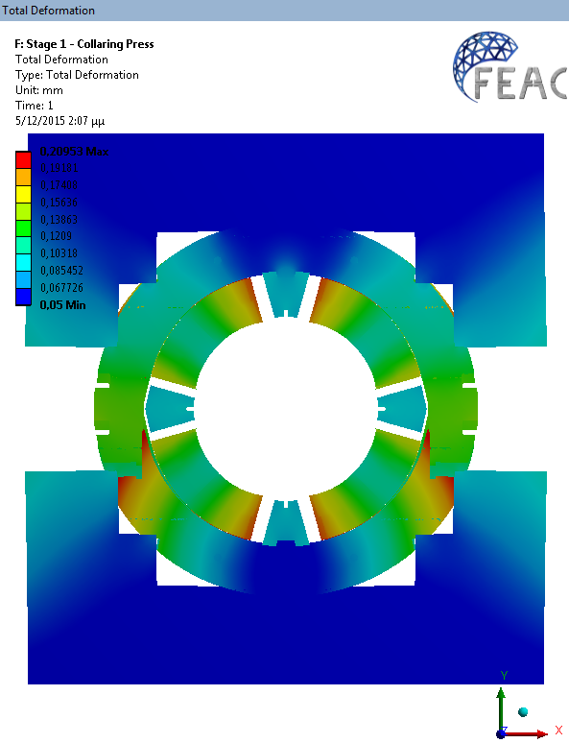
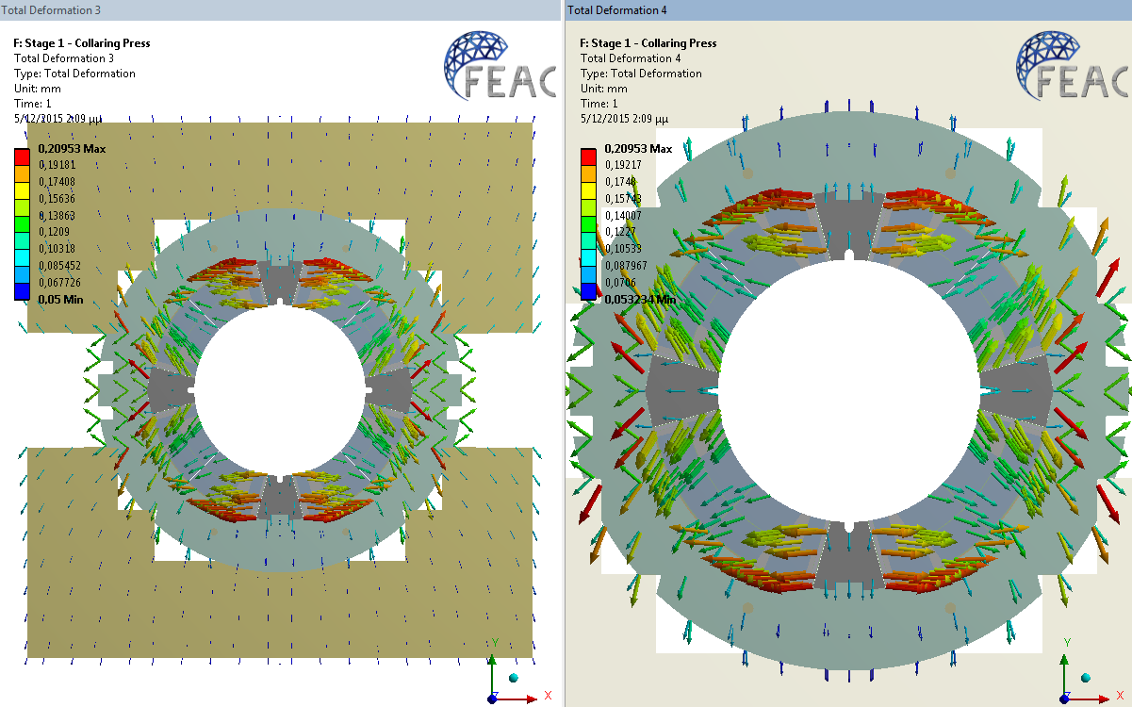
Deformation
x50
Under Press, @ 293 K
Haris Kokkinos
www.feacomp.com

Slide 21
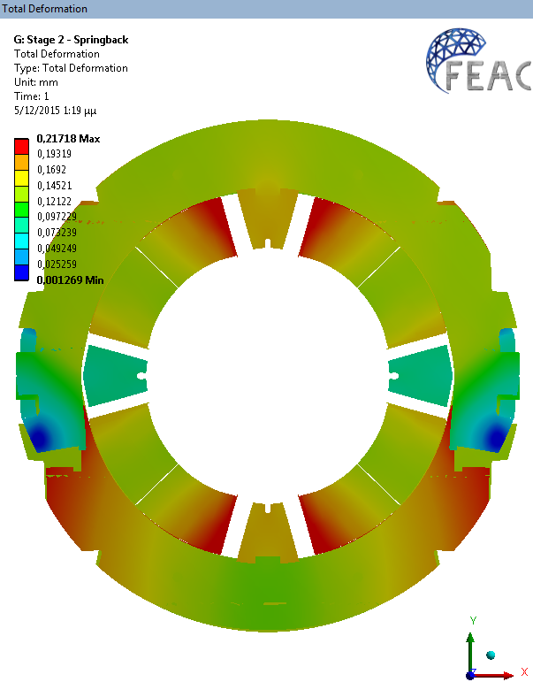
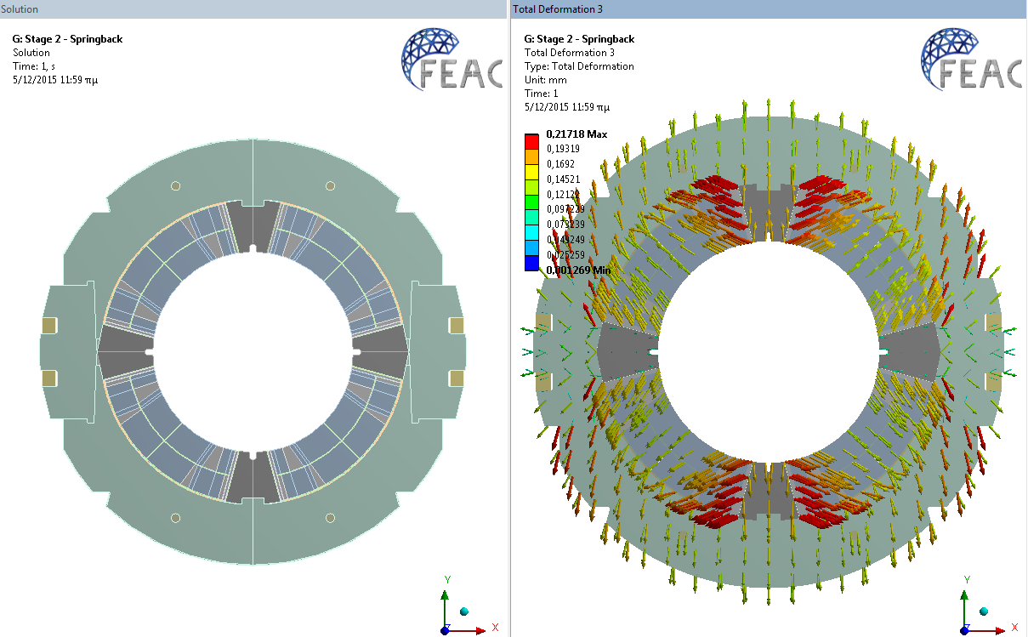
Deformation
x50
After Collaring, @ 293 K
Haris Kokkinos
www.feacomp.com

Slide 22
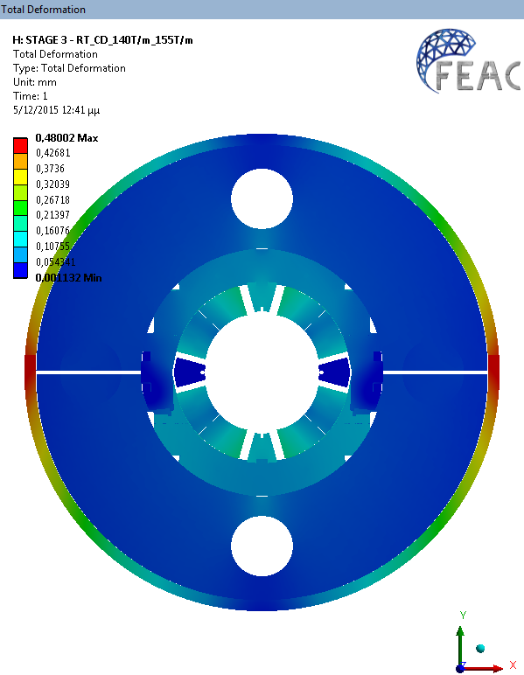
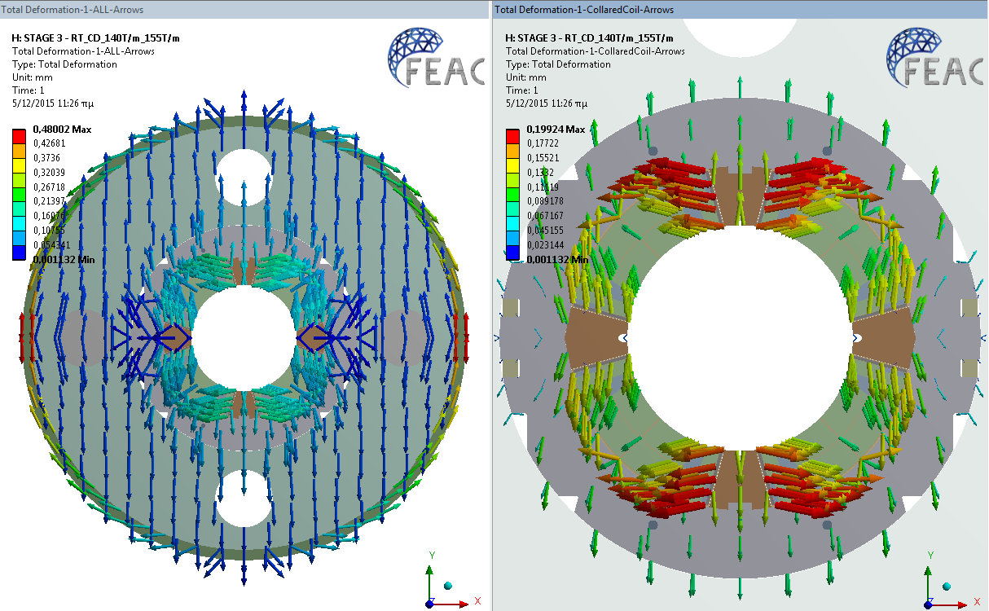
Deformation
x50
After Shell Welding, @ 293 K
Shell shrinks around the yoke and compresses the system. The Al-Bars control the assembly.
Haris Kokkinos
www.feacomp.com

Slide 23
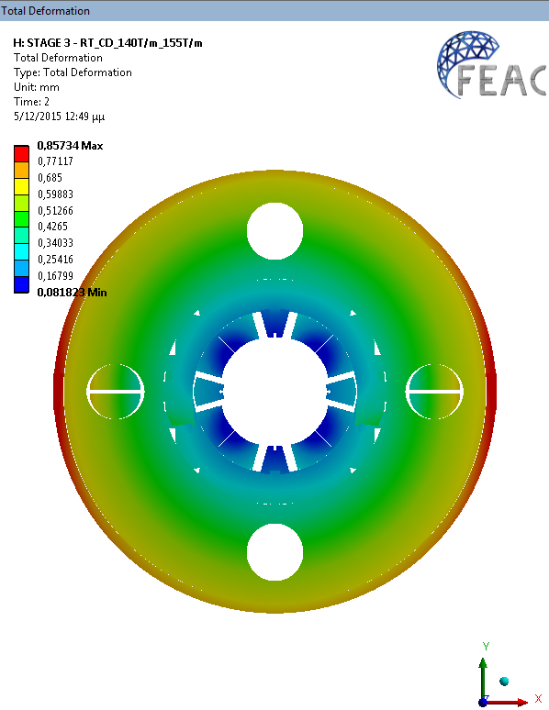
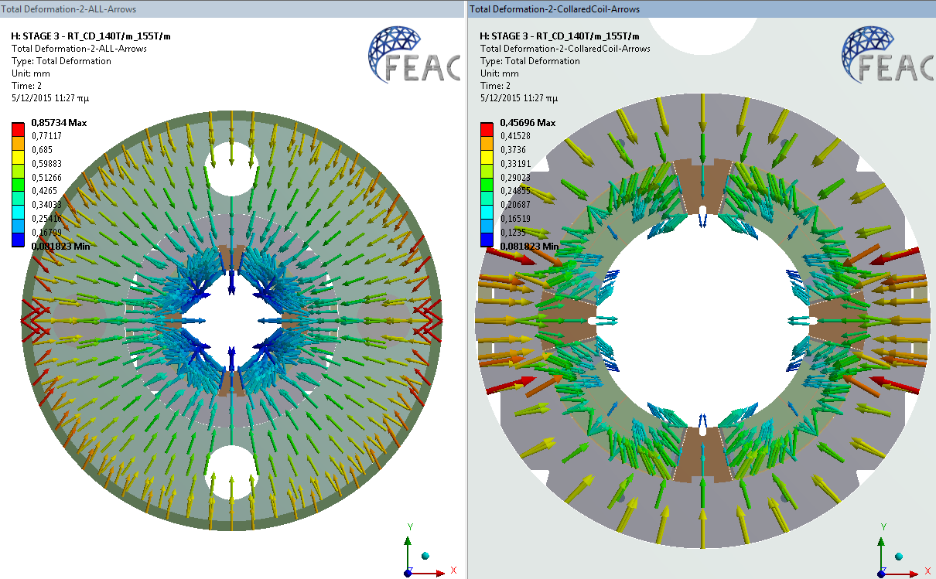
Deformation
x50
@ 4.2 K
Skin shrinks more then the yoke. Skin tension increases. The yoke gap is firmly closed.
Haris Kokkinos
www.feacomp.com

Slide 24
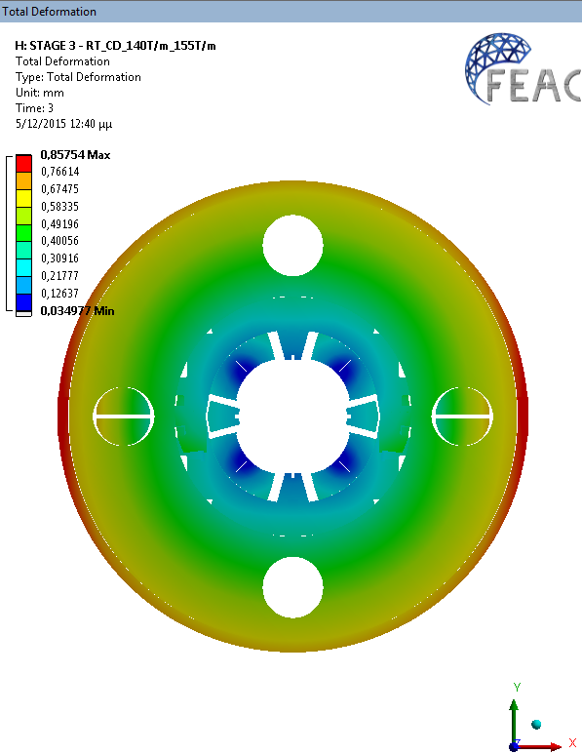
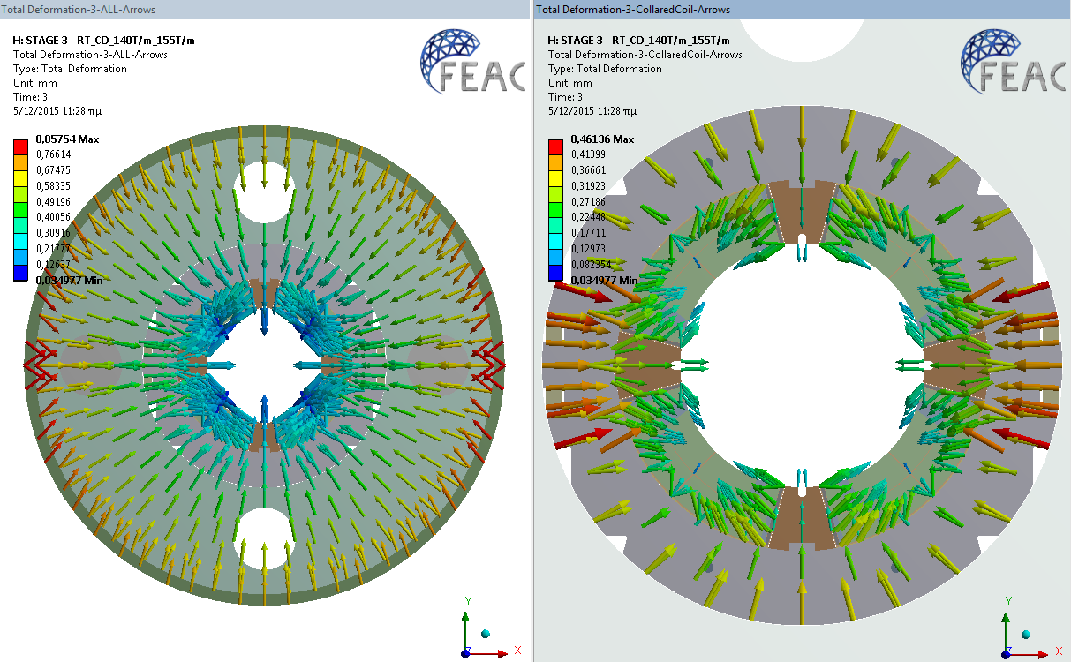
Deformation
x50
@ 4.2 K, 140 T/m
Haris Kokkinos
www.feacomp.com

Slide 25
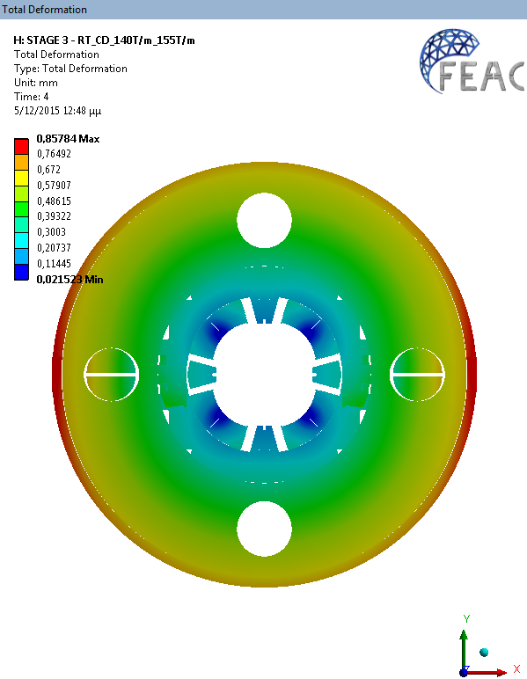
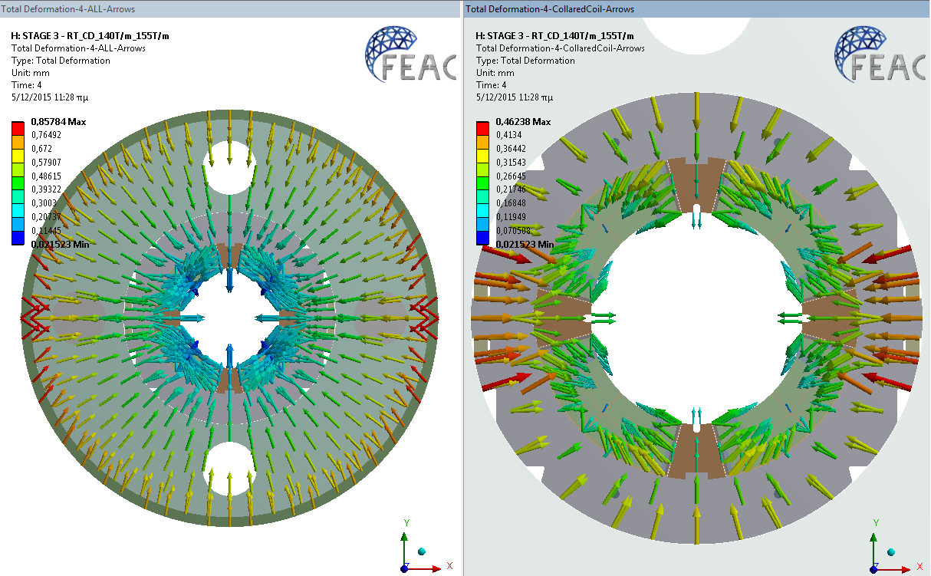
Deformation
x50
@ 4.2 K, 155 T/m
Haris Kokkinos
www.feacomp.com

Slide 26
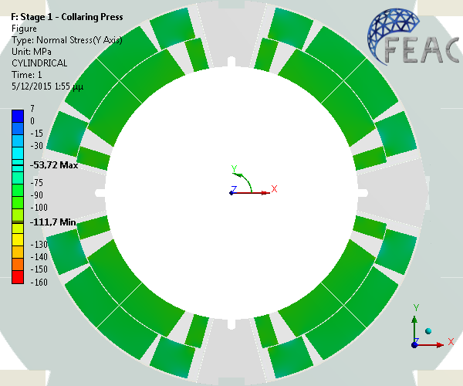
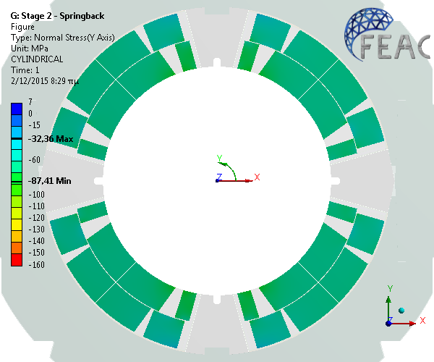

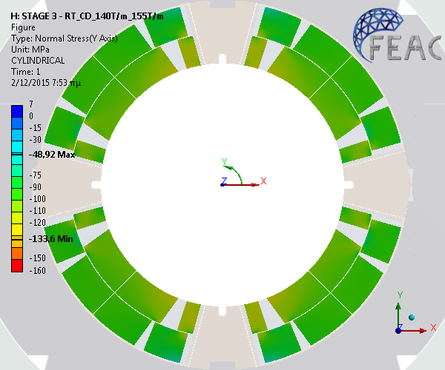
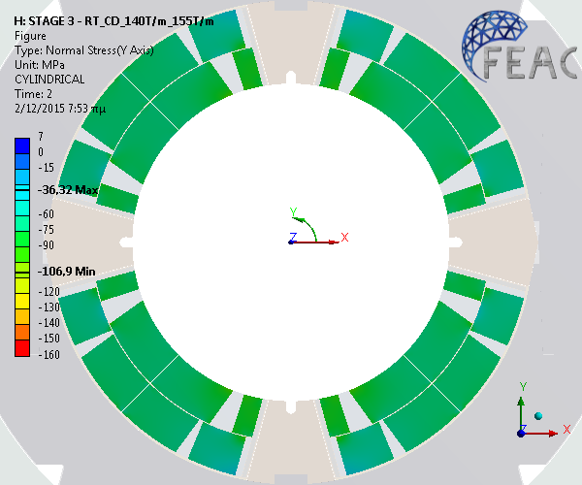
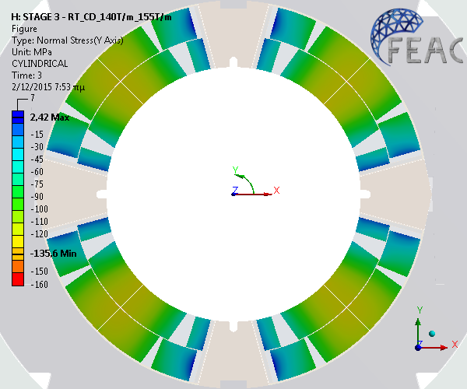
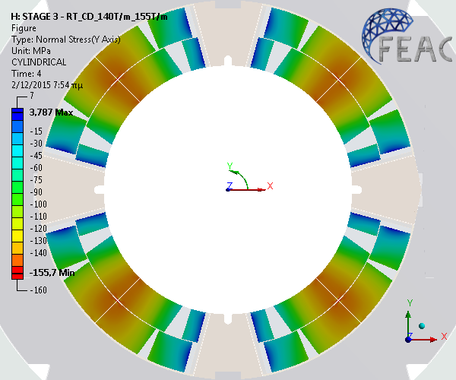
Azimuthal Stress
Coil
Under Press, @ 293 K
After Collaring, @ 293 K
After Shell Welding, @ 293 K
@ 4.2 K
@ 4.2 K, 140 T/m
@ 4.2 K, 155 T/m
Haris Kokkinos
www.feacomp.com
Notes:
The azimuthal coil stress evolution for the six load steps is presented in this plot.
Under the collaring press, the peak stress is about -112 MPa in the inner layer, near the vertical pole wedge.
After releasing the press, the spring back and stress re-distribution reduces the coil stress by about 25 MPa.The yoke assembly increases the coil compression by about 50 MPa.
During cool down to 4.2K, the collared coil contracts more than the yoke and the pre-compression is reduced by about 30 MPa.
At 140 T/m & 155 T/m the very rigid structure keeps the stress distribution very uniform, inside the safe stress levels.
At 155 T/m the coil stress at the poles is 4 MPa in tension. At the coil mid-plane, the maximum stress on the inner layer ranges from -136 to -156MPa at 155 T/m.

Slide 27
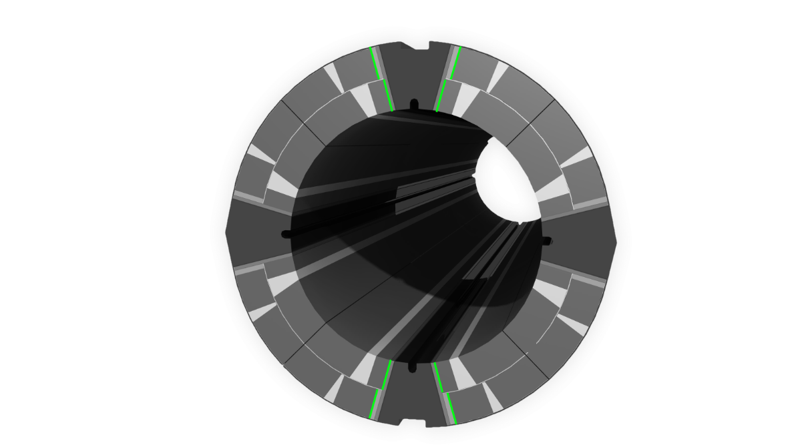
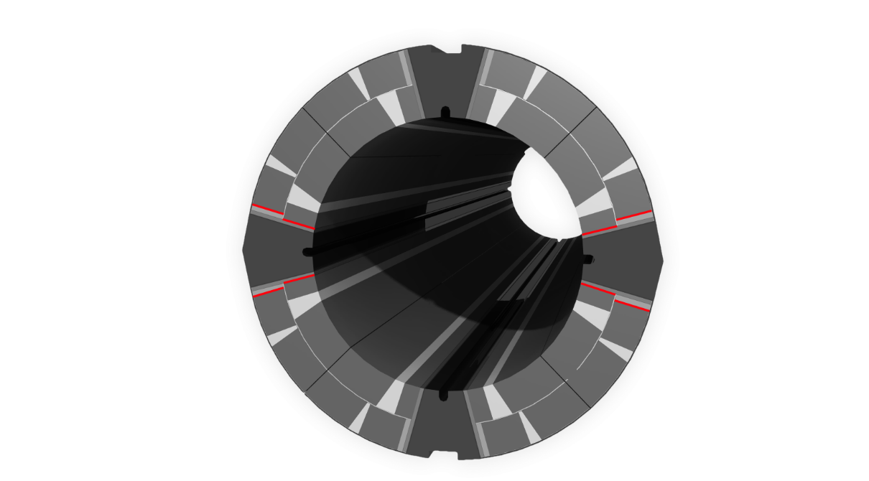
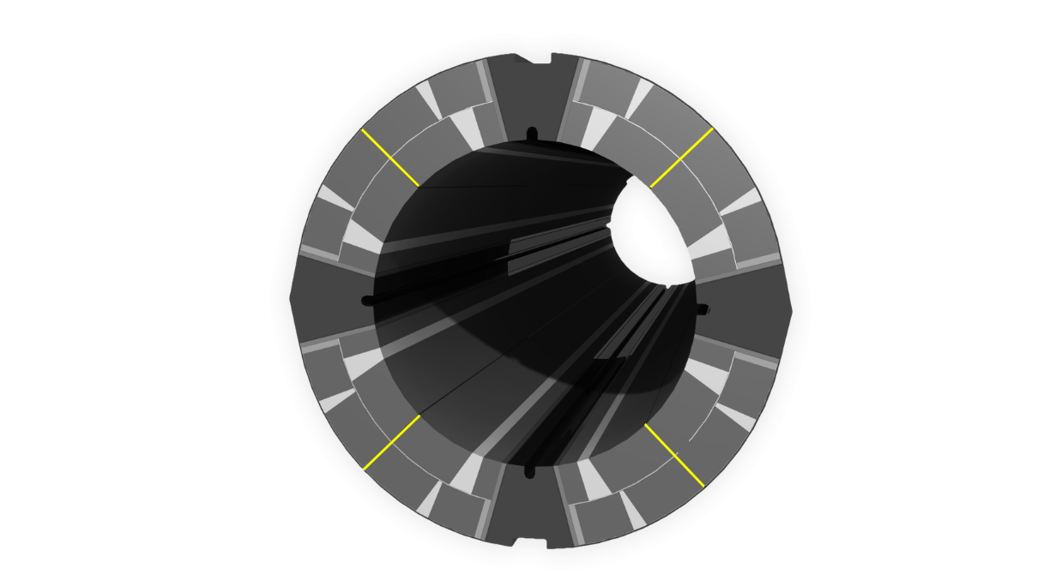
Azimuthal Stresses
Coil
Haris Kokkinos
www.feacomp.com
Notes:
These figures illustrate the azimuthal coil stress evolution for the six load steps.
After collaring and after shell welding, the stress at the horizontal and vertical pole has a maximum difference of about 10 MPa. As the yoke gap is slightly open at RT, there is still a slight asymmetry in the stress distribution of the coils.
After the cool down, the yoke gap is firmly closed. The stress distribution between the vertical and horizontal pole is symmetric. The poles have highest and the mid-plane lowest pressure to counter-balance the Lorentz forces.

Slide 28
Radial Deformation
Coil
Vertical Pole turn
Mid-turn
Horizontal Pole turn
Haris Kokkinos
www.feacomp.com
Notes:
The design goal is to achieve a symmetric deformation of the vertical and the horizontal pole turns during cool down, to prevent any distortions from quadrupole symmetry.
This Figure shows the radial deformation of the coil.
Under press the coil assembly deforms elliptically outwards along the horizontal axis,
while after spring back the elliptic deformation is along the vertical axis.
After the yoke assembly the yoke gap is slightly open and determined by the Al-bars. The additional radial shim pushes the collared coil on the vertical axis and hence some elliptic deformation is visible in the coils.
During cool down the yoke gap is firmly closed restoring the circular symmetry of the coil assembly.

Slide 29
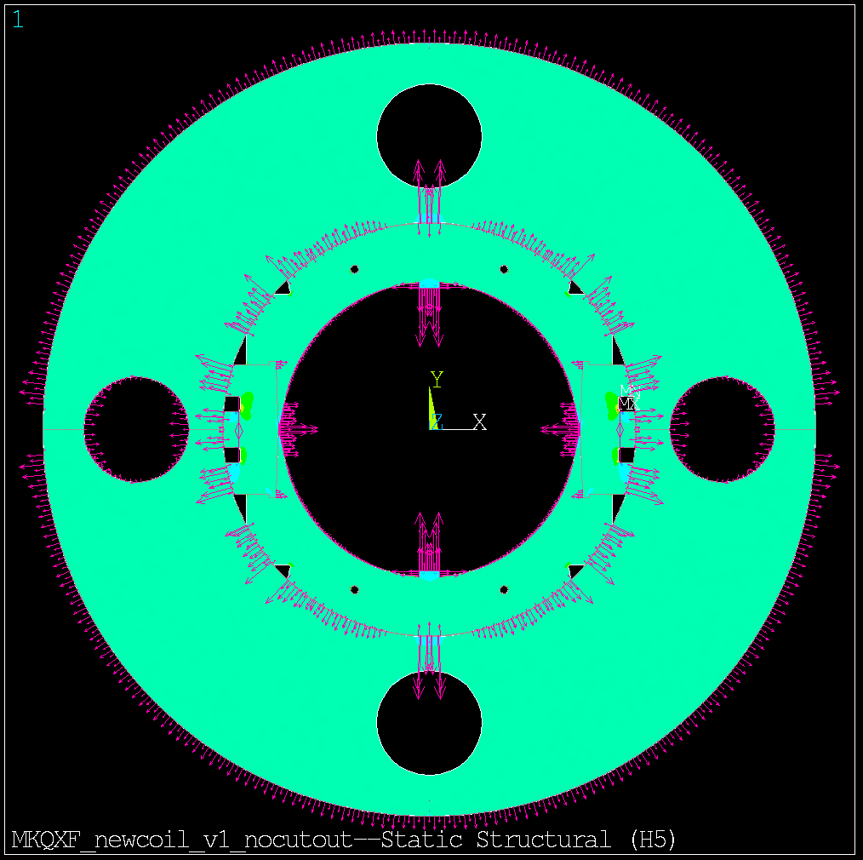
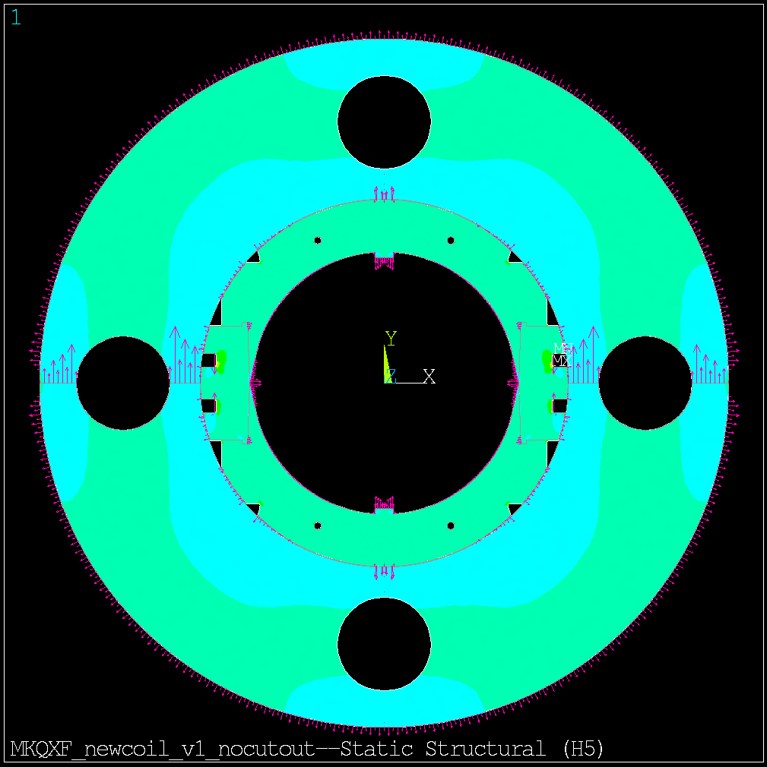
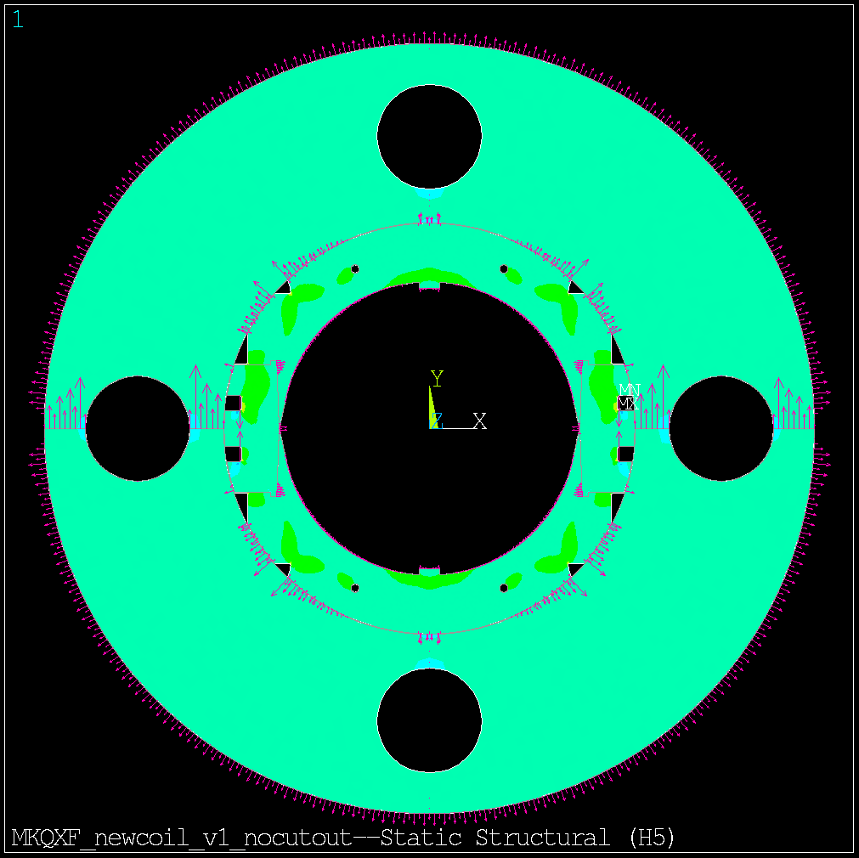
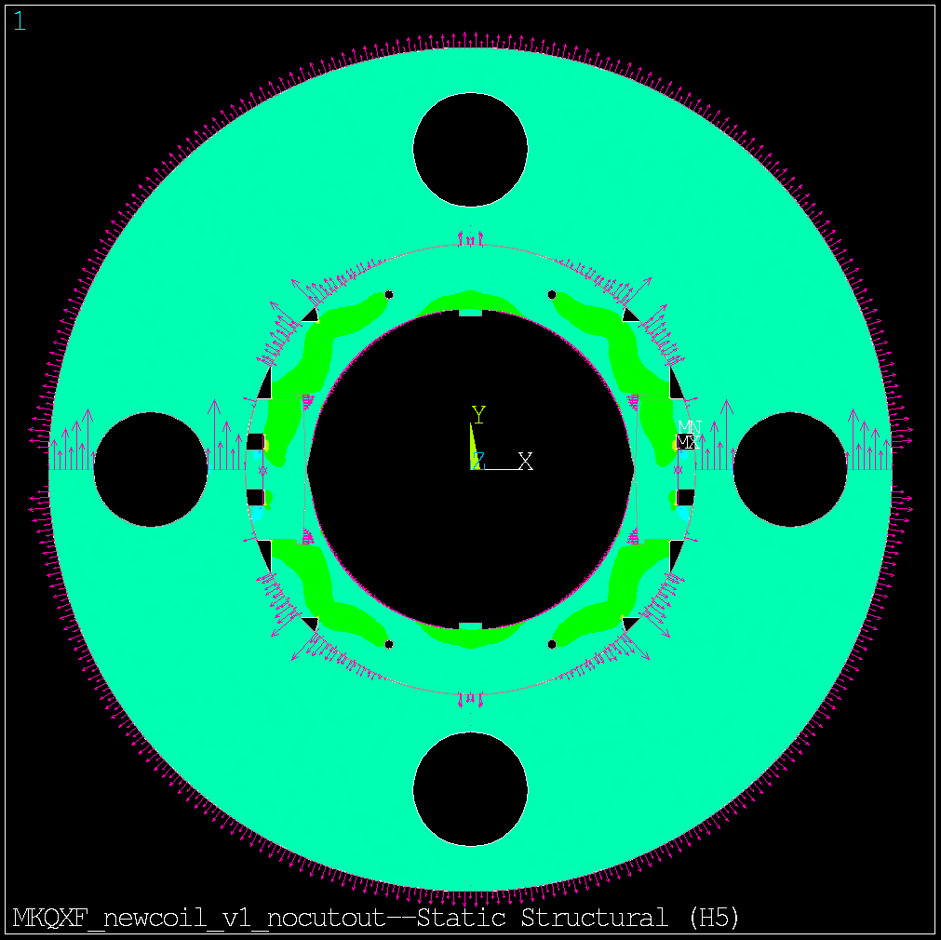
Reaction Forces
Collar-Yoke
After Shell Welding, @ 293 K
@ 4.2 K
@ 4.2 K, 140 T/m
@ 4.2 K, 155 T/m
Haris Kokkinos
www.feacomp.com
Notes:
The reaction forces help understanding the interaction between parts and the pressure applied at their interfaces.
The contact area and contact pressure of the key radial interfaces are presented in these figures. The relative magnitude of the reaction is given by the arrow length.

Slide 30
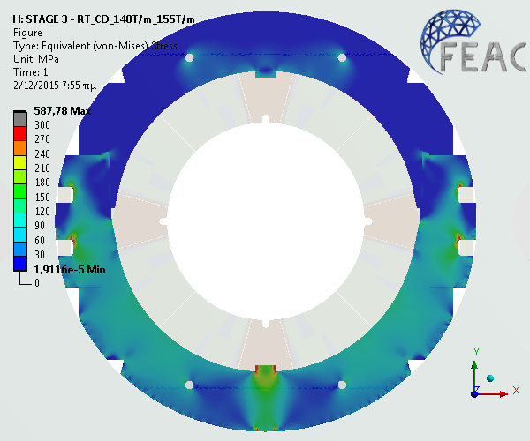
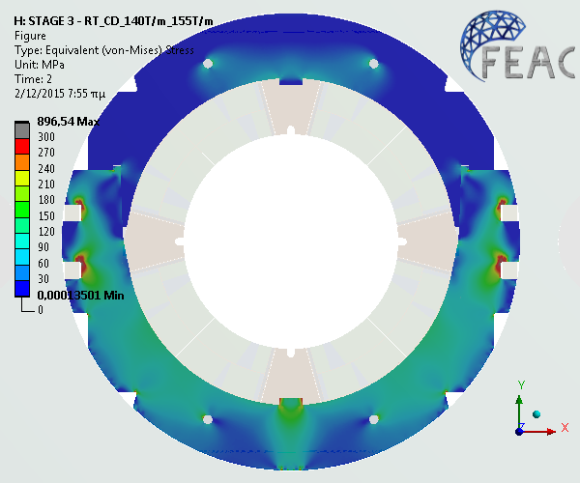
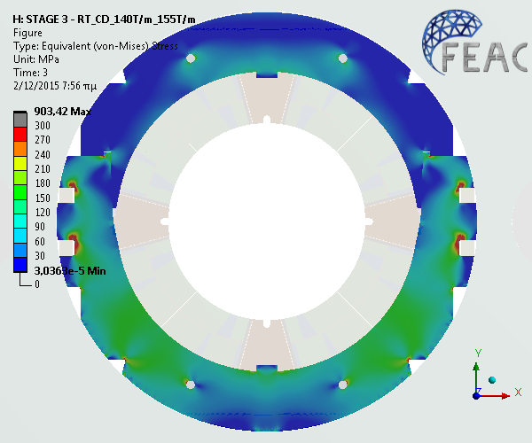

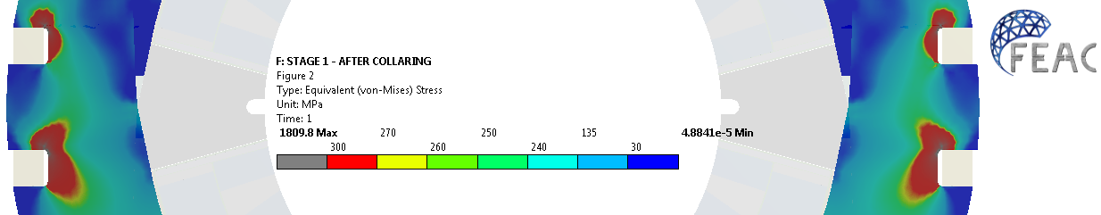
Von-Mises Stress
Collars
After Shell Welding, @ 293 K
@ 4.2 K
@ 4.2 K, 140 T/m
@ 4.2 K, 155 T/m
The areas with stress over 300 Mpa are indicated in grey colour and these are the areas around the keys that typically plastify during the assembly process.
Haris Kokkinos
www.feacomp.com
Notes:
The areas around the keys indicated in grey colour typically plastify due to the stress concentration. Except for these areas, the stress level in the collars stay well within the elastic zone at all time.

Slide 31
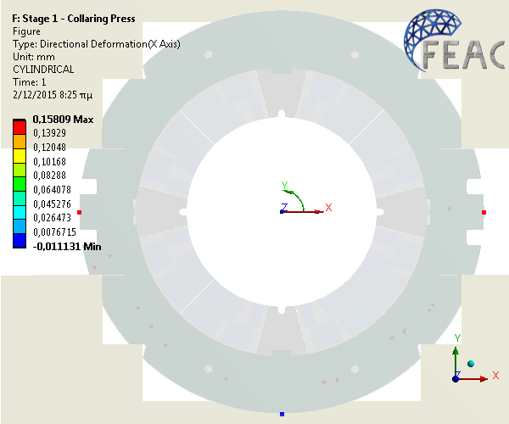





Deformation
Collars
Under Press, @ 293 K
After Collaring, @ 293 K
After Shell Welding, @ 293 K
@ 4.2 K
@ 4.2 K, 140 T/m
@ 4.2 K, 155 T/m
Haris Kokkinos
www.feacomp.com
Notes:
In this plot one can see the evolution of the radial displacement of the collar outer radius along the horizontal and vertical axis relative to the nominal (free) dimensions.
At the ambient temperature one can observe the slightly ovalised shape along the vertical axis.
After cool down the circular symmetry is restored
During powering the horizontal split yoke provides rigid support for the collared coil.

Slide 32




Von-Mises Stress
Yoke
After Shell Welding, @ 293 K
@ 4.2 K
@ 4.2 K, 140 T/m
@ 4.2 K, 155 T/m
Haris Kokkinos
www.feacomp.com
Notes:
The general rigidity of the yoke laminations is reduced by the heat exchanger holes and the horizontal split plane.
During the yoke assembly the interference between the collared coil and the yoke around the vertical axis induce slight bending of the yoke lamination around the collared coil. To compensate for this and to store the strain energy in the yoke we have introduced the additional radial shim at the collar-yoke interface in the region of the vertical axis and there is the slight taper at the mid-plane.

Slide 33





Contact Pressure
Half Yokes
Tapered
After Shell Welding, @ 293 K
@ 4.2 K
@ 4.2 K, 140 T/m
@ 4.2 K, 155 T/m
Haris Kokkinos
www.feacomp.com
Notes:
At ambient temperature, the yoke gap is defined by the Al-bars while at cryogenic temperature the gap is firmly closed, starting from the inner diameter towards the outer.
As discussed above, the slight bending of the yoke laminations results in higher contact pressure on the inner side of the Al-bars.
The yoke gap remains closed up to 155 T/m creating a rigid envelope for the collared coil to sustain the very high electromagnetic forces.

Slide 34




Contact Pressure
Gap Controllers
After Shell Welding, @ 293 K
@ 4.2 K
@ 4.2 K, 140 T/m
@ 4.2 K, 155 T/m
Haris Kokkinos
www.feacomp.com
Notes:
The Al-bars control the gap between the two half-yokes at the ambient temperature.
The diameter of the Al-bars is chosen to shrink away from the yoke during cool down due to the differential thermal contraction allowing the closure of the yoke gap.

Slide 35





Azimuthal Stress
Shell
After Shell Welding, @ 293 K
@ 4.2 K
@ 4.2 K, 140 T/m
@ 4.2 K, 155 T/m
Haris Kokkinos
www.feacomp.com
Notes:
The stainless steel outer shell tension shall remain below 250 MPa at ambient temperature.
After the welding process, the peak value of 334 MPa is localized in the welding area while the mean stress in the shell remains below 215 Mpa.

Slide 36


ANSYS 2 ROXIE
Haris Kokkinos
www.feacomp.com

Slide 37


Ansys 2 Roxie
 | 9 T/m | 140 T/m | 155 T/m
b4 | 1.6 | 1.9 | 1.6
b6 | -9.6 | -10.3 | -10.6
b10 | -0.1 | 0.0 | 0.0
Excluding iron saturation, persistent current effect, systematic errors, etc.
Offsets can be compensated by tuning the coil dimensions and shimming
Very small differences from 9 to 155 T/m confirm the very high structural rigidity
Haris Kokkinos
www.feacomp.com

Slide 38
Sensitivity Analysis
Haris Kokkinos
www.feacomp.com

Slide 39

Tolerances
Yoke | ± 3,8 μm
Collar | ± 6,3 μm
Angle of loading plate | ± 0,2°
Coil (outside diameter) | ± 75 μm
Coil (azimuthal length) | ± 50 μm
The sensitivity analysis is conducted by utilizing the DOE method (Design of Experiments) which determines sampling points on a response surface
About 8 input parameters have to be checked
About 100 variations of the model have to be run
Haris Kokkinos
www.feacomp.com

Slide 40



The dimensional tolerances on the coil size play the most important role on the maximum coil stress level
Coil’s azimuthal length:
Δl = 0.1 mm → Δσmax ≈ 25 MPa
Coil’s outer diameter:
Δd = 0.075 mm → Δσmax ≈ 15 MPa
Haris Kokkinos
www.feacomp.com

Slide 41

The dimensional tolerances on the coil size play the most important role on the maximum coil stress level
Haris Kokkinos
www.feacomp.com

Slide 42
Comparison to QXF
Haris Kokkinos
www.feacomp.com

Slide 43


Comparison
Azimuthal Stress
MQXF
MKQXF
P. Ferracin
@ 4.2 K, 140 T/m
@ 4.2 K, 155 T/m

Slide 44


Comparison
Radial Deformation
MQXF
MKQXF
Vertical Pole turn
48 μm
Mid-turn
Inner Layer
P. Ferracin
30 μm
Horizontal Pole turn
Outer Layer

Slide 45
Conclusions
Haris Kokkinos
www.feacomp.com

Slide 46
Conclusions
New mechanical design concept for a Nb3Sn quadrupole, suitable for industrial production
To make a maximum use of existing coil fabrication tooling and infrastructure the demonstrator magnet design is based on the HL-LHC QXF coils that can be used as-is with minor modifications in the fabrication process.
The FEA shows that coil pre-stress can be applied in a well-controlled manner during the collaring and easily tuneable shimming allows the compensation of coil dimensional variations and mechanical tolerances of the magnet components.
To counteract the very large electro-magnetic forces the pole-loading concept provides the “tuning knobs” to tailor the coil pre-stress such that it is the highest at the pole and the lowest at the coil mid-plane at 0-current.
The tapered-shape of the mid-plane poles together with the dipole-type collars makes it possible to carry out the collaring process in a dipole-type press and simultaneously over the entire coil length.
The horizontally split iron yoke with a closed gap at operating temperature up to the ultimate design gradient of 155 T/m provides a very rigid structure around the coils minimizing any conductor movements and distortions from the ideal coil geometry.
The Al-bars control the yoke gap during the assembly phase and limit the stress level in the coils. The stainless steel shell assembly parameters are achievable and the stresses remain at an acceptable level at all times.
The sensitivity analysis shows that the tolerances used in the study, originating from the 11 T dipole experience, create a design space, which is within the acceptable limits for all components. As expected, the dimensional tolerances on the coil size play the most important role on the maximum coil stress level, underlining the need for high precision metrology of the coils to carefully determine the assembly parameters. During the model magnet phase the shims can easily be adjusted to generate the required pre-stress levels and to compensate for the field errors.
Haris Kokkinos
www.feacomp.com

Slide 47
Conclusions
A short demonstrator magnet could be constructed and tested with a very moderate investment in magnet components using the existing QXF coil geometry. The main advantage would be that all existing coil fabrication tooling could be used as such profiting from the QXF conductor and coil development. To make a maximum use of existing coil fabrication tooling and infrastructure the demonstrator magnet design is based on the HL-LHC QXF coils that can be used as-is with minor modifications in the fabrication process.
The parametric CATIA models created as part of this design optimization together with the sensitivity analysis allow very rapid production of the manufacturing drawings of the missing magnet components including the collars, yoke laminations, pole wedges, and the outer shells.
This collared quadrupole concept can easily be extended to any length, and also applied on a 2-in-1 configuration, which opens very interesting prospects for the FCC main quadrupoles.
References
[1]M. Karppinen, “New Mechanical Concept for Nb3Sn Quadrupole”, CERN-ACC-2014-0244.
[2]M. Karppinen et al., “Design of 11T Twin-Aperture Nb3Sn Dipole Demonstrator Magnet for LHC Upgrades”, IEEE Trans. Appl. Supercond., Vol. 22, No. 3, June 2012
[3]M. Juncho, “Support Structure Design of the Nb3Sn Quadrupole for the high Luminosity LHC”, ASC-14, Charlotte, August 2014.
[4]C. Kokkinos et al., "The Short Model Coil (SMC) Nb3Sn Program: FE Analysis with 3D Modeling", IEEE Trans. Appl. Supercond., Vol. 22, No. 3, June 2012.
[5]P. Ferracin, “Mechanical aspects of Nb3Sn magnets for HL-LHC MQXF” presentation, presented in the MSC technical meeting.
Haris Kokkinos
www.feacomp.com

Slide 48







www.feacomp.com

Slide 49
Additional slides
Haris Kokkinos
www.feacomp.com

Slide 50


Contact Tools
Collaring Press
Height of Keyways: 12 mm
Vertical Deformation of Probes (active side of the keyways):
Remaining gap for the tapered keys: 11.84 mm
Upper Collar | Lower Collar
-0,077 | 0,085
Haris Kokkinos

Slide 51

Contact Tools
Yoking Press
Haris Kokkinos

