Slide 1
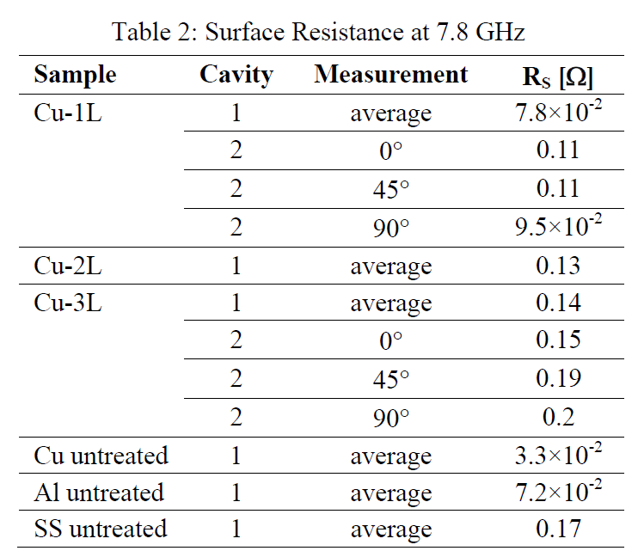
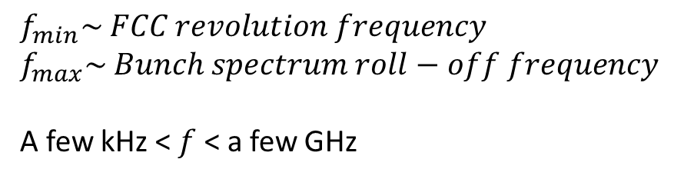
Impedance of a laser-treated beamscreen
$$f_{min}\sim FCC revolution frequency$$
$$f_{max}\sim Bunch spectrum roll−off frequency$$
A few kHz < $f$ < a few GHz
Frequency range of interest:
Measurements: classical wire measurement lacks sensitivity and repeatability.*
Alternatives:
High frequency:
f=multiple GHz
Measuring Q-factor of a sample in a cavity
Low frequency:
f< 1 MHz
Eddy-current testing
Medium frequency
Resonance method with a pipe made of laser treated sheets, several meters long
* Personal communication with F. Caspers

Slide 2
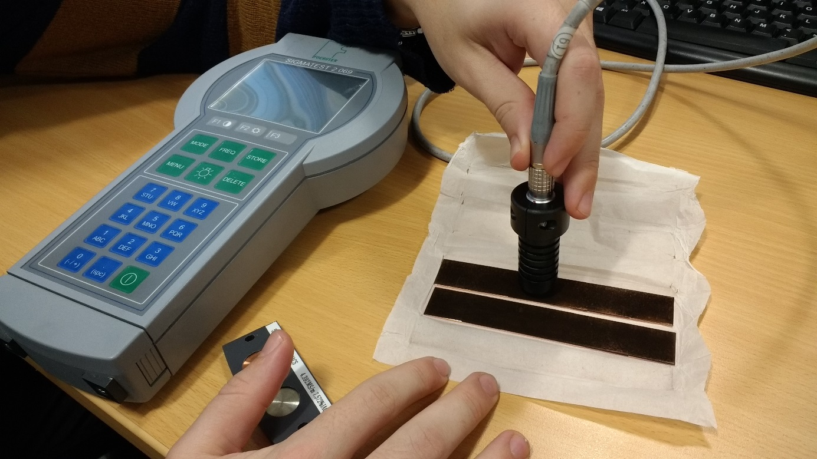
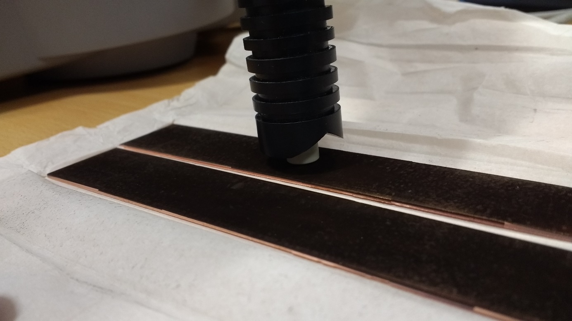
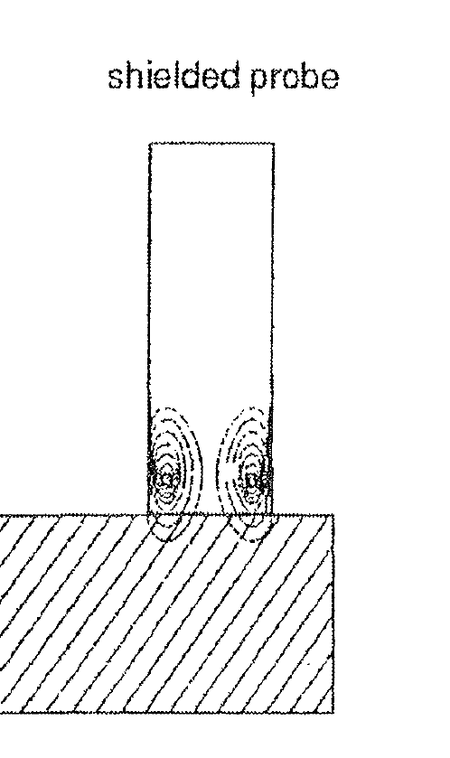
Eddy-current testing
Sigma meter by Förster: frequency range 60 kHz <f< 960 kHz
We need a model to extrapolate data to other frequencies and to convert eddy-current measurements to wake impedance.

Slide 3
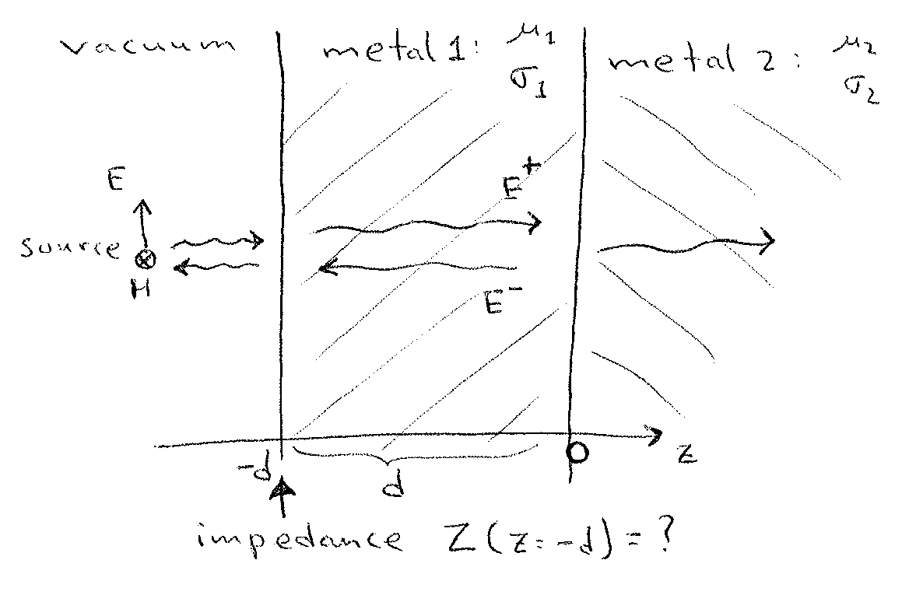

Theoretical model for laser-treated copper surface. A naïve approach: two-layer model.
Impedance “felt” by a wave incident on the two-layer structure:

Slide 4
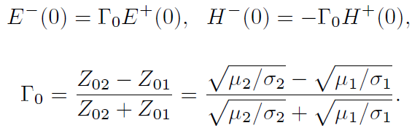
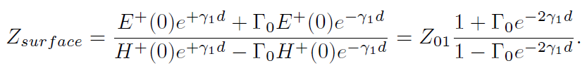
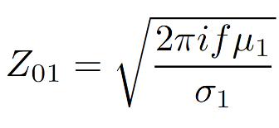

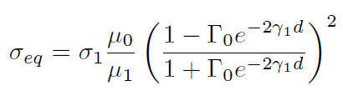
Boundary condition between the layers:
Final answer for surface impedance:
Characteristic impedance of metal 1
Propagation constant in metal 1
Quantity measured by the sigmameter:

Slide 5
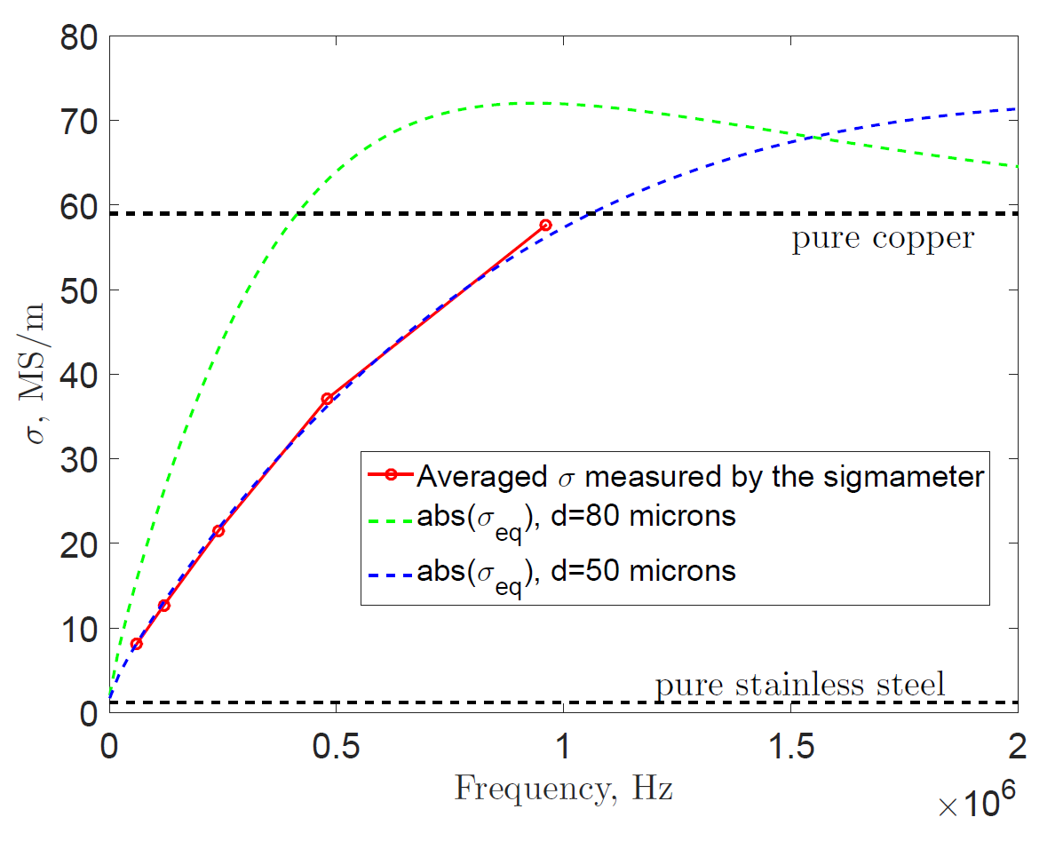
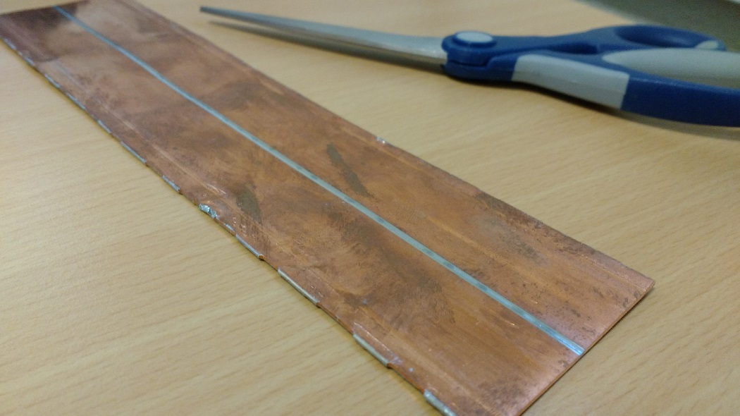
Two-layer model check: LHC beamscreen (copper + stainless steel)
LHC beamscreen stripe: copper-coated stainless steel

Slide 6
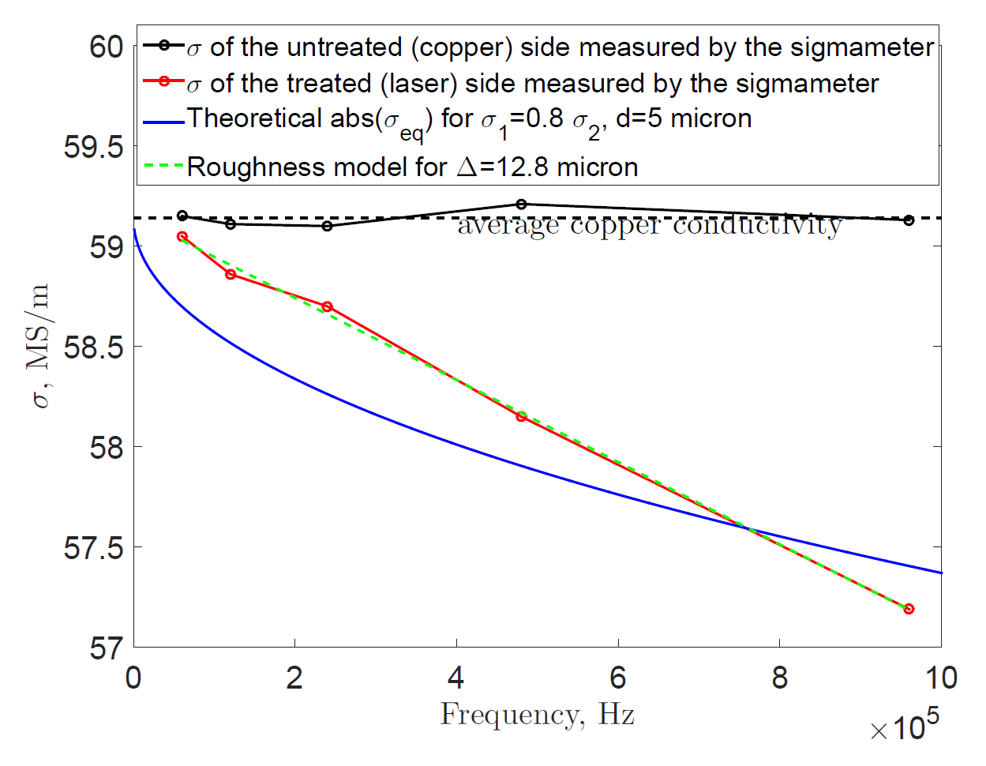
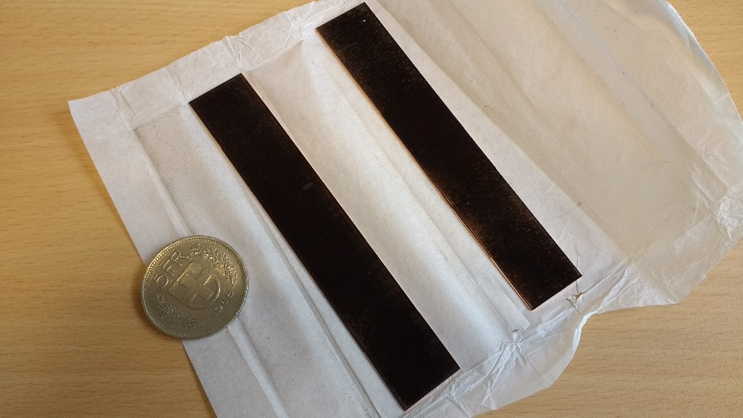
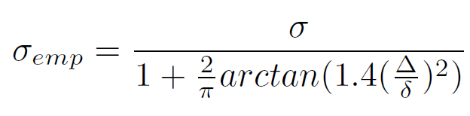
Two-layer model check: laser-treated copper stripe
Conclusion: for eddy-current measurements to be useful, a better theoretical model is necessary.

Slide 7
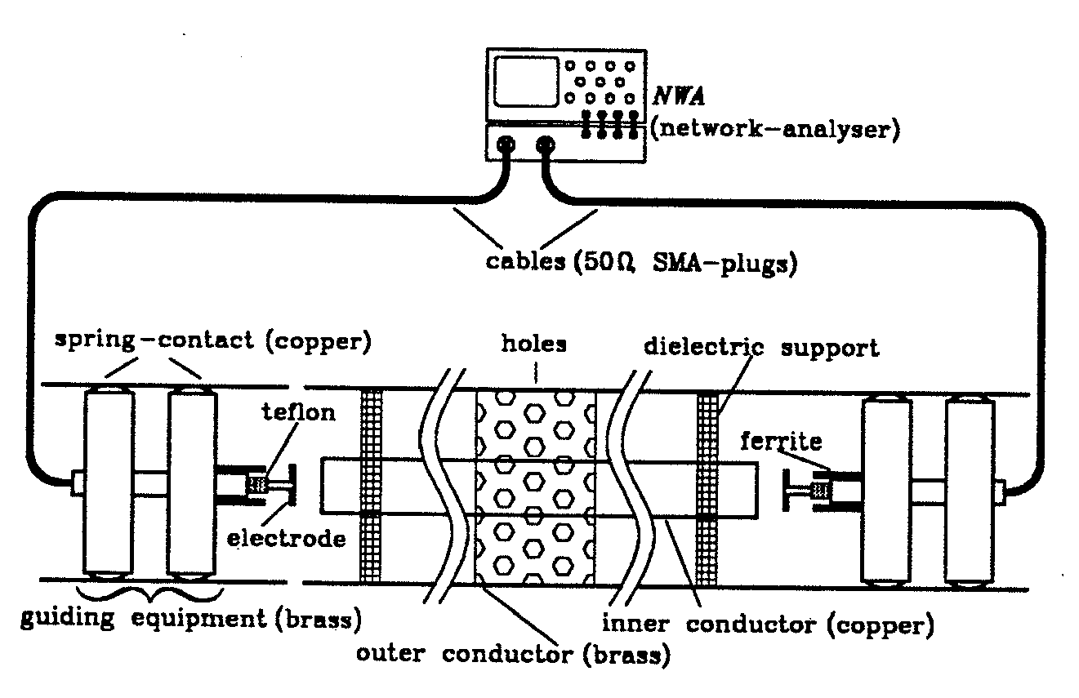
Proposal for a future experiment with the resonator method
Can we make a pipe of laser-treated stripes a few meters long?
Figure from F. Caspers and T. Scholz 1995 - Resonator method for impedance determination

Slide 8
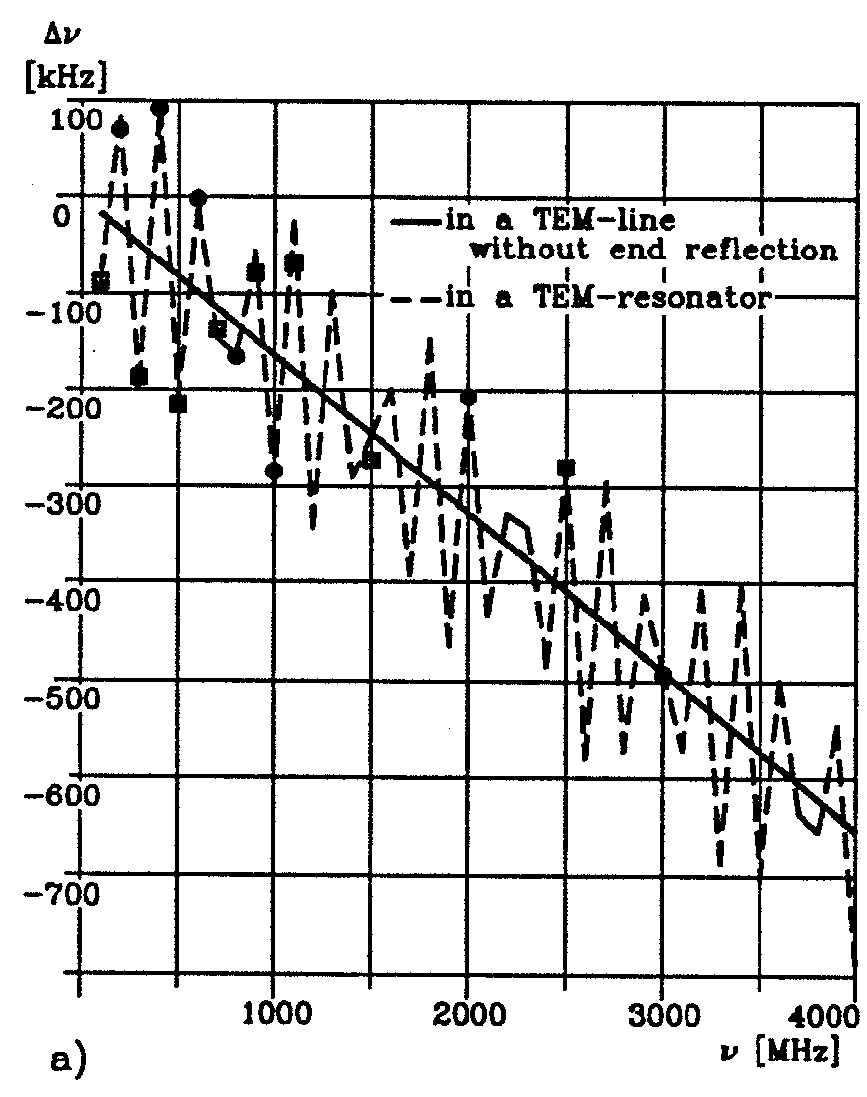
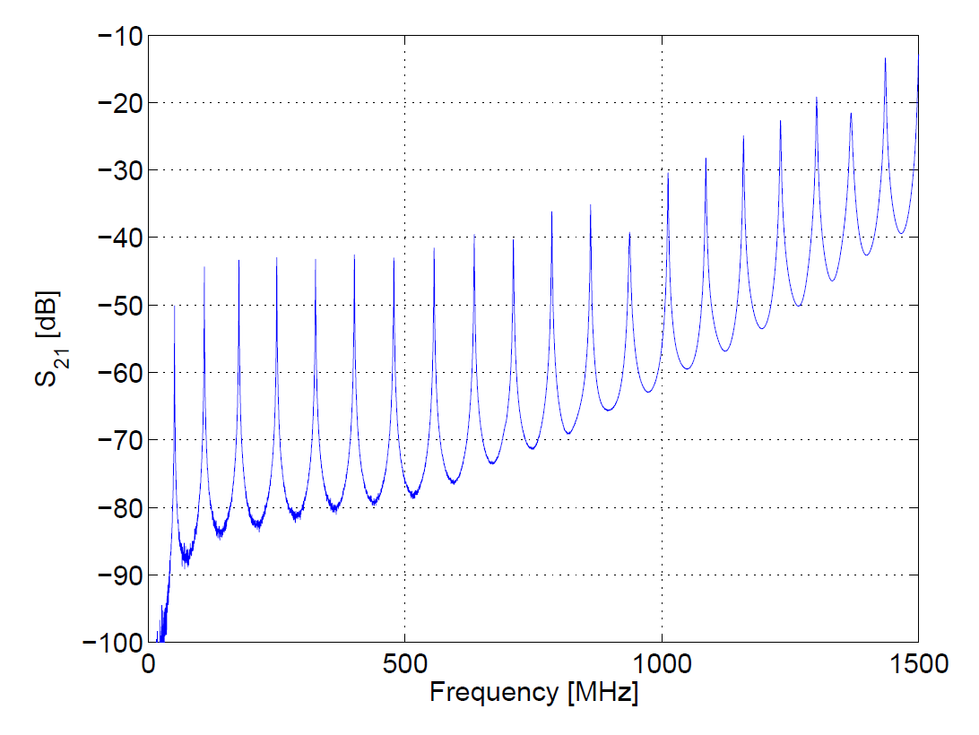
Proposal for a future experiment with the resonator method
Q-factor deviations from the case of untreated sample are used to find the real part of impedance.
Shifts in resonance frequency are used to determine the imaginary part of impedance.
Papers:
F. Caspers and T. Scholz 1995 - Resonator method for impedance determination
T. Kroyer, F. Caspers, E. Gaxiola - Longitudinal and Transverse Wire Measurements for the Evaluation of Impedance Reduction Measures on the MKE Extraction Kickers

Slide 9
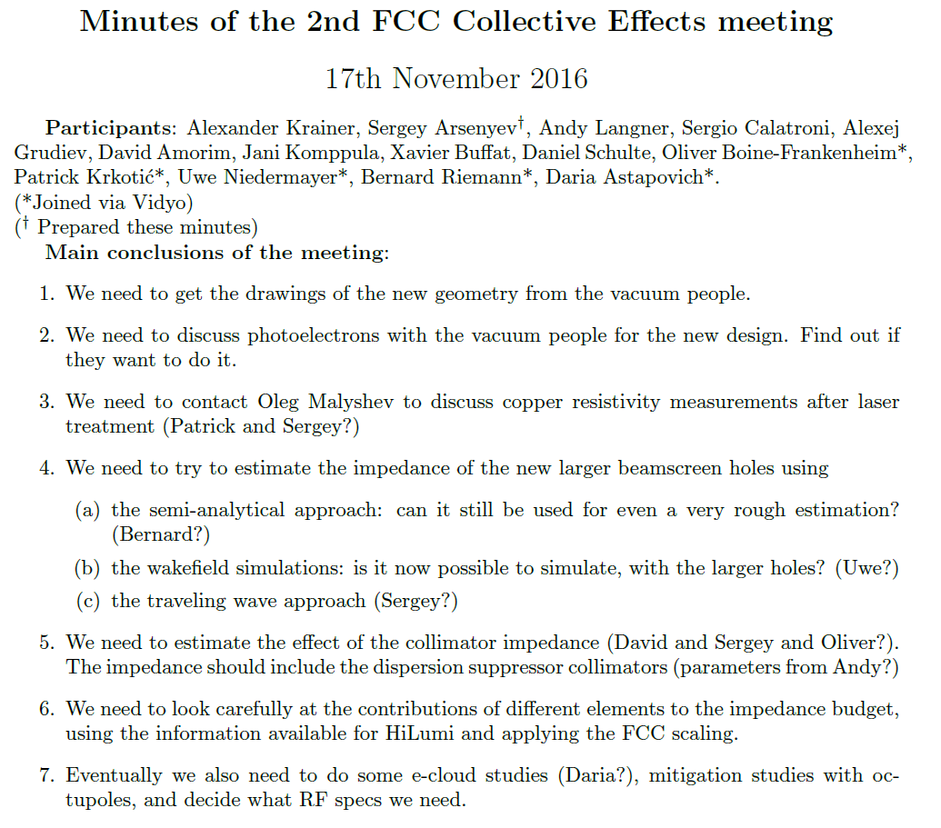
Done. See FCC impedance database.
Done. Oleg is willing to conduct more experiments in his laboratory if there is interest.
In progress
In progress

