Slide 1


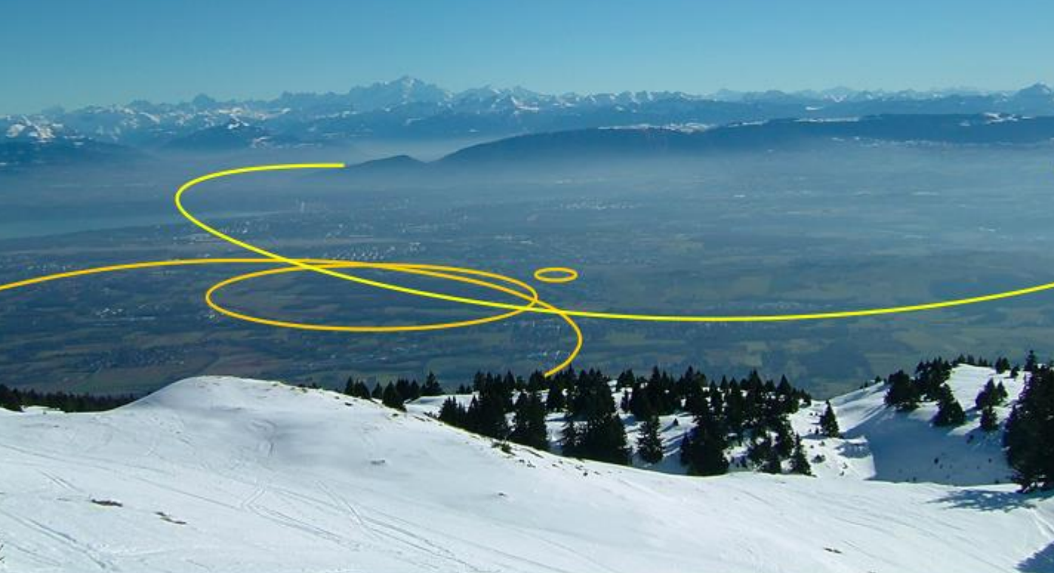

FCC-hh collimator impedance
Daria Astapovych (Task 2.4)
Material from O.Boine-Frankenheim, P. Krkotic,
U. Niedermayer

Slide 2
Contents
Beam Screen Design
FCC-hh collimation system
Transverse impedance simulations
Beam screen updates
Outlook
Notes:
1/8/17
|
| 2

Slide 3
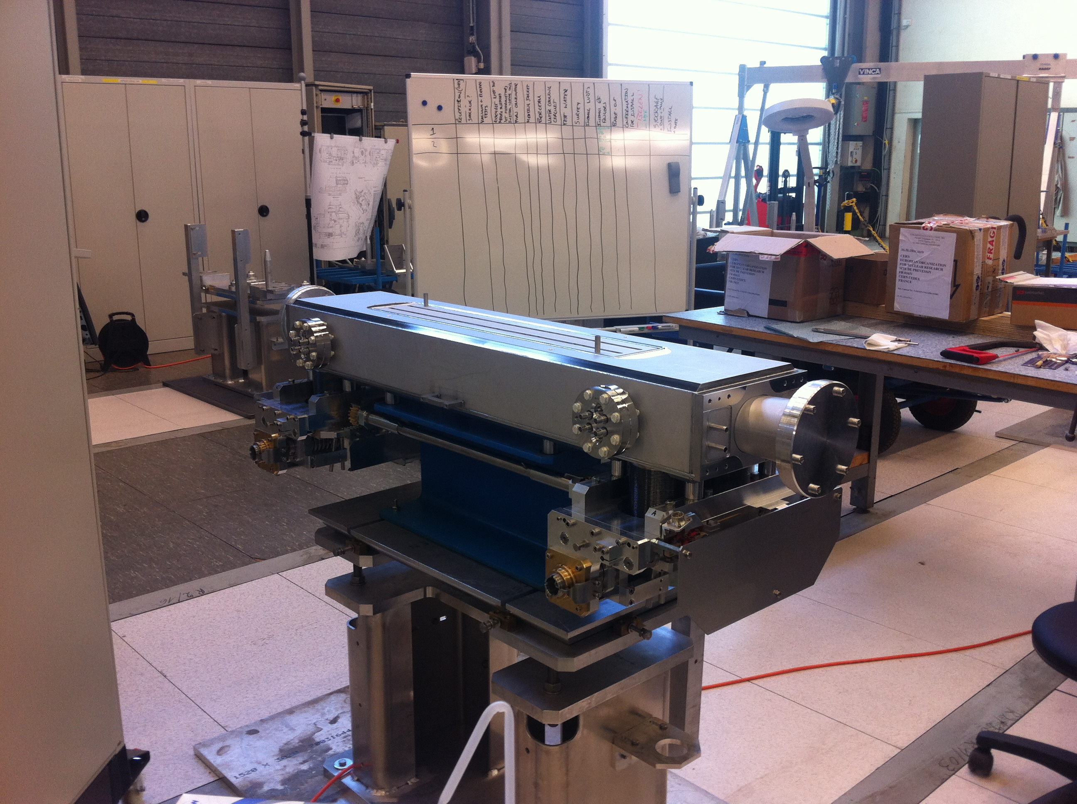
FCC collimation system Screen Design
FCC energies and intensities pose great
challenges for the collimation hardware design:
• Beam stored energy:
360 MJ (LHC design) →8500 MJ (FCC)
• Power load (tau=0.2h):
500 kW (LHC design) →11800 kW (FCC)
First FCC collimation layout assumed same collimator types as at the LHC.
TCTP (Target Collimator Tertiary with Pick-up)
An efficient collimation system must be developed to prevent any stray halo protons from colliding with the cold regions of the machine.
Notes:
1/8/17
|
| 3

Slide 4
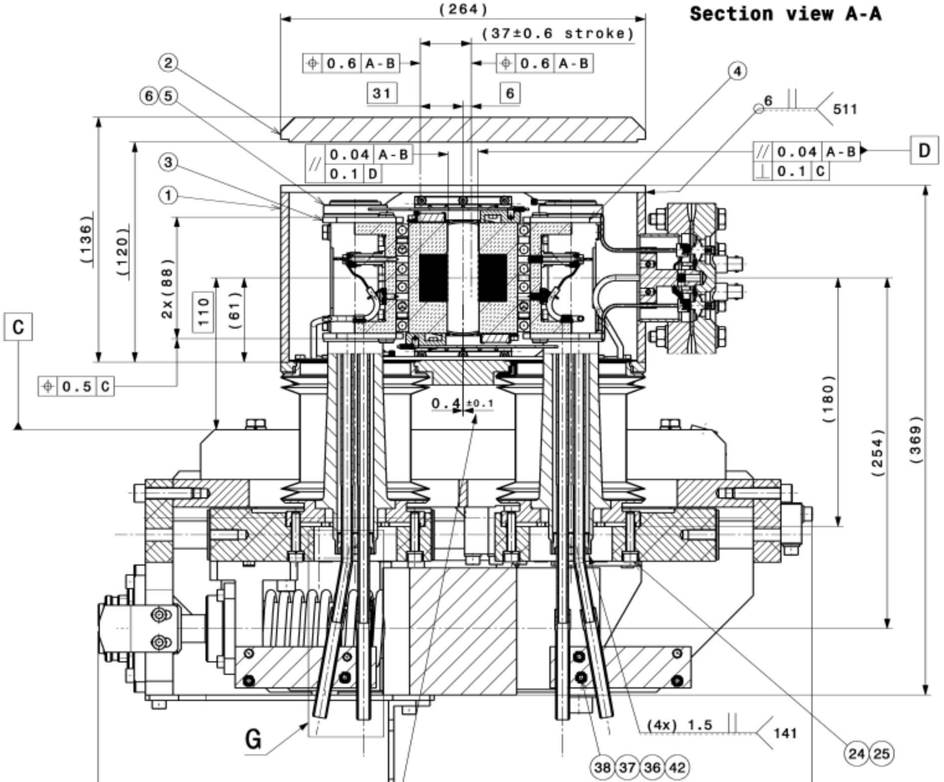
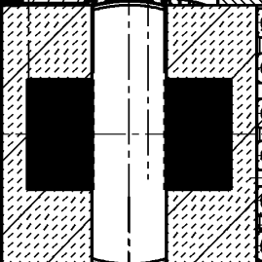
FCC collimator drawing Screen Design
2 type of collimators:
- TCTP with Tungsten (Inermet180 W) + Main girder in Glidcop (Cu alloy)
- TCSP with Graphite (Carbon-Carbon)
Glidcop/Graphite
Tungsten/Graphite (CFC)
Notes:
1/8/17
|
| 4

Slide 5
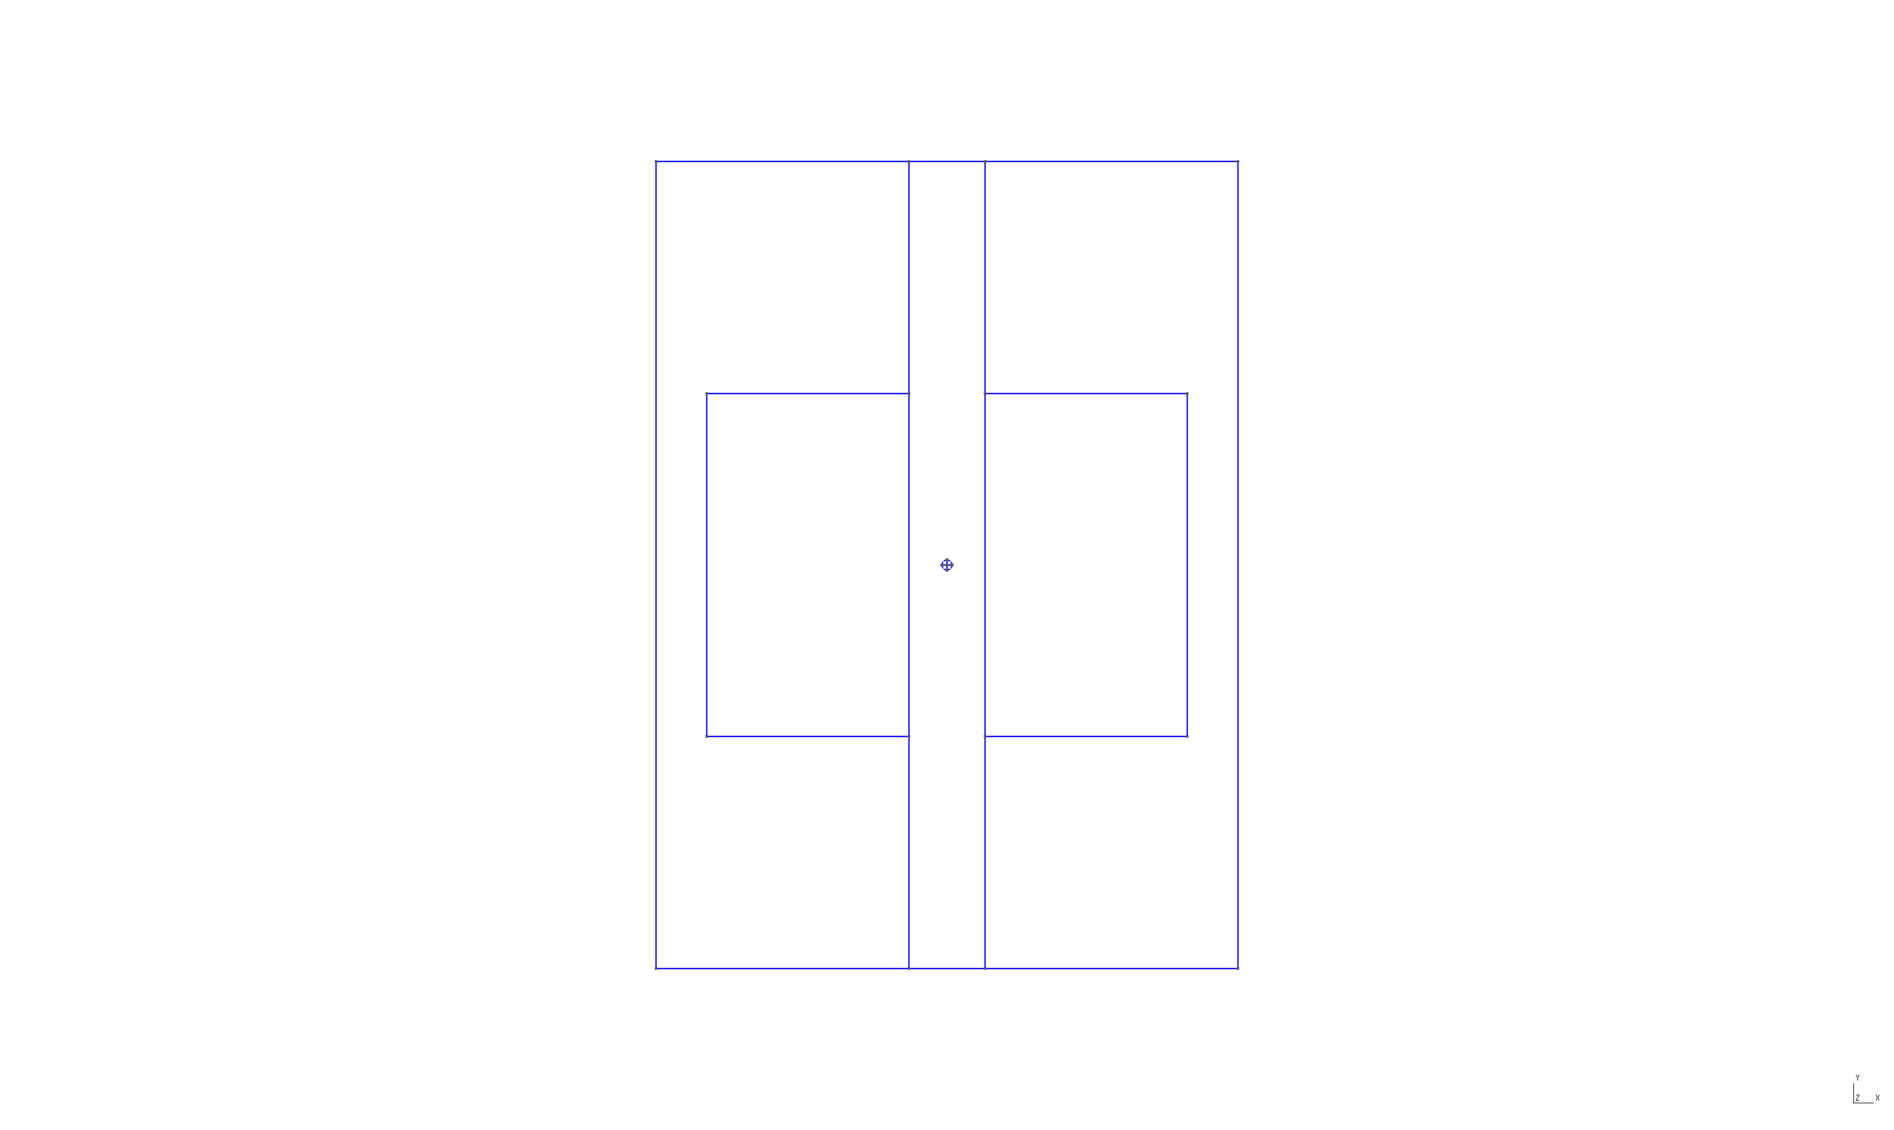
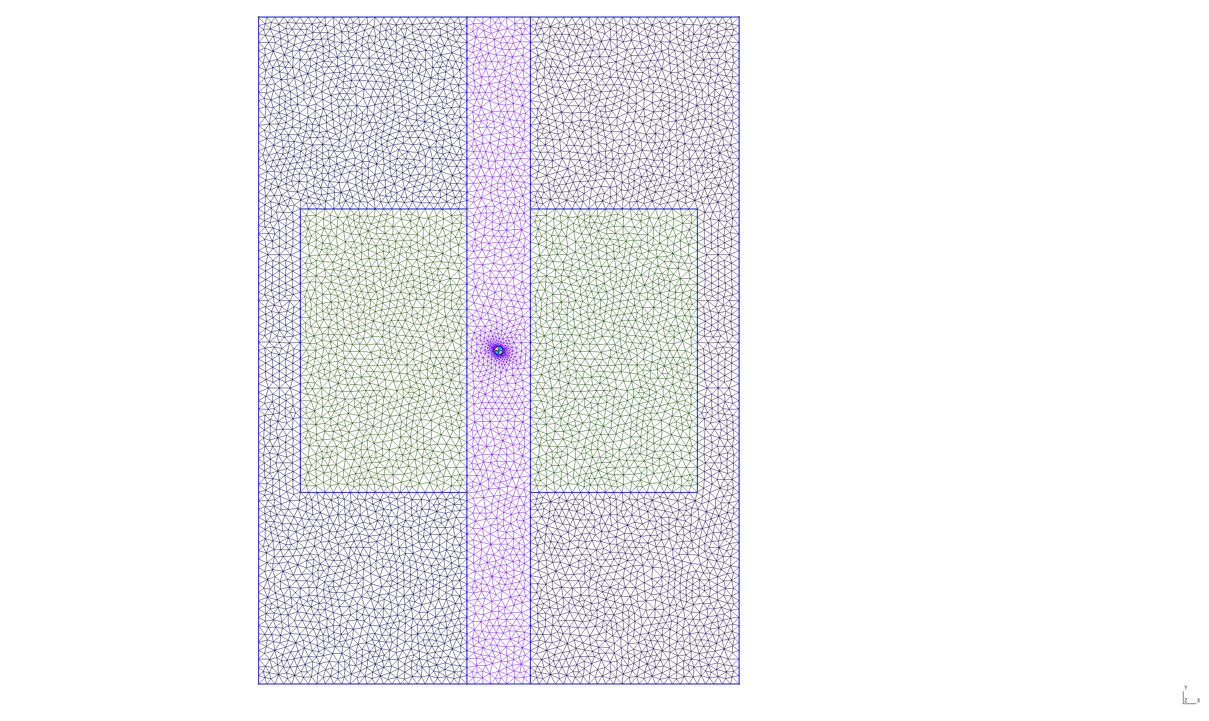
Schematic drawing and meshed drawing of FCC collimator
The height of the active material changes between 34 mm (W) and 80 mm (CFC).
Collimator length = 1 m
σ_Inermet180 W =10.42 MS/m
σ_Glidcop = 53.3 MS/m
σ_CFC = 0.03 MS/m
Using BeamImpedance2D
(U. Niedermayer)
Notes:
1/8/17
|
| 5

Slide 6
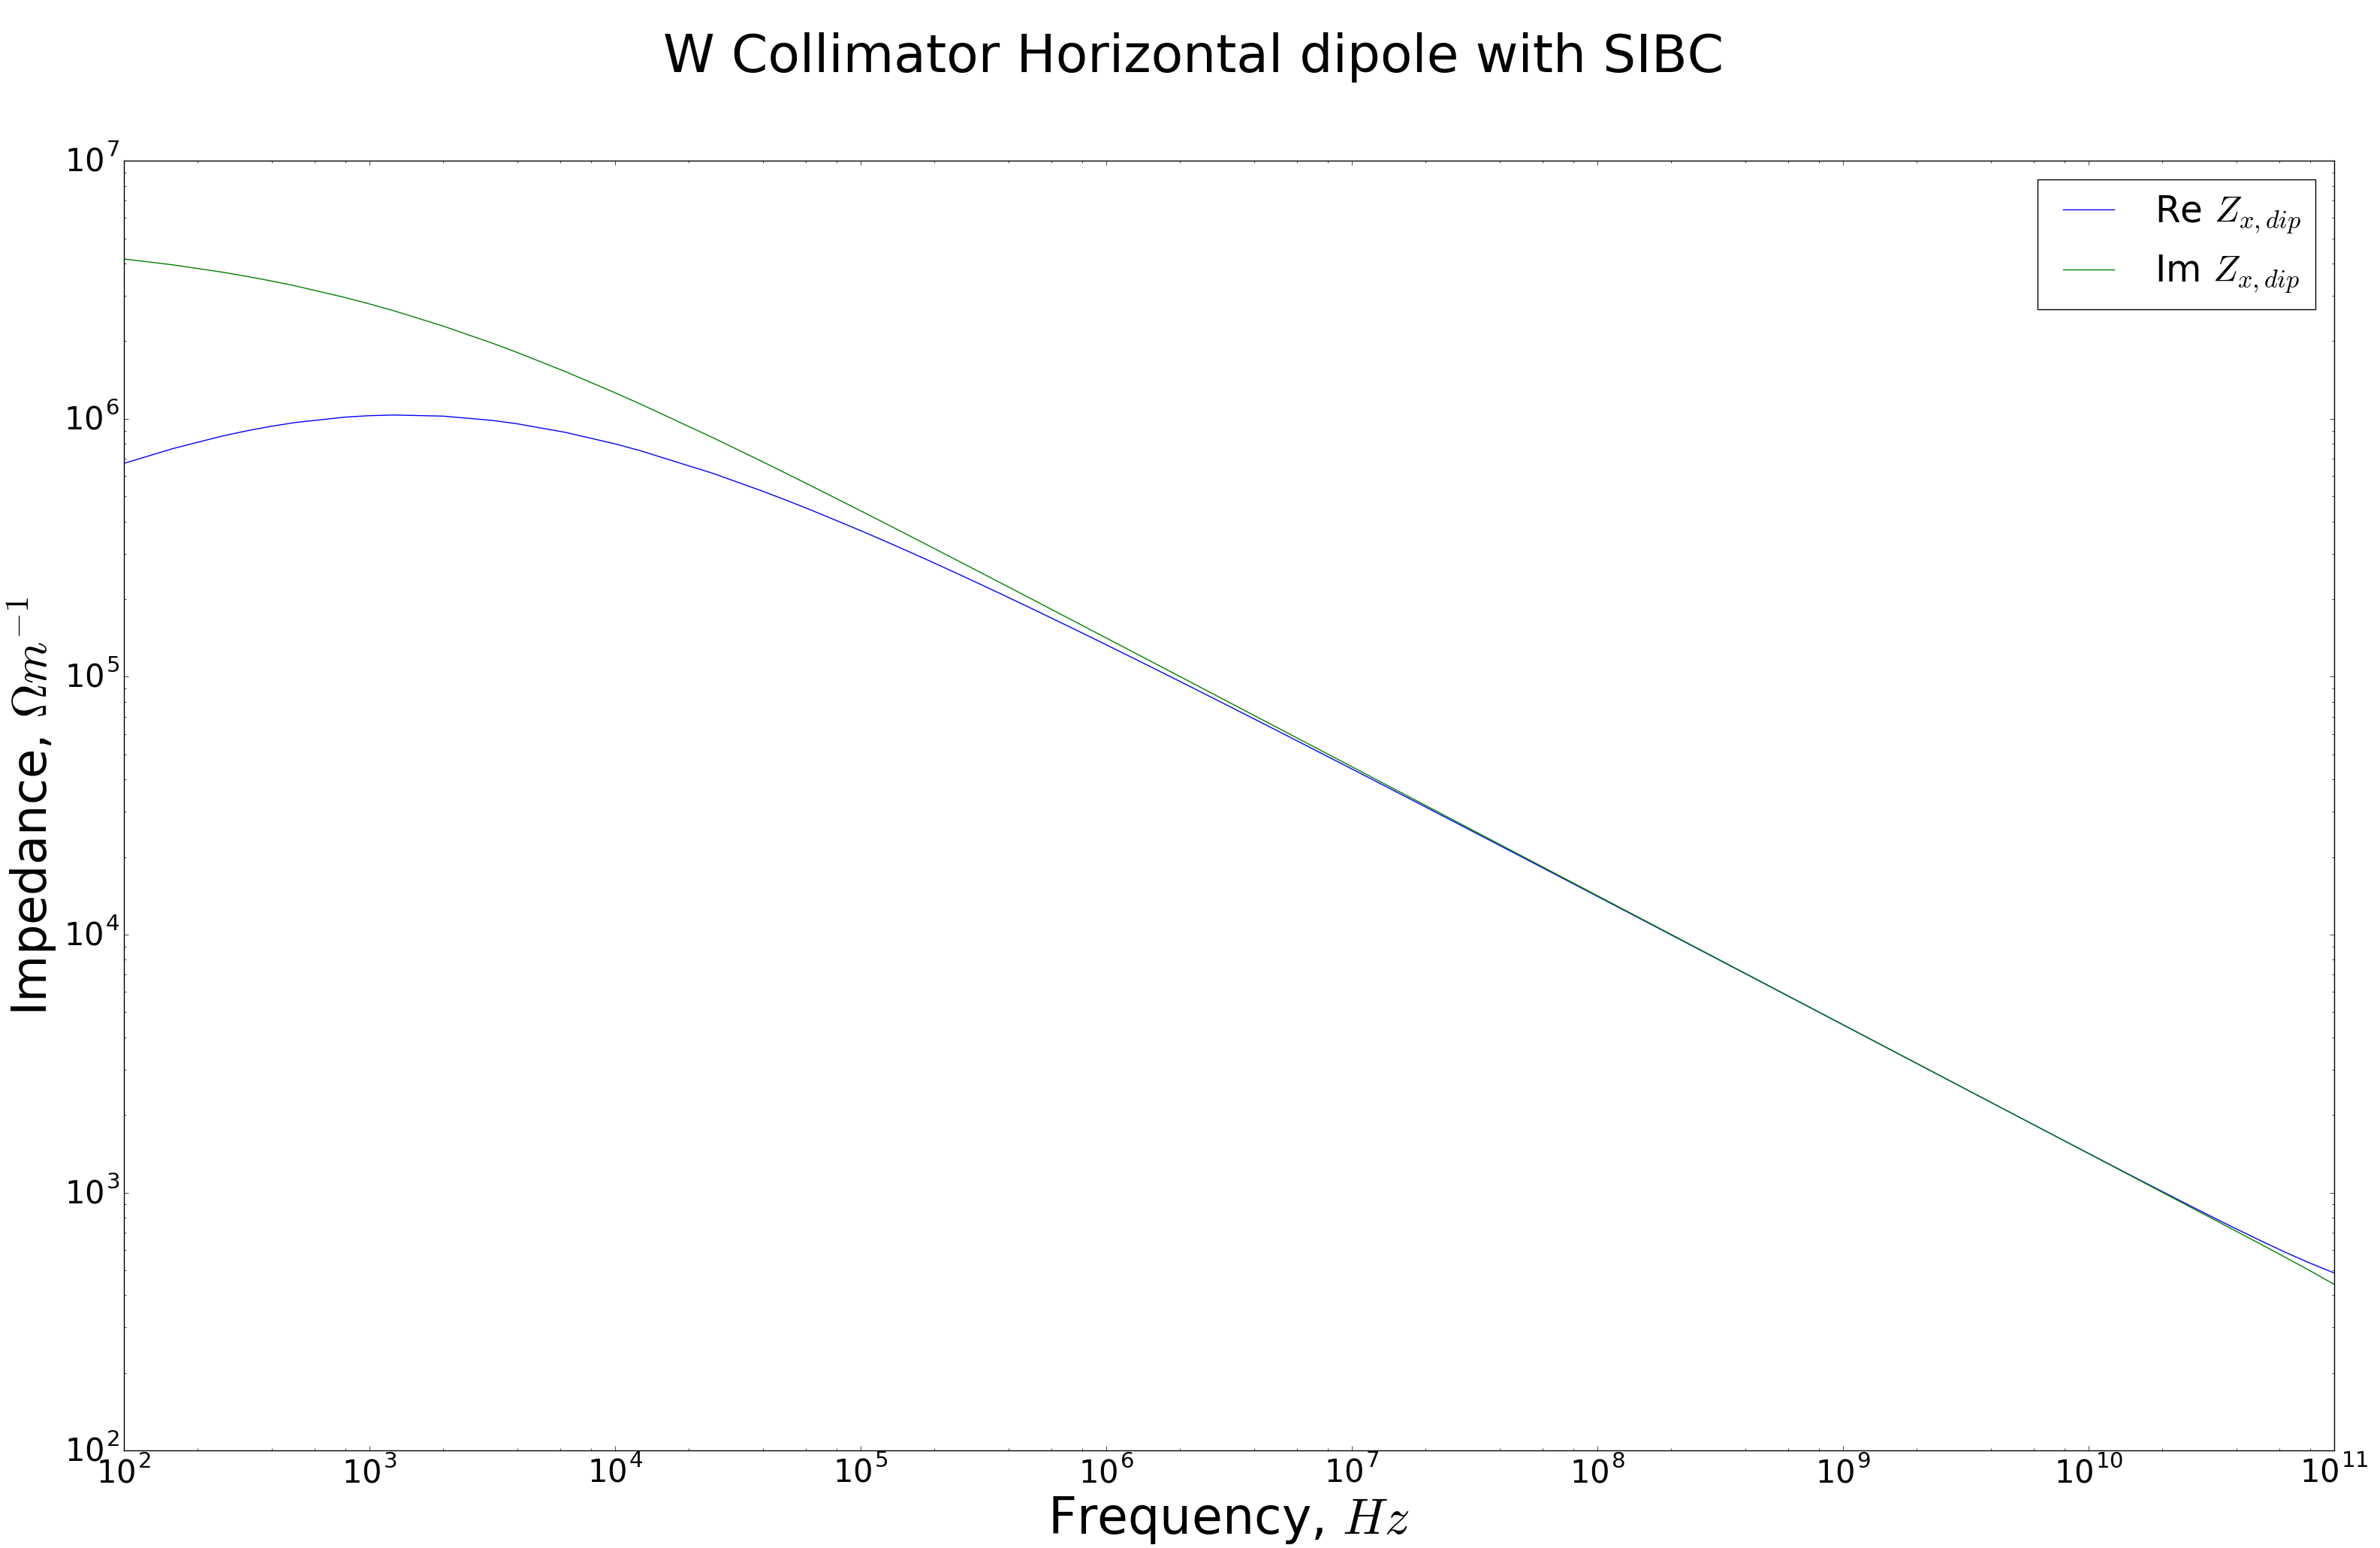
Transverse impedance simulations for collimator with Tungsten at injection
Notes:
1/8/17
|
| 6

Slide 7
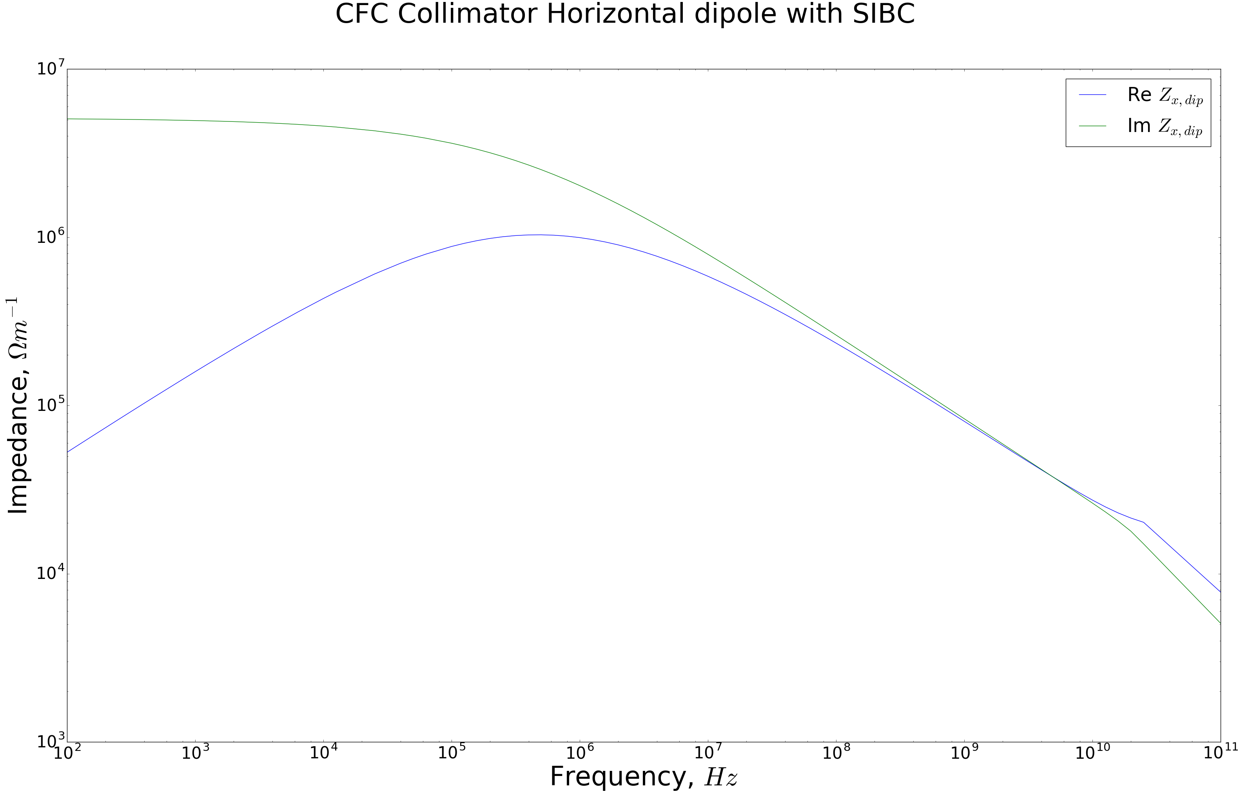
Transverse impedance simulations for collimator with Graphite (CFC) at injection
Notes:
1/8/17
|
| 7

Slide 8
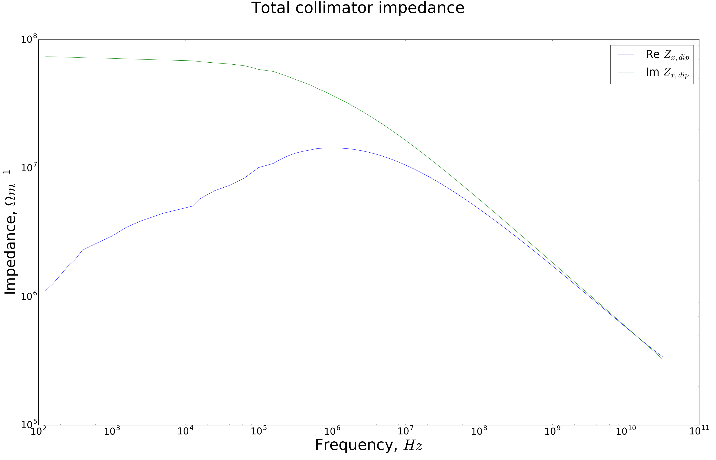
Total collimator impedance at injection
Notes:
1/8/17
|
| 8

Slide 9
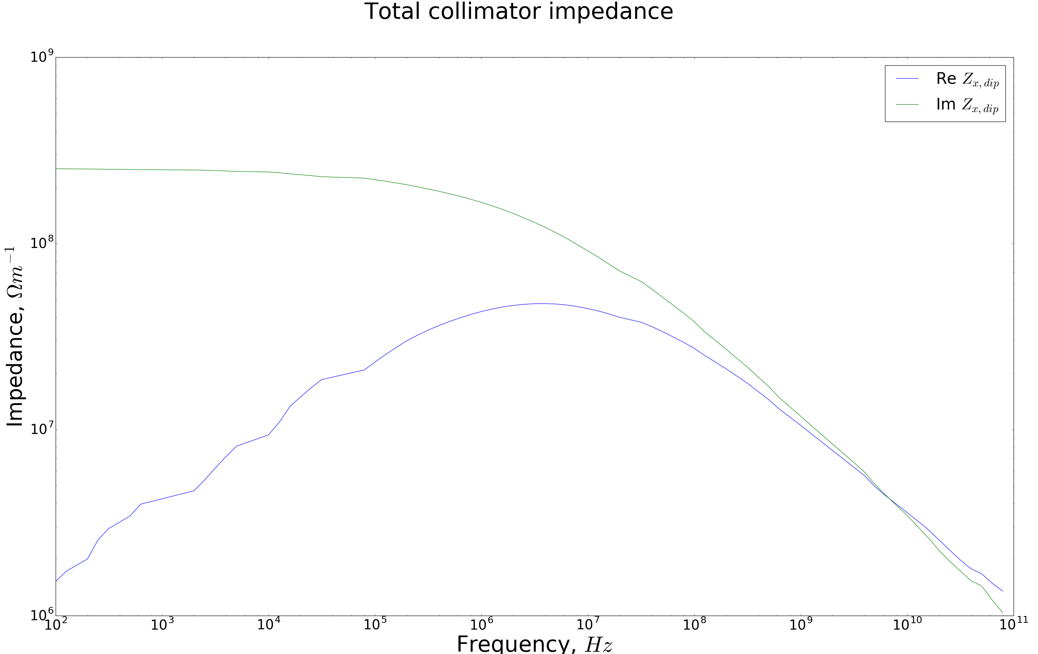
Total collimator impedance at top energy
Notes:
1/8/17
|
| 9

Slide 10
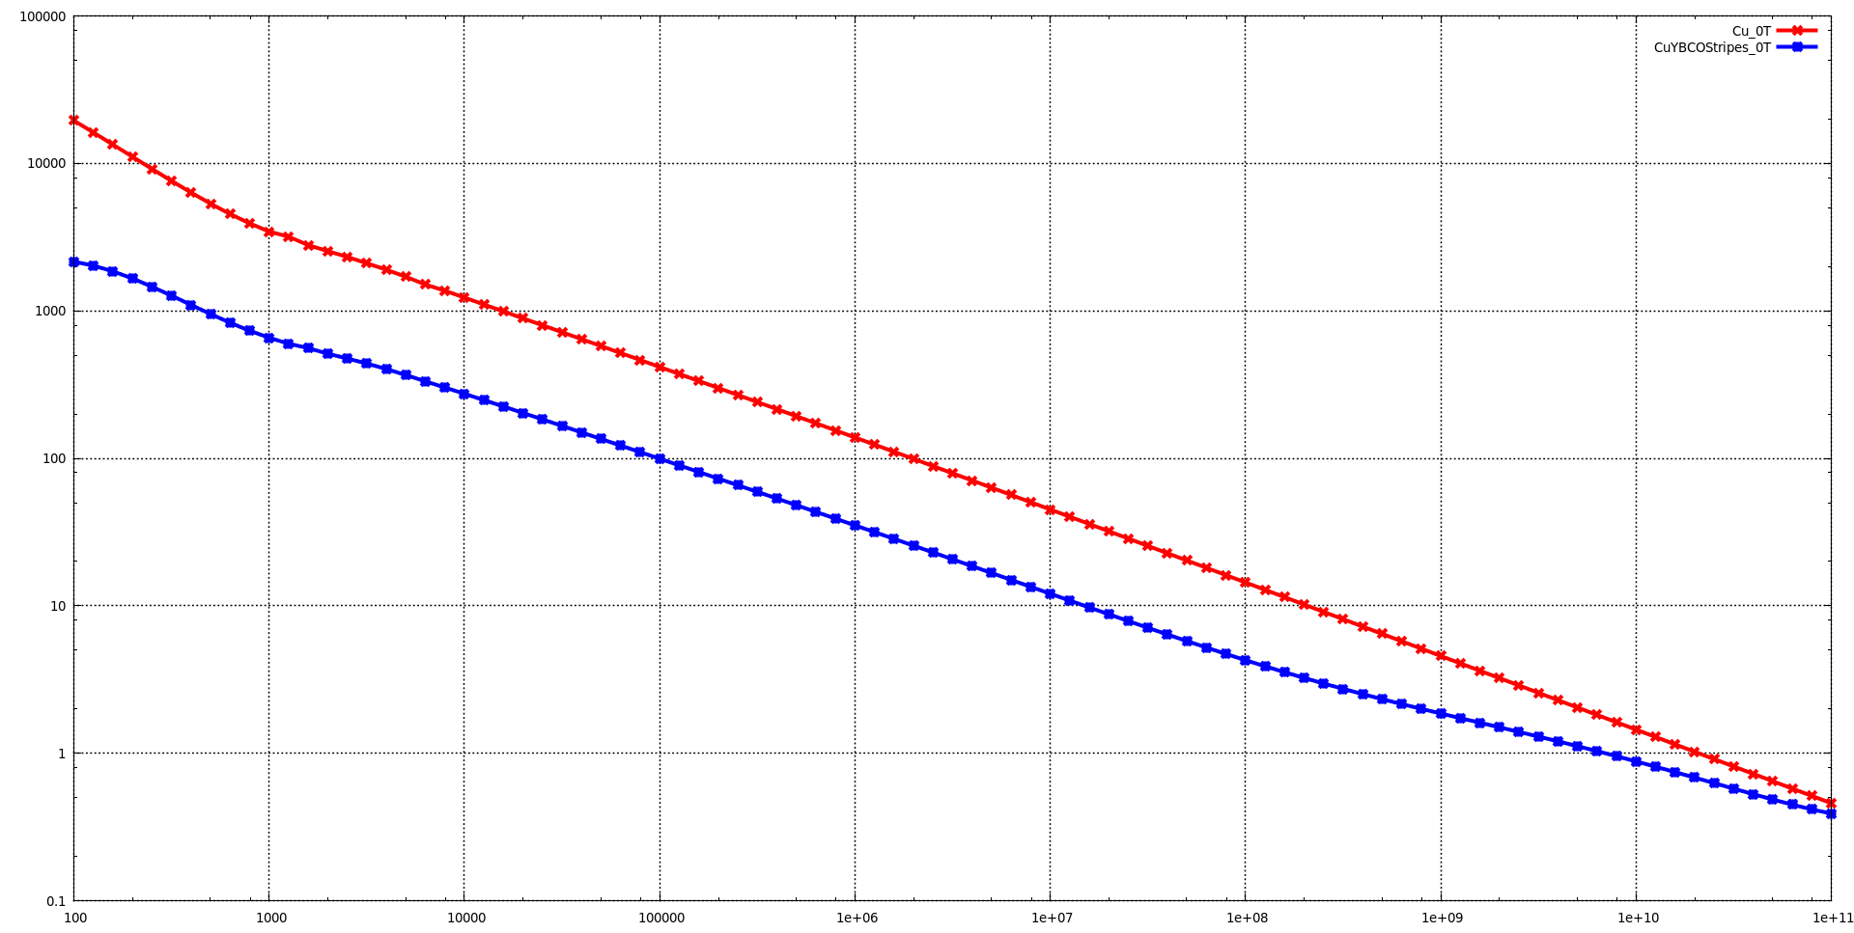



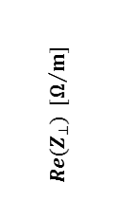

Impedance Calculation
Transversal Impedance - Effect of the magnetic Field [*]
B = 0 T
$${Re(Z}_{⊥}) [Ω/m]$$
Steel beam screen:
$κ=$ 180 MS/m
Copper coating:
$κ=$ 6 GS/m
Thickness: 300 µm
YBCO coating:
$κ_{n}=$ 1.37 MS/m
Thickness: 1 µm
P.Krkotic
f $[Hz]$
*Superconductor surface resistance in the presence of a dc magnetic field: frequency and field intensity limits
Sergio Calatroni – (submitted to PR-AB )

Slide 11
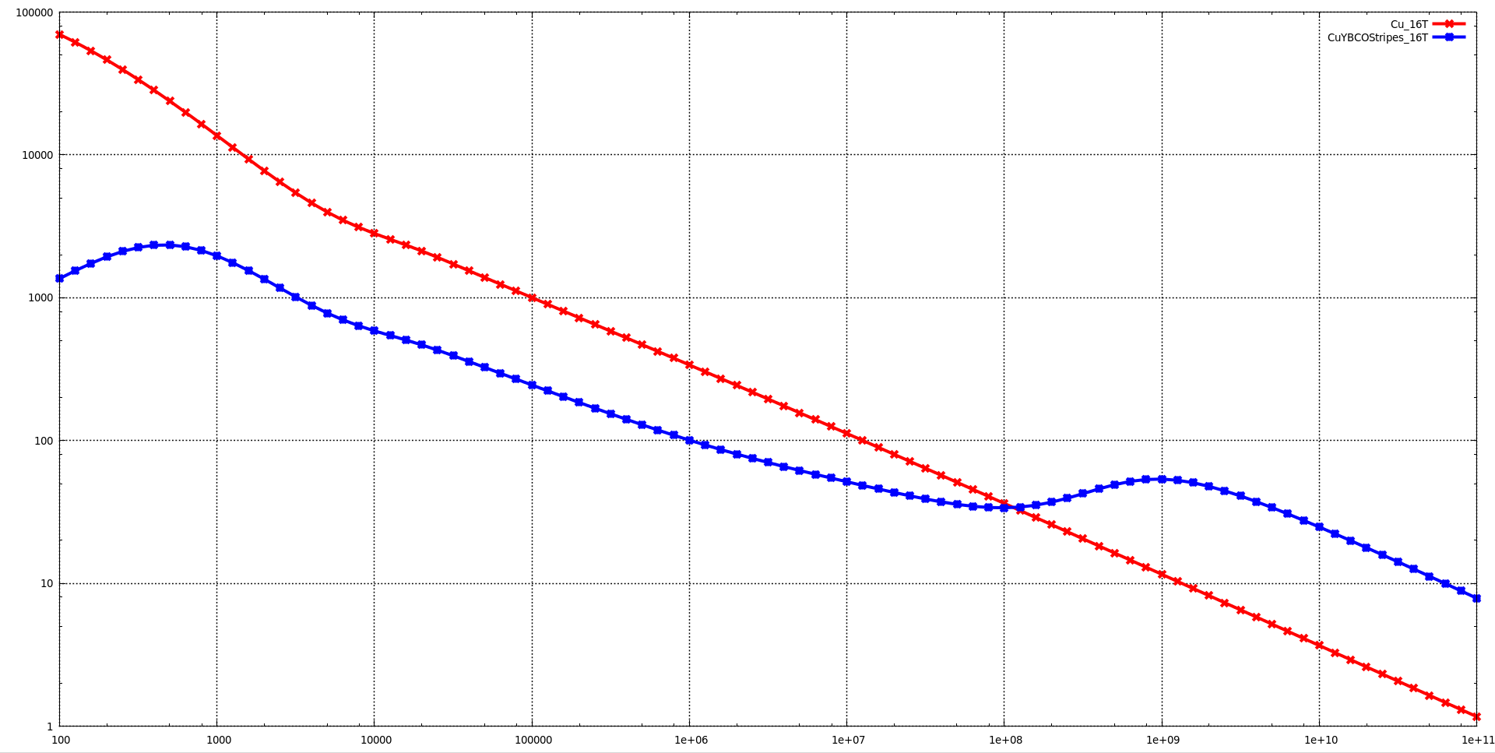

Impedance Calculation
Transversal Impedance - Effect of the magnetic Field [*]
Due to magnetoresistance, the conductivity
is reduced by an estimated factor of about 0.155 at 50 K
B = 16 T
$${Re(Z}_{⊥}) [Ω/m]$$
Depinning frequency
Steel beam screen:
$κ=$ 180 MS/m
Copper coating:
$κ=$ 6 GS/m
Thickness: 300 µm
YBCO coating:
$κ_{n}=$ 1.37 MS/m
Thickness: 1 µm
[*]
$B_{C2}=$ 45 T
$$f_{dep}=4 GHz$$
P.Krkotic
f $[Hz]$
*Superconductor surface resistance in the presence of a dc magnetic field: frequency and field intensity limits
Sergio Calatroni – (submitted to PR-AB )

Slide 12
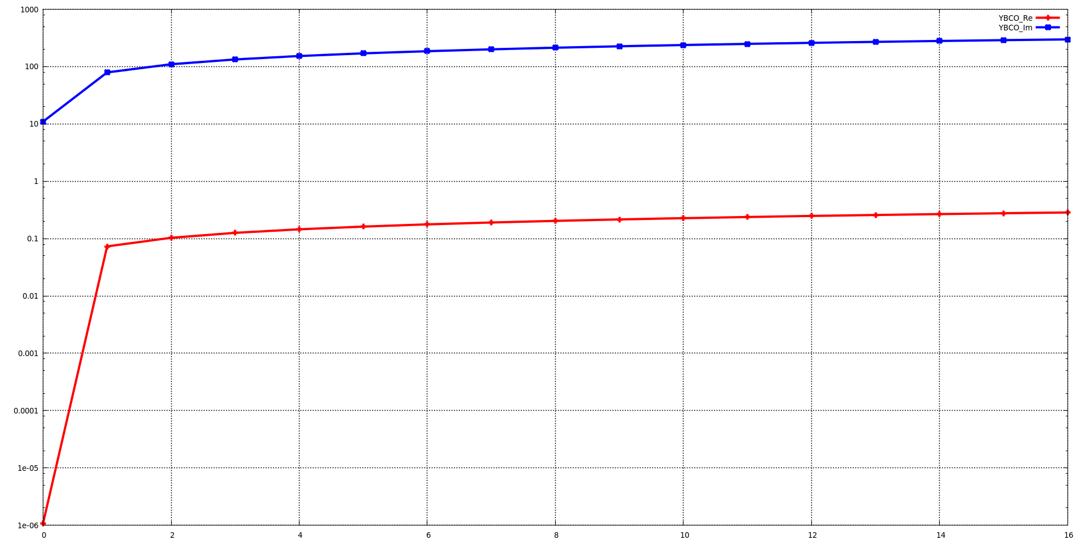
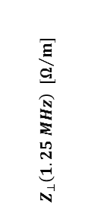

Impedance Calculation
Transversal Impedance - Effect of the magnetic Field [*]
$$Z_{⊥}\left(1.25 MHz\right) [Ω/m]$$
At injection
B= 1 T necessary
P.Krkotic
B $[T]$
*Superconductor surface resistance in the presence of a dc magnetic field: frequency and field intensity limits
Sergio Calatroni – (submitted to PR-AB )

Slide 13
Outlook
Using the impedance data to find the Transverse Mode-Coupling Instabity (TMCI) threshold and coupled-bunch growth rate:
- analytically;
with PyHEADTAIL simulations.
Compare the results for collimator impedance with analytical solution.
Notes:
1/8/17
|
| 13

Slide 14
Beam Screen Design
Thank you for your attention!
Notes:
1/8/17
|
| 14

