Slide 1

Tsinghua High-power
X-band test stand plans
HG2017 Valencia
Wei Gai, Jiaru Shi
Department of Engineering Physics, Tsinghua Univ.
2017.6.13

Slide 2
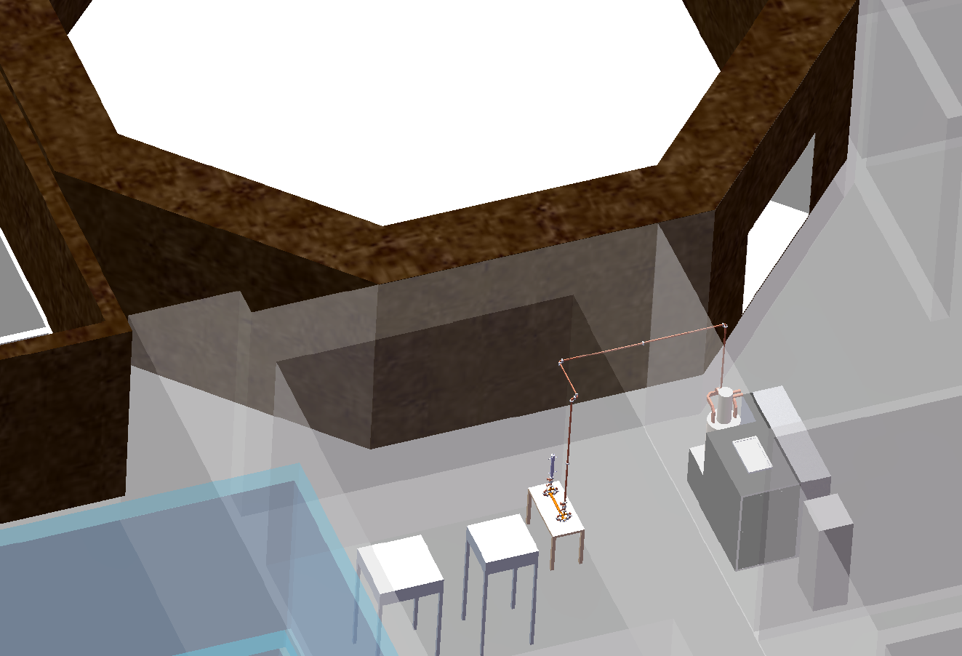
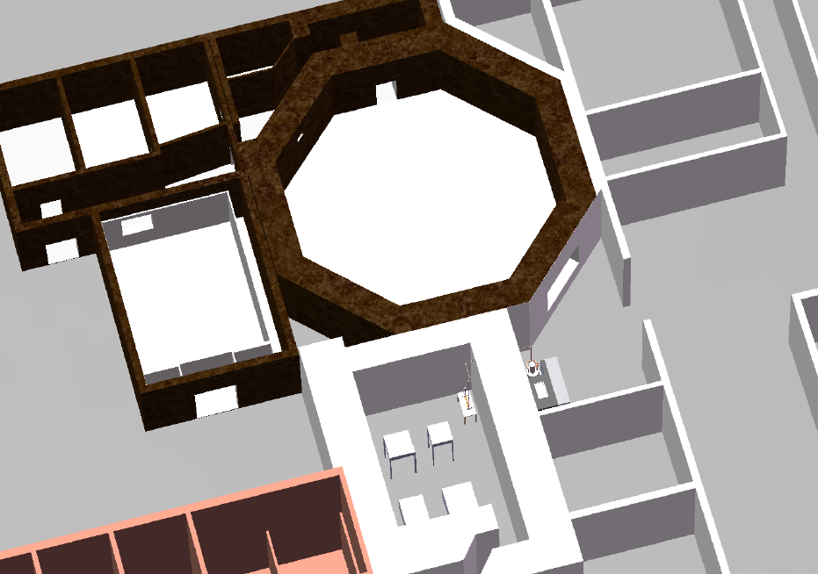
Layout

Slide 3
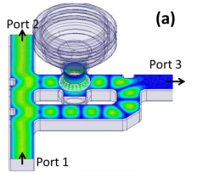
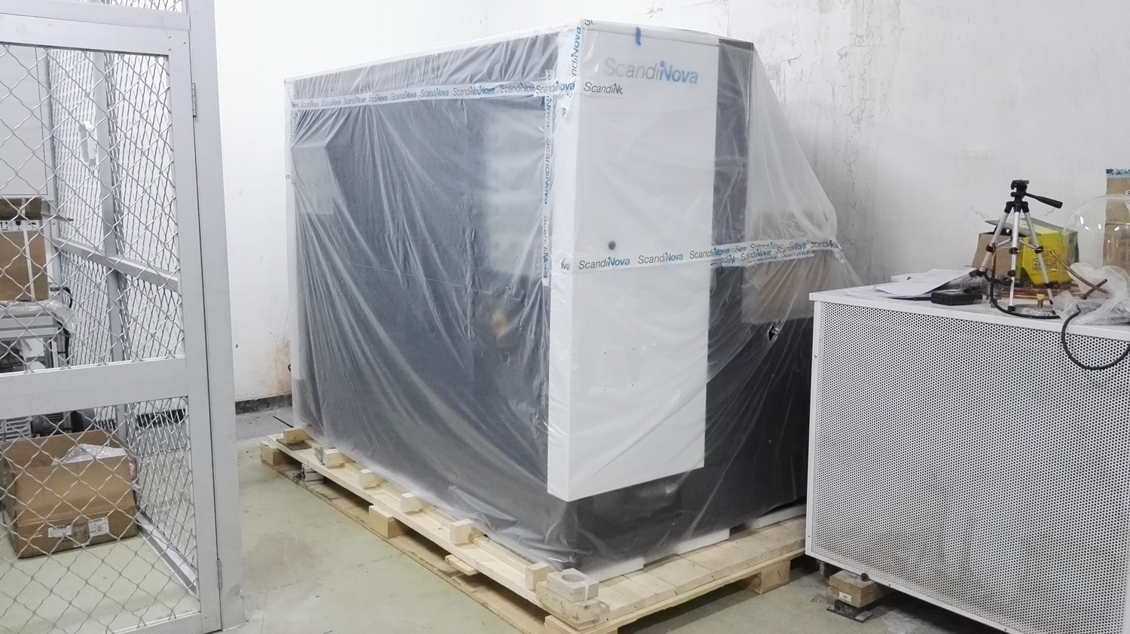
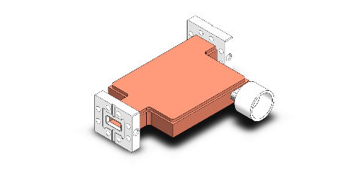
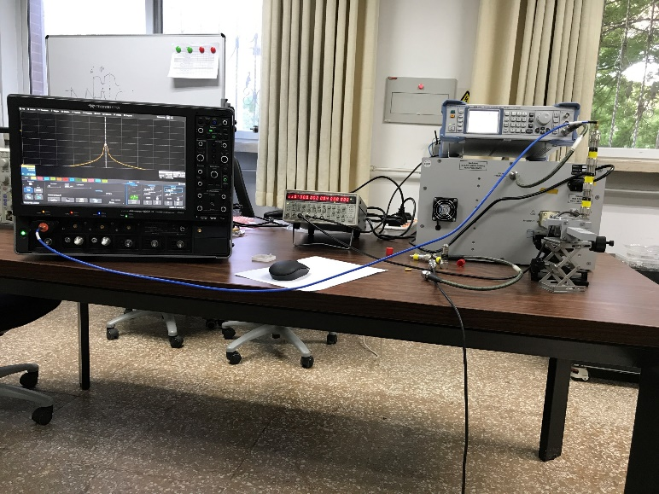
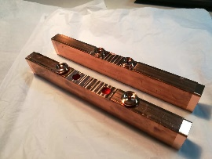
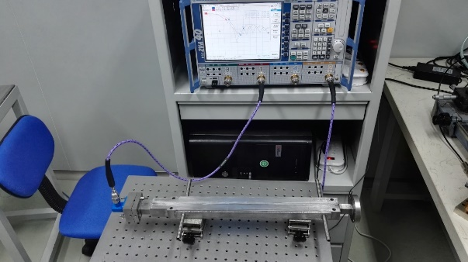
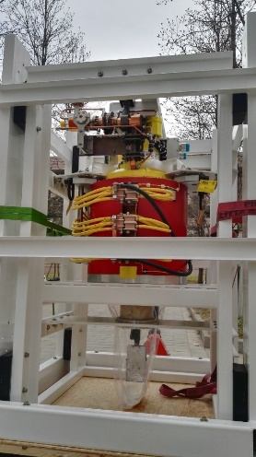
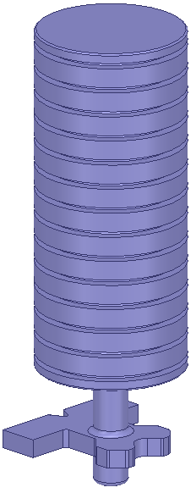
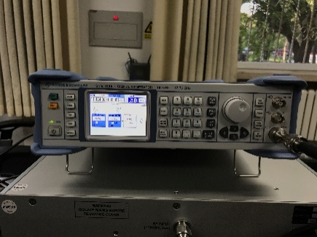
Status of Tsinghua X-band test stand
Available
In fabrication
In design
Variable RF power splitter
X-band test structures
Vacuum pumping port
XC72 on beamline
Computer
Directional coupler
LLRF system
Modulator
RF seed Generator
SSA
Klystron
Directional coupler
Pulse compressor
R&S® SMB100A

Slide 4
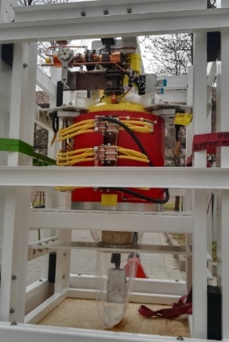
Klystron
11.424GHz Klystron
(CPI:VKX-8311B)
52.6 MW achieved in the factory test
Peak Output Power | 52.6 MW
Pulse Length | 1.5 us
Average Output Power | 4.75 kW
Drive Power | 470 W
Gain | 50.5 dB
Efficiency | 43.1 %
-1dB Bandwidth | 36.0 MHz

Slide 5

Modulator
ScandiNova
http://www.scandinovasystems.com/solid-state-modulator-no-400-from-scandinova

Slide 6
SSA
From Microwave Amps
Frequency Range | 11.404-11.444 GHz
Gain Small Signal | 80 dB
Gain Flatness | 0.9 dB
Peak Output Power | 61.8 dBm (5us, 100Hz)
Pulse Droop | 0.4 dB (5 us, 100Hz)

Slide 7
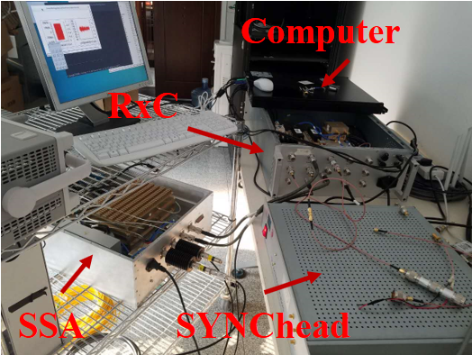
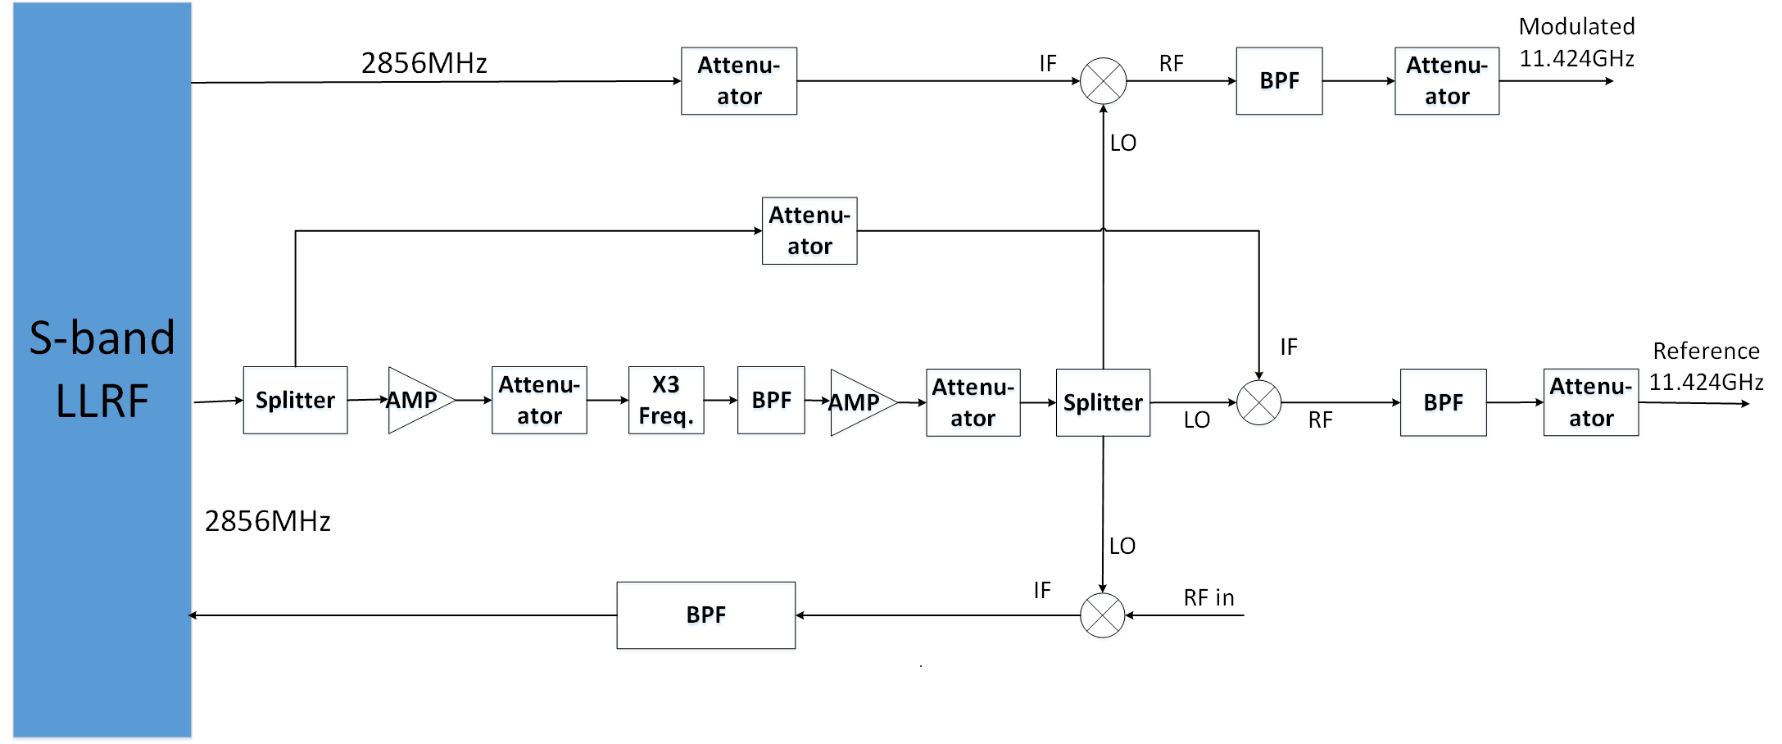
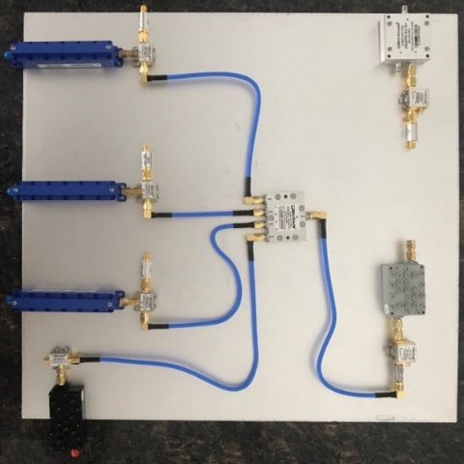
LLRF system
Using existing S-band RF system
2856*3 + 2856(modulated)

Slide 8
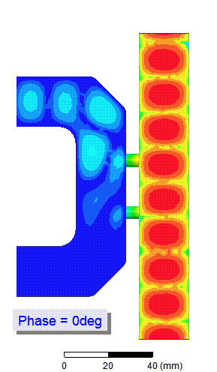
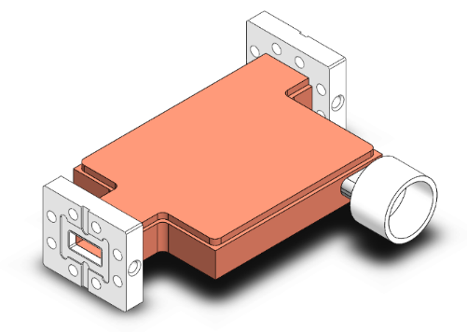

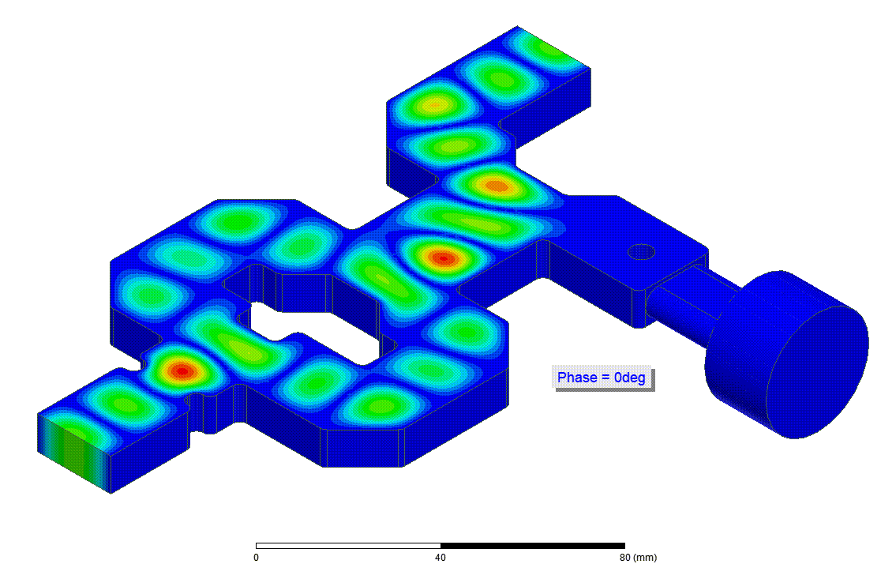
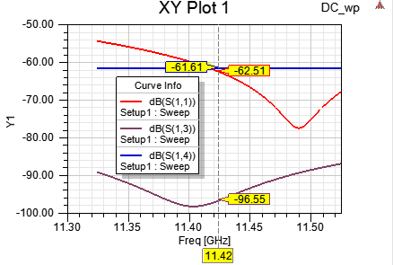
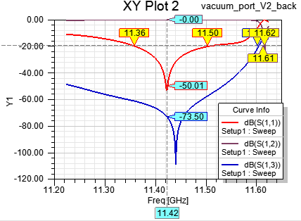
RF components
Directional coupler
(In fabrication)
S13 = -60 dB; S14 = -97 dB
Vacuum port(In fabrication)
Reflection = -50 dB;
Isolation = -73 dB

Slide 9
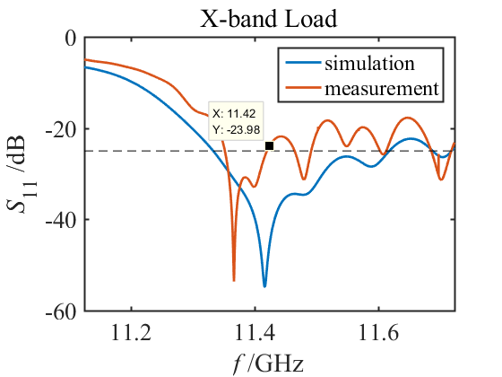

RF components
Steel stainless RF load (Homemade one)
Reflection = -23 dB;
(Also borrowd from CERN)

Slide 10
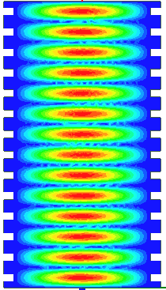
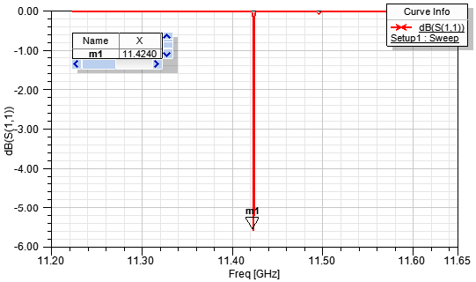
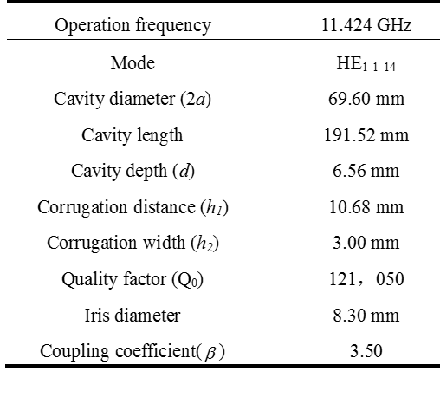
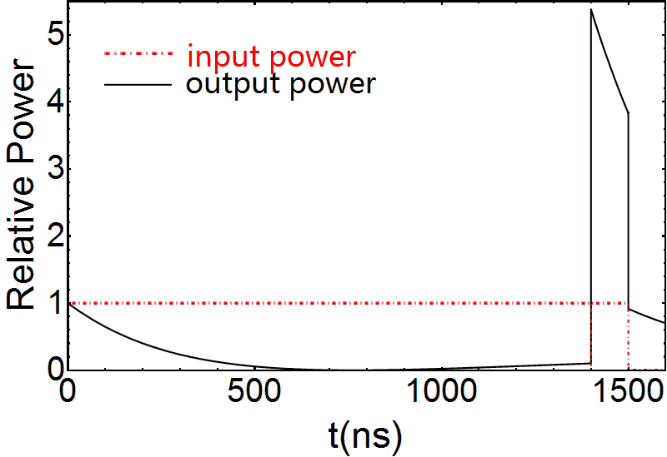
RF pulse compressor
Our goal: 150 ~ 200 MW at 150 ns pulse width.
The design is optimized for XC-72 structures: β is small. (Larger β yields a higher peak power but also results in the stronger attenuation after the peak)

Slide 11
Test plan
T24: T24_THU_#1 (Tested at KEK)
  warming up test
T24_THU_#2
Choke-mode single cell structure
Open structure
TTX XC-72 structure
X-band 3.5-cell photocathode gun
Field emission/dark current study in 1.5-cell gun

Slide 12
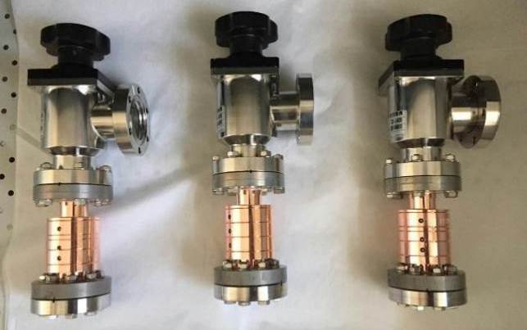
Choke-mode
Single cell of CLIC choke-mode
Choke-Gap 2.1mm
Choke-Gap 1.68mm
Un-damped
Notes:
The cell in the open structure is from the first cell (a=3.15 mm) of CLIC Open-T24.
We may design and test more open structure/choke cells in the future.

Slide 13
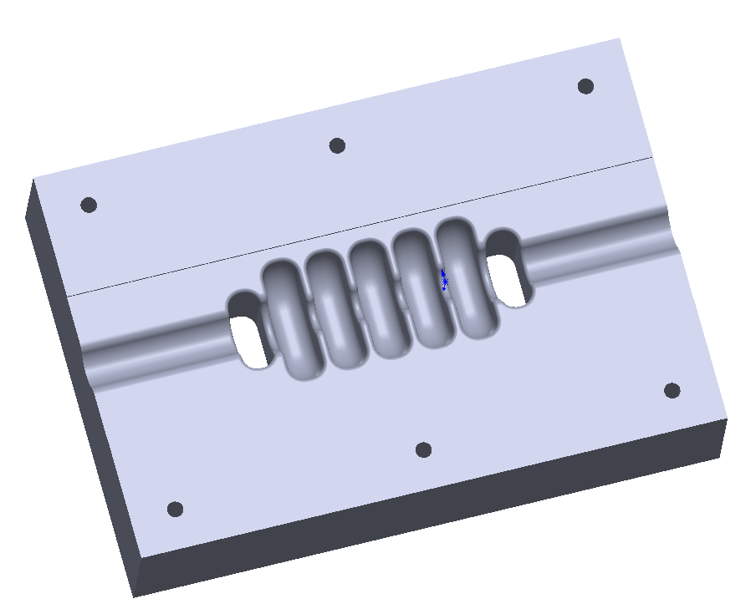
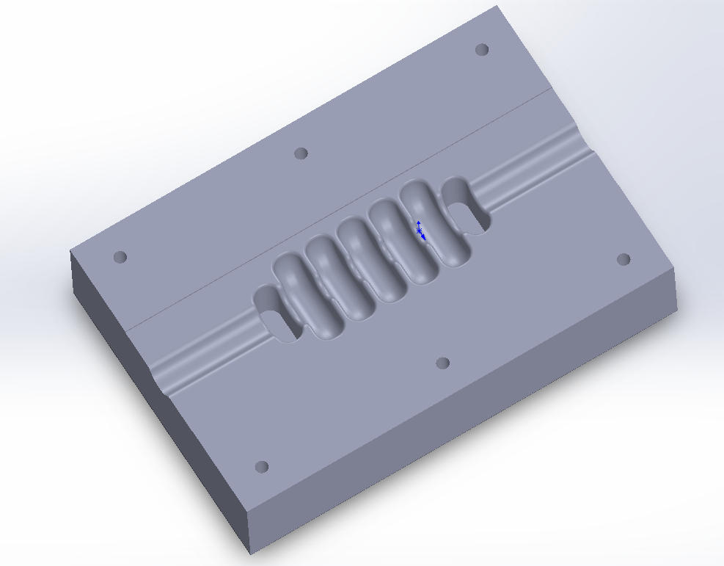
Open structure
3-cell structure
  C3-OPEN
  a3.15, first cell of CLIC-open-T24
Notes:
The cell in the open structure is from the first cell (a=3.15 mm) of CLIC Open-T24.
We may design and test more open structure/choke cells in the future.

Slide 14
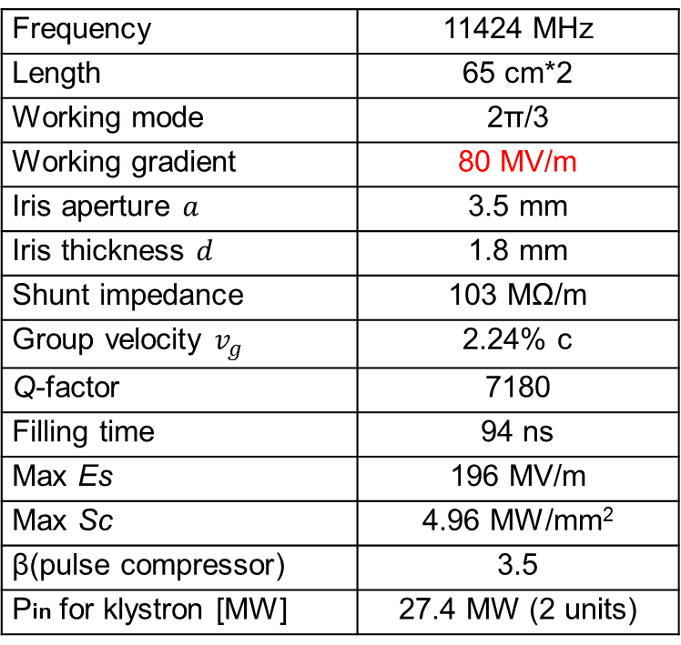
TTX XC-72 structure
We will build two XC-72 units to boost the electron energy from 50 MeV to 150 MeV.
Constant impedance structure is preferred for the compressed RF pulse.
Frequency | 11424 MHz
Length | 65 cm*2
Working mode | 2π/3
Working gradient | 80 MV/m
Iris aperture $a$ | 3.5 mm
Iris thickness $d$ | 1.8 mm
Shunt impedance | 103 MΩ/m
Group velocity $v_{g}$ | 2.24% c
Q-factor | 7180
Filling time | 94 ns
Max Es | 196 MV/m
Max Sc | 4.96 MW/mm²
β(pulse compressor) | 3.5
Pin for klystron [MW] | 27.4 MW (2 units)
X-band klystron
50 MW, 1.5 us
SLED-I
RF load
50 MeV
XC-72
XC-72
150 MeV

Slide 15
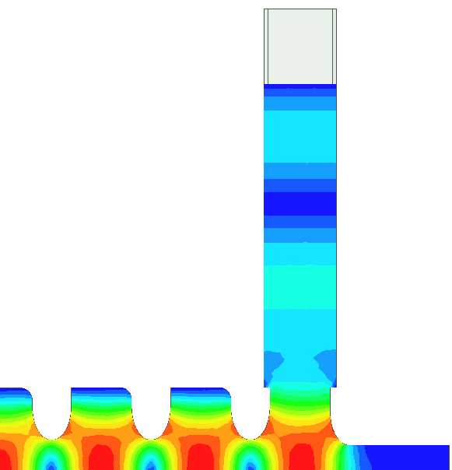
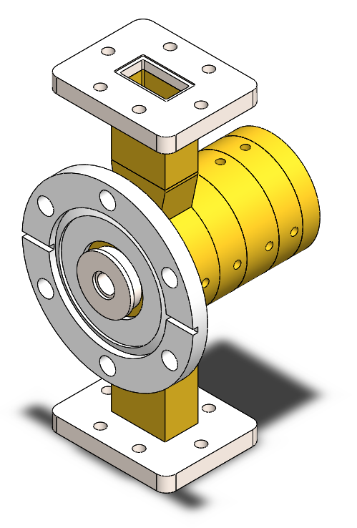
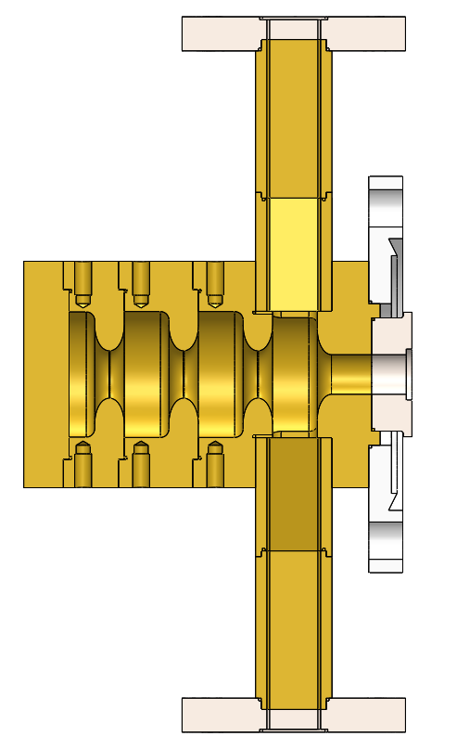
X-band 3.5-cell photocathode gun
X-band RF gun for high brightness electron beam generation (FELs, Thomson scattering sources, etc)
Frequency | 11.424 GHz
Shunt impedance | 170 MΩ/m
Length | 5.9 cm
Input power (Ec = 200 MV/m) | 6.3 MW
Es/Ec | 0.89
Ec =Max field at the cathode Es =Max field at the iris surface
0.55 Cell
Notes:
The structure geometry is optimized for Ec = 200 MV/m.

Slide 16
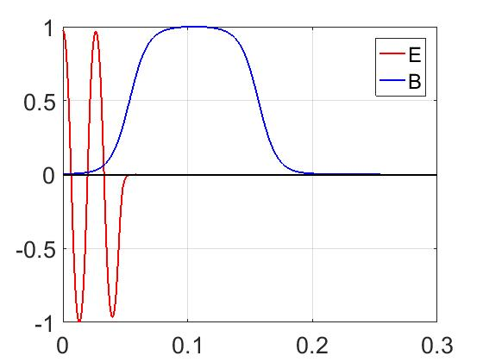
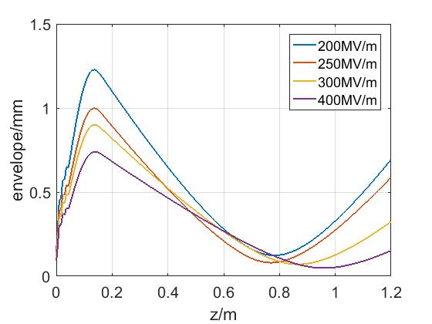
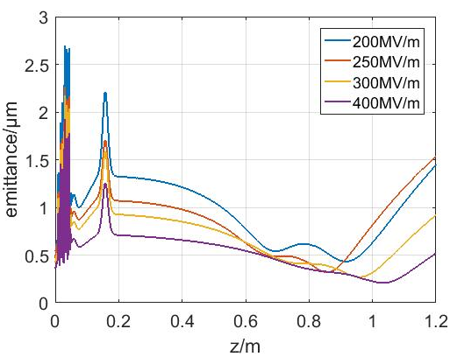
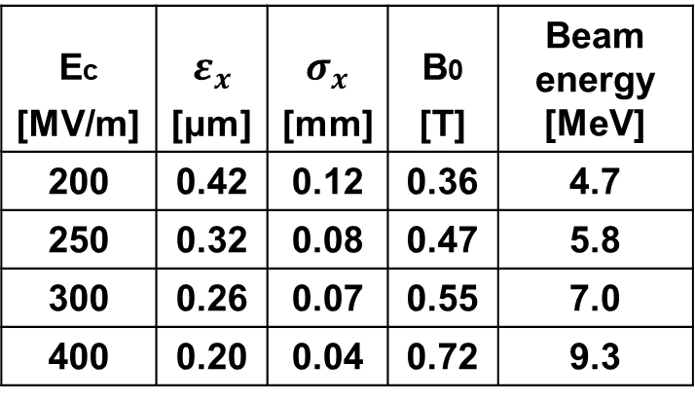
Emittance vs. gradient in the gun
Ec [MV/m] | $$ε_{x}$$ [μm] | $$σ_{x}$$ [mm] | B0 [T] | Beam energy [MeV]
200 | 0.42 | 0.12 | 0.36 | 4.7
250 | 0.32 | 0.08 | 0.47 | 5.8
300 | 0.26 | 0.07 | 0.55 | 7.0
400 | 0.20 | 0.04 | 0.72 | 9.3
Normalized field
Ez/Ec at GUN
Bz/B0 at solenoid
z [mm]
Beam spot size
Emittance
Notes:
Simulations on beam parameters (spot size or emittance) were carried out. The solenoid (10 cm) is placed consecutively after the gun, then a long drift. The gradient in the X-band RF gun is ultra-high, such that it needs a longer drifts to compensate the (sliced) phase space.
The numbers emittances or beam sizes listed in the table are the RMS ones at the matching point (where the projected emittance reaches its minimal)
We may use PM-AM technologies to reduce the filling time (e.g., 50~100 ns) to reduce BDR.

Slide 17
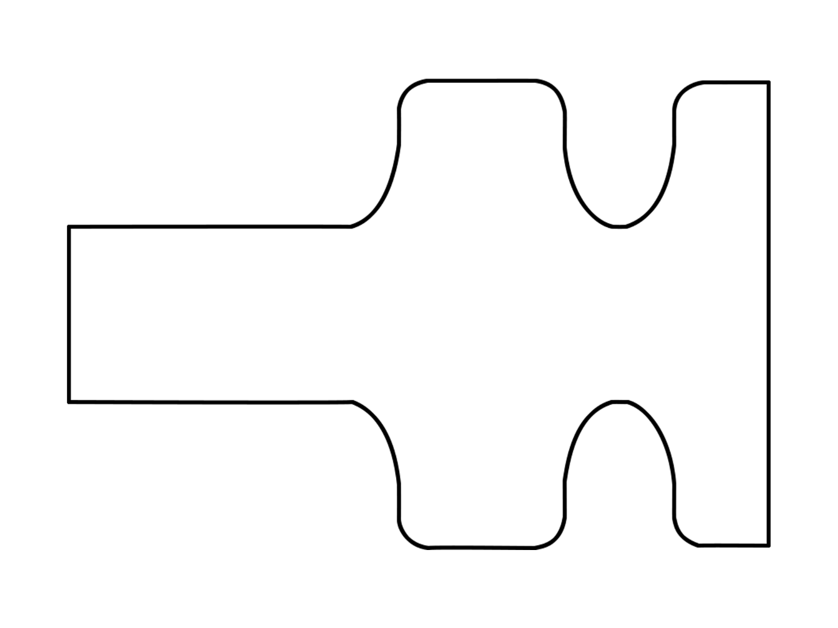
Field emission/dark current study in 1.5-cell gun
Imaging system for dark current or field emission in the X-band RF gun.
μm level of resolution achieved according to Astra simulations.
Powerful tool to study the physics inside the RF break down!
X-band RF power
solenoid
Cathode plug
YAG
Collimator
Collimator aperture = 1 mm
Collimator aperture = 0.2 mm
Notes:
Small aperture may have a higher spatial resolution but result in a lower exposure.

Slide 18
Thank you!
HG2017 Valencia

