Slide 1
Xband Klystron/modulator experience at CERN
HG2017
G. McMonagle
16/06/2017
On behalf of all the Xbox team

Slide 2
OUTLINE
Xbox1 and Xbox2
  (summary)
Xbox3
  Modulators
  klystrons
IUWR90 Flanges
Future

Slide 3
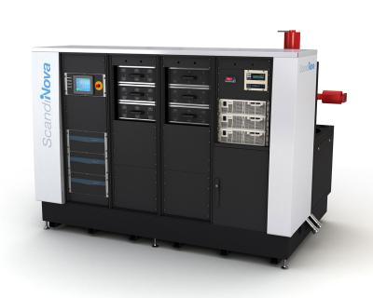
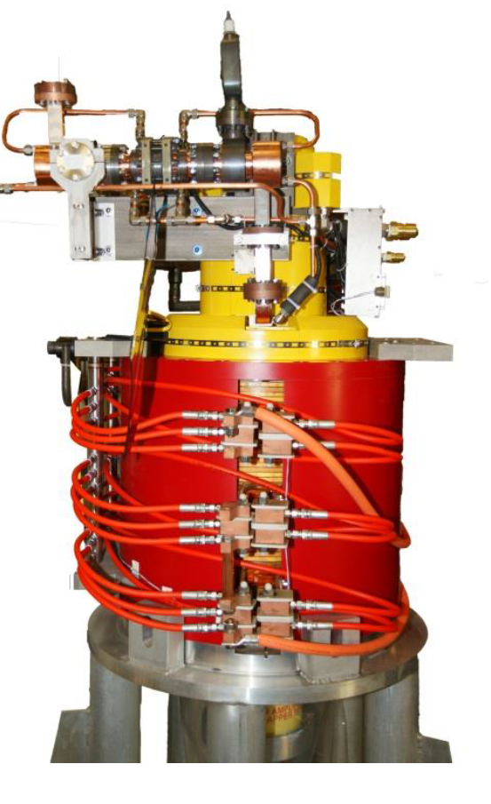
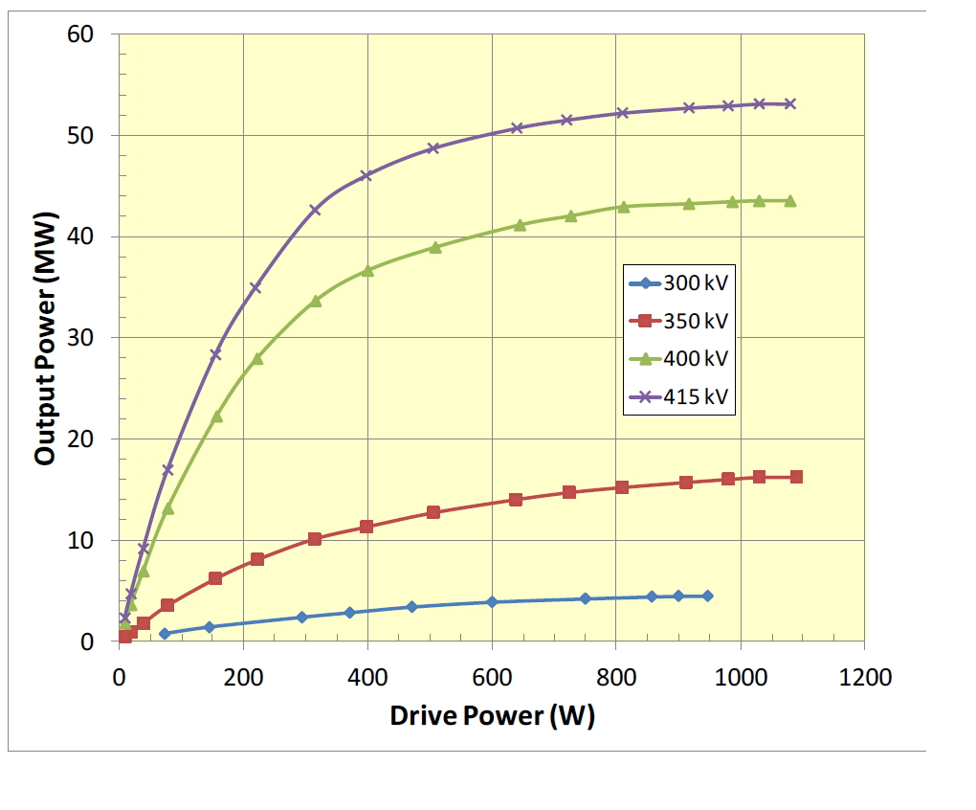
Xbox1 and Xbox2
Scandinova solid state modulators
CPI Klystron (commercial SLAC XL5)
Parameters | Specifications | units
 | VKX-8311A
RF Frequency | 11.9942 | GHz
Peak RF power | 50 | MW
RF pulse length | 1.5 | µs
Pulse repetition rate | 50 (100) | Hz
Klystron voltage | 410-470 | kV
Micro perveance | 1.15E-6

Slide 4
Xbox1 and Xbox2
Xbox1
  Modulator installed since 2010 in CERN, first generation solid state K300
  Initially with XL5 klystron now CPI
  Structure testing in CTF2 or dogleg (beam tests CTF3)
  LLRF getting ‘tired’, pulse compressor difficult to tune
  Still running reasonably well with lots of babysitting
  Never reached nominal power out of klystron , limited by the high power RF network
  Using solid state 1.2KW klystron driver

Slide 5
Xbox1 and Xbox2
Xbox2
  same configuration as Xbox1 for modulator and klystron, (modulator more recent generation)
  LLRF, National Instrument PXI development
  New generation pulse compressor
In commissioning with CPI klystron, oscillations observed (now disappeared)
has been running very reliably this year, really good pulse to pulse stability
TWT driver will be replaced with solid state amp next week

Slide 6
Spare Klystron
3rd Klystron ordered from CPI
Klystron acceptance was done in January 2016
When dismantling test load klystron went up to air
Broken window
Klystron repaired
Initial testing (~January 2017) gun oscillation observed
Discussions between CPI and SLAC
Modification to gun and modulator tank (ferrite tiles)
Acceptance tests next week

Slide 7
Spare Klystron
  Hoping this is compatible
  with CERN
  modulator connectivity

Slide 8
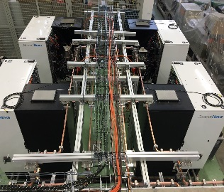
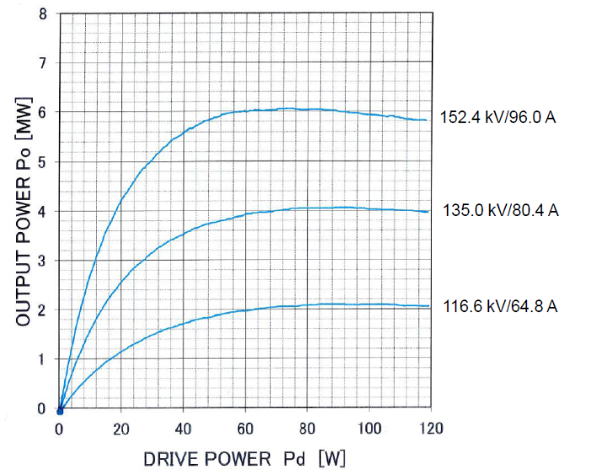
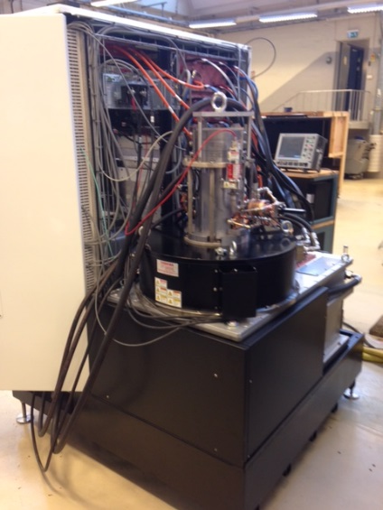
Xbox3
multi slot High Gradient Test Facility
Turnkey solution
Toshiba E37113 klystrons
Scandinova solid state modulators
Parameters | Specifications | units
 | E37113
RF Frequency | 11.9942 | GHz
Peak RF power | 6 | MW
RF pulse length | 5 | µs
Pulse repetition rate | 400 | Hz
Klystron voltage | 150 | kV
Micro perveance | 1.5

Slide 9
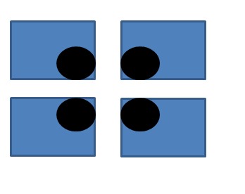
Xbox3_initial configuration
To lines 3 and 4
C
D
#2
#3
#1
#4
A
B
To lines 1 and 2

Slide 10
Xbox3_modulators
all 4 modulators tested successfully in factory with klystron serial #1
All four modulators delivered to CERN and installed with tubes serial #1-4
SAT test in diode mode with Scandinova technicians completed
Software problem (while in remote mode) caused soft start board to burn out in charging supplies, resolved by Scandinova,
performance of modulator now excellent, more user friendly GUI

Slide 11
Xbox3_klystrons
Initial RF tests started with individual klystrons
First three ok
Fourth tube did not give any RF power output
Full reflection on input cavity back to driver
VNA measurement showed cavity detuned
Sent back to Toshiba with solenoid
To lines 3 and 4
C
D
#2
#3
#1
A
B

Slide 12
Toshiba investigation #4

Slide 13
Toshiba investigation #4

Slide 14
Toshiba investigation #4

Slide 15
Toshiba investigation #4

Slide 16
Toshiba investigation #4

Slide 17
Toshiba investigation #4

Slide 18
Toshiba investigation #4

Slide 19
Toshiba investigation #4

Slide 20
Toshiba investigation #4

Slide 21
Toshiba investigation #4

Slide 22
Toshiba investigation #4

Slide 23
Toshiba investigation #4
Toshiba investigation #4

Slide 24
Toshiba investigation #4

Slide 25
Toshiba investigation #4
When did this happen ?
Why ?
Why did the body delta T interlock not work ?
Was it damaged at low rep rate
hence no large temperature difference ?

Slide 26
Toshiba investigation #4

Slide 27
Xbox3_klystrons
#2 and #3 combined together
#1 used to condition loads
LLRF works very well
Conditioned RF network without structure lines 3&4
Opened network to install structure , klystron #3 vacuum problem ,
Toshiba engineer diagnoses window problem, tube sent back to Toshiba for evaluation last week
Install #1 in modulator D to allow two klystron operation for lines 3 and 4
To lines 3 and 4
C
D
#2
#1
A
B

Slide 28
Implementation LLRF algorithm
Works well in test bench
Implemented on modulators C and D
Combination of high power very good and switching between lines worked well (Matteo's talk)
Operation problem when ramping up after breakdown, phase instability
Investigation shows problem with tube #2
FIlament hours 4619 , high voltage hours 3229
Solid state amplifier and low level changed
Problem stayed with klystron
Small changes in solenoid or counter coil only shifted the problem to different input power
VNA measurement on input cavity , frequency ok

Slide 29
Implementation LLRF algorithm
26th May
9th June
Increased radiation levels
Water cooling outlet of solenoid

Slide 30
Perveance change of #2 with rep rate
Initially asked to investigate why power output had reduced on klystron
Noticed perveance change
Increased heater current by 1 amp and recovered tube perveance
Rep rate changed
again perveance changed
More investigations

Slide 31
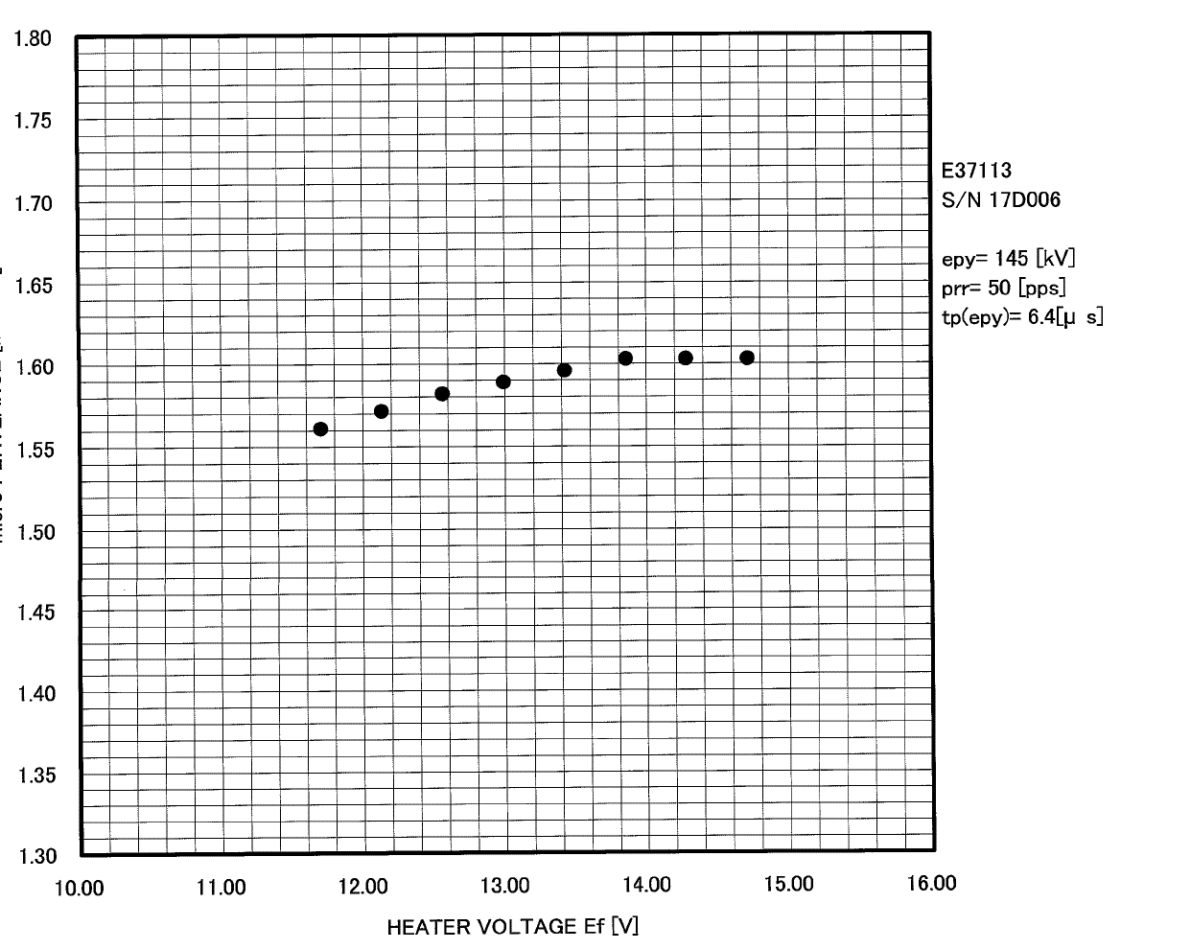
Heater curves #2
Constant Klystron Voltage 150kV
Limit of heater power supply in modulator
Nominal operating point from factory test

Slide 32
Xbox3 today
To lines 3 and 4
Continue testing lines 3 an 4
With instability
First week in July do commissioning of #5 and #6 with Toshiba engineer
After successful tests remove #2 and replace with one of the new tubes
July/August hopefully receive refurbished #4 to complete lines 1 and 2
C
D
#2
#1
#66
#5
A
B
To lines 3 and 4
C
D
To lines 3 and 4
#5
#1
C
D
#66
#5
#1
A
B
#6
#4
A
B
To lines 1 and 2

Slide 33
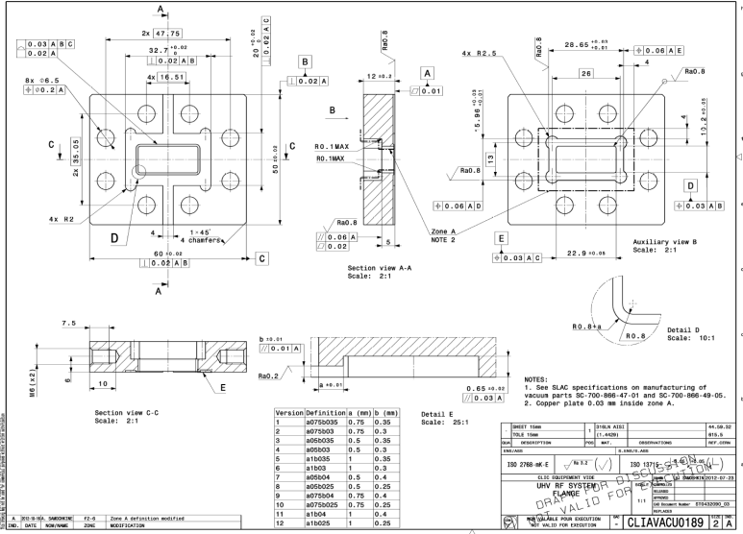
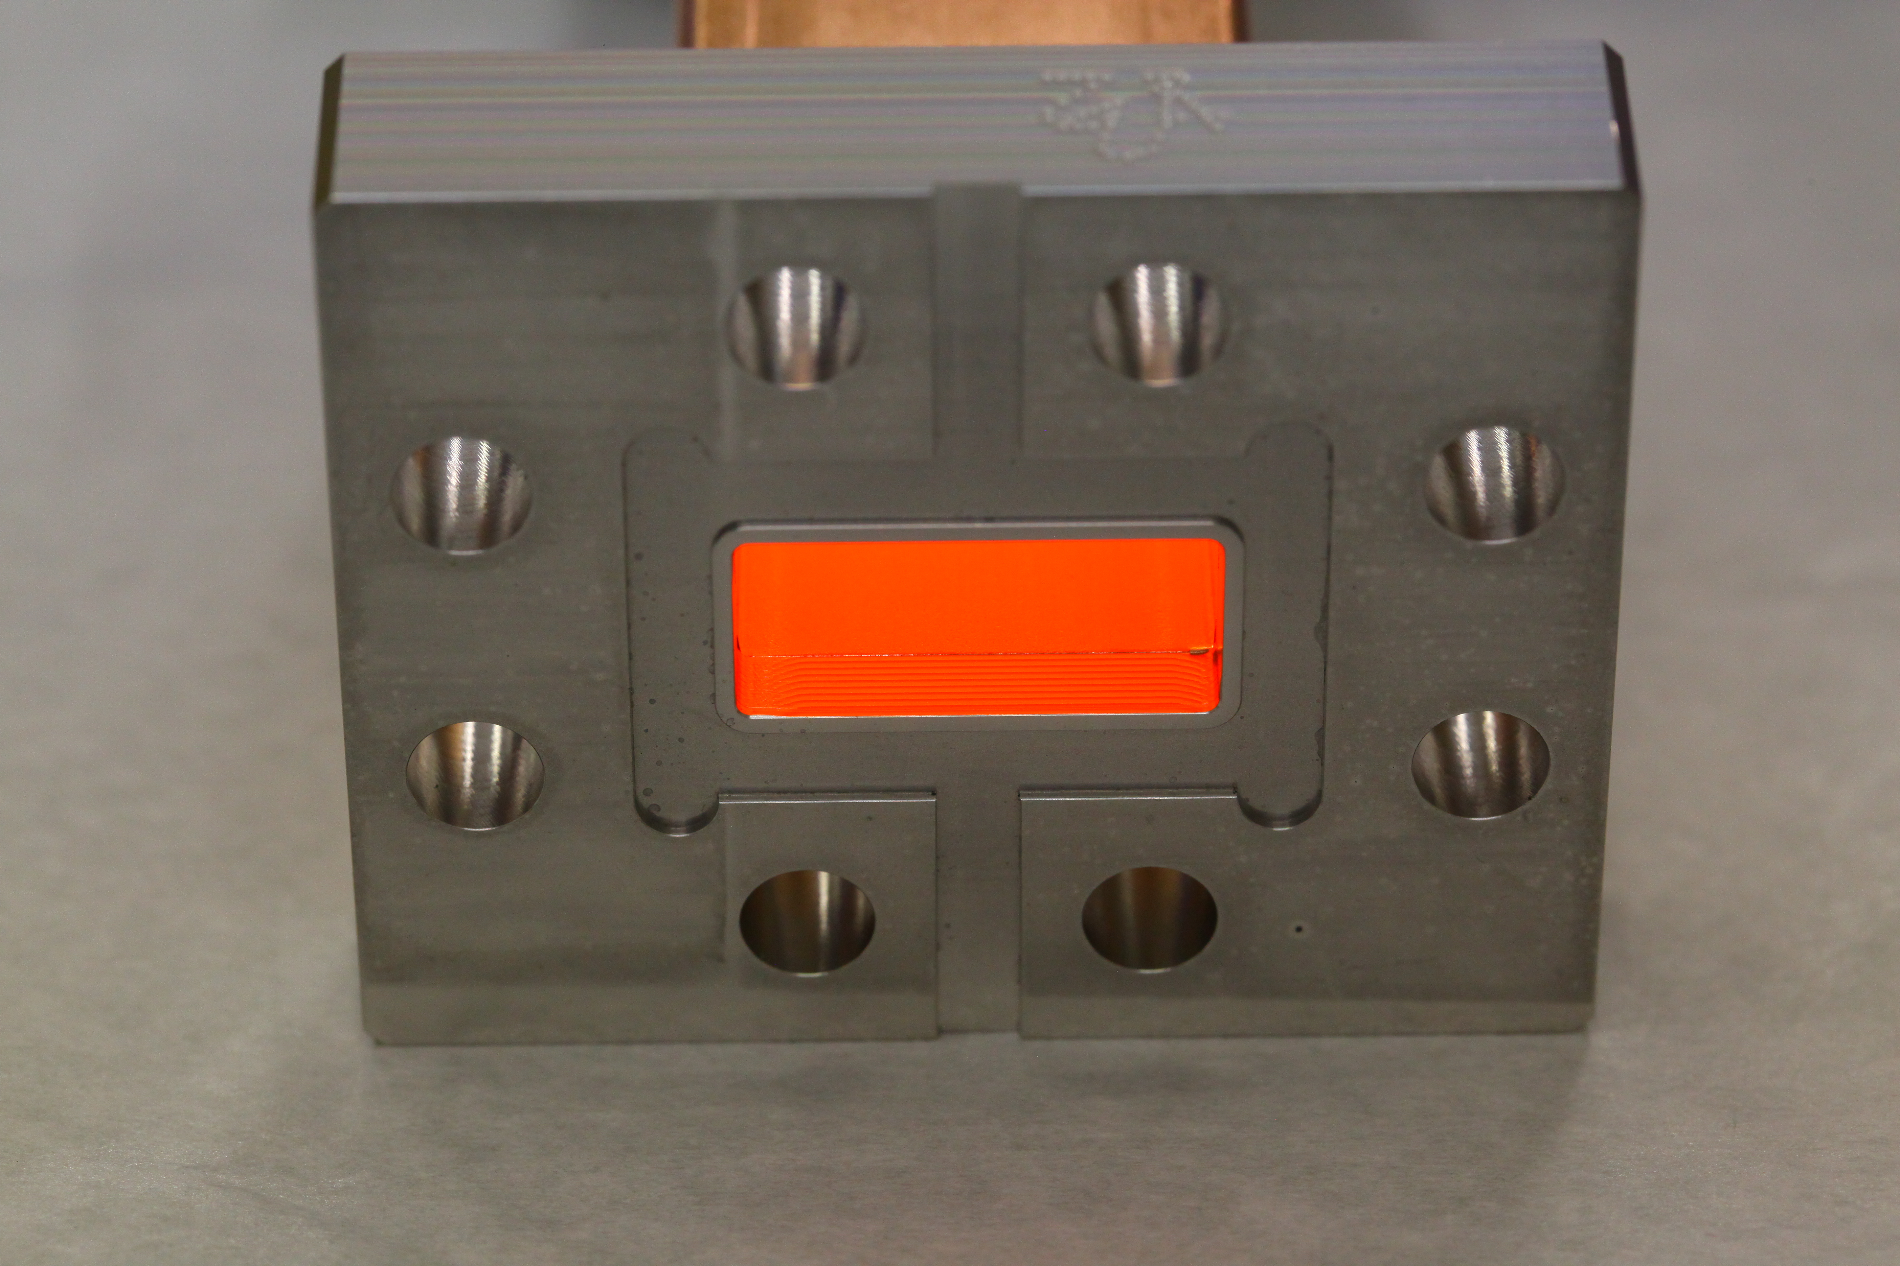
IUWR90 flanges
New unisex Xband flanges are used in Xbox3
  International committee with representatives of KEK, SLAC and CERN
  Tested in SLAC up to 40 MW,1us and 10MW,200 ns
  Tested at CERN, 5us, 5MW, 400Hz and ~42 MW, 200ns, 200Hz
  Copper plating optimised
  Vacuum gasket optimised, tried machined gasket and stamped gasket

Slide 34
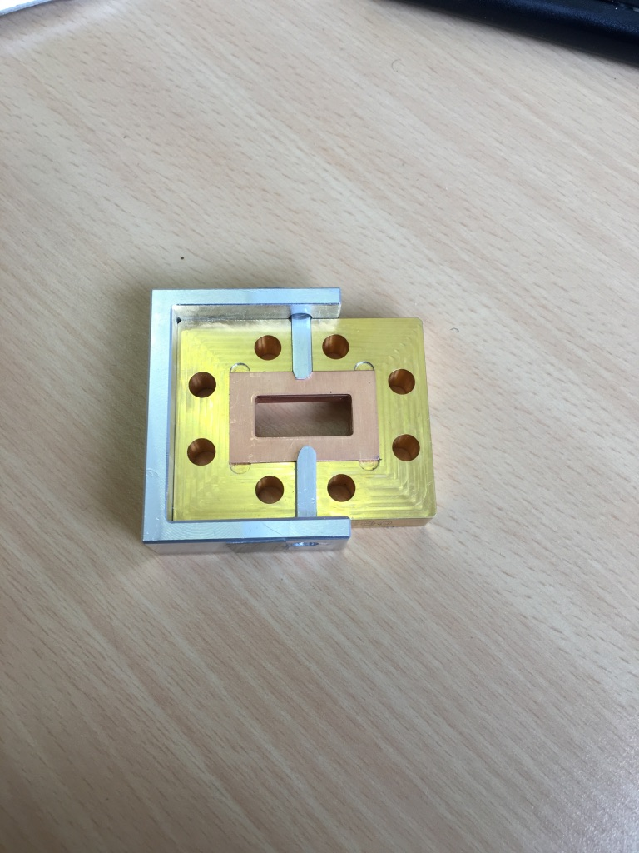
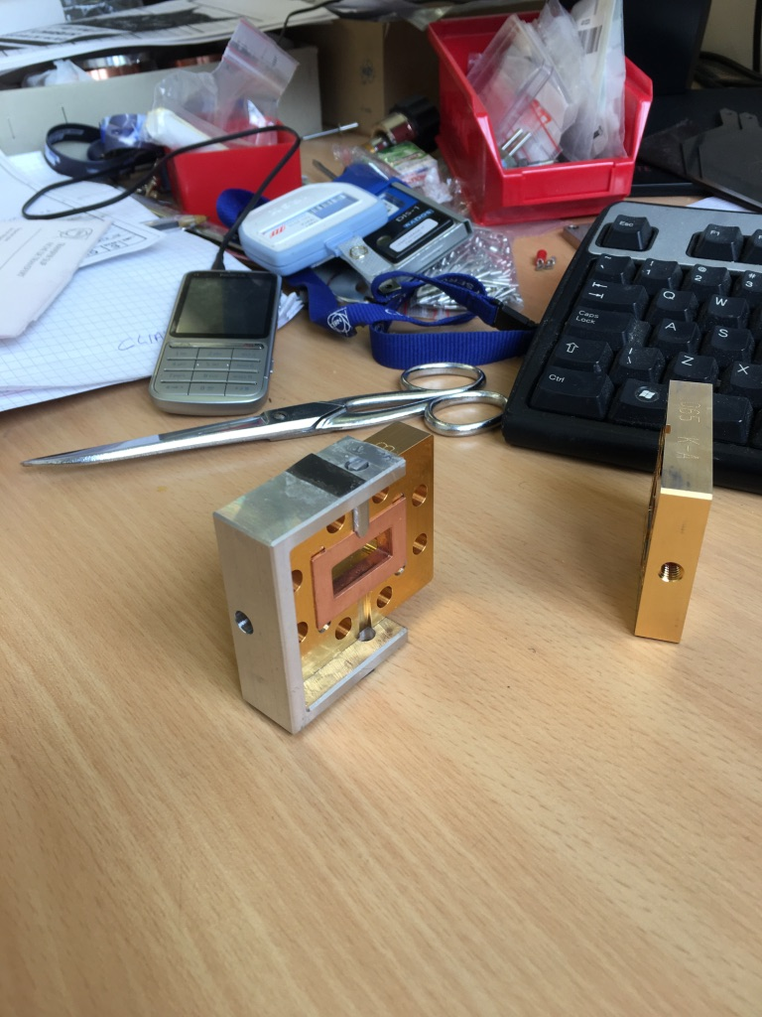
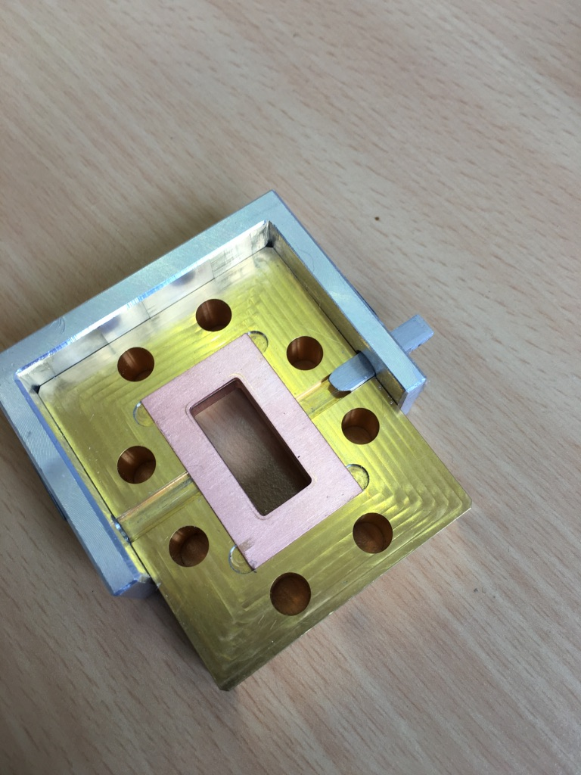
IUWR90 flanges
Stamped gaskets
  Friction fit
  No problem in mounting
  external machined edges of flange allowed alignment by touch
Machined gasket
  Loose fit needs to be held in place
  Mounting jig needed
Stamped gasket with friction fit is now being used

Slide 35
FUTURE
Complete high gradient structure testing program by 2019
Complete commissioning Xbox3 this year
Configure Xbox1 to power structure in CLEAR (2018)
    Upgrade LLRF ? And change pulse compressor?
    Upgrade existing modulator to 100Hz?
Upgrade Xbox2
  Two structure testing, variable attenuator (Veronicas talk)
  Upgrade existing modulator to 100Hz
Xbox3
  50% of Xbox3 to Melbourne, collaboration
  Conditioning structures seems to be dependant on number of pulses
  Higher rep rate faster conditioning ?

Slide 36
FUTURE

Slide 37
FUTURE
Klystron based CLIC
High efficiency klystron development (Igor's talk) ?
Would need two klystrons per 2 m of LINAC
Compact modulator needed for tunnel integration
Test stand at CERN?

Slide 38
FUTURE

Slide 39
FUTURE

Slide 40
Thanks for your attention
ANY QUESTIONS ?
ANY QUESTIONS ?

