Slide 1
Alternative and Flat Beam Triplet
Léon van Riesen-Haupt
17th March 2017

Slide 2
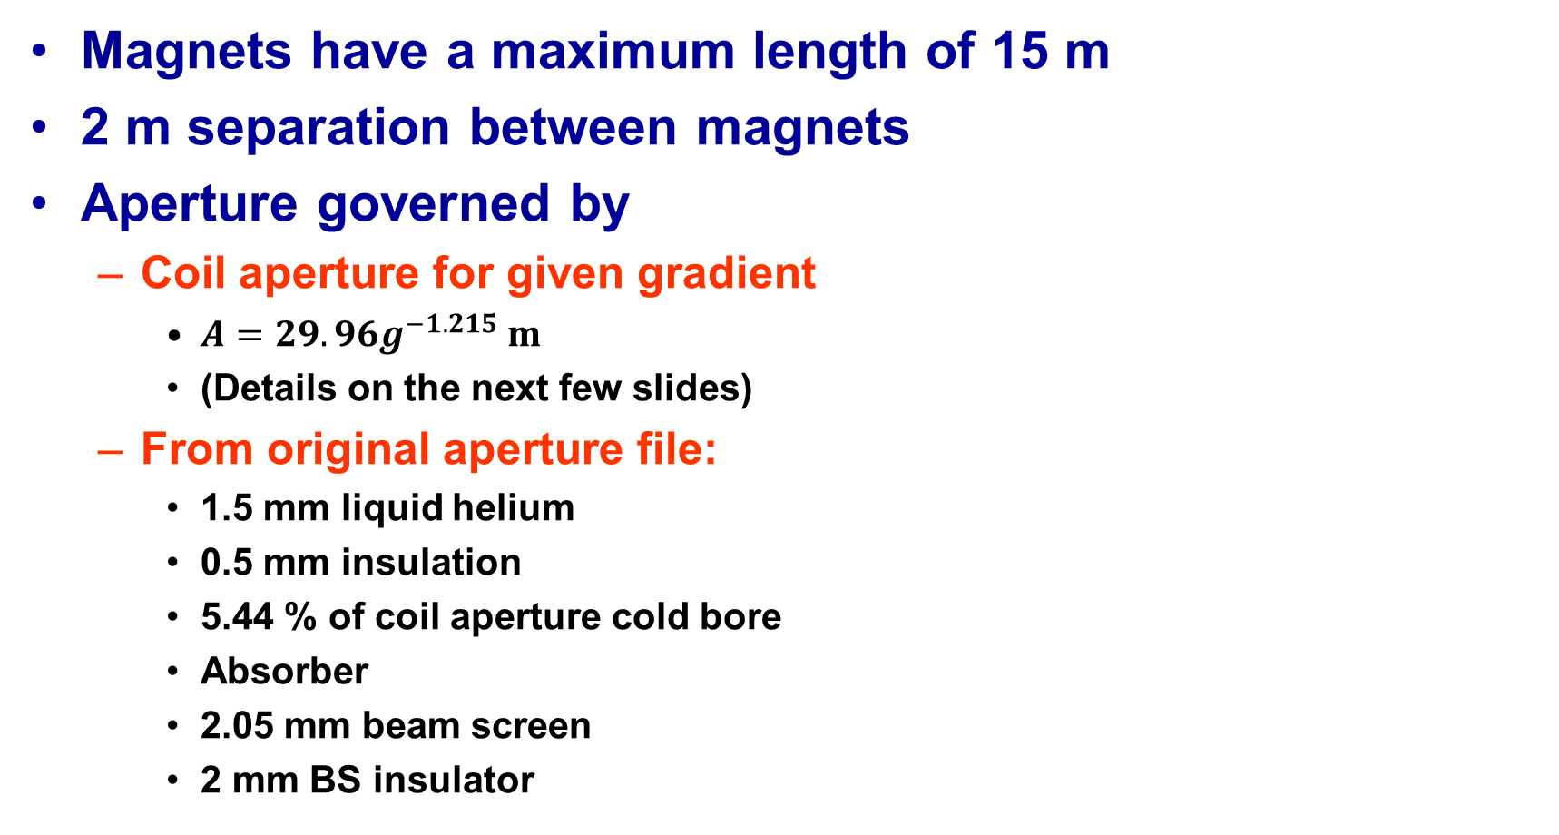
Assumptions
Magnets have a maximum length of 15 m
2 m separation between magnets
Aperture governed by
  Coil aperture for given gradient
    $A=29.96g^{−1.215} m$
    (Details on the next few slides)
  From original aperture file:
    1.5 mm liquid helium
    0.5 mm insulation
    5.44 % of coil aperture cold bore
    Absorber
    2.05 mm beam screen
    2 mm BS insulator

Slide 3
Formula for Coil Aperture
ap. R | w | G
(mm) | (mm) | (T/m)
50 | 25 | 193
60 | 28 | 166
70 | 33 | 149
80 | 35 | 133
90 | 38 | 120
100 | 40 | 110
110 | 43 | 102
120 | 45 | 94
130 | 48 | 88
Old Apertures

Slide 4
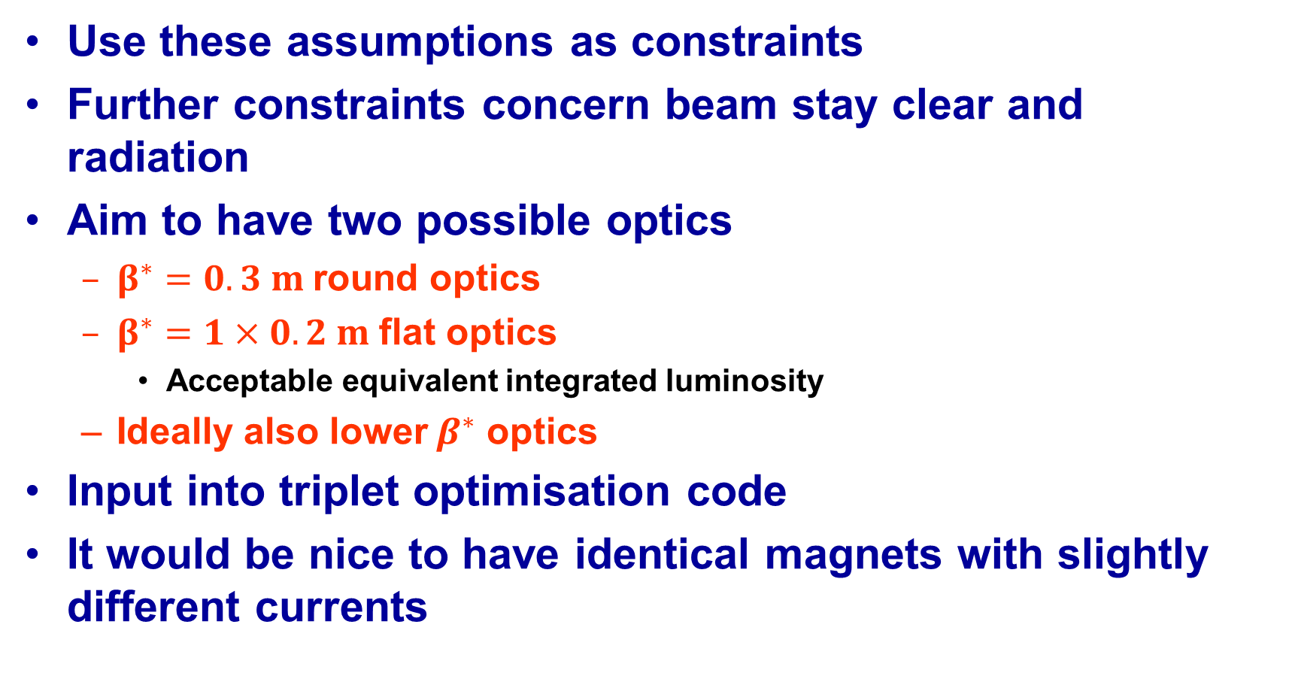
Use these assumptions as constraints
Further constraints concern beam stay clear and radiation
Aim to have two possible optics
  $β^{∗}=0.3 m$round optics
  $β^{∗}=1×0.2 m$flat optics
    Acceptable equivalent integrated luminosity
  Ideally also lower$β^{∗}$ optics
Input into triplet optimisation code
It would be nice to have identical magnets with slightly different currents

Slide 5
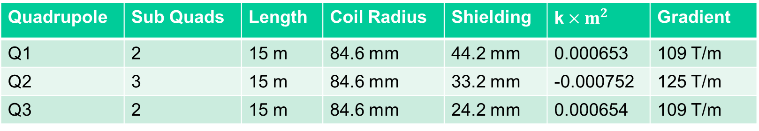
Results
Triplet made of 2-3-2 pattern of identical magnets
Triplet remains the same for all optics – matching section changes
Matched to arc
Quadrupole | Sub Quads | Length | Coil Radius | Shielding | k$×m^{2}$ | Gradient
Q1 | 2 | 15 m | 84.6 mm | 44.2 mm | 0.000653 | 109 T/m
Q2 | 3 | 15 m | 84.6 mm | 33.2 mm | -0.000752 | 125 T/m
Q3 | 2 | 15 m | 84.6 mm | 24.2 mm | 0.000654 | 109 T/m
15 m
2 m
Q1A
Q1B
Q2A
Q2B
Q2C
Q3A
Q3B
45 m
Q1
Q2
Q3

Slide 6
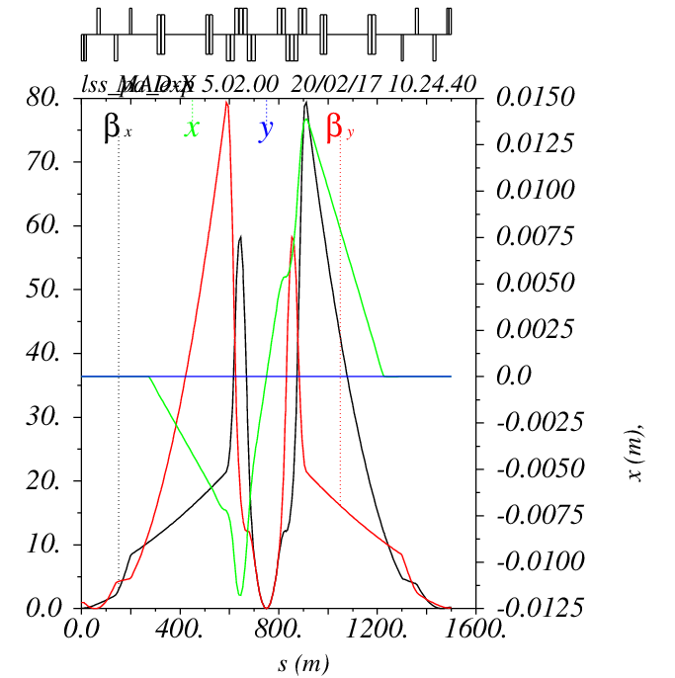
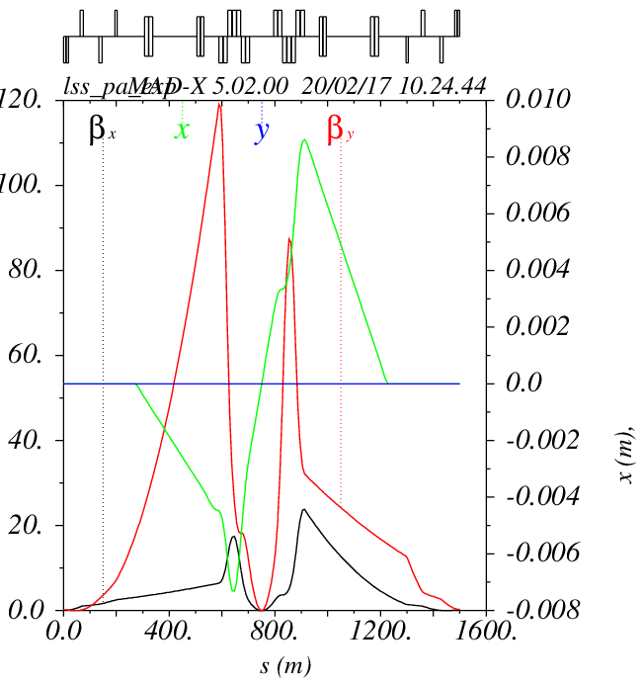
Optics
Round
Flat

Slide 7
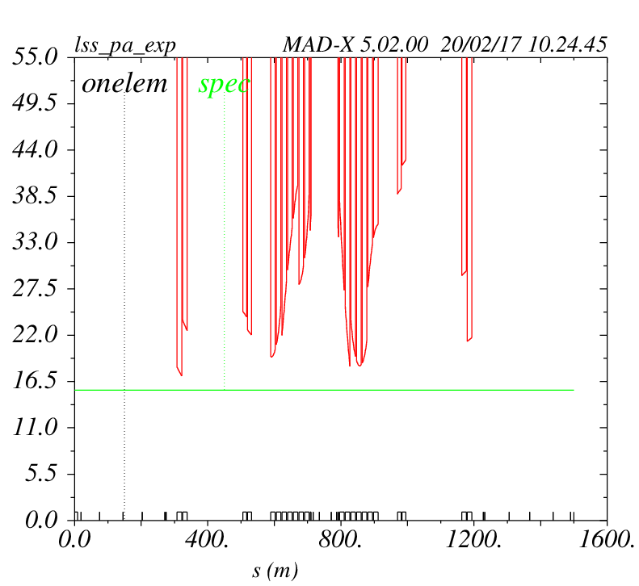
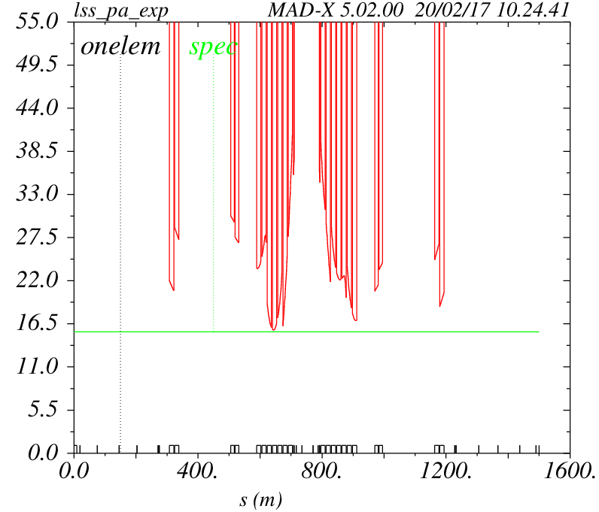


Beam Stay Clear
Round
Flat
$$15.5σ$$
$$17σ$$

Slide 8
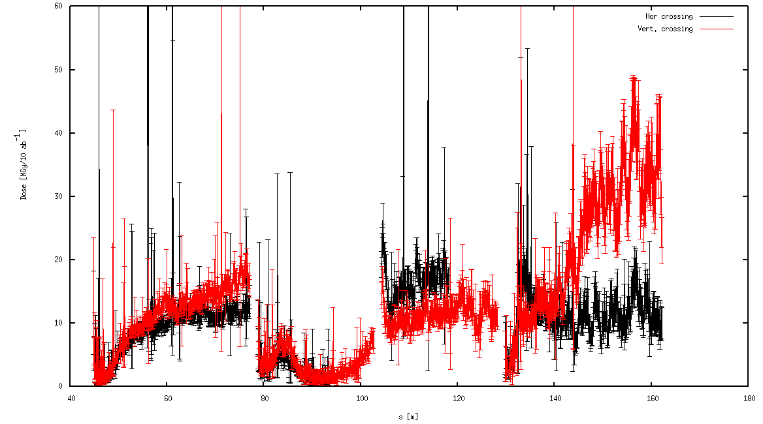
Radiation
Round

Slide 9
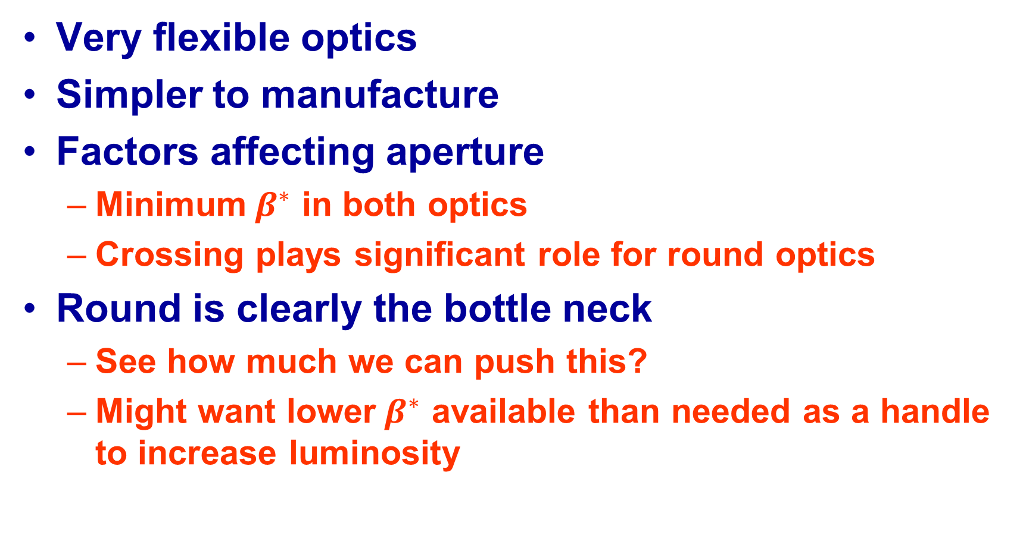
Results
Very flexible optics
Simpler to manufacture
Factors affecting aperture
  Minimum$β^{∗}$ in both optics
  Crossing plays significant role for round optics
Round is clearly the bottle neck
  See how much we can push this?
  Might want lower$β^{∗}$ available than needed as a handle to increase luminosity

Slide 10
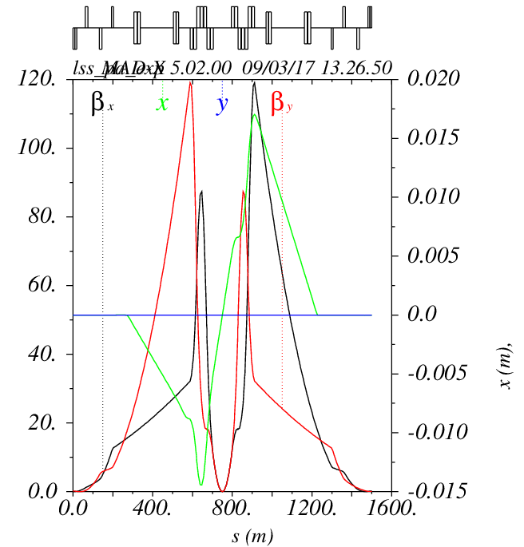
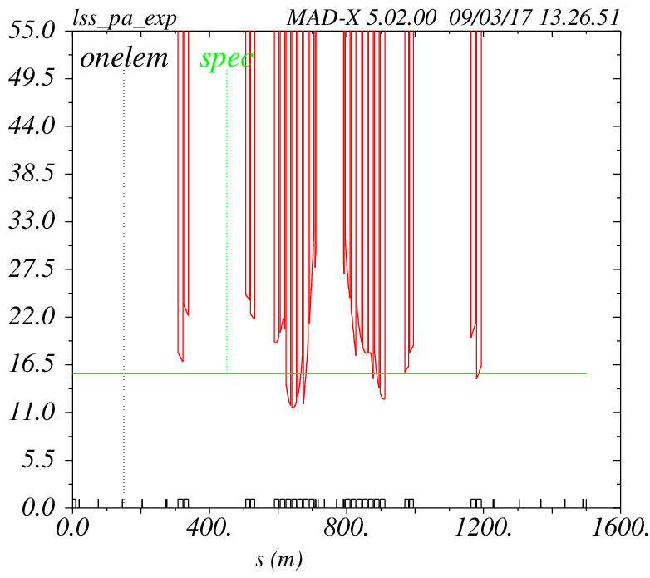

$β^{∗}=20cm$ in Hybrid Triplet
$$11.5σ$$

Slide 11
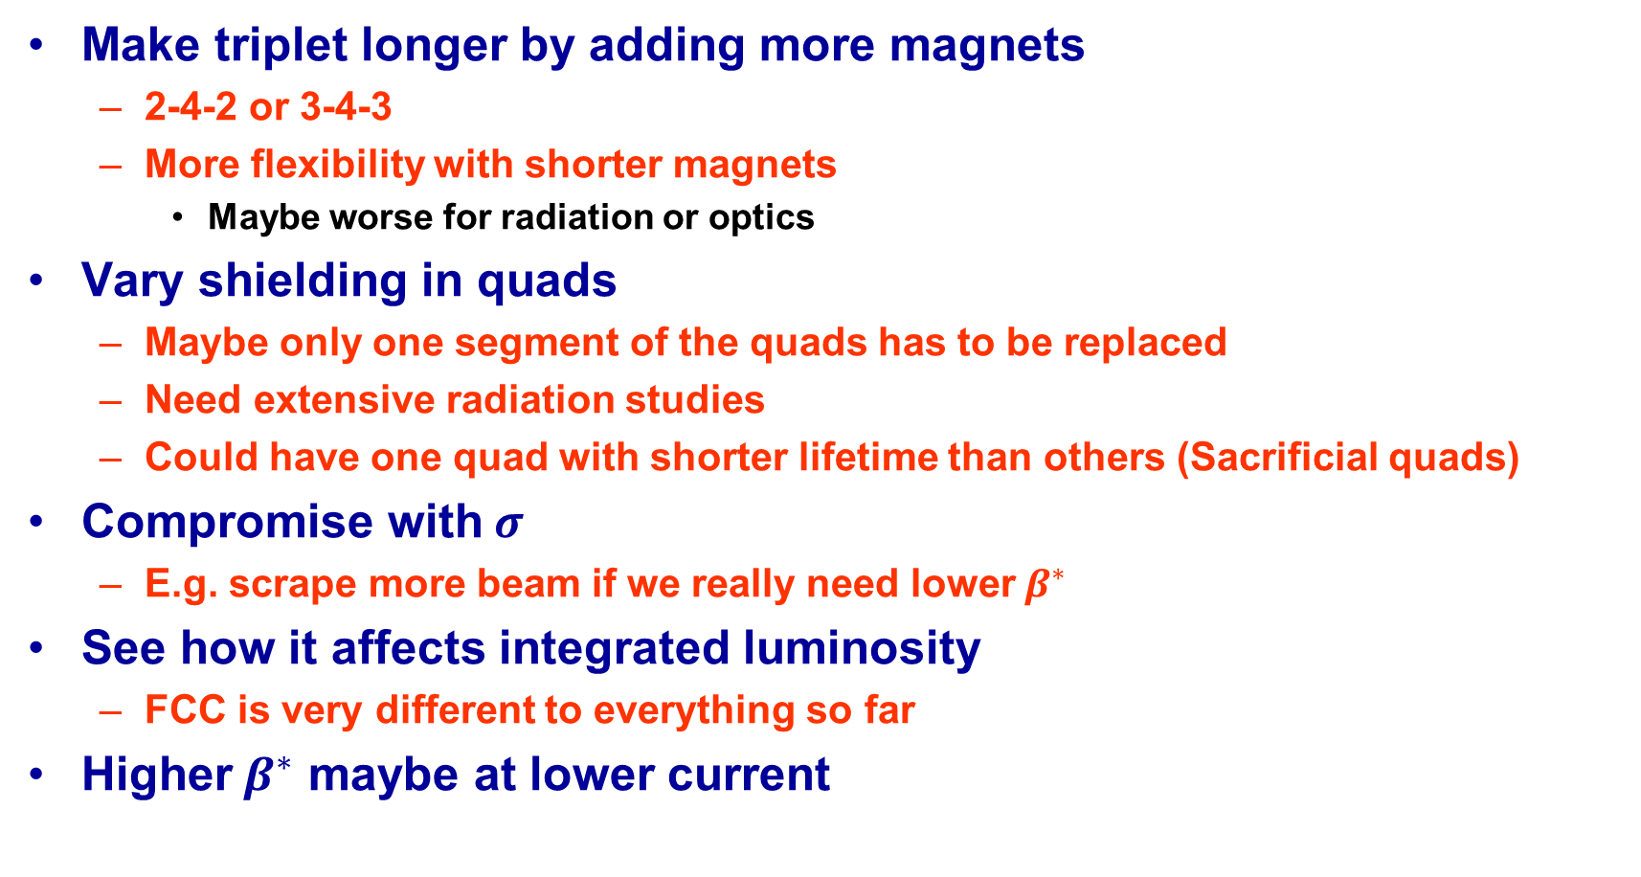
Work Arounds
Make triplet longer by adding more magnets
  2-4-2 or 3-4-3
  More flexibility with shorter magnets
    Maybe worse for radiation or optics
Vary shielding in quads
  Maybe only one segment of the quads has to be replaced
  Need extensive radiation studies
  Could have one quad with shorter lifetime than others (Sacrificial quads)
Compromise with$σ$
  E.g. scrape more beam if we really need lower$β^{∗}$
See how it affects integrated luminosity
  FCC is very different to everything so far
Higher$β^{∗}$ maybe at lower current

Slide 12
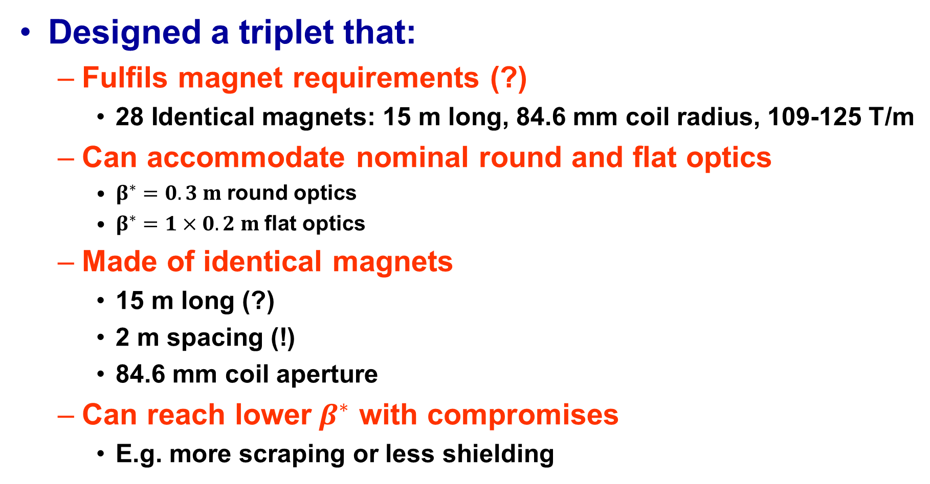
Conclusion
Designed a triplet that:
  Fulfils magnet requirements (?)
    28 Identical magnets: 15 m long, 84.6 mm coil radius, 109-125 T/m
  Can accommodate nominal round and flat optics
    $β^{∗}=0.3 m$round optics
    $β^{∗}=1×0.2 m$flat optics
  Made of identical magnets
    15 m long (?)
    2 m spacing (!)
    84.6 mm coil aperture
  Can reach lower$β^{∗}$ with compromises
    E.g. more scraping or less shielding

Slide 13
More Questions
2 m spacing between quads enough
How much radiation can it take
How hard to replace a quad
Even out radiation by rotating magnets
Nature of interconnects
Length of correctors and skew quads
Are identical magnets useful

