Slide 1


Field quality in FCC-hh dipoles - Discussion
Daniel Schoerling
17/03/2017
Thanks to all members of EuroCirCol and FCC for material and discussion

Slide 2
Estimate of FCC dipole errors
Review of past experience (LHC, Nb₃Sn magnets)
Nb₃Sn magnet model experience (F. Borgnolutti et al., IEEE Trans. Appl. Supercond., Vol. 19, No. 3, June 2009): Potential of improvement, currently ~5 times worse coil position reproducibility than for Nb-Ti (large series) magnets
New information from Fresca-2, 11 T and MQXF is being gathered by Susana Izquierdo Bermudez
Conductor has larger filaments (->larger persistent currents effects)
Coils are stiffer (E-modulus is ~30 GPa instead of 10 GPa) and are strain sensitive. Therefore, it is harder to constrain them into the same cavity to ensure a reproducible field quality

Slide 3
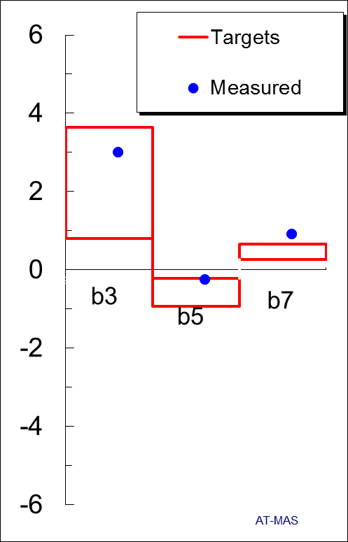
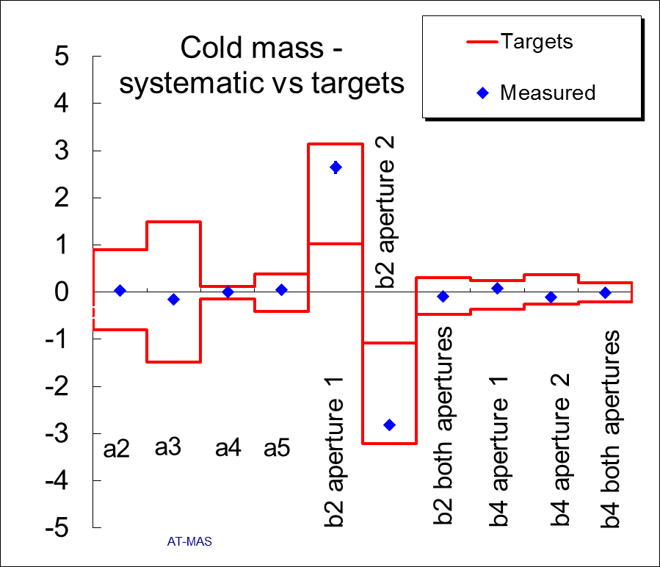
Experience from LHC
Collison energy

Slide 4
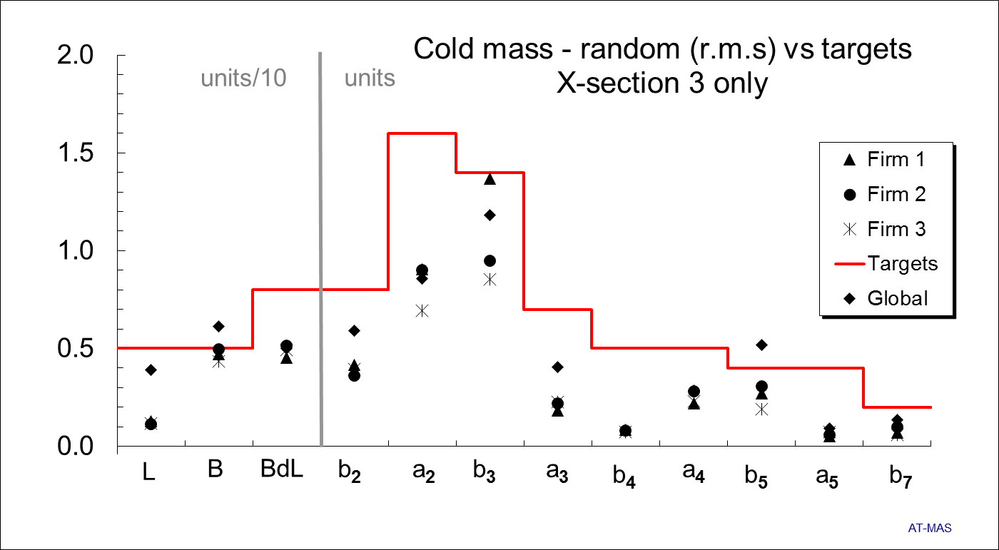
Experience from LHC

Slide 5
Example of Table
Separate the contributions into the following categories:
Design values (geometric)
Systematic wrt design from manufacturing, persistent current, snap-back, saturation (different at injection and collision energy)
Random contribution from manufacturing tolerances
Explanation b₃:
Design (geometric): reference value ±1 unit
Systematic wrt design (Inj): Persistent current effects (11 T dipole, state of the art)
Systematic wrt design (Coll): Saturation (10 units) ± LHC range/2 (slide 3)
Random: 2 x LHC value (slide 4)
S. Izquierdo Bermudez et al., IEEE Trans. Appl. Supercond., Vol. 26, No. 4, June 2016
 | Design | Systematic wrt Design |  | Random
Normal | Geometric | Inj | Coll | Inj/Coll
b3 | Ref±1 | <20 | Sat±2 | 3
b4
b5
b6
b7
Skew
a3
a4
a5
a6
a7

