Slide 1
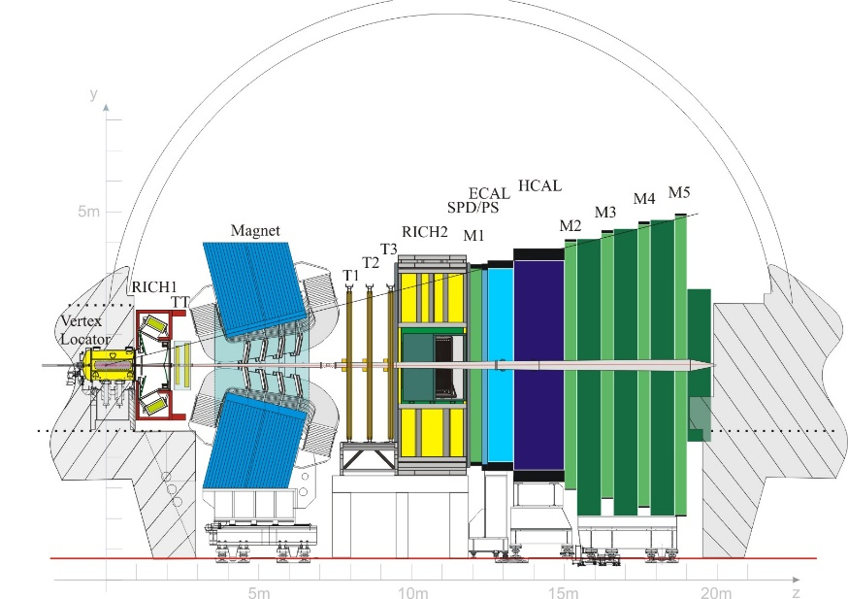
LHCb & EYETS 2016-2017

Slide 2
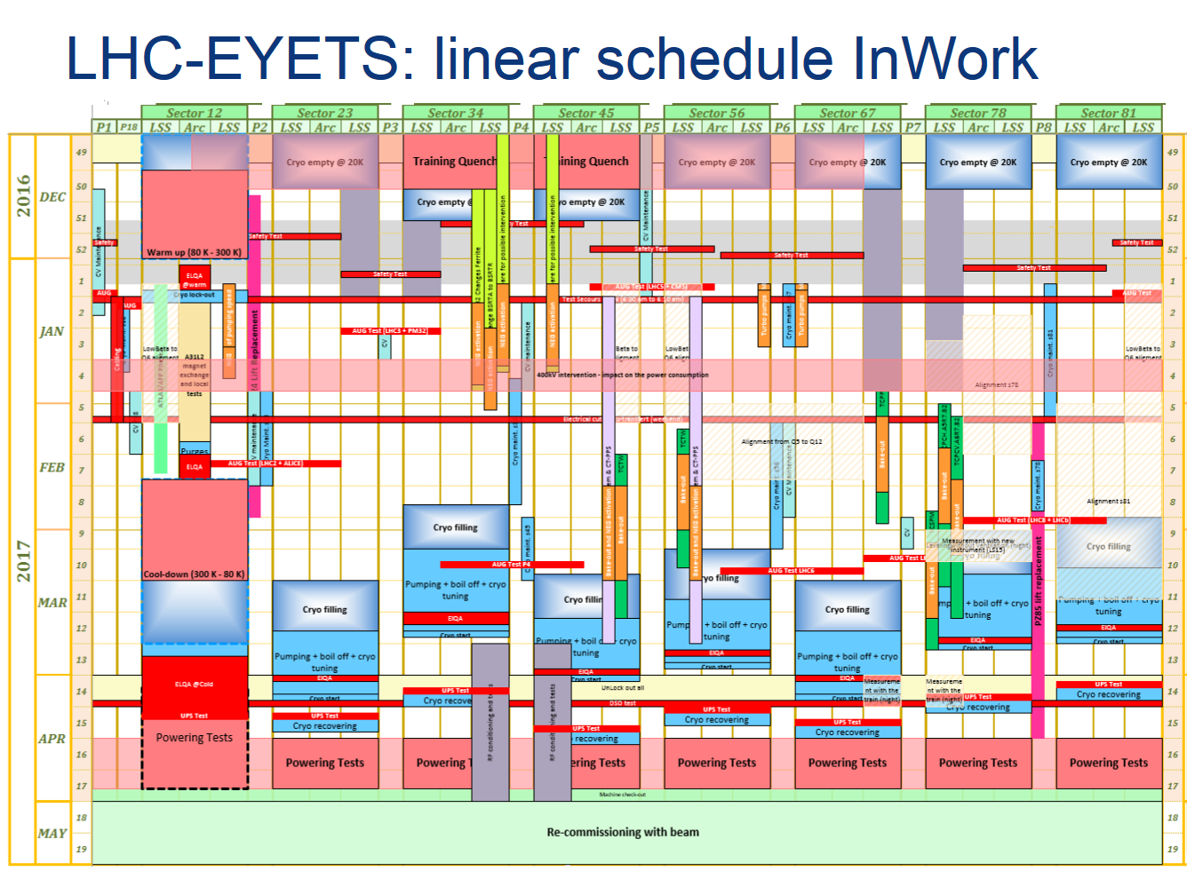
LHC planning

Slide 3
Detector Activities
VELO: Fix C02 pump
RICH1+2: HPD box RICH1 A-side out (FE electronics & HPD). HPD exchange (RICH2).
TT: Repair broken bonds (3 modules removed and shipped to Zurich). Replace dead VCSEL.
Dipole: Tightening current feed connectors, MSS PLC upgrade.
IT: -
OT: -
ECAL/HCAL: Change PMTs, CS 137 Scan, passive dosimeters exchange
PS/SPD: fix SPD VFE LV distribution, PRS VFE replacement, passive dosimeters exchange
M1: A Side open - fix chamber M20A1 (FEB) + other FE issues
M2-M5: Fix FE electronic issue on M2-front and M5-back, debugging of some electronic Boards (Towers). HV training…
Herschel L0/Scintillators replacement

Slide 4
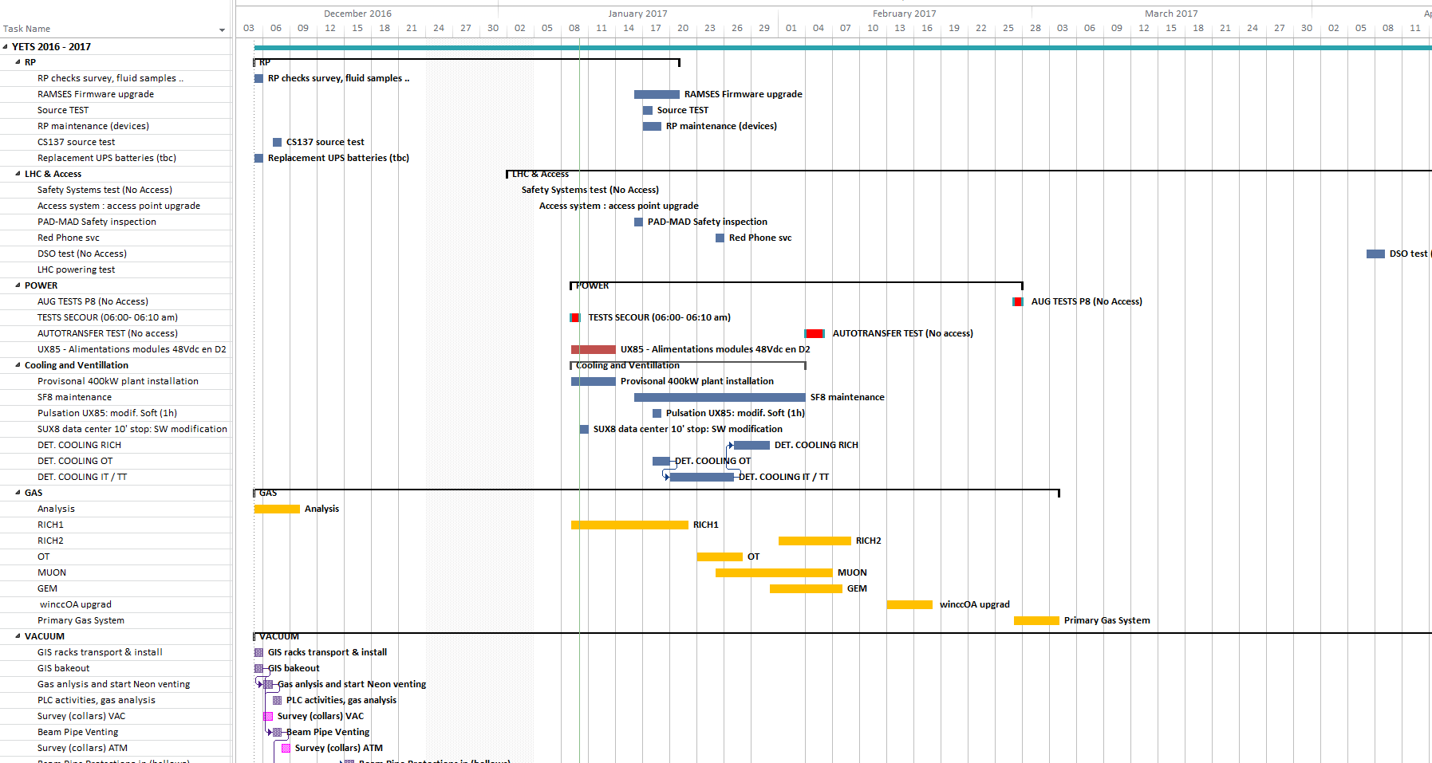
Planning

Slide 5
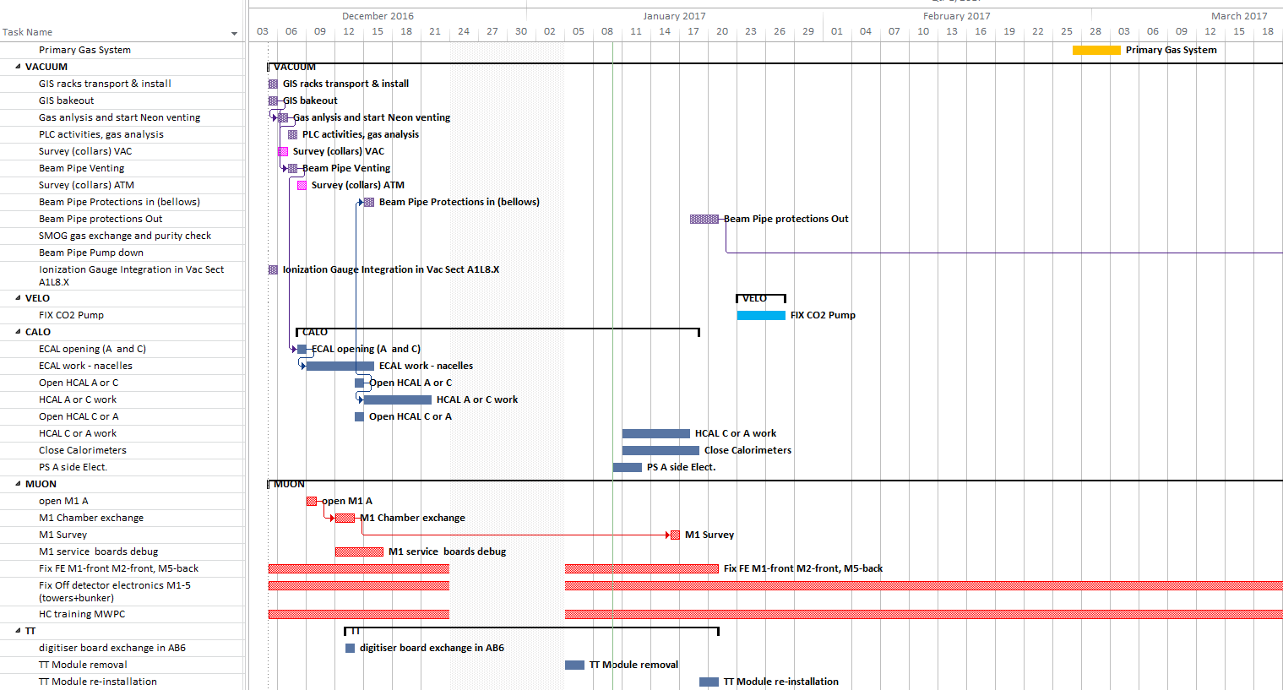
Planning

Slide 6
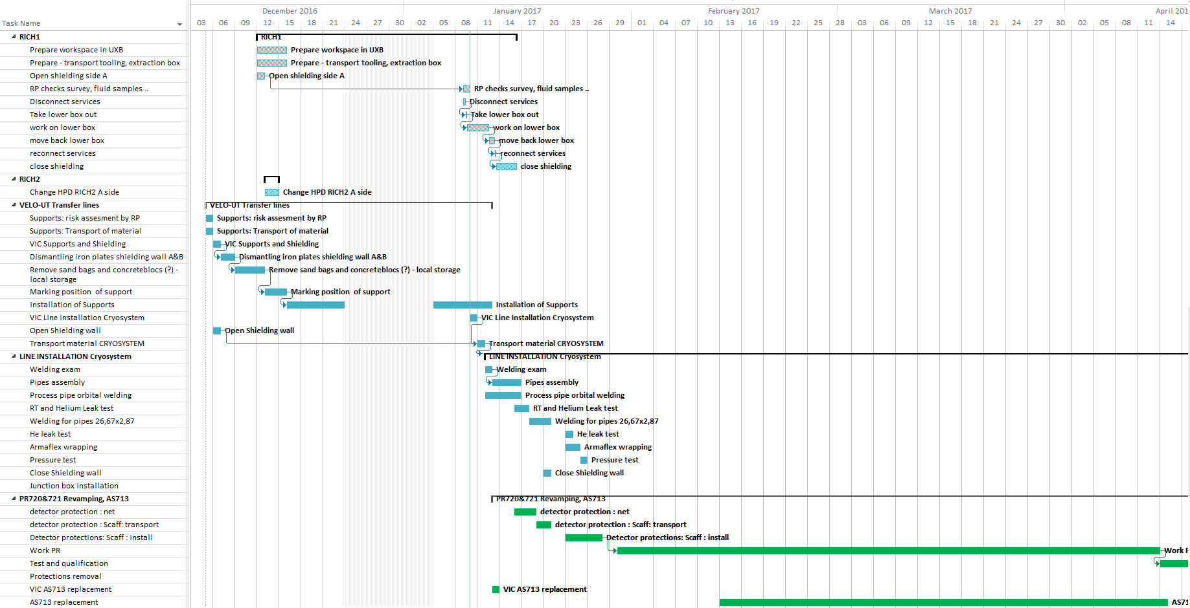
Planning

Slide 7
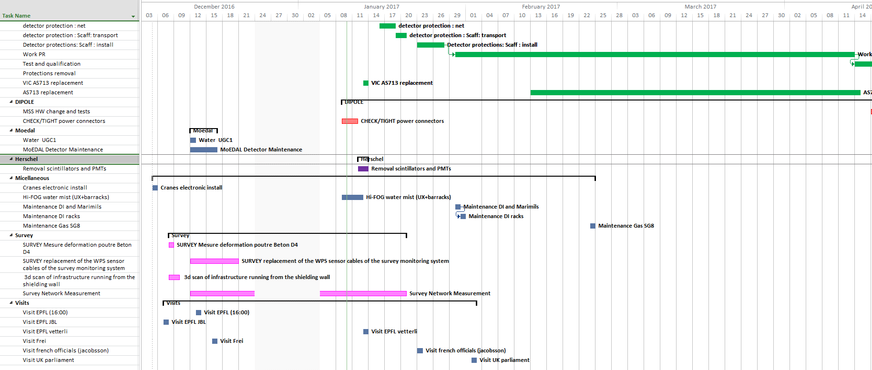
Planning

Slide 8
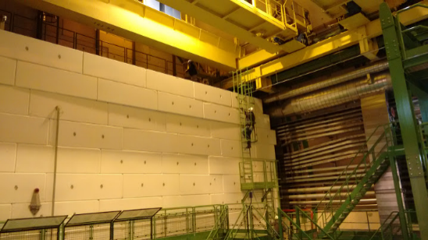
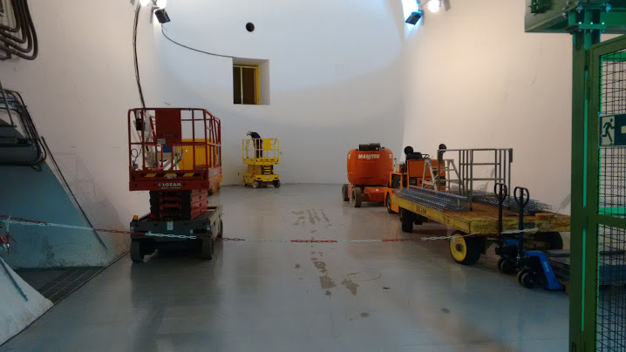
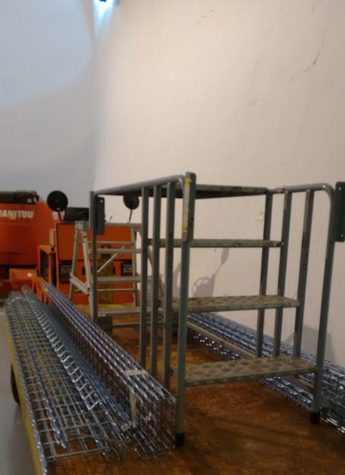
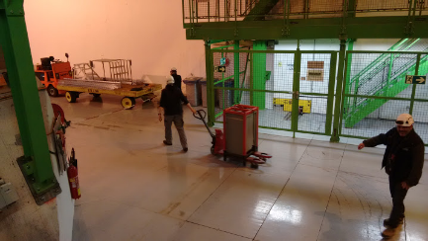
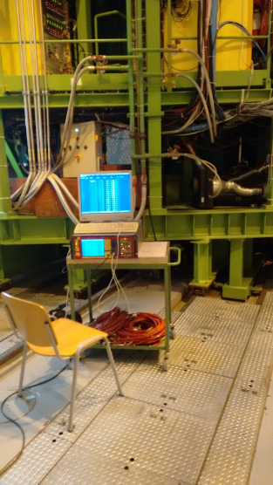
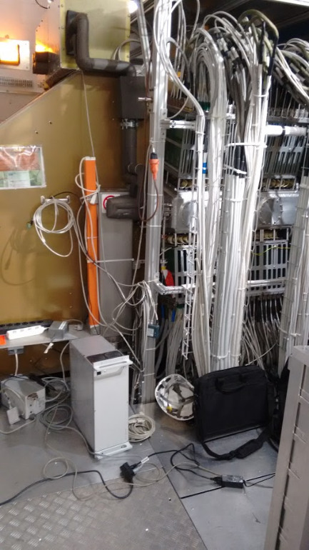
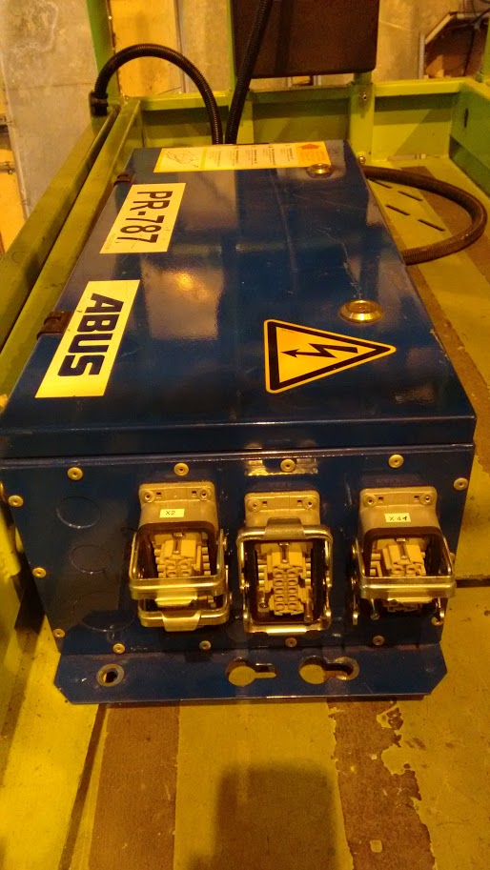
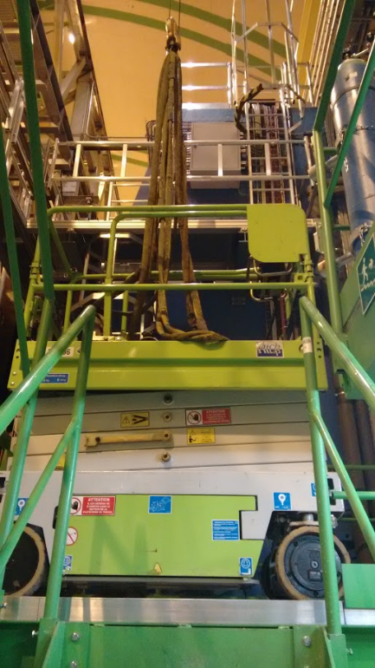
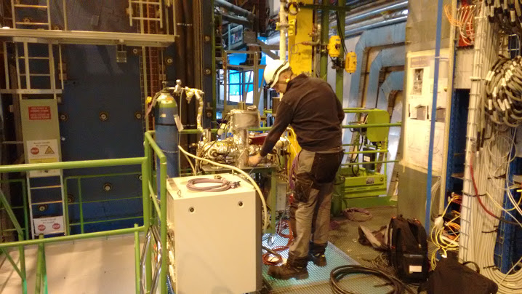
Day 1 (Dec 5)
Material for
TT
CO2 cooling/control box/cable
Preparing transfer lines support
New (rented) nacelle for CALO
SMOG gas analysis
MUON HV training
PR787 crane electronic (RICH1)
GIS Bakeout

Slide 9
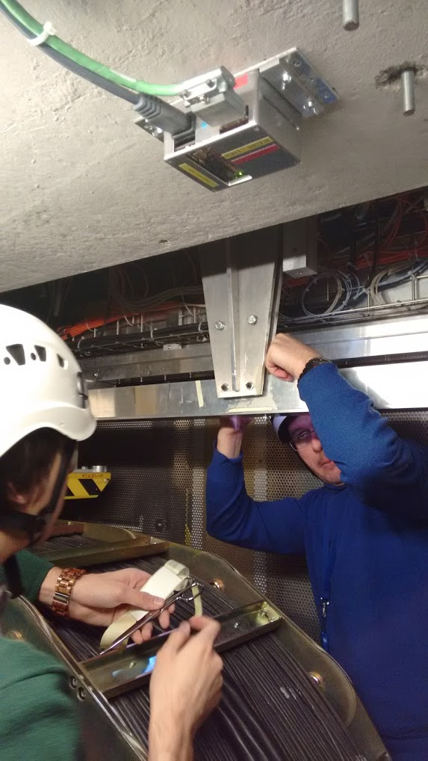
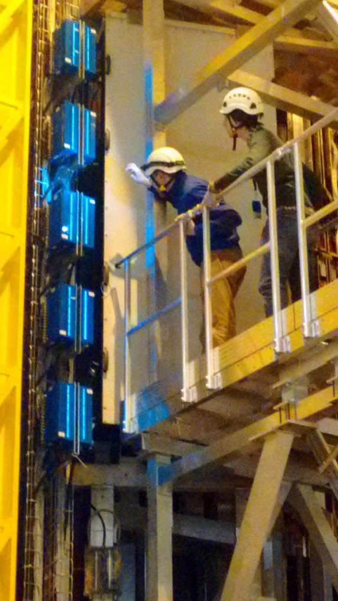
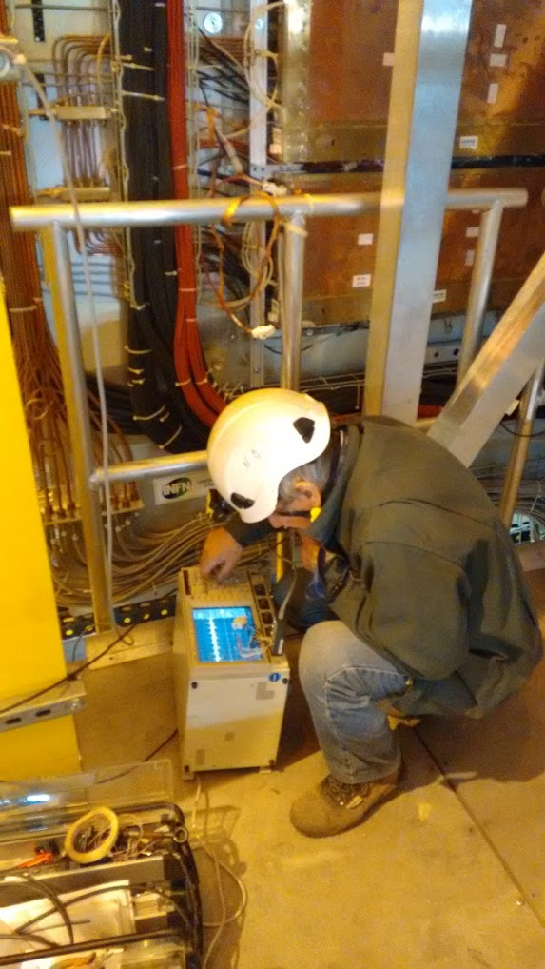
M1

Slide 10
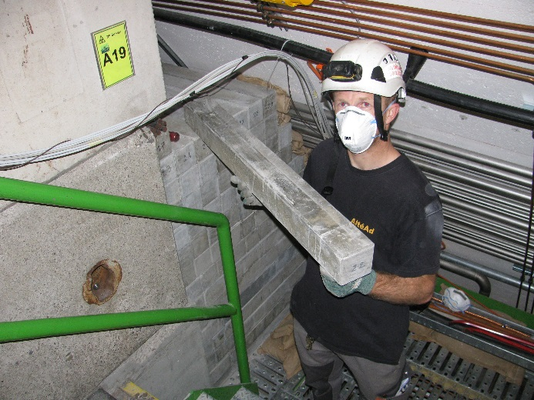
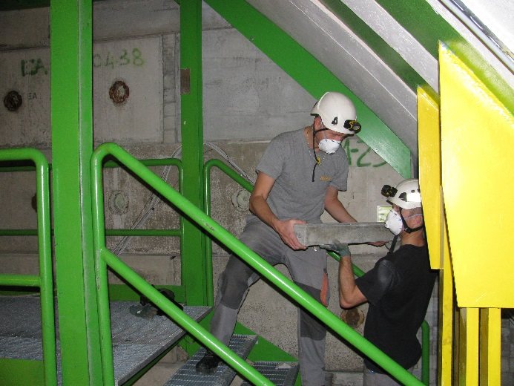
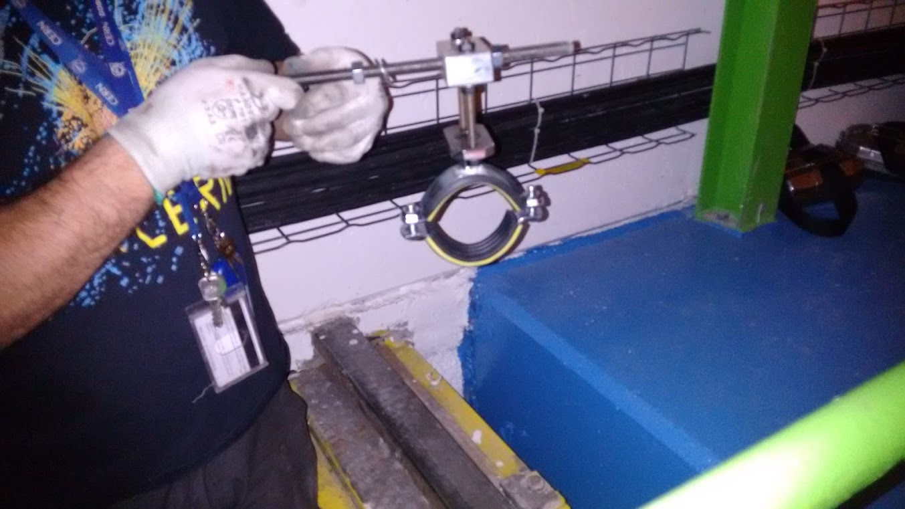
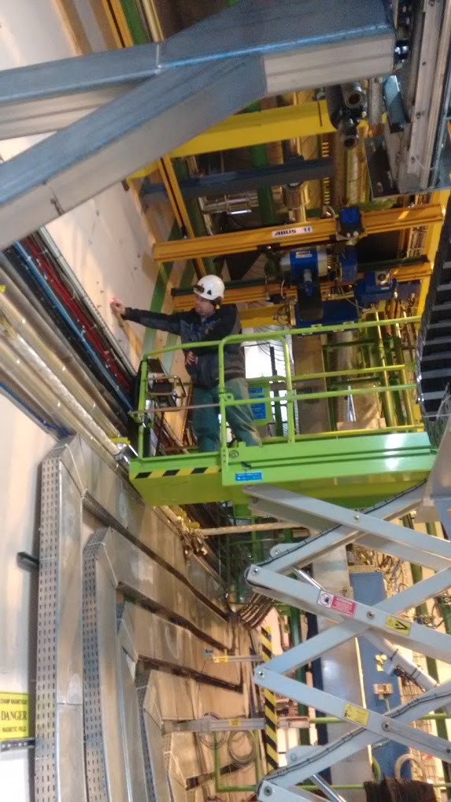
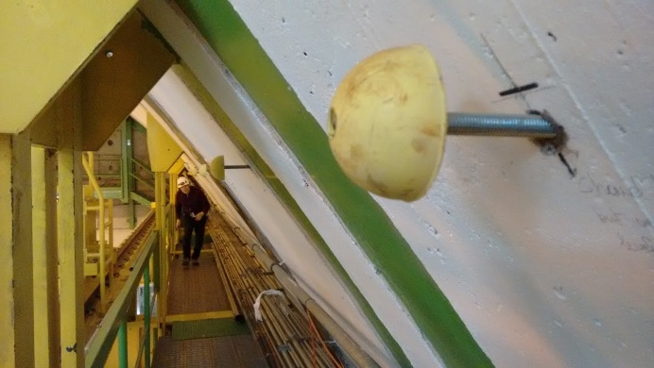
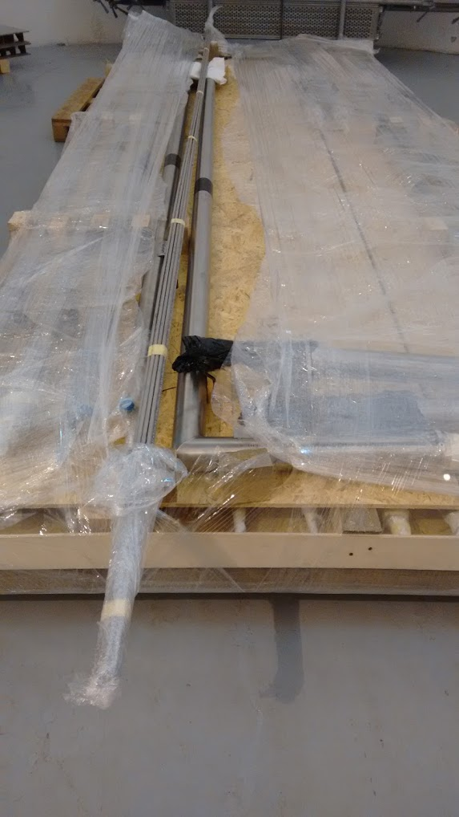
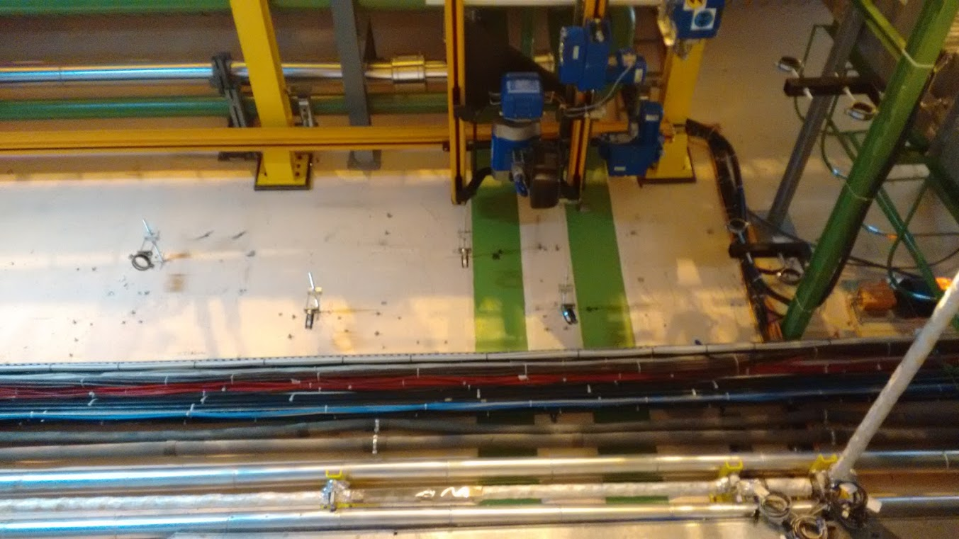
CO2 transfer lines

Slide 11
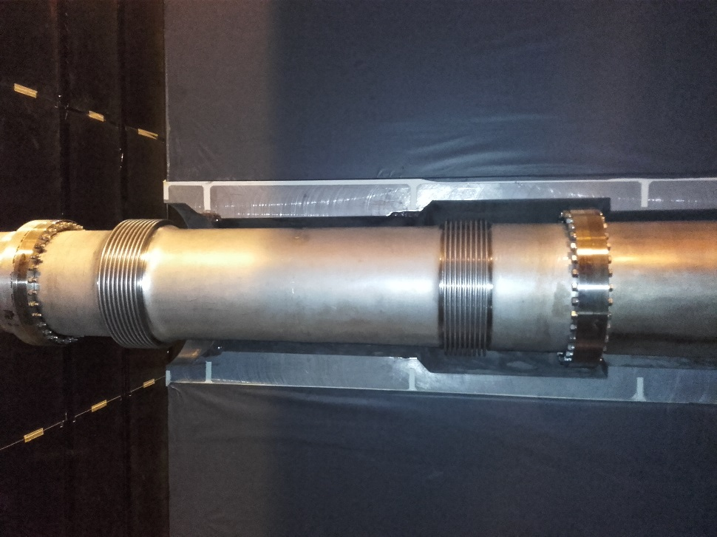
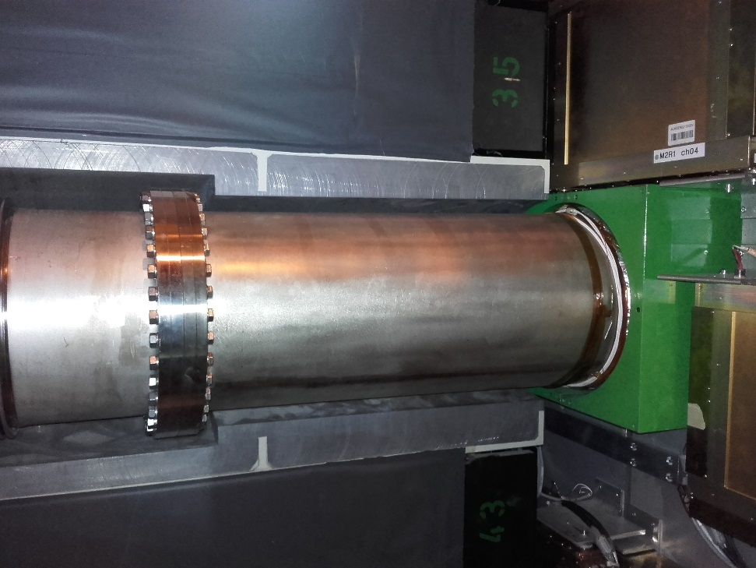
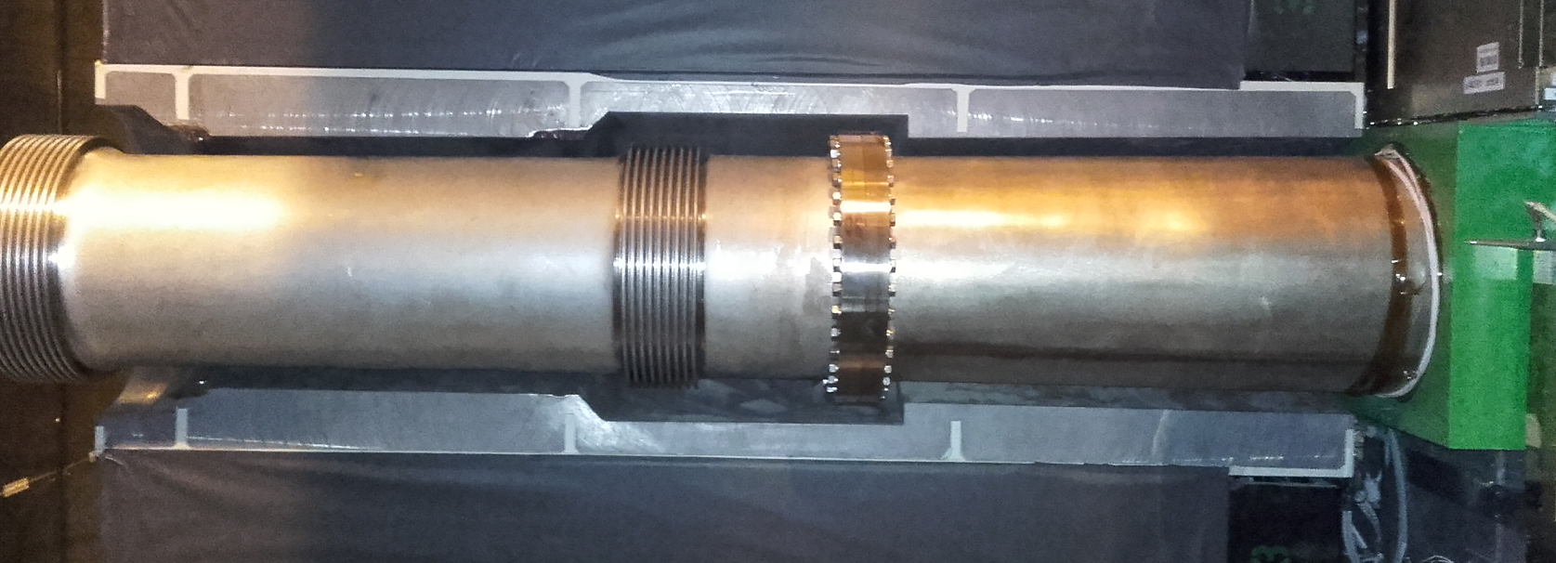
Improved Muon Shielding
74 mm
85 mm

Slide 12
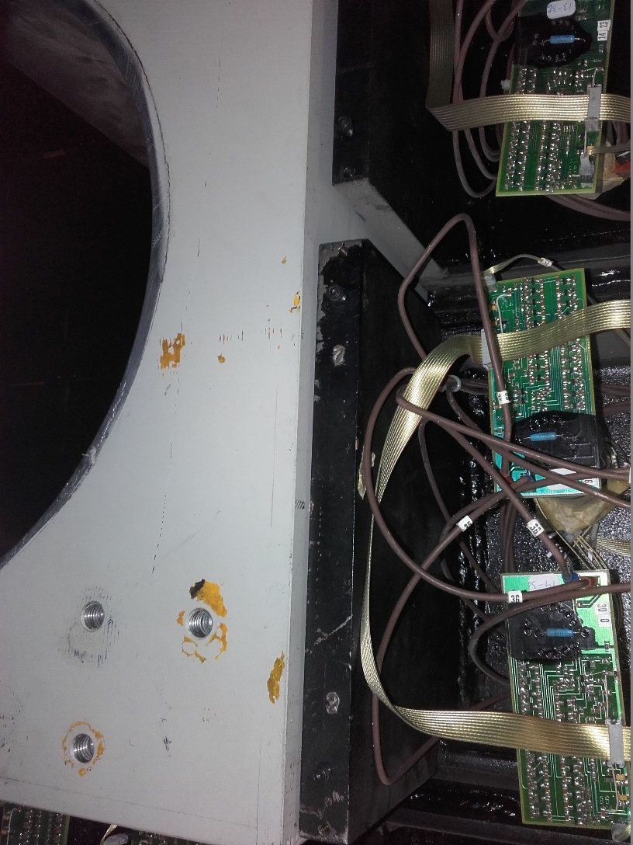
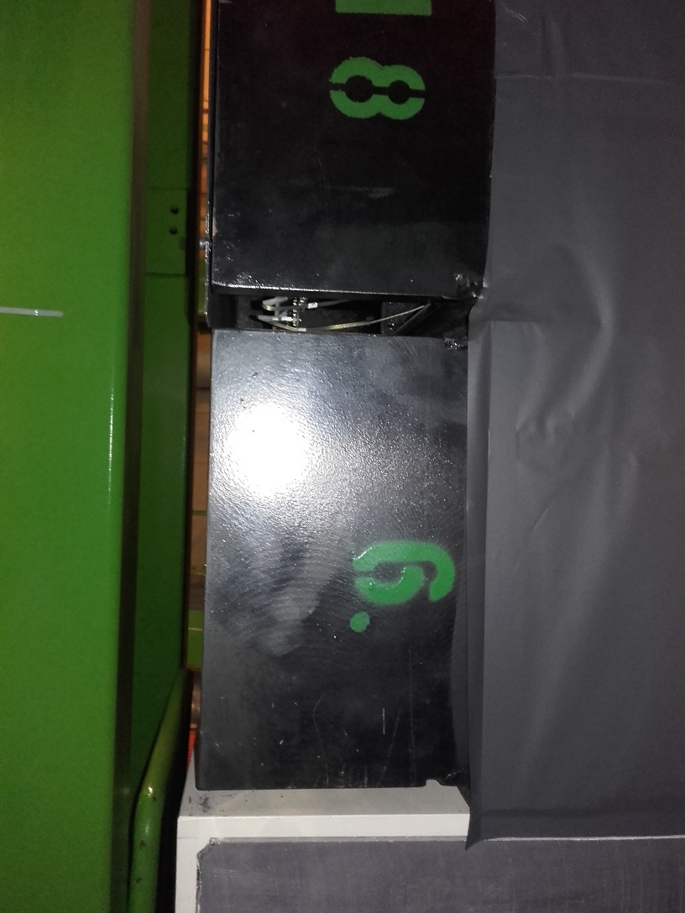
Back side of HCAL

Slide 13
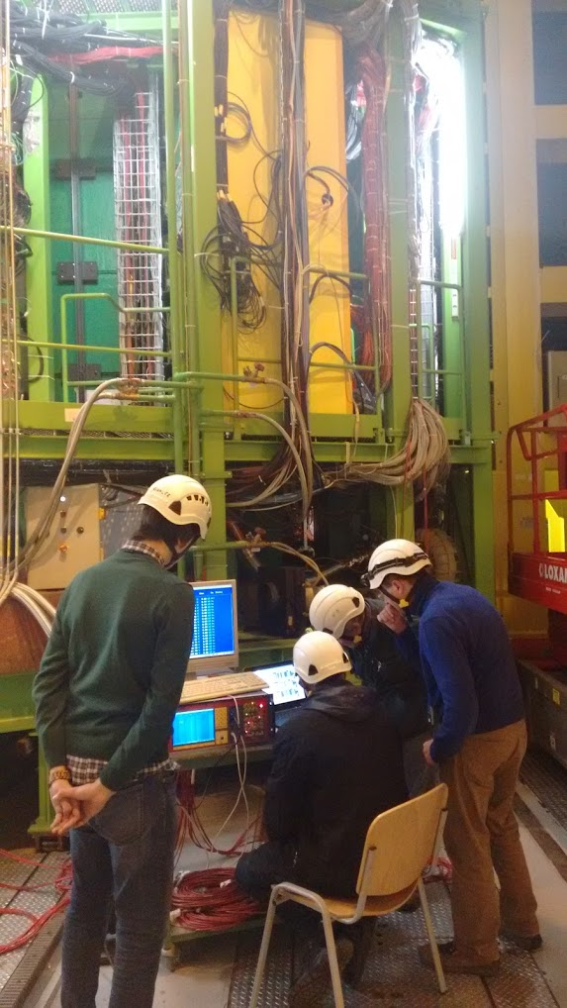
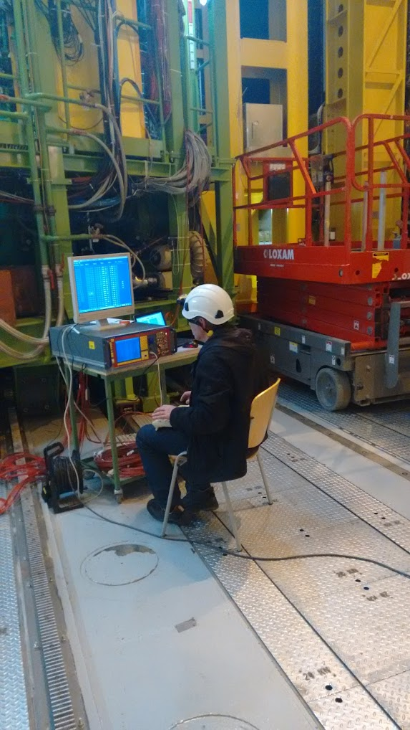
M2-5 HV training

Slide 14
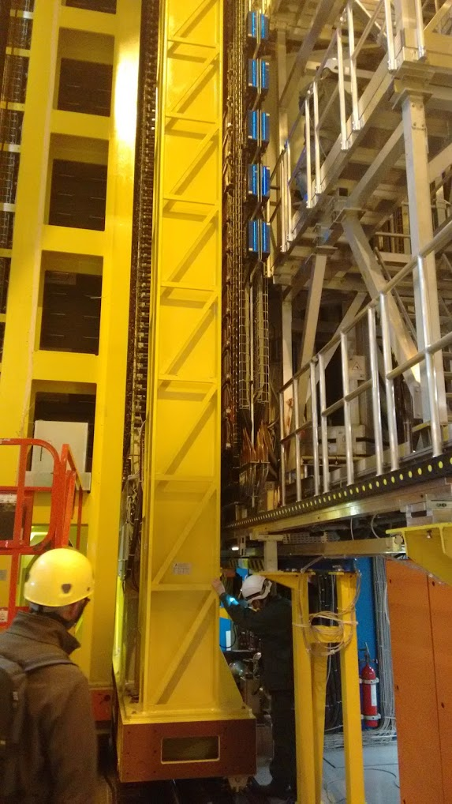
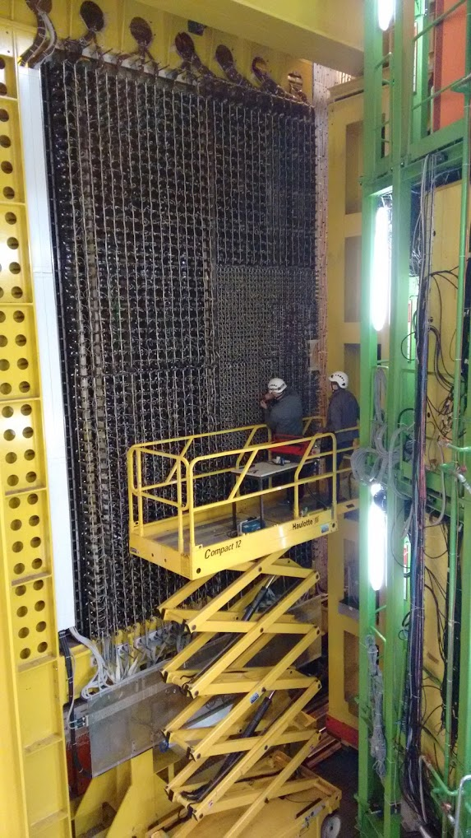
CALOs

Slide 15
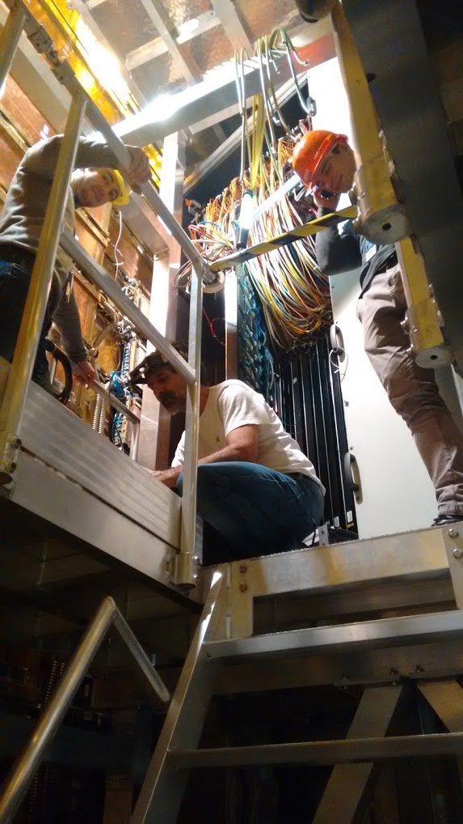
RICH2 HPD

Slide 16
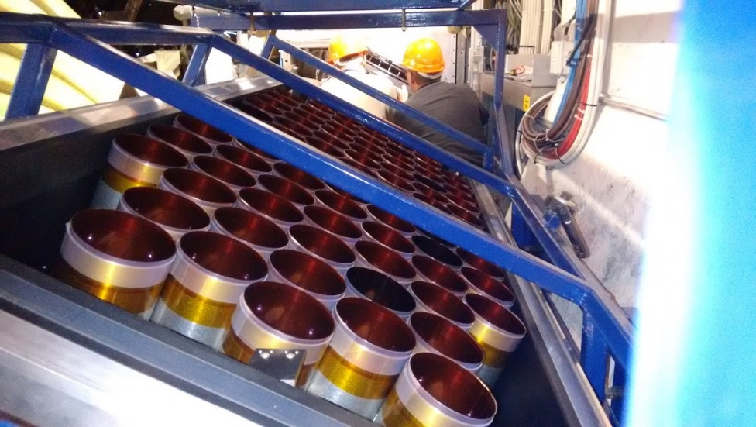
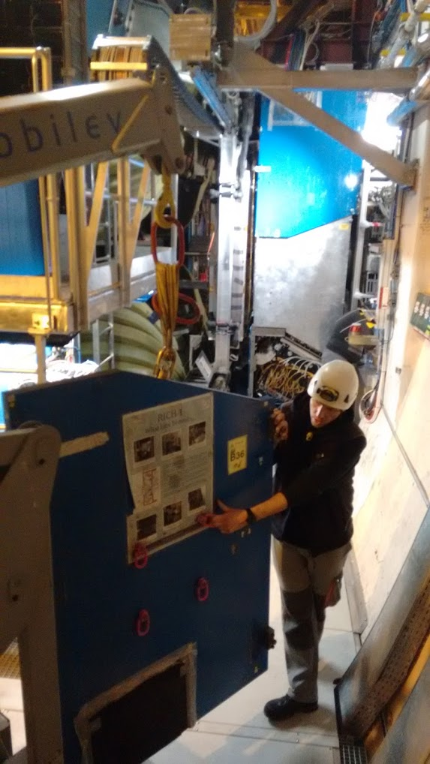
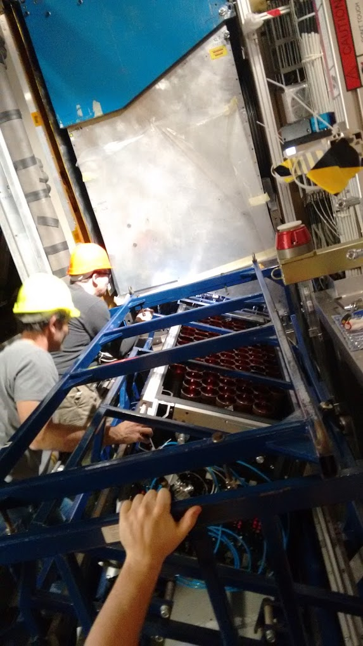
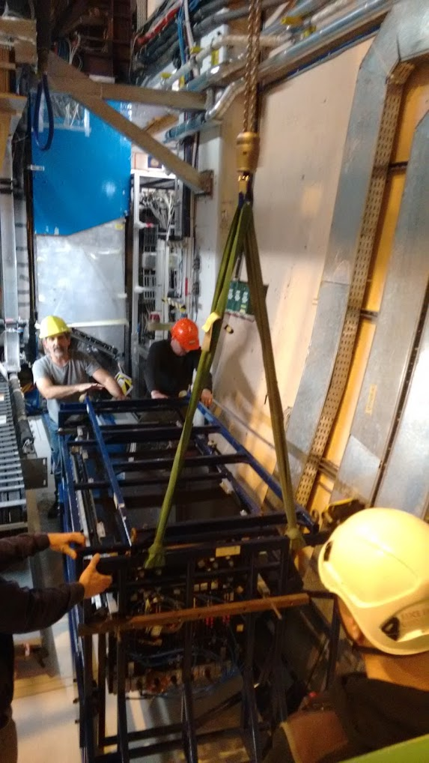
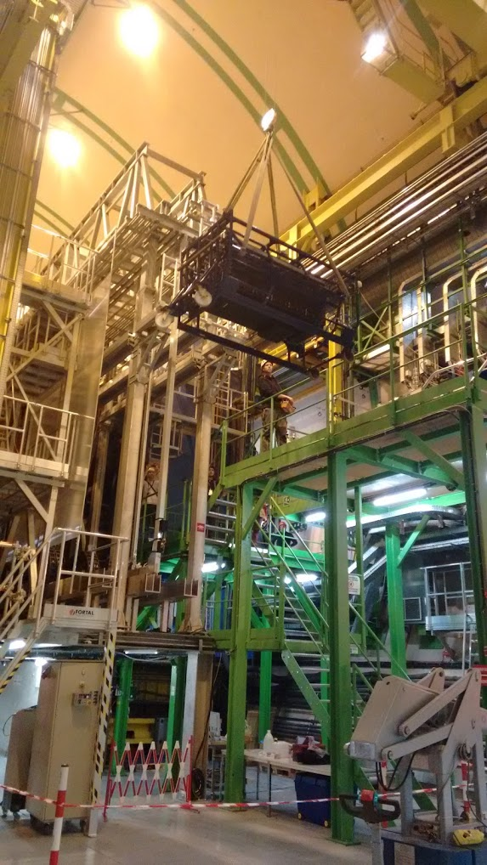
RICH1

Slide 17
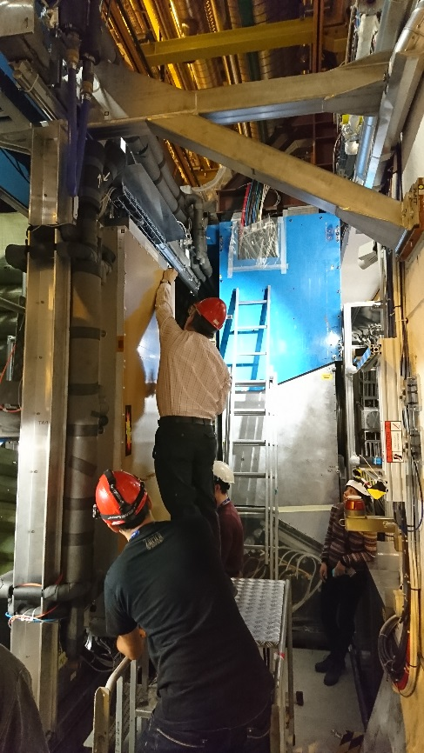
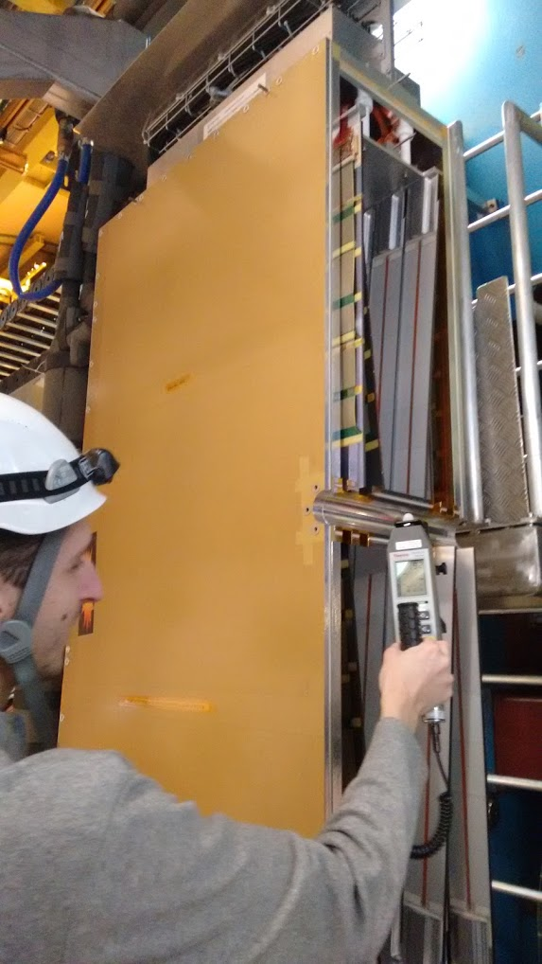
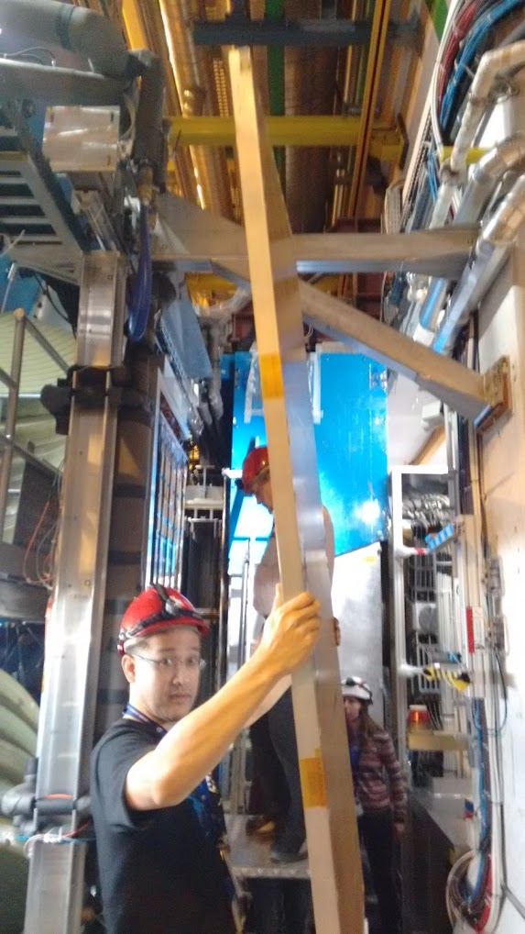
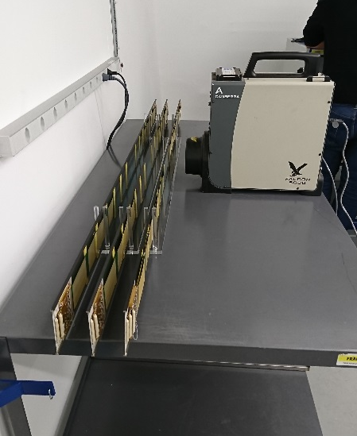
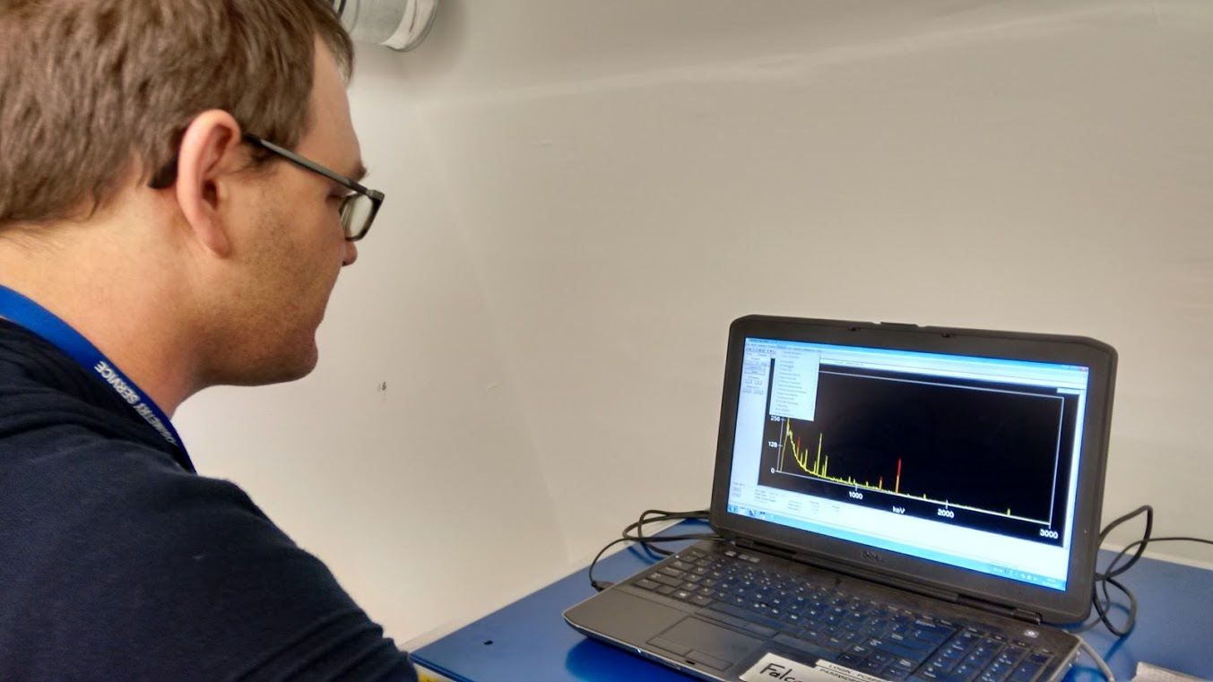
Opening TT

Slide 18
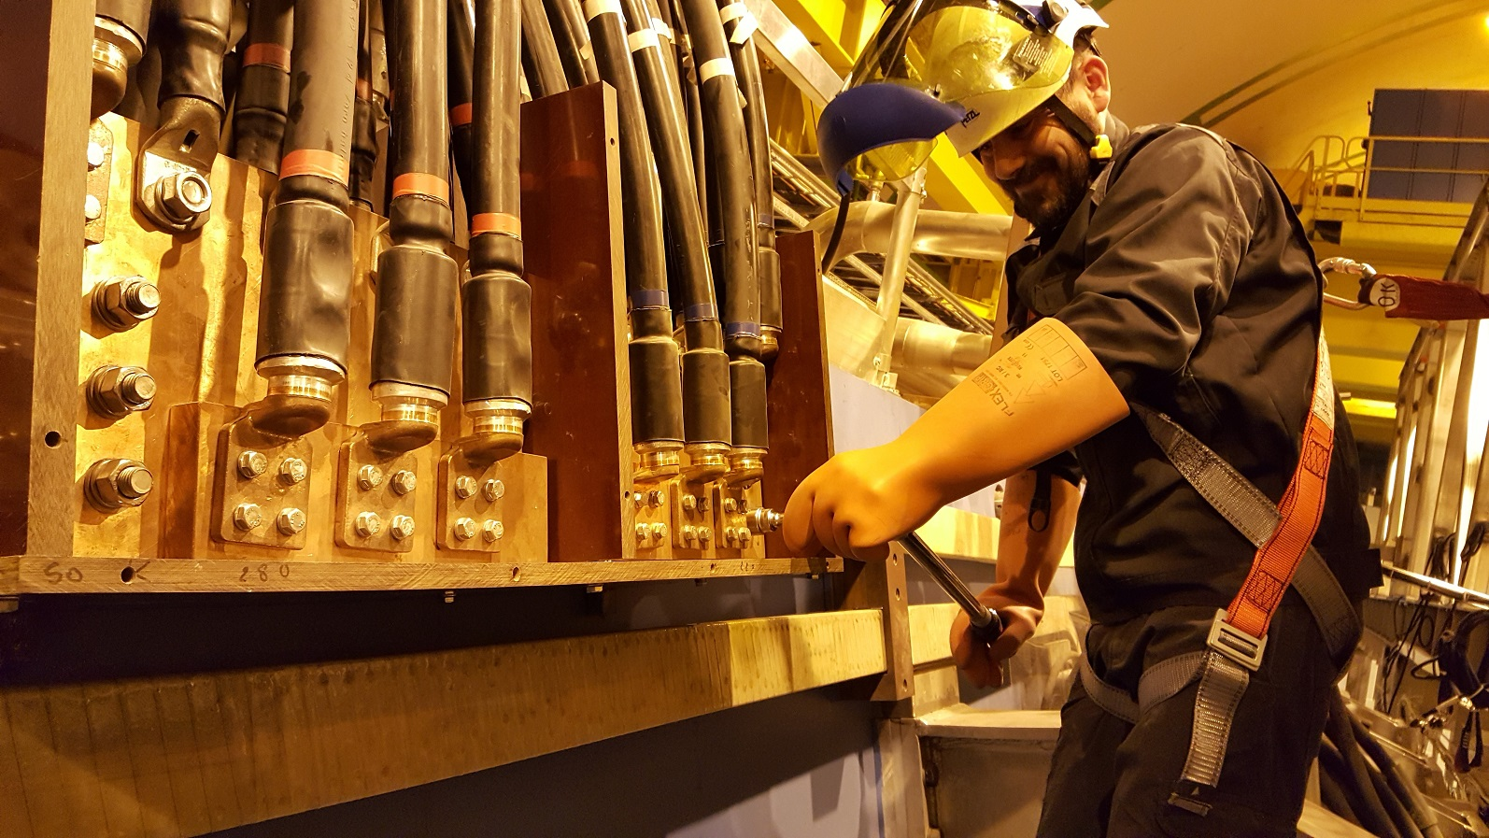
Dipole

Slide 19
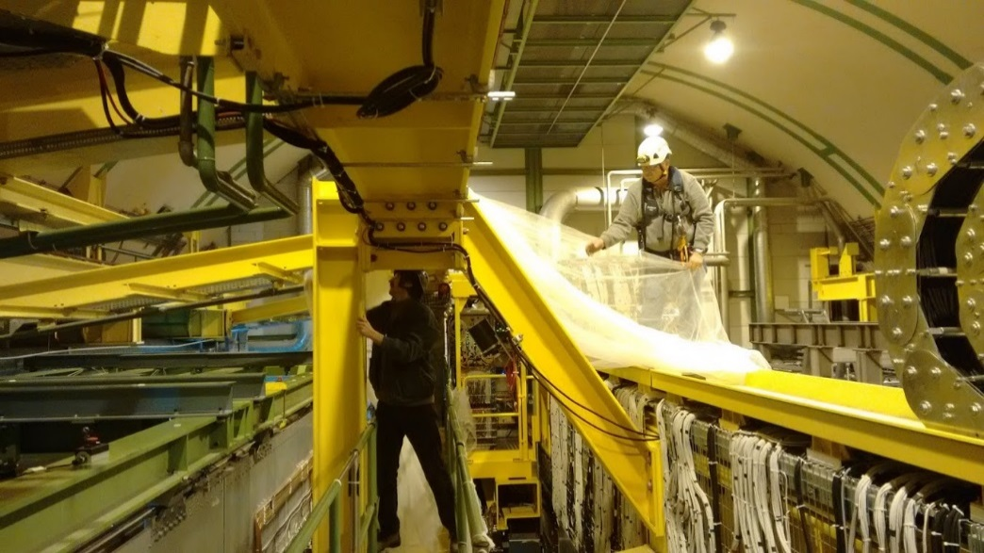
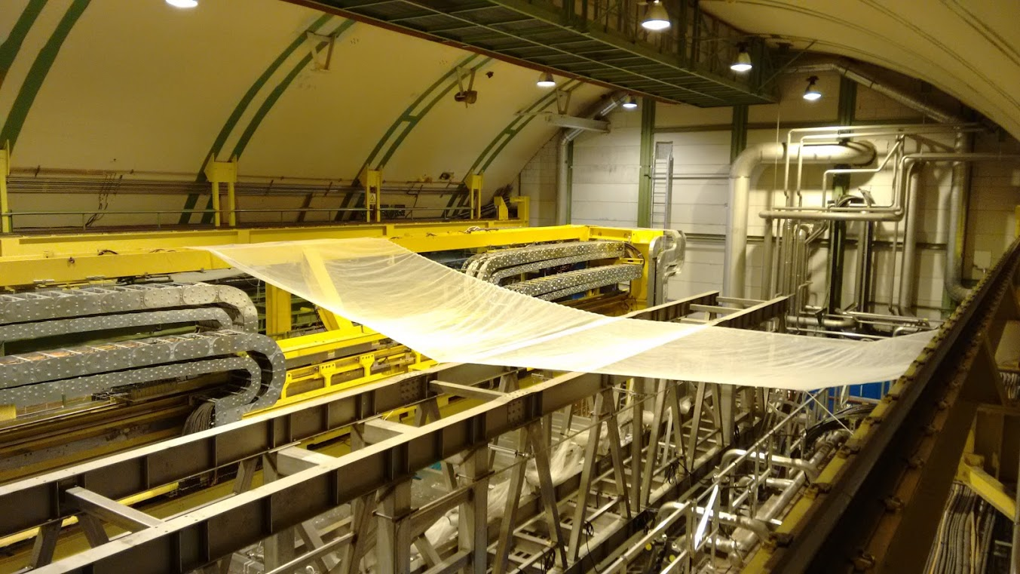
Cranes revamp.

Slide 20

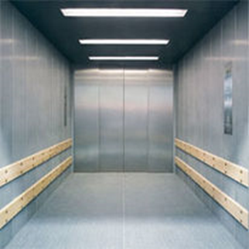
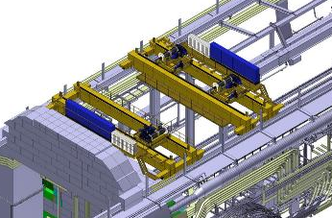
EYETS: Main tasks and constraints
Replacement AS713 (PZ85 lift) by EN-HE
    Schedule: 06/02/17 -14/04/17
    Access via PM85 shaft
    Access condition EDMS1682496
Revamping PR720&PR721 (UX85 80t overhead cranes) by EN-HE
    Schedule: Jan 30 – 14/04/17
    Limited access to detector
Very limited Time window for detector work :
From Dec 5 2016 to Jan 22 2017

Slide 21

Access to UXA during Cranes revamping (provisional design)
(G. Roche)

Slide 22

Access to UXA during Cranes revamping (provisional design)
(G. Roche)

Slide 23
Important dates
EYETS from 5th of December 2016 @6am until April 30th
LHC back to OP on 14th April (powering tests)
(No access to CERN, incl. surfaces, offices …)
Experiments closed on 30th April
NO ACCESS during ➔
  AUG test P8: Feb 27th (incl. surface)
  Auto Transfer test Feb. 4-5th 2017
  DSO test April 7-8th (!Warning Patrol w14)

Slide 24



CV / P8 yearly maintenance
Weeks 3-4-5 From Jan 16th to Feb 3rd 2017
  Stop of SF, SU, UW facilities
  Mechanical cleaning of towers
  Mechanical and electrical maintenance
Back-up cooling power: limited to 400kW
400 kW
Weeks 3-4-5

