Slide 1

46th WP8 Bi-weekly meeting VAX lay out
Lukasz Krzempek TE-VSC-DLM
29.11.2016

Slide 2
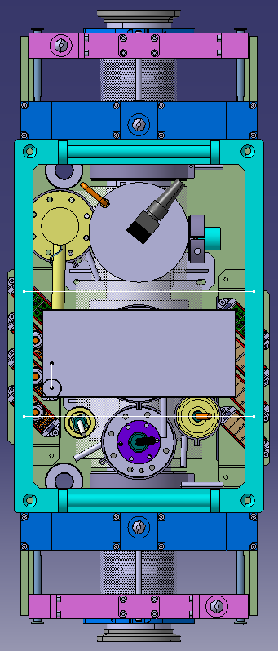
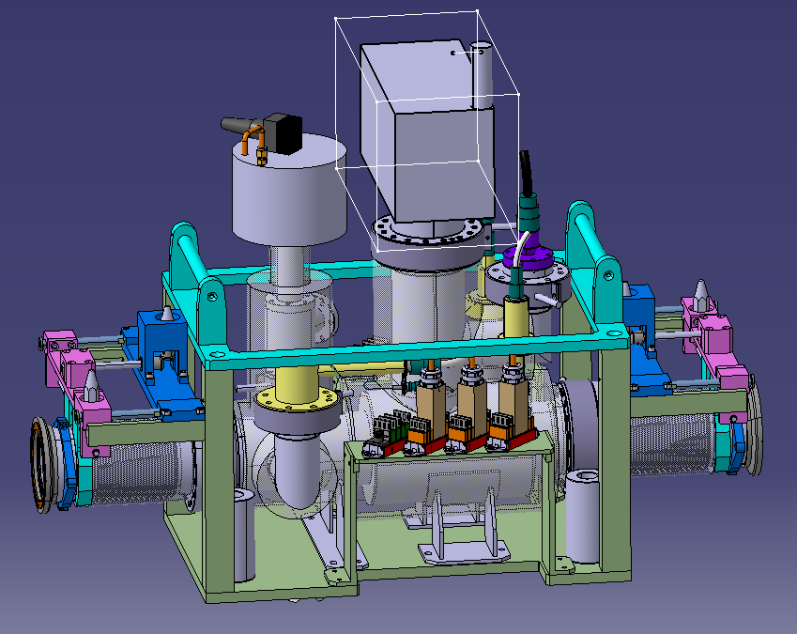
VAX: Integration of Staubli connectors
Comment 1:
Not enough space inside the VAX structure to integrate connectors longitudinally or transversally;
Staubli connectors
Comment 2:
To integrate female columns of alignment inside the VAX structure, it takes additional 50mm to extend frame longitudinally;
Female columns of alignment
Comment 3:
Position of connectors stays at the same height as indicated during previous meeting

Slide 3
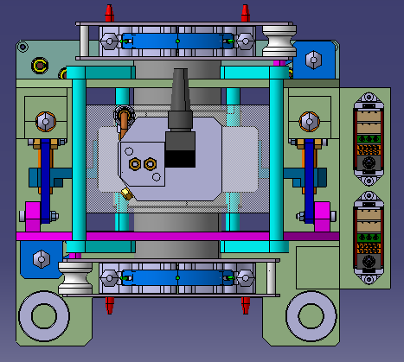
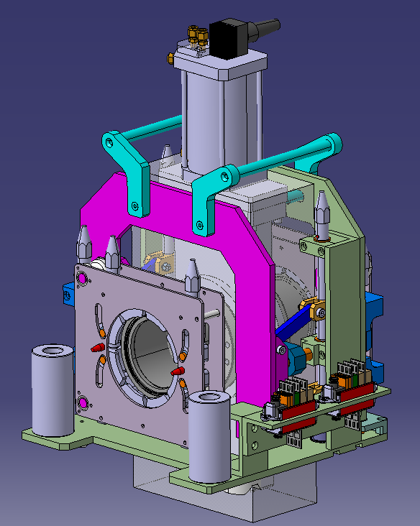
Sector valve (TAS side): Integration of Staubli connectors
Staubli connectors
Comment 1:
No place to integrate connectors inside the structure;
Comment 2:
One side position of connectors is determined by service line presence on the opposite side;
Female columns of alignment
Additional 80mm to extend valve frame to house female alignment columns
Lukasz Krzempek TE-VSC-DLM

Slide 4
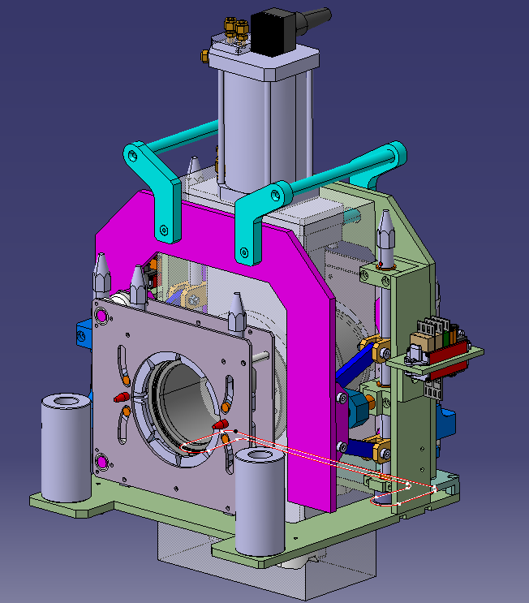
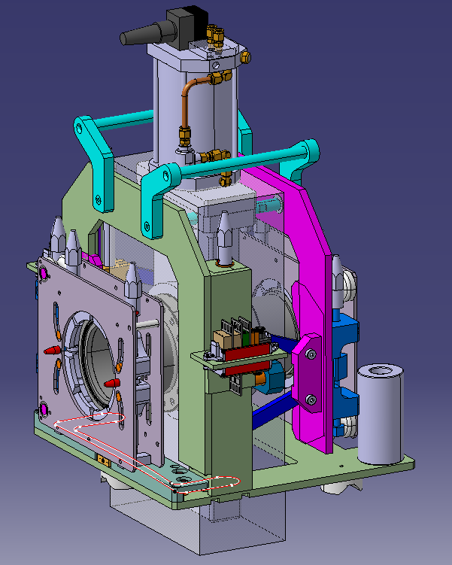
Sector valve (IP side): Integration of Staubli connectors
Staubli connectors
Comment 1:
No place to integrate connectors inside the structure;
Comment 2:
Staubli connectors placed symmetrically on both sides of sector valve frame;
Female columns of alignment
Lukasz Krzempek TE-VSC-DLM

Slide 5
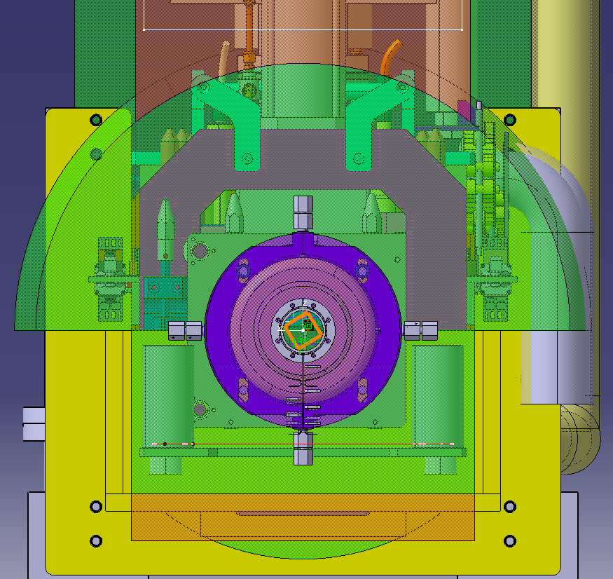
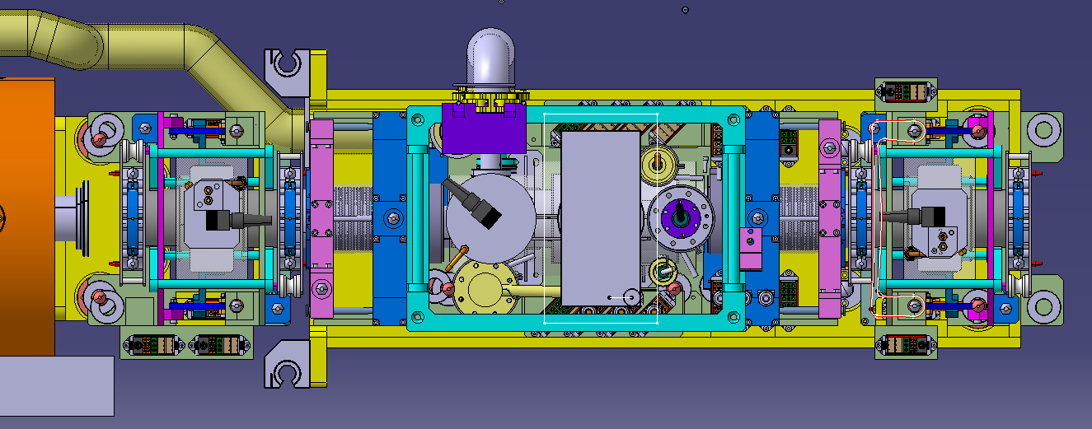
General view in ATLAS (connectors)
Staubli connectors for sector valve of TAS side s
Staubli connectors for VAX assembly stay inside yellow support
Staubli connectors for sector valve of IP side are outside yellow structure (no place to integrate them inside)
Following available space (green), we can go with VAX connectors out of yellow support, like with connectors for IP sector valve
Lukasz Krzempek TE-VSC-DLM

Slide 6
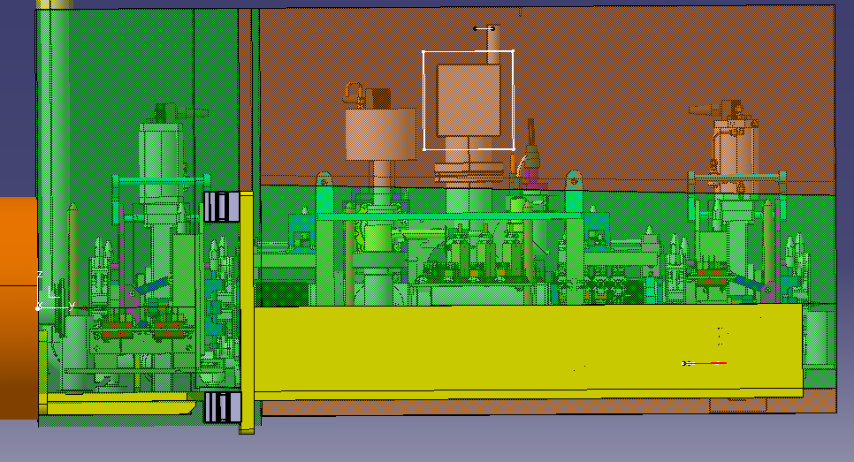
General view in ATLAS (lay out length)
Integration of female columns in VAX makes lay out extended 50mm (IP side sector valve flange)
Integration of female columns in IP sector valve frame makes assembly extended to extremity of given (available space)
140mm [TAS wall-Flange of TAS sector valve]
1567mm [Distance between flanges of TAS and IP sector valves]
1789mm [Given available space for ATLAS]
Lukasz Krzempek TE-VSC-DLM

Slide 7
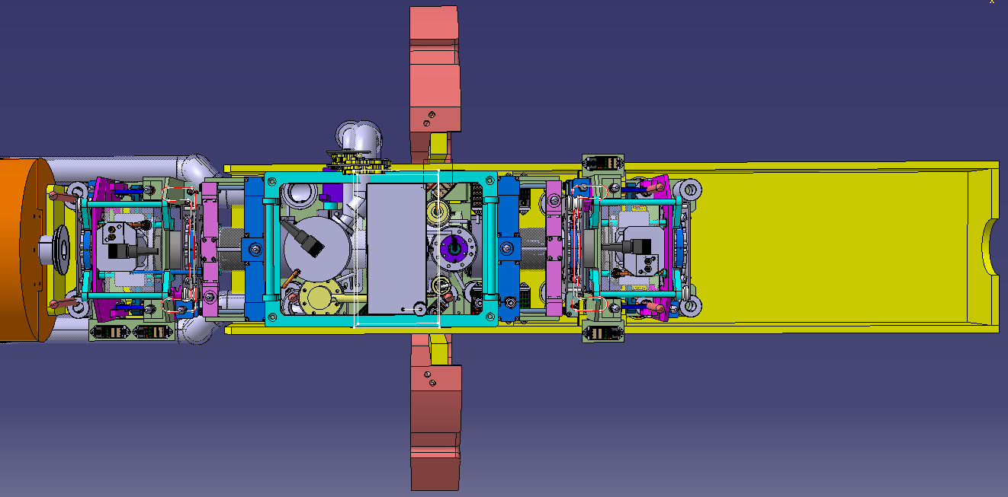
General view in CMS (connectors)
Staubli connectors for sector valve of TAS side
Staubli connectors for VAX assembly stay inside yellow support
Staubli connectors for sector valve of IP side are outside yellow structure (no place to integrate them inside)
Lukasz Krzempek TE-VSC-DLM

Slide 8
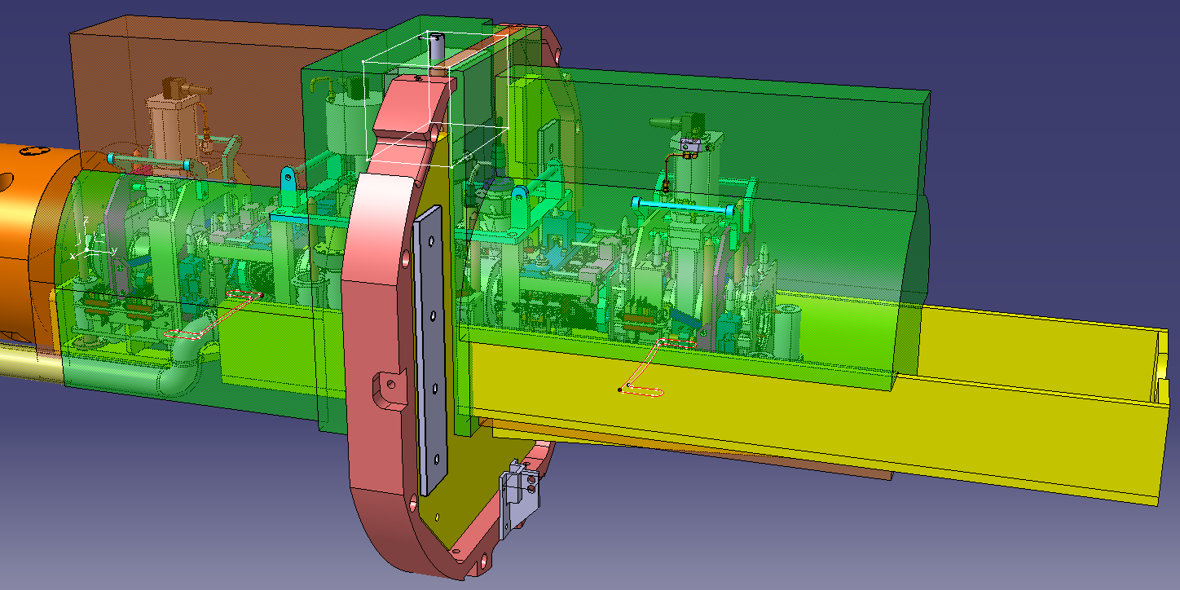
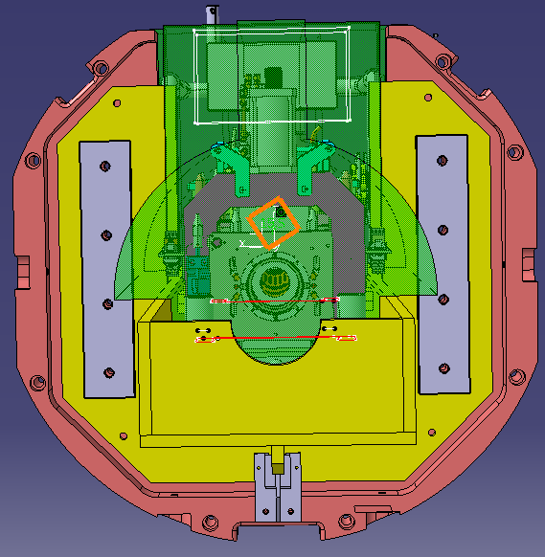
General view in CMS (lay out length)
140mm [TAS wall-Flange of TAS sector valve]
Available space for IP sector valve connectors (outside yellow support)
1567mm [Distance between flanges of TAS and IP sector valves]
2048mm [Given available space for CMS] (1789mm for ATLAS)
Lukasz Krzempek TE-VSC-DLM

Slide 9
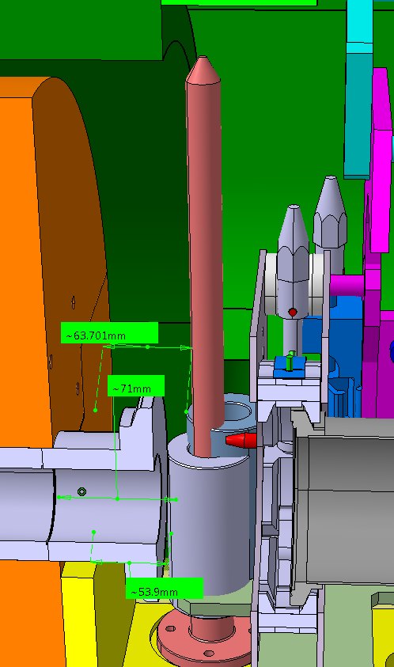
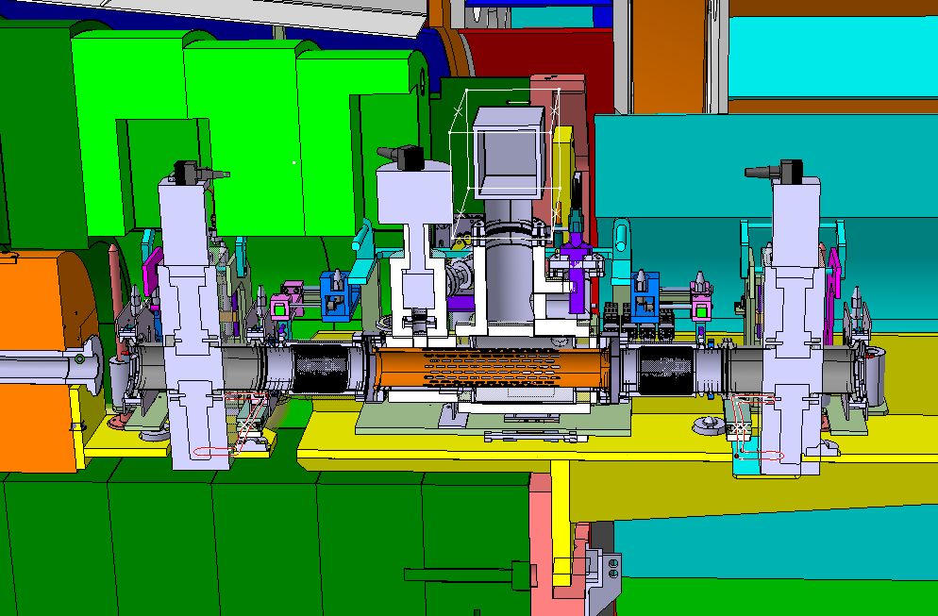
Identified issue related to maintenance
71mm
Dimension between TAS WALL and end of FIXED IRON NOSE SHIELDING
54mm
Dimension between TAS WALL and FEMALE ALIGNMENT COLUMN WALL
63mm
Dimension between TAS WALL and FEMALE ALIGNMENT COLUMN WALL (TE VSC DLM)
Clash in case of maintenance
Lukasz Krzempek TE-VSC-DLM

Slide 10
Next steps
To freeze position of connectors
Second angle valve integration in VAX structure (CMS layout)
Integration of sector valve DN80 (nowadays DN63) at IP side and analysis of space constrains
To define inserts for impedance reduction
Design of MKT tensioning chain assembly of service line & angle valve
Lukasz Krzempek TE-VSC-DLM

Slide 11
Thank you
Lukasz Krzempek TE-VSC-DLM

