Slide 1

VAX-Beam pipe, handling VJ
F. Sanchez Galan

Slide 2
ATLAS
What will change in LS2 (input G. Bregliozzi)
What will change for HL-LHC
What could (should) be advanced to LS2
How to split tasks and costs

Slide 3
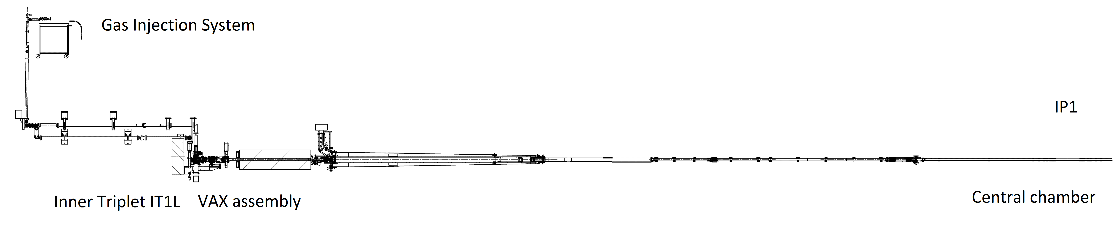
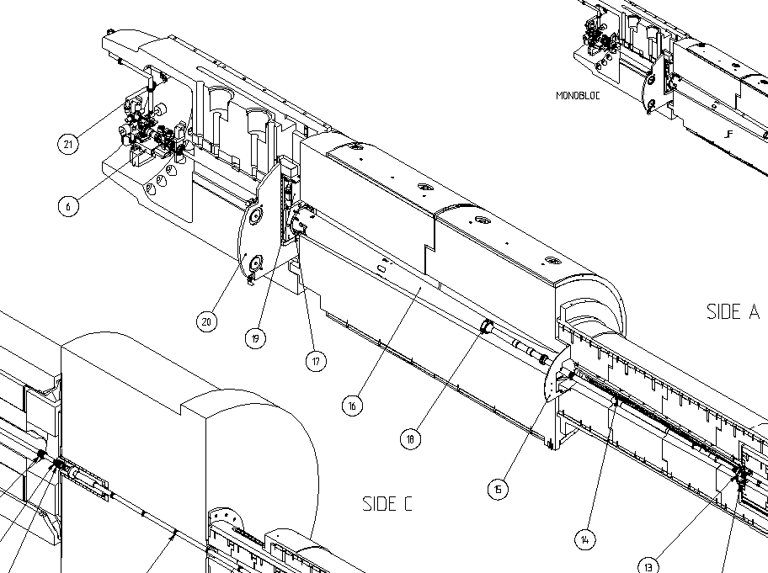
ATLAS After LS1 – current installation
G. Bregliozzi, 18th HL-LHC-CG 13 Sept 2016

Slide 4
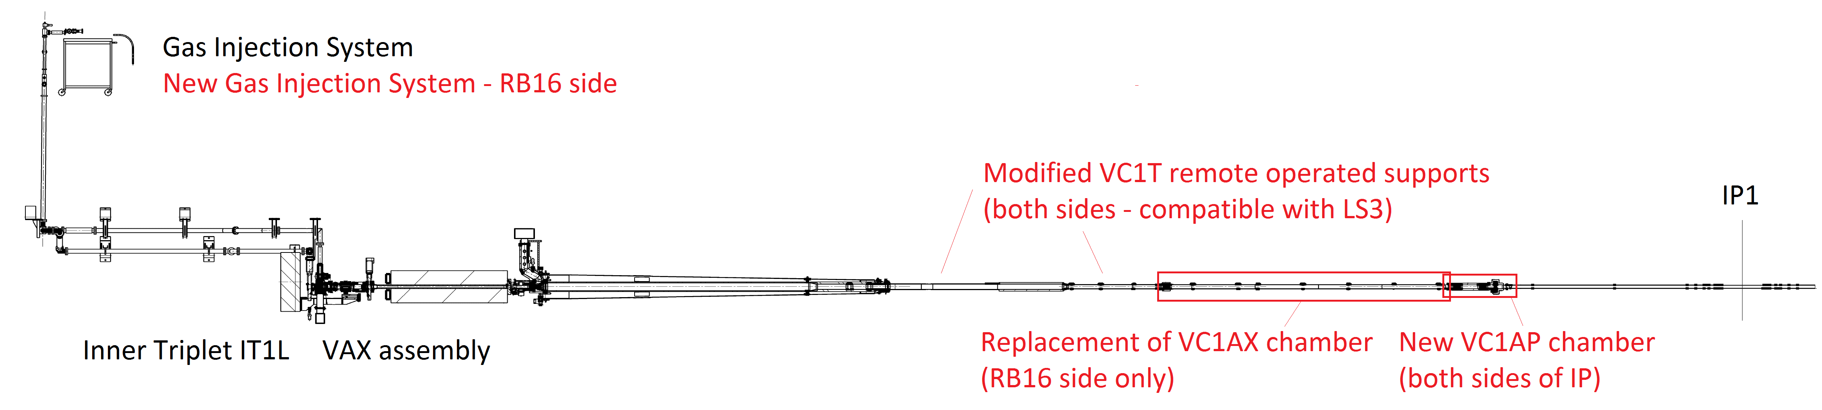
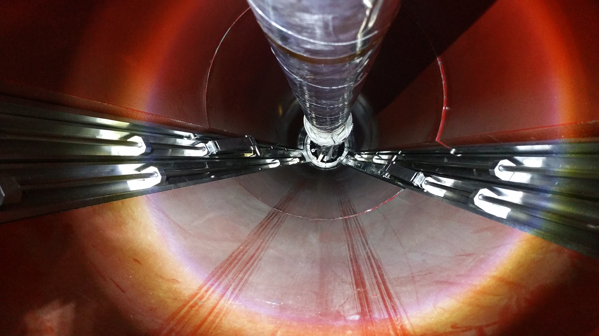
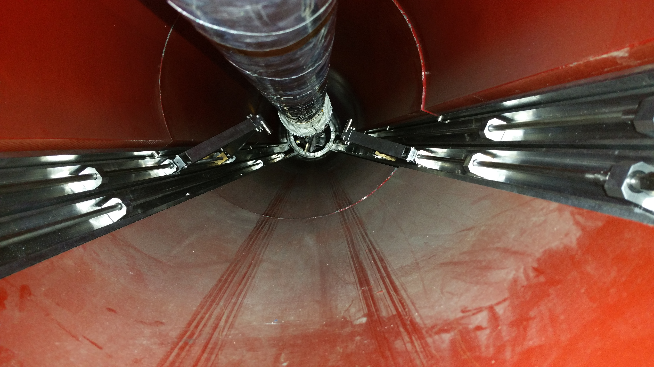
ATLAS LS2 changes
After LS2
G. Bregliozzi, 18th HL-LHC-CG 13 Sept 2016

Slide 5
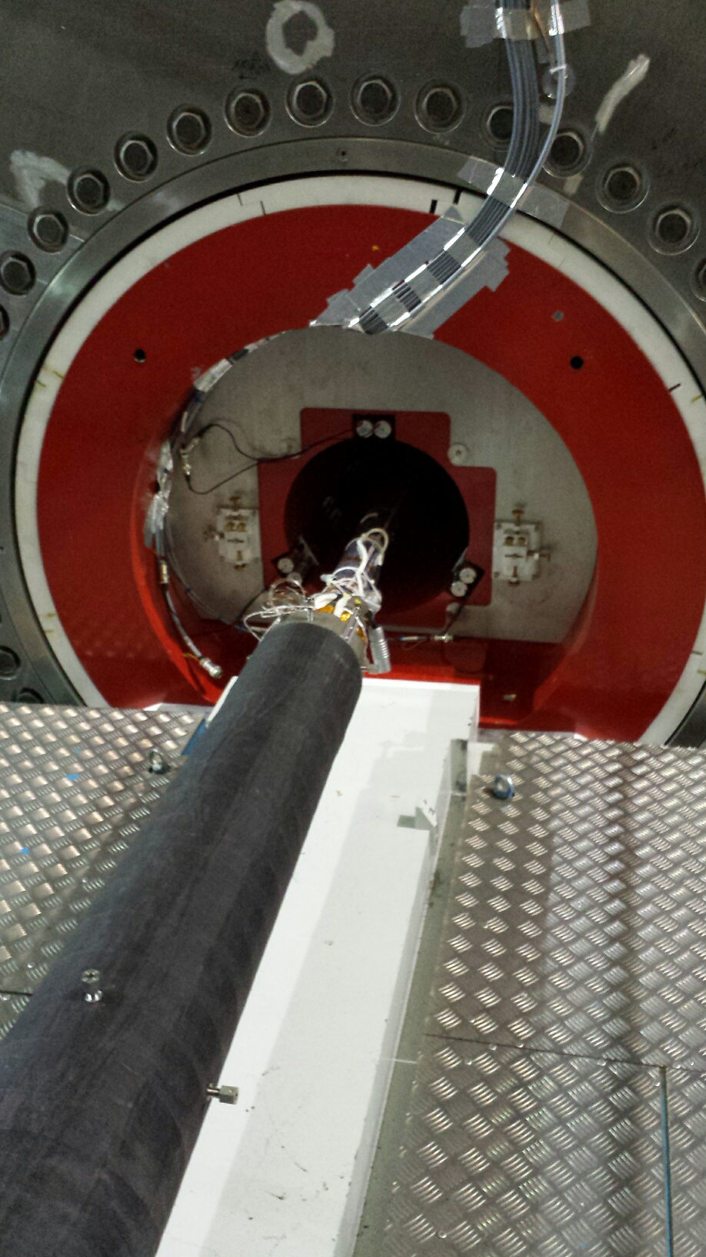
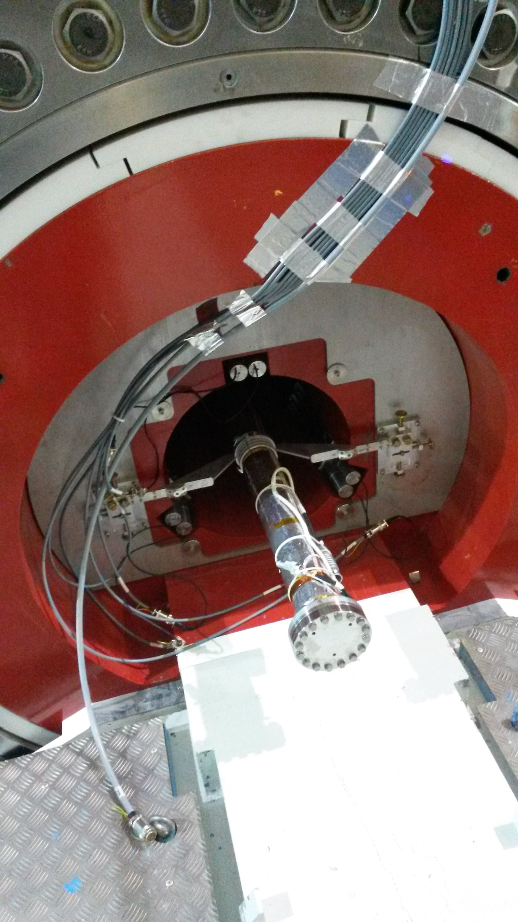
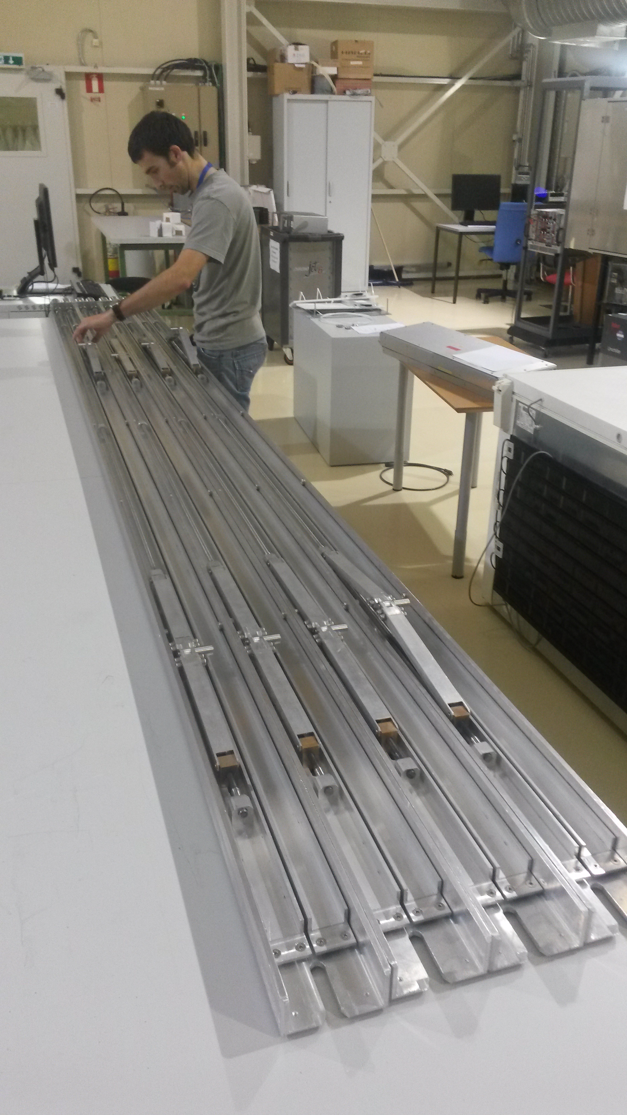
ATLAS Beam vacuum actions during LS2
Possible room for improvements of the remote VT support system - TBD.
.
No “safe” end stop system at the moment.
Upper support not used – can be dismounted
G. Bregliozzi, 18th HL-LHC-CG 13 Sept 2016

Slide 6
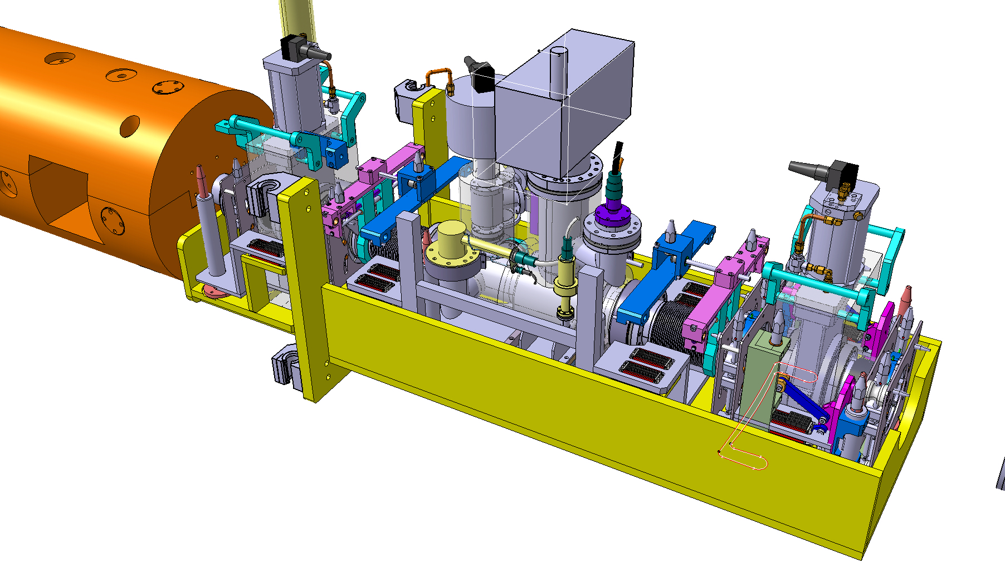
ATLAS VAX needs (post LS3)
VJ support cone must start 1.5 m away from TX1S
Compatibility with detector opening

Slide 7
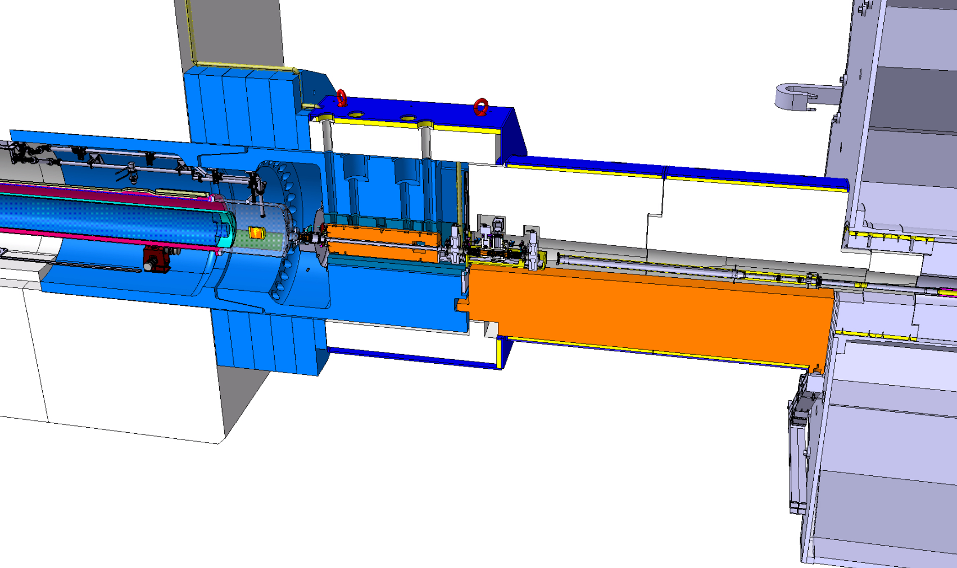
VAX relocation-ATLAS
New support hosting VAX modules, need services re-routed, shielding modified

Slide 8
During Shutdown period: Toroid moved toward the octagon
To avoid clash with new HL vacuum configuration, the JTT 1 has to be modified.
JTT1
Octagon
ECT
M. Lazaronni, 37th WP8 meeting

Slide 9
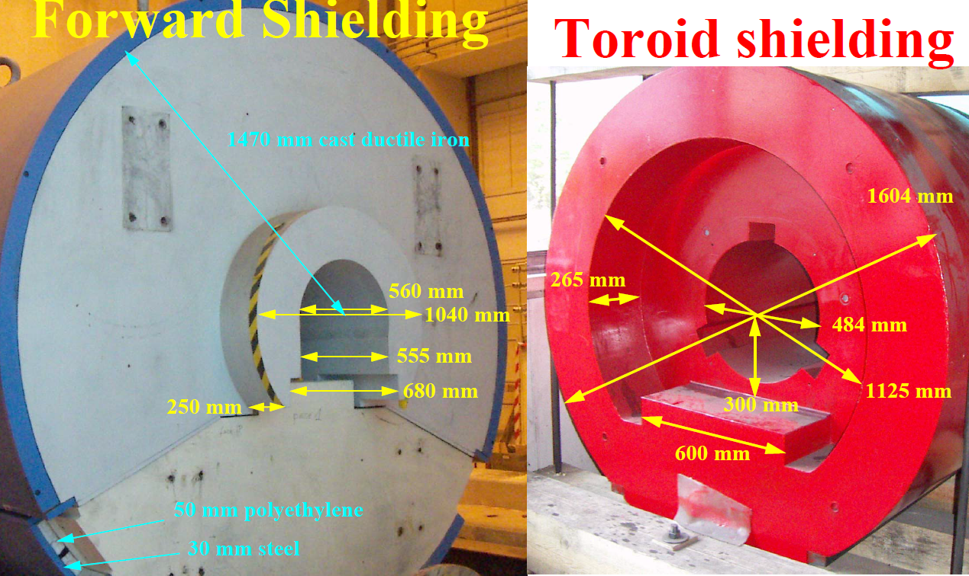
Shielding's modifications on JTT&JFC2
Current Shielding

Slide 10
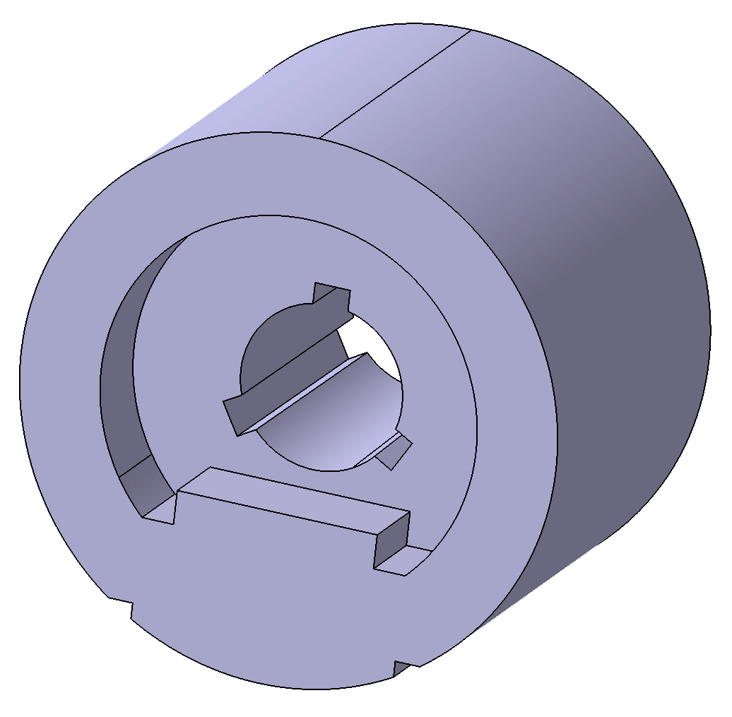
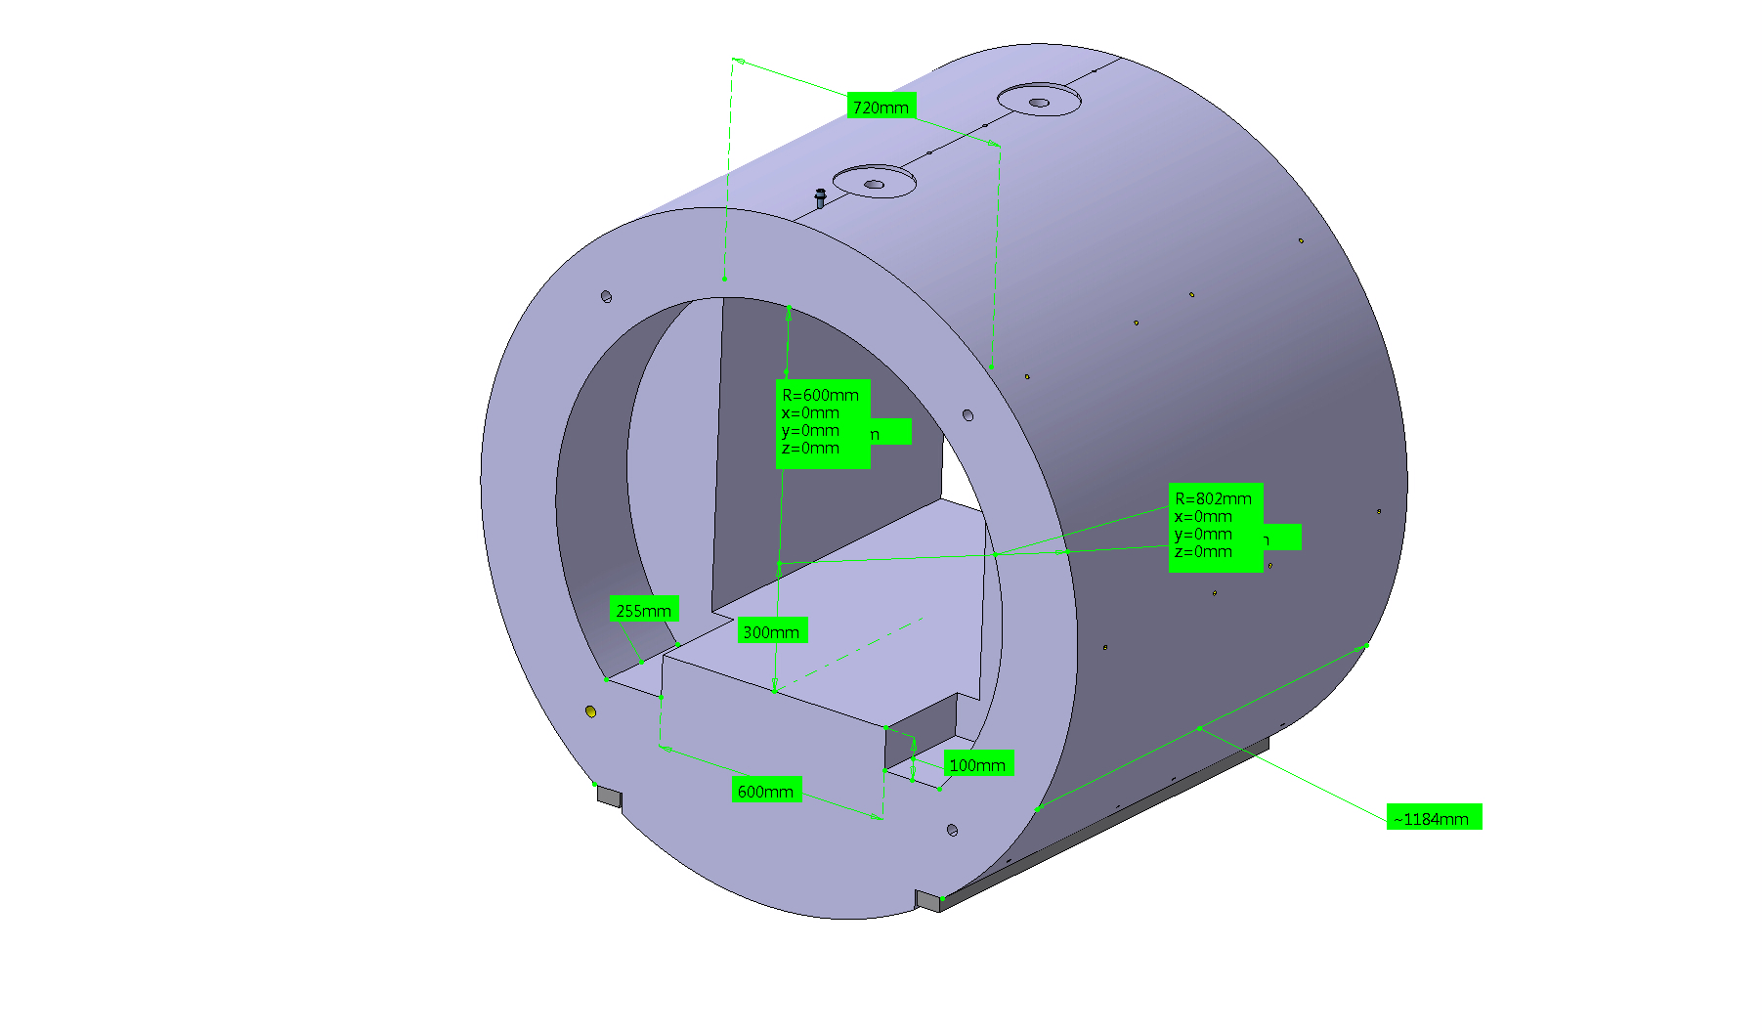
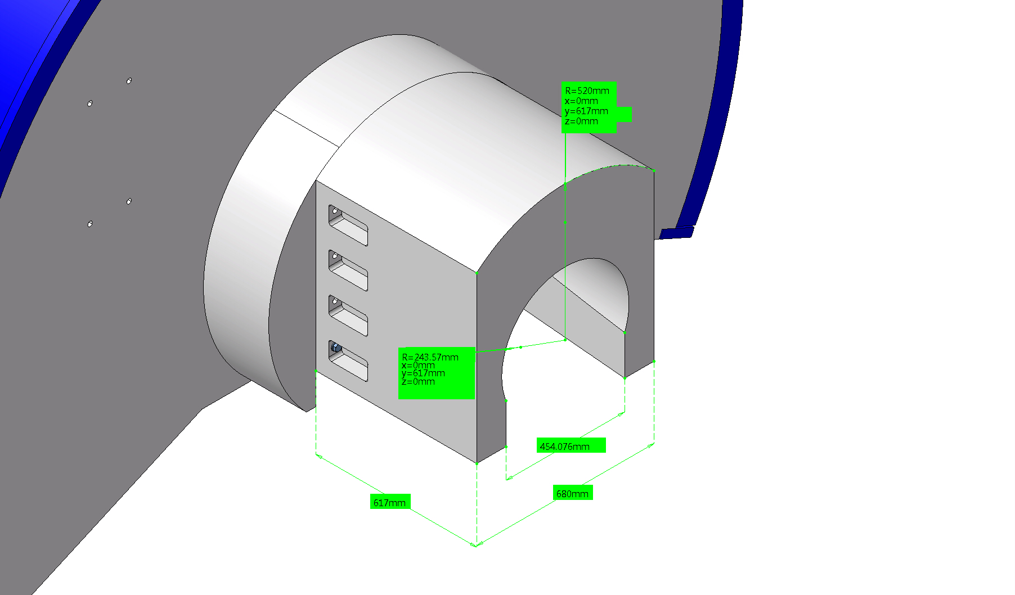
Shielding's modifications on JTT&JFC2
Post LS2
D. Brethoux
The bore inside of the ECT (JTT) needs to be modified
Shielding performance not affected as the shielding will be added on the JFC2 side. Doses to personnel improved?
This activity is proposed to be advanced to LS2
(Activation, planning, synergies with TE VSC plans for VT chamber.

Slide 11
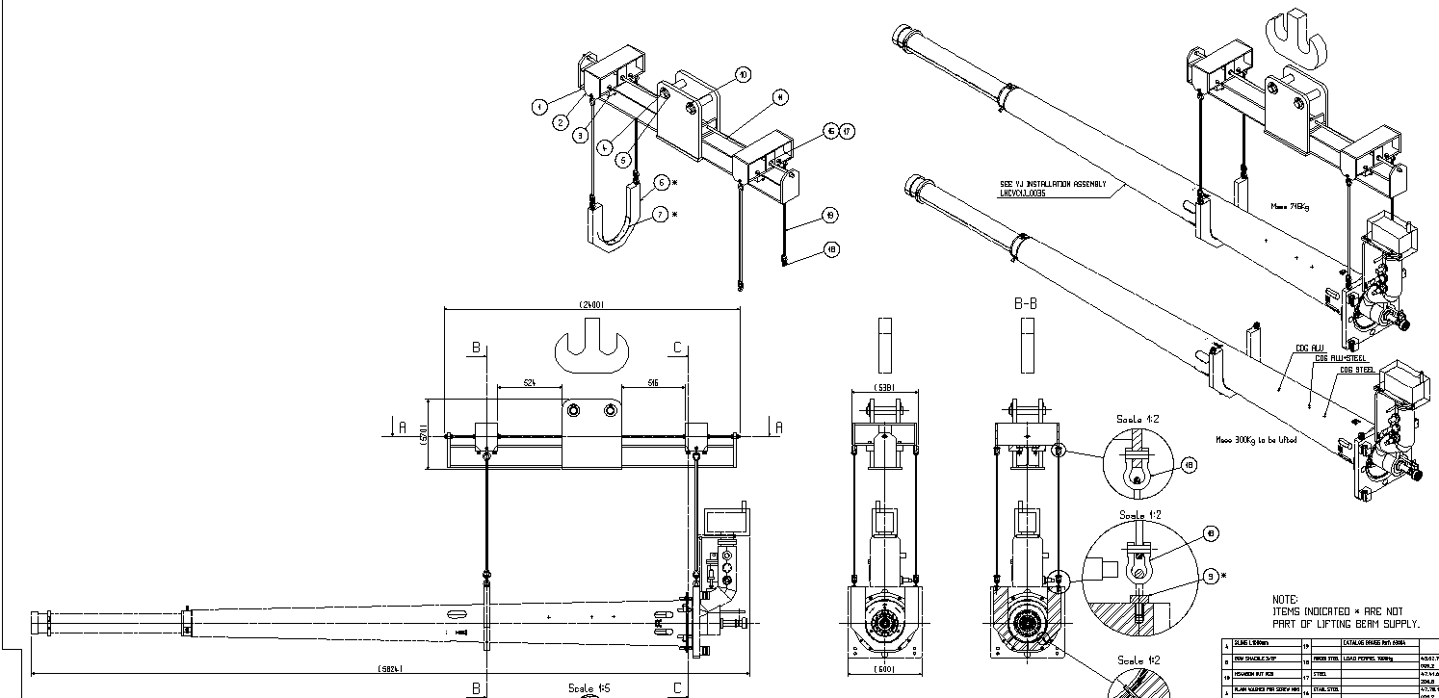
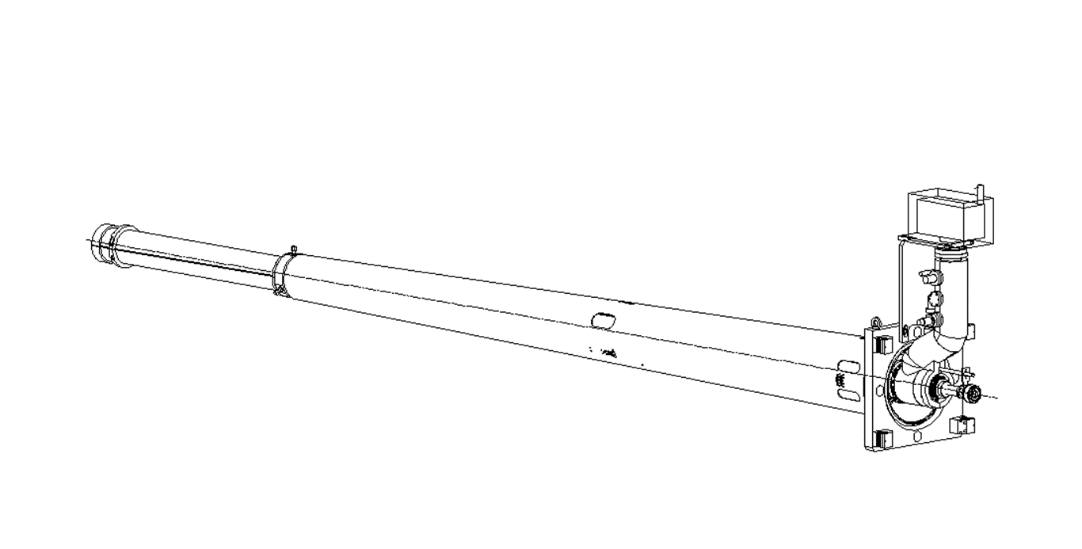
LS3- Additional modifications
Tooling
Procedures
Changes in VJ @ 19 m region needed: shorter cone, No VAX in the assembly, lifting tools, support.

Slide 12
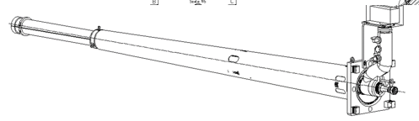
How to handle VJ?
If VJ is fixed to VAX support, we could consider to remove the assembly together
Alignment needs of the beam pipe need to be taken into account: No re-alignment of the support has been performed since LHC start
Could be this acceptable for HL-LHC?

Slide 14
How to handle VJ?
Changes of beam pipe (VC1AX, VC1AP) will be followed by TREX as done for ALICE beampipe. Consolidation budget
Shielding changes followed by WP8
Report to HL-LHC-TCC, ATLAS (M. Raymond)
Still on definition phase.

