Slide 1
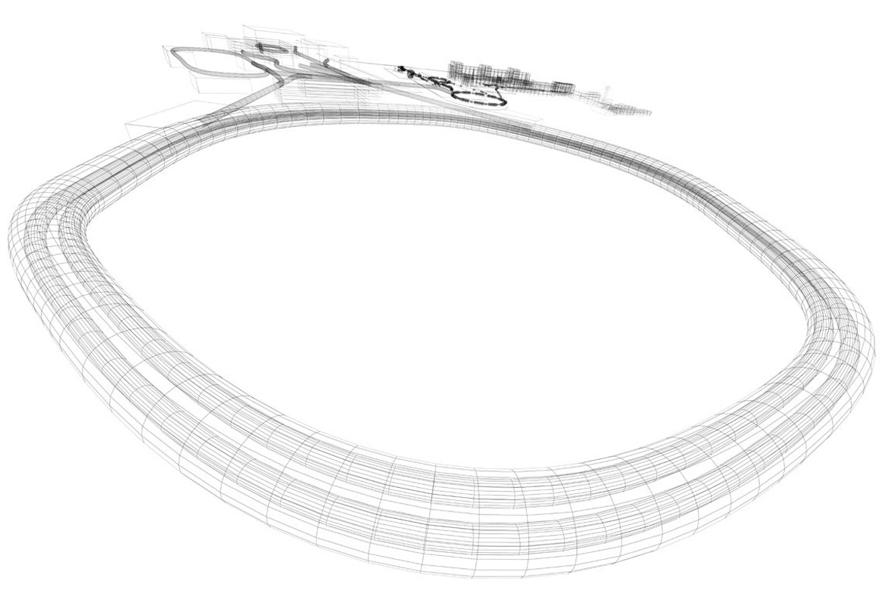
CBM Engineering
Mechanical Concept, design and prototyping of the STS for the CBM Experiment at FAIR
Oleg Vasylyev,
GSI Helmholtz Center, Darmstadt, Germany
for the CBM Collaboration
Forum on Tracking Detector Mechanics,
Marseille, 03.07.2017

Slide 2

Agenda
Overview of the Silicon Tracking System
Precision requirements
STS Mechanics
Prototyping activities
Material choice
Cooling concept
Outlook and future plans

Slide 3
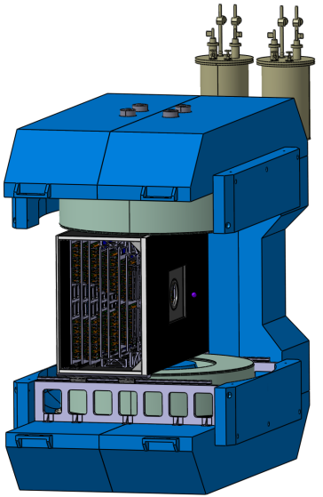
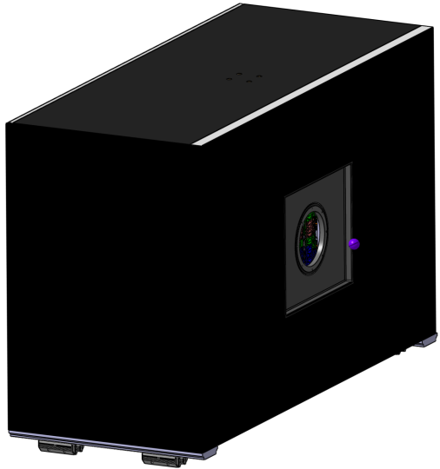
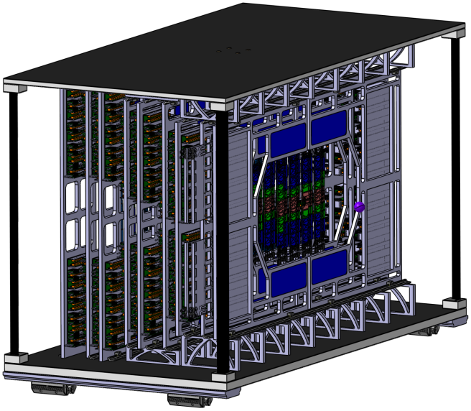
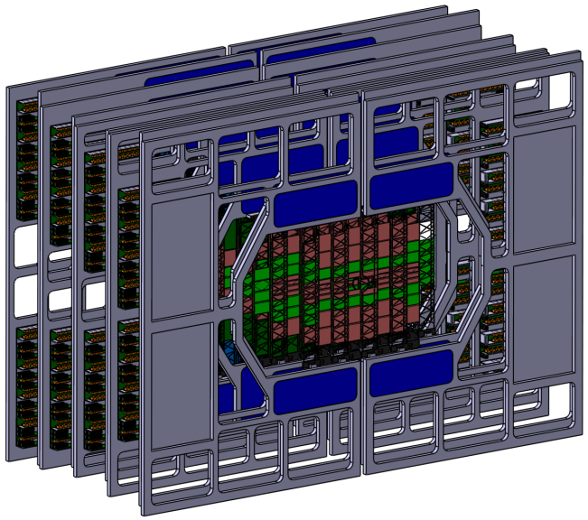
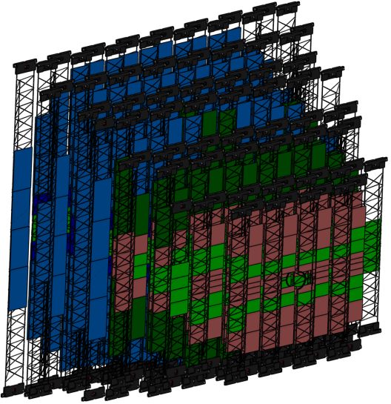
1. STS general overview
STS inside the magnet
STS inside the thermal enclosure
Self carrying STS Mainframe
Magnetic field - 1[T]
STS Units
STS Carbon ladders
General facts:
8 Stations
9 Units
106 Carbon ladders
896 Sensor modules
silicon area: ~ 4 m²
X0/station: ≈ 0.3 – 1%

Slide 4
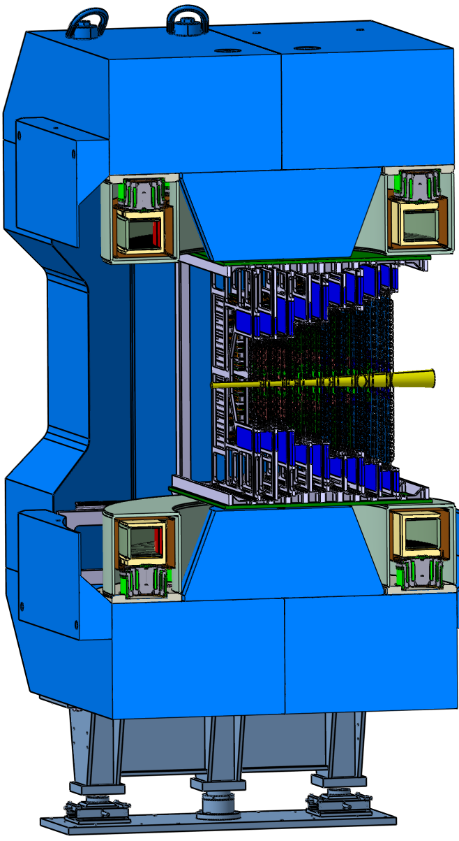
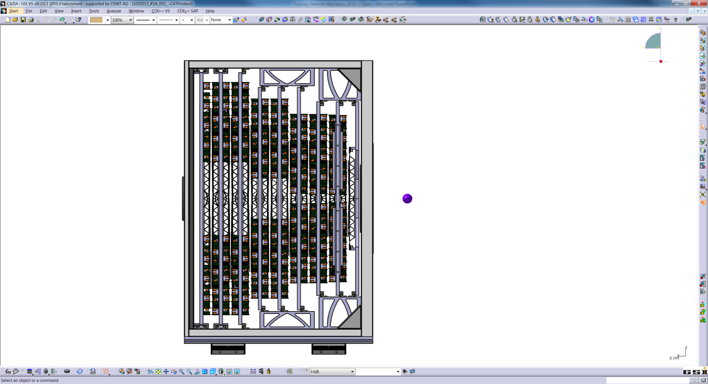
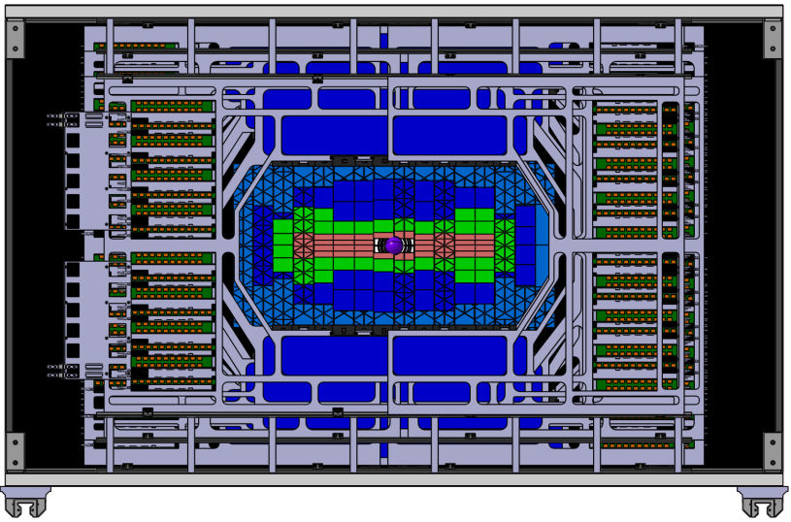
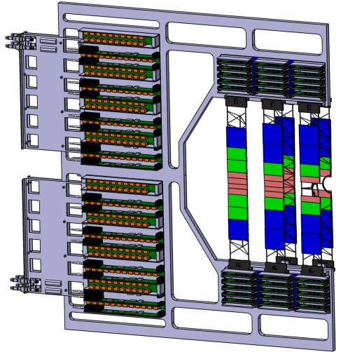
1. STS general overview
971
2300
1425
STS
Beam axis
2.5°
General facts:
large aperture
low material budget
~40 kW dissipated power
-5°C operating temperature
self-triggering read-out electronics
collision rates up to 10 MHz
25°
18 STS half- units

Slide 5
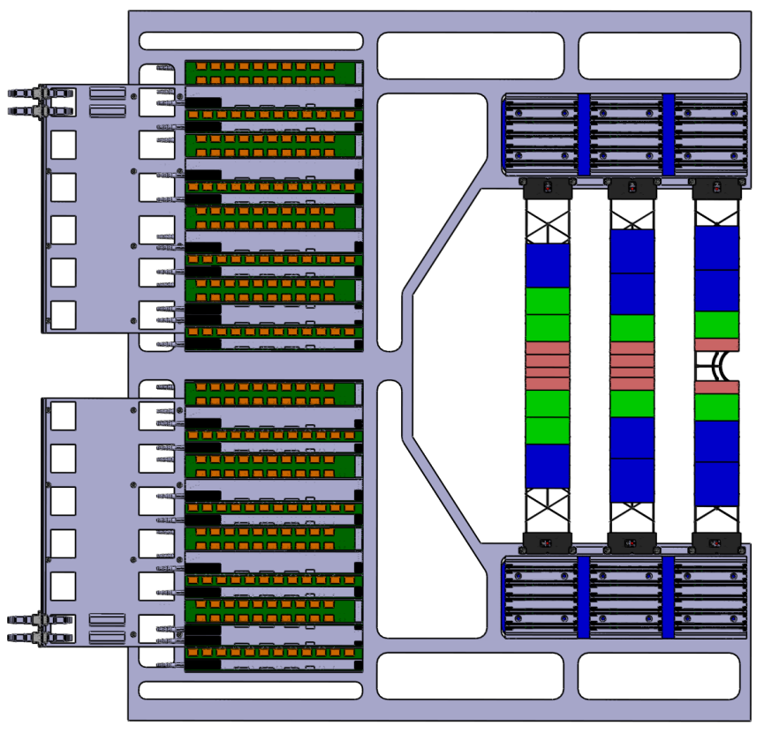
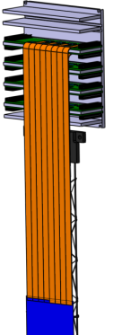
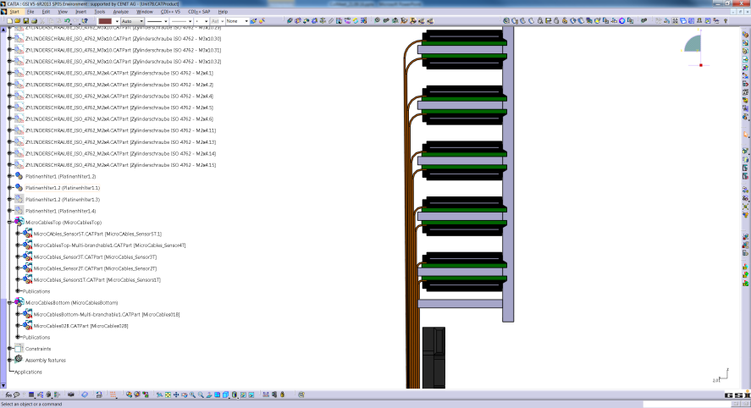
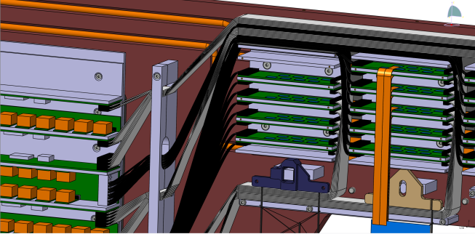
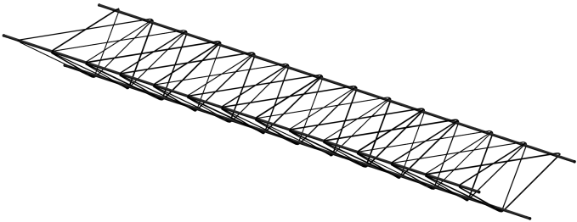
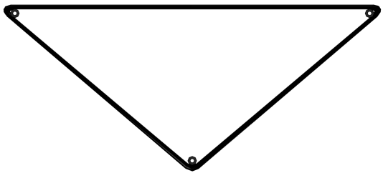
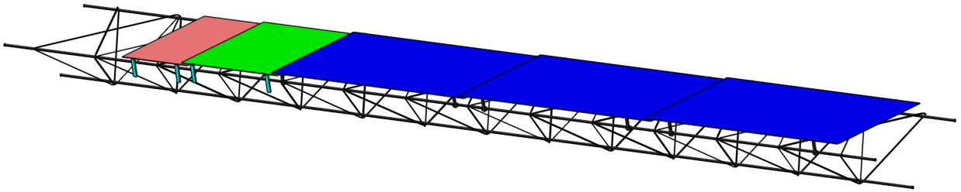
1. STS general overview
Half-Unit details:
C-Frame
Front-End electronics
Cabling concepts:
Front-End to peripheral:
r/o cables
On the Ladder
ultra-thin r/o cables
power cables
Double-sided silicon
micro-strip sensors
(different sizes)
Carbon fiber ladder
Isometric view
Silicon sensor carrier
Extremely light
Manufactured by winding
Peripheral electronics
Carbon fiber “Ladders”
Front view
Ladder with silicon sensors
Winding
ladder concept based on ALICE ITS (S. Igolkin et al.)

Slide 6

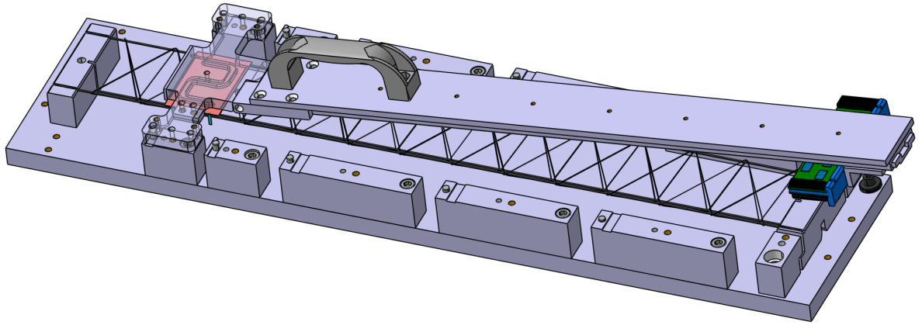
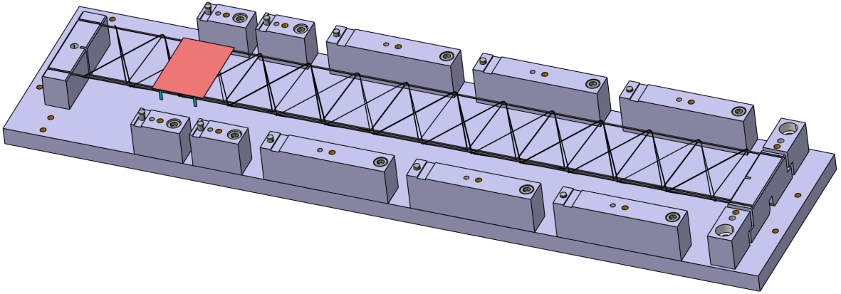
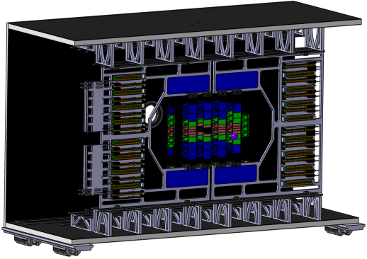

2. Precision requirements
Sensor position on the CF Ladder
Ladder position on the C-Frame
Prototype assembly tool
Floating bearing on top
r/o cable support arm
Different concepts considered!
Vacuum sensor holder
Fixed bearing at the bottom
Positioning via dowel pins
≤ 0.1 mm XYZ Positioning tolerance
Tilting precision – not yet defined
Achievable through precise tooling and mounting concept
≤ 0.1 mm XY positioning tolerance
Z positioning – less relevant
Tilting precision – not yet defined
Achievable through mounting concept
C-Frame position in the Mainframe
STS position in the Magnet
+- 0.5mm Positioning
Precise rail system
Precise support structure/baseplate
Mounting concept
+- 2mm Positioning
Precise rail system
Precise support structure
Position measurement

Slide 7
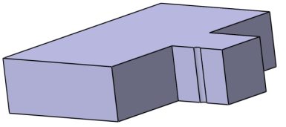
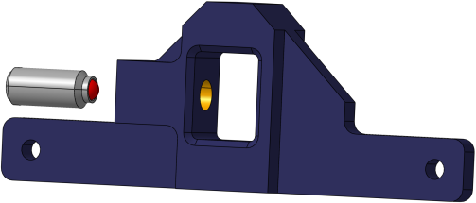
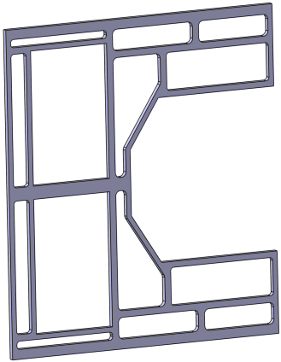
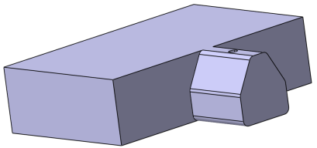
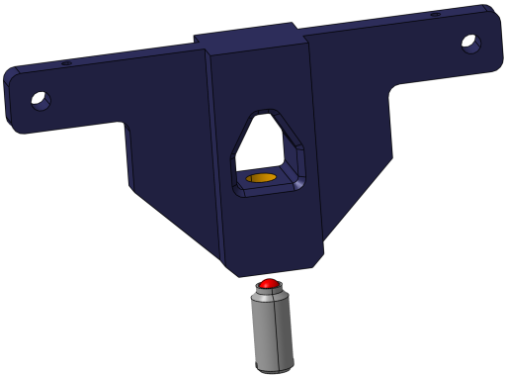
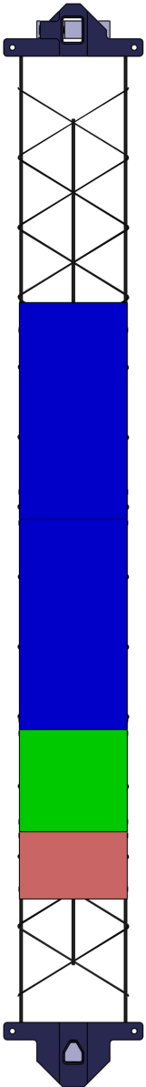
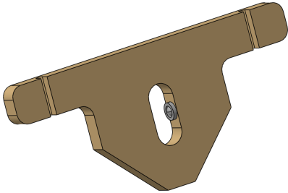
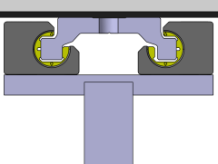
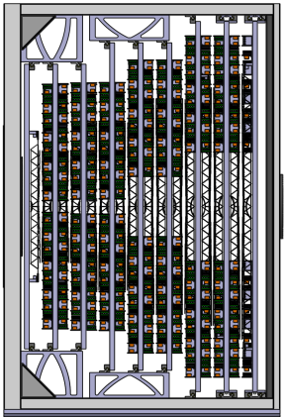
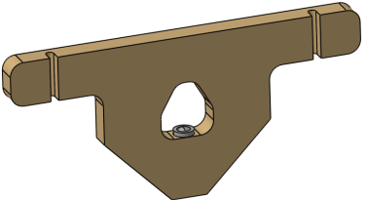
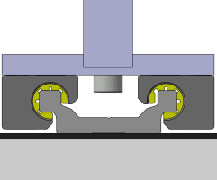
3. STS Mechanics
Floating bearing pin
Positioning groove
C-Frame:
Spring plunger
Floating ladder
bearing
CF Ladder DOF
Compensation of thermal deformations!
CF Ladder DOF
Design iterations so far:
Different designs
Different Materials
Still ongoing
Fixed bearing pin
Fixed ladder
bearing
Ceramic floating
bearing
Positioning hole
Spring plunger
C-Frame Mounting
Floating bearing rails
Spring plunger
Ceramic fixed
bearing
C-Frame vertical DOF
Fixed bearing rails
Advantages:
no thermal stress
thermally incompatible materials possible

Slide 8
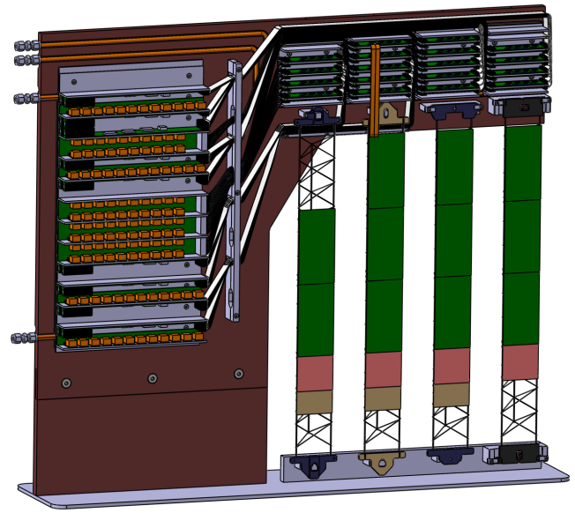
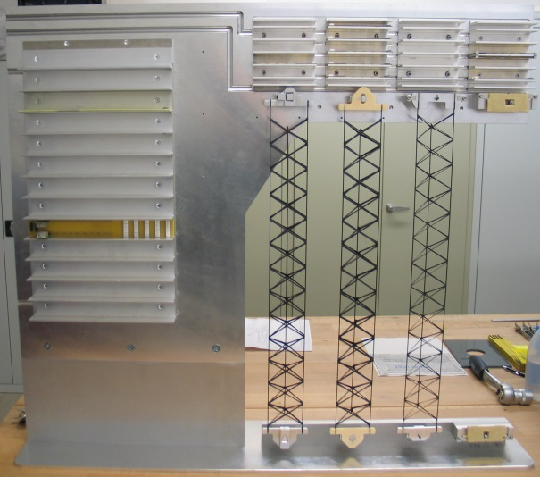
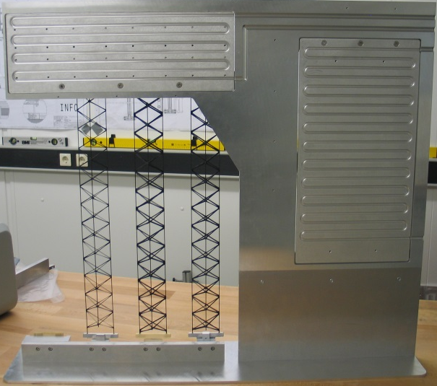
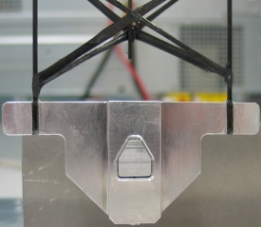
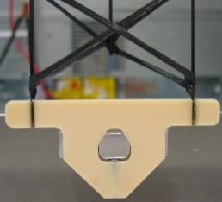
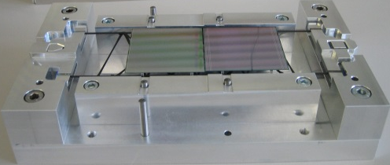
4. Prototyping
Starting point -> ¼ Unit 07 detailed CAD:
Mechanical parts completed and assembled
Front-End electronics
cooling block
=>
Peripheral electronics
cooling block
Features:
Unit 07 is the most critical in terms of height
Different ladder bearings
C-Frame cabling
Full dummy - electronic assembly
Assembled CF ladders
Cooling blocks for electronics
Real mounting sequences
Still pending:
Electronic dummy components
Cabling
Validation of the CAD cabling
Al Bearing
Al2O3 Bearing
Small assembled ladder prototype:
Prototype tooling tests
Assembly sequence and method test
Room for improvement

Slide 9
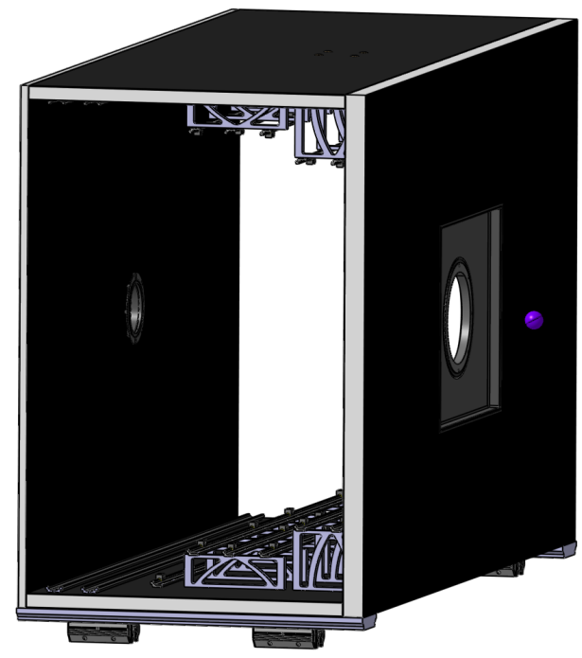

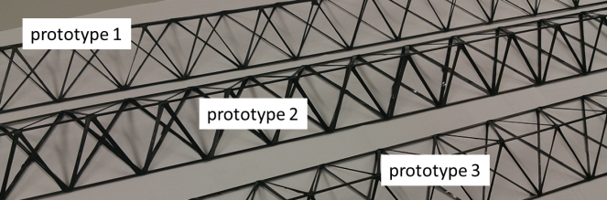
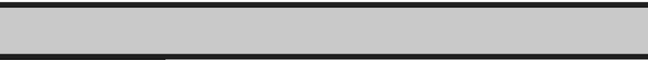
5. Materials
Al pin
Al Bearing
Ceramic bearing
Ladder bearings:
Aluminum pins, anodized?
Aluminum or ceramic bearings
C-Frame:
Glass fiber
Fiber reinforced PEEK
Thickness 15mm
More ideas?
Should be lightweight, electrically insulating and allow threads and fittings
CF composite 2mm
Thickness: 40mm
Rohacell 36mm
Mainframe:
CF – Rohacell Sandwich considered
High stiffness + thermal insulation
Inserts for threads/fittings
Inner skeleton – Aluminum profiles e.g. ITEM, or CF Profiles
CF Ladders:
Multiple prototypes
Different fibers and manufacturing procedures

Slide 10
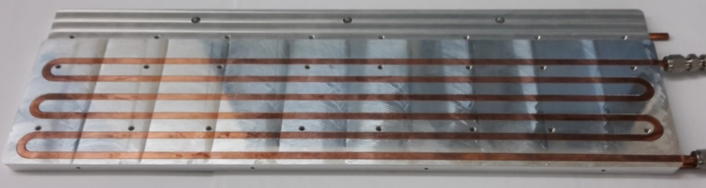
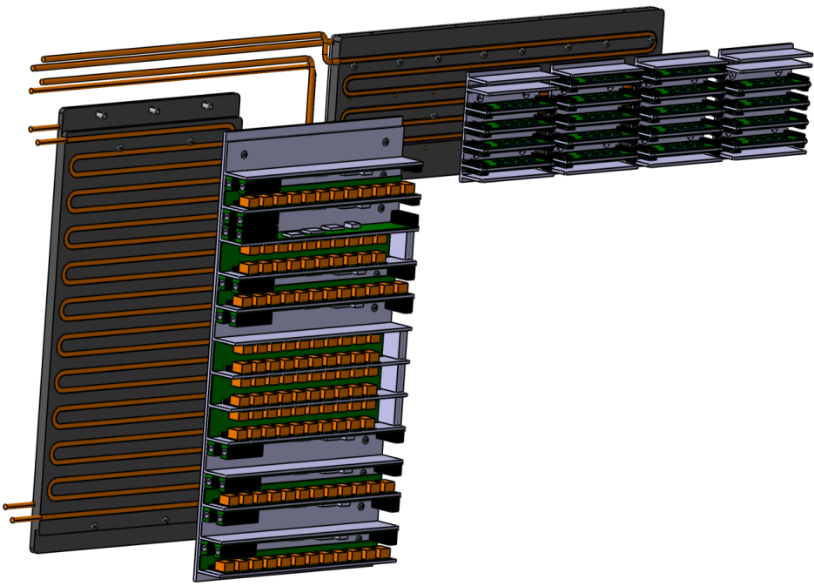
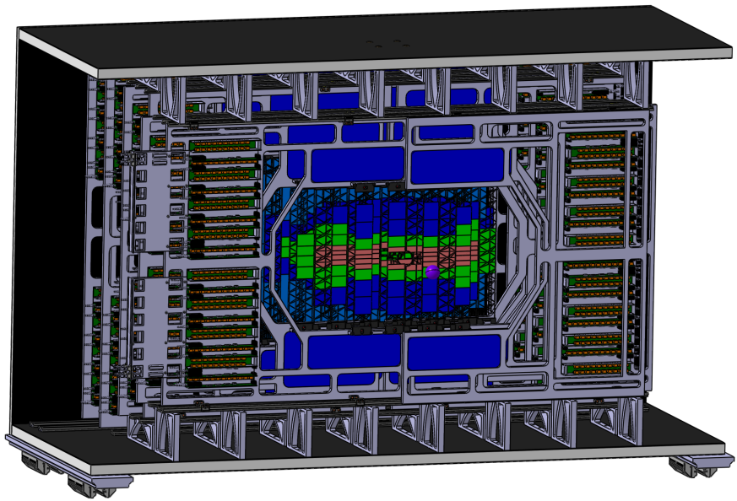
6. Cooling concepts
Combination of two concepts:
Local cooling for the electronics
Global cooling of the detector atmosphere
1. Local cooling:
Front-End cooling block
[Cooling Block prototype; Fa. Cool Tec Electronic GmbH]
2. Global cooling:
Front-End electronics
Peripheral electronics
Key points:
Removal of the 40 kW electronics power
Local overheating prevention
Industrially manufactured coolers
Good conductive contact required
CO2 cooling system planned
Key points:
Required to achieve cold and dry operation atmosphere: -5°C
Blowing cold Nitrogen
Removal of additional heat dissipated by sensors currents (avoid thermal runaway)
Peripheral cooling block

Slide 11
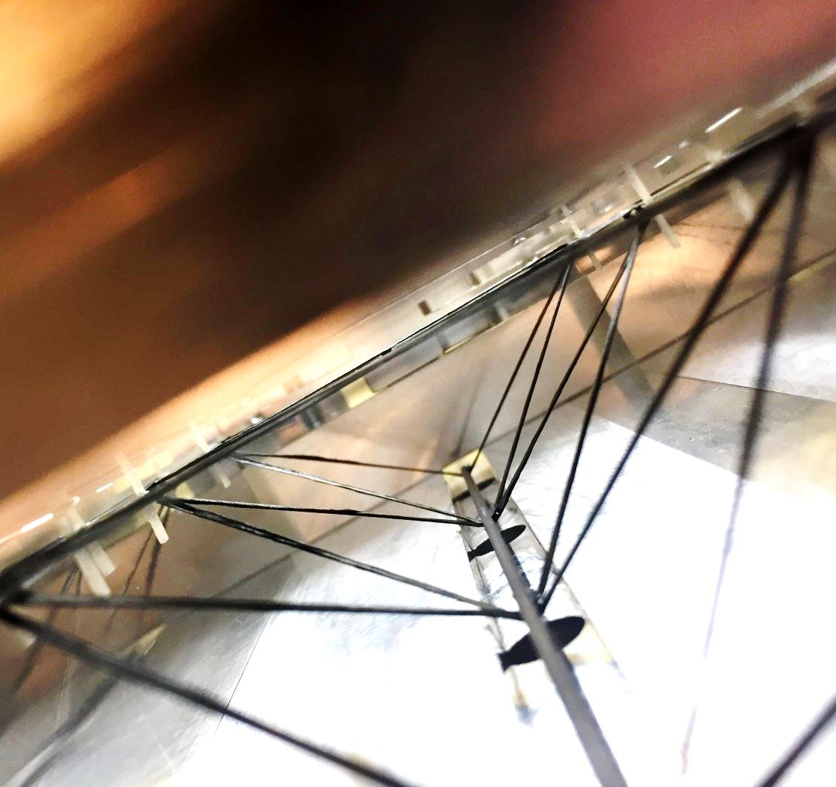
7. Outlook
Further assembly of the ¼ Unit 07
  Dummy-electronics
  Cabling
Material definition based on
  Requirement analysis
  Prototyping activity
Concept testing and development
  Local and global cooling
  Multiple unit assembly
Further prototyping
  Large scale prototypes
  Thermal tests

Slide 12
CBM Engineering
Thank you for your attention!

Slide 13
BACKUP
BACKUP

Slide 14
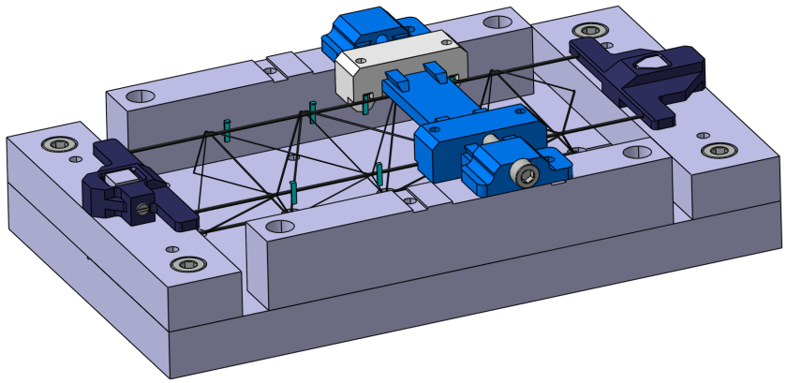
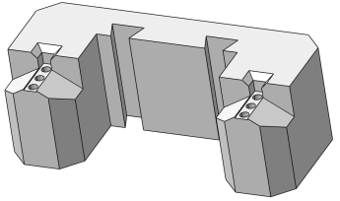
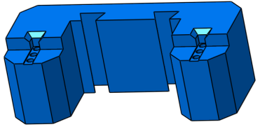
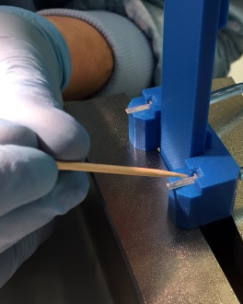
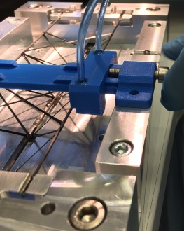
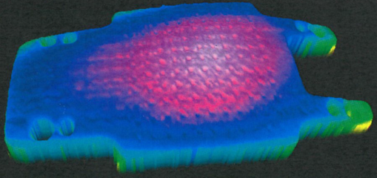





3. Tooling
L-Leg gluing concept tool
Sensor holder:
Lapped surface
Vendor data: $R_{z}=0.57μm$
Flatness$=6μm$
applying glue onto the
L-Legs
L-Leg holder in position for gluing
L-Leg suction cup
3D print, version 2
L-Leg suction cup
3D print, version 1
Short Ladder piece with 8 L-Legs

Slide 15

CBM Engineering
prototype 1
prototype 2
prototype 3
 | Prototype #1 | Prototype #2 | Prototype #3
Support | CFK-pipe / 1,5mm | CFK-pipe / 1,5mm | CFK-pipe / 1,5mm
Matrix | L20/EPH960 | L20/EPH960 | L20/EPH960
Fiber | M55J / 6K | M55J / 6K | M60J / 3K
Roving | 1 | 2 | 3
Weight | 11,2 g | 14,8 g | 11,2 g

Slide 16


STS module assembly

Slide 17


Compressed Baryonic Matter (CBM) experiment at FAIR
Physics aim
Observables
Observables
Recent paper
Exploration of the QCD phase diagram at high net baryon densities and moderate temperatures
Starting with SIS100 projectile energies:
2÷11 GeV/nucleon / $\sqrt{sNN}$ = 2.7÷4.9 GeV,
protons up to 29 GeV
Hadrons, electrons, muons, photons
Particle yields and multi-differential cross-sections
Rare diagnostic probes: strange mesons,
light vector mesons (ρ, ω, φ), charm production
Challenges in QCD matter physics – The scientific programme of the CBM experiment at FAIR;
arXiv:1607.01487v2 [nucl-ex] 24 Nov 2016

