Slide 1

Status of triplet cryostat and magnet support scheme
D. Ramos, M. Moretti, C. Eymin, V. Parma
HL-LHC TCC, 19 Jan 2017

Slide 2
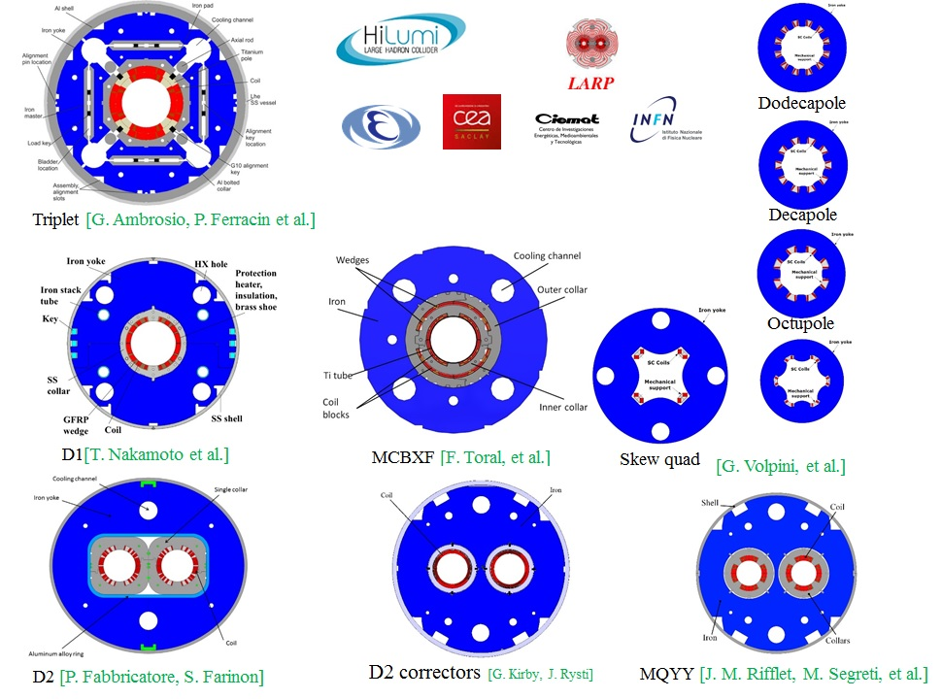
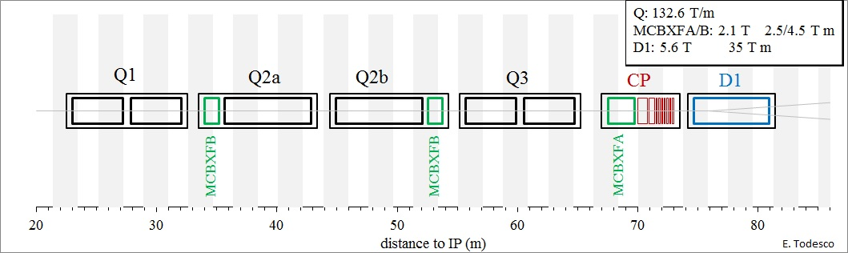
The “triplet” cryostat string
Ø 630 mm
~ 10.1 / 9.8 m length
Ø 570 mm
~ 7.4 m length
~ 2 ton per meter length
Ø 630 mm
6.1 m length

Slide 3
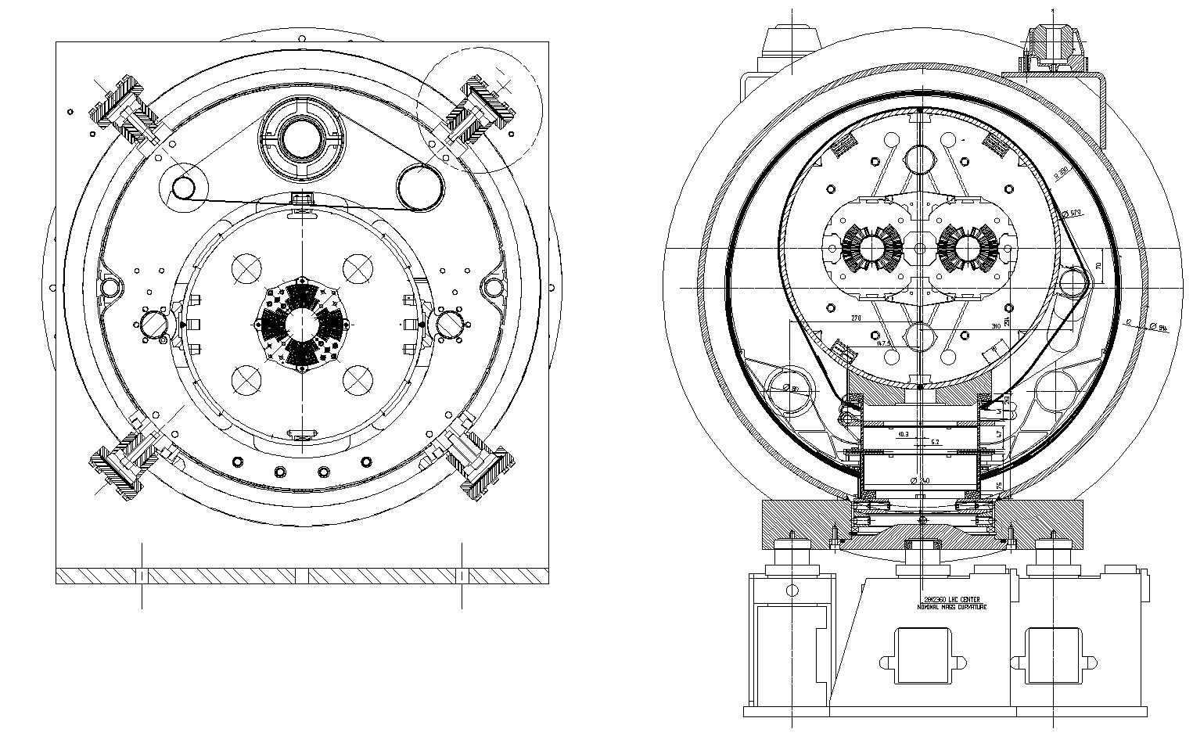
LHC triplet and dipole cross sections
Preference for column support posts but LHC layout cannot fit a larger cold mass plus pumping lines
Alignment principle: The magnet postion w.r.t vacuum vessel is measured (fiducialization); the cryo-magnet is then positioned in space by moving the whole assembly on support jacks. Cold supports are not adjustable.

Slide 4
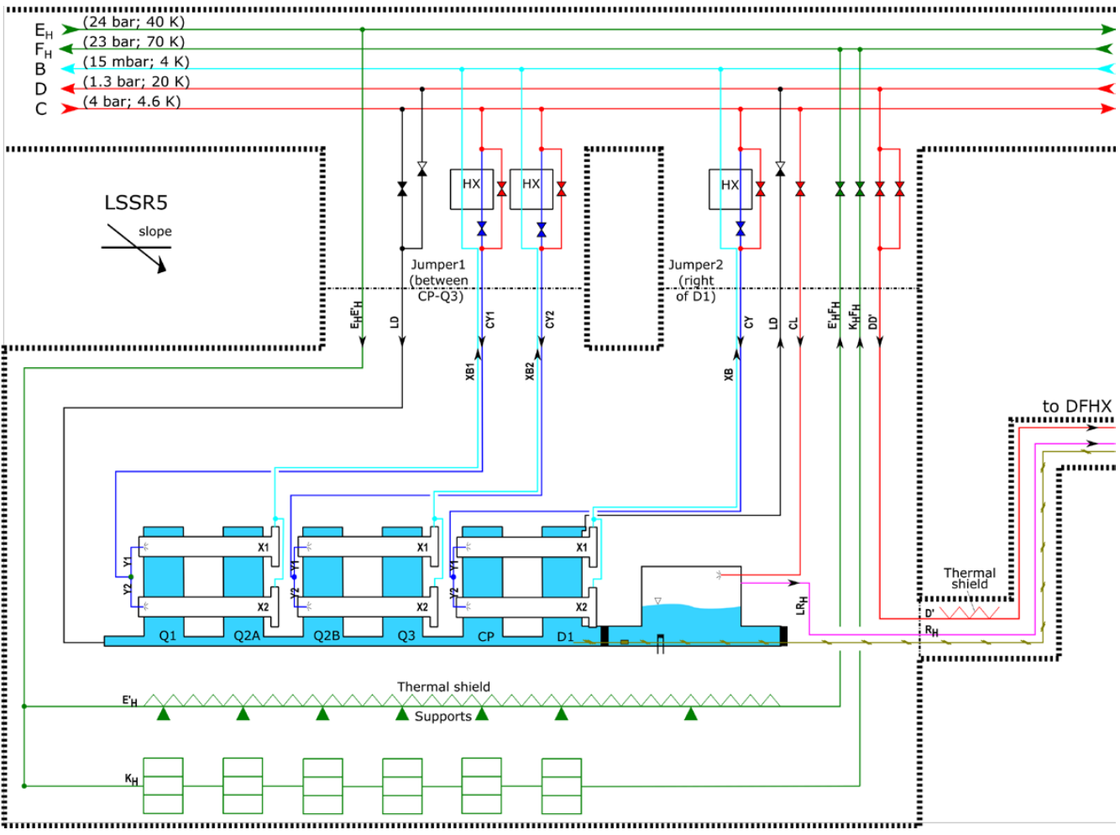
Preliminary cryo flowscheme (WP9)
Slope dependent!
https://edms.cern.ch/document/1710017/0.3

Slide 5
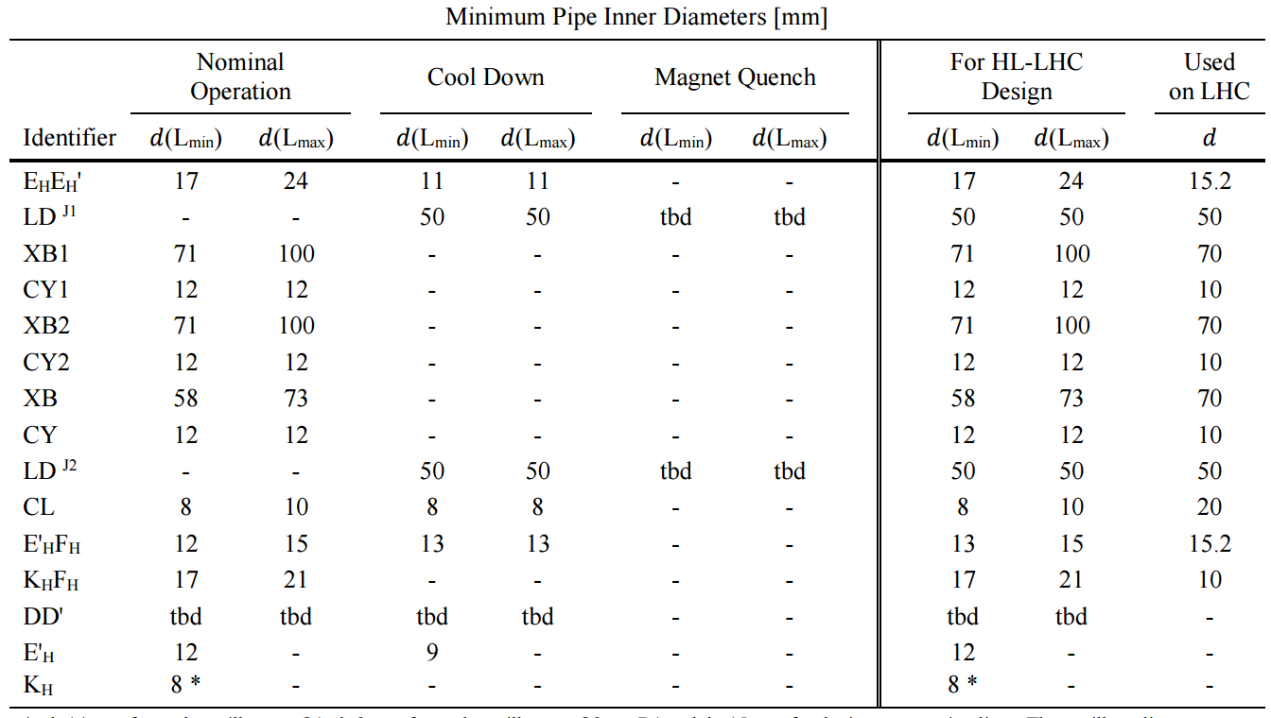
Pipe size estimations (WP9)
Integration inside the cryostat is driven by the Ø100 mm pumping lines
And…
Free longitudinal cross section for HeII: 150 cm² (100 cm² btw. CP and D1)
Size of phase separators: 12.5 L for Q1 to Q3; 5.5 L for CP and D1
https://edms.cern.ch/document/1710017/0.3
Heat loads: https://edms.cern.ch/document/1610730/1.1
Static heat loads: https://edms.cern.ch/document/1690235/0.1

Slide 6
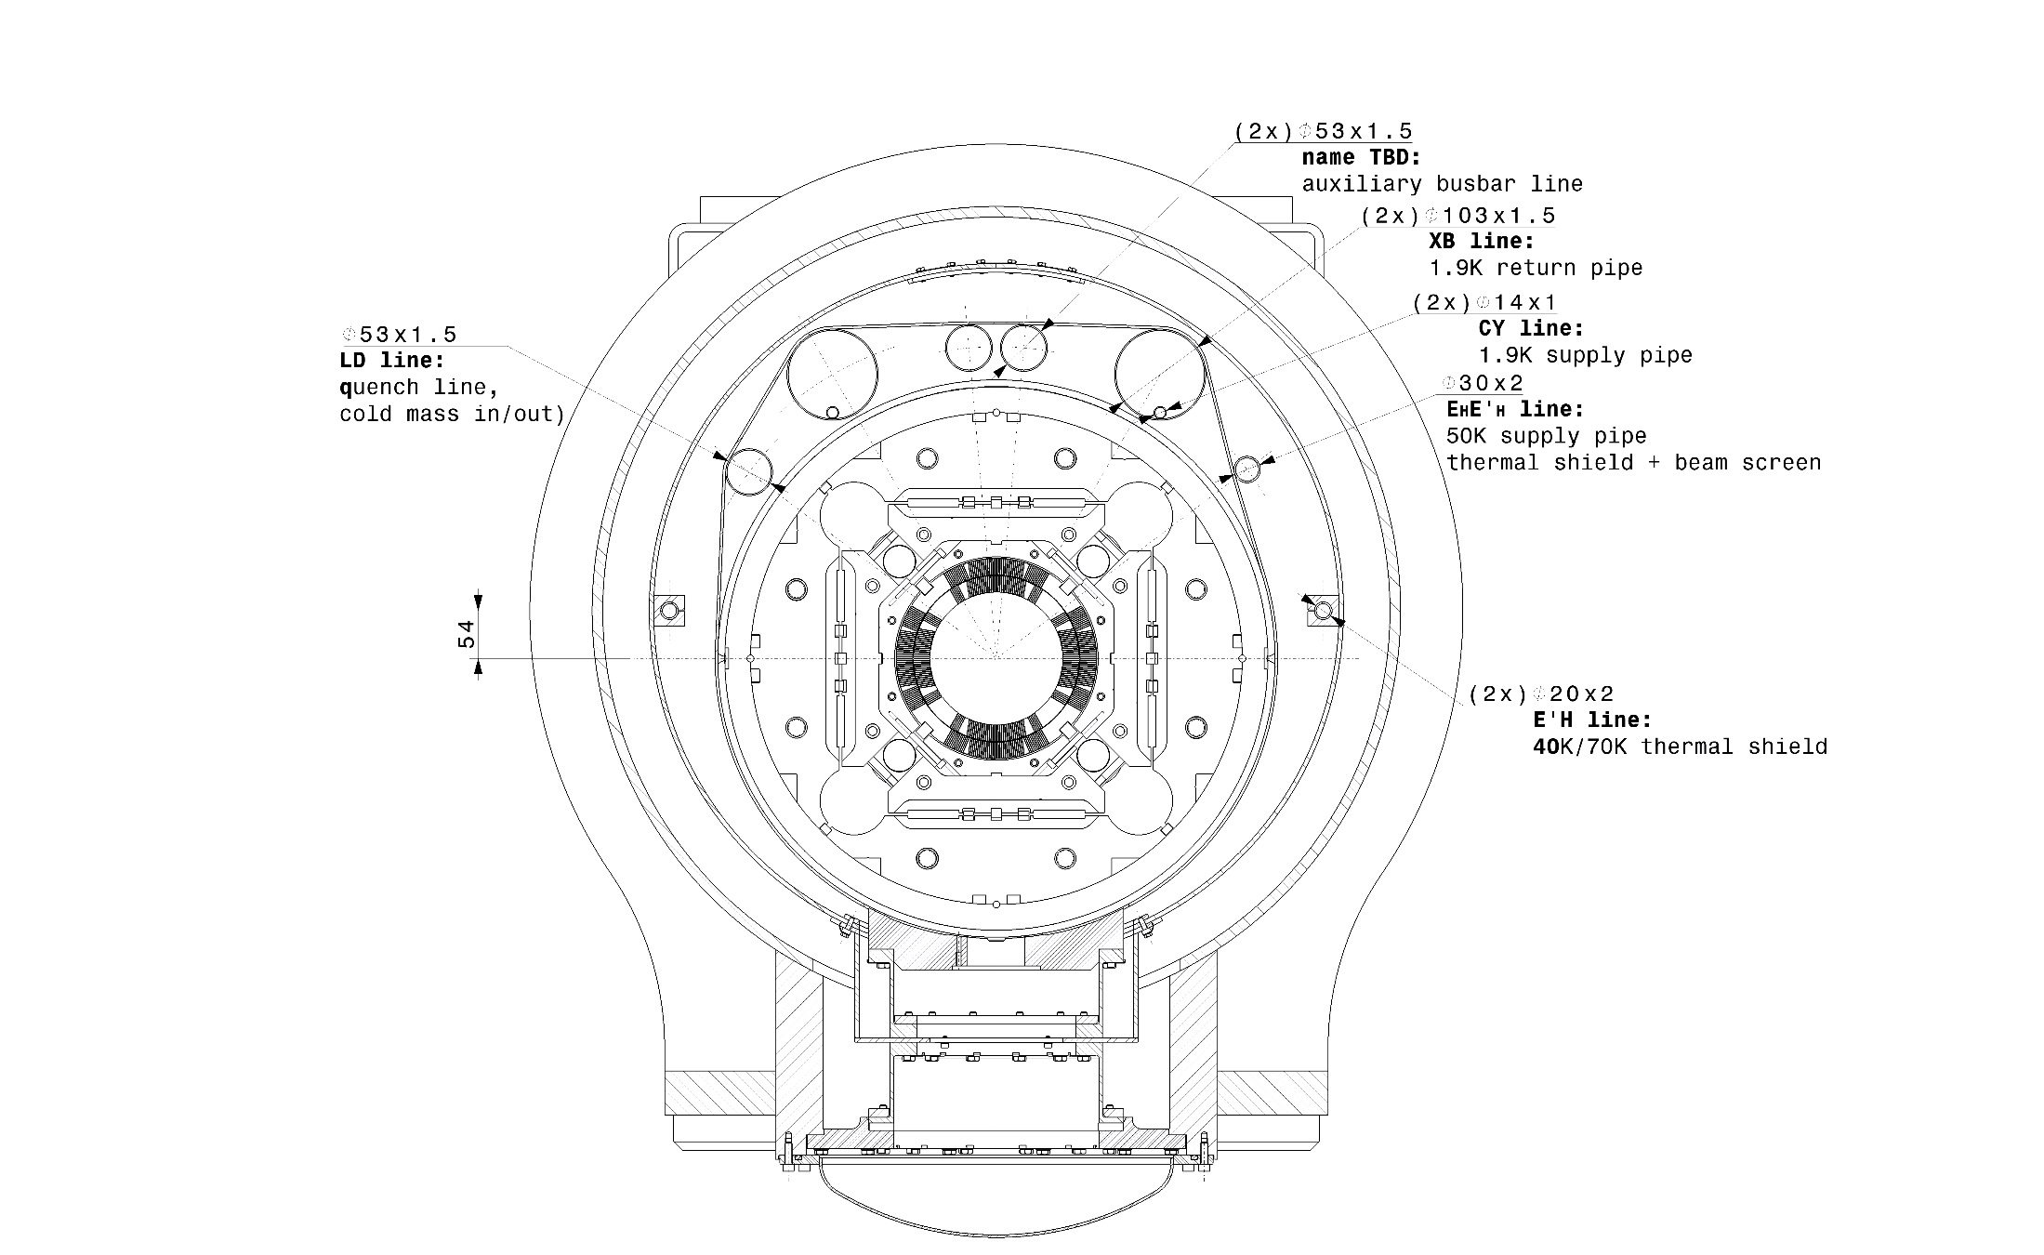
HL-LHC triplet cryostat
Radial gap at the top required for cryostating sledge
Offset creates space for piping inside the cryostat
Aluminium thermal shield 40-60K
Carbon steel vacuum vessel
Cryo pipe diameters take into account cryo parameters and industrial availability
GFRE column type supports (3x) with intermediate heat intercept
Sledge on rail cryostating method
More details on drawing: LHCQQX__0001

Slide 7
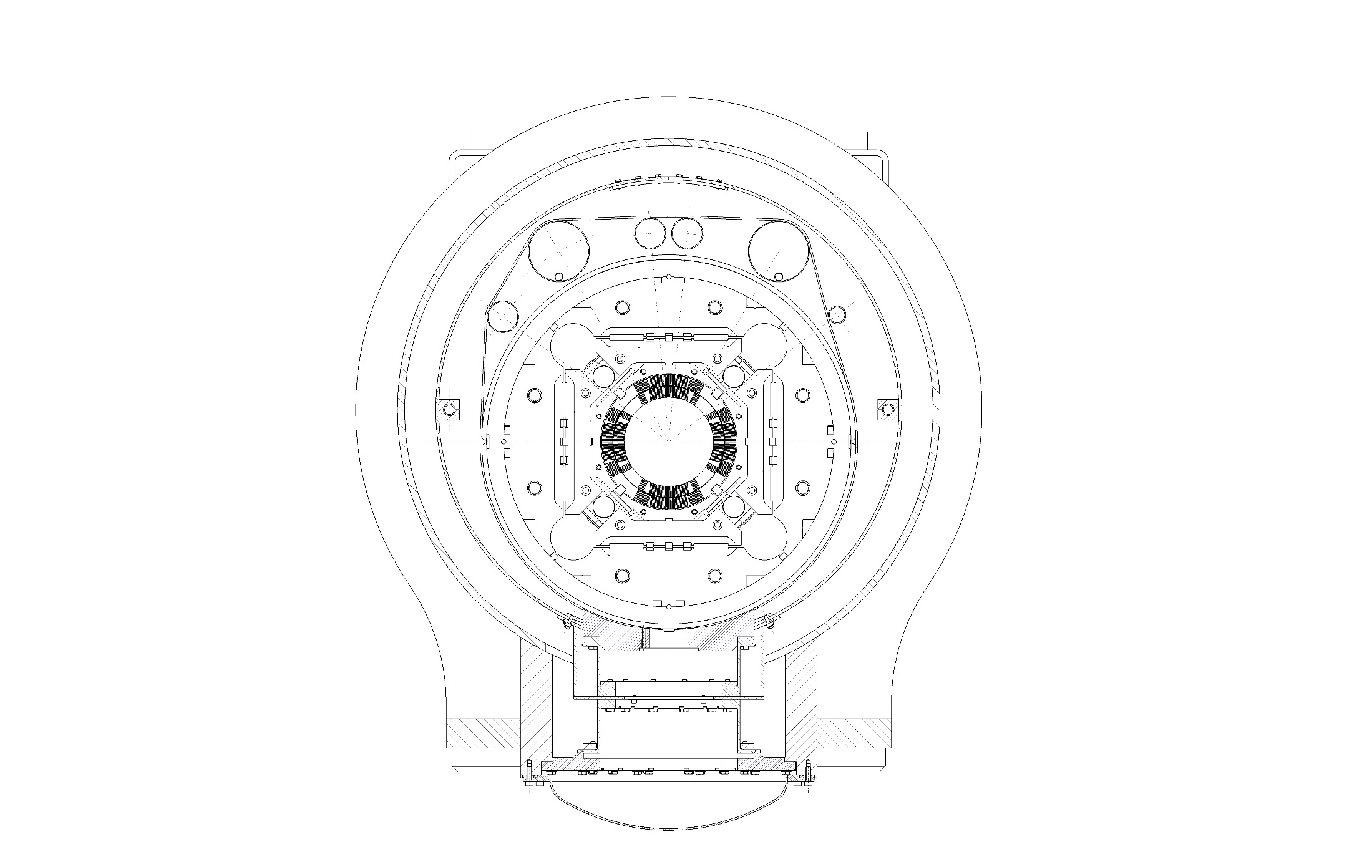
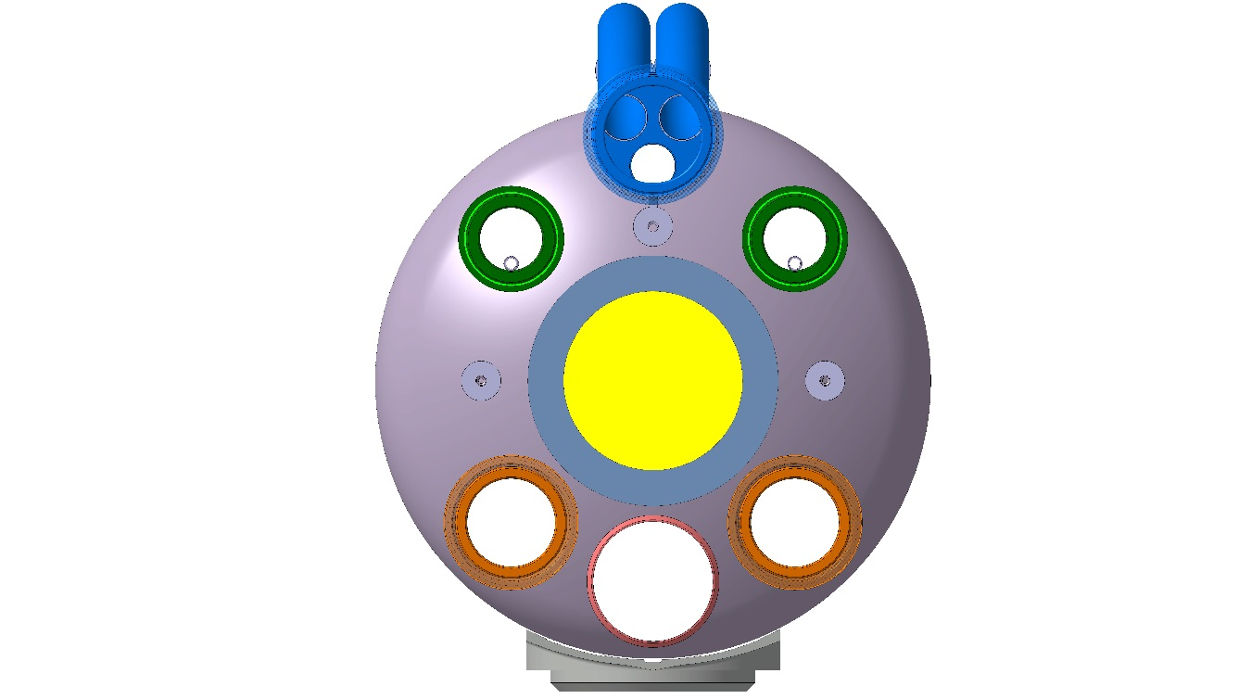
Cold mass interfaces
Distance between lines compatible with existing cutting machines
Trim+Correctors / CLIQ
or
Trim / Correctors
Heat exchangers (2x)
18 kA busbars
HeII inlet
Beam line
Beam screen bellows
HeII cross section 2x75 cm² located the at same radius as the heat exchanger
Alternative: HeII cross section 150 cm². Less work in the tunnel but too close to beam line and large (rigid) bellows!
More details on drawing: LHCQQX__0001

Slide 8
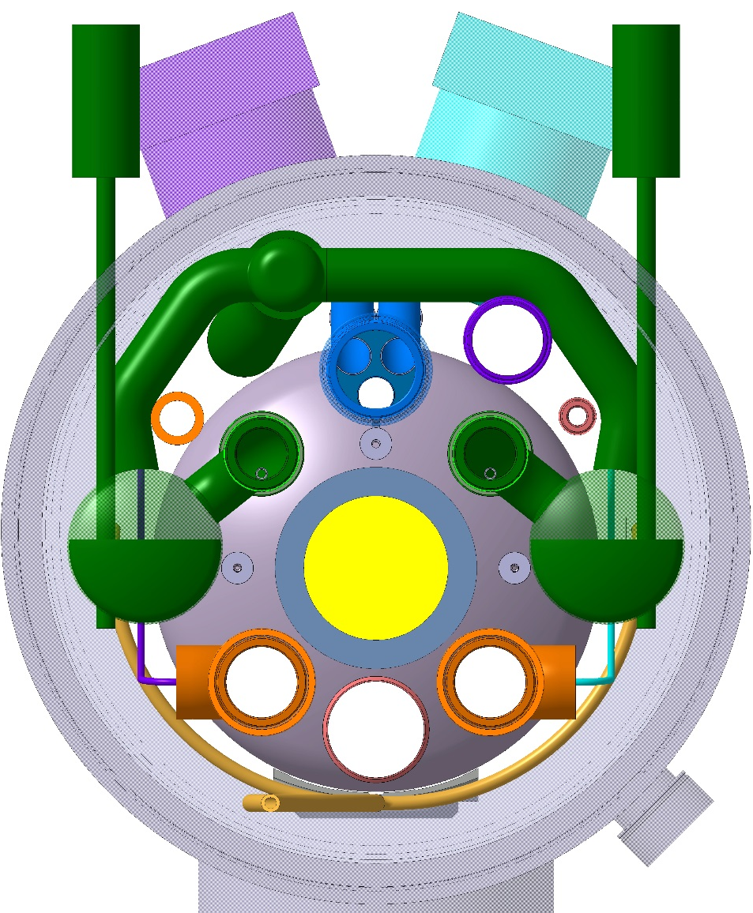
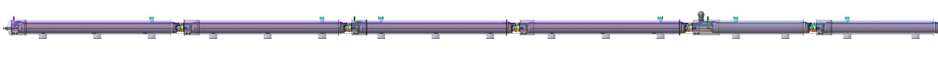
Phase separators and pumping lines
Reservation for level gauge (if needed)
Pumping manifold requires locally enlarged diameter: service module
Lower than heat exchanger
2x 6.5 L of liquid volume
Q1
Q2a
Q2b
Q3
CP
D1

Slide 9
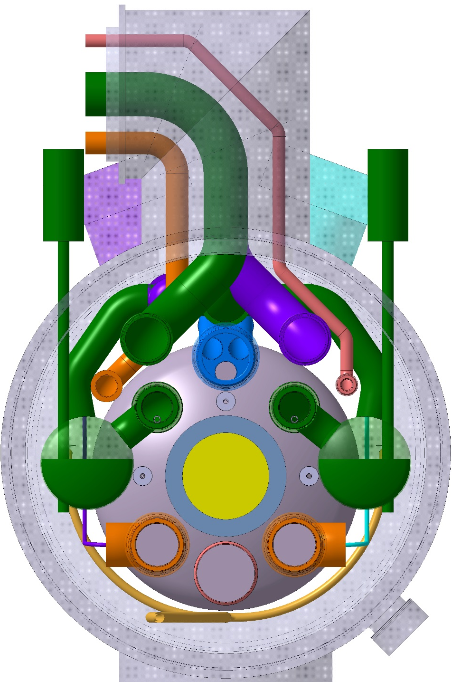
Jumper between Q3 and CP
Larger diameter and height than today in the LHC
Standardised position of phase sepatators and pumping manifold
Q1
Q2a
Q2b
Q3
CP
D1

Slide 10
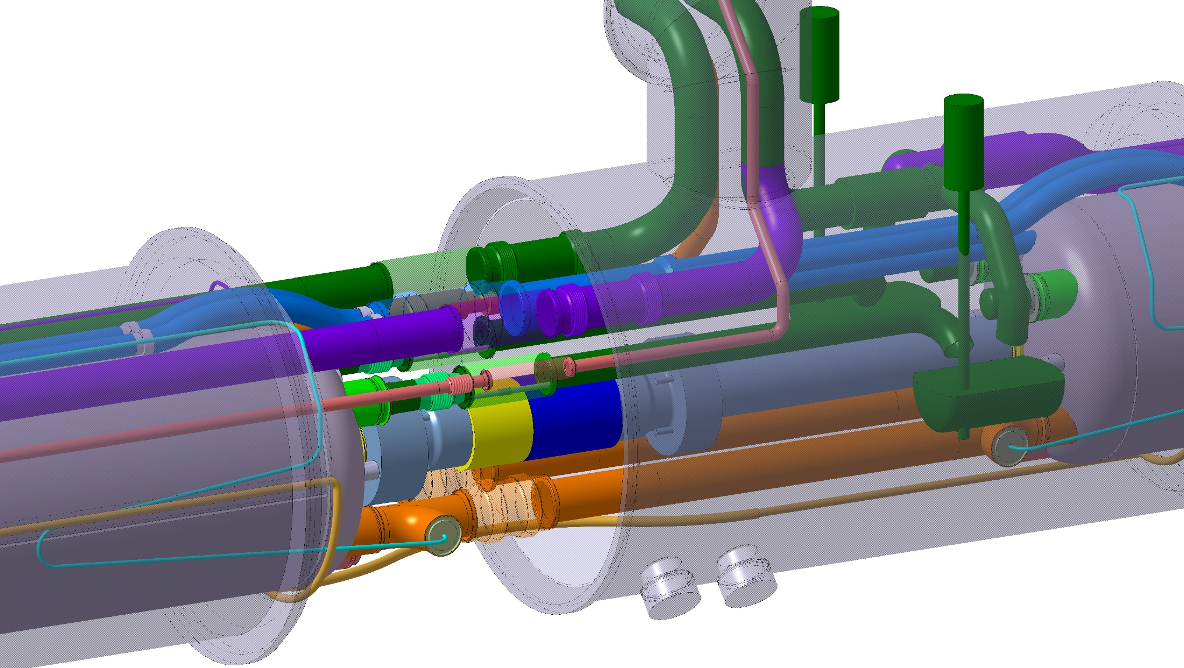
Interconnect and service module Q3-CP
Would not be possible if the heat exchangers of MQXF and CP and D1 were not aligned!
Pumping line if reverse slope
Phase separator is always in same position but connected to IP or non-IP magnet depending on slope
BPM cable feedthroughs
Beam line pumping port (only on CP)
Q1
Q2a
Q2b
Q3
CP
D1

Slide 11
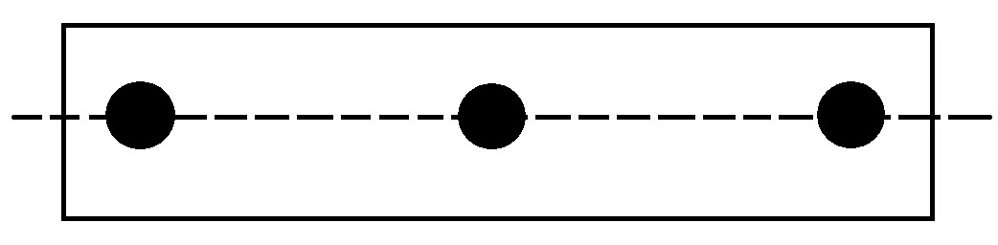
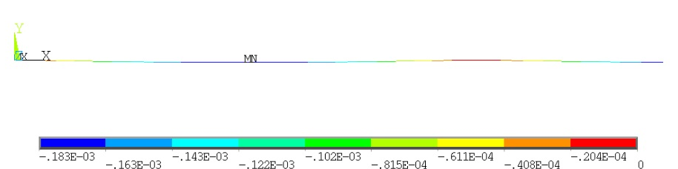
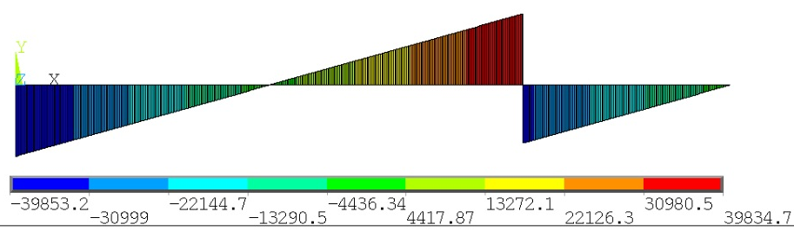
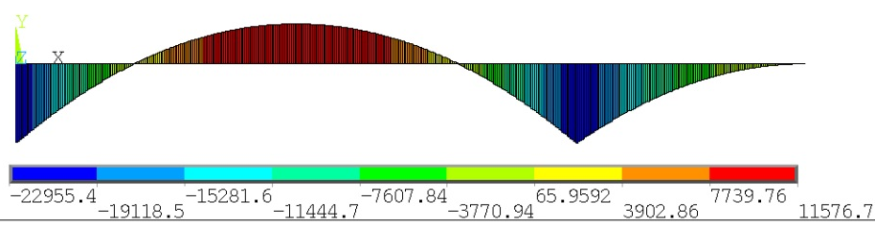
Distance between cold mass supports
a = 3500 mm
  length 9.785 m
  weight 22.5 ton
Minimum deflection at
a = 0.715xL/2 ≈ 3500 mm

Slide 12
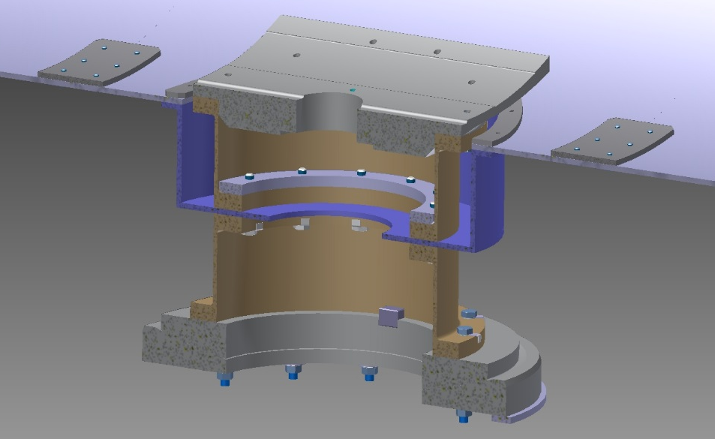
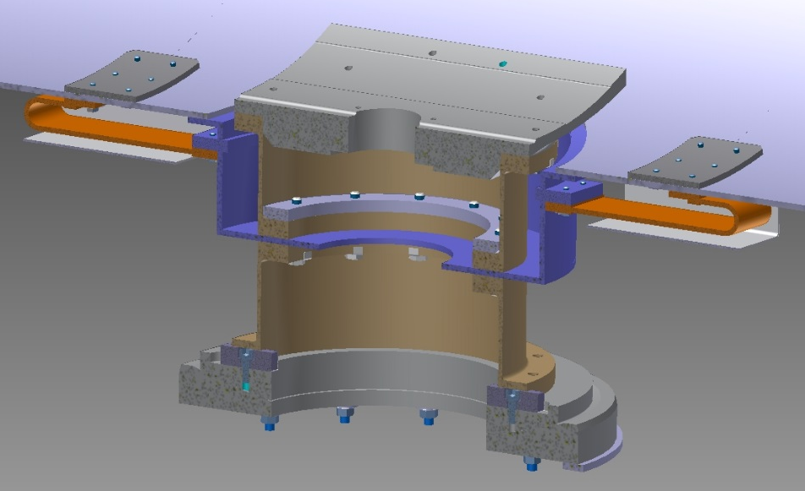
Cold mass support posts
Two-part GFRE column
Aluminium heat intercept plate (perfect heat intercept)
Fixed support in the centre of cold mass rigidly connects the cold mass to vacuum vessel
Sliding support bolted to the cold mass and sliding on vacuum vessel
Bolted assembly using invar washers and lock tab washers to ensure preload maintained at cold
Thermal shield is supported by the heat intercept plates, thus without additional heat load
Thermalization straps on sliding support for independent movement between cold mass and thermal shield
Fixed support
Sliding support (2x)

Slide 13
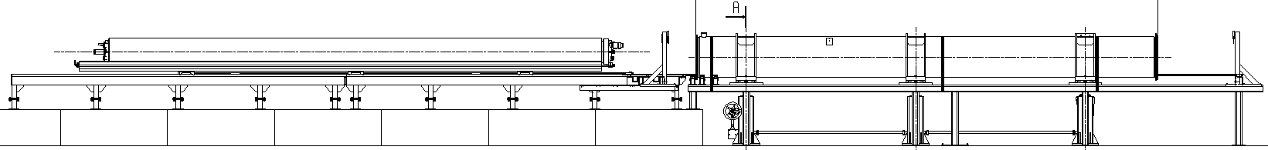
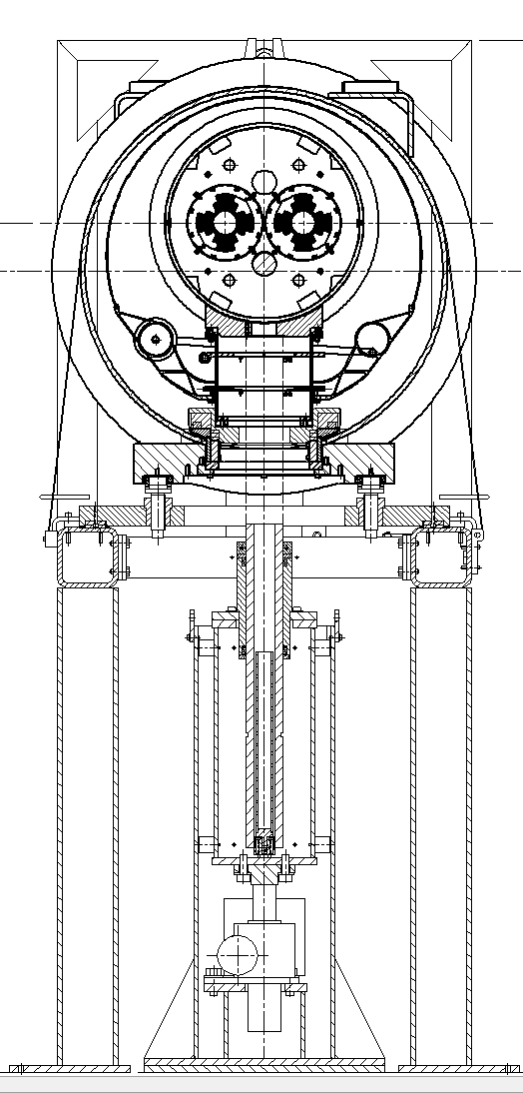
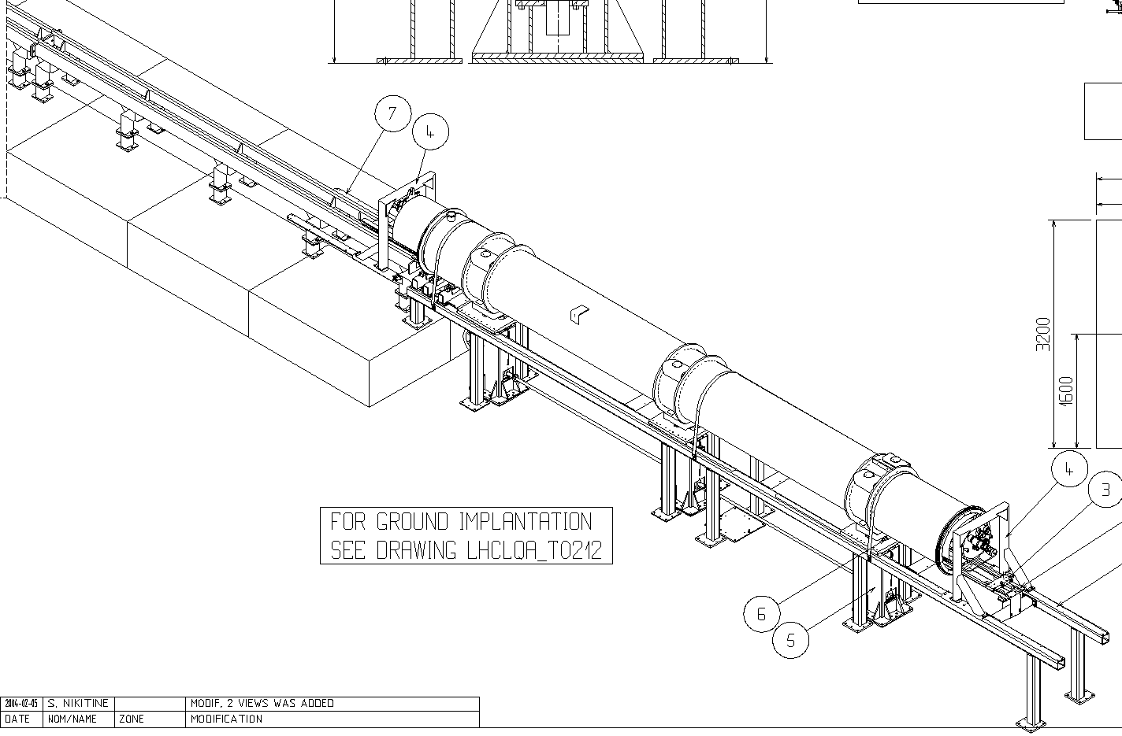
Cryostating tooling: sledge on rails
The principle currently used in dipoles and long SSS
Cold mass supported on at least 3 points at all times
Minimum gaps for cold mass insertion and removal of sledges must be accounted for

Slide 14
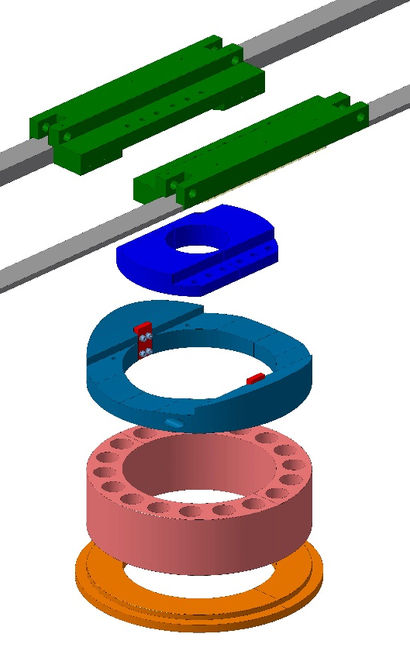
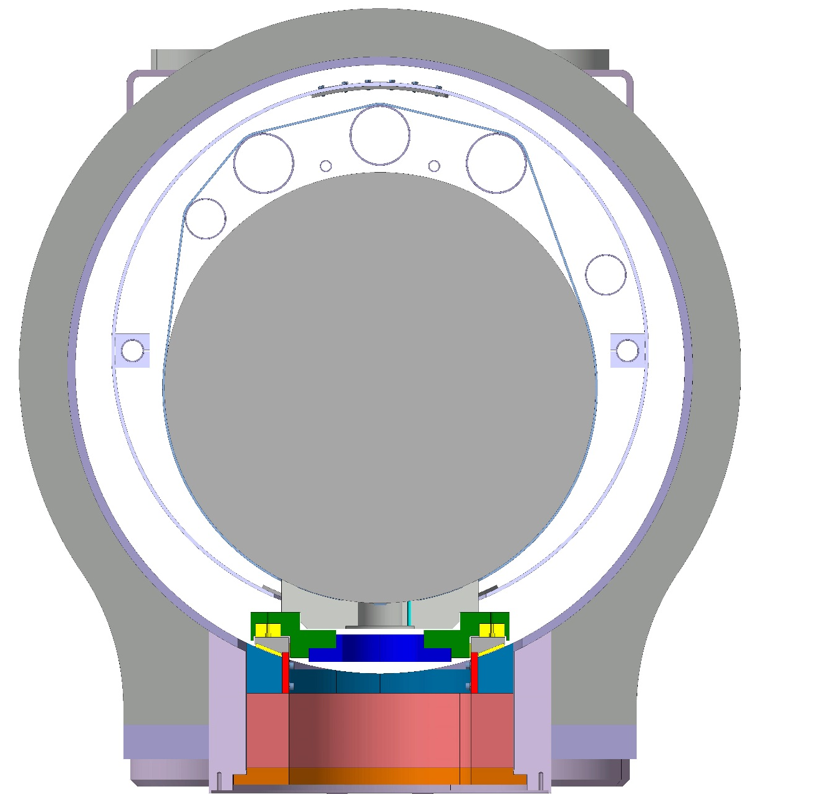
Cryostating tooling
Cold mass+shield lifted wrt nominal
Sledge on rails
Lifting jack
Lifting jack
Support assembly
Tooling removal

Slide 15
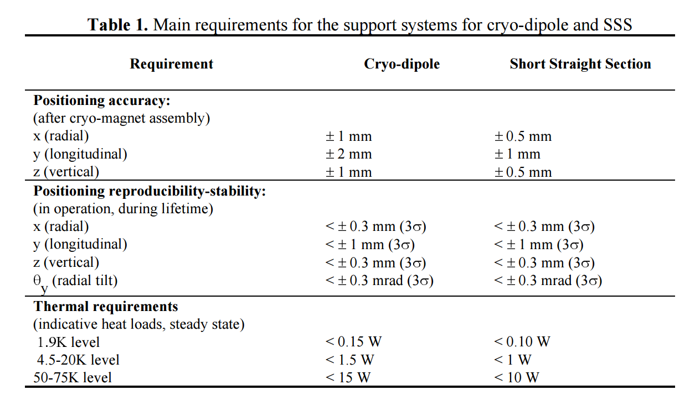
LHC Cryo-magnet stability specifications
“Quasi-static” movements
Position reproducibility after repeated thermal cycling
Position stability with respect to parasitic loads (interconnects, jumper, friction, tunnel slope)

Slide 16
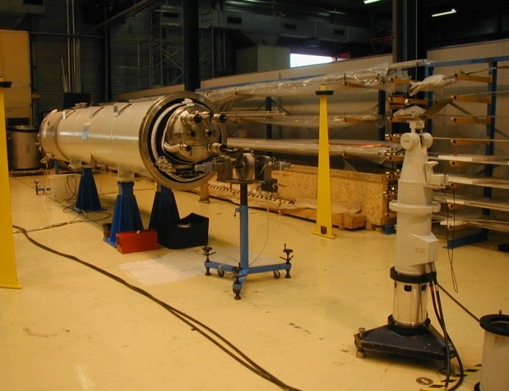
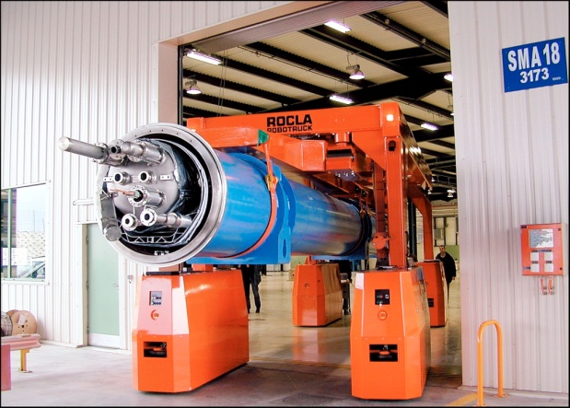
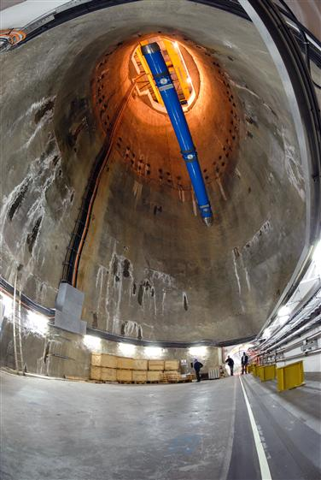
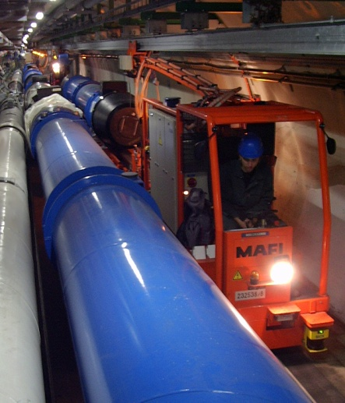
LHC Geometrical Stability: survey measurements
SSS positional stability and reproducibility at cold
Cryo-dipole positional stability after transport to tunnel
Survey measurements
with laser tracker
Cold mass stability w.r.t. fiducials measurements on 20 cryo-dipoles
Transversal movements
Cryo-dipole
Mean: +0.1mm; St.dev.: 0.17mm
ROCLA vehicle
Vertical movements
Tunnel transportation
Cryo-dipole
100 m descent to the tunnel
Mean: +0.08mm; St.dev.: 0.11mm
Courtesy of CERN Survey Team

Slide 17
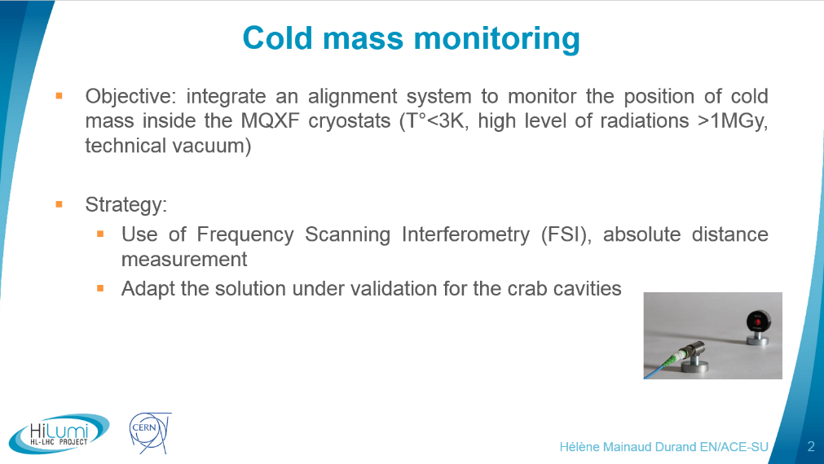
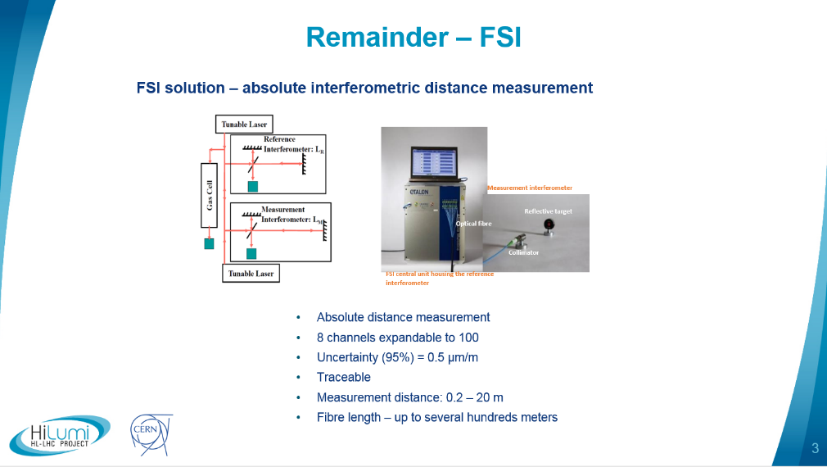
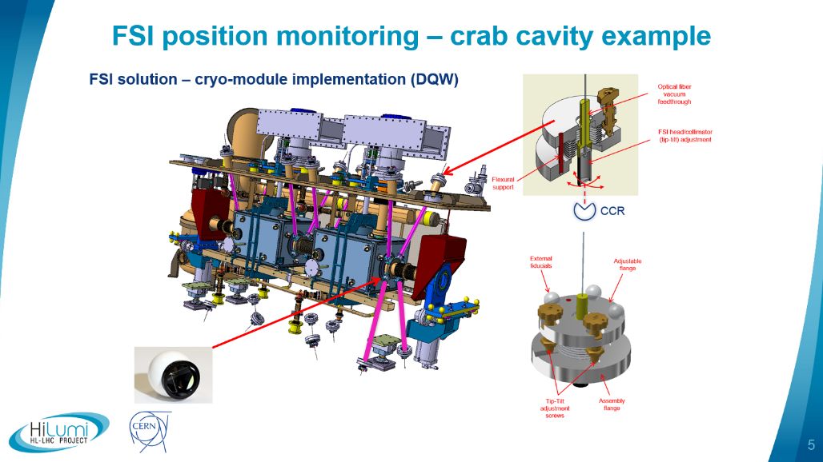
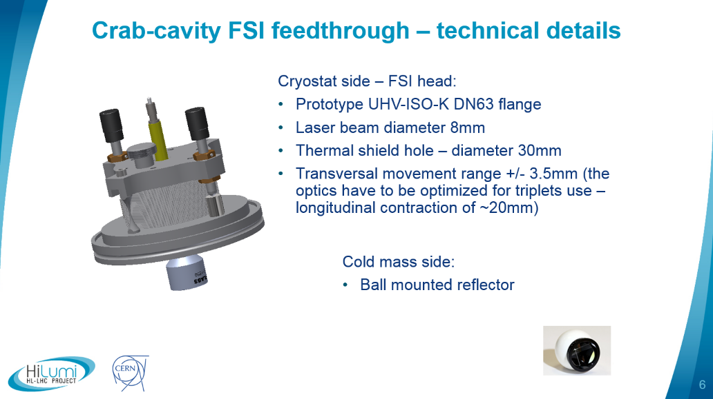
Cold mass position monitoring with Frequency Scanning Interferometry
Test on LHC cryo-dipole being prepared
Helene Mainaud Durand and Mateusz Sozin

Slide 18
Vacuum vessel
Reinforcing rings to prevent ovalisation
Minimum length for opening of interconnect sleeve
3 cold support posts
Fixed support post in the middle for better cold mass stability when handling + lower sliding stroke on other supports
Optimum distance ~3500 mm
Isostatic vacuum vessel supports (3 points) postioned for minimum cold mass bending
Low carbon steel certified resilience down to -50 ºC for pressure applications
Flanges from 304L forged rings

Slide 19
Dealing with vacuum and pressure end loads
“Vacuum force” (~80 kN, @ Q1 and D1)
(free,free,0)
(0,free,0)
(0,free,0)
Tie rod for longitudinal loads
(free,0,free)
Pressure end effect from cold mass interconnect
(20 bar in case of quench; actual force depends on interconnect design)
Q1
Q2a
Q2b
Q3
CP
D1

Slide 20
Vibrations (> few Hz)
Possible sources
  Background noise: measurements available; the response can be simulated (exitation ~nm)
  Helium flow:
    No data available, cannot be simulated
    Consider testing in SMI2 with first prototype?
How to address it, if an issue
  Active beam feedback
  Increase natural frequencies: can’t decrease mass, hence increase stiffness by adding supports (cost, more heat loads, hyperstatic, compromised alignment, higher risk of unknowns)
See also Paolo Fessia’s talk at Chamonix 2017

Slide 21
A concept of cryostat and cold mass that…
Fits in the tunnel (same width as other LHC cryostats) and encloses all the cryogenic piping running along the string, including phase separators.
Interconnects based on all welded seals (LHC solution), including space required for cutting and welding machines.
Minimises work in the tunnel, by design.
Corrector busbars, trims and CLIQ circuit cables may be routed on auxiliary lines along the cryostat.
Cold mass supports based on LHC dipole and SSS concept. Sledge on rails cryostating principle.
Isostatic support of the cryo-assembly, designed to accomodate pressure end loads (vacuum and quench) and allow remote alignment.
Aims at alignment stability requirements comparable to those of the LHC SSS and cryo-dipole.
Minimises the number of component and assembly variants.

Slide 22
Thank you for your attention!

Slide 23
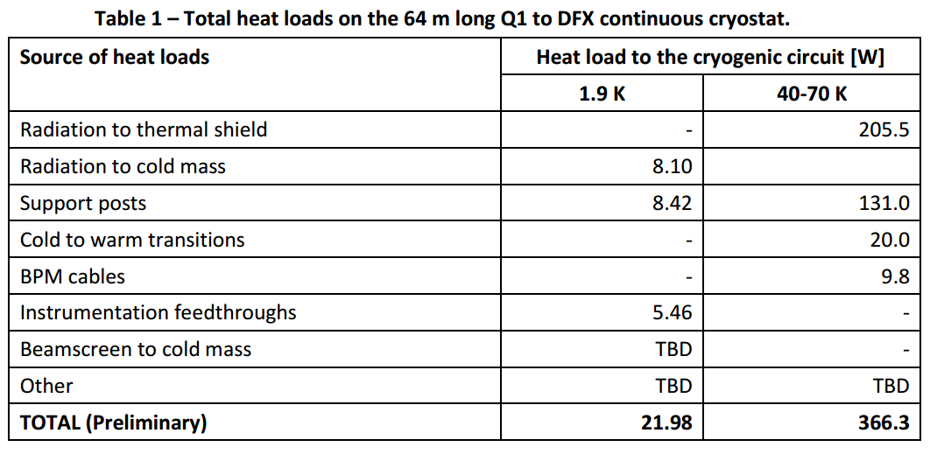
Static heat loads in the cryostat
https://edms.cern.ch/document/1690235/0.1

Slide 24
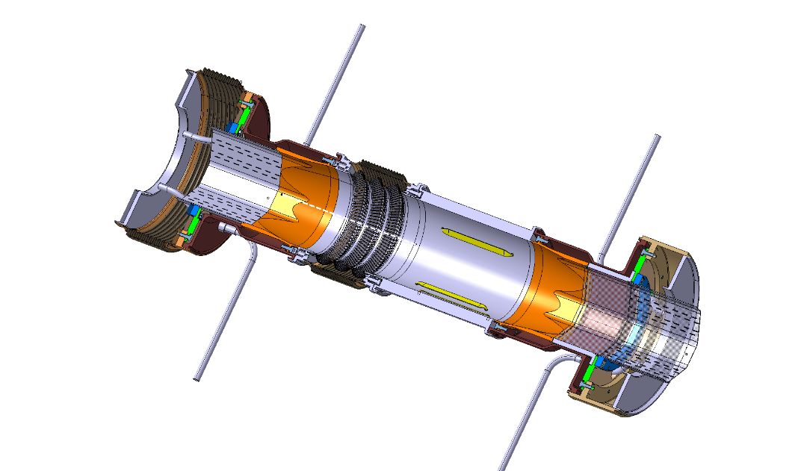
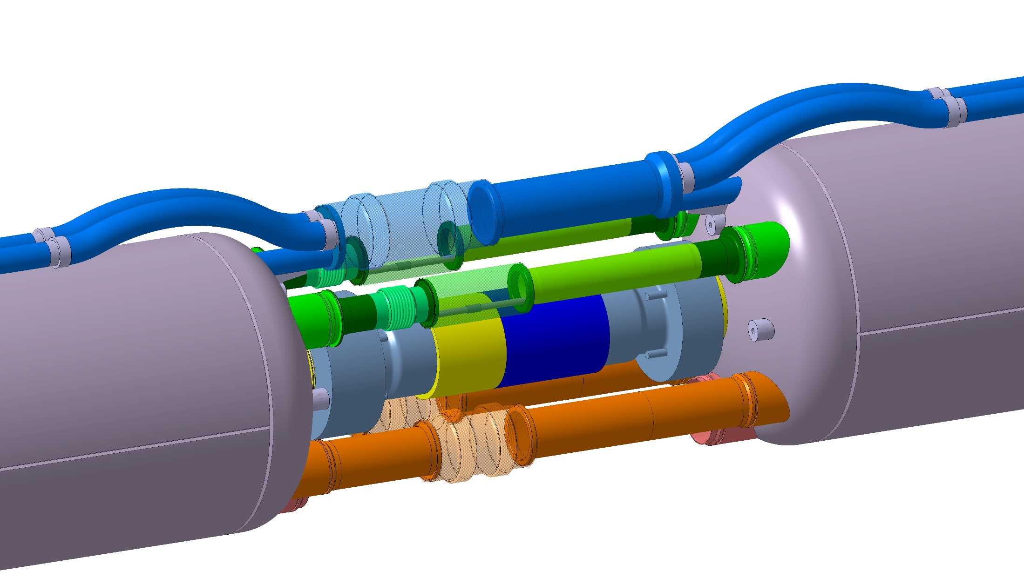
The simplest magnet interconnect config.
(Q1/Q2a or Q2b/Q3 or CP/D1)
Splice box
Universal expansion joints for lower interc forces
Q1
Q2a
Q2b
Q3
CP
D1

Slide 25
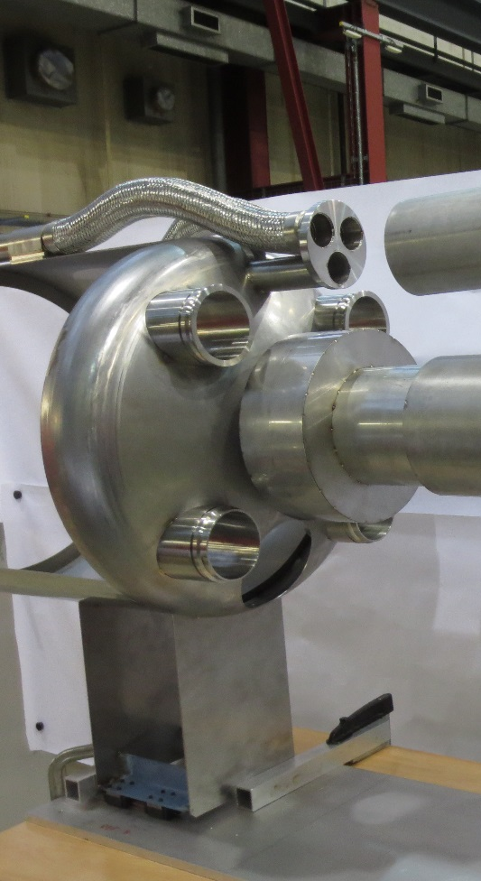
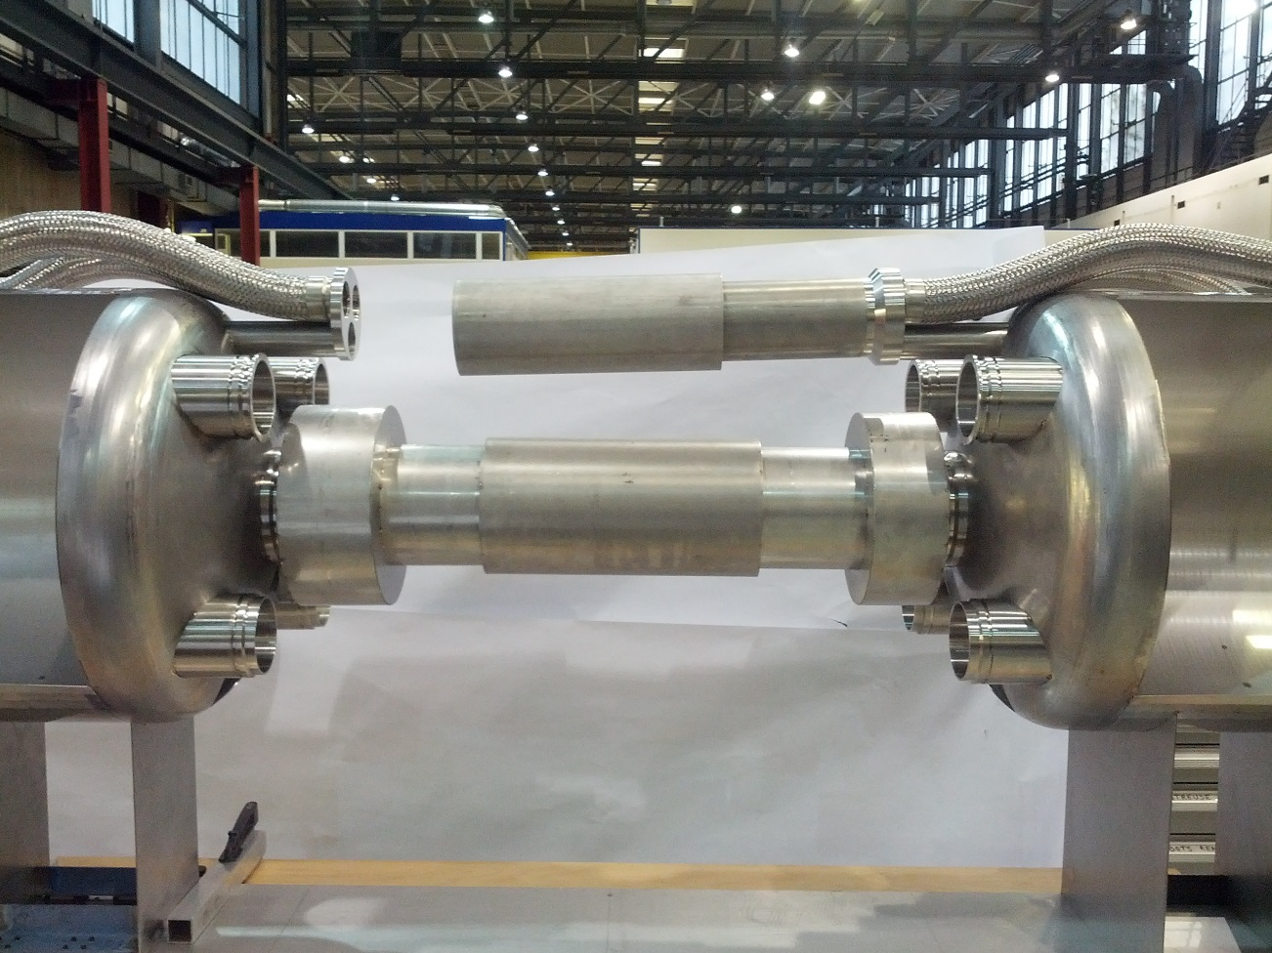
Full scale mockup being built
Busbar splices and routing
Welding clearances
Envelope for cutting tools

Slide 26
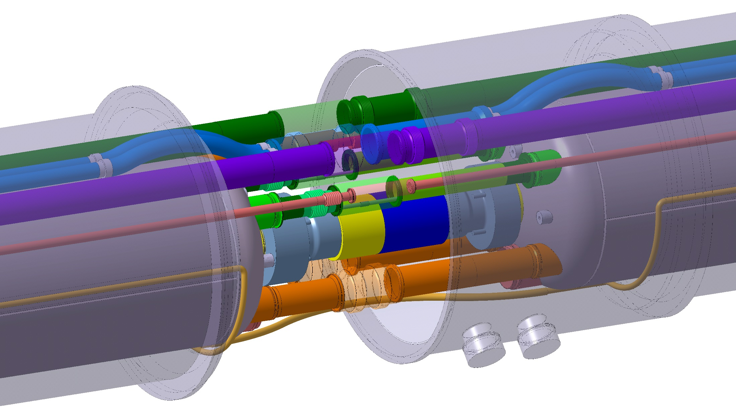
Complete interconnect
Vacuum vessel sleeve opens towards the IP
Service module
Q1
Q2a
Q2b
Q3
CP
D1

Slide 27
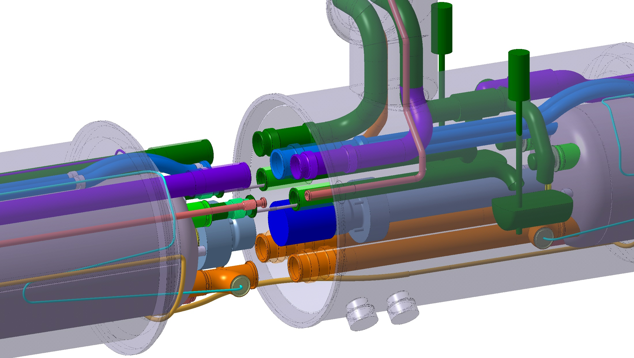
Before interconnecting
Sliding sleeves
2 orbital welds per line to be done in the tunnel: up to 20 welds in total
Q1
Q2a
Q2b
Q3
CP
D1

Slide 28
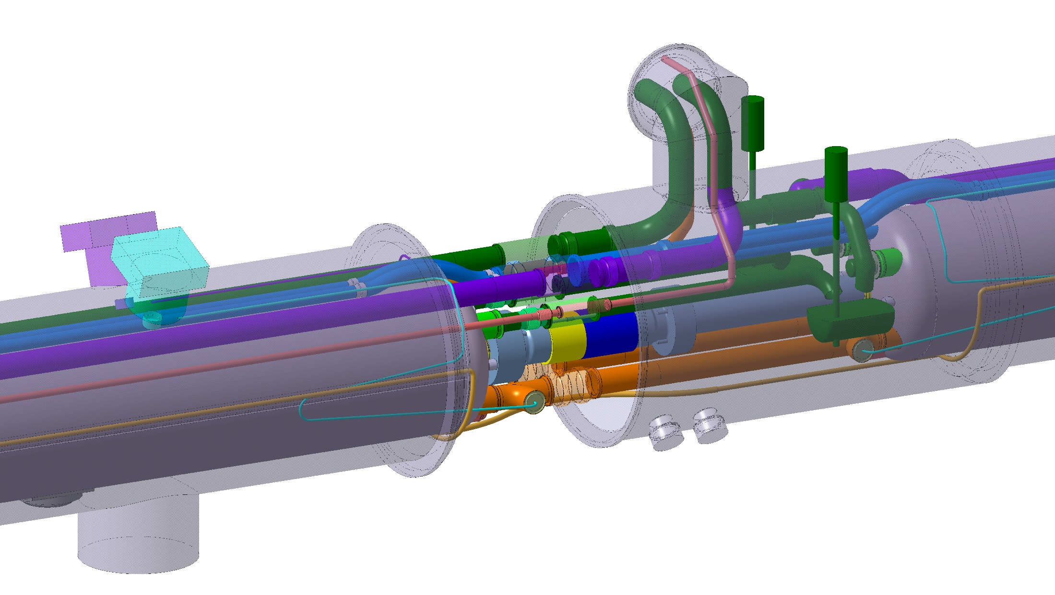
2 feedthroughs per cold mass:
Instrumentation
CLIQ (to be decided)
Opening direction of vacuum vessel sleeve
Feedthroughs are preferably on the connection side of the main magnet
Q1
Q2a
Q2b
Q3
CP
D1

Slide 29
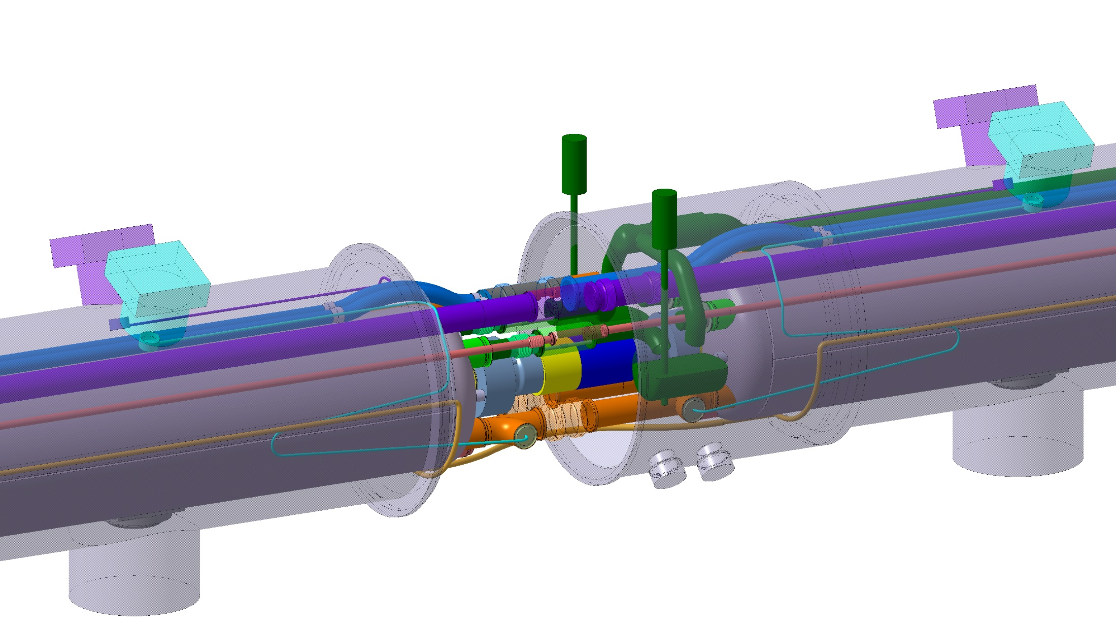
Q2a/Q2b: both are connection side
Q1
Q2a
Q2b
Q3
CP
D1

Slide 30
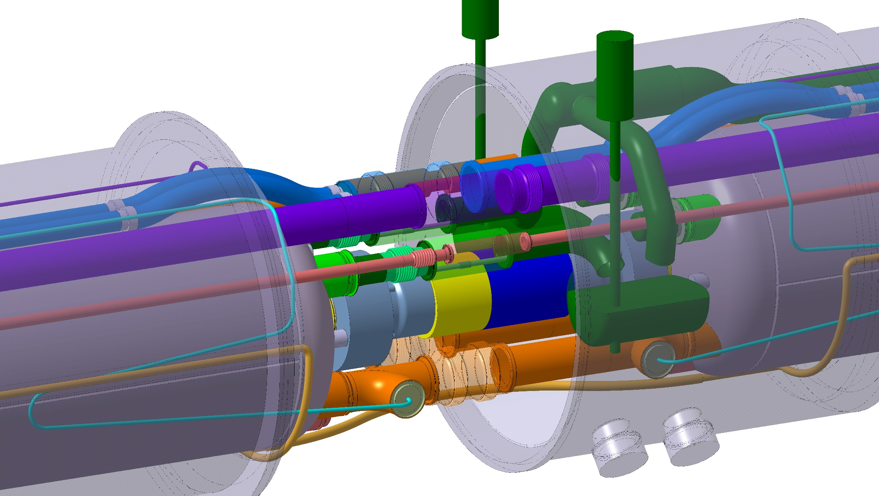
The most compact interconnect
Service module at the IP extremity of every cryoassembly
Q1
Q2a
Q2b
Q3
CP
D1

Slide 31
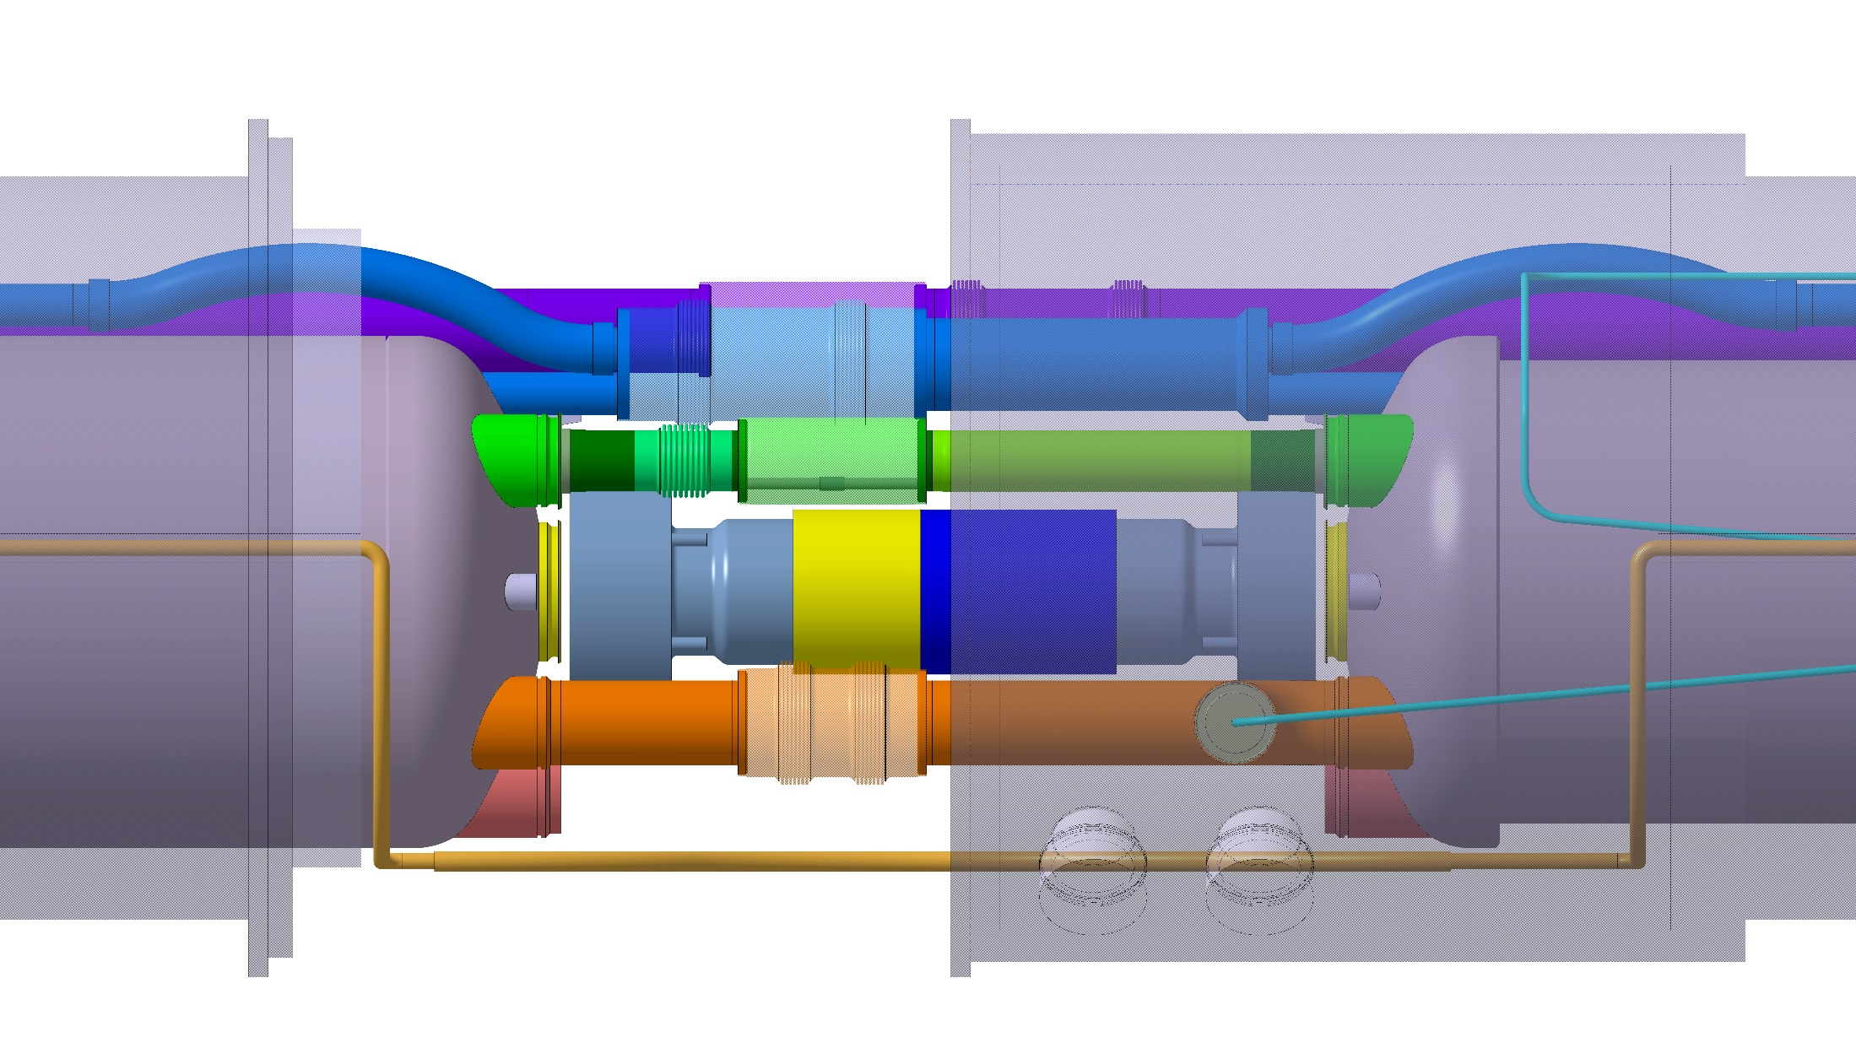
CP to D1
D1 cold mass diameter is 570 mm. The heat exchangers and HeII lines will be close to the edge – End covers of same design as other magnets may be required
Similar to what exists today in LHC SSS
Q1
Q2a
Q2b
Q3
CP
D1

Slide 32
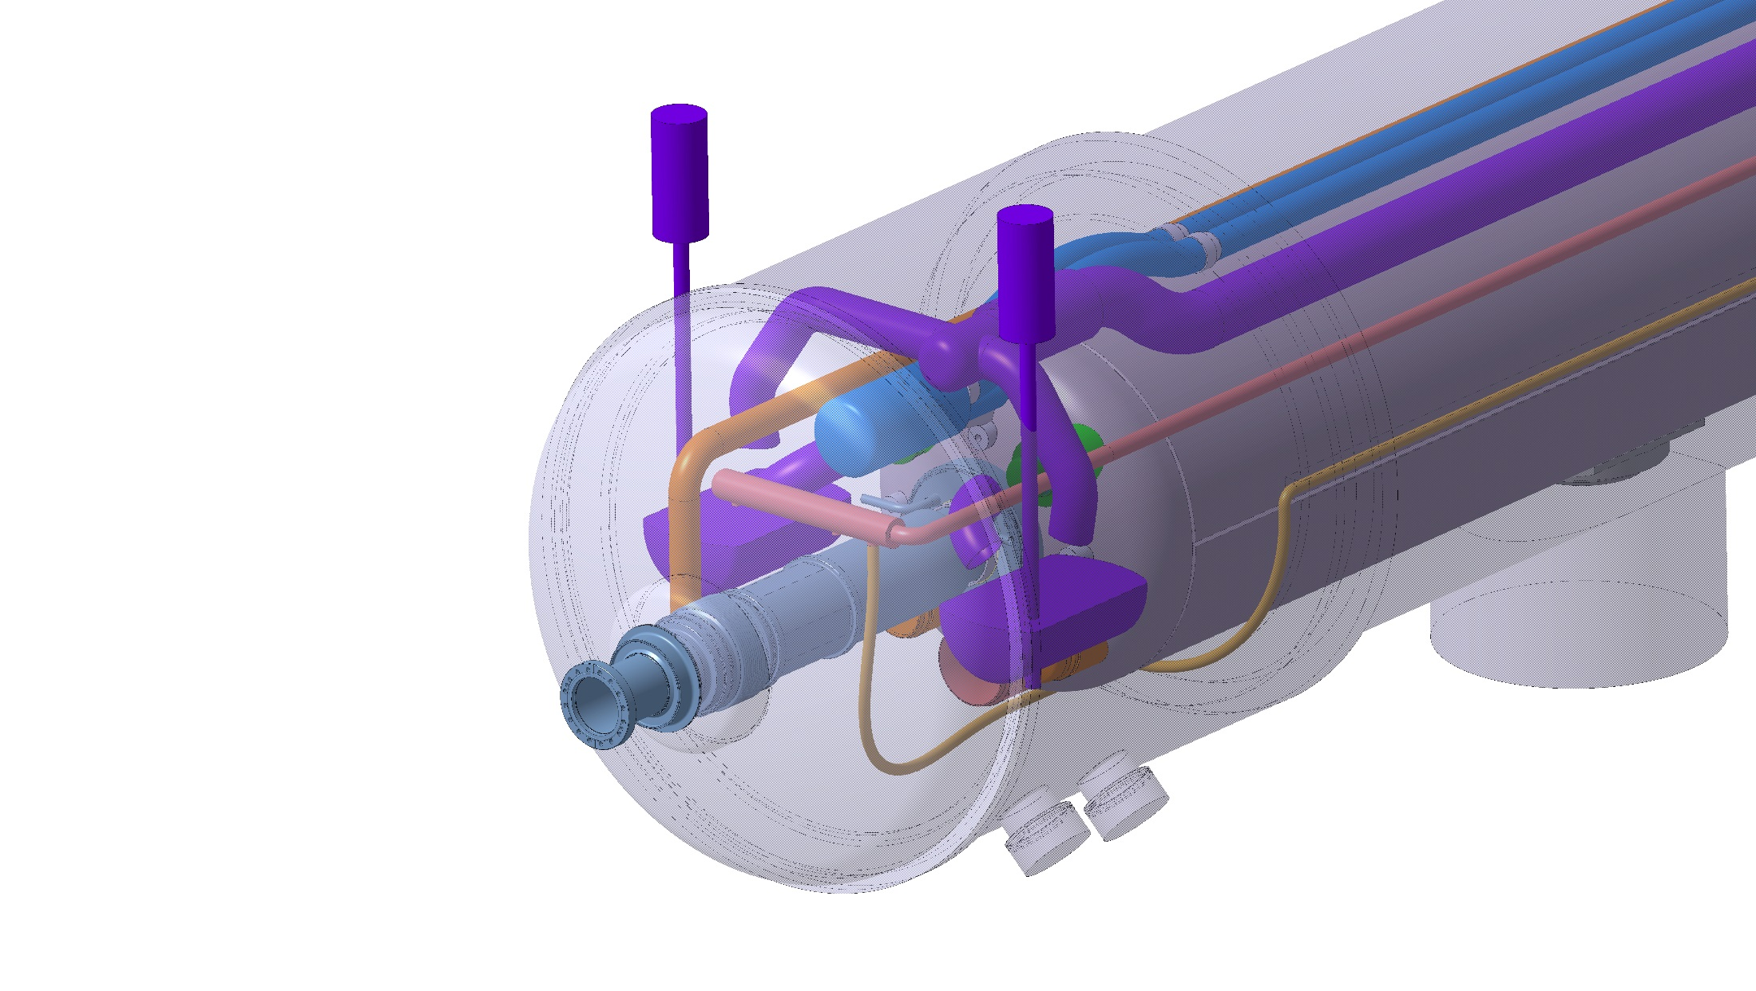
Q1 IP end
RF bellows inside cryostat
Cold to warm transition
Module required for integration of phase separators and pumping line
BPM
Q1
Q2a
Q2b
Q3
CP
D1

Slide 33
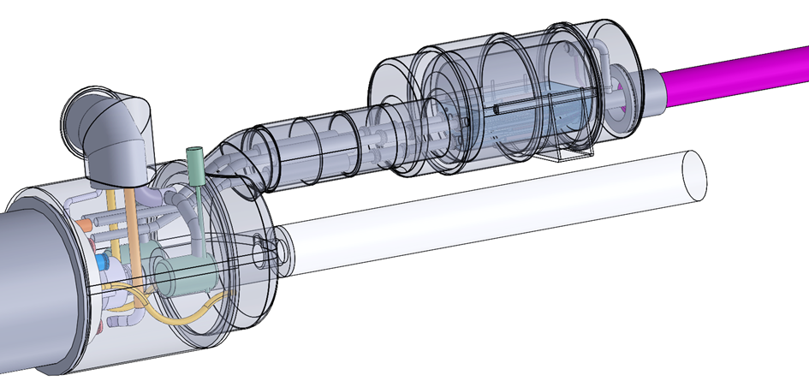
D1-DFX extremity (non-IP side)
Various configurations under discussion taking into account integration, accessibility, pressure loads, etc.
See talk by Yann Leclercq on WP6a
Ex. in this configuration the vacuum force is taken by the D1 vacuum vessel and its supports. Q1 support scheme may be used.
Q1
Q2a
Q2b
Q3
CP
D1

Slide 34
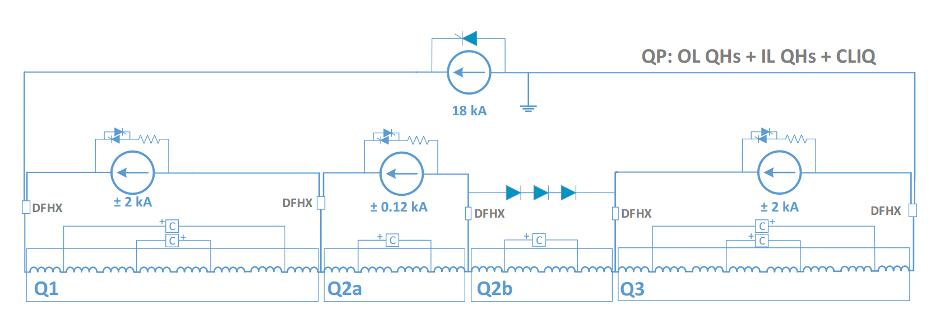
Present circuit for busbar routing
As of October 2016
The approach being to route the larger and stiffer 18 kA busbars inside the cold masses and the remaining in auxiliary lines

Slide 35
This is probably not the last iteration…
Pressure drop calculations must now be updated taking into account proposed diameters, bends, bellows, etc.
We need to design the bellows in order to evaluate the distances available for tooling and estimate interconnect forces.
Some interconnect lines will need stiffening supports.
CAD is not enough for the design of interconnects - we build mockups.
Finding a solution for the busbar routing and splicing is very much related to the circuit and busbar characteristics.
Very compact interconnects – intervention time and accessibility will be a challenge when minimising radiation doses to personnel.
There will be opportunities for improvement - let’s give ourselves some more time before agreeing on the cold mass interfaces.

