Slide 1
Use and prospects of HiRadMat
Accelerator Material studies at HiRadMat
Adrian Fabich
HL-TCC, CERN, 2. March 2017
with input from HiRadMat user collaborations

Slide 2
Overview
Motivation for HiRadMat
HiRadMat layout
Beam parameters
Experiments and first data views
Long-term view
Future extensions

Slide 3
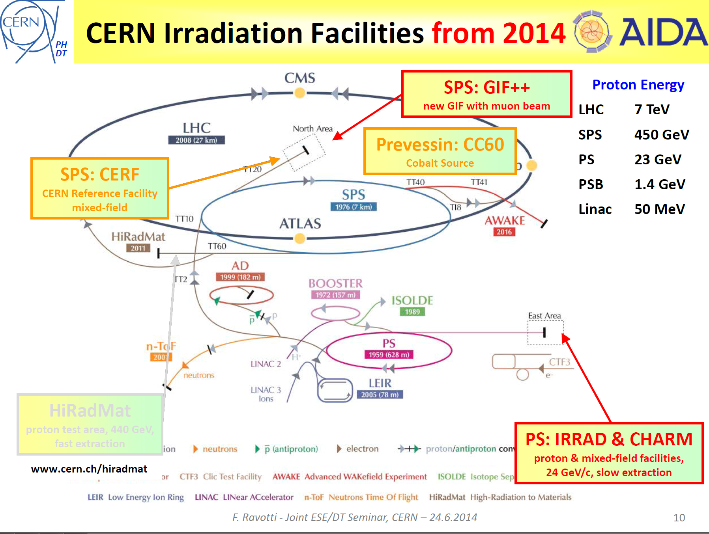
Courtesy F. Ravotti, EP-DT
https://indico.cern.ch/event/303726/
HiRadMat
Proton beam, 440 GeV, fast extraction

Slide 4
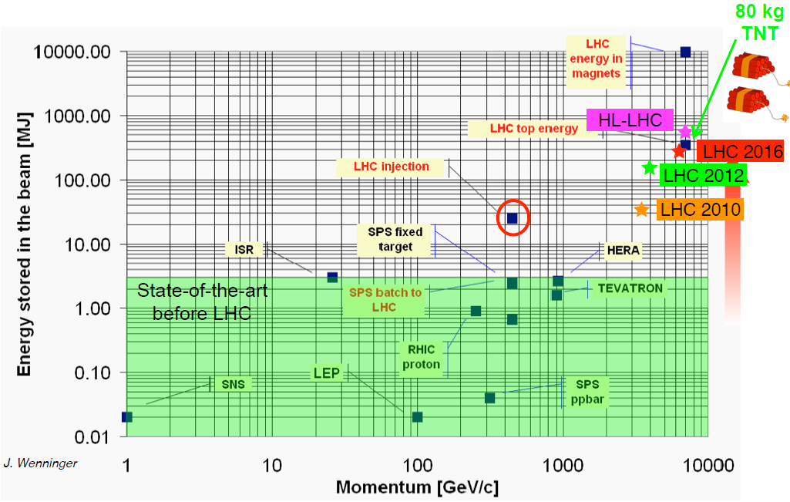
From Motivation to Proposal
Beam intensity increases in particle accelerators
  materials of near-beam equipment must be able to withstand the higher energy deposition/radiation
Testing in an existing facility is difficult/inconvenient
  Typically an accelerator is already used for physics
  Limited in access for installation works
  Limited in space along the beam line
  Missing infrastructure
  Limited in beam time
Request for a dedicated test facility:
HighRadMat - High Radiation to Materials
  Initiated and executed by R. Assmann and I. Efthymiopoulos
Facility target:
  provide irradiation area with beams similar to LHC injection regime
  with scanning possibilities in intensity and spot size
  Designed for single-pulse experiments (long-term irradiation is excluded for operational aspects)
Applications:
machine components, protection devices, targets, material studies, detector testing, electronics

Slide 5

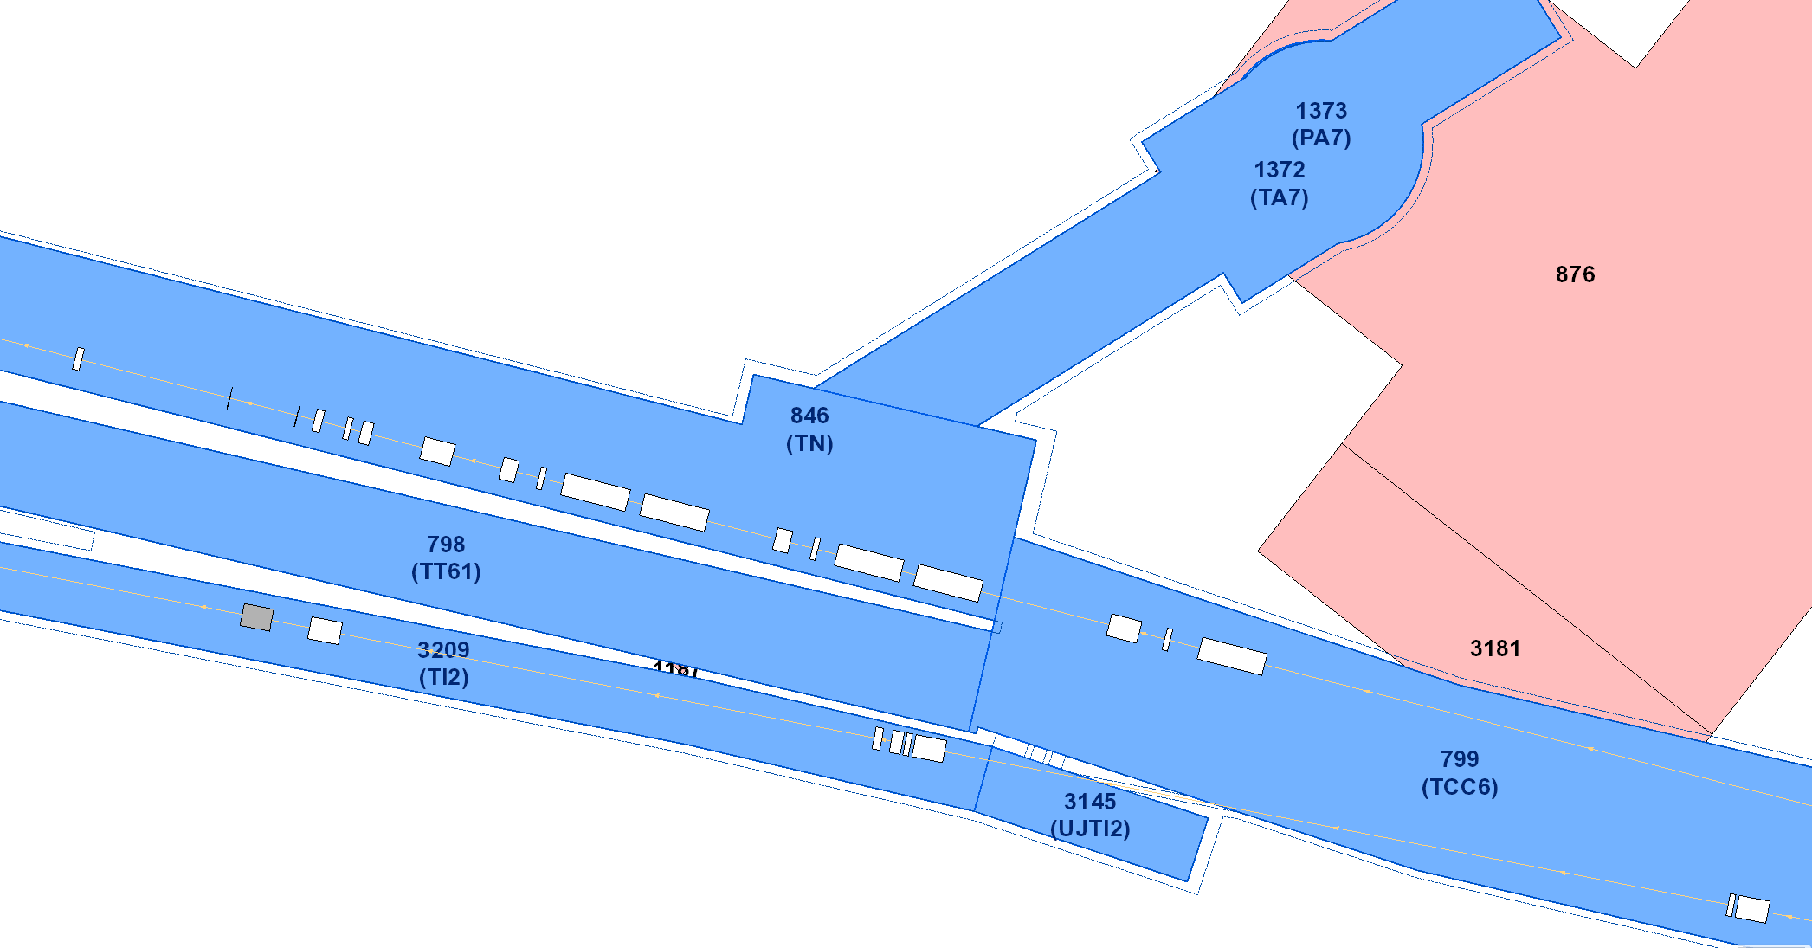
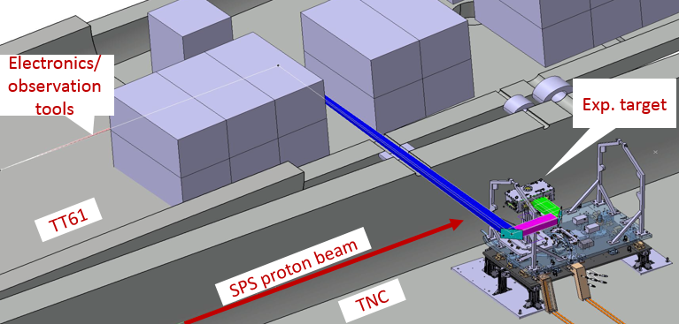
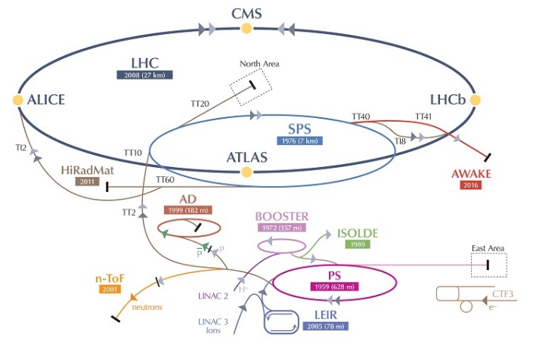
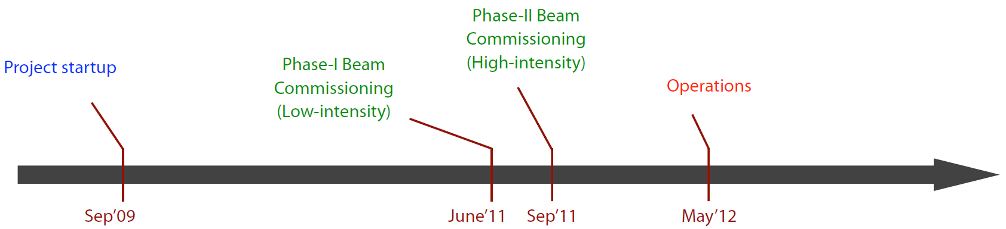
Dedicated user facility for studying the impact of intense, pulsed beams on material http://cern.ch/hiradmat
Operated by EN/EA supported by BE/OP, RP and EN/HE
providing support to visiting user collaborations
HRM
surface lab
Target area (TNC)
TT61
HRM CR
TI2

Slide 6
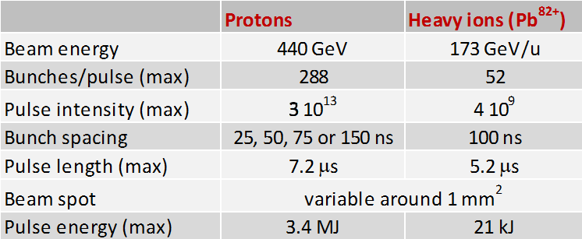
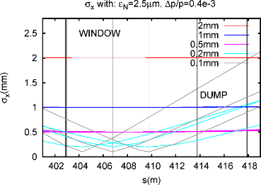
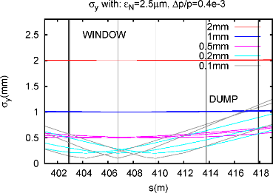
Beam Parameters
Similar to LHC injection
Single pulses
  Typically 100 pulses per experiment (10/year)
  Limitation on air activation
  Allow personnel access to irradiation area
  For long-term irradiation studies: GSI, BNL-BLIP, IRRAD, CC60, GIF, GSI, AREVA …
Variable pulse intensity
Variable bunch sequence
Variable beam focus
Courtesy C. Hessler

Slide 7
Maximum beam intensity/density
Eagerly waiting for nominal LIU intensities
Increasing from 1.3e11 to 2e11 protons/bunch
Required for full testing in the regime of HL-LHC and beyond
Only available after LS2 (beyond LS2)
Already today, HiRadMat achieves future energy densities in targets
focussing beam spot down to sub-millimeter range

Slide 8
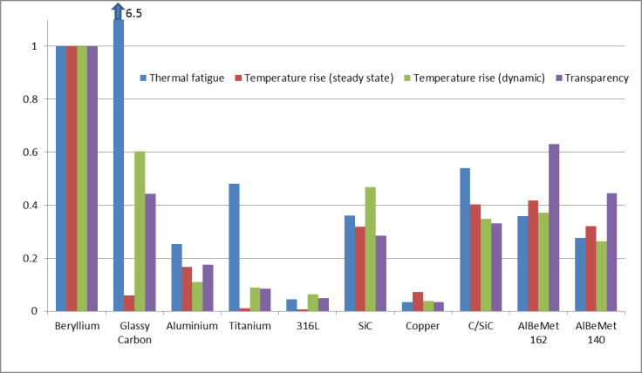
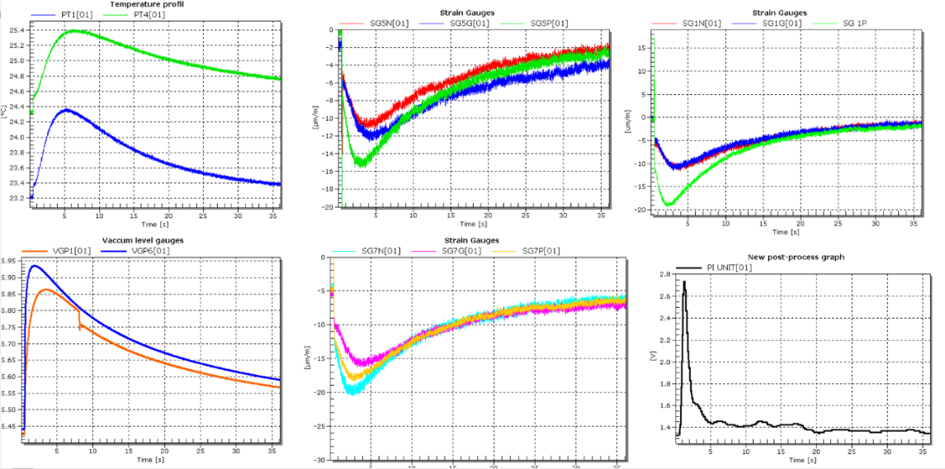
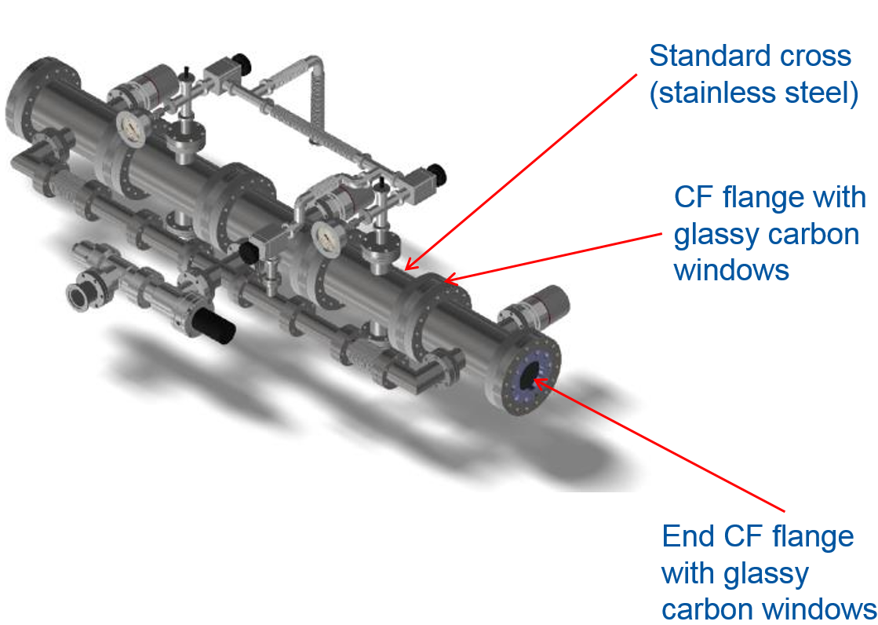
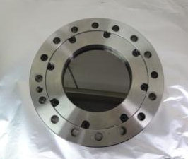
GlassyC experiment
HiRadMat experiment
Courtesy: C. Garion, L. Baudin et al.
New material for vacuum windows
Glassy Carbon obtained by the pyrolysis at high temperature of a highly reticulated resin
98 % (weight) of carbon and 2% of oxygen.
Option for HiRadMat itself?
Online monitoring using strain gauges and temperature sensors
Post-irradiation evaluation (PIE) ongoing: microscopy

Slide 9
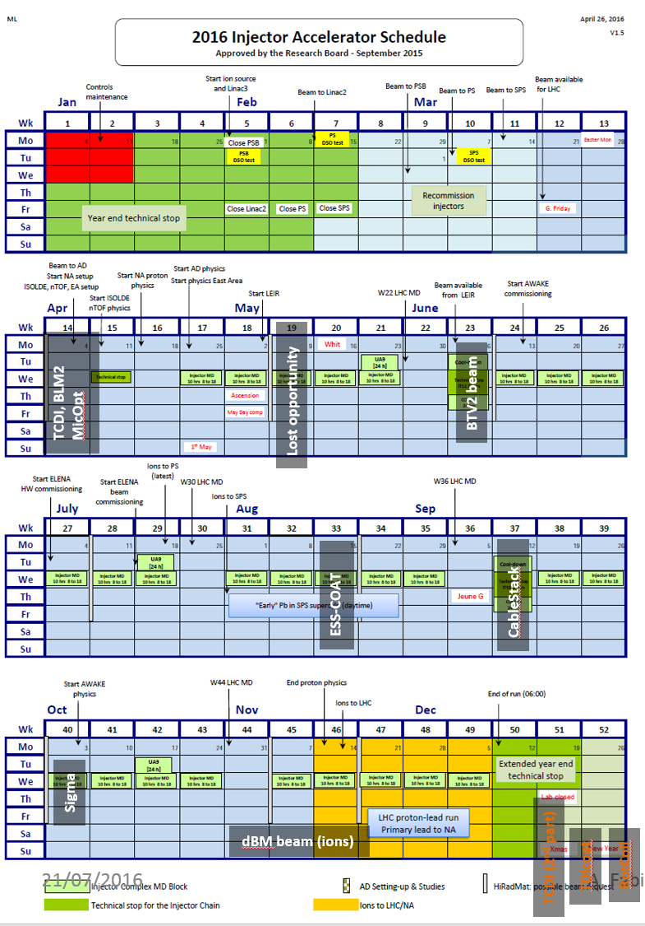
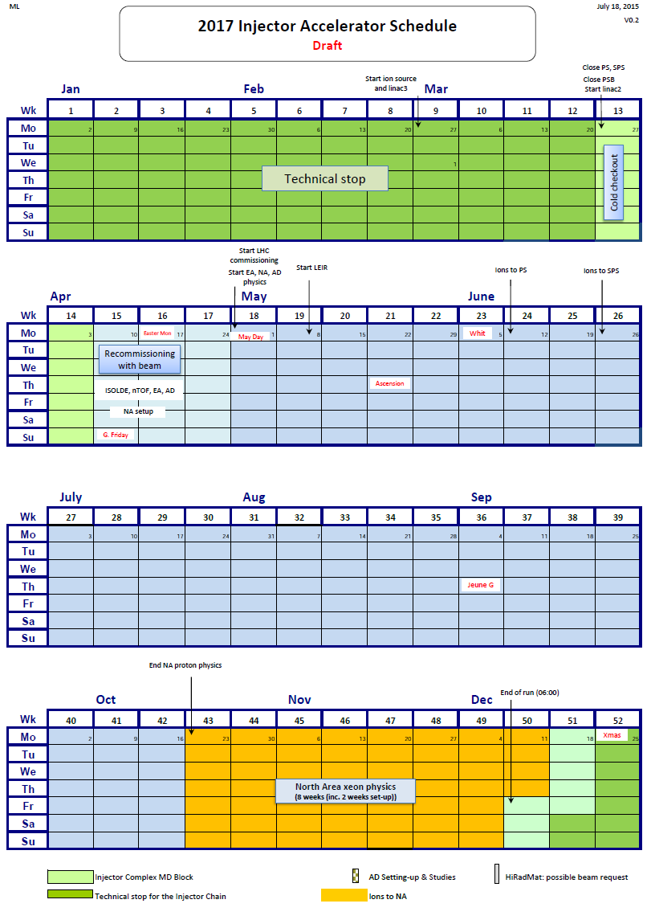
Exp. Schedule 2016/2017
TCDI
CRY2
FlexMat
TDIcoat
RotColl
SextSC
MultiMat
Backup+

Slide 10
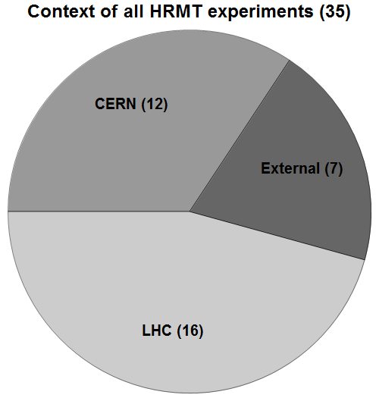
Context of HiRadMat Experiments
Status January 2017
User collaborations from CERN, BNL, FNAL, GSI, ESS and universities Europe-wide
HiRadMat is participant to FP7-TransNationalAccess (EuCARD2 & Aries) providing travel funds to visiting scientists.

Slide 11
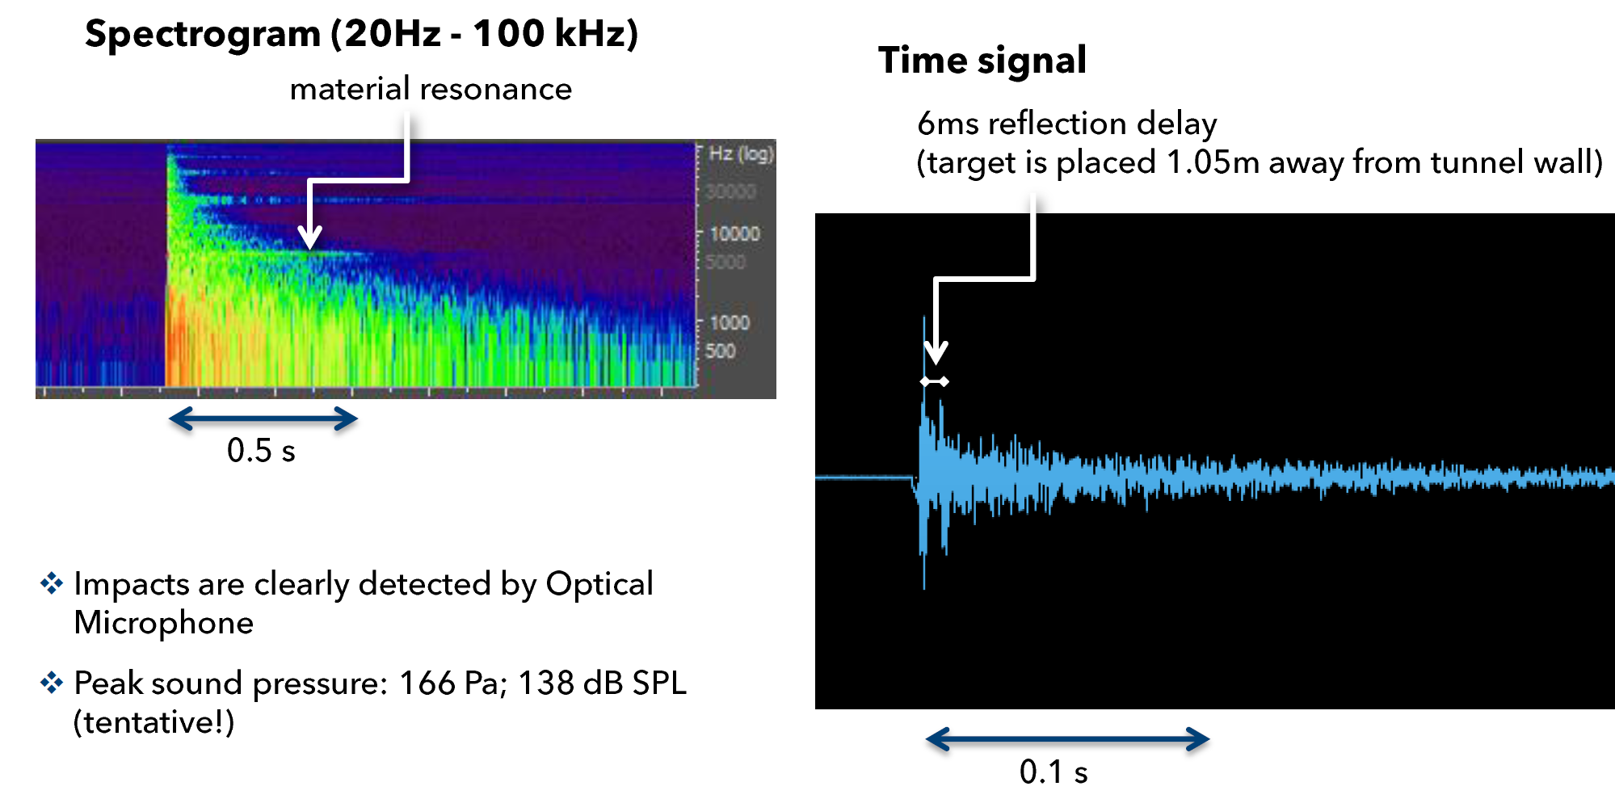
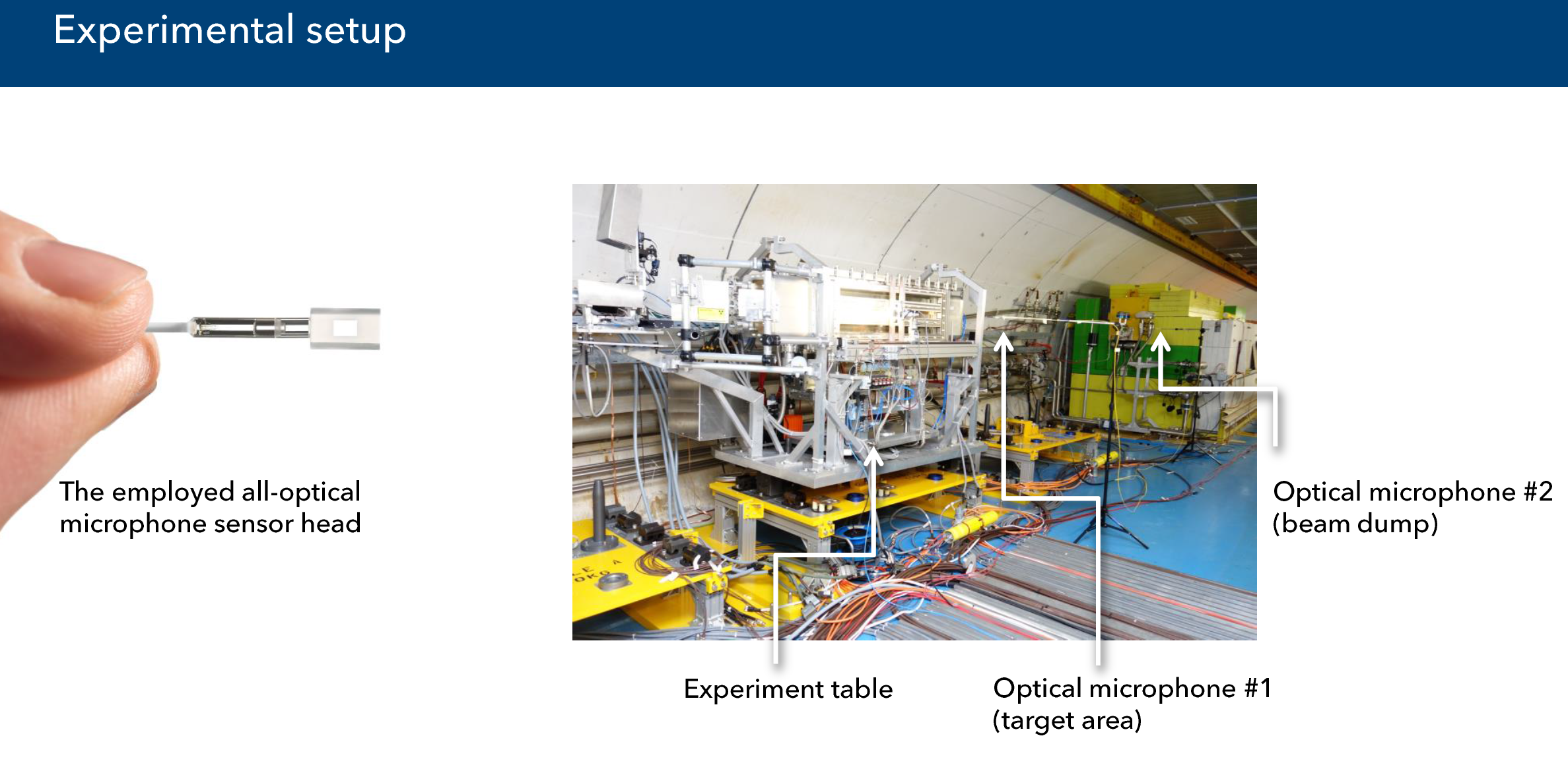
Testing an Optical Microphone
Courtesy:
Balthasar Fischer, Xarion (AT)
Daniel Deboy, KUG
Thorough analysis:
  radiation effects
  correlation between intensity and sound pressure level
  sound time-of-arrival for location detection

Slide 12
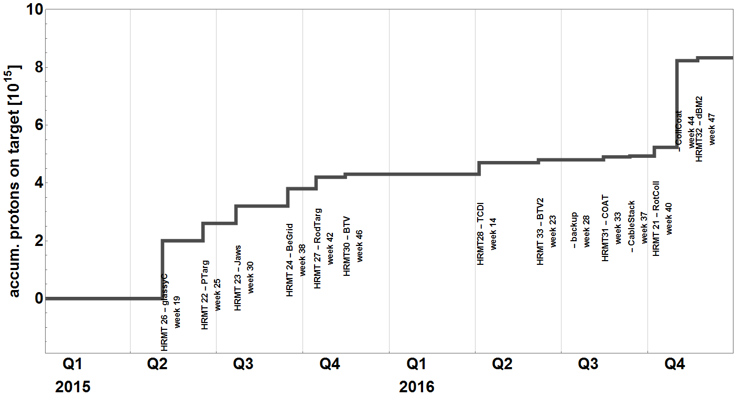
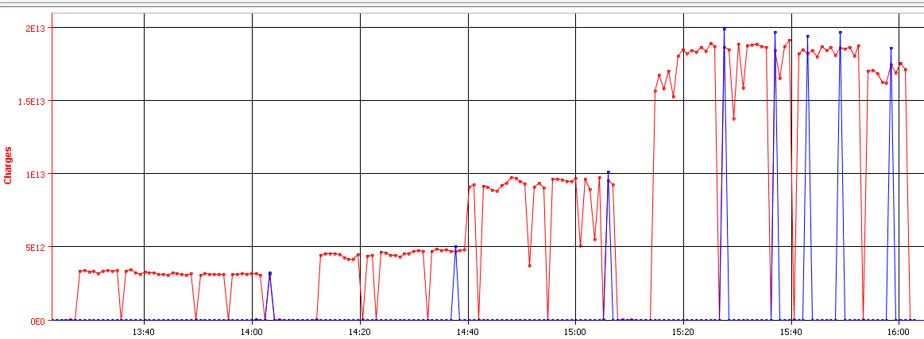
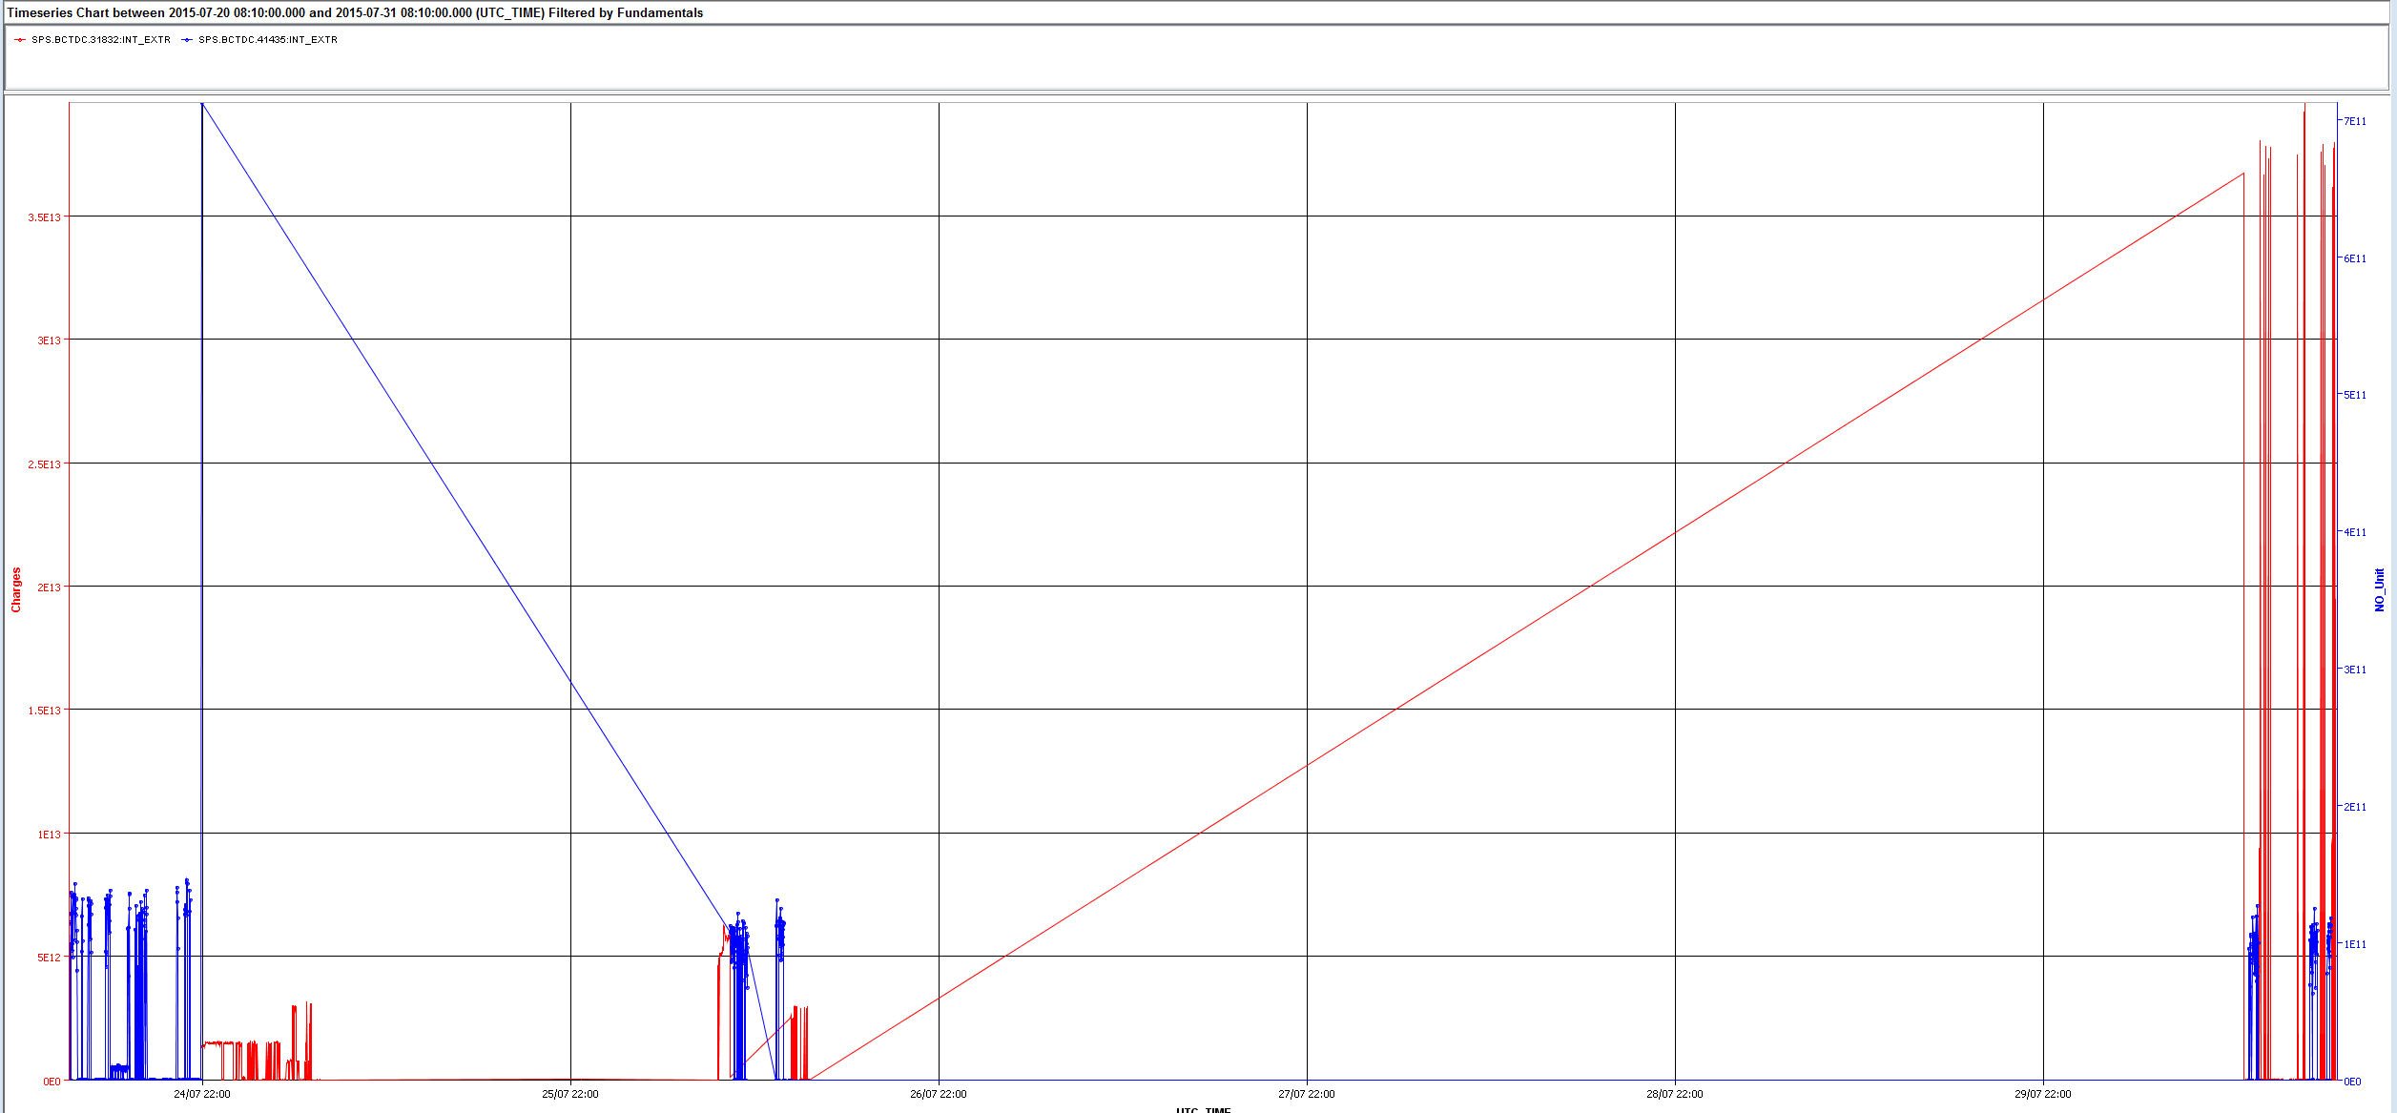
An experimental beam program
Single pulse experiments
Typically 100-500 pulses per experiment (10 exp./year)
  Lasting a few shifts per experiment
Limitation on air activation
Allowing easier personnel access to irradiation area
SPS intensity
Extracted on target
Logging of pulse intensity
14:00
16:00
Friday
Wed

Slide 13
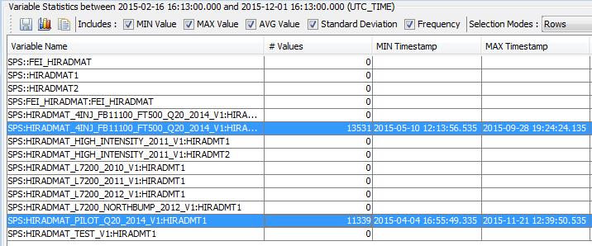
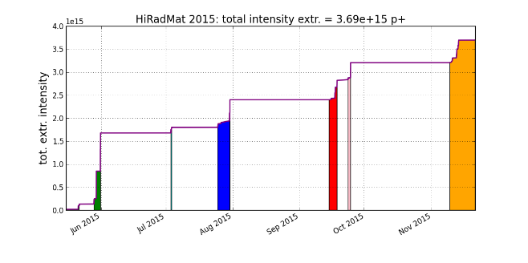
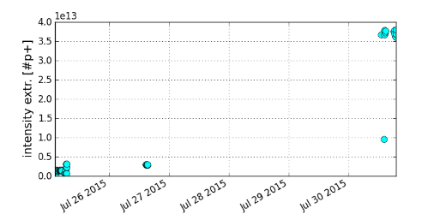
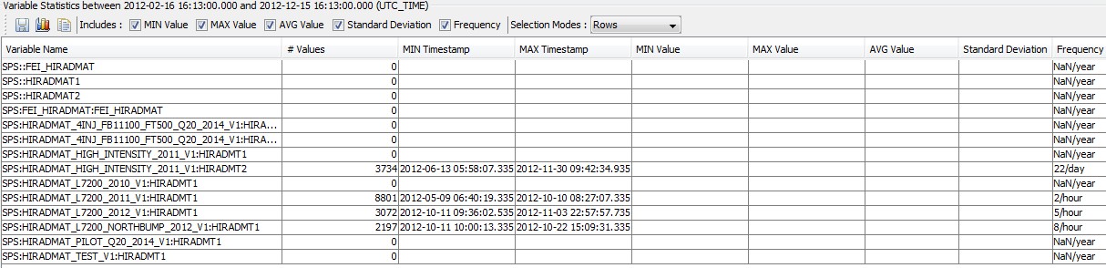
Injectors to HiRadMat in 2015
Accumulated SPS cycle time: 4.0 days
Total intensity extracted: 3.7e15 pot
Excellent performance of the injectors providing beams with large flexibility, in the largest intensity range for multi-bunch pulses. All planned beams provided.
2012: 2 days, 1.4e16 pot
Courtesy V. Kain

Slide 14
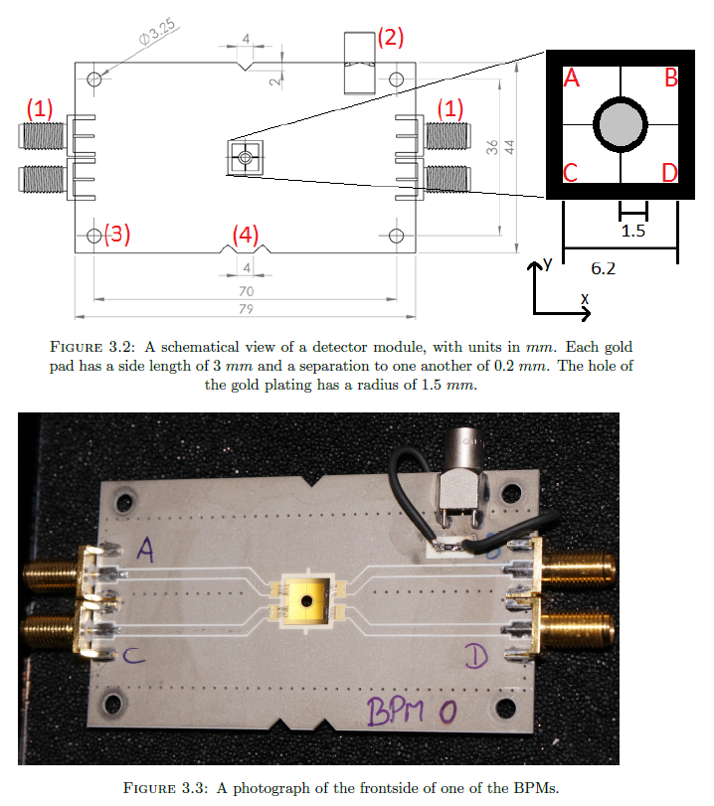
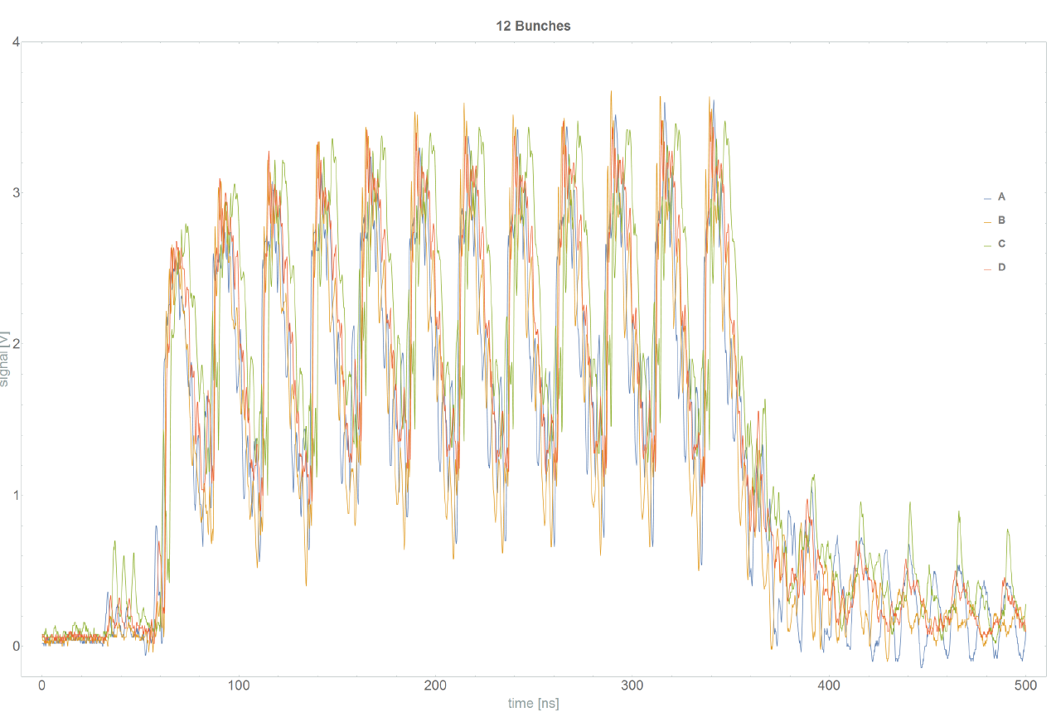
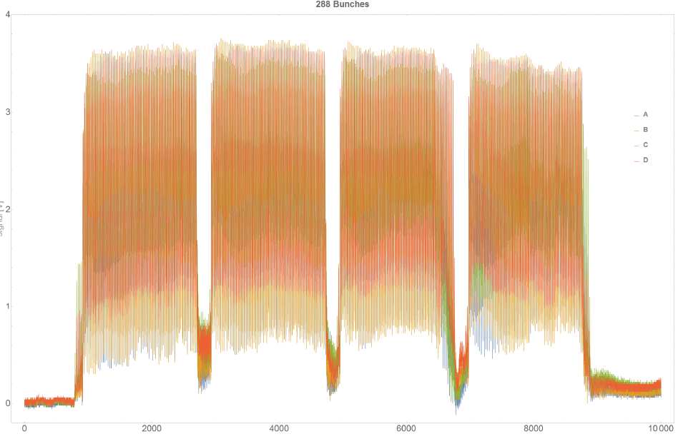
BPM diamond detectors
HiRadMat experiment
Development of
Online monitoring of beam position at experiment
Measuring of beam halo on four quadrants
Courtesy B. Lindstrom, CERN-THESIS-2015-228
I. Efthymiopoulos et al.

Slide 15
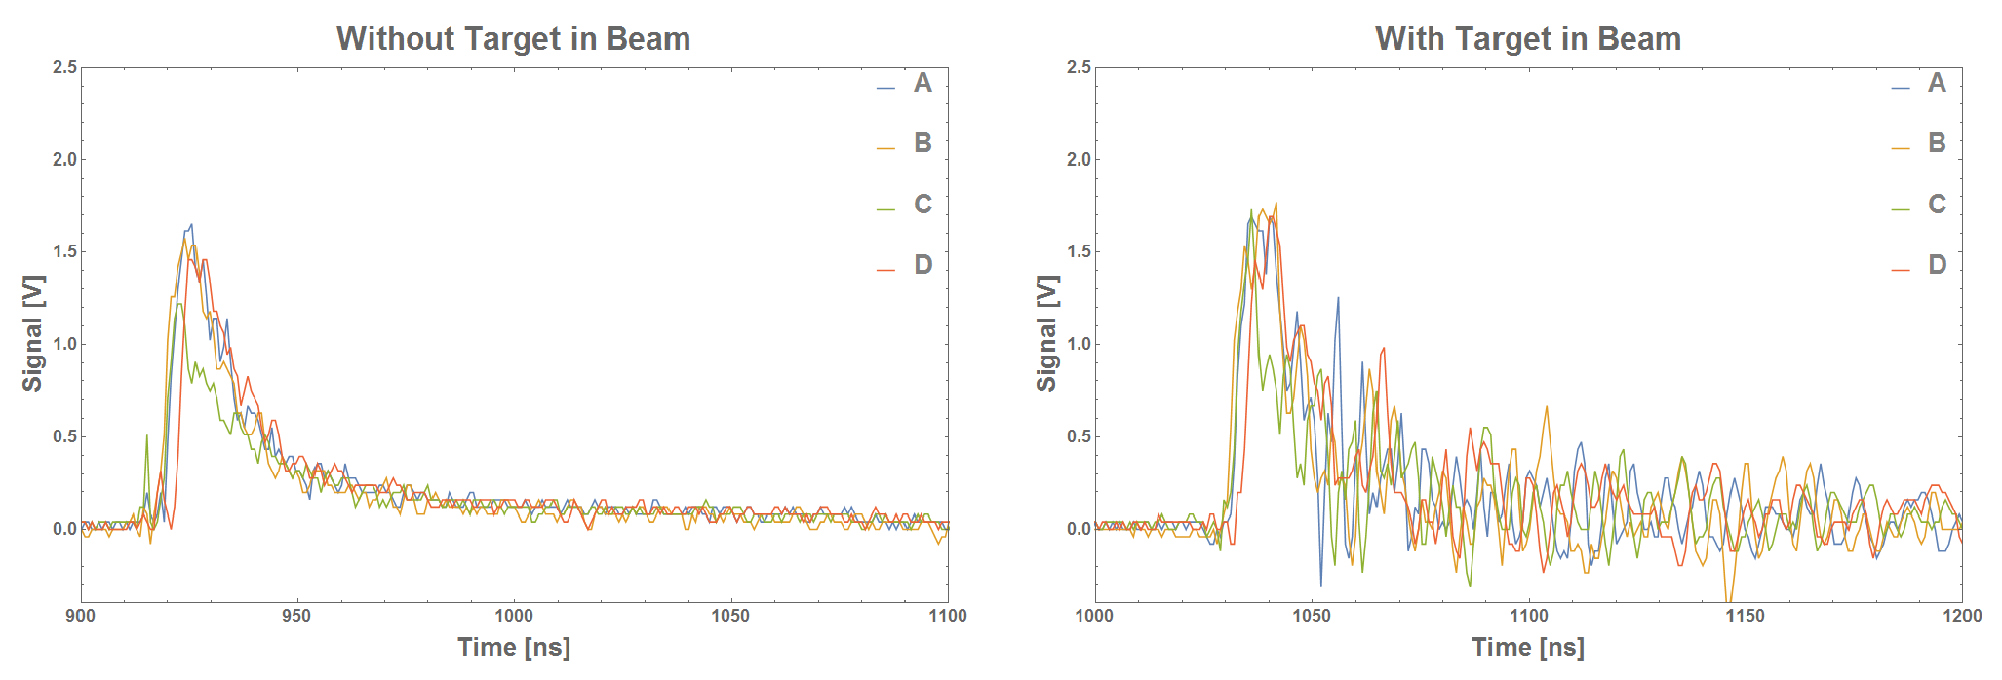
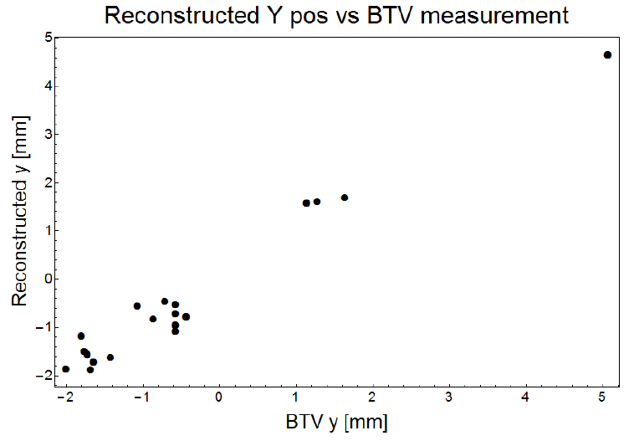
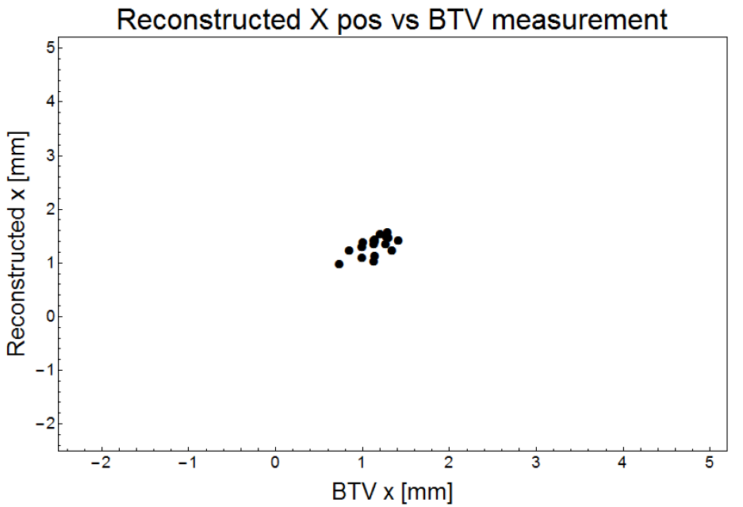
Beam position with TARGET downstream
Noise induced from backscattered particles
Beam position still deducible
Tungsten 2λ
Courtesy B. Lindstrom, CERN-THESIS-2015-228

Slide 16
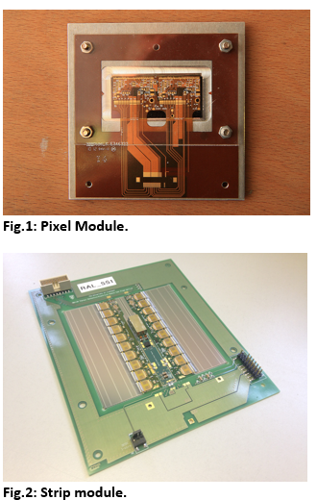
ATLAS pixel/strip modules
HiRadMat experiment
New user in 2017
Testing ATLAS inner detector and electronics
  Present models and prototypes of future models
Estimate the damage threshold of the under fast extracted, intense proton beam irradiation
As basis for the evaluation of the damage risk in case of fast HL-LHC beam losses.
Candidate for permanent reference measurements in HiRadMat?

Slide 17
Online monitoring
Provided by the HiRadMat facility
Beam performance
  Intensity: BCT transformers in SPS/transfer line
  Beam position/profile
    BPM in transfer line
    Air core current transformer, BTV at experiment
Radiation monitoring
  RadMons in TNC and TT61
  BLMs along the transfer line and experimental setup

Slide 18
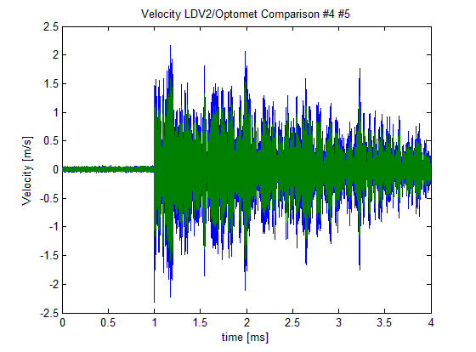
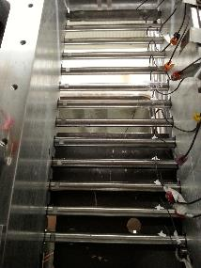
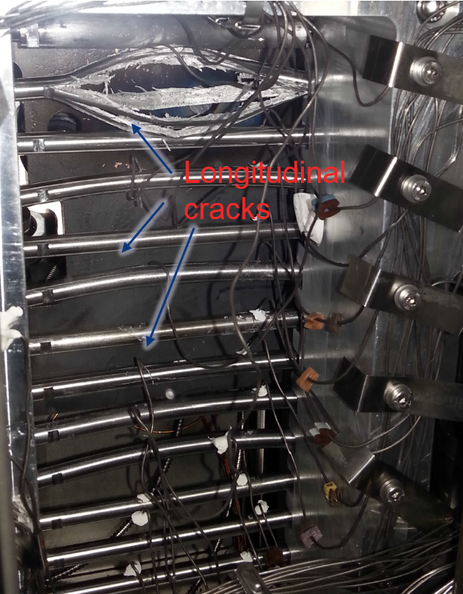
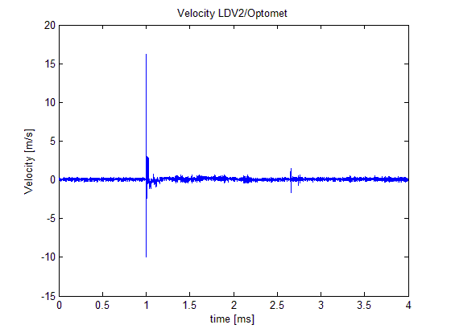
Production targets
HiRadMat experiment
M. Calviani et al.
Motivation:
  Reduce the uncertainties existing in the core material response of the AD-Target
  Assess the material selection for a new AD-Target for LS2
Goals:
  Recreate the same extreme conditions as reached in the AD-target in a controlled environment (validation of hydrocodes calculations)
  Identify mechanism of failure and limits of the materials of interest impacted by proton beams
Low beam intensity
W-Ta
Ir
W
WLa
Ta
High beam intensity
TZM
Mo

Slide 19
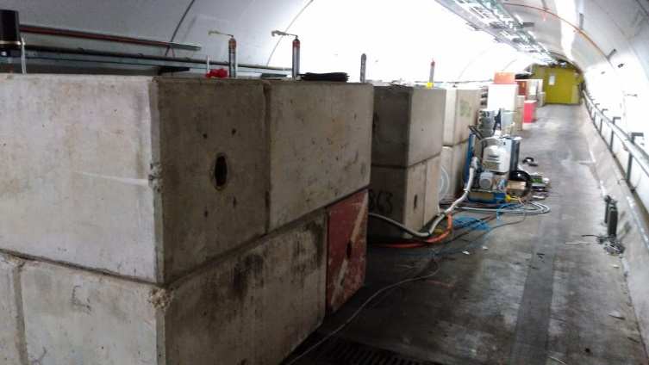
Electronics/DAQ in TT61
with feed-through to TNC for direct cabling
Specifications
Maximum cable length/optical path: 15 m
  From electronics to target center
Similar prompt radiation levels as in TJ7 bunker
  Thick target, 3e12 ppp
  10e6 hadrons/cm2 for full intensity pulse
Additional shielding implemented (September 2015):
Optional counter measures: Increase distance (additional optical path/cable length)
TT61

Slide 20
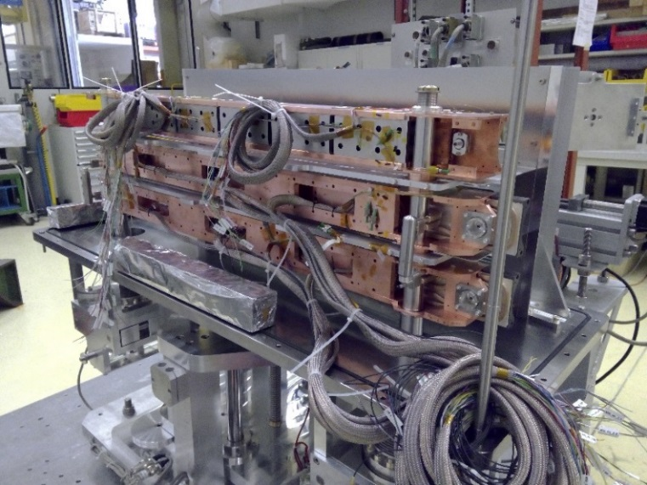
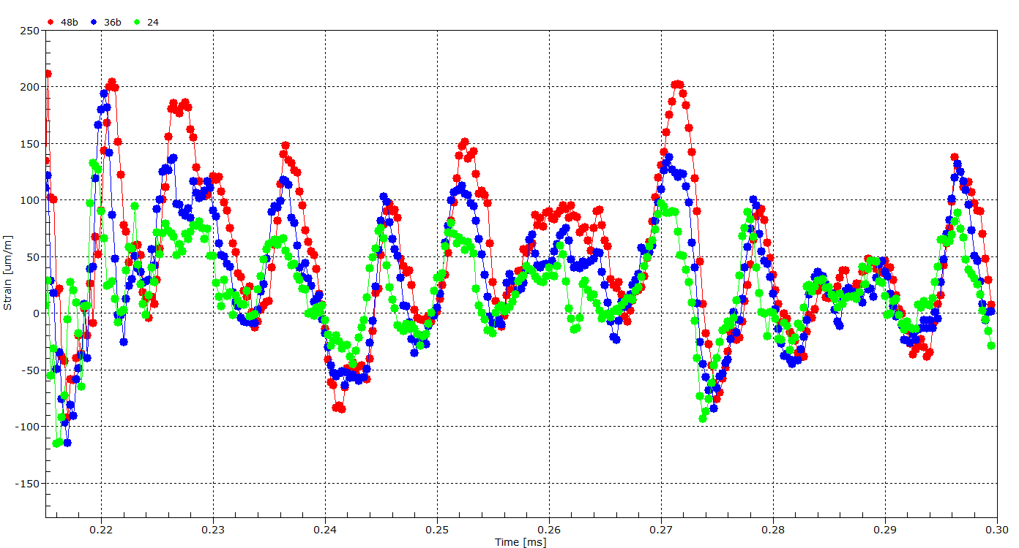
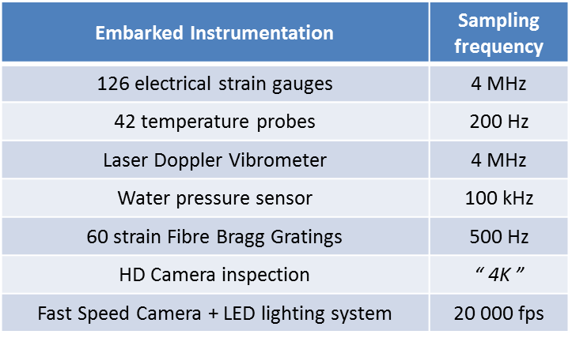
HRMT-23 JAWS
designed to test and qualify against LHC and HL-LHC accident scenarios three collimator jaws (HL-LHC with MoGr, HL-LHC with CuCD, LHC with CFC)
With high intensity beam pulses on thick target - electronics in TT61 failed
Courtesy: M. Guinchard et al.
 | GlassyC | PTarg | Jaws | BeGrid | BLM2 | RodTarg
Target | Thin 0.1 λ | Thick 2 λ | Thick >2λ | Thin 0.25 λ | Thin 0 λ | Thick 2 λ
p.o.t. (1e15) | 1.2 | 0.03 | 1.1 | 0.3 | 0.3 | 0.2
Max. pulse intensity (1e13) | 3.5 | 0.2 | 3.8 | 3.8 | 3.8 | 0.2
BLM411 response | 0.016 | 0.0001 | 0.003 | 0.0004 | 0.0004 | 0.0003
BLM518 response | 0.1 | 0.01 | 0.14 | 0.02 | 0.02 | 0.01
BLM526 response (just after nominal target position) | 0.23 | 0.2 | 0.27 (sat.?) | 0.22 | 0.15 | 0.2

Slide 21
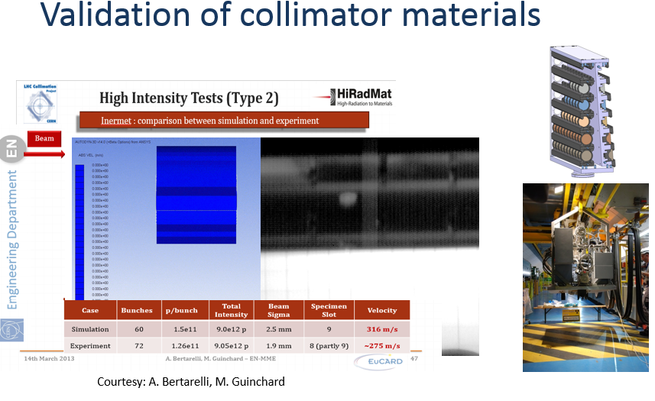
HiRadMat experiment in 2012

Slide 22
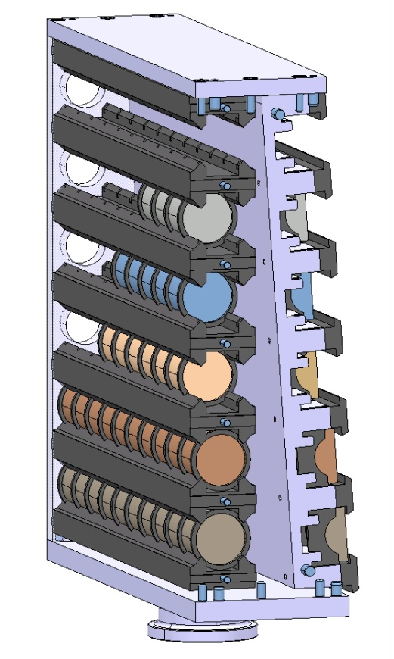

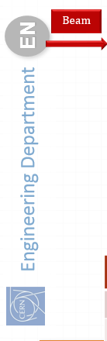
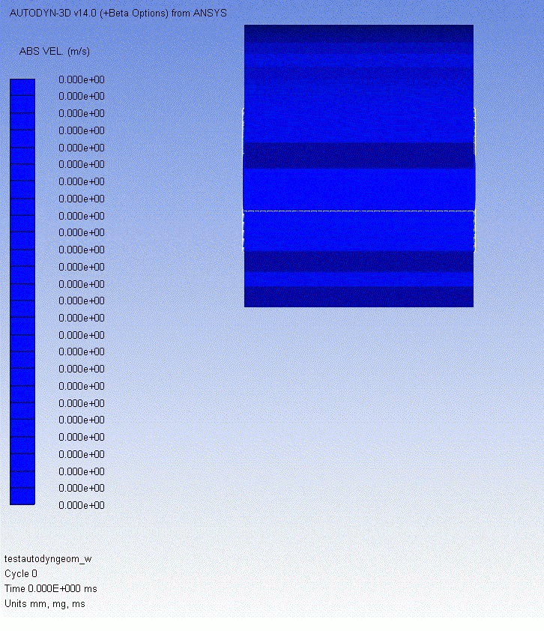
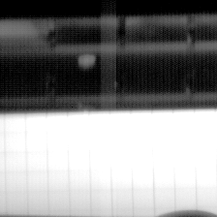
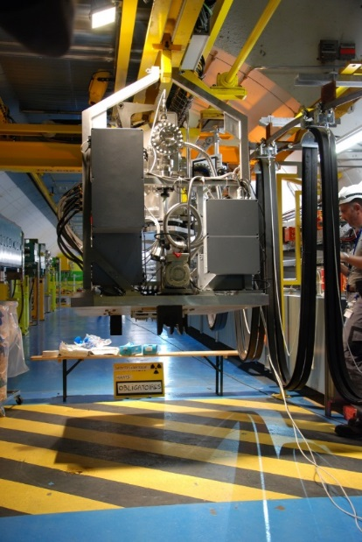
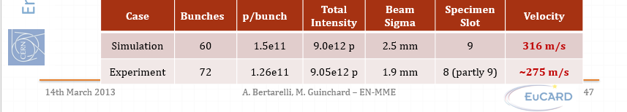
Validation of collimator materials
Courtesy: A. Bertarelli, M. Guinchard

Slide 23
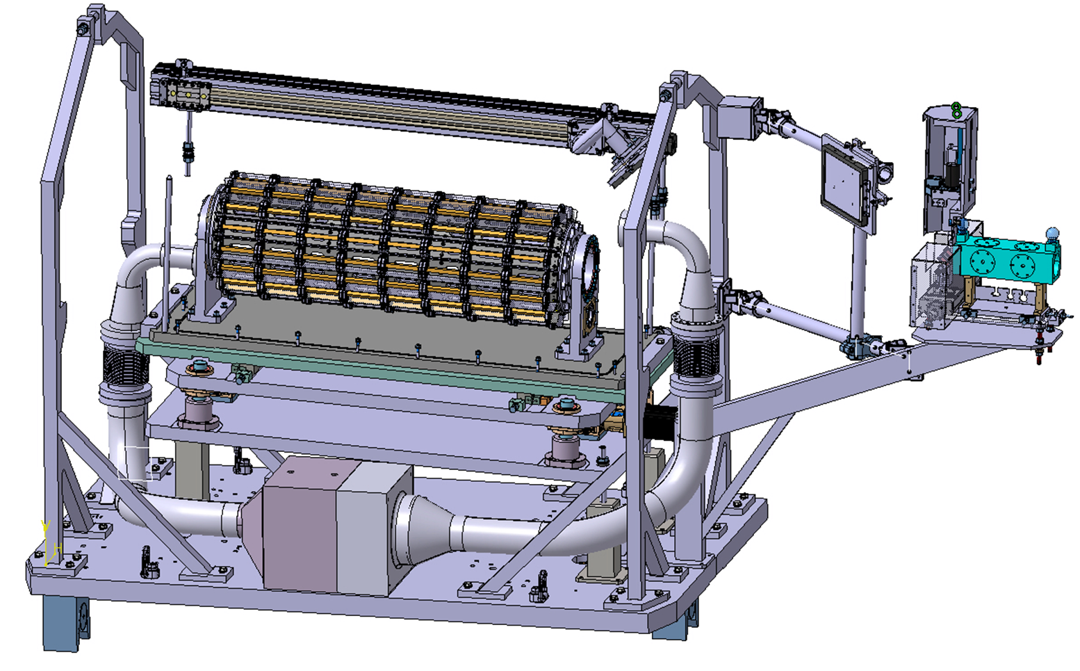
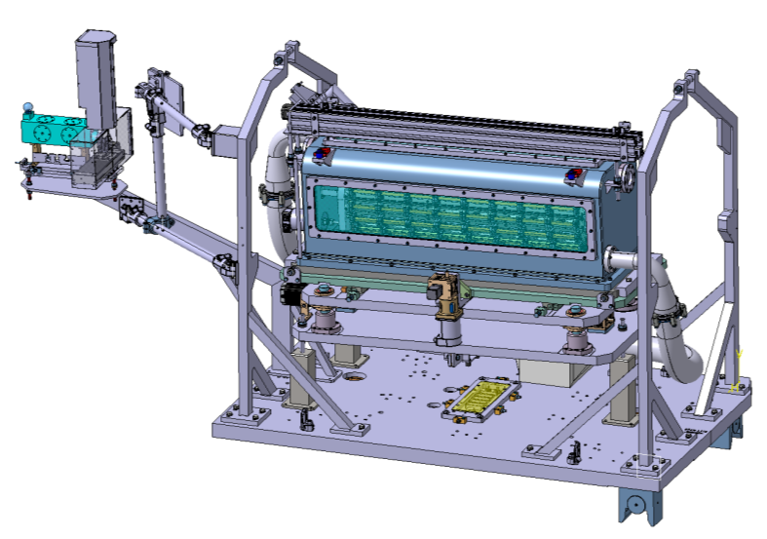
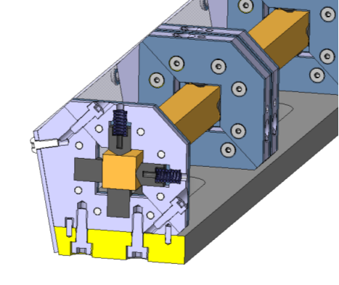
HRMT36 - MultiMat experiment in 2017
Rotatable Barrel with up to 16 independent target stations (1 m long) easy to mount and dismount, hosting several specimens and/or small devices.
Comprehensive Acquisition system based on Strain Gauges, Fiber Bragg Grating (FBG), Temperature probes, LDV, Rad-hard Camera, Accelerometers
Bench-marking simulation codes with material properties/response
Non-destructive testing
Additional design criteria: containment and target holder re-usable for further material tests
Courtesy: A. Bertrarelli

Slide 24
Experiment proposals 2017 and beyond
First ideas/proposals in preparation:
FCC collimation/absorbers/dumps
  Reasonable testing for present material choices
Vacuum windows for high power beams
Studies for production targets
  “physics beyond colliders”
High power proton targetry
Beam monitoring for LHC/FCC
  “permanent” test bench for BE/BI
BLMs
Material research with pre-irradiated materials

Slide 25
Material Testing and Research
Explore the potential for conducting unique experiments that cannot be realized elsewhere
Exposing materials with accumulated irradiation damage to intense particle beams
  E.g. HRMT38 by GSI, dynamic response of pre-irradiated targets of high-damping materials
  Testing of a several Beryllium grades (intended for targets and vacuum windows) that can have wider impact (fusion reactors, moderators, etc.) (HRMT24-BeGrid)
  Novel carbon structures (i.e. Glassy Carbon) while searching for vacuum window materials with potential applications outside the original aim (HRMT26-GlassyC)
Collaborations from FNAL, BNL, GSI, CERN, PSI

Slide 26


Cryogenic experiments
V. Raginel, D. Wollmann
See also MPP 11/11/16
https://indico.cern.ch/event/587075/
HiRadMat experiments on cable strands suggested in 2015
Motivated by HL-LHC failure cases (injection, extraction)
Several experiments planned without beam and with beam:
  Heat stacks of cables in an oven to different peak temperatures and measure dielectric strength of the insulation
  Heat insulation by a short current pulse and measure dielectric strength
  Heat a single strand by a current pulse and measure critical current
  Expose stacks of cables to radiation in HiRadMat at RT and measure dielectric strength and critical current
  Expose stacks of cables to radiation in HiRadMat at cryogenic temperatures and measure dielectric strength and critical current
Experimental campaign from 2016-2018
  Measure the degradation of the insulation
  Measure the degradation of critical current of Nb-Ti
Currently preparing the cryogenic
infrastructure and operational procedures

Slide 27
Summary
HiRadMat is a user facility
  dedicated for in-beam testing
  with fast extracted beams (LHC injection like)
Proposals are made extending the variety of research topics – also in view of HiLumi.
Continuously investigating further needs taking advantage of HiRadMat

Slide 28
Annex

Slide 29

Transnational Access
EU funded support for external users on travel/subsistence
More than 280 user*days at CERN enabled
HiRadMat is work package in the recently approved FP7-Aries (2017-2021).
EuCARD-2 is co-funded by the partners and the European Commission under Capacities 7th Framework Programme, Grant Agreement 312453.

Slide 30
Applying for beam time
ATSMB
Beam time application
Proposal submission to HiRadMat management
Experiments are reviewed by the HiRadMat Scientific Board
  Scientific interest of the experiment, feasibility and post-irradiation analysis
  Expected results and publications to the interest of the scientific community
Approval validated by the HiRadMat Technical Board
  Integration, operational and safety aspects, radiation protection and waste management
Accessible to the world-wide science community
HiRadMat coordination
EATM, IEFC
Operation
Experiments
feed-back?
Beams
BE/OP
Scientific Board
User proposals
Facility
EN/EA
HSE/RP
EN/HE
Techn. Board
Regular meetings for daily operation:
Experimental Area management with CERN groups
Users meeting (with video conferencing)

Slide 31

Adrian FABICH (scientific secretary)
Beam physicist – EN/EA group
Stefano SGOBBA
Materials Engineer – EN/MME group
Sebastien EVRARD
Mechanical Engineer – EN/EA group
Stefano Redaelli
Mechanical Engineer - BE/ABP group
Alfredo Ferrari
Senior physicist - EN/STI group

Slide 32

Beam availability until LS2
Two years left until LS2
    2016: 34 weeks
    2017: “shorter” beam year (26 weeks)
  3 experiments shifted from 2016, total 6 dedicated experiments already in the pipeline
Long Shutdown
Commissioning
Operation
Technical Stop

Slide 33



With CERN support to visiting teams
Assisting during preparation, installation, operation and follow-up
Advising in safety matters and radiation-protection

Slide 34

Measurement tools
Provided with the expertise of various groups at CERN
Laser-Doppler vibrometer
  Measuring surface velocities of several m/s
  tens of MHz sampling
Optical high-speed recording
  High-speed camera with several kHz frame rate
Diamond detectors, strain gauges, temperature sensors …
Beam monitoring
  High precision (< 0.1 mm) alignment/survey to experimental tables/beam
  Based on BTV/air core current transformer
  Intensity monitoring
Radiation monitoring with RadMons and beam loss monitoring
Fast camera LDV

Slide 35
Facility extensions and improvements
Hot cell for HRM users
  Potentially in collaboration with PSI
Surface lab: full mock-up scenario of TNC/TT61+feed-throughs
  Also reduces working hours in tunnel
Infrastructure for cryogenic experiments
Develop/identify common instrumentation
  Preclude redundant developments of identical systems
  Develop instrumentation and read-out as a facility service
Beam monitoring
  Units of BPKG/BTV available to experiments
  Beam sigma measurement in the full range
    BTV, diamond detectors
  Performance to be established/documented

Slide 36


Beam sigma to be measured in the full intensity range
Courtesy: T. Lefevre
  BTV screen with variable screen materials
  Camera to be located outside target area
  ALTERNATIVE:
Investigating the possibility to perform Beam size measurement on the experimental tank entrance window observing Black-body radiation
To get the best profile of the beam, we should use longer wavelentgh (8-14um)
IR camera from BI can be tested at some point.
  Less photons at longer λ – is the camera sensitive enough
  Still some distortion of the image. Thermal image profile will be smaller than the real beam profile
  Would require an optical line since the camera are not rad-hard digital camera

Slide 37

Radiation levels in TT61
1e15 protons on target (1 experiment)
Thick target – 2 nuclear interaction lengths
Maximum radiation levels: 1e6 to 1e7 heh/cm2 at electronics in TT61
Further improvements only by increasing distance
TNC annual dose (for 1e16 pot): 1-5 kGy
Hadron fluence >20 MeV
TT61
Courtesy: N. Charitonidis
TNC

Slide 38

Tungsten powder target
Collaboration RAL-CERN
Trough with tungsten grains
proton beam

Slide 39

Tungsten powder target
High speed imaging provided by EN/EA
Different grain sizes along beam direction
proton beam

