Slide 1
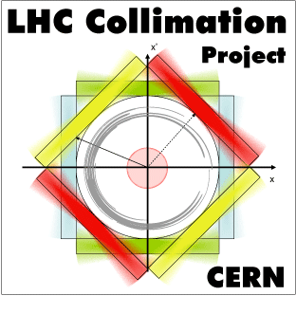
LRBB - readiness of hardware and installation
A. Rossi on behalf of (alphabetical):
BE-ABP, BE-BI, BE-OP, EN-MME, EN-ACE, EN-STI, TE-EPC, TE-VSC

Slide 2
TCTPH.4R5.B2:
  Collimator installed, aligned, pumped, baked out
  Wire connection on-going on tunnel side, local tests
  PC power module is missing
  Acquisition box ready to be installed to test WIC
Wire tests foreseen (~mid march)
  both inner+outer wires up to 350A
  effect of current on LVDTs (inner wire) // wire tension recalibration
TCL.4L5.B2
  Collimator installed, aligned, sector pumped next week, end of bake-out in 2 weeks’ time

Slide 4
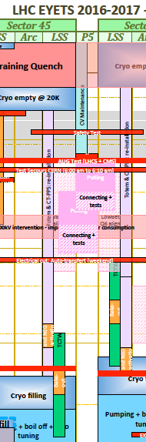
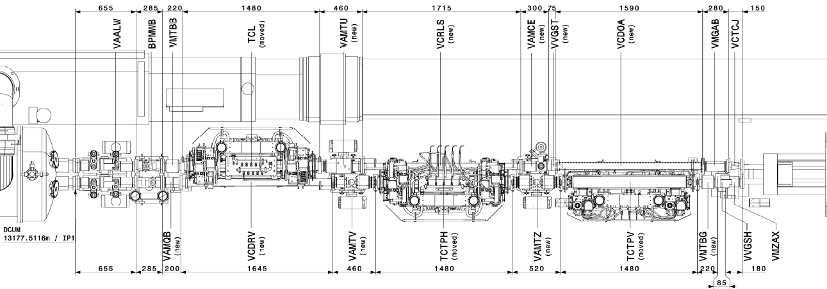
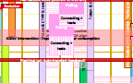
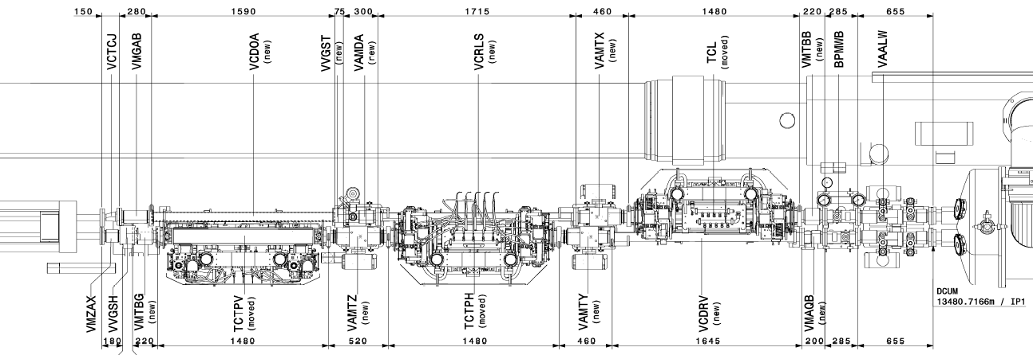
Zone between TAN and D2
~π/2 phase from IP5
TCL.4L5.B2
D2.L5
TAN.L5
TCTPV.4L5.B1 TCTPH.4L5.B1
WK 6-10
TCL.4R5.B1
TAN.R5
D2.R5
WK 9-12
TCTPV.4R5.B2 TCTPH.4R5.B2

Slide 5
Wire protection and interlocks
SIS
Control
  PC hardware initially limited to 300A
  If U_{w}>2.5-3V T_{max} wire 200-300°C PC off via WIC
  If T_{jaw} > 50°C beam dump + if > 100°C wire switched off
  If wire on accidentally during standard LHC ops wire switched off
PC
FGC
WIC
T_{jaw}
wire
If U_{w}>2.5-3V
U=f(T)
If T_{jaw}>50°C beam dump + if > 100°C wire off

