Slide 1
Recent results of D1 short model magnet test
Andrea Musso – Ezio Todesco on behalf of KEK team:
Tatsushi Nakamoto, Michinaka Sugano, Sun Enomoto, Kento Suzuki, Yukiko Ikemoto
26th HL-LHC TCC meeting – 16 March 2017

Slide 2
Summary
Performance Result after the first cold test of model magnet #1(a) [MBXFS01]
Upgrade and assembly of the model magnet #1(b)
Training quench performance of #1(b)
Preparation of Model magnet #2

Slide 3
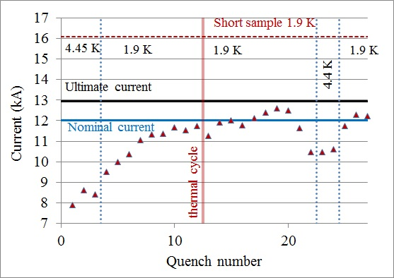
Quench performance of MBXFS01(a)
(HCMBXFM001-KJ000001)
Assembly => ended April 2016
Cold test => May 2016
Nominal current reached after thermal cycle and 13 quenches
Ultimate current was not reached
De-training and erratic behavior

Slide 4
Insufficient azimuthal coil pre-stress in MBXFS01
MBXFS01(a)
Straight section
Coil end
Variation of coil pre-stress at pole
during excitation
Coil size measurement after curing
T-b
T-a
B-a
B-b
35 MPa
I=13 kA
Proposal to increase the pre-stress and the axial pre-load
During the review in July 2016 the decision was officialized

Slide 5
Model magnet 1a Vs. 1b pre-stress
MBXFS01(b)
Pre-stress is given by yokes
Activity | ∆ (Mpa)
After collaring | 6
Yoking with load | 33
After yoking | 35
Before shell welding | 30
After shell welding | 30
MBXFS01(a)
0.8mm shims added in the mid-plane
Magnet re-assembly Autumn 2016

Slide 6
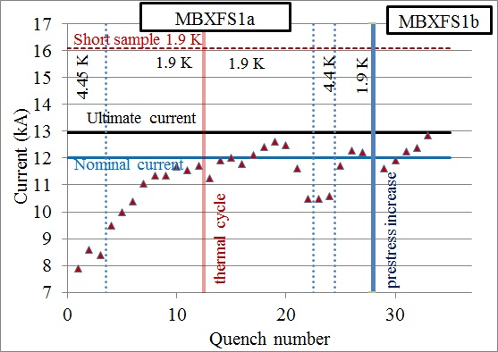
Quench performance of MBXFS01(b)
Cold test => February 2017
Nominal current reached after 2 quenches
Ultimate current reached after 5 quenches (plateau 1’)
Plateau at nominal current 1h

Slide 7
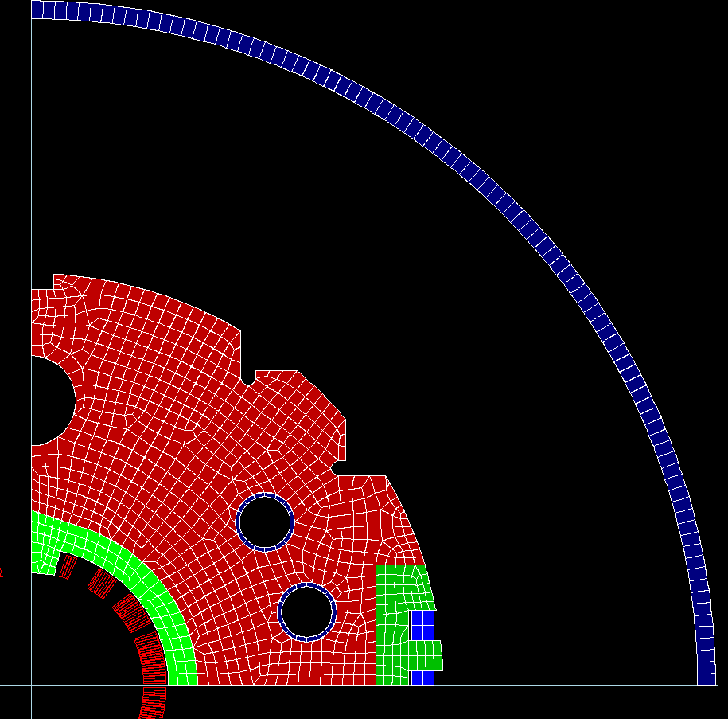
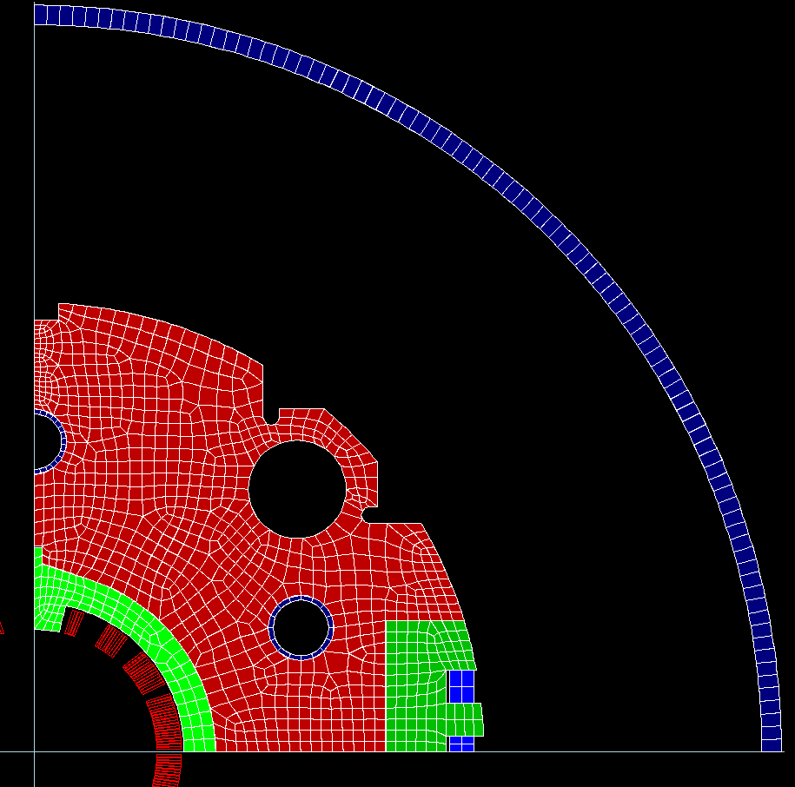
Design change in MBXFS02
The cross section design needs to be changed following a request from CERN in order to be in line with the adjacent magnets (simplified interconnection)
The magnetic measurement and the simulations (2d and 3d) need fine adjustment to meet the required specification
For these reasons the model magnet #2 will have a different cross section
Model magnet #1 cross section
Model magnet #2 cross section

Slide 8
Conclusions
The test of model magnet #1a showed a lack of pre-stress
The magnet was disassembled and assembled again with shims in the mid-plane
The test of model magnet #1b showed a good behavior and the problem seems to be solved
Model magnet #2 will be manufactured starting in August 2017, with a new cross section as requested by CERN
Model magnet #2 will have a new (final) cross section

