Slide 1
Experimental Interaction Region – outcomes from review at ALBA
Andrei A. Seryi (JAI)
On behalf of EuroCirCol WP3 EIR design team:
CERN, CI, EPFL, INFN, JAI
BDS meeting
25 November 2016

Slide 2
Overall status and plans
Oct 2015 to Apr 2016 (Orsay to Rome)
  Consolidation to a single baseline
  Successfully achieved
    Model of detector
    EIR optics with L* 45m and triplet model
    Ring optics
Apr 2016 to Nov 2016 (Rome to ALBA)
  Variations around Rome baseline
    Model of detector changed
    Alternatives for EIR triplet model
Nov 2016 to May 2017 (Alba to Berlin)
  Next round of consolidation to a single and more optimal baseline
    Converge on detector model (confirm L* fixed or…)
    Converge on triplet configuration
    Consider flat beams and alternative to crab cavities

Slide 3
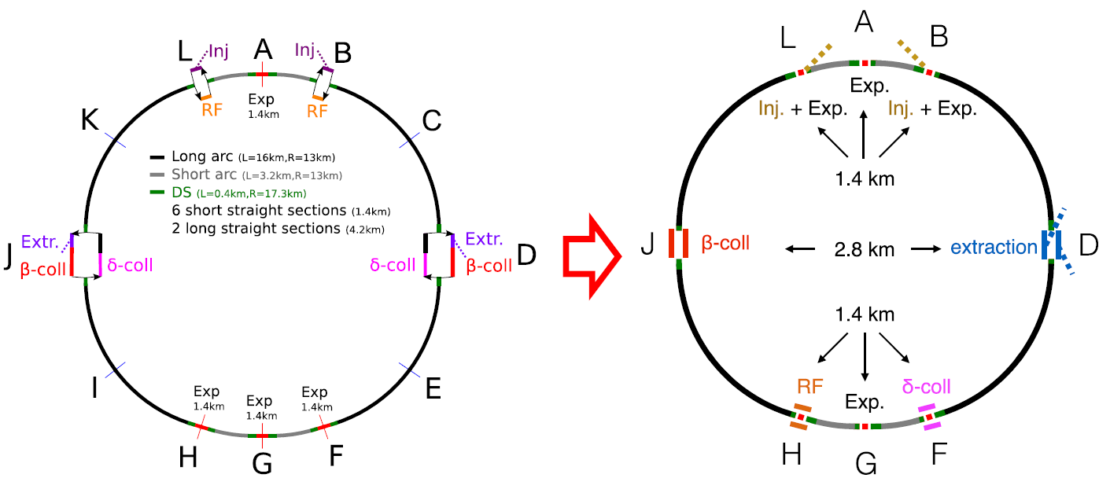
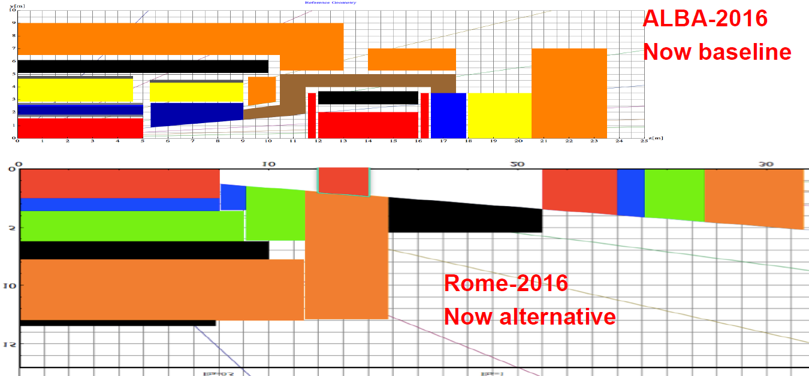
“In the wind of change”
New layout
New detector

Slide 4
The tasks and the team:
CERN: Rogelio Tomas,
Roman Martin, Andy Langner
IR Work Package
  Development of the EIR lattice
    JAI/Oxford, CERN, task 3.2
    PhD student started Oct 2015 & Oct 2016
    OX PostDocs: started in Jan and Feb
      { OPTICS }
      { OPTICS / ENERGY DEPOSITION }
  Design of machine detector interface
    CI/Manchester, INFN, CERN, task 3.3
    PostDoc in Manchester, topic:
      { MDI }
    PostDoc in INFN, topic:
      { MDI }
  Study of beam-beam interaction
    EPFL, CERN, task 3.4
    PostDoc started in Aug 2015
    Plans for more hires
JAI/OX: Andrei Seryi,
Emilia Cruz Alaniz,
Jose Abelleira Fernandez, Leon van Riesen-Haupt
JAI/RHUL: Laurie Nevay
Andrei Abramov
CI/Manchester: Rob Appleby,
Haroon Rafique
CERN: Francesco Cerutti,
Maria Ilaria Besana,
Helmut Burkhardt
INFN: Manuela Boscolo,
Francesco Collamati
EPFL: Javier Barranco,
Jorge Patrik Gonçalves
CERN: Tatiana Pieloni,
Xavier Buffat

Slide 5
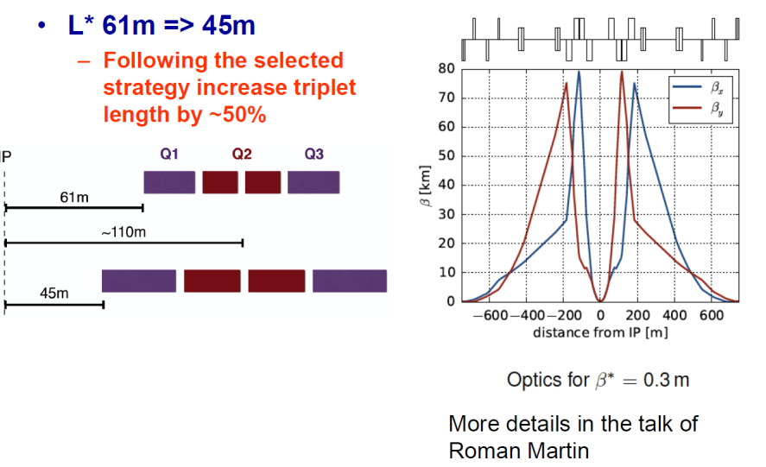
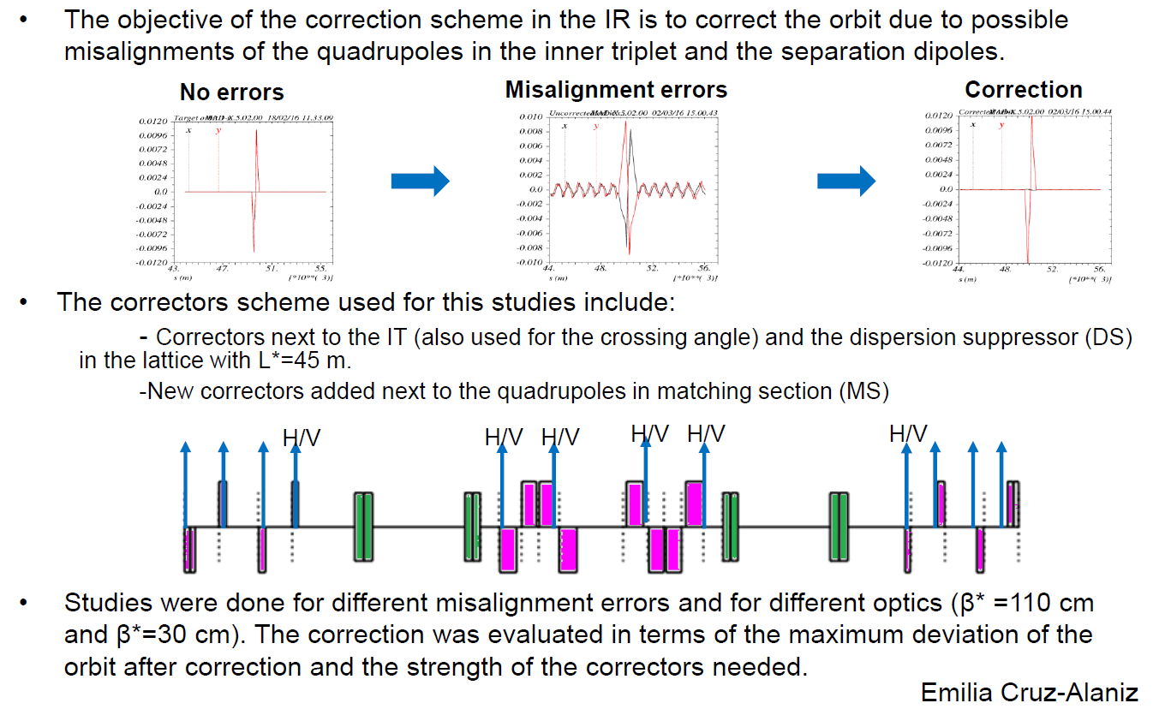
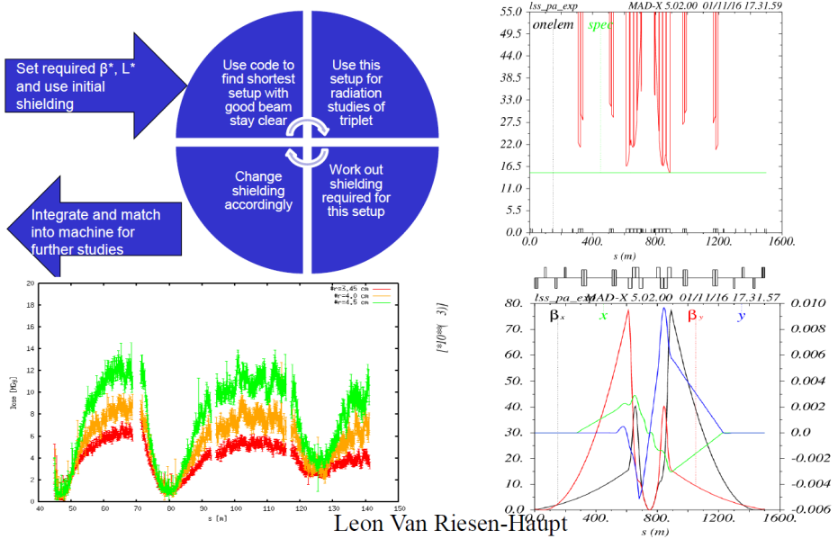
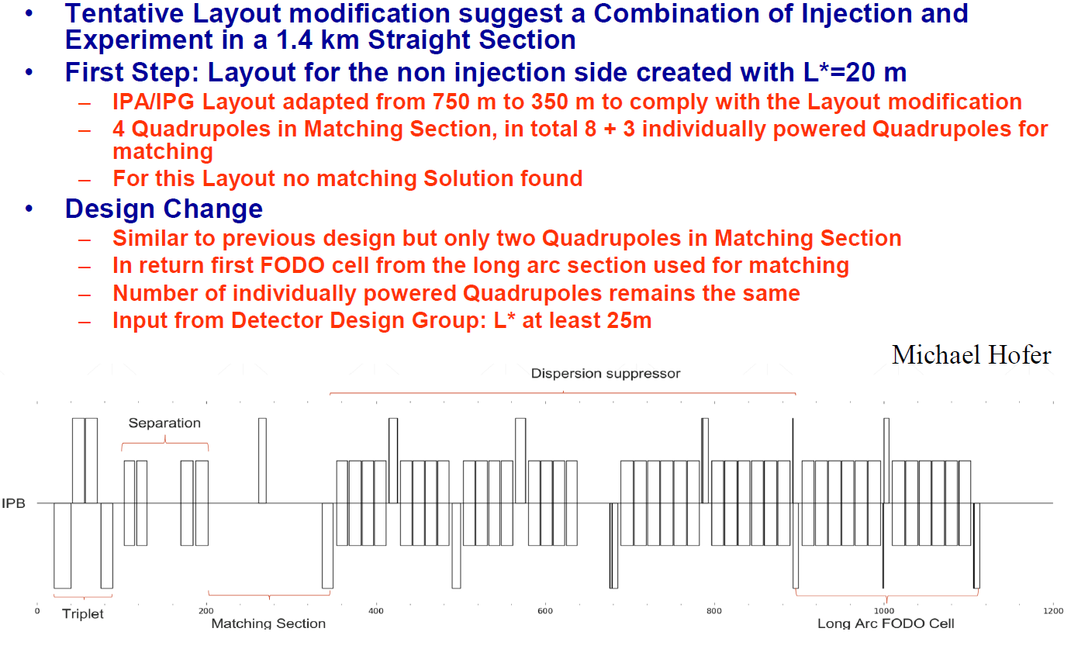
Recent highlights

Slide 6
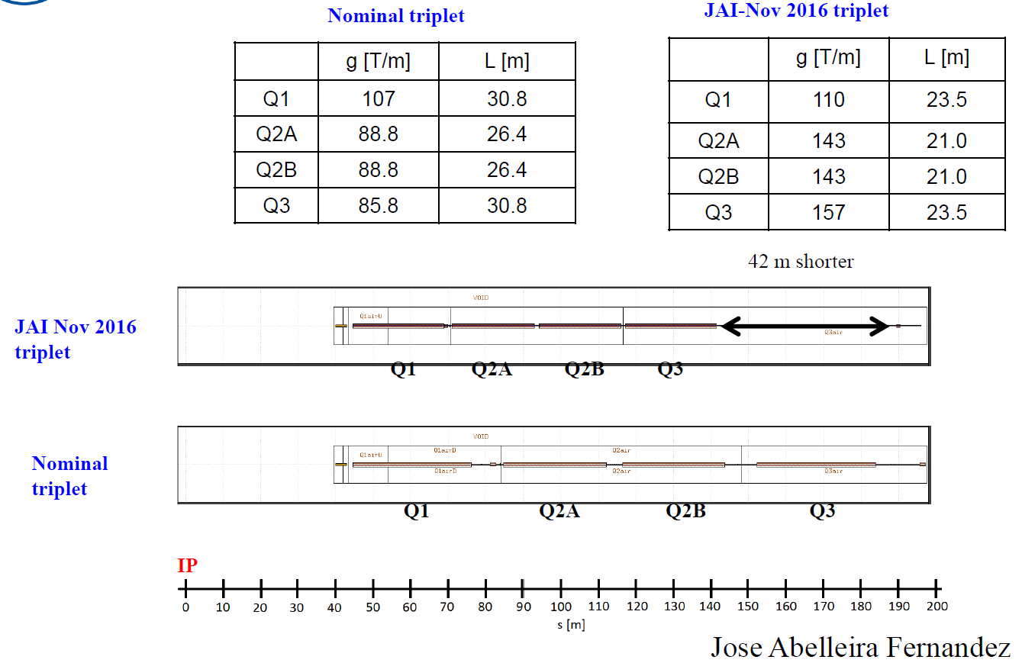
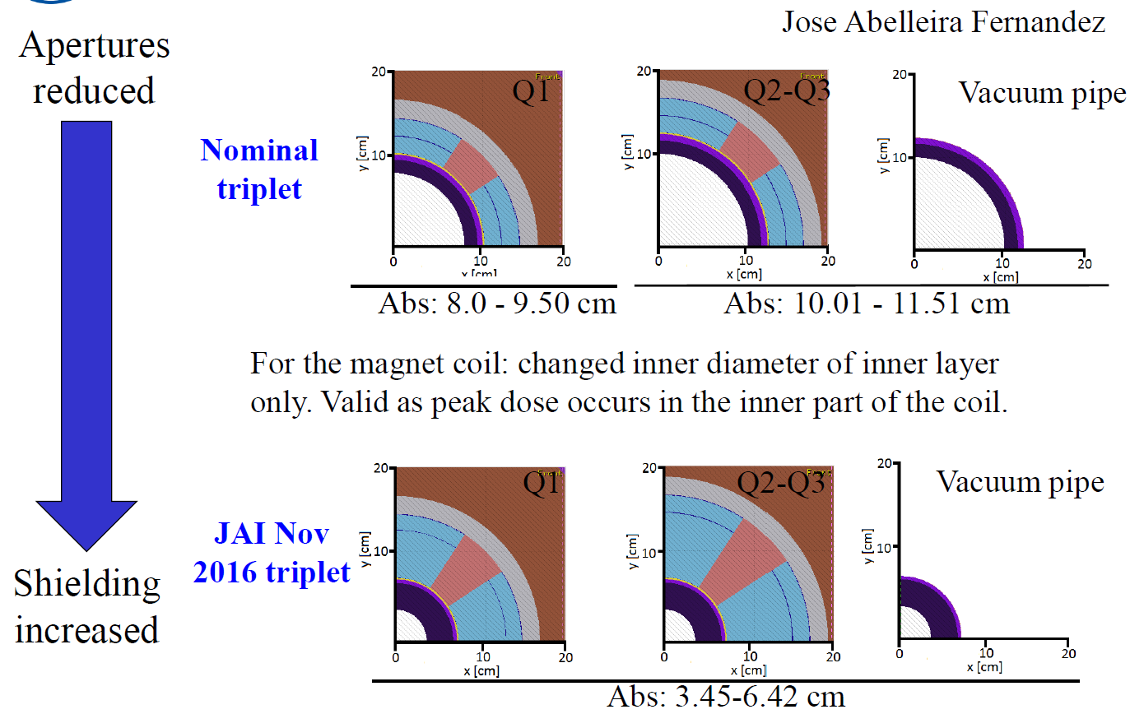
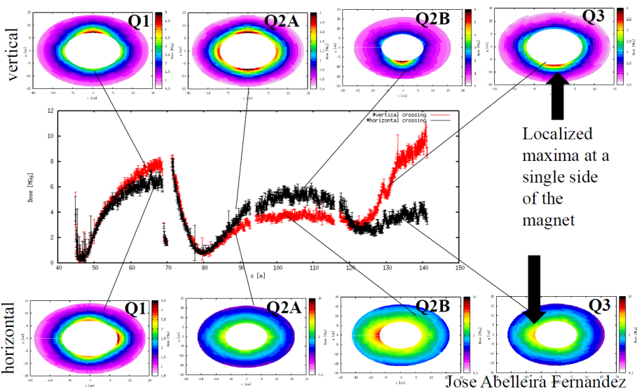
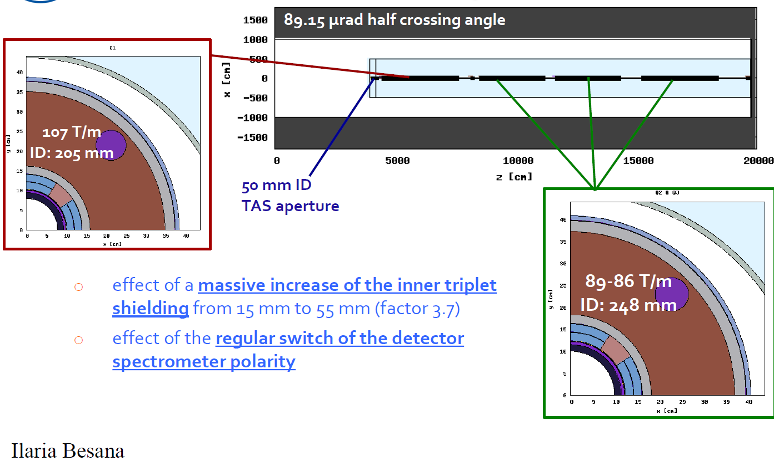
Recent highlights

Slide 7
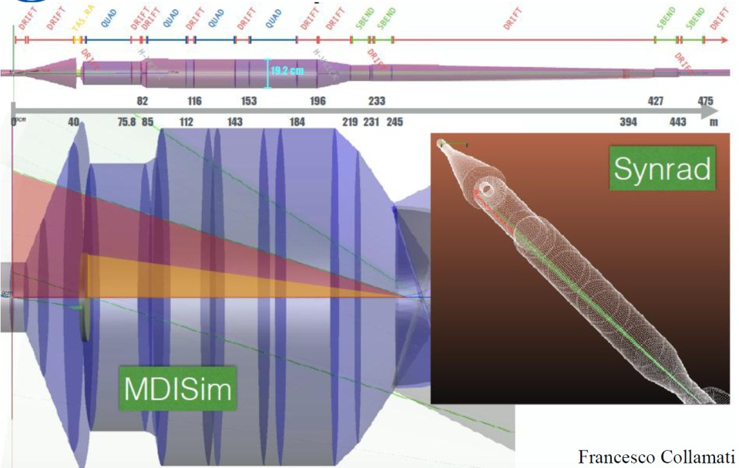
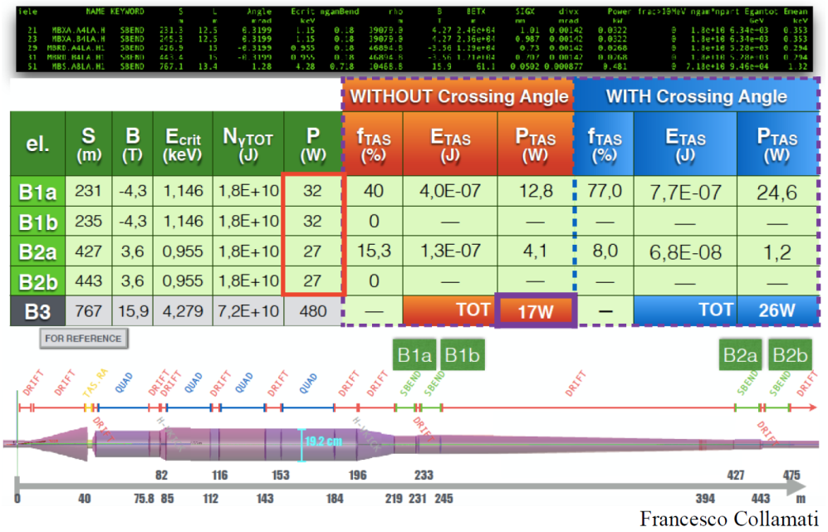
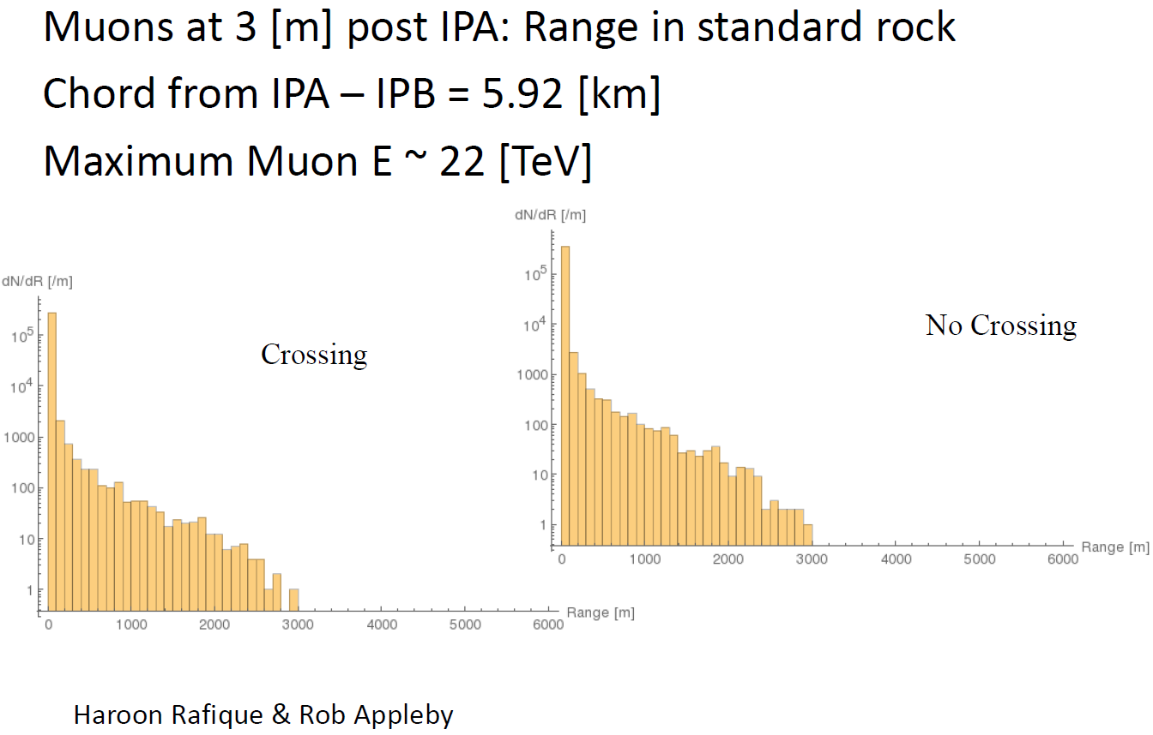
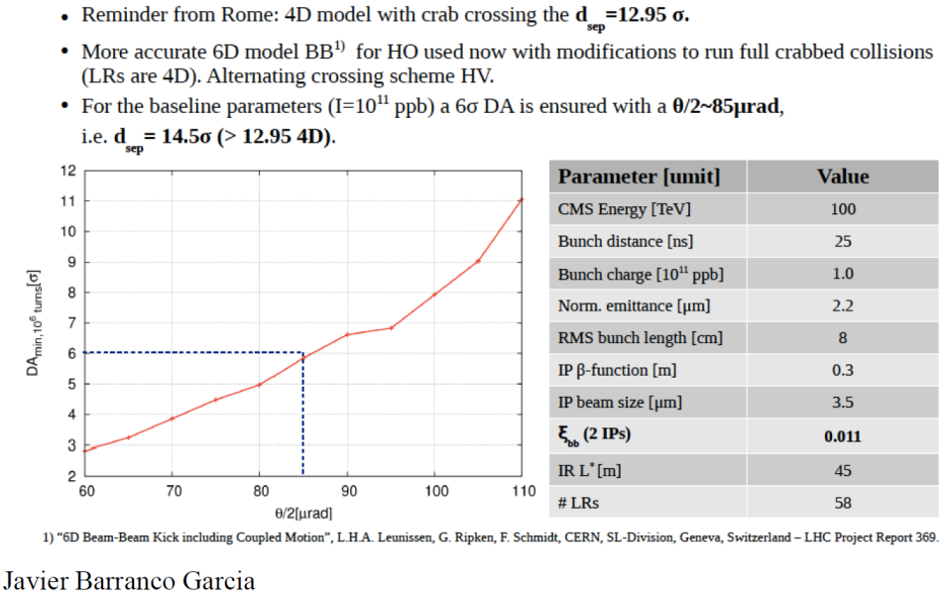
Recent highlights

Slide 8
Status
Experimental Interaction Region progress
  Converged on L* of 45m
  Optics of IR with new L*
  Designed for beta* of 0.3 m
  Study of inner triplet shielding and beam-beams are encouraging
  Cross-talks between IRs show the issues likely tolerable
    Confirm with FLUKA
  IR orbit correction works
  SR radiation studies in IR are encouraging
    Effect of spectrometer dipole to be checked
  Further optimization of triplet for alternative beta* and L* ongoing
  Beam-beam studies are ongoing
  More detailed studies and explorations of parameters are ongoing

Slide 9
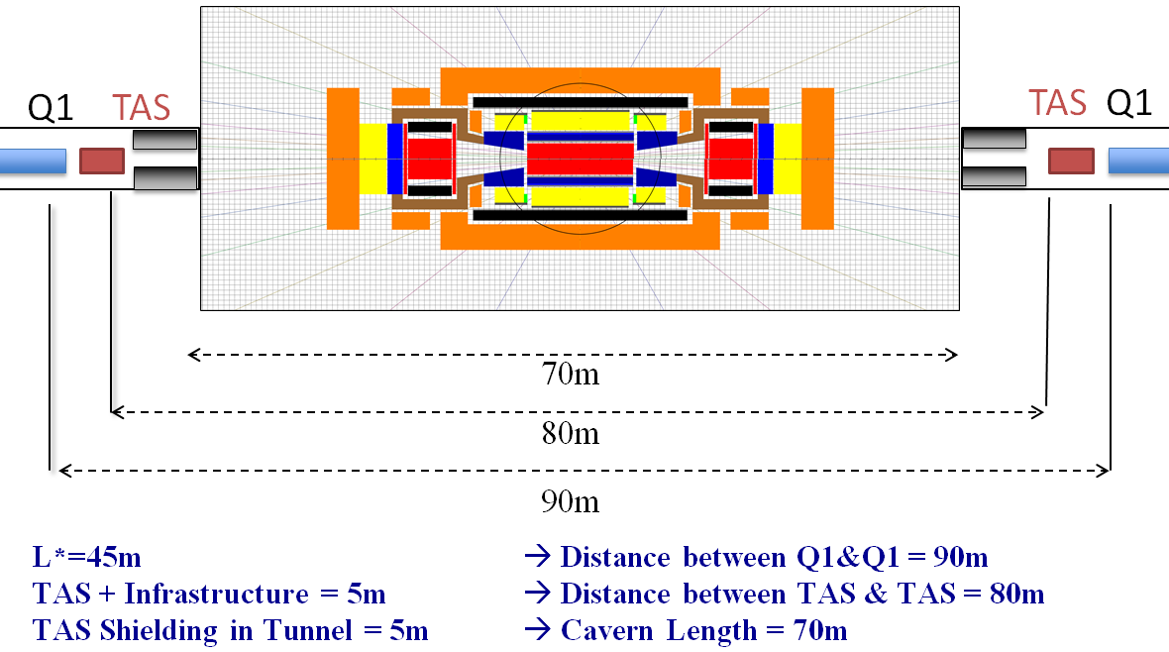
“In the wind of change”
  While we continue studies of present baseline, we may anticipate that optics performance (DA, etc.) will push us to reduce L*
  Reduced size of baseline detector gives an opportunity to re-optimize the design
  To reduce L* the old larger detector should be removed from alternatives
  We have all tools and knowledge to quickly re-optimize the design

Slide 10
Work focus for Berlin-2017
Oct 2015 to Apr 2016 (Orsay to Rome)
  Consolidation to a single baseline
  Successfully achieved
    Model of detector
    EIR optics with L* 45m and triplet model
    Ring optics
Apr 2016 to Nov 2016 (Rome to ALBA)
  Variations around Rome baseline
    Model of detector changed
    Alternatives for EIR triplet model
Nov 2016 to May 2017 (Alba to Berlin)
  Next round of consolidation to a single and more optimal baseline
    Converge on detector model (confirm L* fixed or reduce it
    Converge on triplet configuration
    Consider flat beams and alternative to crab cavities

