Slide 1
FLUKA studies on alternative designs
Jose L. Abelleira on behalf the JAI-FCC team
University of Oxford
7 November 2016
Thanks to Ilaria Besana and Francesco Cerutti (CERN)

Slide 2
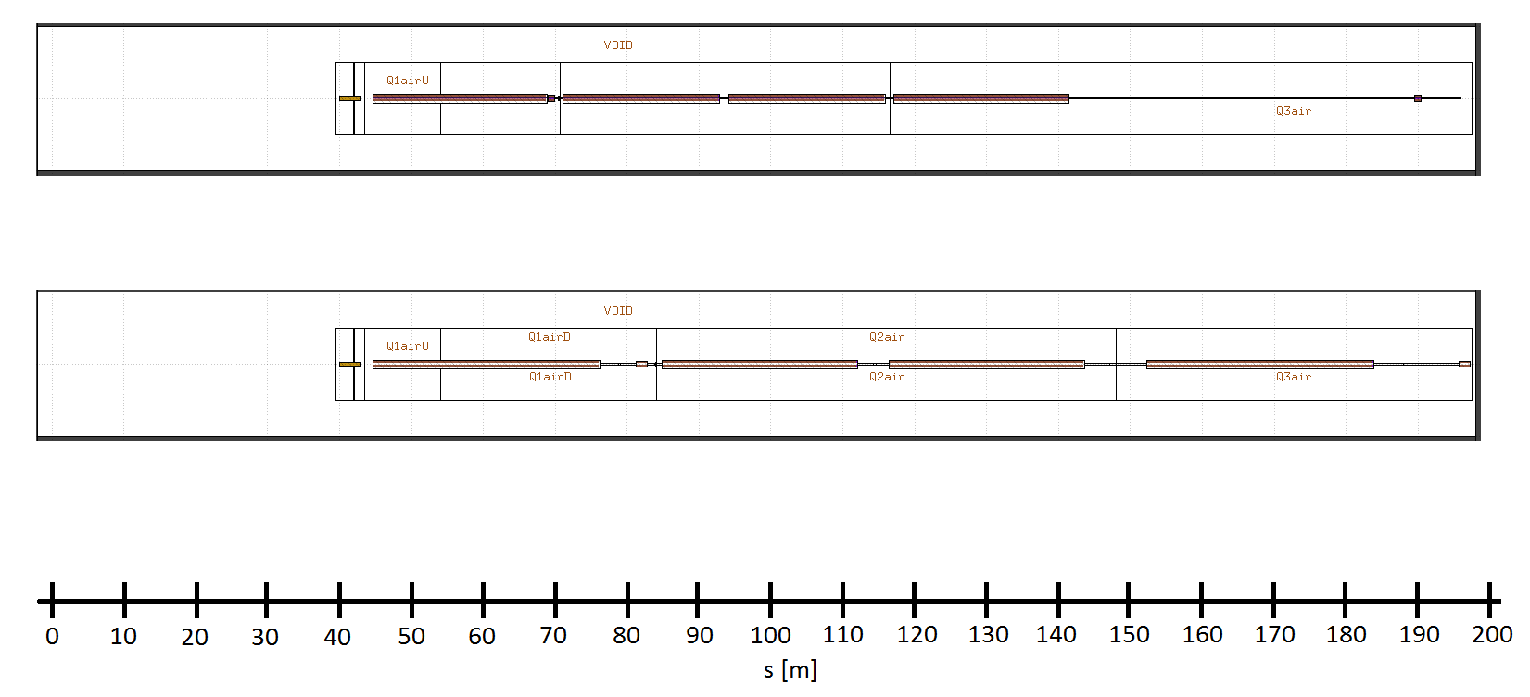
The new triplet
A new triplet is proposed*
42 m shorter
JAI Nov 2016 triplet
Q1
Q2A
Q2B
Q3
Nominal triplet
Q1
Q2A
Q2B
Q3
IP
The question is if this new, short triplet will withstand the high radiation, already considerable for the nominal triplet
*See talk by Leon Van Riesen-Haupt: Global chromatic aspects, L*, triplet lenght, etc.

Slide 3
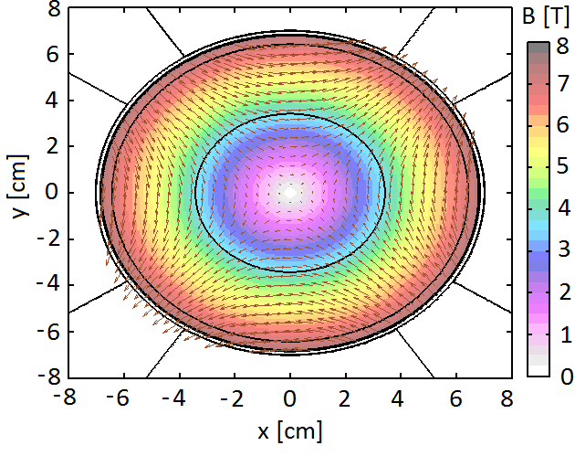
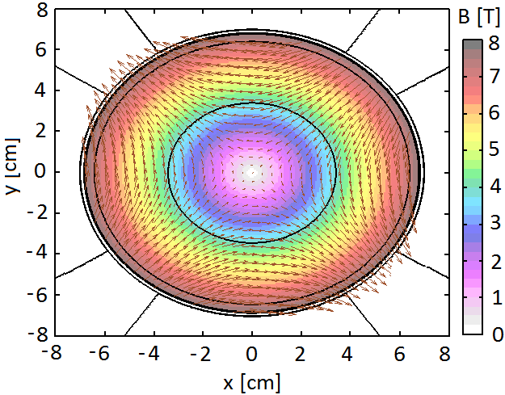
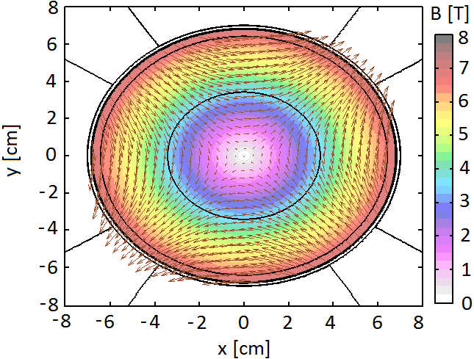
The new triplet
Comparison of the FF quadrupoles
Nominal triplet
JAI-Nov 2016 triplet
 | g [T/m] | L [m]
Q1 | 107 | 30.8
Q2A | 88.8 | 26.4
Q2B | 88.8 | 26.4
Q3 | 85.8 | 30.8
 | g [T/m] | L [m]
Q1 | 110 | 23.5
Q2A | 143 | 21.0
Q2B | 143 | 21.0
Q3 | 157 | 23.5
Shorter and stronger magnets
Q1
Q2
Q3
*See talk by Leon Van Riesen-Haupt: Global chromatic aspects,L*, triplet lenght, etc.

Slide 4
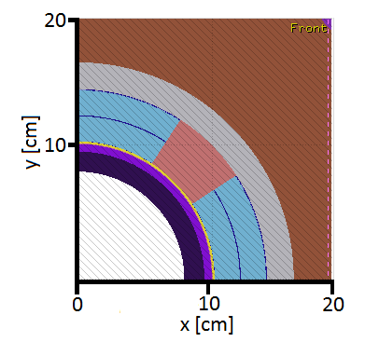
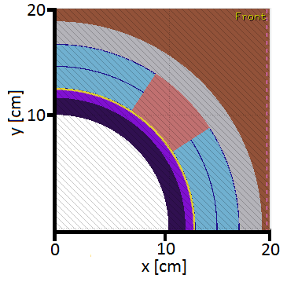
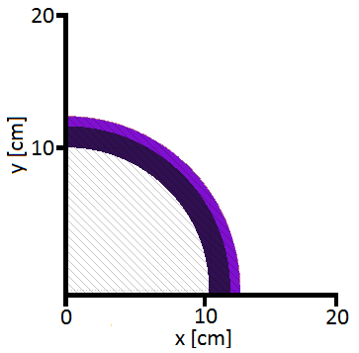
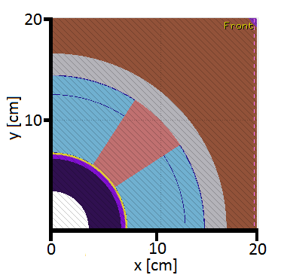
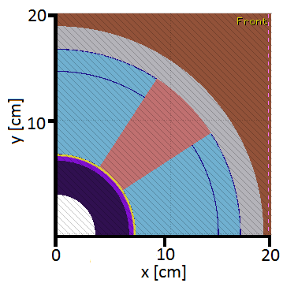
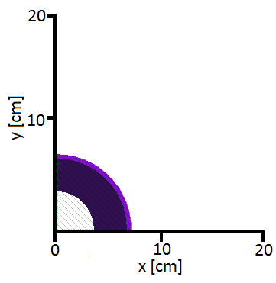
The new triplet
Apertures reduced
Q1
Q2-Q3
Vacuum pipe
Nominal triplet
Abs: 8.0 - 9.50 cm
Abs: 10.01 - 11.51 cm
For the magnet coil: changed inner diameter of inner layer only. Valid as peak dose occurs in the inner part of the coil.
Q1
Q2-Q3
Vacuum pipe
JAI Nov 2016 triplet
Shielding increased
Abs: 3.45-6.42 cm

Slide 5
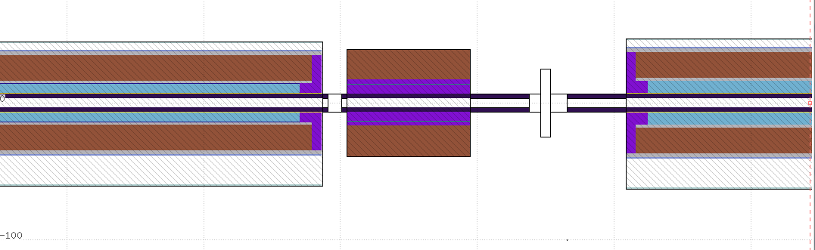
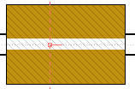
The new triplet
JAI-Nov 2016 triplet
2 m
corrector
Q1
Q2A
0.9 m
For the moment not needed if Q1 shielding is as in Q2-Q3 (slide 4)
Free space to add an additional TAS

Slide 6
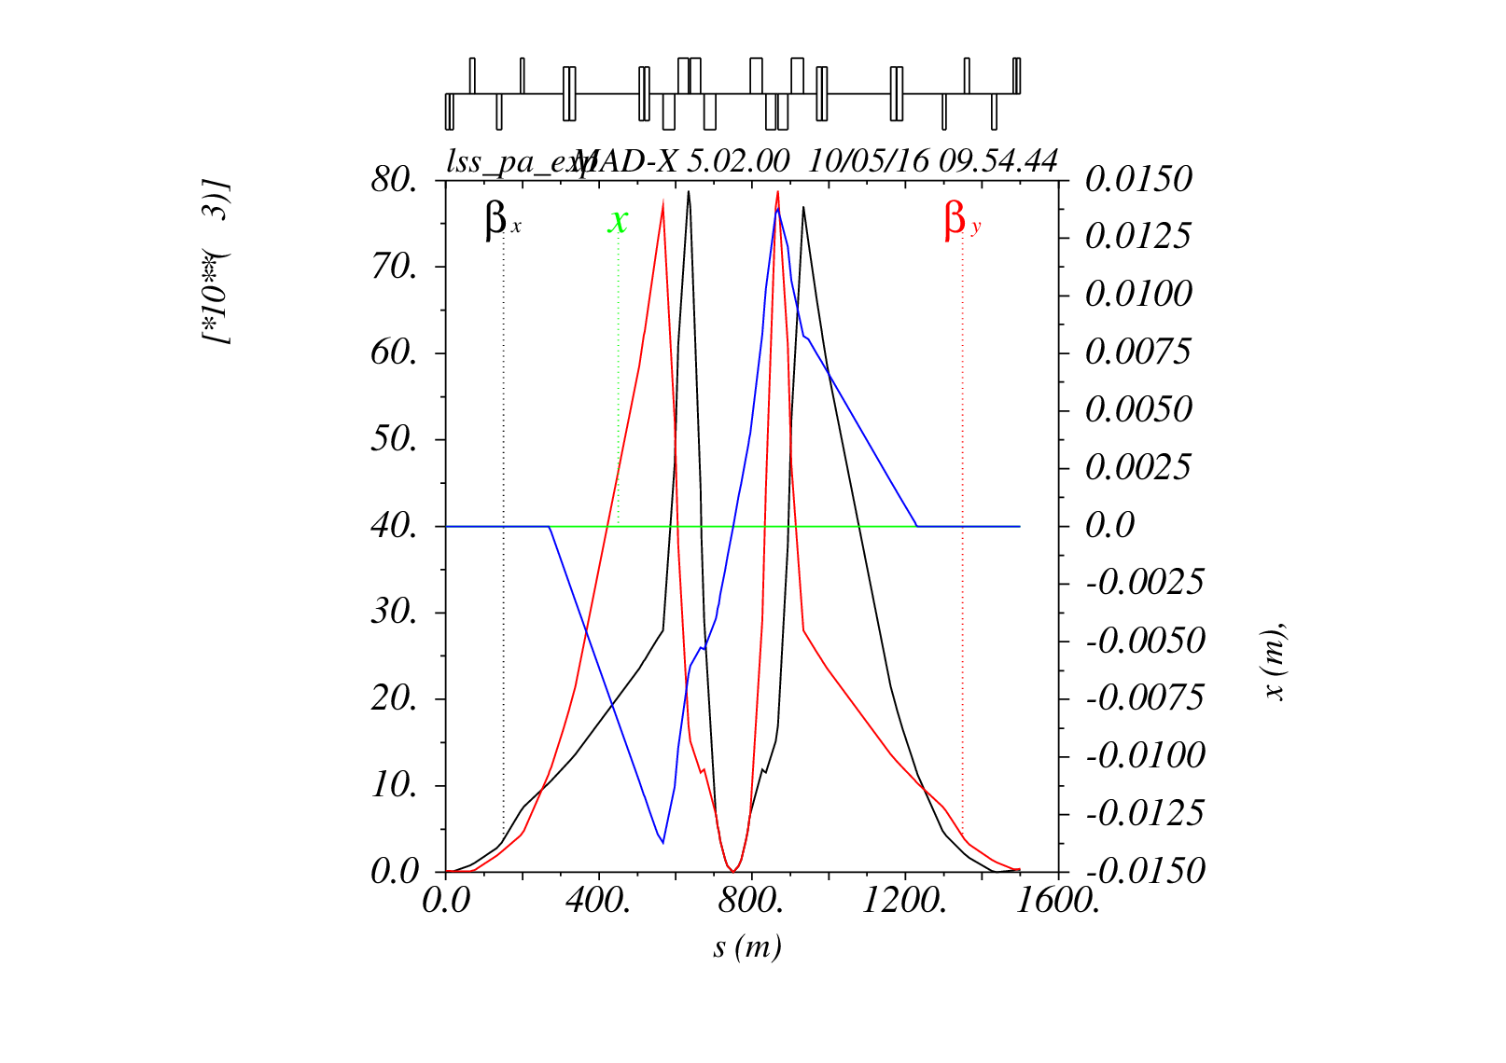
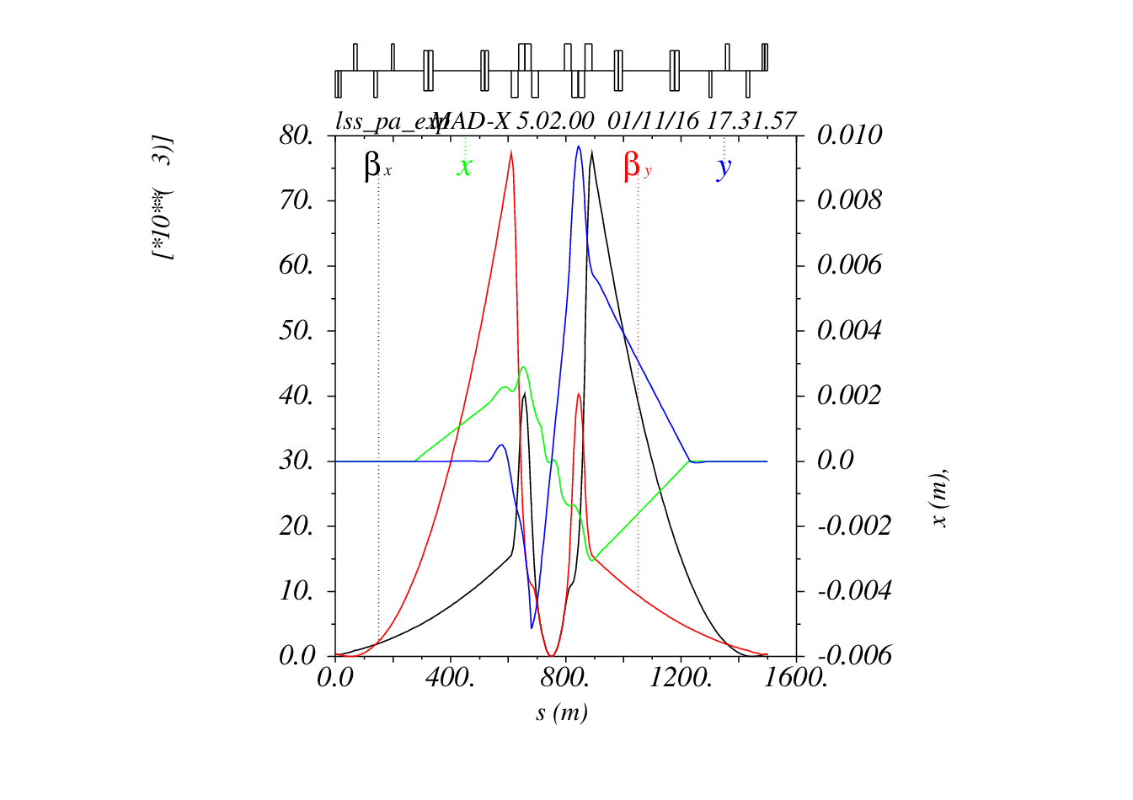
The new triplet
Nominal triplet
JAI-Nov 2016 triplet
Beta functions reduced at Q1 and Q2
* Leon Van Riesen-Haupt: Global chromatic aspects,L*, triplet lenght, etc.

Slide 7
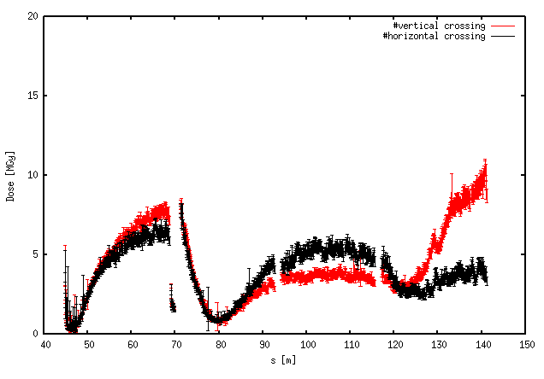
FLUKA simulations
Model parametrized for fast iteration with optics
Parameters: magnet length, position, B, absorber, quadrupole coils
Spectrometer off
(Half) Crossing angle 89.15 μrad both horizontal and vertical crossing
L integrated: 3 ab⁻¹
Cross section : 108 mbarn
Simulated dose for 3 ab⁻¹
The increased shielding at Q1 aimed a reduction of the dose in Q2A (otherwise the peak goes very high)

Slide 8
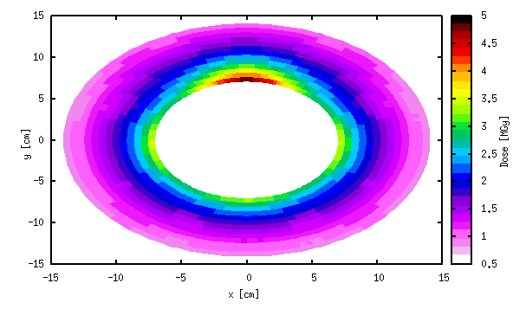
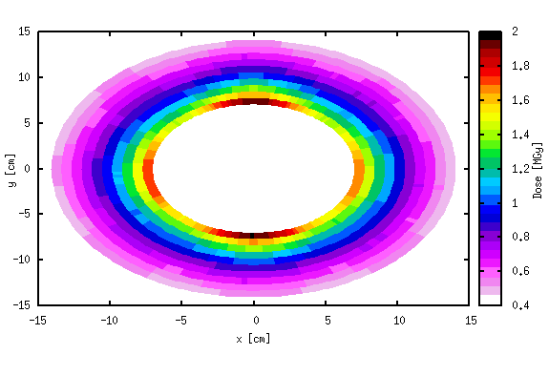
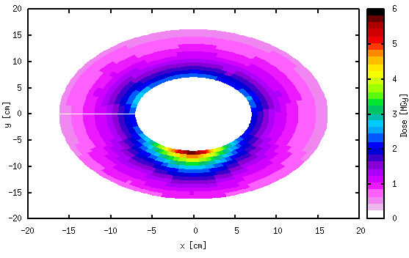
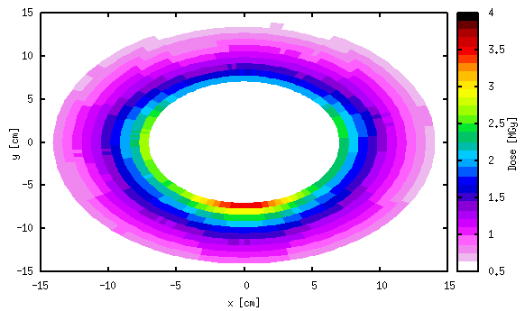
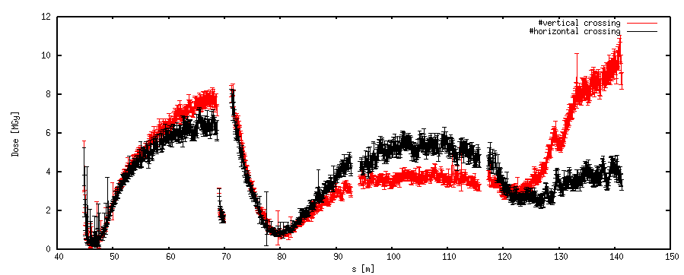
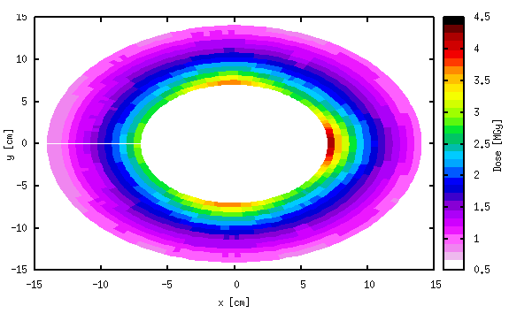
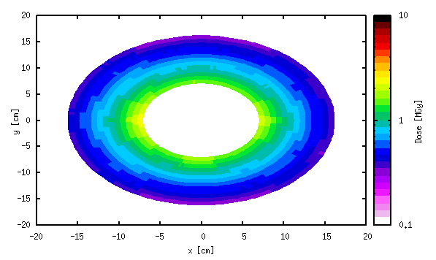
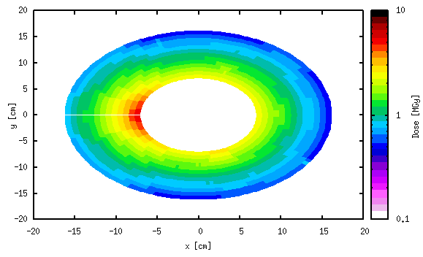
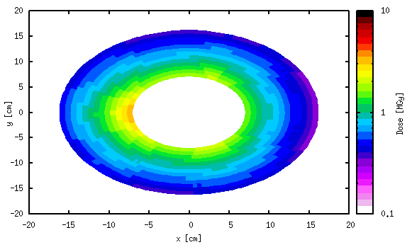
The new triplet: dose
Q1
Q2A
Q2B
Q3
vertical
Localized maxima at a single side of the magnet
Q1
Q2A
Q2B
Q3
horizontal

Slide 9
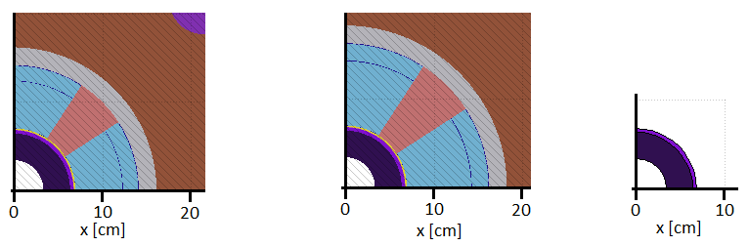
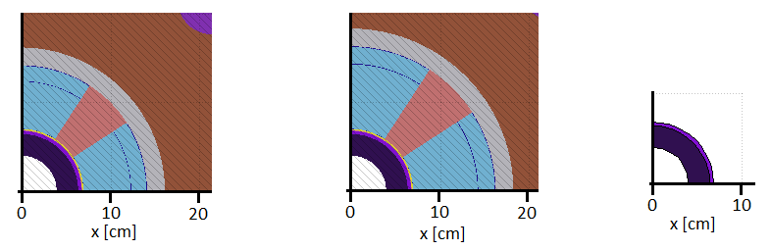
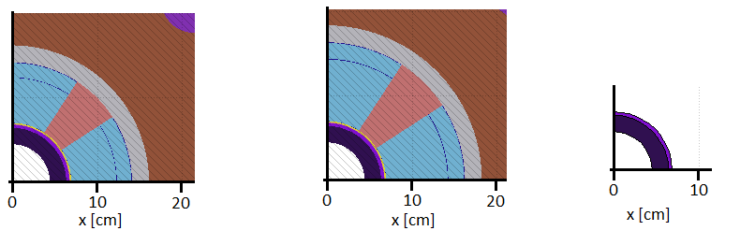
Variation of the absorber
This case is limited in acceptance
Q1
Q2-Q3
r = 3.45 cm, A = 12σ
Other two cases have been simulated. Same magnets, varying the thickness of the absorber.
Q1
Q2-Q3
r = 4.0 cm, A = 16σ
Q1
Q2-Q3
r = 4.5 cm, A = 19σ

Slide 10
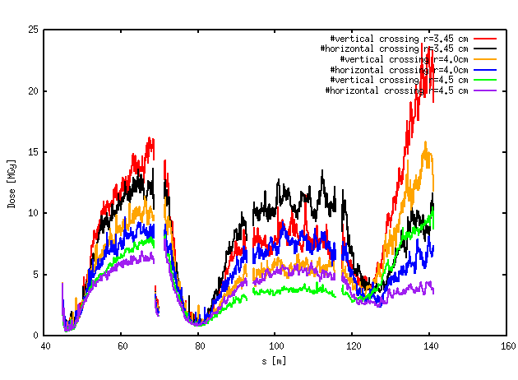
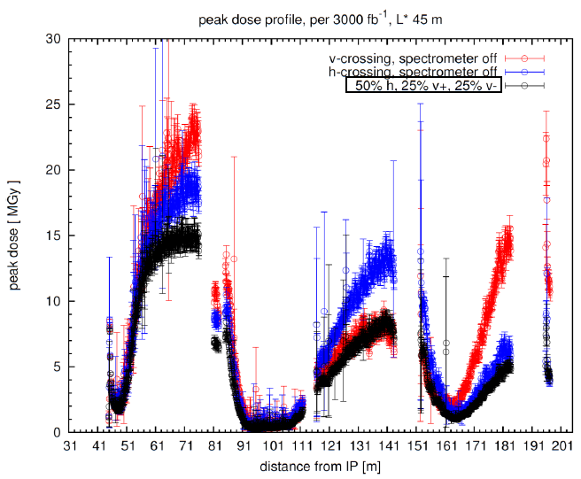
Variation of the absorber: dose
Simulated dose for 3 ab⁻¹
Maximum dose 10-25 MGY for the vertical crossing and 8-15 for the horizontal.
Excessive at Q3 (large beta function), specially for the vertical crossing.
Comparison with the results of the nominal triplet (Ilaria, FCC week 2016)

Slide 11
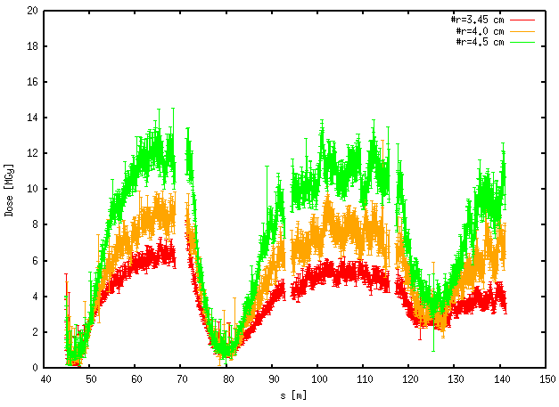
Variation of the absorber: dose
As the maxima are localized within one side of the magnet, alternating crossing plane reduces the peak dose [Ilaria*].
Maximum dose for 50% time horizontal crossing and 50 % vertical.
Peak dose reduced and more evenly distributed across the quadrupoles
*Ilaria Besana: FCC week 2016: Collision debris on the triplet quadrupoles

Slide 12
Variation of the absorber: dose
Comparison with the results of the nominal triplet (Ilaria, FCC week 2016)
Inner radius [cm] | Shielding thickness [cm] | Beam stay clear [σ] | Max dose H [MGy] | Max dose V [MGy] | Max. dose 50% hor 50% ver [MGy]
4.5 | 1.9 | 19 | 25 | 15 | 14
4.0 | 2.4 | 16 | 15 | 10 | 10
3.45 | 3.0 | 12 | 10 | 7 | 7
Even for the highest acceptance the peak dose is reduced to 14 MGy

Slide 13
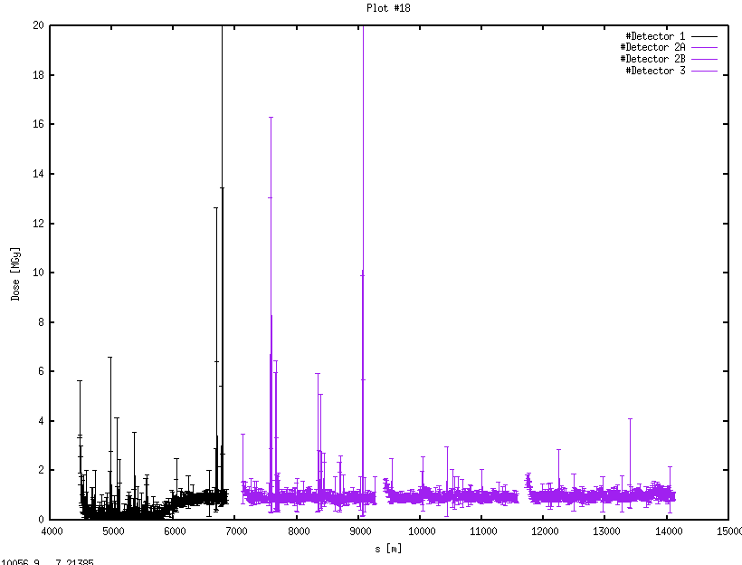
Other studies
Trying to get an solution for the energy dose profile
  Identifying main parameters that play a role:
    Crossing angle
    Beam size and beam divergence
    Magnet strength (k changes for different p)
    Shielding thickness
    Inner radius
Example: simulation without k=0 for the quads

Slide 14
Other studies
Muons through rock
  Simulations ongoing, two step method
    Simulate pp collision and dump muons at the end of the detector
    Transport muons through the tunnel model
Elliptical optics
  Each triplet configuration needs now 4 simulations: left/right and hor/ver.

Slide 15
Conclusions
A new triplet ‘JAI November 2016’ has been designed.
This triplet is more compact that the nominal one.
After some iteration with optics, three different variations in the quadrupoles have been presented.
The dose is reduced with respect to the original case thanks to the increased shielding in pipe and magnets.
The results improves considerably if alternating crossing is used.
Dose does not represent a stopper for shortening the triplet.

