Slide 1



Gentner Programme
Started October 2007
    after CERN visit of State Secretary Meyer-Krahmer from German BMBF (Federal Ministry of Education and Research)
  special German Doctoral Student Programme
    in addition to the existing CERN Doctoral Student Programme
    (almost) identical conditions except funding (subsistence) by BMBF, also extra funds for travel to Germany
  mid- and long term goals
    better usage of CERN resources by Germany
    better connection between German Universities and CERN
    long-term: more German staff at CERN
      presently only ~7.0% German staff (177/2532), but 20.4% contribution of DE to CERN budget
      IT: 11.6% (10.6% contribution), GB: 8.1% (15.1% contribution), ES: 6.4% (7.2% contribution)
3 parties involved: BMBF – CERN – DESY
    Programme Coordination by DESY (Manfred Fleischer)
    + local Coordinator at CERN (MH)

Slide 2
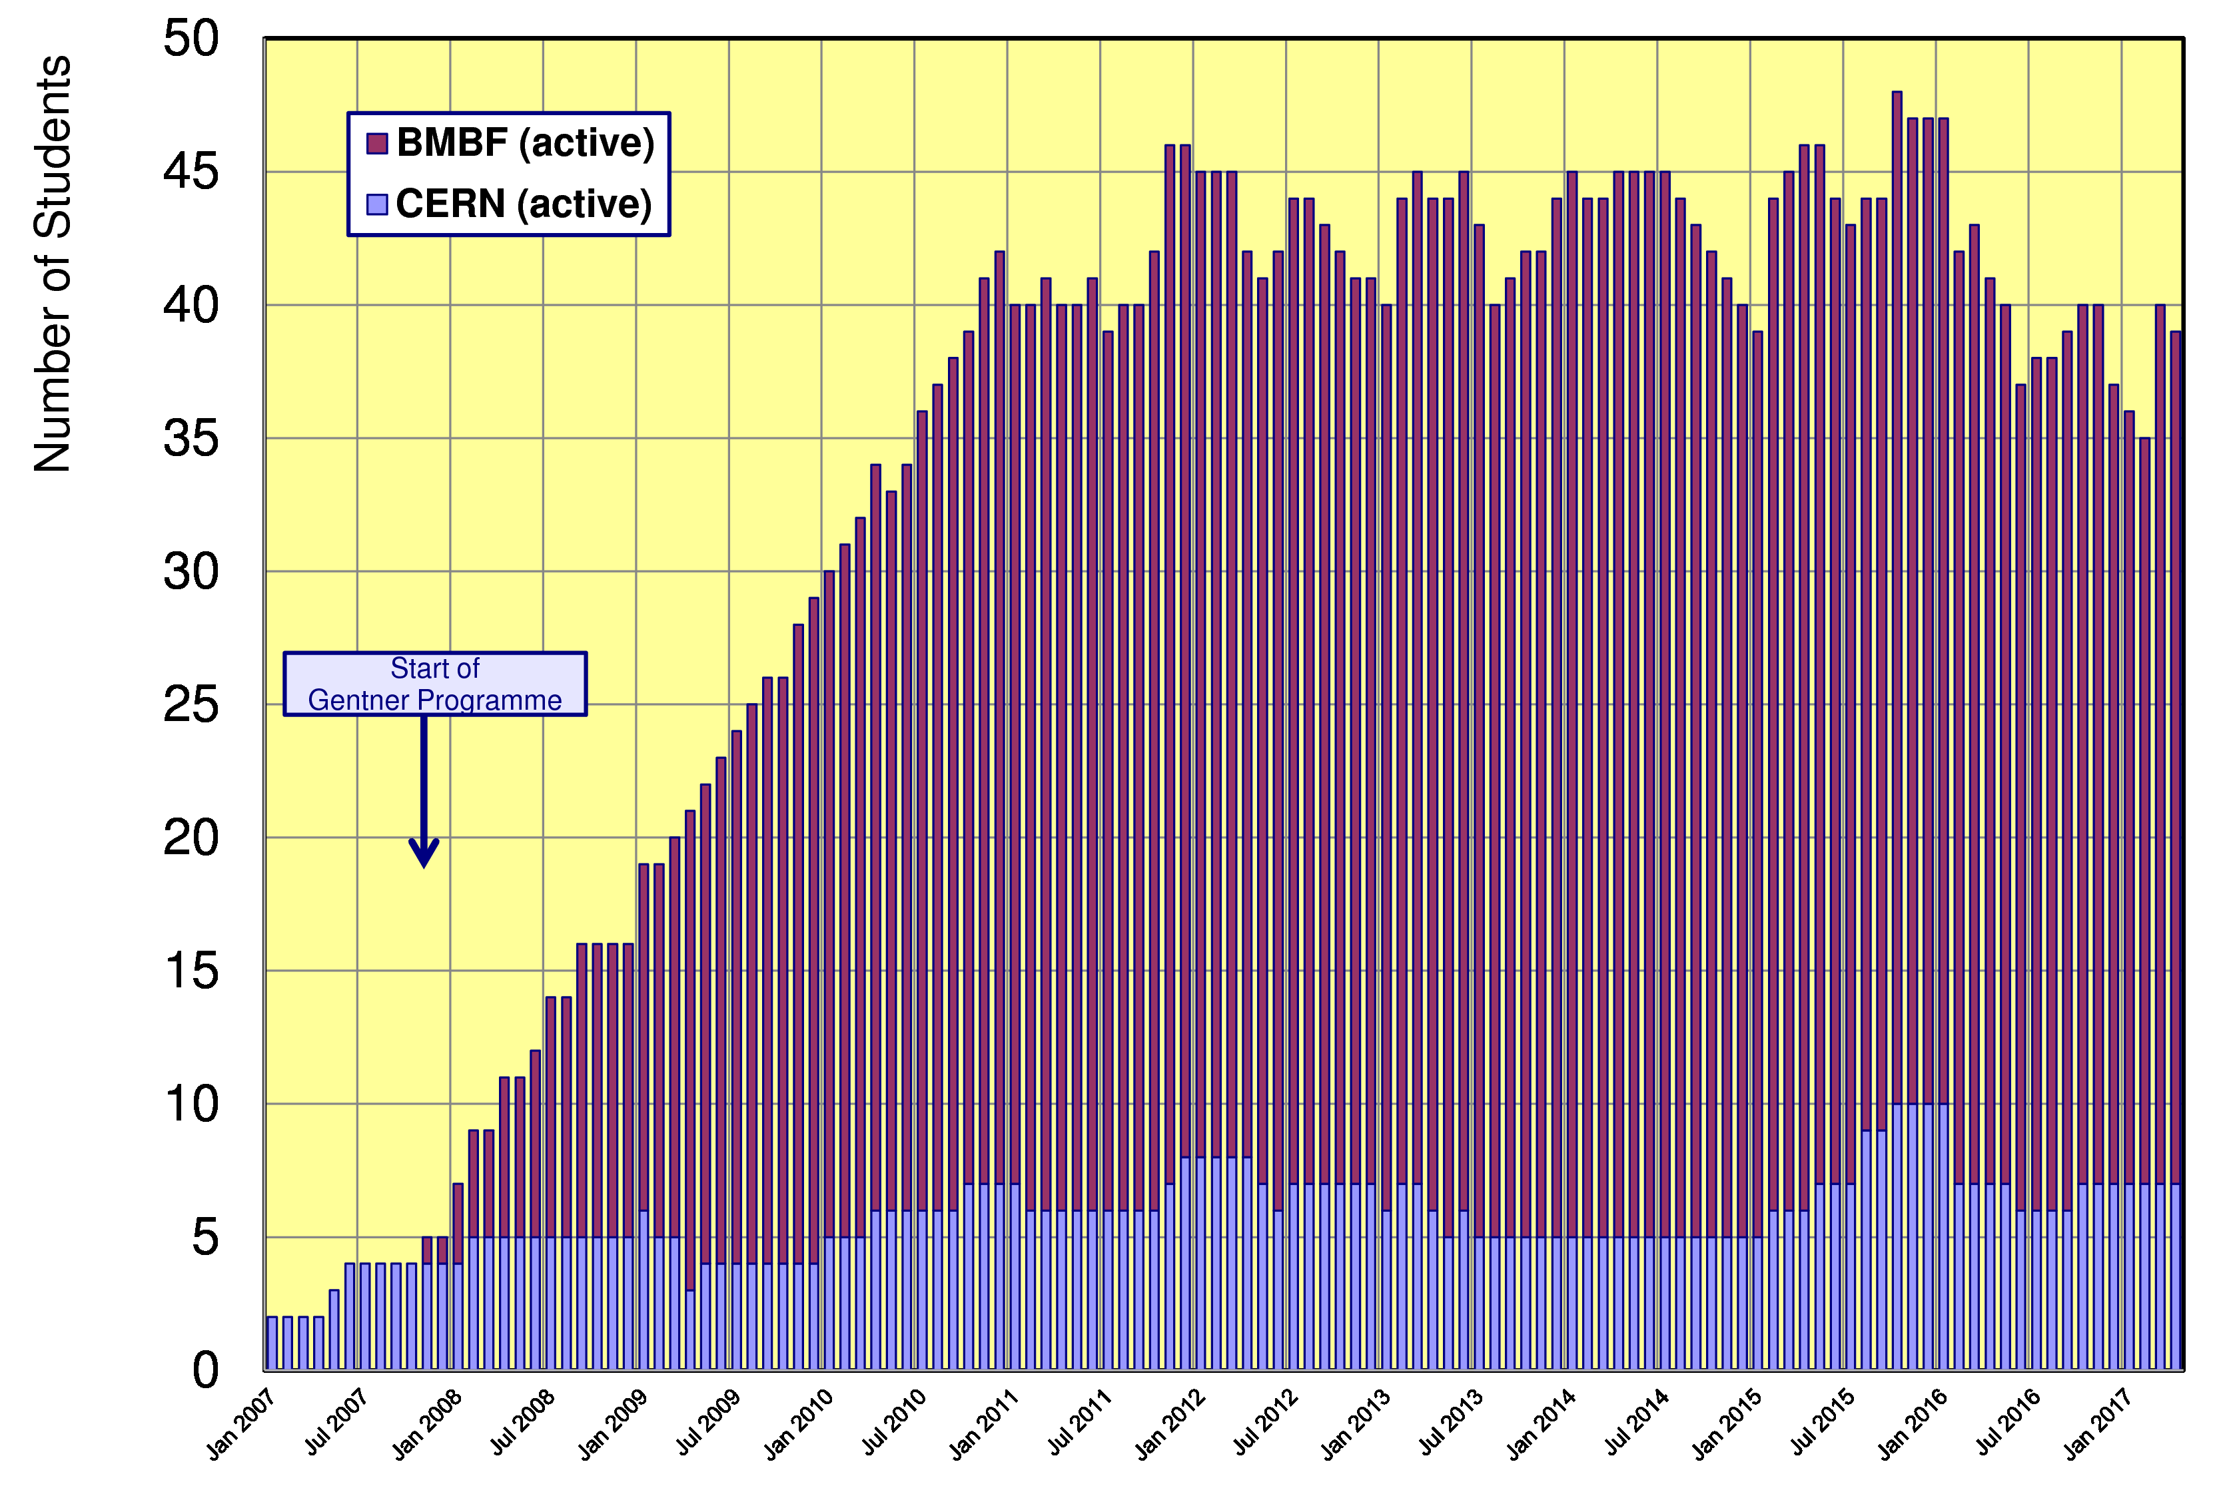
Status Gentner Programme
Presently 32 active Gentner Students (9 female = 28%)
    + 7 Germans in regular CERN Programme
    Number of Students ~stable 2011 – 2015
Slight drop in 2016
because of EUR/CHF
exchange rate

Slide 3
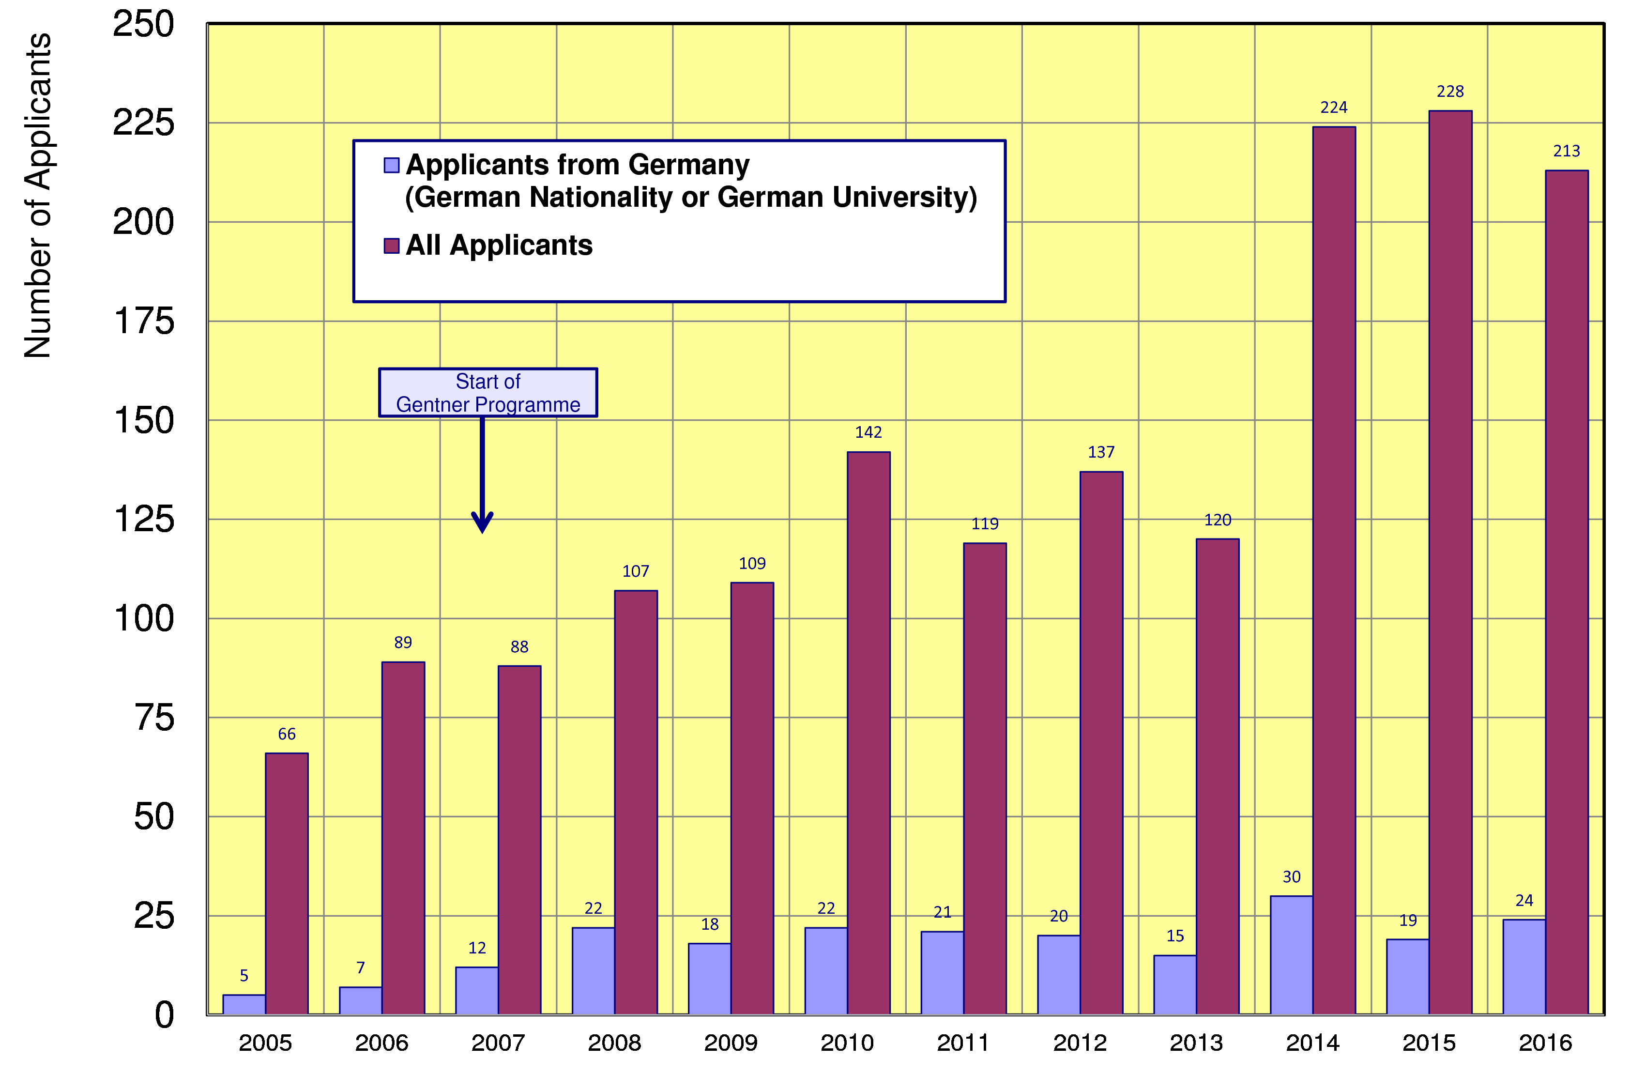
Doctoral Student Applications
Typically ~21 applicants/year from Germany (~stable since 2008)
    but overall number of applications is raising → fraction of DE applications went down
~21

Slide 4
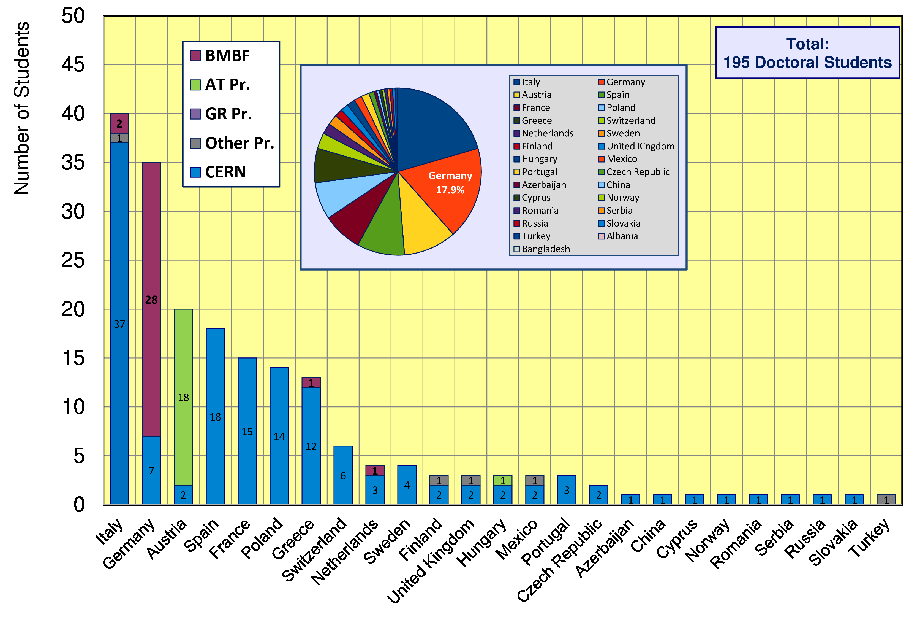
CERN Doctoral Students
Nationalities of all Doctoral Students at CERN
  Italians (40 Students) + Germans (35 Students) are leading

Slide 5
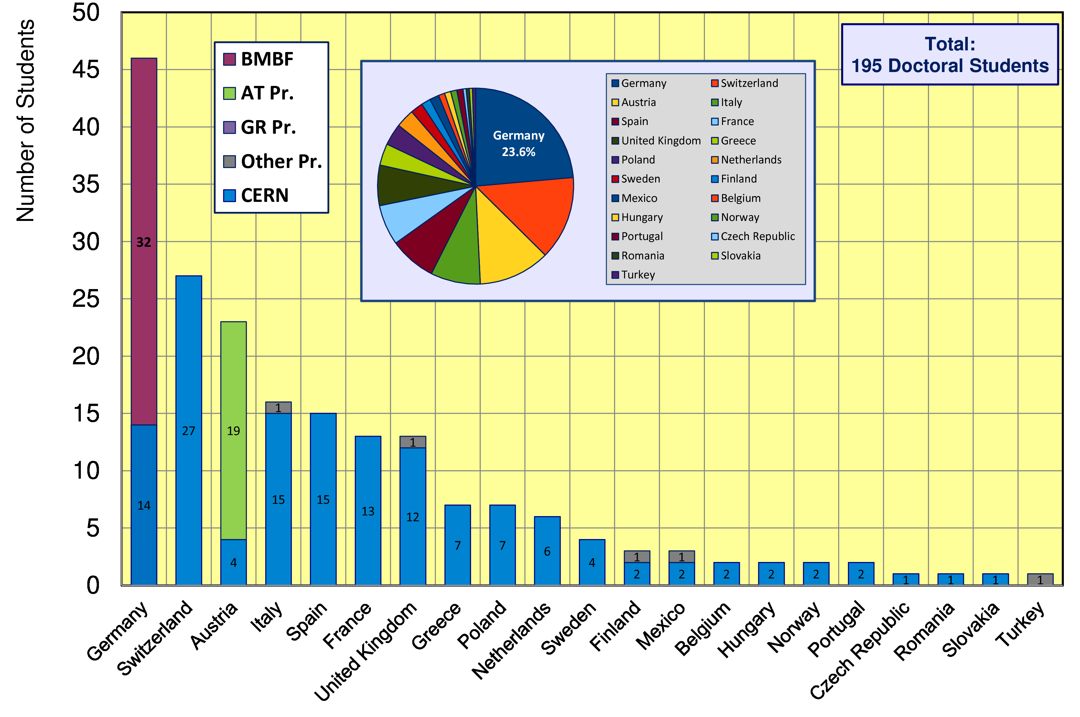
CERN Doctoral Students
Institute Country of all Doctoral Students
  46/195 Students enrolled at German Universities (23.6%)

Slide 6
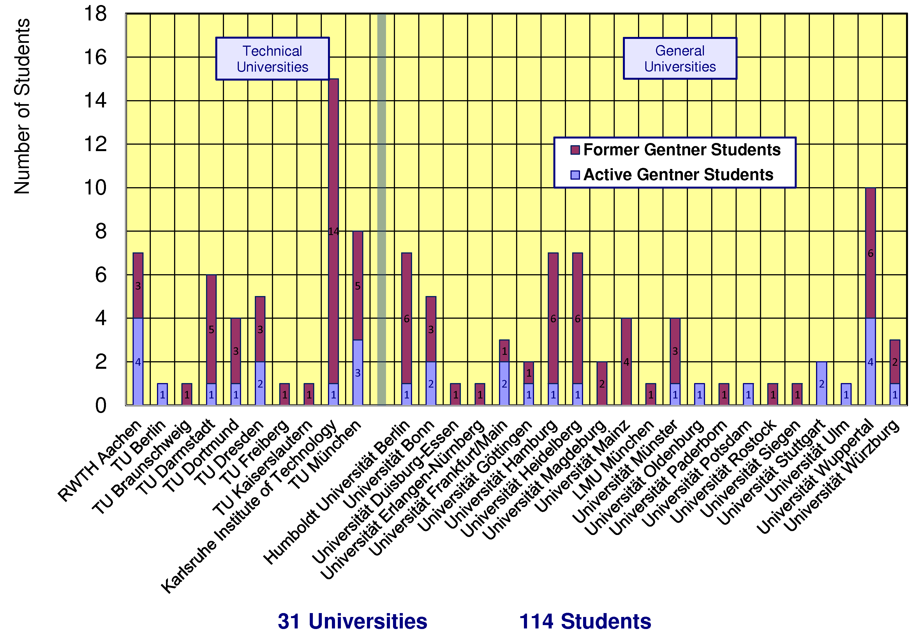
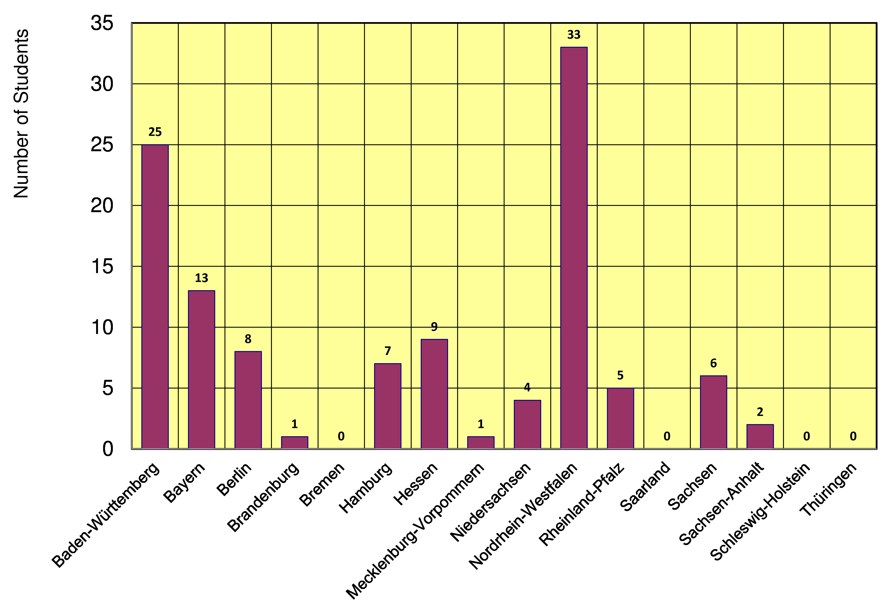
Gentner Students
  coming from 31 different Universities in DE
    also from university groups without or with little CERN contacts beforehand
  43% of Gentner Students from Technical Universities
NEW:
NEW:
  12/16 German States
    NRW and BW are leading
    only a few small(er) States are missing

Slide 7
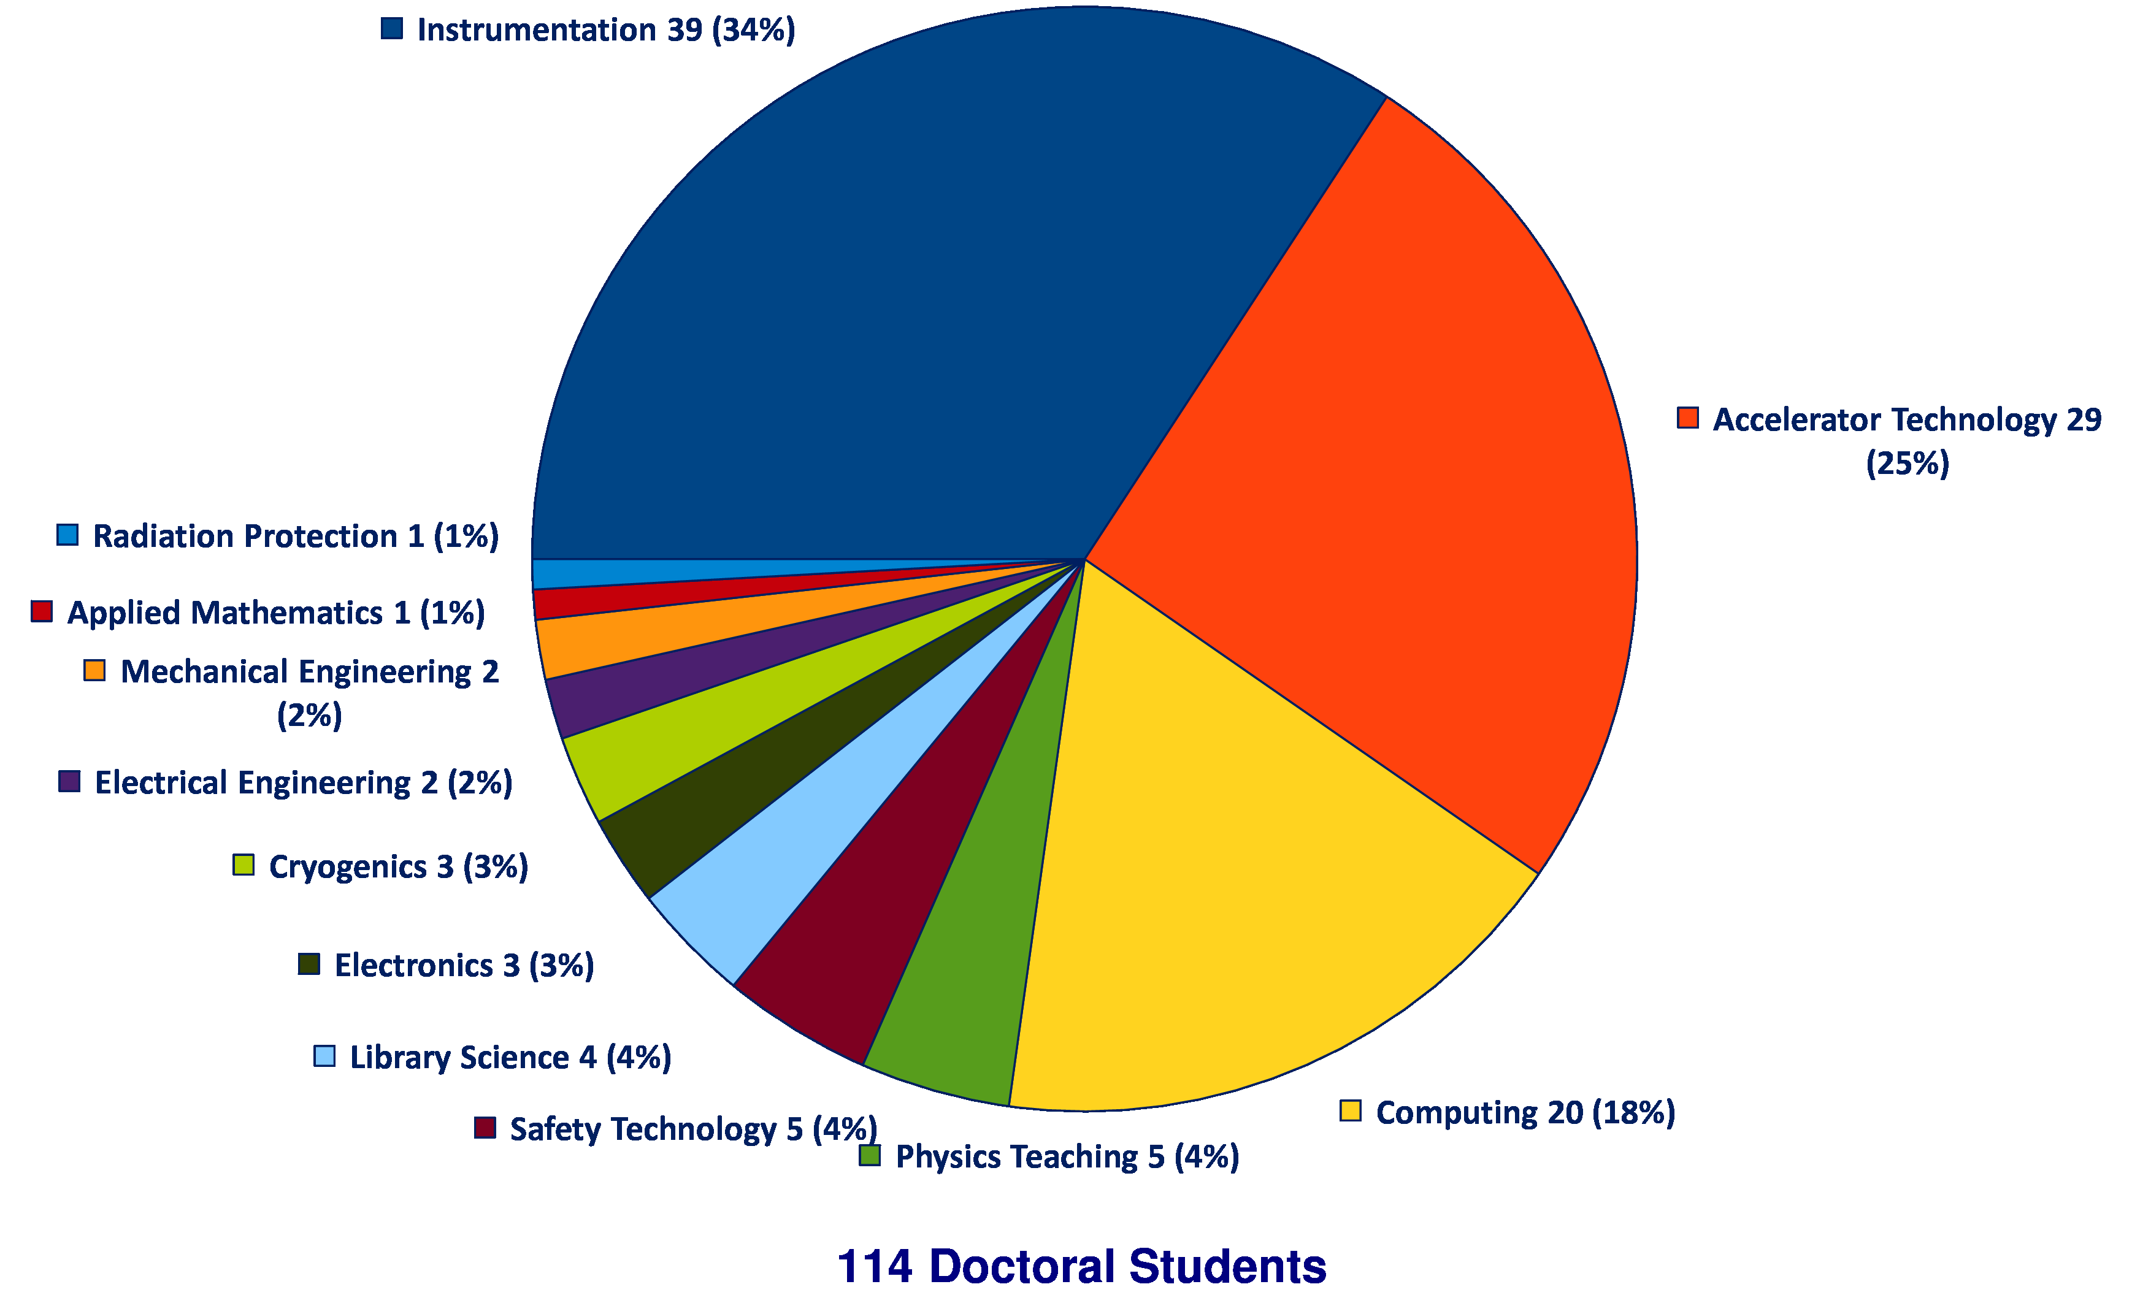
Thesis Topics of Gentner Students
(active + former)
Majority of topics in Instrumentation (34%), Accelerator Technology (25%), Computing (18%), all others = 23%
Trend over past 1-2 years:
fewer Students in Accelerator Technology
slightly more in Computing

Slide 8
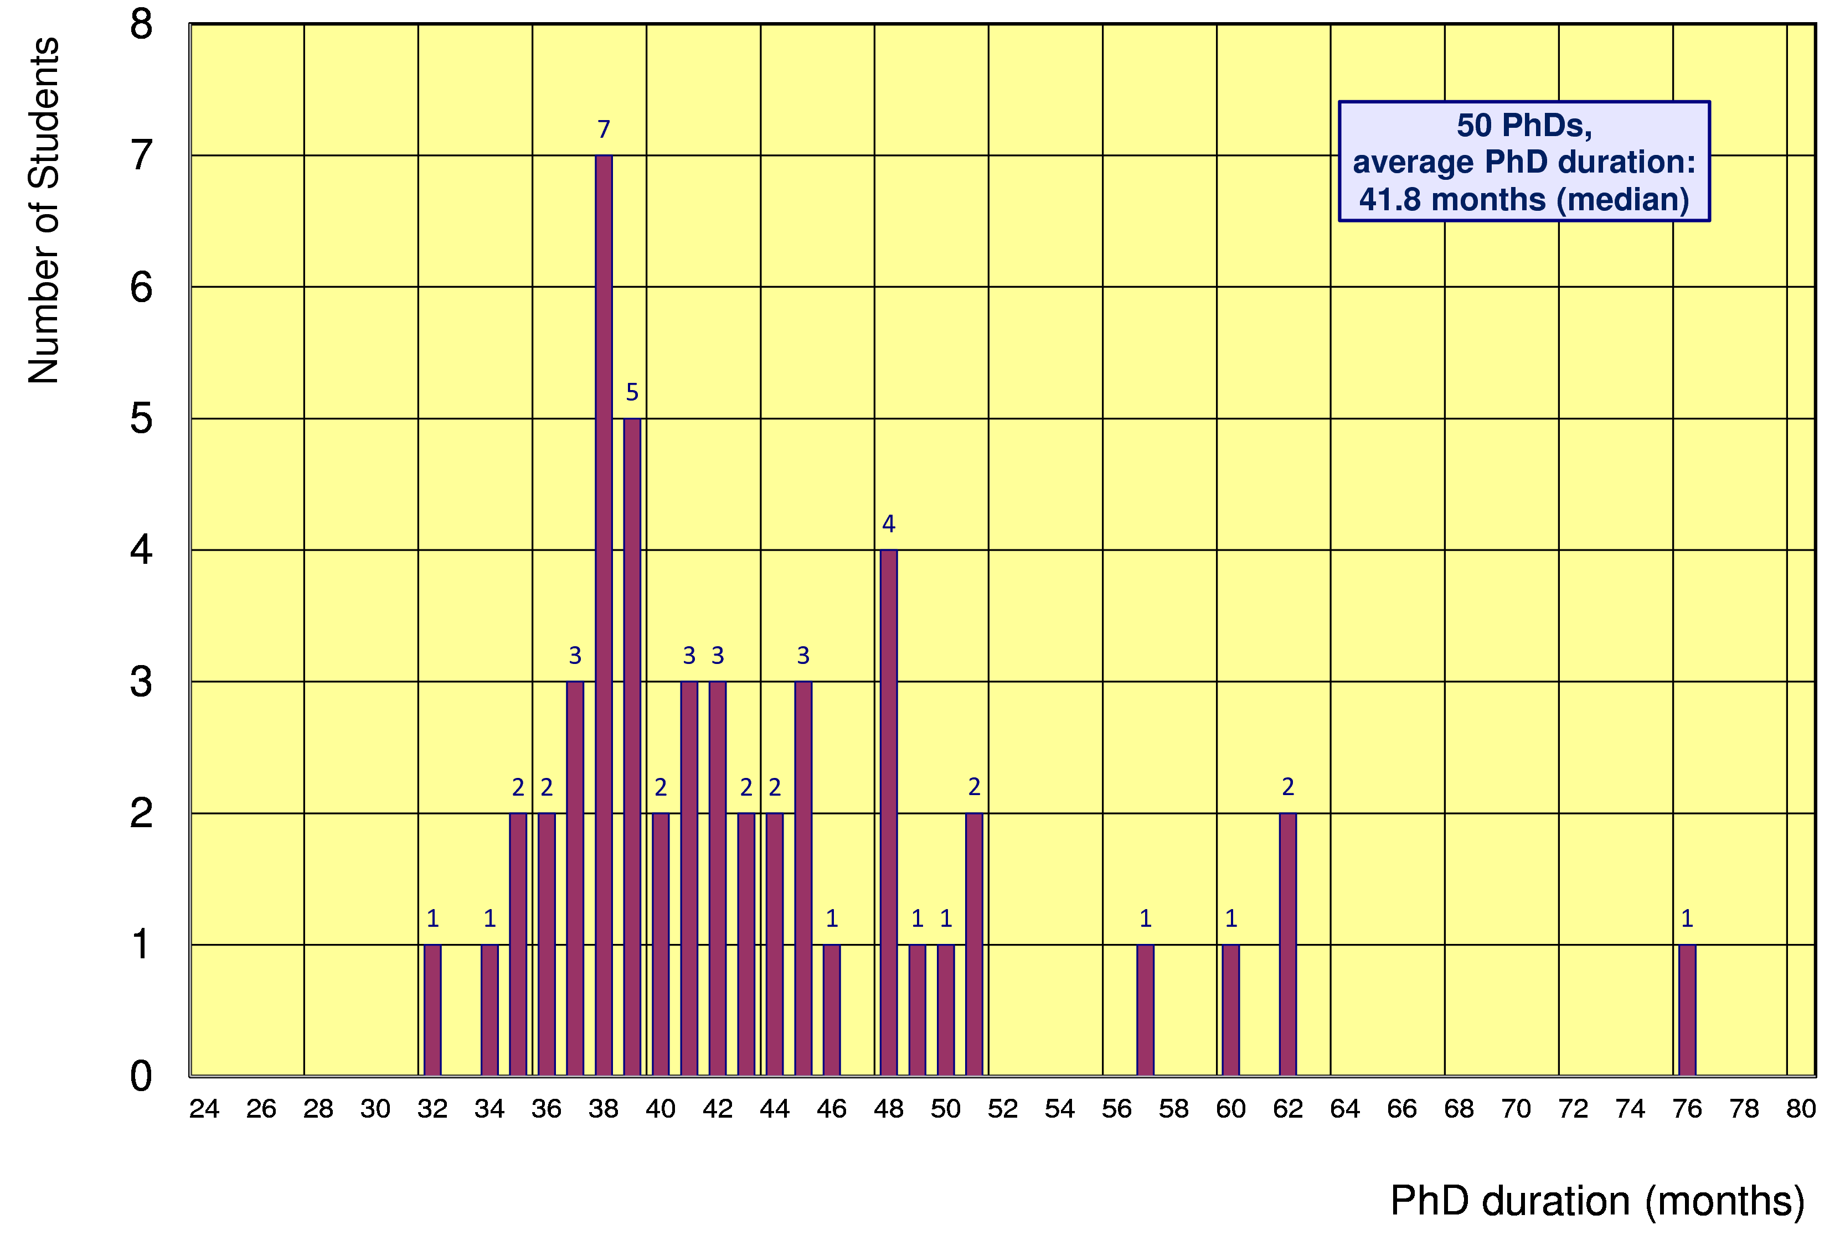
Former Gentner Students
50 PhDs so far (12 female = 24%), 7 Students have cancelled their PhD
    average age at PhD (defense): 30.4 years (median)
    average duration of PhD: 41.8 months (median) = 5.8 months after end of CERN 3-years contract
Physics PhDs in Germany (2015)
19% female PhDs students
30.2 years (median) at PhD
50.4 months (median) duration of PhD

Slide 9
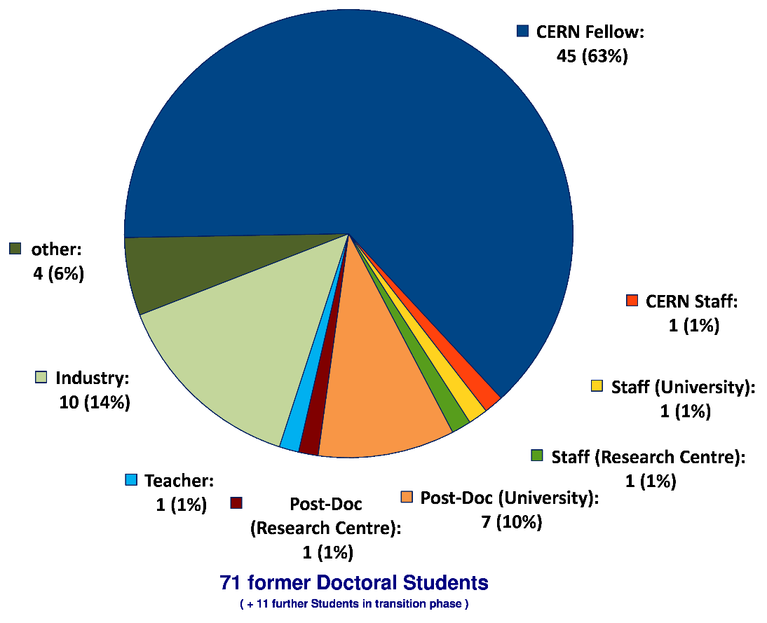
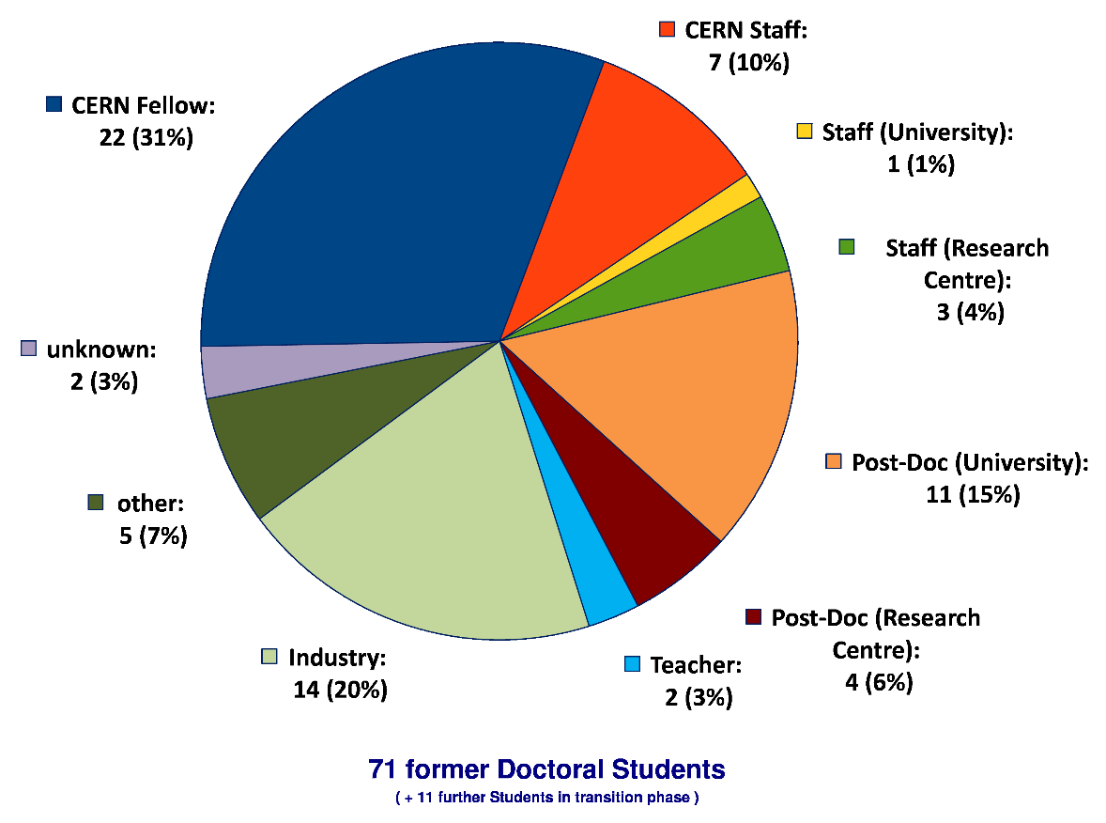
Whereabouts of Gentner Students
  first employment of ~2/3 of the Gentner Students: CERN Fellow(!)
First Employment
Present Employment
presently 7 CERN Staff Members,
1 with indefinite contract (since 1 April 2016)
2 Staff now are supervising
Gentner students

Slide 10
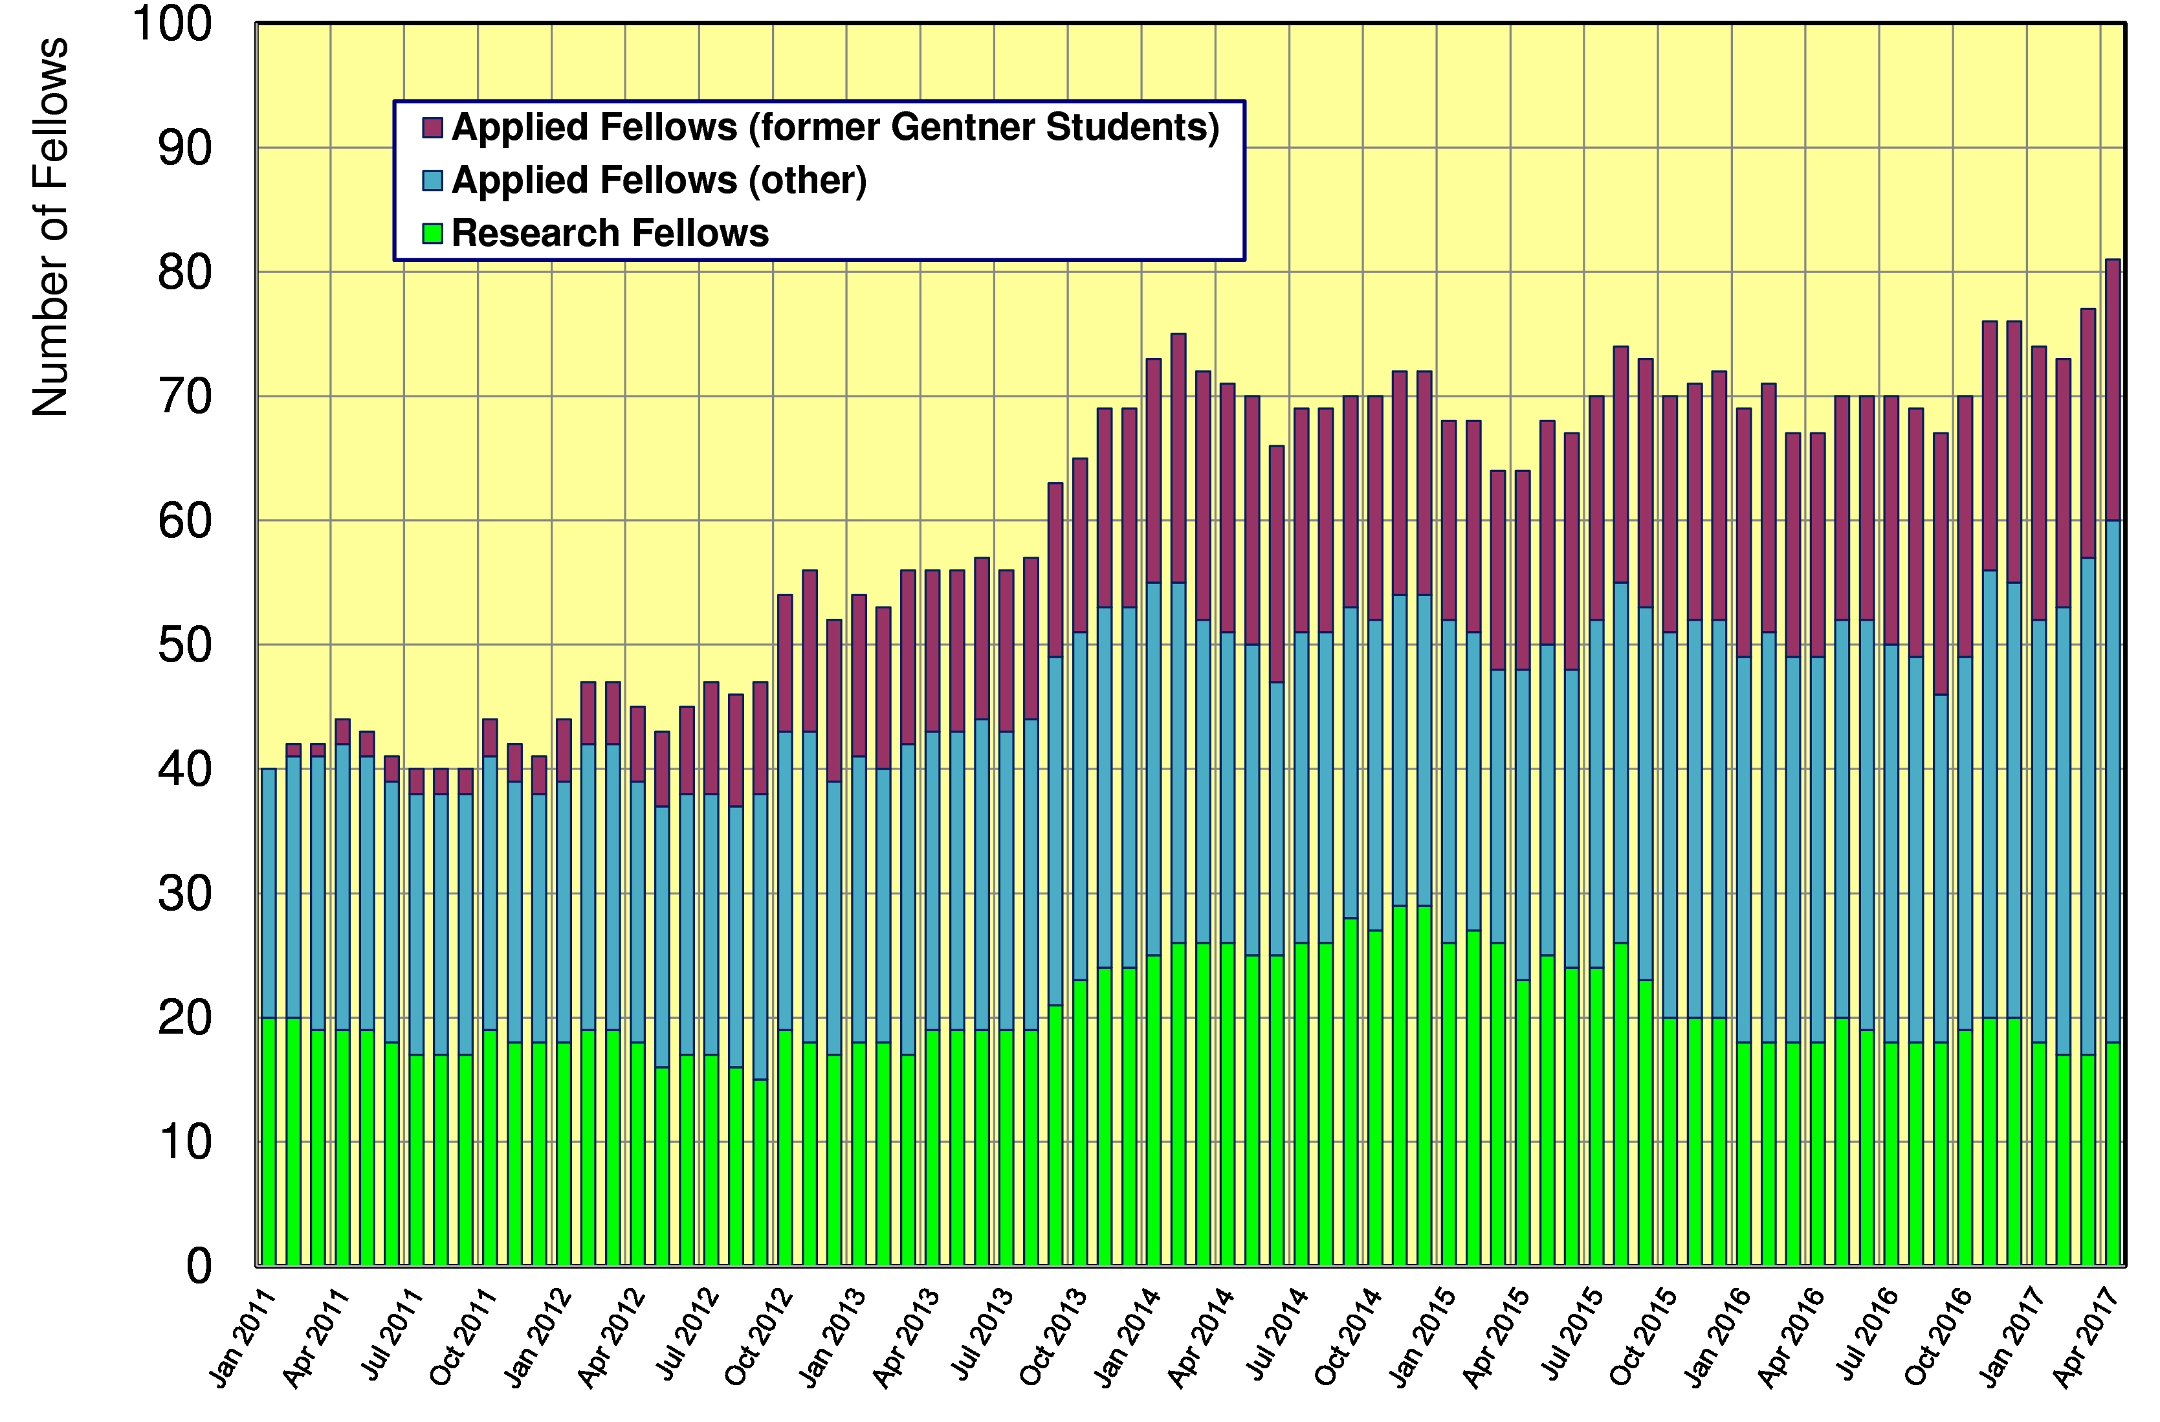
Gentner Students → Fellows
  significant increase of DE Fellows by former Gentner Students
    about 40% of German Applied Fellows are former Gentner Students

Slide 11
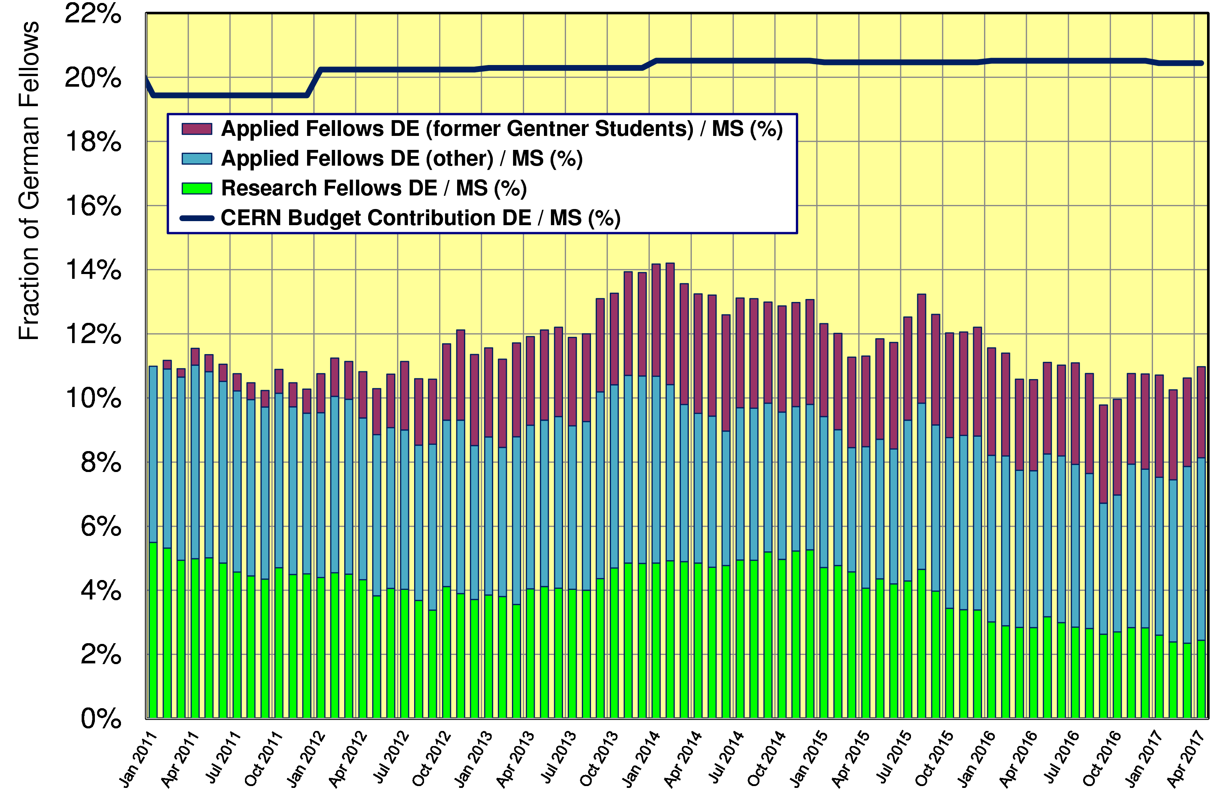
Gentner Students → Fellows
  without additional former Gentner Students → fraction of German Fellows w.r.t. to all Member States would be ~8% now

Slide 12
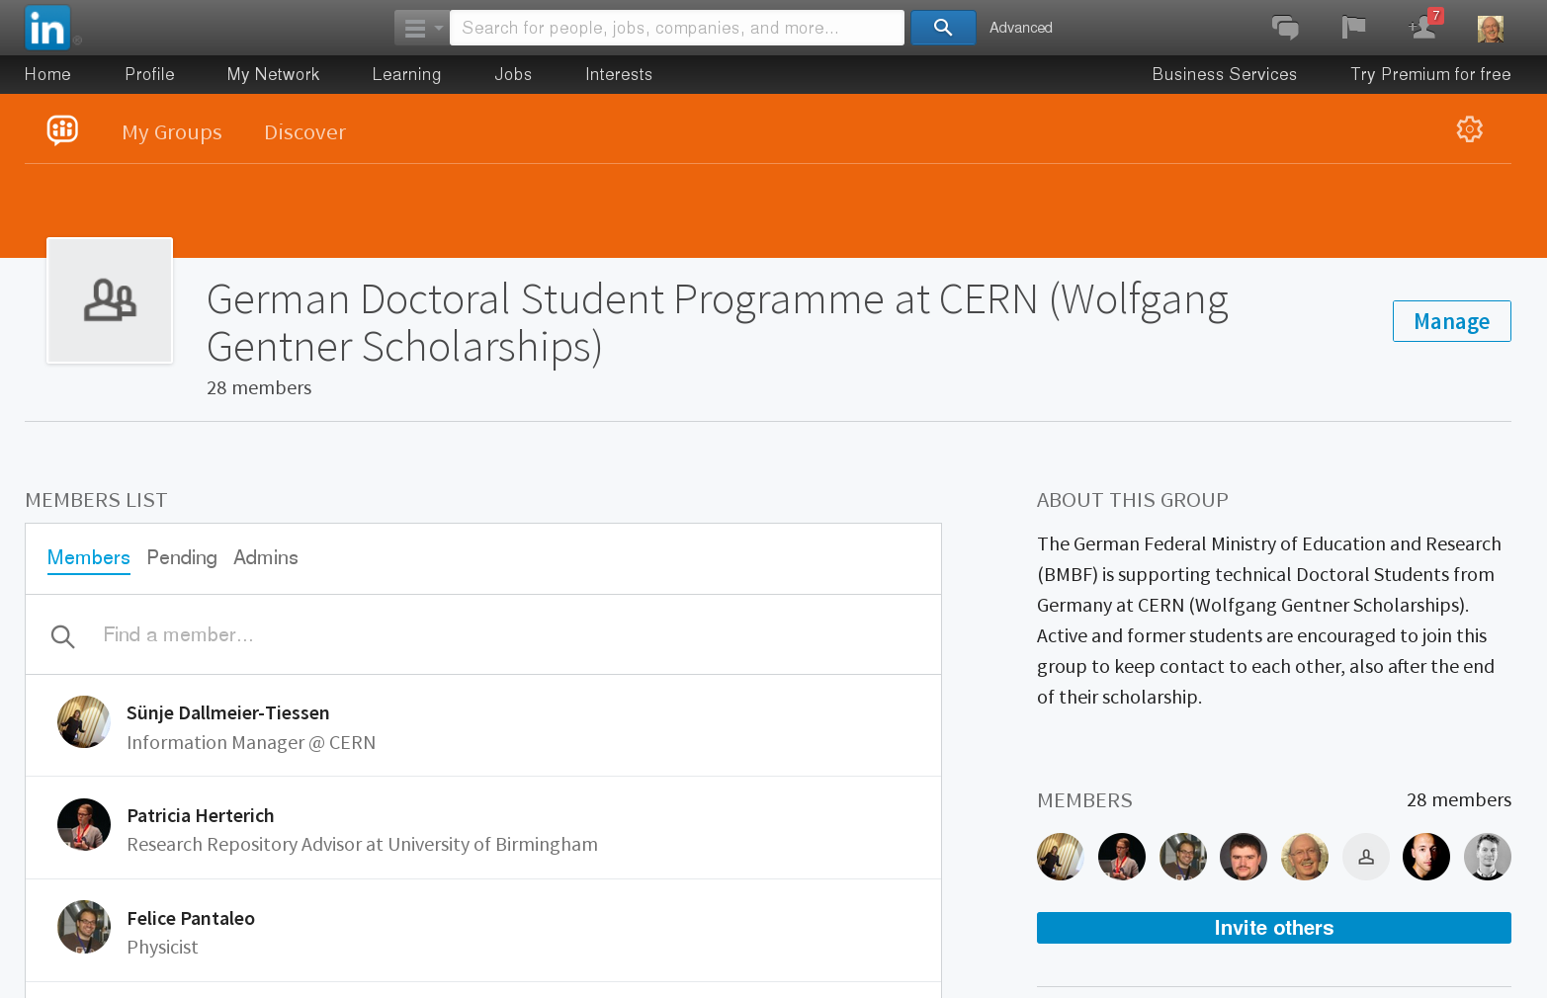
Gentner LinkedIn Group
Gentner Group @ LinkedIn (active + former Students)
  52 of 114 active + former Students are at LinkedIn professional network
    presently 37 Students in Gentner Group, more to come
    important to follow whereabouts of former Students (feedback to BMBF!)
    + good way to stay connected

Slide 13
General News and Remarks
Travel
  travel to home university constantly used (stable over years)
  trend since 2015:
    ~25% less travel to DPG Physical Society Spring Meetings + other national society meetings
    please make use of these opportunities, funding available and should be used!
Advertisement
    no. of applicants from Germany ~stable, but more applicants welcome
  distribute flyers, brochures + posters when travelling to home university
    pick-up in my office
Very important!!!
  when finishing → please keep me informed on your further whereabouts + upload your thesis to CDS
  key figures needed for BMBF indicating the Programme success!

Slide 14
Gentner Programme Extension
Present Gentner agreement ends in December 2017
  renewal needed beyond 2017
  extension procedure started at last Gentner Day in October 2016 (Poster Session visited by BMBF)
VERY GOOD NEWS
  agreement extension between BMBF – CERN – DESY has been SIGNED by all parties!
New agreement valid 3 years + 3x1 years → end of 2023
  identical conditions (e.g. students to be enrolled in DE, EU citizenship)
Funding increased to 1.95 M€/year (+13.4%)
  new funding based on 1 € = 1.07 CHF
  sufficient for (on average) 39 Students as foreseen in initial Programme

Slide 15
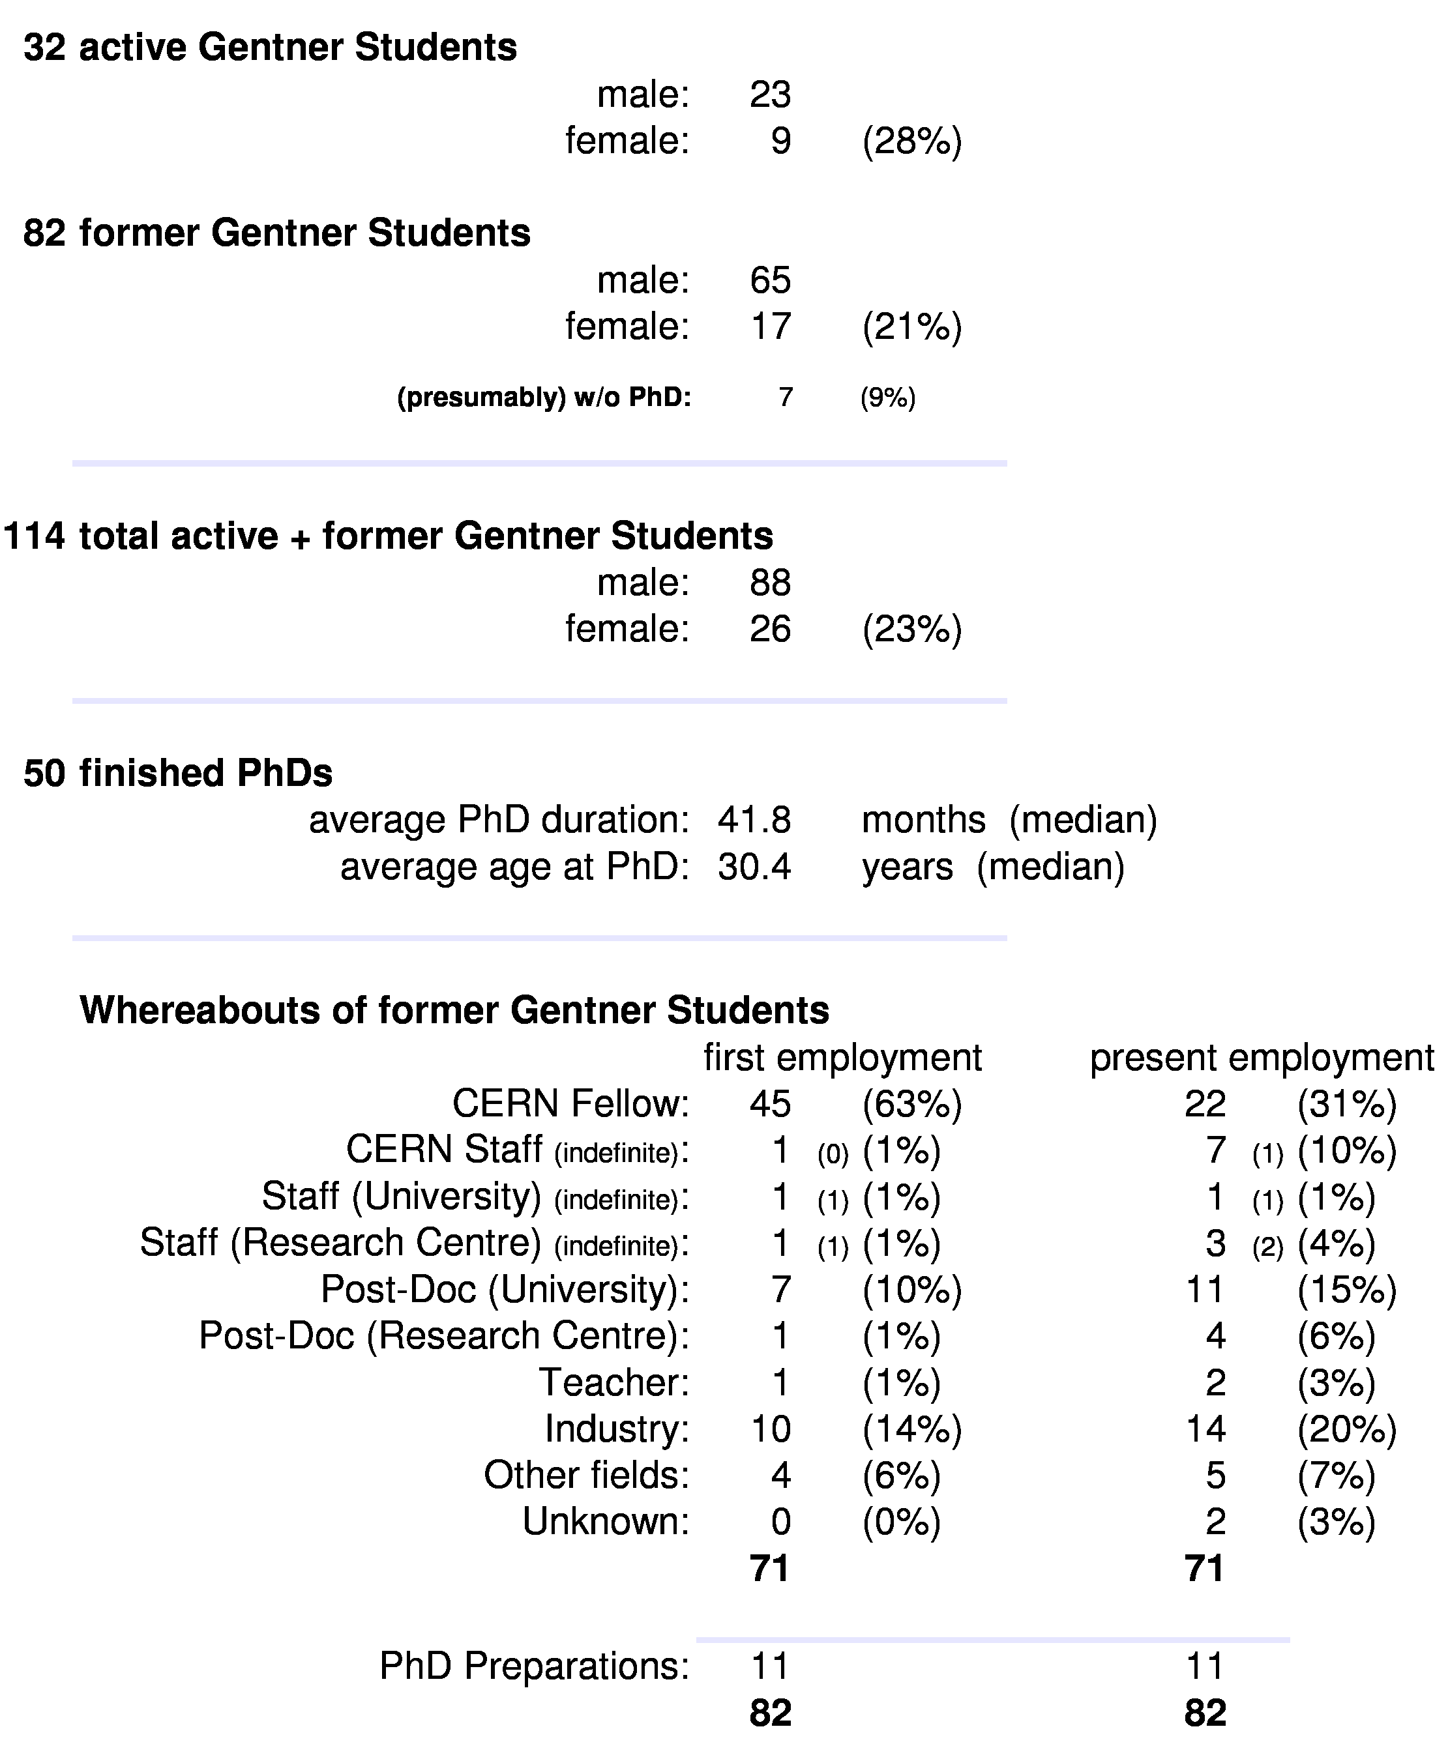
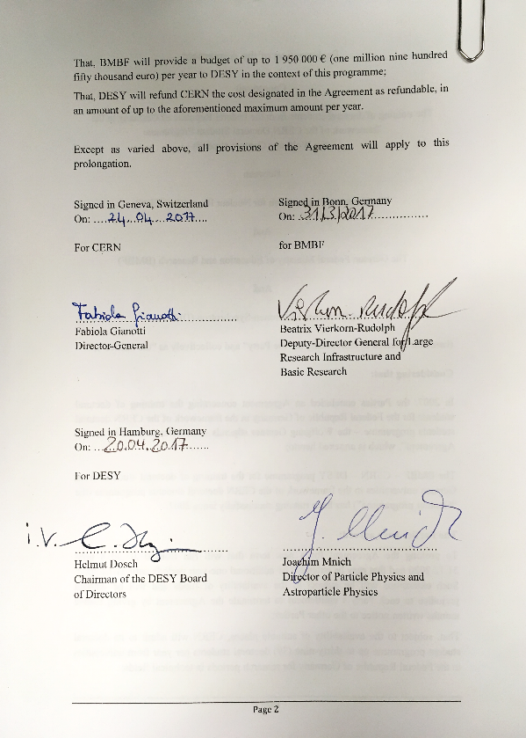
Summary Gentner Programme
Next Gentner Day:
25 October 2017
10 YEARS of GENTNER PROGRAMME!
Prolongation by further 6 years until 2023 JUST SIGNED!

